Slide 1
Introduction to chaos
Sarah Keeley
(based on lecture material prepared by Tim Palmer)

Slide 2
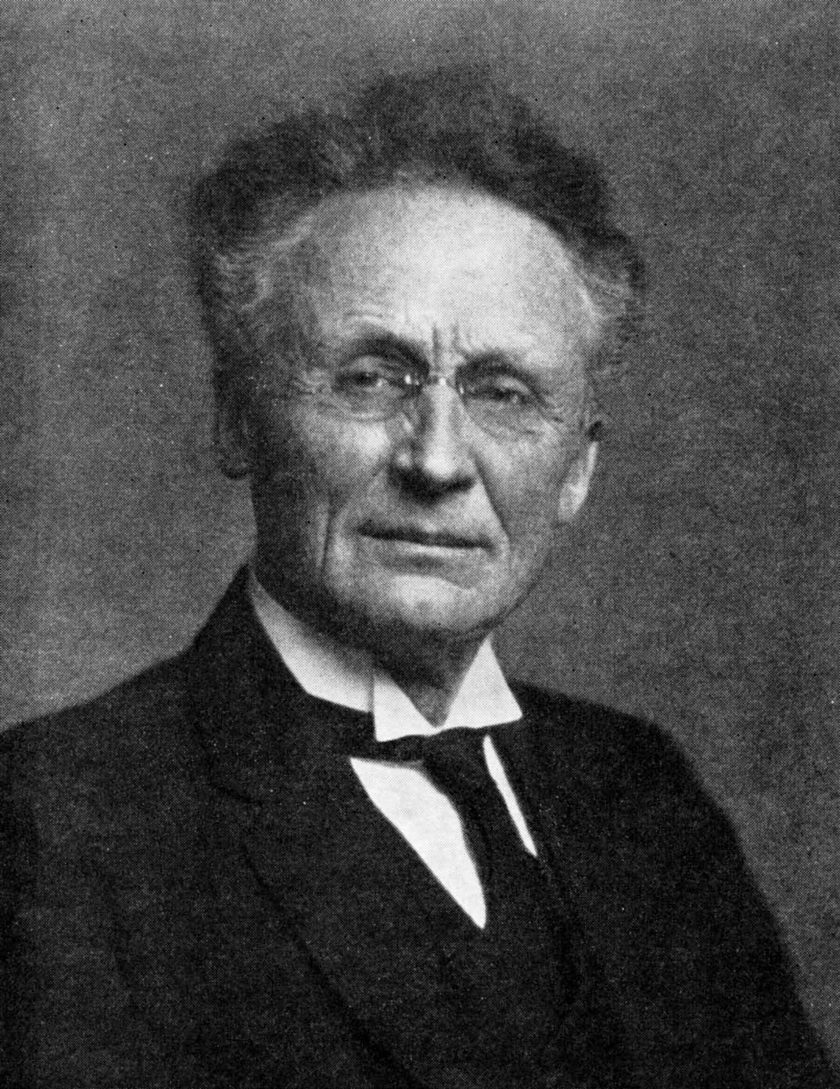
Vilhelm Bjerknes (1862-1951)
Proposed weather forecasting as a deterministic initial value problem based on the laws of physics

Slide 3
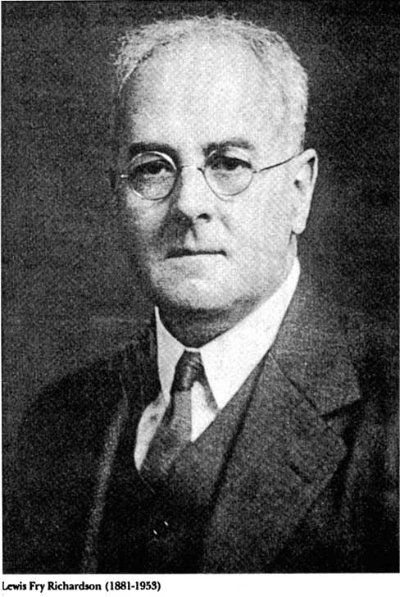
Lewis Fry Richardson (1881-1953)
The first numerical weather forecast

Slide 4
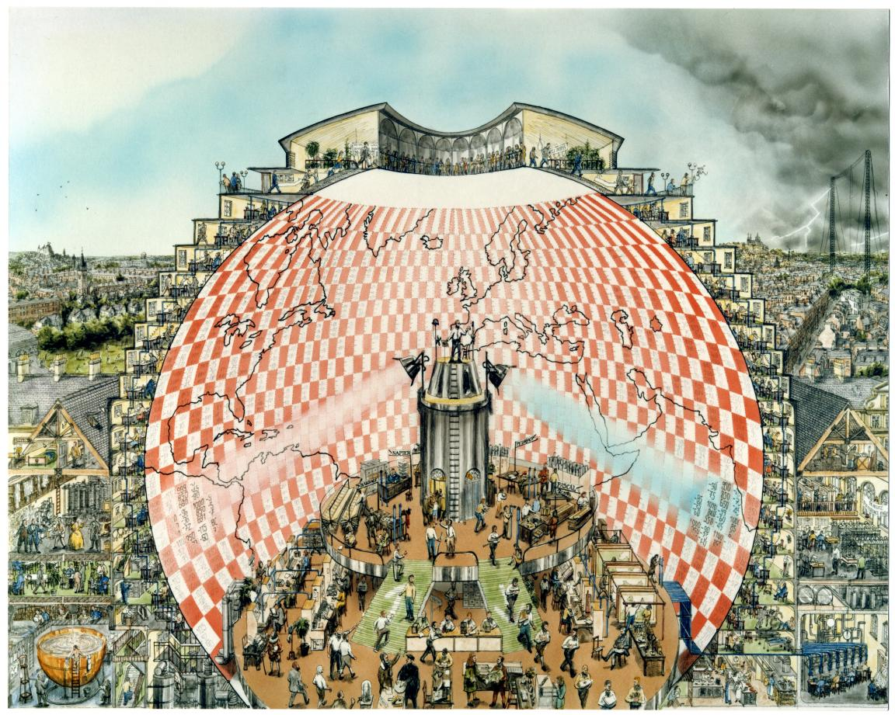
http://www.emetsoc.org/resources/rff

Slide 5
“Why have meteorologists such difficulty in predicting the weather with any certainty? Why is it that showers and even storms seem to come by chance ... a tenth of a degree (C) more or less at any given point, and the cyclone will burst here and not there, and extend its ravages over districts that it would otherwise have spared. If (the meteorologists) had been aware of this tenth of a degree, they could have known (about the cyclone) beforehand, but the observations were neither sufficiently comprehensive nor sufficiently precise, and that is the reason why it all seems due to the intervention of chance”
Poincaré, 1909

Slide 6
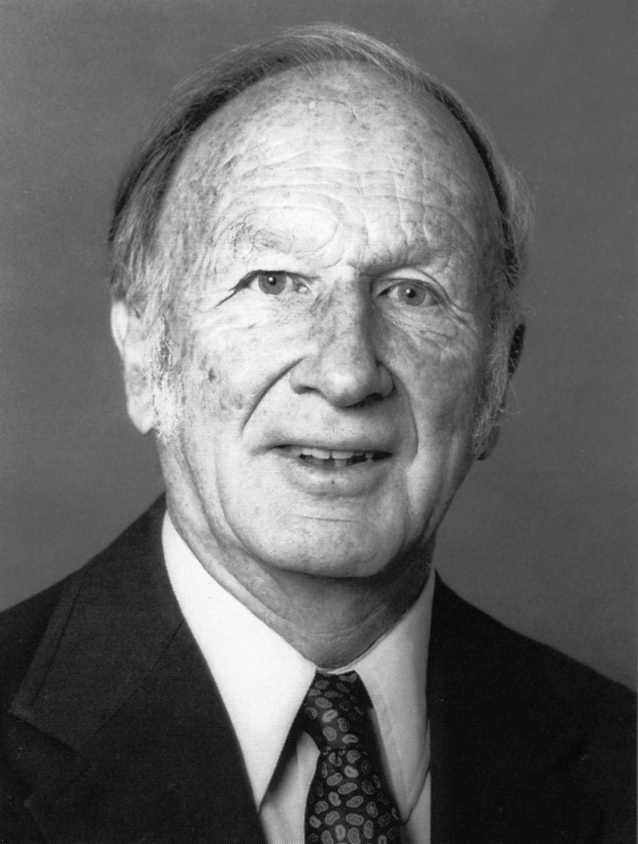
Edward Lorenz (1917 –2008)
“… one flap of a sea-gull’s wing may forever change the future course of the weather” (Lorenz, 1963)

Slide 7
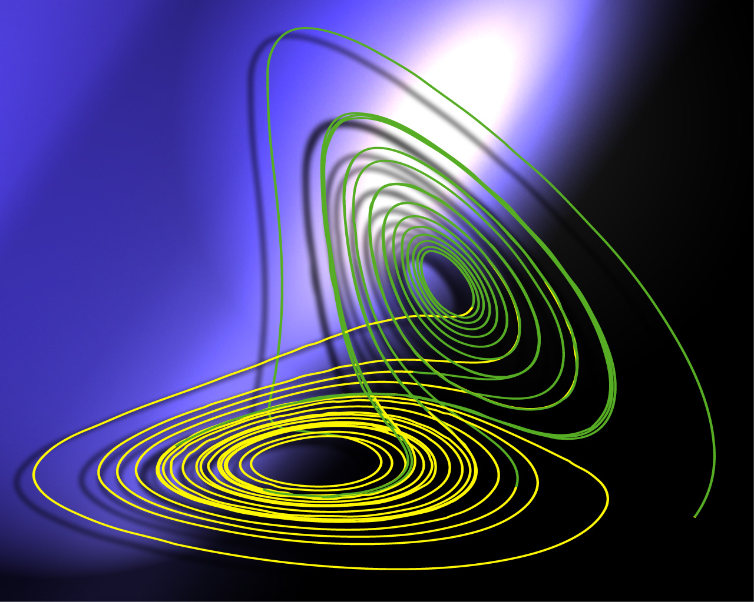
The Lorenz (1963) attractor, the prototype chaotic model…..

Slide 8
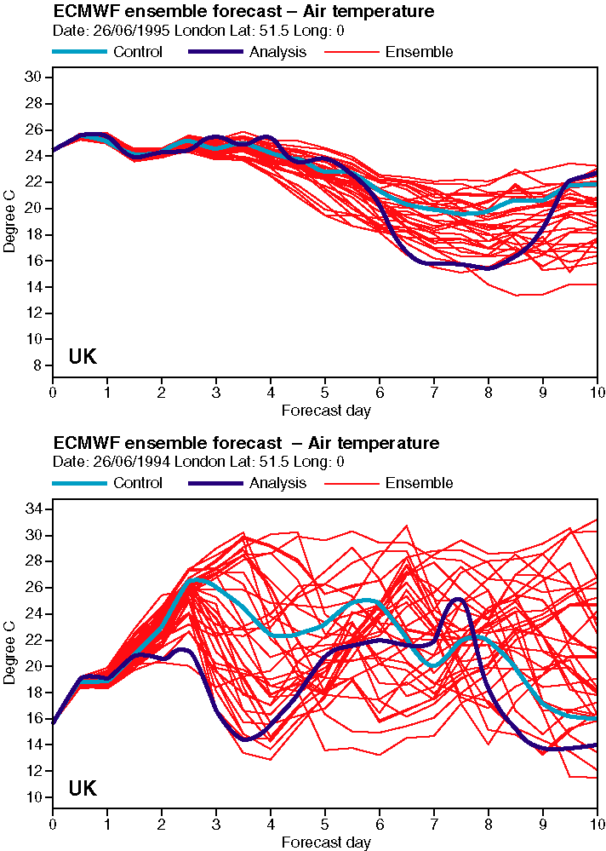


Slide 9
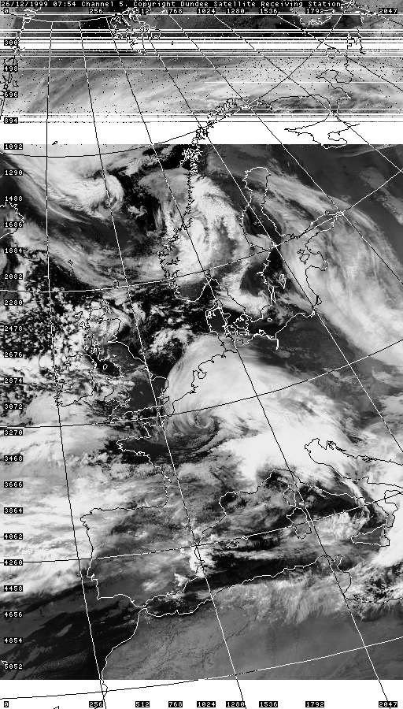
Lothar: 08Z, 26 Dec. 1999
Lothar +Martin
100 Fatalities
400 million trees blown down
3.5 million electricity users affected for 20 days
3 million people without water

Slide 10
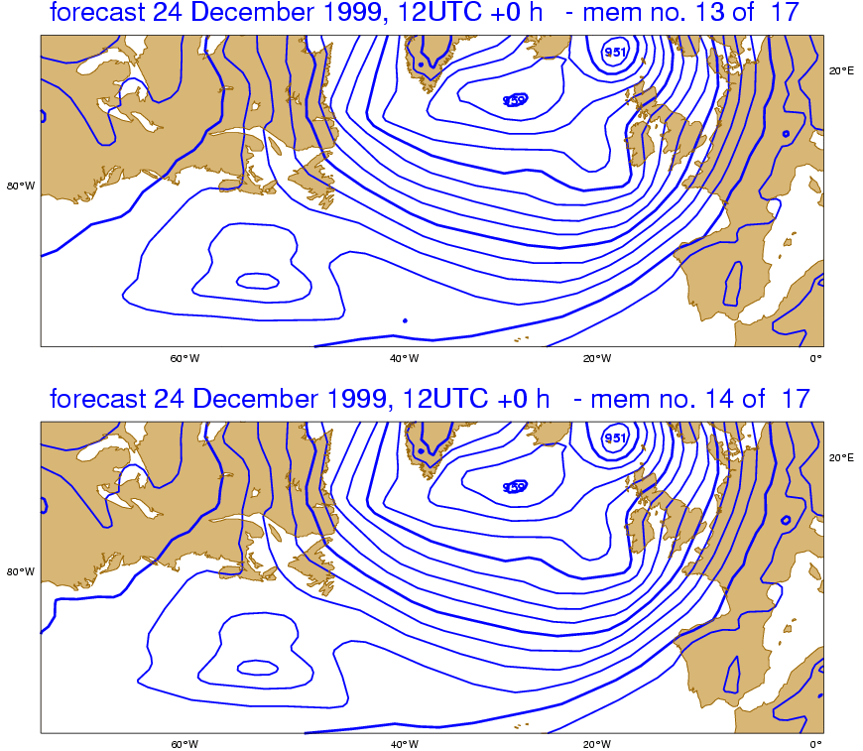

Slide 11
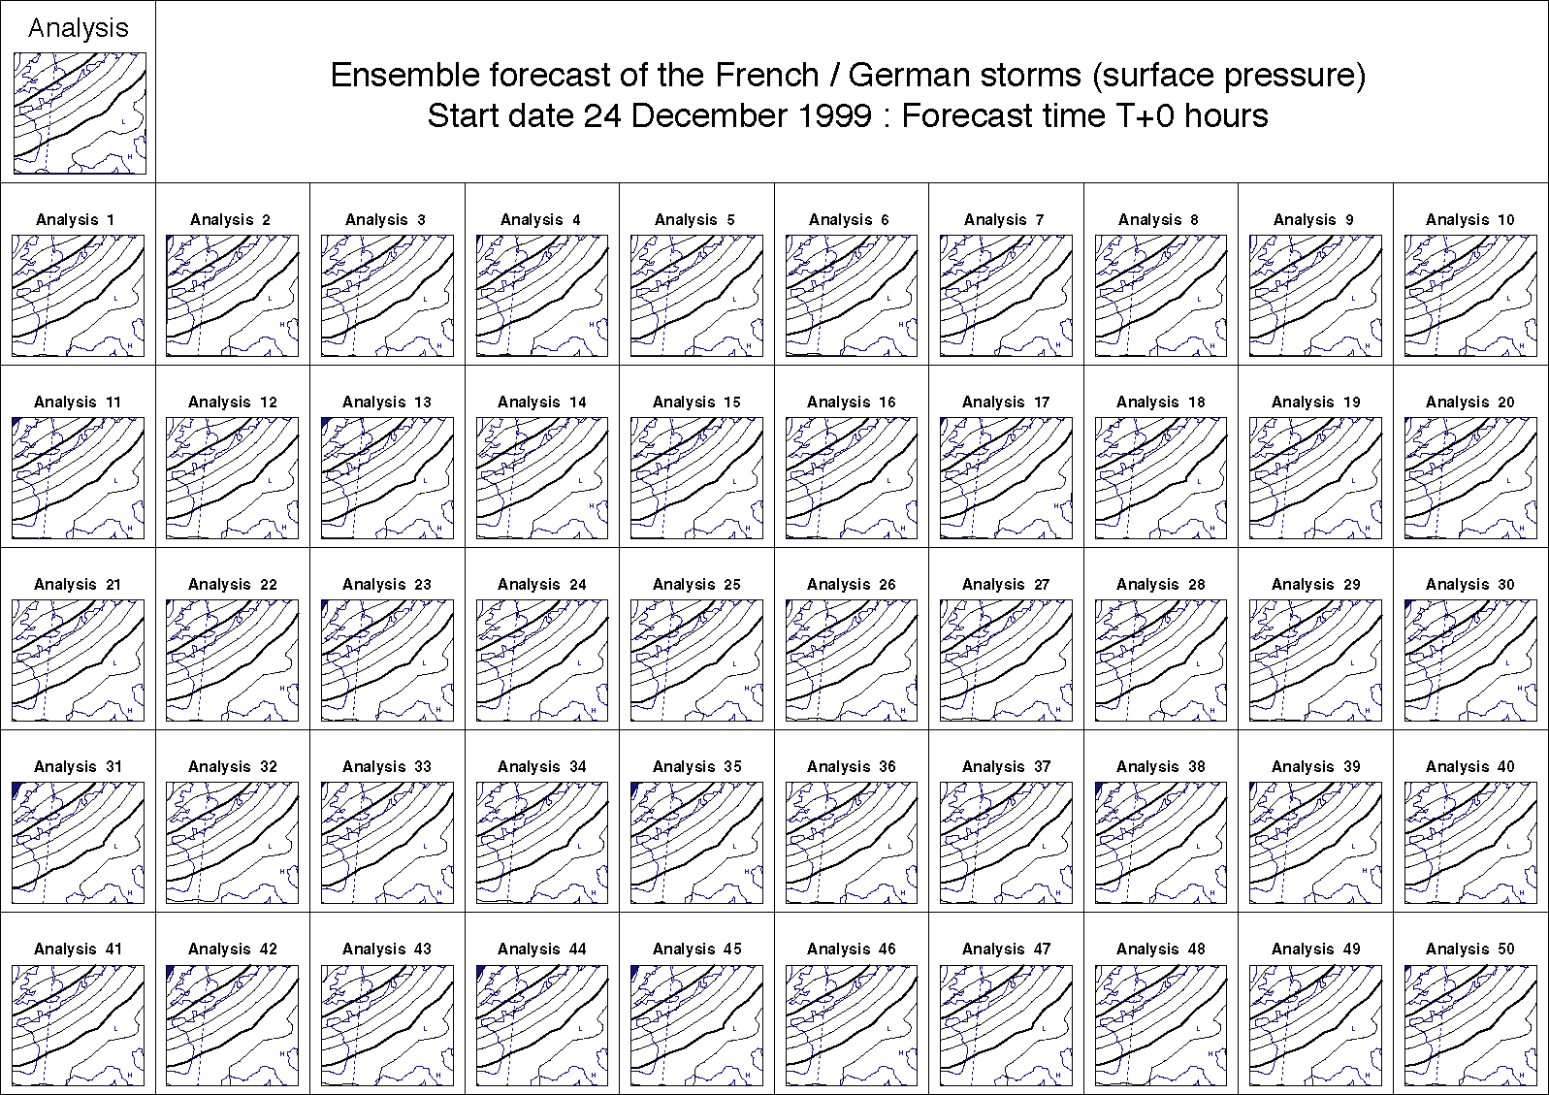
Ensemble Initial Conditions 24 December 1999

Slide 12
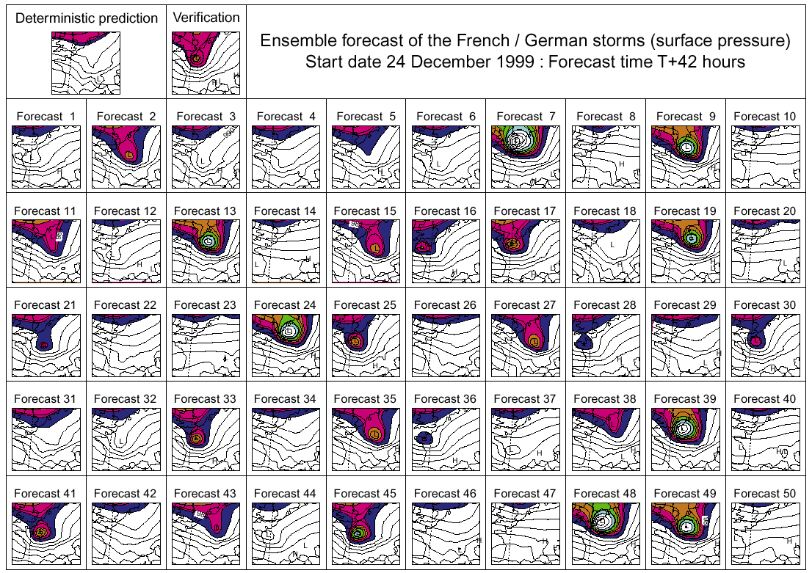
Lothar (T+42 hours)
Notes:
Figure 4

Slide 13

Headlines: Oct 28 2002
Thanks to Rob Hine

Slide 14
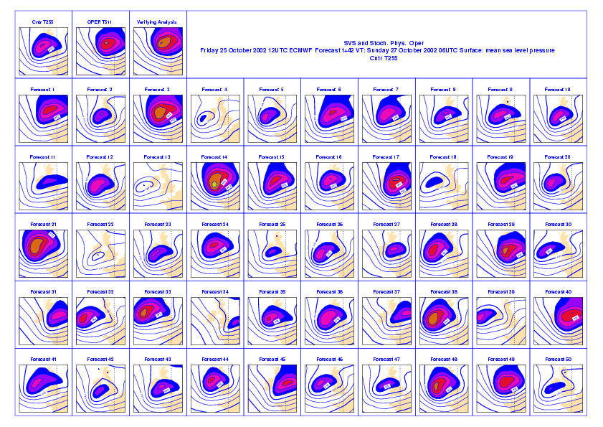

Slide 15
NO
?
Charlie is planning to lay concrete tomorrow.
Consensus forecast: frost free ⇒ YES
Frost free
Frosty
Should he?
Charlie loses L if concrete freezes.
But Charlie has fixed (eg staff) costs
There may be a penalty for late completion of this job.
By delaying completion of this job, he will miss out on other jobs.
These cost C
Is Lp>C? If p > C/L don’t lay concrete!
NO
Let p denote the probability of frost

Slide 16
Introduction to chaos for:
Seasonal climate prediction
Atmospheric predictability arises from slow variations in lower-boundary forcing

Slide 17
Edward Lorenz (1917 – 2008 )
What is the impact of f on the attractor?

Slide 18
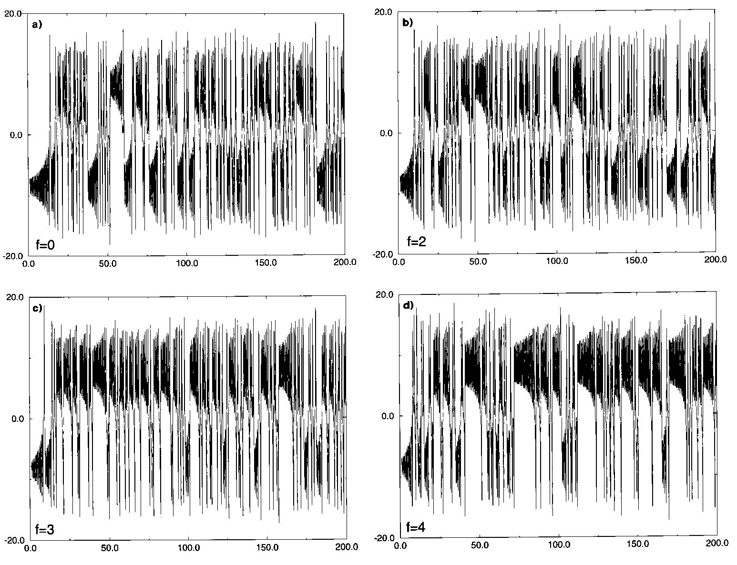
Add external steady forcing f to the Lorenz (1963) equations
f=0
f=2
f=3
f=4
The influence of f on the state vector probability function is itself predictable.

Slide 19


Slide 20


Slide 21
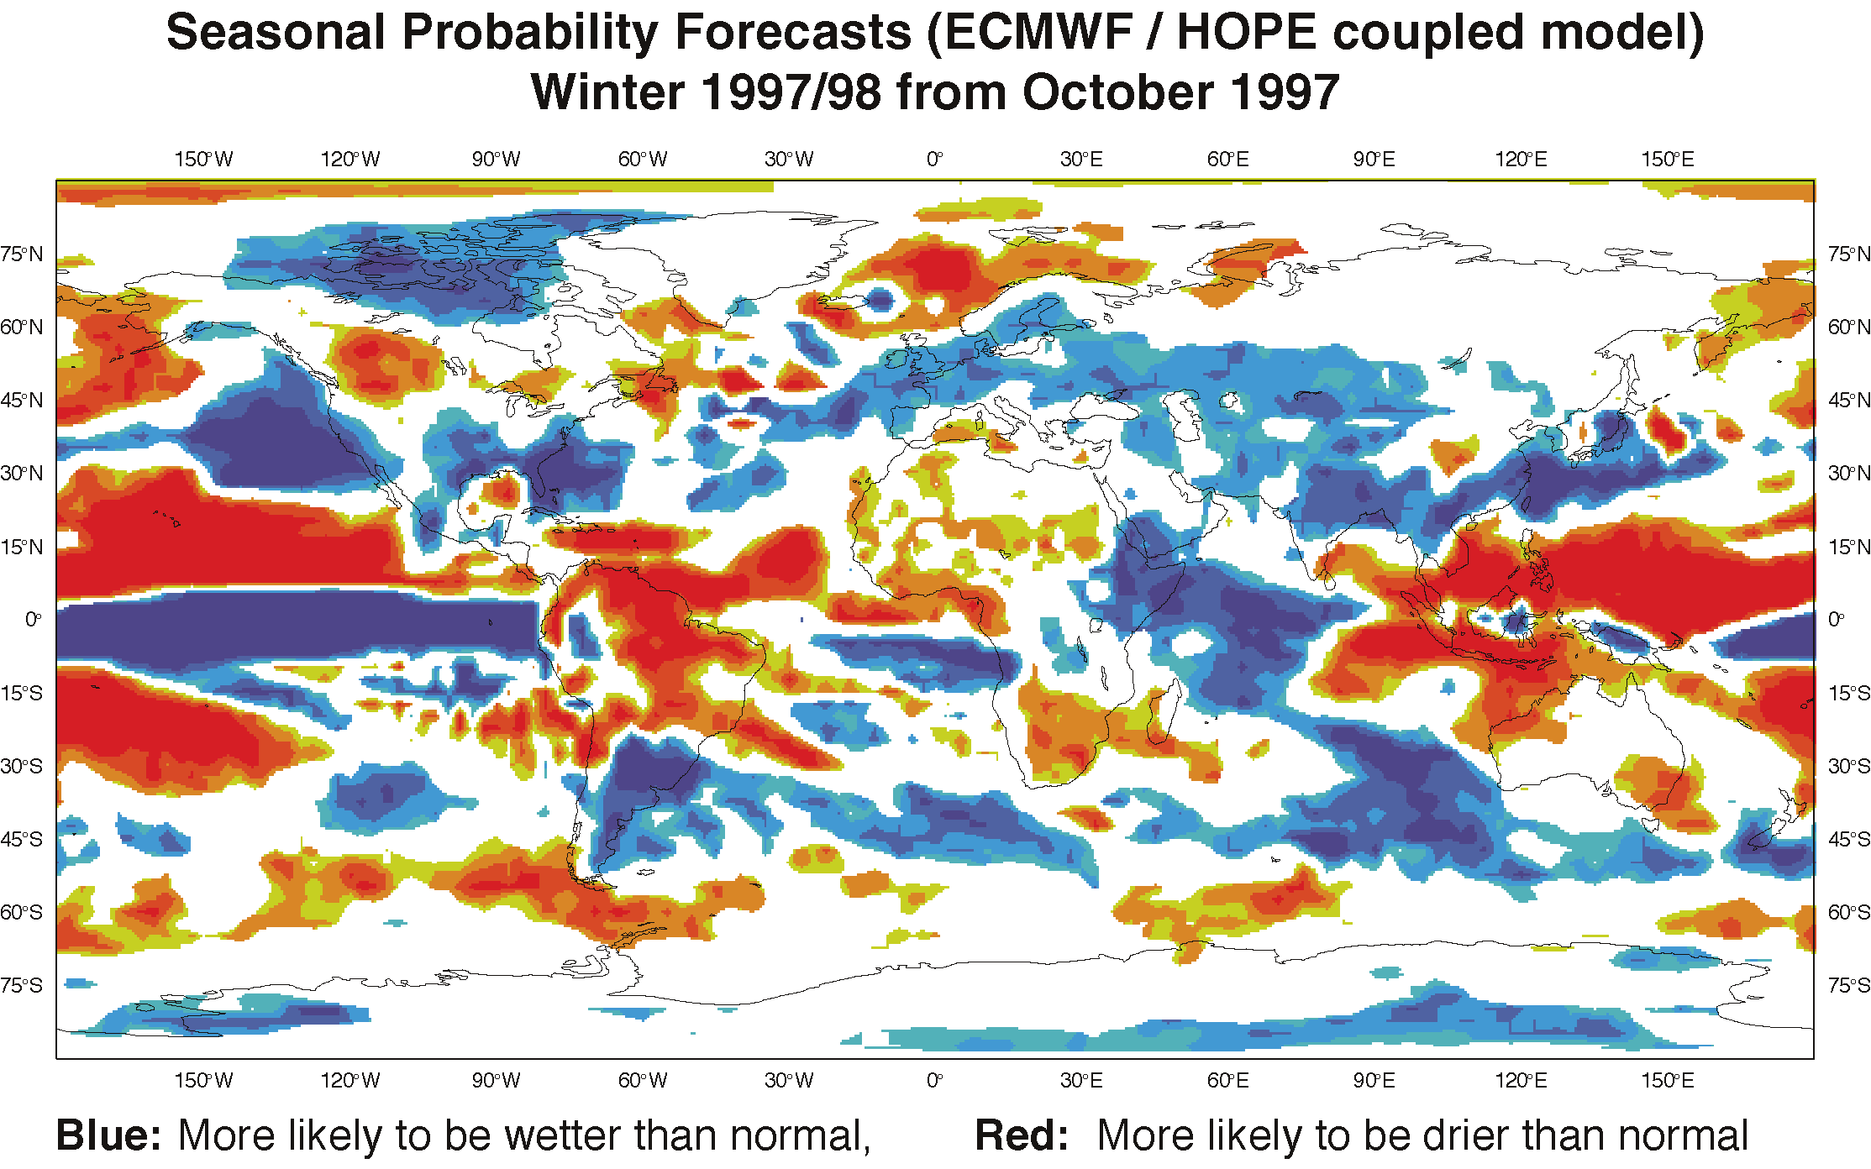

Slide 22
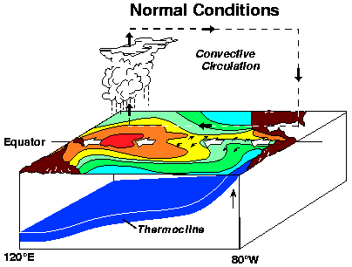
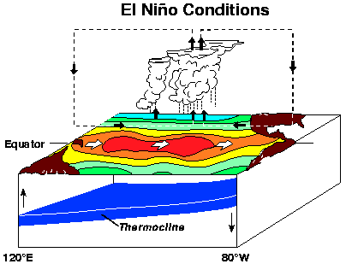
The tropical Pacific ocean/atmosphere

