Slide 1
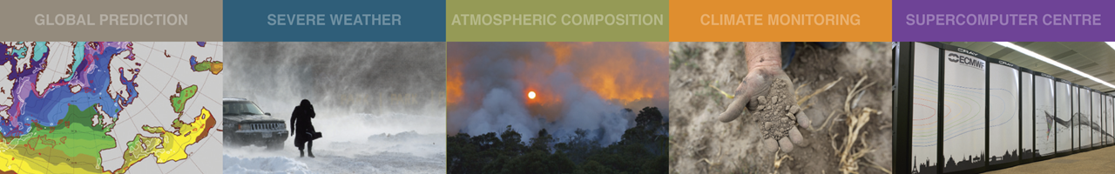
The Global Observing System
Stephen English
ECMWF
Stephen.English@ecmwf.int

Slide 2
Contents
The role of observations in data assimilation
Conventional observations
Satellite observations
The WMO Integrated Global Observing System (WIGOS)
OSCAR and SATURN

Slide 3
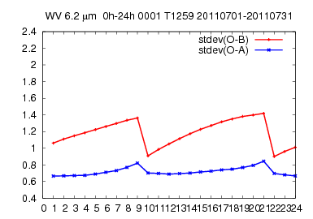
Role of observations
SEVIRI 6.2 µm
Every 12 hours we assimilate ~20,000,000 observations to correct the model’s variables….
The model has many more variables than we have observations.
RMS error (m)
Time (hours)
Observations limit error growth and make forecasting possible….

Slide 4
Data sources: Conventional
Instrument | Parameters | Height
SYNOP SHIP METAR | temperature, dew-point temperature, wind | Land: 2m, ships: 25m
BUOYS | temperature, pressure, wind | 2m
TEMP TEMPSHIP DROPSONDES | temperature, humidity, pressure, wind | Profiles
PROFILERS | wind | Profiles
Aircraft | temperature, pressure wind | Profiles Flight level data

Slide 5
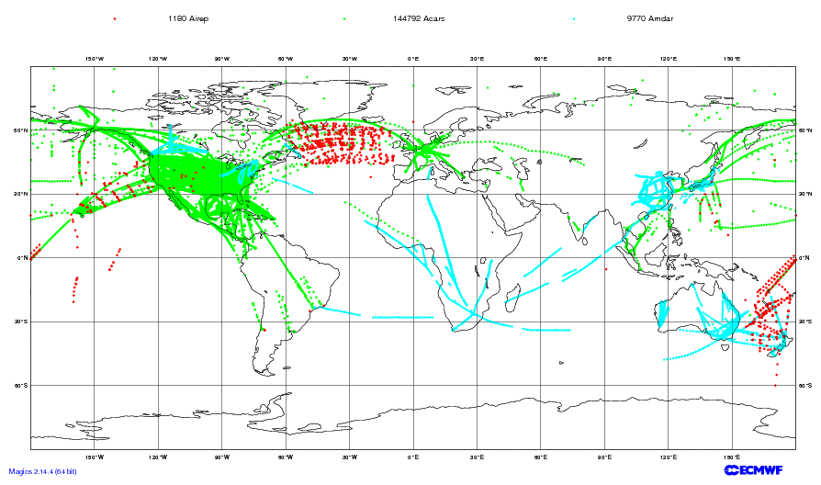
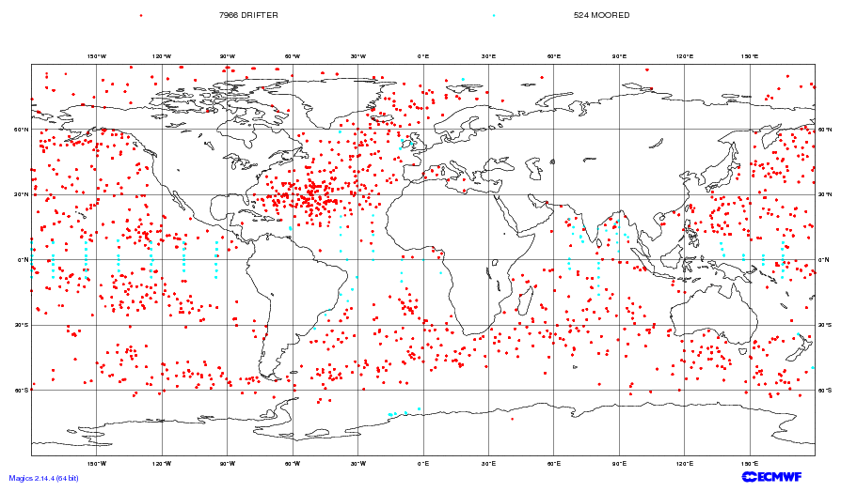
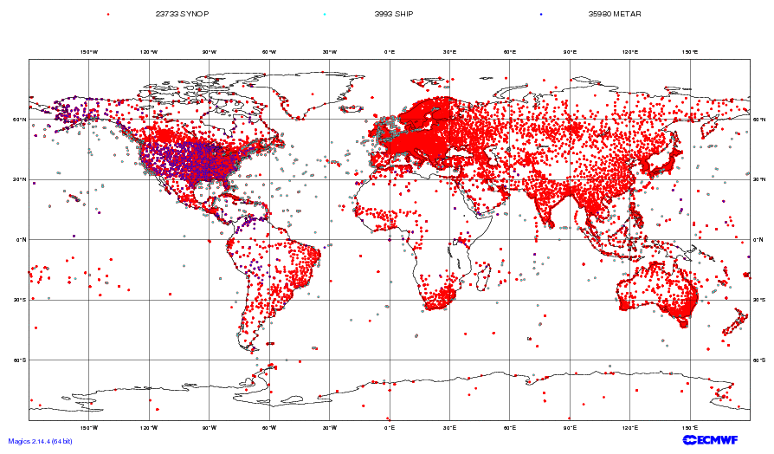
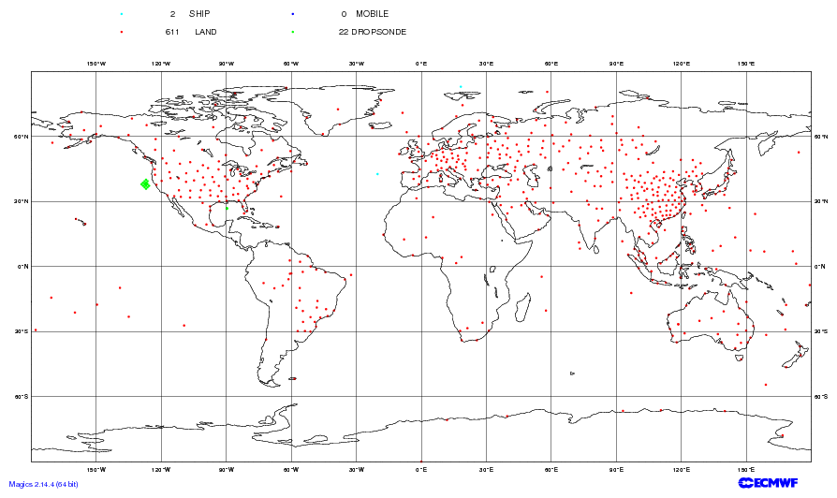
Example of 6hr conventional data: 28 Jan 2015
Aircraft
Buoy
Surface (synop) + ship
Radiosondes

Slide 6
Conventional data issues
Biases, duplicates, incorrect locations.
Representivity error….if we measure temperature here at ECMWF is it representative of model grid resolution?
Data voids.
Data quality – some radiosondes are good quality, others less so; absolute calibration can vary with age.
Old alphanumeric codes -> BUFR.
Sampling e.g. significant levels in radiosonde vs full resolution data.
But, they are a direct, in situ measurement.
Interpretation is usually more straightforward than remotely sensed data.

Slide 7
Remotely sensed data issues
Poor vertical resolution (in general).
Rarely an absolute measurement – long term drifts, observation biases.
Data voids: less of a problem than for in situ, but there are areas where data is hard to interpret.
Data quality – whilst most remotely sensed observations are of very high quality, this can change suddenly.
An indirect measurement – we need complex observation operators.
Incompleteness of observation operators e.g. new species of trace gas affects measurement (HCN on IASI for example).
But, they measure on a global or regional scale – often for years or even decades.
Representivity error is lower – large volumes are more representative of what the model is trying to represent.

Slide 8
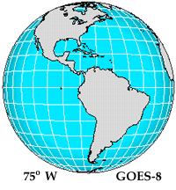
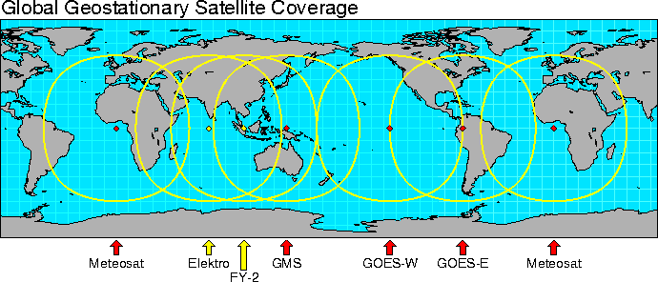
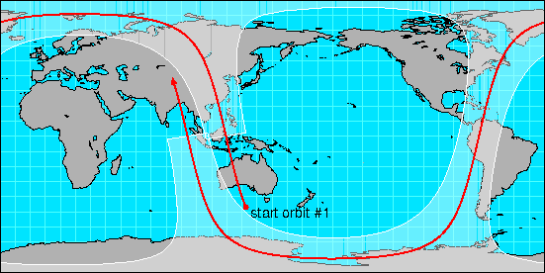
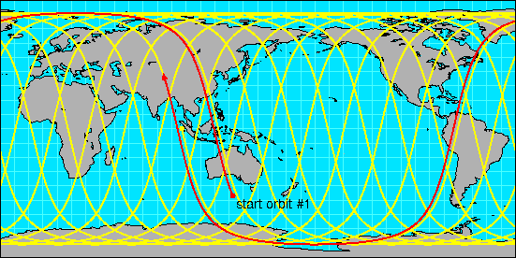
What types of satellites are used in NWP?
Advantages Disadvantages
GEO - Regional coverage No global coverage by single satellite
- Temporal coverage
LEO - Global coverage with single satellite

Slide 9
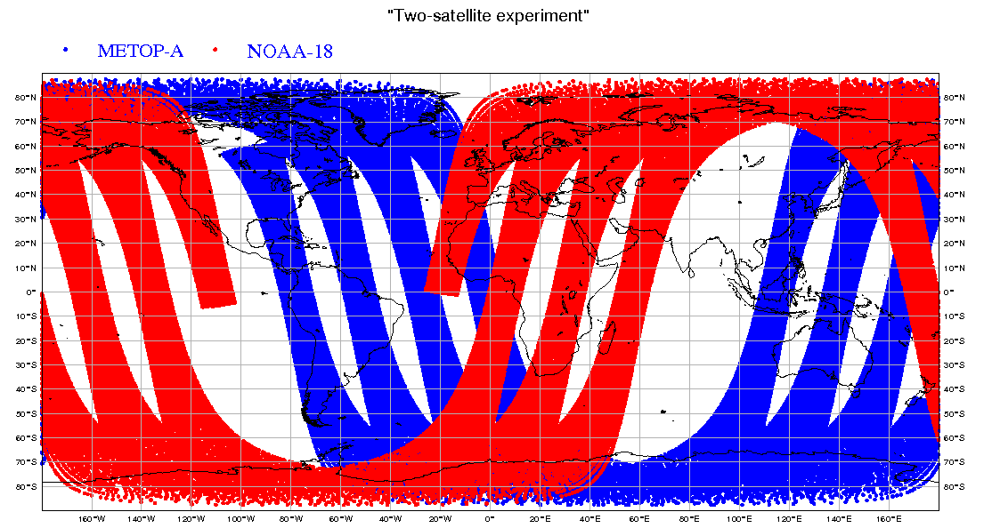
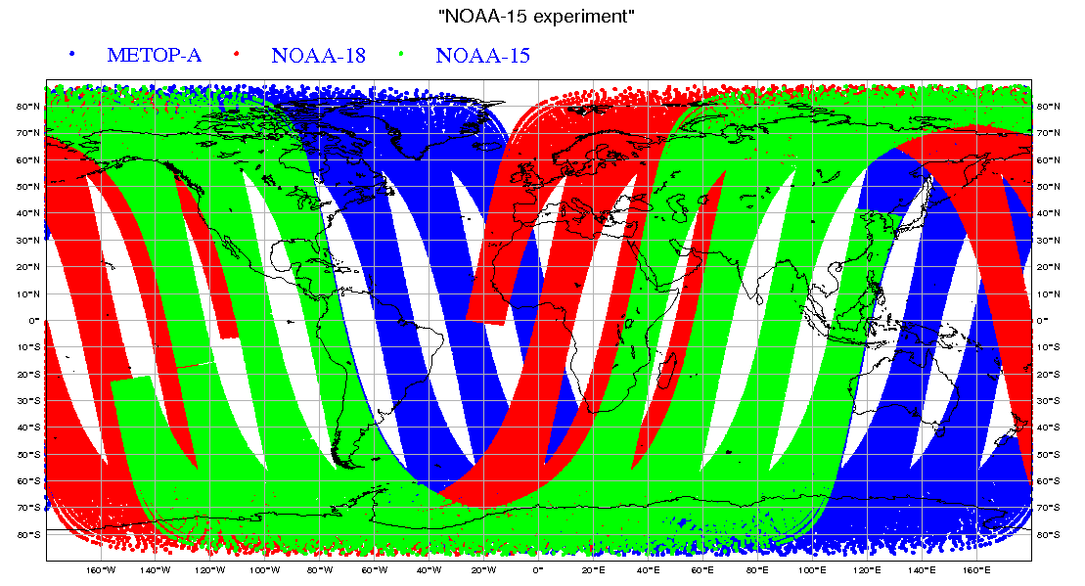
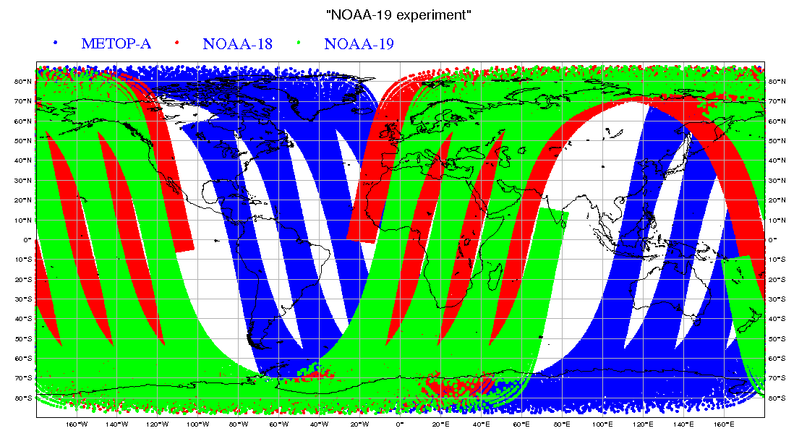
Satellite orbits
AM + PM
* MetOp-A * NOAA-18
E-AM + AM + PM
* MetOp-A * NOAA-18 * NOAA-15
AM + 2 x PM
* MetOp-A * NOAA-18 * NOAA-19

Slide 10
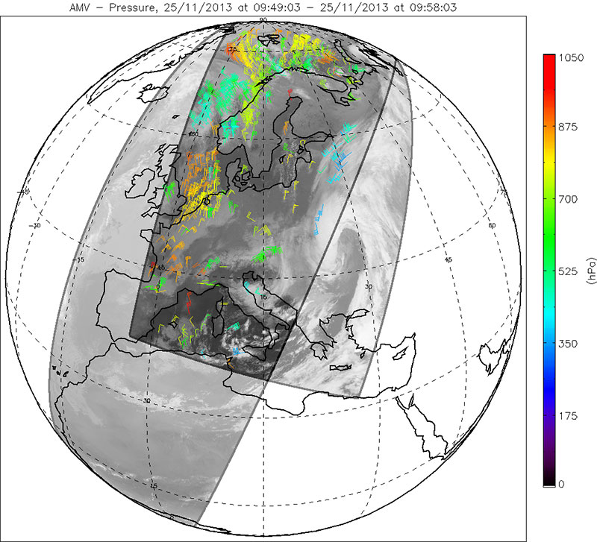
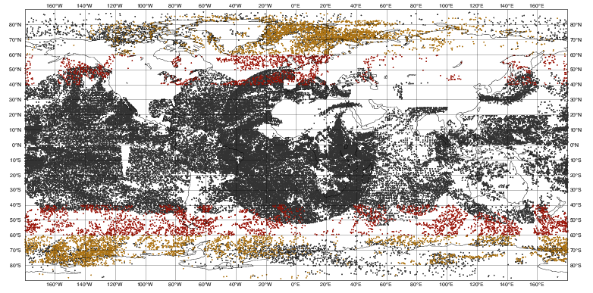
Dual Metop
Metop-A and B fly with same ECT but 180 degree phase shift, leading to an effective ~50m time difference. Allows global “AMVs”.

Slide 11
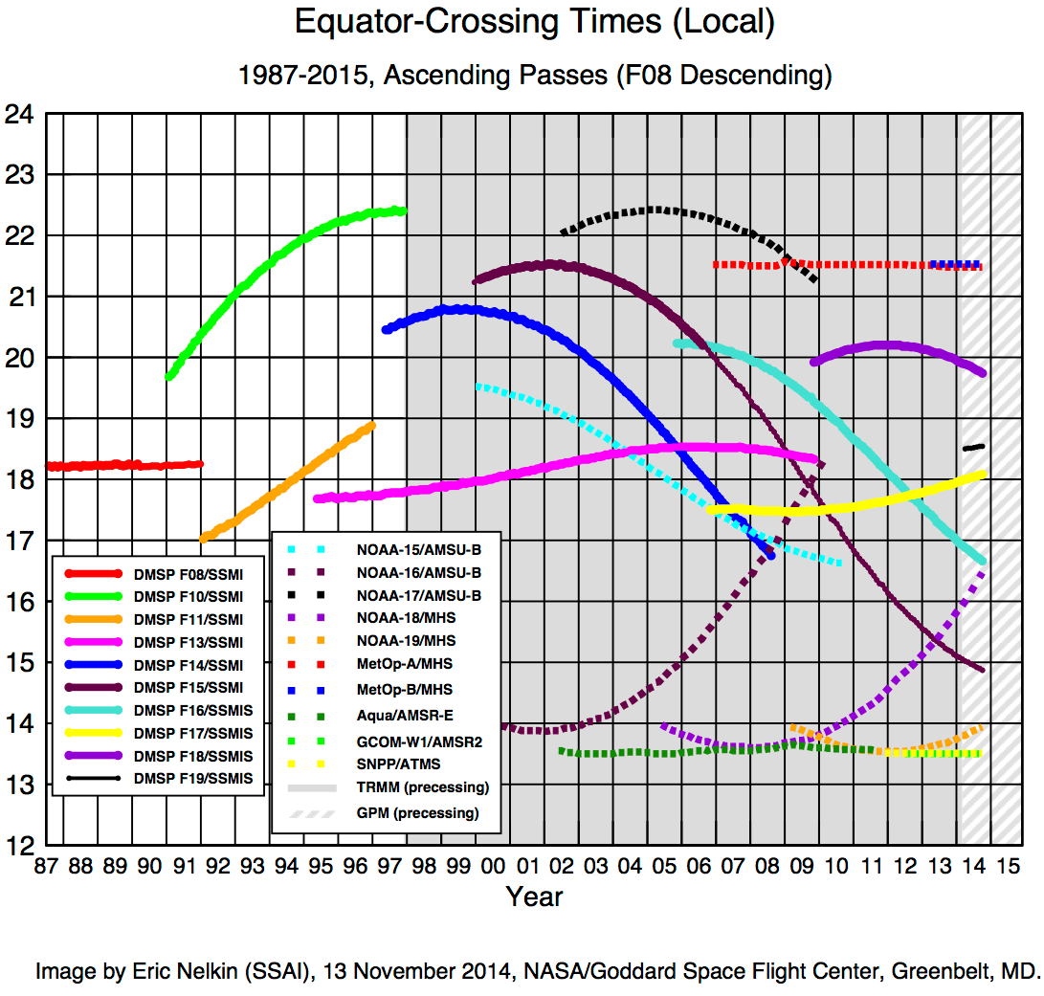
Satellite orbits
Mid AM
Early AM
PM
Europe
China
US
MetOp-B, A
FY-3A
T
i
m
e
DMSP F17, F18
NOAA-18
NOAA-15
NOAA-19, S-NPP, Aqua, Terra, Aura, FY-3B
Adapted from
Notes:
Colours for satellite names denotes what they started as e.g. NOAA-18 started as PM, and has drifted to Early AM

Slide 12
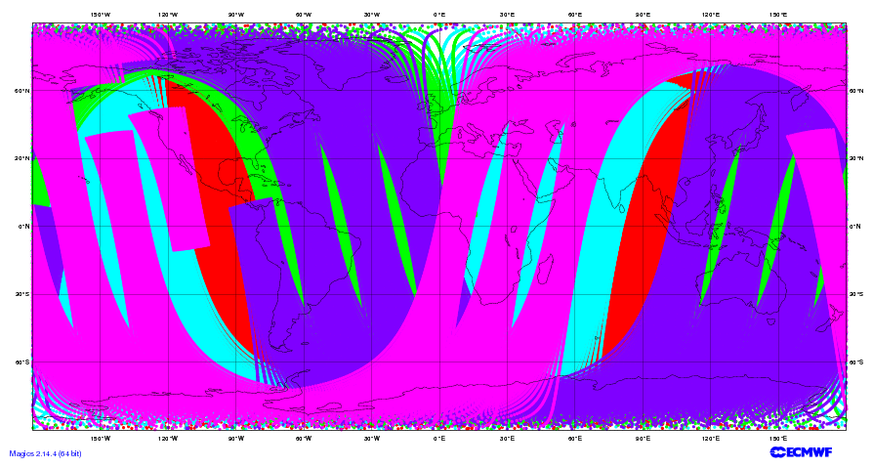
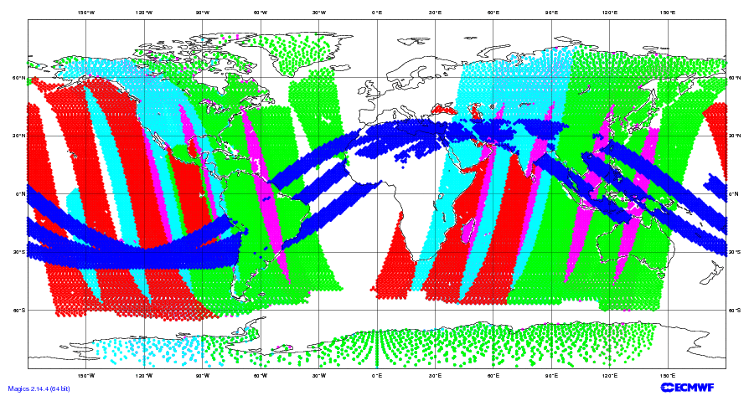
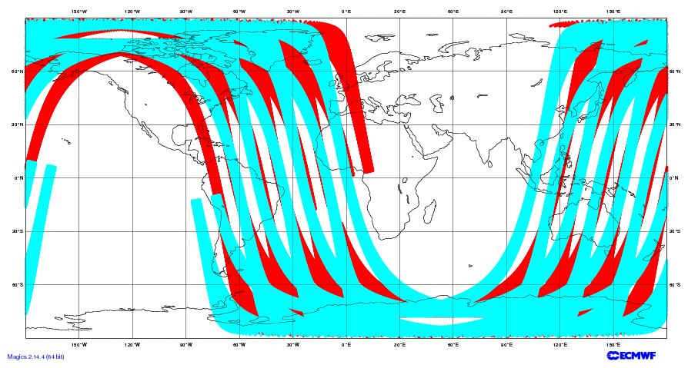
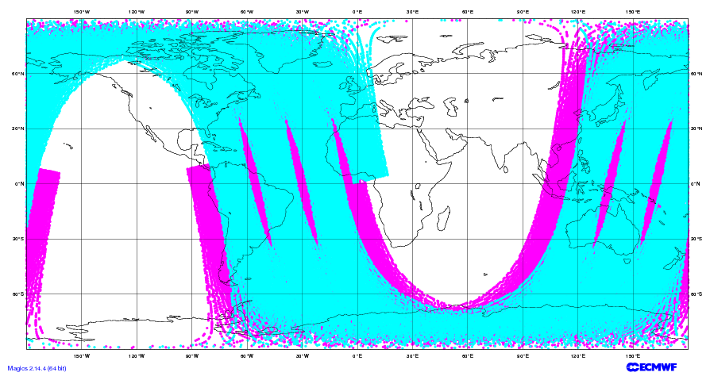
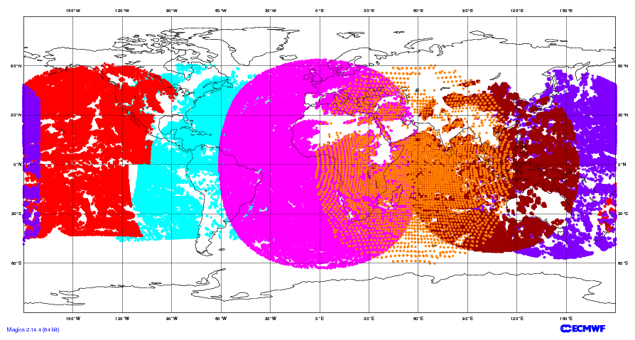
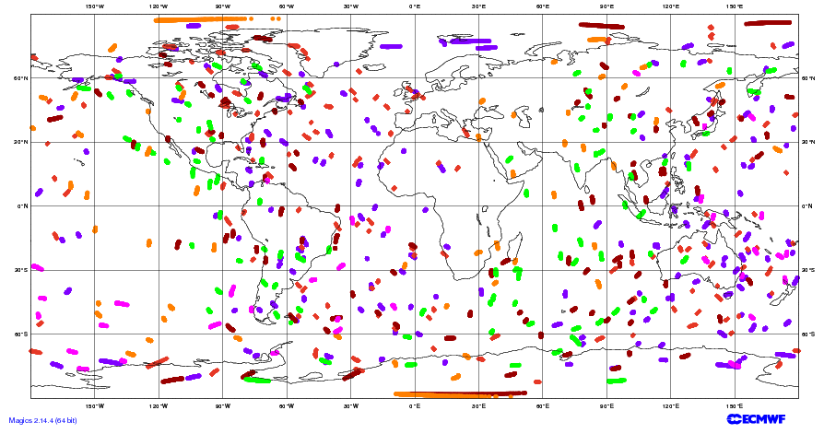
Example of 6hr satellite data coverage: 28 Jan 2015
MW Sounders
MW all-sky
Scatterometers
IASI
Satellite Geo Winds
Radio Occultation

Slide 13
Composition
Ultraviolet sensors
Sub-mm,
and near IR plus
Visible (e.g. Lidar)
Polar
IR + MW
sounders
Mass
Radar and
GPS total path delay
Moisture
Radio occultation
Geo IR Sounder
Geo IR and Polar MW Imagers
Feature tracking in imagery (e.g. cloud track winds), scatterometers and doppler winds
IR = InfraRed
MW = MicroWave
Wind

Slide 14
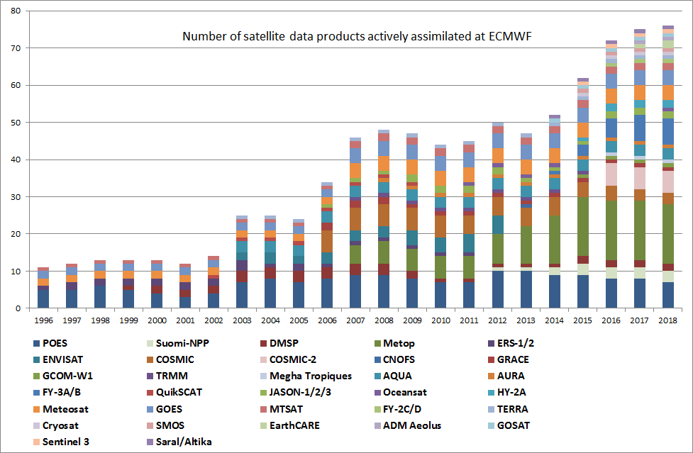
Metop

Slide 15
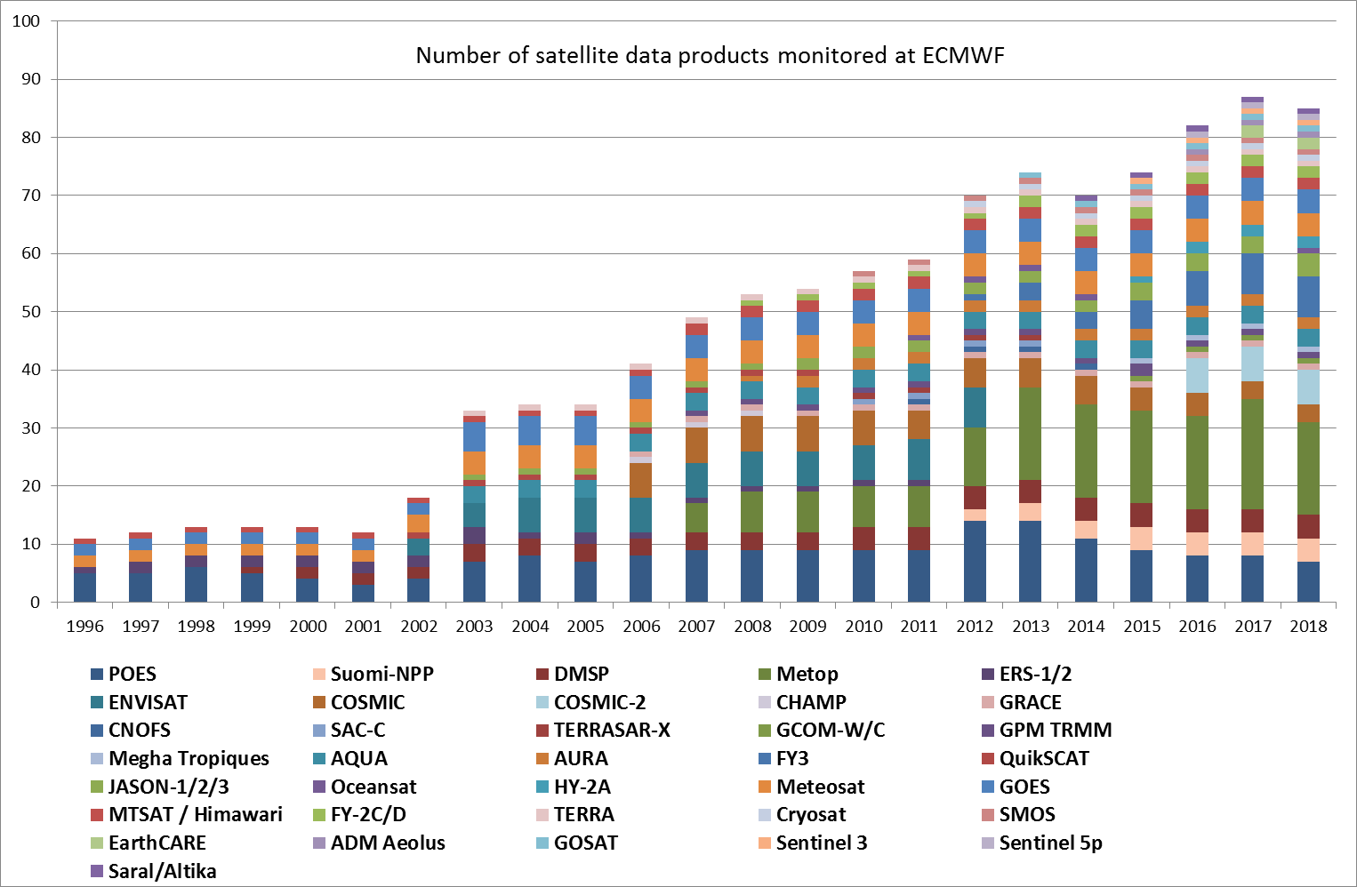

Slide 16
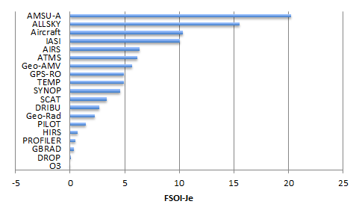
Impact of Satellite Observations by “FSO” a global measure of 24 hour forecast impact
Emergence of “all-sky” humidity obs (MHS, SSMIS) as 2nd most important after AMSU-A.

Slide 17
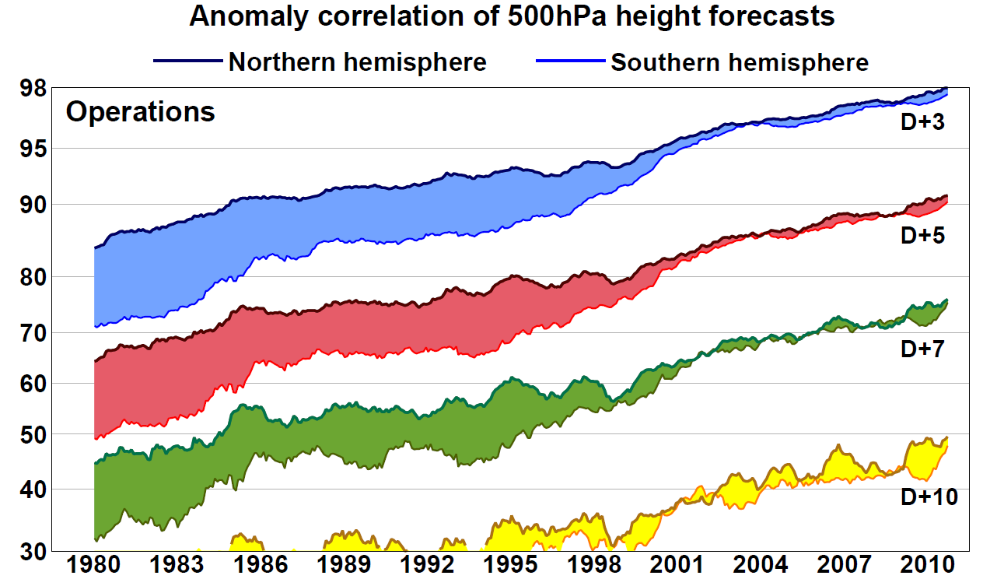
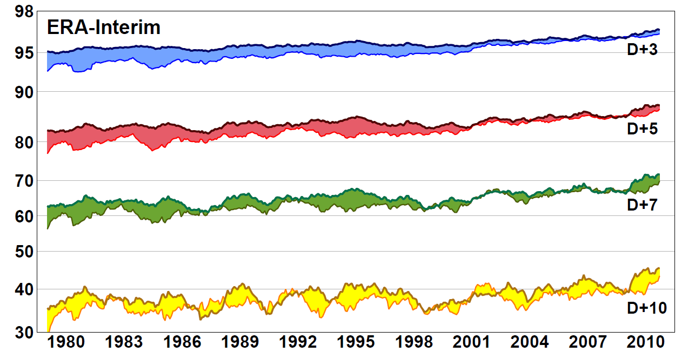
Full operational system. GOS + forecast changes with time
ERA-Interim skill shows little change 1980-2000 when there was little change in the GOS.
The ATOVS era shows a gain of around 6-18 hours in predictable skill compared to the TOVS era.
ERA-Interim excludes more recent data e.g. IASI and ASCAT so the impact of newer data is hard to judge.
This compares to overall ECMWF gain in skill of about 2-3 hours per year.
Re-analysis system. Only GOS changes with time
TOVS
ATOVS
ATOVS + Hyperspectral IR

Slide 18
WMO Integrated Global Observing System (WIGOS) design
Examples questions we use Data Assimilation techniques to study:
Very specific questions e.g. Would it be beneficial for the Chinese FY3 program to move to the “early morning orbit” with the Europeans occupying the “mid morning orbit” and the Americans the “afternoon orbit”?
Preparation for future instruments such as lidar and radar (EarthCARE) – will these observations make a difference?
Which observations are most critical to forecast skill?
Monitoring the quality of observations – protecting the operational system e.g. HCN event.
Protecting our needs e.g. Radiofrequency interference.

Slide 19
Developing WIGOS
Vision for WIGOS in 2025 adopted June 2009
Vision for WIGOS in 2040 currently under development
  Goal of new WIGOS vision by 2018 or 2019
  Sets goals for the Space Agencies and attempts to coordinate
Understanding WIGOS - WMO Space provide detailed support for satellite data from www.wmo-sat.info:
  OSCAR lists what exists, what is planned, what it can do, how this compares to requirements:
  http://www.wmo-sat.info/oscar/
  SATURN provides detailed information to prepare for forthcoming launches: data availability, formats, meta data, test data, points of contact:
  https://www.wmo-sat.info/satellite-user-readiness/
  The Product Access Guide provides information on existing datasets and how to obtain them:
  https://www.wmo-sat.info/product-access-guide/

Slide 20
Summary
The Global Observing System is essential to weather forecasting
Mass – is well observed by satellites and conventional observations, albeit only on the large scale.
Moisture – satellite observations are data rich but difficult to exploit to their full potential. Radar and lidar may become important.
Dynamics – wind observations are scarce. Aeolus (doppler wind lidar) may help. AMV impact has increased recently.
Composition – NWP techniques have been successfully extended to environmental analysis (ozone, aerosol, trace gases…)
Surface – Some “static” fields are needed e.g. vegetation, orography, land:sea, lakes; others are more dynamic e.g. sea ice, snow, soil moisture, surface temperature, flooding

Slide 21
OSCAR demonstration
http://www.wmo-sat.info/oscar/

Slide 22
Sun-Synchronous Polar Satellites
Instrument | Early morning orbit | Mid Morning orbit | Afternoon orbit
High spectral resolution IR sounder |  | Metop-A+B IASI | Aqua AIRS S-NPP CrIS
Microwave T sounder | F17 SSMIS | Metop-A+B AMSU-A FY3C MWTS2 DMSP F18 SSMIS Meteor-M N1 MTVZA | NOAA-15, 18, 19 AMSU-A Aqua AMSU-A S-NPP ATMS
Microwave Q sounder + imagers | F17 SSMIS | Metop-A+B MHS DMSP F18 SSMIS FY3A MWHS2+MWRI | NOAA-18, 19 MHS FY3B MWHS+MWRI S-NPP ATMS GCOM-W/AMSR-2
Broadband IR sounder |  | Metop-A+B HIRS FY3C IRAS | FY3B IRAS
IR Imagers |  | Metop-A+B AVHRR Meteor-M N1 MSU | Aqua+Terra MODIS NOAA-15, 16, 18, 19 AVHRR
Composition (ozone etc). |  |  | NOAA-19 SBUV AURA OMI, MLS GOSAT

Slide 23
Sun-Synchronous Polar Satellites (2)
Instrument | Early morning orbit | Morning orbit | Afternoon orbit
Scatterometer |  | Metop-A+B ASCAT (Coriolis Windsat)
Radar |  |  | CloudSat
Lidar |  |  | Calipso
L-band imagery | SMOS, SMAP SAC-D/Aquarius
Non Sun-Synchronous Observations
Instrument | High inclination (> 60°) | Low inclination (<60°)
Radio occultation | GRAS, GRACE-A, COSMIC
MW Imagers |  | GPM/GMI Meghatropiques/SAPHIR
Radar Altimeter | JASON RA + SAR, Cryosat, Sentinel-3

