Slide 1
Monitoring the observations impact in the short-range forecast
András Horányi on behalf of Carla Cardinali
(original slides prepared by CC and tailored by AH)
Carla.Cardinali@ecmwf.int; Andras.Horanyi@ecmwf.int
Many Thanks
Mohamed Dahoui, Anne Fouilloux, Alan Geer,
Fernando Prates
ECMWF DA training course, 10 March, 2016

Slide 2

Let’s hope that nobody will fall asleep!
AH

Slide 3
Introduction: how to quantify the observation impact in data assimilation
ECMWF 4D-Var data assimilation system is using around 70 million observations per a 12h assimilation window → it is not obvious how to quantify their (individual) impact
Methods:
  Observing System Experiments (OSE): quantifies the impact of one change of the observing system to any forecast metric
  Observing System Simulation Experiments (OSSE): used for future observing systems (the observations should be simulated and properly calibrated; requires a “nature run”)
  Ensemble of Data Assimilations (EDA): the uncertainties of the DA system can be quantified by the ensemble spread (if the DA uncertainties are properly represented in the EDA and the error characteristics are appropriate; mostly for future observations)
  Adjoint diagnostic tools: quantifies the impact of all perturbations of the observing system to a single forecast metric
AH

Slide 4
REMINDER: Lecture Notes: Data assimilation concepts and methods
(Bouttier and Courtier)
AH

Slide 5
Forecast sensitivity to observation: some equations (1)
Aim: quantify the impact of observations
J_{e} is a measure of the forecast error e.g in energy norm
Forecast error sensitivity to the analysis (Rabier et al, 1996)
slide‹#›
+
-
-
Degree of Freedom for Signal (DFS)
Cardinali et al, 2004; Lupu & Gauthier, 2010

Slide 6
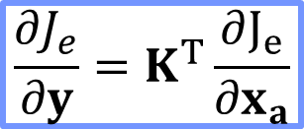
Forecast sensitivity to observation: some equations (2)
$$\frac{∂J_{e}}{∂y}=K^{T}\frac{∂J_{e}}{∂x_{a}}$$
Linear System Solver (see van der Vorst, 2003 or Cardinali, 2009)
Computing the Forecast Error Contribution δJ or FEC
ADJOINT EQUALITY
Langland & Baker, 2004; Zhu & Gelaro. 2008; Cardinali 2009
Note: Forecast Sensitivity to Observations Impact (FSOI) = FEC

Slide 7
Monitoring the satellite data impact in the 24 h forecast:
Global impact of the Observing System September & October, 2011
Forecast sensitivity tool computes the variation of forecast error due to the assimilated observations
  Positive variation means forecast error increase
  Negative variation means forecast error decrease
Forecast error is Forecast-Analysis → Analysis is a proxy for Truth
Bias in the Verifying Analysis can mask the observation impact
Linearity assumption must be applied therefore only 24 or 48 hour forecast can be examined
Interpretation of forecast improvement or degradation as depicted by the tool is Necessary

Slide 8
Monitoring the satellite data impact in the 24 h forecast:
Global impact of the Observing System September & October, 2011
Forecast Error Assimilation System Adjoint Observation Departure

Slide 9
Monitoring the satellite data impact in the 24 h forecast:
Global impact of the Observing System September & October, 2011
TOTAL
MEAN

Slide 10
DFS and FEC October 2011
Forecast sensitivity tool computes the variation of forecast error due to the assimilated observations: Forecast Error Contribution FEC → K^{T},FcE,d
Degree of Freedom for Signal DFS quantifies the number of statistically independent directions constrained by each observation. The average can be expressed as Observation Influence OI → K^{T}

Slide 11
FEC monthly variation (variability)
FEC is not a static measure, it depends on the meteorological characteristics (seasons) → proper interpretation is needed (e.g. the forecast error also depends on seasons)

Slide 12
Monitoring the satellite data impact in the 24 h forecast:
Global impact of the Observing System September & October, 2011
TOTAL
AMSU-A
Advanced Microwave Sounding Unit (sensitive to temperature)
MEAN
AMSU-A

Slide 13
Global AMSU-A forecast impact by Channel

Slide 14
Global AMSU-A forecast impact by Satellite and Channel
September
October

Slide 15
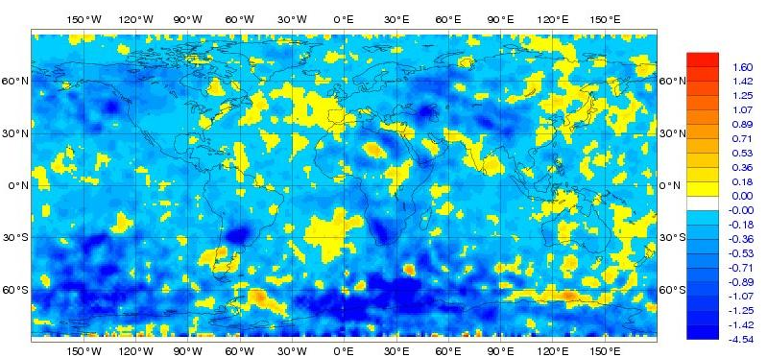
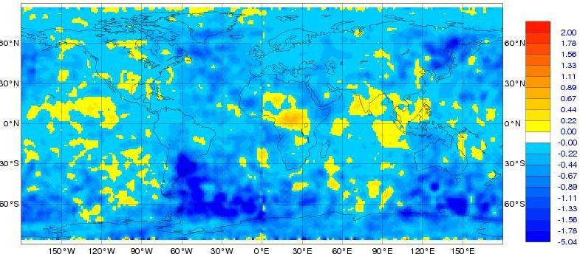
AMSU-A ch8 forecast impact September & October, 2011:
Geographical mean forecast impact pattern
METOP-A
Min=-4.5, Max=2.3, Mean=-0.3
Rather negative impact over the North Atlantic
NOAA 15
Min=-5.0, Max=2.0, Mean=-0.3
Positive impact over the North Atlantic

Slide 16
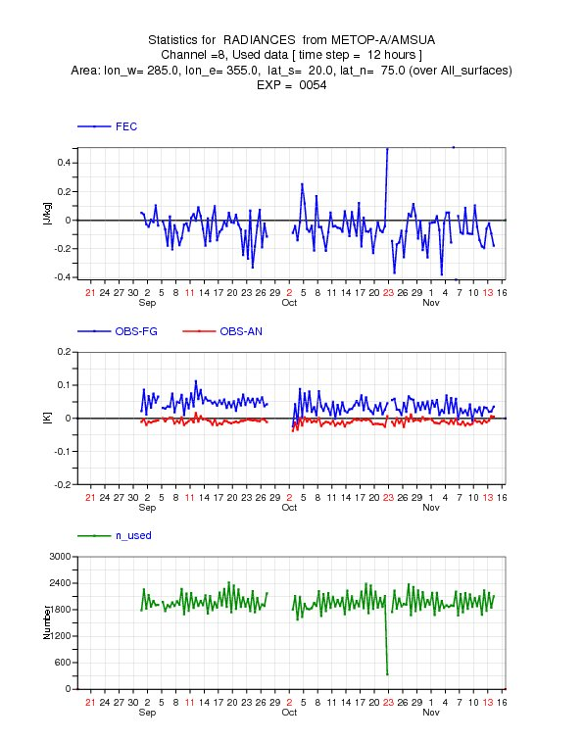
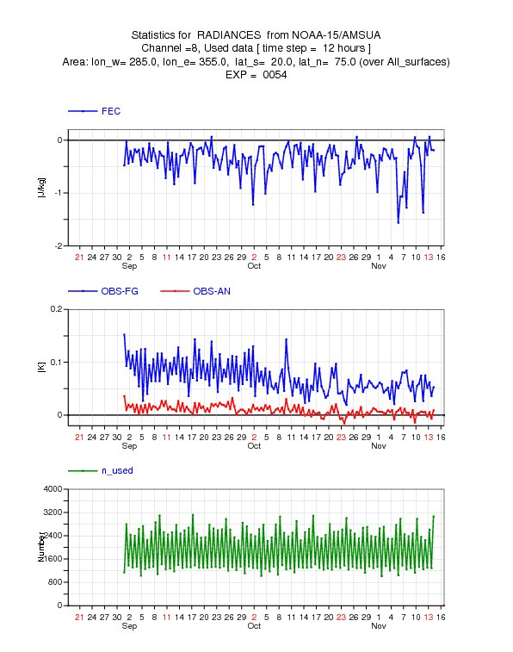
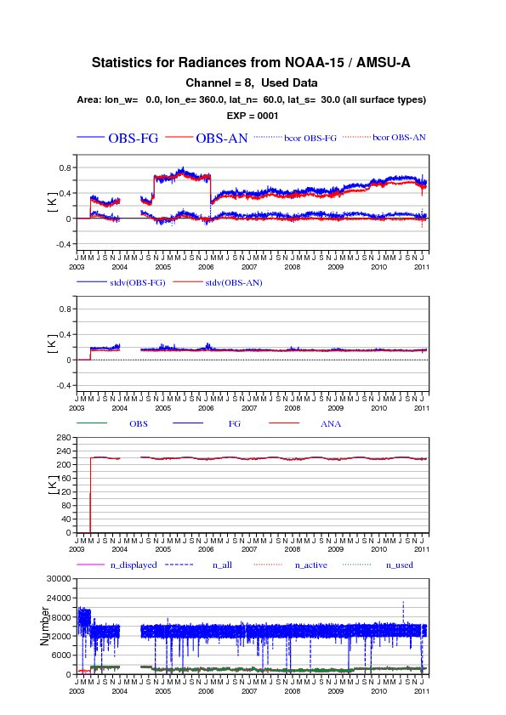
AMSU-A ch8: time series of forecast impact over N. Atlantic
METOP-A
NOAA-15

Slide 17
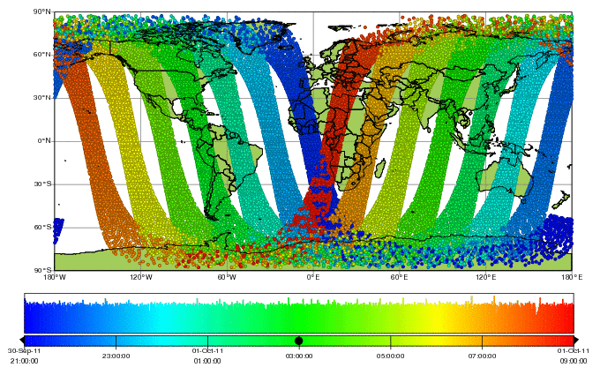
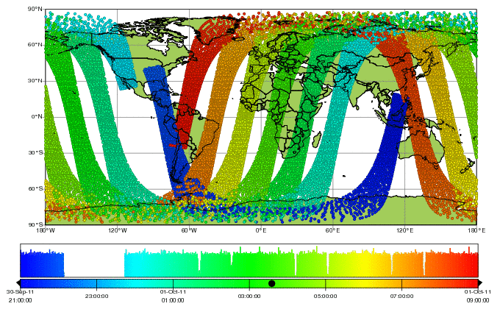
AMSU-A METOP-A versus NOAA-15 orbit over the Atlantic
METOP-A
Observing the Atlantic
at the beginning of 4D-Var window
The colour code shows the timing of the observations
NOAA-15
Observing the Atlantic
at the end of 4D-Var window
→ There is no problem with the observation, in spite of the negative impact!

Slide 18
Monitoring the satellite data impact in the 24 h forecast:
Global impact of the Observing System September & October, 2011
AMV

Slide 19
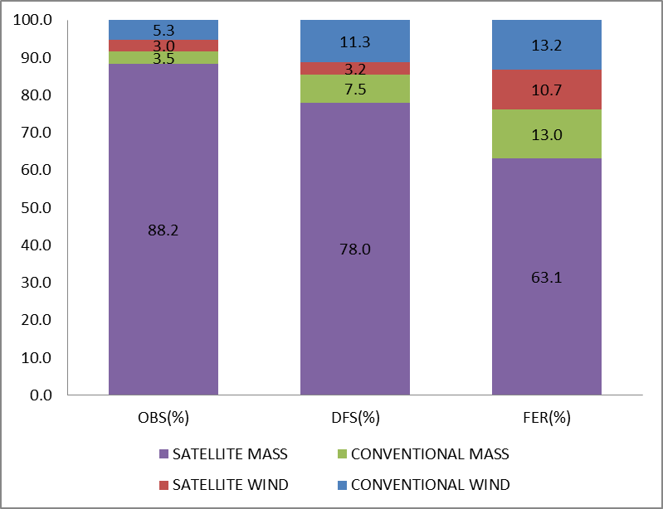
The amount and impact of conventional/satellite wind/mass observations; September, 2011
Horányi et al., 2015
AH

Slide 20
AMV FEC September by satellite and pressure level
Zonal wind
Larger impact of zonal wind at the upper air and meridional wind near to the surface
Meridional wind

Slide 21
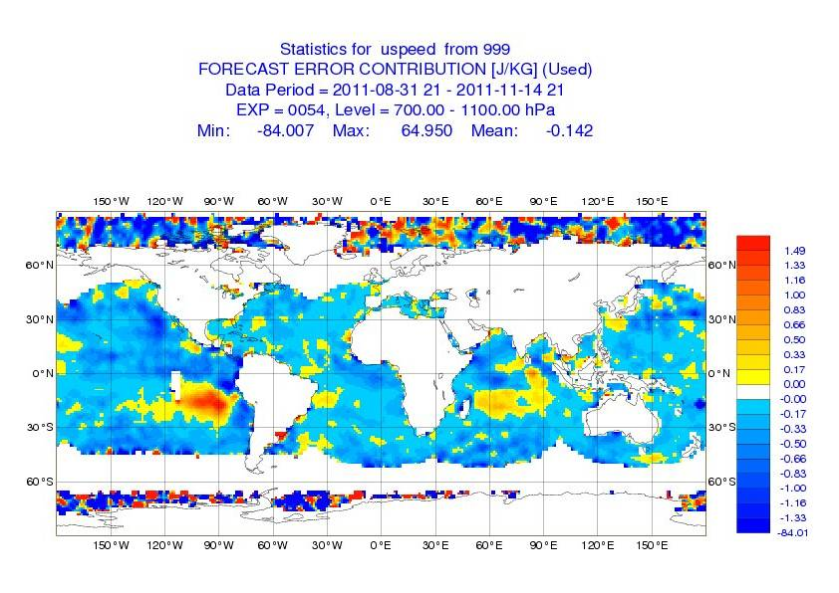
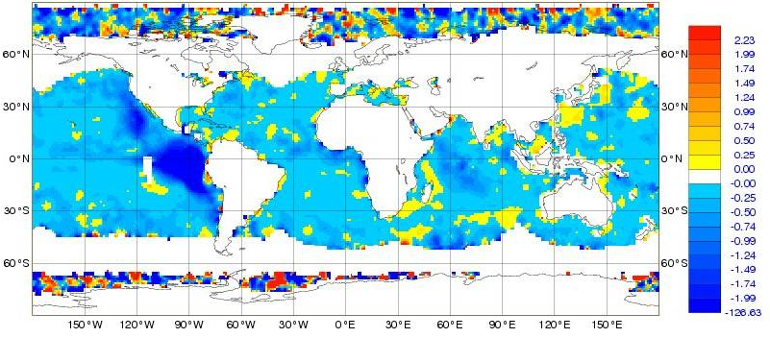
AMV Mean FEC September-October, 2011: 700 hPa - surface
GOES region
METEOSAT region
MTSAT region
U-Comp
Min=-84, Max=65, Mean=-0.15
Meridional wind component seems to have larger impact
V-Comp
Min=-127, Max=59, Mean=-0.24

Slide 22
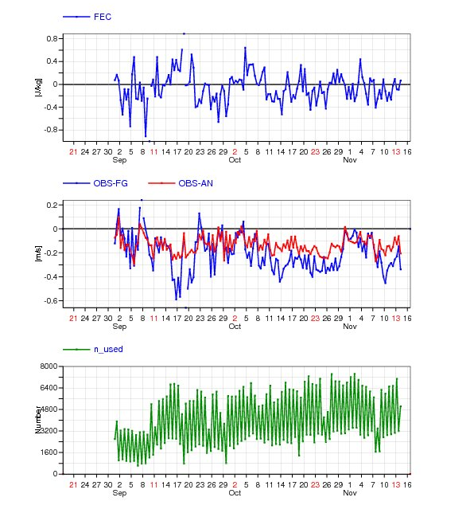
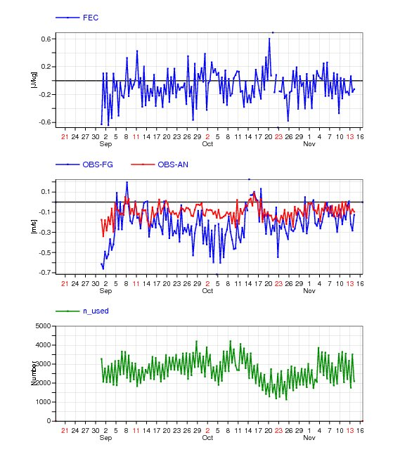
AMV FEC time series: 700 hPa - surface
GOES-13
METEOSAT-7

Slide 23
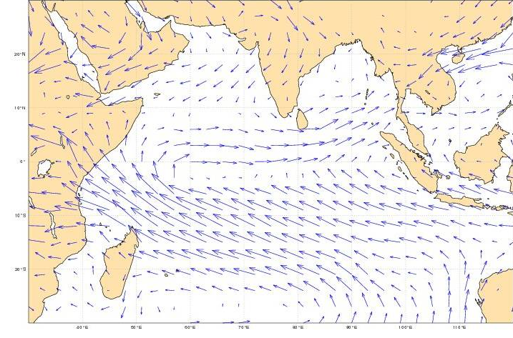
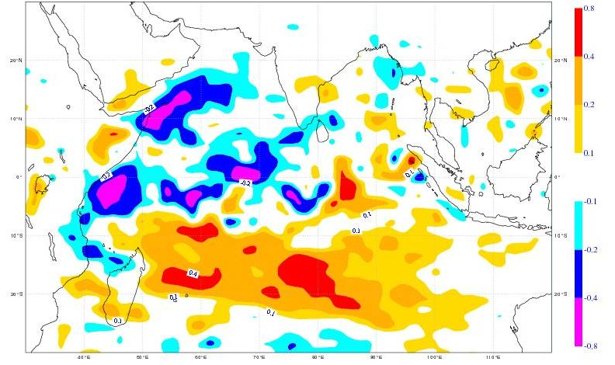
AMV METEOSAT-7 degradation investigation over the Northern Indian Ocean:
September-October, 2011; OSE NOAMV-CNTR 700hPa-surface
Question: what is the reason for the degradation seen over the Northern Indian Ocean?
FEC METEOSAT Degradation
Mean Wind field
NOAMV-CNTR mean analysis difference
AMV observations reinforce
the zonal circulation

Slide 24
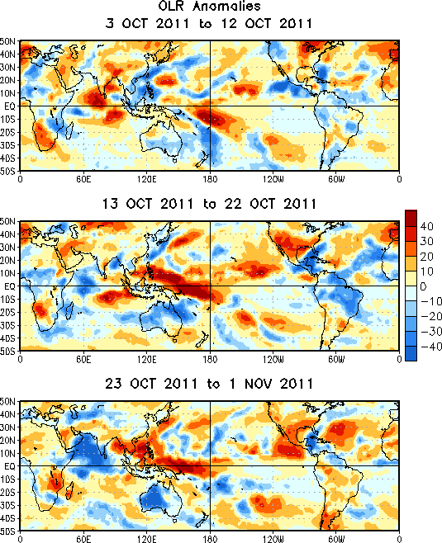
AMV OSEs + MJO Activity in October
OLR=Outgoing Long Wave Radiation
AMV-CNTR mean analysis difference
Red Circle: suppressed convection
→ increased zonal circulation
Blue Circle: enhanced convection
→ decreased zonal circulation
MJO pattern over the Indian Ocean justifies
a reinforcement of the zonal circulation
AMVs increase the zonal circulation,
so it is in agreement with other diagnostics
AMV does the right job as cross-checked with other diagnostics → FEC does not reflect observation problem (but rather model bias)

Slide 25
Monitoring the satellite data impact in the 24 h forecast:
Global impact of the Observing System September & October, 2011
ASCAT
Scatterometers: measuring near surface winds over the oceans

Slide 26
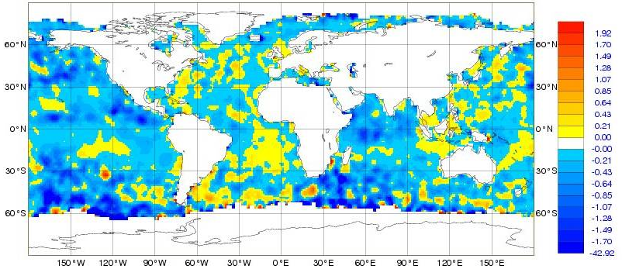
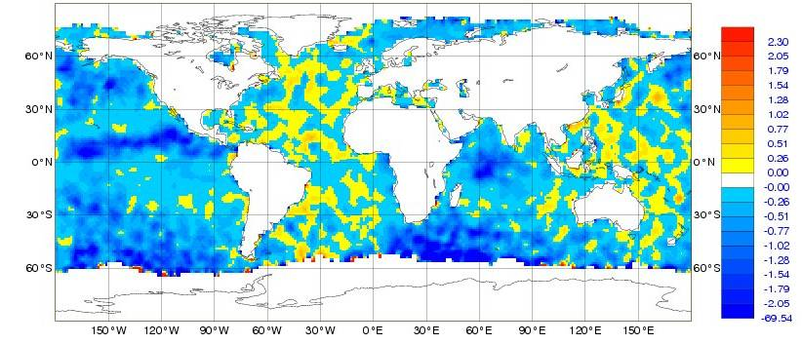
ASCAT Mean FEC: September & October, 2011
ASCAT U-Comp
Min=-43, Max=34, Mean=-0.3
Meridional wind component seems to have larger impact
ASCAT V-Comp
Min=-70, Max=55, Mean=-0.4

Slide 27
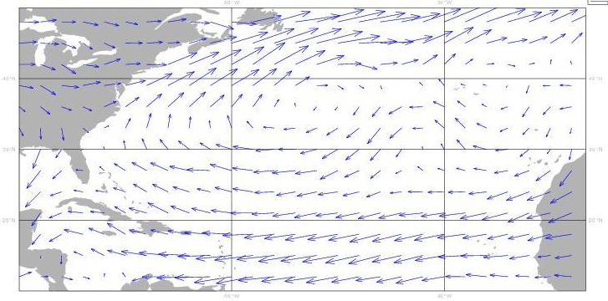
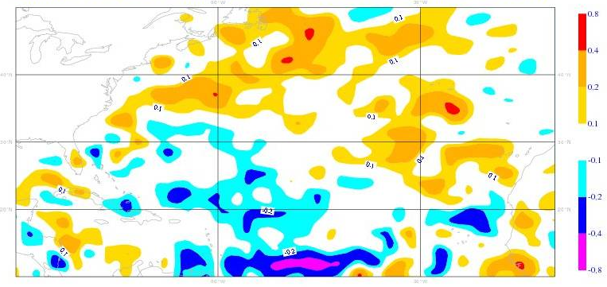
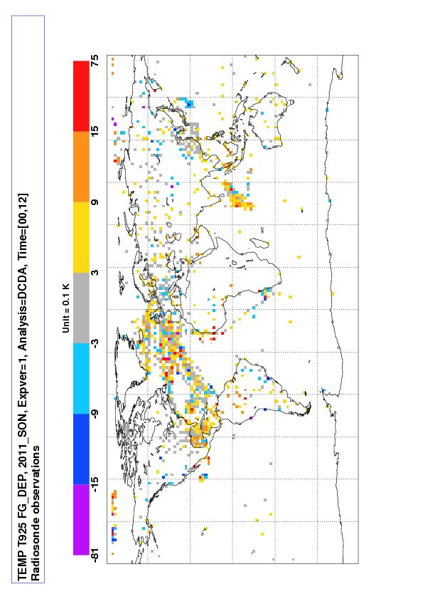
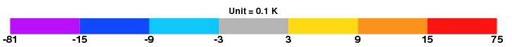
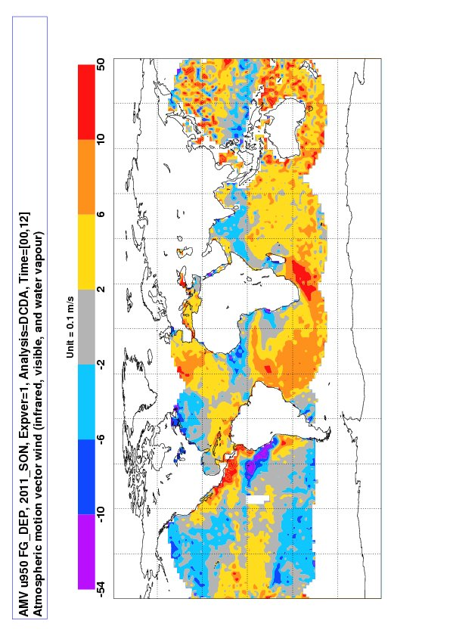
ASCAT September & October degradation over N. Atlantic
OSE: NOSCAT-CNTRL; 850hPa - surface
Mean Wind field
NOSCAT-CNTRL Mean Analysis Differences
ASCAT
data
weaken
the
circulation
TEMP
U-Comp
FG-dep
reinforce the circulation
AMV
U-Comp
FG-dep
ASCAT does not do the right job as cross-checked with other diagnostics → FEC does reflect properly observation-related problem

Slide 28
Monitoring the satellite data impact in the 24 h forecast:
Global impact of the Observing System; September & October, 2011
AllSky
SSMIS: Special Sensor Microwave Imager Sounder
TMI: TRMM Microwave Imager

Slide 29
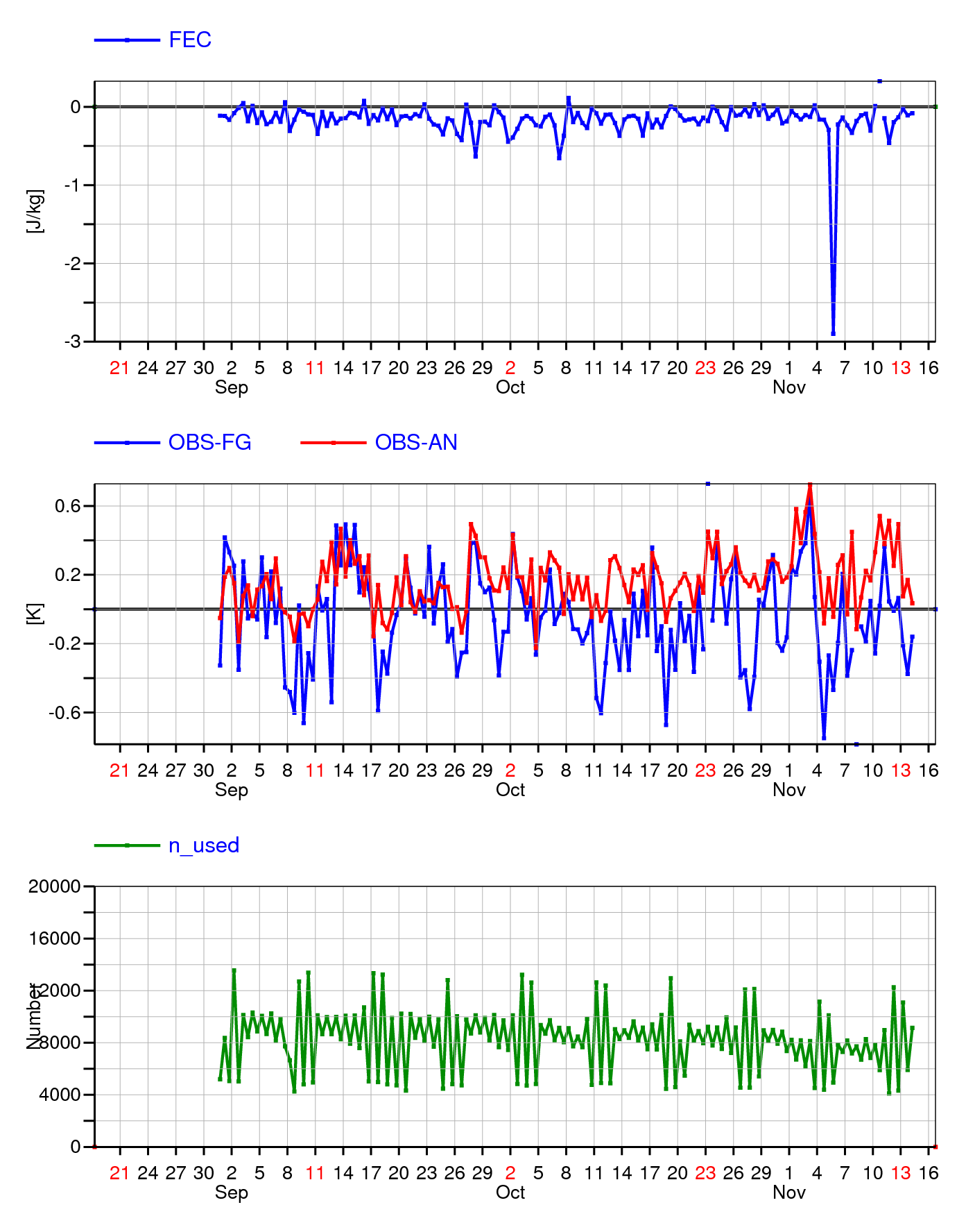
SSMIS FEC North Atlantic; November, 2011: case study

Slide 30
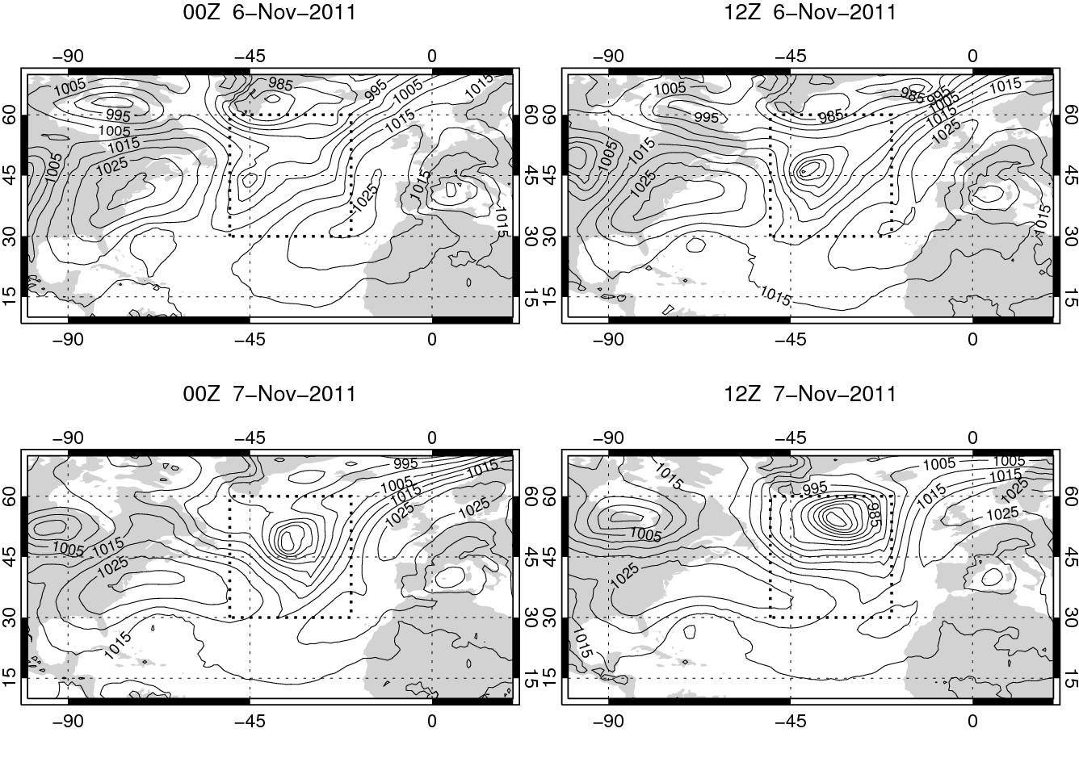
6th November: case of a rapidly developing cyclogenesis
Analysis
12h Forecast
24h Forecast
36h Forecast
Minimum pressure from 990 to 950 hPa between 00Z 6/11 and 18Z 7/11

Slide 31
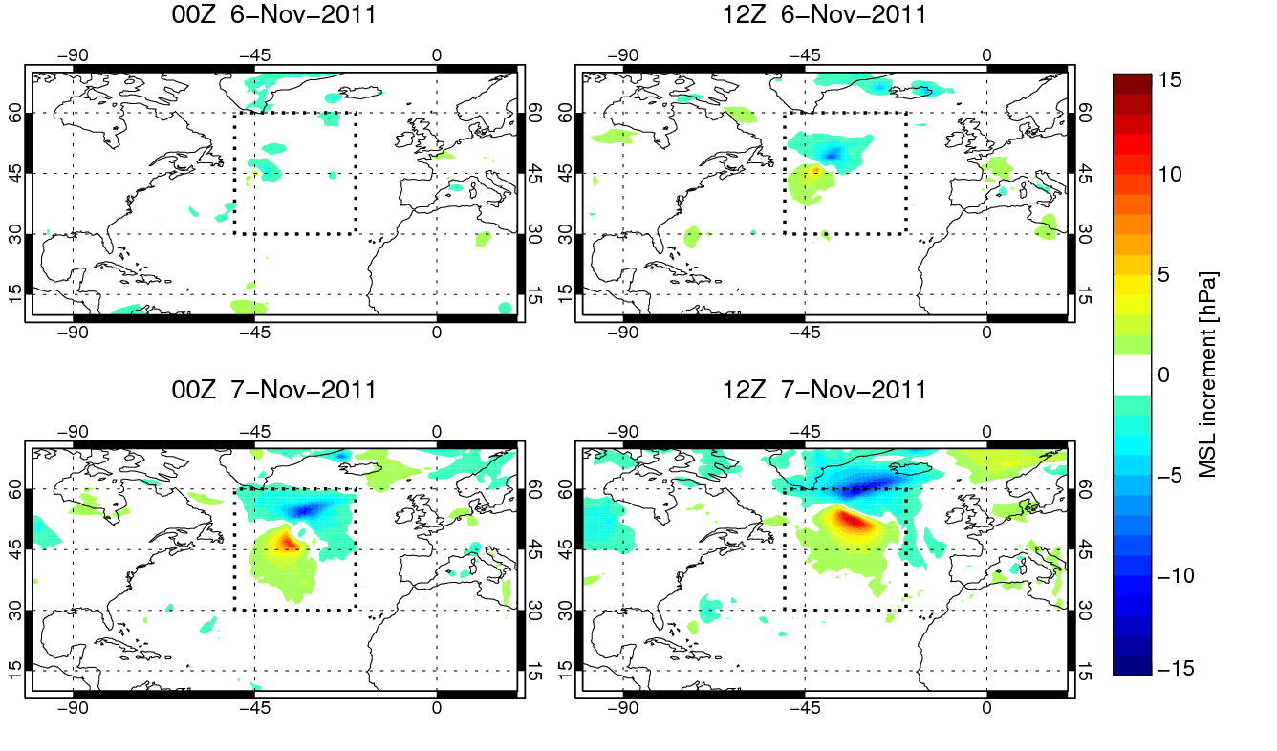
Mean sea level pressure: evolved increments
Forecasts valid at the same time and initialised from subsequent analyses
Increments
12-24h Forecast
24-36h Forecast
36-48h Forecast
00Z 6th Nov analysis shifts the storm North West

Slide 32
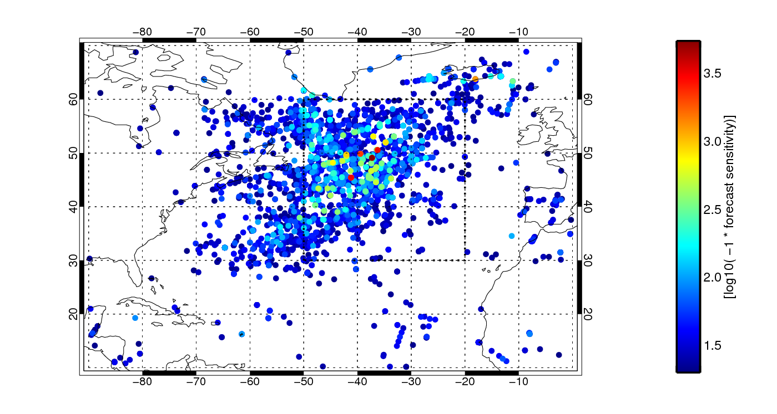
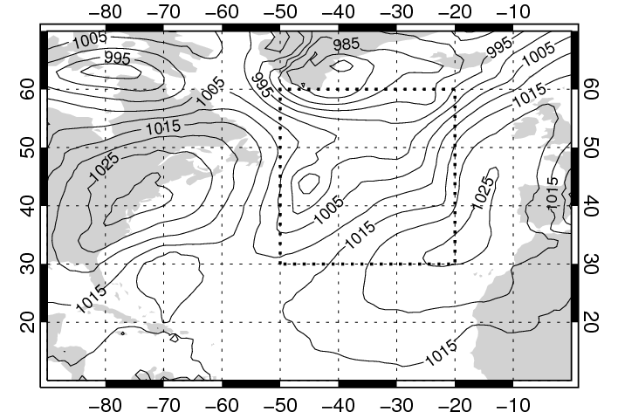
00Z 6th November FEC: all observations with FEC < -20 J
MSL pressure

Slide 33
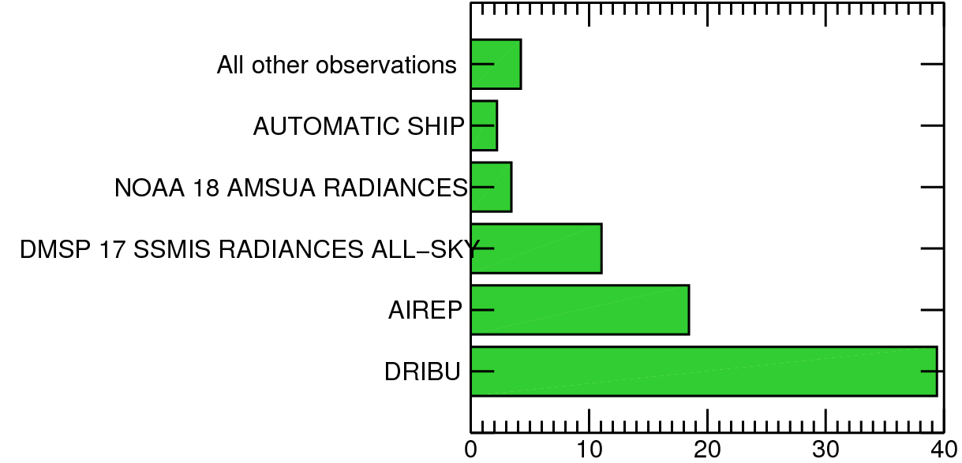
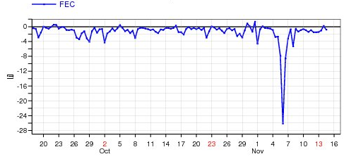
00Z 6th November FEC in the 30⁰ x 30⁰ domain
DRIBU
MSL pressure

Slide 34
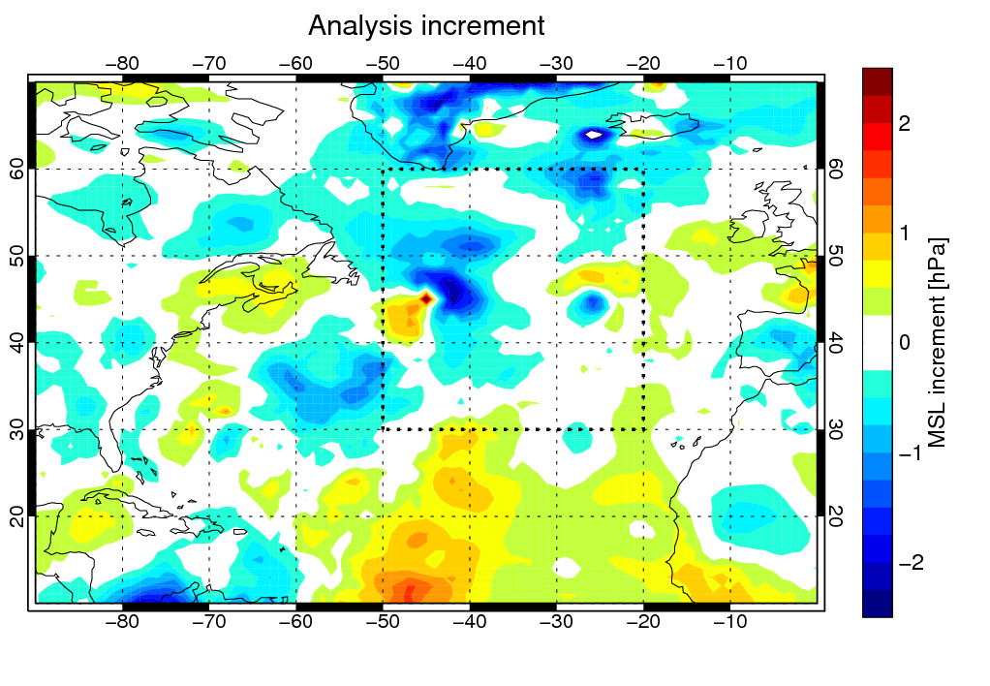
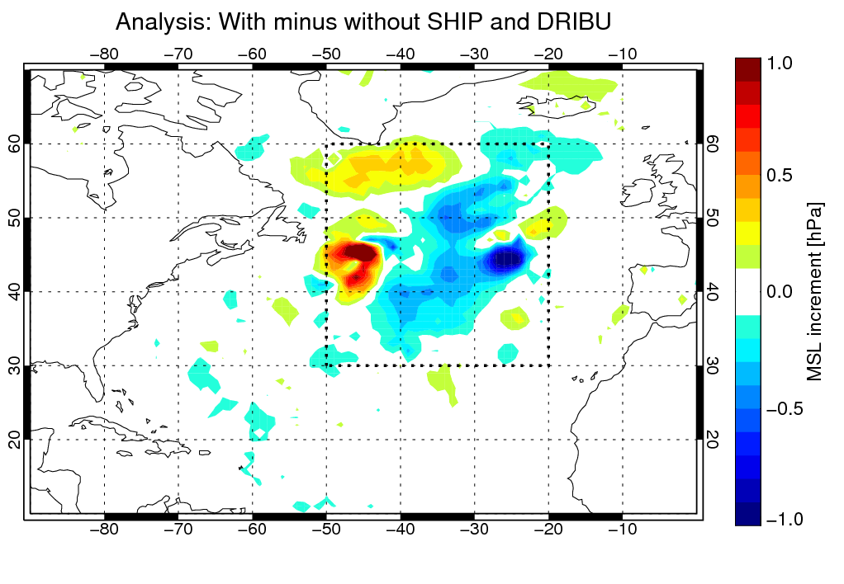
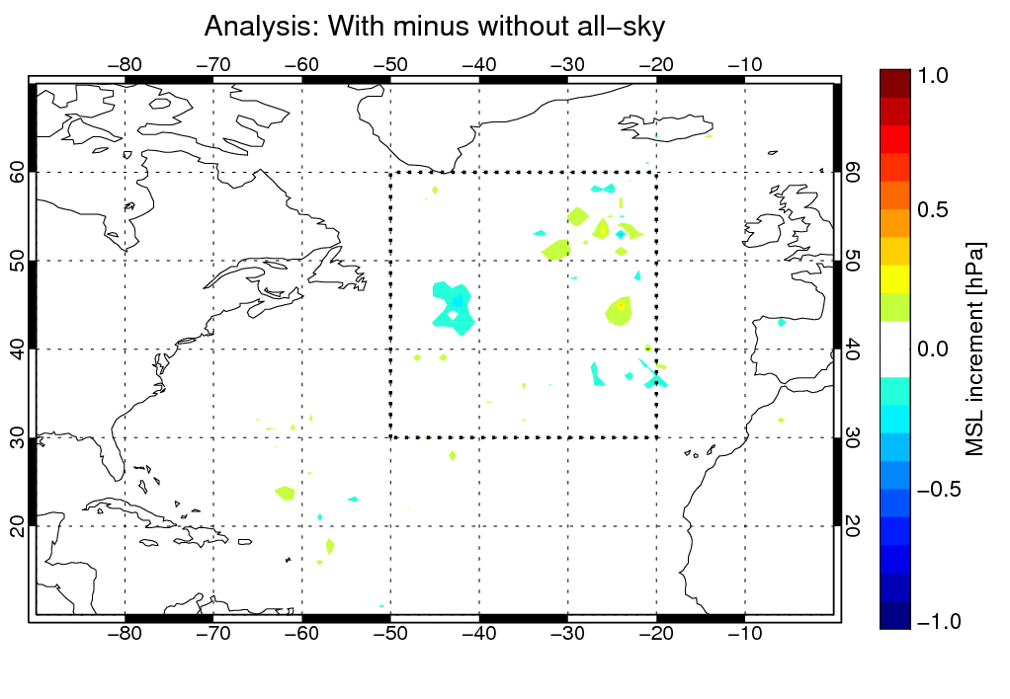
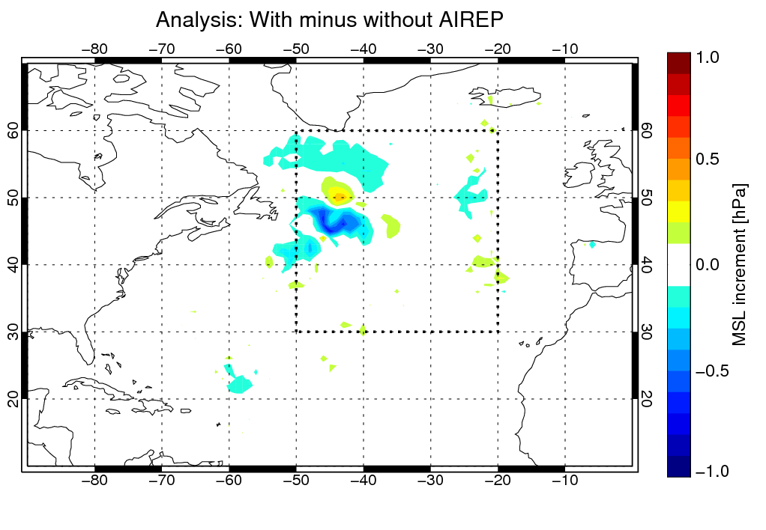
Denial OSEs vs. operations
Mean sea-level pressure increment at 00Z, 6th November
Operations: total increment
Ship and DRIBU
All-sky SSMIS F-17
AIREP

Slide 35
Summary, conclusions
Use of Forecast Error Contribution of the observing system components at ECMWF has been demonstrated
The observation impact is daily monitored
Illustrative examples include:
      Impact of AMSU-A
        NOAA and METOP-A
      Impact of AMV
        METEOSAT-7 over Indian Ocean: degradation related to model bias
      Impact of ASCAT
        North Atlantic degradation related to underestimation of observed wind speed
      Allsky forecast improvement: a case study
Potential and limitation of the diagnostic tool have been shown (be careful: cannot be used for “blind” ranking)

Slide 36

AH

