Slide 1
Operational and research activities at ECMWF now and in the future
Sarah Keeley
Education Officer

Slide 2
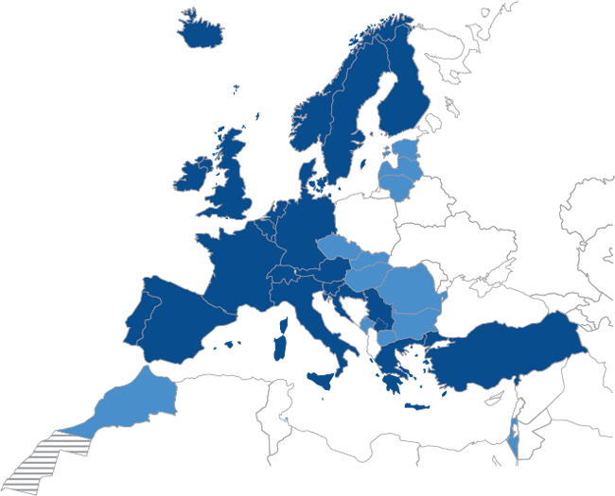
An independent intergovernmental organisation
established in 1975
Currently:
22 Member States
12 Co-operating States
Notes:
For 2011:
Age of ECMWF: 36 years
Employees: 227
Supported by: 34 States
Budget: £43 million per annum
Contributions by Member States
and Co-operating States £39.8 million per annum
Slovenia becomes ECMWF's 20th Member State

Slide 3
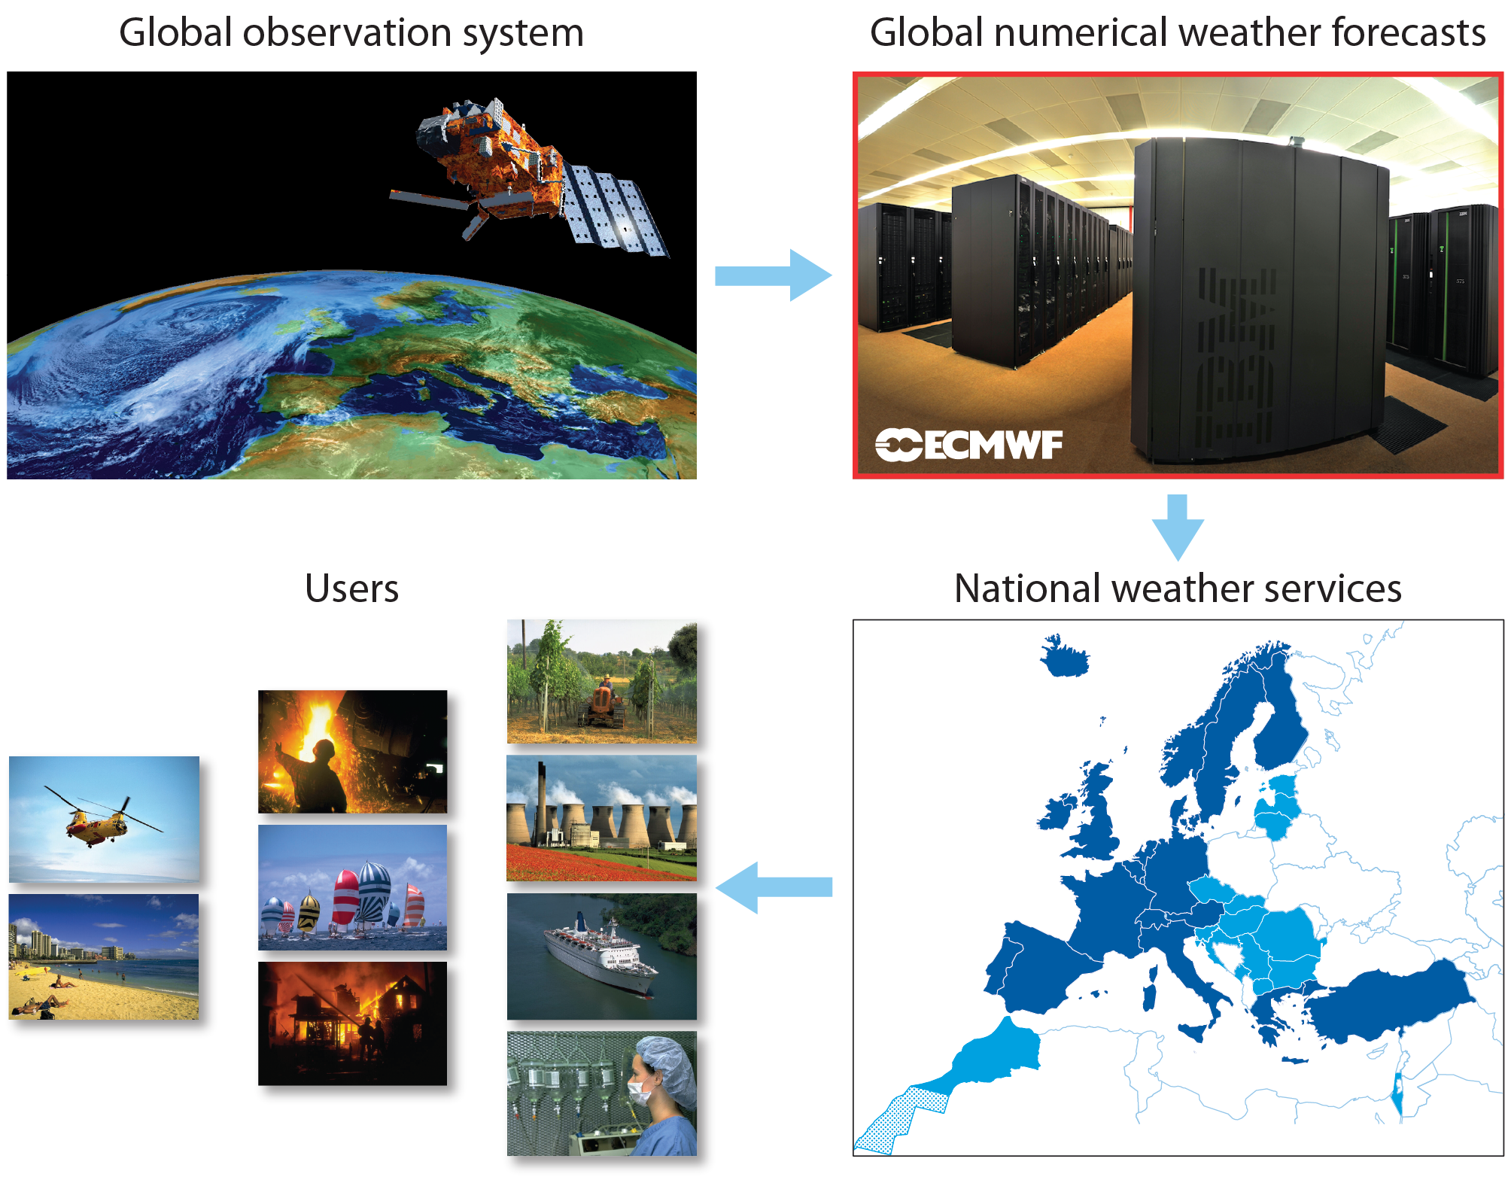

Slide 4
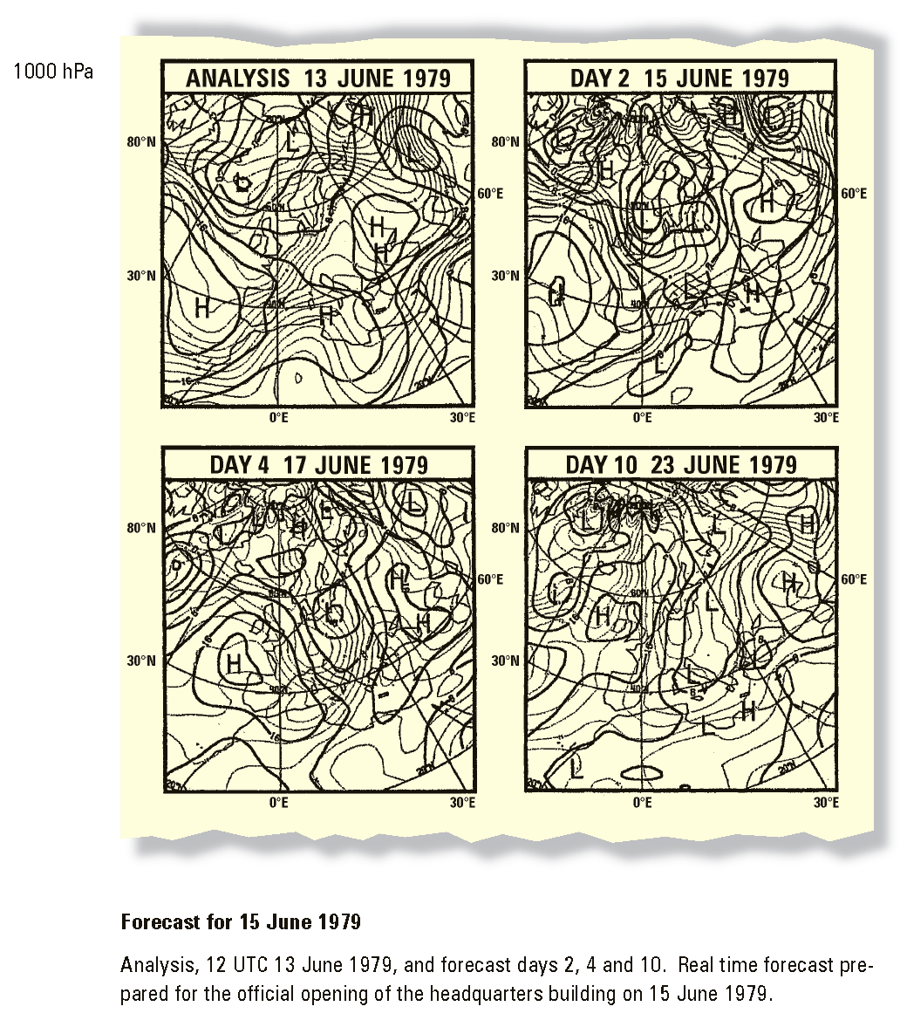
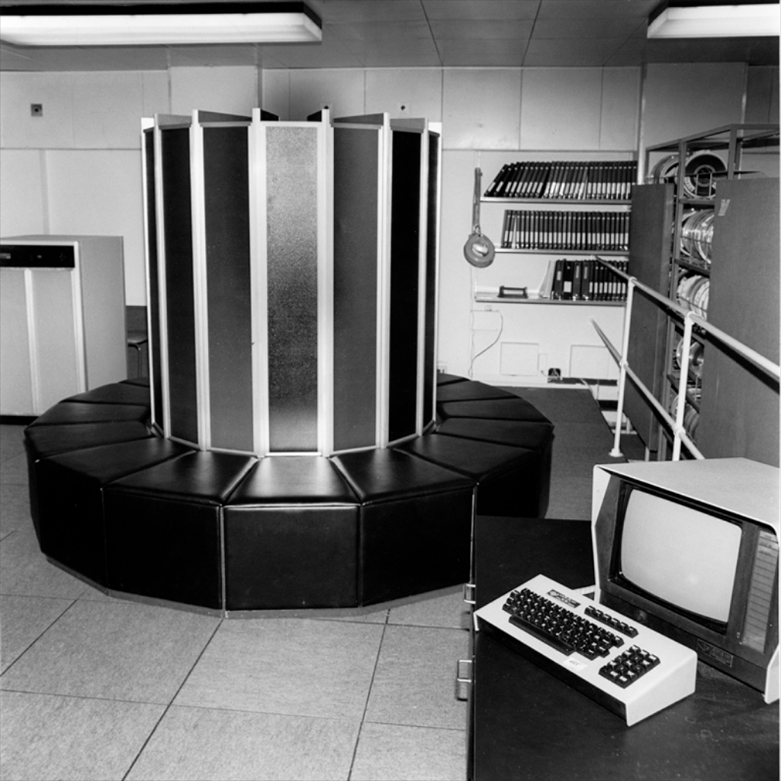
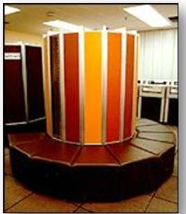
How ECMWF was established
Start of operational activities
1978 Installation of first computer system (CRAY 1-A)
Start of operations
  N48 grid point model – 200km
Notes:
250 MFLOPS
Issued 5 days a week 200km resolution, 25km
7 days a week august 1980
Wave model operational 1992 – but the model in semi operational state 1987 – 1998 two way coupling with atmosphere

Slide 5
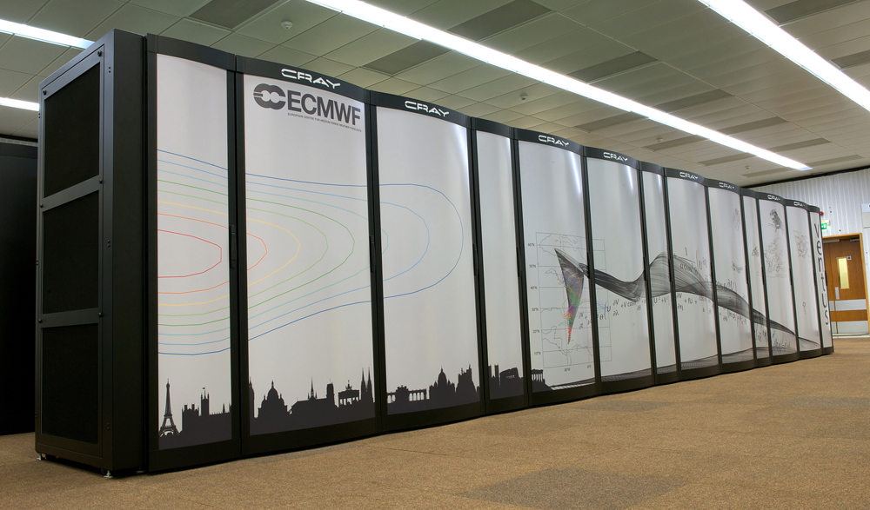
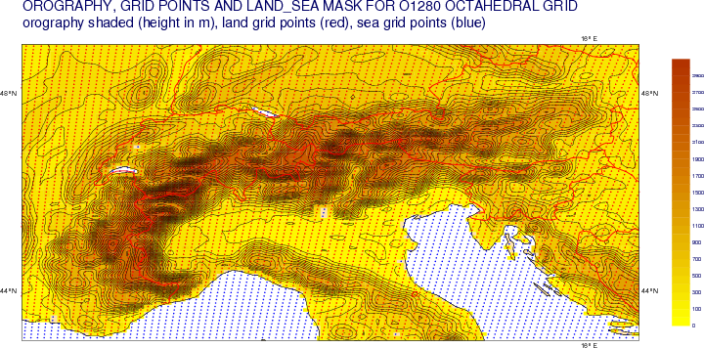
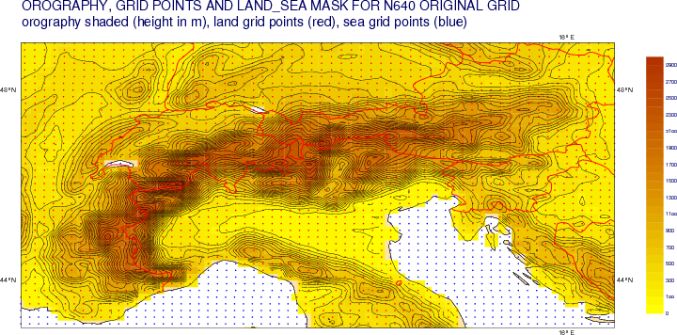
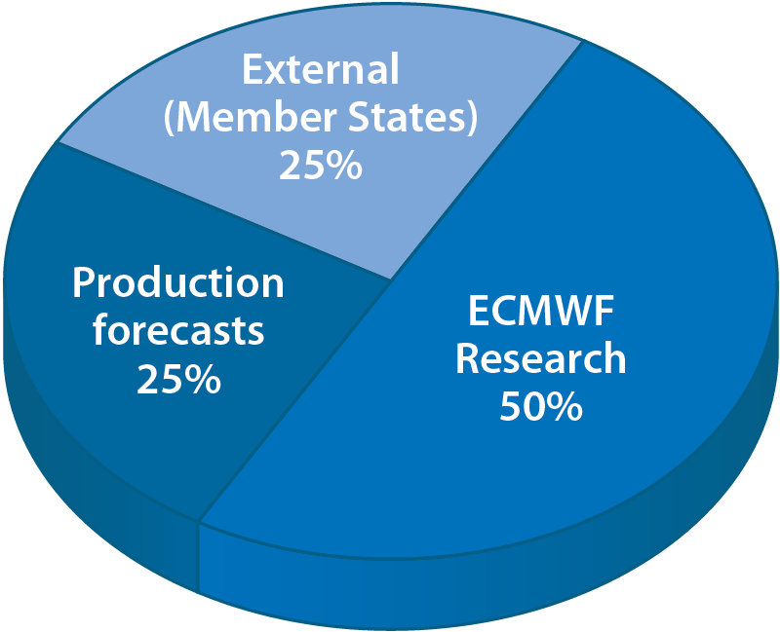
Current system
Cray XC30
  Two identical systems for resiliency
  3.5 Petaflops peak performance (3.5×10¹⁵)
Operational Model - TCo1279 (9km)
Ensemble Prediction System - TCo639 (16km)
Notes:
1978 – 1996: Cray (Cray-1A, XMP, YMP, C90, T3D)
1996 – 2002: Fujitsu (VPP700, VPP700E, VPP5000)
2002 – today: IBM (Power4, Power5, Power6)
ECMWF has currently the 10th and 11th in Europe (in terms of compute capacity)

Slide 6
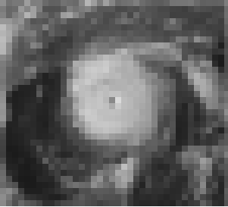

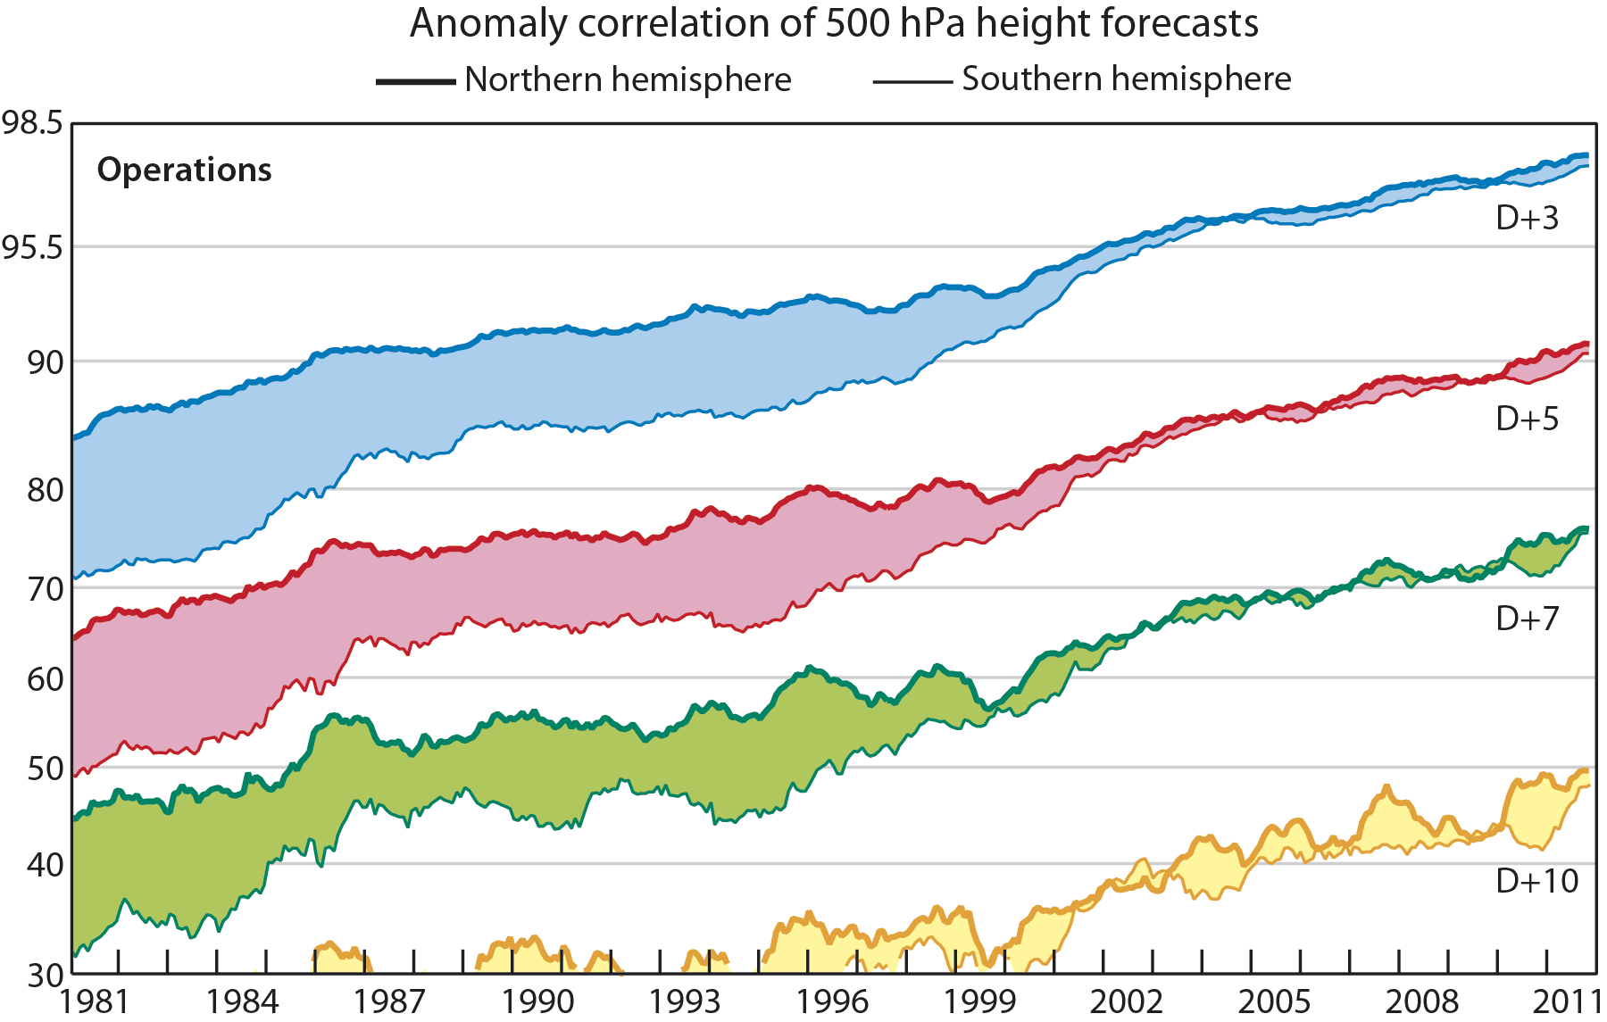

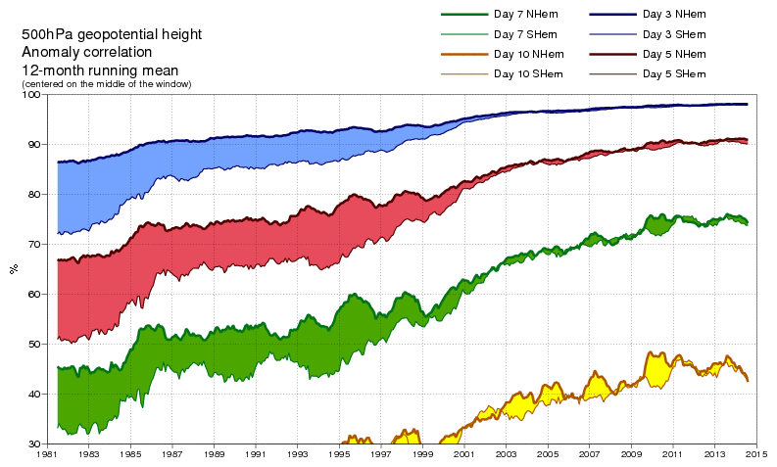
Evolution of ECMWF scores
~16km
~210km
Adapted and extended from Simmons & Hollingsworth (2002)
Notes:
Important elements 4dvar and T511 resolution

Slide 7
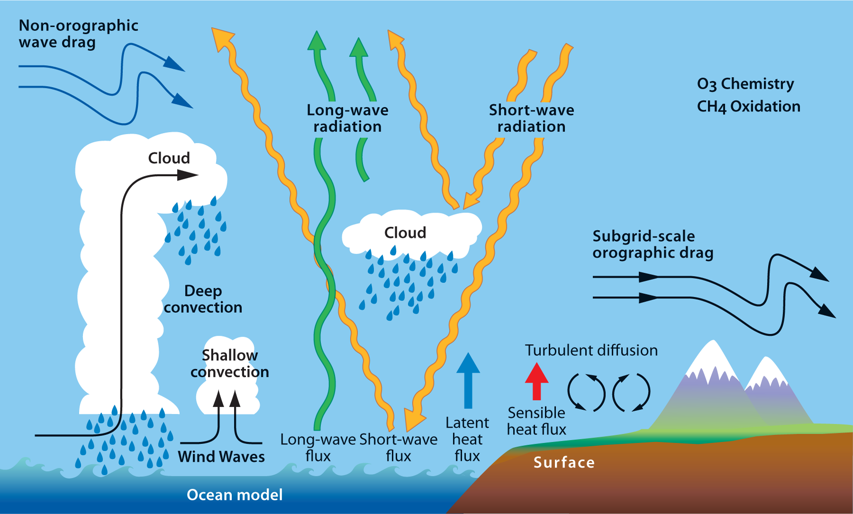
Physical aspects, included in IFS
Notes:
Orography (terrain height and sub-grid-scale characteristics)
• Four surface and sub-surface levels (allowing for vegetation cover,
gravitational drainage, capillarity exchange, surface / sub-surface runoff)
• Stratiform and convective precipitation
• Carbon dioxide (345 ppmv fixed), aerosol, ozone
• Solar angle
• Diffusion
• Ground & sea roughness
• Ground and sea-surface temperature
• Ground humidity
• Snow-fall, snow-cover and snow melt
• Radiation (incoming short-wave and out-going long-wave)
• Friction (at surface and in free atmosphere)
• Sub-grid-scale orographic drag
• Gravity waves and blocking effects
• Evaporation, sensible and latent heat flux

Slide 8
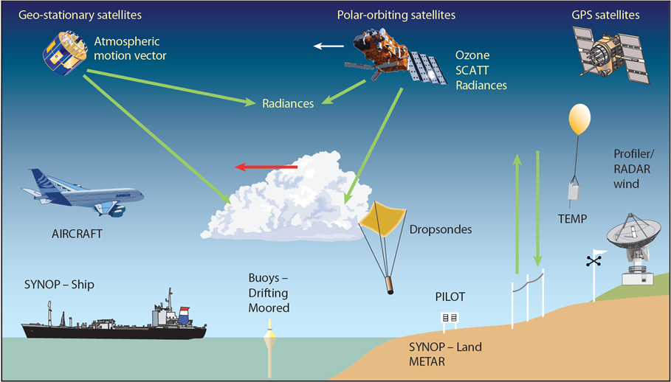
Data assimilation
Notes:
ECMWF’s assimilation system uses 40 million observations a day from more than 50 different instruments on satellites, and from many ground-based and airborne measurement systems.

Slide 9
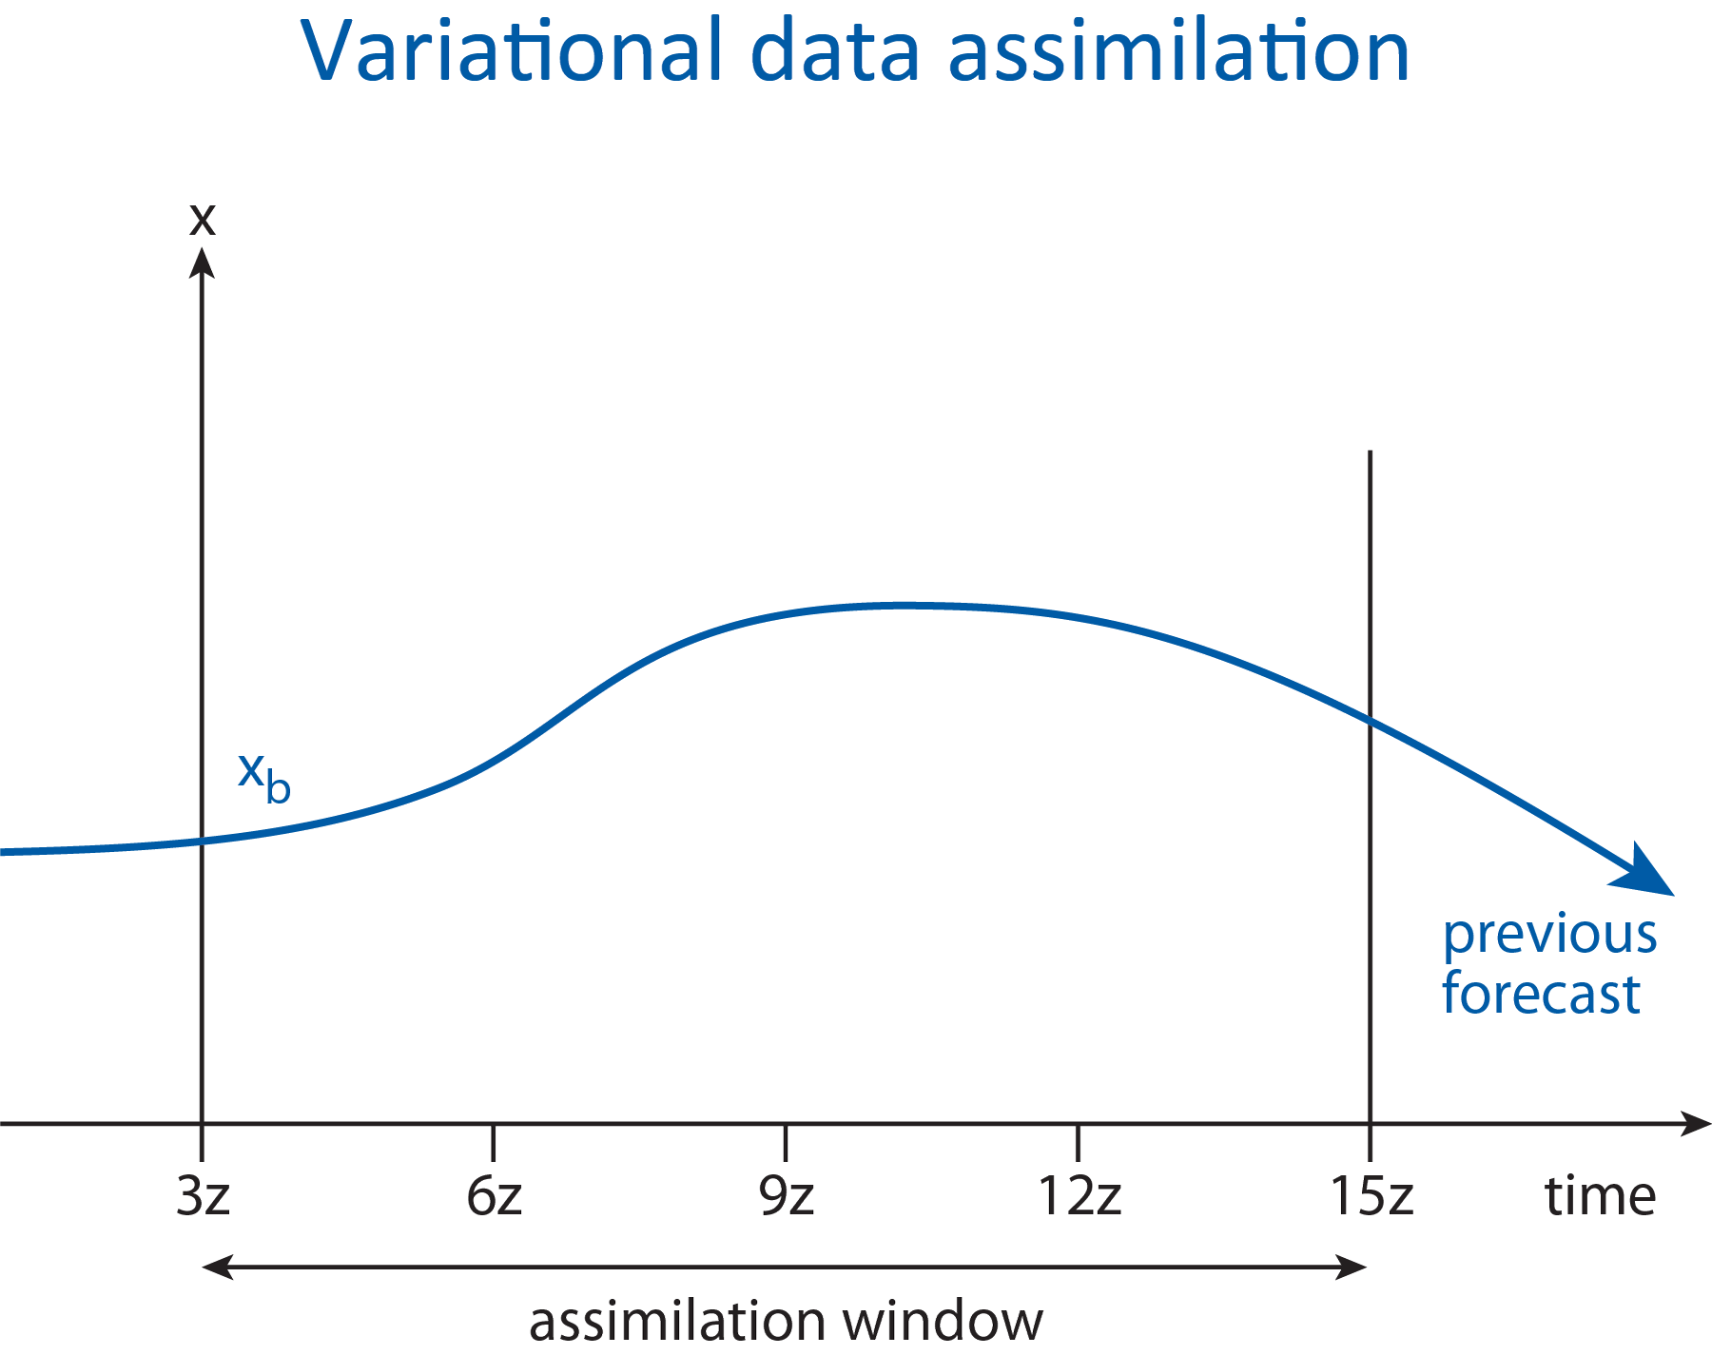
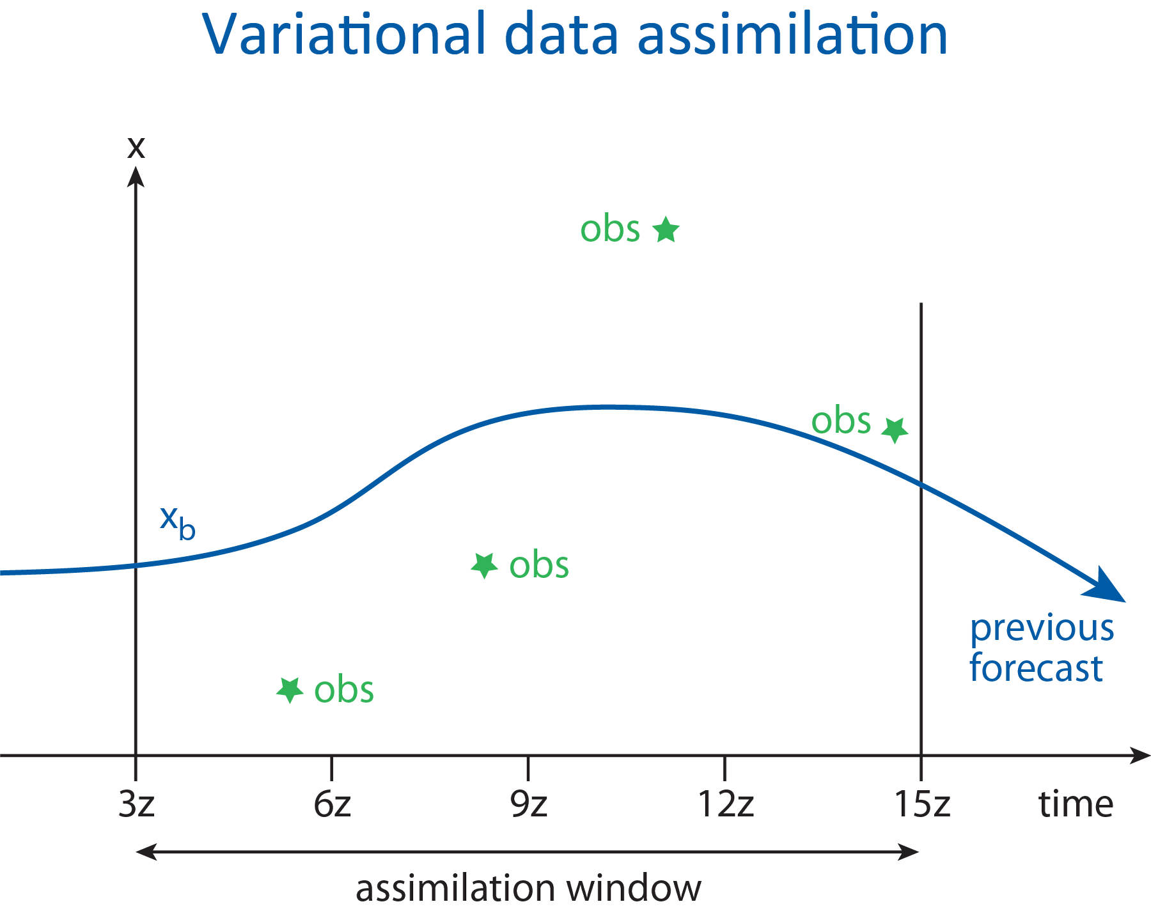
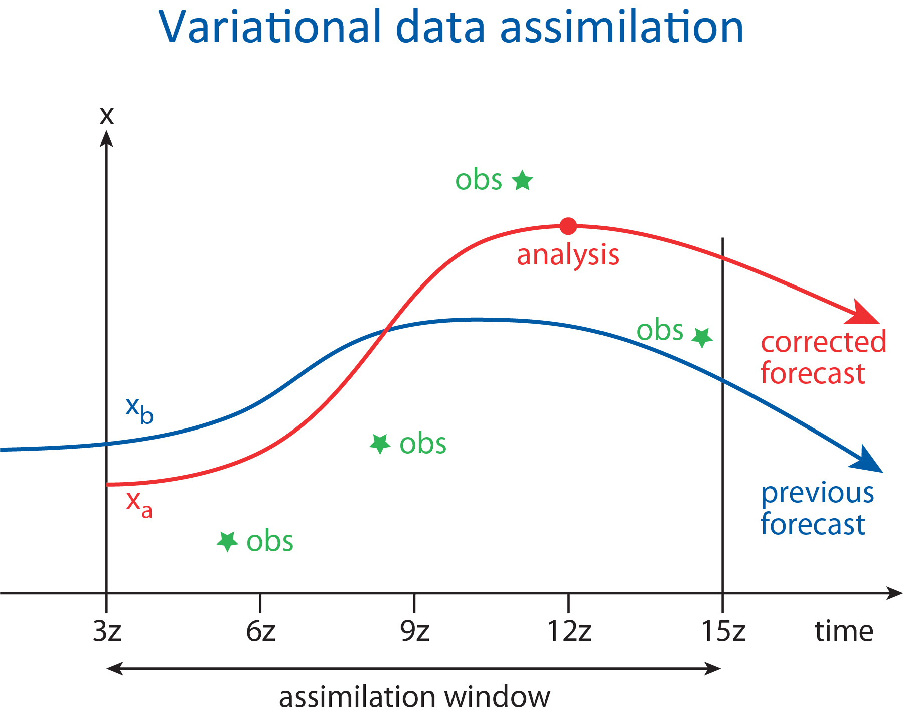
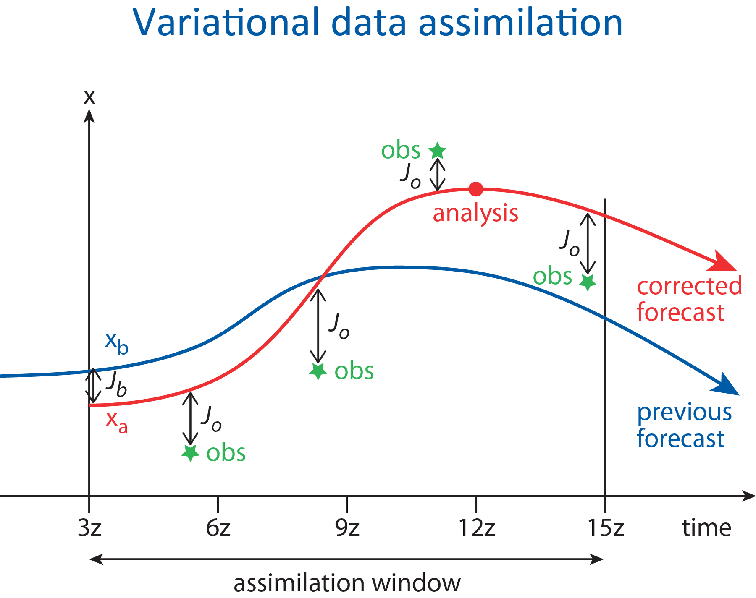
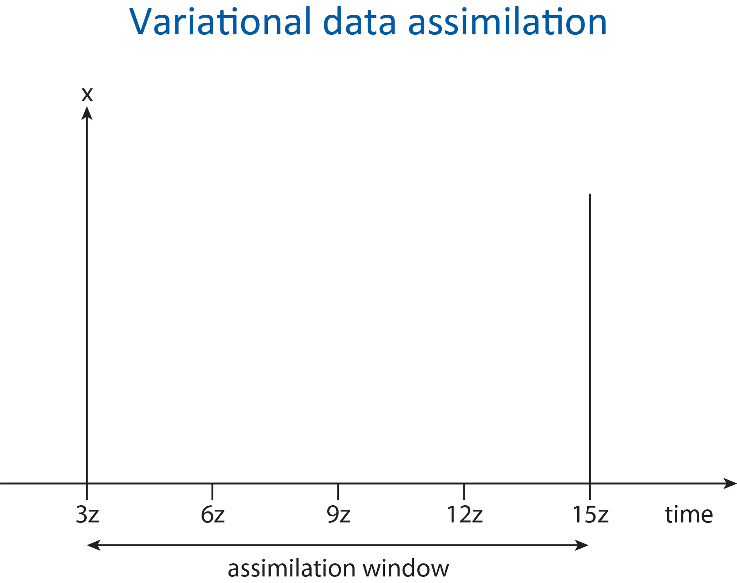

Slide 10
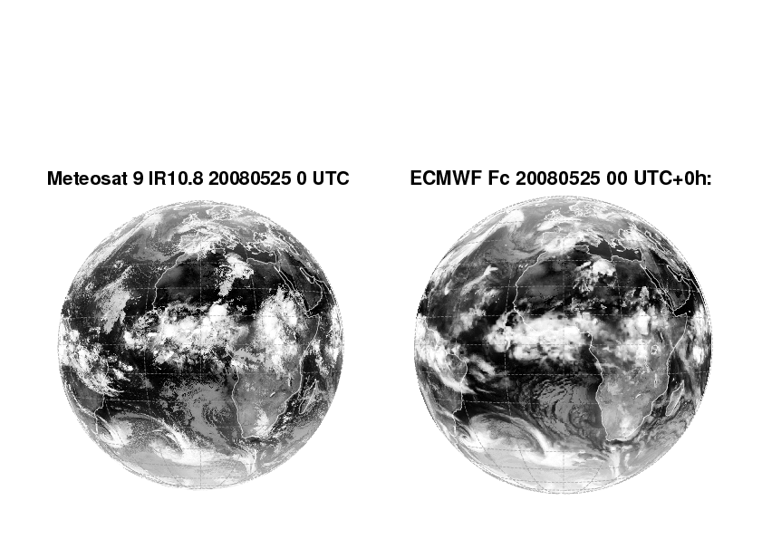

Slide 11
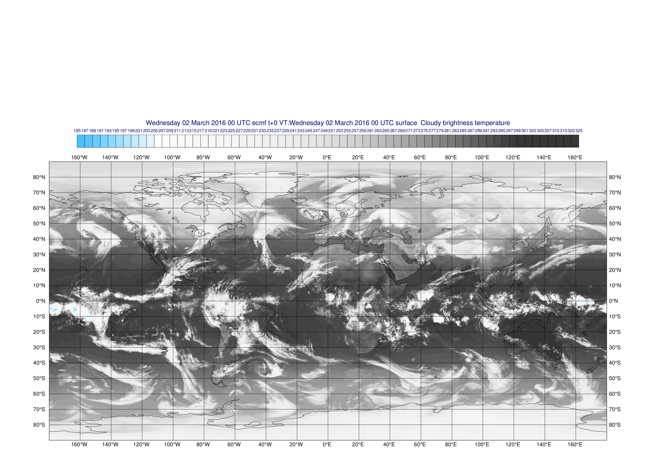
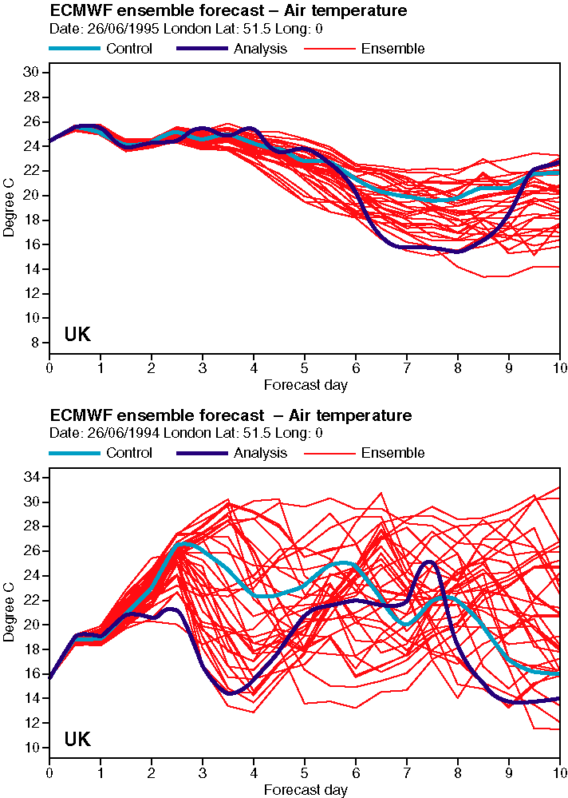
Simulated satellite image from model forecast
The atmosphere is a chaotic system
Small errors can grow to have major impact (butterfly effect)
This limits detailed weather prediction to a week or so ahead
Slowly evolving components of the climate system can give predictability at longer timescales
Notes:
EPS forecast for London temperature
Like the Lorenz system, the predictability of the atmosphere is itself a function of initial state. This figure shows the forecasts for air temperature in London given by an ensemble of 33 forecasts. Top: a relatively predictable situation. All forecasts started on 26 June 1995 give similar forecasts; in this case, small errors in the starting conditions did not seriously affect the forecast. Bottom: an unpredictable situation. Exactly one year earlier, on 26 June 1994, small initial differences had a dramatic effect on the forecasts.
The forecast model is very sensitive to small differences in initial conditions
➢ accurate analysis crucial for accurate forecast
➢ EPS used to represent the remaining analysis uncertainty

Slide 12
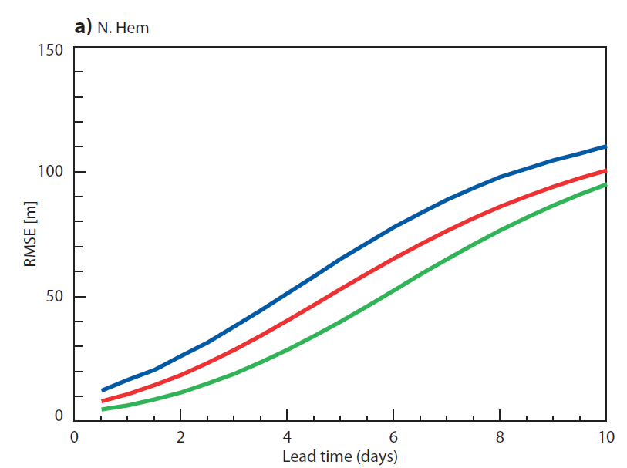
RMS error of 500 hPa height field
Northern Hemisphere
1990
2000
2010
Acceptable error level
Initial state error
Model error growth

Slide 13
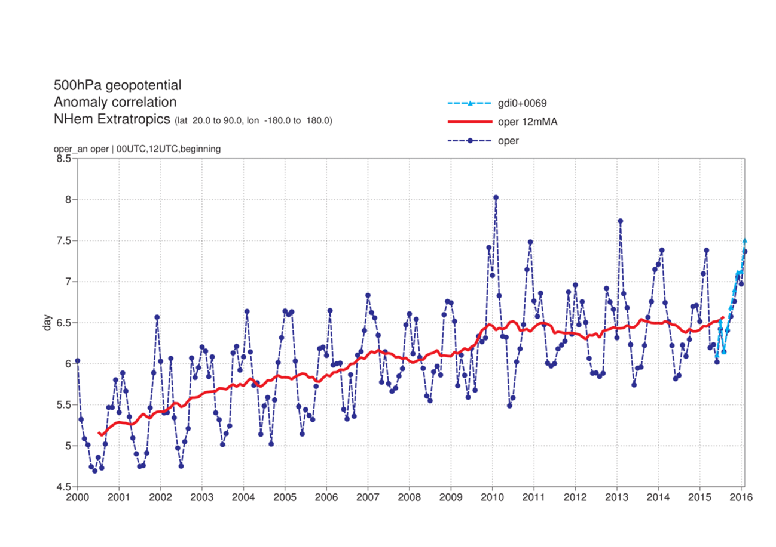
Medium range forecast skill
Forecast range at which the anomaly correlation drops below 80%

Slide 14
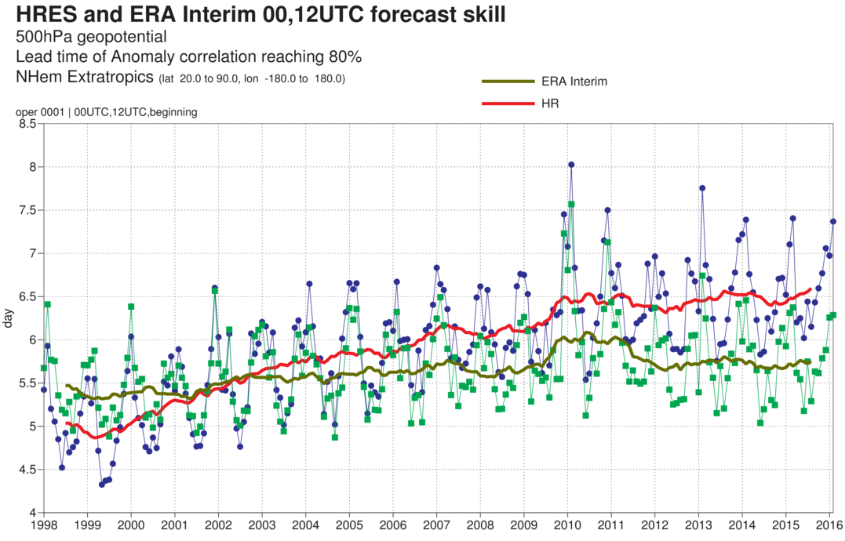
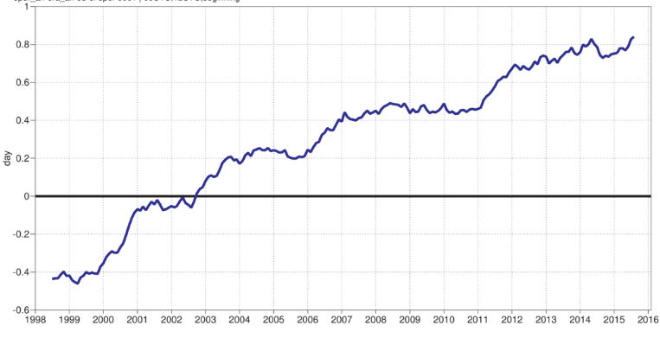
Medium range forecast skill – Normalised with reanalysis

Slide 15
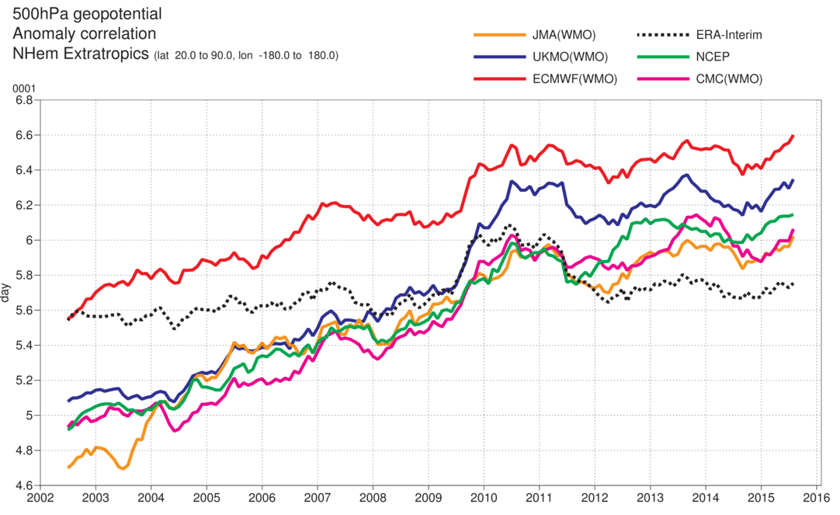
Model intercomparison
ACC reaching 80%

Slide 16
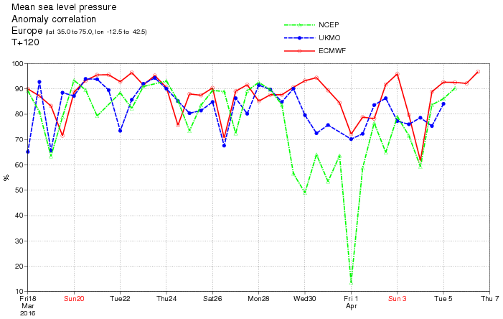
Meteorological Operations

Slide 17
Focus on improved cloud parametrization:
Super-cooled liquid layers in mixed phase stratiform cloud (37r3)
Ice water content in cirrus (38r1)
Reduction of drizzle occurrence
ice
liquid
anvil cirrus
cirrus
mid-level cloud
frontal
deep convection
shallow Cu
stratocumulus
SLW stratus
Freezing level
Notes:
This year, the cloud parametrization development work has been focussed on three areas:
a wider assessment of the representation of supercooled liquid water in mixed-phase stratiform cloud and it’s radiative impacts (after the cloud changes in CY36R4 and CY37R3), using ground-based and space-borne lidar/radar to determine the performance of the model and identify scope for further improvements.
improvements in the distribution of ice cloud (particularly cirrus) and associated radiative impacts, as well as for rain and snow, through modifications to the parametrization of sedimentation due to gravity (in CY38R1).
reduction in the over-occurrence of light precipitation (drizzle) in the model (in preparation for future IFS cycle).

Slide 18
Changes in resolution
Increased horizontal resolution in 2016
  16 km → 8-10 km
  Increased vertical resolution in 2013
  91 → 137 levels
  In the future:
  ~5 km ensembles (2025)
  Computing requirements:
  3 km → 60 MW!! (scalability)

Slide 19

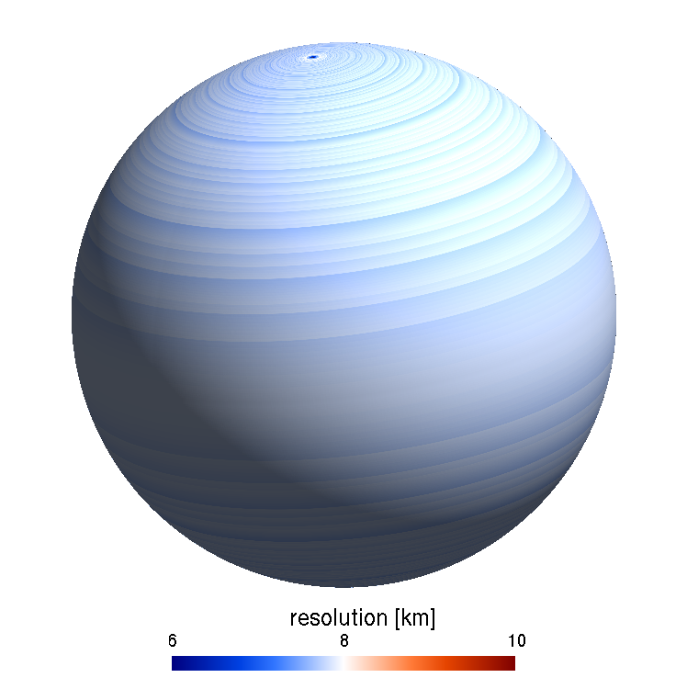
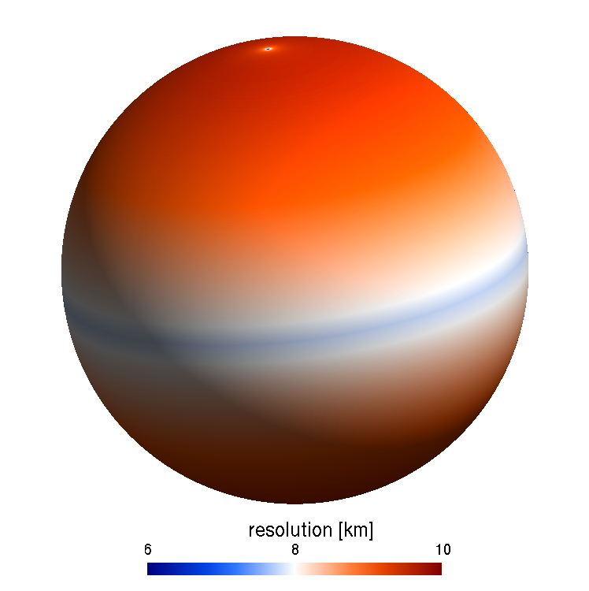
More specific resolution increases
Horizontal resolution
High resolution forecast (HRES): twice per day
9 km 137-level, to 10 days ahead
Ensemble forecast (ENS): twice per day
51 members, 18 km 91-level, to 15 days ahead
Monthly ENS extension: twice a week (Mon/Thursdays)
51 members, 36 km 62 levels, to 46 days ahead
Comparing the global variations in resolution between current (Gaussian-reduced) and new (octahedral) grids at ~9km.
Notes:
High resolution forecast (HRES): twice per day, 9 km 137-level, to 10 days ahead
Ensemble forecast (ENS): twice per day
51 members, 18 km 91-level, to 15 days ahead
Monthly ENS extension: twice a week (Mon/Thursdays)
51 members, 36 km 62 levels, to 46 days ahead

Slide 20
Kinetic energy spectrum at 200 hPa

Slide 21
HPCF performance vs Strategy

Slide 22
Scalability activities
Preparation for future HPC architectures (2018 onwards)
  Data assimilation (OOPS)
  IFS dynamical core
  Model code optimisation
  Other code optimisations (observation handling)

Slide 23


Strategy for IFS dynamical core
Fully compressible equations
Retain semi-implicit, semi-Lagrangian schemes
Retain spectral transform technique
Improve parallelisation/scalability by implementing unstructured grids

Slide 24
ENsemble prediction System (ENS)
EDA, singular vectors and ENS
Stochastic physics
91 levels in the vertical TCo639
Coupled to the ocean model from the start of the forecast
Monthly forecasting
  MJO skill scores
Seasonal forecast System 4
  EUROSIP including NCEP
Applications of ENS
  Flooding/drought prediction
  Health

Slide 25
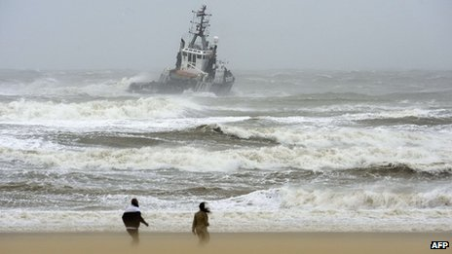
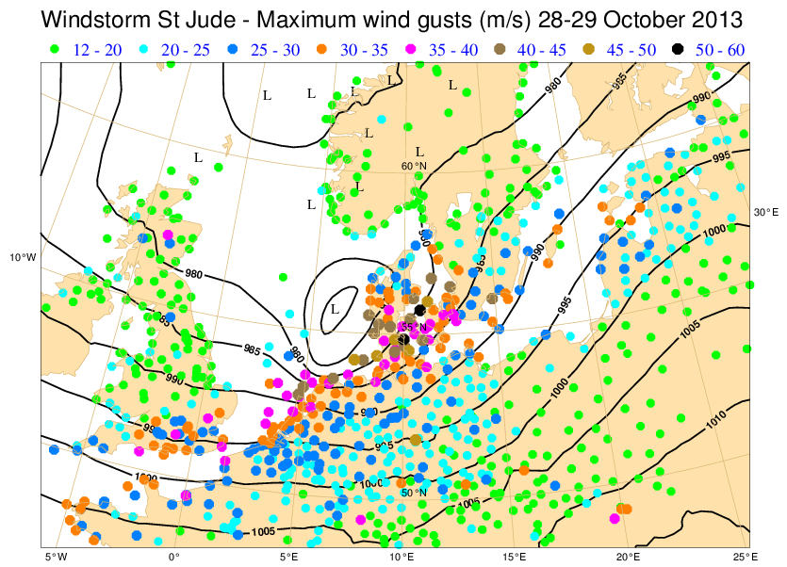
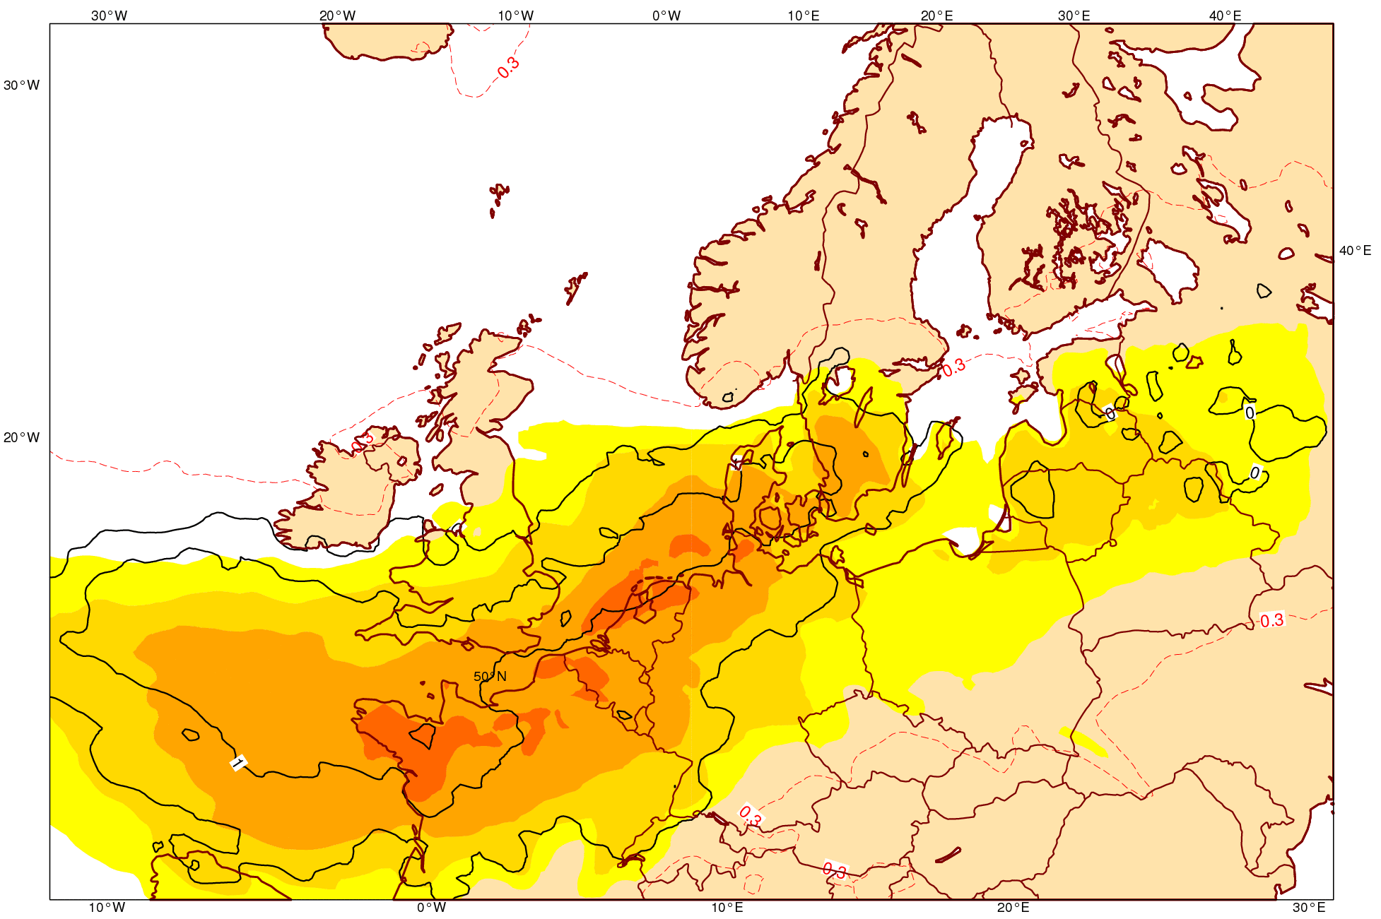
Wind storm NW Europe 28 October 2013
Signal from 4-5 days ahead in the Extreme Forecast Index (EFI)
Notes:
Maximum reported wind gusts (coloured symbols) on 28 to 29 October, together with the MSLP for 28 October 12 UTC. Along the path of the storm, the event exceeded the 10 year return period for wind gusts. The potential for extreme winds during 28 October 2013 is shown in the EFI from 00 UTC on 24 October: yellow and orange shading indicate the areas most at risk.

Slide 26
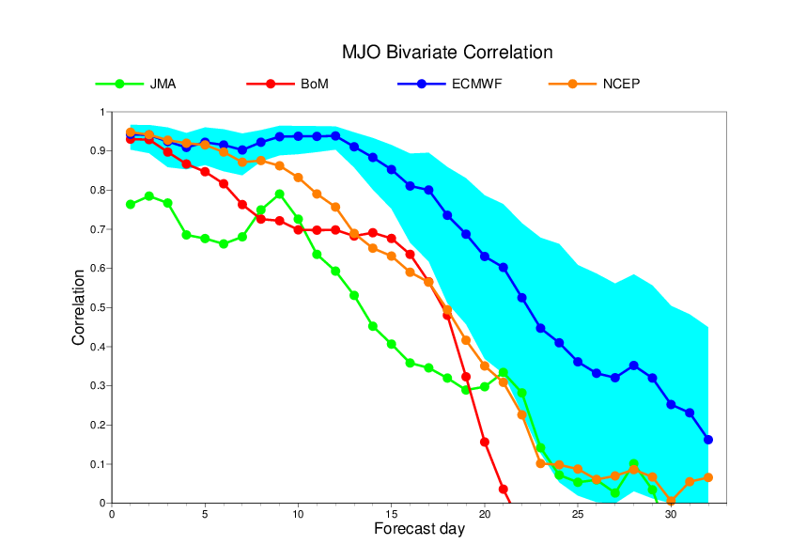
Madden-Julian oscillation correlations (TIGGE)

Slide 27
Performance of the monthly Forecasts since 2002
Hindcasts covering the period 1995-2001
Tropics
N. Extratropics
2002
2011
ERA
Day 12-18

Slide 28
Data assimilation
Variational assimilation
Ensemble of Data Assimilations (EDA)
Ensemble Kalman Filter (EnKF)
Surface analysis

Slide 29
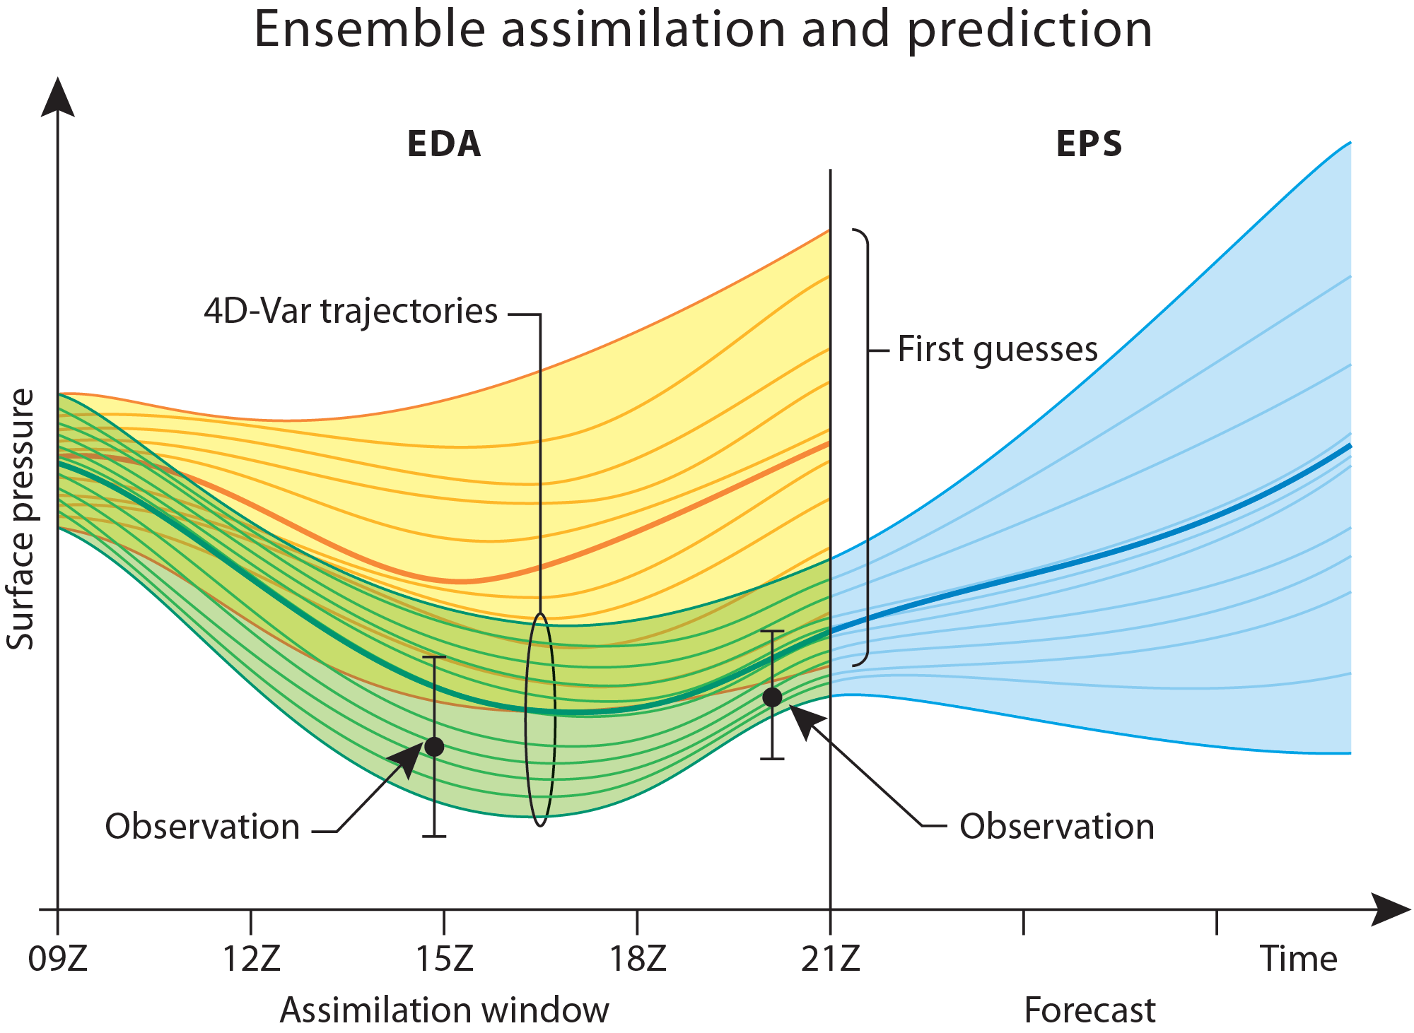

Slide 30

Aeolus Doppler wind Lidar (launch 2016)
(ESA Earth Explorer Mission)

Slide 31
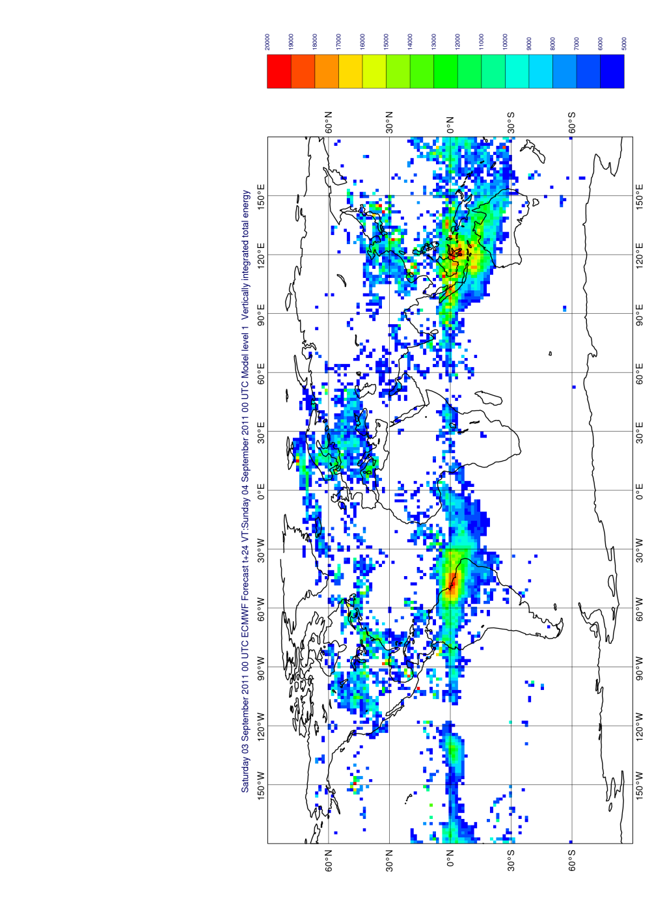
Aeolus Doppler wind lidar
Aeolus wind profile impacts

Slide 32
Conclusions
Forecasts will continue to improve
  Initial error reduction
  Model improvements
By 2025:
  5 km ensemble forecasts
  Severe weather warnings up to two weeks ahead
  Regime shift up to one month ahead

Slide 33
Reanalysis (ERA)
Climate monitoring in near real time
Verification data set for reforecasts
ERA-20th century reanalysis in preparation
Ocean reanalysis

Slide 34
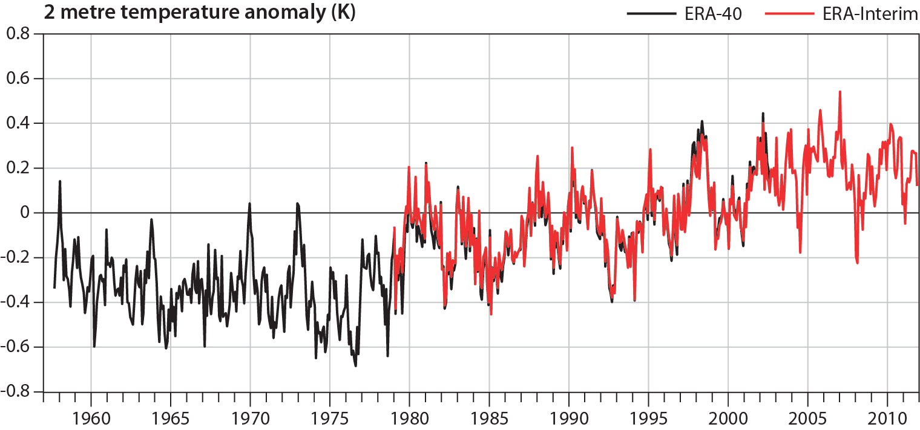
Global Warming since 1957
Anomalies of monthly-means relative to 1989 – 2001 average
Stagnation?

Slide 35
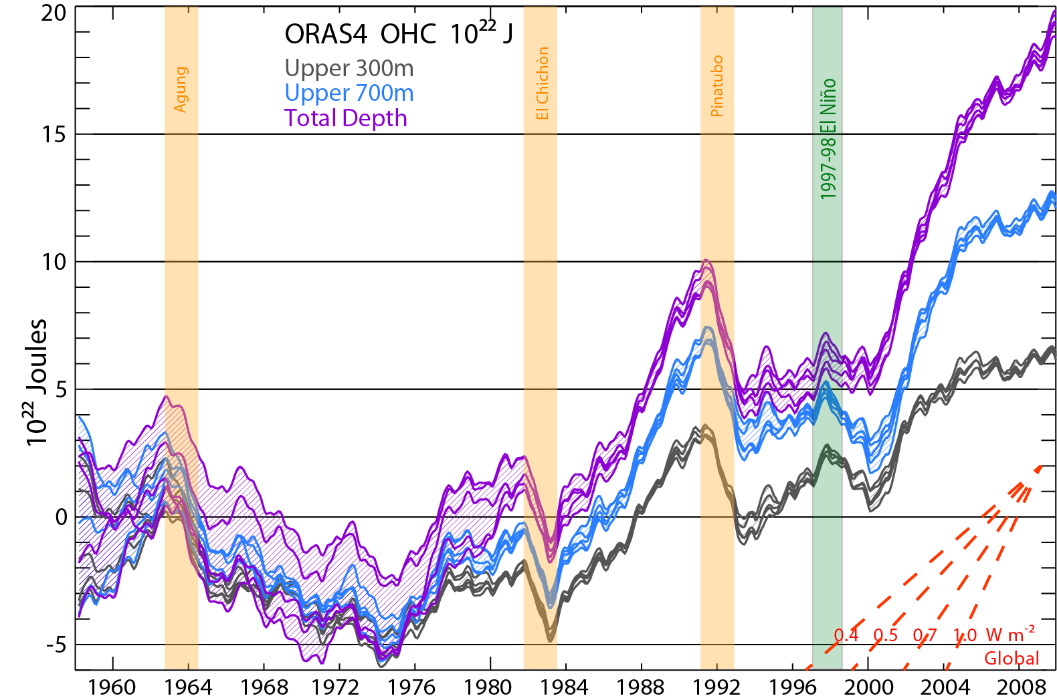
Time evolution of ocean heat content

Slide 36
Atmospheric composition
Modelling and data assimilation
Monitoring and evaluation
Impact on NWP – aerosols

Slide 37

July 2013
Canadian smoke over Europe

Slide 38
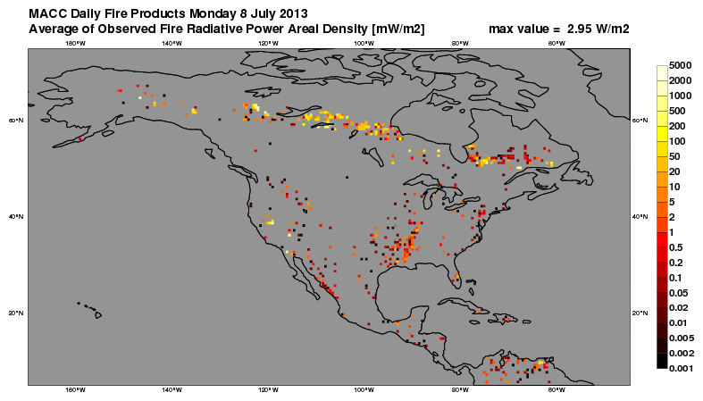
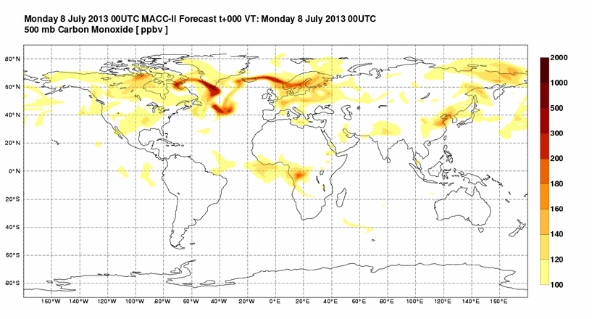
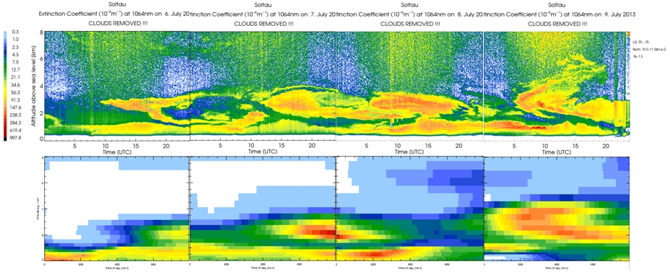
GFAS
Ceilometer, obs. & simul.
CO @ 500 hPa

Slide 39
Summary
ECMWF world leader medium range weather forecasting
Variational and ensemble data assimilation
Very high resolution possible
Atmospheric composition
Reanalysis

Slide 40
ECMWF Research
Erland Källén
Director of Research
ECMWF

