Slide 1
Satellite data monitoring
Mohamed Dahoui
Mohamed.Dahoui@ecmwf.int
Office 160 Phone +44-118-9499 043
Notes:
.

Slide 2
Outline
Why do we need monitoring?
Monitoring tools
Automatic data checking system
Other benefits of data monitoring

Slide 3
Outline
Why do we need monitoring?
Monitoring tools
Automatic data checking system
Other benefits of data monitoring

Slide 4
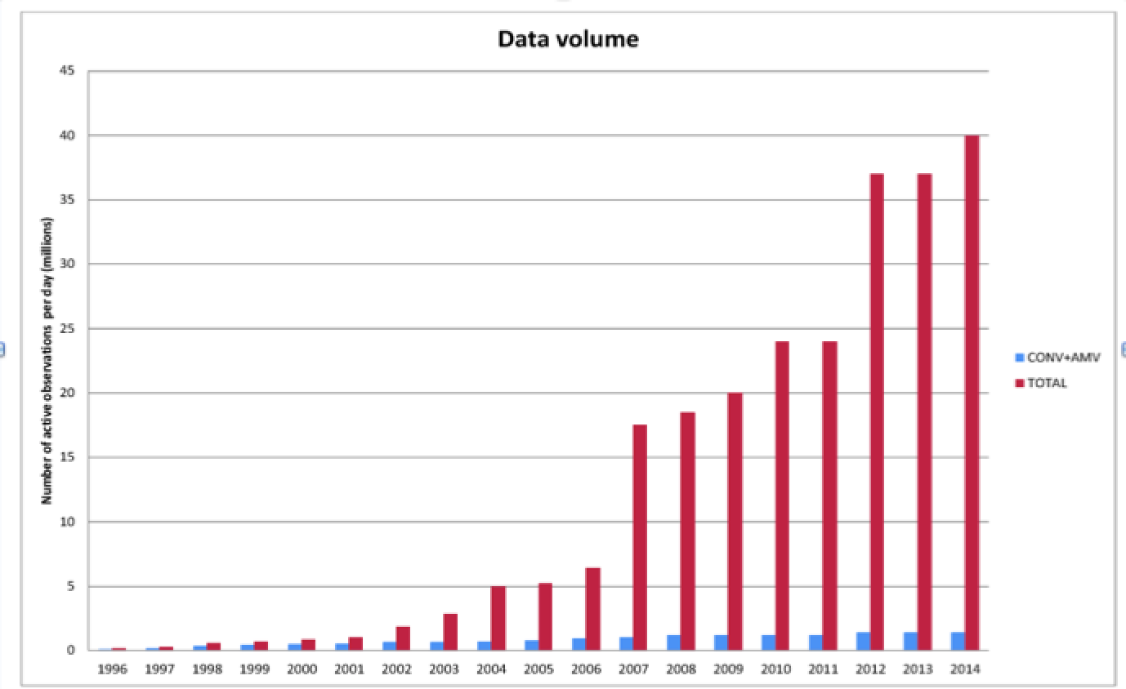
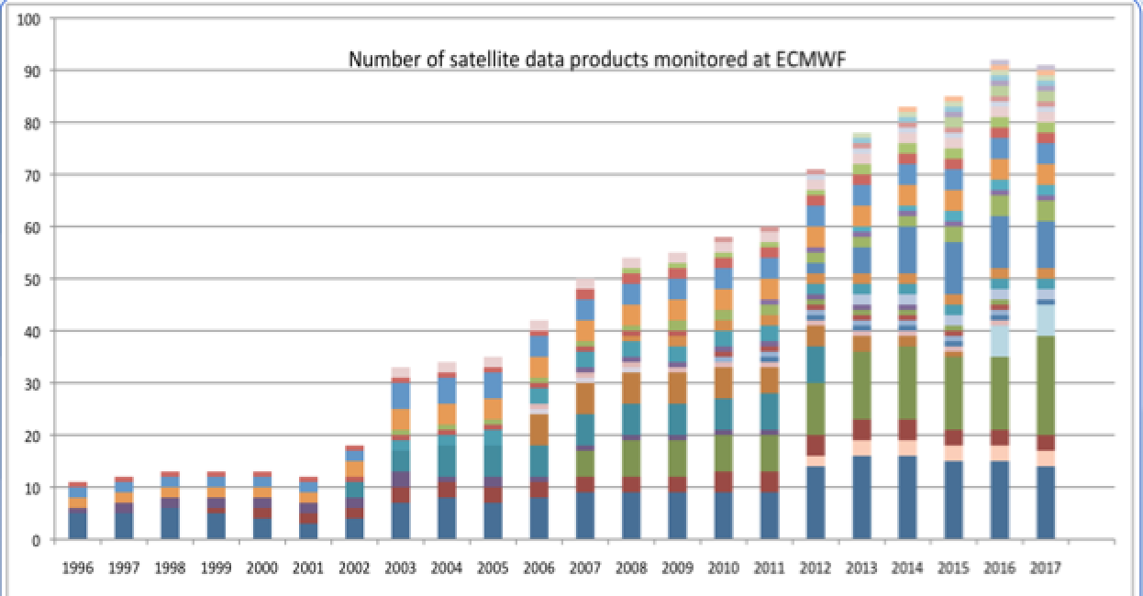
Why do we need monitoring
More than 400 million pieces of observations received daily. A lot of potential
~12 millions are effectively used daily. More data are used indirectly (e.g. cloud detection).
Data characteristics are subject to variation
The impact of observation depends on the quality of data, spatial and temporal distribution of data, appropriate specification of errors, successful bias correction, etc.

Slide 5
Why do we need monitoring
Asses the quality/availability of new data before any decision to activate the data
Help in the estimation of errors characteristics
Detects changes in the quality/availability of data
Asses the quality/availability of data during periods of blacklisting
Monitor the data impact on the forecast (FSOI)
Provision of feedback to data providers

Slide 6
Outline
Why do we need monitoring?
Monitoring tools
Automatic alarm system
Other benefits of data monitoring

Slide 7
Monitoring tools
Monitoring tools consist of the routine production and display of statistics over large data samples
Statistics are generally computed for observation quantities related to the data assimilation: departures, bias correction, data counts, etc.
Statistics are produced for various data selection criteria
Monitoring tools are designed to produce plots allowing the investigation of data from various perspectives: time, area, vertical, FOV, etc.
Monitoring tools allows generic comparison of statistics from different experiments

Slide 8
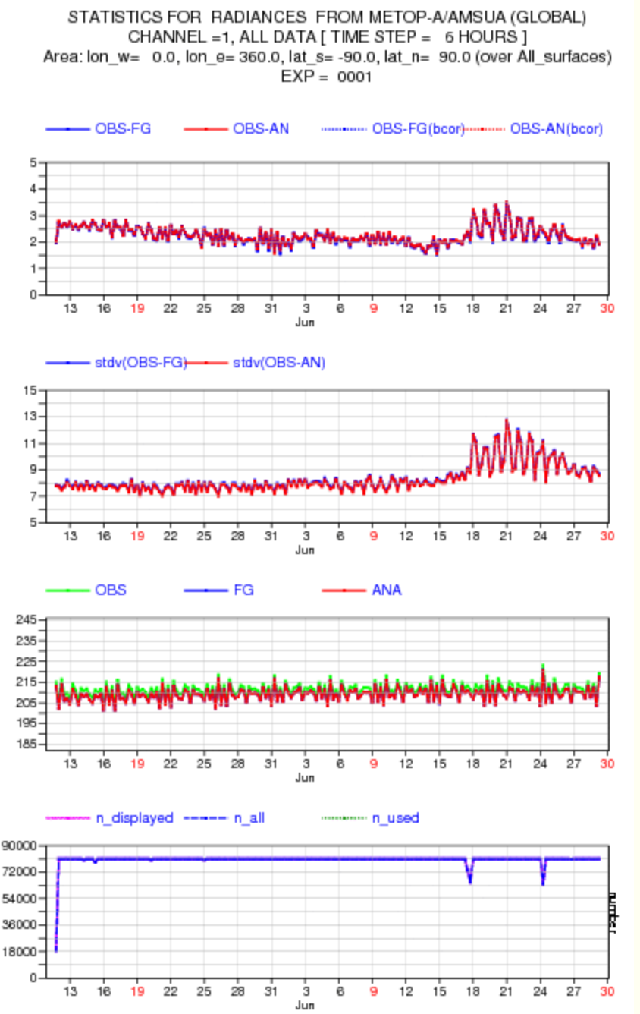
Monitoring tools
Time evolution of statistics over predefined areas/surfaces/flags

Slide 9
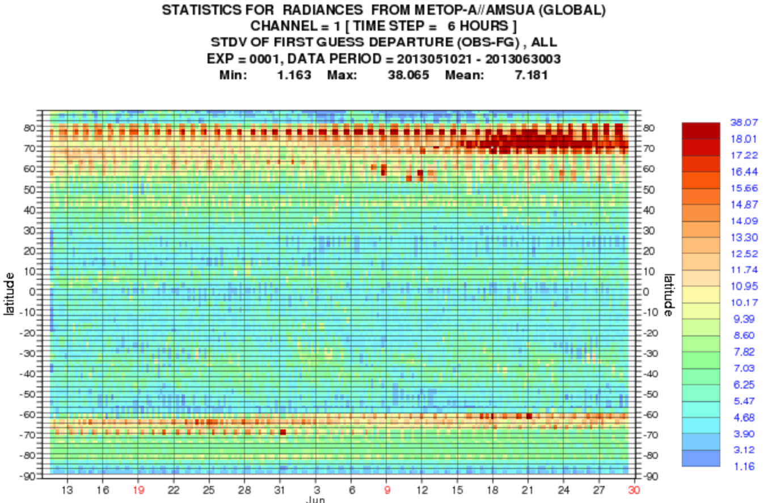
Time evolution of statistics of zonal means

Slide 10
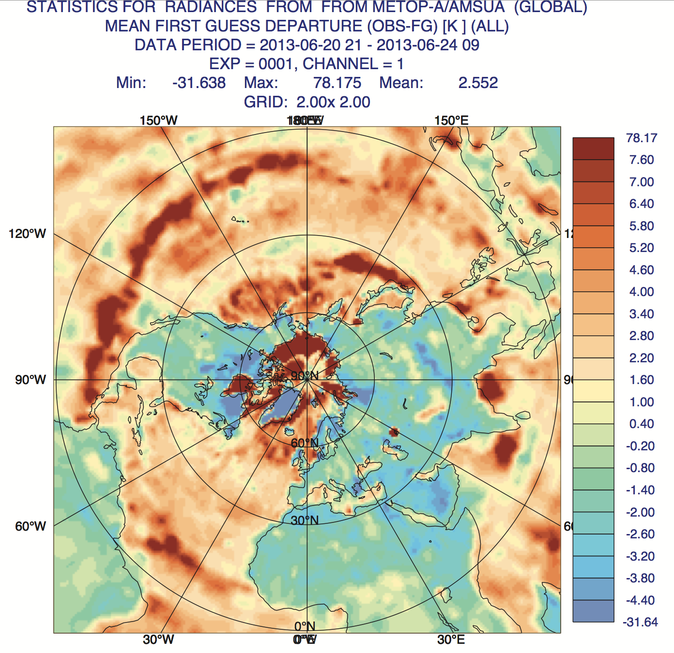
Assessment of the geographical variability of statistics:
location effect
air mass effect

Slide 11
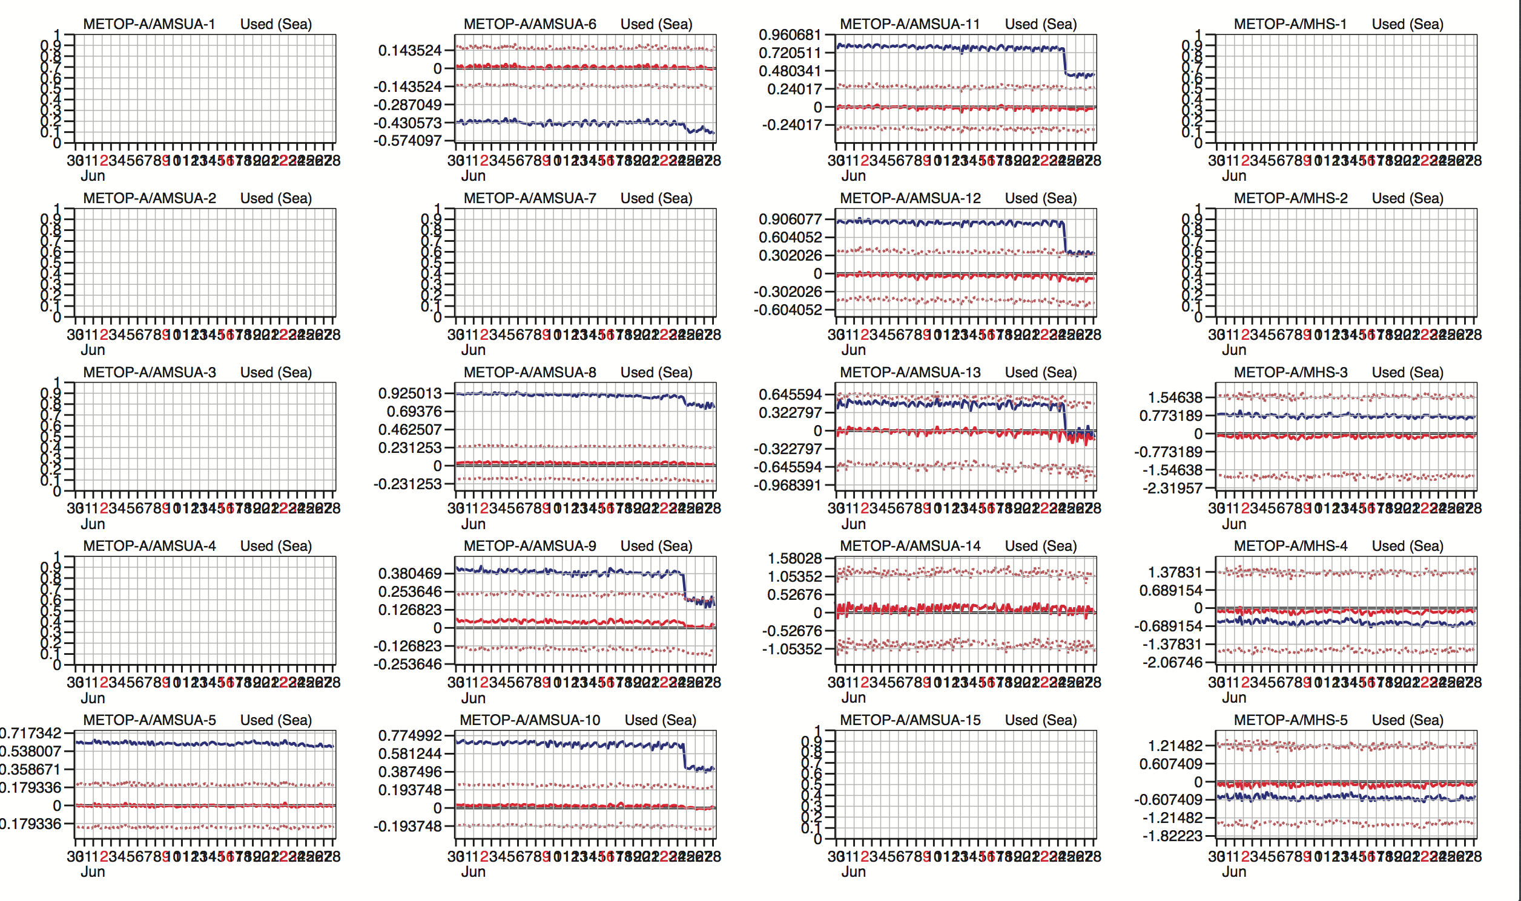

Slide 12
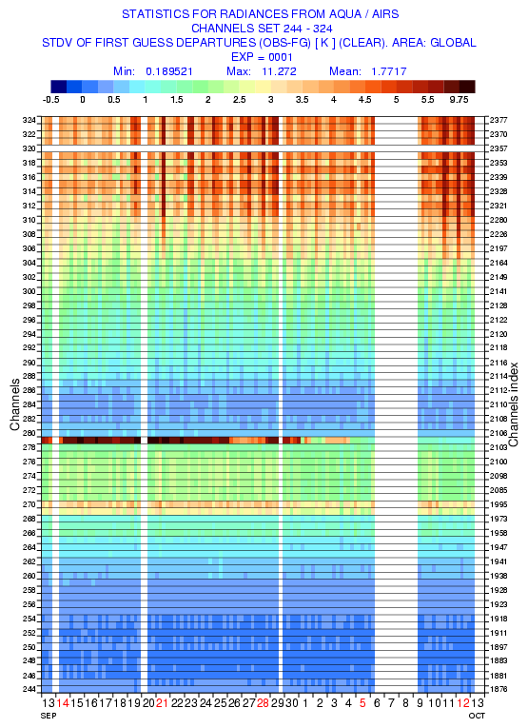
compact product for high spectral resolution sounders

Slide 13
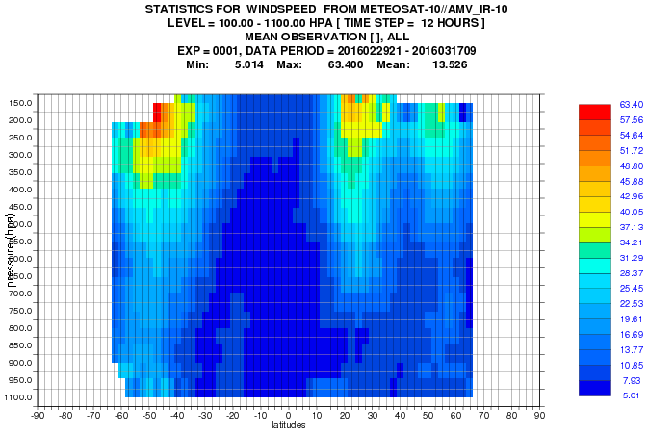
Vertical versus latitudes

Slide 14
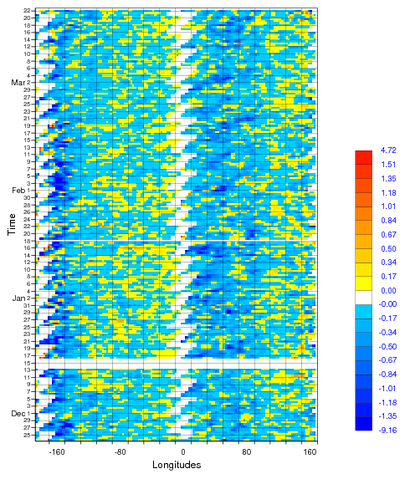
Time versus longitudes

Slide 15
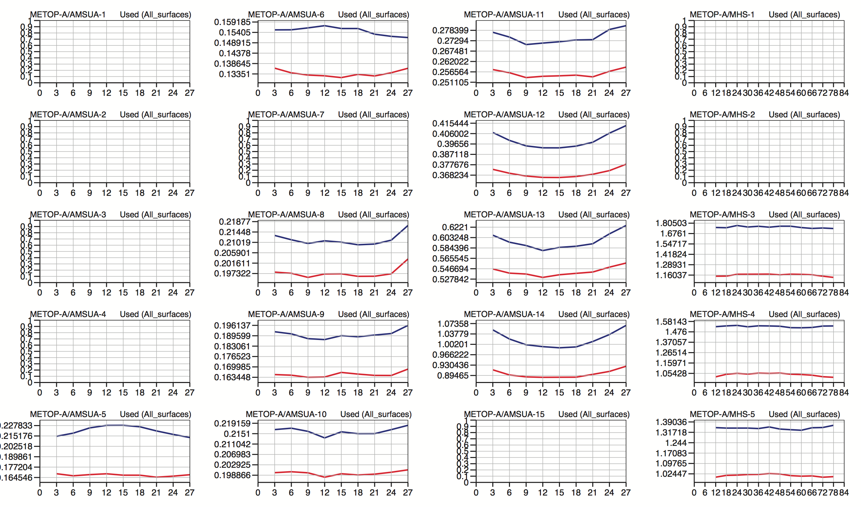

Slide 16
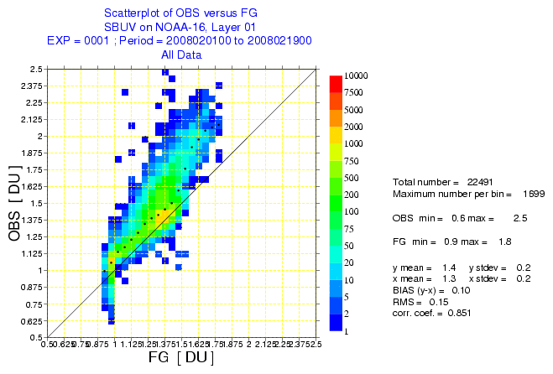
Useful way to compare observed values against model ones

Slide 17
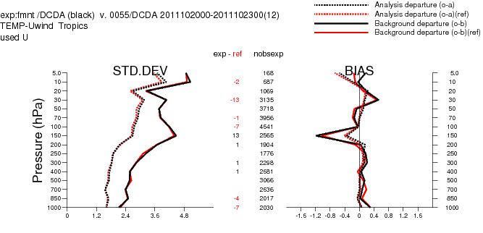
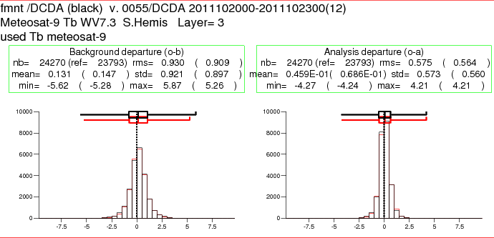
Vertical statistics of time and area averages
Histograms of time and area averages

Slide 18
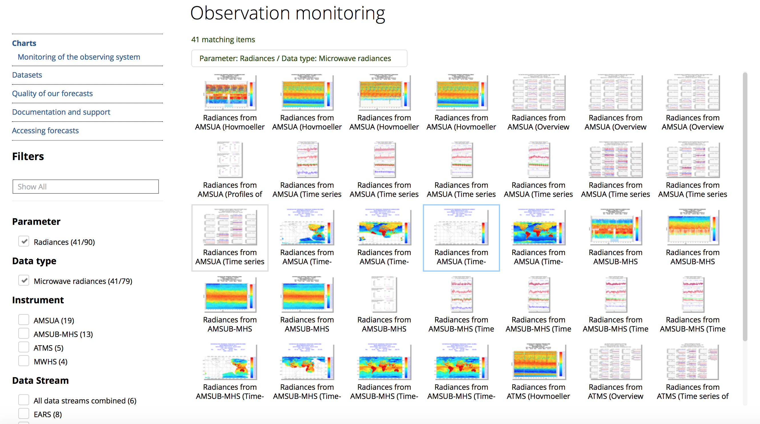
http://www.ecmwf.int/en/forecasts/quality-our-forecasts/monitoring-observing-system#Satellite

Slide 19
Outline
Why do we need monitoring?
Monitoring tools
Automatic data checking system
Other benefits of data monitoring

Slide 20
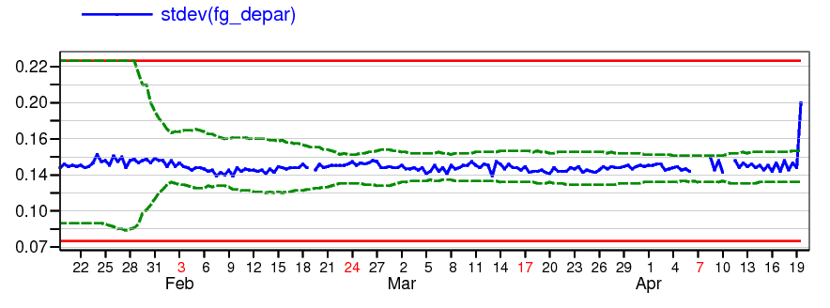
Automatic data checking system
Alert message
Soft limits (5±stdev of statistics to be checked, calculated from past statistics over a period of 20 days ending 2 days earlier and excluding extremes)
Hard limits (fixed)
Slightly: Statistics outside ±5 stdev from the mean
Considerably: Statistics outside ±7.5 stdev from the mean
Severely: Statistics outside ±10 stdev from the mean
Notes:
Now how it works. For each data type, we select a number of observation quantities that are informative about the quality and availability of the data. For each quantity (like here the stdev of fg departures) the aim is to detect sudden changes of the statistics but also slow changes that are tricky to detect from daily statistics but over time they reach a limit that requires attention. To detect sudden changes we use what we call soft limits that are computed dynamically every cycle based on past statistics. Over a period of 20 days and excluding the extremes we compute define the limits as 5 times the standard deviation from the mean. Soft limits are not effective to detect slow drifts. Instead we use hard limits that are fixed on purpose. Once one of these two limits is reached a warning is triggered. A severity level is assigned to the warnings based on how far the value is from the mean.

Slide 21
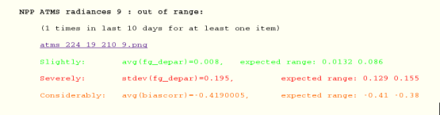
Obs Feedback info (ODB)
Current statistics
Selected Obs quantities
Past statistics
Selected Obs quantities
Hard limits
Detects slow drifts
Soft limits
Detects sudden changes
Change detection
Thresholds based tests
Static tests
Quantities comparison
Flexibility to add other tests
Ignore facility
Past warnings
Email
Web
Event Data base

Slide 22
Automatic Alarm system
Web publishing:
  Public access
  Published by data types
  Time series provided
  Severity highlighted
  Time limited archive
E-mail dissemination:
  Subscription by data type
  Subscription by severity level
  Time series provided
http://www.ecmwf.int/en/forecasts/quality-our-forecasts/monitoring-observing-system#checking

Slide 23
Checking 0001 DCDA 2009012700
=================================
atovs
=================================
NOAA-16 AMSU-A 9 clear radiances : out of range:
(2 times in last 10 days for at least one item)
http://intra.ecmwf.int/users/str/sat_check/atovs_207_3_9_210.png
Considerably: stdev(fg_depar)=0.32668, expected range: 0.17(H) 0.29
NOAA-16 AMSU-A 10 clear radiances : out of range:
(11 times in last 10 days for at least one item)
http://intra.ecmwf.int/users/str/sat_check/atovs_207_3_10_210.png
Slightly: avg(fg_depar)=0.019286, expected range: 0.021 0.107
Severely: stdev(fg_depar)=0.427388, expected range: 0.19(H) 0.28(H)
NOAA-16 AMSU-A 12 clear radiances : out of range:
(5 times in last 10 days for at least one item)
http://intra.ecmwf.int/users/str/sat_check/atovs_207_3_12_210.png
Severely: stdev(fg_depar)=0.584939, expected range: 0.32(H) 0.48(H)

Slide 24
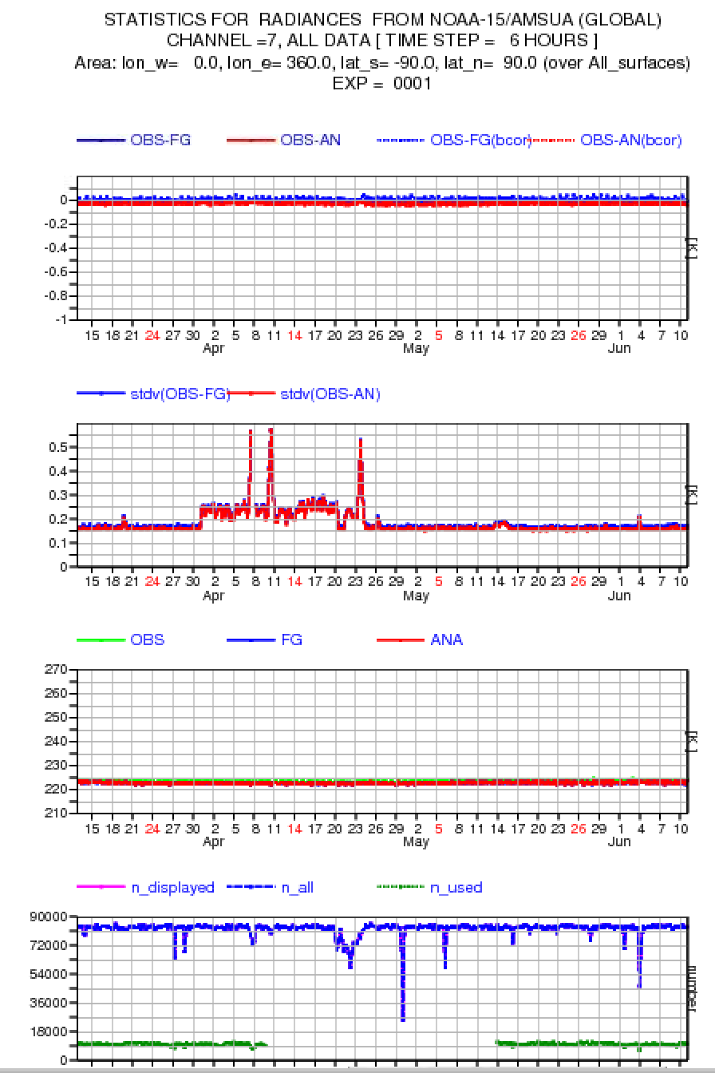
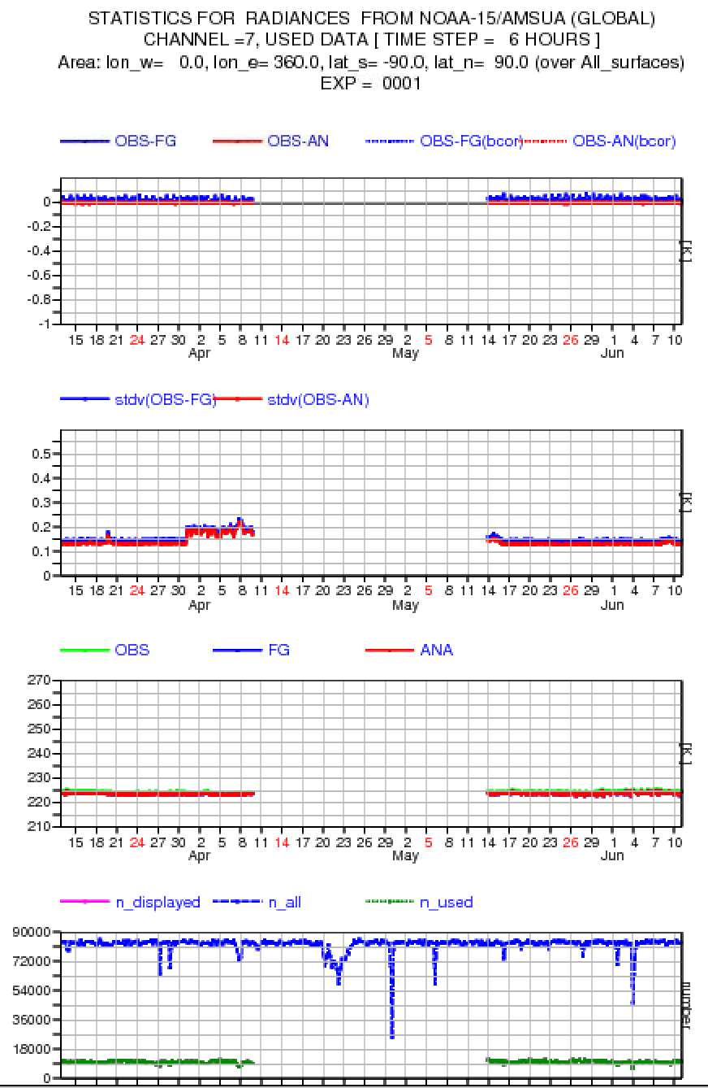

Slide 25
Outline
Why do we need monitoring?
Monitoring tools
Automatic data checking system
Other benefits of data monitoring

Slide 26
Other benefits of data monitoring
Data monitoring is mainly based on statistics of FG departures
FG departures are the combination of observation errors, FG errors and observation operator errors.
In most cases, change in statistics is due to change in the characteristics of observations
In many other cases, change in statistics is due to issues affecting the model or data assimilation (Observation operators).
With many satellite providing the same data, it’s possible (via a consistency check) to detect model problems

Slide 27
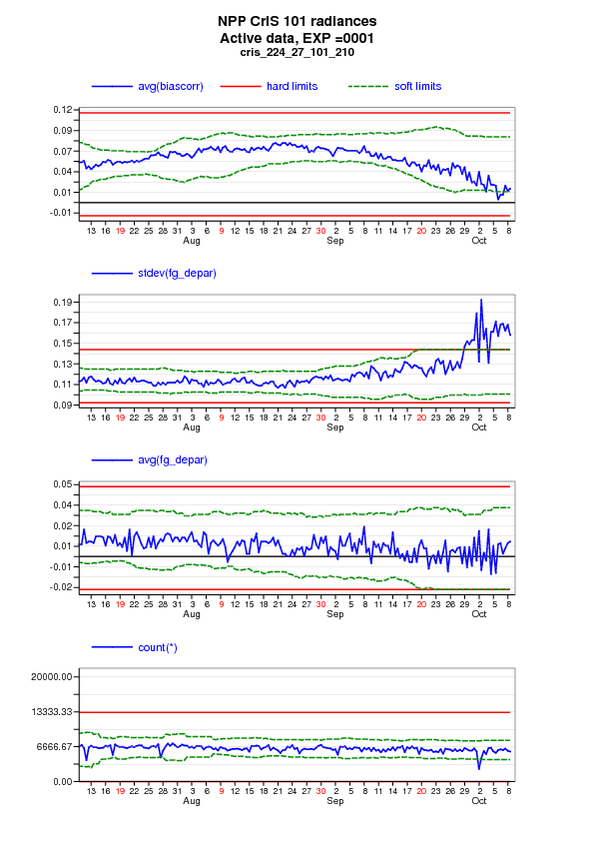
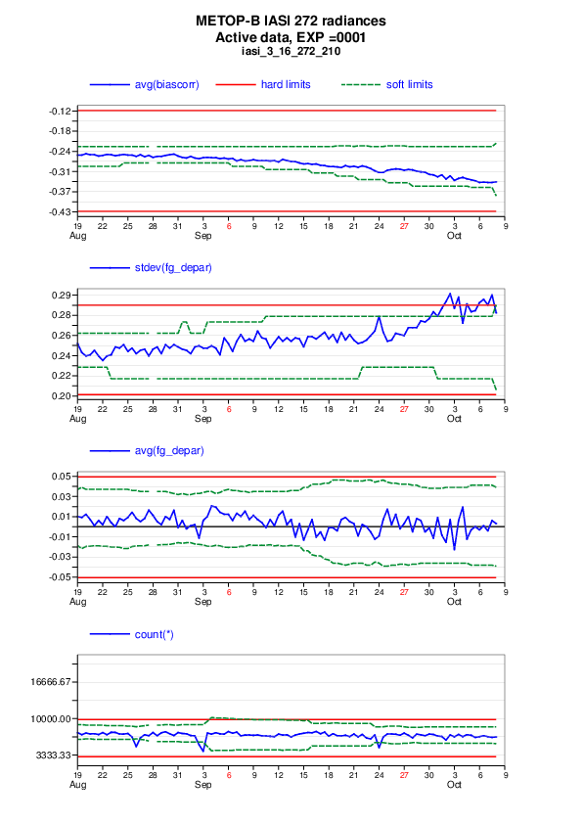
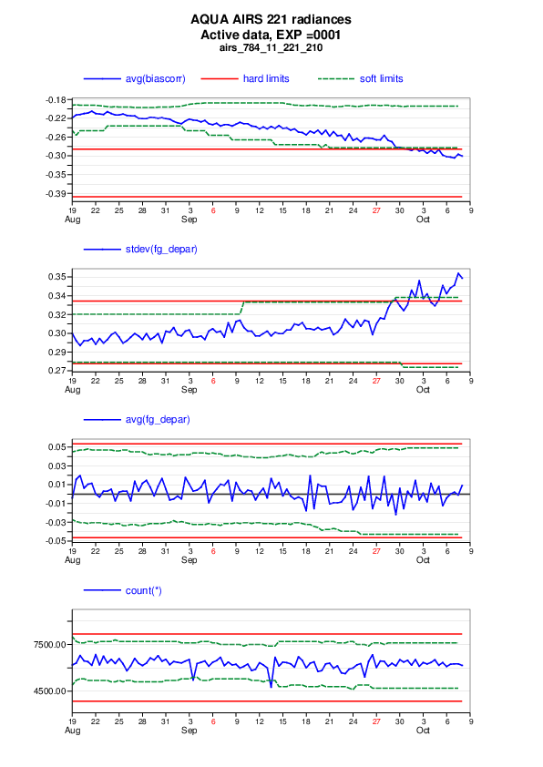

Slide 28
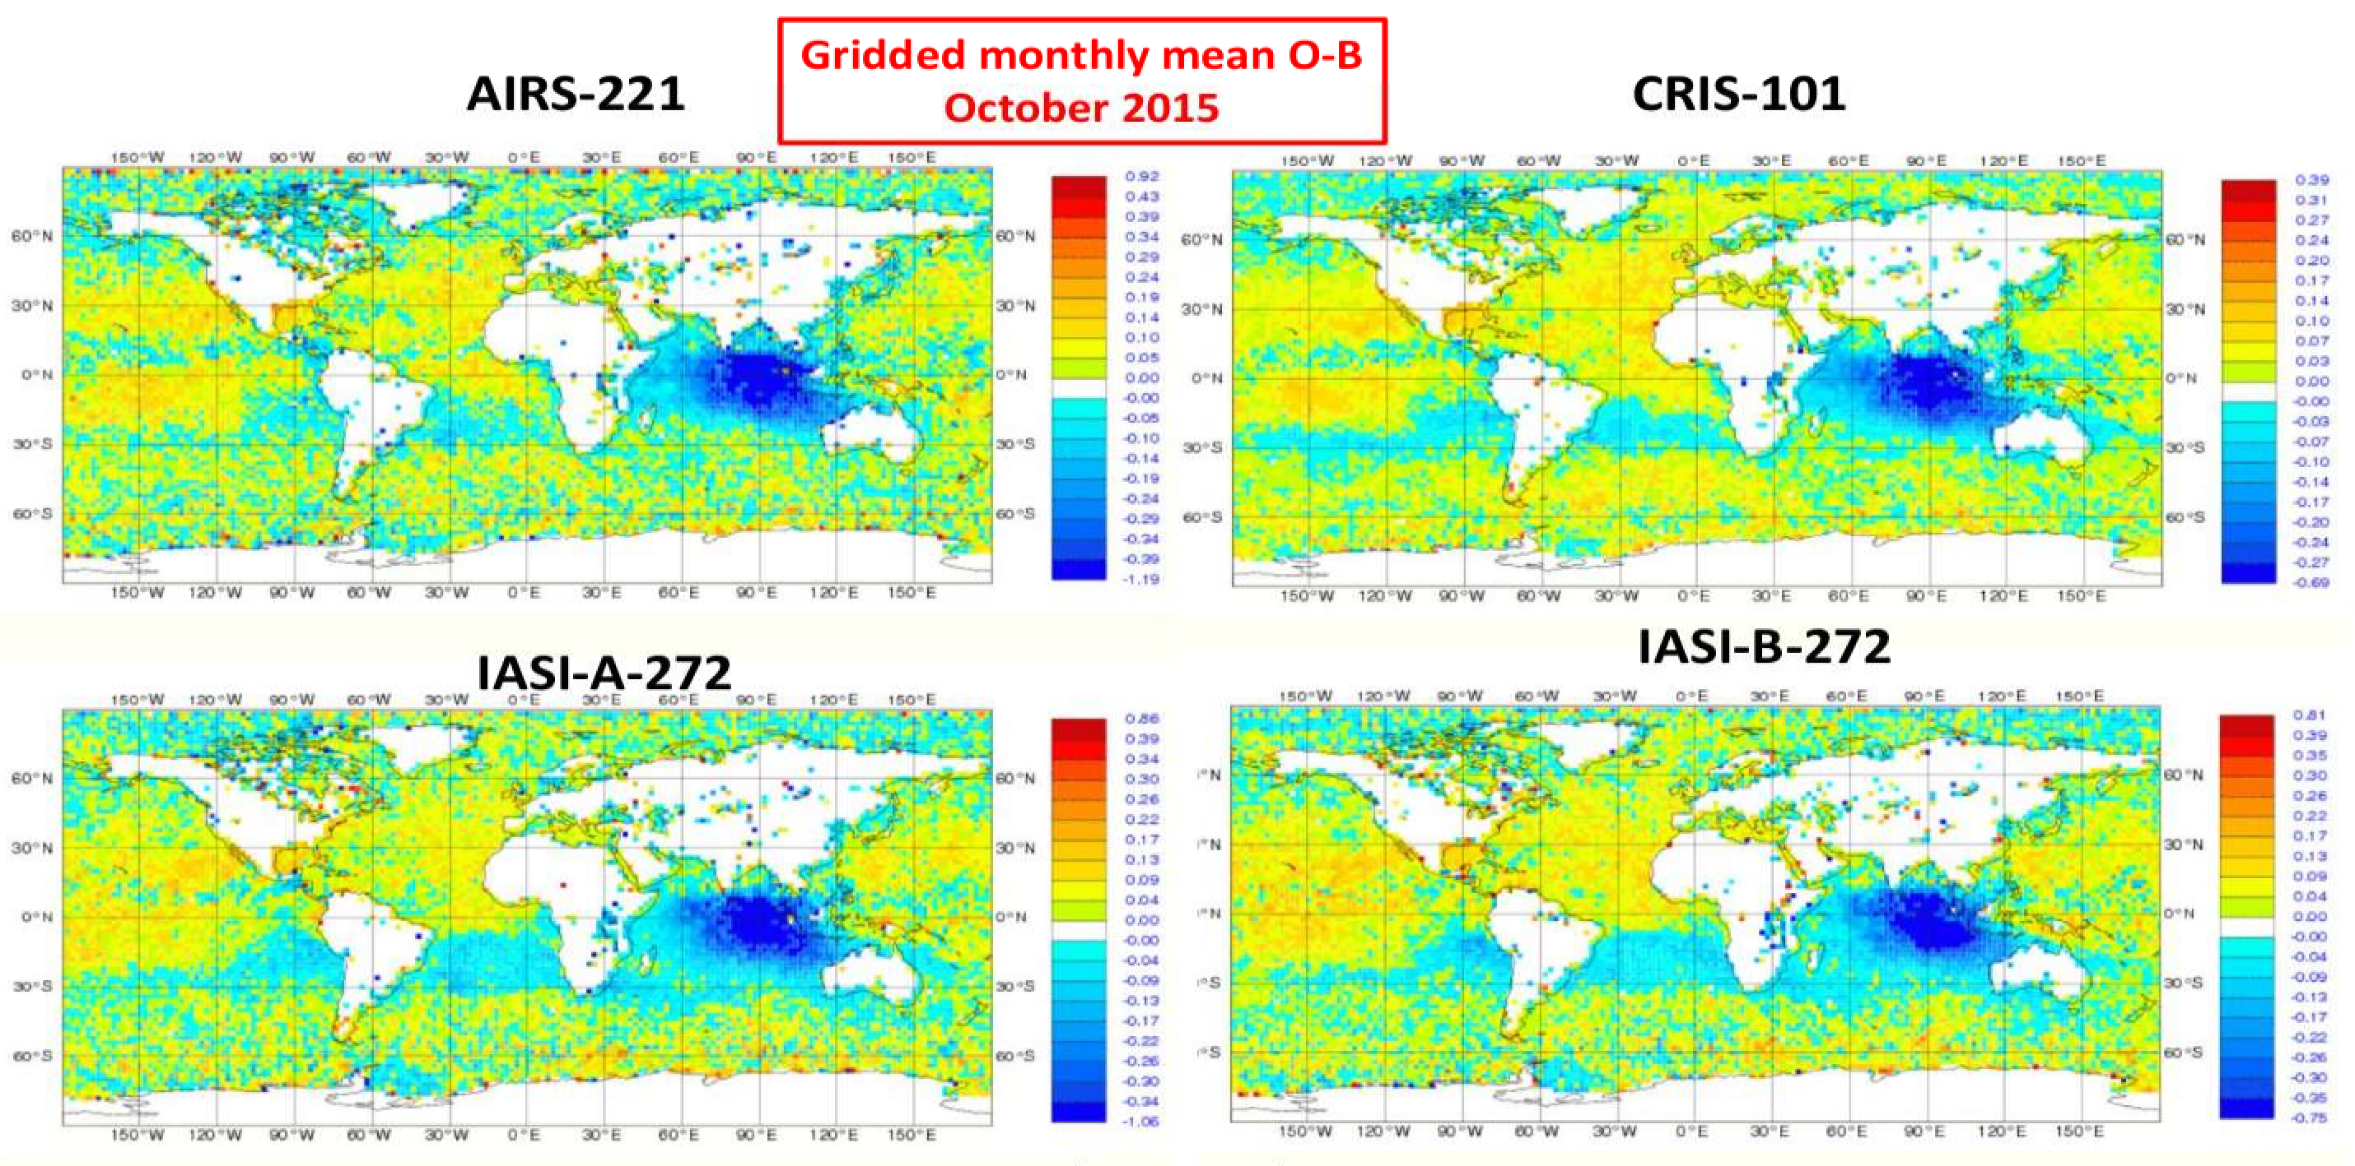
M. Matricardi

Slide 29
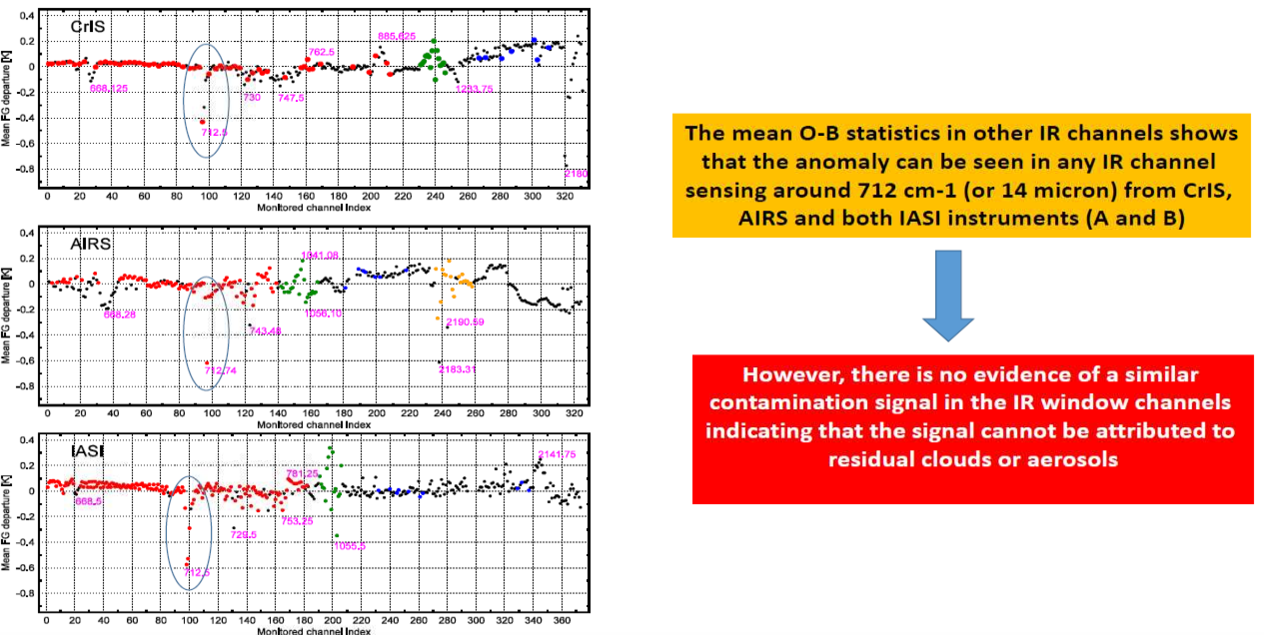
M. Matricardi

Slide 30
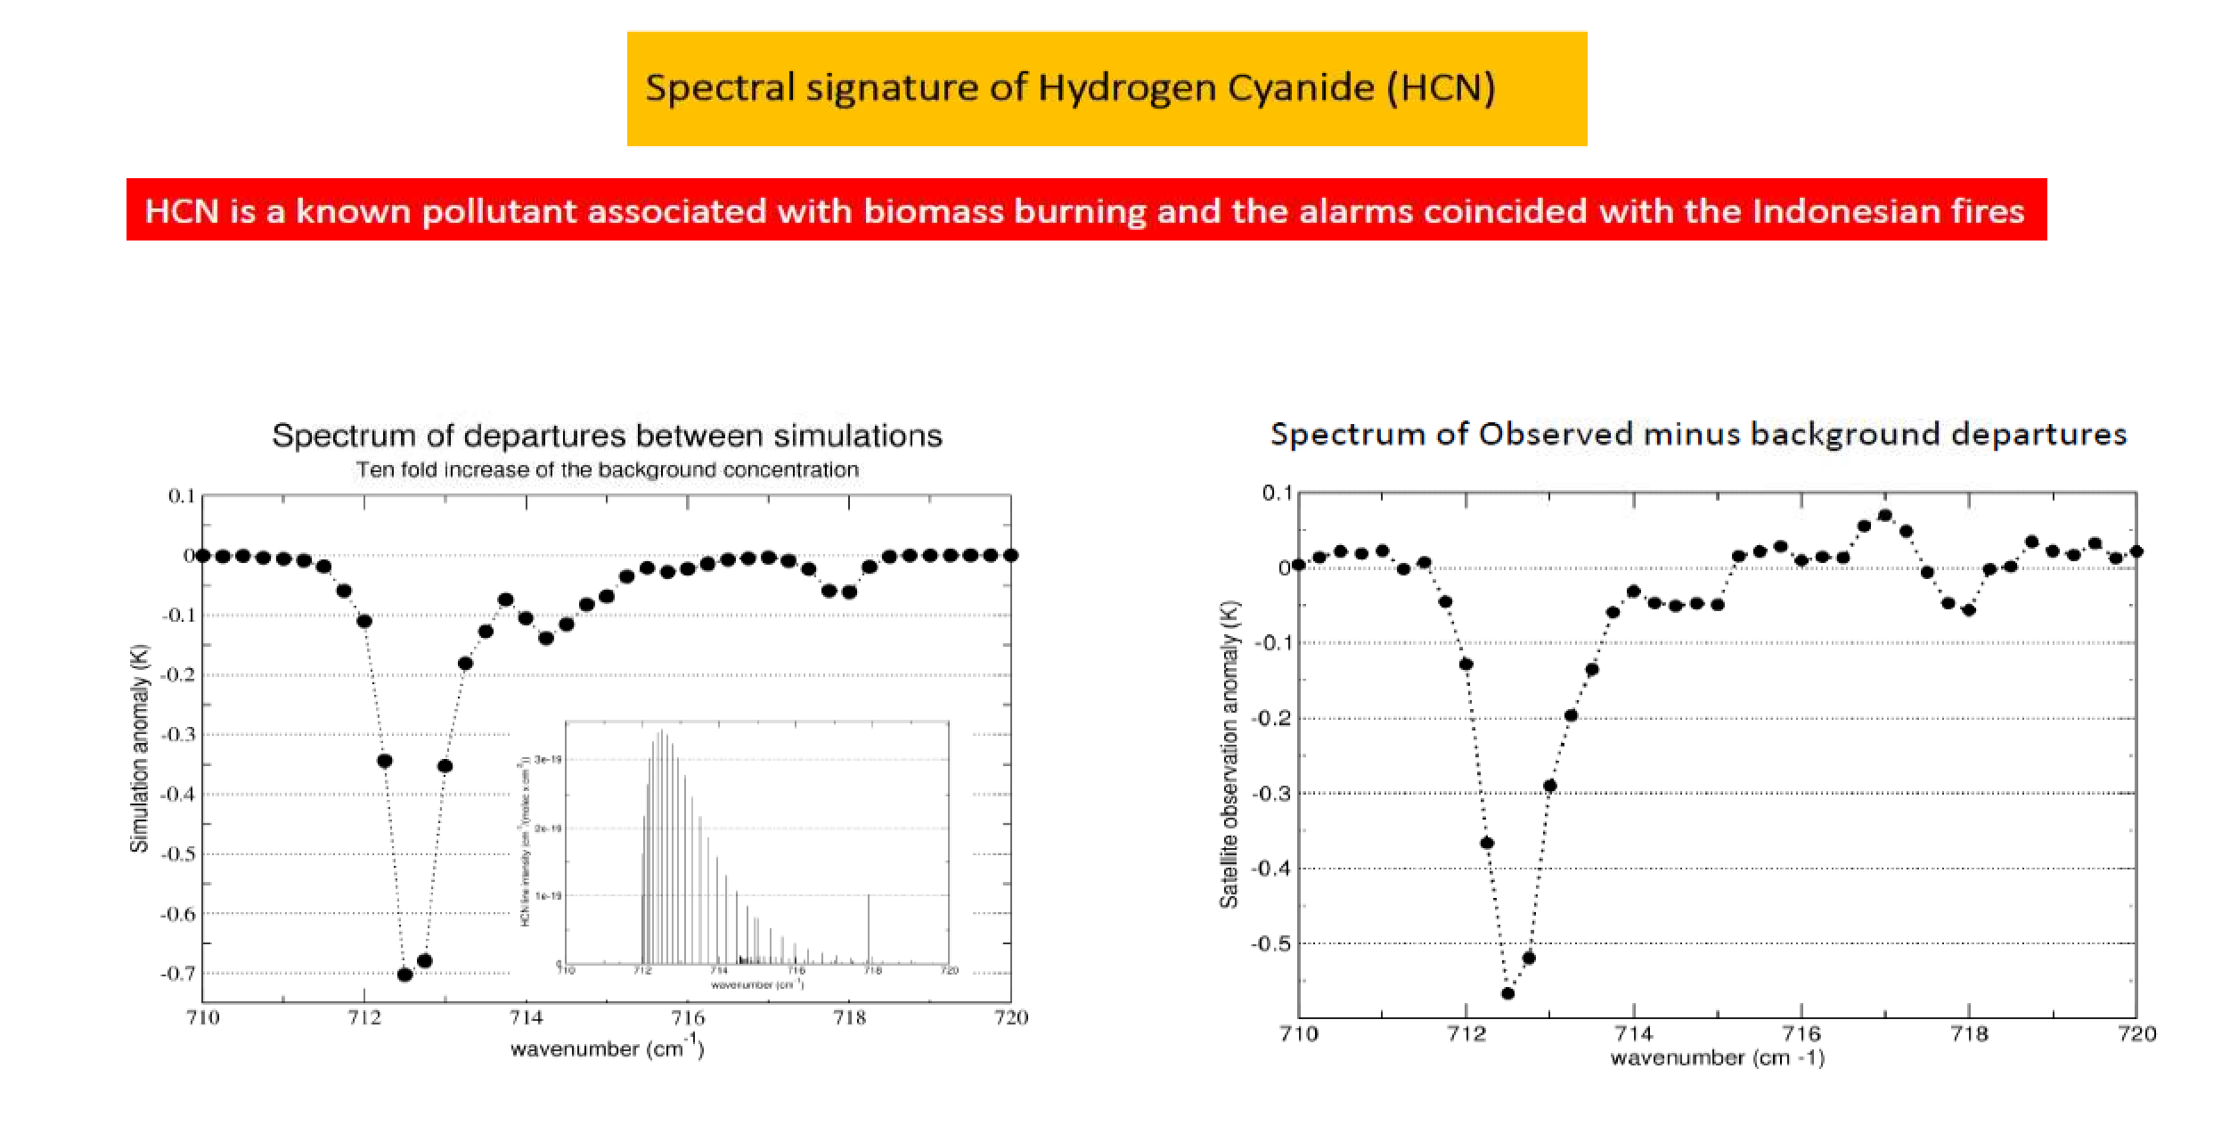
M. Matricardi

Slide 31
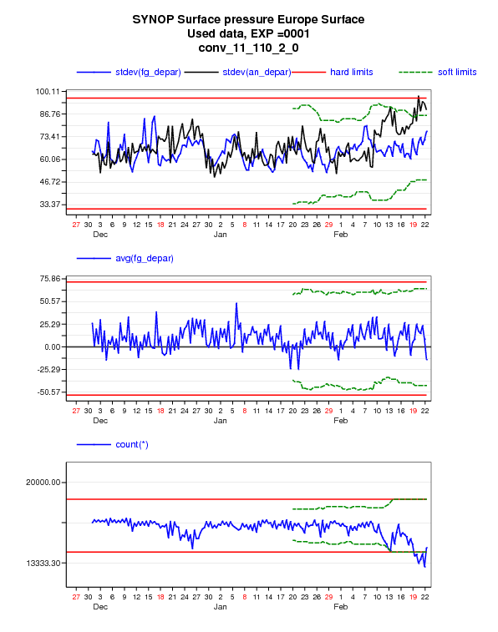
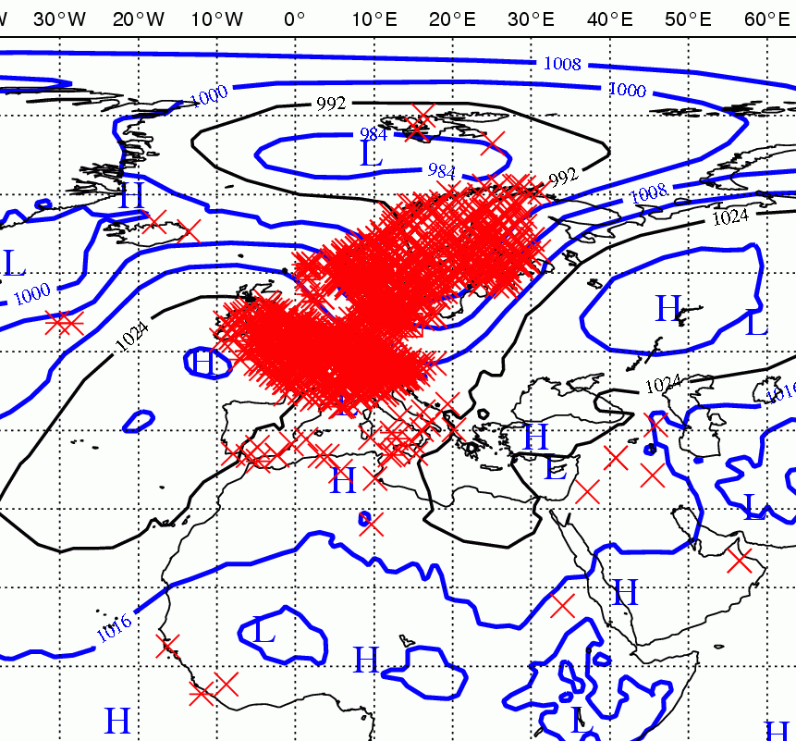
Surface pressure from SYNOP @20120222
SYNOP Surface pressure Europe Surface : out of range:
(19 times in last 10 days for at least one item)
http://wedit.ecmwf.int/products/forecasts/satellite_check//do/get/satcheck/969/59315?showfile=true
Slightly: count(*)=13632, expected range: 14227.5(H) 18606.9(H)
Severely: stdev(fg_depar)=73.073 < stdev(an_depar)=88.41

Slide 32
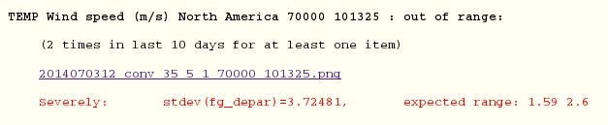
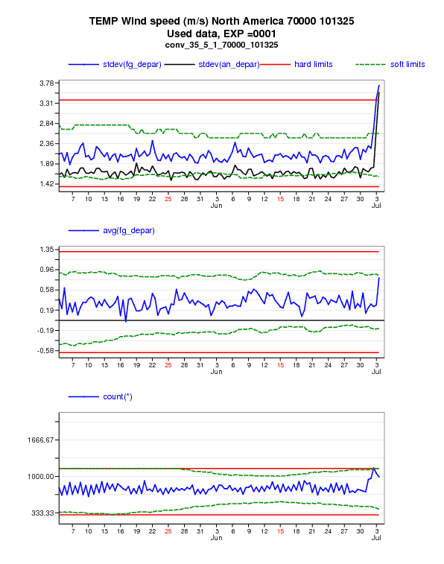
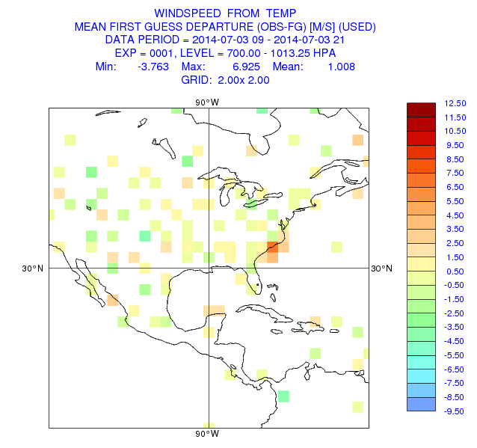
Wind speed from TEMP @2014070312

Slide 33
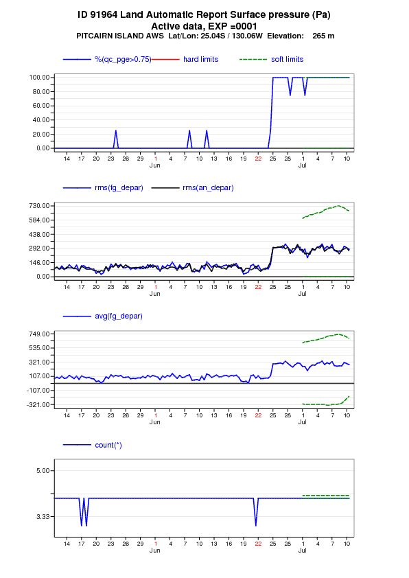
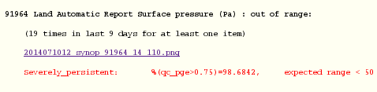
Lack of Bias correction

Slide 34
Thank you for your attention

