Slide 1
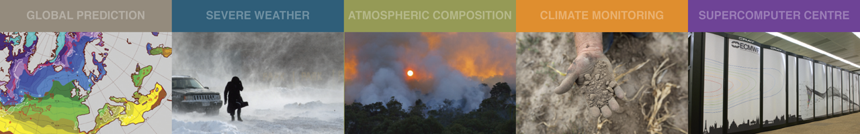
Current Satellite Observing Network and its Future Evolution
      A brief introduction to the Satellite GOS
      OSCAR – WMO’s database for information on observations, user requirements and gap-analysis
      EPS Second Generation / Meteosat Third Generation
      ESA Earth Explorer missions: EarthCARE and Aeolus
      Quick summary of other missions
      WMO Vision 2040 for the WIGOS
Stephen English
Stephen.English@ecmwf.int

Slide 2
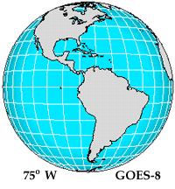
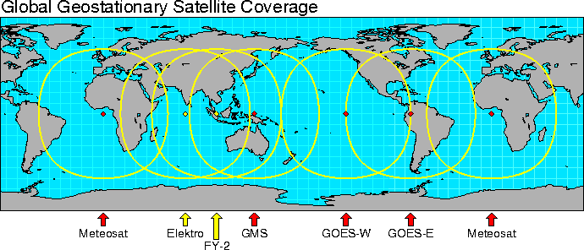
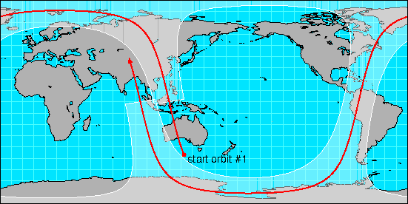
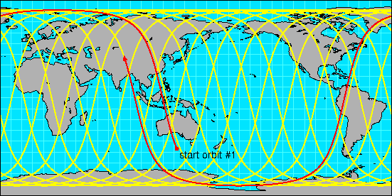
What types of satellites are used in NWP?
Advantages Disadvantages
GEO - Regional coverage No global coverage by single satellite
- Temporal coverage
LEO - Global coverage with single satellite

Slide 3
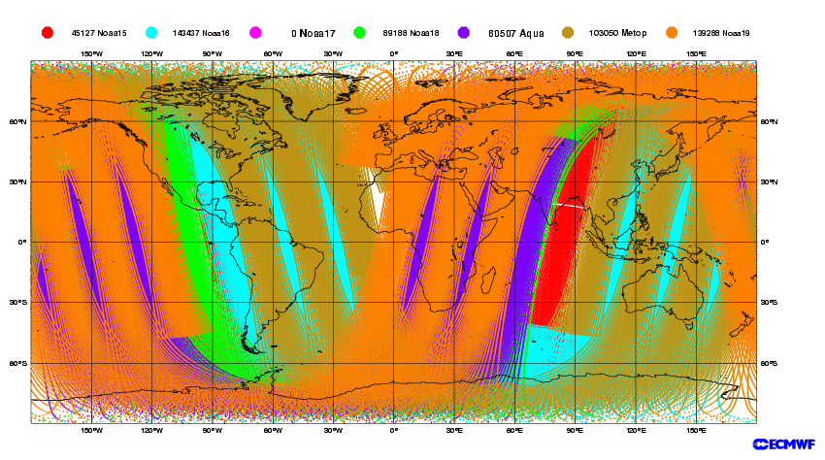
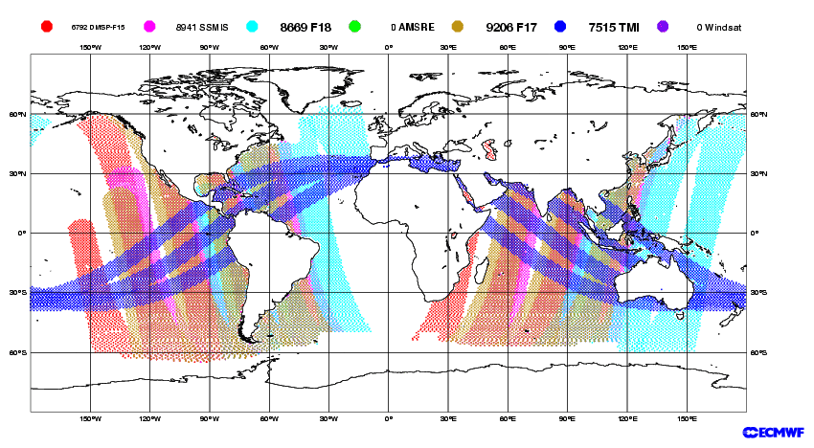
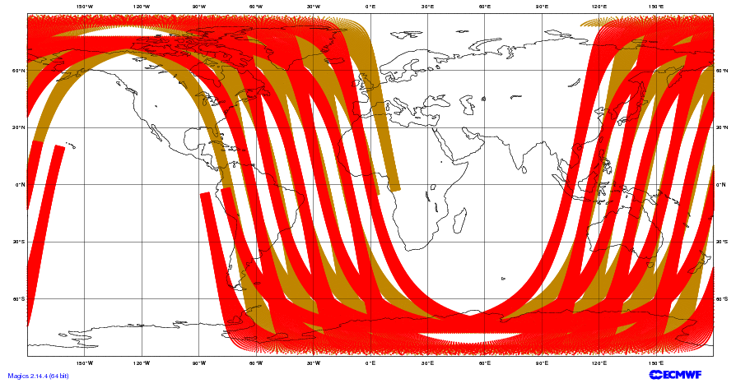
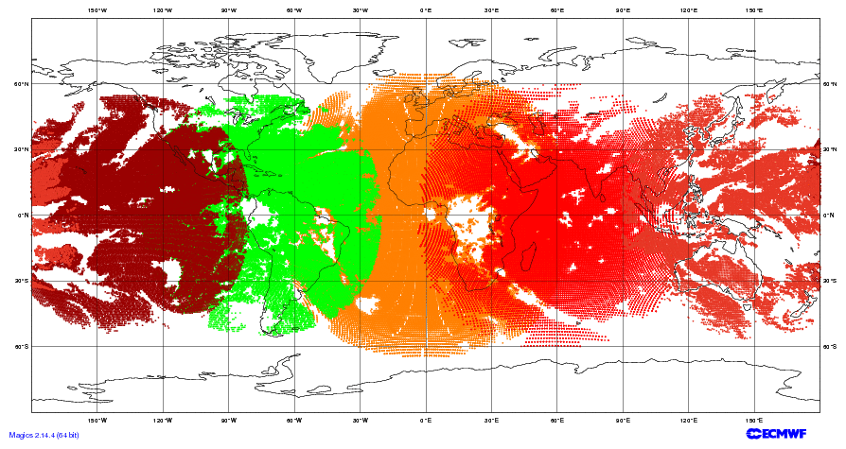
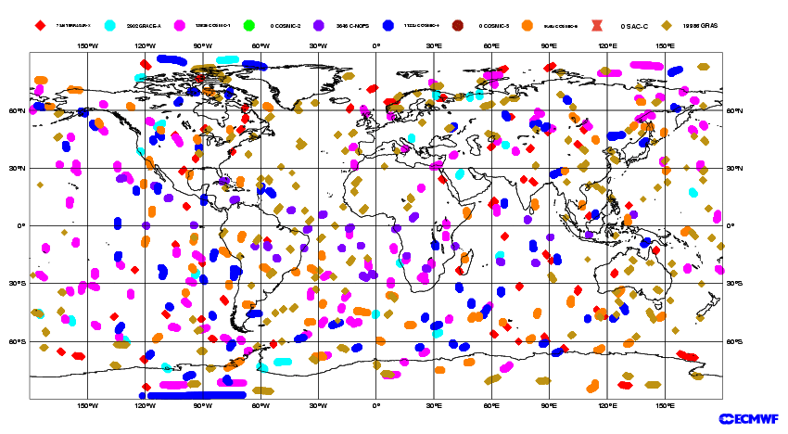
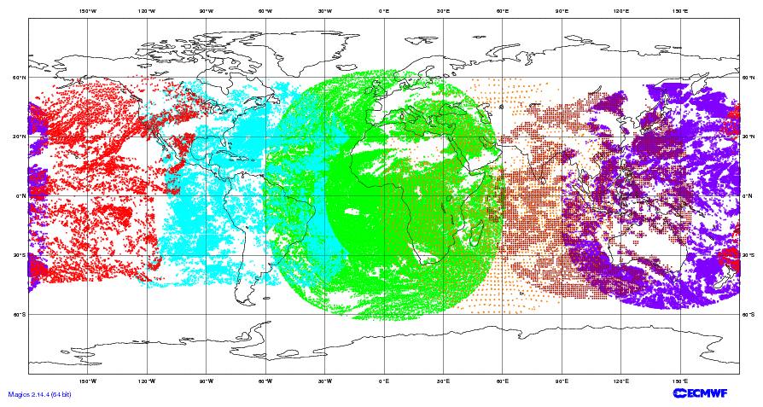
Example of 6-hourly satellite data coverage
LEO Sounders
LEO Imagers
Scatterometers
GEO imagers
Satellite Winds (AMVs)
GPS Radio Occultation
30 March 2012 00 UTC

Slide 4
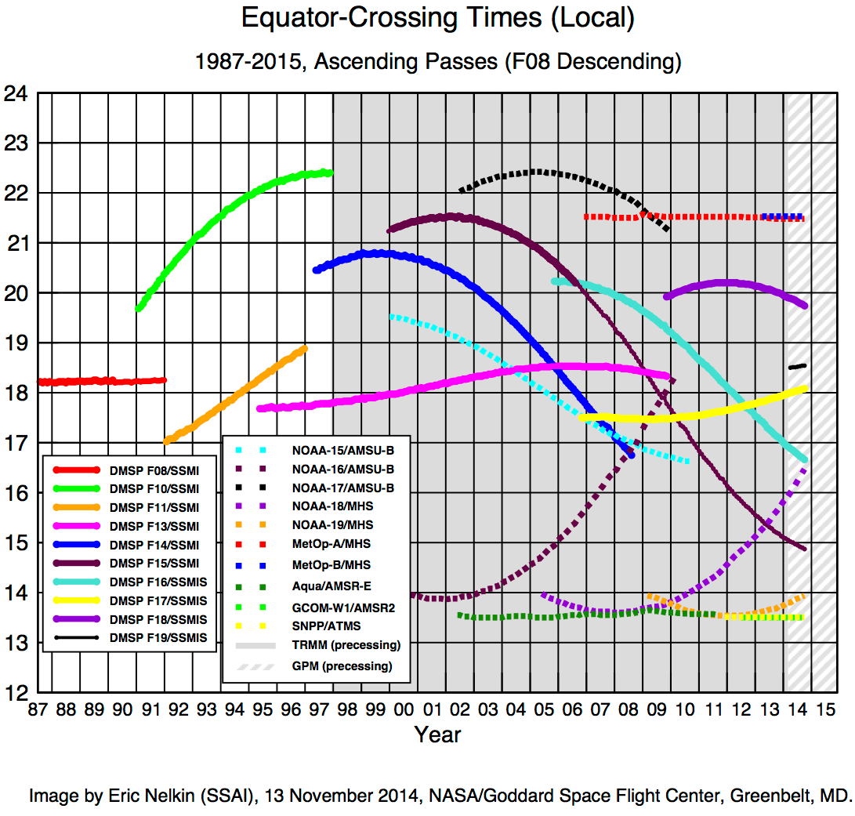
Satellite orbits
Mid AM
Early AM
PM
Europe
China
India
US
China
MetOp-B, A
FY-3A
T
i
m
e
DMSP F17, F18
NOAA-18
NOAA-15
NOAA-19, S-NPP, Aqua, Terra, Aura, FY-3B
Adapted from
Notes:
Colours for satellite names denotes what they started as e.g. NOAA-18 started as PM, and has drifted to Early AM

Slide 5
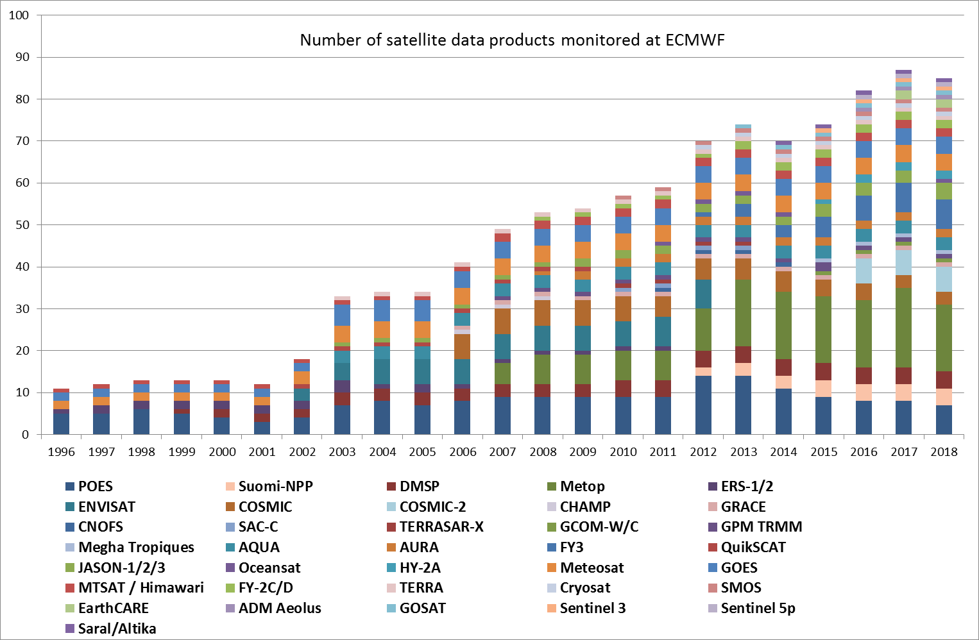

Slide 6
OSCAR
Observation Systems Capability Analysis and Review
  A tool developed by WMO to assist with the “Rolling Requirements Review” and the development of “WMO Integrated Global Observing System” WIGOS
    What do we need?
    What is there?
    Where are the gaps?
But OSCAR is more than this. It provides valuable and usually very up to date information both to satellite data specialists and the wider interested meteorological community.
http://www.wmo-sat.info/oscar/

Slide 7
Types of sensor
Orbit
View geometry
Wavelength
Passive or Active
Calibration accuracy
Signal to noise ratio
Complexity of interpretation
3D spatial and temporal resolution
Issues
Notes:
Show x-track vs conical, show how open design of conical leads to inferior calibration. Not an issue for rainfall etc. But huge issue for large scale temperature.
Hyperspectral – means measuring spectrum in 1000s narrow channels. E.g. Interferometer, grating spectrometer.
Imager: Measuring where atmosphere has low opacity giving information on surface, clouds, boundary layer.
Sounder: Mearing where atmosphere has high opacity giving information on upper air temperature, humidity, cloud height.
Passive: measuring natural emissions, peaking thermal infrared or using sun as source (limb geometry)
Active: Measure back scatter from man-made emission.
Calibration – need to do pre-flight characterisation, need traceable calibration. Hard for conical.
S2N: noise governed by integration time and bandwidth. Bandwidth controlled by Radio Regulations – very unwise to go outside, as some instruments have discovered.
Integration time – can oversample with high noise if desired but creates processing headache.
Polarisation: Info only possible with conical scan – hence conical scan is best for large signal surface, cloud, precipitation, which can have polarised emission) but very poor for low signal atmospheric temperature and humidity (which have unpolarised emission).

Slide 8
EPS Second Generation
A little of the history that led to EPS-SG…
1970s : Research sounders with a few channels = SCAMS,VTPR+
1979 : TOVS (NOAA) = HIRS/2→/3,MSU,SSU,AVHRR
1999 : ATOVS (NOAA) = HIRS/3→/4,AMSU-A,AMSU-B→MHS,AVHRR
2002 : A-train: AIRS,MODIS,CloudSat,Calipso+
2007 : EPS First Generation (Metop) = ATOVS + IASI, ASCAT, GRAS, GOME-2
2011 : S-NPP = ATMS, CrIS, VIIRS, OMPS
~2021: EPS-SG
  EPS-SG-A (3 sats) 2021-2042 = mostly EPS follow on instruments
  EPS-SG-B (3 sats) 2022-2043 = mostly new instruments

Slide 9
EPS Second Generation
~2021 EPS-SG will have updated counterparts to Metop 2nd generation instruments on EPS-SG-A:
  ATOVS + AVHRR/MODIS → MWS + MetImage
  IASI → IASI-NG
  ASCAT → SCA (on EPS-SG-B)
  GOME-2 → Sentinel-5 UVNS
  GRAS → RO
Plus some instruments new compared to Metop, on EPS-SG-A
  MWI: based on SSM/I
  3MI: based on POLDER and PARASOL (VIS/NIR/SWIR)
  ICI: completely new! Sub-mm imager for cloud ice

Slide 10
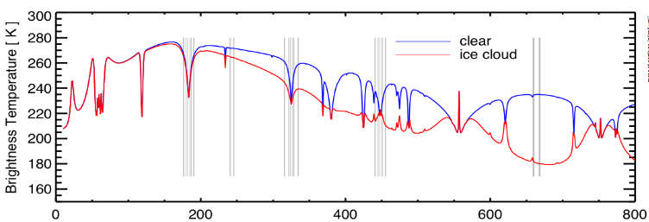
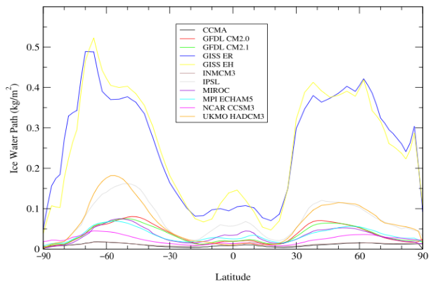
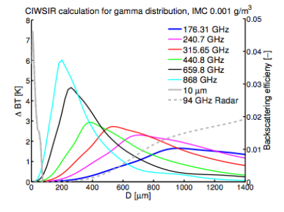
EPS-SG: Ice Cloud Imager - ICI
ICI
From John and Soden (2006)
From CloudIce proposal (Buehler et al.)

Slide 11
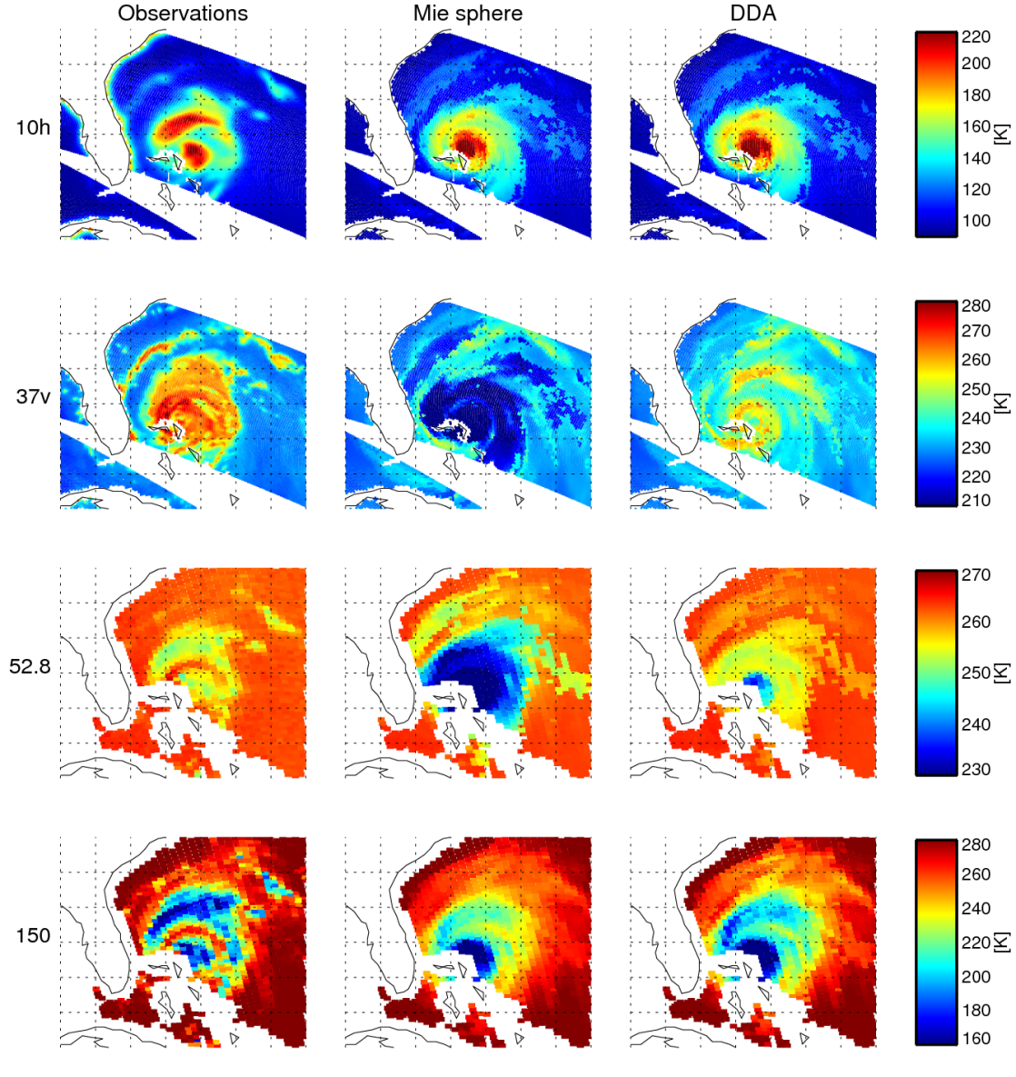
Observations
Mie simulations
DDA simulations
Improving accuracy of scattering radiative transfer
Liu (2008, BAMS) DDA scattering database
Implementation in RTTOV-SCATT: Geer and Baordo (2014, AMT)
Result: We can do all-sky assimilation in convective areas at frequencies above
30 GHz for the first time.
Needed for ICI.

Slide 12
EPS-SG: Multi-Viewing Multi-Channel Multi-Polarisation Imaging Mission - 3MI
3MI = POLDER + MODIS heritage
Multi-directional : 10-14 views for one pixel
              Exploits bi-directional reflectivity
Multi-polarization : ±60, 0º
Multi-spectral : 12 channels
388 to 2130 nm (close to MODIS specification)

Slide 13
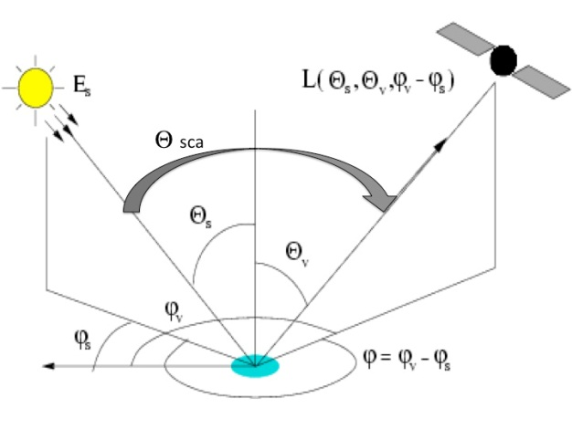
What can be obtained depends on avoiding sun-glint
GLINT
West
Case 1
Optical depth + size and refractive index information for coarse and fine particles
Optical depth + some size and refractive index information
Optical depth

Slide 14
Meteosat Third Generation
A little of the history that led to MTG-IRS
1977 : Meteosat-1: 3 channel MVIRI instrument (by ESA)
1989 : Meteosat-4: first operational Meteosat
1995 : EUMETSAT takes over Meteosat operations
2002 : 2nd generational Meteosat: 12 channel SEVIRI on Meteosat-8
2005 : NASA aspiring to launch first Geo interferometer
~ 2019 Meteosat Third Generation
  MTG-I 2019 (4 sats) 2019-2039
  MTG-S 2021 (2 sats) 2021-2037

Slide 15
Meteosat Third Generation
~2018 MTG-I will have updated counterpart to SEVIRI on MSG:
  SEVIRI → FCI 16 channel imager
    European rapid scan 2.5 minutes, full disk 10 minutes.
Plus new instruments on MTG-I and MTG-S (from ~2020):
  IRS: IR interferometer (never previously launched in Geo orbit)
  LI: Lightning imager (777.4nm)
  UVN: Ultraviolet, Visible and Near IR imager

Slide 16
MTG: Infrared Sounder - IRS
An imaging Fourier-interferometer with a hyperspectral resolution of 0.625 cm⁻¹ wave-number
Two bands, the 700–1210 cm⁻¹ Long-Wave InfraRed (LWIR) and the 1600–2175 cm⁻¹ Mid-Wave InfraRed (MWIR)
Spatial resolution of 4 km.
Full Disk basic repeat cycle of 60 min.
Moisture flux convergence from combination of humidity and wind (through feature tracking)
High potential for nowcasting and NWP.
ECMWF workshop in January 2017 dedicated to exploitation of high temporal Advanced IR Sounder information.

Slide 17
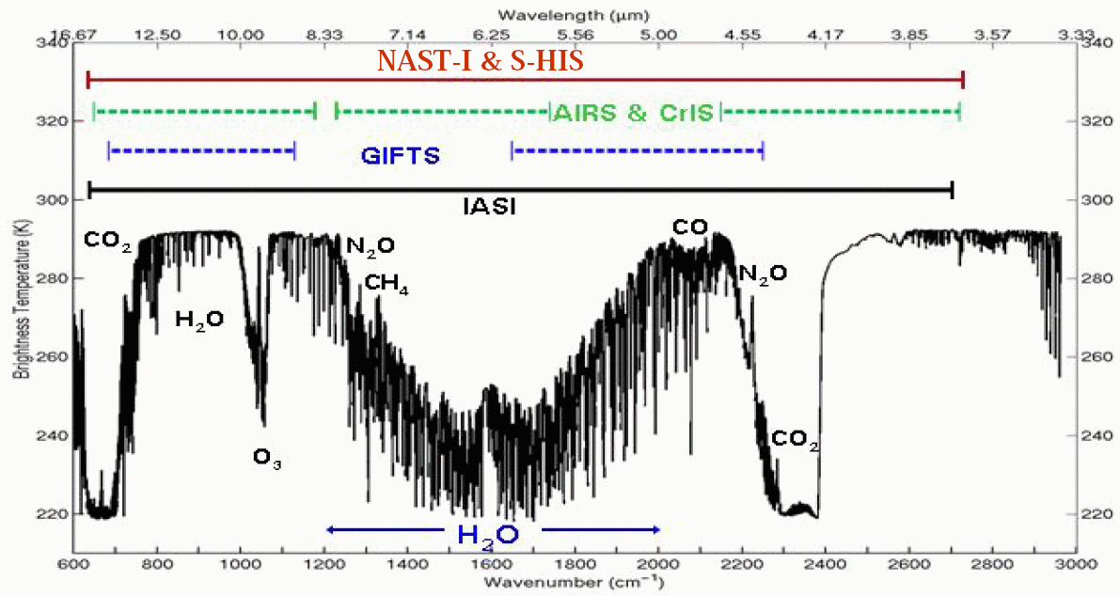
MTG: Infrared Sounder - IRS
LW CO2
MW H2O
Notes:
LTE
N2 continuum
H20 continuum
1000s spectral lines

Slide 18
Aeolus: doppler wind lidar
  Active measurement of Doppler shift in backscattered laser
  Direct information on horizontal line of sight wind mostly in the zonal direction
  Provides a “curtain” of observations along orbit (2D cross section)
    Vertical resolution 250m (PBL) to 2km (Stratosphere)
    Horizontal resolution ~90km
  Winds are derived from molecular (Rayleigh) or particulate (Mie) backscattering
  Technologically challenging and launch date has changed many times. Now expected ~2017.

Slide 19
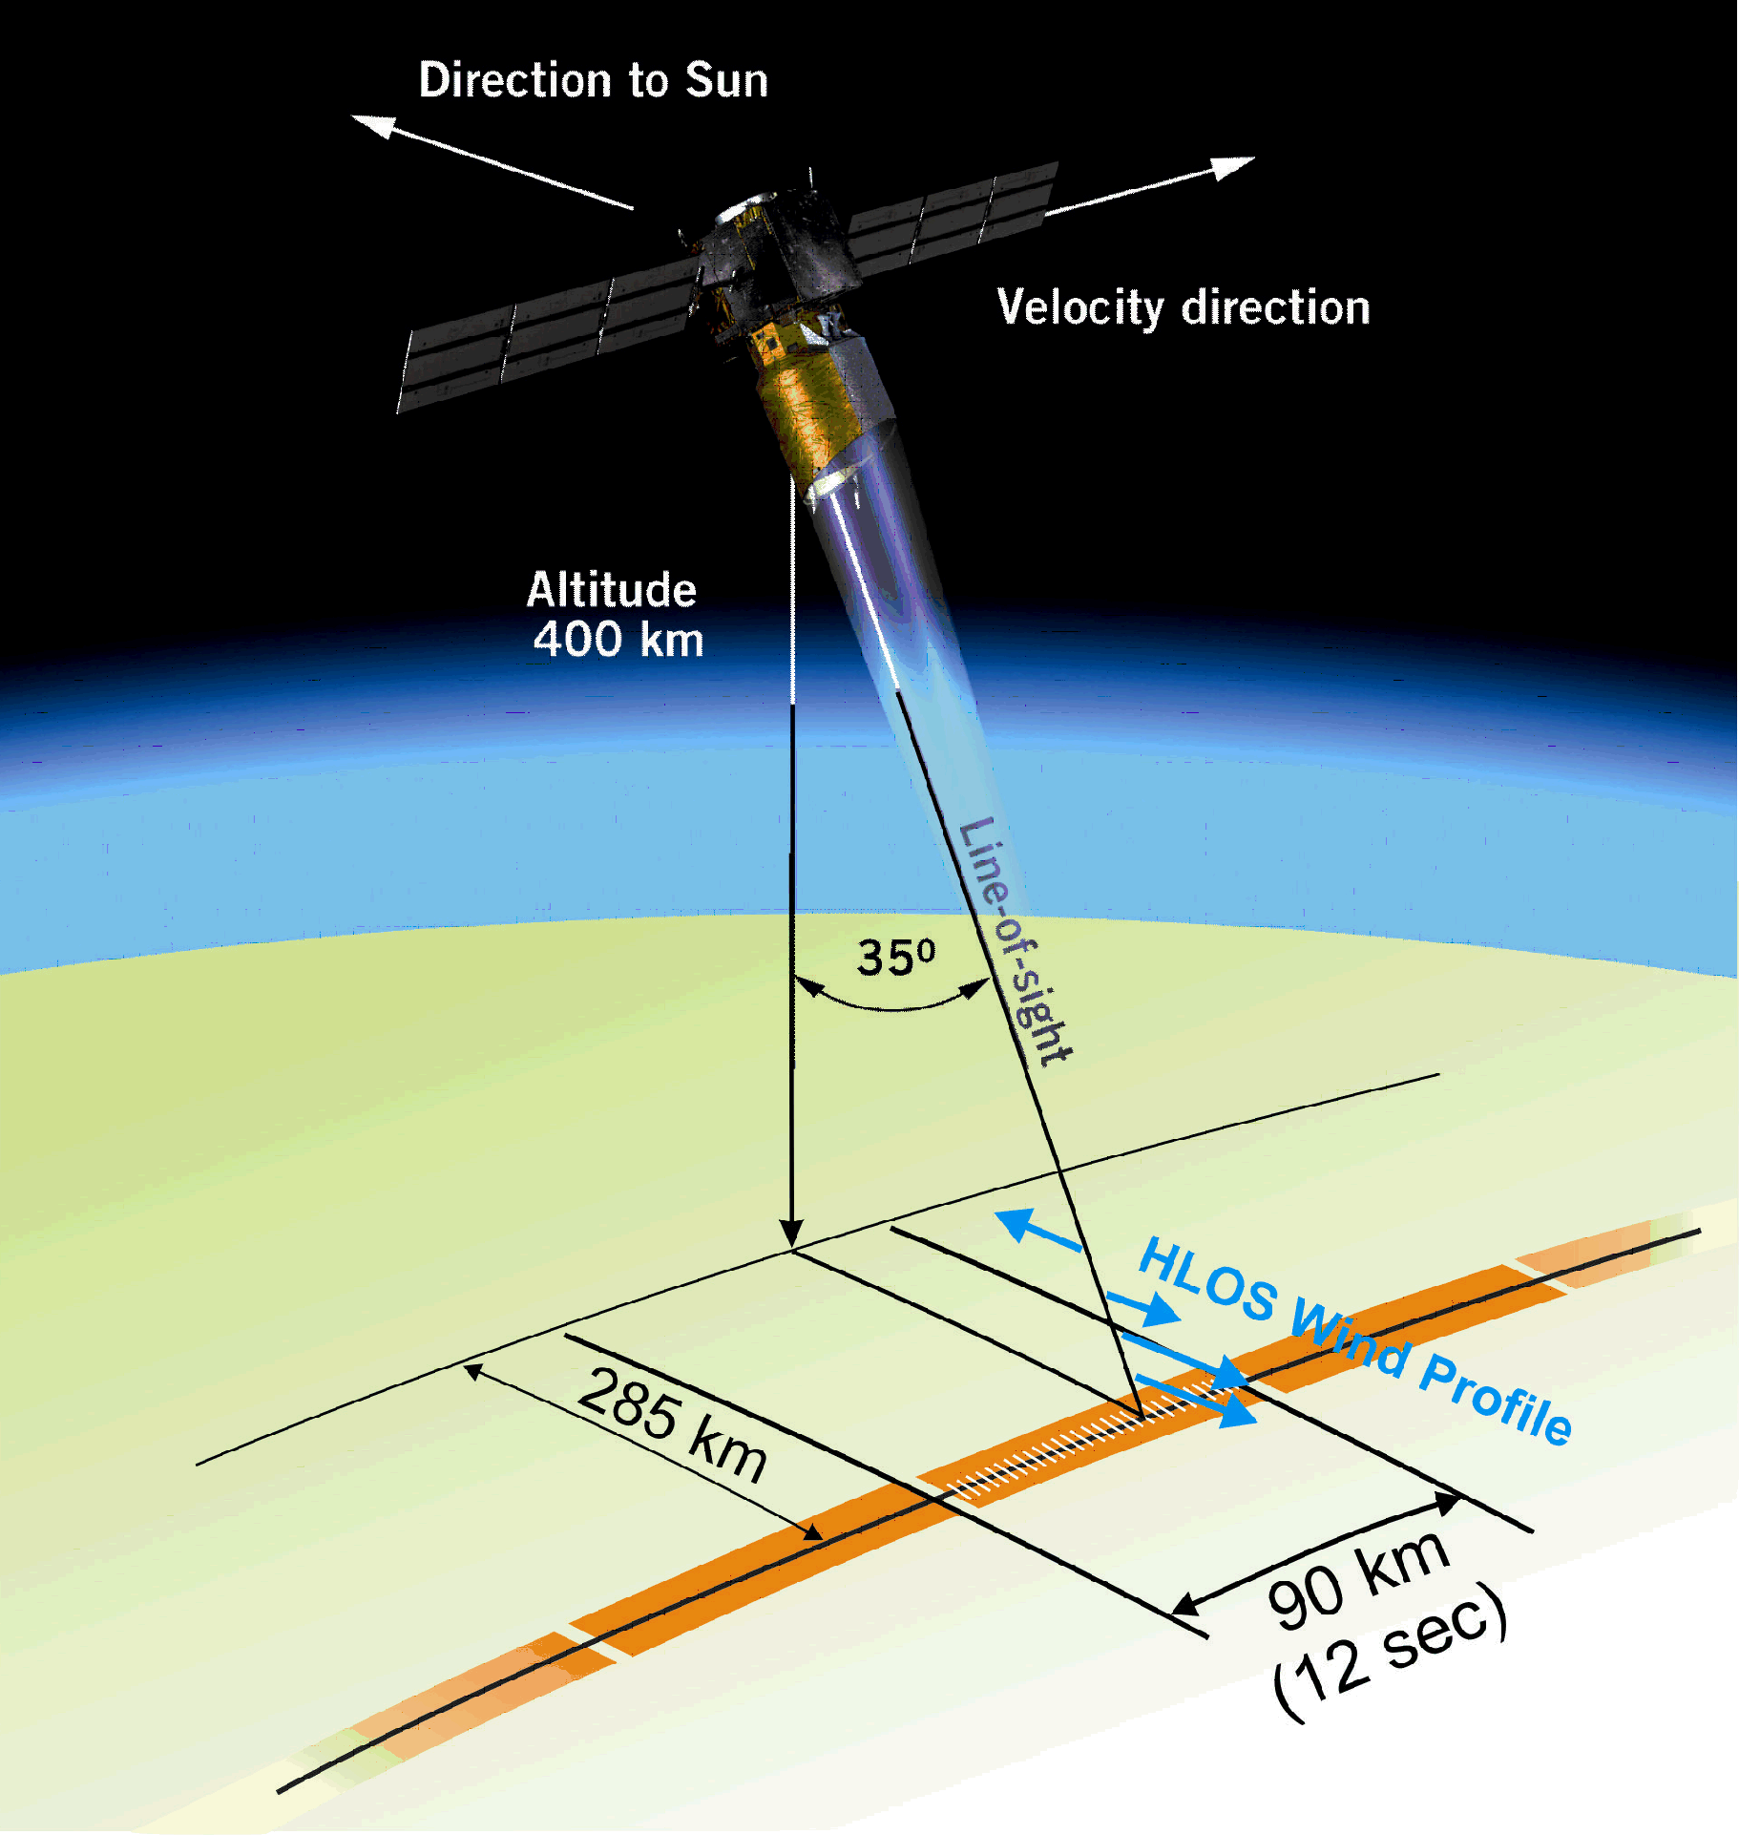
Aeolus: doppler wind lidar
Continuous mode
1 basic repeat cycle
30 x 2.85 km each
6 hr coverage
86 km
(12 sec)

Slide 20
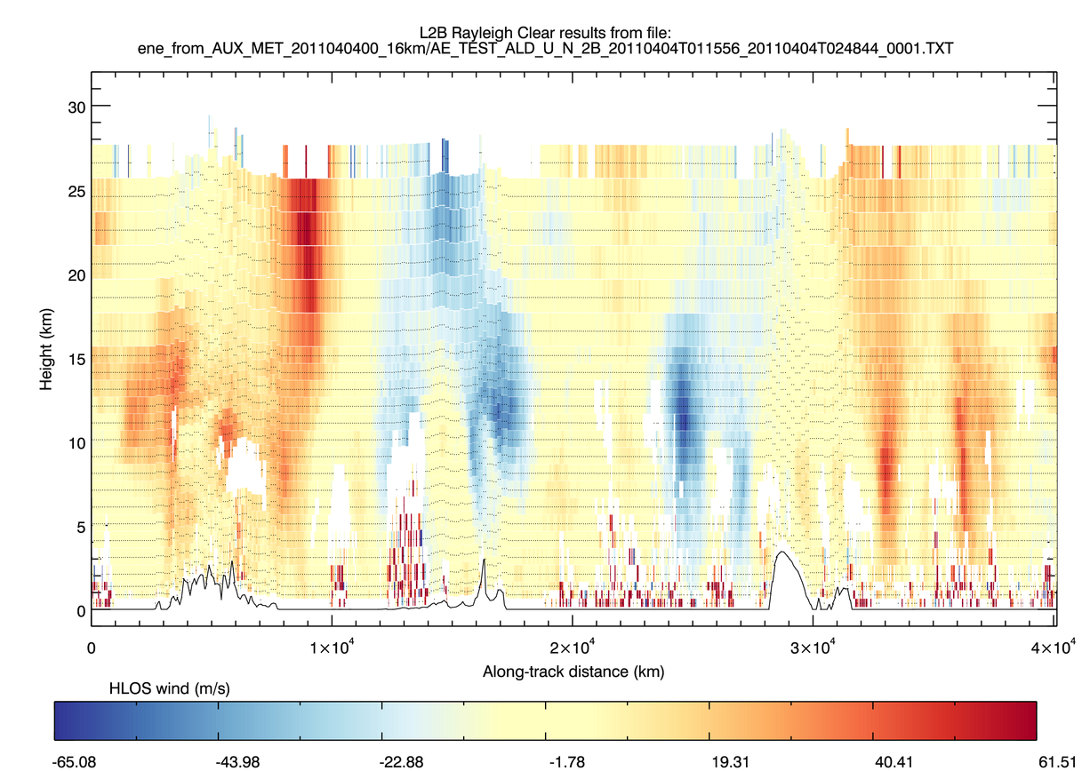
Simulated Aeolus wind observations

Slide 21
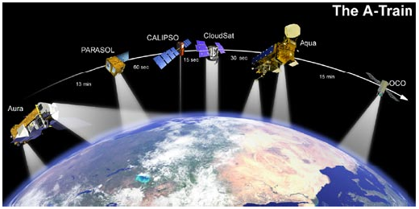
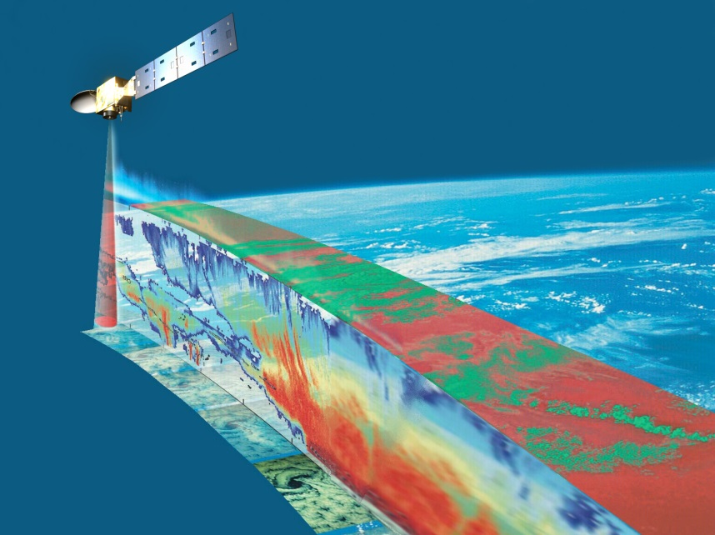
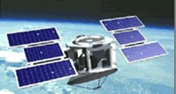
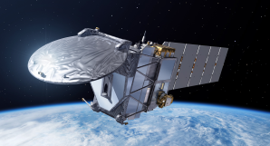
EarthCARE: cloud radar and lidar
EarthCare
ThA-Train
  Launched 2006
  NASA
  700-km orbit
  CloudSat 94-GHz radar
  CALIPSO 532/1064-nm lidar
  MODIS, CERES and AMSR-E radiometers
EarthCARE
  Expected launch c. 2018
  ESA+JAXA
  400-km orbit (more sensitive)
  CPR: 94-GHz Doppler radar
  ATLID: 355-nm lidar
  MSI and BBR radiometers

Slide 22
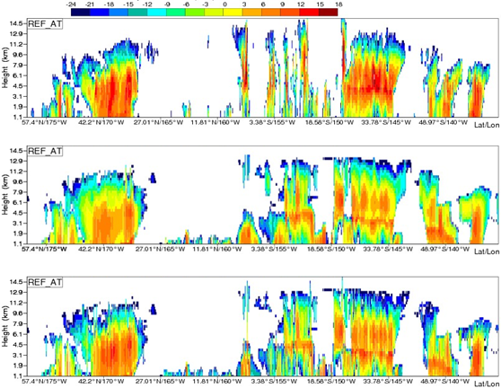
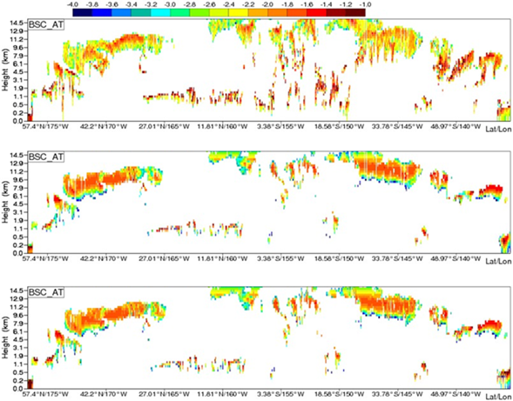
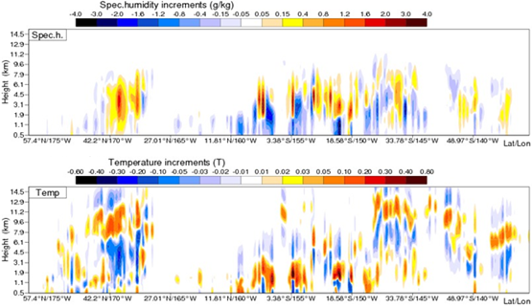
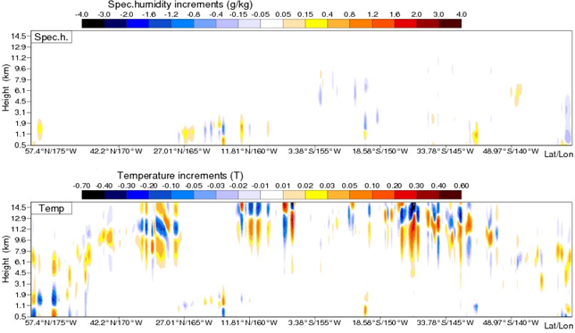
(S Di Michele and M Janisková)
EarthCARE: cloud radar and lidar
O
B
A
δq
δT
Radar
Lidar

Slide 23
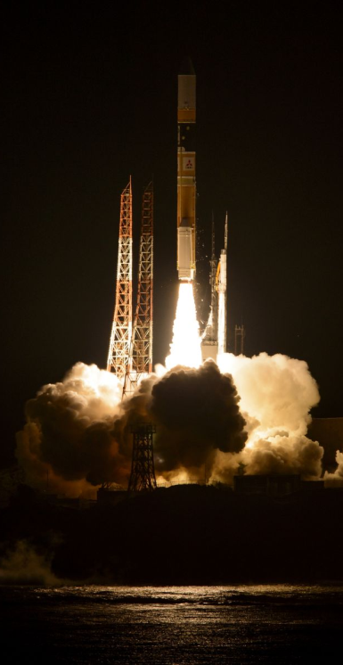
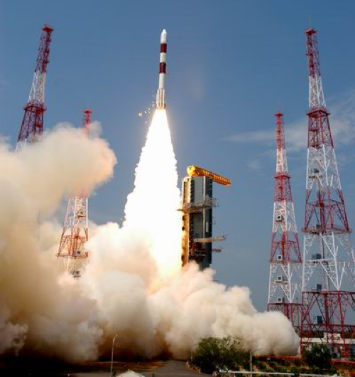
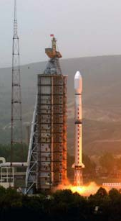
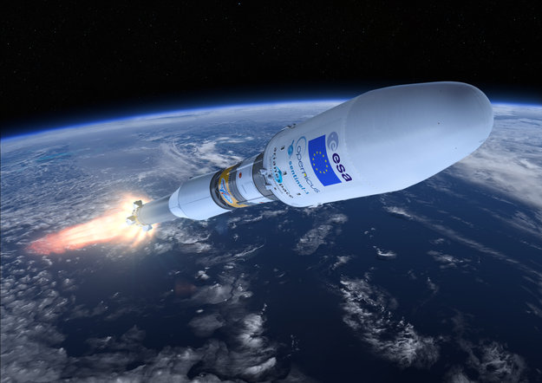
Some other key missions
GPM
Feb 2014
Meghatropiques Oct 2011
JAXA/JMA
  Himawari-8 – “MODIS on GEO!” (as GOES-R)
  GCOM-W1: AMSR2
  GPM: GMI and DPR
CMA
  Feng Yun satellite series
    FY-3C similar to Metop
    FY-4 similar to MTG
ISRO / CNES
  Meghatropiques SAPHIR sounder
ESA / EUMETSAT / European Commission
  Sentinel series (1,2,3 up, 4, 5p, 5, 6 to come)
NSPO
  COSMIC-2 (RO)
DoD, CSA, RosHydroMet, KMA, NSAOS, UCAR, DLR, CONAE, IMD
FY3C
Sept 2013
Sentinel-1 April 2014

Slide 24
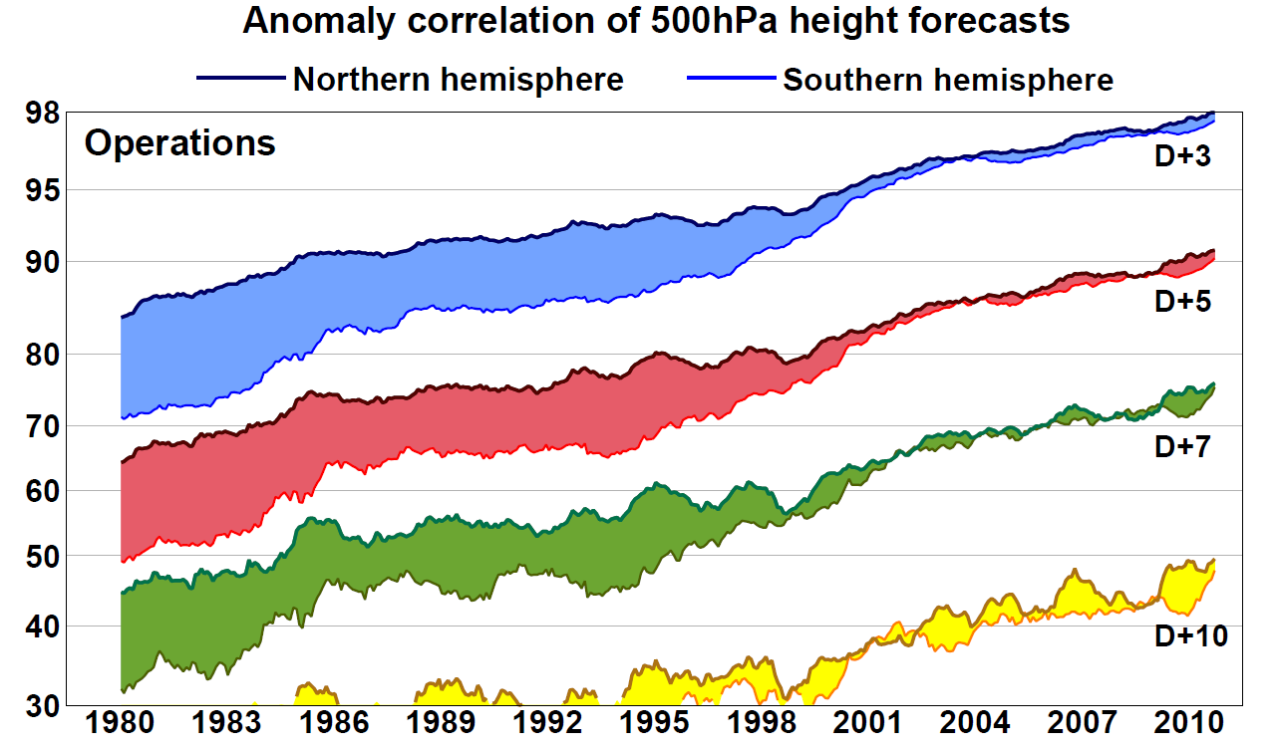
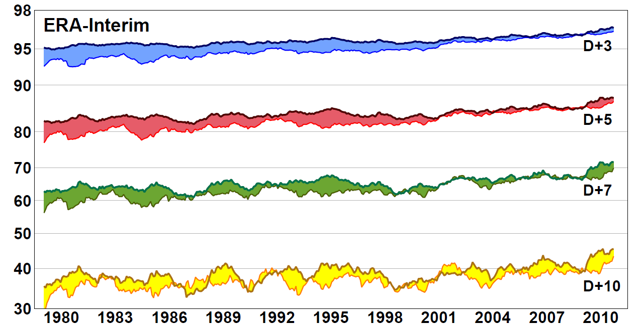
Full operational system. GOS + forecast changes with time
ERA-Interim skill shows little change 1980-2000 when there was little change in the GOS.
The ATOVS era shows a gain of around 6-18 hours in predictable skill compared to the TOVS era.
ERA-Interim excludes more recent data e.g. IASI and ASCAT so the impact of newer data is hard to judge.
This compares to overall ECMWF gain in skill of about 2-3 hours per year.
Re-analysis system. Only GOS changes with time
TOVS
ATOVS
ATOVS + Hyperspectral IR

Slide 25
WMO Integrated Global Observing System (WIGOS) design
Examples questions we use Data Assimilation techniques to study:
Very specific questions e.g. Would it be beneficial for the Chinese FY3 program to move to the “early morning orbit” with the Europeans occupying the “mid morning orbit” and the Americans the “afternoon orbit”?
Preparation for future instruments such as lidar and radar (EarthCARE) – will these observations make a difference?
Which observations are most critical to forecast skill?
Monitoring the quality of observations – protecting the operational system e.g. HCN event.
Protecting our needs e.g. Radiofrequency interference.

Slide 26
Developing WIGOS
Vision for WIGOS in 2025 adopted June 2009
Vision for WIGOS in 2040 currently under development
  Goal of new WIGOS vision by 2018 or 2019
  Sets goals for the Space Agencies and attempts to coordinate
Understanding WIGOS - WMO Space provide detailed support for satellite data from www.wmo-sat.info:
  OSCAR lists what exists, what is planned, what it can do, how this compares to requirements:
  http://www.wmo-sat.info/oscar/
  SATURN provides detailed information to prepare for forthcoming launches: data availability, formats, meta data, test data, points of contact:
  https://www.wmo-sat.info/satellite-user-readiness/
  The Product Access Guide provides information on existing datasets and how to obtain them:
  https://www.wmo-sat.info/product-access-guide/

Slide 27
Summary
WMO trying to coordinate Global Observing System, with some success
We have a core component of WIGOS for meteorology with:
  Microwave, IR and Radio Occultation sounders for temperature and humidity
  Atmospheric Motion winds and Scatterometer winds
  Microwave imagers and cloud + precipitation radar for clouds/precipitation
OSCAR database allows easy examination of what exists, and to what purpose.
New and exciting developments
  Lidar: for wind, clouds and aerosol; Cloud radar (ESA Earth Explorer)
  Visible for aerosol, sub-mm for ice cloud (EPS-SG)
  Hyperspectral IR on Geo (MTG, FY4)
Needs advances in models, data assimilation, observation operators and data handling, quality control and characterisation. Also preparing for future Earth System rather than pure NWP approaches, with coupled models and data assimilation

Slide 28
Sun-Synchronous Polar Satellites
Instrument | Early morning orbit | Morning orbit | Afternoon orbit
High spectral resolution IR sounder |  | IASI | Aqua AIRS NPP CrIS
Microwave T sounder | F16, 17 SSMIS | Metop AMSU-A FY3A MWTS DMSP F18 SSMIS Meteor-M N1 MTVZA | NOAA-15, 18, 19 AMSU-A Aqua AMSU-A FY3B MWTS, NPP ATMS
Microwave Q sounder + imagers | F16, 17 SSMIS | Metop MHS DMSP F18 SSMIS FY3A MWHS | NOAA-18, 19 MHS FY3B MWHS, NPP ATMS
Broadband IR sounder |  | Metop HIRS FY3A IRAS | NOAA-19 HIRS FY3B IRAS
IR Imagers |  | Metop AVHRR Meteor-M N1 MSU-MR | Aqua+Terra MODIS NOAA-15, 16, 18, 19 AVHRR
Composition (ozone etc). |  | NOAA-17 SBUV | NOAA-18, 19 SBUV ENVISAT GOMOS AURA OMI, MLS ENVISAT SCIAMACHY GOSAT

Slide 29
Sun-Synchronous Polar Satellites (2)
Instrument | Early morning orbit | Morning orbit | Afternoon orbit
Scatterometer |  | Metop ASCAT Coriolis Windsat | Oceansat OSCAT
Radar |  |  | CloudSat
Lidar |  |  | Calipso
Visible reflectance |  |  | Parasol
L-band imagery | SMOS SAC-D/Aquarius
Non Sun-Synchronous Observations
Instrument | High inclination (> 60°) | Low inclination (<60°)
Radio occultation | GRAS, GRACE-A, COSMIC, TerraSarX C-NOFS, (SAC-C), ROSA
MW Imagers |  | TRMM TMI Meghatropics SAFIRE MADRAS
Radar Altimeter | ENVISAT RA JASON Cryosat

Slide 30
Data sources: Geostationary Satellites
Product | Status
SEVIRI Clear sky radiance | Assimilated
SEVIRI All sky radiance | Being tested for overcast radiances, and cloud-free radiances in the ASR dataset
SEVIRI total column ozone | Monitored
SEVIRI AMVs | IR, Vis, WV-cloudy AMVs assimilated
GOES | AMVs
MTSAT | AMVs

