Slide 1
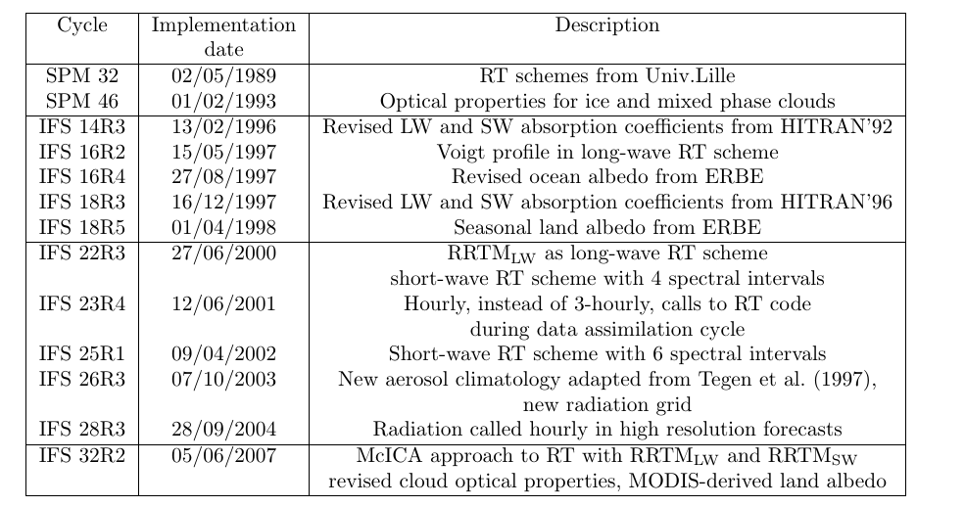
The history of ECMWF radiation schemes

Slide 2
The ECMWF radiation schemes
A number of radiation schemes are in use at ECMWF. Since January 2011, have been active
  McRad including RRTM_LW and RRTM_SW is used in the forward model for operational 10-day forecasts at Tco1279L137, EPS 15-day forecasts at Tco639 L91, and seasonal forecasts at T_{L}159 L62.
  The tangent linear and adjoint of the “old” SW radiation scheme in a 2-spectral interval version
  The tangent linear and adjoint of the “old” LW radiation scheme with 6 spectral intervals,
  These last two schemes are used in the assimilation (cf. P.Lopez’s presentation in TC PA module)
  … and all the dedicated RT scheme used to simulate radiances (RTTOV-based) in the analysis of satellite data (cf. TC DA module)
  A dedicate RT code to compute spectral irradiance in the UV spectrum (a modified version of RRTM-SW in the CAMS system)

Slide 3
McRad, a new radiation package for the ECMWF IFS
McRad (operational with CY32R2, 5 June 2007)
Includes MODIS land surface albedo
A new SW radiation transfer scheme (RRTMG_SW) consistent with RRTMG_LW introduced in June 2000
McICA: Monte-Carlo Independent Column Approximation: a new treatment of clouds in RT schemes
Revised cloud optical properties. Ice: Fu et al. (1996,1998) Water: Lindner and Li (2000) and Slingo (1989)
More extensive use of the flexible radiation grid

Slide 4
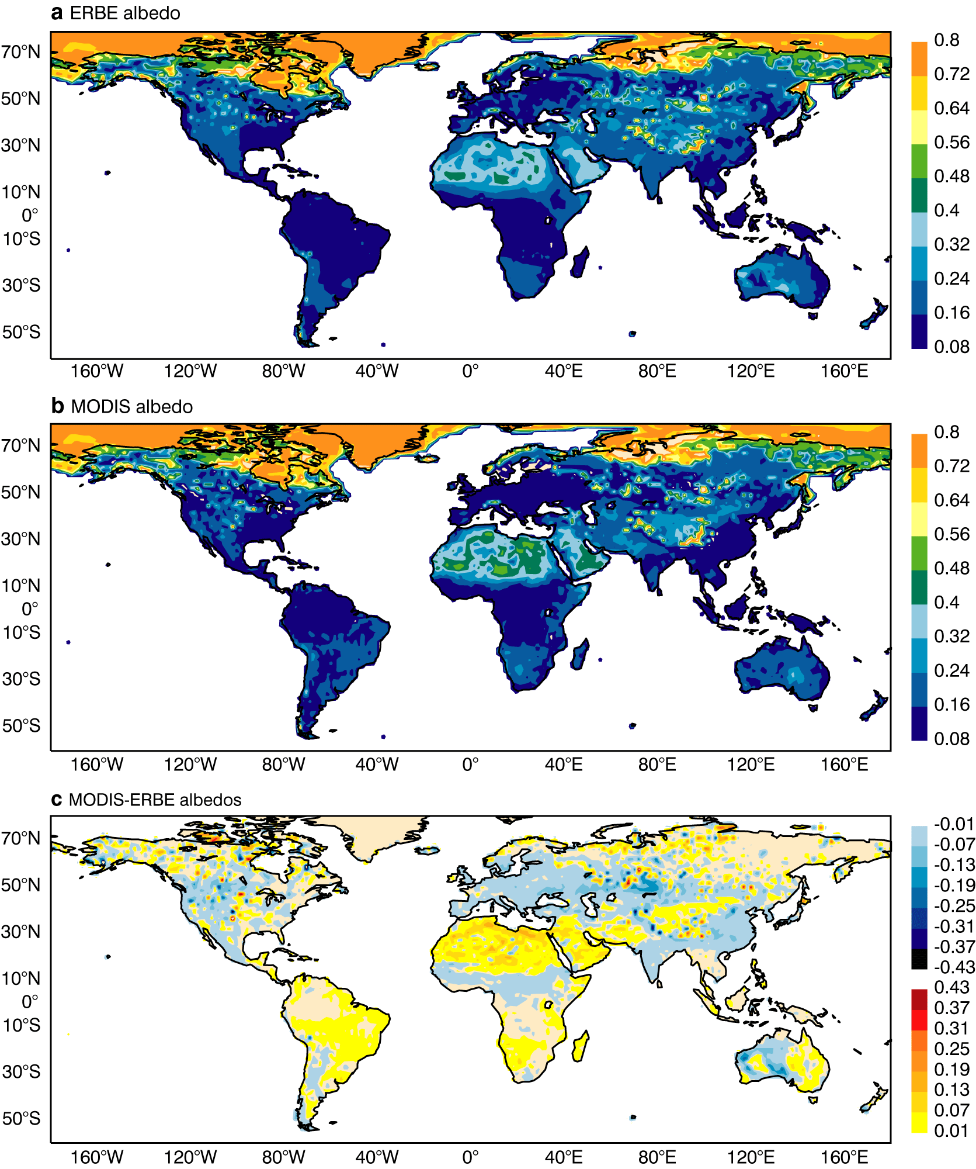
31R1: “old” surface albedo:
one component only (0.3-5.0 microns)
32R2: equivalent surface
albedo from F_{up}/F_{down}
2 components (0.3-0.7 and 0.7-5.0 microns), diffuse and direct
Impact: it depends on which
SW RT scheme is used:
Slightly negative with SW6,
slightly positive with
RRTM_SW
Diff new-old

Slide 5
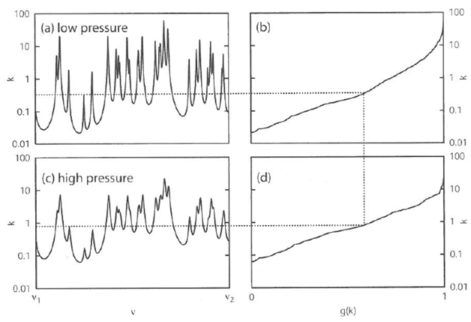
RRTM Mlawer et al., 1997: JGR, 102D, 16663-16682
Aer Inc. Morcrette et al., 1998: ECMWF Tech.Memo., 252
The use of the correlated-k method (mapping k(v) ->g(k)) allows radiative transfer to be performed as a monochromatic process
The original RRTM integrates each of the LW and SW bands with 16 pseudo-monochromatic channels (g-points)
The ECMWF model uses a version with less g-points
RRTMG
A two stream algorithm performs the vertical radiative transfer
M<N

Slide 6
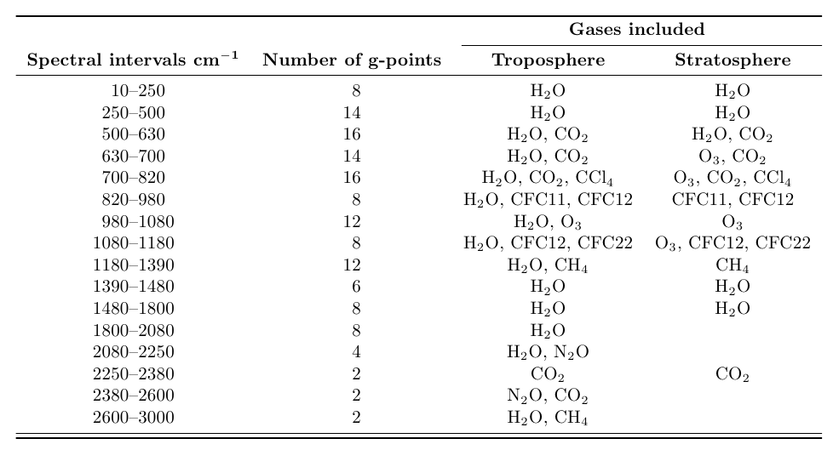
RRTMG-LW configuration
~100 microns
~100 hPa
16
B
A
N
D
S
~3 microns
140 g-points

Slide 7
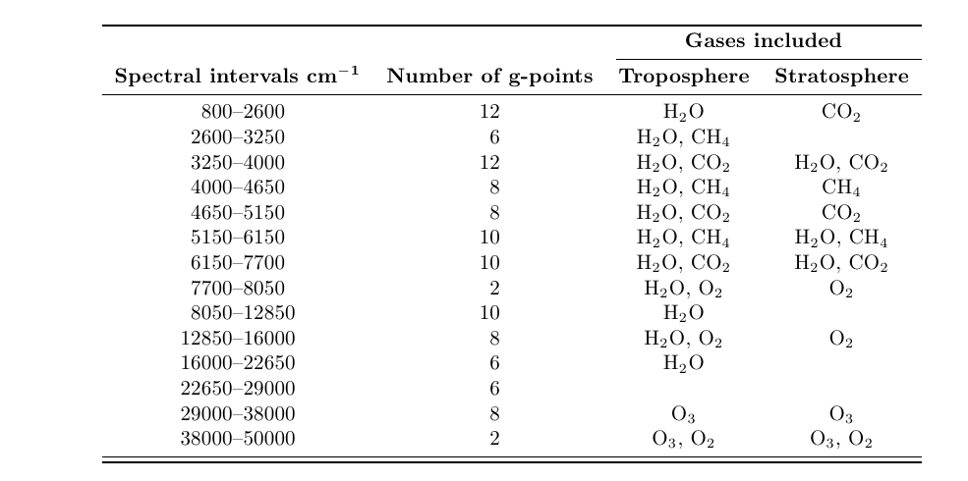
RRTMG-SW configuration
~3 microns
14
B
A
N
D
S
0.2 microns
112 g-points

Slide 8
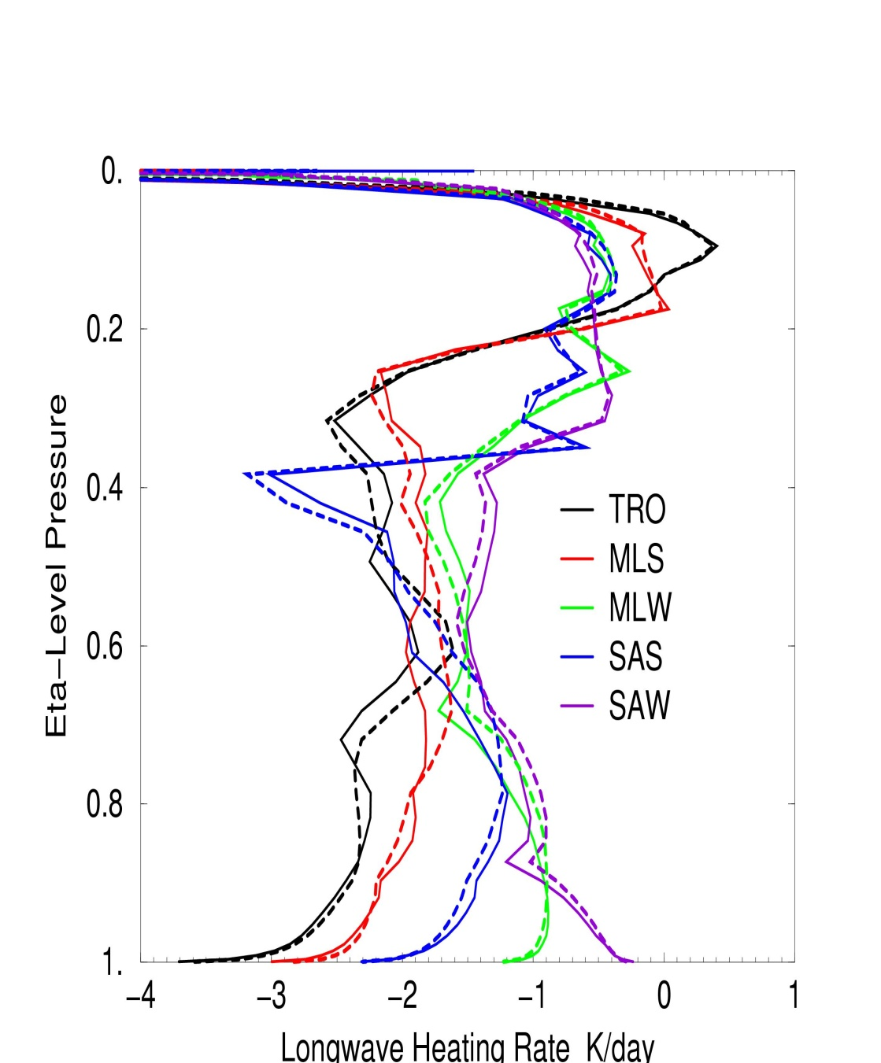
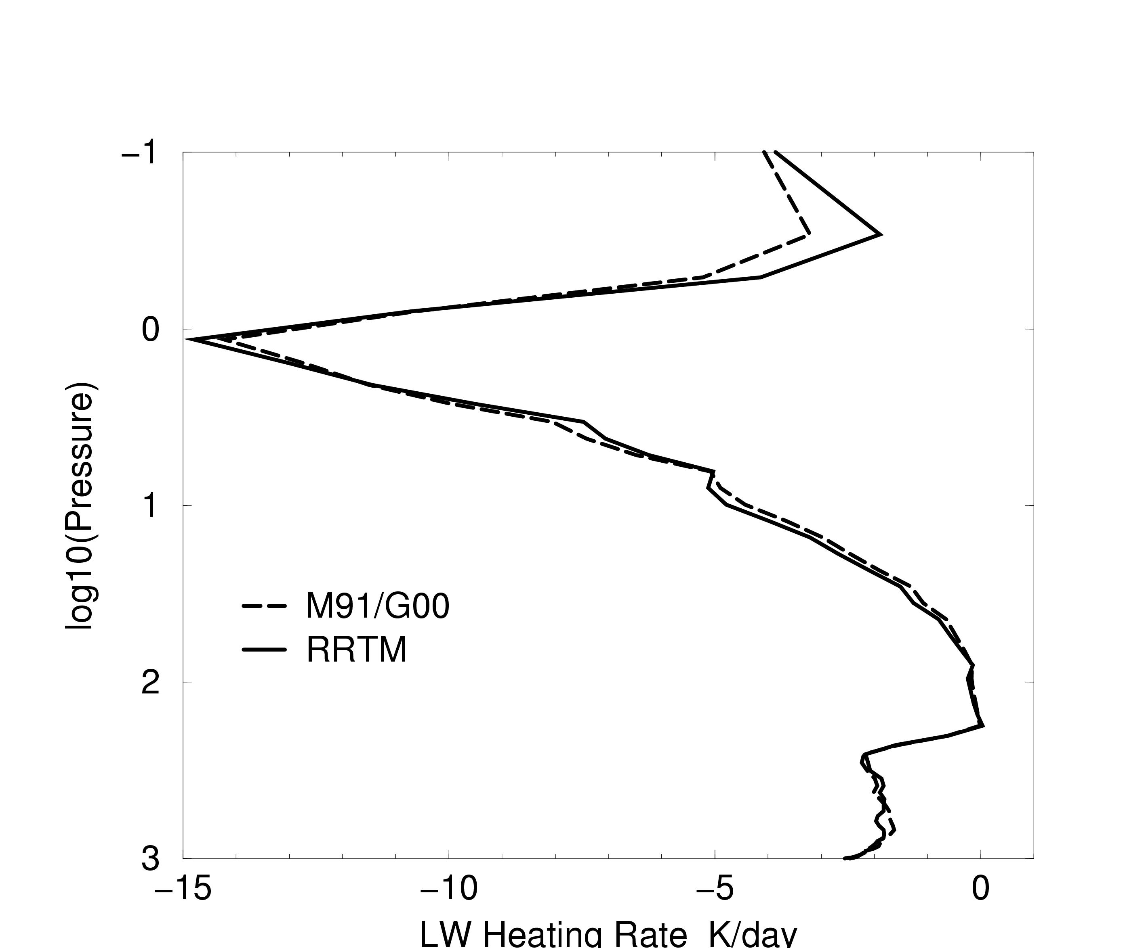
RRTM_LW vs. M91/G00:
Impact when operationally introduced in 2000
MLS profile

Slide 9
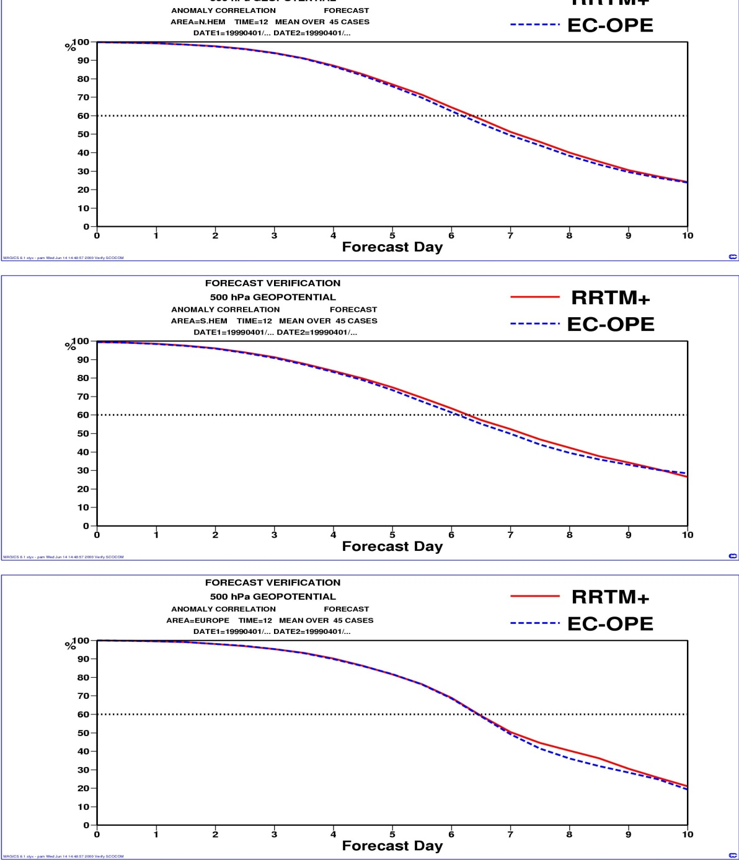
RRTM_LW vs. M91/G00 - 4
Objective scores: RRTM vs. M91/G00
Small detectable improvement in the forecast skill scores

Slide 10
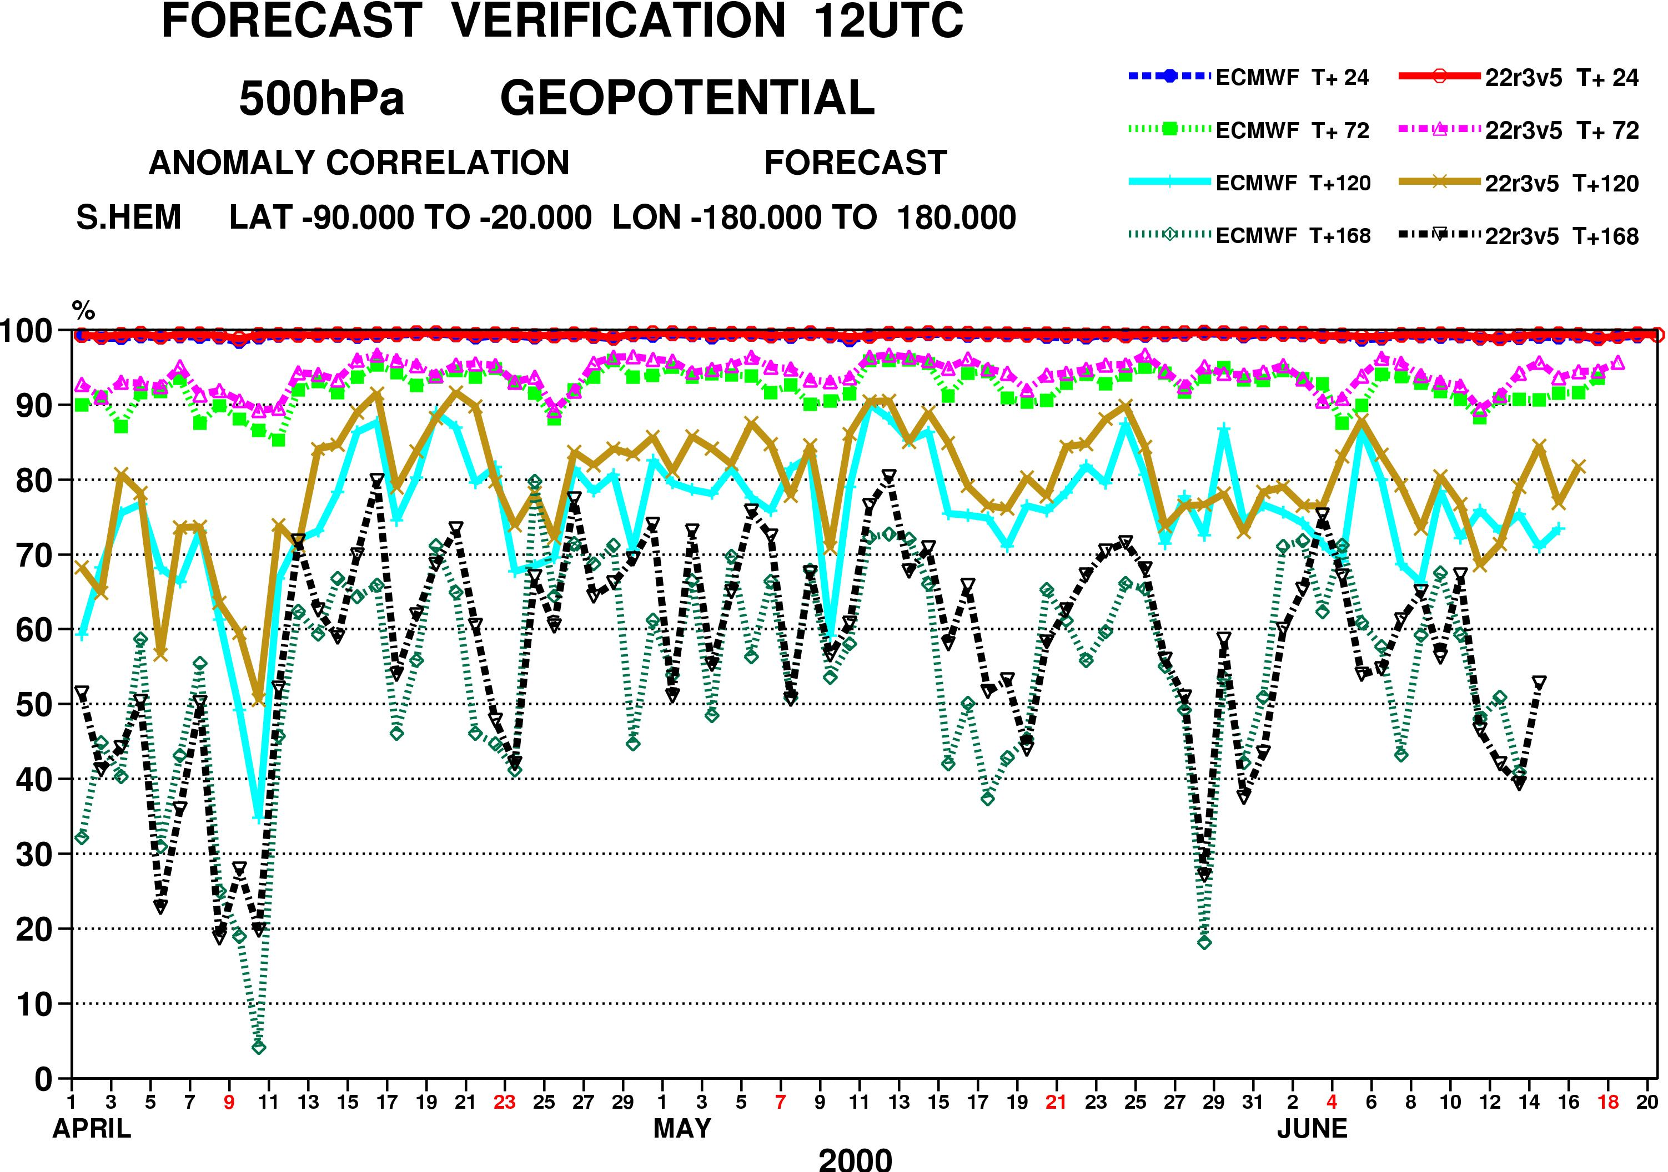
RRTM vs. M91/G00 - 5
M91/G00
RRTM

Slide 11
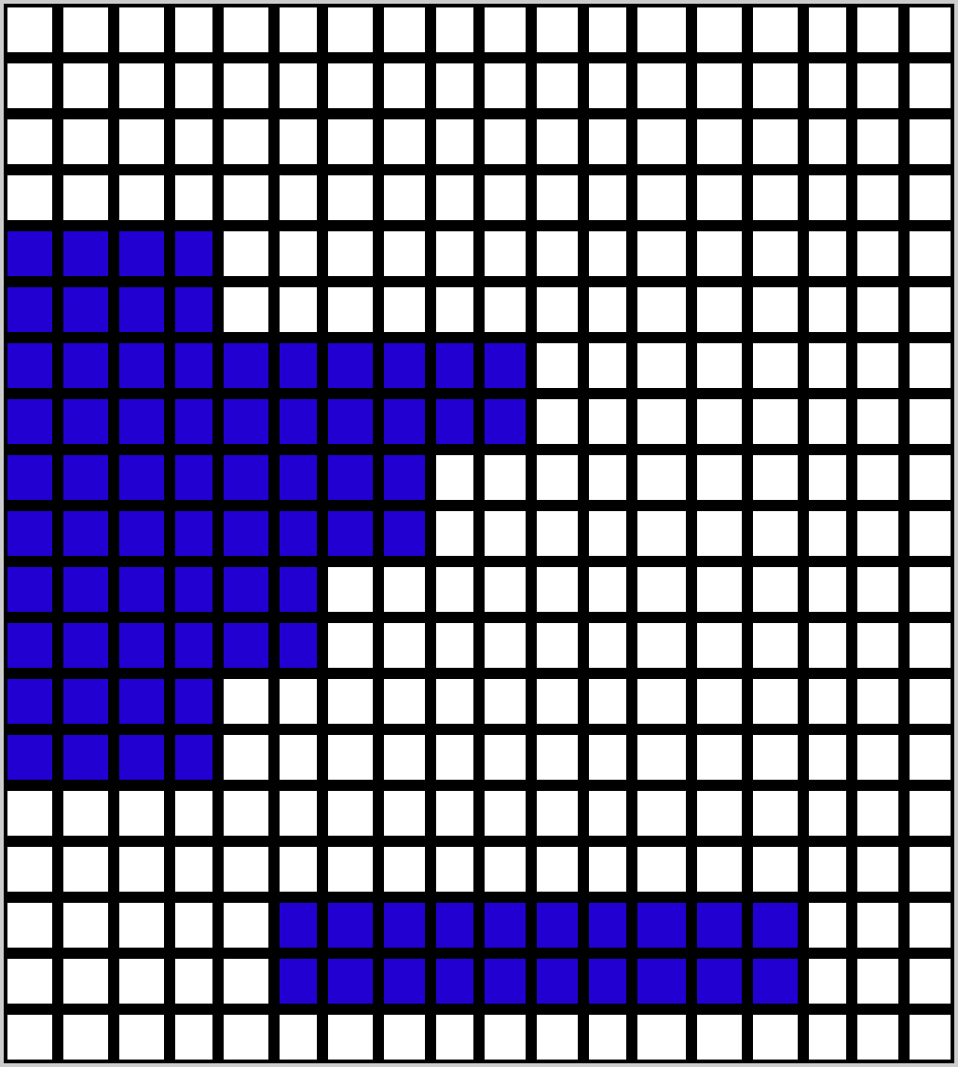
McICA in 2 figures
Monte-Carlo independent column approximation
Barker et al. (2003), Pincus et al. (2003)
K = number of spectral intervals (g-points)
Pressure hPa
<F> average flux in the grid box
N = number of independent sub-columns
Ntot = total number of transmission
function computations
0
200
400
600
ICA RT scheme:
Ntot = N * K ~ O(10^3)
800
1000
1 g-points K
1
N
Number of sub-columns

Slide 12

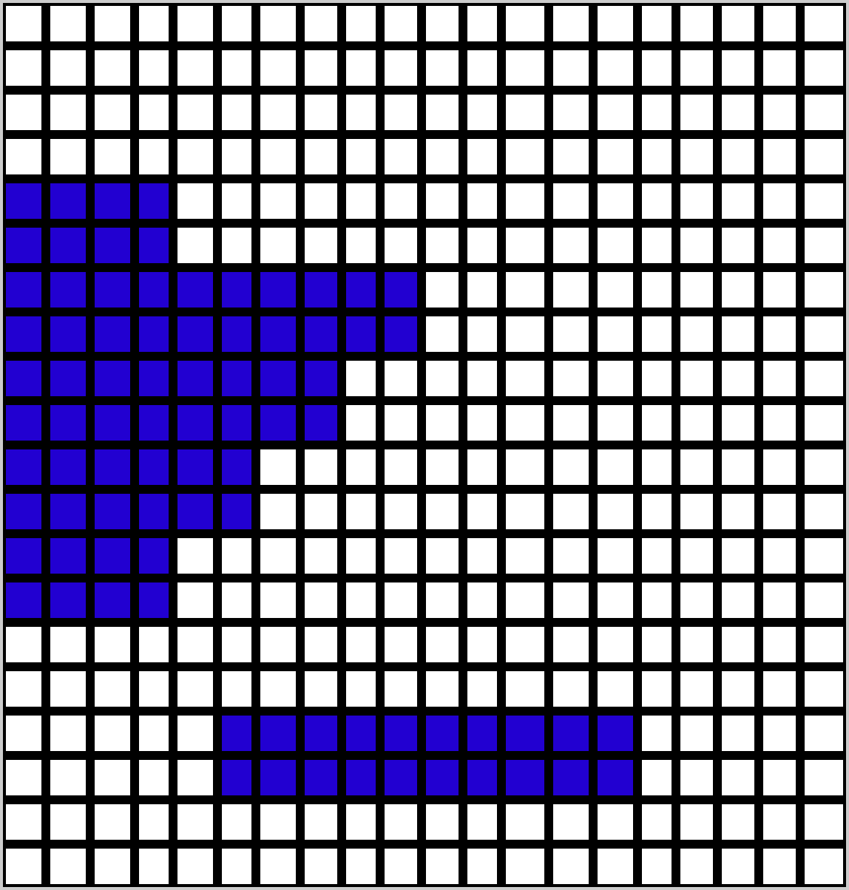
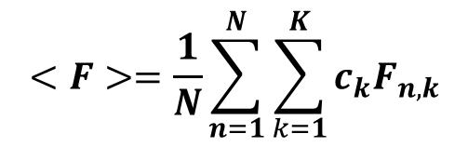
McICA in 2 figures
Cloud generator: Raisanen et al. (2004)
Pressure hPa
Pressure hPa
0
0
200
400
Cloud generator: transforms the input profile from the cloud scheme into a set of M profiles
600
800
1000
1
Number of sub-columns
N
1000
1
Numberof g-points
K
$$<F>=\frac{1}{N}\sum_{n=1}^{N}{\sum_{k=1}^{K}{c_{k}F_{n,k}}}$$
$$<F>\sim \sum_{k=1}^{K}{c_{k}F_{n_{k},k}}$$
McICA: approximates into
randomly assigning a different cloud profile for each g-point from the distribution of M profles created by the cloud generator

Slide 13
ECMWF+McICA - configuration
Random errors are a consequence of the incomplete pairing of sub-columns and spectral intervals.
The errors are unbiased with sufficiently large samples (140+112 for RRTMG)
No explicit need for cloud fraction: at each level the cloud, if present, fills the whole layer. Cloud overlap assumption in the cloud generator as in Hogan and Illingworth (2000,2003)
A way to deal with uncertainty in sub-grid cloud distribution

Slide 14
McICA: : Hoes does the model deal with radiative noise?
In long seasonal runs and high-resolution 10-day forecasts
  How does the model survive noise in radiative heating rate?
  How does the model survive noise in layer cloud fraction?
Tests with 31x10-day FC at T_{L}319L60 from 20010401 to 20010501
Tests with 4-month simulations at T_{L}95 L60 for same period
  control (control)
  Systematic perturbation (cloud effective radius)
  random perturbation within Gaussian distribution x -> x (1+σ*ran)
    σ=2 CF sqrt (HR_{LW}²+HR_{SW}²) applied on x = HR (random3) (heating rate)

Slide 15
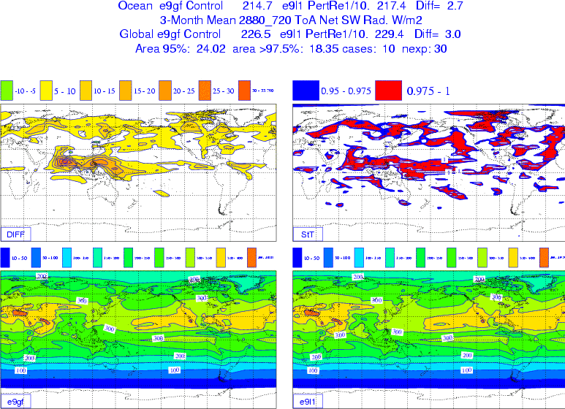
McICA: Hoes does the model deal with radiative noise?
Systematic
perturbation:
Re +1 μm
De +10 μm
T_{L}95 L60 starting
24-hour apart from
20010401 to
20010430
Results averaged
over JJA
Difference Perturb-Control
Student t-test
Ref=Control
Systematic perturbation

Slide 16
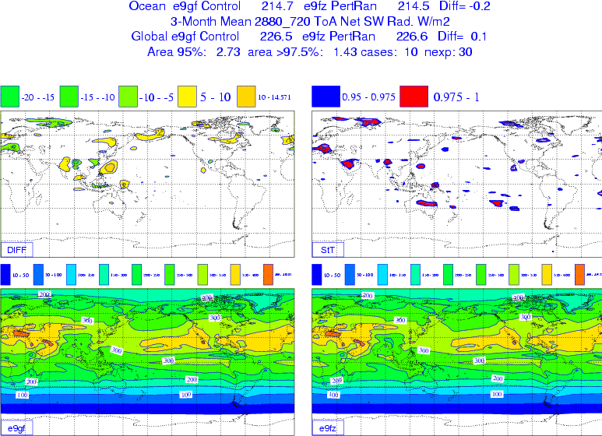
McICA: Hoes does the model deal with radiative noise?
Random
perturbation:
Difference Random-Control
t-test
Uncorrelated random noise applied to radiative fluxes or heating rates does not (significantly) affect the mean circulation

Slide 17
Impact of the change in radiation scheme
Impact in sets of 13-month runs at T_{L}159 L91
Impact in 10-day forecasts at T_{L}799 L91

Slide 18
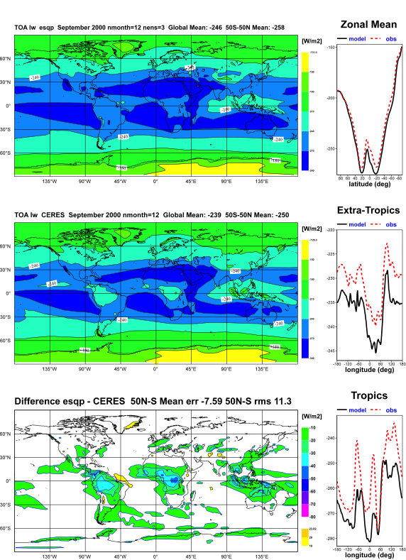
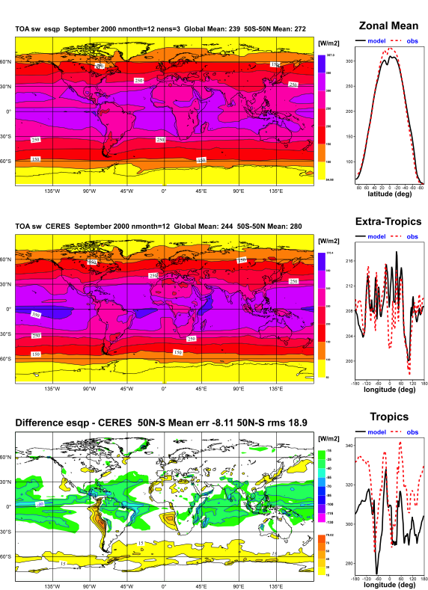
The problem in ECMWF model “climate” runs? Example from 31R1
Outgoing LW Radiation
TOA SW Rad
Lack of cloudiness over tropical continents:
Too large OLR over Africa, South America
Model
Too much cloudiness over tropical oceans
Too much reflection at TOA, too little
downward SW radiation at the ocean surface. Little reflection in stratocumulus regions and close to Antarctica
CERES
Model-CERES

Slide 19
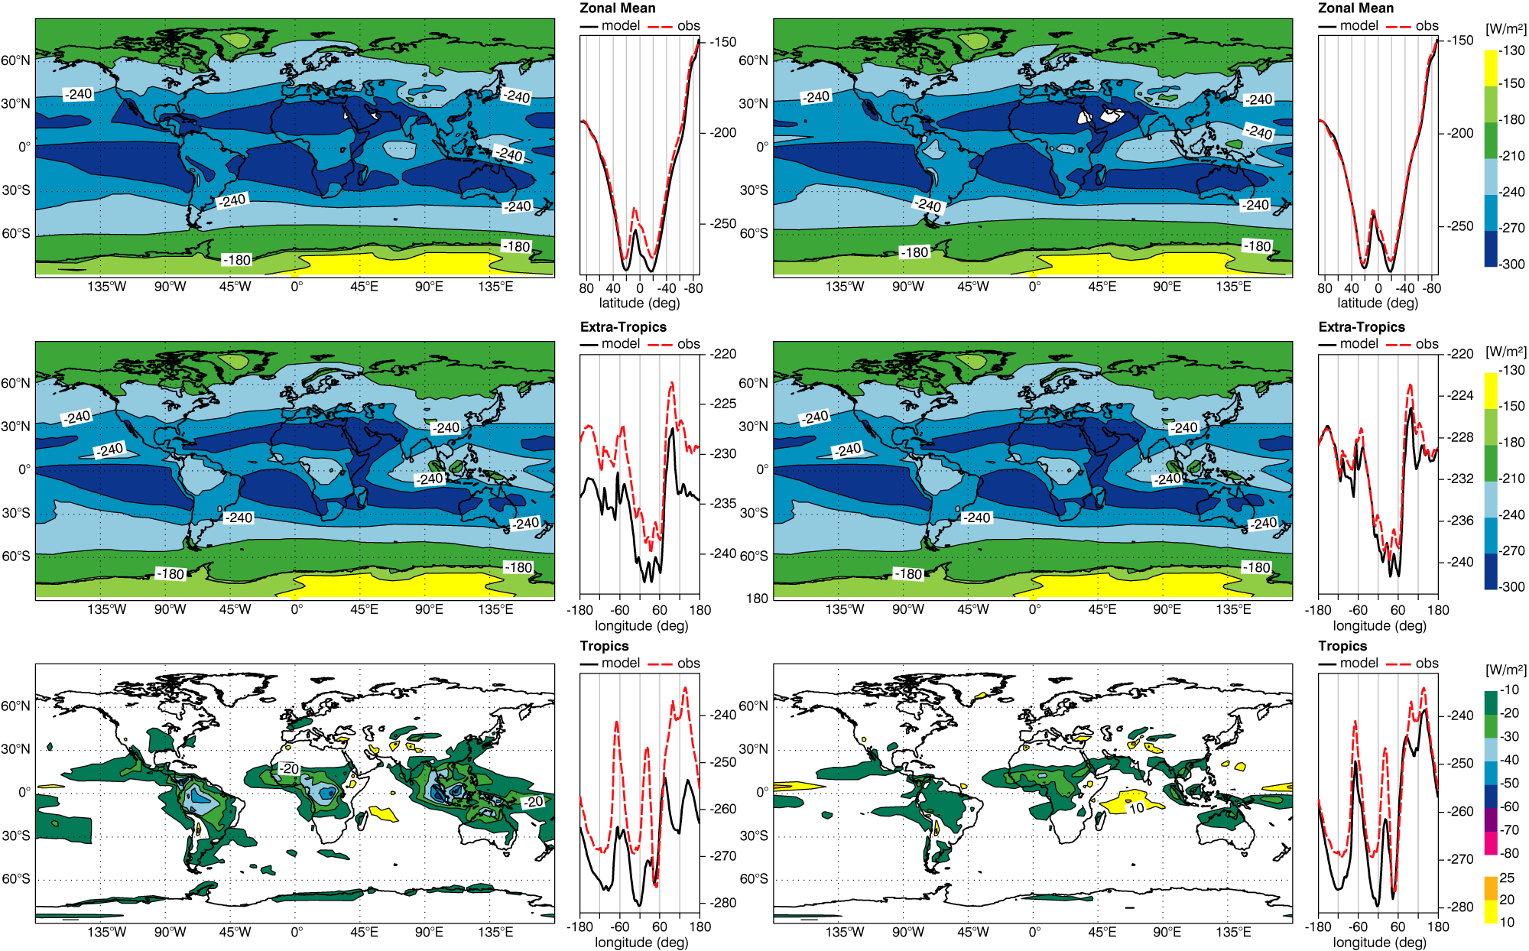
Impact on OLR in ensembles of 1-year simulations
Cy31r2
McRad
CERES
CERES
31r2-CERES
McRad-CERES

Slide 20
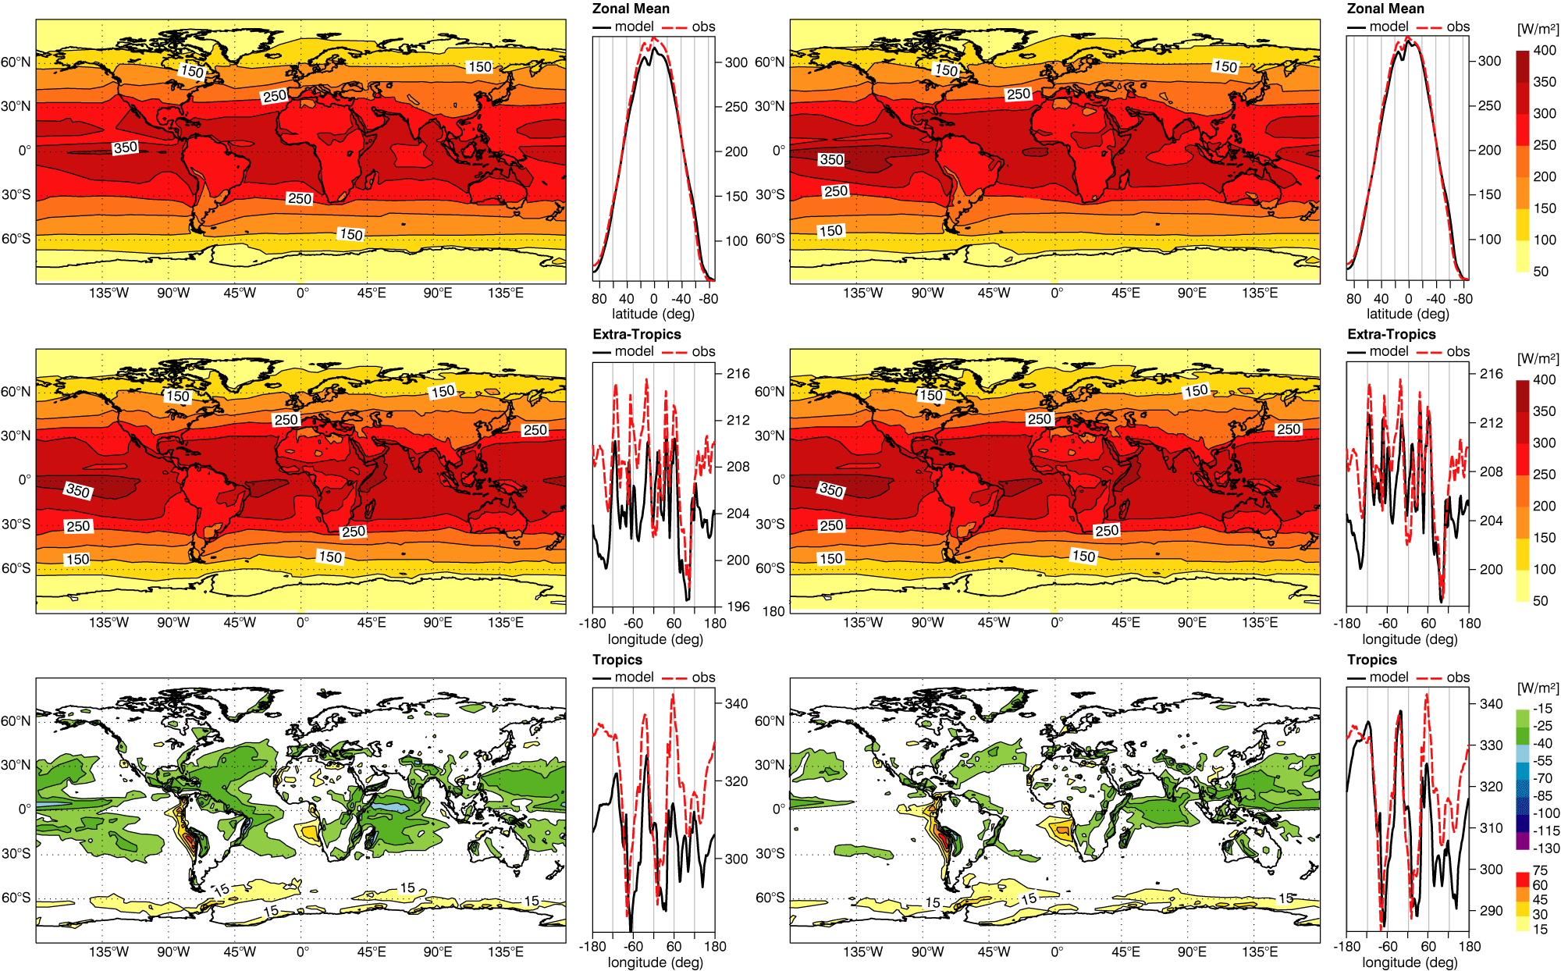
Impact on TOA absorbed SW radiation in ensembles of 1-year simulations
Cy31r2
McRad
CERES
CERES
31r2-CERES
McRad-CERES

Slide 21
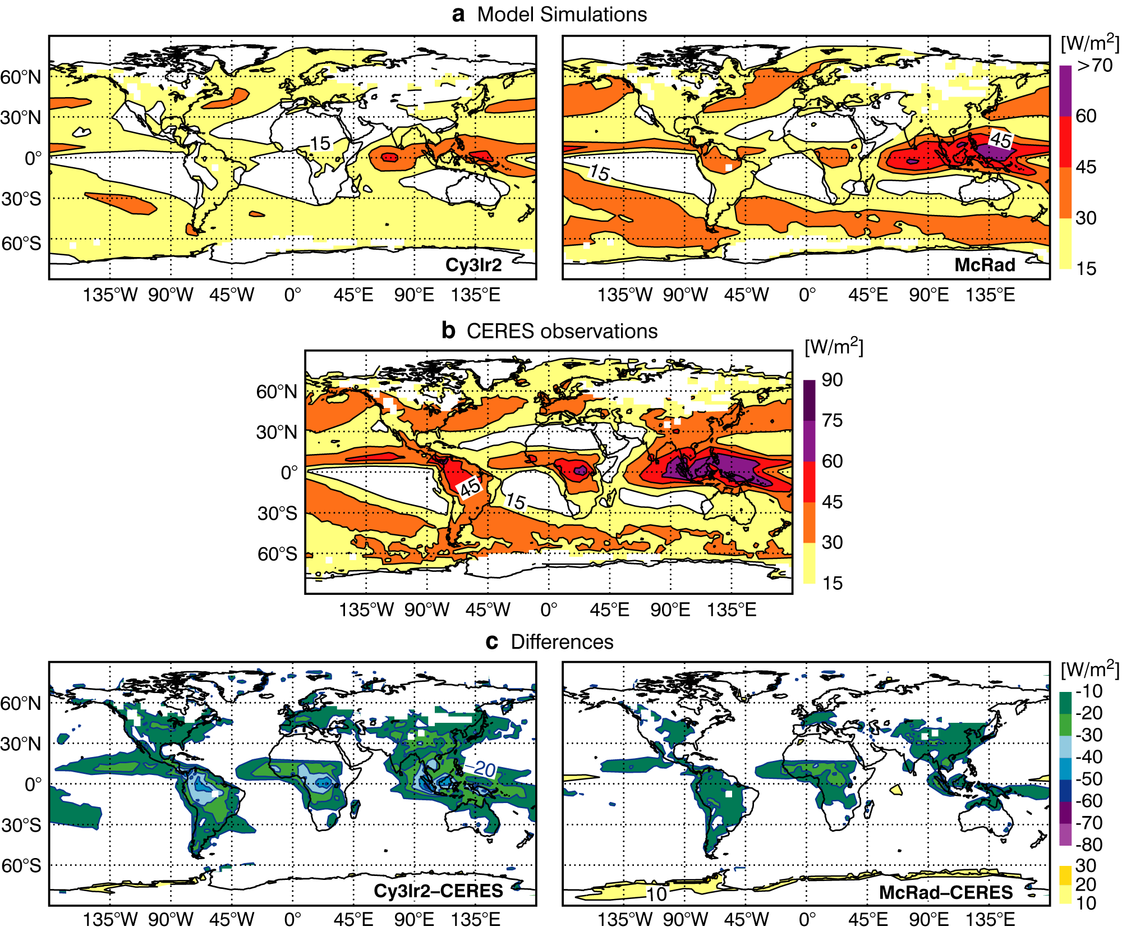
Impact on long-wave cloud forcing in ensembles of 1-year simulations
Much better cloud
LW radiative
effect
at mid-latitudes

Slide 22
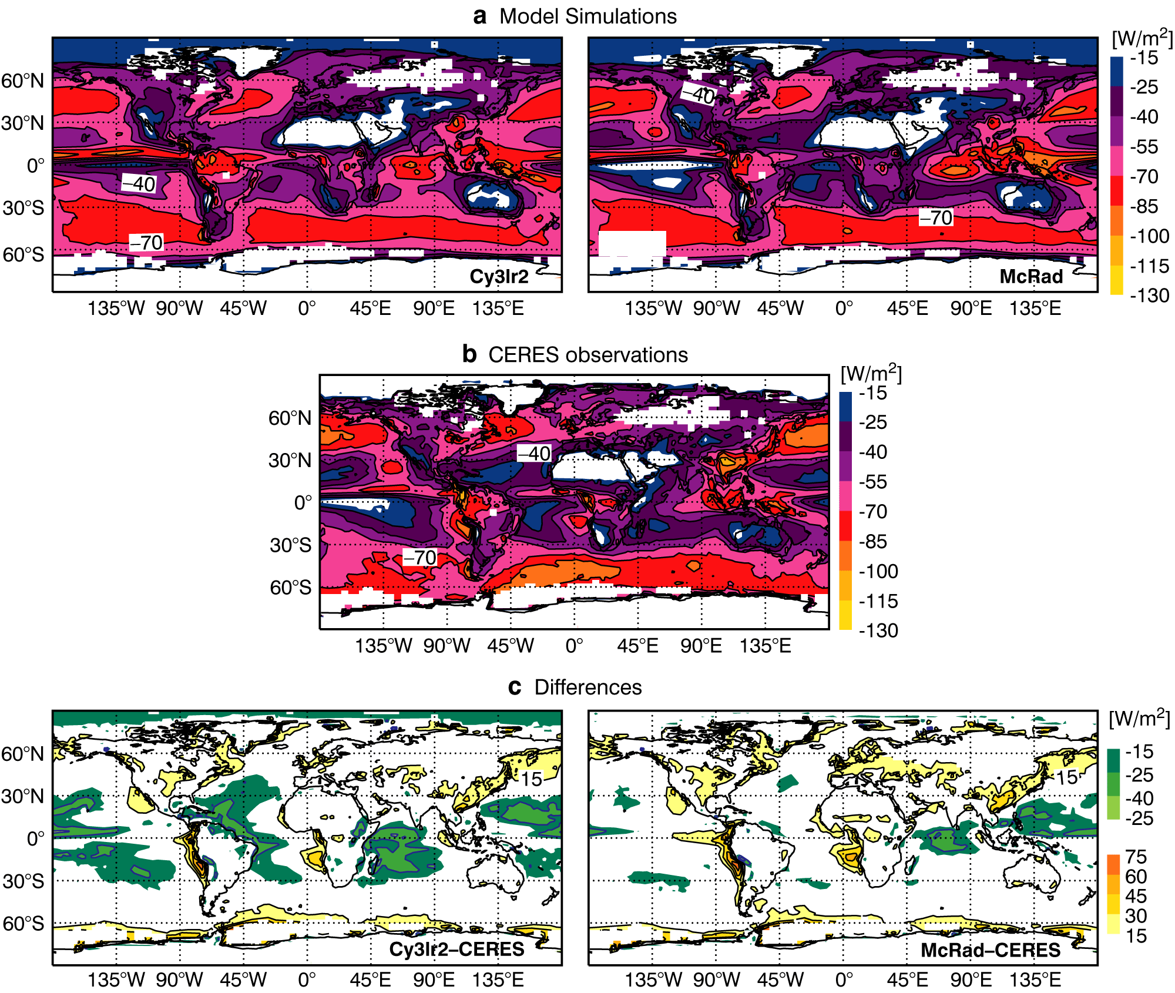
Impact on short-wave cloud forcing in ensembles of 1-year simulations
Better cloud SW
radiative effect
in mid-latitudes

Slide 23
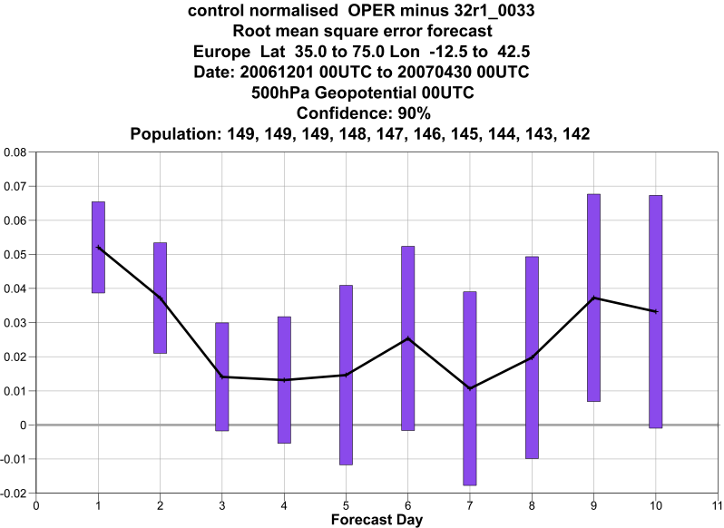
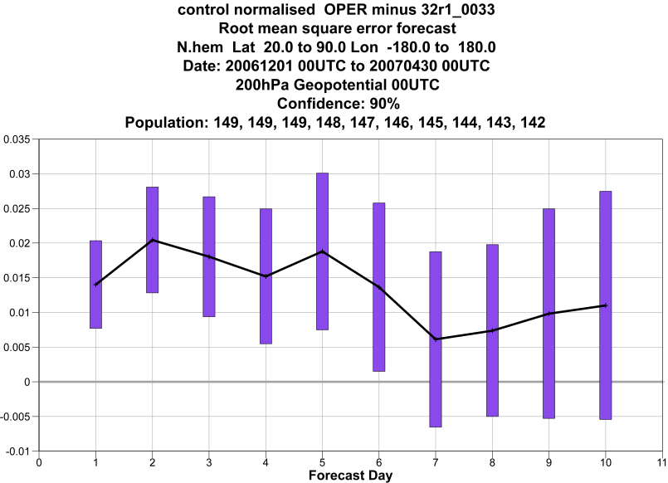
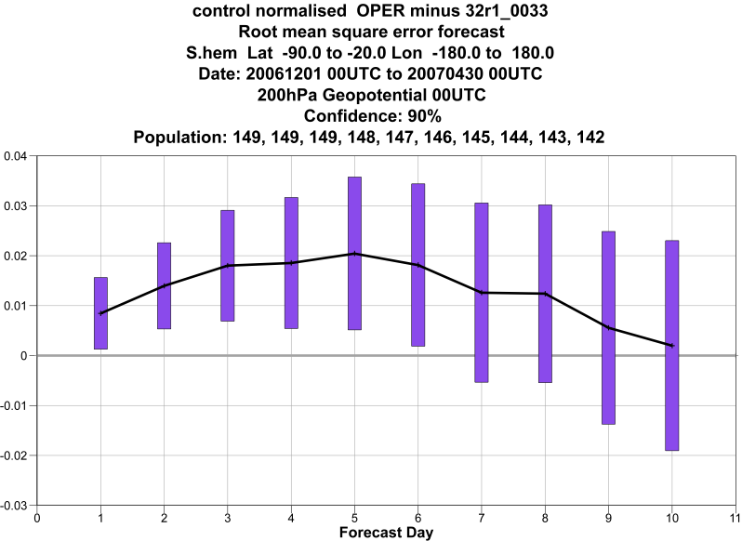
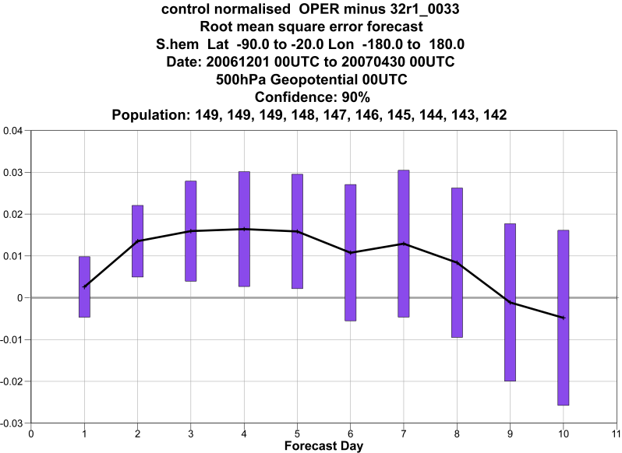
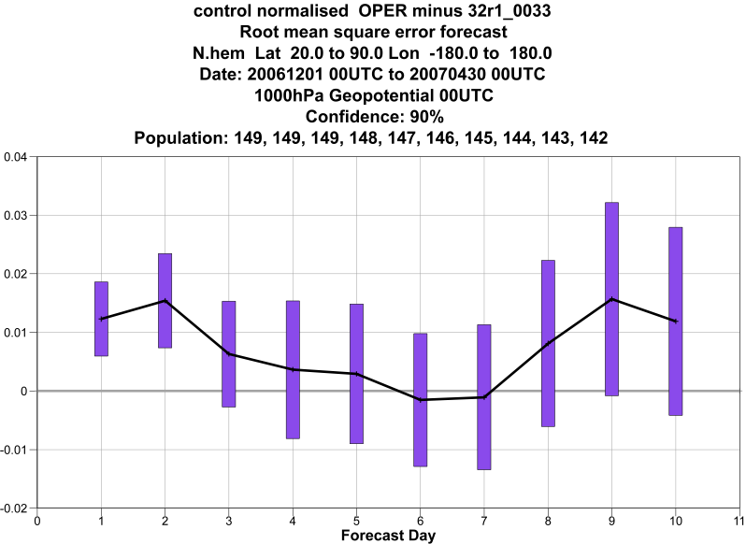
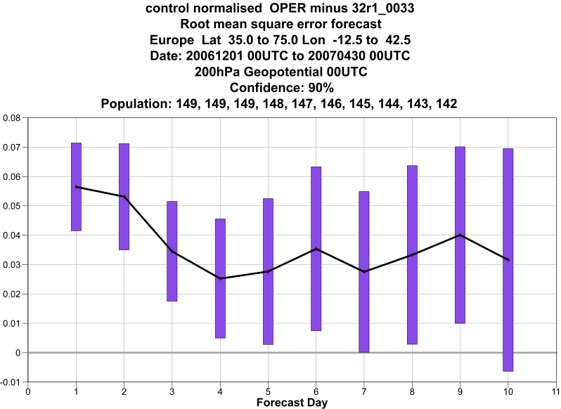
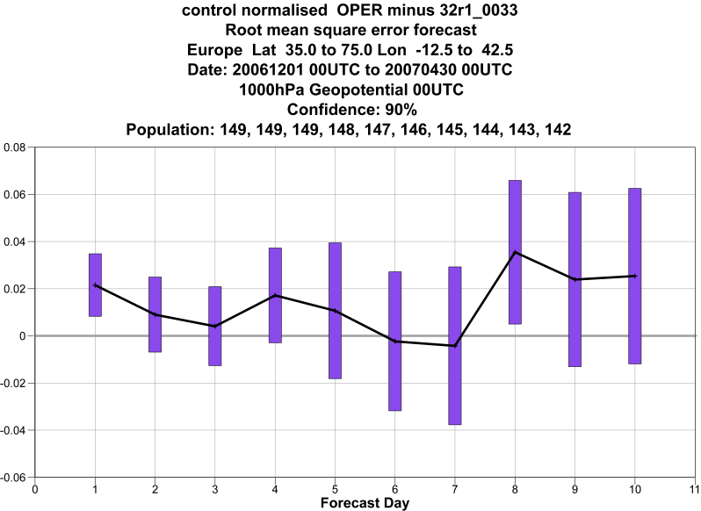
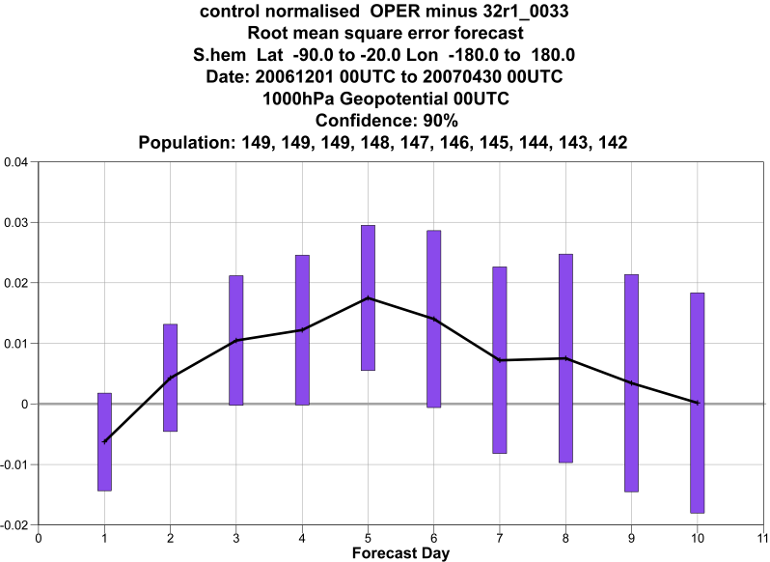
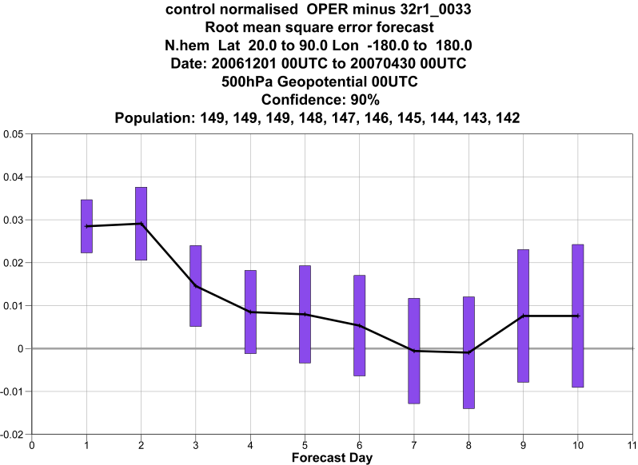
Impact in T_{L}799 L91 10-day FCs Dec’06-Apr’07. RMS GPH
NH 200
Eur 200
SH 200
+
Eur 500
-
NH 500
SH 500
10
NH 1000
Blue line is zero line
SH 1000
0.02 level
Eur 1000

Slide 24
McRAD spatio-temporal resolution
Even if optimised, McRAD is computationally expensive
Operationally, the RT code runs on a spatial grid coarser than the rest of the physics and with a longer time step
  HiRes 10 day forecasts: model Tco1279 (~9 km at the equator) McRAD Tco511 (~20 km). Model time step 10 min, McRAD 1h
  Ensemble forecasts: model Tco639 (~16 km), McRAD Tco255 (~30 km). Model time step 20min, McRAD 3h
LW flux constant between radiation calls, SW flux adjusted for correct solar zenith angle and path length. Minor impact on diurnal cycle, larger for the 3h time step

Slide 25
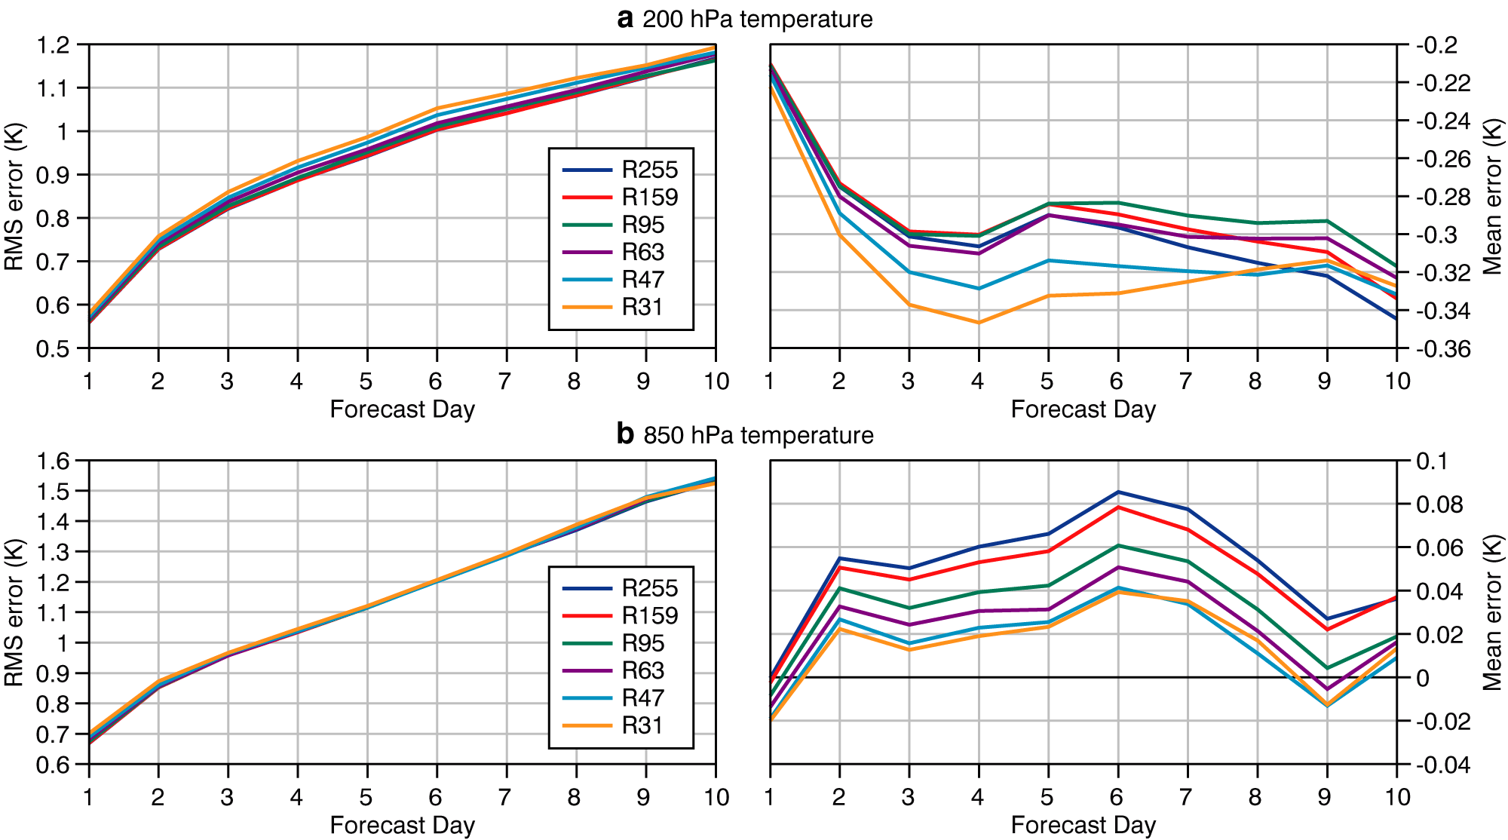
Impact of reduced radiation grid
For 93 FCs at T_{L}399 L62
spanning a year
Tropics: 20ºN-20ºS

Slide 26
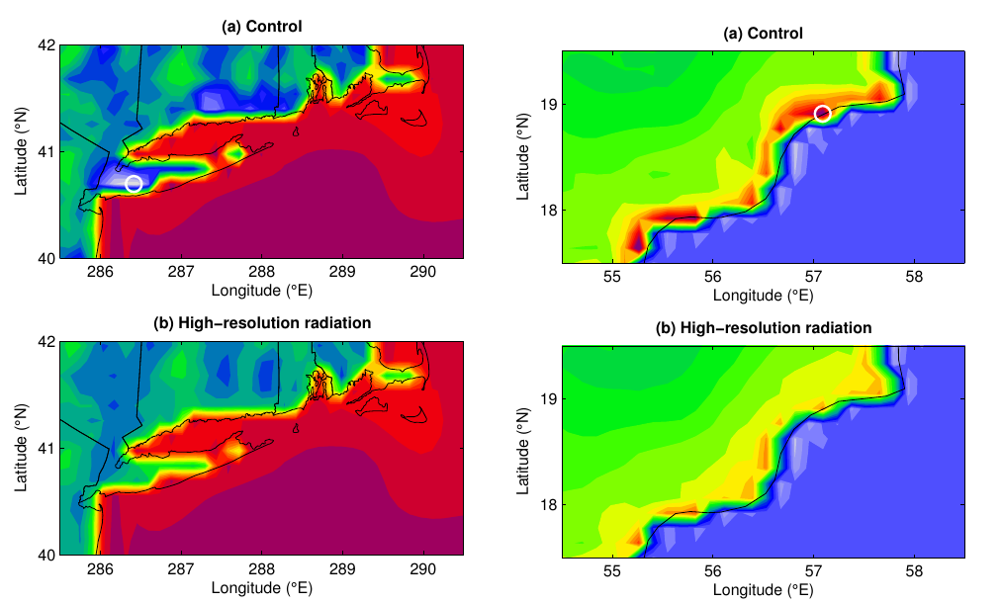
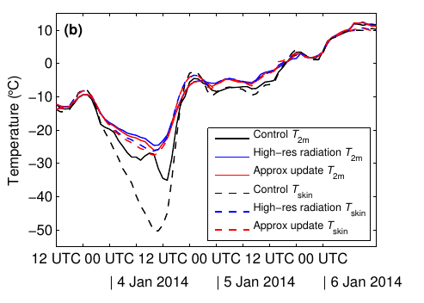
Extreme temperature errors at coastlines a cold case
Approximate solution of the surface energy balance taking into account local albedo and changes in the skin temperature reduces the impact of the coarse radiation grid and time step
Hogan&Bozzo 2015

Slide 27
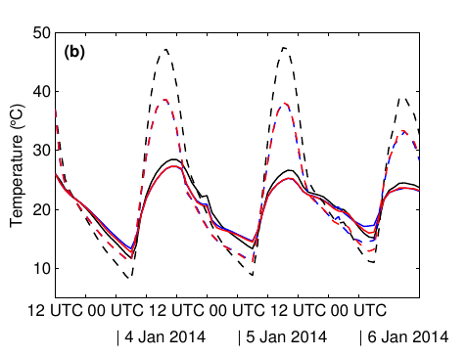
Extreme temperature errors at coastlines
a warm case
Hogan&Bozzo 2015

Slide 28
Reduced errors for coastline stations
Approximate update of surface energy balance between radiation time steps:
Summer: reduced large positive daytime errors
Winter: reduced large negative night time errors

Slide 29
Solar Zenith Angle between time steps
SZA averaged between time steps: too shallow Sun’s elevation at dusk and dawn -> too large path length -> too large O3 absorption in the stratosphere.
Fix: computing the averaged SZA between time steps but only for the sun lit portion
Larger errors for radiation time step>=3h
Hogan and Hirahara, 2015

Slide 30
Conclusions on McRad
As McRad modifies the cloud-radiation interactions, its impact is felt right from the start of the model integrations.
Thanks to McICA and the revised cloud optical properties, improvements in TOA radiation is seen both in the tropics and at higher latitudes.
Whereas McICA does not increase the computational burden, RRTM_SW does. But RRTM_SW and RRTM_LW share the same heritage: based on the same state-of-the-art line-by-line model (LBLRTM), same database of spectroscopic parameters, and both extensively validated as part of the ARM program.
Going for a slightly lower resolution for full radiation computations does not affect the quality of the high-resolution 10-day forecasts. A lower resolution radiation grid neither degrades the quality of the EPS. But biases are introduced in surface fields and these can lead to large errors occasionally

Slide 31
Ongoing development
Revision of the current aerosol climatology (Tegen et al. (1997), 5 species sea salt,dust,organic,black carbon and sulphates) -> towards interactive aerosols?
Interactive radiative active gases (e.g. Ozone)
Code efficiency improvements. Number of g-points maybe over-dimensioned ? Will need to reduce at least 10x to improve the efficiency. Positive tests with stochastic spectral integration (Pincus and Stevens 2009,2013, Bozzo et al. 2014). New radiation scheme in development to test other options (e.g. full-spectrum correlated-k Hogan (2010) )
3D radiation, explicit long wave scattering, clouds optical properties revision, 3D surface effects

Slide 32
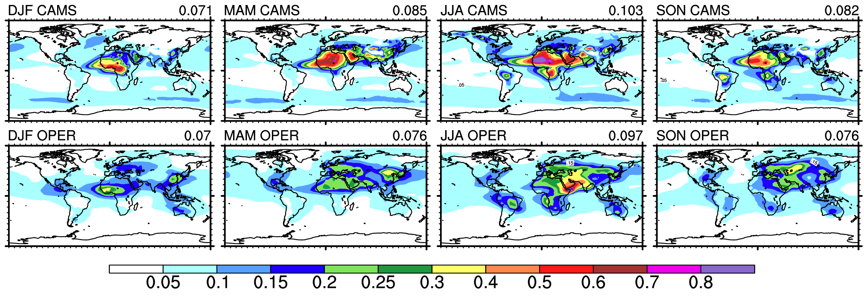
Climatological AOD 550nm distribution
CAMS vs Tegen et al. 1997
Large differences in total AOD distribution for Sea salt, Organic, Black Carbon, Dust.
Different optical properties
Aerosol indirect effect NOT (yet) included

Slide 33
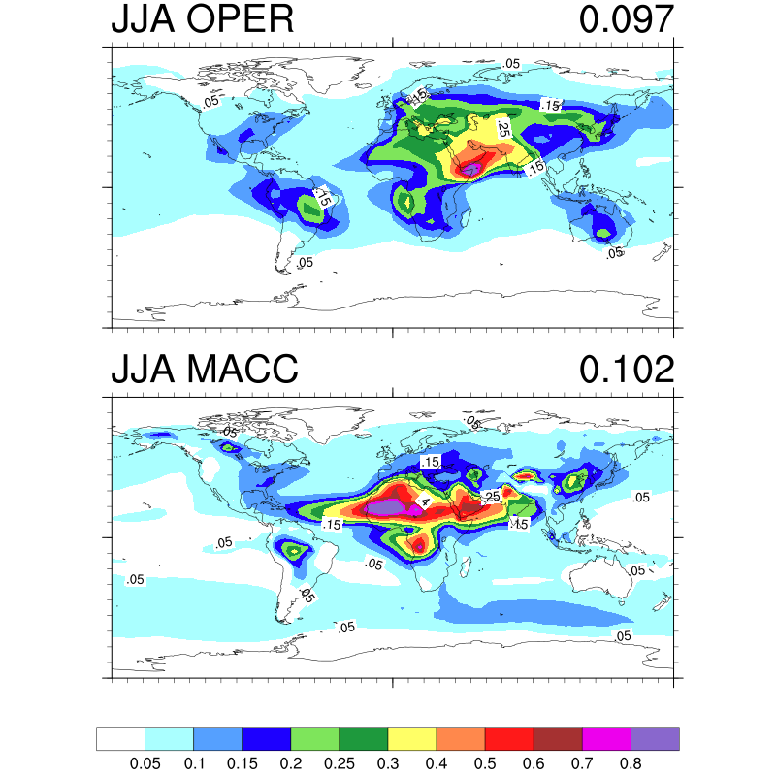
Aerosol distribution and circulation feedbacks
Lagre change in dust AOT due to both change in mass and total extinction
Large reduction in SW absorption
CAMS

Slide 34
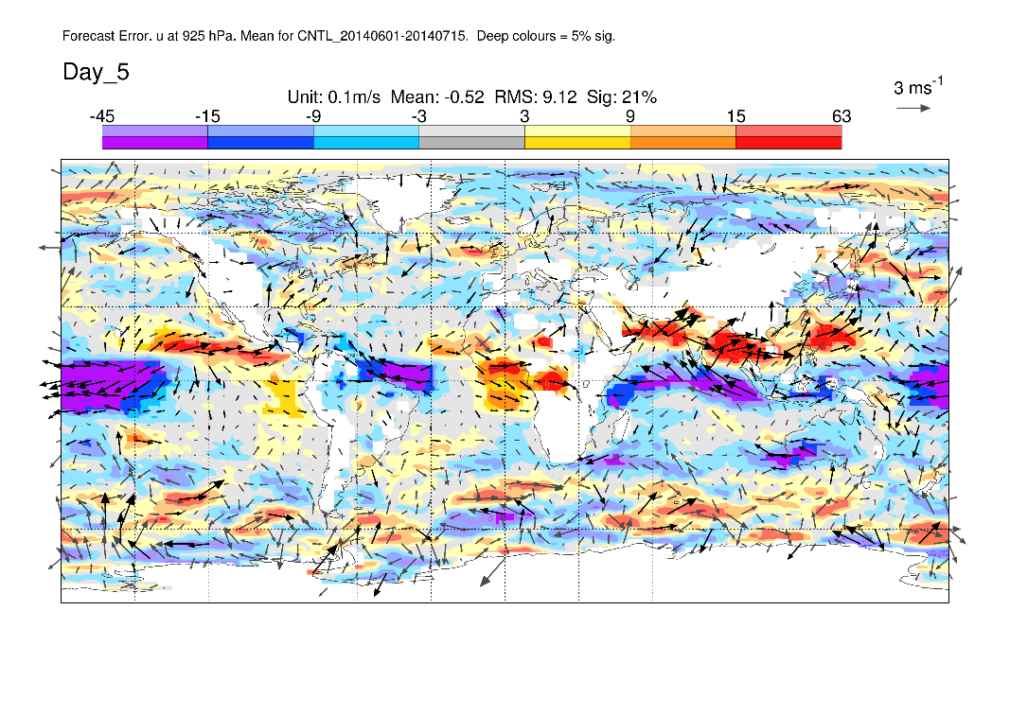
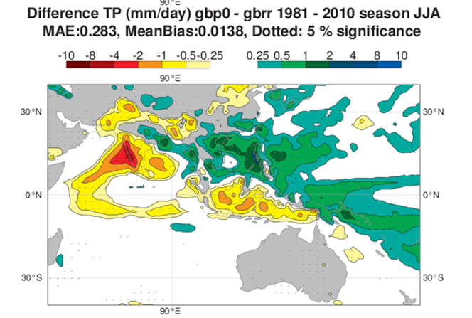
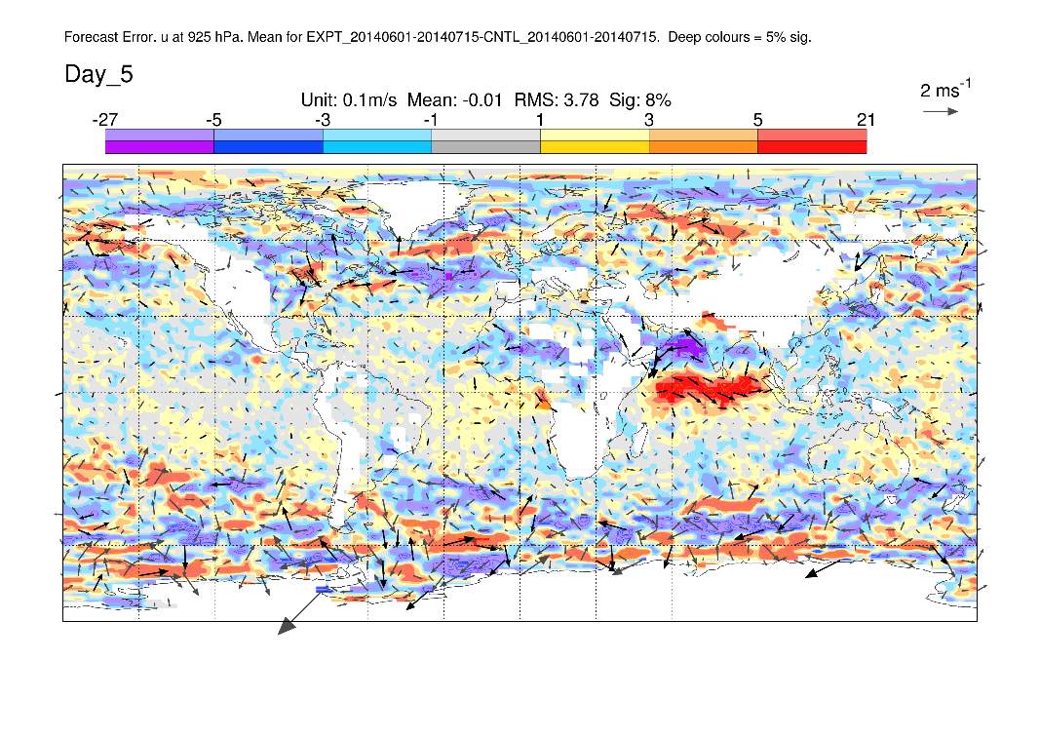
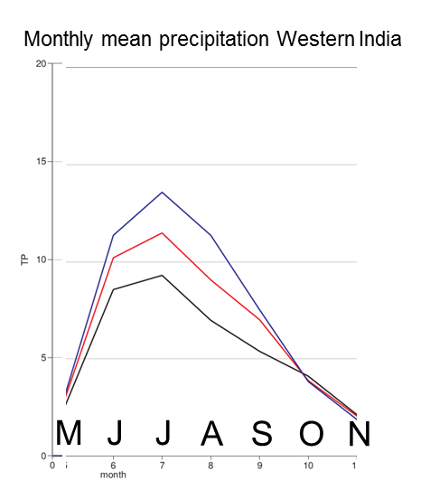
Impacts on FC errors in the Indian Monsoon region
June-July
U 925 hPa – model bias at D+5
OLD
NEW
GPCP
U 925 hPa – change in model bias
Bozzo et al., 2016 in prep
c/o Linus Magnusson

