Slide 1
Sources of predictability
beyond the deterministic limit
Sarah Keeley
(with thanks to Franco Molteni)
European Centre for Medium-Range Weather Forecasts

Slide 2
Outline
Persistent anomalies in the tropics and extra-tropics: examples from the last two decades
Beyond deterministic predictability in non-linear, chaotic systems: the role of variability in surface conditions and energy/water fluxes
Ensemble predictions in the “extended” range: estimates of predictability and actual skill
Coupled ocean-atmosphere variability - predictability on the weekly/monthly time scale arising from sub-seasonal tropical variability and teleconnections

Slide 3
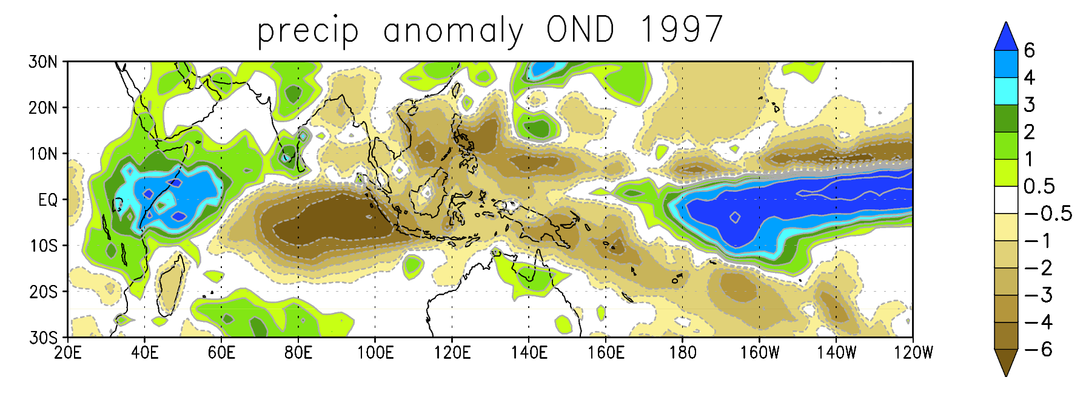
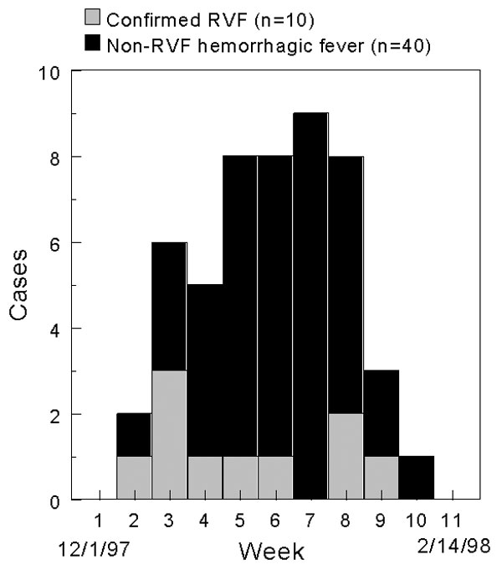
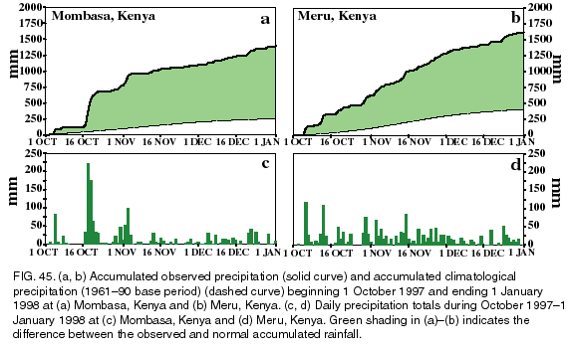
Oct-Dec 1997: floods in East Africa
Rift Valley Fever outbreak
Notes:
Roles of various phenomena that have an impact on society and we would like to predict
ENSO and IOD event – large precipitation anomaly in Eafrica
Lead to much higher rainfall than average and consequently in Rift Valley fever outbreak – mosquito borne disease

Slide 4
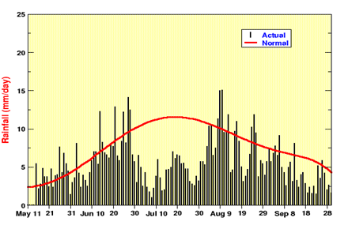

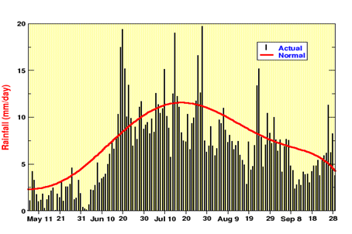
July 2002: drought in India
2002
2003
All-India Rainfall time series
May - October
Notes:
A major drought occurred over India in the year 2002 with a seasonal rainfall deficit of 21.5%, a result of 56% below normal rainfall in the month of July. Back-trajectory analysis reveals a major change in the low-level circulation during July 2002 with frequent advection of dry air from over the deserts around the eastern Arabian Sea instead of marine air from across the equator

Slide 5
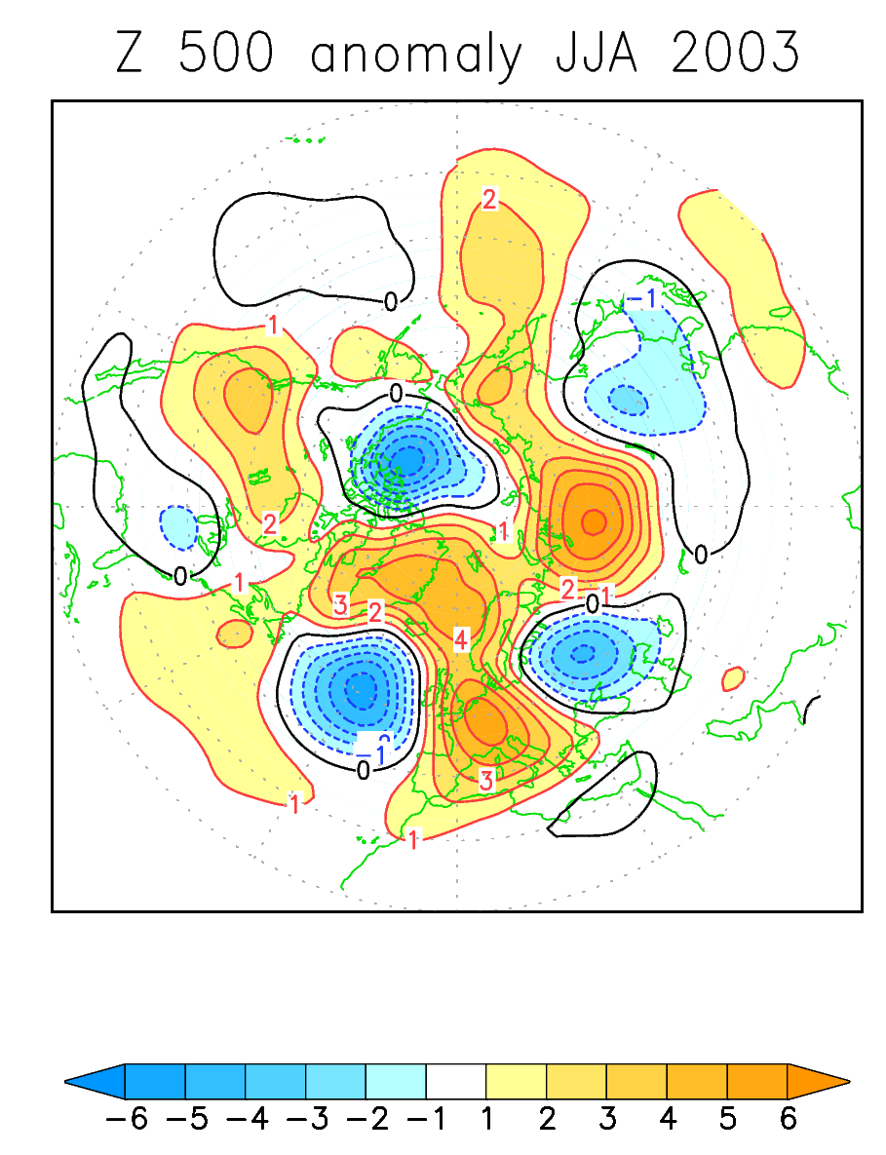
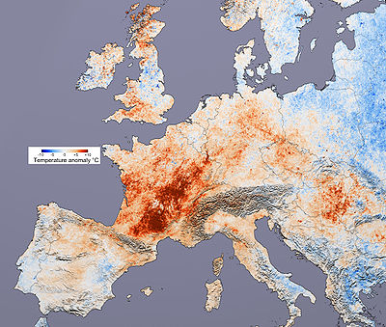
Summer 2003: European heat-wave
Temperature anomaly
20 July – 20 August
Notes:
Heat wave in Europe in 2003 – persistent anticyclone

Slide 6
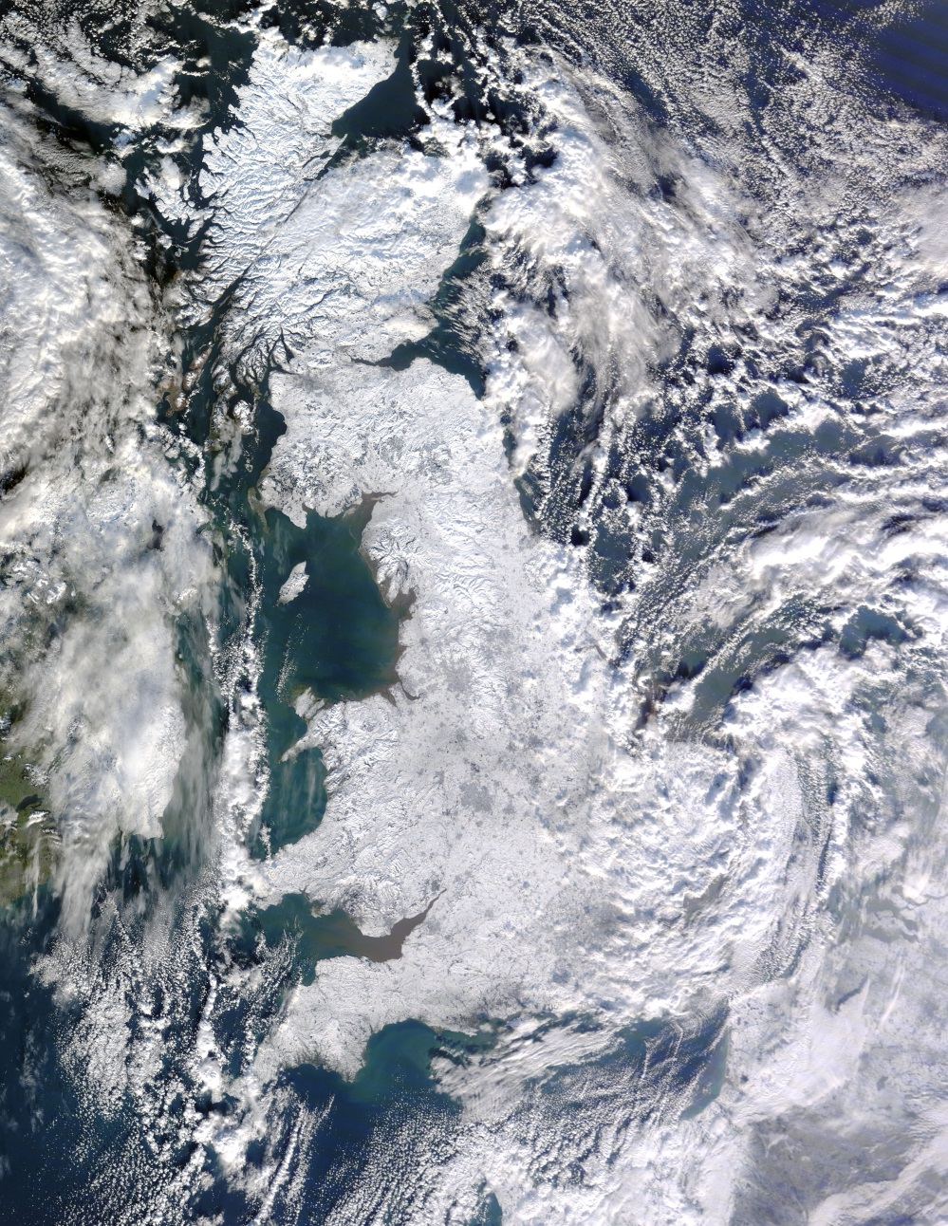
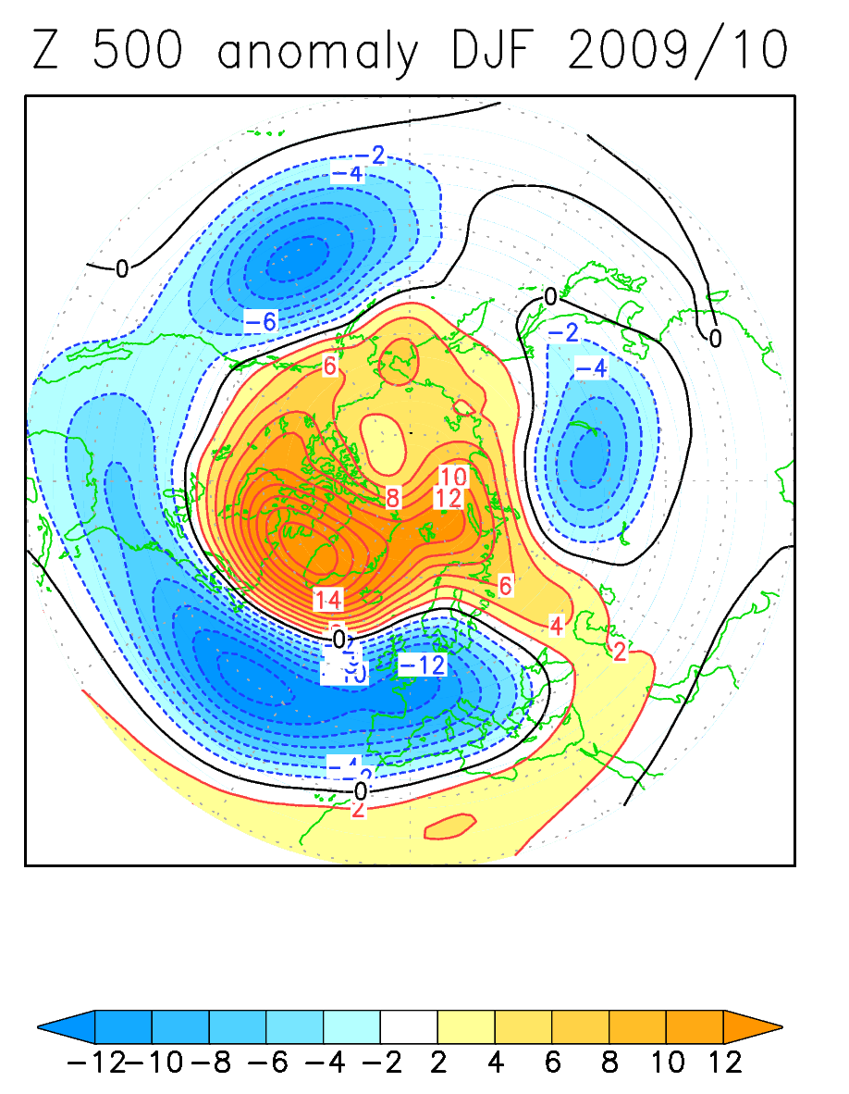
Winter 2009-2010: cold anomaly over N. Europe
7 Jan 2010
Notes:
Prolonged and very strong AO event – lead to cold winter in UK

Slide 7
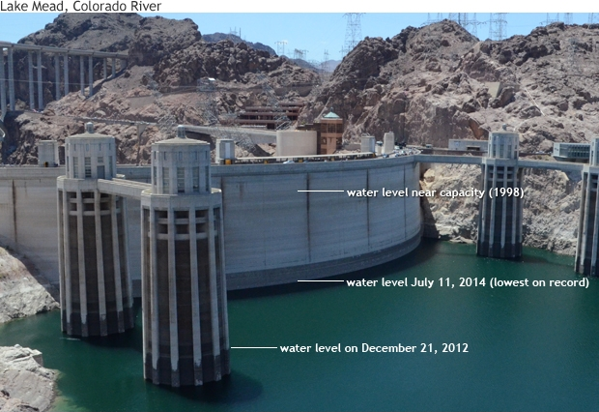
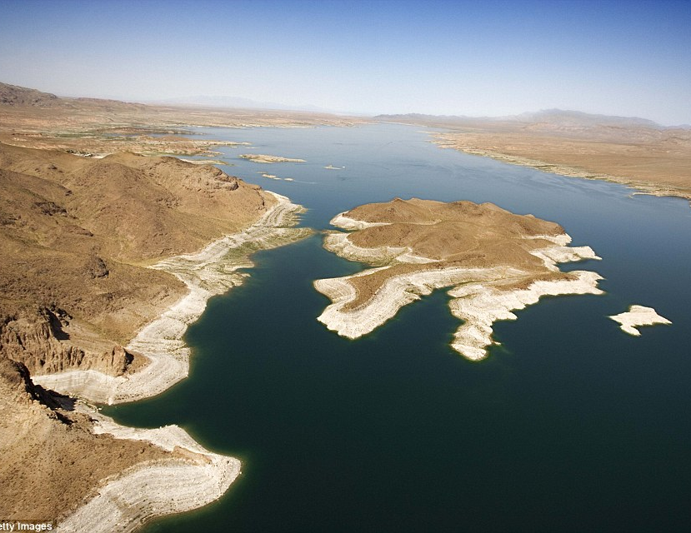
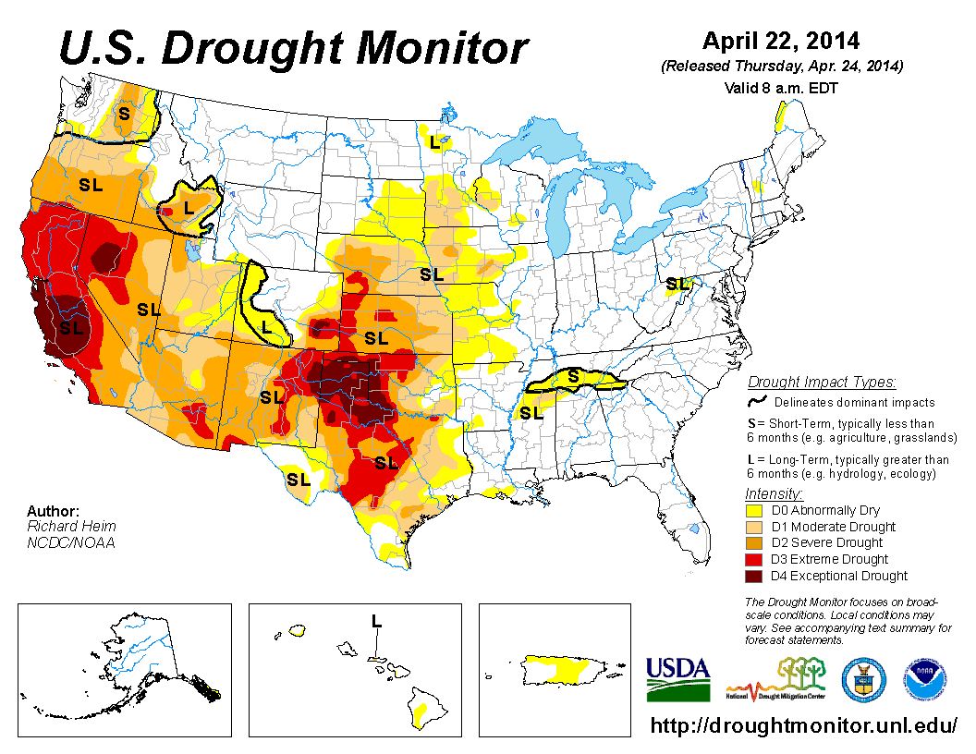
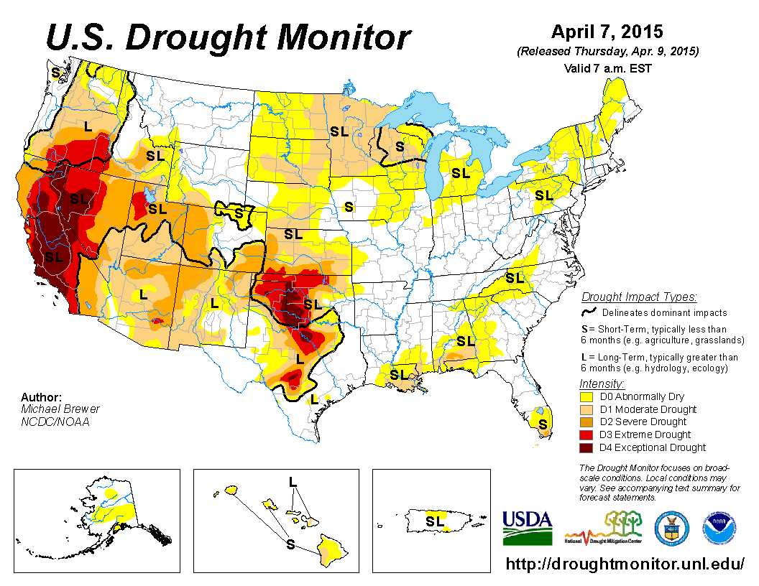
Drought in South-western USA
Lake Mead
(Arizona / Nevada)
15-year drought

Slide 8
What limits deterministic prediction?
Size of the initial condition error
Error growth rate
Saturation value of the error
Explains the seasonal, regional and hemispheric variations in NWP skill.
  Winter more predictable than summer
  Mid-latitudes more predictable than tropics

Slide 9
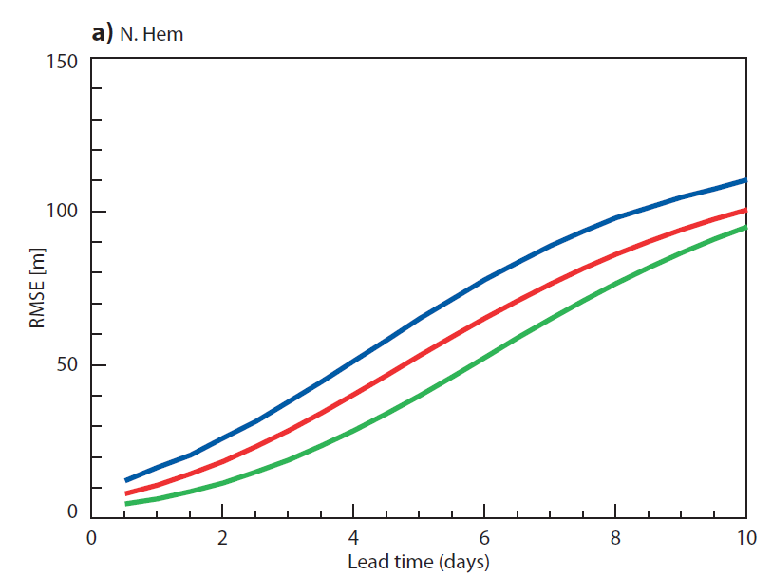
Limits of predictability
RMS error of 500 hPa height field
Northern Hemisphere
1990
2000
2010
Model error growth
Initial state error

Slide 10
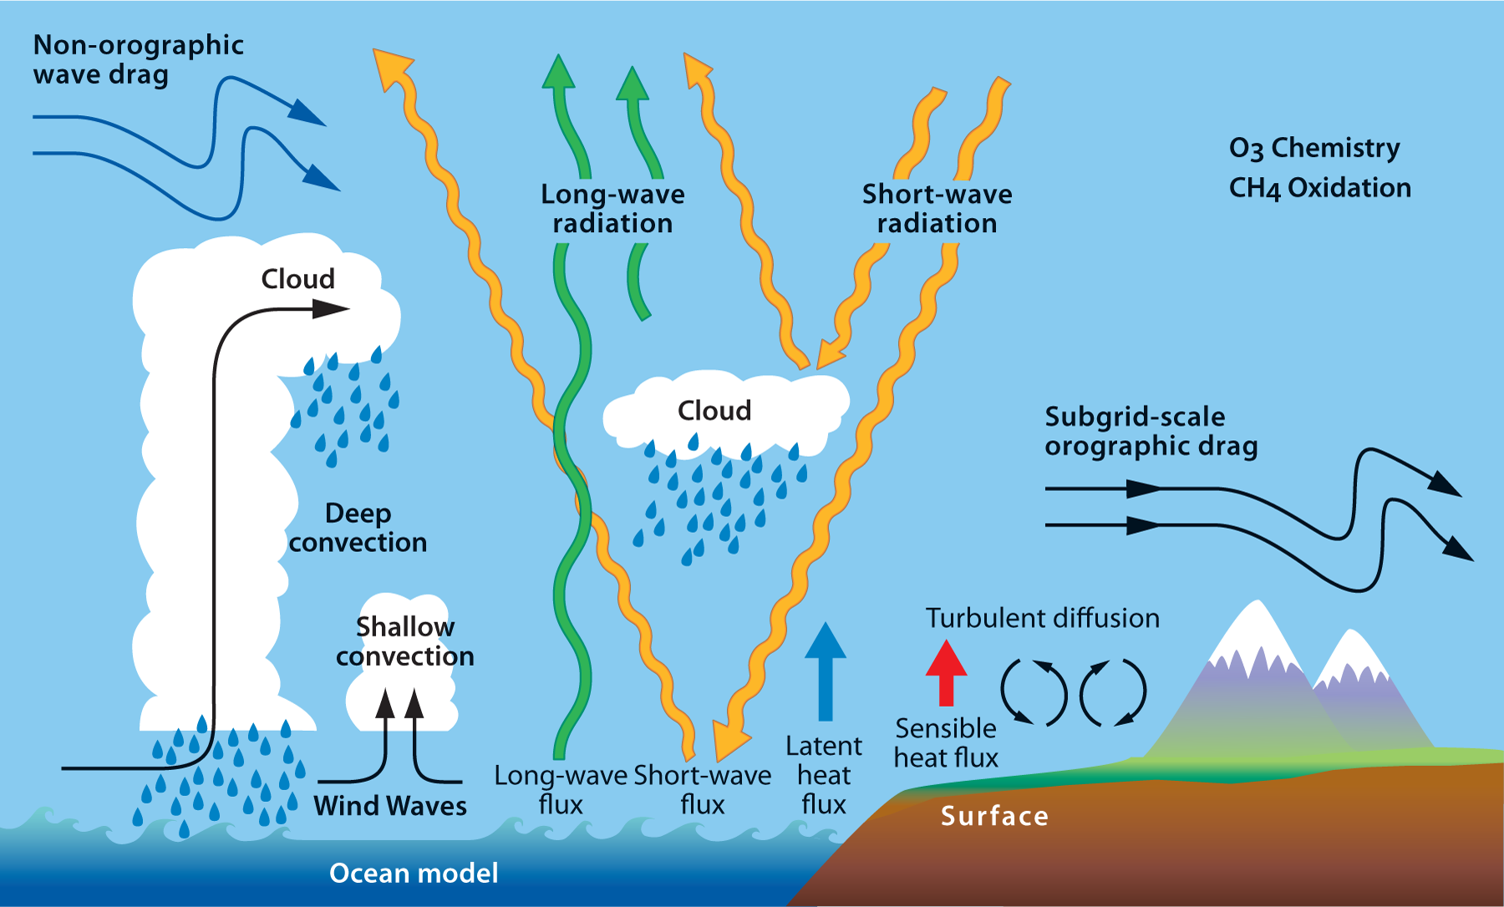
How can we forecast on long timescales?
Ocean – Frederic/ Magdalena
Sea ice
Land Surface
Soil moisture
Vegetation
Snow
Stratosphere – Ted’s talk
Atmospheric composition
Solar

Slide 11
Predictability varies with spatial and time scales
Buizza et al – ECMWF Newsletter Autumn 2015

Slide 12
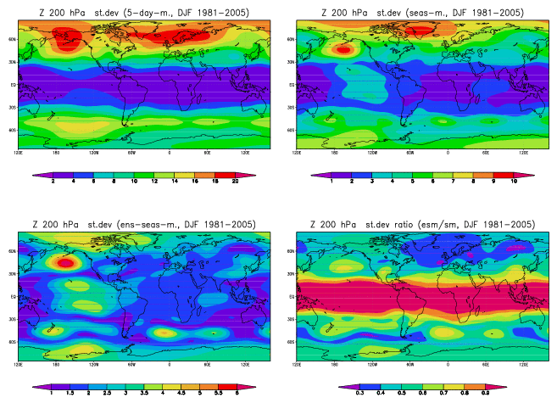
Which regions are most predictable?
Use models to estimate predictable signal by comparing ensemble spread and ensemble mean variability.
Variability of Z 200hPa in DJF from seasonal ensembles
Standard deviation from 11-member ensembles, DJF 1981/2005
5-day
means
Seasonal-
ensemble
means
Seasonal
means
St.dev.
ratio

Slide 13
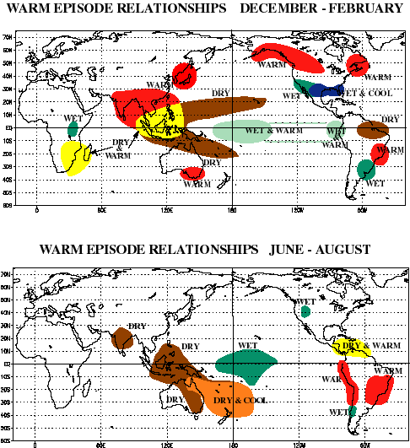
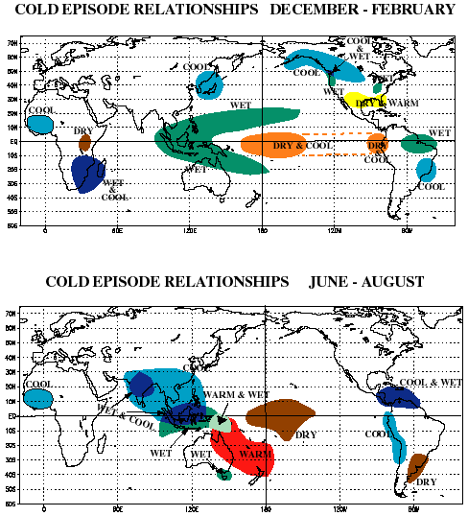
ENSO impacts: rainfall and temperature

Slide 14
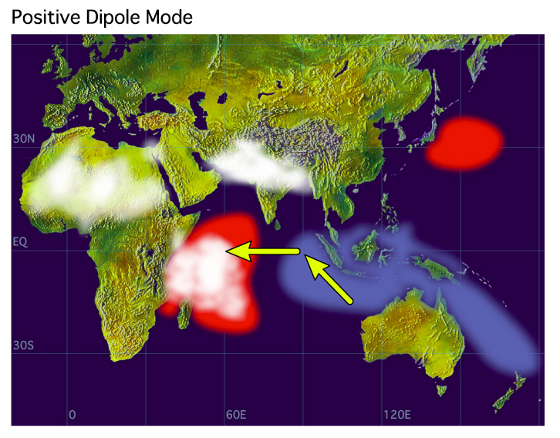
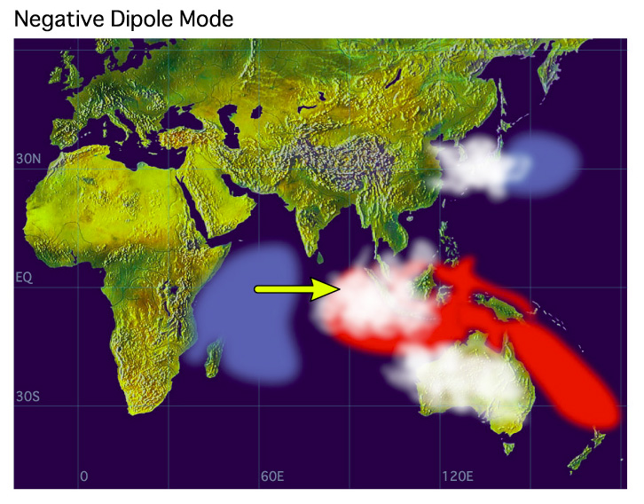
The Indian Ocean Dipole (or I.O. Zonal Mode)
Saji et al. (1999)
Webster et al. (1999)
Notes:
Saji, N.H, B.N. Goswami, P. N. Vinayachandran and T. Yamagata, 1999: A dipole mode in the tropical Indian Ocean. Nature 401, 360-363.
Webster, P.J., A.M. Moore, J.P. Loschnigg and R. R. Leben, 1999: Coupled ocean–atmosphere dynamics in the Indian Ocean during 1997–98. Nature 401, 356-360.

Slide 15
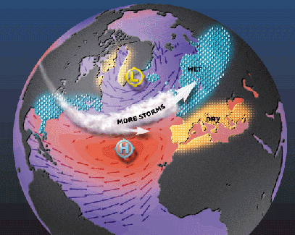
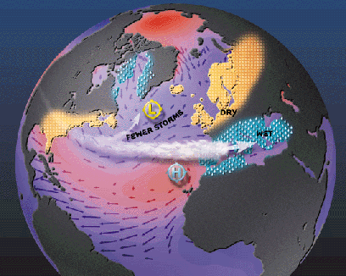
The North Atlantic Oscillation
Walker and Bliss (1932)
Van Loon and Rogers (1978)
Positive NAO phase Negative NAO phase
Notes:
Van Loon, H. and J.C. Rogers, 1978: The seesaw in winter temperatures between Greenland and Northern Europe. Part I: General description.
Mon. Wea. Rev. 106, 296-310.

Slide 16
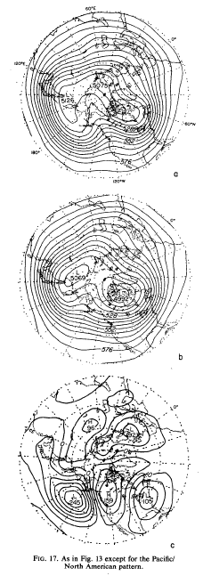
The Pacific /North American (PNA) pattern
500-hPa height composites from
Wallace and Gutzler 1981
Notes:
Wallace, J.M. and D. S. Gutzler, 1981: Teleconnections in the geopotential height field during the Northern Hemisphere winter. Mon. Wea. Rev. 109, 784-812.

Slide 17
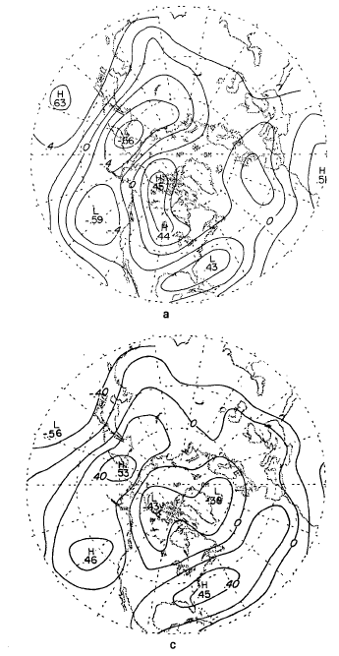
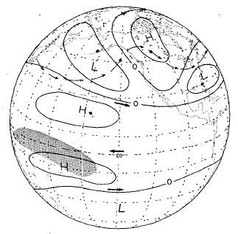
Teleconnections with ENSO
Correlation of 700hPa height with
a) PC1 of Eq. Pacific SST
c) SOI index
Schematic diagram of tropical-extratropical teleconnections during El Niño
Horel and Wallace 1981
Notes:
Horel, J.D. and J.M. Wallace, 1981: Planetary-scale atmospheric phenomena associated with the Southern Oscillation. Mon. Wea. Rev. 109, 813-829.

Slide 18
The ECMWF Seasonal fc. system (Sys-4)
IFS 36R4
0.7 deg (T255)
91 levels
NEMO
1/1-0.3 d. lon/lat
42 levels
H-TESSEL
Initial Con.
Ens. Forecasts
4-D variational d.a.
Gen. of
Perturb.
System-4
CGCM
3-D v.d.a. (NEMOVAR)
Notes:
Molteni, F., T. Stockdale, M. Balmaseda, G. Balsamo, R. Buizza, L. Ferranti, L. Magnusson, K. Mogensen, T. Palmer and F. Vitart, 2011: The new ECMWF seasonal forecast system (System 4). ECMWF Technical Memorandum no. 656.

Slide 19
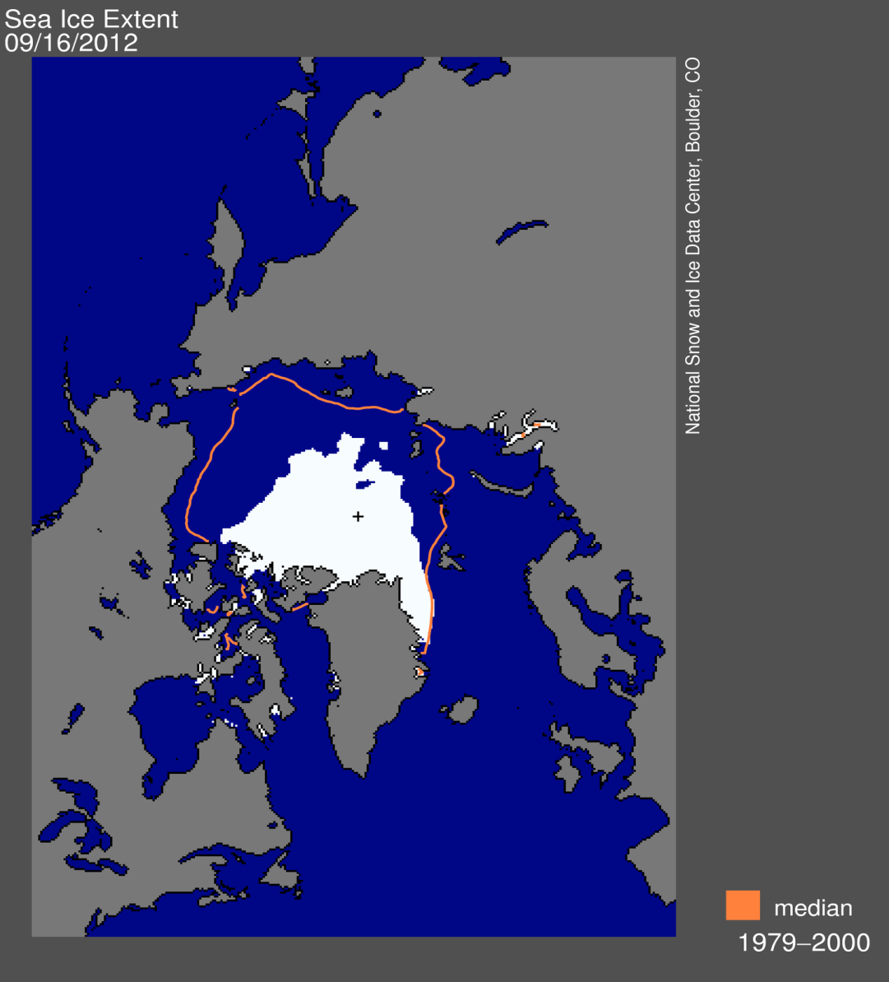
Sea ice: Interaction of climate change and natural variability
Record minimum
in Arctic
sea-ice extent:
16/9/2012
(from NSIDC)

Slide 20
Impacts of Sea Ice
Energy Fluxes:
  Changes albedo of the region – solar heating of upper ocean
  Thickness of the sea ice alters the surface heat fluxes
    Winter; biggest effect – no sun and air colder than ocean
    Leads in the ice are important (Badgerley, 1966)
Impact on waves
Salinity fluxes:
  Production of brine (freezing) and freshwater (melting)
h>0.5m
h<0.5m
Maykut (1978), JGR
Notes:
Ice thickness sets:
Compressive strength
Rate of growth (in winter 3m ice grows 100x slower than refreezing lead – in summer growth rate is negative (melt rate) and independent of thickness)
Surface temperature
Turbulent and radiative heat exchange
Potential energy
Salt content

Slide 21
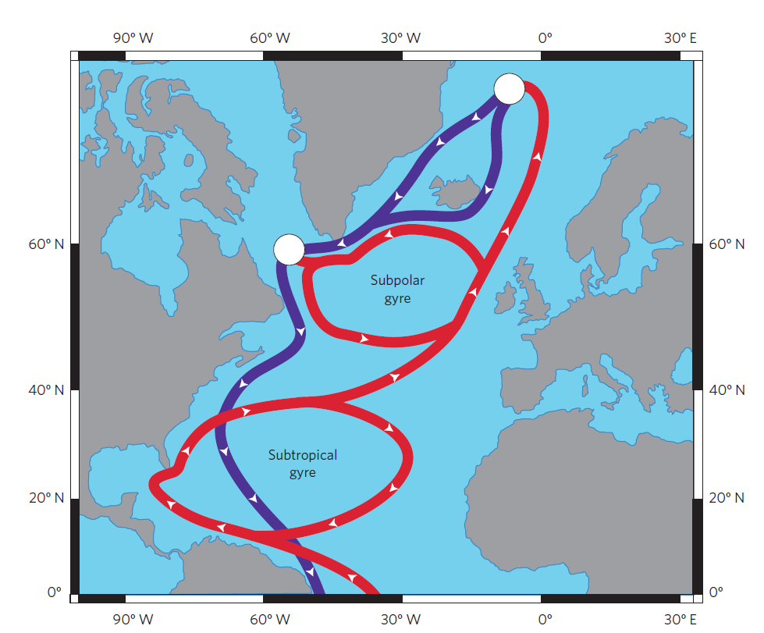
Impacts on the ocean
Deep convection:
More important on longer time scales
Impact on the Gulf Stream and the Thermohaline circulation – part of the feedback on the Arctic system
Cold Halocline Layer:
Layer of freshwater that insulates sea ice from warmer waters that are advected into the basin
Notes:
Deep convection sites in the North Atlantic
Holland et al 2001 – freshwater exchange from variable ice cover is the dominant process for forcing variability in the over-turning (interdecadal timescales)
Great Salinity Anomalies

Slide 22
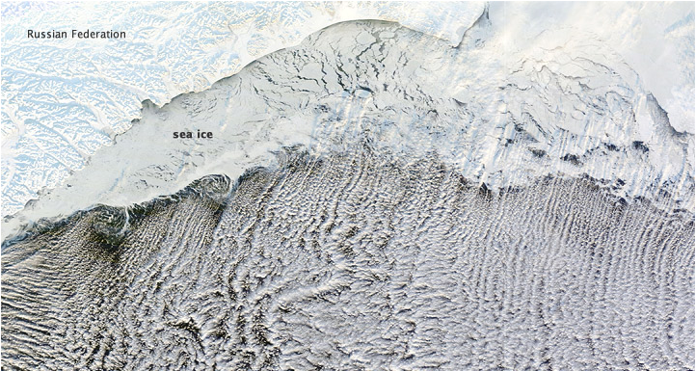
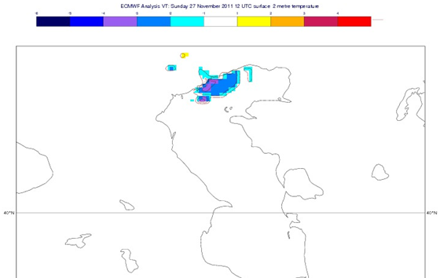
Impacts on the atmosphere
Surface air temperatures
Cloud
Storm tracks
Precipitation
Large scale variability – NAO – seasonal timescale predictions
-6 -5 -4 -3 -2 -1 1 2 3 4
Notes:
Impact on Caspian Sea region Analysis of surface air temperatures.
Lots of past studies:
Rinke et al 2006, Model study, Sea ice/SST impact biggest in winter. Direct thermodynamic effect in winter limited to the near surface (Z800) – important for regional circulation patterns and temperature profiles. Dynamical effect, advection of heat vertically and horizontally important in winter and summer.
Bhatt et al 2008,summer ice reductions (mainly in Pacific) lead to impact on Pacific storm track, leads to changes in precipitation patterns.
Alexander et al 2004, reduced ice increased upward heat flux, local response, near surface warming, baroclinic response, enhanced precipitation and evaporation low SLP.
Large scale response depends on interaction of surface fluxes with large scale circulation
Higgins & Cassano 2009 different responses within the Arctic basin to reduced sea ice, changes in cyclones or thermodynamic changes
Francis et al 2009: Winter weather patterns set by summer sea ice
Petoukhov and Semenov 2010, Barents/Kara Sea winter cold extremes

Slide 23
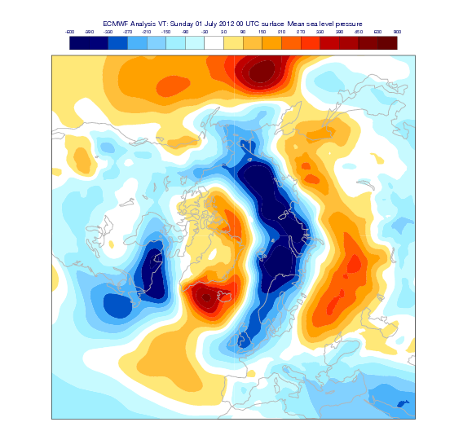
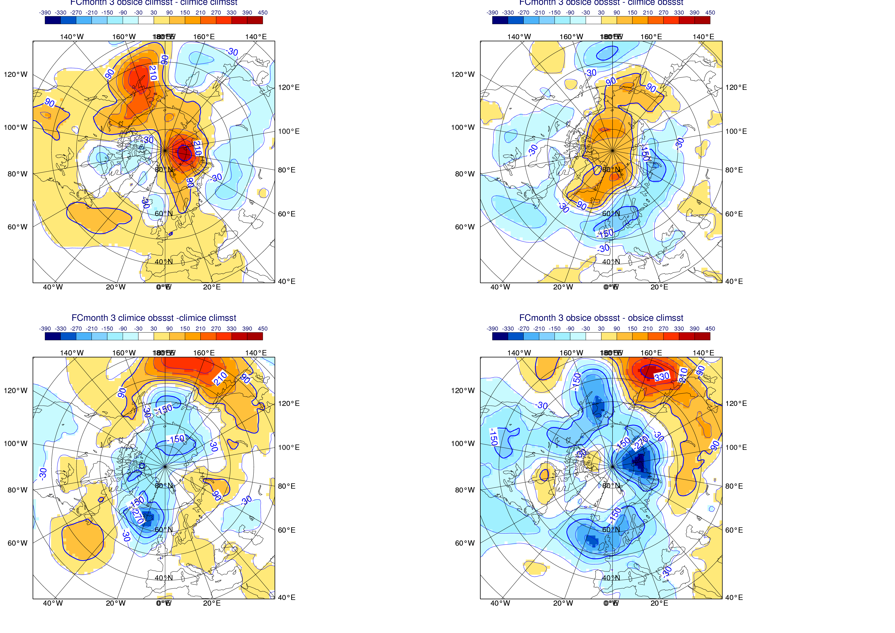
Summer sea ice impacts – Case study 2012
Ensemble mean MSLP differences between experiments:
2012 sea ice - sea ice climatology
Reanalysis
SST 2012
SST Clim
July MSLP anomaly
Era Interim 2012 - climatology

Slide 24
Summer SST impacts – Case study 2012
Ensemble mean MSLP differences between experiments:
2012 SST - SST climatology
Reanalysis
Sea ice clim
Sea ice 2012
July MSLP anomaly
Era Interim 2012 - climatology

Slide 25
Results Sea Ice Predictability – July 2012
sea ice: 2012-climatology
SST2012
SST: 2012-climatology
July MSLP anomaly
Era Interim 2012 - climatology
SeaIce2012
Notes:
The 4 panel picture on the left:
Results are shown for the seasonal forecast model when the SST and the sea ice are strongly relaxed to either climatology or 2012 observations.
Top Left:
Climatological SST used in both experiments – difference between using 2012-clim sea ice
Top Right
2012 SST used in both experiments – difference between using 2012-clim sea ice
Bottom Left:
Climatological sea ice used in both experiments – difference between using 2012-clim sea SST
Bottom Right:
2012 sea ice used in both experiments – difference between using 2012-clim sea SST
You can see that the right hand panels are closer to the anomaly map of ERA-I. You need both the SST and the sea ice to get the correct response.
The Low pressure over the N Atlantic is set by the SST but the sea ice anomalies are required to generate the high pressure over the Arctic (which helps to keep the low pressure anomaly over Europe rather than the ocean?)
For the Siberian region it is clear that the SST response to the melting ice is helping to generate the “heat low” in the region.
The results are not shown for the Z500 field, but although the fields are not identical there is a similar pattern aloft suggesting the anomalies are large enough to affect the large scale flow and not just the surface circulation.

Slide 26
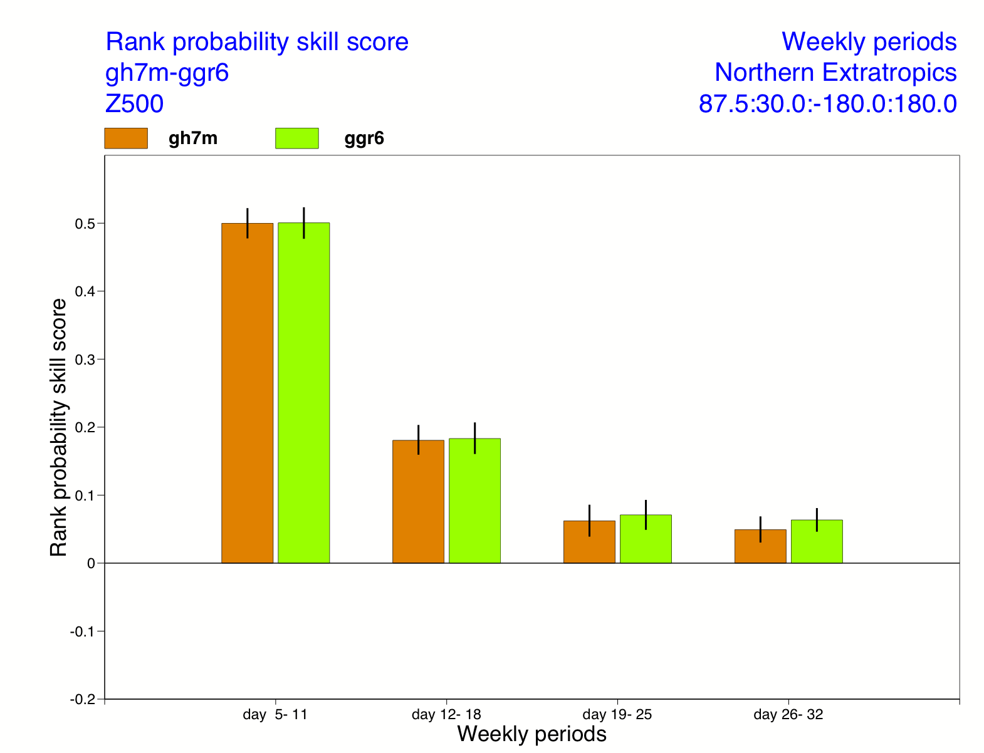
Headline scores comparing ERA-I with:
CNTL (persisted – climate ice) and LIM2
CNTL
ICE
100 cases – The vertical bars represent the 95% level of confidence

Slide 27
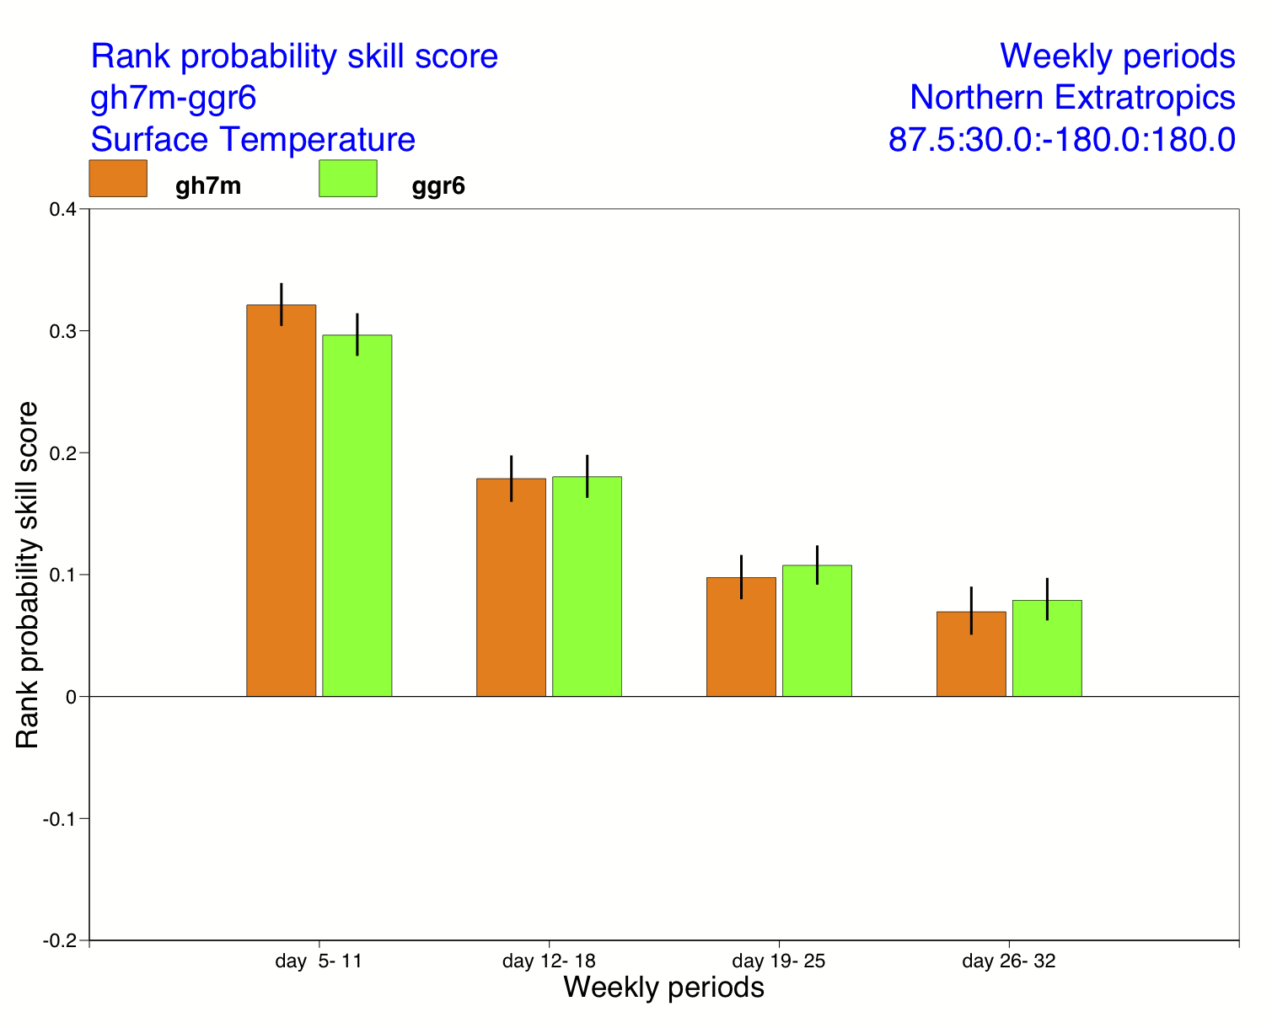
Headline scores comparing ERA-I with:
CNTL (persisted – climate ice) and LIM2
CNTL
ICE

Slide 28
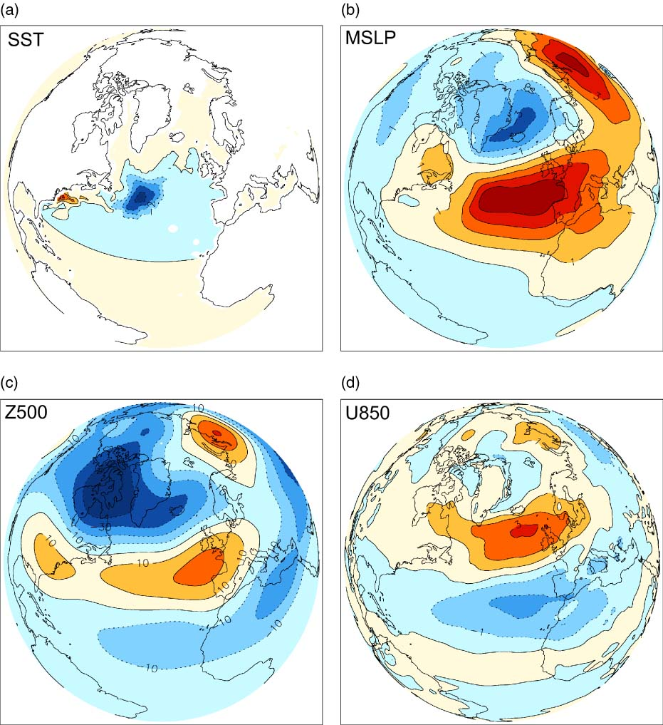
Note of caution about increasing complexity
Keeley et al (2012) QJRMS

Slide 29
ECMWF System 4: main features
Operational forecasts
  51-member ensemble from 1st day of the month
  released on the 8th
  7-month integration
Experimental ENSO outlook
  13-month extension from 1st Feb/May/Aug/Nov
  15-member ensemble
Re-forecast set
  30 years, start dates from 1 Jan 1981 to 1 Dec 2010
  15-member ensembles, 7-month integrations
  13-month extension from 1st Feb/May/Aug/Nov

Slide 30
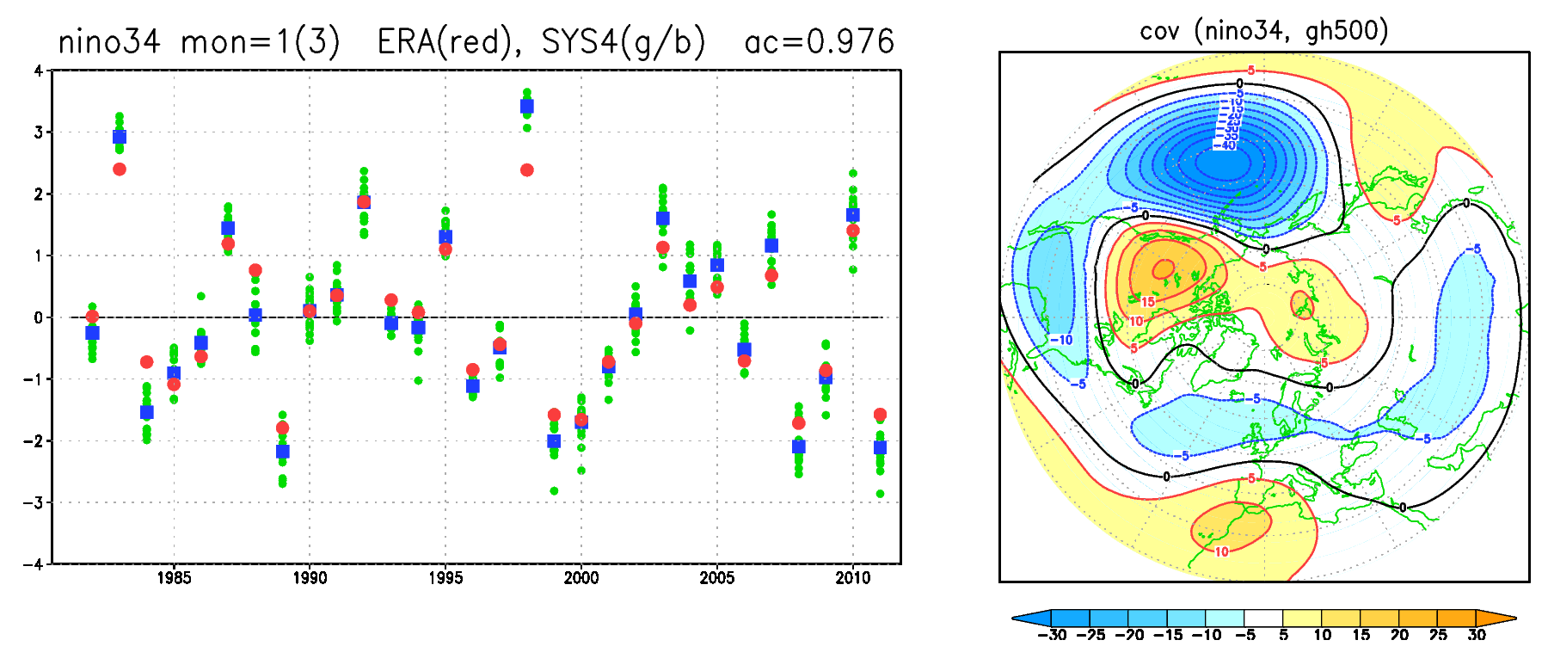
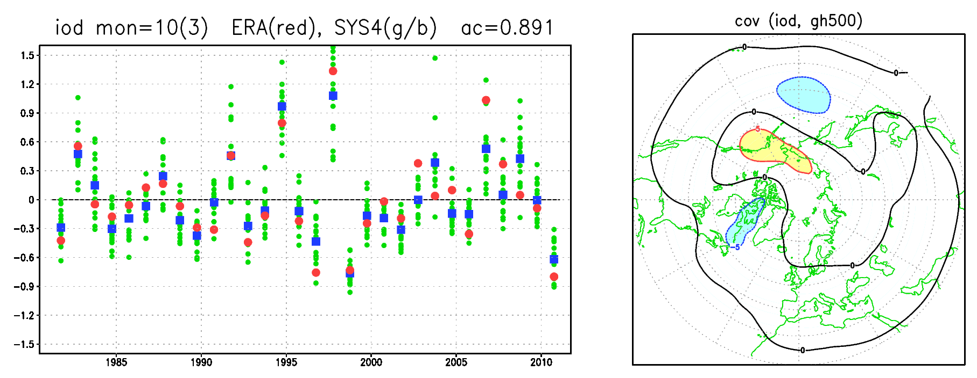
Prediction of tropical SST anomalies in Sys4
Nino3.4
DJF
IOD
SON

Slide 31
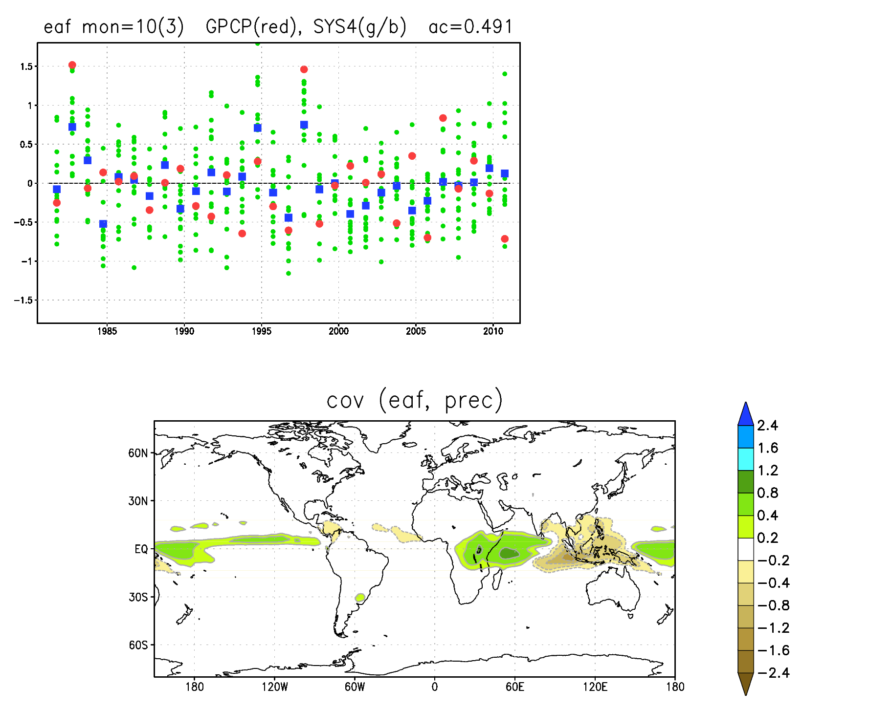
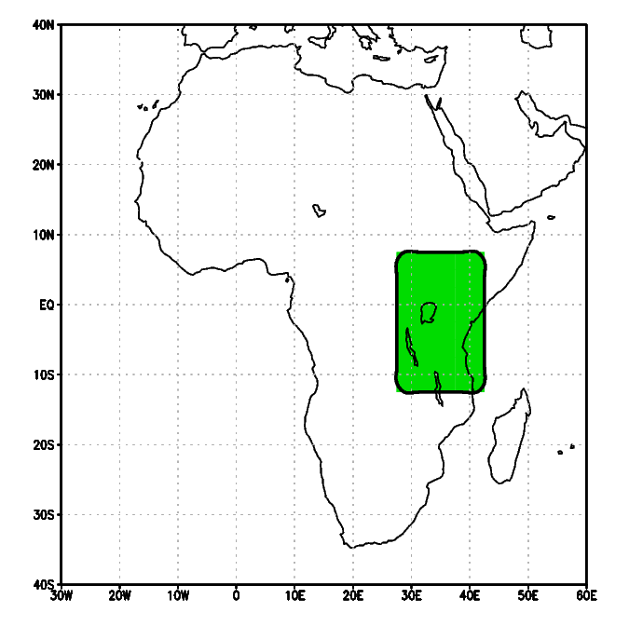
Prediction of tropical rainfall in Sys4: East Africa (SON)

Slide 32
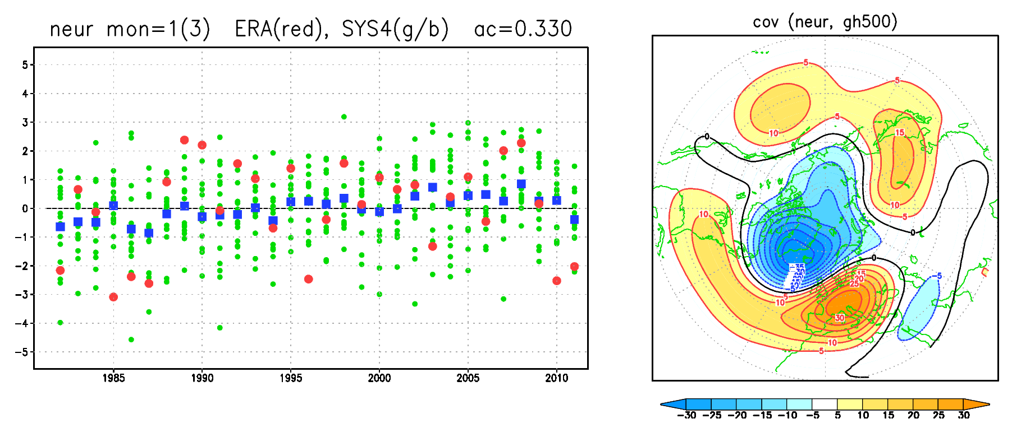
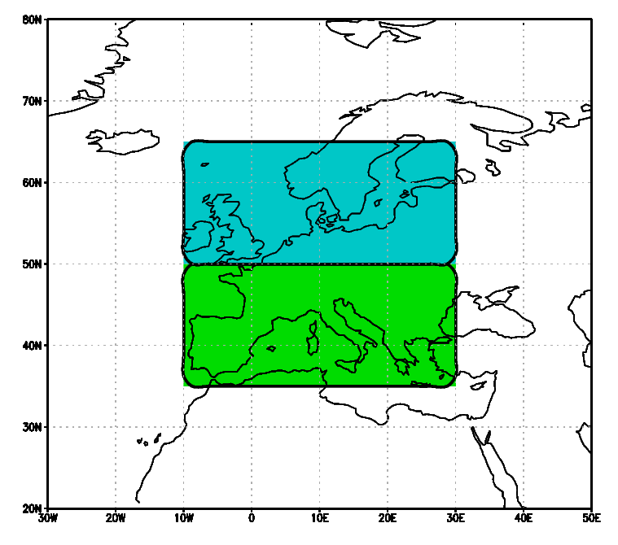
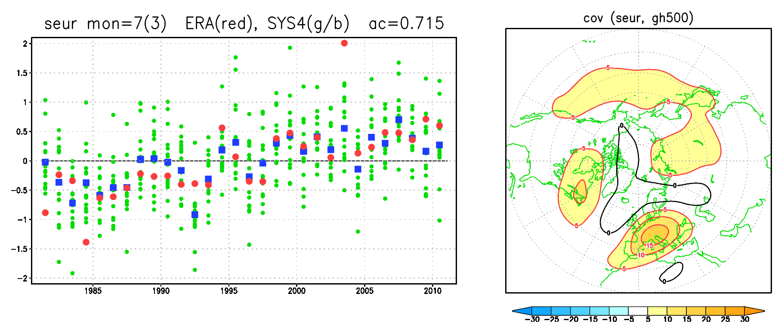
Prediction of 2-m temperature in Sys4: Europe (DJF, JJA)

Slide 33
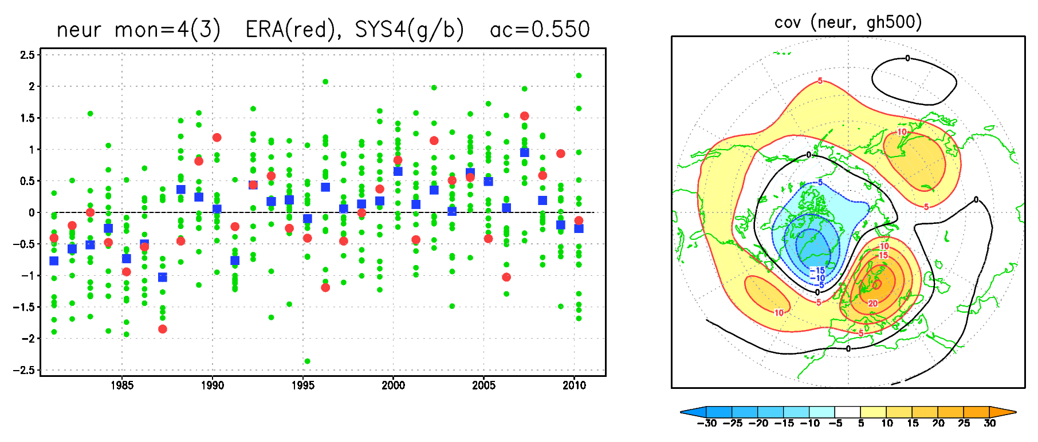
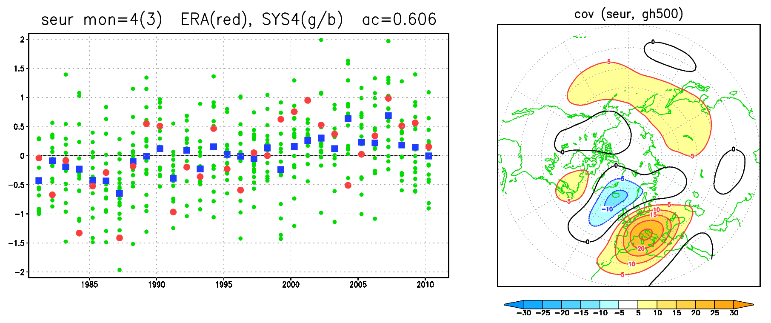
Prediction of 2-m temperature in Sys4: Europe (MAM)

Slide 34
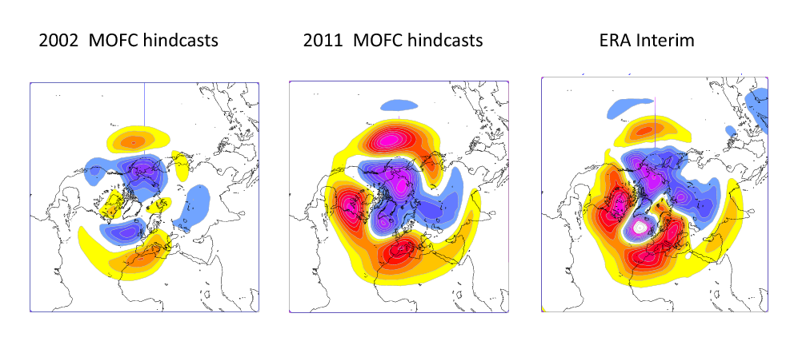
MJO teleconnections in October-March
500 hPa height, MJO phase 3 + 10 days
from Vitart 2014
Notes:
Vitart, F., 2014: Evolution of ECMWF sub-seasonal forecast skill scores. Q.J.R. Meteorol. Soc.. doi: 10.1002/qj.2256

Slide 35
Conclusions
Regional anomalies in atmospheric flow and weather parameters may persist on time scales longer than the deterministic predictability limit, and have substantial societal impacts.
The possibility of performing probabilistic predictions of these events arises from the interaction of the atmospheric flow with slowly varying anomalies in surface conditions, which modify the energy and water sources for the atmosphere. We need to initialise and model the coupled processes important for the atmosphere.
In the extratropics, persistent anomalies can be generated by (linear) teleconnections with tropical variability (eg ENSO) but also from the alternation of different (non-linear) flow regimes.
Ensemble prediction systems provide an estimate of long-range predictability based on the ratio of ensemble spread and ensemble-mean variability.
Predictability over Europe: limited by strong internal variability during winter (but with significant teleconnections on the sub-seasonal scale), higher in other seasons when internal variability is reduced.

Slide 36
References
Bjerknes, J., 1969: Atmospheric teleconnections from the Equatorial Pacific. Mon. Wea. Rev., 97, 163–172.
Charney, J.G. and J.G. DeVore. 1979: Multiple flow equilibria in the atmosphere and blocking. J. Atmos. Sci. 36, 1205-1216
Horel, J.D. and J.M. Wallace, 1981: Planetary-scale atmospheric phenomena associated with the Southern Oscillation. Mon. Wea. Rev. 109, 813-829.
Lorenz E.N, 1963: Deterministic nonperiodic flow. J. Atmos. Sci. 20, 130-141.
Molteni, F., T. Stockdale, M. Balmaseda, G. Balsamo, R. Buizza, L. Ferranti, L. Magnusson, K. Mogensen, T. Palmer and F. Vitart, 2011: The new ECMWF seasonal forecast system (System 4). ECMWF Tech. Memorandum no. 656.
Saji, N.H, B.N. Goswami, P. N. Vinayachandran and T. Yamagata, 1999: A dipole mode in the tropical Indian Ocean. Nature 401, 360-363.
Trenberth K.E., J.T. Fasullo and J. Kiehl, 2009: Earth’s global energy budget. Bull. Amer. Meteor. Soc., 90, 311-323.
Van Loon, H. and J.C. Rogers, 1978: The seesaw in winter temperatures between Greenland and Northern Europe. Part I: General description. Mon. Wea. Rev. 106, 296-310.
Vitart, F., 2014: Evolution of ECMWF sub-seasonal forecast skill scores. Q.J.R. Meteorol. Soc.. doi: 10.1002/qj.2256
Walker, G.T. and E.W. Bliss, 1932. World Weather V, Memoirs of the Royal Meteorological Society, 4, (36) , 53-84.
Wallace, J.M. and D.S. Gutzler, 1981: Teleconnections in the geopotential height field during the Northern Hemisphere winter. Mon. Wea. Rev. 109, 784-812.
Webster, P.J., A.M. Moore, J.P. Loschnigg and R.R. Leben, 1999: Coupled ocean–atmosphere dynamics in the Indian Ocean during 1997–98. Nature 401, 356-360.
Wheeler, M.C. and H. H. Hendon, 2004: An all-season real-time multivariate MJO index: Development of an index for monitoring and prediction. Mon. Wea. Rev. 132, 1917-1932

