Slide 1
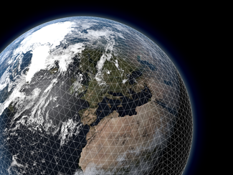

Towards an Earth-System Model.
Jean-Raymond Bidlot
Earth System Modelling Section
Coupled Processes Team
Research Department
European Centre for Medium-range Weather Forecasts
Reading, UK
jean.bidlot@ecmwf.int

Slide 2
Outline
Part 1:
ECMWF global forecast models.
Wave modelling and its role.
Towards an Earth-System model at ECMWF.
Part 2:
- Call sequence and communication issues.
Impact study: Tropical cyclone forecast.
Coupled data assimilation.
Conclusion.

Slide 3
ECMWF global forecast models
High resolution / Ensemble systems
**
including land and
atmospheric composition
modules
Atmospheric
model** (IFS)
TCo1279/TCo639*
9km/18km
Wave model (ECWAM)
14km/28km*
Ocean model (NEMO)
Ice model (LIM)
ORCA1°_Z42
These models are the components of ECMWF Earth-System
* Resolution as of 8 March 2016

Slide 4
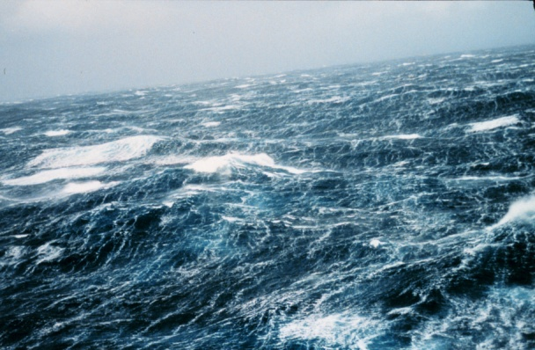
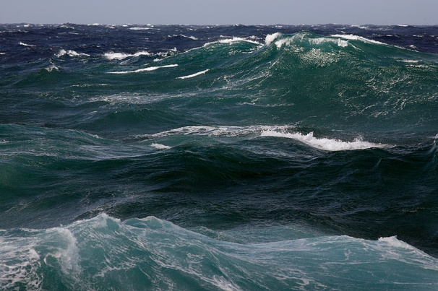
Ocean waves
Wave forecasting took off as an important subject when knowledge of the sea state was required for numerous landing operations during the second World War, for D-Day for example.
From then onwards a rapid development because of improved weather forecasting (better surface winds), enormous increase in the number of observations and faster and bigger computers.
From the beginning it was clear, however, that the sea state was so complicated that only a prediction of the average sea state at a location of interest was possible.
Example of parameters are the average wave height and the average period of the waves.

Slide 5
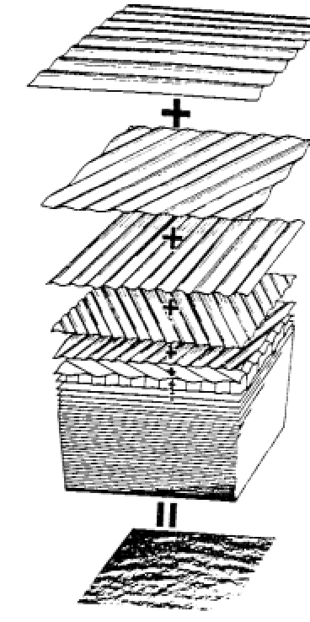
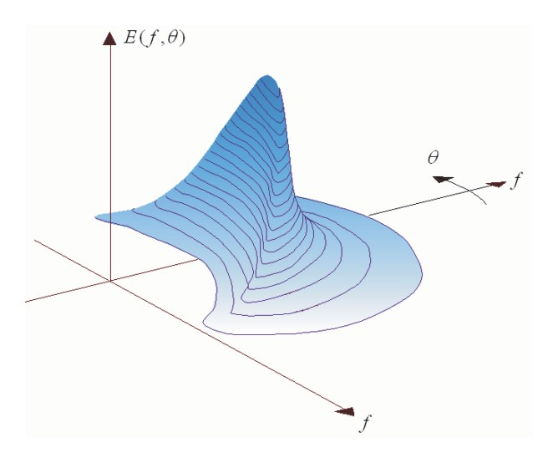
Wave Spectrum
The irregular water surface can be decomposed into (infinite) number of simple sinusoidal components with different frequencies (f) and propagation directions (θ ).
The distribution of wave energy among those components is called:
“wave energy spectrum”, ρ_{w} g F(f,θ).
water density: ρ_{w} and gravity: g

Slide 6
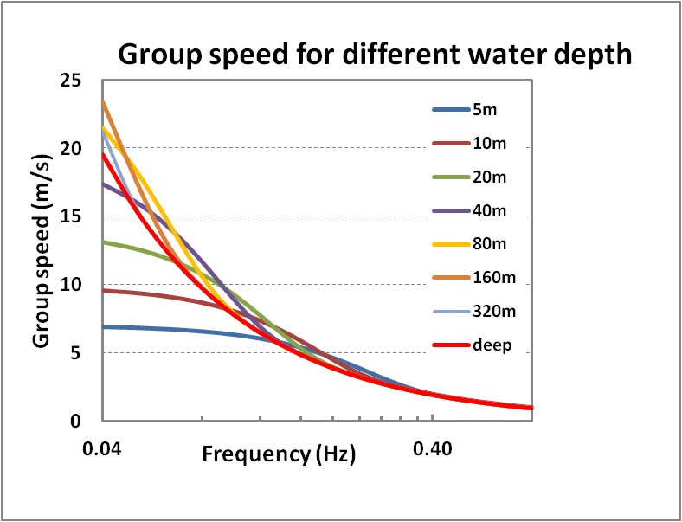
Ocean Wave Modelling
The 2-D spectrum follows from the energy balance equation (in its simplest form: deep water case, no surface currents):
Where the group velocity Vg is derived from the dispersion relationship which relates frequency (f) and wave number (k) for a given water depth (D).
D: water depth

Slide 7
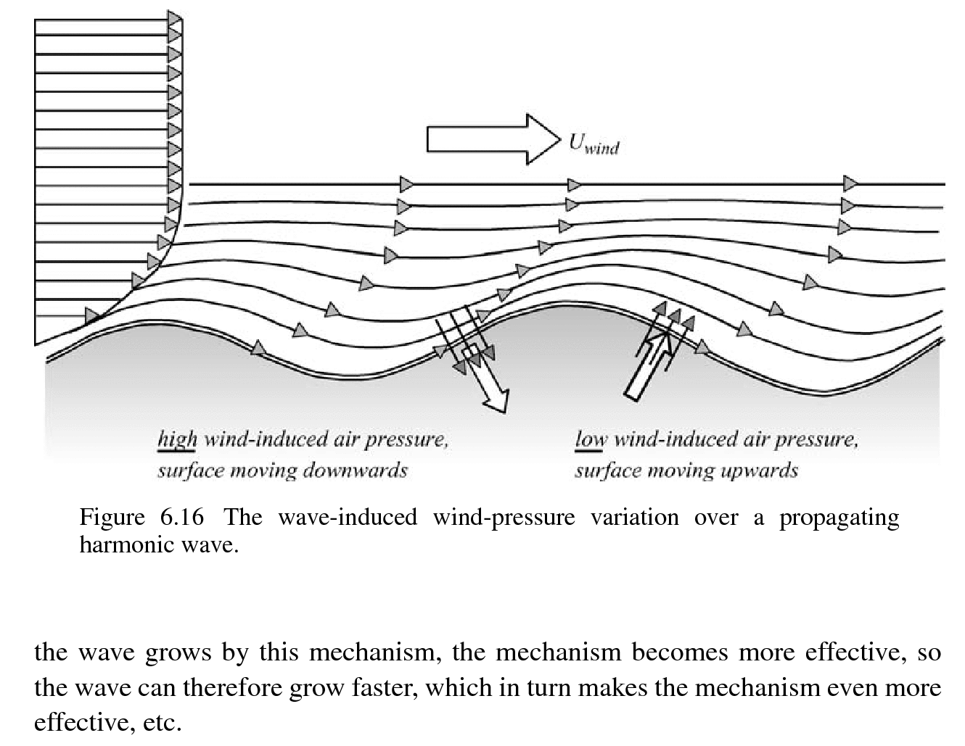
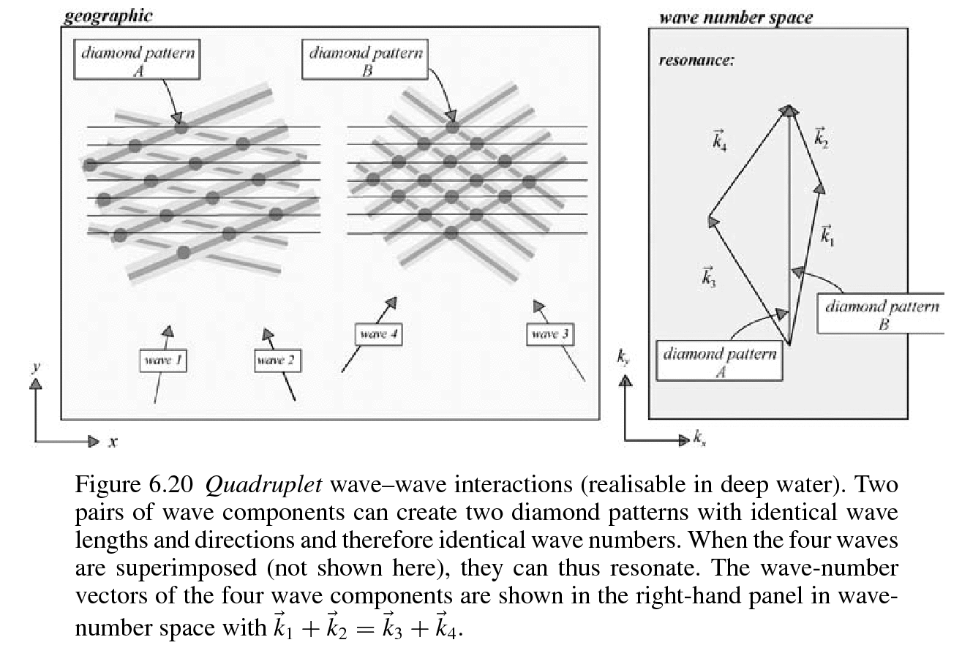
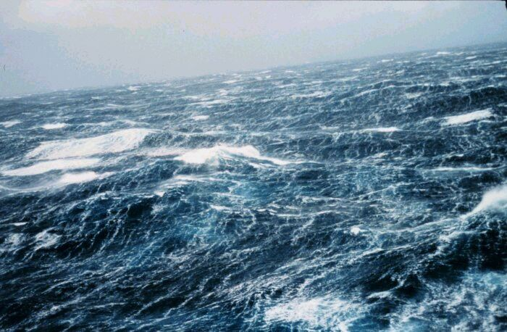
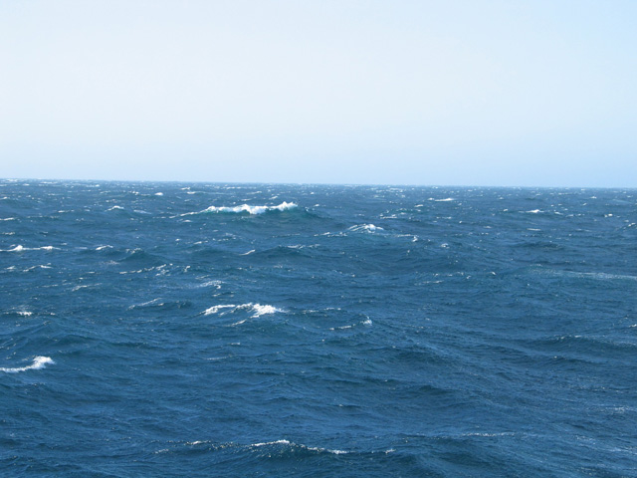
Ocean Wave Modelling
The 2-D spectrum follows from the energy balance equation (in its simplest form: deep water case):
Where the group velocity Vg is derived from the dispersion relationship which
relates frequency (f) and wave number (k) for a given water depth (D).
S_{in}: wind input source term (generation).
S_{nl}: non-linear 4-wave interaction (redistribution).
S_{diss}: dissipation term due to whitecapping (dissipation).

Slide 8
Wind Input
The form of the wind input source function S_{in} was already suggested by Miles
(1957). It depends on the surface stress
and is proportional to the wave spectrum:
with c =ω/k the phase speed of the waves,
ρ_{a} air density and ρ_{w} water density, and
Β is a function of z₀ the roughness length experienced by the airflow.
The wave growth by wind implies a momentum loss/drag of the airflow,
in such a way that the drag is proportional to the steepness of the waves.
As a consequence, for steep waves the roughness length is larger than for gentle waves.
In other words, there is a strong mutual interaction between wind and waves, where the strength of the interaction is determined by the wave-induced stress:

Slide 9
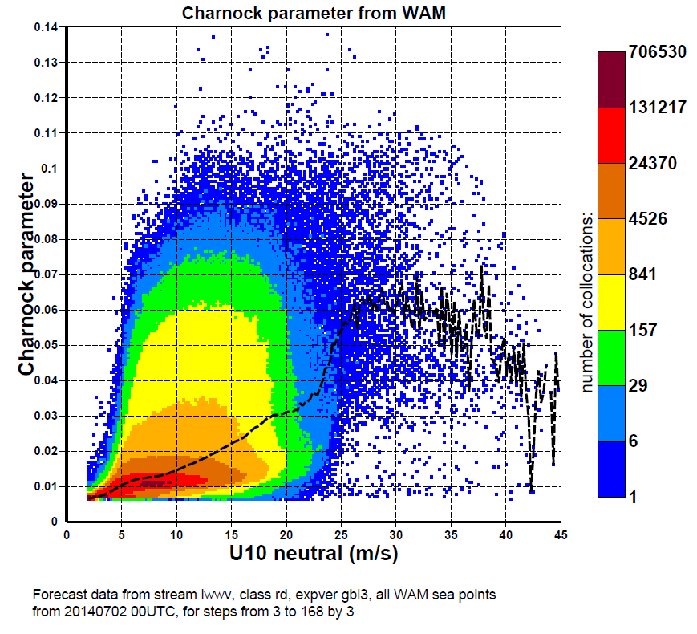
Atmospheric
model (IFS)
TCo1279/TCo639
Towards a coupled system
9km/18km
Every
IFS
time step
All configurations
Neutral wind
Roughness
Since 1998
Single executable
Wave model (ECWAM)
14km/28km
0.10
0.02

Slide 10
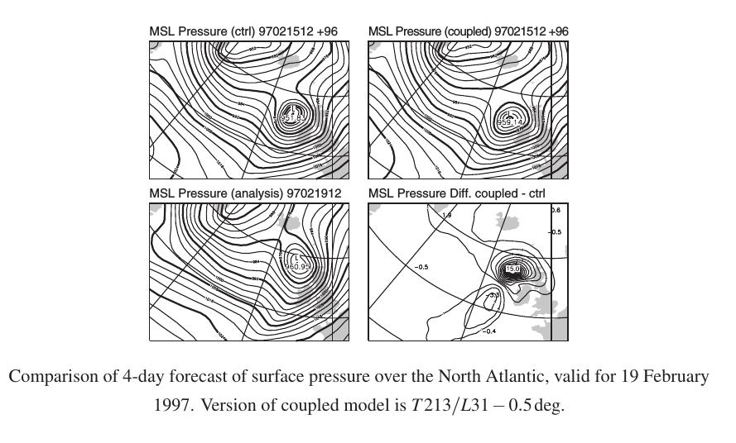
Impact of sea state dependent momentum flux
Minimum pressure
952 hPa
959 hPa
uncoupled
coupled
960 hPa
Verifying analysis

Slide 11
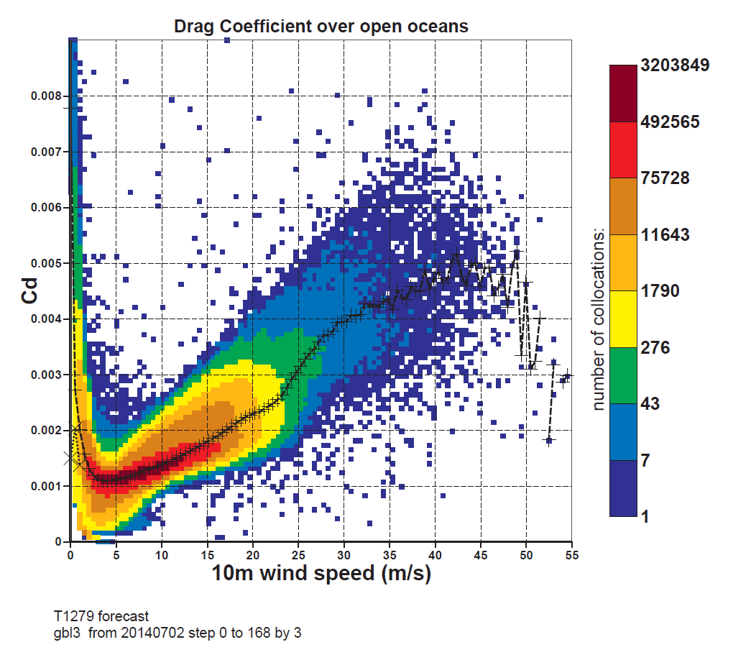
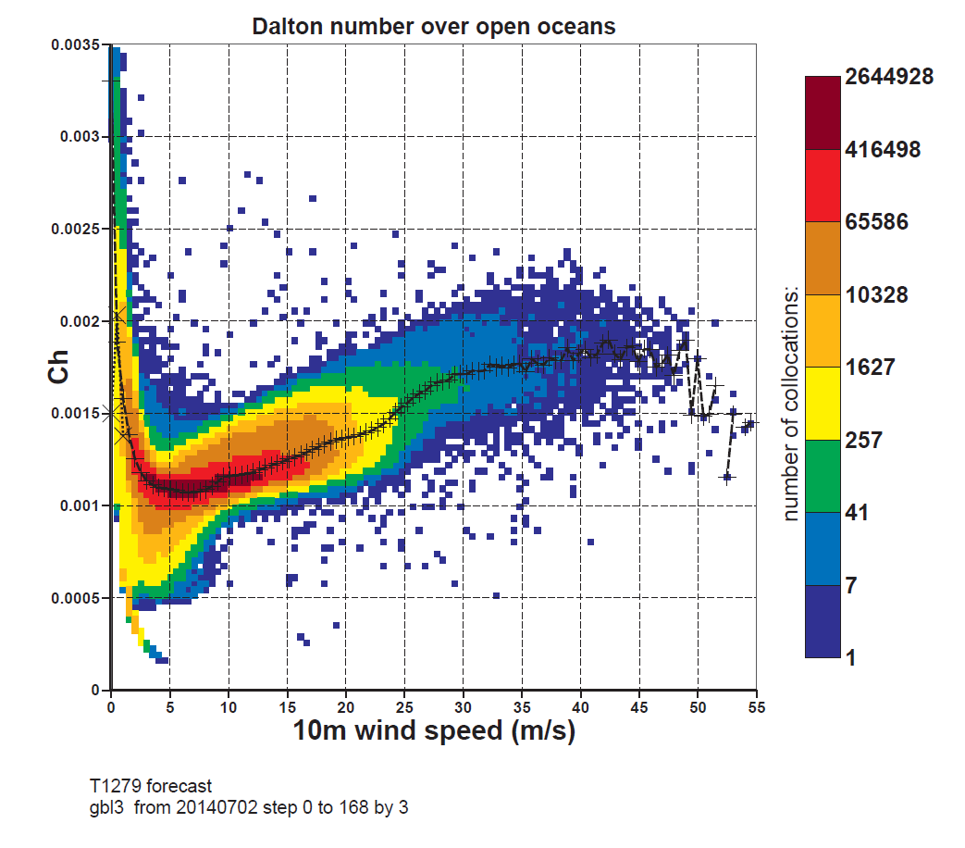
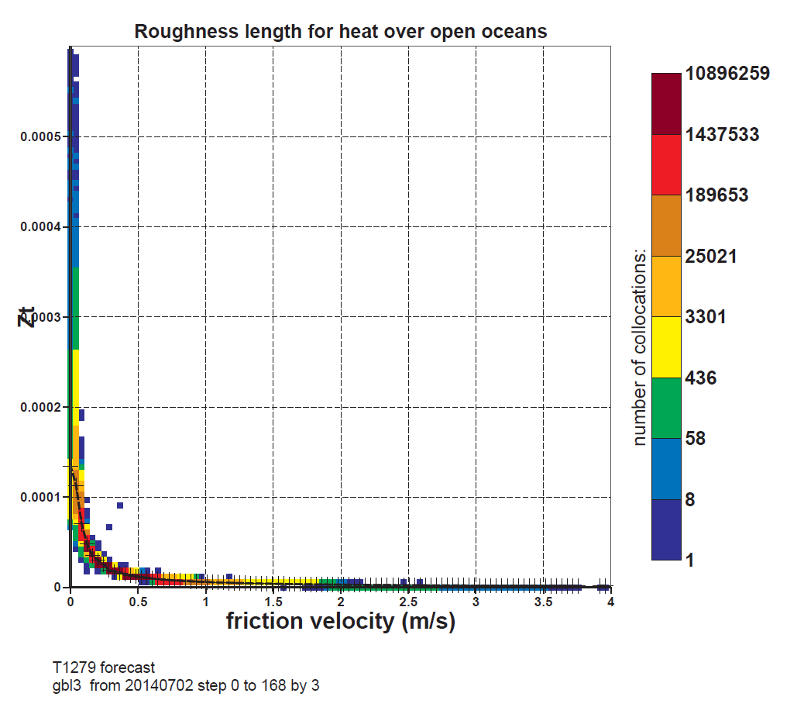
sea state dependency on heat flux
x 10⁻³
x 10⁻³
C_{d}
3
C_{h}
Exchange coefficients
dependency on wind speed
Left: for momentum (Cd)
Right: for heat (Ch)
Forecast from 20140702
t=0 to 168 by 3
all grid points.
6
2
3
1
10
55
10
55
C_{d} is sea state dependent
Z_{T}
Current operational system

Slide 12
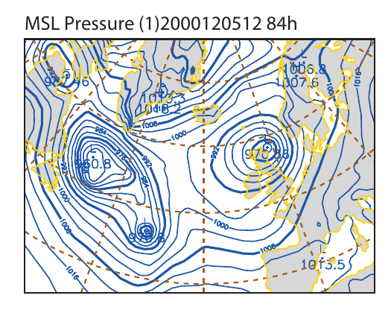
Stability of the Coupled system
Because of this occasional strong interaction between atmosphere and ocean waves there is a need to study the numerical scheme involved in such a coupling.
For example, if the coupling is strong are there possibilities of numerical instability. For instance, the generation of spurious mini-vortices:

Slide 13
Stability of the Coupled system
Two-way interaction of wind and waves was introduced on June 29 1998. The coupling time step was 4 wave model time steps, hence ample time for the wave model to respond to rapidly varying winds, resulting in realistic values of the roughness length.
With the introduction of the TL511 version of the IFS the coupling time step was reduced to one wave model time step. From the start of the operational, introduction occasional small scale, compact features occurred in the surface pressure field that propagated rapidly over the oceans. Called mini-vortices, or even cannon balls.

Slide 14
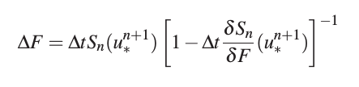
Stability of the Coupled system
The ECWAM model is a wave prediction system based on solving the energy balance equation.
The integration in time was done with an implicit scheme as follows.
1. Calculate dimensionless roughness or the Charnock parameter gz₀ /u∗² from wave-induced stress at t = t_{n} and wind speed at new time level t_{n+1} . Calculate friction velocity u*_{n+1}
2. Spectral increments ∆F are obtained from an implicit scheme:
.
Problem is that under rapidly varying winds (e.g. sudden drop in wind) the waves are still steep given a far too large roughness. This results in considerably enhanced heat fluxes that may generate a mini vortex.
Fix: Do the roughness calculation also after the spectral update F _{n+1} = F _{n} + ∆F.

Slide 15
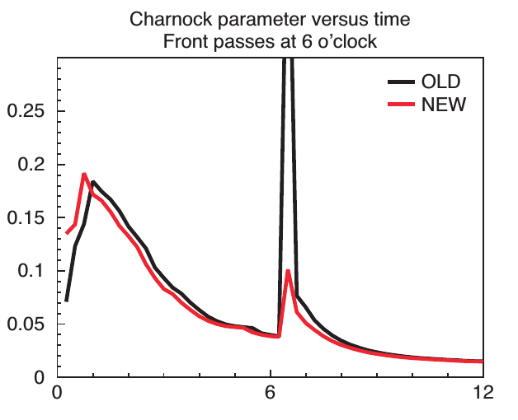
Stability of the Coupled system
α
Evolution in time of the Charnock parameter
during the passage of a frontal system at t = 6 hrs.

Slide 16
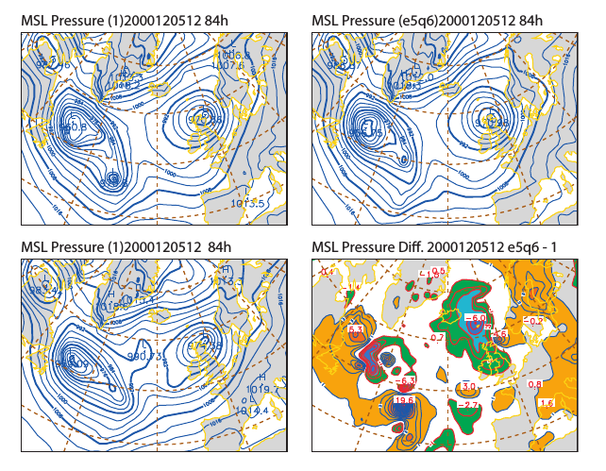
Stability of the Coupled system
Old
New
Verifying
analysis
New - Old
Generation of mini vortices by wind-wave interaction. Top left OPER, Top right
EXP, Bottom left ANALYSIS, Bottom right diff between EXP and OPER.

Slide 17
Atmospheric
model (IFS)
TCo1279/TCo639
Towards a coupled system
9km/18km
All configurations
Air density
Since 2002
Gustiness
Roughness
Neutral wind
Single executable
Wave model (ECWAM)
14km/28km
Gustiness parameterisation:
z_{i} is the height of the lowest inversion,
L is the Monin-Obukhov length
Air density effect:

Slide 18
Atmospheric
model (IFS)
TCo1279/TCo639
Towards a fully coupled system
(currently only operational in EPS)
9km/18km
Every
IFS
time step
All configurations
Air density
Gustiness
Roughness
Neutral wind
Ensemble FC
Single executable
Wave model (ECWAM)
Sea surface temperature
14km/28km
Solar and non solar fluxes, E-P
Currents
Every
coupling
time step
(1 or 3 hours)
Ensemble systems only:
- Medium range forecast
- Monthly forecast
- Seasonal forecast
Ocean model (NEMO)
ORCA1_Z42

Slide 19
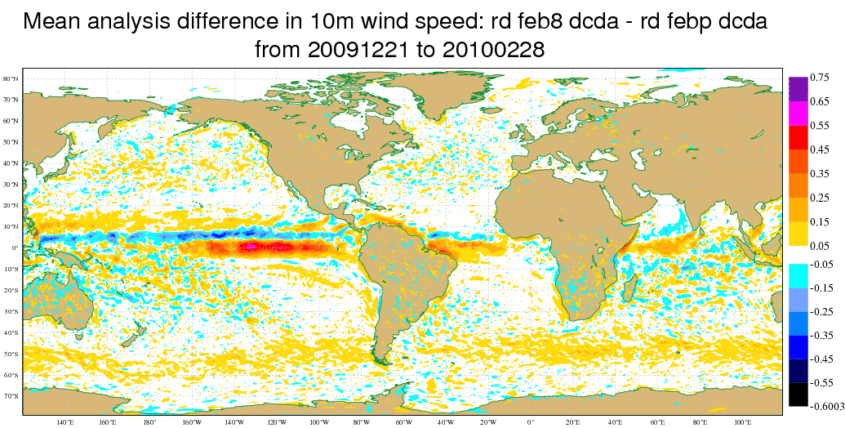
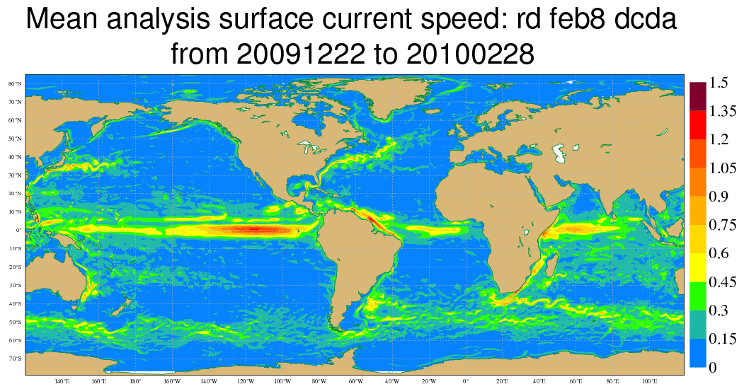
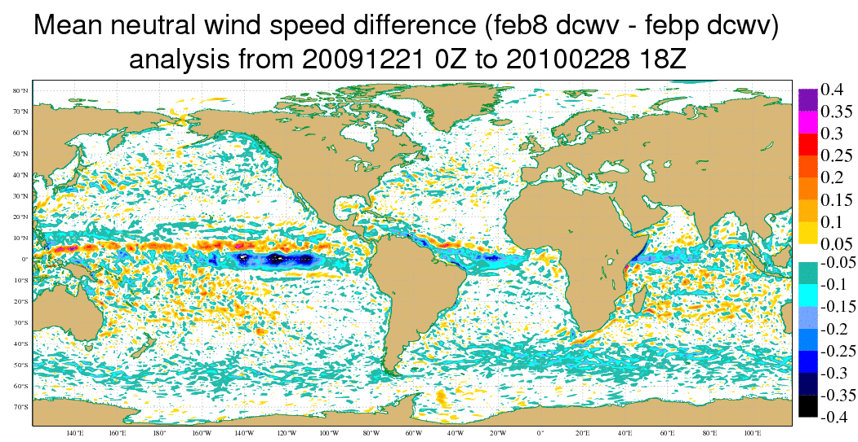
Surface current feedback on atmosphere
Currents – no currents
Average 10m wind speed in absolute frame
Average neutral 10m wind speed
Absolute winds receive about
50% from ocean currents

Slide 20
Atmospheric
model (IFS)
TCo1279/TCo639
Towards a coupled system
(currently only operational in EPS)
9km/18km
Every
IFS
time step
All configurations
Air density
Gustiness
Roughness
Neutral wind
Ensemble FC
Single executable
Every
coupling
time step
(1 or 3 hours)
Wave model (ECWAM)
Sea surface temperature
14km/28km
Solar and non solar fluxes, E-P
Currents
Ensemble systems only:
- Medium range forecast
- Monthly forecast
- Seasonal forecast
Wave effects?
Ocean model (NEMO)
ORCA1_Z42

Slide 21
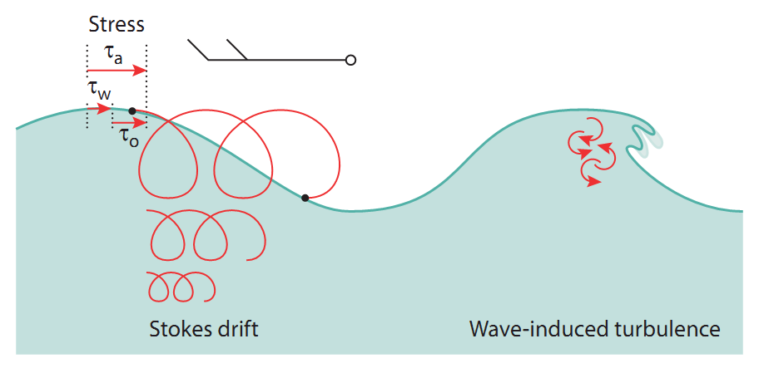
Wave effects in NEMO
Stress: As waves grow under the influence of the wind, the waves absorb momentum (τ_{w}) which otherwise would have gone directly into the ocean (τ₀) .
Stokes-Coriolis forcing: The Stokes drift sets up a current in the along-wave direction. Near the surface it can be substantial (∼1m/s). The Coriolis effect works on the Stokes drift and adds a new term to the momentum equations.
Mixing: Mixing: As waves break , turbulent kinetic energy is injected into the ocean mixed layer, significantly enhancing the mixing.

Slide 22
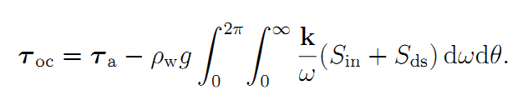
Atmospheric
model (IFS)
TCo1279/TCo639
Towards a coupled system
9km/18km
All configurations
Air density
Gustiness
Roughness
Neutral wind
Ensemble FC
Single executable
Wave model (ECWAM)
Sea surface temperature
14km/28km
Solar and non solar fluxes, E-P
Currents
Stress
Ocean model (NEMO)
ORCA1_Z42

Slide 23
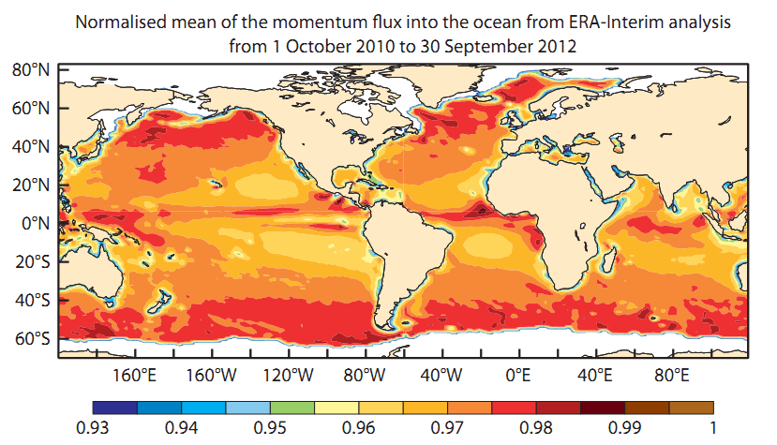
Wave effects in NEMO: sea state modulated surface stress

Slide 24
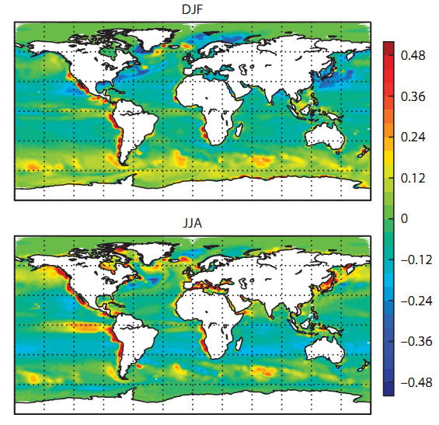
Wave effects in NEMO: sea state modulated surface stress
Boreal winter
SST
mean difference
Boreal summer
Results from standalone runs, forced by ERA-interim fluxes and sea state.
Averages are over a 20 year period

Slide 25
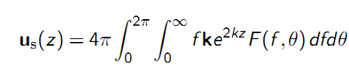
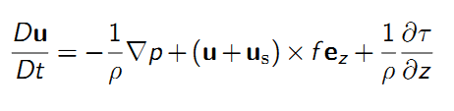
Atmospheric
model (IFS)
TCo1279/TCo639
Towards a coupled system
9km/18km
All configurations
Air density
Gustiness
Roughness
Neutral wind
Ensemble FC
Single executable
Wave model (ECWAM)
Sea surface temperature
14km/28km
Solar and non solar fluxes, E-P
Currents
Stokes drift
Ocean model (NEMO)
U_{s}(z) vertical profile
approximated using
Breivik et al. 2014
ORCA1_Z42

Slide 26
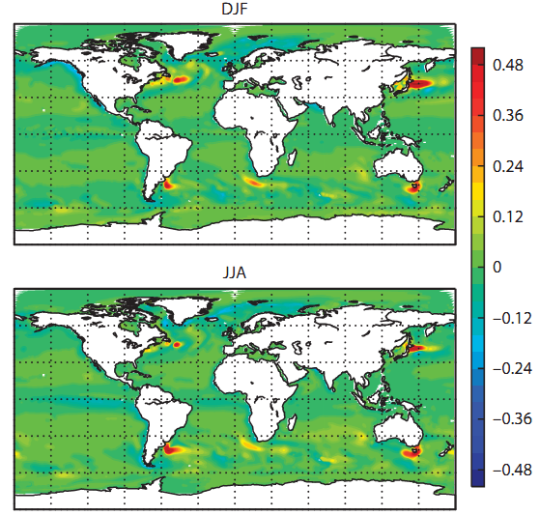
Wave effects in NEMO:
Stokes-Coriolis Forcing
Boreal winter
SST
mean difference
Boreal summer
Results from standalone runs, forced by ERA-interim fluxes and sea state.
Averages are over a 20 year period

Slide 27
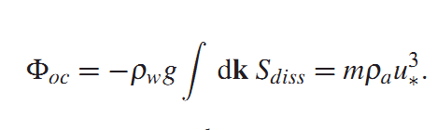
Atmospheric
model (IFS)
TCo1279/TCo639
Towards a coupled system
9km/18km
All configurations
Air density
Gustiness
Roughness
Neutral wind
Ensemble FC
Single executable
Wave model (ECWAM)
Sea surface temperature
14km/28km
Solar and non solar fluxes, E-P
Currents
Turbulent energy
Ocean model (NEMO)
ORCA1_Z42

Slide 28
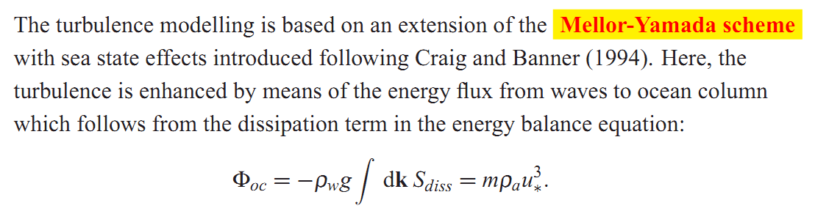
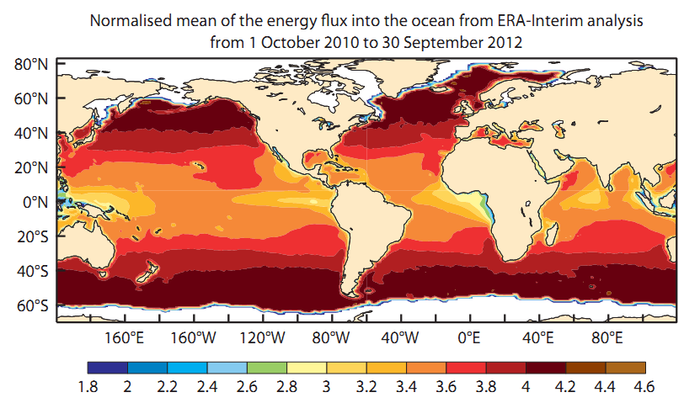
Wave effects in NEMO: input of turbulent kinetic energy
m:
NEMO
default
m=3.5

Slide 29
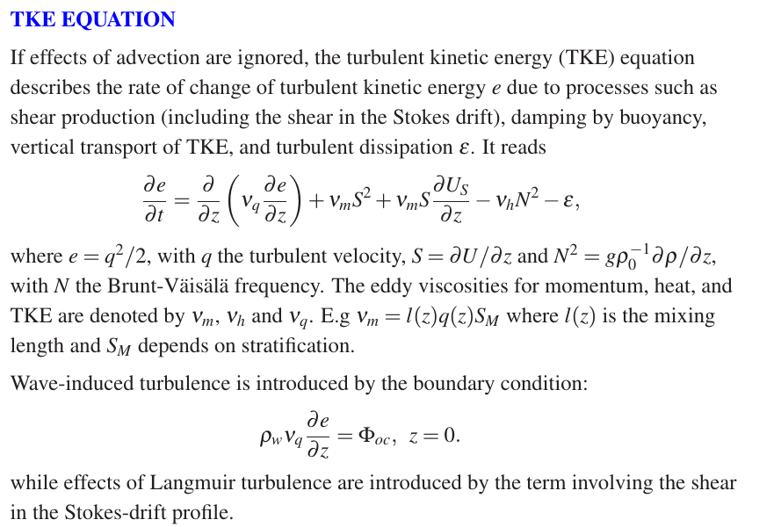

Slide 30
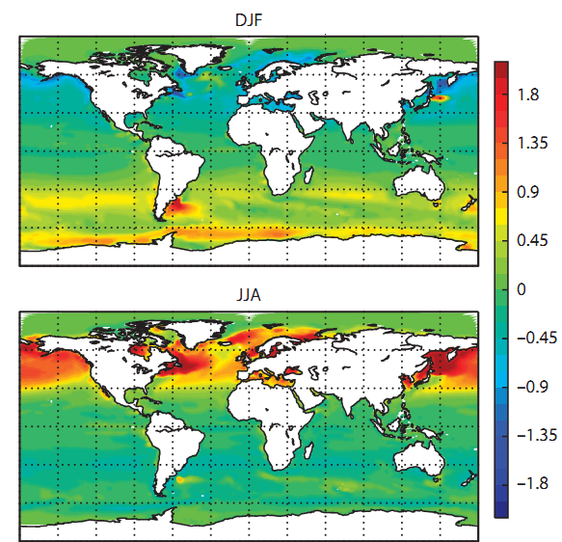
Wave effects in NEMO: input of turbulent kinetic energy
Boreal winter
SST
mean difference
Boreal summer
Results from standalone runs, forced by ERA-interim fluxes and sea state.
Averages are over a 20 year period

Slide 31
Atmospheric
model (IFS)
TCo1279/TCo639
Towards a coupled system
9km/18km
All configurations
Air density
Gustiness
Roughness
Neutral wind
Ensemble FC
Single executable
Wave model (ECWAM)
Operational
from day 0
since 2013
Sea surface temperature
14km/28km
Solar and non solar fluxes, E-P
Currents
Stress
Turbulent energy
Stokes drift
Ocean model (NEMO)
ORCA1_Z42

Slide 32
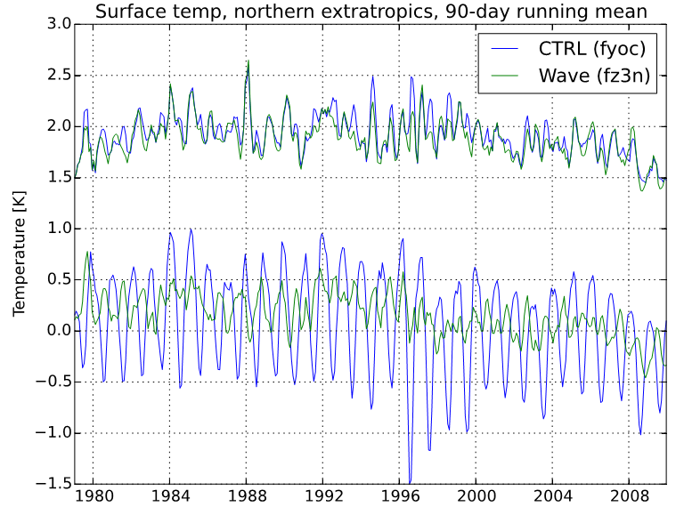
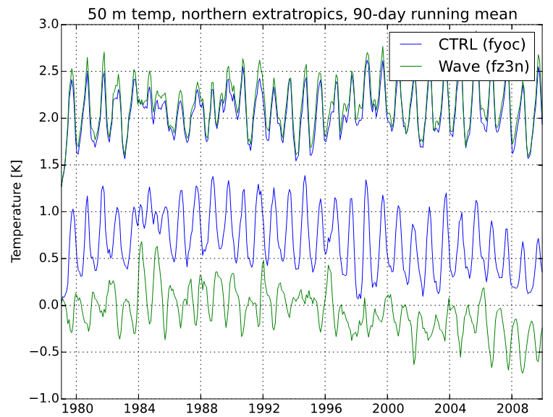
Wave effects in NEMO
Comparison of surface (left) and 50 m depth (right) EN3 ocean temperature observations (Ingleby and Huddleston, 2007) in the northern extra-tropics in the CTRL run (blue) and a run with all three wave effects switched on (green).
The upper curves show the standard deviation
while the lower curves represent the bias.
A 90-day running mean is employed.

Slide 33
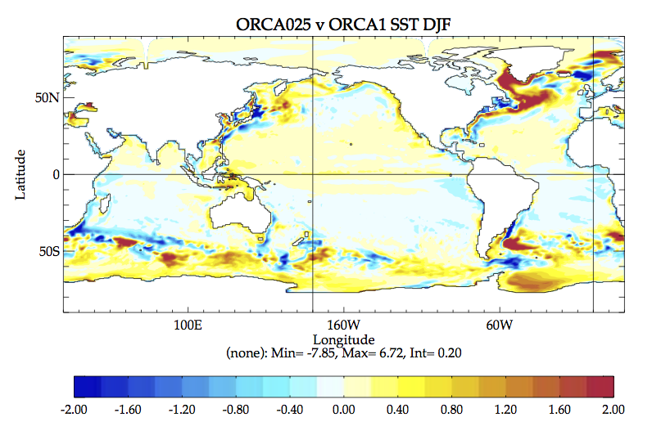
Future development:
Higher-resolution ocean model
SST difference (ORCA025 (¼ degree) - ORCA1) in Boreal Winter
Notes:
MPS – ORCA025z75 preliminary positive results …
Work will continue to investigate the role of mixing, with the goal to define the ORCA025z75 configuration to be implemented in ENS by 2016.

Slide 34
Atmospheric
model (IFS)
Towards a coupled system
All configurations
Air density
Gustiness
Roughness
Neutral wind
Ensemble FC
future operational
Single executable
Wave model (ECWAM)
Sea surface temperature
Ice concentration
Solar and non solar fluxes, E-P
Currents
Adding
active sea ice model
Stress
Turbulent energy
Ice concentration
Stokes drift
Implementation:
End 2016.
Ocean model (NEMO)
Ice model (LIM)
ORCA0.25°_Z75

Slide 35
End of part 1:

Slide 36
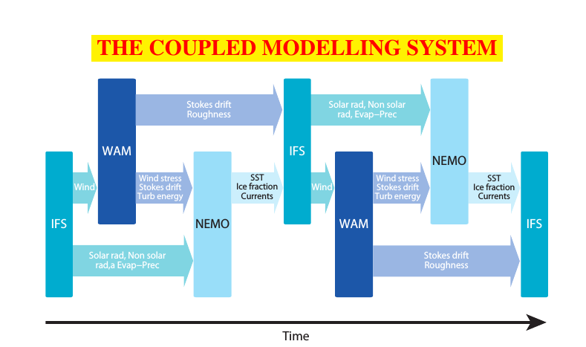
Calling sequence of the single executable
Simplified flow chart of the coupled model, here two time steps are shown.
In reality, IFS/WAM coupling every IFS time step, but
Call to NEMO every hour (or 3 hours) with averaged accumulated fluxes.

Slide 37
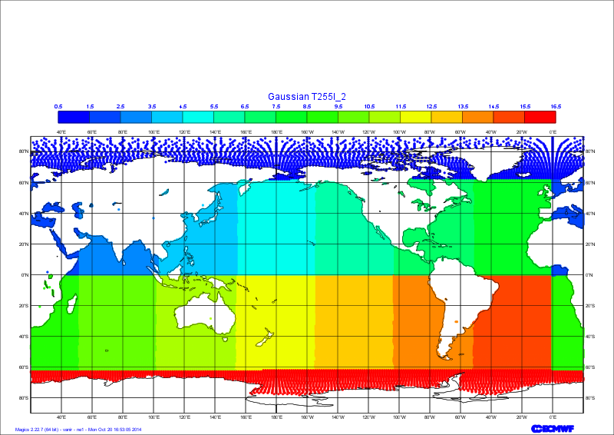
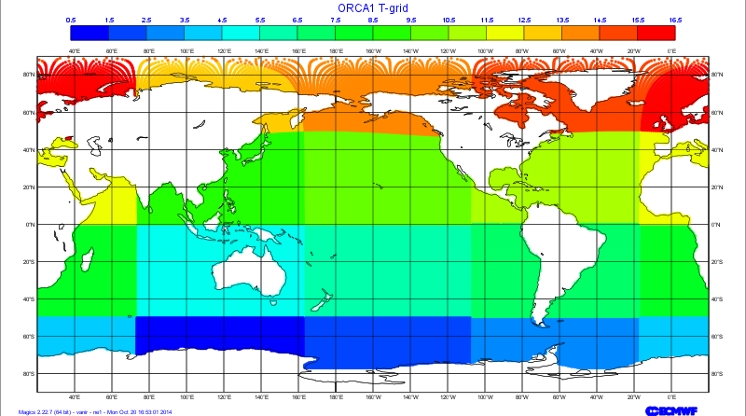
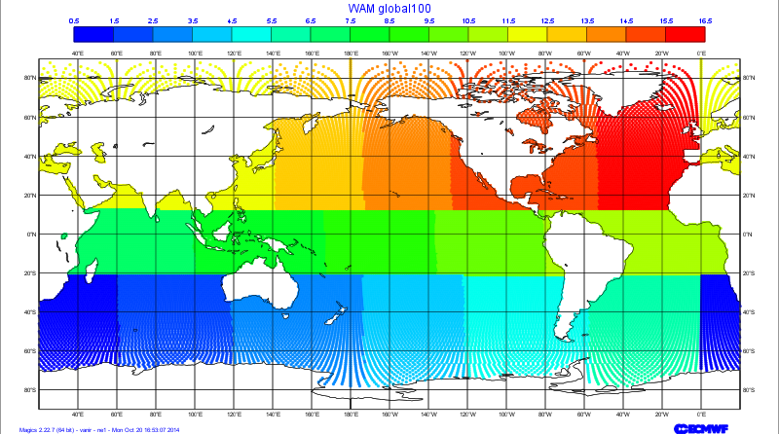
What to send where: domain decompositions for component models
IFS
NEMO
Gaussian grid
Tri-polar grid
Top left Gaussian N128 reduced atmosphere grid
Top right ORCA1 ocean grid
Bottom left 1.0 degree reduced wave grid
16 domains for all grids
Ocean points only.
ECWAM
Irregular let-lon grid

Slide 38
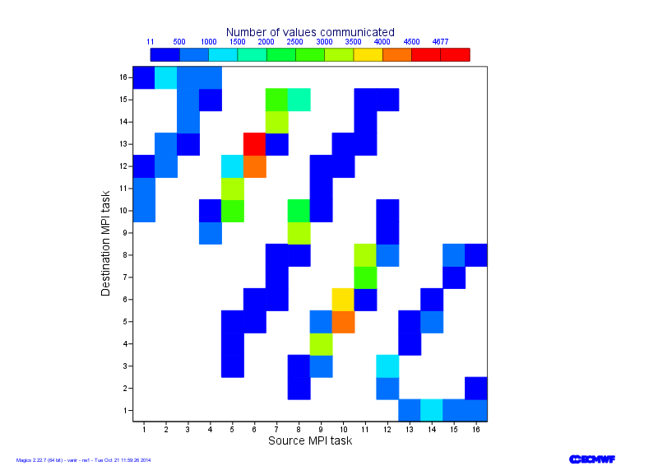
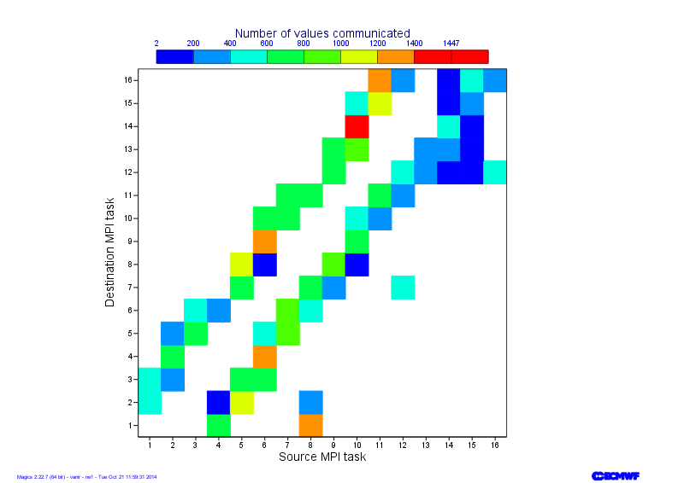
What to send where: communication patterns.
Grids from previous slide
16 point stencil used in interpolation.
Little overlap of areas means all interpolations needs communication.
Short messages of the order of Kbytes
Packing all fields together could be done to decrease the number of exchanges.
A solution could be to reshuffle domains in NEMO, but that would require changes to the halo exchange
IFS to NEMO
WAM to NEMO

Slide 39
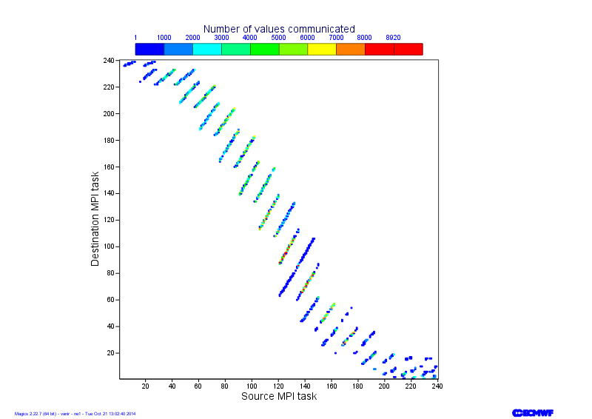
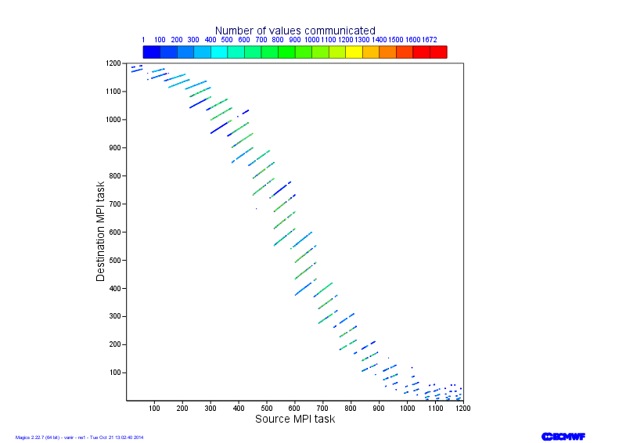
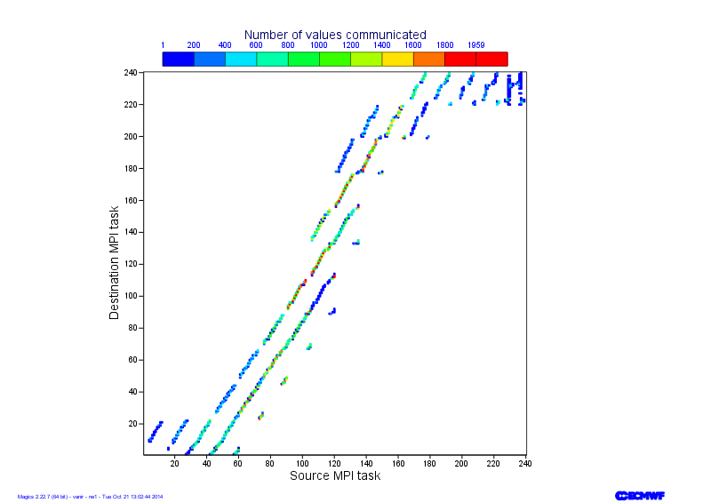
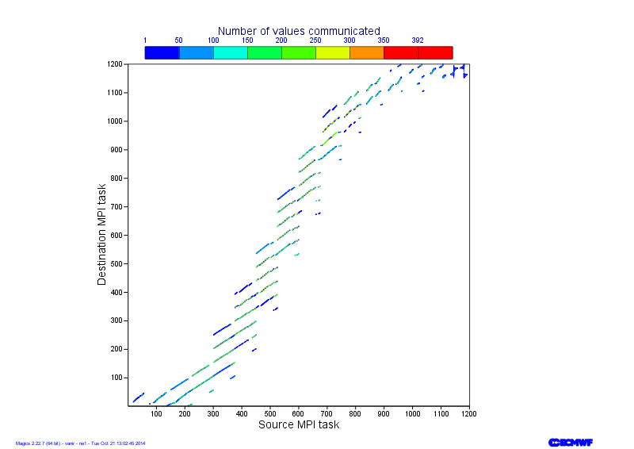
At higher resolutions: T1279+global025 to ORCA025
IFS to NEMO
240 MPI tasks
1200 MPI tasks
WAM to NEMO

Slide 40
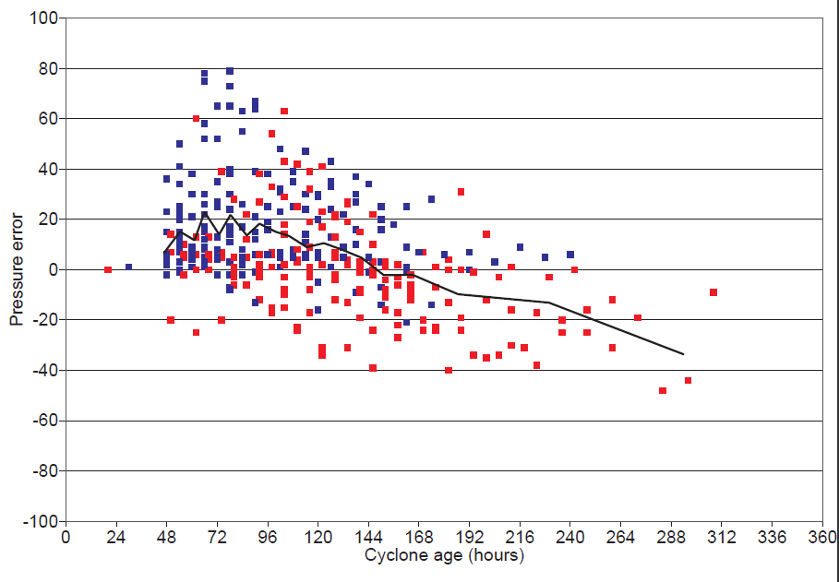
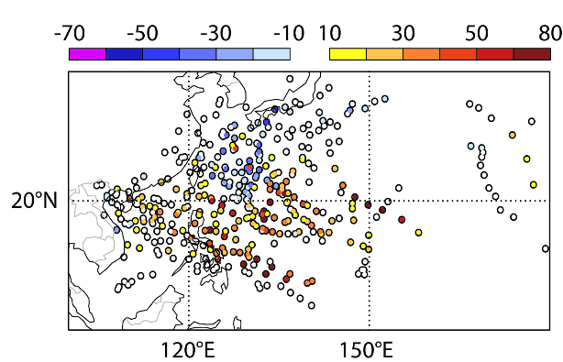
Tropical cyclone forecast performance:
Tropical cyclone core pressure mean error in the Western Pacific (hPa) of the operational high resolution system (HRES) in 2013-2014:
Error (hPa)
too
weak
20
-20
too
strong
Cyclone age (hours)
Red dots: north of 20°N
Blue dots: south of 20°N
Rodwell et al., 2015: New Developments in the Diagnosis and Verification of High-Impact Weather Forecasts. ECMWF Technical Memorandum 759. http://www.ecmwf.int/en/elibrary/technical-memoranda

Slide 41
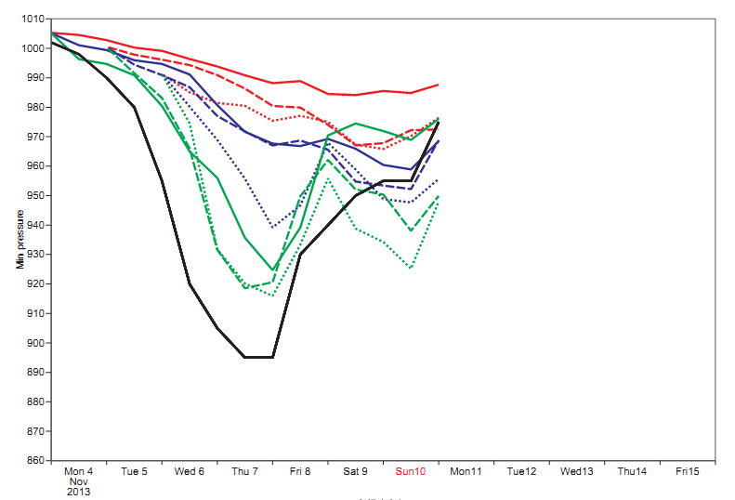

Impact of Resolution on tropical cyclone forecast
For instance Typhoon Haiyan: forecasts from 4th, 5th and 6th November 2013, 0 UTC
all from operational analysis.
min
MSLP (hPa)
950
900
Typhoon Haiyan at peak intensity on November 7, 2013
Black: estimated from observations
Red: old operational Ensemble resolution (32 km)
Blue: old operational HRES configuration (16 km)
Green: experimental: new HRES configuration (10km)

Slide 42


Impact of Coupling on tropical cyclone forecast
For instance Typhoon Neoguri: forecasts from 6 July 2014, 0 UTC
min
MSLP (hPa)
950
900
Neoguri affecting Okinawa on July 8, 2014
Black: estimated from observations
Green: old operational HRES configuration (uncoupled) (16km)
Red: experimental: 16km coupled to NEMO (ORCA025_Z75)
Blue: 16km coupled to NEMO + new physics

Slide 43

Impact of Coupling on tropical cyclone forecast
Difference in
Minimum
SST (K):
Coupled
minus
operational
Difference in
Minimum
MSLP (hPa):
Coupled
minus
operational
Difference in
Maximum
Wind speed (m/s):
Coupled
minus
operational
Difference in
Maximum
SWH (m):
Coupled
minus
operational
From 3 hourly output

Slide 44




Impact of Coupling on tropical cyclone forecast

Slide 45


Climate reanalyses for the coupled earth model
ECMWF coupled Earth model for medium-range weather forecasting
ECMWF coupled Earth model
atmosphere
oceans
Karl and Trenberth 2003
land
waves
sea ice
New coupled assimilation system (CERA) for the coupled Earth model:
atmospheric and ocean observations assimilated simultaneously
ocean observations can impact atmospheric estimate and conversely
CERA-20C reanalysis in production (1900-2010)

Slide 46

Coupled assimilation system (CERA)
EDA variational approach with a 24-hour window that assimilates simultaneously atmospheric and ocean observations
coupled model computes observation misfits in each outer iteration
SST computed in NEMO and constrained by relaxation
atmospheric and ocean increments are computed in parallel to correct the initial state
analysis dynamically consistent with respect to the coupled model

Slide 47

Information exchange in a coupled assimilation system
Atmosphere-ocean temperature cross-section
Ocean increment (assimilation of one temperature observation at 5-meter depth) spreads in the atmosphere during the assimilation process

Slide 48

Information exchange in a coupled assimilation system
Atmosphere-ocean temperature cross-section
Ocean increment (assimilation of one temperature observation at 5-meter depth) spreads in the atmosphere during the assimilation process

Slide 49

Information exchange in a coupled assimilation system
Atmosphere-ocean temperature cross-section
Ocean increment (assimilation of one temperature observation at 5-meter depth) spreads in the atmosphere during the assimilation process

Slide 50

Information exchange in a coupled assimilation system
Atmosphere-ocean temperature cross-section
Ocean increment (assimilation of one temperature observation at 5-meter depth) spreads in the atmosphere during the assimilation process

Slide 51

Information exchange in a coupled assimilation system
Atmosphere-ocean temperature cross-section
Ocean increment (assimilation of one temperature observation at 5-meter depth) spreads in the atmosphere during the assimilation process
Production of a coupled analysis which should be better balanced and consistent with respect to the coupled model

Slide 52
Atmospheric
model (IFS)
Towards a ‘fully’ coupled system
All configurations
Air density
Gustiness
Roughness
Neutral wind
Ensemble FC
future operational
Wave model (ECWAM)
R&D
Ice albido, ice temperature,…
Ice concentration
Sea surface temperature
Snow, …
Solar and non solar fluxes, E-P
Currents
Single executable
Turbulent energy
Ice concentration
currents
Ice thickness
Stress
?
Stokes drift
Ocean model (NEMO)
Ice model (LIM)

Slide 53
Conclusions:
ECMWF has a coupled atmosphere-wave-ocean circulation forecasting system, currently operational in the Ensemble Prediction System.
Work is ongoing on using a higher resolution ocean components (ORCA025z75) planned for end of 2016 in the Ensemble forecasts and later in the High resolution system.
There is a clear benefit in coupling the different models, but it creates new challenges in determining what physical parameters need to be exchanged.
Furthermore, model parameterisations might need revisiting.

Slide 54
Thank you for your attention …
ECMWF annual Seminar, 5-8 September 2016, Reading. UK :
Earth system modelling for seamless prediction:
on which processes should we focus to further improve
Atmospheric predictive skill?
Øyvind Breivik, Kristian Mogensen, Jean-Raymond Bidlot, Magdalena Alonso Balmaseda, and Peter A.E.M. Janssen, 2015: Surface Wave Effects in the NEMO Ocean Model: Forced and Coupled Experiments. JGR, doi: 10.1002/2014JC010565
Janssen, P.A.E.M., 1997: Effect of surface gravity waves on the heat flux. ECMWF Technical Memorandum 239. http://www.ecmwf.int/en/elibrary/technical-memoranda
Rodwell et al., 2015: New Developments in the Diagnosis and Verification of High-Impact Weather Forecasts. ECMWF Technical Memorandum 759.
http://www.ecmwf.int/en/elibrary/technical-memoranda

Slide 55


Impact of Coupling: revisit parameterisations?
x 10⁻³
C_{d}
Exchange coefficients
dependency on wind speed
Left: for momentum (C_{d})
6
3
10
55
C_{d} is sea state dependent
Edson et al., 2013
Holthuijsen et al. , 2012

Slide 56



Impact of Coupling: revisit parameterisations
x 10⁻³
In ECWAM, from about 1.3 times the peak frequency the model has an omega−4 spectrum which is caused by the nonlinear interactions pumping energy from the low frequency waves to the high frequency waves. In fact, we have the model spectra take the form of the Toba spectrum in that frequency
range.
6
3
10
55
x 10⁻³
However, clearly for strong winds, hence large u∗, the Toba spectrum cannot hold because the waves in that frequency range become too steep and breaking should happen.
Therefore, we impose a limitation to the high frequency part of the spectrum based on a limiting Phillips spectrum
6
3
10
55

Slide 57

Impact of Coupling: revisit parameterisations?
x 10⁻³
3
C_{h}
Exchange coefficients
dependency on wind speed
Right: for heat (Ch)
2
1
x 10⁻³
10
55
3
2
1
Brut et al. 2005

Slide 58

Effect of waves on heat flux:
Z_{T}
old
new
Z_{T}
Wave induced stress:
Janssen, P.A.E.M., 1997: Effect of surface gravity waves on the heat flux. ECMWF Technical Memorandum 239. http://www.ecmwf.int/en/elibrary/technical-memoranda

Slide 59

Impact of Coupling: revisit parameterisations
x 10⁻³
x 10⁻³
3
Exchange coefficients
dependency on wind speed
Left: for momentum (C_{d})
Right: for heat (C_{h})
Operational version
6
2
3
1
10
55
10
55
Experimental version
Sea state depend C_{h}
and
Maximum wave spectral
limitation.
x 10⁻³
x 10⁻³
3
6
2
3
1
10
55
10
55

Slide 60
Impact of Coupling on tropical cyclone forecast
min
MSLP (hPa)
950
900
Black: estimated from observations
Green: operational HRES configuration (uncoupled) (16km)
Red: 16km coupled to NEMO (ORCA025_Z75)
Blue: 16km coupled to NEMO + new physics

Slide 61

Impact of Coupling on tropical cyclone forecast

