Slide 1
Predictability Diagnostics 2
Mark Rodwell
(with the support of ECMWF
and external collaborators)
ECMWF Training Course on Predictability
12 May 2016, ECMWF Reading

Slide 2
“All in a spin”

Slide 3
The Vorticity Equation
Motivation (2D flow) :
z
is the unit “vertical” vector and
is the horizontal curl operator
y
x
Curl of the 3D momentum equation in absolute frame of reference:
Shallow atmosphere approximation & assuming horizontal, barotropic, frictionless flow:
Notes:
Vorticity is a key attribute of the atmospheric circulation. This slide introduces the concept of vorticity and the figures hopefully give more physical insight into the mathematical terms.
Note that there is some cancellation between the divergence and tilting terms in the vorticity equation. This cancellation is associated with “stretching”. Indeed, stretching only affects vorticity if it is accompanied by convergence into the axis of rotation: ballerinas spin faster because they bring their hands in, not because they stand up. The figures under the vorticity equation illustrate the four terms after this cancellation has been removed. The baroclinic term is non-zero if the gradients of pressure and density are not parallel. This term explains the “sea-breeze” effect when the daytime air density over the warmer land is less than over the cooler ocean. The frictional term may simply act to damp the flow (as illustrated).
Interestingly, the same form of the vorticity equation also applies if we measure the 3D wind and the change in absolute vorticity relative to the rotating Earth. (The component removed from the material derivative to take account of the Earth’s rotation exactly cancels the component removed from the tilting term, and other terms are unaffected).
Having discussed the mechanisms in which the vorticity of a parcel of air can be modified, we will now assume that the last three terms are negligible! (as a first-order investigation of mid-latitude synoptic scales). This is the case if the flow is horizontal, barotropic and frictionless. The equation at the bottom of the slide shows the remaining terms in the vorticity equation. Basically, the material derivative has been split into an Eulerian time derivative and advection parts (associated with the rotational wind ${\underline{v}}_{ψ}$ and divergent wind ${\underline{v}}_{χ}$). This later term can be combined with the divergence term to produce the “Rossby Wave Source”. By placing this on the right-hand-side of the equation, we have in mind a situation where tropical divergent anomalies can force extratropical non-divergent response – tropical-to-extratropical forcing.

Slide 4
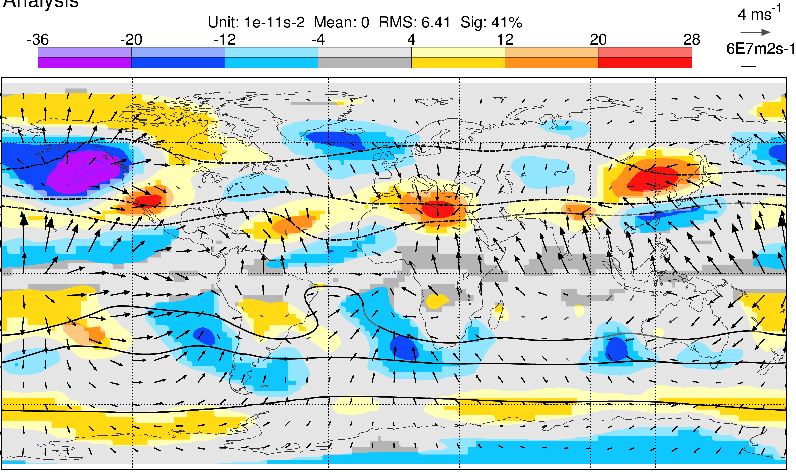
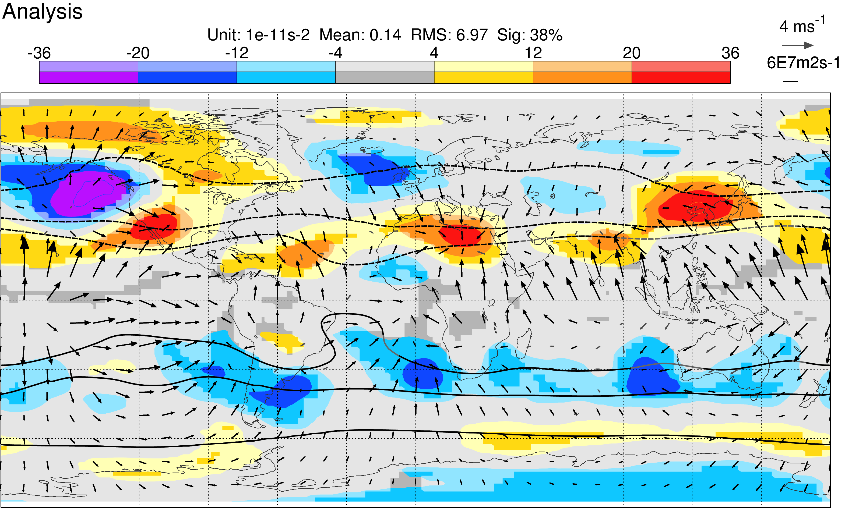
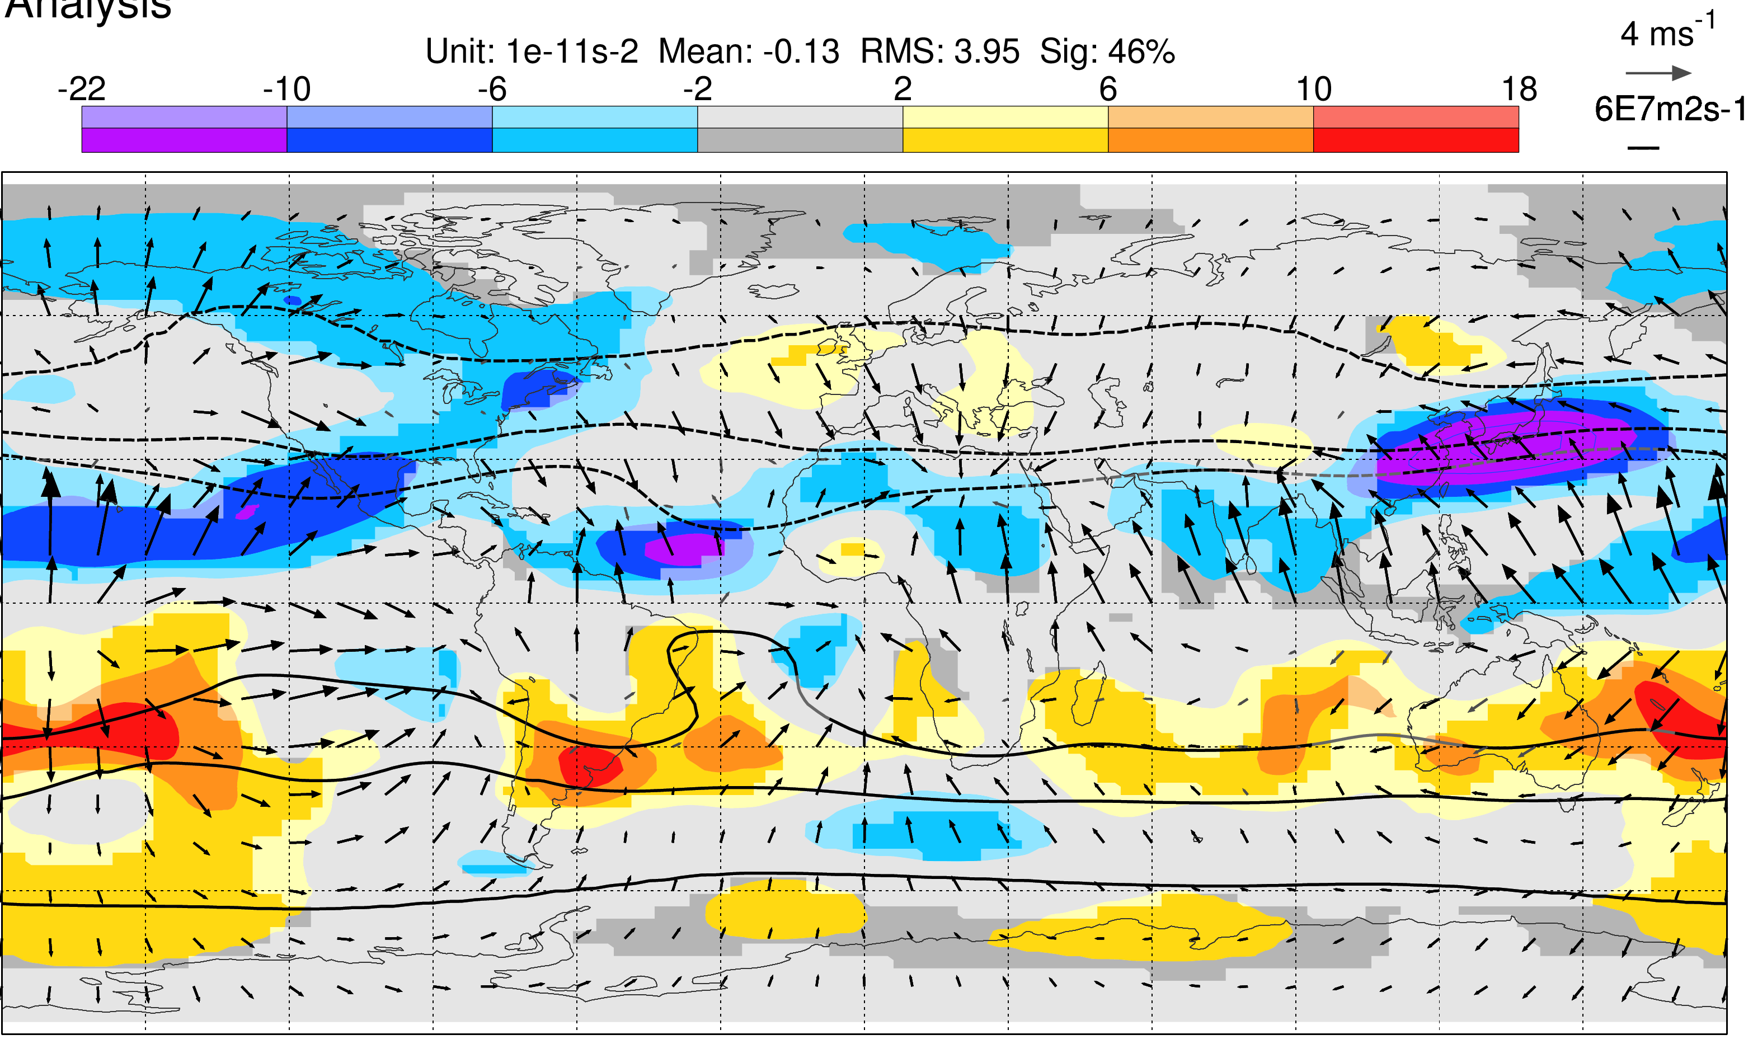
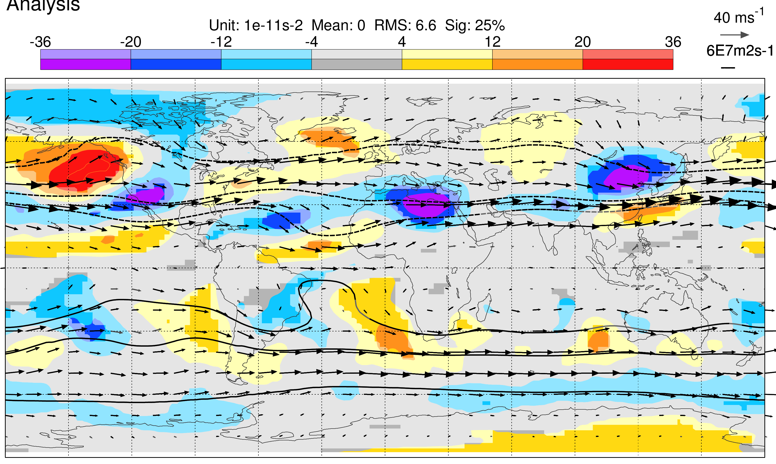
Terms in the Vorticity Equation
Mean Rossby Wave Source
Mean divergence component
Convergence associated with “stretching”
Mean divergent advection
Mean rotational advection
Advection of low planetary vorticity by divergent outflow
Adjustment of rotational flow balances RWS
Based on operational analyses for the period DJF 2015/16, with terms integrated between 100-300 hPa.
Notes:
Here we see some terms of the barotropic vorticity equation averaged over the season DJF 2015/16. The circle in the top-left panel highlights the mean Rossby Wave Source (RWS) down-stream of Tibet. We see that both components are important in the RWS. There is a strong positive vorticity forcing due to convergence associated with stretching as the jet passes the peak in orography (top right). There is also a strong negative vorticity forcing due to advection by the divergent outflow associated with “Warm Pool” convection over Indonesia (bottom left). One can imagine how the MJO might alter this term as it passes-by. Since we have averaged over a whole season, the local time derivative in the barotropic vorticity equation is negligible and so the RWS must be balanced by vorticity advection by the rotational flow, with implied adjustments to the streamfunction field (bottom right).

Slide 5
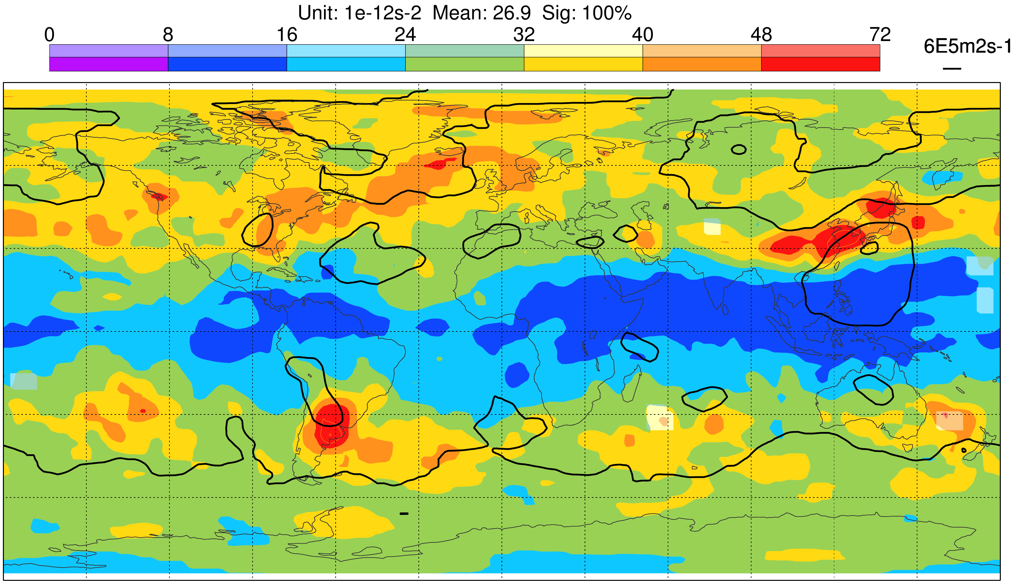
Day 1 RMS Error in Rossby Wave Source
Based on operational analyses and forecasts for the period DJF 2015/16, with terms integrated between 100-300 hPa.
Notes:
Here we see day 1 root-mean-square errors in the Rossby Wave Source for DJF 2015/16. The region down-stream of Tibet is highlighted as a region of particularly large errors. There is another such region down-stream of the Andes and, in other seasons (MAM and JJA) the region down-stream of The Rockies also shows large errors (not shown). This short lead-time error in the RWS is a useful diagnostic of the forecast system – because it highlights vorticity forcing errors at the entrance to the stormtracks, and also because it is important if we are interested in extended-range forecasts where teleconnections from the tropics into the extratropics are important.
In the next slide, we will see an example of a Rossby wave emanating from the down-steam Tibet region.

Slide 6
Extra-tropical Rossby waves
10⁻¹⁰s⁻²
100–300 hPa v_{Ψ}, v_{χ} & RWS
Contour 8ms⁻¹
24 May
Group Speed
(of wave-packet)
25 May
Phase Speed
26 May
✓
27 May
2008
Notes:
Often we see wave-trains within the extratropics that tend to propagate eastward. Here, the contours highlight meridional flow anomalies in the upper troposphere (strictly, what is contoured is the rotational flow component of the total meridional flow. The shading is the RWS and the vectors are the divergent wind)). By drawing a line through some of these features it is clear that they are propagating eastward. What we are seeing is a Rossby wave train. In the tropical waves discussion in the previous lecture, you will recall that Rossby Waves propagate west. This westward (upstream) propagation is still occurring here (see the $β$-term), but the wave is now also being advected downstream by the Jet ($\overline{u}$). (The equatorial wave equations were linearized about a resting basic state, but this is even less appropriate here). Notice also that the head of the wave-train appears to move more quickly than the individual anomalies move themselves. This faster effect happens at the ‘group velocity’ of the wave packet.
When such waves arrive over the Rockies, they can lead to convective instabilities over the Eastern US. Forecast errors in these waves and magnification of these errors by such instabilities can lead to a “perfect storm” whereby forecasts for Europe a few days later can be very uncertain (leading to so-called Forecast “busts”).

Slide 7
Flow dependent reliability is key

Slide 8
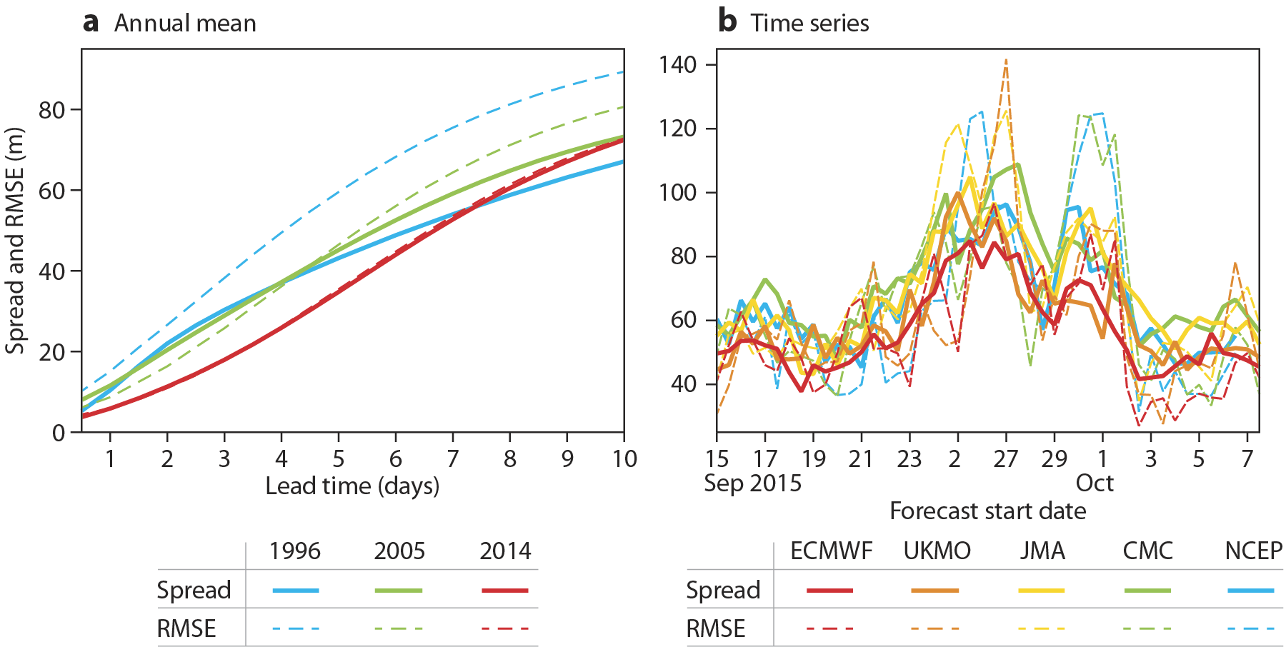
Ensemble spread and error
Z500
Northern Hemisphere, annual mean
Europe, day 6
Rodwell 2016, ECMWF Newsletter
Improvements in sharpness and reliability. Due to:
Ensemble of data assimilations
Stochastic physics
Observations and modelling of observation error
Spread agreement between centres indicates flow-dependent fluctuations in underlying predictability (reason for ensemble forecasting!)
Need to assess flow-dependent reliability
500 hPa geopotential height (Z500). RMSE is of ensemble-mean error. Spread = ensemble standard deviation (scaled to take account of finite ensemble size).
Notes:
A common assessment of ensemble forecasts is to compare the standard deviation of the ensemble with the error of the ensemble-mean. This so-called “spread-error” assessment is shown in the left plot based on operational forecasts of 500 hPa geopotential heights for three different years. In 1996, errors increased sharply from the initial time (blue dashed) and, in an attempt to match this, “singular vector” perturbations were applied to the ensemble members to boost the initial growth of ensemble spread (blue solid). Nevertheless, at longer leadtimes the spread failed to keep pace with the growing errors. In 2005, the situation was somewhat better with smaller initial error growth (green dashed), which was more closely matched by the spread (green solid). In 2014, the initial exponential shape of the error growth curve matches what one might expect based on theory. Importantly the spread curve is also indistinguishable. This remarkable achievement has involved improvements to both ensemble reliability and sharpness, and is due to many incremental changes to the system – notably the introduction of the Ensemble of Data Assimilations (EDA), developments in “Stochastic physics” schemes that attempt to account for model uncertainty, and improvements in observations and the modelling of observation errors.
However, this is not the whole story. A perfect match of mean spread and error is only a zero’th-order requirement for forecast reliability. What we really need is flow-dependent reliability – we wish to “predict the predictability” that will vary from day-to-day. The right-hand plot shows daily variations in spread and error at a leadtime of 6 days for five different NWP centres. The agreement between centres of an increase in spread around 26 October suggests a flow-situation that is inherently less predictable. Are our ensemble forecasts reliable when averaged over a set of similar initial flow regimes?

Slide 9
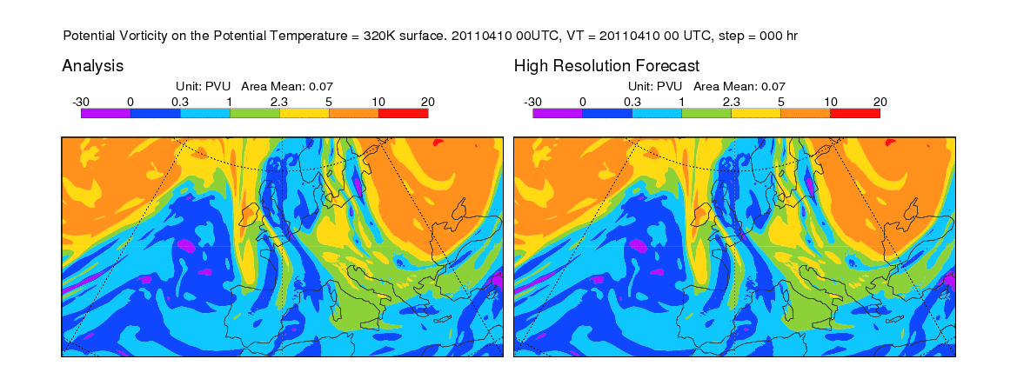
Animation of ‘bust’ forecast: Initial conditions on 10 April 2011
Potential Vorticity on 320K
Animation of forecast started at 0 UTC on 10 April 2011
Notes:
Here is an example that led to a very poor deterministic forecast at day 6. I am showing Potential Vorticity (PV) on the 320K isentropic surface. The orange colours highlight high PV air, primarily from the polar stratosphere. The blue colours highlight tropospheric air from lower latitudes. The green shading in-between highlights where the tropopause intersects this surface. PV is materially conserved in adiabatic, frictionless situations. Hence PV highlights nicely the atmospheric flow and the physical process (convection etc.) that are modifying it. In the next slide, we see an animation of the subsequent analysed and forecast flow.

Slide 10
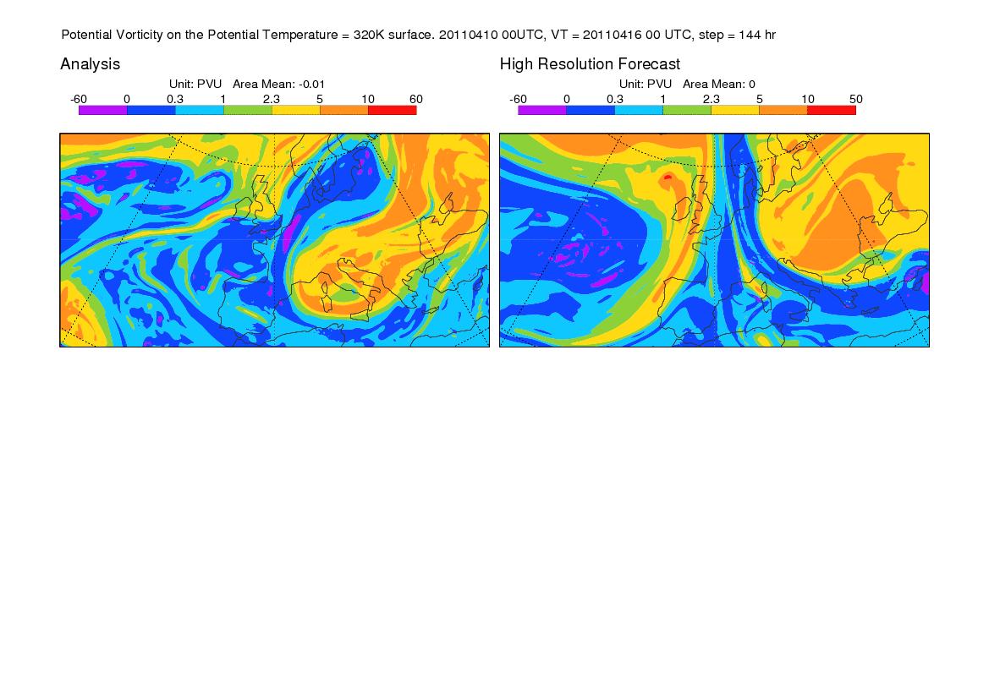

Animation of ‘bust’ forecast: Evolution to day 6
Potential Vorticity on 320K
Block forms in observations, but not in forecast
It is difficult, by day 6, to disentangle model error from the natural growth of initial condition uncertainty (chaos)
Notes:
Over the first 6 days of the forecast, we see how the flow evolves. We see examples of anticyclonic wave-breaking that, in the analysis, lead to a blocked-type flow over Europe at day-6. The single high-resolution forecast is particularly poor by day-6, but what led to this forecast failure? Was it a model error? Was it that the initial conditions were unusually poor? Was it that the flow was more un-predictable than usual? We cannot begin to disentangle these issues at day-6 without moving to the ensemble (probabilistic) forecast system.

Slide 11
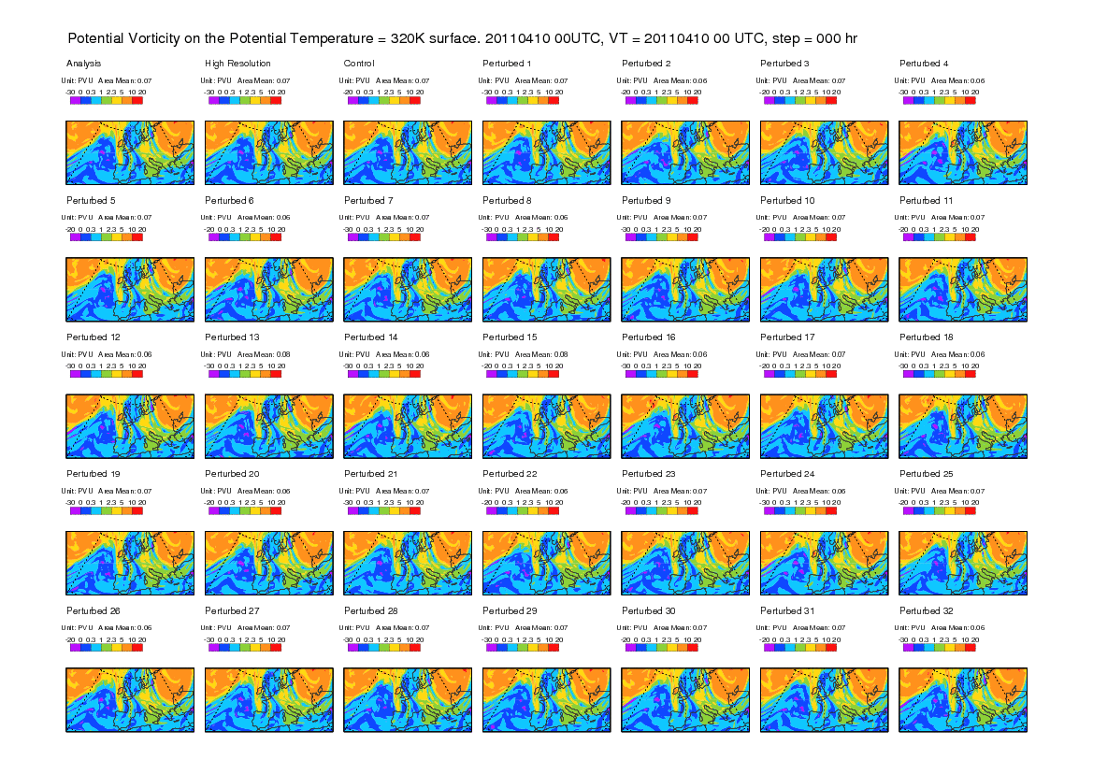
Animation of ensemble forecast: Initial perturbations on 10 April 2011
Potential Vorticity on 320K
Notes:
Here we see the same initial conditions, but I have also included the ensemble forecast system. For clarity, I am only showing the first 32 of the 50 ensemble members (labelled ‘Perturbed’). Looking carefully, it is possible to see slight differences in the initial conditions of these ensemble members. These differences represent our uncertainty in the observations and also errors that are likely to grow most quickly in the early stages of the forecast. I have also included the ‘control’ forecast for the ensemble. The initial conditions for the control forecast match more closely those of the high-resolution forecast, but are at the lower-resolution of the ensemble (although this is not easy to see differences here).

Slide 12
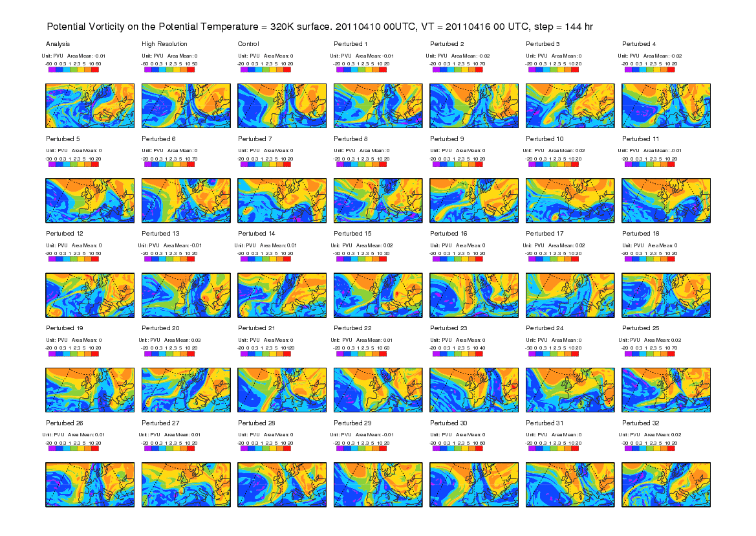

Animation of ensemble forecast: Evolution to day 6
Potential Vorticity on 320K
Notes:
Again we see how the forecasts evolve over the first 6 days. In addition to the differences in initial conditions, the ensemble forecasts also include ‘stochastic physics’ (stochastically-perturbed physical tendencies – SPPT) which acts to represent sub-grid-scale uncertainty (or non-determinism) for a given resolved flow field.
At day-6, there is a lot of ‘spread’ in the ensemble – reflecting our uncertainty in the outcome. But do any members capture the real outcome? One member (‘Pertubed 32’) matches quite well the analysis. It is clearly possible that the issue is purely associated with low inherent predictability. In which case, any improvement would require reducing uncertainties in the initial conditions through access to more observations, or more accurate observations, or improvements to the data assimilation system. (This should sharpen the forecast distribution, but this only makes sense if we can maintain ensemble reliability, and thus keep the truth within this sharper distribution).
Can we identify an aspect of the initial flow that is responsible to this poor forecast? If so, can we assess forecast reliability over a set of cases involving this flow aspect?

Slide 13
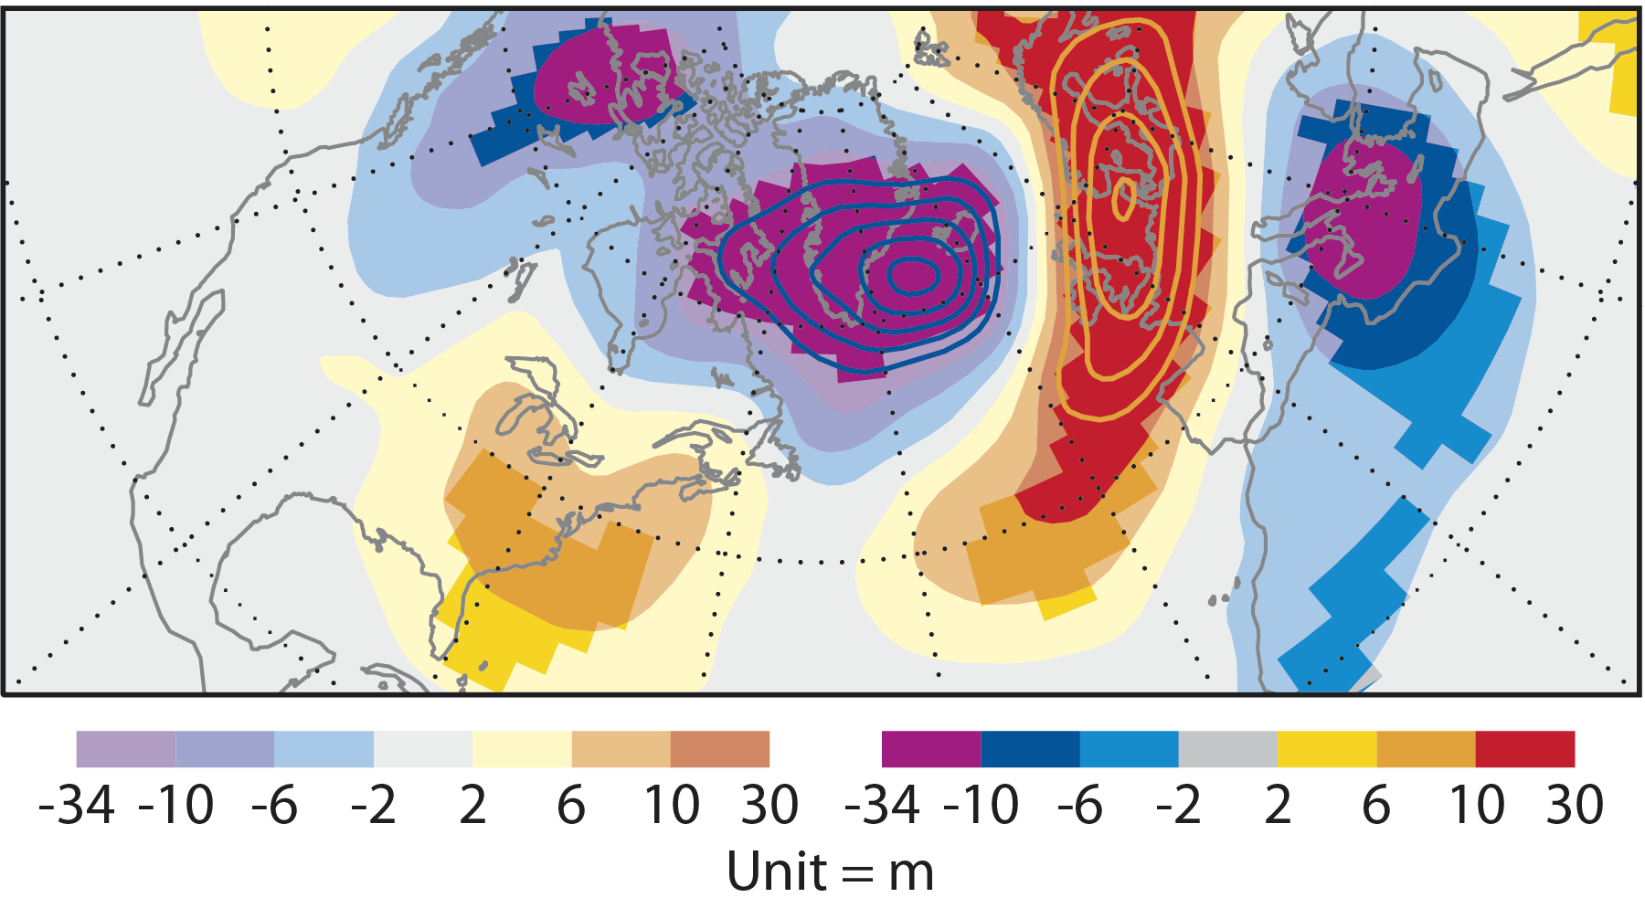
Verifying conditions composited over many bust forecasts
Rodwell et al, 2013, BAMS
500 hPa geopotential height (Z500) anomaly
Rex-type block
Unit = m Bold colours = statistical significance at 5% level
Composite of 584 busts in ERA Interim forecast prior to 24 June 2010
Notes:
If we composite over many forecast busts (here based on the ERA-Interim forecast to maximise the sample size to 584 cases), we find a coherent and statistically significant signal of a wave train ending in a blocking situation over Europe.

Slide 14
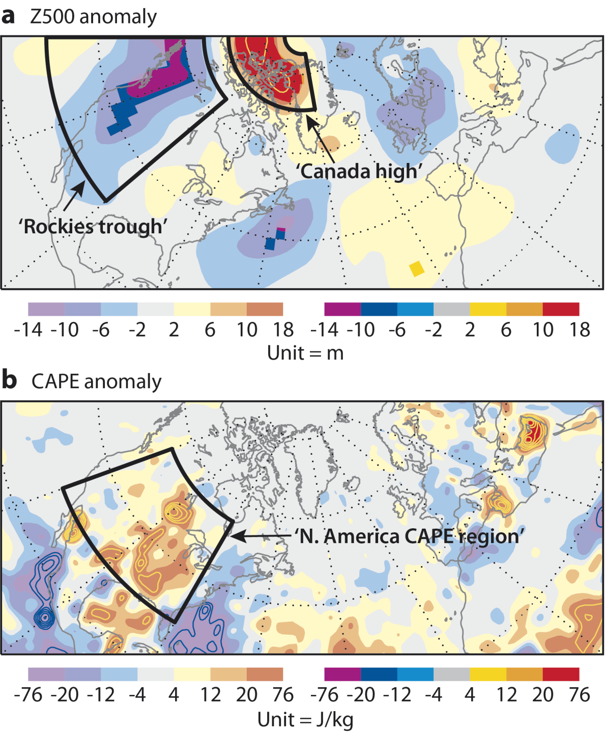
Composite initial conditions of bust forecasts
Rodwell et al, 2013, BAMS
There is an initial flow regime: “Rockies trough” with high CAPE ahead
Conducive to the formation of mesoscale convective events (MCS)
Remarkable that we can identify any significant initial conditions 6 days ahead of the busts – this must be due to the large composite (584 events) used
Other bust causes not so geographically fixed and are not highlighted by this composite-mean
‘CAPE’ = Convective Available Potential Energy
Bold = 5% significance
Notes:
More surprisingly, we also find a statistically significant signal in the initial conditions of these 584 forecasts. This signal is not over Europe, but upstream over North America and includes a trough over the Rockies with high Convective Available Potential Energy (CAPE) over the eastern North America. Not all the bust cases will be associated with this pre-cursor pattern, and it is likely that the one that is highlighted is largely due to the fact that it is in a geographically fixed location. As discussed earlier, what seems to happen (at least sometimes) is that a Rossby wave train arrives from the Pacific region and sets-up conditions where meso-scale convection might occur over North America. The outflow from such convection can perturb the Jetstream and lead to downstream wave-breaking and possible blocking.

Slide 15
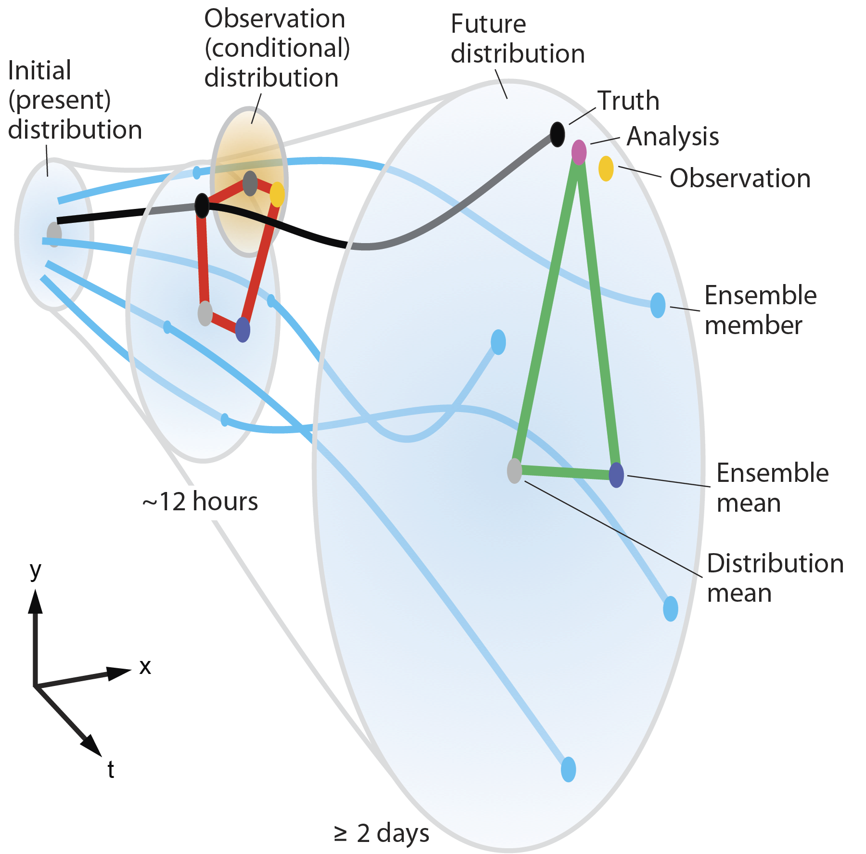
Reliability in ensemble forecasting
Adapted from Rodwell et al. (2015) QJRMS
Error² = EnsVar + Residual
(Cross-terms on squaring have zero expectation. EnsVar is scaled variance to account for finite ensemble-size)
Notes:
It is worth first considering a little further what is meant by ensemble reliability. This figure (re-drawn from Rodwell et al. 2015) shows a perspective diagram of a reliable ensemble forecast system. The light blue curves depict the trajectories of individual ensemble members as a function of leadtime ( “x” and “y” could be two state variables or the principle components of the leading EOFs, for example, and “t” is the leadtime, coming out of the plane). At any given leadtime, the ensemble members represent independent samplings of an underlying distribution (depicted by the light-blue shaded ellipses; and can be thought-of as the distribution one would get from an infinite ensemble). For a reliable forecast system, the truth (black curve) also represents a sampling of the same distributions (Hamill 2001; Saetra et al. 2004). For medium-range forecasts (t ≥ 2 days, right-hand distribution), the analysis (pink dot) is often an adequate approximation for the truth (black dot). The right side of the green triangle represents the error of the ensemble-mean (dark-blue dot) relative to this analysis. The error can also be written in terms of the other two sides of the triangle, which represent the differences of the analysis and ensemble-mean from the distribution-mean (light-grey dot). Using the ensemble and analysis values from a sufficient number (n) of forecasts, the mean-squared lengths of the sides of the triangle can be estimated, and this leads directly to the often-used “spread-error” equality for reliable forecast systems (see, e.g., Leutbecher and Palmer 2008). More generally, this relationship can be written as
$${\text{Error}}^{2}=\text{EnsVar}+\text{Residual}$$
where ${\text{Error}}^{2}$ is defined as the mean-squared error of the ensemble-mean, EnsVar is the mean sample variance of the ensemble (scaled by ${\left(m+1\right)}/{\left(m−1\right)}$ to take account of the finite size $m$ of the ensemble), and Residual represents any imbalance due to sampling uncertainties or deficiencies in reliability (its expected value is zero for a reliable system). It is important to note that the $n$ forecasts considered could represent a sub-set of forecasts associated with a particular initial state, and here we will base the analysis on a composite whose initial states project strongly onto the trough/CAPE patterns.

Slide 16
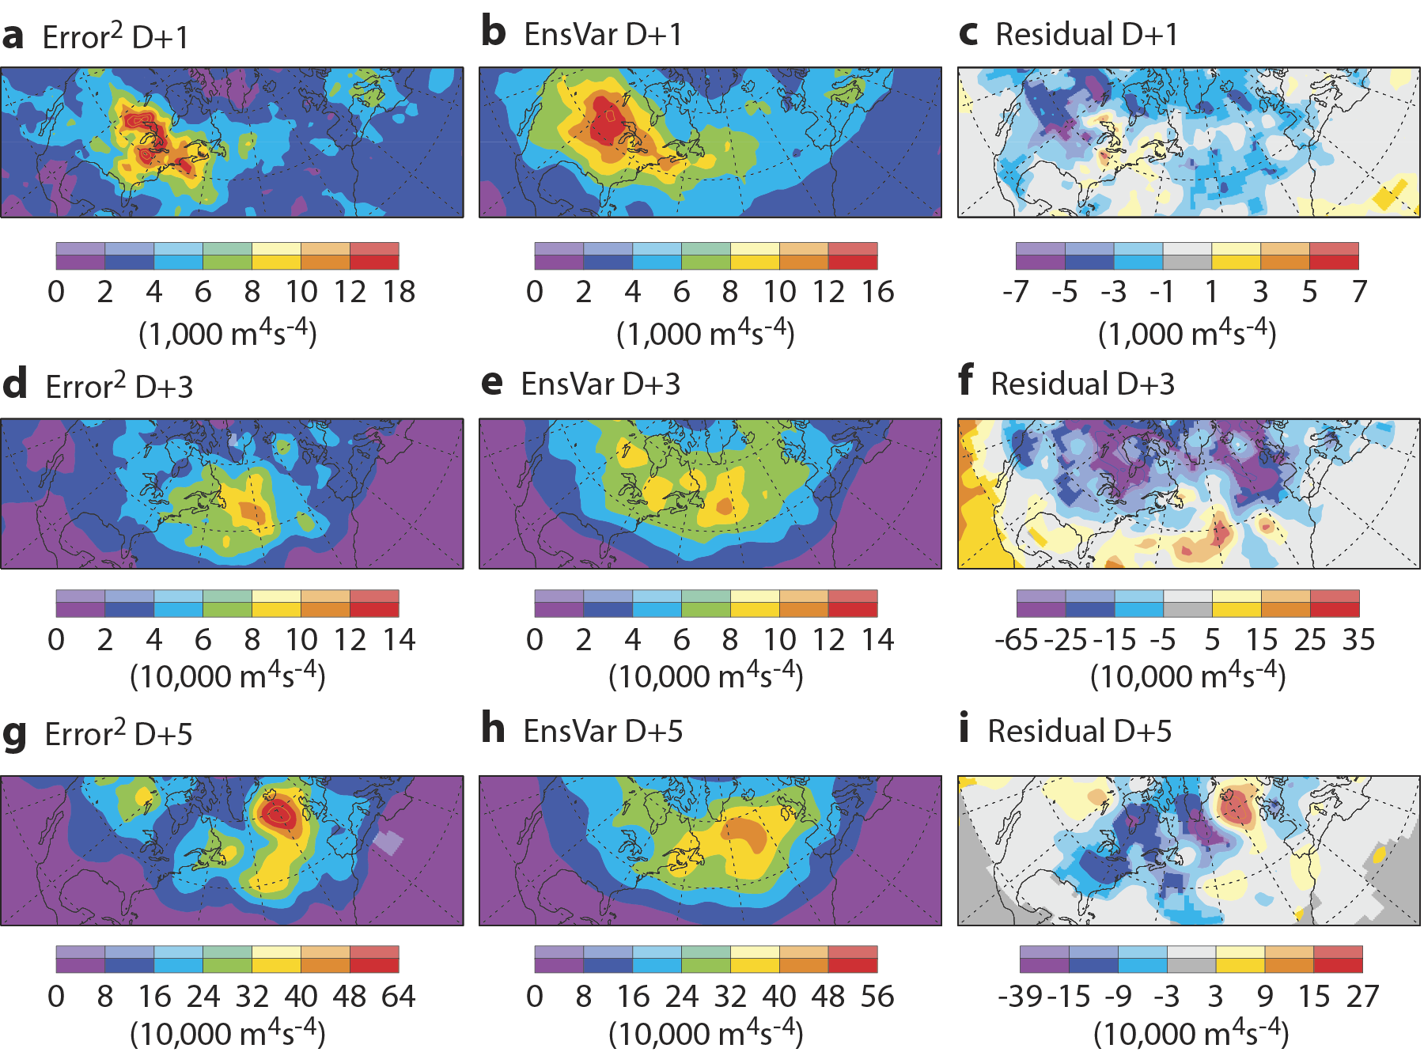
Composite with North American trough & CAPE ( ⇒ Mesoscale convective systems)
Z200, 54 cases
Error²
Ensemble Variance
Residual
Rodwell 2016, ECMWF Newsletter
D+1
Not significant
95% confident
D+3
D+5
Error² = EnsVar + Residual
Reliability ⇒ Ε[Residual]=0
✓
Following conditions conducive to MCS development, enhanced errors and spread propagate east towards Europe → ‘Busts’
Note: -ve residuals occur in non-trough/CAPE situation too.
+ve residual at D+5 is not significant (Chaos? → use bigger sample or shorter leadtime? But analysis uncertainty at D+1?)
✗
Notes:
Using more recent, independent data, can the spread-error relationship tell us anything about the forecast reliability in the North American trough/CAPE flow-regime? Here I have composited on 54 cases that involved a Rockies trough with downstream CAPE in the initial conditions. We do see increased errors at Day 1 in the region where meso-scale convective systems (MCSs) are likely to occur (in reality and/or in the forecast), and these increased errors grow and propagate westward with leadtime (note the changes in contour interval). At a leadtime of 5 days, notice the large mean-squared error just west of Europe – in agreement with the bust scenario. The ensemble variance actually does a reasonable job of predicting the evolution of the errors, although fails to predict the possibility of large errors off western Europe at day 5. The residual is the difference (Error² – Variance). It highlights the discrepancy at day 5 although it is not statistically significant at the 5% level (not shaded with saturated colours). Furthermore, the residual highlights blue values throughout the forecast range – and this is not specific to the trough/CAPE situation. Hence it seems that the spread-error relationship is not able, in this case, to identify residual deficiencies in flow-dependent reliability (assuming they exist). We could increase the sample size to improve statistical significance although this is not practical from a developmental perspective as we only have limited experimental periods available. Alternatively, we could decrease the lead-time (as we did with the Initial Tendencies). However, we would need to account for analysis uncertainty since this has a non-negligible impact on our estimation of error at short leadtimes.

Slide 17
Reliability in ensemble data assimilation
Adapted from Rodwell et al. (2015) QJRMS
Depar² = Bias² + EnsVar + ObsUnc² + Residual
(Cross-terms on squaring have zero expectation. EnsVar is scaled variance to account for finite ensemble-size)
Notes:
The crossing of the blue ensemble trajectories in the figure represents the fact that errors are growing within a non-linear regime, interacting, and dispersing through the action of teleconnections and waves in general. These effects make it inherently difficult to assess ensemble reliability in the medium-range, and even harder to identify the causes of any unreliability.
To avoid such issues, a new diagnostic based on the EDA has been developed. The much shorter leadtime involved (~12hr) means that errors are growing within a more linear regime, and have not had so much time to interact or to disperse geographically. The hope is that this will reduce the required sample size, and make the assessment of ensemble reliability more local. At these short leadtimes, uncertainty in our knowledge of the truth cannot be neglected. We could incorporate an EDA analysis variance term into our reliability test to take account of this aspect, but we choose to work in observation-space since a good estimation of observation bias and random error represents a more ‘foundational’ aspect of the data assimilation process. Because observation errors cannot be neglected, we talk about “departures” from observations rather than “errors” from the truth. The new “EDA reliability budget”, which is based on the red pentagon in the figure, is a decomposition of the mean-squared departures of the form
$${Depar}^{2}={Bias}^{2}+EnsVar+{ObsUnc}^{2}+Residual$$
EnsVar is, as before, the scaled sample variance – but now of the EDA background forecasts. ObsUnc² is the sample variance of the observation errors – as assigned within the assimilation system (see, e.g., Hollingsworth and Lönnberg 1986; Desroziers et al. 2005; Bormann and Bauer 2010 for how observation error variances are estimated). Bias² is the square of the estimated remaining bias – for example, after the application of variational bias correction (Dee 2004). Note that this equation reduces to the traditional spread-error relationship if biases and random observation errors are neglected.
We will apply, for the first time, the EDA reliability budget in a flow-dependent situation; the trough/CAPE composite. There are two key questions to answer. (a) Is the EDA reliability budget able to identify statistically significant reliability deficiencies when composited on this flow regime? (b) If so, then what are these deficiencies?

Slide 18
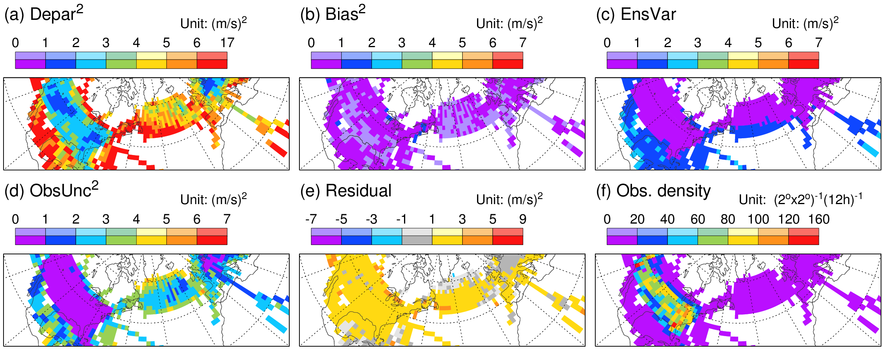
EDA reliability budget: Non-trough/CAPE comp.
u200, ~1000 cases
Rodwell 2016, ECMWF Newsletter
Relative to aircraft observations of zonal wind 200hPa (±15)
Depar² = Bias² + EnsVar + ObsUnc² + Residual
Reliability ⇒ Ε[Residual]=0
Residual suggests general underestimation of background variance or observation uncertainty
Not interested in this here as we are interested in flow-dependent reliability
Notes:
First we consider EDA reliability in a more normal situation by computing the budget for the non-trough/CAPE composite. The figure shows the terms in the EDA reliability budget, together with the observation density, for 200 hPa (±15 hPa) zonal wind speed measurements made by aircraft, and actively assimilated in (the control member of) the EDA. Aircraft observations are numerous over central North America at this cruising altitude (f) and, indeed, they are particularly influential in the data assimilation system. Observation uncertainty (d) is computed from the (independent) observation errors assigned within the data assimilation system. When averaged onto a 2ºx2º grid, the observation uncertainty is naturally smallest where the observation density is largest. The EDA reliability budget decomposes the squared departure term (Depar²; a) into contributions from the bias (Bias²; b), ensemble variance (EnsVar; c), observation uncertainty (ObsUnc²; d) and a Residual term (e). The spatial structure of the Depar² term in the non-trough/CAPE composite largely follows that of the observation uncertainty. There is a more uniform offset that is partly associated with the ensemble variance (and possibly also the bias). However, there is a small but statistically significant residual term. As discussed by Rodwell et al. (2015), this residual indicates that either the forecast model’s error growth-rate is deficient, or that the assigned observation errors are too small. We will not investigate this issue here as we are interested in diagnosing flow-dependent reliability.

Slide 19
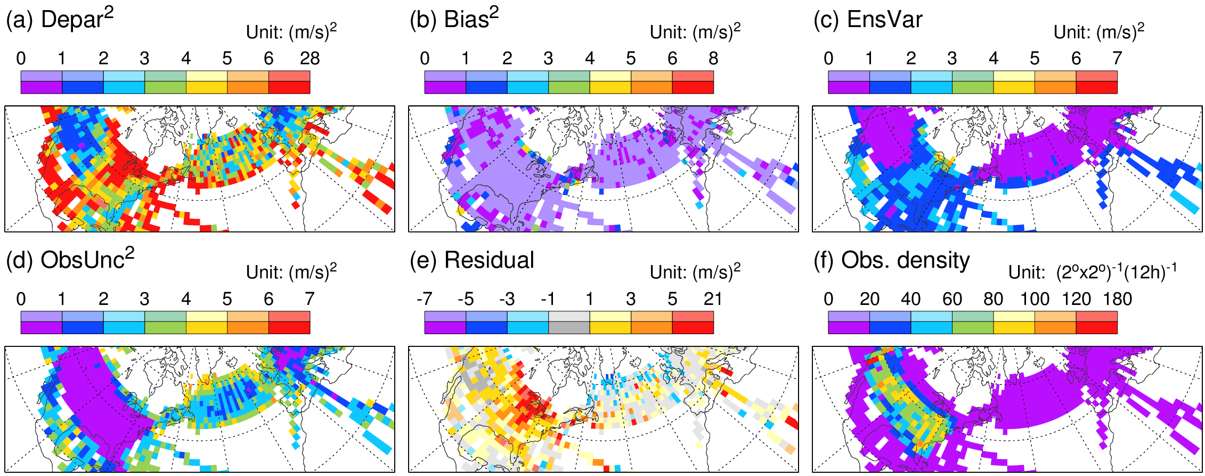
EDA reliability budget: Trough/CAPE comp.
u200, 54 cases
Rodwell 2016, ECMWF Newsletter
Relative to aircraft observations of zonal wind 200hPa (±15)
Depar² = Bias² + EnsVar + ObsUnc² + Residual
Reliability ⇒ Ε[Residual]=0
Key result: Residual in trough/CAPE regime highlights MCS, and suggests lack of background variance
(Observation uncertainty changes should be a second-order effect for this large-scale wind field)
One interpretation: The inherent un-predictability of the existence, intensity and location of MCS events is not adequately reflected in Jetstream uncertainty (with downstream consequences)
Notes:
This figure shows the EDA reliability budget terms for the trough/CAPE composite. Comparison with the non- trough/CAPE composite shows increased departures around the Great Lakes in the trough/CAPE composite. Larger departures are to be expected because of the strong (and less predictable) convection liable to be taking place. The increased ensemble variance indicates more forecast uncertainty in this region. Notice, however, that this increase does not fully account for the increased departures, and consequently the Residual term (note the different shading interval) increases markedly too in the region associated with MCS activity and has roughly twice the magnitude of the ensemble variance. One possibility is that the ObsUnc² term does not increase sufficiently in these convective situations. However, aircraft wind observations are thought to be quite accurate (they are assimilated without bias correction) and they are probably dense enough in this region (≥60 per 2ºx2º grid box per 12 hour, and with little change in density) to rule out an increase in representativeness errors for the upper-tropospheric wind field. Hence it is likely that the background variance is strongly deficient in these trough/CAPE (and MCS) regimes. This ensemble variance deficit could be due to deficiencies in stochastic physics – either in magnitude or formulation in these mesoscale convection situations. Systematic model error may also contribute – as will be seen next.
From a diagnostic development point of view, the key result here is that the EDA reliability budget is able to identify flow-dependent deficiencies in reliability.

Slide 20
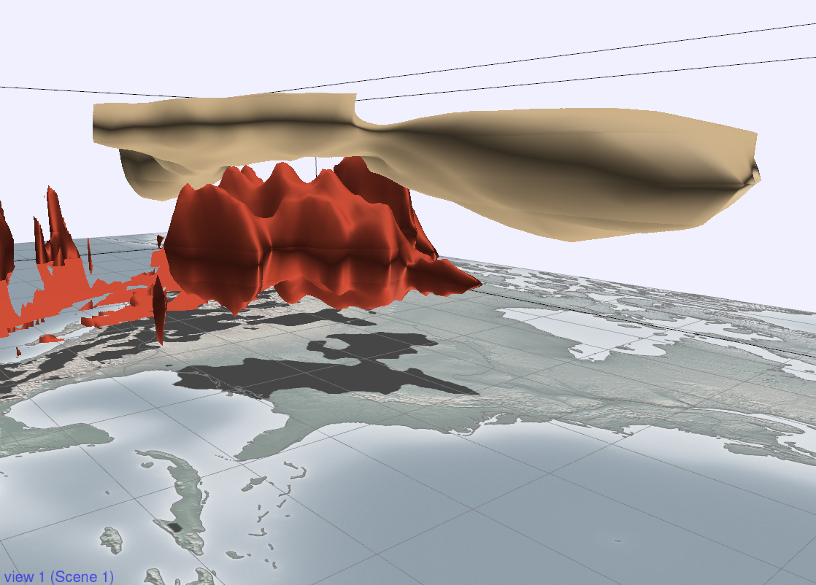
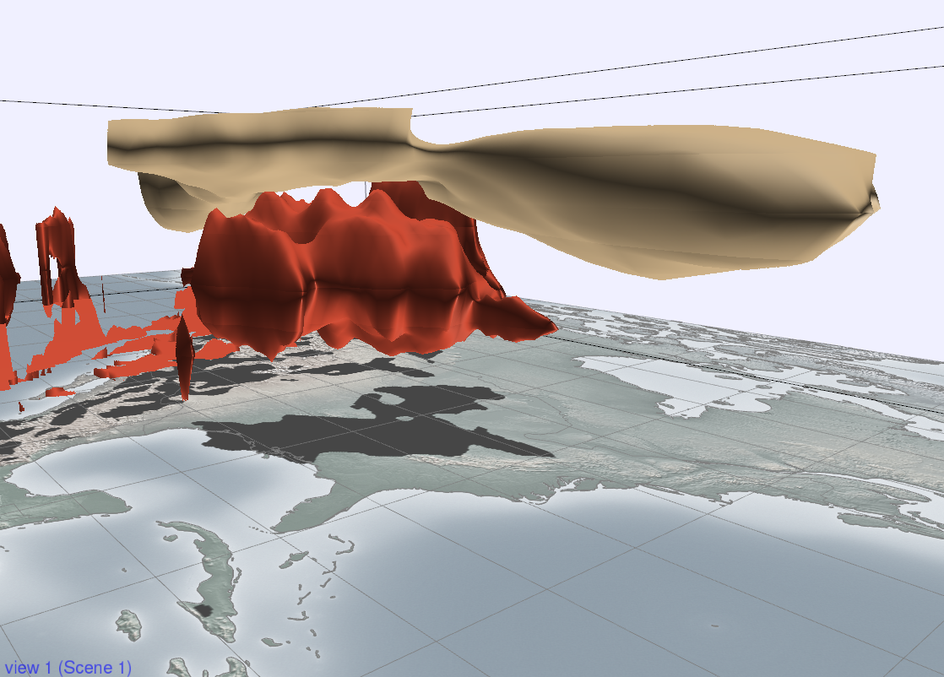
A role for systematic model error?
54 cases
Physics + analysis increment
Met3D: Marc Rautenhaus
Physics
u=25ms⁻¹
Jetstream
MCS
3Kd⁻¹
Increments highlight a role for model systematic error: MCS does not interact enough with Jetstream
Also need to strengthen stochastic physics to increase background variance?
Notes:
Here we revert to the Initial Tendencies approach to investigating systematic errors. The figure (created using Met3D by Marc Rautenhaus) shows in red surfaces where the total temperature tendency from all the physical schemes and the analysis increment is 3Kday⁻¹ when composited over all the 54 trough/CAPE cases. We nicely see the composite MCS heating. The gold surface depicts where the zonal wind is 25ms⁻¹ and highlights the Jetstream. This figure nicely shows how these two features are juxtaposed, and the possibility for MCS activity to perturb the Jetstream is clear. When the analysis increment is not included (this is animated in the talk – but see the next slide), we see that the heating associated with the background MCS activity is located at a lower level – with the implication that the interaction with the Jetstream will be less profound, and a possible contributory factor in the variance deficit seen in the EDA reliability budget.

Slide 21
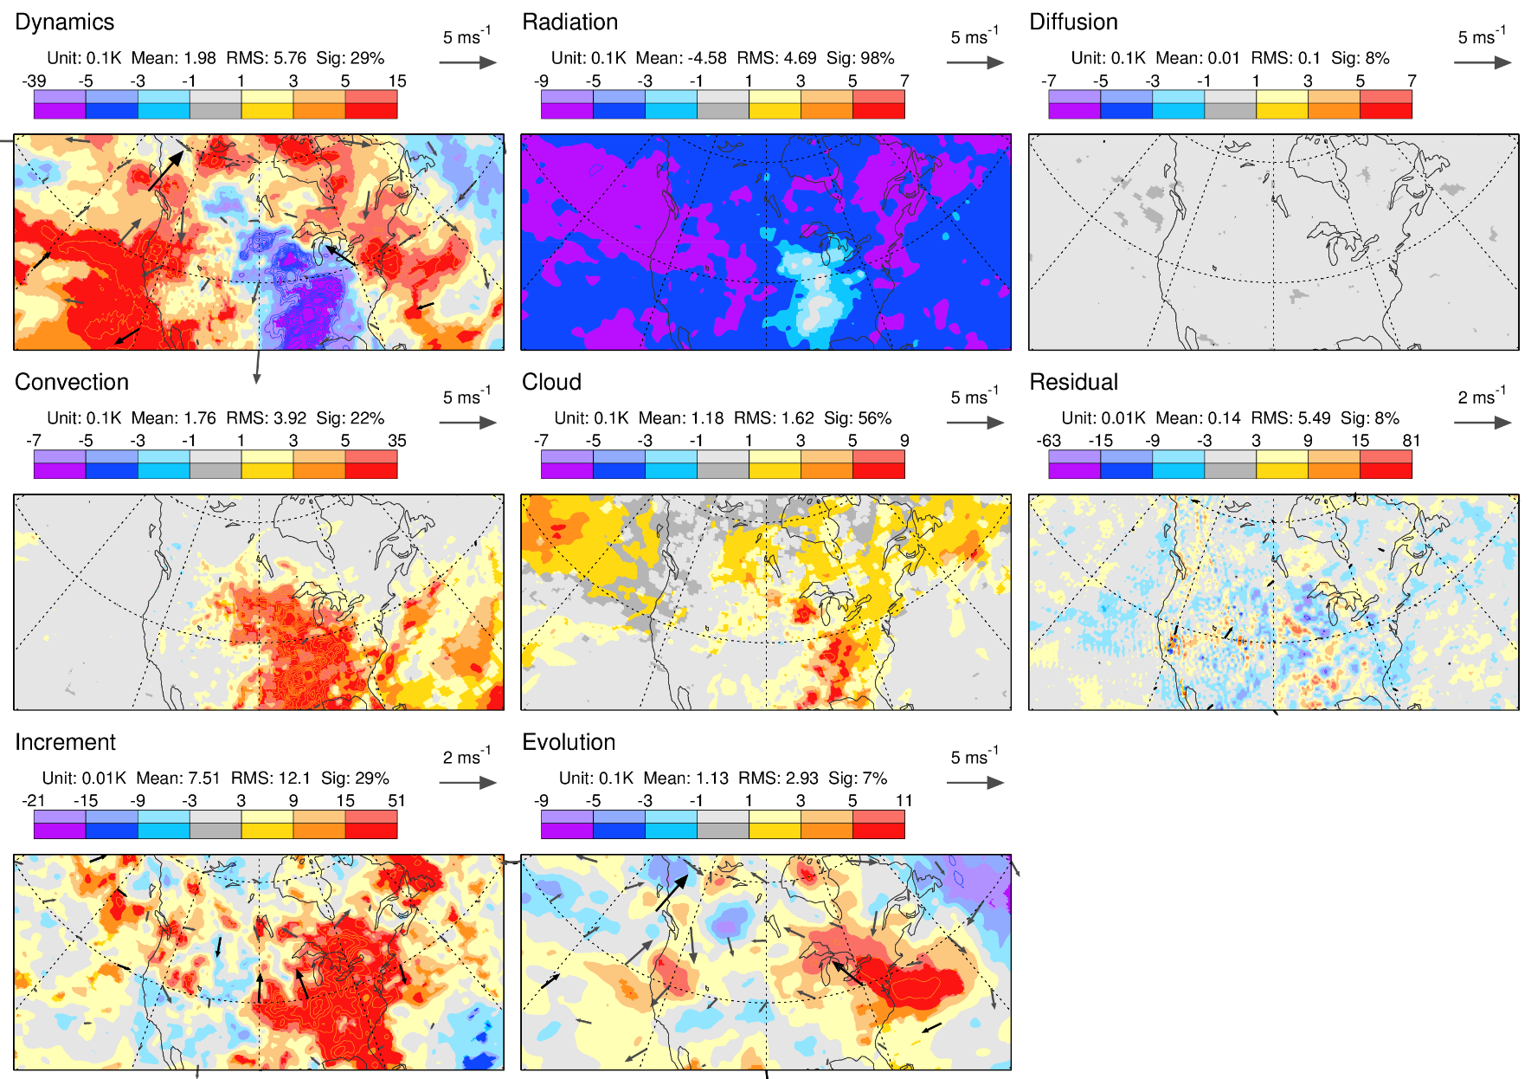
Initial tendency budget from control forecast: Trough/CAPE comp.
T300, 54 cases
Decomposing EDA control forecast into process tendencies shows how the model represents dynamics and physics of MCS
The positive (and statistically significant) increment suggests observations are warmer than the model
Process tendencies accumulated over 12hr background, the analysis increment, and evolution of the flow
Notes:
Here we see the terms in the Initial Tendency budget for temperature at 300 hPa, again composited over the 54 trough/CAPE cases. The total physical warming within the MCS region involves more than the convective heating – there is some heating from the cloud scheme too, and a “hole” in the background radiative cooling. The warming increment (plotted with a different contour interval) implies that the observations suggest the model is systematically (and statistically significantly) under-heating at this level by up to 0.5Kday⁻¹. Meso-scale convection is at a scale that is difficult to resolve or parametrise at this time, and remains a key challenge for global NWP.
Although we may be improve their representation in the future, instabilities of the flow (convective, baroclinic etc) are likely to always lead to an enhancement of forecast uncertainty

Slide 22
Optimising forecast configuration and usage

Slide 23
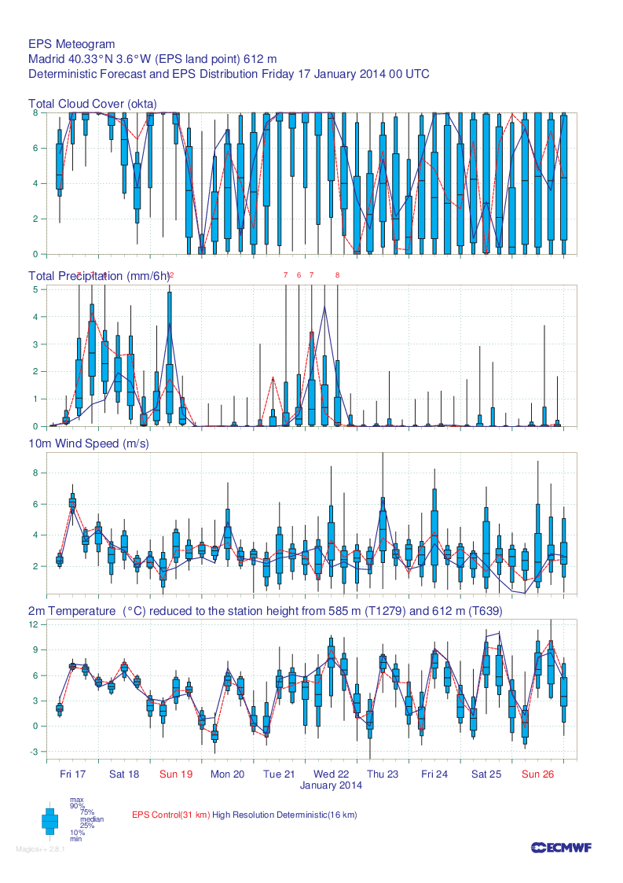
Ensemble and high-resolution information
How do we optimally combine information from the ensemble and the high-resolution forecast?
Is this dependent on lead-time?
Notes:
Here we see a precipitation ‘Meteogram’ for Madrid. The blue boxes highlight the distribution of forecast precipitation from ECMWF’s 50-member ensemble. Also plotted is the single high-resolution forecast (dark blue curve) and the single control forecast (consistent with the resolution of the ensemble, show by the red dashed curve). All three forecast ‘products’ are predicting precipitation in the first three days, but notice that the high-resolution forecast predicts quite a bit less than most of the ensemble members. Sometimes, the high–resolution forecast can be completely outside the range of the ensemble. This should, of course, happen once in about 25 forecasts on average for statistical reasons (everything else being equal, there would be a 1 in 51 chance it is above all the members, and a 1 in 51 chance it would be below). However, perhaps the high-resolution forecast is providing additional information to the forecaster. Perhaps, for example, it is more accurate (at short lead-times) than a single ensemble member because it is run at higher resolution, and started from unperturbed initial conditions. One simple approach to estimating the addition information provided by the high-resolution system, and thus enabling the forecaster to make sense of the full set of forecasts, is discussed in the next slide.

Slide 24
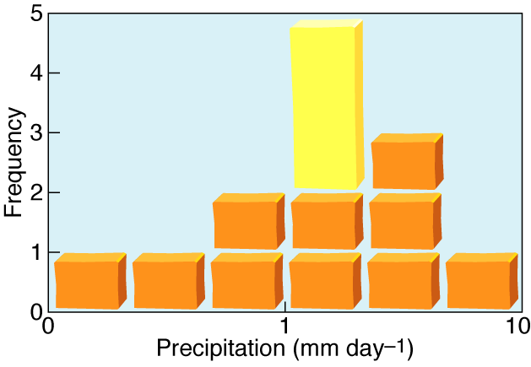
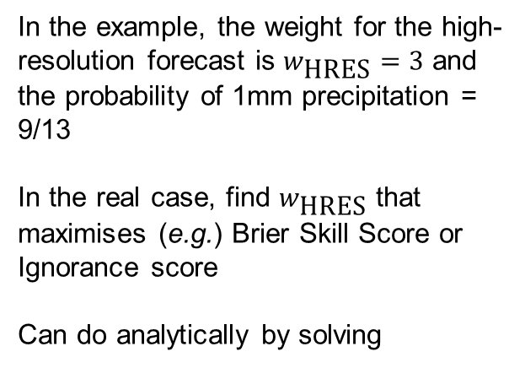
Combined Prediction System: Methodology
Rodwell, ECMWF Newsletter 106 (2006)
High-resolution
forecast
In the example, the weight for the high-resolution forecast is $w_{\text{HRES}}=3$ and the probability of 1mm precipitation = 9/13
In the real case, find $w_{\text{HRES}}$ that maximises (e.g.) Brier Skill Score or Ignorance score
Can do analytically by solving
Ensemble
member
Notes:
If would be useful if we could quantify the information that the ensemble and high-resolution systems bring to the forecaster on the bench. One intuitive approach (Rodwell 2006: Comparing and combining deterministic and ensemble forecasts: How to predict rainfall occurrence better, ECMWF Newsletter, 106, 17-23) is discussed here (there are many other possible approaches).
The figure shows how we could combine the ensemble prediction system and the high-resolution deterministic forecast into a single probabilistic forecast. Each ensemble member (shown by the orange squares) is given a weight of 1. If the high-resolution forecast (shown by the yellow rectangle) brings more information to the system than any individual ensemble member (by virtue of its higher resolution or more likely initial conditions), then this should be rewarded with a weight greater than 1. The schematic shows an ensemble of size 10 and gives a weight to the high-resolution forecast equivalent to 3 ensemble members. Hence the probability for the event that precipitation is greater than 1 mm is 9/13.
The aim in reality is not to assume a weight of 3, but to calculate the optimal weight to give to the high-resolution forecast. The optimal weight could be dependent on the user’s application, but here we keep to the physical problem by maximising the Brier Skill Score for a given precipitation threshold. This is done for each year in a cross-validated way to ensure that we do not artificially inflate the score. The verification data is European gauge observations.

Slide 25
The weight to give the high-resolution system
At short lead-times, high-resolution system is very valuable. At longer lead-times weight →1. Based on years 2001-2005
Notes:
Here we see the mean optimal weights that should be applied to the deterministic forecast. The weights are shown as a function of lead-time and for three precipitation thresholds. In general, the weight is rather insensitive to the threshold. At a lead-time of 1 day, the deterministic forecast provides the same information as about 15-18 ensemble members. As the lead-time increases, the optimal weight decreases so that by day-10, the deterministic forecast is equivalent to perhaps 2 ensemble members.
This diagnostic is useful to the forecaster on the bench (and we can produce combined probabilistic products), but it could also be useful to help us decide how much computer resources to give to each forecast system. At the time of this work, the high resolution system was run at T511 while the ensemble was run at T255. This meant that the high resolution forecast required about 18 times as much computing power as one ensemble member. Hence, we can conclude that the deterministic system is valuable early in the forecast, but other strategies may be more optimal. For example making only short forecasts with the high resolution system, and devoting the saved computing resources to the ensemble may be one option. Of course, this diagnostic is only one source of information - there are many other (sometimes competing) considerations for how we configure our forecast system.

Slide 26
Combined system is more skilful
Rodwell, ECMWF Newsletter 106 (2006)
The combined system is more skilful (on average) at all leadtimes and for each threshold
Results are cross-validated so no artificial inflation of skill. Based on years 2001-2005
Notes:
Finally, here is the comparison of the scores obtained by combining the high-resolution deterministic forecast with the ensemble. Again, results are cross-validated to ensure the combined scores are not artificially inflated. For each precipitation threshold (x), the Brier Skill Score is improved and this improvement is statistically significantly at the 5% level, as indicated by the orange circles.

Slide 27
New approaches to using forecasts

Slide 28
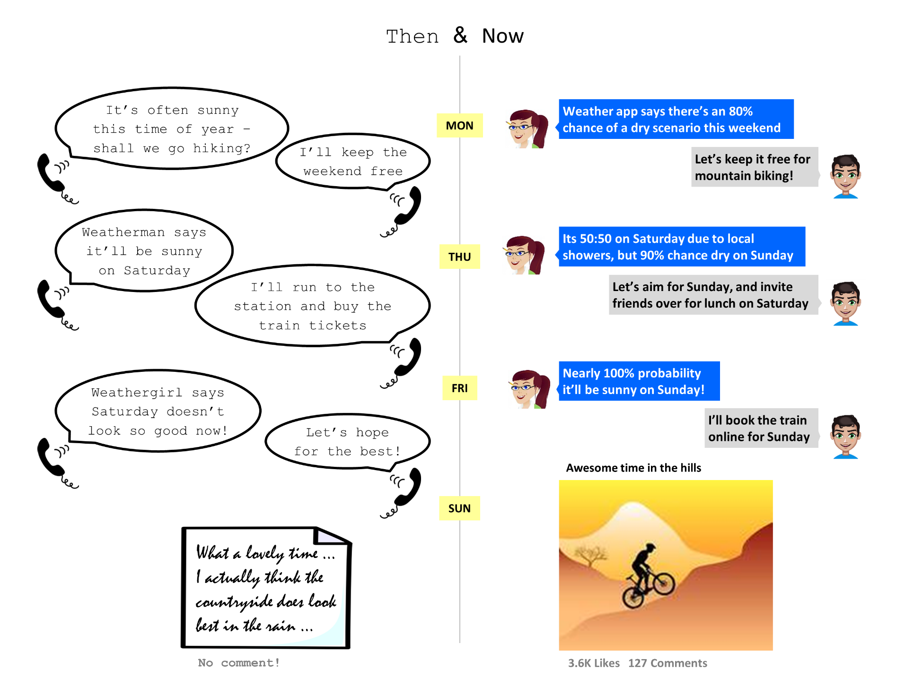
Public use of probabilistic forecasts
Rodwell, RMetS theWeatherClub
Notes:
This is a cartoon I put into a science lesson for the UK Royal Meteorological Society’s “theWeatherClub” newsletter (winter 2014/5). It is primarily aimed at schools, with the hope of promoting the use of probabilistic weather forecasts. I am hoping that we might get some students to have a go at creating their own cartoons. There is also a simple experiment in the article.

Slide 29
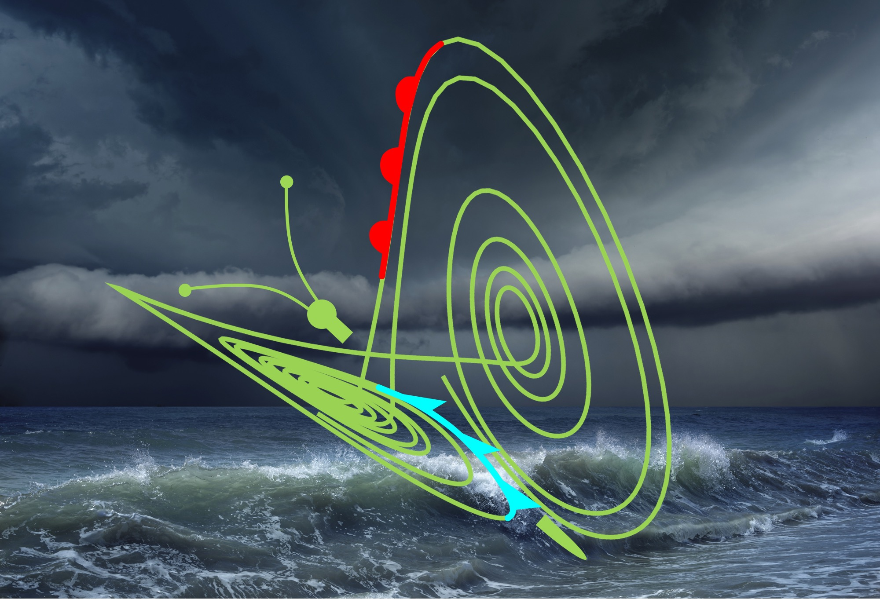
Chaos and Confidence in Weather Forecasting
Chaos in weather forecasting
The science of chaos and modelling of uncertainty
Evaluating forecast uncertainty
Coffee, mince pies and movie loops
Working with uncertainty and confidence
Confidence in weather forecasts
Competition - portrayal of uncertainty to the public
“Chaos and Confidence in Weather Forecasting”
Royal Meteorological Society
14 December 2016
Imperial College, London
Notes:
This slide is to advertise the up-coming Royal Meteorological Society meeting on “Chaos and confidence in weather forecasting”. The aim is for this meeting to be accessible to a broad range of members, students and forecast users. We will also have a competition for people (or teams) to submit ideas for ways in which probabilistic information can be portrayed to users. This will be the Christmas meeting of the Society and so it should be more informal (and there will be mince pies).

Slide 30
Discussion
Rossby waves and the “Rossby Wave Source” – simple models make useful diagnostics
Flow-dependent reliability is key – EDA reliability budget seems useful
  Effective, efficient, focuses on reliability - not sharpness
  Development and diagnosis of ensemble data assimilation likely to be key to future NWP progress
Instabilities as magnifiers of uncertainty
Approaches to optimising system configuration and combining multiple sources of information
New approaches to the use of probabilistic forecasts
Previous talk
Spatio-temporal variability
Initial tendencies approach

