Slide 1
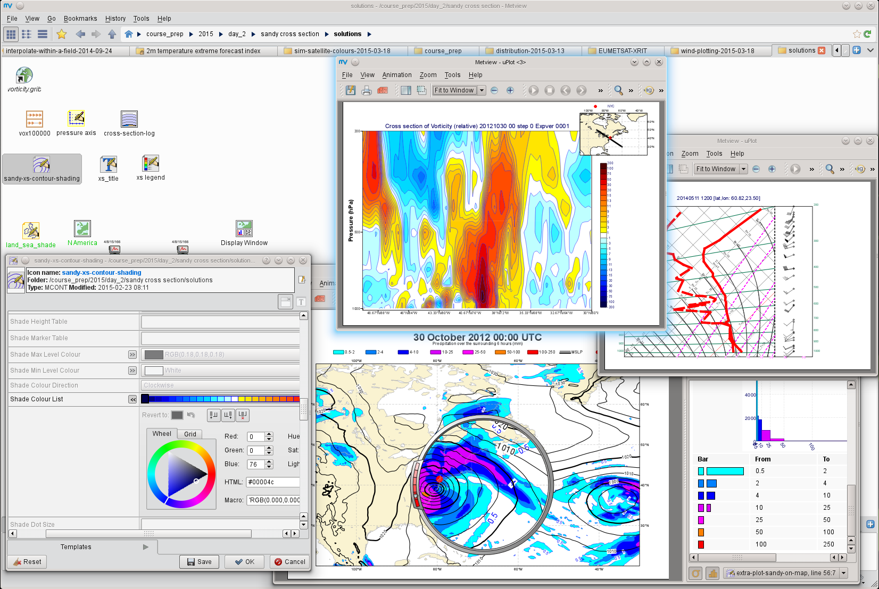
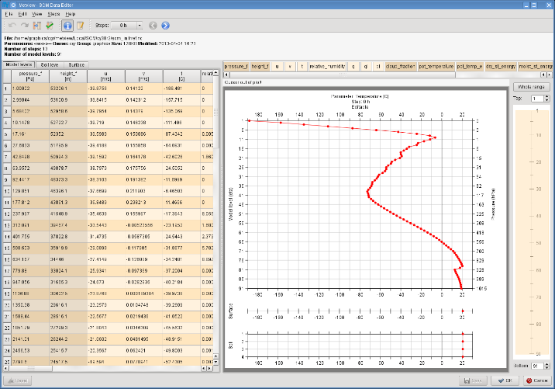


Introduction to Metview
Using the Single Column Model
Iain Russell, Sándor Kertész
Development Section, ECMWF

Slide 2
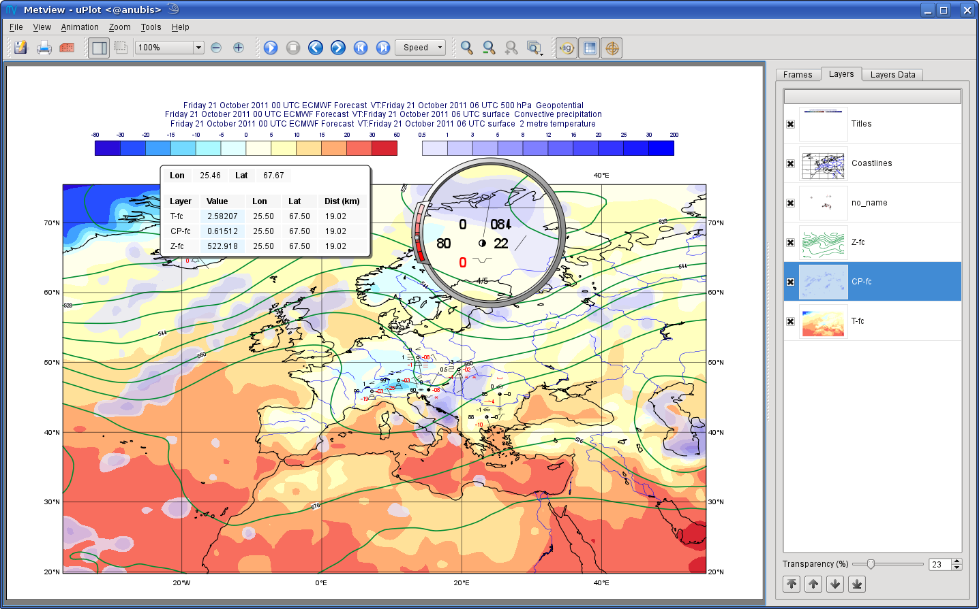
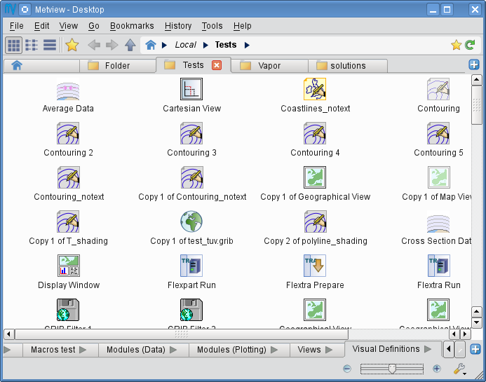
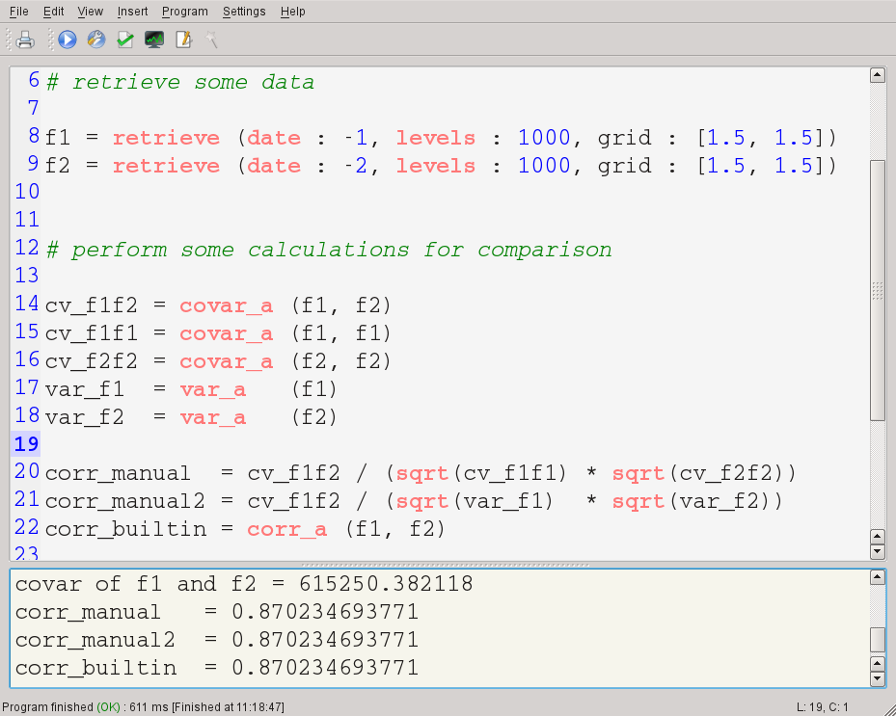
What is Metview?
Workstation software for researchers and operational analysts
  Runs on UNIX, from laptops to supercomputers
  (now includes Mac OS X)
  Used also in the OpenIFS project
Retrieve/manipulate/visualise/examine meteorological data
Drag & drop user interface / powerful scripting language
Handles GRIB, BUFR, NetCDF, ODB, Geopoints, CSV, ASCII
Can access MARS, either locally or through the Web API
Open Source under Apache Licence 2.0
Metview is a co-operation project with INPE (Brazil)
Built on core ECMWF technologies:
MARS, GRIB_API, Magics, ODB, Emoslib

Slide 3
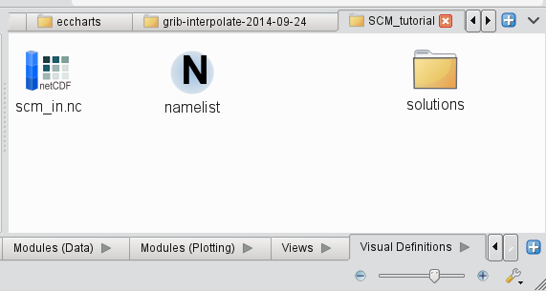
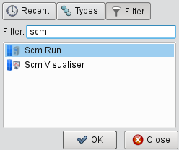

User interface – desktops and icons
A “desktop” corresponds to a directory on the file system (under ~/metview)
An icon represents a data file, or parameters for processing or visualising data
To get existing files into Metview, copy them into
~/metview or a subdirectory
To create new icons for running the SCM or plotting its output, find the appropriate icon in the Create New Icon context menu from the Metview desktop

Slide 4

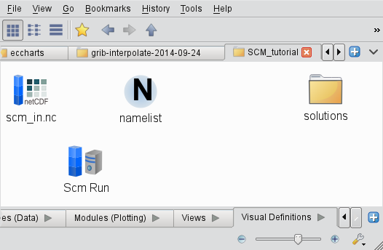
Modifying an SCM input data file
Custom editor for SCM input netCDF files
Right-click, edit the netCDF file in Metview
Parameter selection
Vertical level ‘zoom’
Editable curves
Editable table (light columns only)

Slide 5
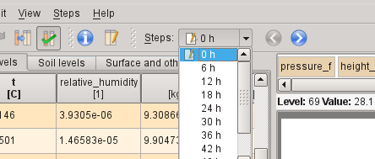
Modifying an SCM input data file (2)
Copy data from this time step to all other steps
Step selection

Slide 6
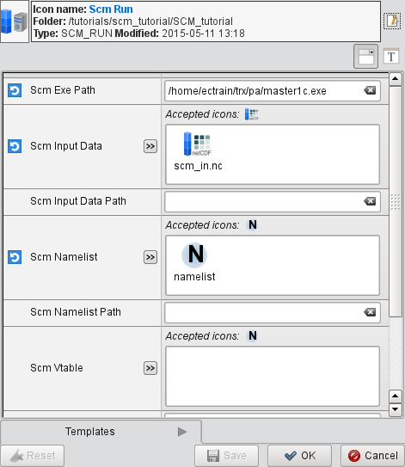
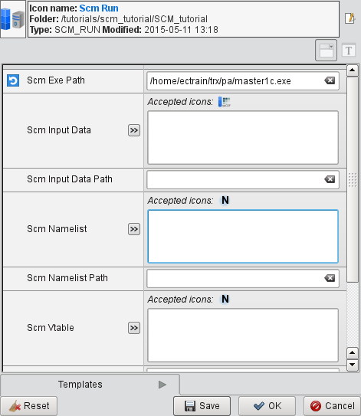
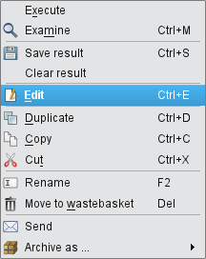
Icons as input to other icons
- right-click, edit an icon
- data input icons can be dropped into the editor

Slide 7
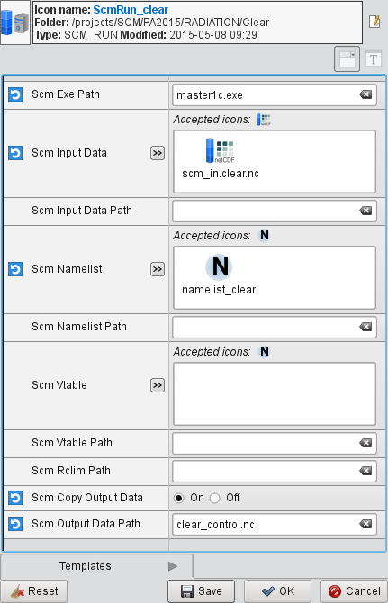
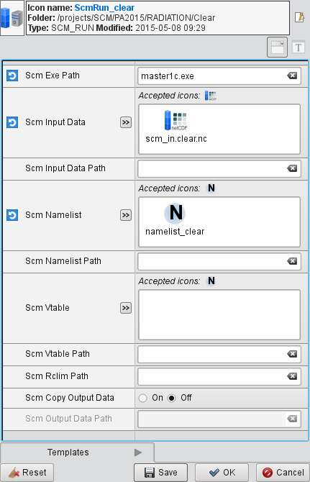
Running the SCM through Metview
Edit your copy of the Scm Run icon
Set the path to the SCM executable
Set the input data and namelist
By default, the result is stored ‘in the background’ and can be accessed via the Scm Run icon
Editor has an option to copy the output file in order to keep a copy
Save, then execute the icon from the main user interface

Slide 8
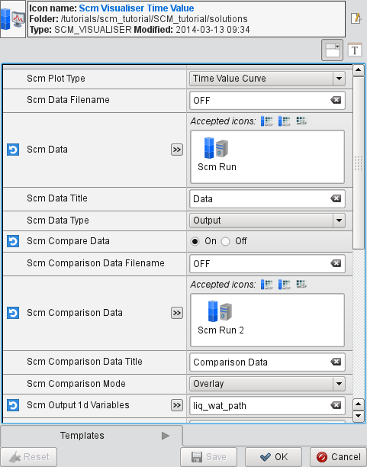

Visualising data in Metview
For most data types, just right-click the data icon and select visualise
For netCDF, there is no default visualisation so this approach does not work
We use ‘visualiser’ icons
The Scm Visualiser icon has high-level options to produce different plot types and to compare two runs
The NetCDF Visualiser icon is available for lower-level specification of plotting from netCDF files

Slide 9
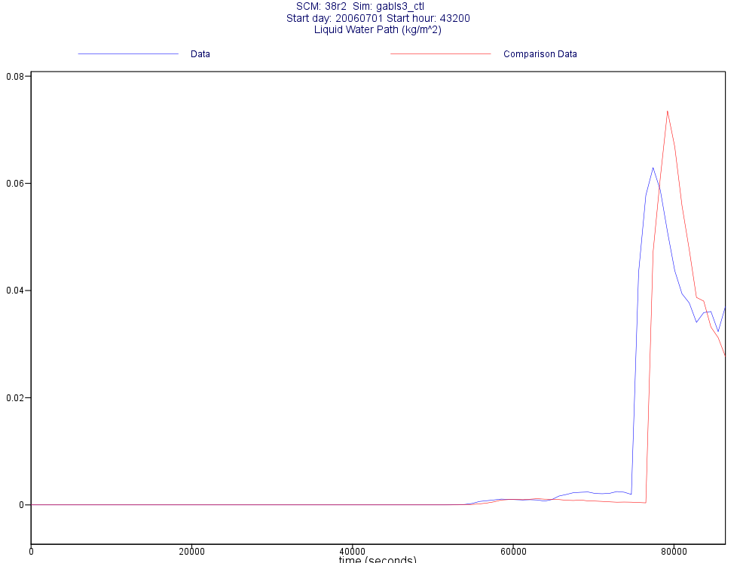
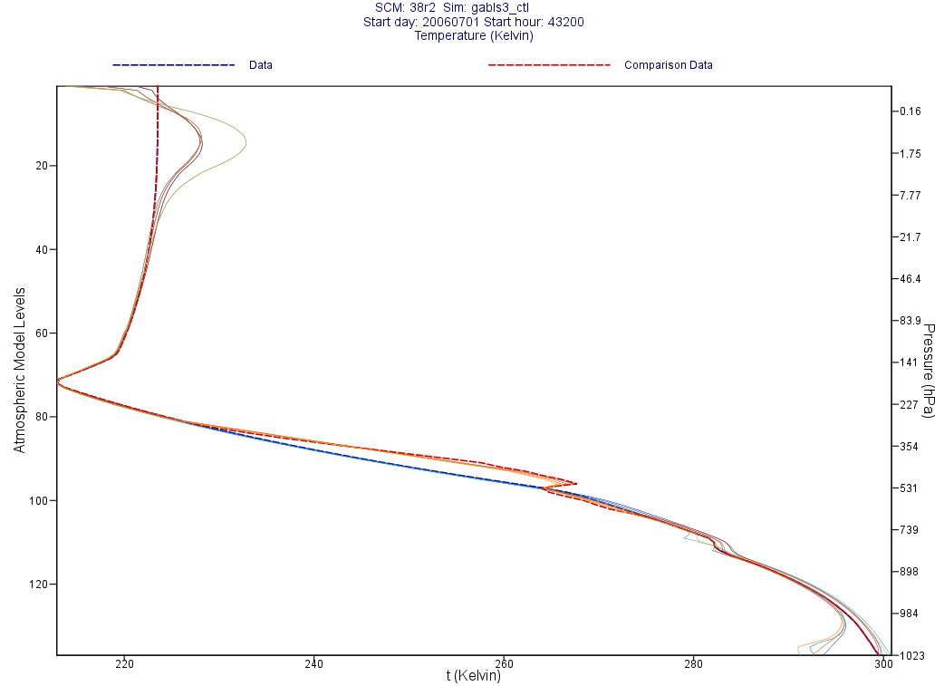
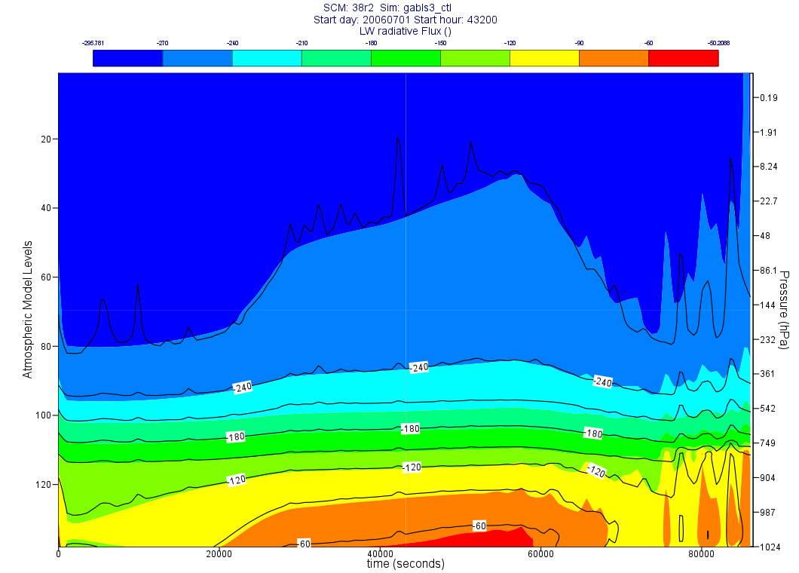
SCM Visualisation in Metview
Time-value curve
Time-sliced profiles
Time-height matrix

Slide 10
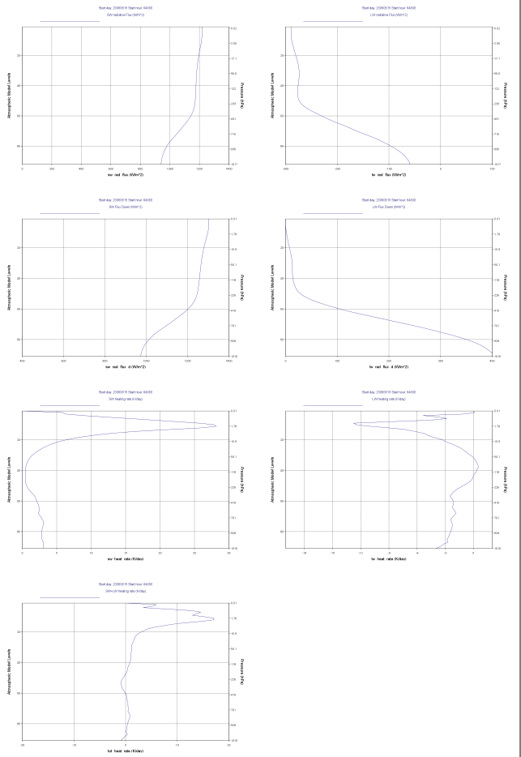

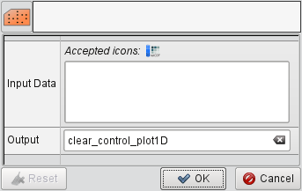

Pre-prepared SCM plotting macro icons
Some exercises generate plots through a pre-prepared macro (script)
Right-click, execute this icon – a small user interface will appear
Drop the SCM output data
icon into the Input Data box,
then click OK to generate the pdf file

Slide 11
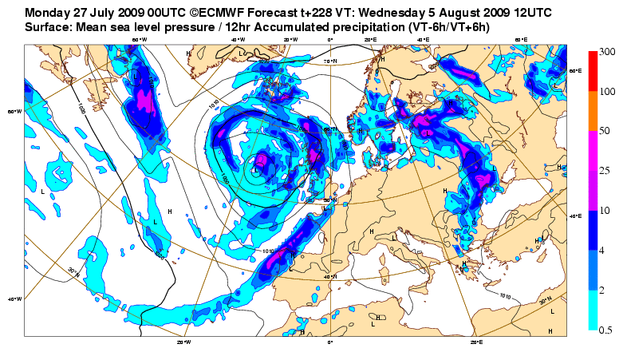
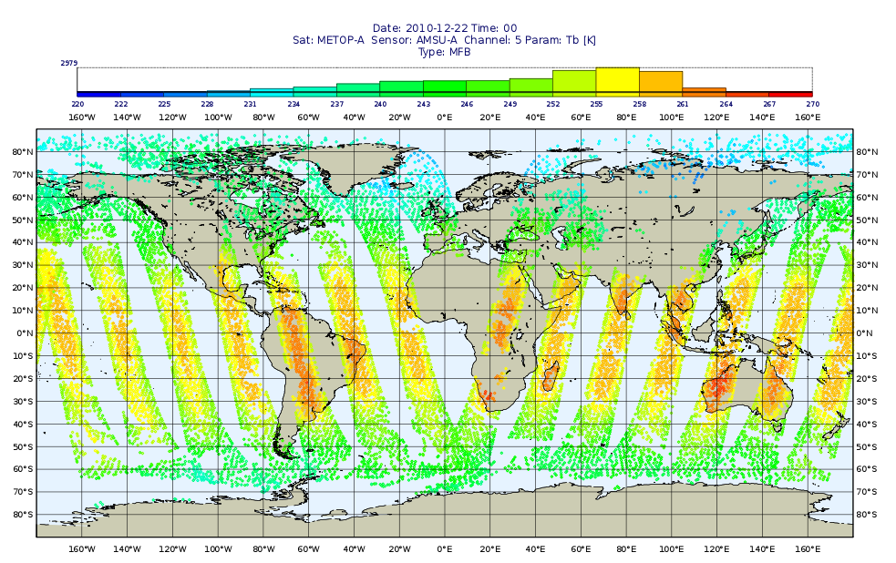
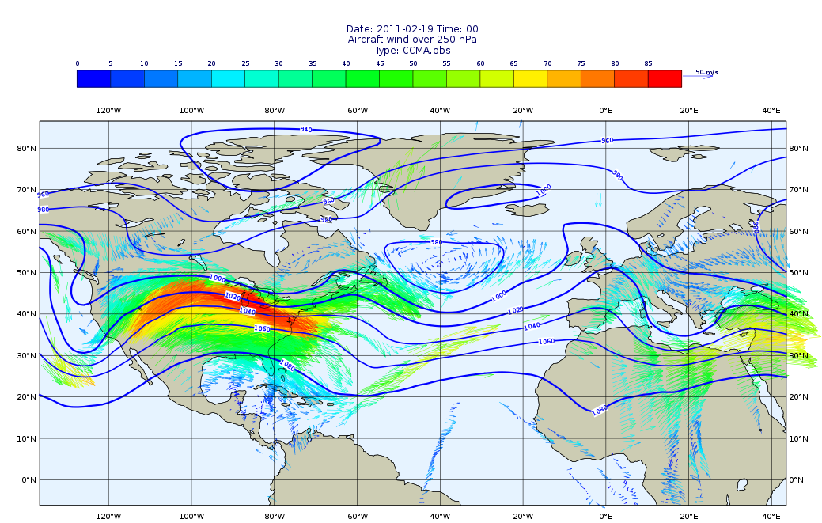
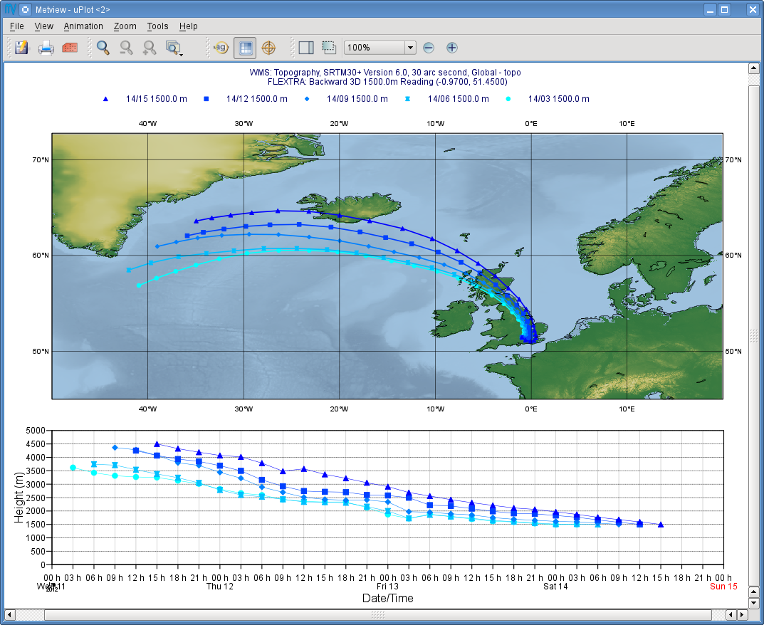
For more information …
email us:
  Metview: metview@ecmwf.int
visit our web pages:
  https://software.ecmwf.int/metview
  Download
  Documentation and tutorials available
  Metview articles in ECMWF newsletters

Slide 12
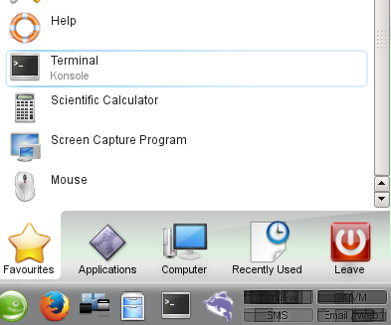
Starting Metview
Open a new terminal
Type:
metview &

