Slide 1

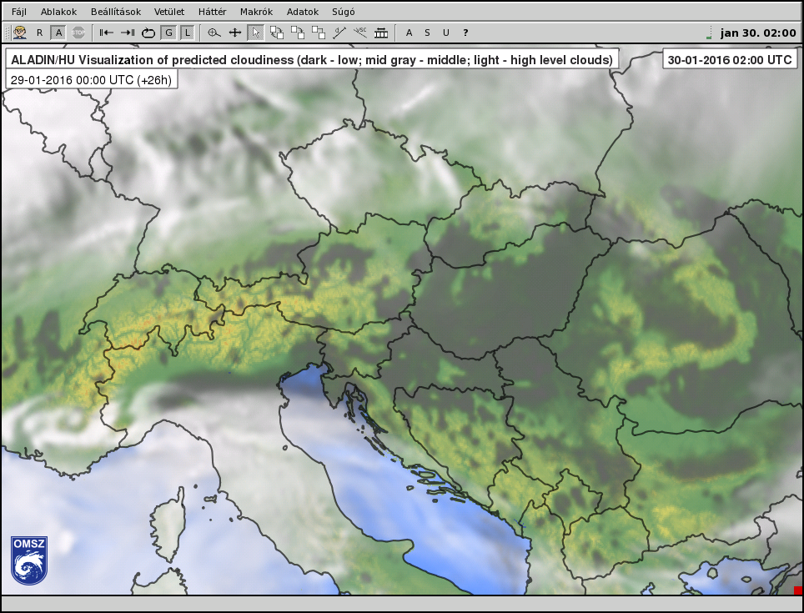
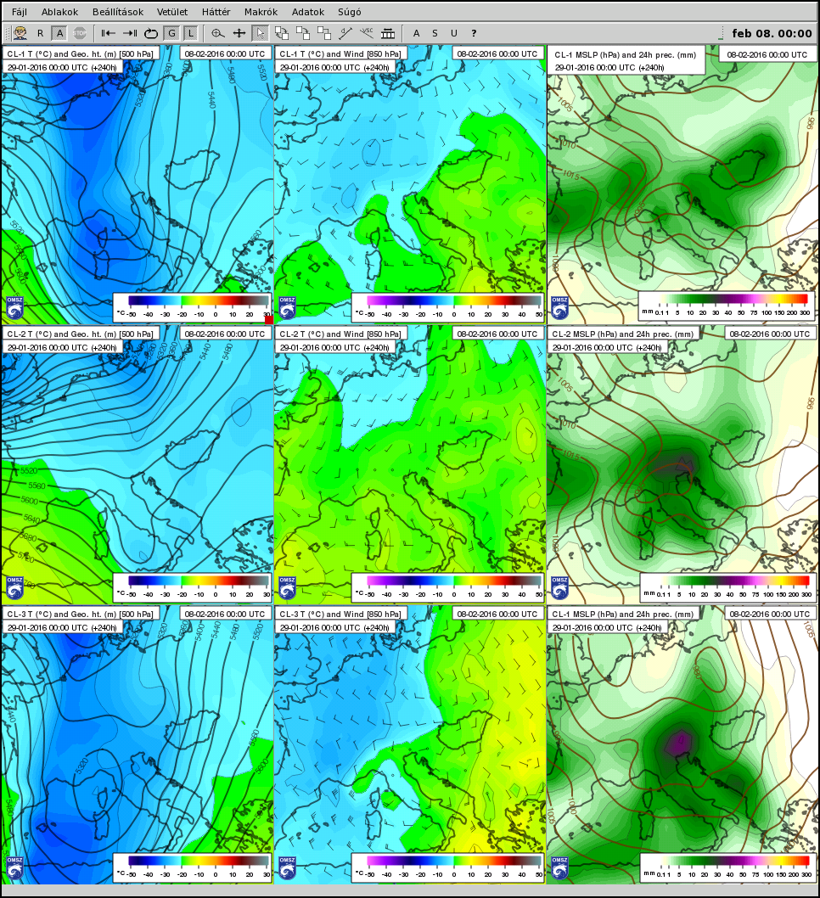
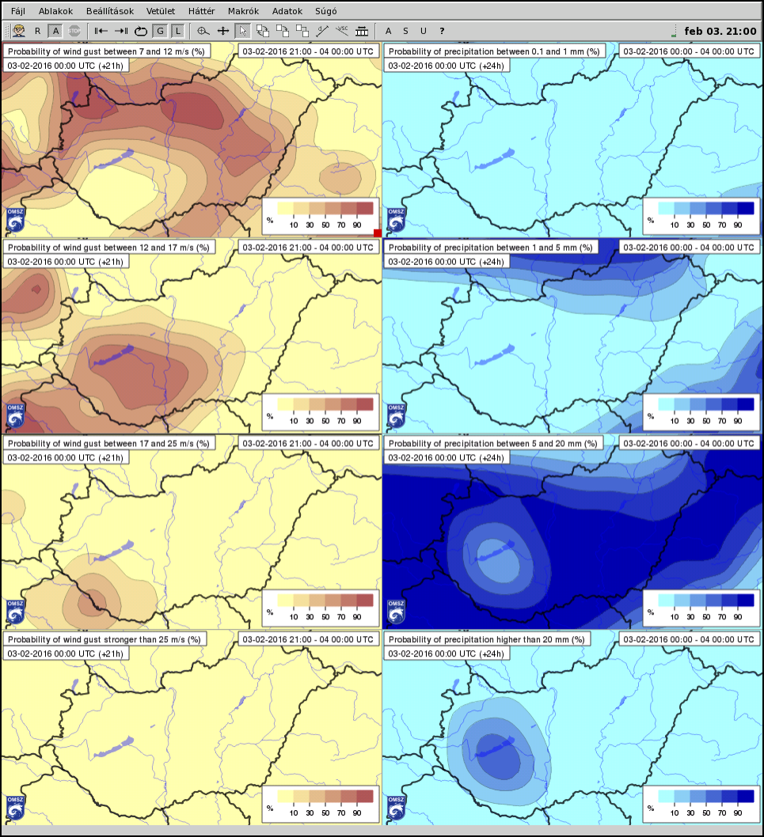
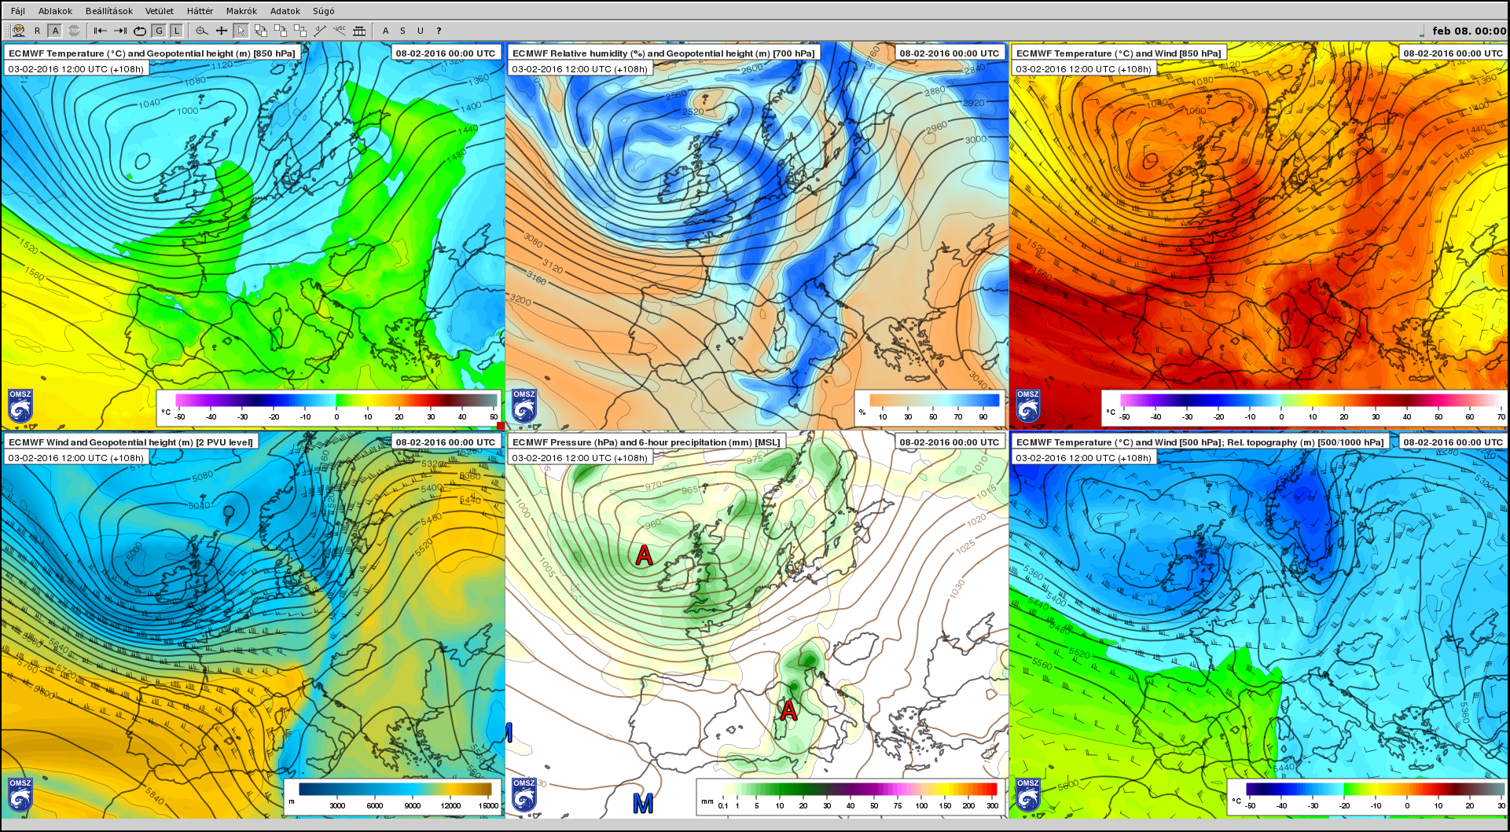
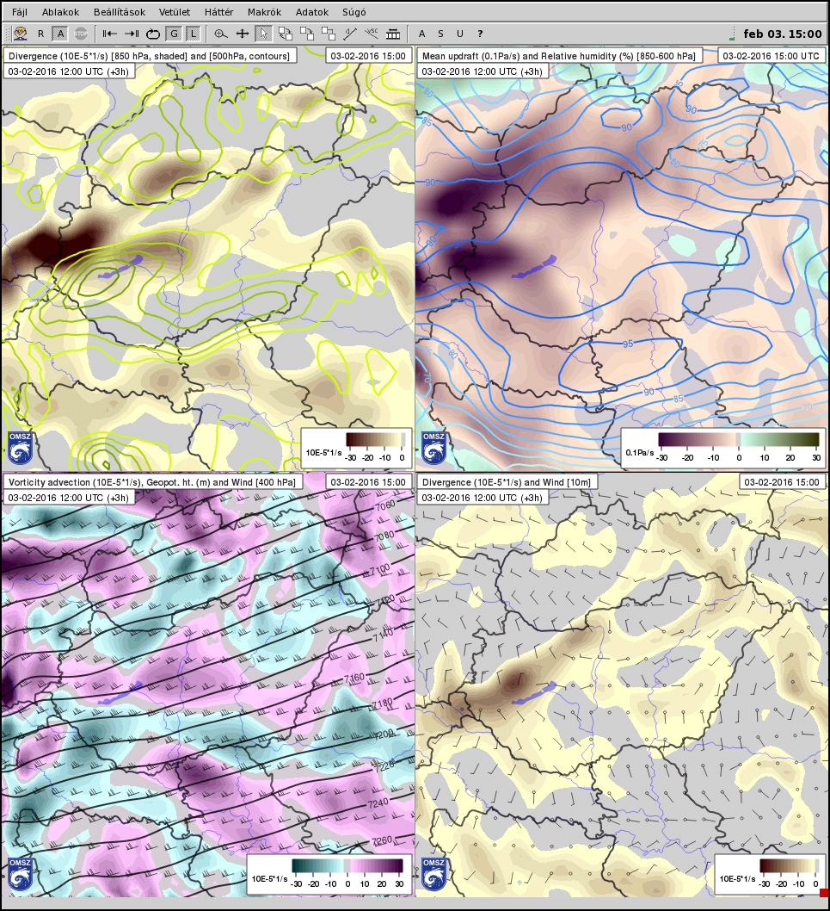
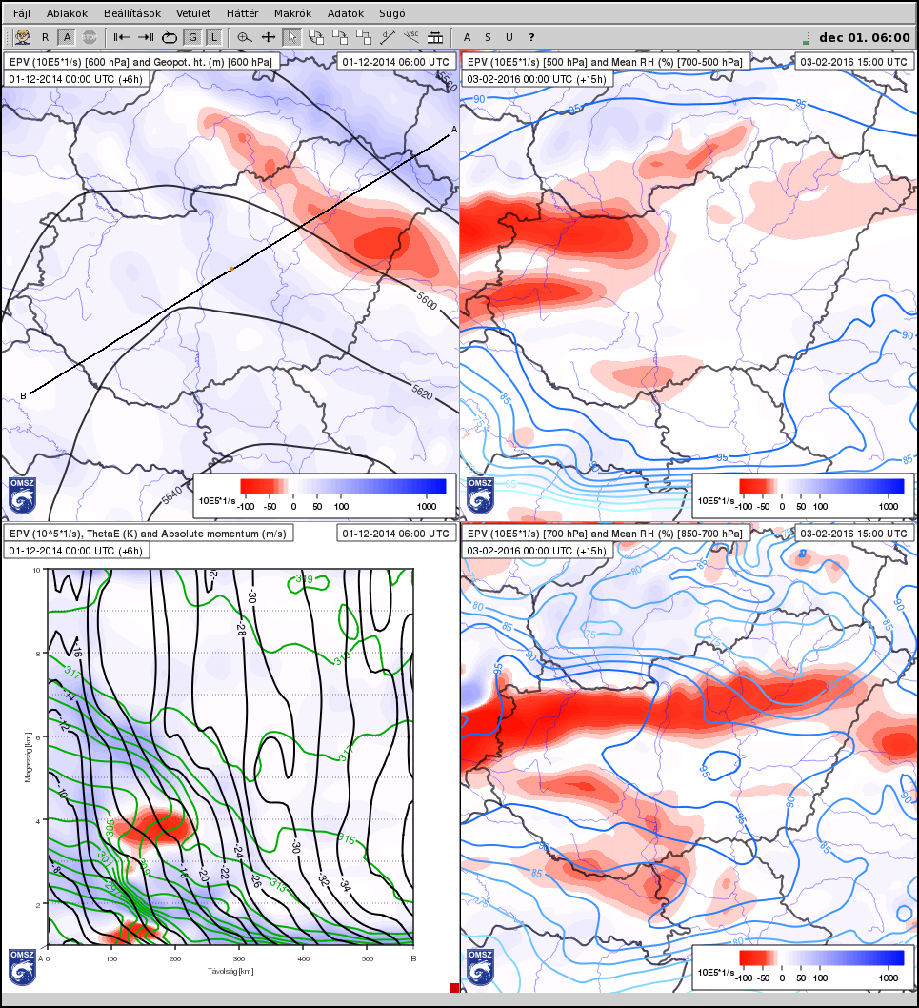
Researchal and operational applications of ECMWF data at HMS
Tamás Allaga
Hungarian Meteorological Service (OMSZ), Budapest
Key words: HAWK-3 workstation, PROFORCE, graphical visualization, EPS products,
clusters, probability forecast, case study, symmetric instability, EPV concept
E-mail: allaga.t@met.hu
HMS
Benefits of operational use of LAMs
The Hungarian Meteorological Service (HMS), located in Budapest, Hungary, was established in 1870. As a national service, HMS has several main tasks such as maintaining the synoptic weather station network, lightning localization system and radar network, releasing weather balloons, collecting, controlling and handling datasets. Its operational task is to produce forecasts based on international and adapted numerical weather prediction models. Besides, research is conducted on several scientific areas such as NWP and climate modelling, atmospheric chemistry.
Carpathian Region is geographically one of the most complex areas in Europe. In some weather situations, such as cold pools, usage of LAMs with better resolution and more suitable surface parameterization tends to provide better results. All LAMs run at HMS get their initial and boundary conditions from ECMWF deterministic model or from the EPS system.
HMS and ECMWF
Cold pool and stratus clouds in Carpathian Basin as seen by ALADIN/HU. High resolution topography is required, just note the hills in Northern Hungary arising up from low level cloud layer, not to mention the chain of Carpathian Mountains.
On 1 July, 1994 Hungary became a cooperating-member of ECMWF and its forecasts have been available for forecasters since 1995.
HMS has 8 researching, developing and forecasting activities based on ECMWF model data:
1) Graphical visualization of ECMWF forecasts with HAWK-3; some outputs are available on the public website
  HAWK-3 software, developed at the HMS, is able to produce and visualize 2D charts, vertical cross sections, and pictures (plumes, meteograms, histograms) derived from ECMWF and other NWP model and SYNOP data
2) Verification of deterministic and ensemble (EPS) forecasts
  based on identical aspects a verification report is prepared annually by the Service
3) Clustering of ensemble forecasts specified for the Carpathian Region
  2-6 clusters are created, then cluster mean and cluster representative members are calculated
4) Running limited area numerical models (LAM) using initial and lateral boundary conditions derived from ECMWF deterministic and EPS forecasts
  new forecasts of hydrostatic (ALADIN/HU) and non-hydrostatic (AROME, WRF) deterministic LAMs are available for operational use four times, the results of ALADIN ensemble system (LAMEPS) once a day
5) Ensemble calibration
  the post-processing method of assuming that the distribution of the observations is more representative for a given location than a reforecast model climate can eliminate or at least reduce systematic errors of EPS forecasts
6) Ensemble pseudo-TEMP
  in the medium range highlighting the uncertainty of vertical profiles is very important particularly in forecasting severe weather events
7) Studying ensemble dispersion models
  in 2011-2012 dispersion models were run based on EPS cluster representative members
8) Comprehensive study of cold drops based on ERA-Interim
An example for the wide applicability of EPS products is PROFORCE project (Bridging probabilistic forecasts and Civil Protection, www.echo-proforce.eu) with the partnership of ZAMG, HMS and local civil protection agencies. With PROFORCE, decision makers and civil protection agencies get access to maps and diagrams created from ECMWF EPS and LAMEPS forecasts showing probability of severe weather events.
Some methods of applying ECMWF EPS products
Beyond widely known ensemble products (e.g. plumes, meteograms), forecasters at HMS use some more specific interpretation of EPS forecasts during their work. Especially in very uncertain mid-range synoptic situations, creating clusters from EPS members can help distinguishing the main different weather scenarios. In many cases end users need categorical forecast of such parameters as wind gust and amount of precipitation. Rather than downgrading the question to a simple „yes or no” problem, a more detailed percentage-based answer can be given by calculating the probability of each involved weather event.
The left panel shows the clusters of main possible synoptic situations on 8th February, 2016 in Central Europe. The uncertain development of an upper level through determines the weather of Hungary. Another interesting application of EPS forecasts is not only a simple view of probability thresholds of different parameters, but probabilities of well distinguished meteorological events. On the right-side panel probabilites of wind gust and precipitation amount categories can be seen during the passage of an intense cold front on 3rd February, 2016.
ECMWF data visualization with HAWK-3
Investigating symmetric instability with ECMWF data
One of the biggest challenges for a forecaster are high precipitation events as the additional knowledge of the forecasters to the model outputs is very important in these cases. However, parameterization of precipitation sometimes does not perfectly suitable for such situations. One possible explanation for banded precipitation improperly predicted by numerical models is Conditional Symmetric Instability (CSI).
This instability may produce heavy banded precipitation mostly in winter related to warm fronts as it may produce updrafts in the order of m/s. Therefore, elevated and slantwise convection sometimes can produce unexpected precipitation bands and amounts. To be able to visualize the spatial appearance of CSI and also Conditional Instability (CI), special indices were calculated like Equivalent Potential Vorticity (EPV), which is a useful tool to assume the potential of these instabilities. Vertical cross sections of ThetaE and Absolute Geostrophic Momentum (M_{g}) in order to make a distinction between different instabilities.
Examples of displayed ECMWF data fields in HAWK-3. While the image above shows an overview of basic fields, more complex parameters are illustrated on the left one.
In the left column of the image the presence of CSI (red shaded areas) is shown on 1th December, 2014 during a devastating freezing rain event in Hungary. In this case precipitation bands were much more intense than expected and some bands were missed by models. With EPV charts conditonally (symmetrically) unstable regions and the potential for generation of these bands could had been easily detectable.
The second column contains images of a recent discussed event, the passage of a cold front on 3rd February. HAWK-3 is also capable of computing and visualizing EPV, thus, this concept can be used operationally as well.
HAWK-3 meteorological workstation offers versatile visualization of ECM model fields. Besides basic fields of variables, more complex parameters (e.g. vorticity advection, stability indices) can be computed and displayed as well. A huge advantage of the software is the extreme wide range of user settings (drawing options, time adjustments, computing and displaying special data fields for different purposes). Time loops and animations can also be created and exported for publication.

