Slide 1
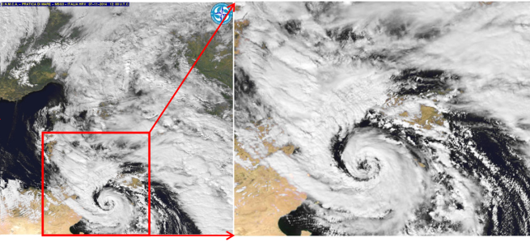
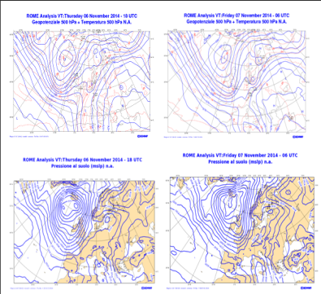
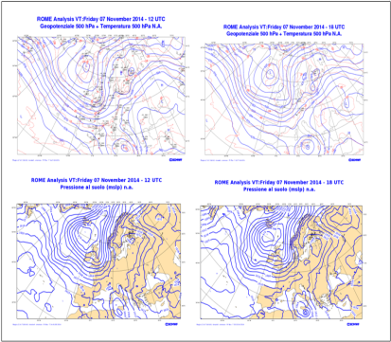
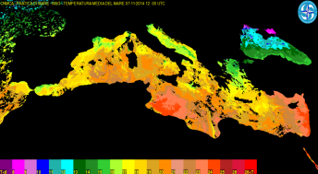
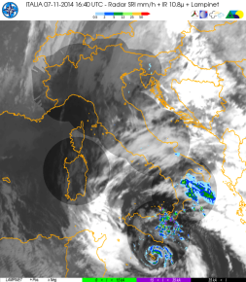
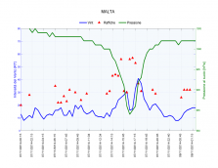
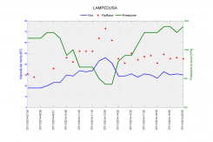
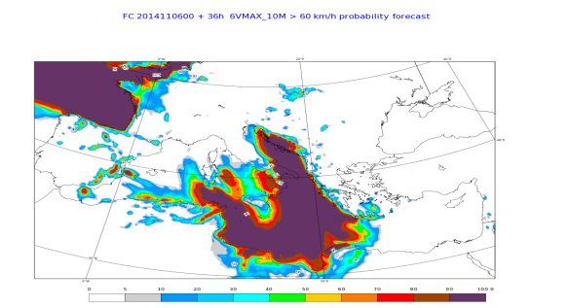
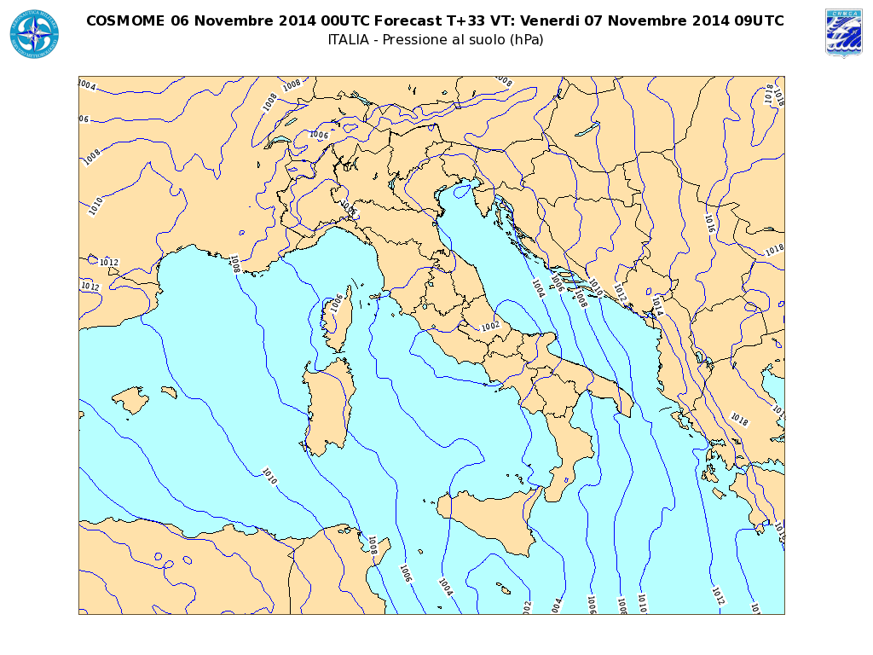
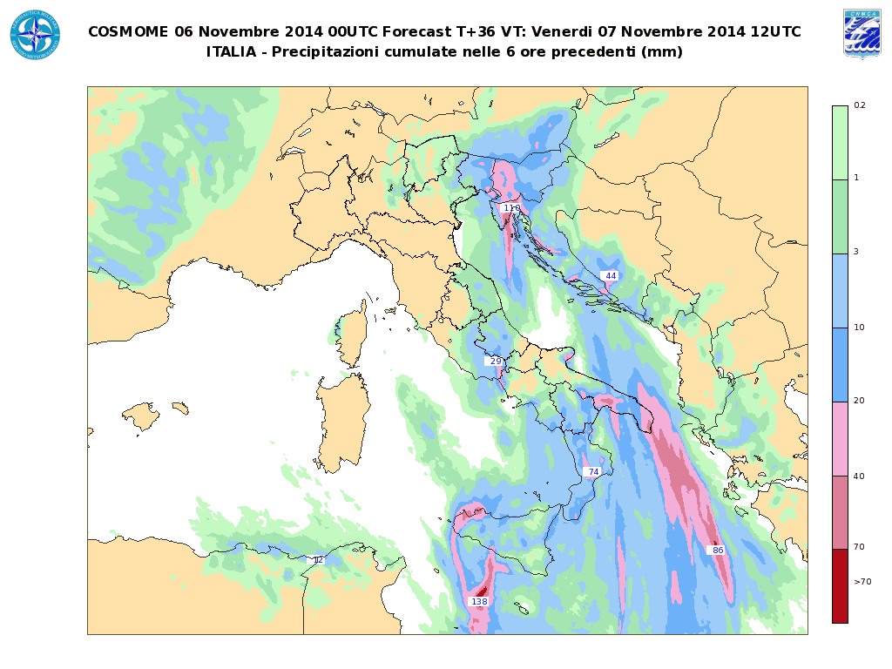
1. Introduction
“Medicane” acronym of Mediterranian Hurricane or Tropical Like Cyclone (TLC) are a mesoscale phenomena developing in the Med. Sea . They have a lot of similarities with Tropical Ciclones
Their max diameter is 200-400 km and the duration is from a very few hours to 1 or 2 days.
Their formationi is a rare event in the Med. Sea just 100 cases identified as Medicane from 1948 tp 2014. They occur in the autmn season when the sea State Temperature is high.
«Medicane in the Strait of Sicily – Sept 07th 2015»
1.2 Formation and characteristic:
unlike Tropical Cyclones to have a developing TLC in the Med. Sea, an upper level forcing process is needed. As a fact of matter many TLC formed in the Med. Sea with a SST between 15 °C and 26 °C. A triggering factor such as an anomaly of the Tropopause (IPV thinking) in the middle-high troposphere has to contribute.
1.3 Synoptic situation and development
1.4 Models performance
1LT Cristian PACINI

