Slide 1





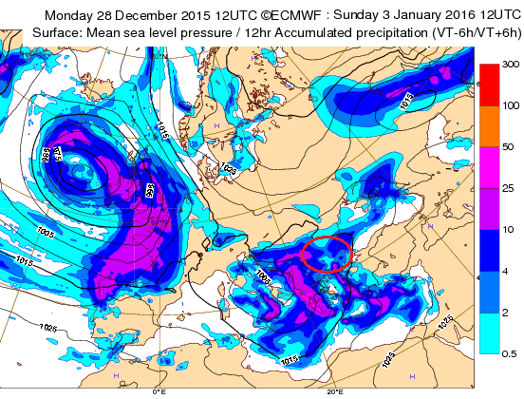
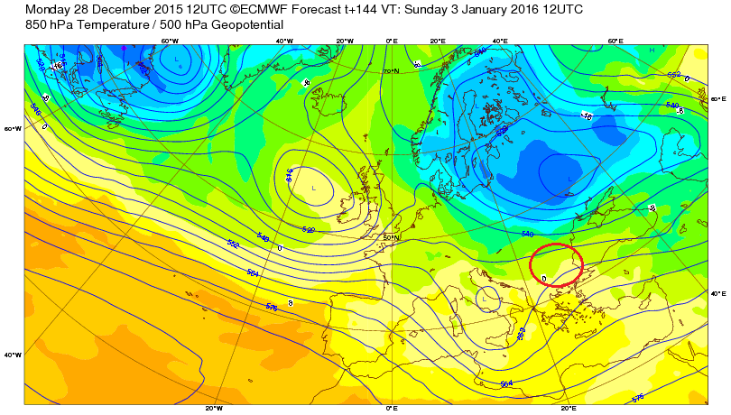
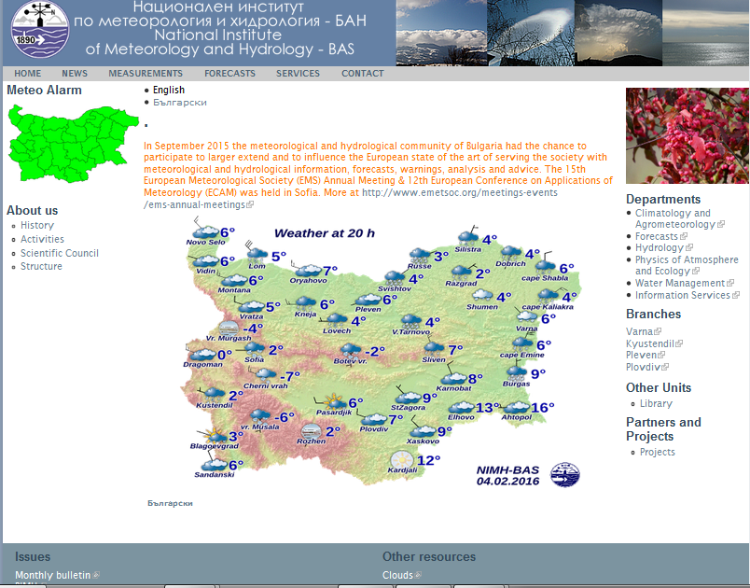
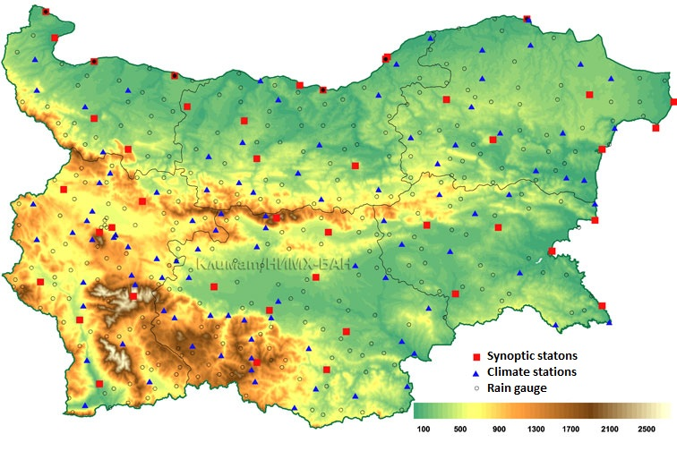
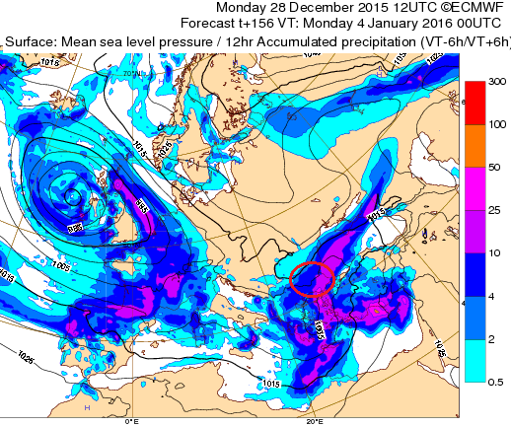
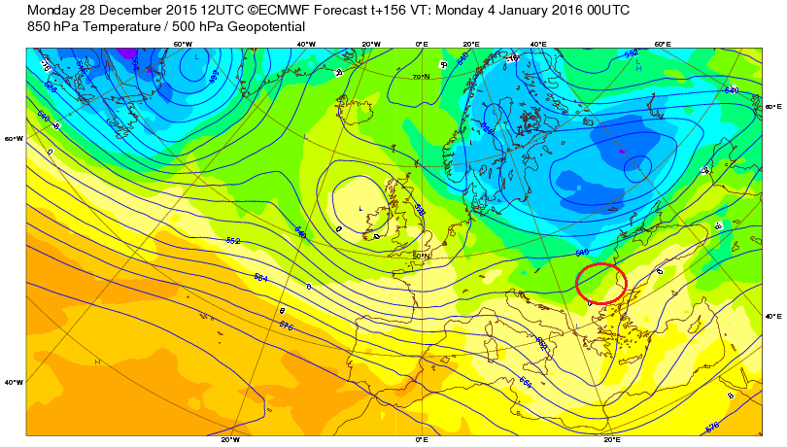
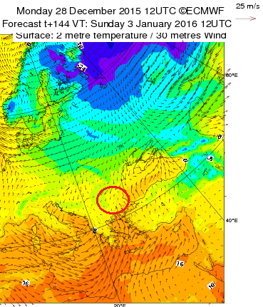
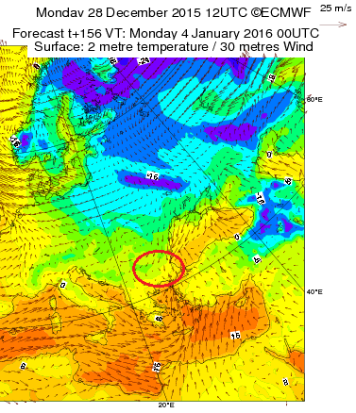
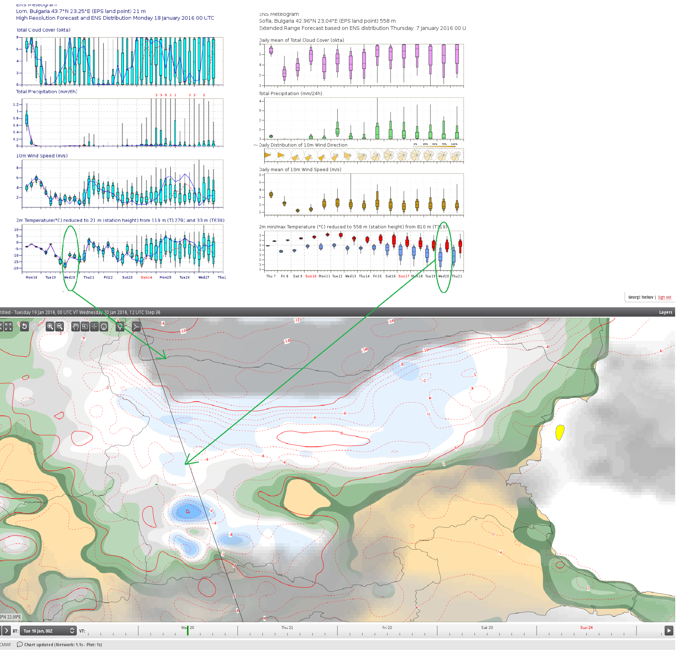
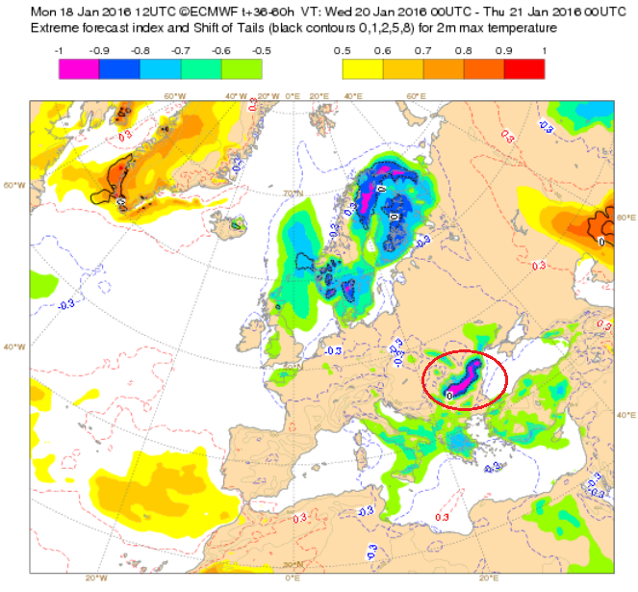
USE AND INTERPRETATION OF ECMWF PRODUCTS IN THE DEPARTMENT OF WEATHER FORECASTS OF NATIONAL INSTITUTE OF METEOROLOGY AND HYDROLOGY OF
REPUBLIC OF BULGARIA
Reading, UK, Feb.8-12.2016
Winter 2015/2016, Georgi Tsekov, forecaster at NIMH-BAS, Bulgaria
About NIMH:
National Institute of Meteorology and Hydrology (NIMH) is a part of the Bulgarian Academy of Sciences (BAS). NIMH-BAS is the national Hydrometeorological Service for research and operational activities in Meteorology, Agro-meteorology and Hydrology in Bulgaria. NIMH is the official representative of Bulgaria in WMO. The Institute is founded in 1890. The general director is Dr. Hristomir Branzov (Hristomir.Branzov@meteo.bg). The Headquarters is situated in the capital - Sofia, blvd Tsarigradsko Shosse 66.
CASE 1
Weather forecasts become very popular before the main public holidays such as the festive period. Few days in advance NIMH’s weather forecasting department issued a warning of heavy snowfall and big accumulation of snow on the ground valid for 3rd of January (Sunday) 2016, which was the last day off during the New Year and the traffic was supposed to be heavy.
The forecast turned to be correct. There was heavy snowfall and the citizens were alarmed early enough not to plan their travel on that day.
The cause of the adverse weather conditions was a Mediterranean cyclone, centered over Greece.
This type of cyclones brings very often high-impact weather on the Balkan peninsula including Bulgaria.
The images below (fig. 3) represent some of routine charts when forecasting the general synoptic situation over Europe. The charts below represent the 6-day HRES provided by ECMWF. It shows precipitation amounts and cold temperatures that suggest wet snowfall. ECMWF forecasts from both HRES and ENS helped forecasters issue an early warning of excessive snowfall 6 days in advance. Fig.3 shows gradual drop of temperatures from the north towards the end of the day. Although the actual temperatures were even lower well-predicted by the model in later run even the 6-day HRES forecast was quite good. Some new forecast products such as precipitation type available through ecChrats were of great help in this case.
Activities of NIMH:
- Monitoring, analysis, and forecast of atmospheric and hydrological processes;
- Research on spatial-temporal characteristics of climate and water resources;
- Research and forecasting of atmospheric and hydrological compositions and their variations of natural and anthropogenic origin;
- Hydrometeorological Service for the territory of the country and the Black Sea dealing with the state authorities, public and a wide range of users that need specialised information;
- Protecting lives and property through timely prediction of hazardous and weather and flooding;
- Provision of national and international data exchange in South-eastern Europe and the Middle East for the World Weather Watch (WWW).
The Forecast Department is a subdivision of NIMH-BAS and it is responsible for preparing of short-range, medium-range and monthly forecasts. The department is the main source of weather forecasts for the Bulgarian citizens, public institutions, media and private customers in different areas of the industry. It consists of a central office in Sofia and three regional branches in three cities of Varna, Pleven and Plovdiv. Each of them has specific responsibilities related to different climate zones and public needs (e.g. the office in Varna has the duty to provide marine forecasts for the Black sea area). The main office in Sofia has the responsibility to provide general and specialized forecasts for the whole country. Most of the operational forecasters and scientists in the department are physicists graduated in Meteorology in the Faculty of Physics of Sofia University St. Kliment Ohridski.
The main forecasting office in Sofia is a 24/7 operational centre. Its team comproses 11 forecasters, managed by Dr. Anastassia Stoycheva (email: anastassia.stoycheva@meteo.bg).
The other members of the team are: Krasimir Stoev, Hristo Hristov, Anastasya Kirilova, Mariana Popova, Boryana Markova PhD, Anna Dyakova, Martin Slavchev, Boris Dimitrov, Evgenia Egova and Georgi Tsekov.
fig.1 Home web page of NIMH www.meteo.bg
fig. 2 NIMH observation network
Fig.3
In order to provide quality weather forecasts, it is essential for every forecaster to use various sources of information (ground observations, atmospheric soundings, synoptic analysis, numerical weather prediction models(NWP), satellite and radar data , etc.). NWP models are essential tools in the contemporary forecast process. The ECMWF Integrated Forecasting System (IFS) provides forecasts for multiple time ranges, for various meteorological variables and indices. It is an important component of Forecast Department tools used extensively in operations and its good performance is highly valued. In this poster two cases from winter 2015/2016 are presented displaying different ECMWF products.
CASE 2
20th of January was the coldest day in winter 2015/2016 and the coldest day since Feb. 2012. Then, Bulgaria was at the center of anticyclone in combination with very cold airmass. The night was clear and that led to a strong cooling. The minimum temperatures were mainly between -20° and -10°C, but there was places in the Danube Plain with -25° to -28°. The day was sunny, and the temperatures increased in about 5-10°.
Icy fog formed in a vast area along Danube and that prevented temperature from rising during daytime. The moisture coming from Danube river in combination with strong temperature inversions and lack of wind led to dense fog formation. ECMWF IFS was the only forecast system that predicted low-level clouds and extremely cold temperatures pretty well. Fig.4 shows the forecast of cloud cover, snow depth and maximum temperatures at 12UTC(14:00 local time) as seen on the eCharts. The 15-days ensemble meteogram for Sofia suggests that the day of interest could be the coldest during that period and this forecast turned to be correct despite the fact that the validity time was towards the end of the 15-day forecasting period. The other ensemble meteogram is from a run closer to the day, for the small town of Lom, where it was foggy and very little diurnal cycle of temperature was observed. Fig. 5 shows the Extreme Forecast Index (EFI) for 2-metre max. temperatures.
Fig. 4 Meteograms for Sofia and Lom and ecCharts forecaster view screen with the forecast of maximum temperature, cloud cover/type and snow depth.
Fig. 4
Fig. 5

