Slide 1
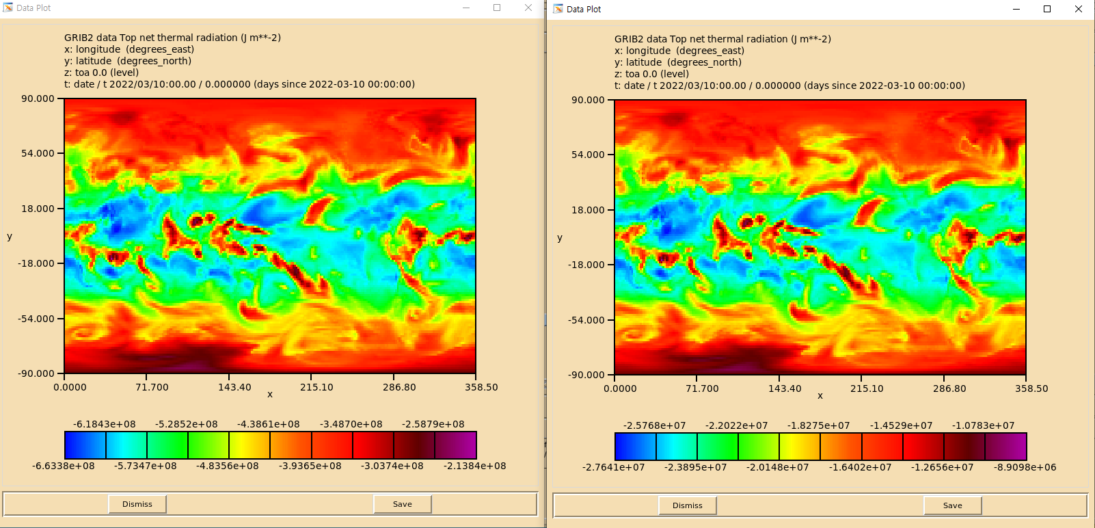
before
after
z_s2s_c_RKSL_202203100000_glob_prodf_cf_1440_000.grb2 (first time)

Slide 2
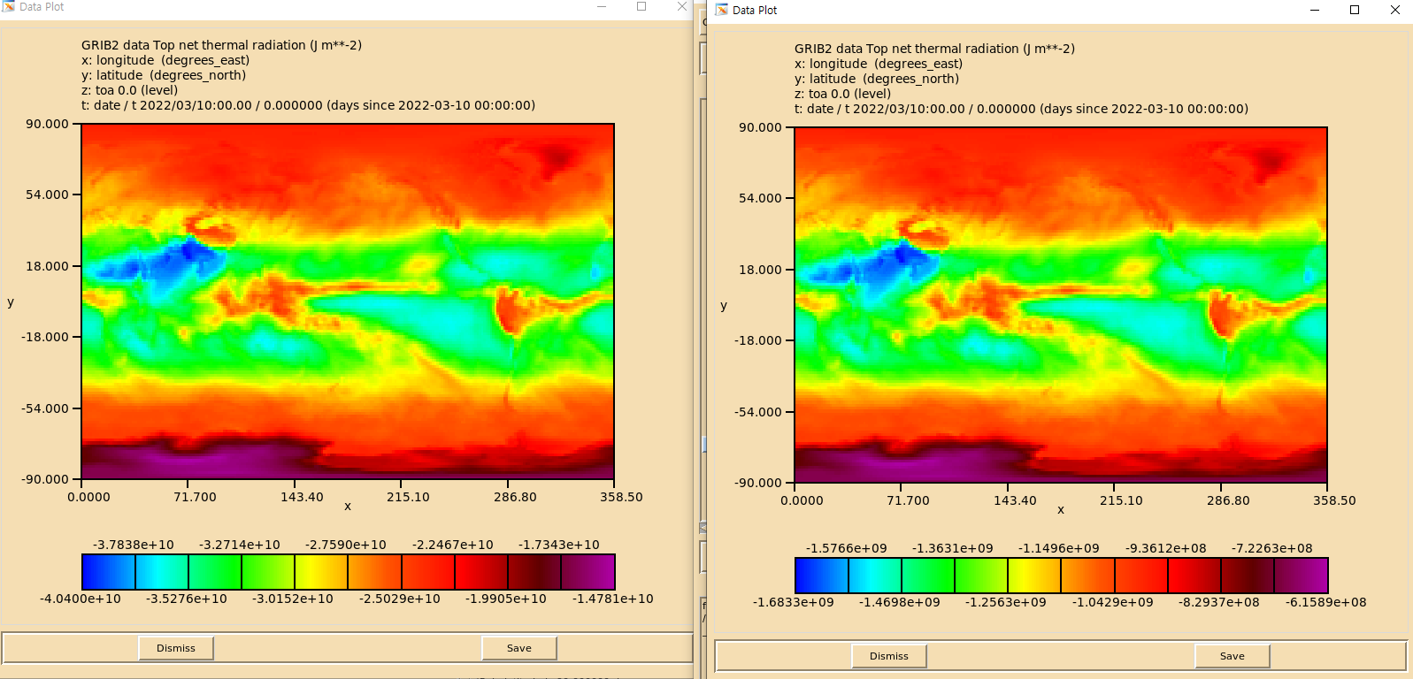
before
after
z_s2s_c_RKSL_202203100000_glob_prodf_cf_1440_000.grb2 (last time)

