Slide 1
Global and regional reanalysis needs for current satellite observations
from the perspective of C3S activities
Hans Hersbach,
Bill Bell, Adrian Simmons, Julien Nicolas, Dinand Schepers,
Paul Berrisford, Andras Horanyi, Joaquin Munoz-Sabater, Raluca Radu
C3S Reanalysis Team, Copernicus Department , ECMWF

Slide 2
Overview
Overview of C3S reanalysis activities
The principle of reanalysis
Some details on data usage in ERA5
Needs for current satellite observations
Final remarks

Slide 3




















The Copernicus Climate Change Service
USERS
Policy Makers
&
Public
&
Private, Commercial
Different
Needs
Examples of
areas covered
Farming
Oil Spill Tracking
Air Quality
Flood
Surveillance
Arctic change
6 Information
Services
Land
Marine
Atmosphere
Emergency
Security
Climate
Space
Infrastructure
&
In Situ
Infrastructure
Sustainable
observation
capabilities
OBSERVATIONS
ECMWF operates the Copernicus Climate Change Service (C3S) and Copernicus
Atmosphere Monitoring Service (CAMS) on behalf of the European Commission.
Notes:
The services are the intermediate between the Sentinels and the end users.
ECMWF outsources most of the C3S funding. Global reanalysis, part of seasonal forecasting and operating the service (e.g., contract management) occur in-house.
C3S makes use of the massive European investment in R&D; it is based on mature science to provide an operational service. It is a young service, which needed time to build up.

Slide 4
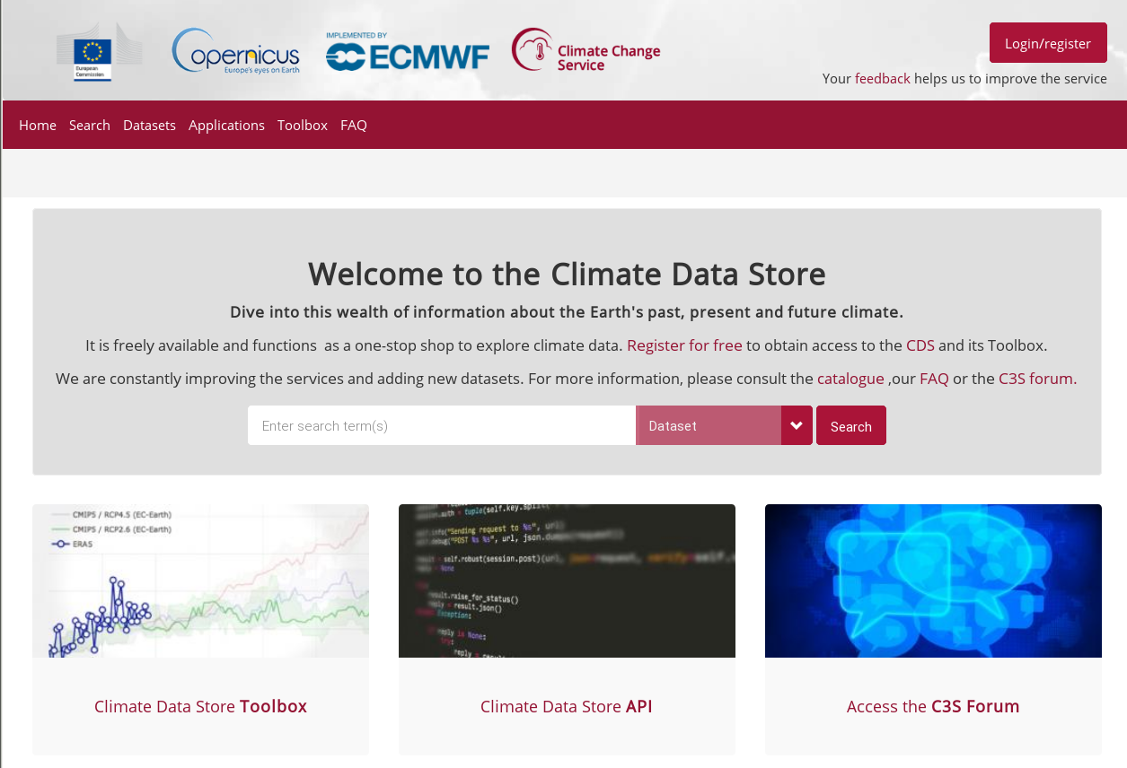
The C3S Climate Data Store
Notes:
4

Slide 5
Climate Data Store content
C3S ECMWF: Global Climate Reanalysis
C3S_322: Regional Reanalysis for Europe
and the European Arctic
C3S_312a/b: Satellite-based ECV products
C3S_311a: In situ observations
C3S_311b: Satellite data reprocessing
C3S_311c: Support for climate reanalysis
including satellite data rescue
Observations
Global estimates of ECVs from satellite and in-situ observations
Reprocessed CDRs, reference observations
Climate reanalysis
Global atmosphere, ocean, land
Regional reanalysis for Europe
Model output
Multi-model seasonal forecast products
Access to CMIP data and products (global and regional)
Support for data rescue, climate data collections
Coupled climate reanalysis for 100 years
Reference set of climate projections for Europe
Climate Indicators

Slide 6
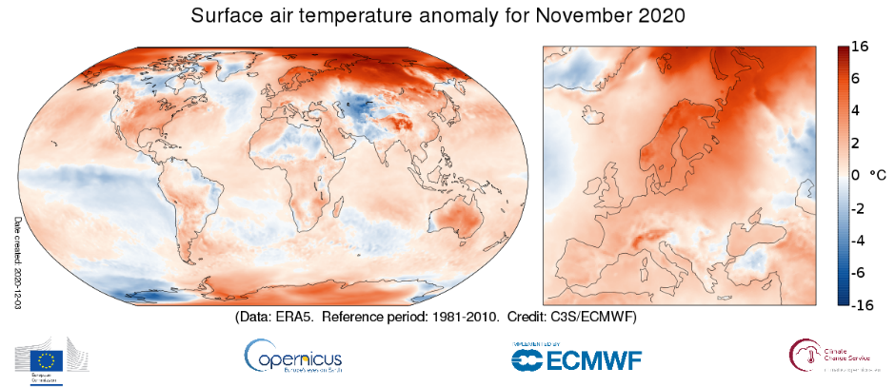
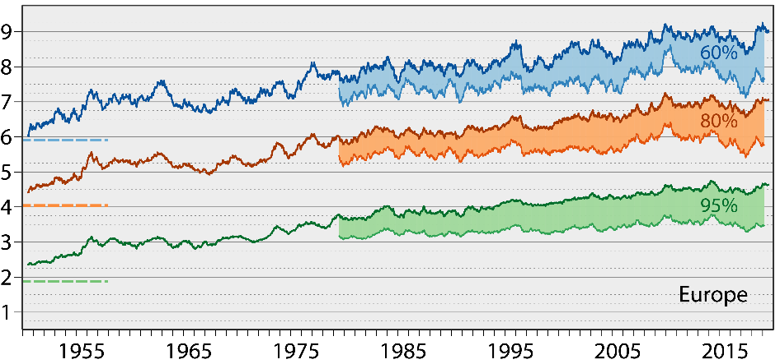
The ERA5 global reanalysis
ERA5 is in production at ECMWF for C3S
Atmosphere, land, ocean waves
ERA5 has replaced ERA-Interim
(ERA-I was stopped end August 2019)
Improvements compared to ERA-Interim:
Benefit from additional 10 years R&D development
Much higher resolution; 31km versus 80km
More and better input data
Hourly output
10-member EDA-based uncertainty estimate (at 63km)
Continued close to real time; latency of 5 days
Reaches further back in time (1950 versus 1979)
(highest quality over data rich areas)
Forecasts from ERA5 have higher skill than those from ERA-Interim

Slide 7
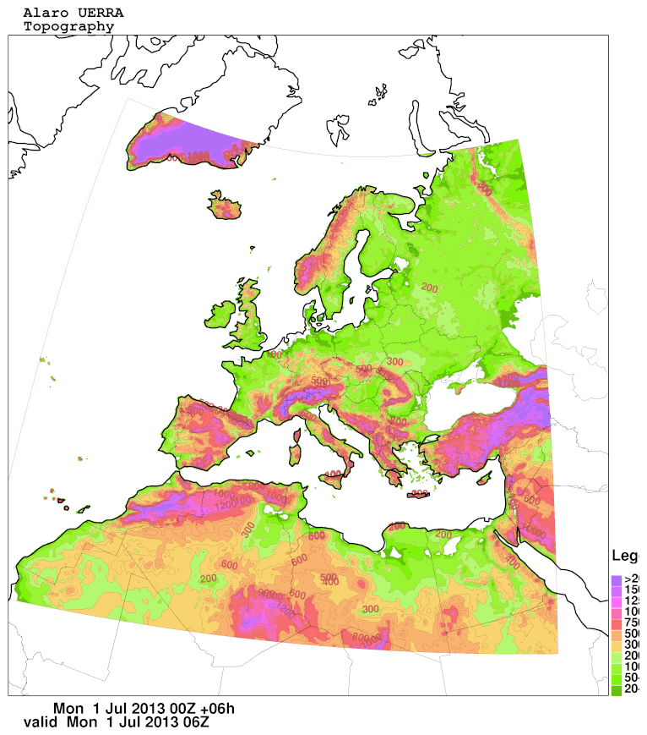
Copernicus regional reanalysis for Europe (CERRA)
2017
2018
2019
2020
2021
UERRA system in near real time (11km resolution)
HARMONIE ALADIN model and 3D-VAR with ensemble information
New system in operational mode (5.5km resolution)
Development of the new system
EDA system (10 members at 11km resolution)
User support and guidance
Uses satellite observations
11 km (565x565 grid points), 65 levels
Surface downscaling analysis 5.5 km (MESCAN)
1961 to July 2019 (no timely updates)
Contractor : SMHI – subcontractors: Météo-France - MET Norway
5.5 km (1069x1069 grid points), 106 levels
Surface analysis at 5.5 km – no downscaling
Plus 10 ensemble members at 11km
Started from September 1984
Notes:
UERRA=Uncertainties in Ensembles of Regional ReAnalysis, a preoperational FP7 project, www.eurra.eu
EDA=Ensemble data assimilation
Note that the surface downscaling in the UERRA system is decoupled (offline) from the 3D product. In contrast to that the surface analysis will be included into the new system.
7

Slide 8
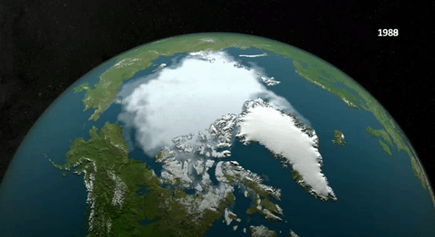
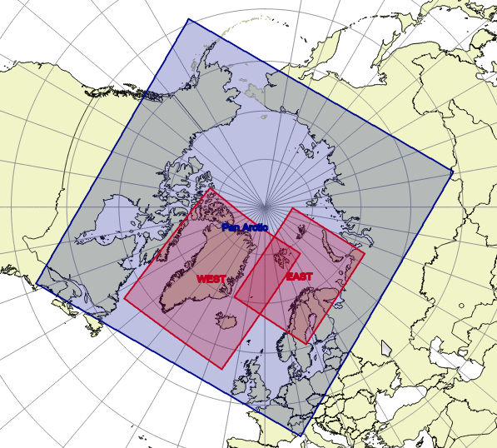
Copernicus Arctic Regional Reanalysis (CARRA)
Met Norway (lead), the Nordic countries and Météo-France.
Warming in the Arctic (observational records and future scenarios) roughly twice as high as global average
Need for understanding and management of change processes
Increased economic activity in the region
Animated gif: NASA
Two domains, main areas of interest in the European sector of the Arctic
High resolution, 2.5 km, adds value to global products
Reanalysis period July 1997 – June 2021 (24 years)
Extensive use of satellite data
Use local surface observation datasets available in the partner countries
Special emphasis on NWP schemes and observations for the handling of “cold surfaces”: Snow, sea ice, glaciers
One year proof of concept (grey area) pan-Arctic reanalysis at 3.75km.

Slide 9
Overview
Overview of C3S reanalysis activities
The principle of reanalysis
Some details on data usage in ERA5
Needs for current satellite observations
Final remarks

Slide 10
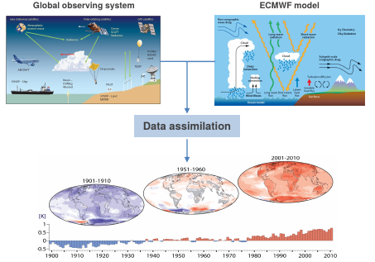
Reanalysis uses past observations with today’s weather model
The data from reanalysis are widely used (39,000 users of the ERA5 reanalysis, so far)
Complete: combining vast amounts of observations into (global) fields using data assimilation
Consistent: use the same physical model and data assimilation system throughout
Convenient: “maps without gaps”, always available in the same way
Observations are absolutely key!!
availability has evolved drastically over time
Reanalysis uncertainty product is important

Slide 11
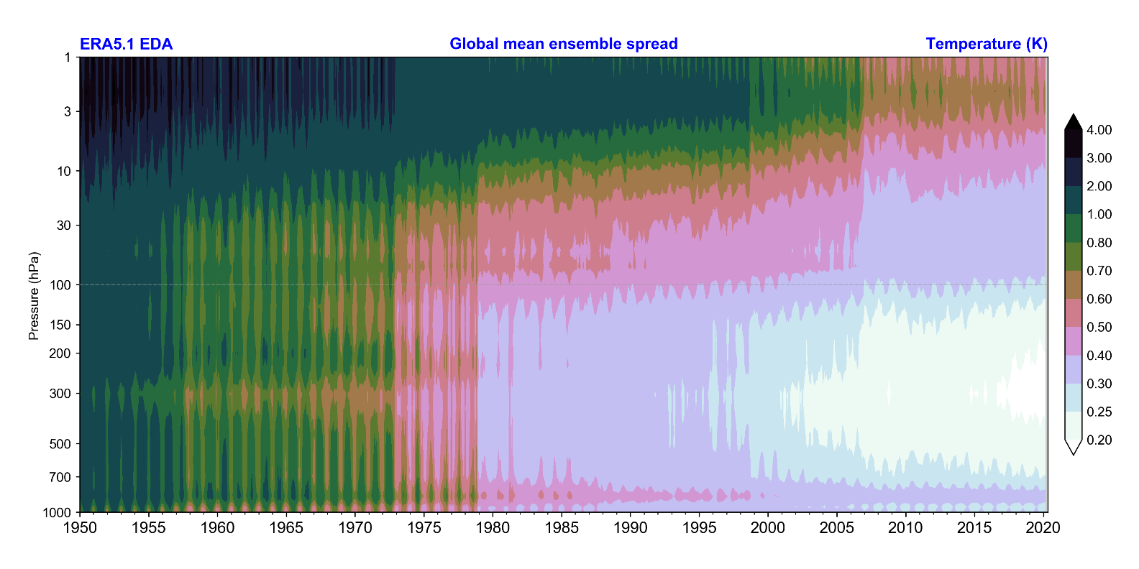

Ensemble spread as a measure for the synoptic ERA5 uncertainty
Spread decreases over time when more and more observations become available
Major changes in the observing system are clearly visible
IGY
VTPR
TOVS
(HIRS, MSU, SSU)
ATOVS
(AMSU-A)
GNSS-RO
(COSMIC,..)

Slide 12
Overview
Overview of C3S reanalysis activities
The principle of reanalysis
Some details on data usage in ERA5
Needs for current satellite observations
Final remarks

Slide 13
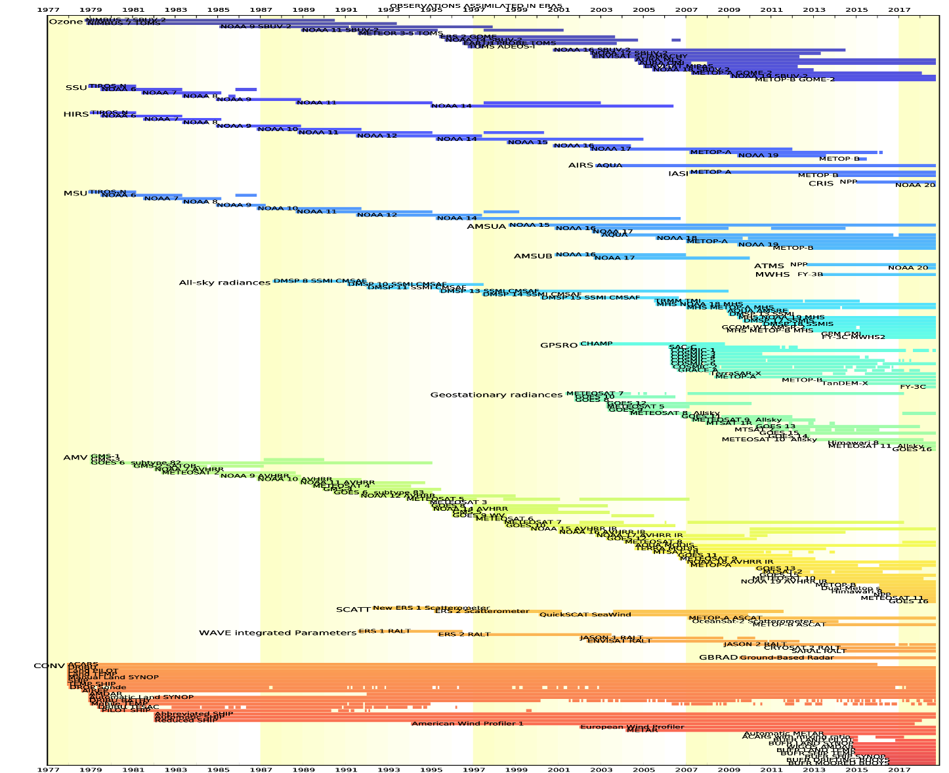
The ERA5 observing system
0.75 (1979) – 24 Million (2019) obs per day
Over 200 types of reports
Reprocessed data sets
Radiances: SSM/I brightness temp from CM-SAF
MSG from EUMETSAT
Atmospheric motion vector winds: METEOSAT, GMS/GOES-9/MTSAT, GOES-8 to 15, AVHRR METOP and NOAA
Scatterometers: ASCAT-A (EUMETSAT),
ERS 1/2 soil moisture (ESA)
Radio Occultation: COSMIC, CHAMP, GRACE, SAC-C, TERRASAR-x (UCAR)
Ozone: NIMBUS-7, EP TOMS, ERS-2 GOME, ENVISAT SCIAMACHY, Aura MLS, OMI, MIPAS, SBUV
Wave Height: ERS-1,ERS-2, Envisat, Jason
Latest instruments
IASI, ASCAT, ATMS, CrIS, MWHS, Himawari, …
Improved data usage
all-sky vs clear-sky assimilation,
latest radiative transfer function, corrections,
extended variational bias control
Courtesy: Paul Poli

Slide 14
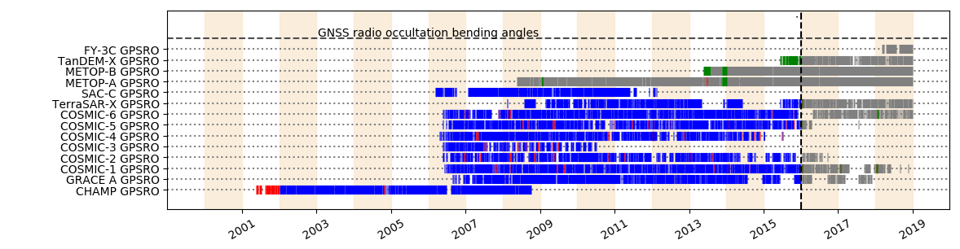
GNSS-RO observations assimilated in ERA5
Reprocessed
In reference, but not ERA5
In ERA5, but not reference
Used in both
Reference: ERA-Interim ECMWF NWP
Reprocessed (from UCAR):
CHAMP, GRACE-A, SAC-C
TerraSAR-X, COSMIC 1-6
Operational product:
METOP-A, B and C (from March 2019)
TanDEM-X
FY-3C
KompSAT-5 (from end July 2019)
COSMIC 2 (from March 2020)

Slide 15
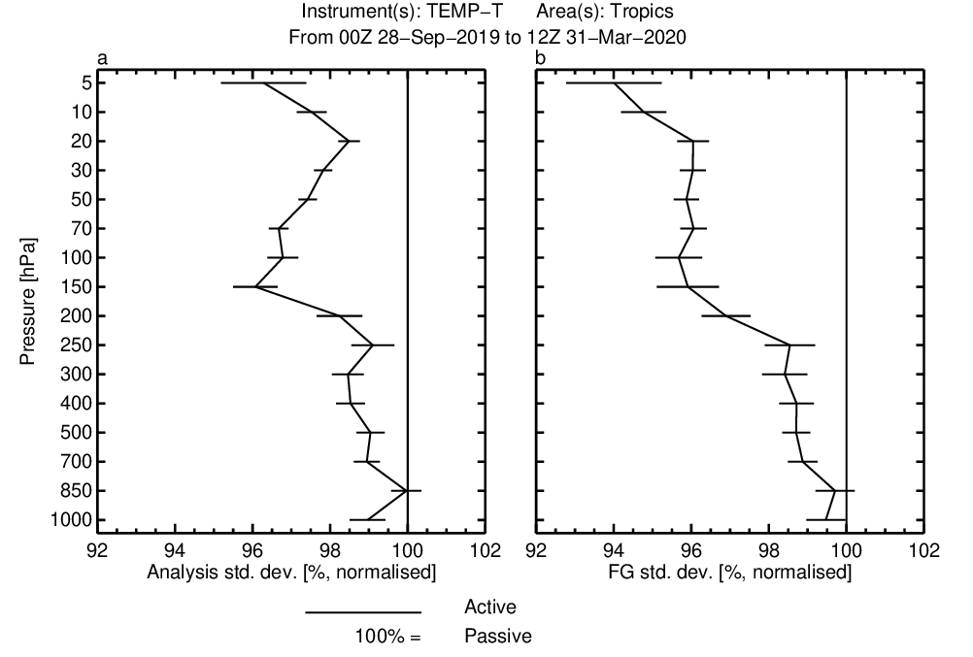

Positive impact of COSMIC 2 ; improved fit of radiosondes to the NWP model
good
Analysis
First Guess
Courtesy: Sean Healy

Slide 16
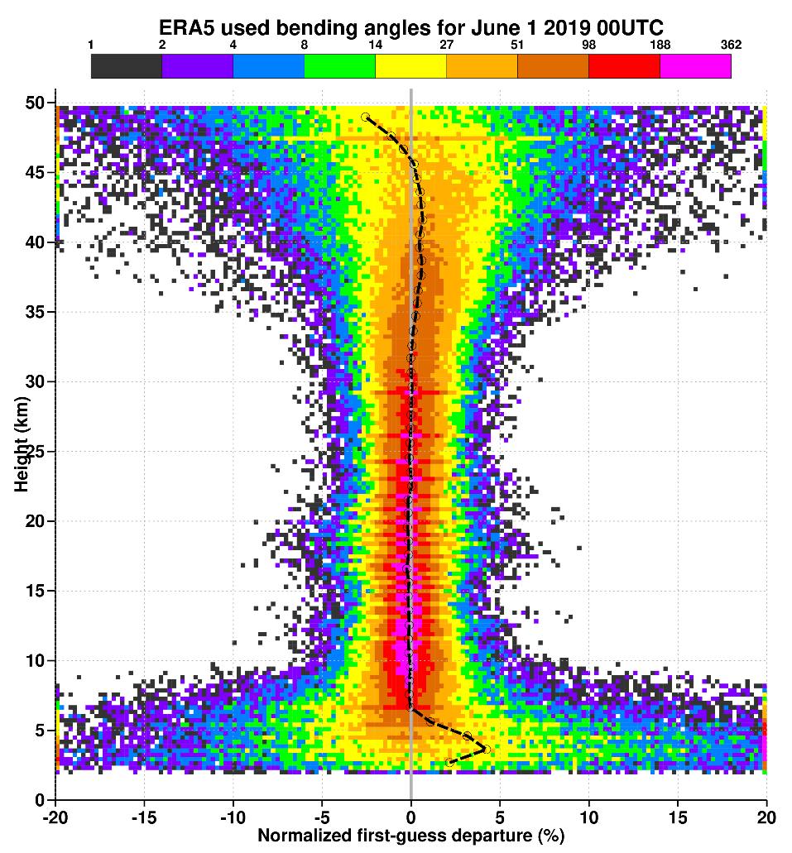
Assimilation of GNSS-RO data in ERA5; use bending angles rather than level 2 retrievals
Observation operator for bending angle:
2-Dimensional
account for both temperature and humidity
account for tangent drift point
Assimilation:
Increased weight compared to ERA-Interim
Use from 2-50 km
Anchor measurements
Do not bias correct
Note: radiosonde temperatures are subject to prescribed corrections (RICH)

Slide 17
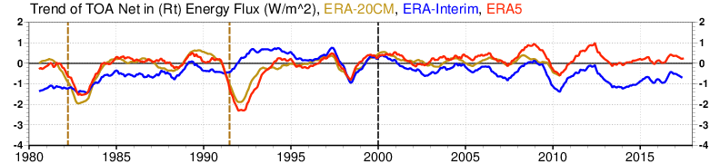
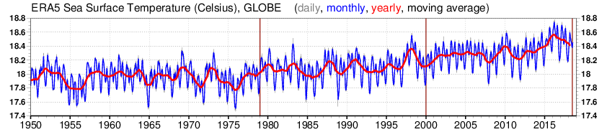
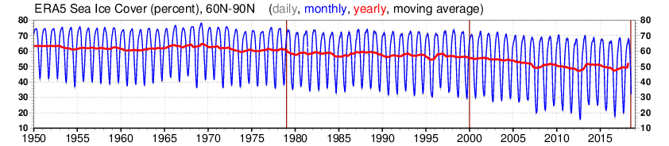
ERA5 forcing appropriate for climate; these are ingested ‘as is’ and need to be level 4
Anomaly
CMIP5 recommended data sets
Total solar irradiance, greenhouse gases, ozone, aerosols (including volcanic)
(Prepared in the ERA-CLIM project, ERA-20CM,
Hersbach et. al., 2015)
1989-2008 (W/m^2)
ERA5 0.4
ERA-Interim -1.2
El Chichón
Pinatubo
SST and sea ice cover
Carefully selected from OSTIA, OSI-SAF and HadISST2 (Hadley Centre, ERA-CLIM)
Different ensemble members use different SST realizations
(Hirahara et. al., 2016)

Slide 18
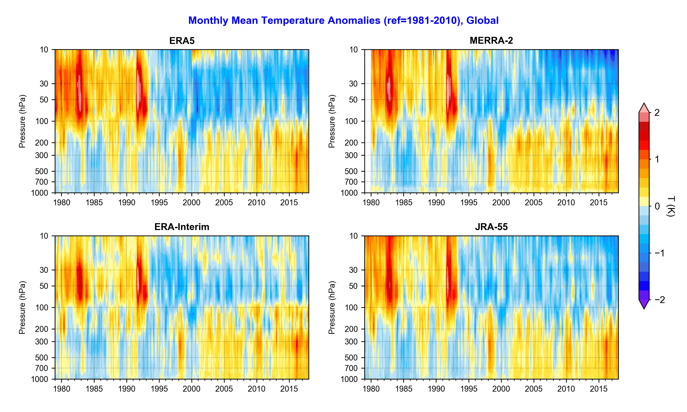
Intercomparison with reanalysis products from other major centres
El Chichón
Pinatubo
Julien Nicolas
Notes:
Over the troposphere and lower stratosphere there is a general consensus between reanalyses; some differences in the details.
The larger response of ERA5 to volcanic eruptions is the result of the forcing with the CMIP5-recommended data set for volcanic sulphate.
The B from 2000 has smaller correlation lengths and makes it more difficult for radiosondes to correct a model warm bias. Large amount of GPS-RO from 2006 (COSMIC) improve the situation.

Slide 19
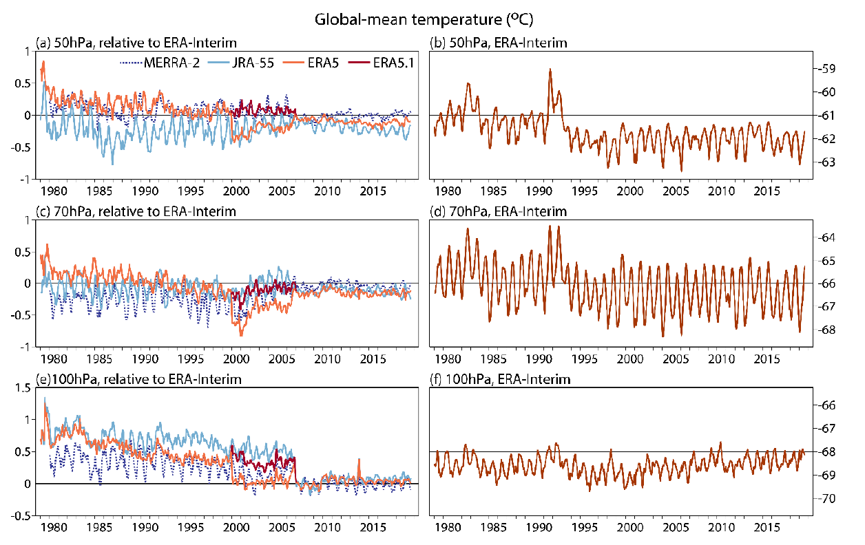
Inter-comparison of global reanalyses: convergence from 2006 COSMIC anchor observations
Simmons et. Al., 2019
Notes:
850K isentropic surface is around 10 hPa.

Slide 20
Overview
Overview of C3S reanalysis activities
The principle of reanalysis
Some details on data usage in ERA5
Needs for current satellite observations
Final remarks

Slide 21
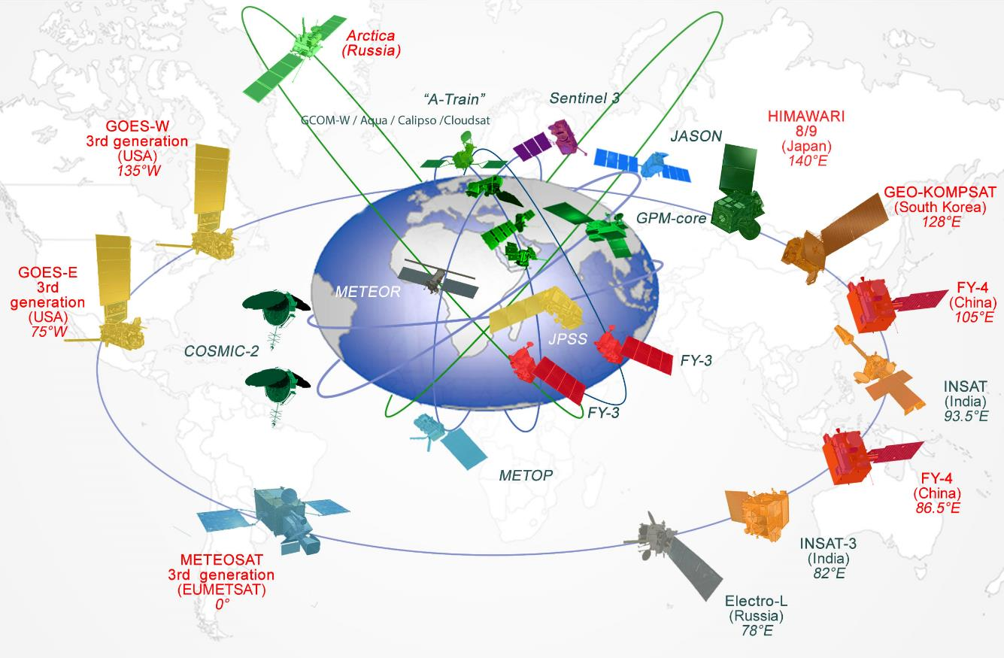
WMO Integrated Global Observing System
In 2020 there are 190 active satellites supporting weather, climate, earth system and space weather

Slide 22
2000
70% American
20% European
10% Asian
2020
30% American
45% European
25% Asian
COSMIC-2
CMA LEO
~10 satellites
~12 instruments
~50 satellites
~95 instruments
EUMETSAT LEO
NOAA LEO

Slide 23
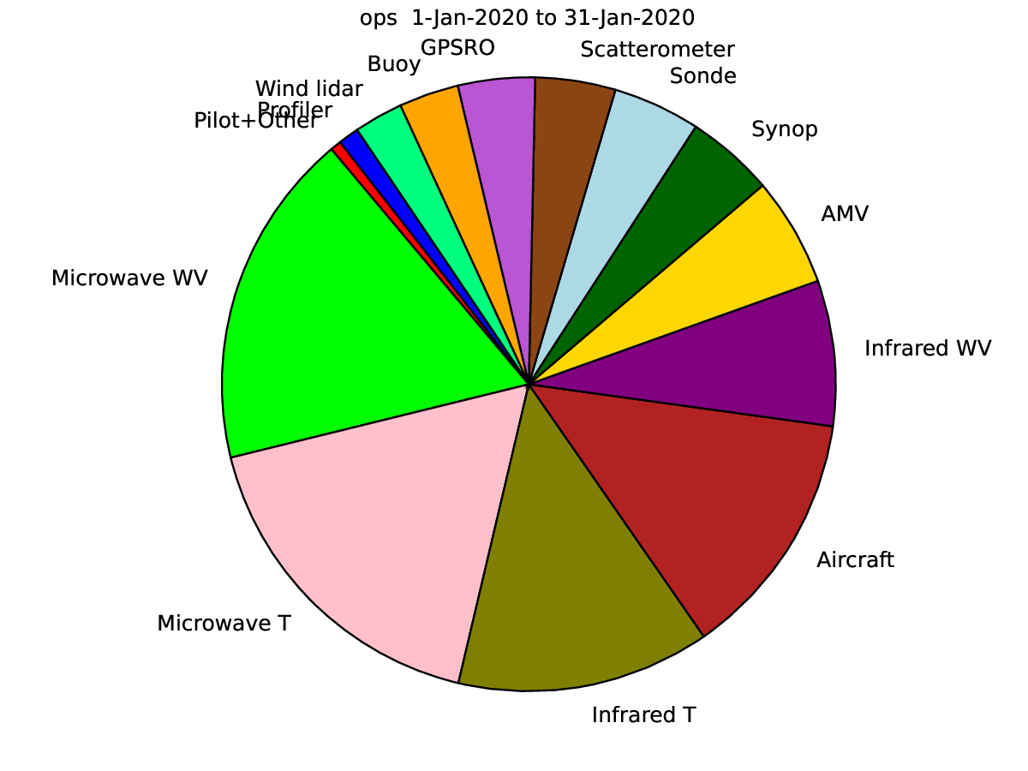
Impact of observing systems in the ECMWF NWP system, January 2020 (FSOI based)
Reanalysis enjoys a synergetic relationship with NWP:
essentially uses the same observing system, and;
uses the data assimilation system developed for NWP
Both global and regional
Therefore, the requirements for reanalysis are largely the same as for NWP:
Continuation of the main components of the satellite observing system: radiances (IR & MW), RO, Scat & AMVs are important, as well as the likely evolution (e.g. Aeolus DWL for tropical winds)
However, there are some differences:
Requirement for NRT data is more relaxed, enabling the use of research missions (e.g. MLS O₃ );
Accurately representing the whole atmosphere is more important for reanalysis, regardless of forecast skill, eg:
  stratospheric humidity (MLS H₂O);
  upper stratospheric & mesospheric temperatures (SSMIS Upper Atmospheric Sounding channels)
Anchor missions and high quality calibration will, most likely, become increasingly critical for RA (e.g. RO + CLARREO-like missions + TRUTHS)

Slide 24
In addition
Reanalyses typically directly assimilate satellite observations
Level 1B radiances rather than level 2 retrievals
Reanalyses typically use online bias-estimation methods
However, the stability of satellite products remains important
ERA5 is maintained close to NRT
Use the same input streams in the ECMWF operational observation stream for those observations we share
For the ‘historical part’ access to the best data (like reprocessed) is very important, though
Tries to keep in pace with ingesting the latest instruments; not always possible (need for new generations of reanalysis)
Reanalyses need in addition appropriate forcing fields and continuity of these is absolutely essential
SST, sea-ice cover, greenhouse gases, aerosols, surface physiographic dataset (Arctic reanalysis)
These are typically taken ‘as is’ as level 4, so they need to be complete, accurate and guaranteed.
Special requirements for regional reanalysis
E.g. high horizontal resolution (AMVs, Geo hyperspectral-IR, MVIRI, SEVIRI)
Snow cover, satellite glacier albedo (both from IR imagers), high-res sea ice (including the Baltic), soil moisture
The availability of high-quality conventional observations remains essential
Ground truth, used for calibration of satellite observations, etc.

Slide 25
Overview
Overview of C3S reanalysis activities
The principle of reanalysis
Some details on data usage in ERA5
Needs for current satellite observations
Final remarks

Slide 26
Final remarks and outlook for future C3S reanalysis-related activities
Reanalysis provides ‘maps without gaps’ and are able to deliver consistent estimates based on the entire observing system, rather than focused on a specific subset.
The ongoing production of ERA5 and regional reanalysis is undertaken within the Copernicus C3S framework at ECMWF as part of the C3S operational service.
Many reanalysis-related tasks are being carried out by C3S providers:
satellite reprocessing (EUMETSAT), data rescue, consolidation of historical datasets, to be fed into ERA6
the production of two high-resolution regional reanalyses, for Europe and the Arctic
ECMWF’s vision for C3S post-2020 continues to allocate a high priority to reanalysis:
Potentially expanding ERA5 further back to 1940 or earlier.
Next full-observing-system coupled reanalysis (ERA6)
State-of-the-art NWP system, coupled with the ocean
CMIP6 forcing
Improve the handling of model bias
Improve the uncertainty estimate, especially for the mean state
Production to start early 2024
Next high-resolution regional reanalyses going further back in time
Truly pan-Arctic reanalysis

Slide 27
Backup slides
Back-up slides

Slide 28
What is new in ERA5?
 | ERA-Interim | ERA5
Period | 1979 – present | 1950 – present, produced in 2 phases
Availability behind real time | 2-3 months | 2-3 months (final product) 2-5 days (ERA5T)
Assimilation system | 2006 (31r2), 4D-Var | 2016 (41r2), 4D-Var, hybrid EDA providing B
Model input (radiation and surface) | As in operations, (inconsistent SST and sea ice) | Appropriate for climate, e.g., evolution greenhouse gases, volcanic eruptions, sea surface temperature and sea ice
Spatial resolution | 79 km globally 60 levels to 10 Pa | 31 km globally 137 levels to 1 Pa
Uncertainty estimate |  | from 10-member EDA at 62 km
Output frequency | 6-hourly Analysis fields | Hourly (three-hourly for the ensemble), Extended list of parameters ~ 9 Peta Byte (1950 - timely updates)
Extra Observations | Mostly ERA-40, GTS | Various reprocessed CDRs, latest instruments
Variational Bias control radiosondes | Satellite radiances, RAOBCORE | Also ozone, aircraft, surface pressure, RISE
Land downscaling product | ERA-Interim land, 79km | ERA5L, 9km (forced by ERA5)

Slide 29
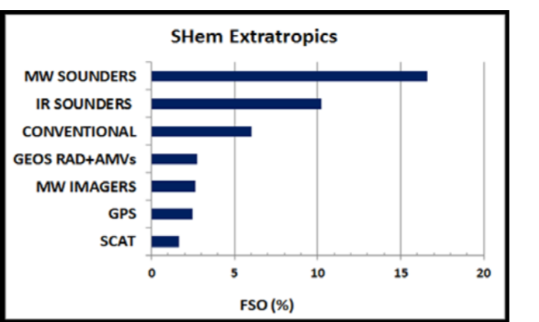
Satellite Data Records for ERA6
EUMETSAT provides high impact CDRs for ERA6 back to the 1970s
Atmospheric Sounding Radiance (Microwave and Infrared)
Meteosat Radiance and Atmospheric Motion Vectors
Radio Occultation bending angle profile
Metop ASCAT backscatter
Meteorological CDRs:
  Metop global and polar Atmospheric Motion Vectors (LEO)
  Metop multi-sensor aerosol AOD product
Ranked contributions to forecast error reduction estimated by Adjoint Sensitivity Diagnostics averaged over the test period in the Southern Hemisphere. From McNally (2014).
Aims at going back in time as far as possible, best possible individual instrument correction, error flagging, advanced uncertainty estimates and harmonisation over the time series.

Slide 30
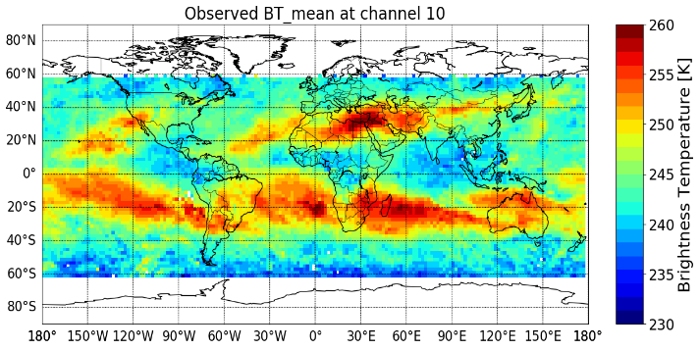
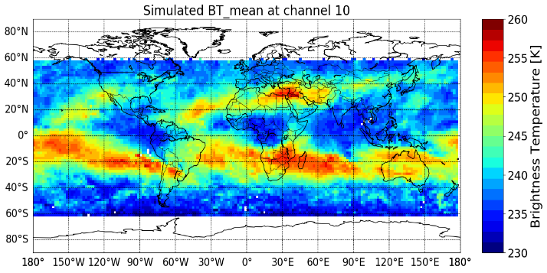
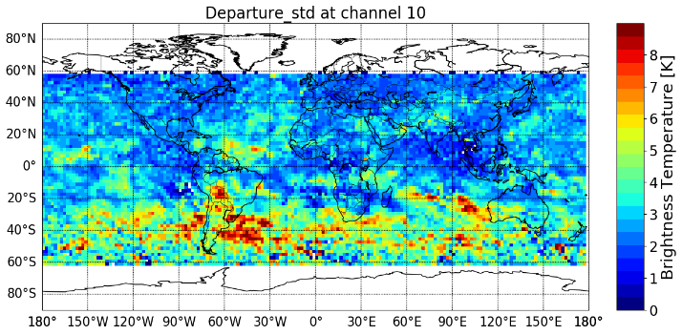
Analysis of NIMBUS-6 HIRS-1 Data
Nimbus-6 (Aug 1975)
ERA5 (Aug 1975)
Better models
Better
observations
Better
reanalysis
Standard Deviation
Nimbus-6 – ERA5 departures
Reanalysis provides a tool to analyse historical data in absence of satellite and ground-based references;
High standard deviations in SH may point to additional information from HIRS-1 if assimilated.

Slide 31
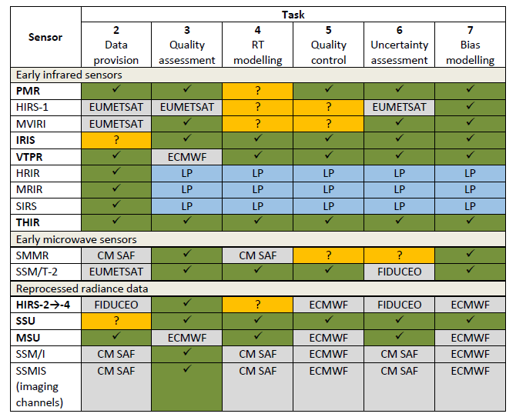

C3S_311c:Support for climate reanalysis including satellite data rescue
Better models
Better
observations
Better
reanalysis
Lot 1 Satellite Data Rescue
Focus on early datasets
Range of activities: data provision → bias modelling and uncertainty assessment
Lot 2 Historical Upper Air Data
Focus on observations prior to 1979
Includes development of bias adjustments and uncertainty estimates

Slide 32
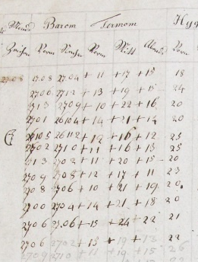

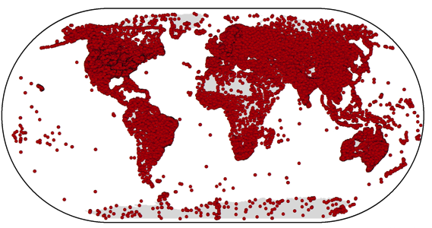
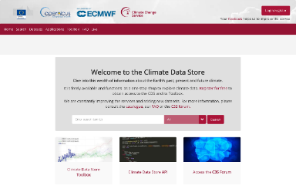
Collection and processing of in situ observations
Historical in situ observations play an important role
in C3S, e.g.:
for accurate climate monitoring,
as input to global and regional reanalyses,
as ‘ground truth’ for verification of ECV products.
C3S focuses on:
the facilitation of data rescue activities,
the improvement of historical records,
collection into well-maintained archives,
to provide access via the C3S Climate Data Store.
23000+
registered users
Some challenges:
data rescue and improvement is an enormous task,
urgency due to degradation of original records,
non-gridded, irregular in space and time
a wide range of data licenses.
Notes:
The first datasets will be available soon in the CDS.
32

Slide 33
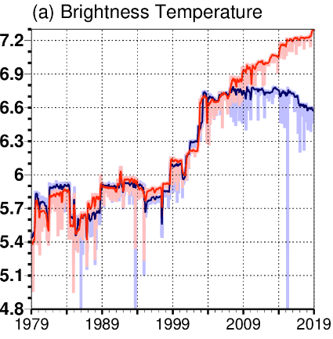
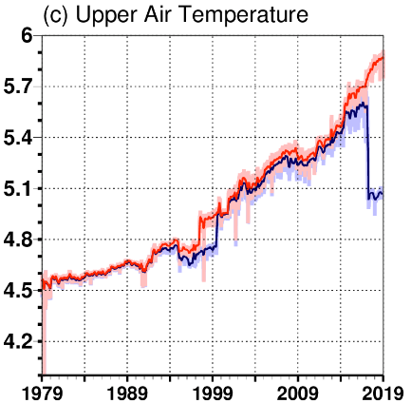
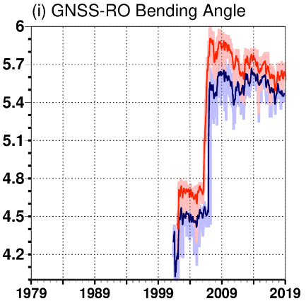
ERA5 data counts; satellite observations are increasingly dominant
ERA5 data usage has increased from
0.75 (1979) to 24 million/day (2019).
Around 100 Billion observations
Assimilated (1979 - 2020)
Number of used observations per day (log₁₀ scale) for ERA5 and ERA-Interim
Radiances:
Largest volume
Conventional:
Radiosondes, aircraft
GNSS-RO:
Initially low numbers
Counts ~ conventional
Some recent decline

Slide 34
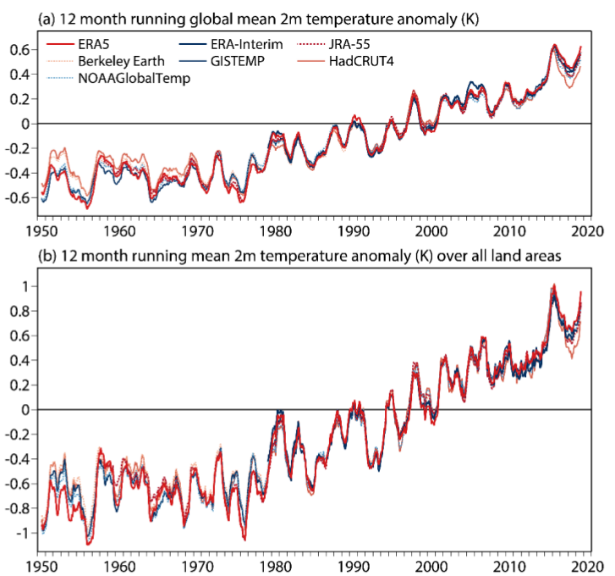
Inter-comparison of global 2m temperature anomalies
Simmons, A. et al., 2020 (in preparation):
In general there is a good agreement between datasets.
Each dataset shows considerable warming over the period shown, with a peak early in 2016 associated with a strong El Niño event and generally high values over the past six years. ERA5 and ERA-Interim are the datasets with the largest anomalies since 2016, but not the datasets with the largest
trends over the period since 1979.
Trends from ordinary least squares fits to monthly values for
the forty years 1979 to 2018 are 0.182K/decade for ERA5, 0.183K/decade for ERA-Interim, 0.180K/decade for JRA-55 and otherwise range from 0.171K/decade for NOAAGlobalTemp to 0.188K/decade for Berkeley Earth.
The reanalyses are colder prior to 1970.
Time series of monthly values from 1950 to 2020. (a) Twelve-month running averages of the global average two-metre temperature (K) anomaly with respect to 1981-2010 from ERA5, ERA-Interim, JRA-55, Berkeley Earth, GISTEMP, HadCRUT4 and NOAAGlobalTemp. (b) As (a), but for averages over land only.

Slide 35
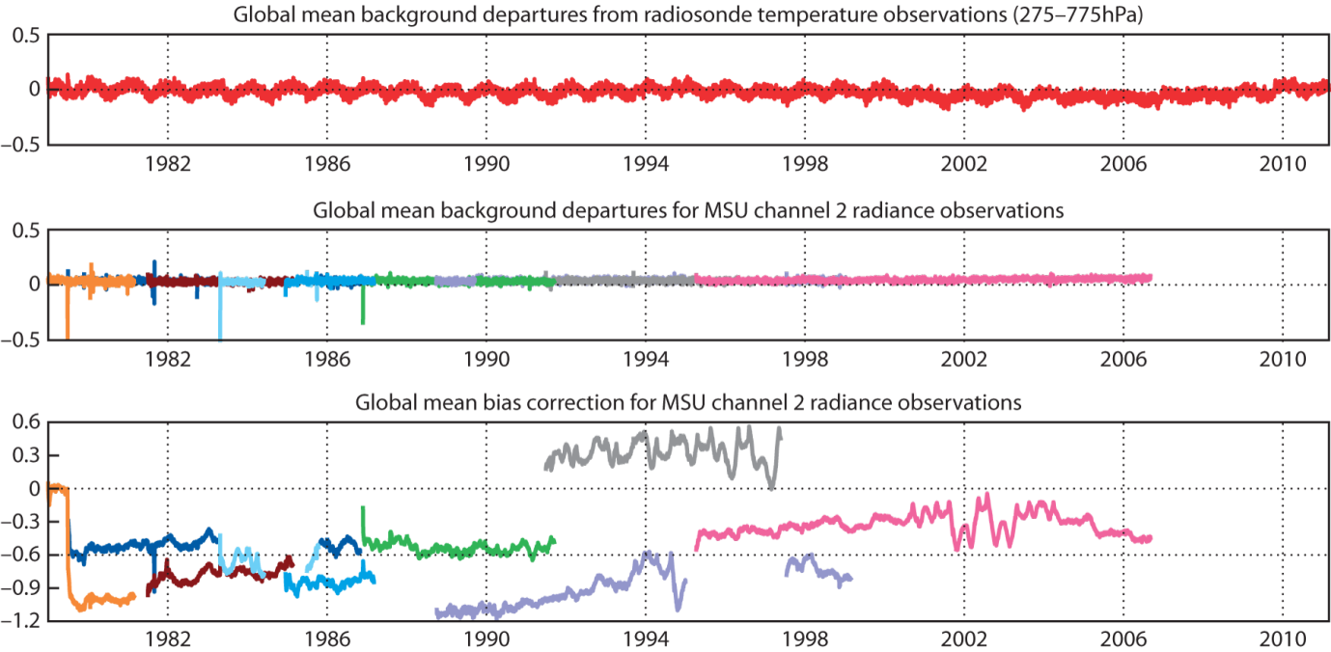
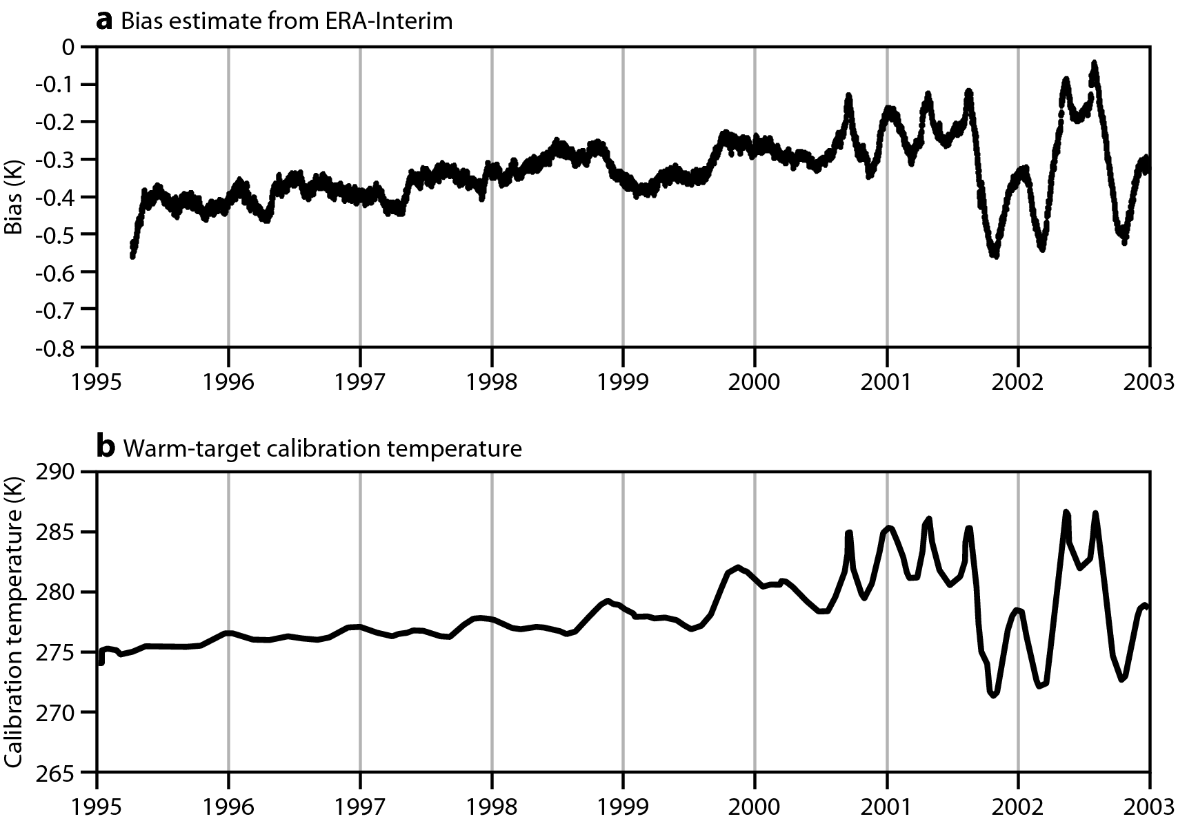
The merits of variational bias correction
Like ERA-Interim, ERA5 has a dynamic way of estimating biases in the observing system:
time-evolving biases (both gradual and abrupt)
relative biases between different components
Note: need anchors.
The bias parameters are included in the variational control:
On-board warm target variations for
MSU NOAA-14: (Dee and Uppala 2009)
Resulting bias estimates also provide a path to more homogeneous observational records
Notes:
A key aspect of the data assimilation used for ERA-Interim is the way that biases in satellite radiance measurements are estimated and adjusted for.

