Slide 1
IGARSS Brussels virtual conference, 14 July 2021
L-BAND DATA FOR NUMERICAL WEATHER PREDICTION AND EMERGENCY SERVICES AT ECMWF
Patricia de Rosnay, Pete Weston, Nemesio Rodríguez-Fernández, Calum Baugh, David Fairbairn, Francesca Di Giuseppe, Ruth Coughlan, Joaquín Muñoz-Sabater, Stephen English, Christel Prudhomme, Matthias Drusch,
and many other colleagues
European Centre for Medium-Range Weather Forecasts

Slide 2
Earth System approach
Coupled assimilation for NWP & reanalyses
Integrated Forecasting System (IFS)
4D-Var
Atmosphere
Sea Ice
3D-Var
Coupled Forecast Model
Coupled assimilation
  Ocean-atmosphere (Browne et al Rem. Sens. 2019)
  Land-atmosphere (de Rosnay et al. Surv. Geophys. 2014)
Land
EKF-OI
Ocean
3D-Var
Waves
OI
Importance of observations sensitive to interface variables, e.g. SST, sea ice, snow and soil moisture

Slide 3

ECMWF Soil Analysis for NWP
Simplified Extended Kalman Filter (SEKF)
with EDA Jacobians
Ensemble Data Assimilation (EDA)
NWP Forecast
Coupled Land-Atmosphere
Land initial conditions
EDA Jacobians
T2m, RH2m
& soil moisture
Background
Soil Analysis (SEKF)
SM1, SM2, SM3
σ_{O_T2M}= 1K
σ_{b_}= 0.01m3/m3
σ_{SMOS_NN}= 0.02+3ε
σ_{O_RH2M}= 4%
σ_{ASCAT}= 0.05m3/m3
SMOS Neural network
SMOS TB
Screen level analysis (2D-OI)
T_2m RH_2m
in situ
T_2m RH_2m
satellite
ASCAT SM
SMOS SM
$$σoT2m=2K$$
$$σoRH2m=10\%$$
3

Slide 4
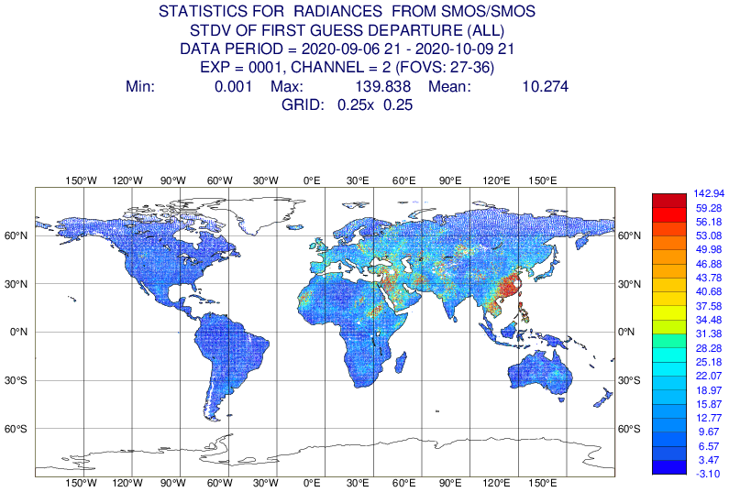
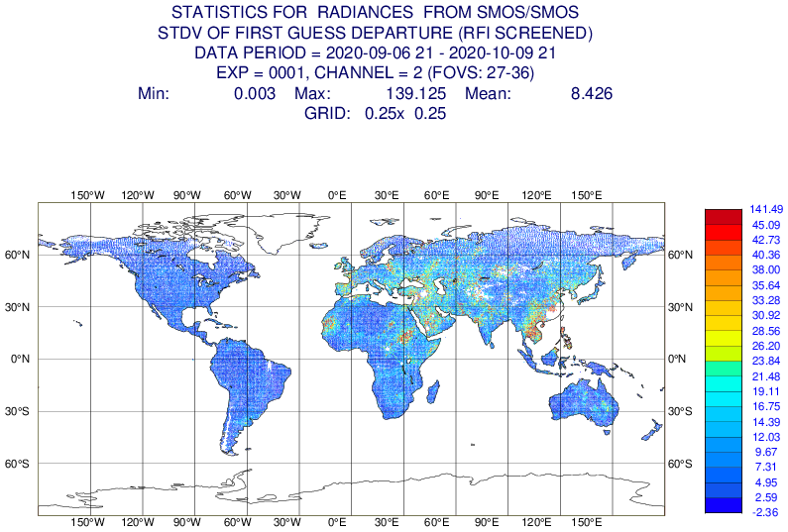
Observation monitoring and quality control
SMOS brightness temperature operational monitoring
Summer 2020: a large area of RFI (Radio Frequency Interference) contamination over South-East China
Improved screening does a better job of filtering it out but still not perfect
  Need for further improvements in RFI filtering flags
  Importance of quality control
Basic RFI screening
Stronger RFI screening

Slide 5
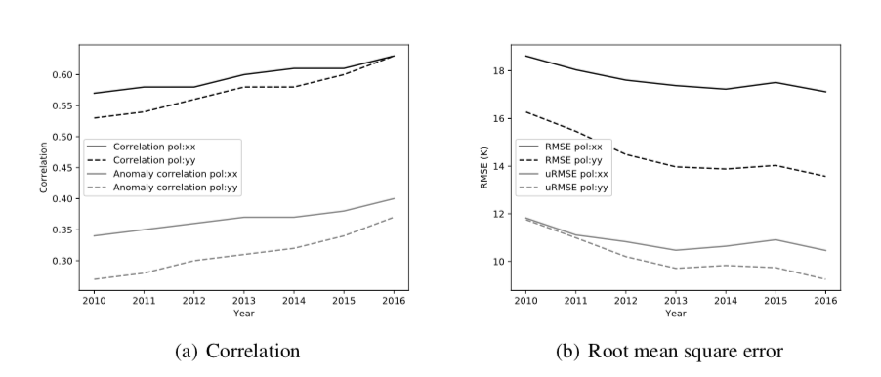
SMOS TB multi-year monitoring
CMEM: Community Microwave Emission Modelling platform
de Rosnay et al, RSE, 2020
5

Slide 6
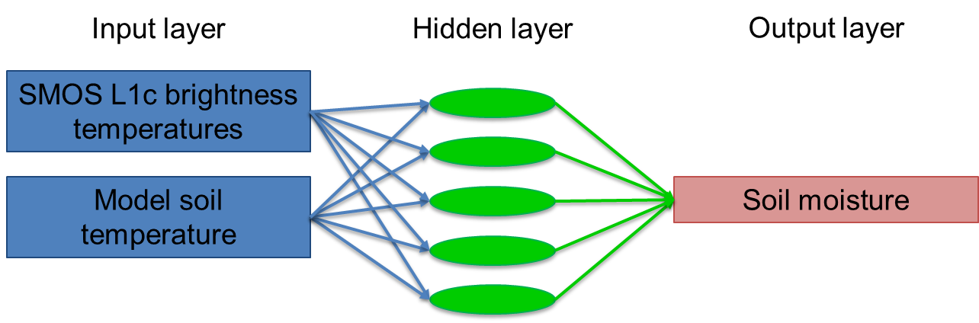
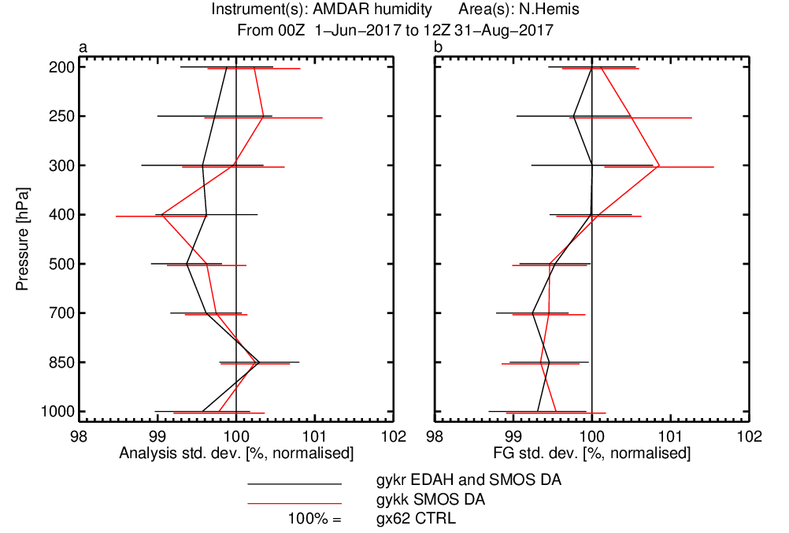

SMOS neural network soil moisture assimilation
NWP
SMOS soil moisture impact
Aircraft humidity (JJA 2017)
Rodriguez-Fernandez et al., HESS 2017, RS 2019
A priori training of the SMOS neural network processor
-> retraining when L1Tb or IFS soil change
Online training possibilities?
Further explore ML/AI for forward modelling
Pressure (hPa)

Slide 7
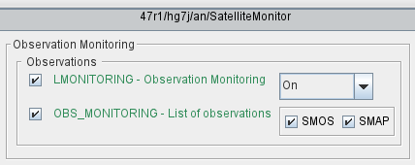
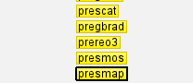
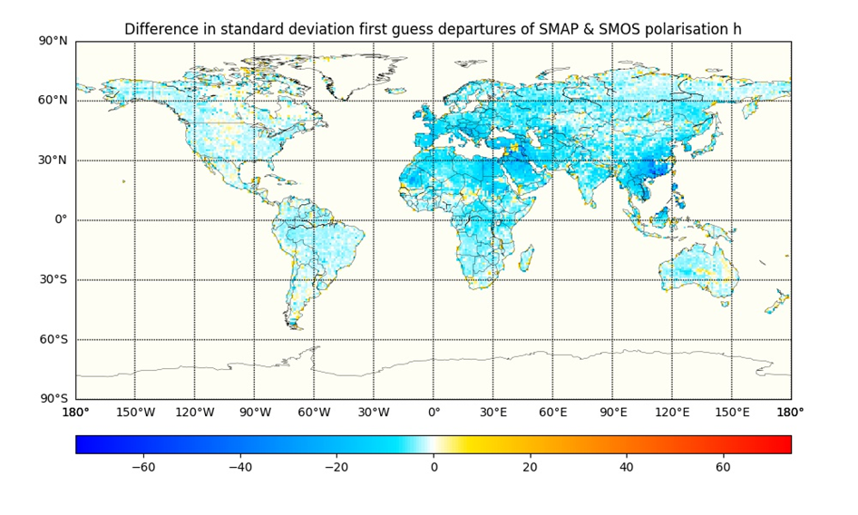
SMAP L-band data
Operational in the IFS for monitoring since May 2021
Set-up operational NRT acquisition
Scripts suite and prepIFS changes complete
SMAP Observation interface (Obs Data base, ODB)
Script and Fortran changes
Suite definition and prepIFS
Monitoring webpage update
Next: SMAP assimilation evaluation
→ SMOS and SMAP L-band operational
Pete Weston

Slide 8


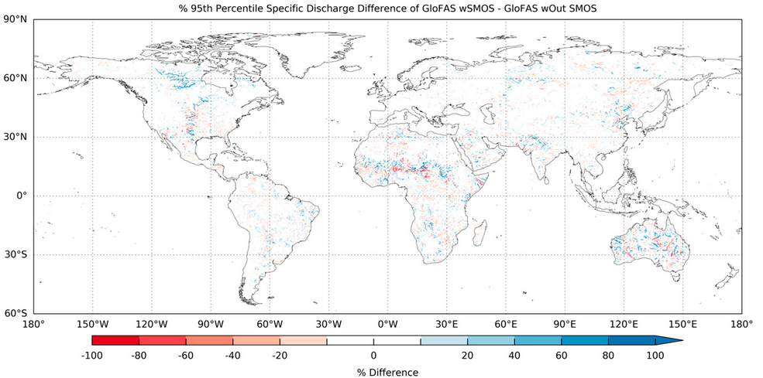
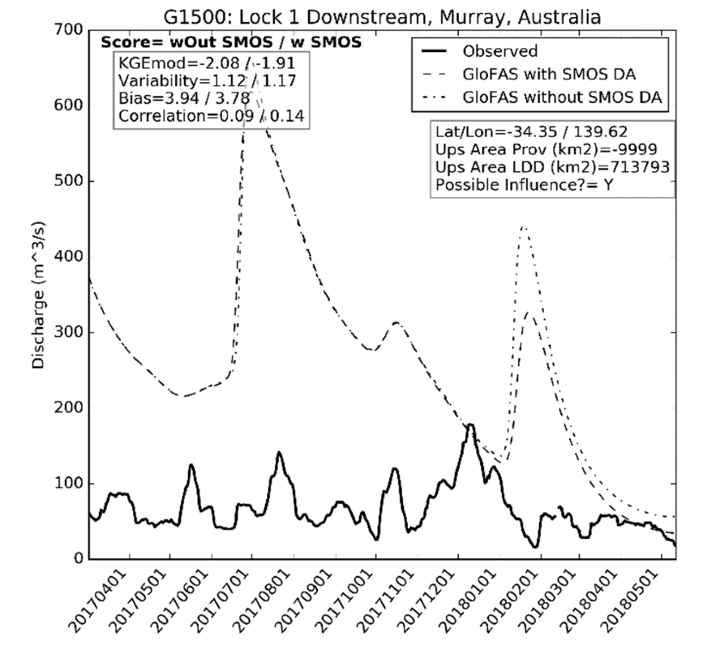
SMOS applications for the Copernicus Emergency Management Service (CEMS)
Data assimilation impact upon hydrology
Figures from Baugh et al., 2020
Data denial experiments with SMOS show similar results
  i.e. muted impact on streamflow
ECMWF LDAS corrects for random errors, not systematic ones
Process errors in Australia for example, maybe poor representation of processes such as irrigation and lake storage

Slide 9
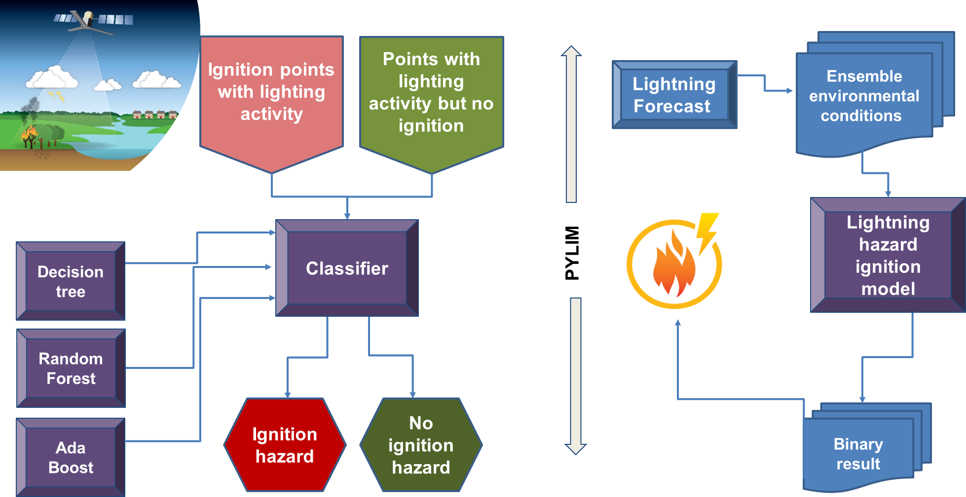
SMOS applications for the Copernicus Emergency Management Service (CEMS)
Using machine learning to predict fire-ignition
occurrences from lightning forecasts
Connection between fuel moisture and the probability of ignition
Mechanisms are poorly understood and predictive methods are underdeveloped
Lightning–ignition relationship for early warning systems
ML predictive model for wildfire ignition based on lightning forecasts and environmental conditions, including SMOS NN soil moisture
Couglhan et al., Met App 2021
Three different classifiers
  Decision tree, AdaBoost, Random Forest
Verification for 145 lightning-ignited wildfires in regions of Australia (2016)
More than 71% correct prediction
Updated model using SMOS VOD
Future plans in operational context
Notes:
For Fire Forecasting a lightning ignition model which is the basis for an operational lightning ignition hazard probability product for fire management has been developed using SMOS soil moisture and currently new updated models are being developed with SMOS L-VOD.​
​
The lightning ignition model is a machine learning classifier, an algorithms that maps data to a specific category, in this context a predicts either a Ignition hazard or no ignition hazard. The binary classifiers were developed on environmental conditions for two types of events: ignition points with lighting activity and points where there was lightning activity but no ignition.
Previously, 15 environmental conditions were explored to build the classifier- variables and derived variables from the IFS as well as SMOS soil moisture (Relative humidity, precipitation, 2m temp, vegetation coverage, SMOS soil moisture, vegetation coverage and Vegetations drought index to name a few).
Three different binary classifiers were developed: one single estimator, the decision tree and two ensemble methods. The goal of the ensemble methods is to combine the predictions of several base estimators to improve robustness over a single estimator.​ There are two families of ensemble methods; the first is the averaging method, the driving principle is to build several estimators independently and then to average their predictions, for the average method a Random Forest classifier was developed and the second method is the boosting method where base estimators are built sequentially and one tries to reduce the bias of the combined estimator. The motivation is to combine several weak models to produce a powerful ensemble for the boosting method a Ada Boost classifier was developed.
The overall accuracy for these three classifiers based on their cross validation train data accuracy values reigned ranged from 76.1% for the decision tree to 78.13% for the random Forest.
Further refinements of the classifiers are underway with the introduction of new environmental conditions and the development of new bagging and boosting ensemble methods which will be identified by the use of AutoML. Currently the introduction of new environmental conditions (SMOS VOD, IFS type of vegetation, Leaf area index, Soil Temp, Solar Radiation, Wind speed) have seen the cross validation train accuracy scores increase by 2% to 80 % for the ensemble methods.
PYLIM package, is a package that has been designed to undertake all the data processing to produce a probability by lightning ignition product. The chain of production is- the ECMWF total lightning density product and each ensemble data will be gathered and passed to the lightning Hazard ignition model, where total lightning density will be used as a trigger for the model, the binary results for each ensemble will then be collated together to the produce probability product. Once the current developments and refinements on the machine learning models have been completed, a cross classifier analysis will be undertaken to select the best performing model to be put in placed into PLYIM for production.
(Map image is of overlay of Lightning density with ignition points and non ignition points for March 2016, this is given a a s

Slide 10
Summary
-ECMWF Earth system approach
Interface observations → relevance of L-band data
-SMOS brightness temperature long term monitoring, SMOS NN soil moisture assimilation operational NWP and research for CEMS flood and fire foreacasts
-SMOS used for sea-ice assimilation test (Balan-Sarojini et al., The Cryosphere, 2021) and SMOS Sea Surface Salinity used for OCEAN5 system verification.
-SMAP used in operations for Monitoring since 2021
-Future L-band missions (e.g. CIMR) will contribute ECMWF’s Earth system approach for NWP and future reanalyses
4D-Var
Atmosphere
Sea Ice
3D-Var
Land
EKF-OI
Ocean
3D-Var
Waves
OI

