Slide 1
Joaquín Muñoz Sabater & the C3S team
European Centre for Medium-Range Weather Forecasts (ECMWF)
2nd Climate Observations Conference – Darmstadt, Germany– 17-19 October 2022

Slide 2
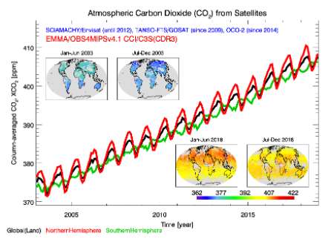
Why Essential Climate Variables (ECVs)?
Required to support the work of the UNFCCC and the IPCC
Provide empirical evidence to understand the evolution of climate (climate indicators)
Guide mitigation and adaptation measures (decision making)
Assess risks and enable attribution of climate events to underlying causes
Underpin climate services.
Climate Data Record: A (Thematic) Climate Data Record is a time series of measurements of sufficient length, consistency, and continuity to determine climate variability and change.
Essential Climate Variables: An Essential Climate Variable is a bio-physical variable (or a group of linked variables) that critically contributes to the characterization of Earth’ s climate.
→ Relevant, Feasible, Cost-effective
We use historical observations from satellite sensors to build Climate Data Records of Essential Climate Variables (ECVs)
Notes:
Without observations we would not understand the climate as we do it today.
Climate data records can be created by merging data from surface, atmosphere and space-based systems across decades.
► GCOS has defined a set of 54 ECVs for atmospheric, terrestrial and oceanic domains

Slide 3
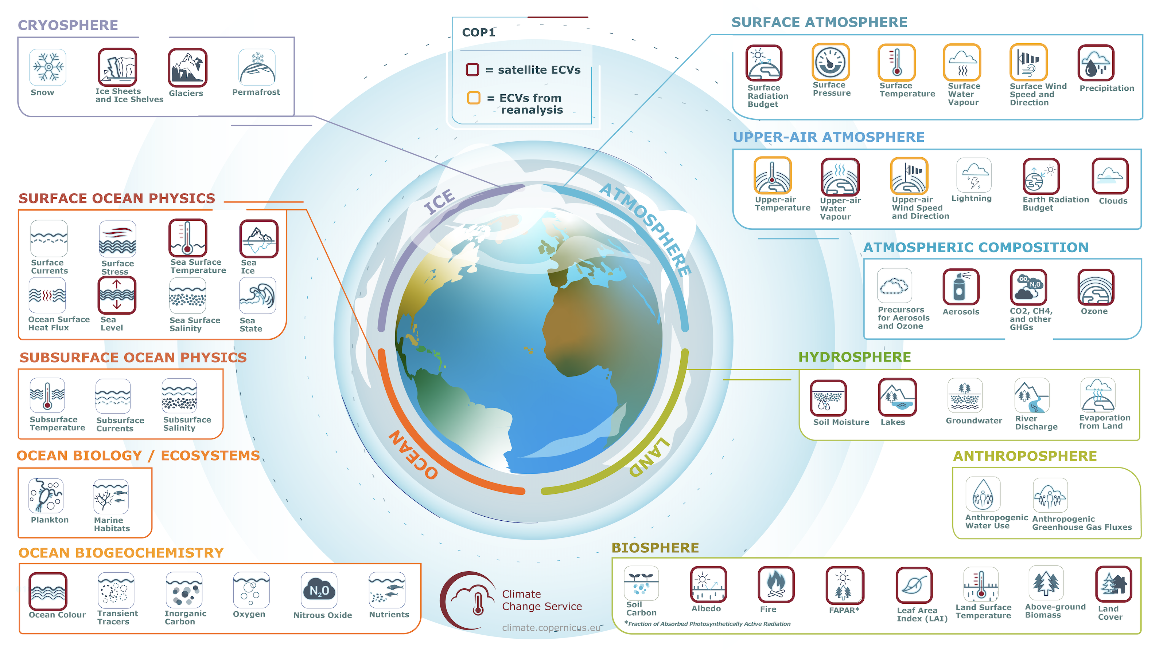
The Essential Climate Variables (ECVs)

Slide 4
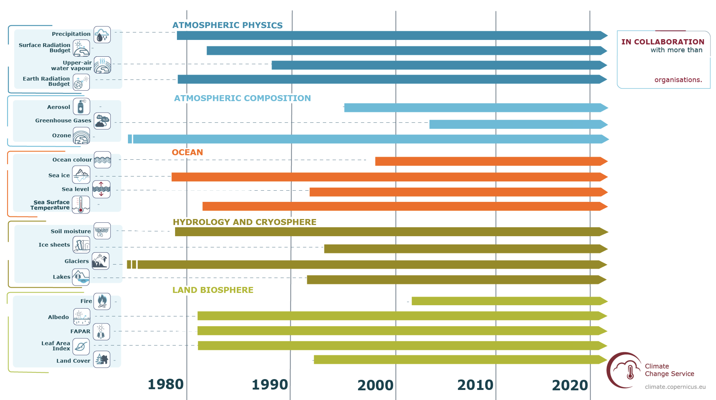



Providing long-term, quality-assured, homogeneous and accessible global climate data records
50
Clouds
50
Mainly use Sentinel-3 data
Future use of other Sentinel data

Slide 5
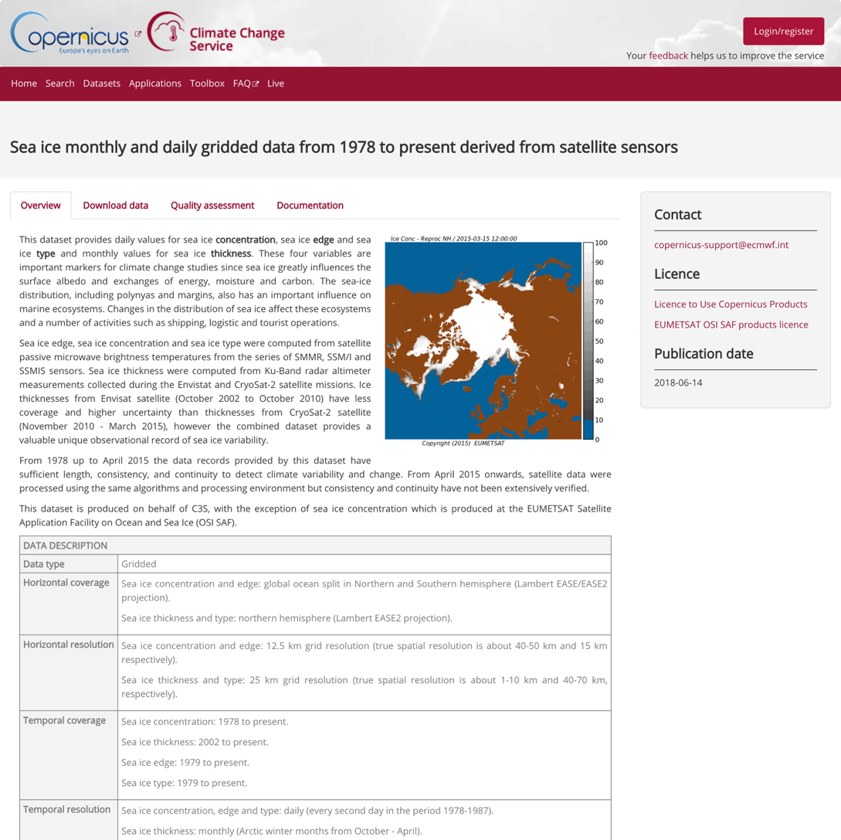
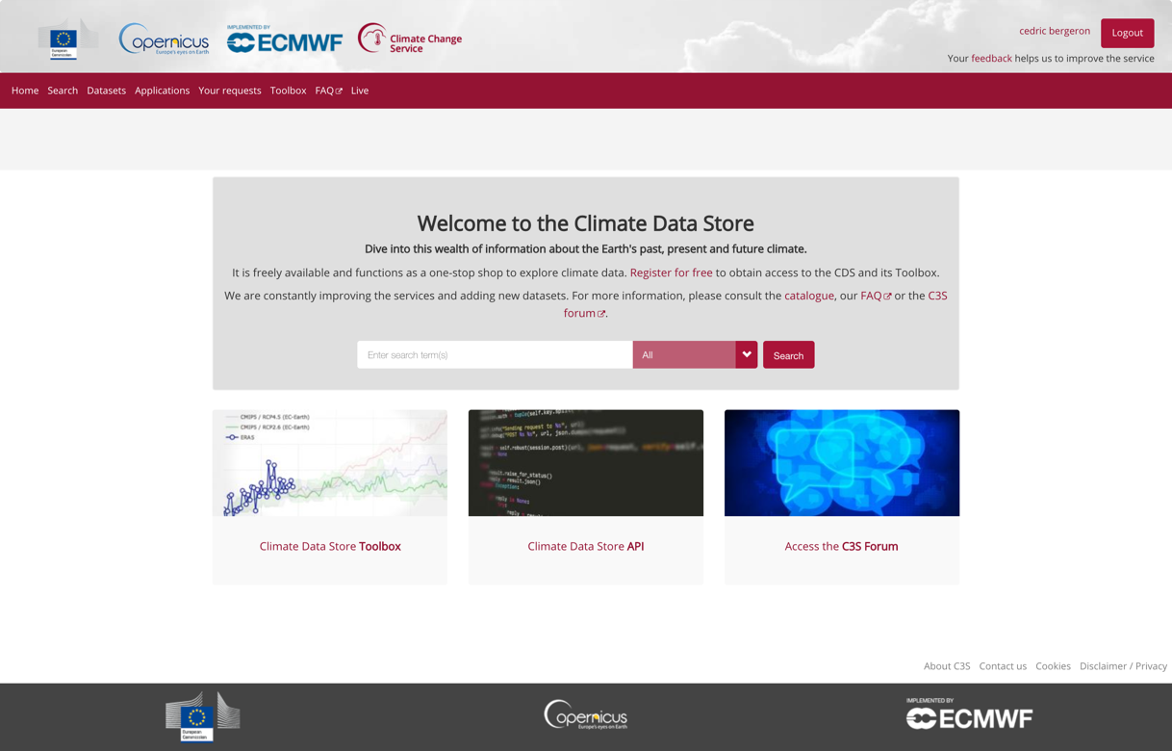
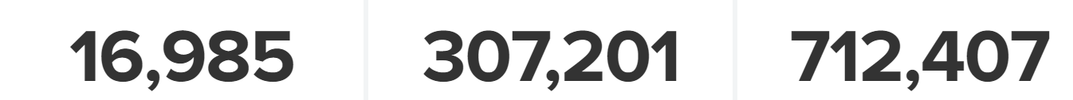


The Climate Data Store – ‘A one stop shop for ECV data & information’
Landing page
Sea ice
Overview of ECV & products
152,000+ users
Support link
Licenses
Citation
Acknowledgments
DOI
Related products
https://cds.climate.copernicus.eu
Metadata
Total number users (ECVs)
Total volume downloaded (in GB)
Total number requests
Variables description
Notes:
Established agreement on the operational interface for data presentation

Slide 6
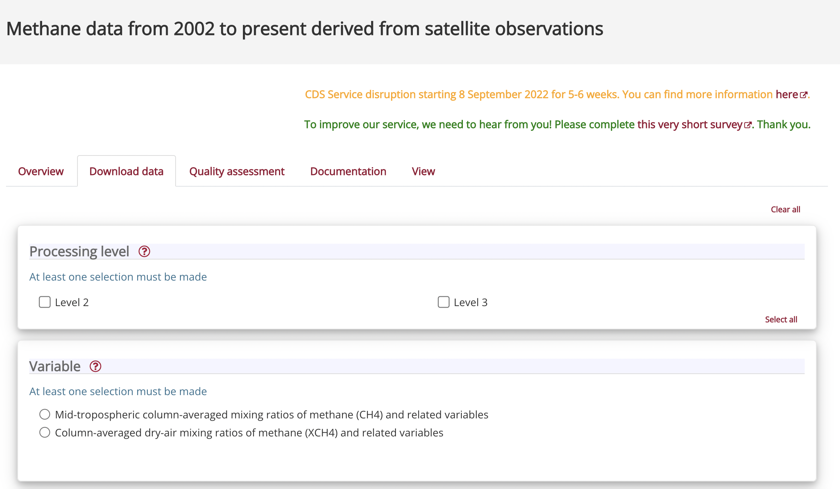
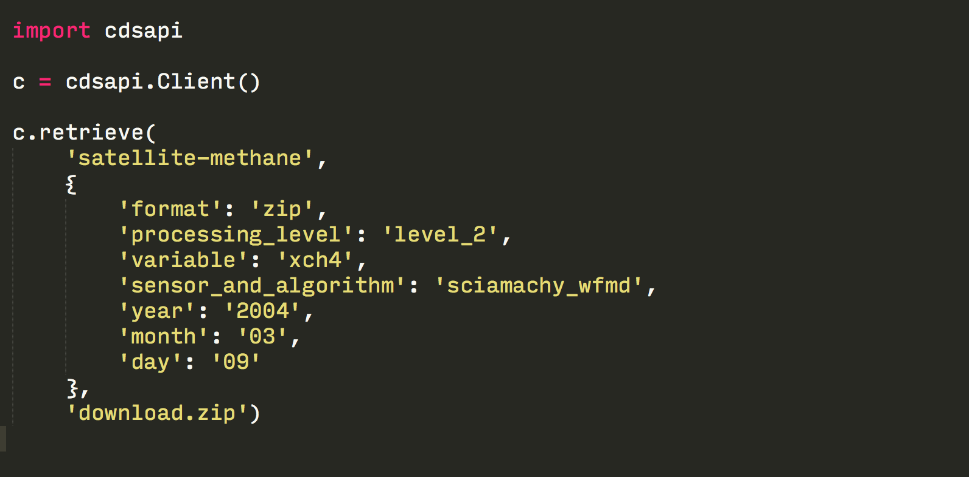
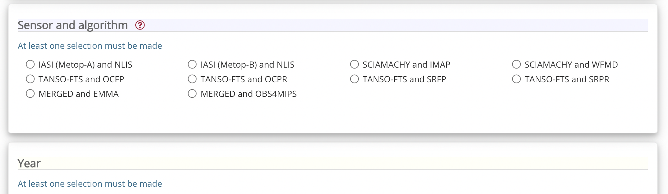
Access to ECV data
Download form

Slide 7
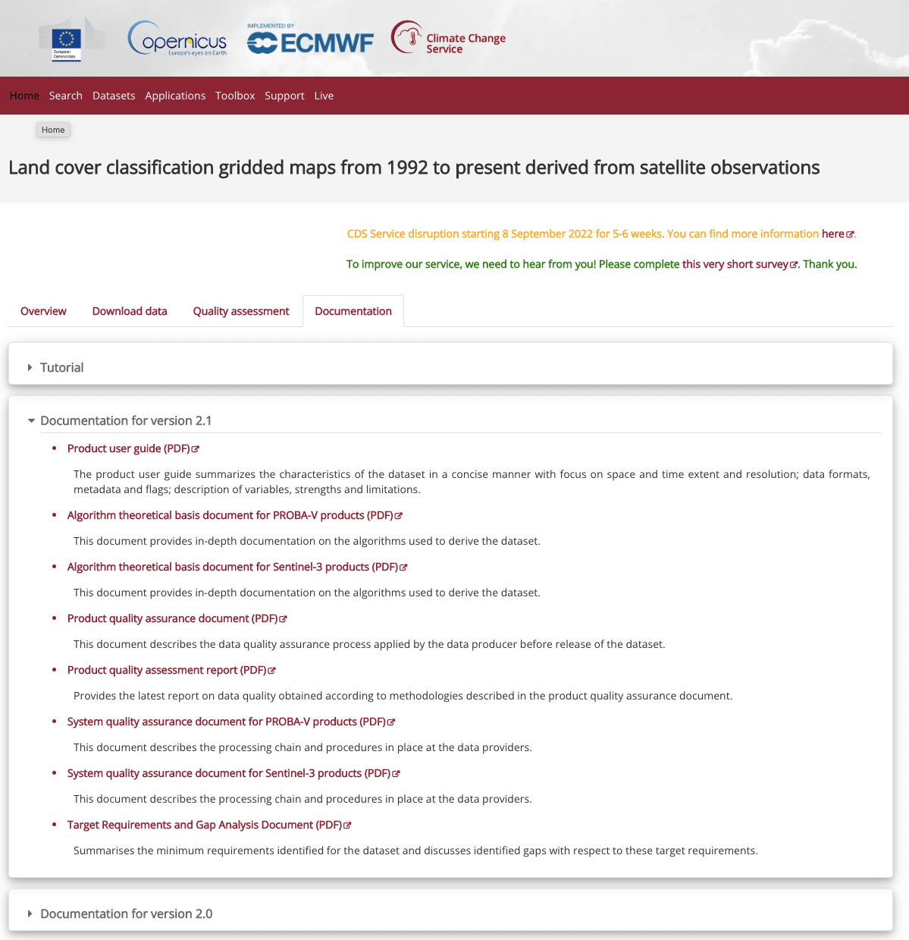
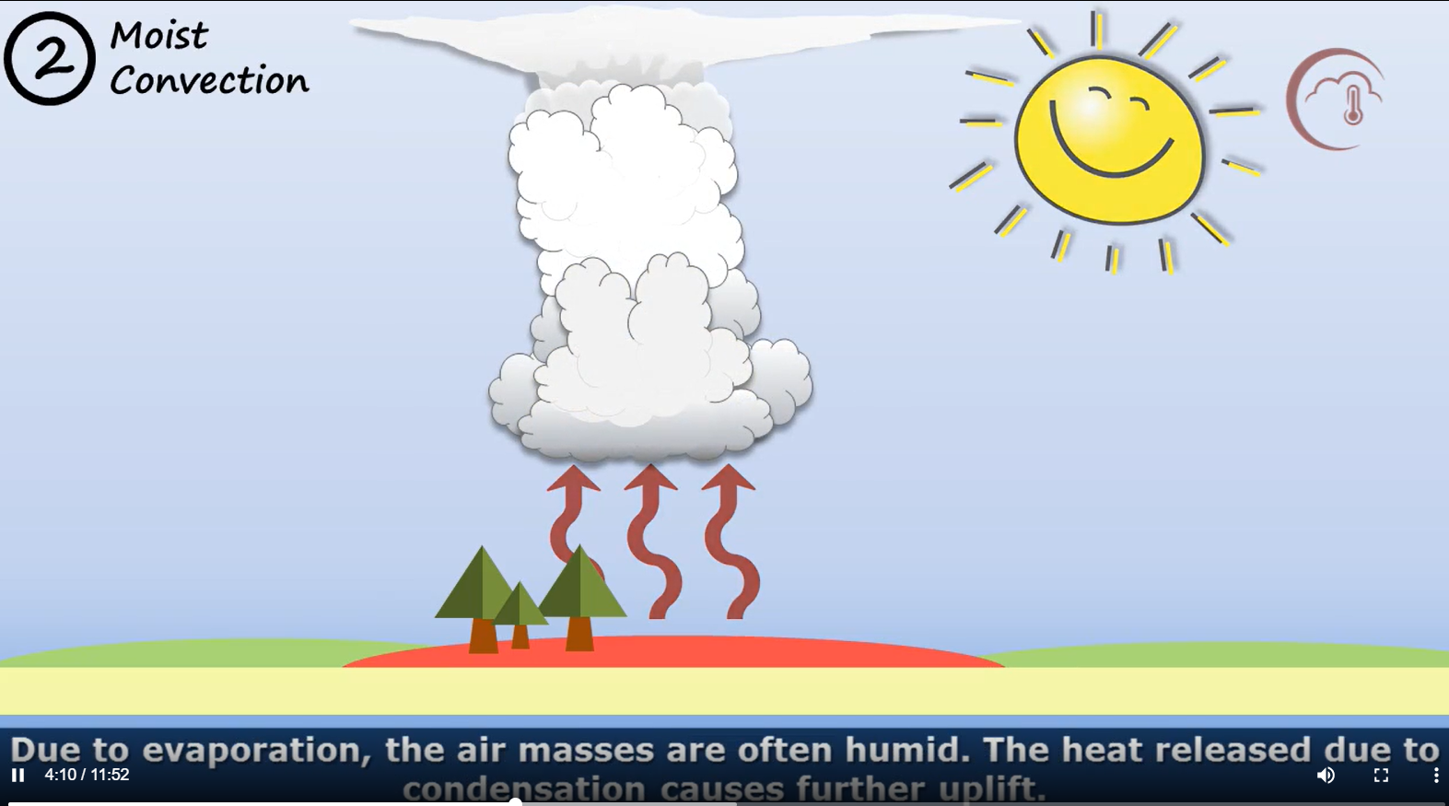
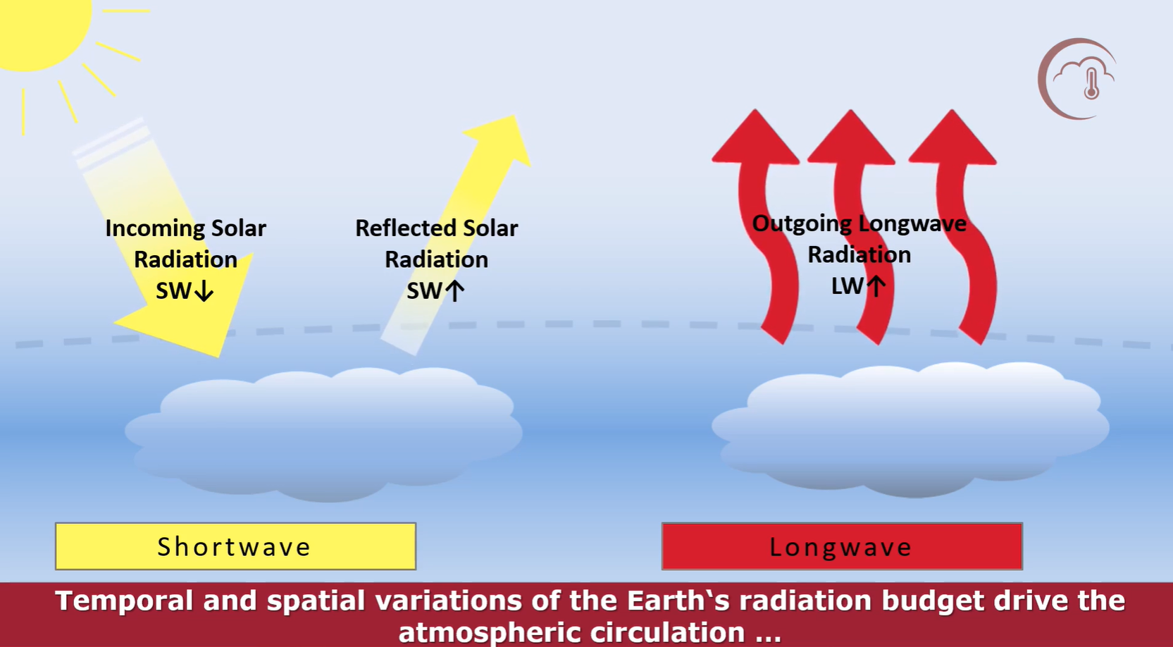
Comprehensive documentation & Tutorials
Documentation

Slide 8
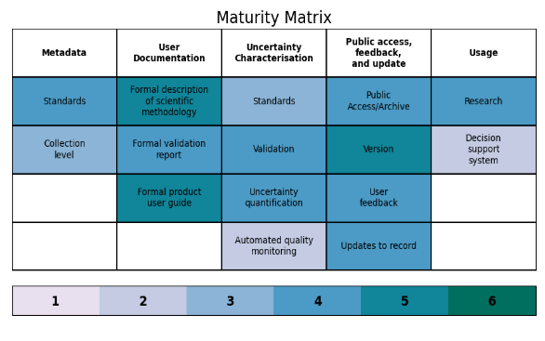
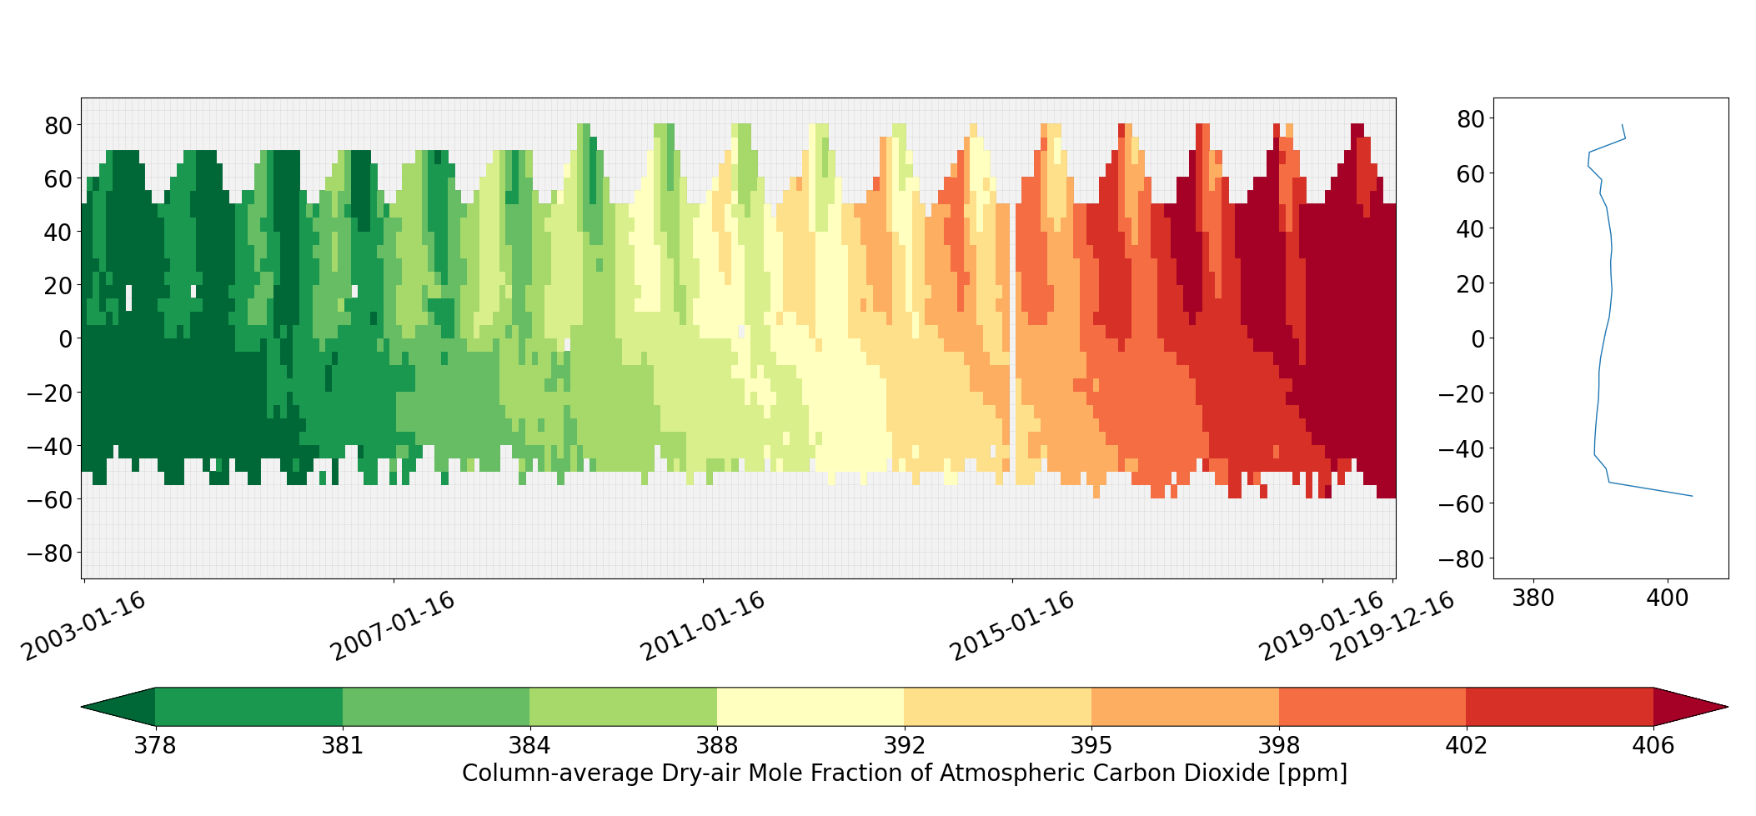
Quality assurance
Three levels of quality assurance:
  Scientific validation conducted by the data provider
  C3S pre-publication review
  Service independent evaluation and quality control
Carbon dioxide data from 2002 to present derived from satellite observations - XCO2 Level 3 v4.2 (01/2003- 12/2019)
Mean values for XCO2 as function of latitude and time (aggregated over longitude; left), and as latitudinal averages (aggregated over longitude and time; right). Grey areas represent missing values. Based on the CDS data downloaded on 28 January 2021.

Slide 9
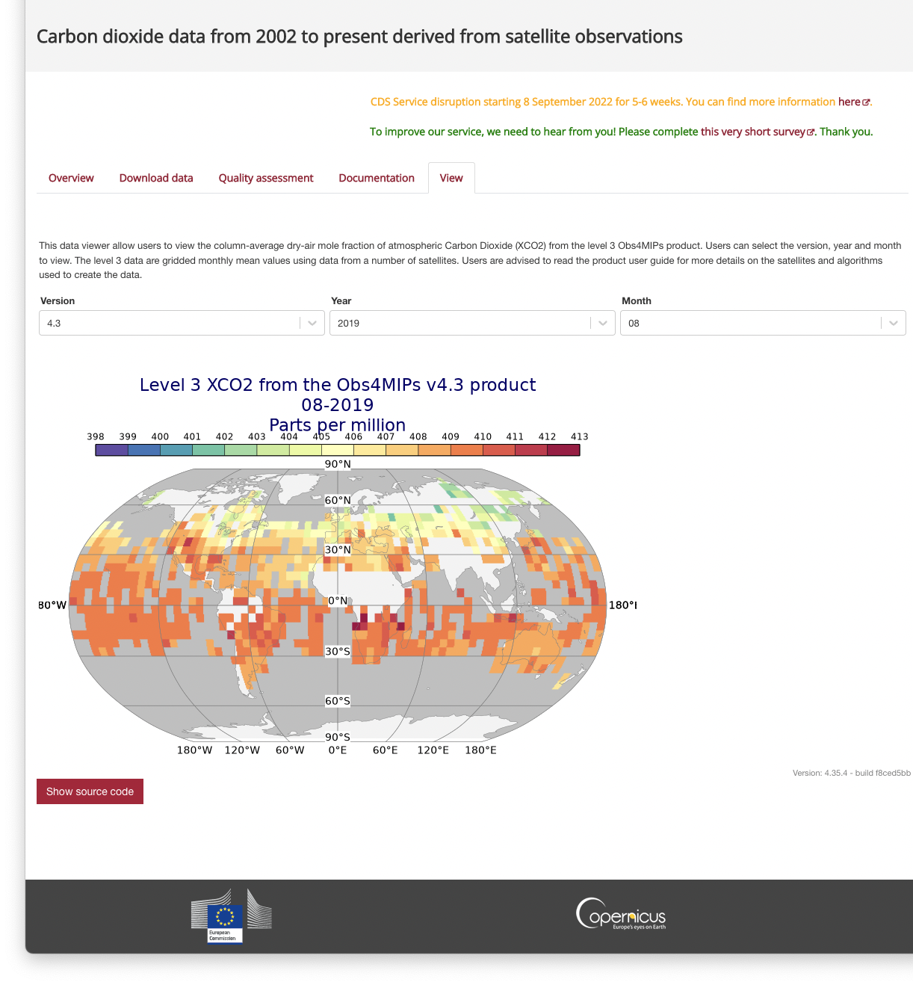
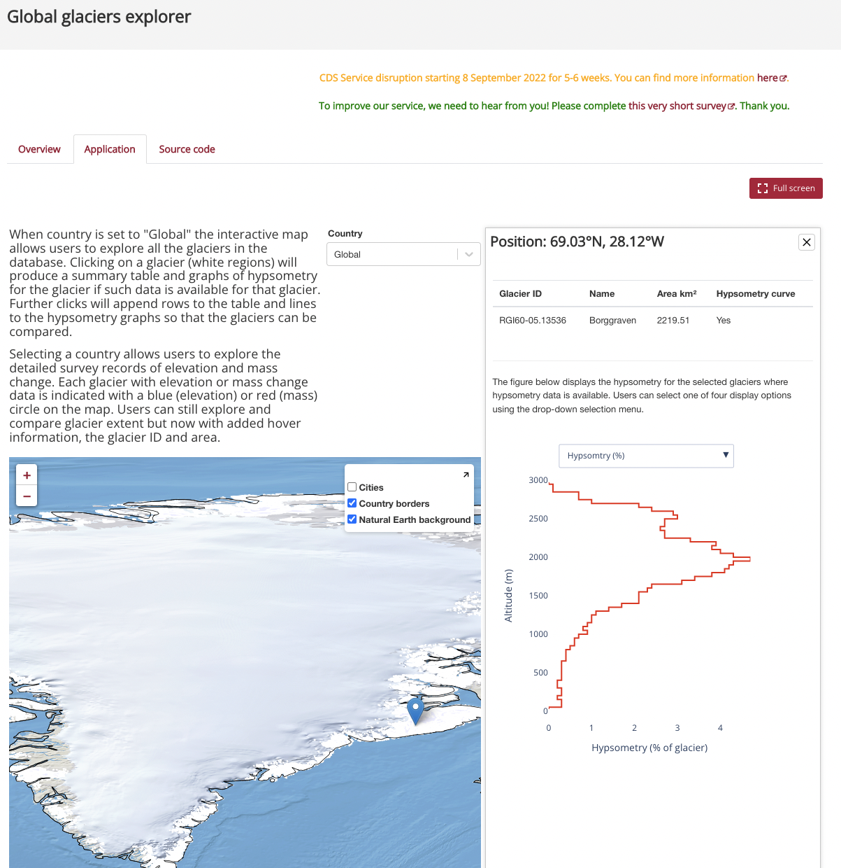
Data viewers and toolbox applications
Data viewers
Toolbox applications
Notes:
Newest of all Lots
Currently phase-1, preparing CPS and brokering different datasets
Consortium led by: Deutscher Wetterdienst (DWD)
ECVs covered:
Precipitation
Water Vapour (TC, UT, Profiles)
Earth Radiation budget
Surface Radiation budget
Cloud properties
Talking points:
Recently added to the C3S ECV product portfolio.
Pulling together expertise -and effort!- from many different parties and existing initiatives, i.e.
CLARA (cloud-properties) by CM-SAF.
ERB developed in the US (NOAA-University of Maryland)
Precip. Product (sourced from national research initiative on climate change) (DapaCliP) --CHECK THIS IN PROPOSAL!--
All ECVs covered by CDR and ICDRs
Earth Radiation budget (3x)
Water valour (TC, UTH, and Profiles)

Slide 10
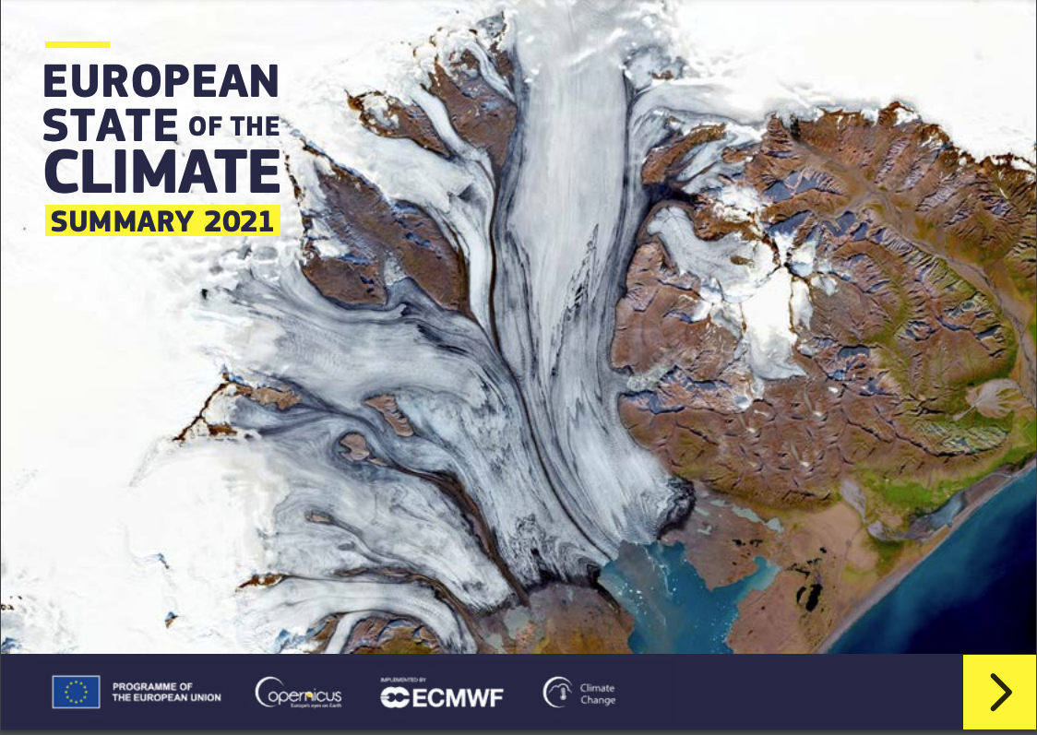
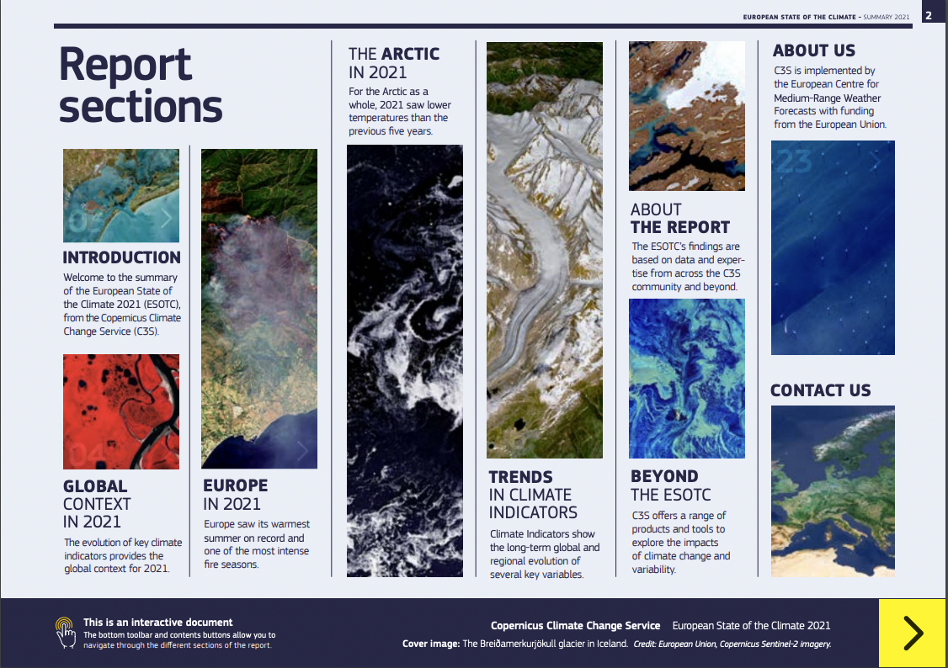
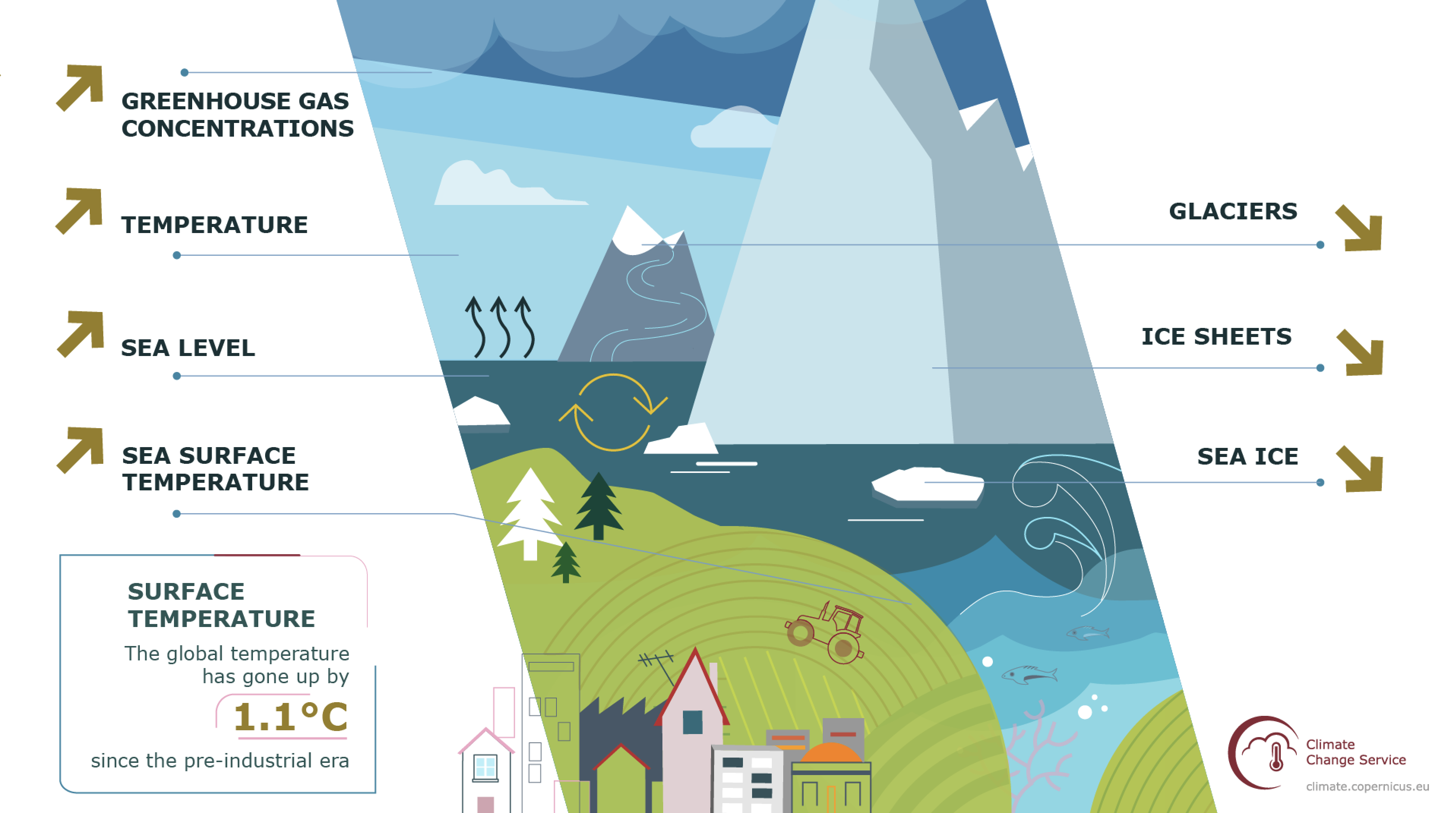
Climate monitoring
Key climate indicators
Responding to monitoring and reporting for UNFCCC
Capture long-term trends, but also year-to-year variability
414 ppm CO₂
1876 ppb CH₄
Europe 2.2ºC
Global ~ 30 m
3.1mm
Greenland ~ -3800 +/-340 Gt
Antarctica ~ -2720 +/-1390 Gt
Arctic ~ -12.2% /y¹⁰
Global 0.9ºC
1.2ºC

Slide 11
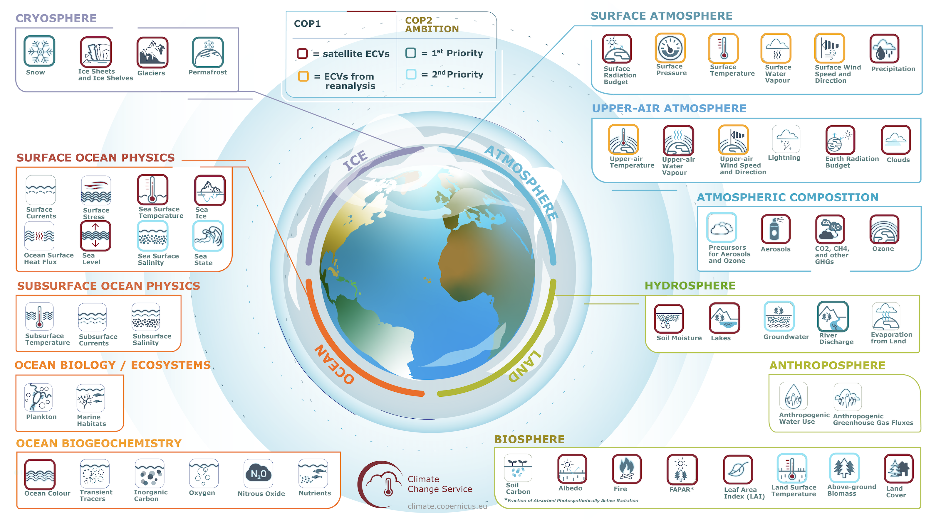
Evolution within the current framework agreement
Focus on users
Enhanced collaboration with ESA & EUMETSAT
Exploit synergies with other Copernicus Services

Slide 12
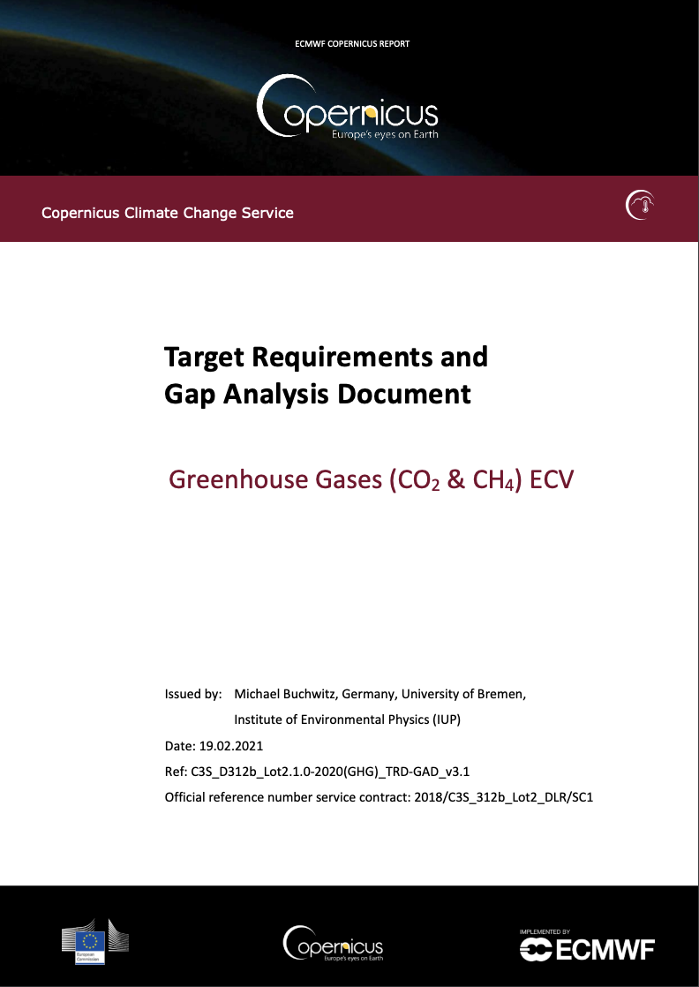
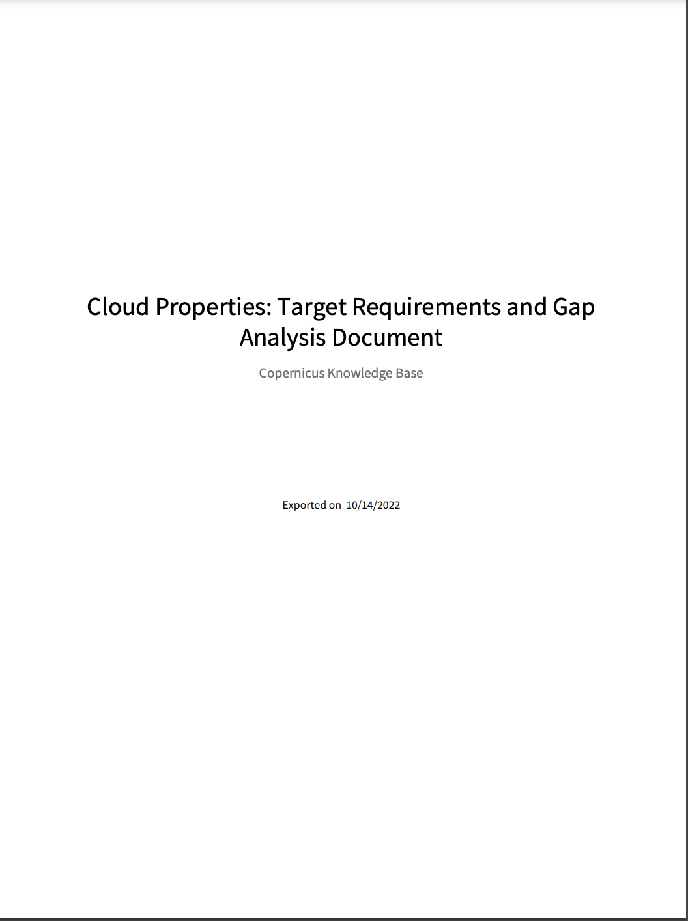
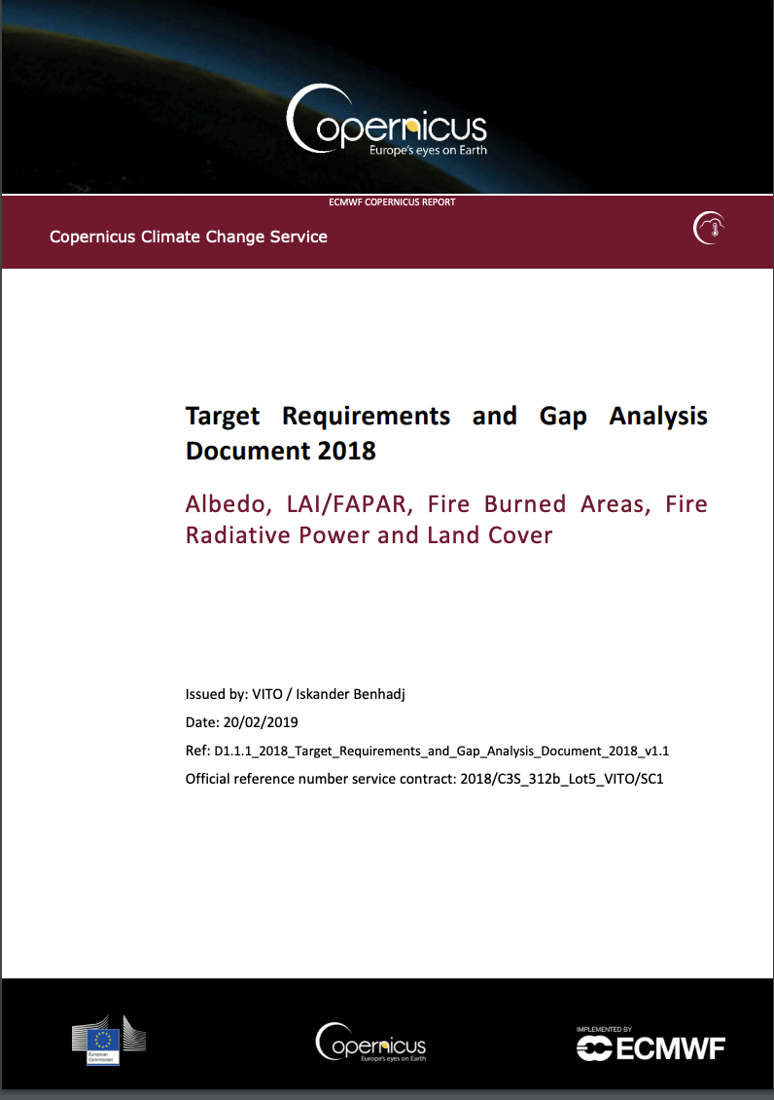
What are the bottlenecks in today’s observations system in terms of…
o meeting scientific needs in climate science (Topic 2, Cluster 1)
o building and sustaining climate data records (Topic 4)
Partially discussed in the C3S ”Target Requirement and Gap Analysis” Document.
Define and formulate the (potentially evolving) target requirements for satellite-derived ECV products based on [C3S] user needs, such as required precision (random error, scatter) and accuracy (systematic error, bias)
Analyses the various aspects of the retrieval methodologies that limit the fitness for purpose of the current CDRs
Identifies the remaining activities to be carried out to fully satisfy the scientific target requirements
Notes:
the past, current and future Earth Observation (EO) landscape providing relevant Fundamental Climate Data Records (FCDR) for the LAI, FAPAR, Albedo, BA, LC and FRP CDR and ICDR. It analyses the various aspects of the retrieval methodologies that limit the fitnessto-purpose of the current CDRs, and identifies the opportunities and research needs for improvement. Therefore, the gap analysis identifies the remaining activities to be carried out to fully satisfy the target requirements. More specifically, the topics addressed in this document include the data availability from existing space-based observing systems, the development of processing algorithms, methods for estimating uncertainties and the scientific research needs

Slide 13
Thank you for your attention
Copernicus EU
@copernicusecmwf
Copernicus EU
Copernicus ECMWF
Copernicus ECMWF
@j_munoz_sabater
@CopernicusEU
@CopernicusECMWF
www.copernicus.eu
climate.copernicus.eu

