Slide 1
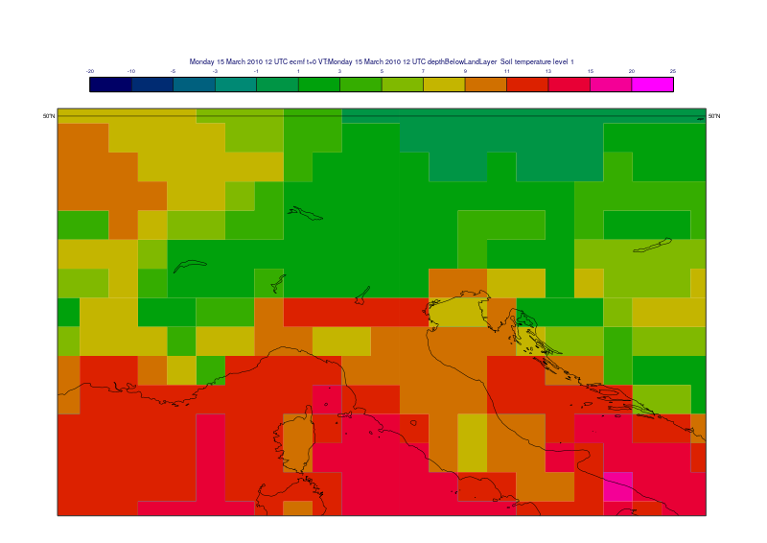
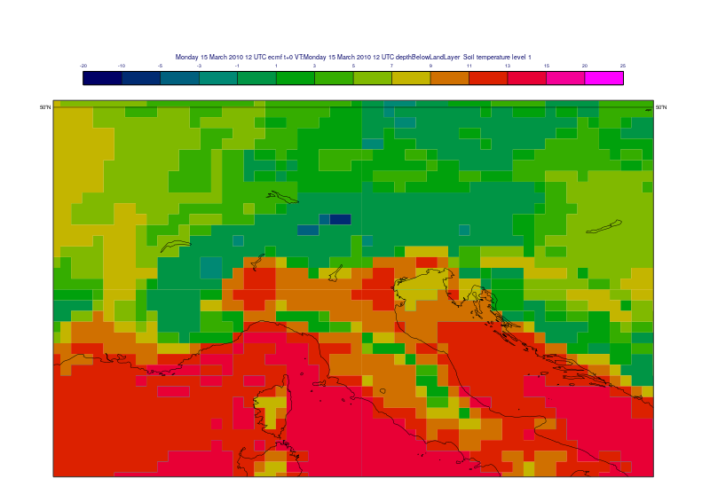
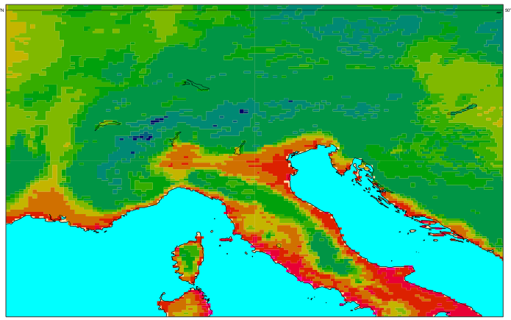
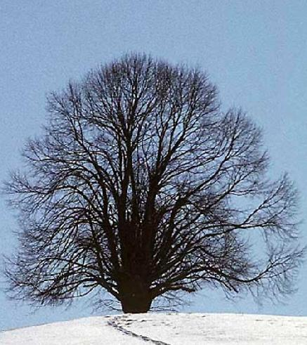

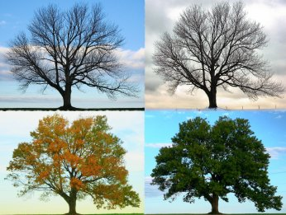
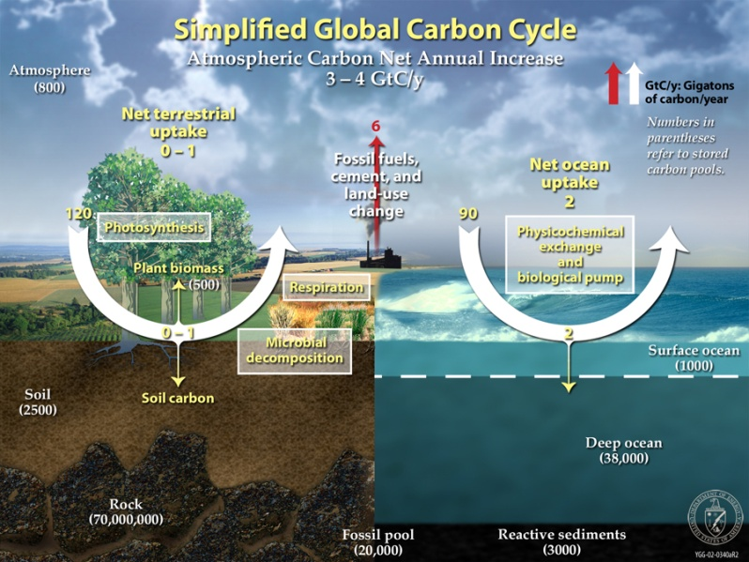
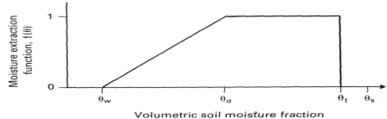
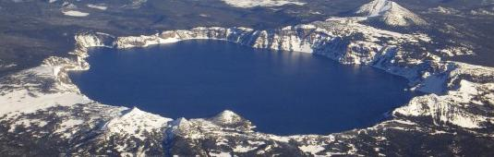
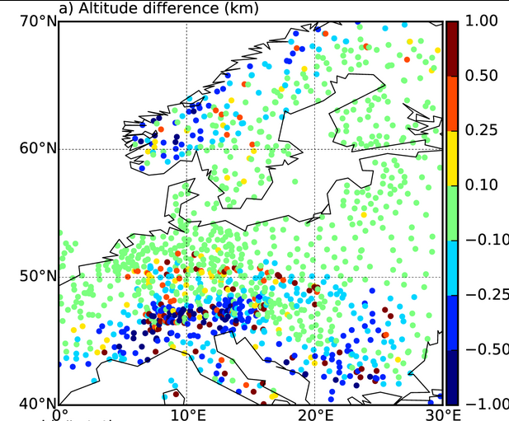
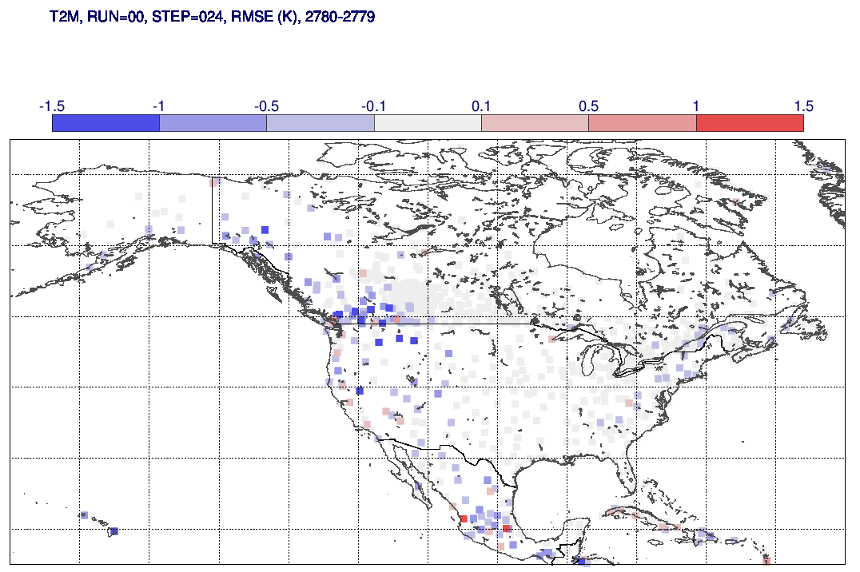
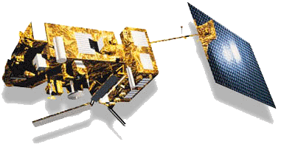

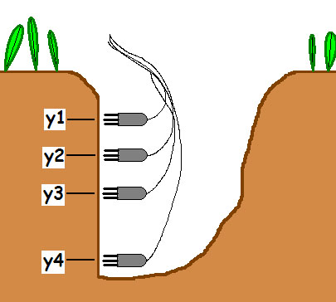
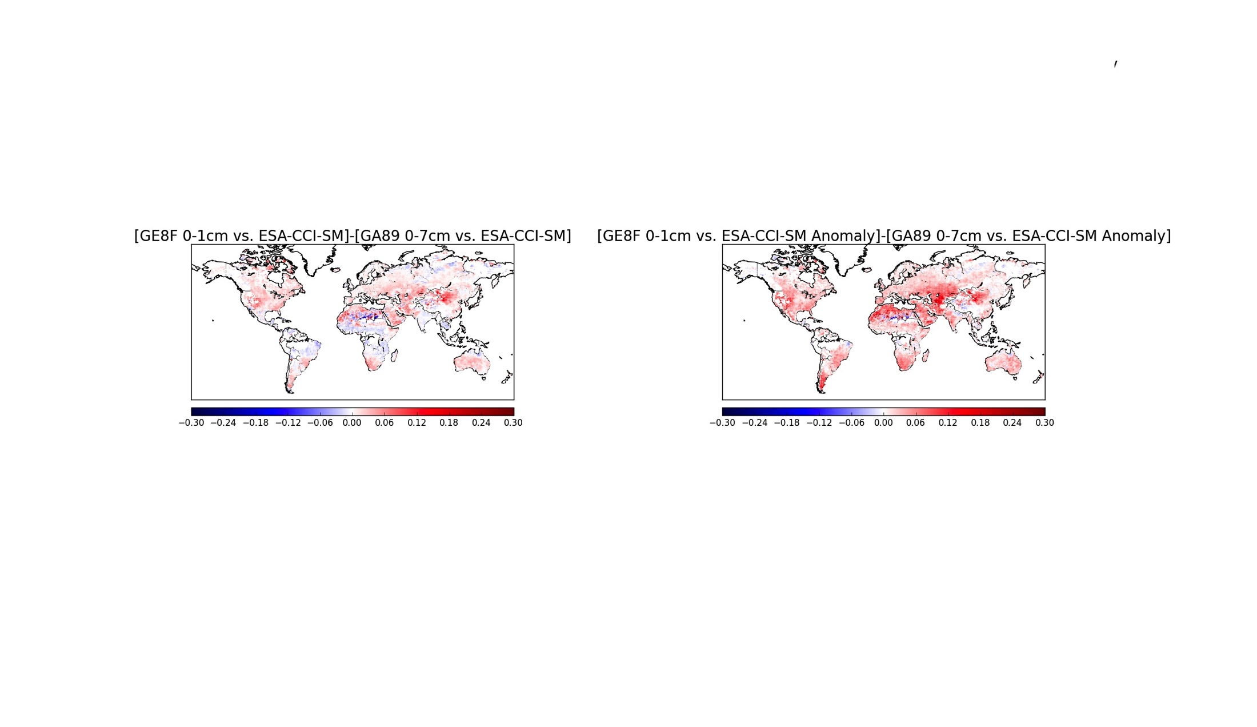
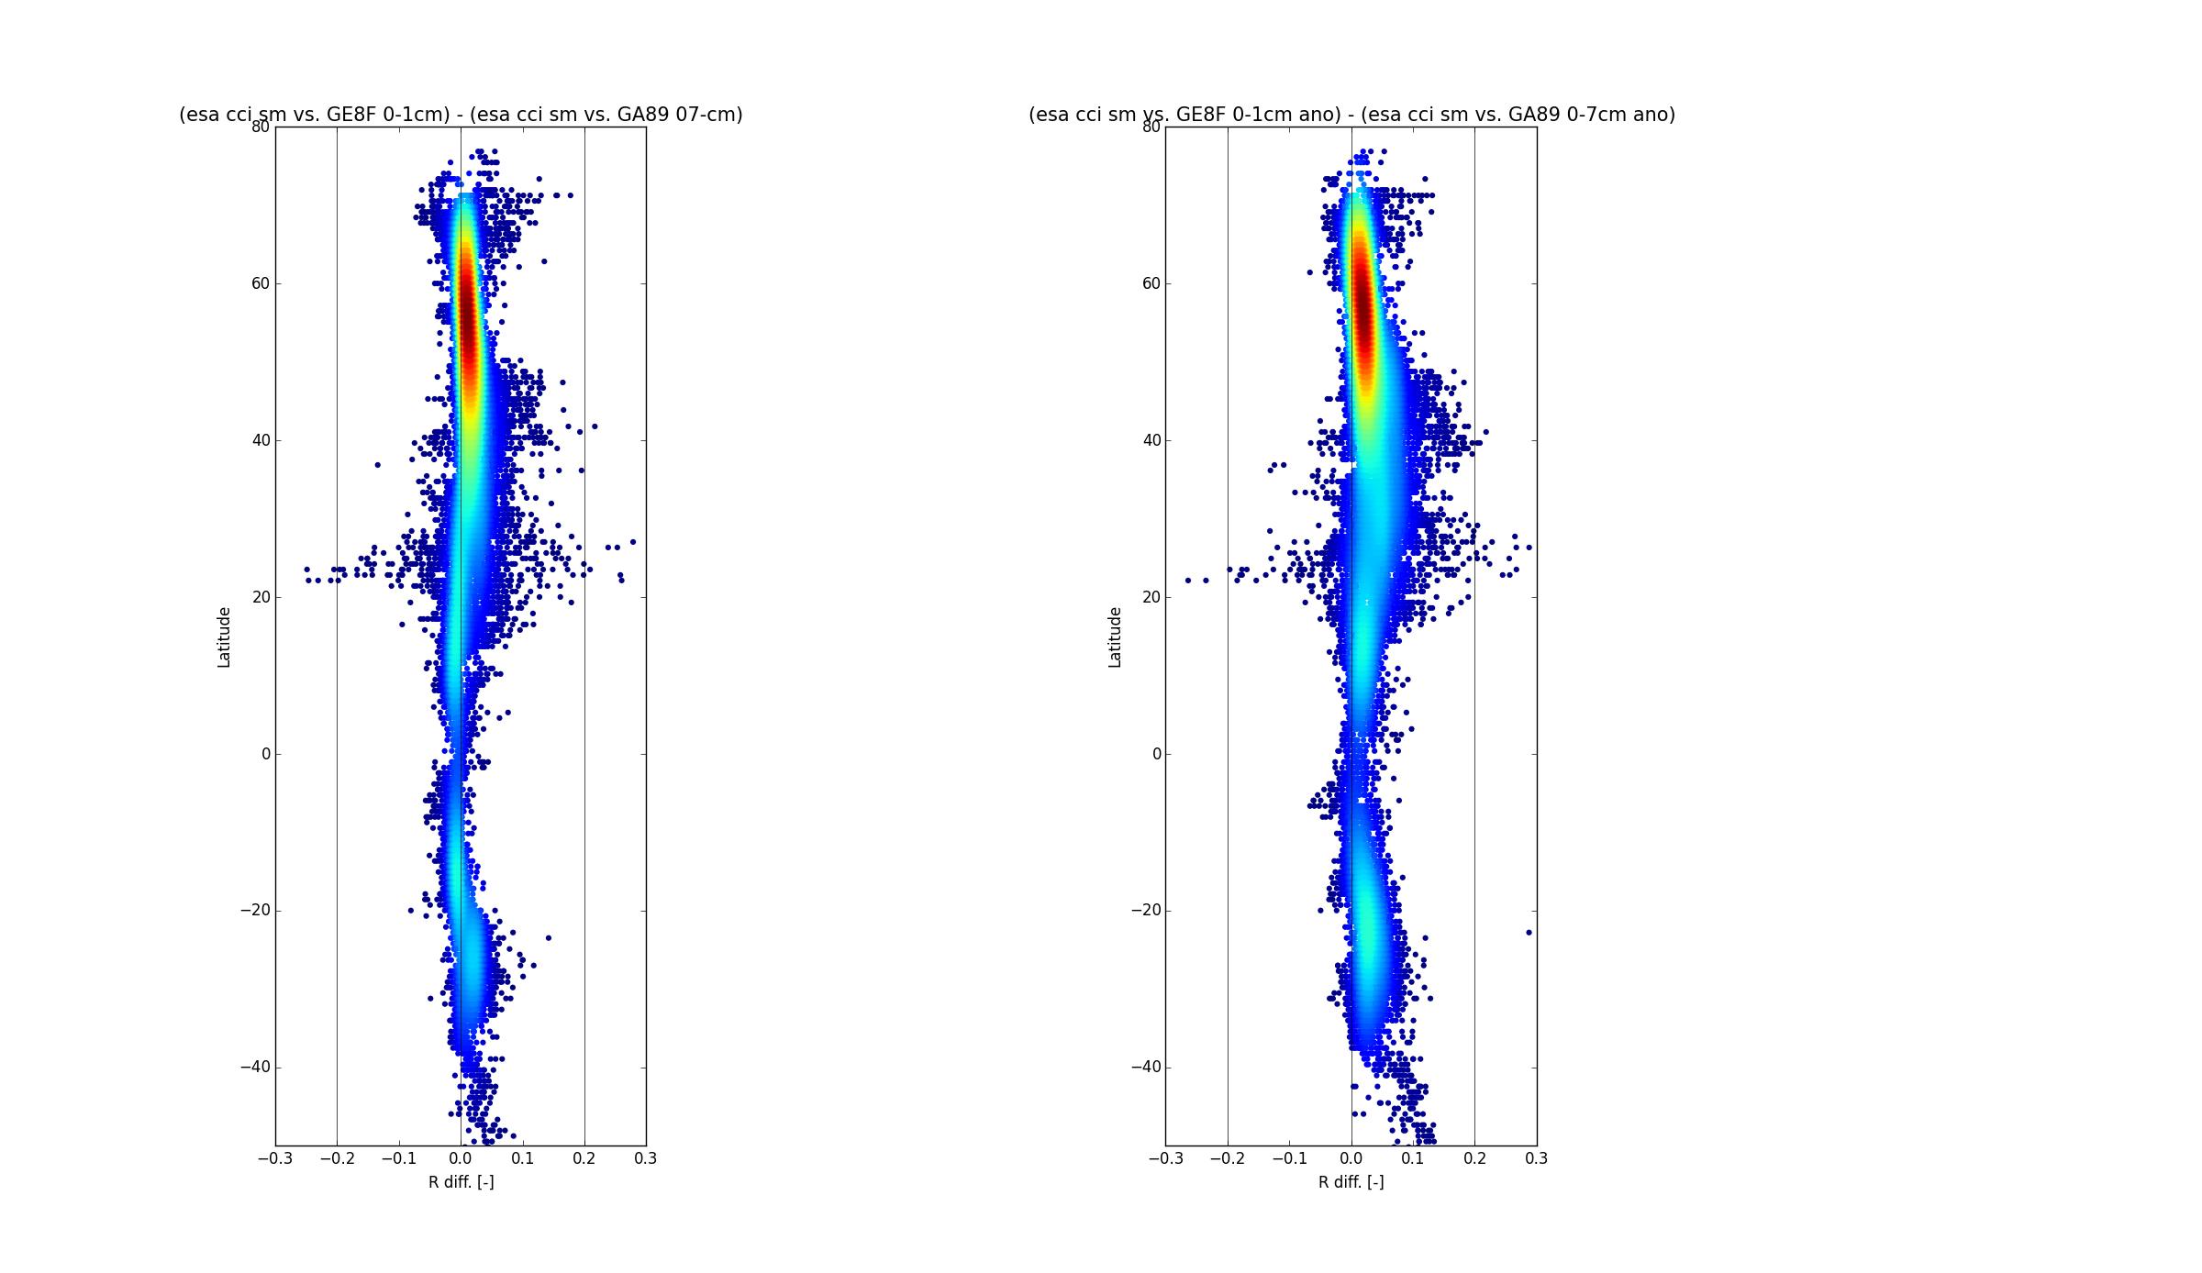

The ECMWF land surface scheme and its initialisation in S2S reforecast applications
Gianpaolo Balsamo, Souhail Boussetta, Frederic Vitart, Joaquin Muñoz Sabater
Outline
A stand-alone version of the ECMWF surface scheme CHTESSEL (Carbon and Hydrology Tiled ECMWF scheme for surface exchanges over Land) forced with the meteorology provided by atmospheric reanalysis is generating the land surface initial conditions for the ECMWF S2S reforecast system as operational in 2018.
Compared to the version used in the ECMWF Interim Reanalysis (ERA-Interim), several changes have been implemented within :
  Model representation of vegetation – LAI
  A new snow scheme
  Model Surface roughness – Aerodynamic Resistance
  Improvement in the representation of water bodies
  Improvement of the soil evaporation
  Integration a biogenic carbon module
Perspectives of enhanced horizontal resolution
-20
0
10
20
-20
0
10
20
ERA-Interim (79 km)
ERA5 (31 km)
Land surface model status at ECMWF and evolution since
ERA-Interim
Hydrology-TESSEL
  Balsamo et al. (2009)
  van den Hurk and Viterbo (2003)
  Global Soil Texture (FAO)
  New hydraulic properties
  Variable Infiltration capacity & surface runoff revision
NEW SNOW
  Dutra et al. (2010)
  Revised snow density
  Liquid water reservoir
  Revision of Albedo
  and sub-grid snow cover
NEW LAI
Boussetta et al. (2013)
New satellite-based
Leaf-Area-Index
SOIL Evaporation
Balsamo et al. (2011),
Albergel et al. (2012)
H₂O / E / CO₂
Integration of
Carbon/Energy/Water
Boussetta et al. 2013
Agusti-Panareda et al. 2015
Flake
Mironov et al (2010),
Dutra et al. (2010),
Balsamo et al. (2012, 2010)
  Extra tile (9) to
  for sub-grid lakes and ice
  LW tiling (Dutra)
ERA5-Land (9 km)
Added value of higher spatial resolution on Soil Temperature (15 March 2010)
Impact of horizontal resolution
Δh (km)
T2m
RMSE(corrected)- RMSE(no corrected) (K)
Forcing and Surface offline configuration
Correct for differences in orography due to different model resolutions, with lapse rate adjustment.
Schematic representation of the ERA-Interim meteorological forecasts concatenation for the creation of the 3-hourly forcing time series used in ERA-Interim/Land for a given day.
Orange circles indicate instantaneous variables valid at their time stamp: 10m temperature, humidity, wind speed, and surface pressure.
Green boxes indicate fluxes valid on the accumulation period: surface incoming short-wave and long-wave radiation, rainfall, and snowfall.
Perspectives of enhanced soil vertical resolution
The model bias in Tskin amplitude shown by Trigo et al. (2015)
motivated the development of an enhanced soil vertical
discretisation to improve the match with satellite products.
Better initialisation consistency of the reforecast system with the real time analysis
7 cm
1 cm
2 cm
4cm
4-layers:
# 0-7 cm
# 7-28 cm
# 28-100 cm
# 100-289 cm
10-layers:
# 0-1 cm
# 1-3 cm
# 3-7 cm
# 7-15 cm
# 15-25 cm
# 25-50 cm
# 50-100 cm
# 100-200 cm
# 200-400 cm
# 400-800 cm
Impact of soil vertical resolution compared to ESA CCI soil moisture
Old Soil Initial Conditions (Era-I)
New Soil Initial Conditions (Era-I-Land)
Impact on Anomaly Correlation (1988-2014) with ESA-CCI satellite soil moisture (courtesy of C. Albergel)
Surface Temperature Anomalies
01/05/2011- Day 5-11
Globally Improved match to satellite soil moisture (shown is ΔACC calculate on 1-month running mean). Dorigo et al., 2017
1
Summary
A consistent initialisation of the reforecast system with the real time analysis based on up-to-date land surface model version is beneficial for the predicted surface parameters.
Surface model improvement can be readily tested in S2S system in a flexible way.
Perspective
Improved horizontal and vertical resolutions within CHTESSEL showed potential improvement on surface and near surface parameters for a better initialisation of the reforecast system.
SYNOP data verification
Improvement in predicted surface temperature anomalies when initialised with Era Interim Land justified in better consistency between real time analysis and reforecast initialisation.
1

