Slide 1
Initialisation of the land surface component of ECMWF systems
Gianpaolo Balsamo, Patricia de Rosnay, Emanuel Dutra,
Joaquin Munoz-Sabater, Souhail Boussetta, Clement Albergel, others
CM-SAF and EUMETSAT workshop, 16 November 2016

Slide 2
Outline
Land surface components of ECMWF systems
Motivations for land reanalysis as support to long-term climate data records (e.g. ERA-Interim/Land and follow-on)
Impact of land systems changes (few cases)
The Land Data Assimilation System (LDAS) for NRT and its perspectives for future reanalysis
Summary

Slide 3
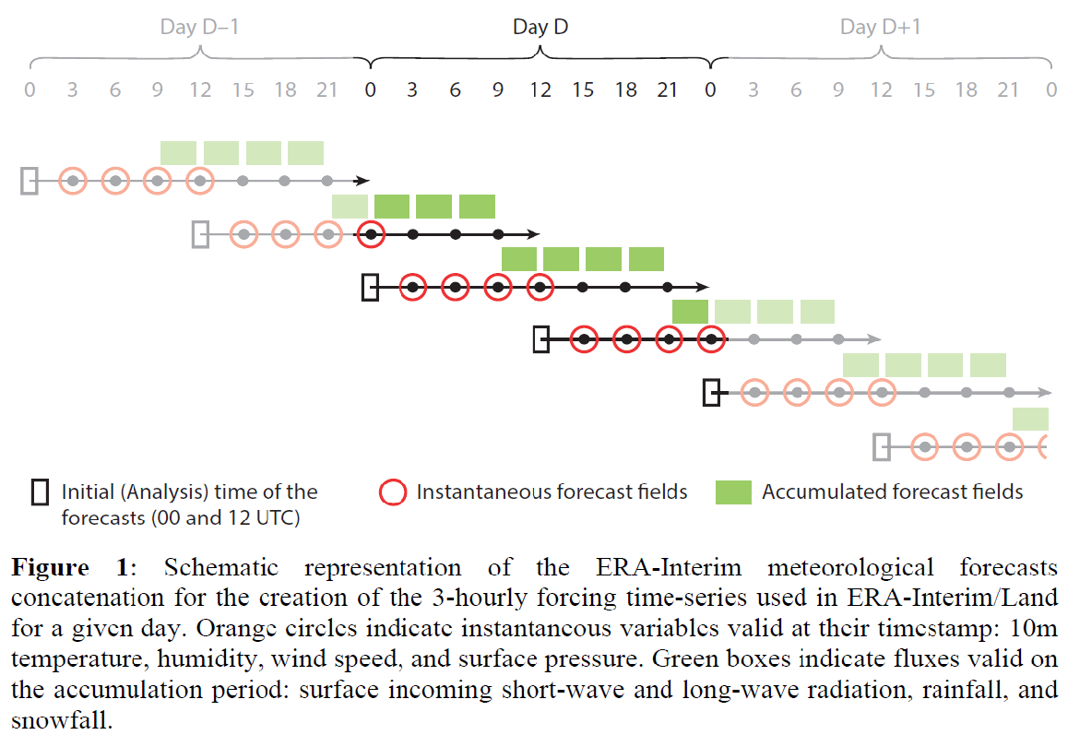
Based on ERA-Interim meteorological forcing and land surface modelling component
ERA-Interim/Land forcing for precipitation and radiation was validated along with a simple bias correction method using GPCPv2.0 monthly precipitation (1979-2010)

Slide 4
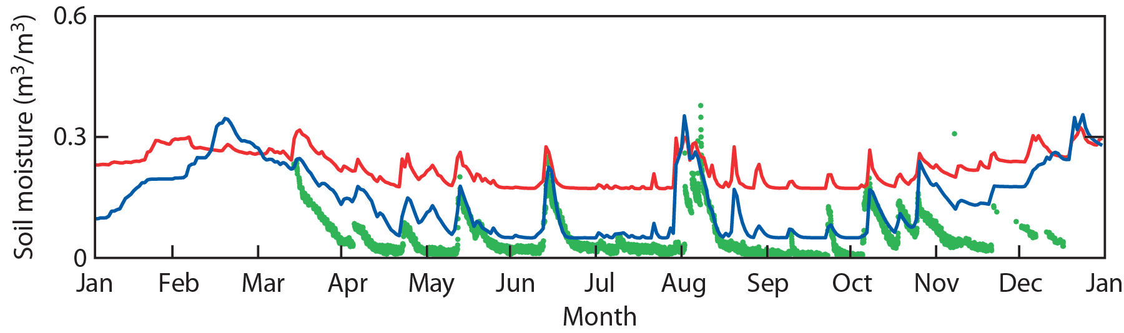
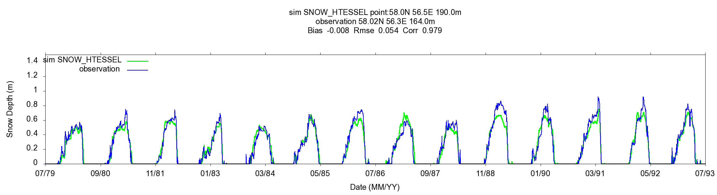
ERA-Interim/Land: storages verification
Albergel et al. (2013 JHM), Balsamo et al. (2013 HESSD)
ERA-Interim/Land integrates land surface modelling improvements with respect to ERA-Interim surface scheme and provided a balanced initial condition for the Monthly/Seasonal Re-Forecasts
Soil moisture
Evolution of soil moisture for a site in Utah in2010. Observations, ERA-Interim, and ERA-Interim/Land.
Snow depth
Evolution of snow depth for a site in Perm Siberia (58.0N, 56.5E) ERA-Interim/Land and in-situ observation between 1979 and 1993.

Slide 5
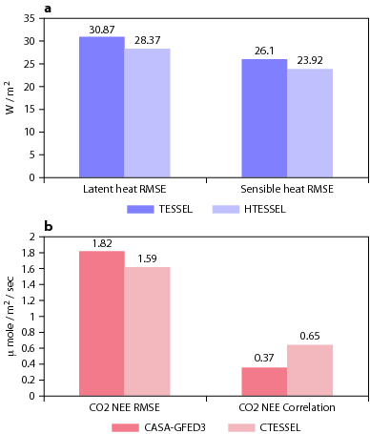
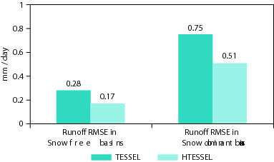
ERA-Interim/Land: fluxes verification
The ERA-Interim/Land fluxes are validated with independent datasets used as benchmarking.
Validation of H₂O / E / CO₂ cycles
E
H₂O
CO₂
GEOLAND-2 R&D support
Figure 2: Mean performance measured for the monthly rivers discharge verified with GRDC observations
Figure 1: Mean performance measured over 36 stations with hourly Fluxes from FLUXNET & CEOP Observations networks

Slide 6
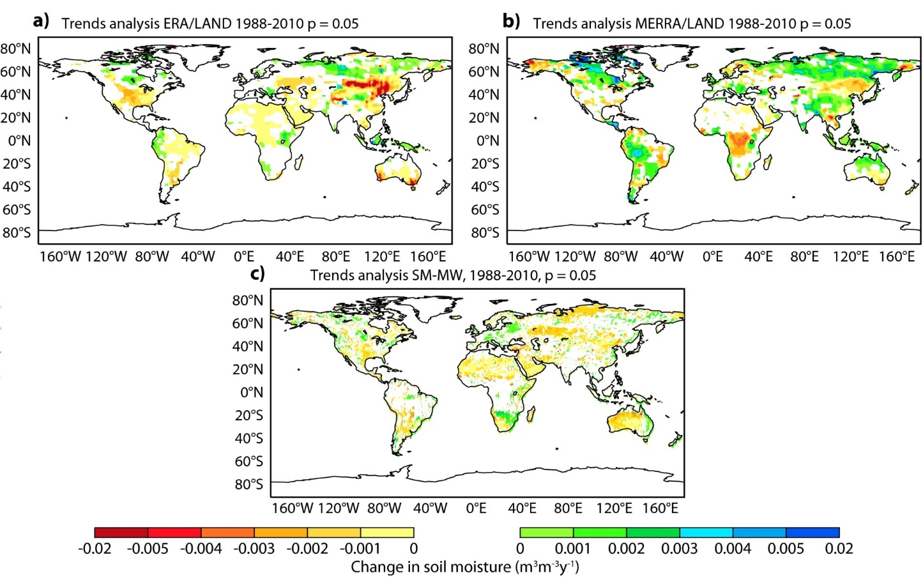
Combining Land-reanalyses, In-situ,
Remote-sensing for characterizing drying trends
Albergel et al. (2013)
72% of – (drying) trends
44% of – (drying) trends
73% of – (drying) trends
1988-2010 trends in monthly surface soil moisture (m³m⁻³y⁻¹) for a) ERA-Interim/Land, b) MERRA-Land and c) SM-MW (ESA-CCI / ECV). Only significant trends (p=0.005) based on the Mann-Kendall test are shown.

Slide 7
ECMWF Land Data Assimilation System (LDAS)
Soil moisture (SM)
  Methods: - 1D Optimal Interpolation in ERA-Interim
    - Simplified Extended Kalman Filter (EKF) for NWP and for ERA5
  Conventional observations: Analysed SYNOP 2m air rel. humidity and air temp.
  Satellite data: Scatterometer for NWP (ASCAT) & for ERA5 (ERS/SCAT &ASCAT)
  SMOS brightness temperature in dvpt, research NASA SMAP
Snow depth
  Methods: 2D Optimal Interpolation (OI) for NWP & for ERA5, Cressman interpolation for ERA-Interim
  Observations: in situ snow depth and NOAA/NESDIS IMS Snow Cover
Soil Temperature and Snow Temperature
1D-OI using T2m analysis increments
Notes:
7

Slide 8






Soil moisture analysis at ECMWF
ECMWF IFS cycle 41r2
NWP Forecast
Coupled Land-Atmosphere
T_2m RH_2m bg
Soil Moisture layers L1,L2,L3 bg
Jacobians, screen obs operator
Soil Analysis (SEKF)
Soil Moisture L1, L2, L3
$$σoT2m =1K$$
$$σb =0.01 m3m_3$$
$$σoRH2m=4\%$$
$$σoASCAT=0.05 m3m_3$$
T_2m RH_2m
SYNOP
OBS
Screen level analysis (OI)
T_2m RH_2m
ASCAT SM
Satellite
OBS
$$σoT2m=2K$$
$$σoRH2m=10\%$$
Operational soil moisture data assimilation: combines SYNOP and satellite data

Slide 9
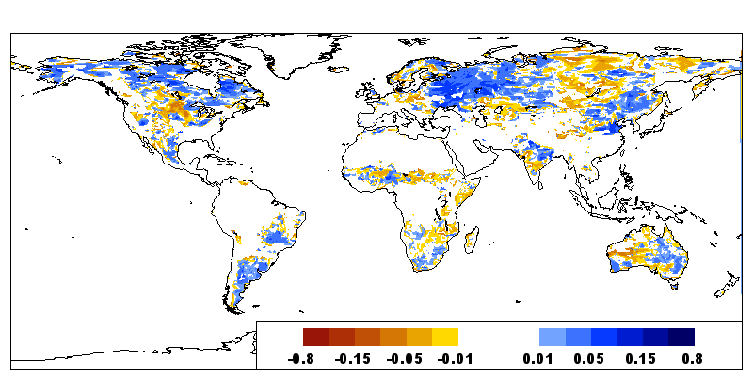
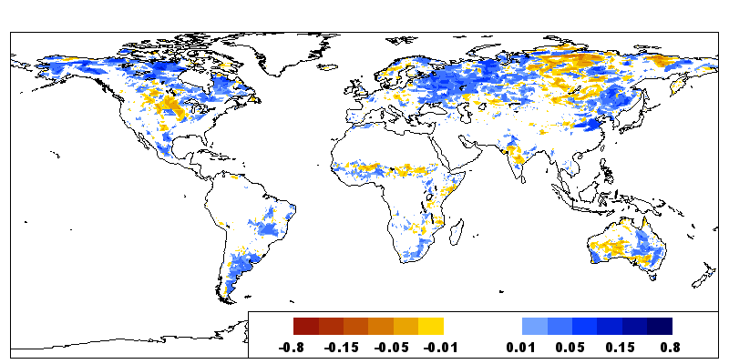
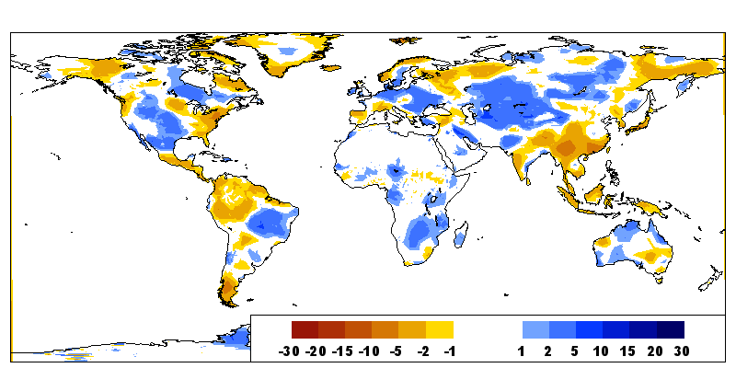
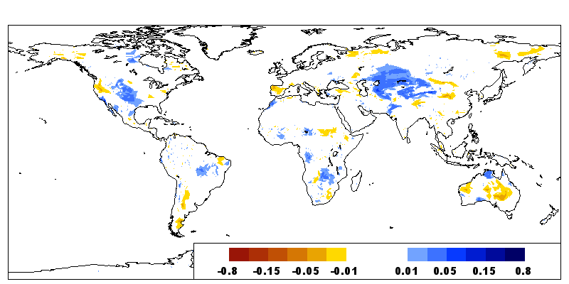
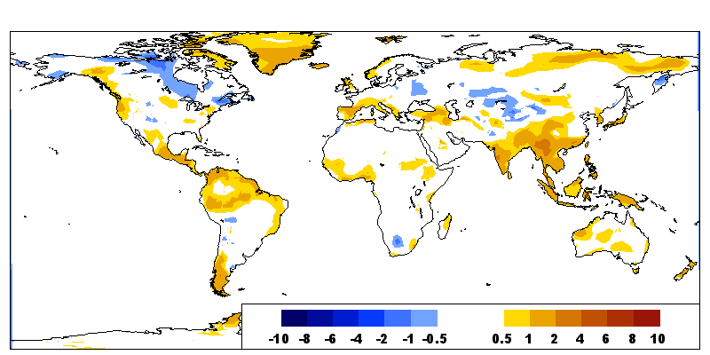
Inclusion of ASCAT Soil Moisture in data assimilation
Innovation (Obs- model)
25-30 June 2013
Accumulated Increments (m³/m³)
in top soil layer (0-7cm)
ASCAT
(m3/m3)
Due to ASCAT
RH2m (%)
T2m (K)
Due to SYNOP T2m and RH2m

Slide 10
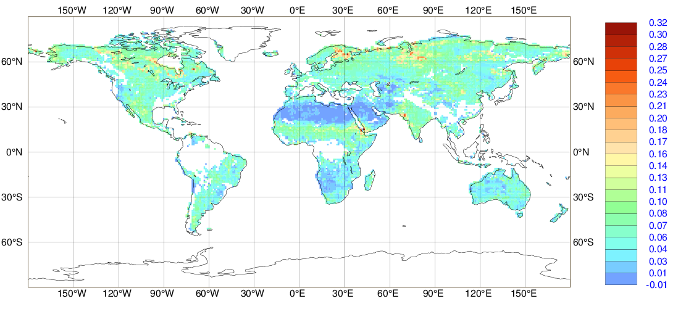
Future ECMWF Re-analysis (ERA5)
Assimilation of Scatterometer soil moisture data ERS/SCAT and MetOpA/B ASCAT
Use of EUMETSAT ASCAT-A reprocessed data (25km sampling)
 | FG departure Mean m³m⁻³ | FG departure StDev m³m⁻³
Using NRT ASCAT | 0.013 | 0.05
Using Reproc ASCAT | 0.006 | 0.044
(FMA 2010)
Reprocessed ASCAT has reduced background departure statistics both in mean and Stdev
ERA5 production (C3S) started (will be available end of 2017)
ASCAT surface soil moisture first guess departure (Obs-Model) in m3/m3
for JJAS 2014

Slide 11
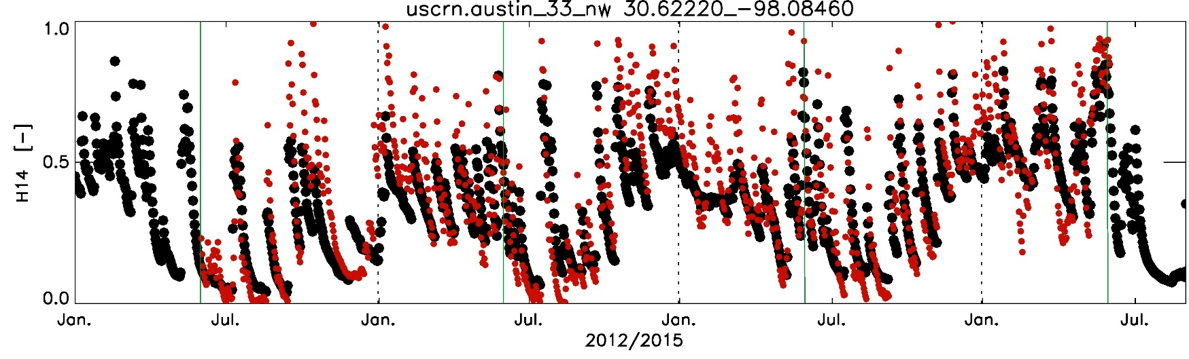
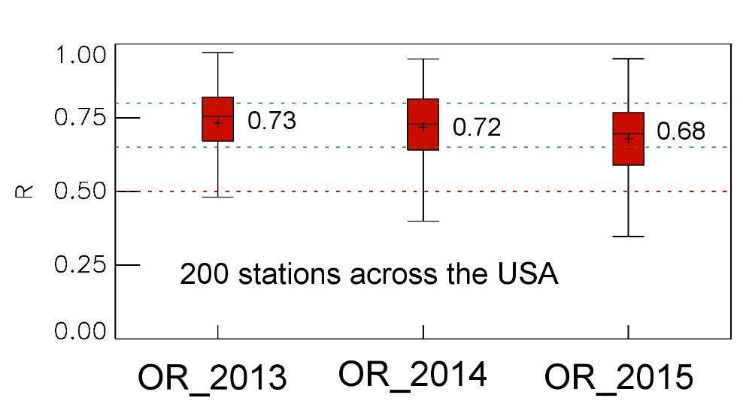

EUMETSAT H-SAF soil moisture
Scatterometer root zone soil moisture products based on data assimilation in dedicated LDAS suites
Evaluation of SM-DAS-2/H14
Surface and root zone liquid soil moisture content
OR_2013
OR_2014
OR_2015
Observation (5cm)
SM-DAS-2 (0-7cm)
Accuracy requirements for product SM-DAS-2 [R]
Unit | Threshold | Target | Optimal
Dimensionless | 0.50 | 0.65 | 0.80

Slide 12
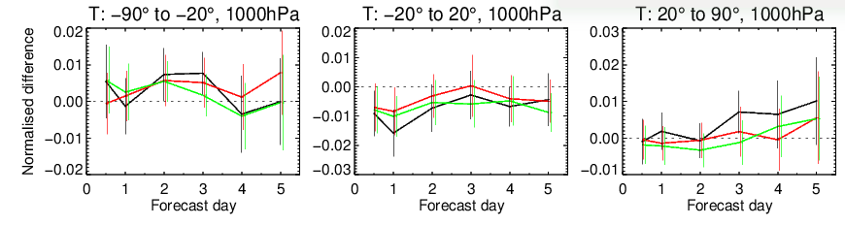
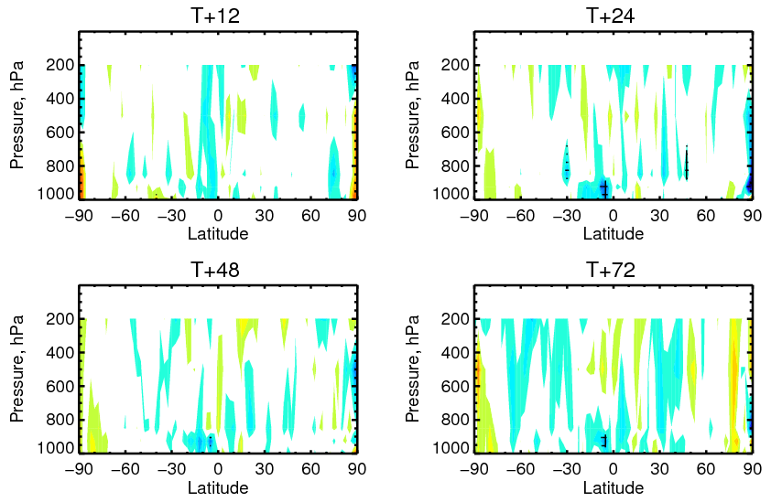


ESA-SMOS data assimilation in the IFS
Config.1
Normalized change in rms of fc error:
Config.2
Config.3
    SH- extratropics
    Tropics
    NH- extratropics
degradation
Based on short experiments
Longer experiment under evaluation
improvement

Slide 13
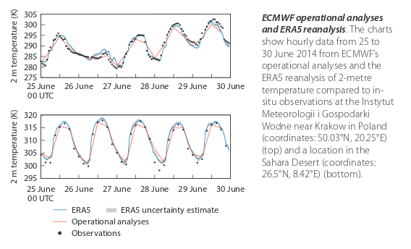
ERA5 a first look
Notes:
13

Slide 14
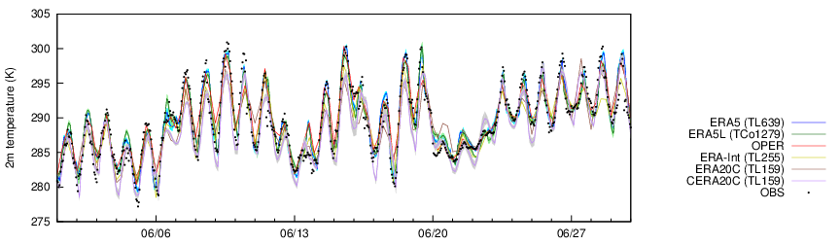
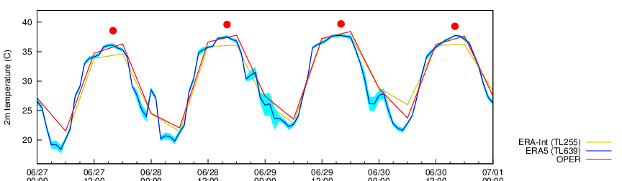
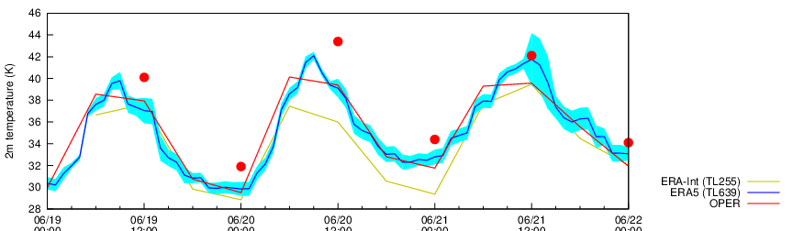
Heatwave in SouthWest Europe, 2015:
  Madrid, Area ~ 650 km², Population ~ 4 million (Parque el Retiro, 29 June, Tmax= 39.9°C (new record)
Heatwave in Pakistan, June 2015:
  Karachi, Area ~ 3,600 km², Population ~ 24 million (20 June Tmax=43.4°C, Tmin= 34°.2C)
Notes:
14

Slide 15
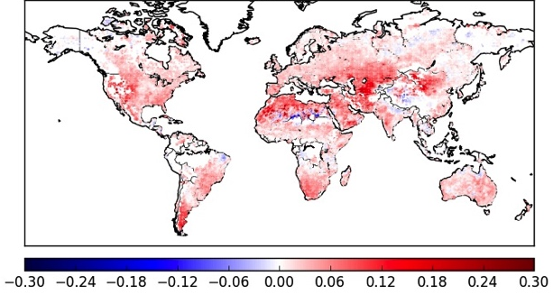
ESA-CCI soil moisture to validate soil vertical resolution
Tests to investigate possible H-TESSEL soil resolution increase:
H-TESSEL top soil layer 0-7cm replaced by 3 layers 0-1cm, 1-3cm, 3-7cm
Impact on Anomaly Correlation with ESA-CCI satellite soil moisture
Globally Improved match to satellite soil moisture (shown is ΔACC calculate on 1-month running mean)
Anomaly correlation (1988-2014) measured with ESA-CCI soil moisture remote sensing (multi-sensor) product.
→ Provides a global validation of the usefulness of increase soil vertical resolution
Notes:
Anomaly correlation calculated as centred reduce on a 1-month sliding window for the period 1988-2014.
Shown is the difference between the experiment (ge8f 0-1 cm depth of top soil) and ga89 (control 41r1).

Slide 16


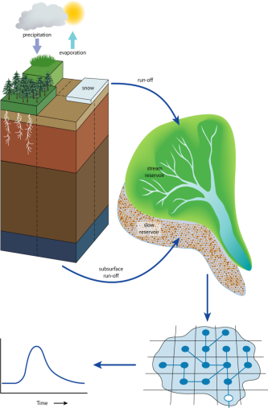
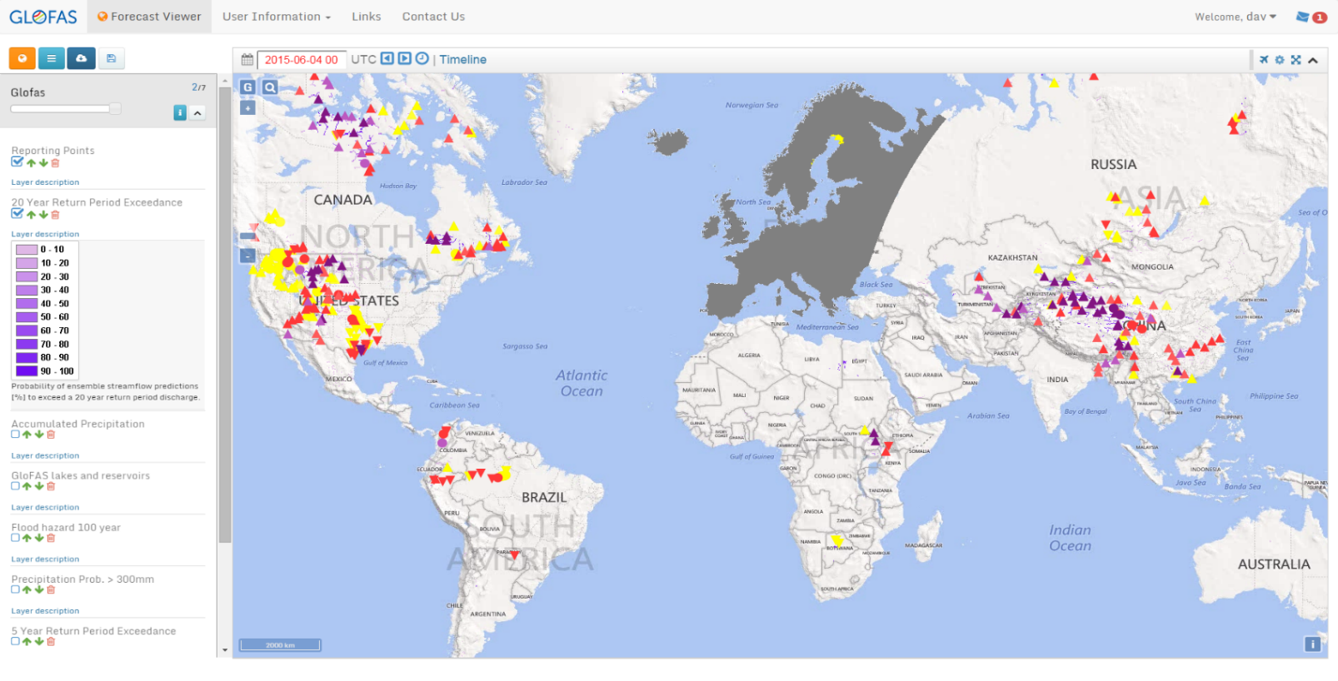
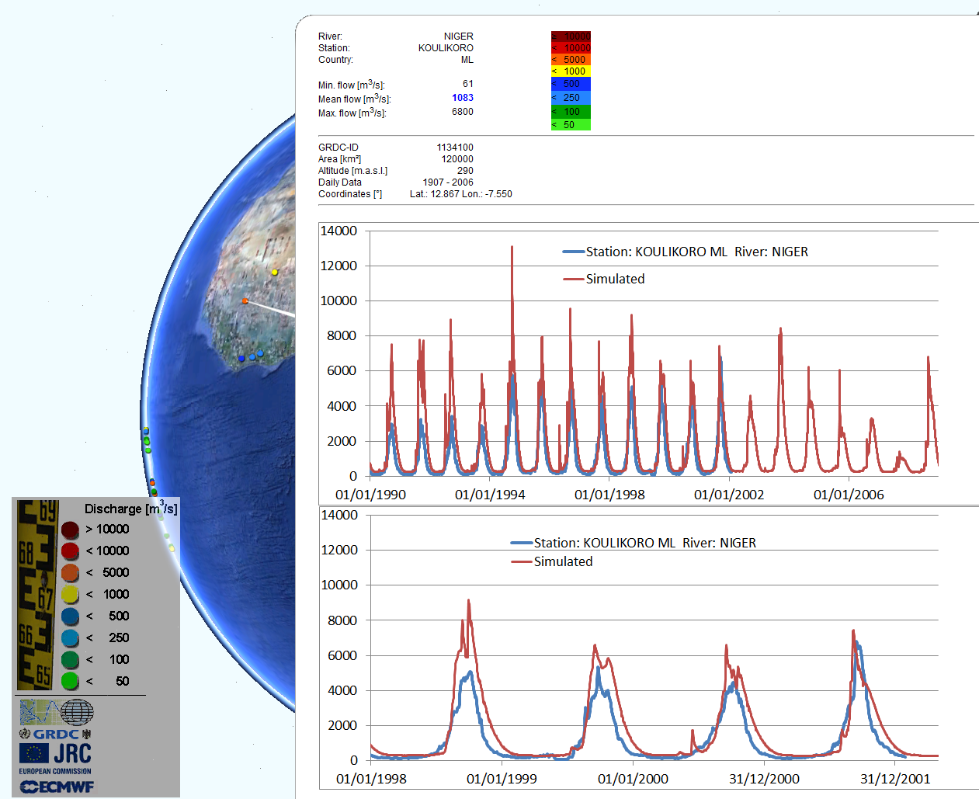
The Global Flood Awareness System
www.globalfloods.eu
Output from global ECMWF NWP land-surface forecast is fed into a routing model (Simplified LISFLOOD (JRC)) to produce flood forecasts – benefiting from all the improvements in the ECMWF Integrated Forecasting System (model and assimilation)!

Slide 17
ERA-5Land plans
High-resolution land component forced by ERA5 atmospheric reanalysis
    Running in a stand-alone suite, decoupled from the atmosphere (lower computational cost)
    Resolution will follow ECMWF operational system (TCo1279 → approx. 9 km)
    Extended archive of variables compared to ERA-Interim
    Monthly means and ensemble spread will be included
    Higher resolution of land fields very useful for commercial applications too→ C3S end-user
    Expected start of production by the Q1-Q2 2017 (ERA-5L lags behind the ERA5 production)
Some characteristics
    Atmospheric forcing from ERA5
    T, Q and P fields corrected from orography height difference (lapse-rate correction)
    Surface fields uncertainty estimated from 10-ensemble members run at TCo639 resolution
    Currently no assimilation implemented
Current & future developments
    Precipitation & lapse-rate corrections
    Post-processing of carbon fluxes with BFAS
    More realistic ensemble spread through additional perturbations
    Possible increase to 10 soil layers (from the current 4 layers)

Slide 18
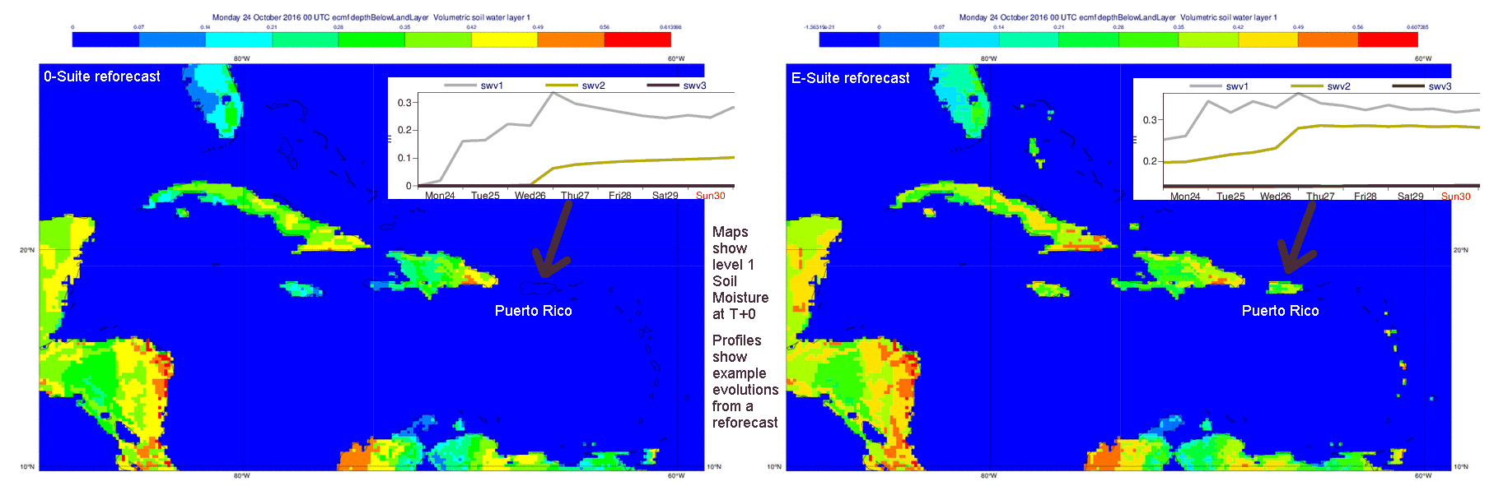
ERA-5Land: a case for HRES
Why High-resolution land ? A case for Puerto Rico from daily-report

Slide 19
Summary
Land reanalyses at ECMWF are necessary to provide appropriate initial conditions to reforecasts
The quality of meteorological forcing combined with model advances have made them added-value products (e.g. conservation, hydrological consistency, verification effort).
The extension to further processes shall enhance the monitoring capacity (e.g. in ERA-5 there are lakes)
Land reanalyses (such as ERA-Interim/Land and ERA5-Land) do not yet include stand-alone land data assimilation system and work to include this component will be beneficial to constrain modelling errors and enhance the consistency with the NRT-LDAS
Land dedicated reanalyses foreseen in future ERA products will probably still include forced-mode integration as they are water-conserving and can provide useful guidance on trends and further information for model error characterisation.

Slide 20
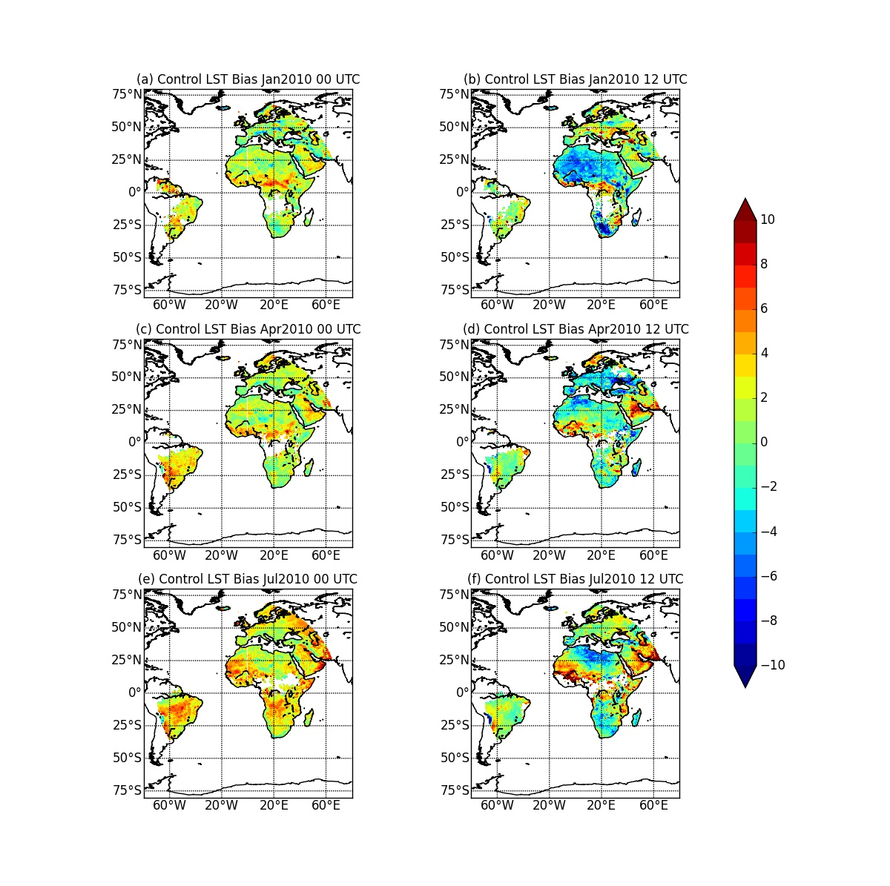
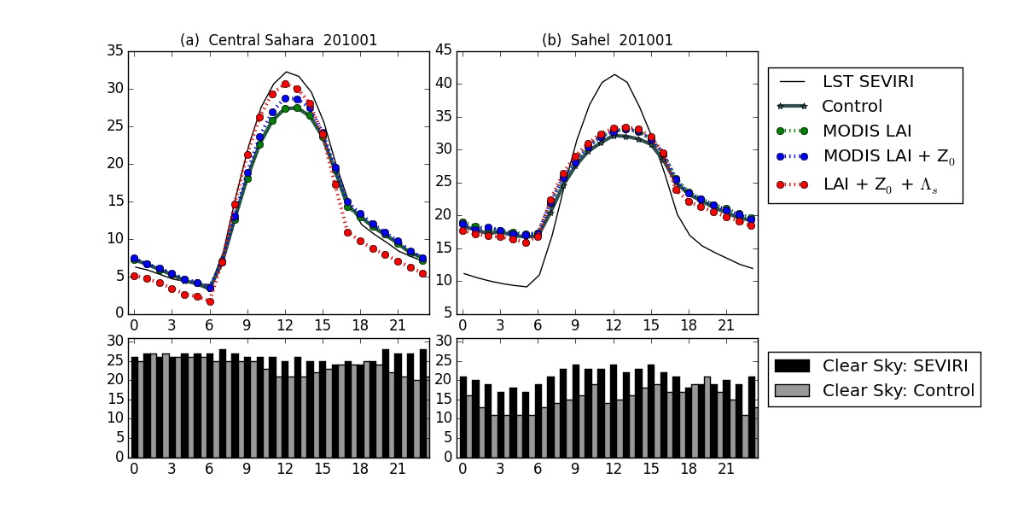
Coupling and diurnal cycle: vegetation
Trigo et al. (2015, JGR in rev.), Boussetta et al. (2015, RSE)
T amplitude
20°C smaller
on vegetation
Findings of large biases in the diurnal temperature reposed on the use of MSG Skin Temperature.
However with the current model version we are limited (both over bare soil and vegetation)

Slide 21
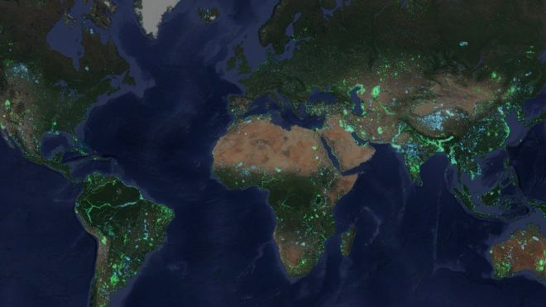
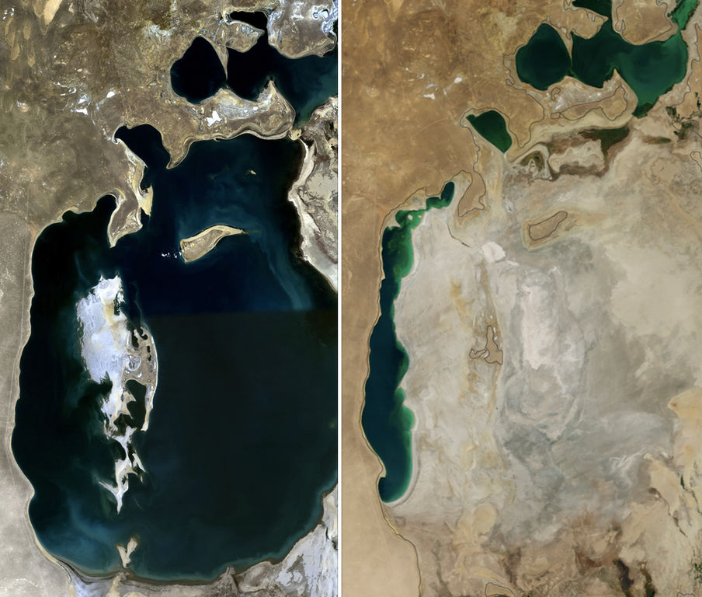
Inland water bodies dataset: a moving target?
http://aqua-monitor.appspot.com
Lake Aral in 1989 and 2014
(source: NASA)

Slide 22
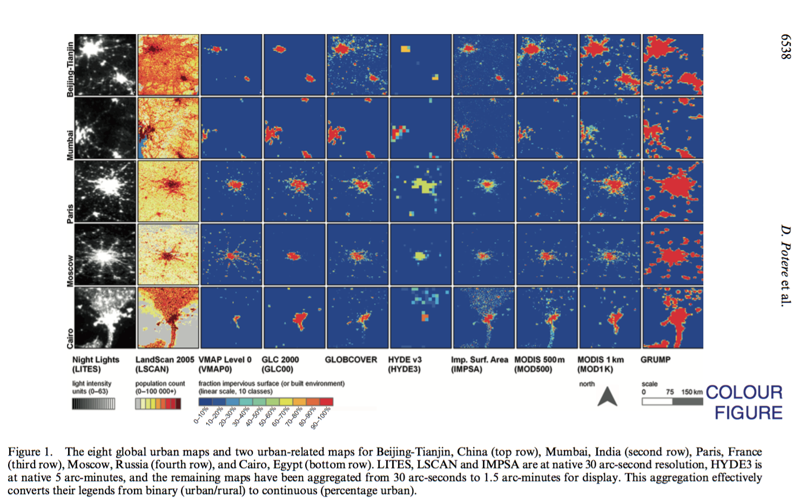
Urban cover uncertainties
Urban area dataset comparison on selected cities (Potere et al., 2009 IJRS) reveal large uncertainties and discrepancies

Slide 23
CM-SAF and EUMETSAT workshop, 16 November 2016
Thank you for your Attention!
Useful links:
ECMWF LDAS: https://software.ecmwf.int/wiki/display/LDAS/LDAS+Home
ECMWF SMOS: https://software.ecmwf.int/wiki/display/LDAS/SMOS
ECMWF CMEM: https://software.ecmwf.int/wiki/display/LDAS/CMEM
ECMWF Land Surface Observation monitoring:
https://software.ecmwf.int/wiki/display/LDAS/Land+Surface+Observations+monitoring

