Slide 1
TC Soudelor
Impact of 41r2 TCo1279

Slide 2
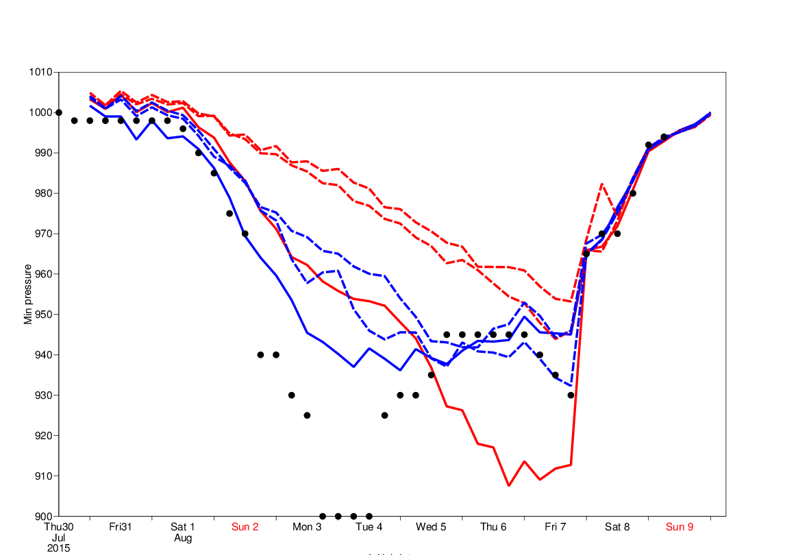
Minimum pressure in analysis
41r1 (red), 41r2 (blue); HRES (solid), EDA (dashed)

Slide 3
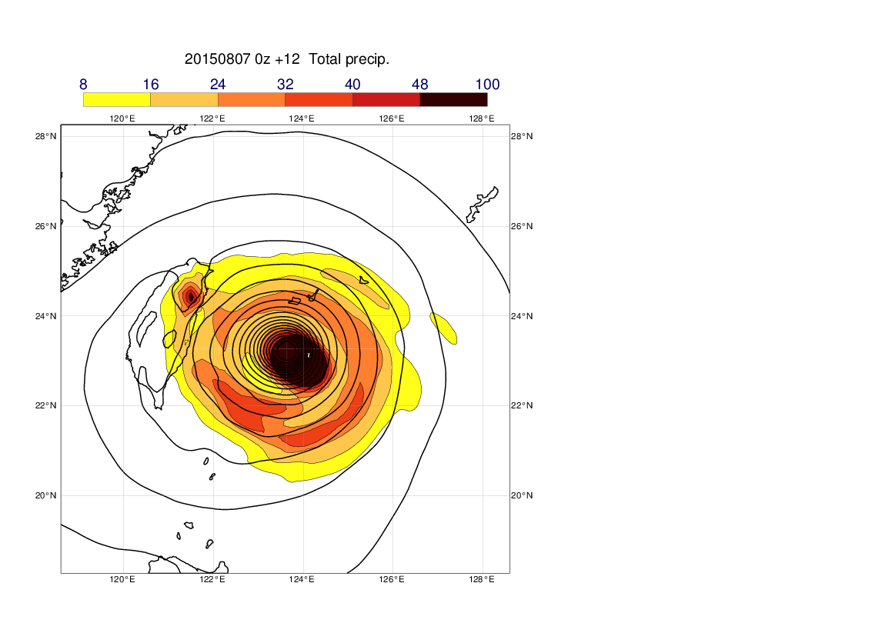
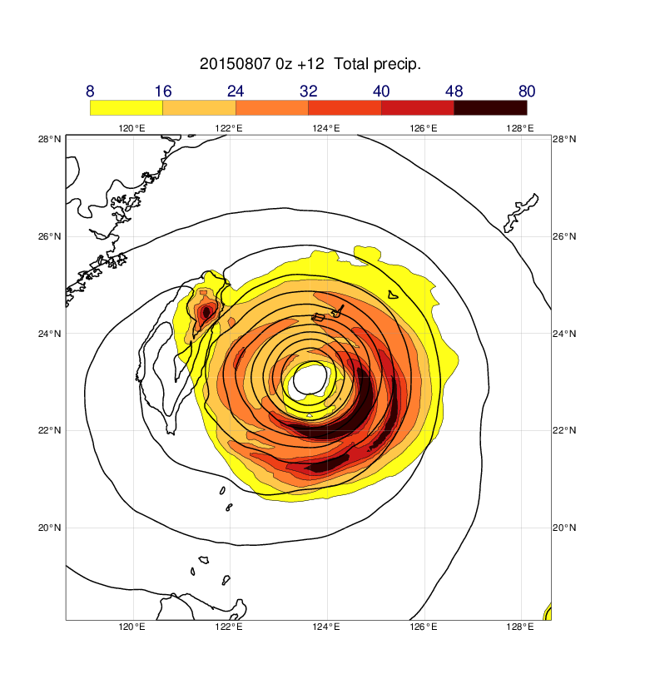
3-hourly precipitation (mm/h)
41r1
41r2

Slide 4
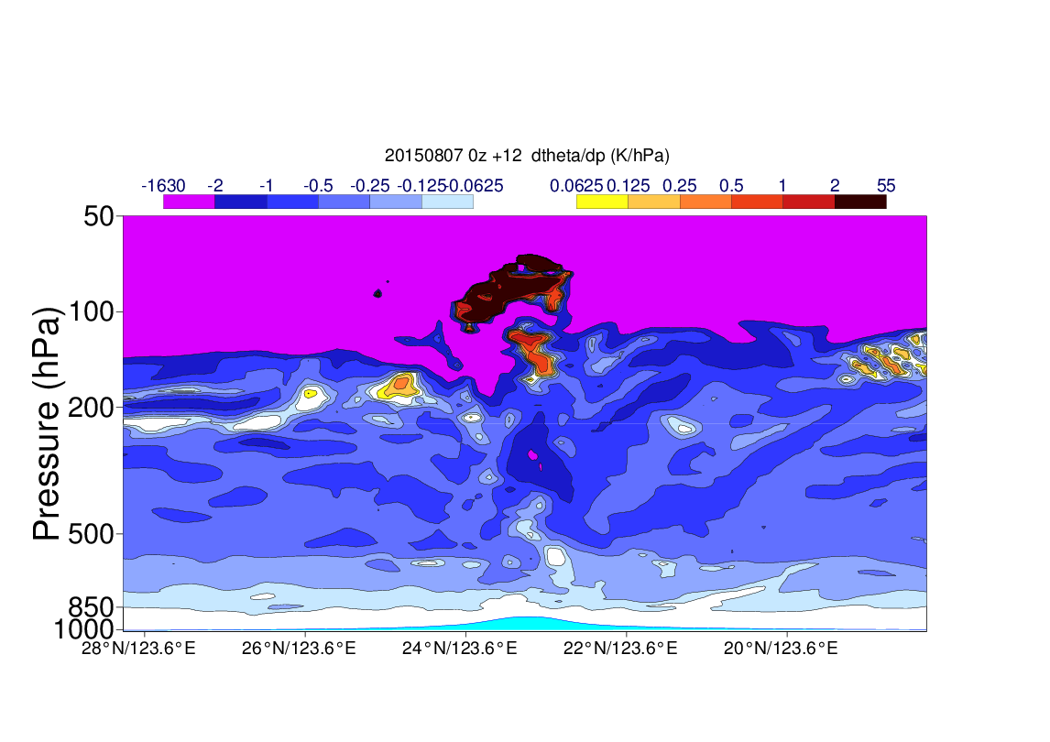
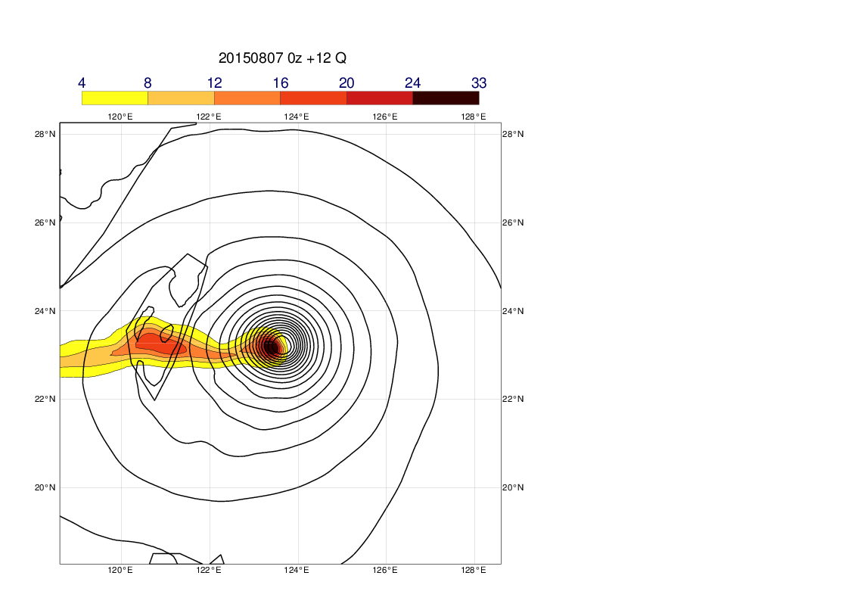
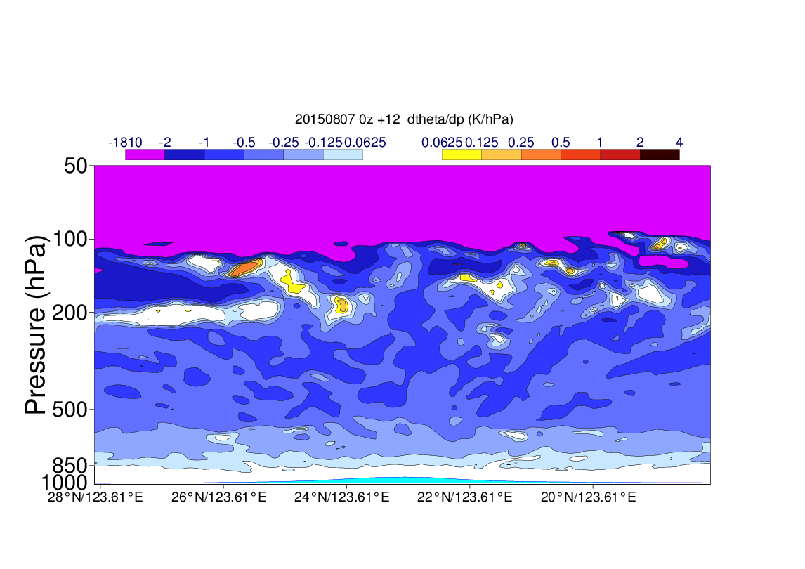
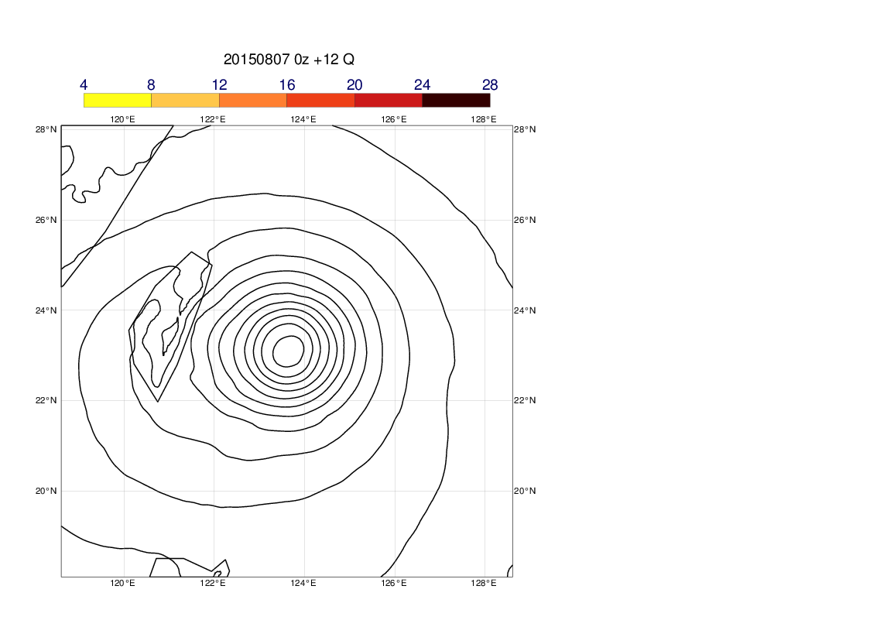
Q 50 hPa
dTheta/dp
41r1
41r2

