Slide 1

Introducing ECMWF
Anna Ghelli
anna.ghelli@ecmwf.int

Slide 2
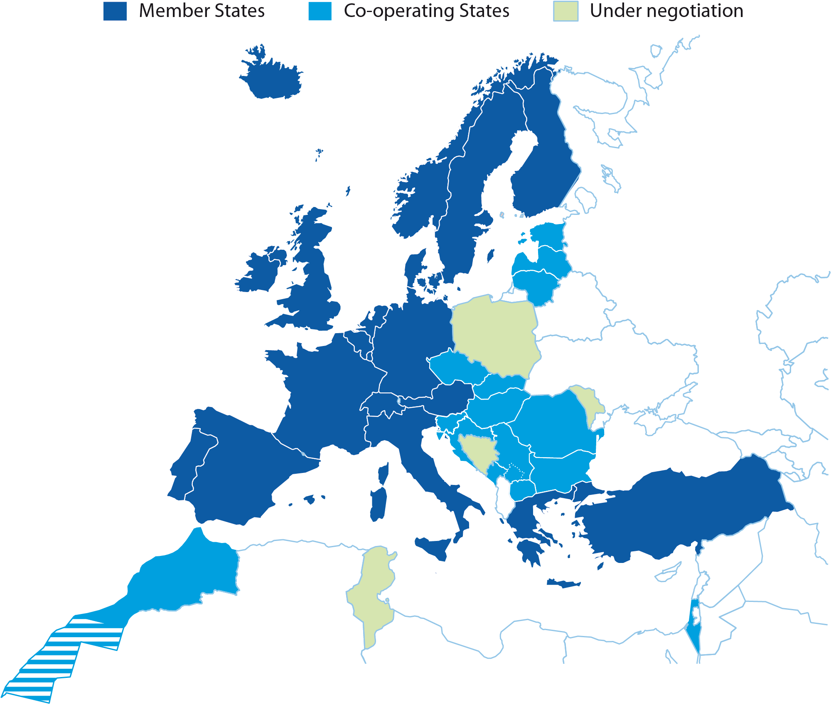
ECMWF
An independent intergovernmental organisation
established in 1975
With
20 Member States
14 Co-operating States
Notes:
For 2011:
Age of ECMWF: 36 years
Employees: 227
Supported by: 34 States
Budget: £43 million per annum
Contributions by Member States
and Co-operating States £39.8 million per annum

Slide 3
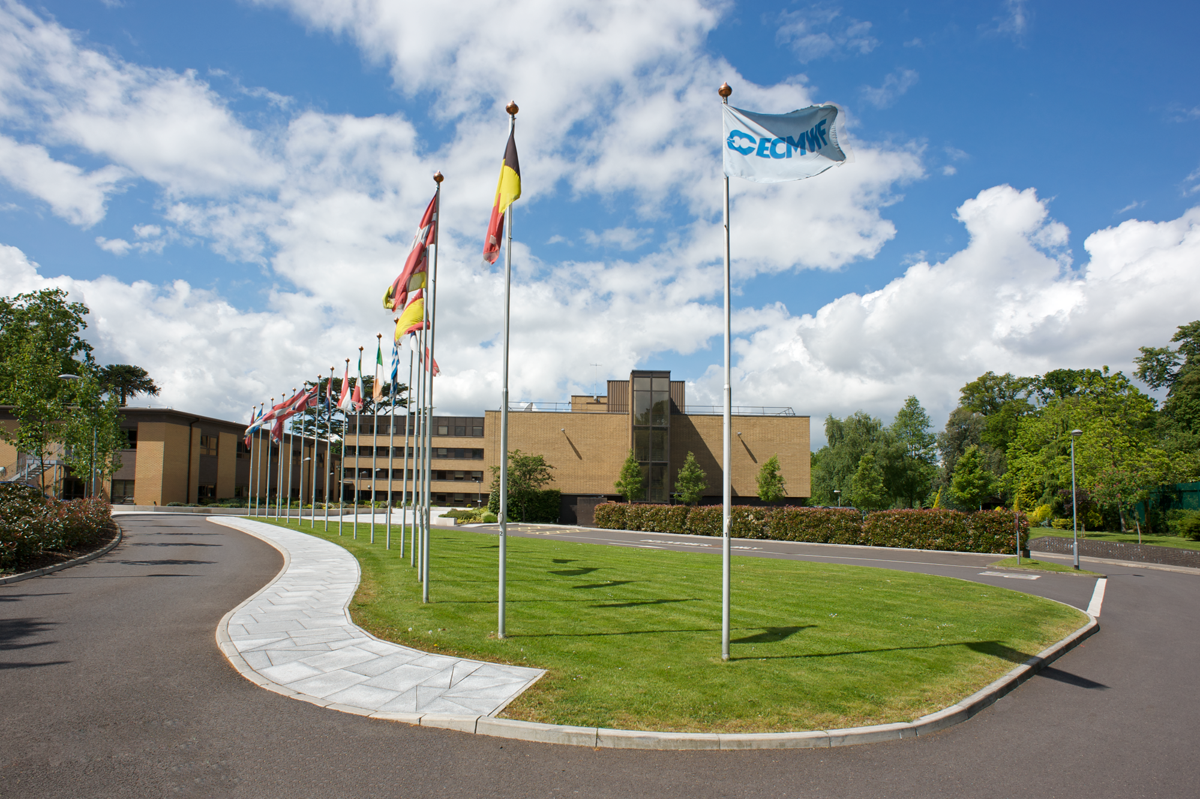
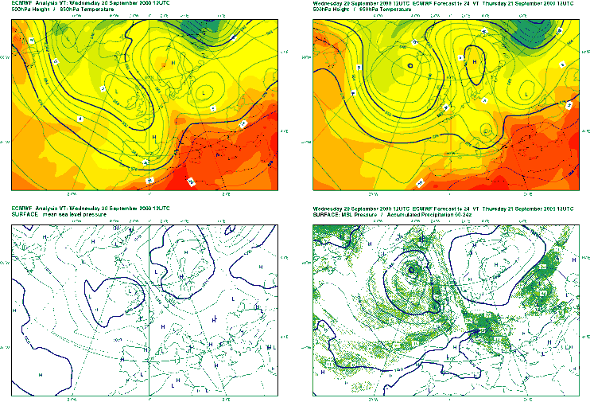
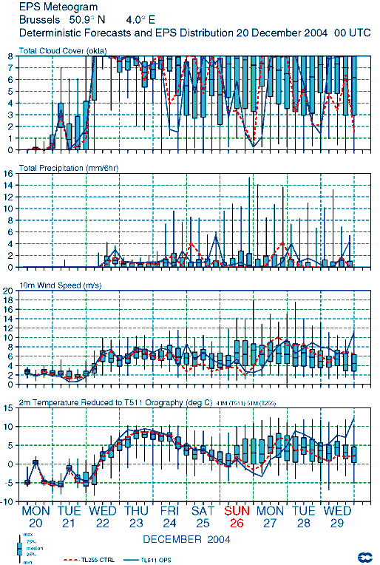
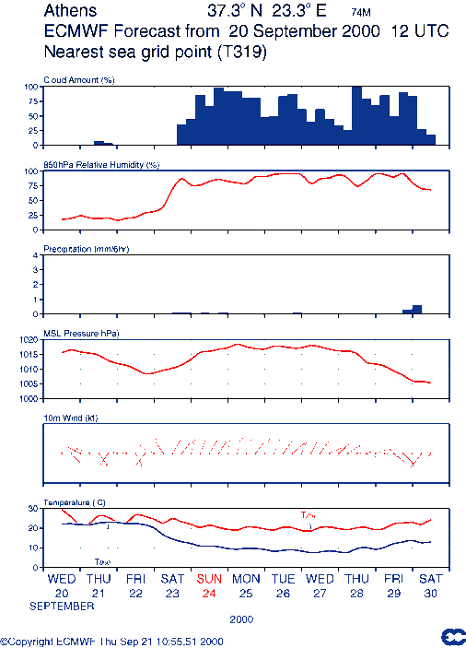
Who are we and what do we do?
Medium-Range Up to fifteen days ahead.
Also monthly and seasonal forecasts. We collect and store meteorological data.
Weather Forecasts We produce world-wide weather forecasts
What do we have to achieve this?
People About 270 staff,
specialists and contractors
Equipment State-of-the-art supercomputers and data handling systems
Budget £50 million per year
Experience 40 years

Slide 4
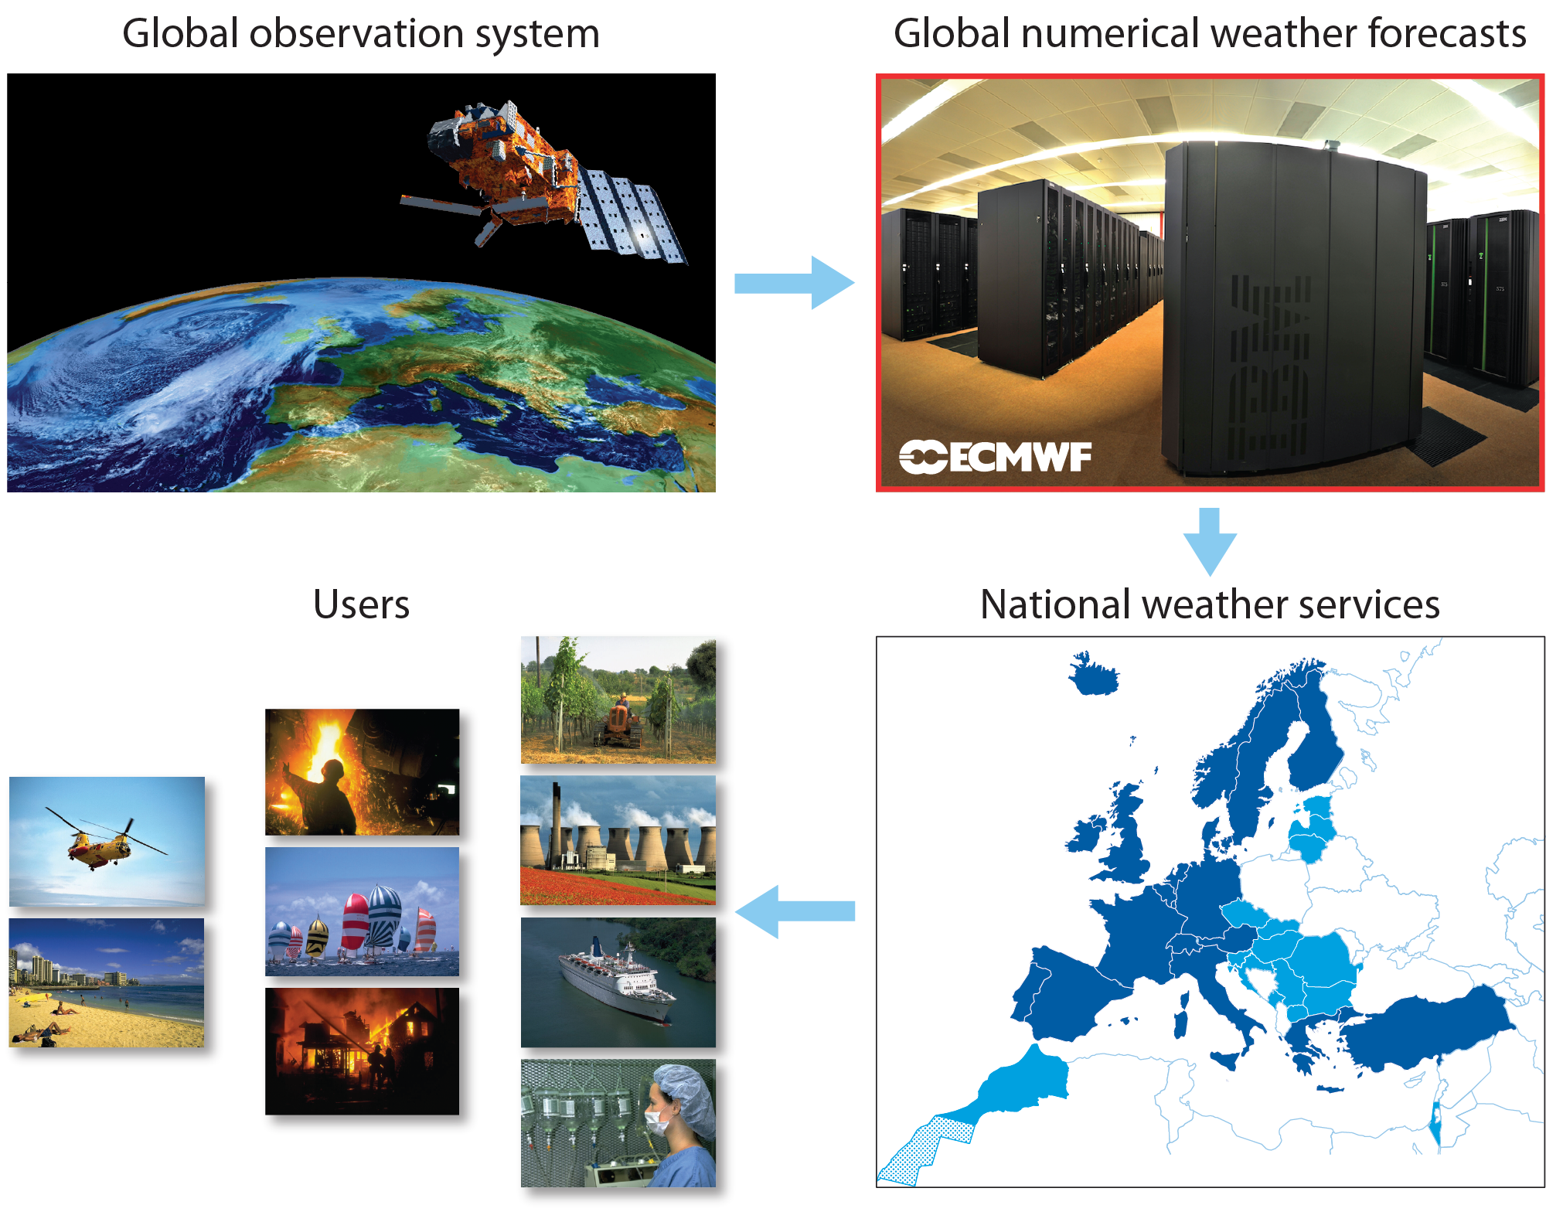

Slide 5
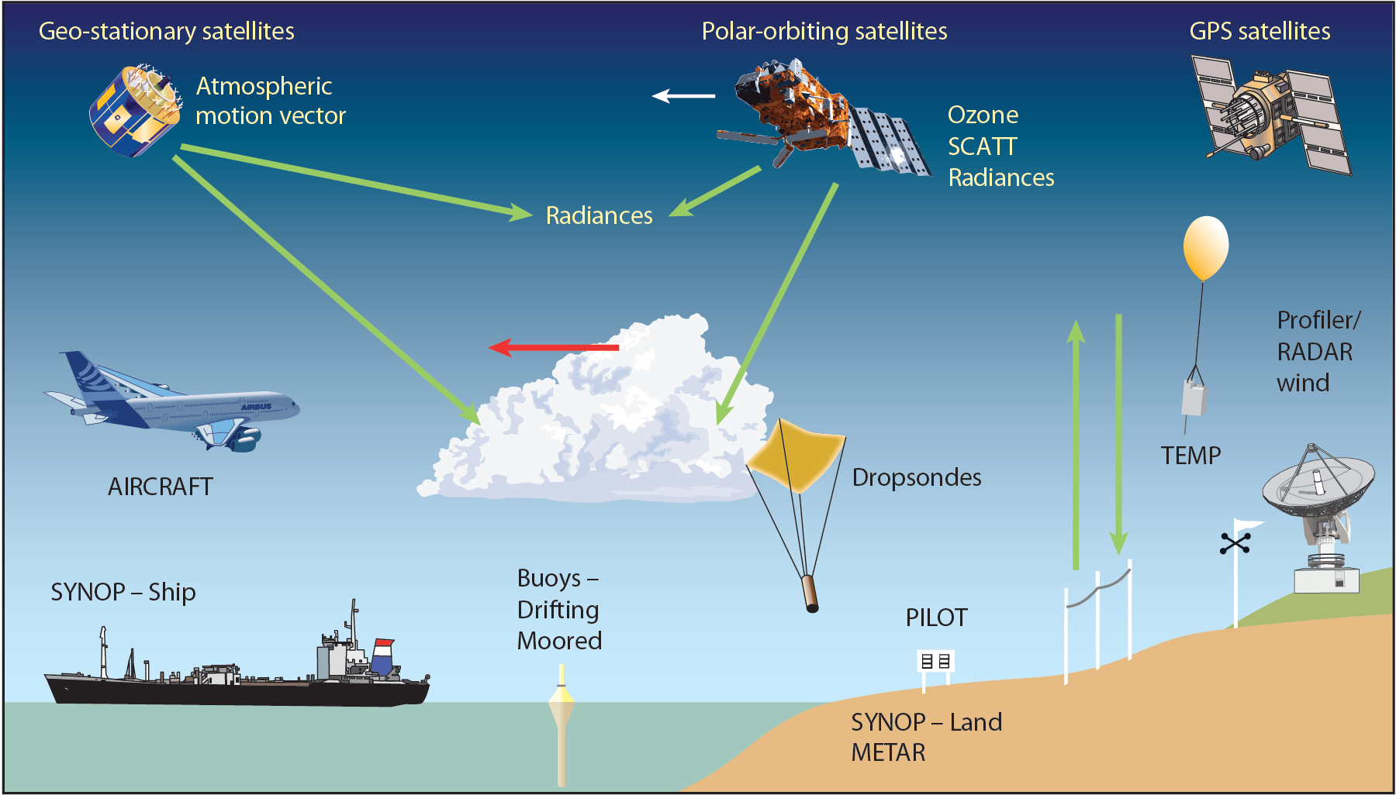
Data sources for the ECMWF Meteorological Operational System
Notes:
Red Arrow indicates Atmospheric Motion Vectors (AMVs)

Slide 6
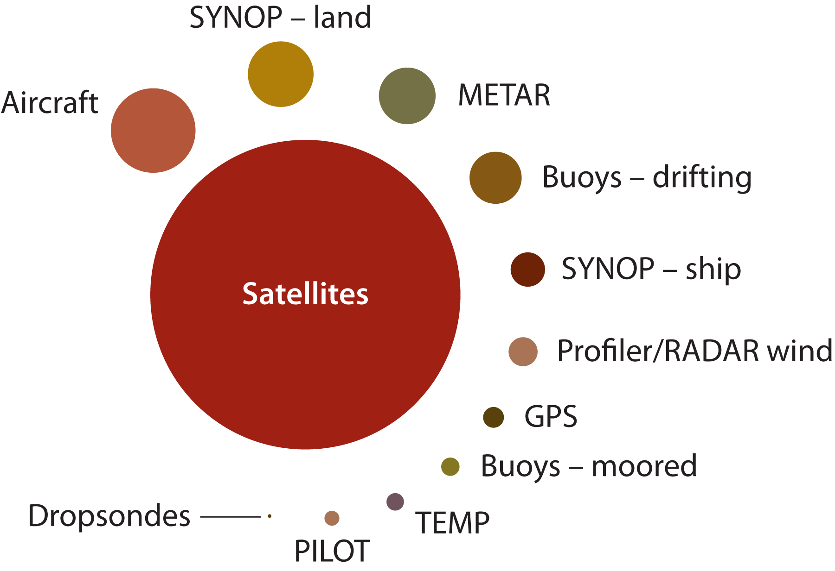
Data used
Notes:
TEMP = radiosonde
METAR=

Slide 7
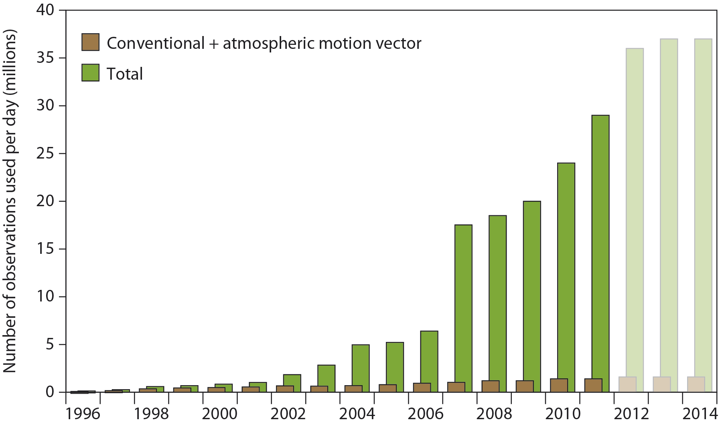
Satellite data used by ECMWF

Slide 8

Notes:
When scientists forecast the global weather they need to know two things:
firstly the state of the current weather conditions right now and
secondly the physics of how weather conditions interact and evolve over time.
Knowledge of the current state requires an extensive set of measurements and estimates of conditions both at the Earth’s surface and higher up in the atmosphere, while the physics is represented by thousands of equations in the global weather model.
The problem for the forecaster is that the models and input measurements are never perfect and small inaccuracies grow naturally in the calculations, resulting in large errors in forecasts a few days hence.

Slide 9
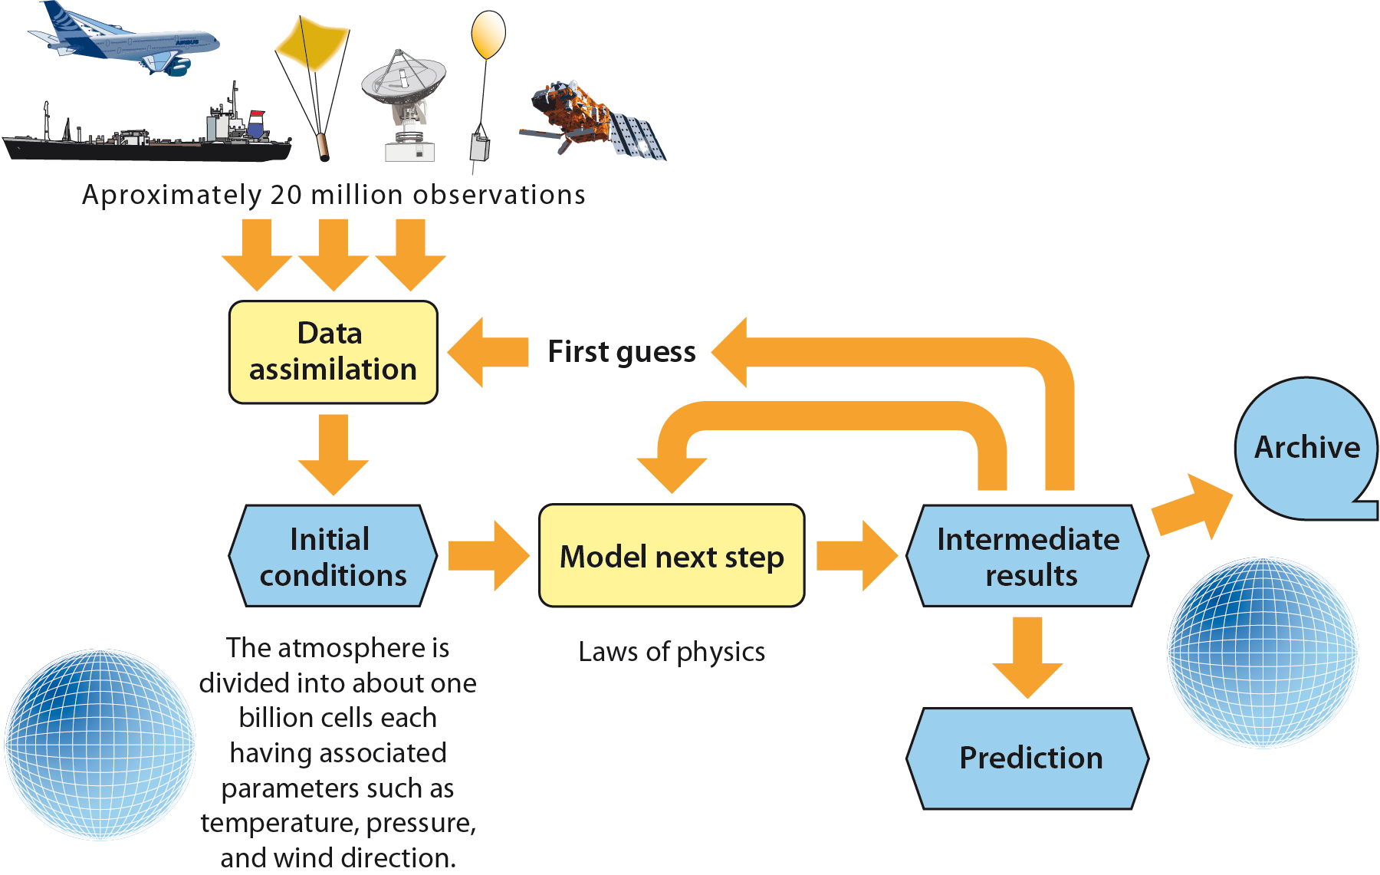
Our models

Slide 10
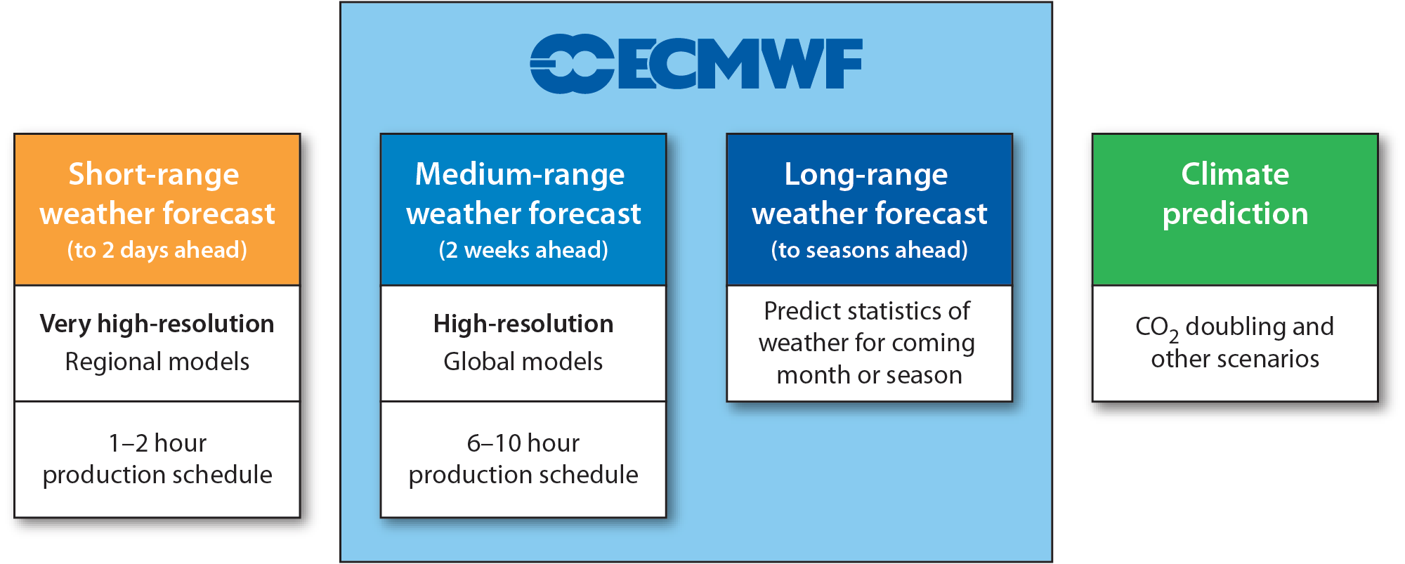
Why “medium-range”?
Notes:
Short-range weather forecast (0–2 days ahead)
Detailed prediction – regional forecasting system
Produce forecast an hour or two after observations are made
Medium-range weather forecast (2 weeks ahead)
Less detailed prediction – global forecasting system
Produce forecast up to 6 hours after observations are made
Long-range weather forecast (more than 2 weeks ahead)
Predict statistics of weather for coming month or season
Climate prediction
Predict what the climate would be like if . . .

Slide 11
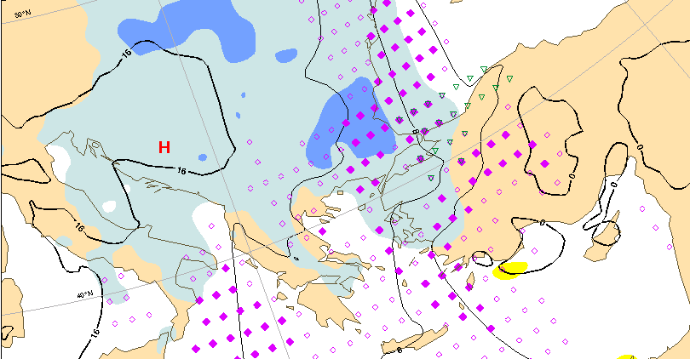
The operational forecasting system
High resolution deterministic forecast: twice per day
16 km 137-level, to 10 days ahead
Ensemble forecast: twice daily
51 members, 30/60 km 91-level, to 15 days ahead
Monthly forecast: twice a week (Mon/Thursdays)
51 members, 30/60 km 91 levels, to 1 month ahead
Seasonal forecast: once a month (coupled to ocean model)
51 members, 80 km, 91 levels, to 7 months ahead
Notes:
Observations
Surface (weather stations, balloons, ships, buoys, …)
Space (satellites)
Mathematical model
Modelling software developed by the Research Department
Very large computer (supercomputer)
Was central to the establishment of ECMWF
Today, a single 10-day forecast requires 6,500,000,000,000,000 calculations
Four-dimensional variational data assimilation based on 16 / 80 km horizontal resolution and 91-level vertical resolution (4D-Var).
16 km 91-level model for single-valued (deterministic) forecast twice daily.
Ensemble Prediction System
With 32 km (62 levels) to 10 days twice per day
With 65 km (62 levels) coupled to an ocean model out to 15 days
(32 days on Thursdays at 00 UTC)
Coupled ocean model with horizontally varying resolution
(110 km midlat / 33 km tropics)
Seasonal Forecast System (once a month)
125 km horizontal (62 levels) to 7 months (12 months every quarter) with coupled ocean model
(All forecasts are coupled to an ocean wave model)

Slide 12
ECMWF scores
Reducing error

Slide 13
ECMWF Objectives
Operational forecasting up to 15 days ahead (including ocean waves)
R & D activities in forecast modelling
Data archiving and related services
Operational forecasts for the coming month and season
Advanced NWP training
Provision of supercomputer resources
Assistance to WMO programmes
Management of Regional Meteorological Data Communications Network (RMDCN)

Slide 14
ECMWF training course
A warm welcome to all participants!
The forecasting systems: observations & models
Operational forecasting / Lab Sessions
Discussion and exchange of ideas

