Slide 1
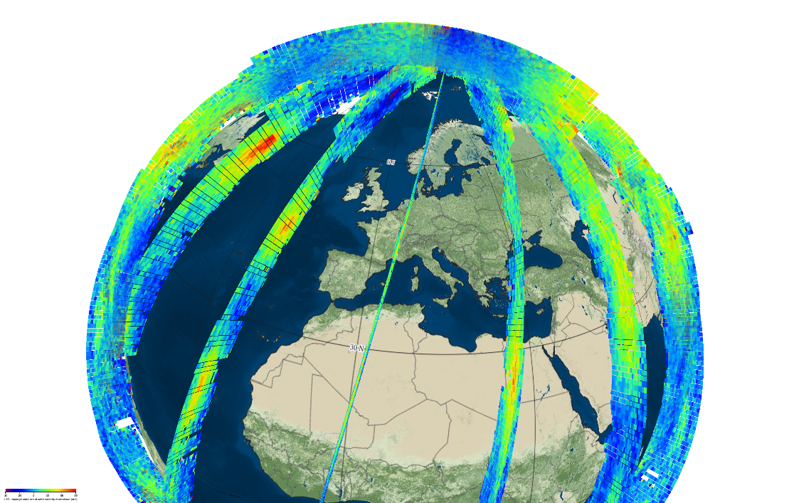
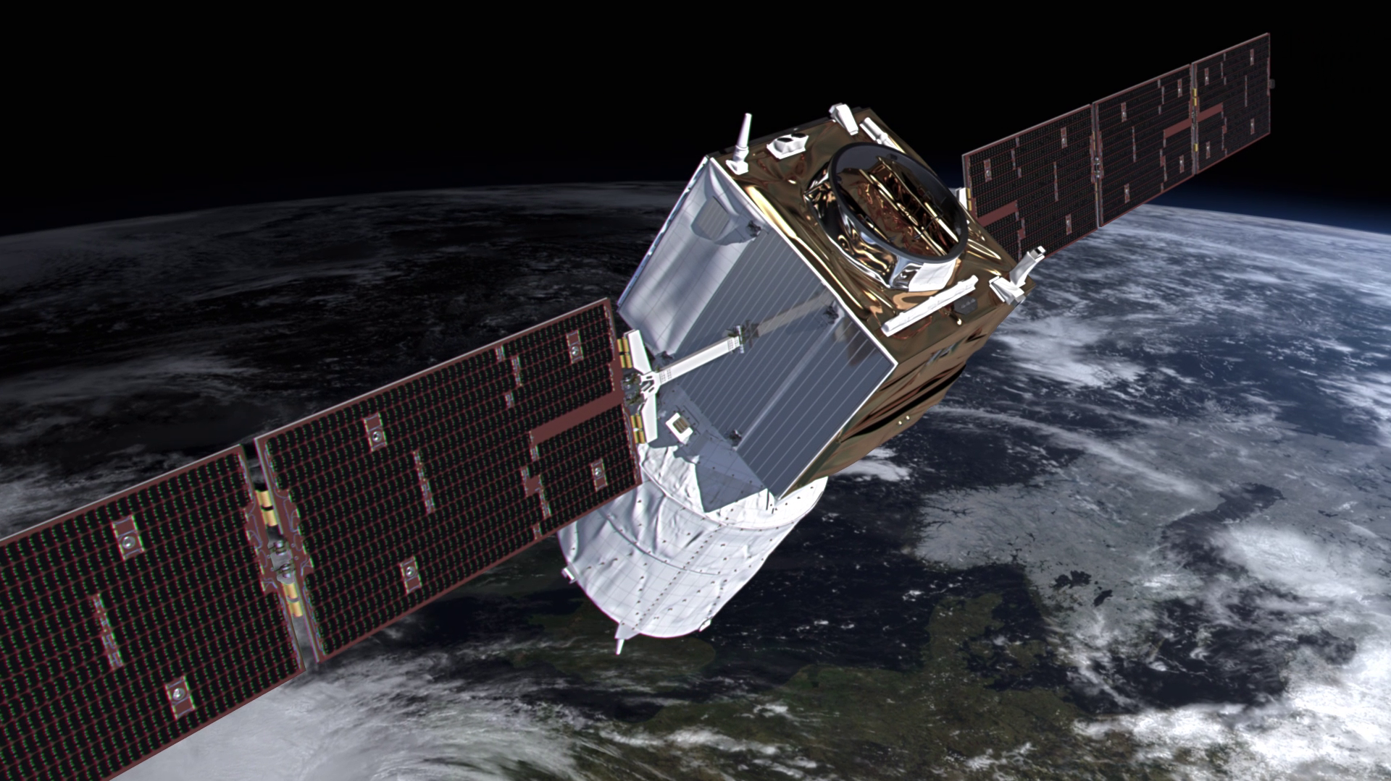


Wind information from Aeolus
EUMETSAT/ECMWF NWP-SAF Satellite data assimilation training course, 2022
by Michael Rennie (m.rennie@ecmwf.int)
Many thanks to ECMWF, ESA, Aeolus DISC and particularly DLR colleagues for providing material

Slide 2
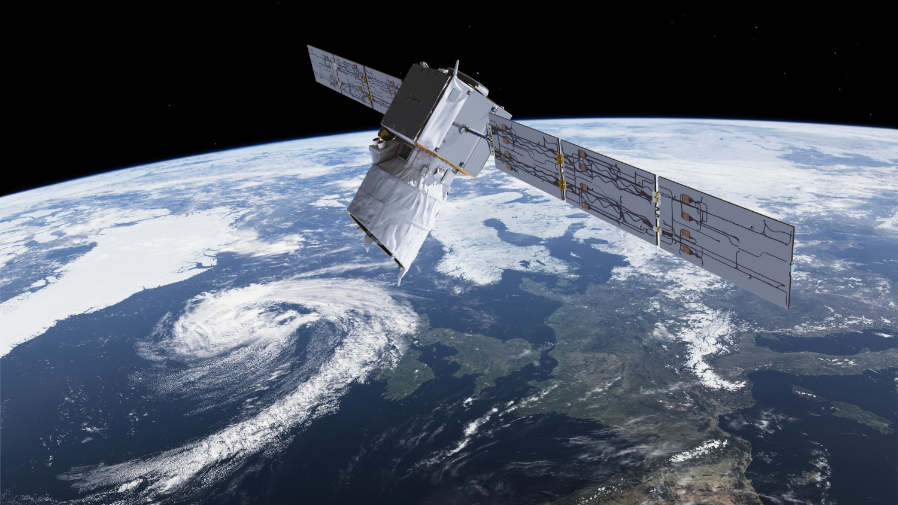
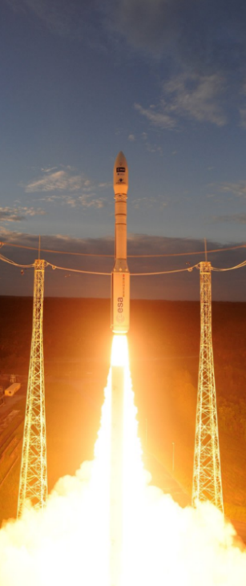
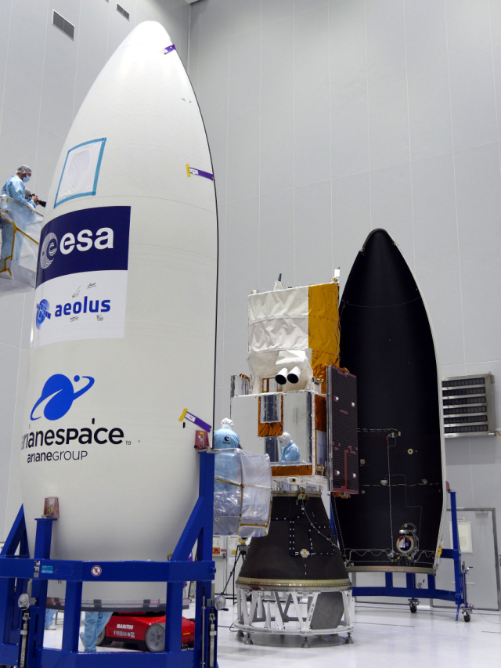
An introduction to Aeolus

Slide 3

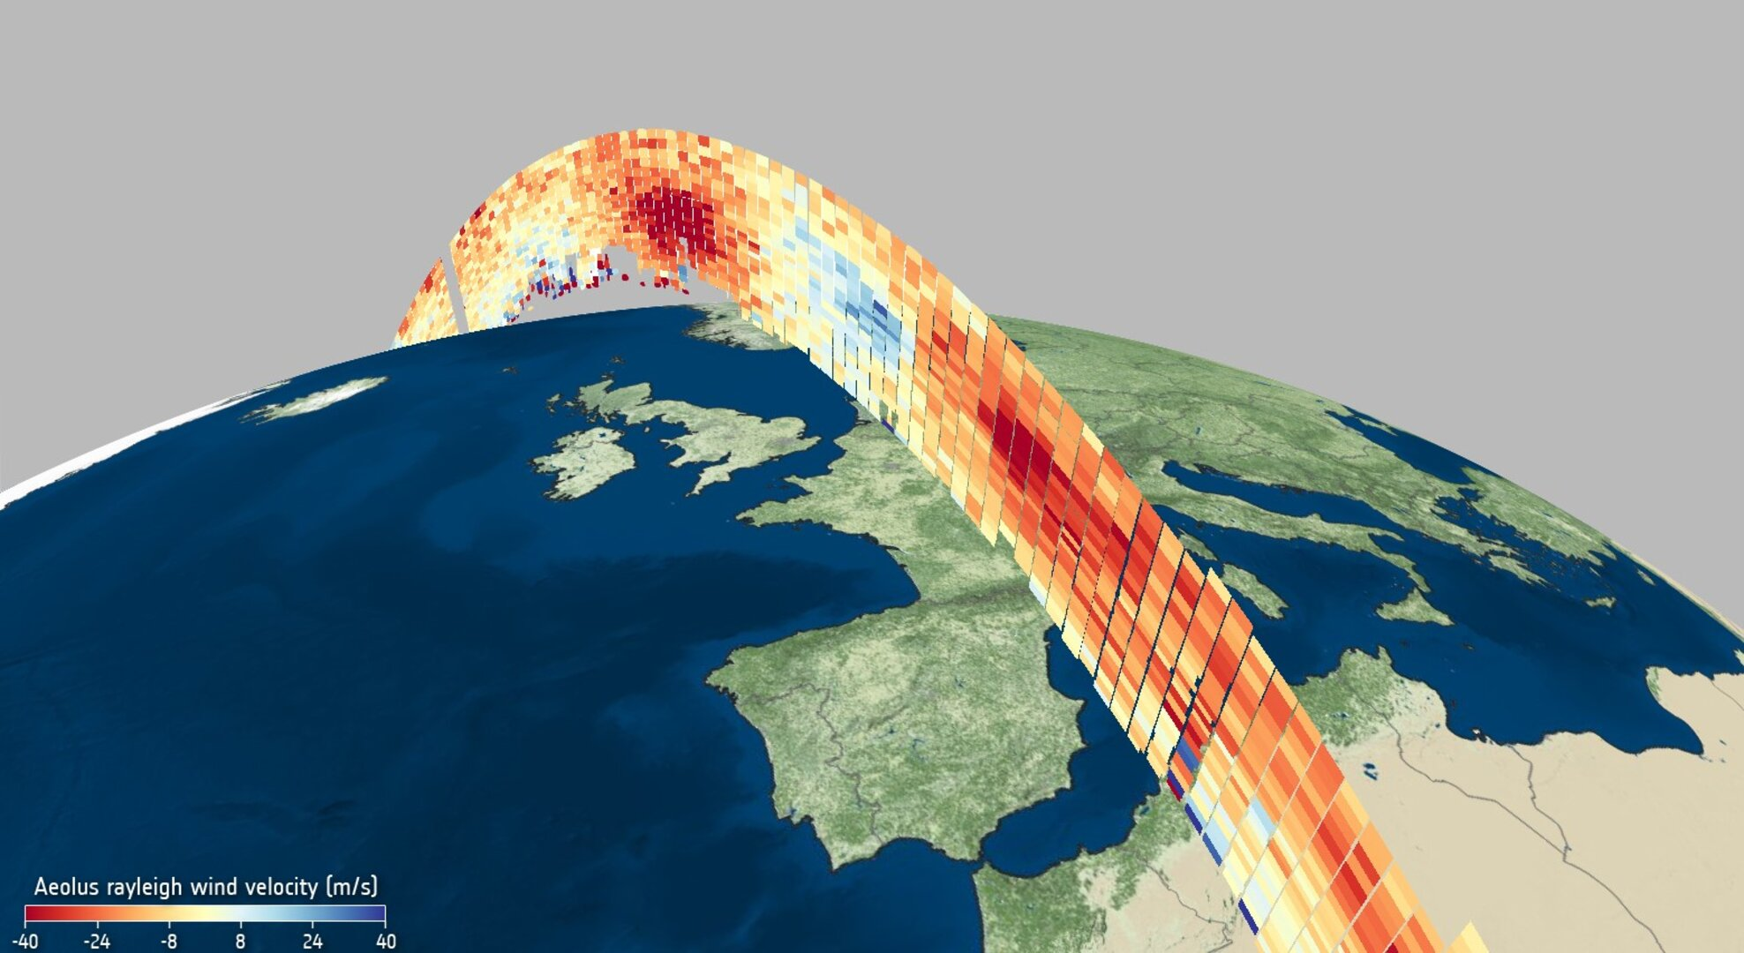
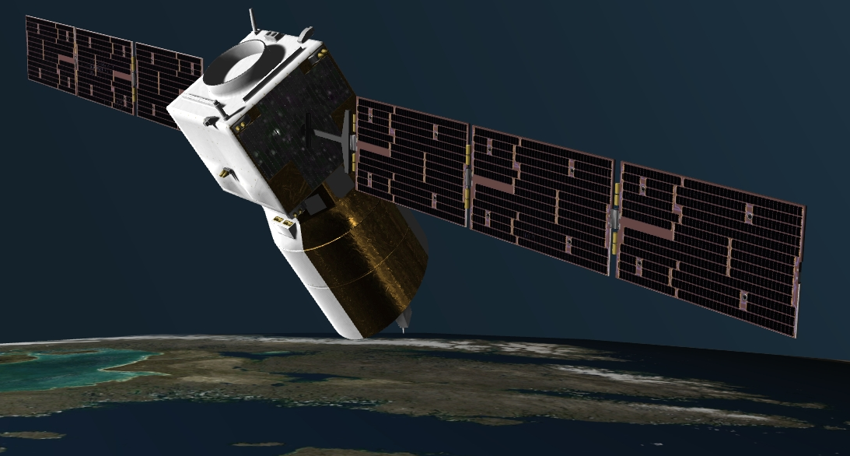
Aeolus satellite mission
European Space Agency Earth Explorer mission to measure profiles of wind globally
  Chosen in 1999
  Named from Greek mythology: “Keeper of the Winds”
Payload: Doppler wind lidar (DWL); ALADIN: Atmospheric LAser Doppler INstrument
Technology demonstration; engineered to last for 3 years
Satellite and instrument built by Airbus Defence and Space
Status of mission:
  After a decade delay due to instrument technical problems it was successfully launched on 22 August 2018
  Aeolus is the first wind lidar in space and first European lidar in space
  Producing wind profiles in Near Real Time since 3 September 2018. Still working! So has exceeded the nominal mission lifetime.

Slide 4
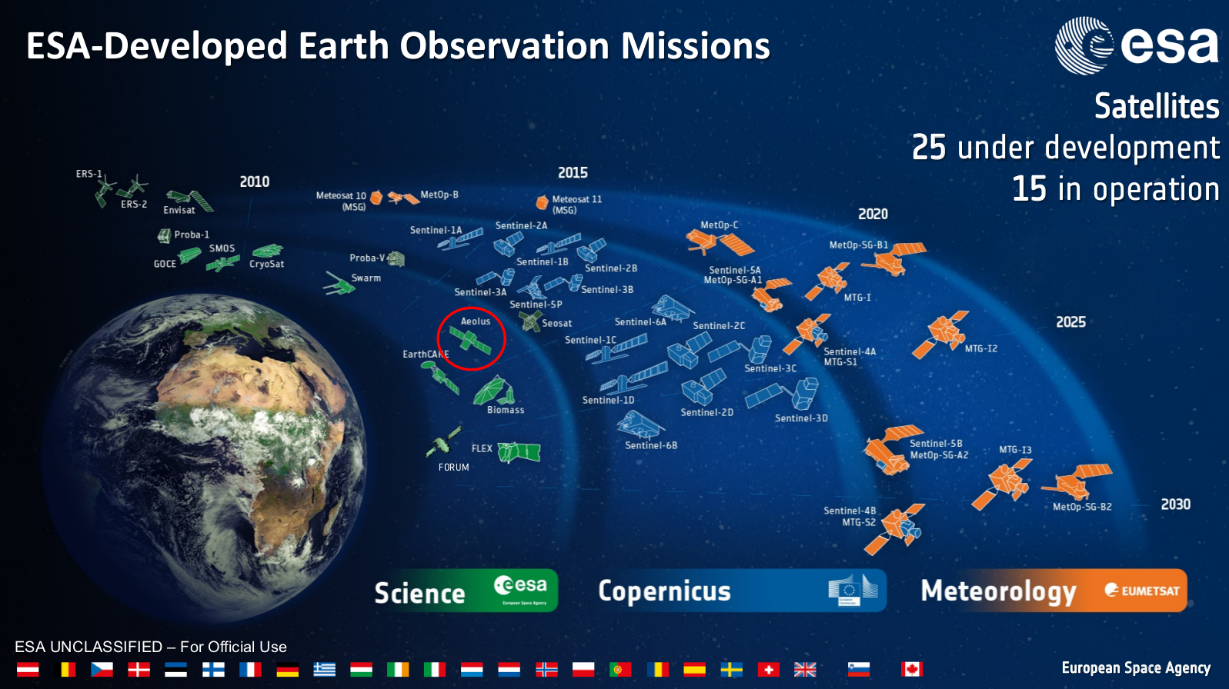

Slide 5
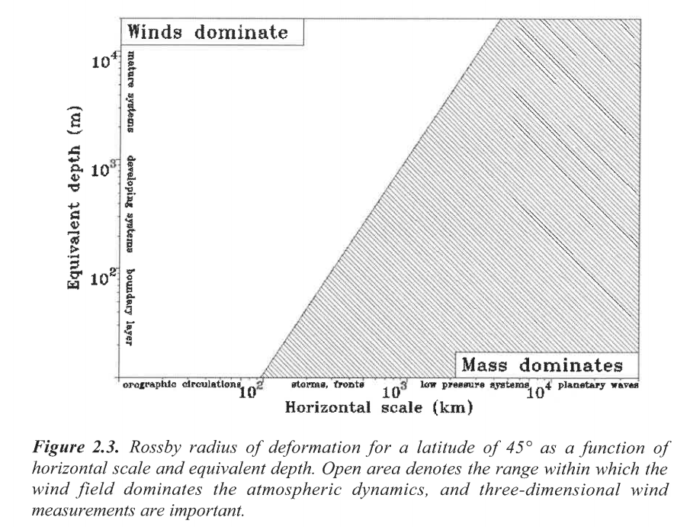
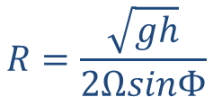




Aeolus satellite mission continued
Scientific Objectives:
To improve the quality of weather forecasts by providing global profile measurements of horizontal line-of-sight wind in the troposphere and lower stratosphere
To advance understanding of atmospheric dynamics and climate processes
Long-term goal:
Demonstrate space-based Doppler wind lidar’s capability for operational use
Global Observing System still lacks globally distributed wind profiles
NWP impact was predicted before launch to be greatest in the tropics due to the lack of conventional wind profiles and dynamical arguments regarding the importance of wind versus mass information near the equator
Geostrophic adjustment theory
Rossby radius of deformation:
$$R=\frac{\sqrt{gh}}{2ΩsinΦ}$$
10 km
$$h$$
~typical Aeolus wind observation resolution
1 km
$$L<R$$
$$L>R$$
<90 km
1000 km
$$L$$
courtesy: ESA, 1999

Slide 6
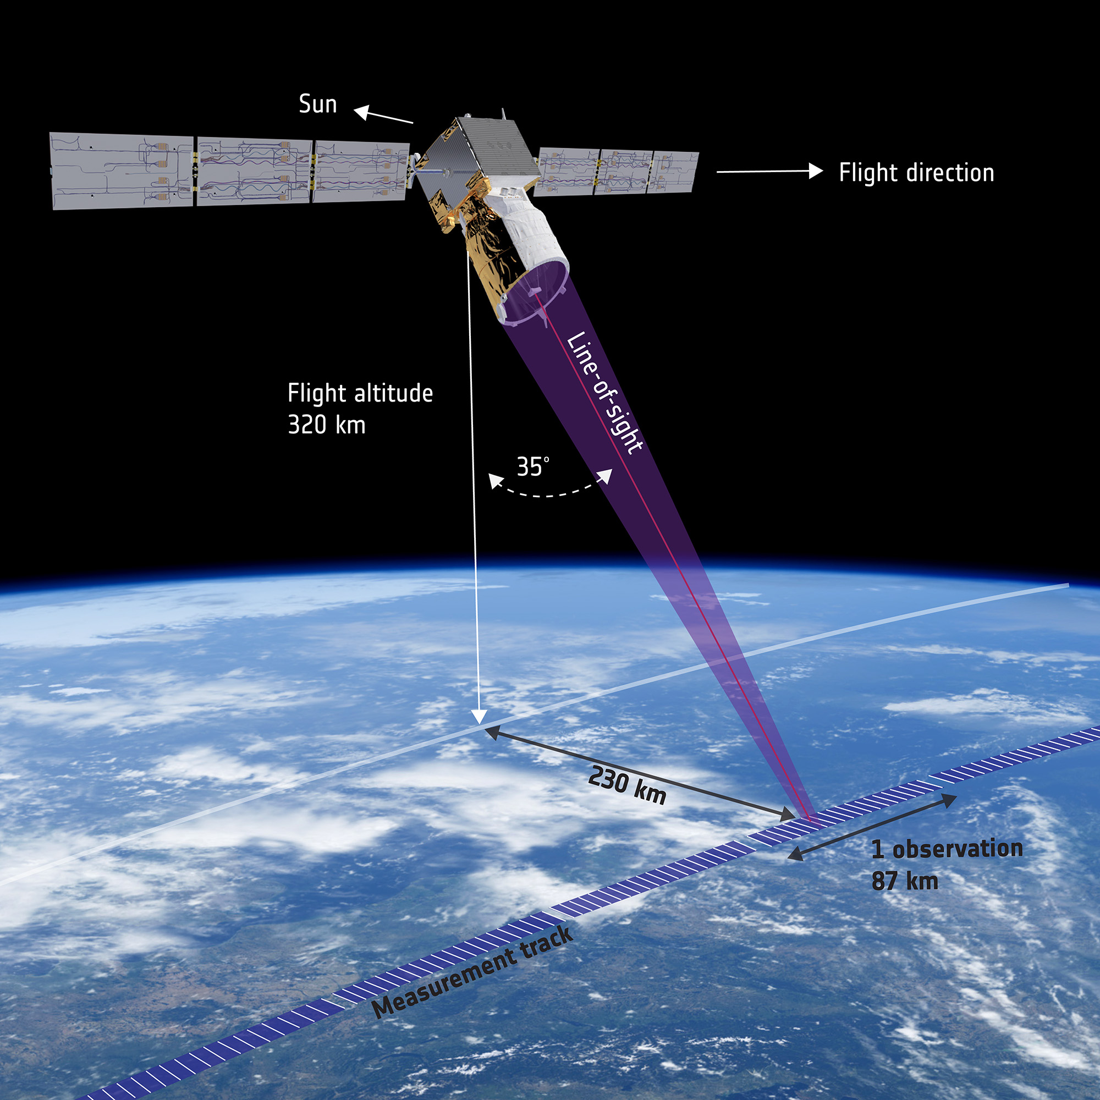
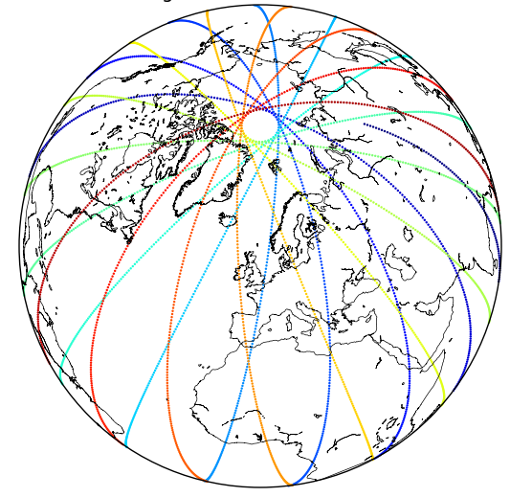
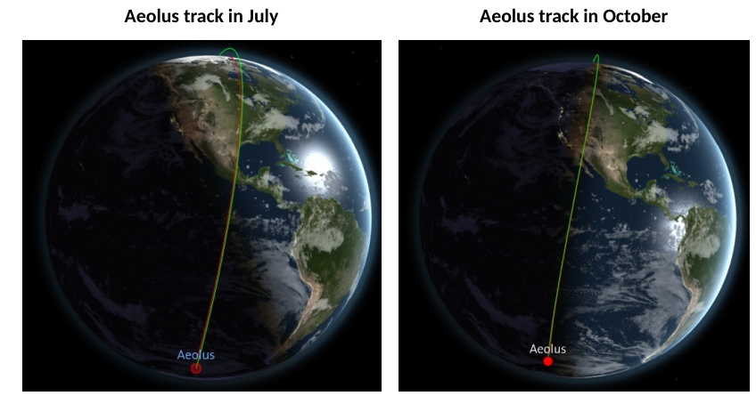
Aeolus measurement principle
Satellite: sun-synchronous, dawn-dusk (06/18 Local Solar Time) near polar orbit; ~15-16 orbits per day (111 per week)
  rides the terminator between day and night to keep solar panels in light and to minimise solar background noise
Instrument:
  Direct detection Doppler wind lidar operating at ~355 nm (long wave ultraviolet), fires ~50 laser pulses per second
  Two receiver channels:
    Mie to determine winds from cloud and aerosol backscatter (cloudy-air)
    Rayleigh to determine winds from molecular backscatter (clear-air)
  Lidar line-of-sight points:
    35° off-nadir to determine horizontal line-of-sight wind component (not vector wind)
    Perpendicular to satellite velocity to minimise Doppler shift due to satellite-earth relative motion
    To dark side to minimise solar background noise
Coverage in one day

Slide 7
Introduction to lidar, Doppler wind lidar and Aeolus’ specific design

Slide 8
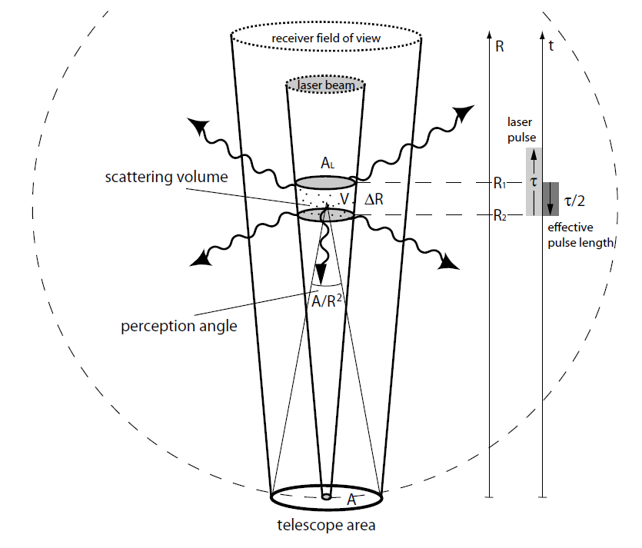
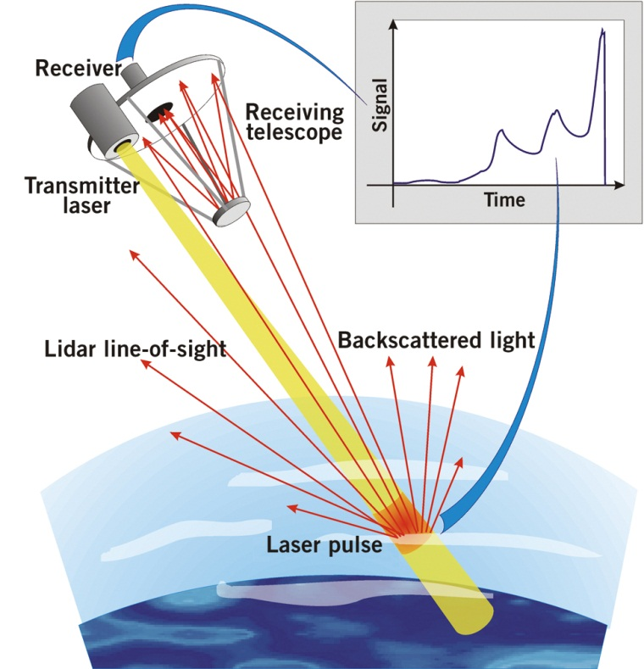
Lidar (light detection and ranging)
Active remote sensing
Backscatter
signal
Figure from Wandinger, U. (2005), Introduction to lidar, in LIDAR—Range-Resolved Optical Remote Sensing of the Atmosphere, edited by C. Weitkamp, pp. 1–18, Springer, New York.
Time ≡ range

Slide 9
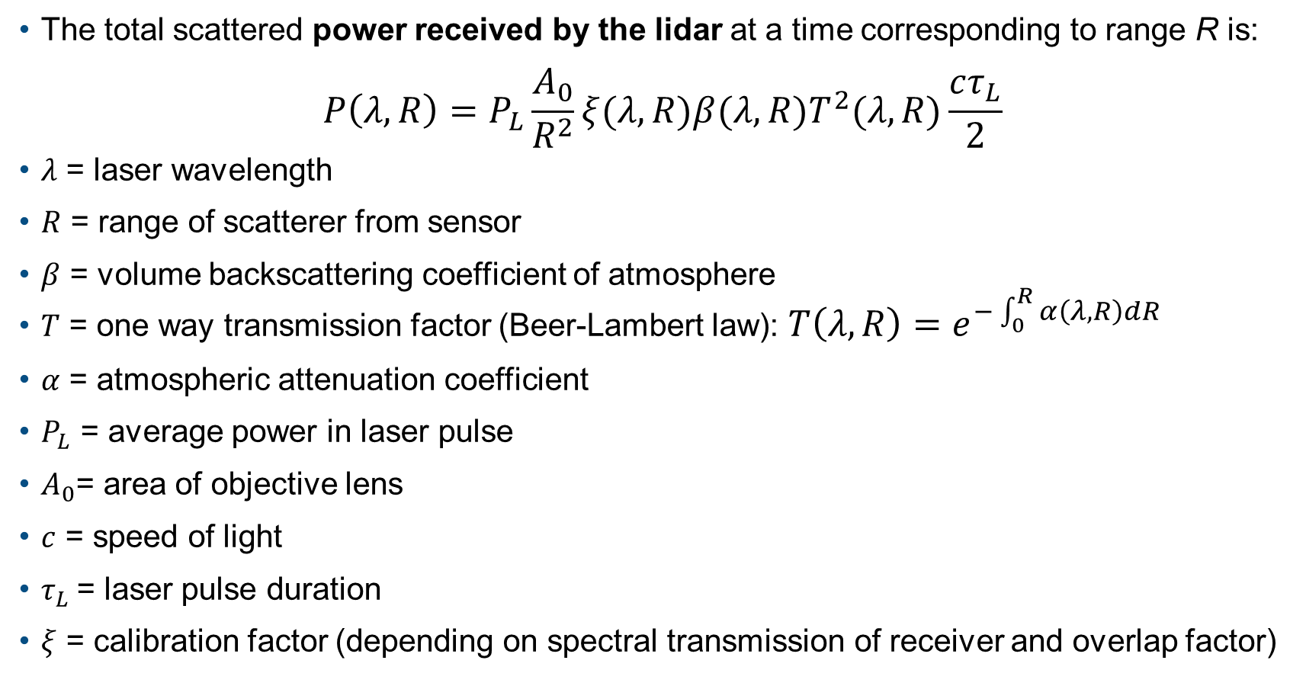
Lidar equation (a simplified form)
Source: Measures (1992); R.M. Measures,
"Laser Remote Sensing. Fundamentals and
Applications". John Wiley & Sons, 1984
The total scattered power received by the lidar at a time corresponding to range R is:
$$P\left(λ,R\right)=P_{L}\frac{A_{0}}{R^{2}}ξ(λ,R)β(λ,R)T^{2}(λ,R)\frac{cτ_{L}}{2}$$
$λ$ = laser wavelength
$R$ = range of scatterer from sensor
$β$ = volume backscattering coefficient of atmosphere
$T$ = one way transmission factor (Beer-Lambert law): $T\left(λ,R\right)=e^{−\int_{0}^{R}{α\left(λ,R\right)dR}}$
$α$ = atmospheric attenuation coefficient
$P_{L}$ = average power in laser pulse
$A_{0}$= area of objective lens
$c$ = speed of light
$τ_{L}$= laser pulse duration
$ξ$ = calibration factor (depending on spectral transmission of receiver and overlap factor)

Slide 10
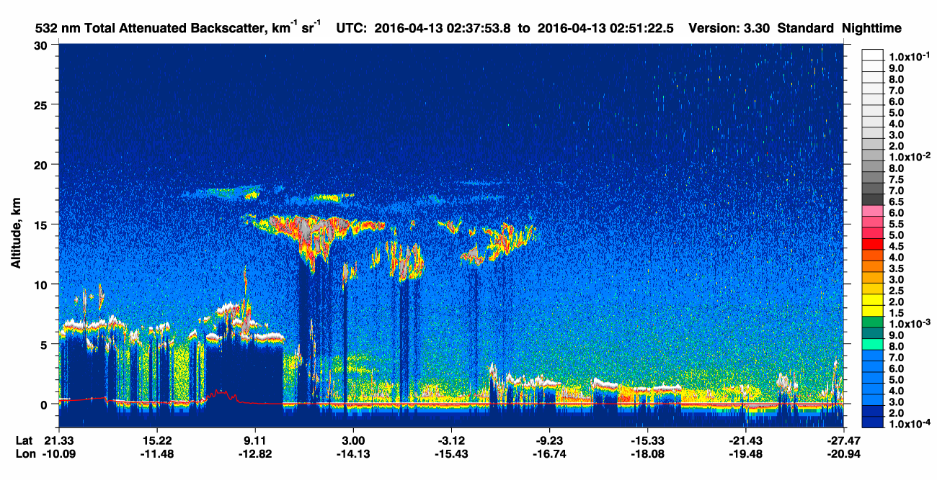
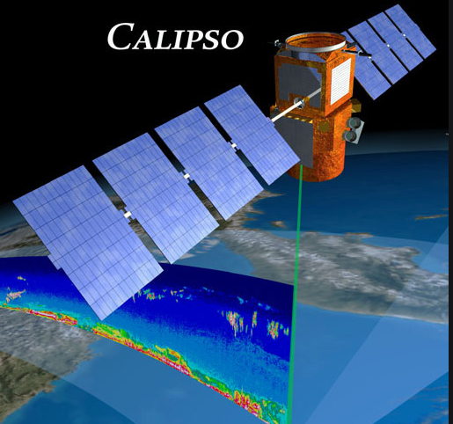

“Lidar curtain” of space-borne lidar (CALIPSO (532 nm)), attenuated backscatter: βT²
Transparent clouds – cirrus
Total attenuation below optically thick clouds
Scattering from molecules (clear air) $∝density$
aerosol e.g. dust, smoke
credit: NASA

Slide 11
What’s different about a Doppler lidar
Lidars for atmospheric measurements (like CALIPSO) exploit the amplitude of backscatter signal and properties such as the polarisation (at several frequencies) to provide information about the atmospheric composition
Doppler lidars measure the change in the frequency (Doppler shift) of the received signal relative to that emitted to determine line-of-sight wind
  N.B. Aeolus also provides atmospheric composition information (Level-2A product) and is a useful demonstration of space-based UV lidar for this purpose; in anticipation of ESA’s EarthCare mission (ATLID lidar)

Slide 12
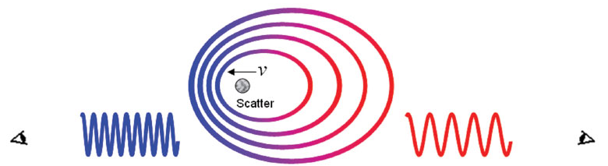
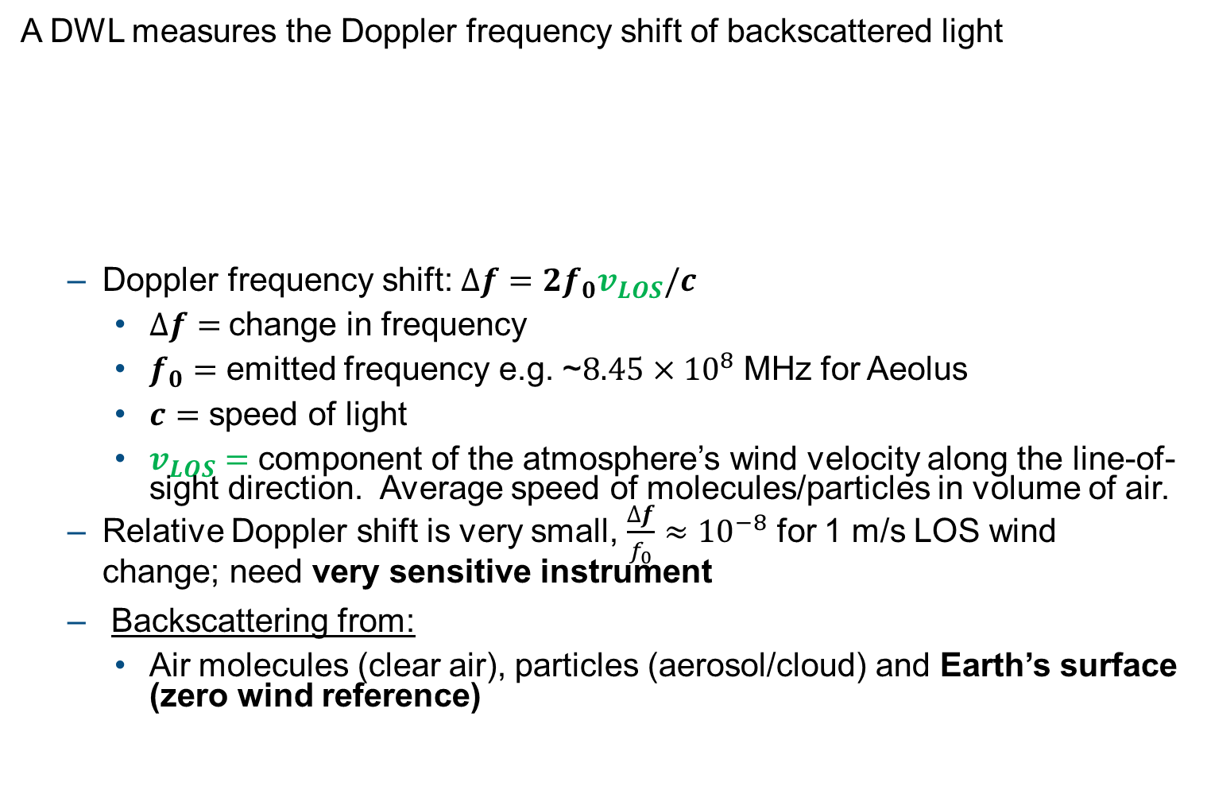

Doppler wind lidar
A DWL measures the Doppler frequency shift of backscattered light
  Doppler frequency shift: $∆f=2f_{0}v_{LOS}/c$
    $∆f=$ change in frequency
    $f_{0}=$ emitted frequency e.g. ~$8.45×{10}^{8}$ MHz for Aeolus
    $c=$ speed of light
    $v_{LOS}=$ component of the atmosphere’s wind velocity along the line-of-sight direction. Average speed of molecules/particles in volume of air.
  Relative Doppler shift is very small, $\frac{∆f}{f_{0}}≈{10}^{−8}$ for 1 m/s LOS wind change; need very sensitive instrument
  Backscattering from:
    Air molecules (clear air), particles (aerosol/cloud) and Earth’s surface (zero wind reference)
Blue shift
Red shift
  $$v_{LOS}$$

Slide 13
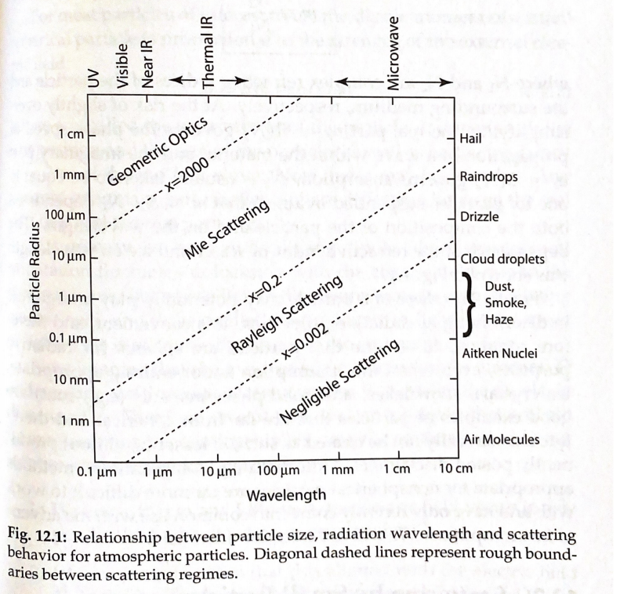
Aeolus operates lidar at 355 nm wavelength
Mie winds
Particulates backscatter
Rayleigh winds
Molecular backscatter
355 nm
Figure from: A First Course in Atmospheric Radiation, G Petty

Slide 14
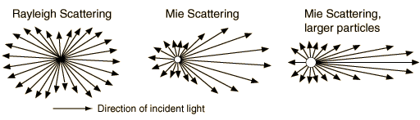
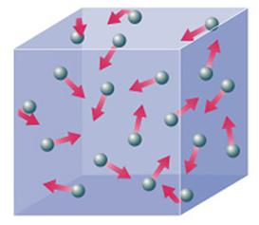

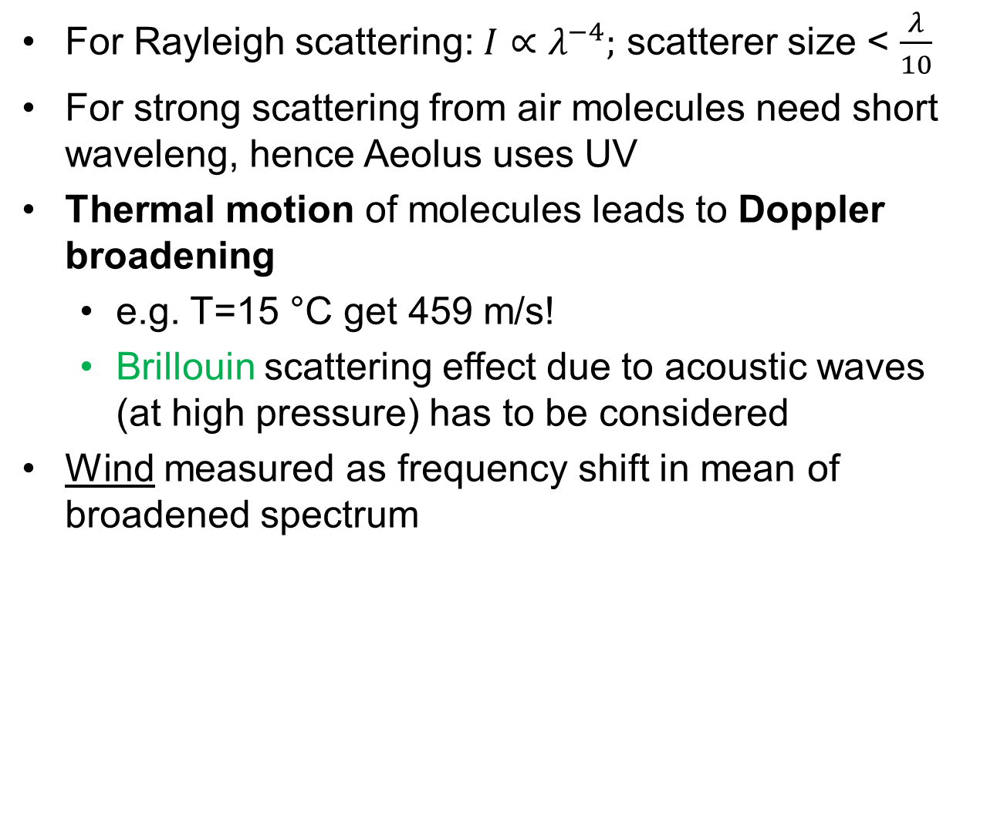
Winds from clear sky conditions; Rayleigh scattering
For Rayleigh scattering: $I∝λ^{−4};$ scatterer size < $\frac{λ}{10}$
For strong scattering from air molecules need short waveleng, hence Aeolus uses UV
Thermal motion of molecules leads to Doppler broadening
  e.g. T=15 °C get 459 m/s!
  Brillouin scattering effect due to acoustic waves (at high pressure) has to be considered
Wind measured as frequency shift in mean of broadened spectrum
Spectrum
Doppler shift
from wind
$$σ_{v}=\frac{2}{λ}\sqrt{\frac{kT}{m}}$$
Rayleigh (Gaussian)
Rayleigh-Brillouin
-5
0
5
Δf (GHz)

Slide 15
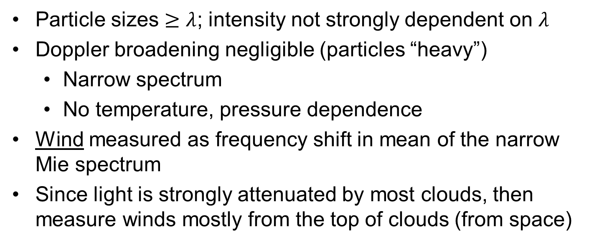
Winds from “cloudy” conditions i.e. scattering from cloud water/ice droplets and aerosols; Mie scattering
Particle sizes $≥λ$; intensity not strongly dependent on $λ$
Doppler broadening negligible (particles “heavy”)
  Narrow spectrum
  No temperature, pressure dependence
Wind measured as frequency shift in mean of the narrow Mie spectrum
Since light is strongly attenuated by most clouds, then measure winds mostly from the top of clouds (from space)
Spectrum
Doppler shift from wind
Rayleigh-Brillouin + Mie peak
-5
0
5
Δf (GHz)

Slide 16
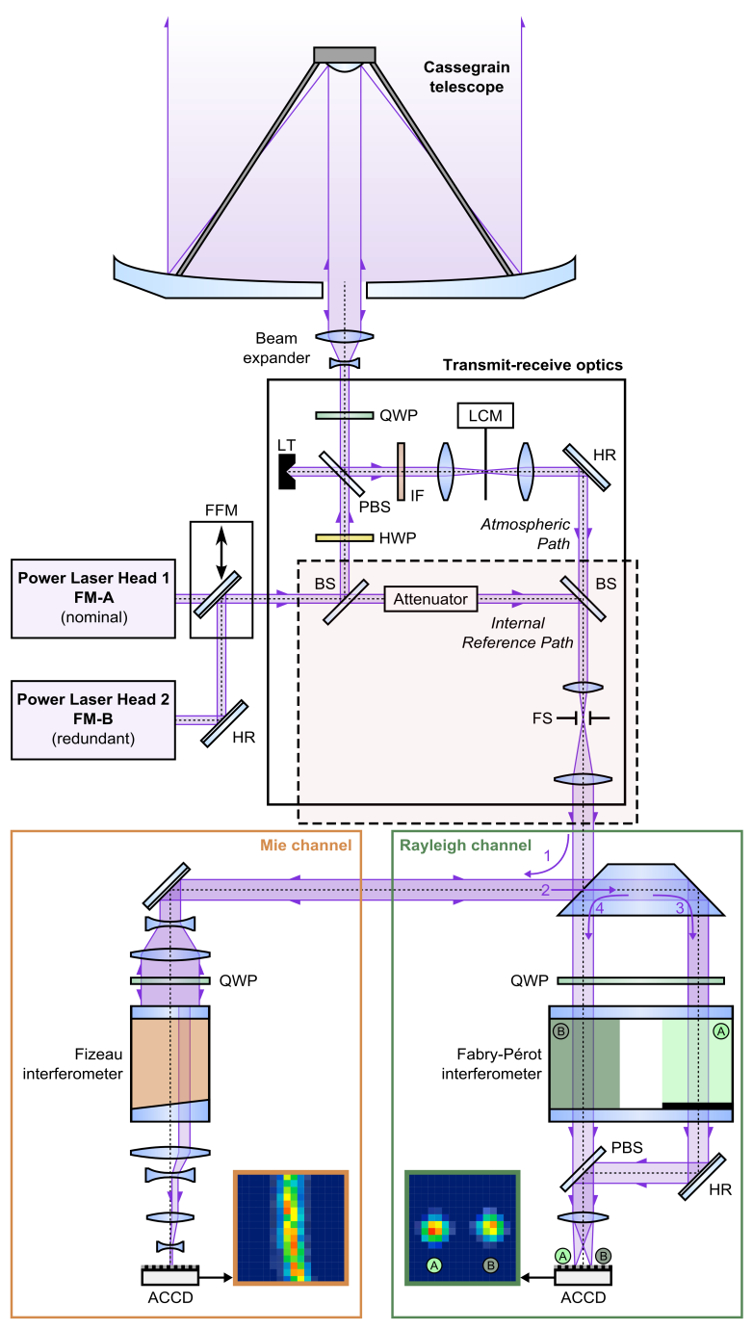
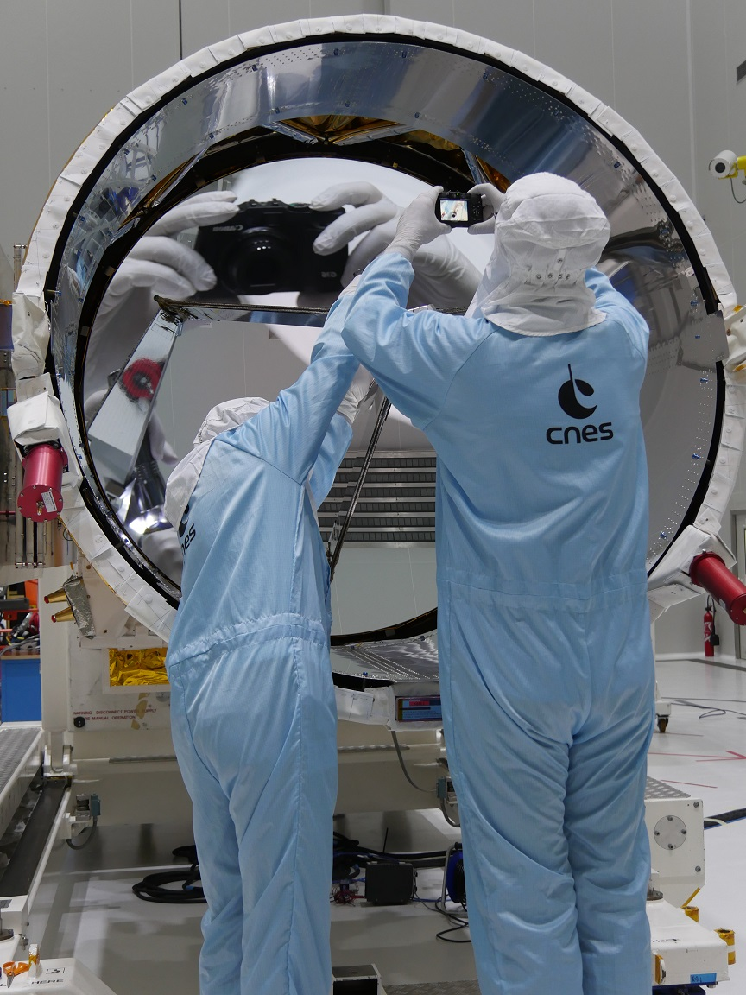
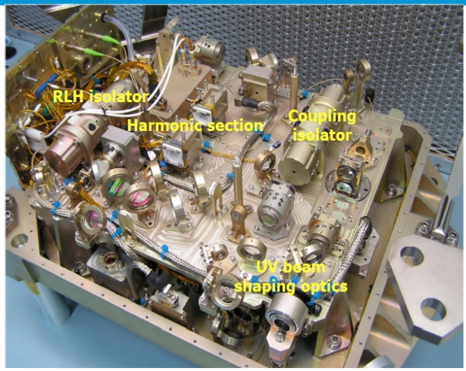
Aeolus’s payload: ALADIN: Atmospheric LAser Doppler Instrument
credit: Oliver Lux (DLR)
credit: ESA/Airbus
Complicated!
credit: ESA/Airbus

Slide 17
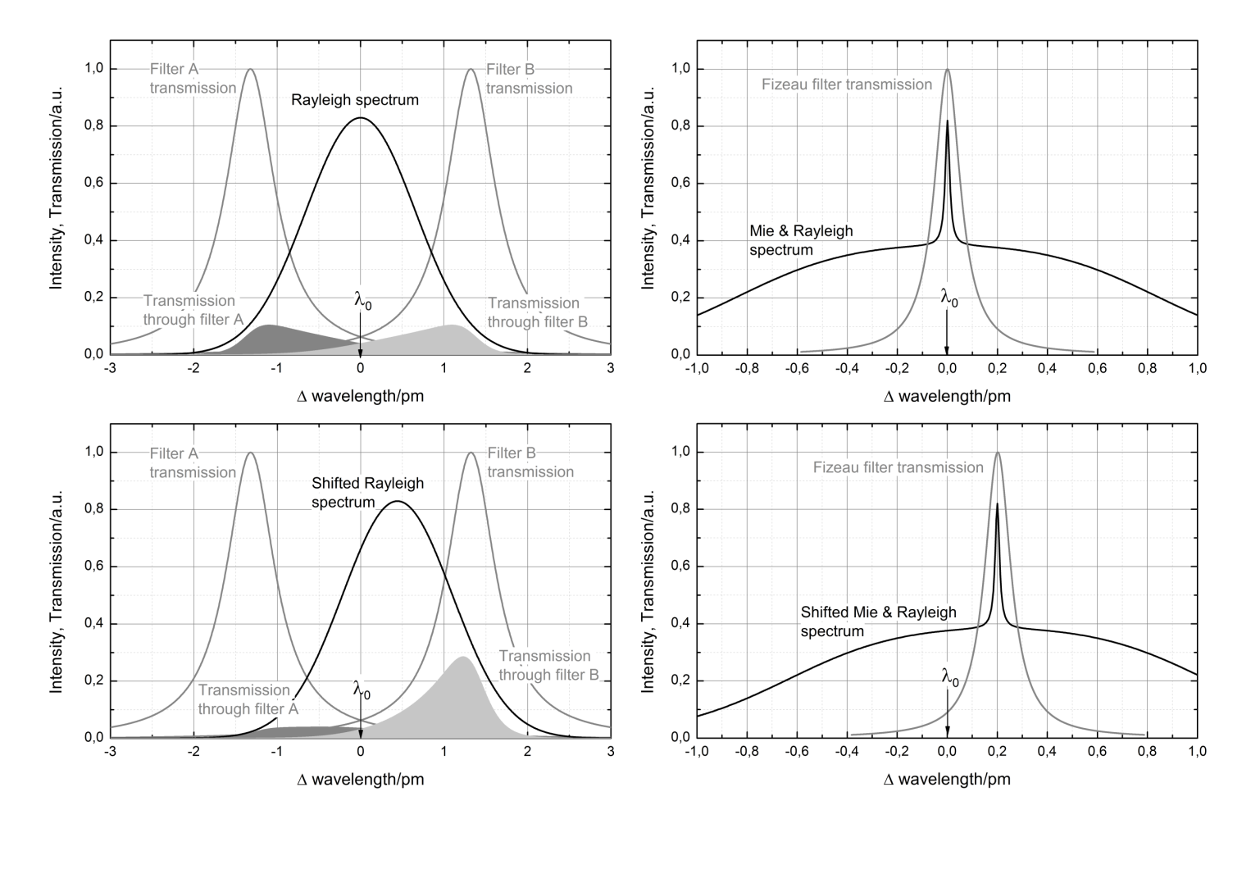
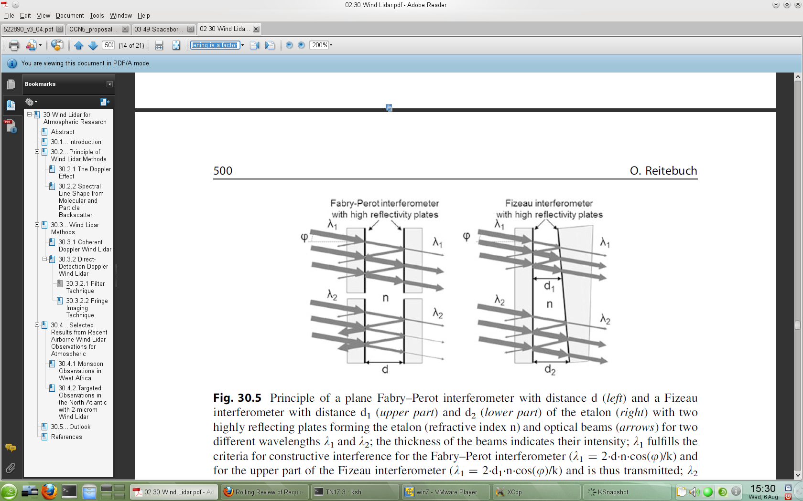
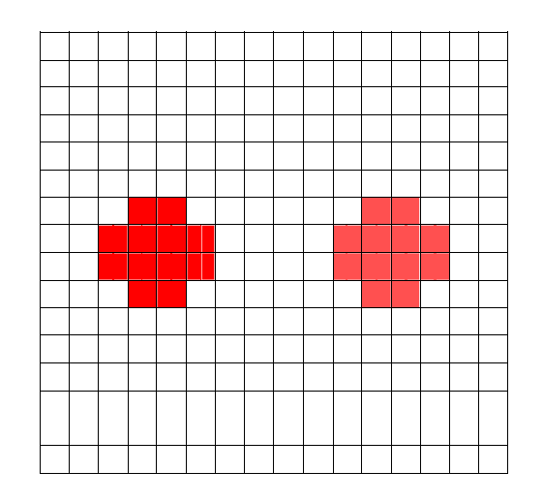
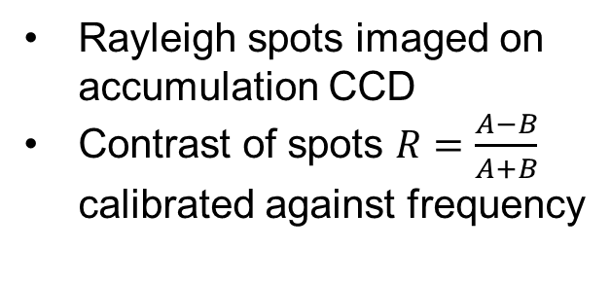
Rayleigh channel method
Doube-edge Fabry-Pérot interferometer
transmission maximum occurs for a specific wavelength of light; which differs for each interferometer
d
A
A
B
B
+Δd
Rayleigh spots imaged on accumulation CCD
Contrast of spots $R=\frac{A−B}{A+B}$ calibrated against frequency
Figure from Reitebuch (2012) The Spaceborne Wind Lidar Mission ADM-Aeolus, Springer
Figure from Reitebuch (2012):
Wind Lidar for Atmospheric
Research, in Springer Series

Slide 18
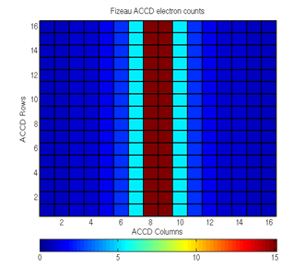
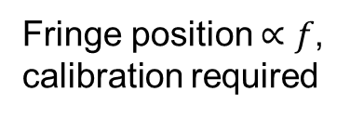
Mie channel method
Mie fringe on ACCD
Fringe position $∝f$,
calibration required
Narrowband Fizeau interferometer
Transmission max. for f depends on x-position – thickness of gap (wedge shape)
Figure from Reitebuch (2012):
Wind Lidar for Atmospheric
Research, in Springer Series
Figure from Reitebuch (2012) The Spaceborne Wind Lidar Mission ADM-Aeolus, Springer

Slide 19
Examples of Aeolus Level-2B horizontal line-of-sight (HLOS) winds
Several orbits of L2B Rayleigh-clear HLOS winds

Slide 20
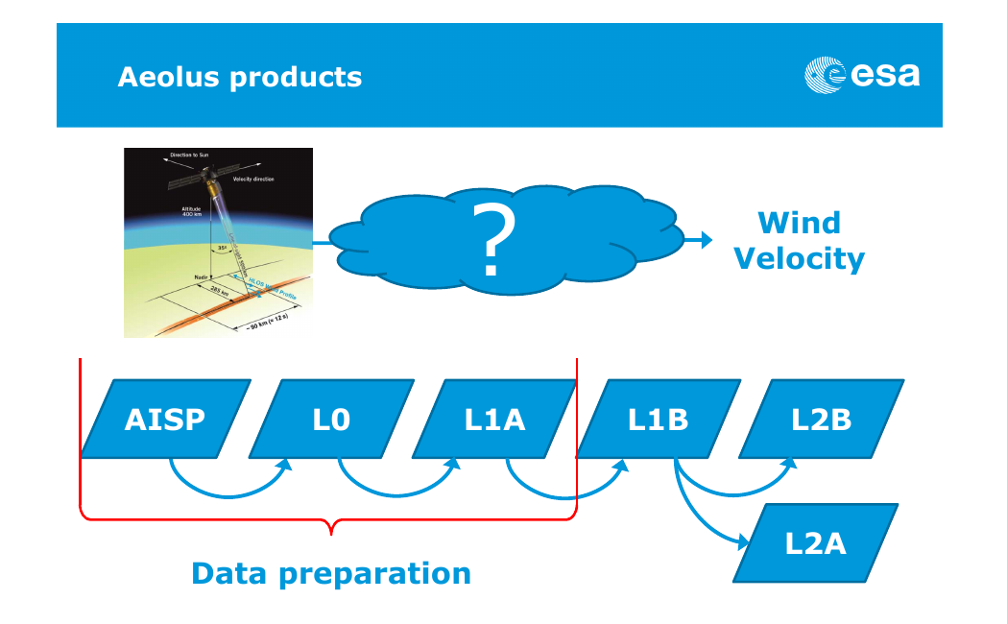
ECWMF data assimilation analysis
ESA-ESRIN produce Level-1B data (calibrated signal levels)
Level-2B wind product (suited for NWP); produced by ECMWF
Since May 2020
  L2B BUFR from ECMWF to EUMETSAT for distribution on GTS/EUMETCast
Raw satellite telemetry
L2C
L0 and L1A data
ESA-ESRIN produce L2A (optical properties) product
Wind products available in NRT for benefit of NWP

Slide 21
Level-2B wind processing summary
Line-of-sight (LOS) or Horizontal LOS wind components suitable for use in NWP/research
  Using measurement-level L1B data and calibration products
Enhancements compared to L1B observations:
  Grouping of measurements: control of horizontal resolution and noise
  Classification of measurements: into different types using optical properties (clear/cloudy); to avoid significant Mie contamination of Rayleigh
  Accumulation: of L1B signal of grouped and classified measurements
  Wind retrieval for different observation types:
    Rayleigh-clear; Mie-cloudy; Rayleigh-cloudy; Mie-clear
  Rayleigh corrections:
    Temperature, pressure sensitivity (Rayleigh-Brillouin Correction) using a priori (AUX_MET) information
      without this correction up to 10 m/s HLOS wind biases could occur
    Account for Mie signal on Rayleigh channel using L1B scattering ratio

Slide 22
… continued
Uncertainty estimates (dynamic instrument error estimate) and quality flags for each wind result
Wind observations are essentially independent – however profile also provided pointing to observation index
Processing settings controlled (with AUX_PAR_2B file)
Software freely available and highly portable: https://confluence.ecmwf.int/display/AEOL
Additional tools in software package:
  L2B EE to BUFR converter for NWP users
  Various tools to write products to ASCII
Aeolus L2B data can be browsed in the ADDF archive (https://aeolus-ds.eo.esa.int) and browsed and plotted by the VirES tool (https://aeolus.services/)
Notes:
~110 downloads of L2Bp so far

Slide 23
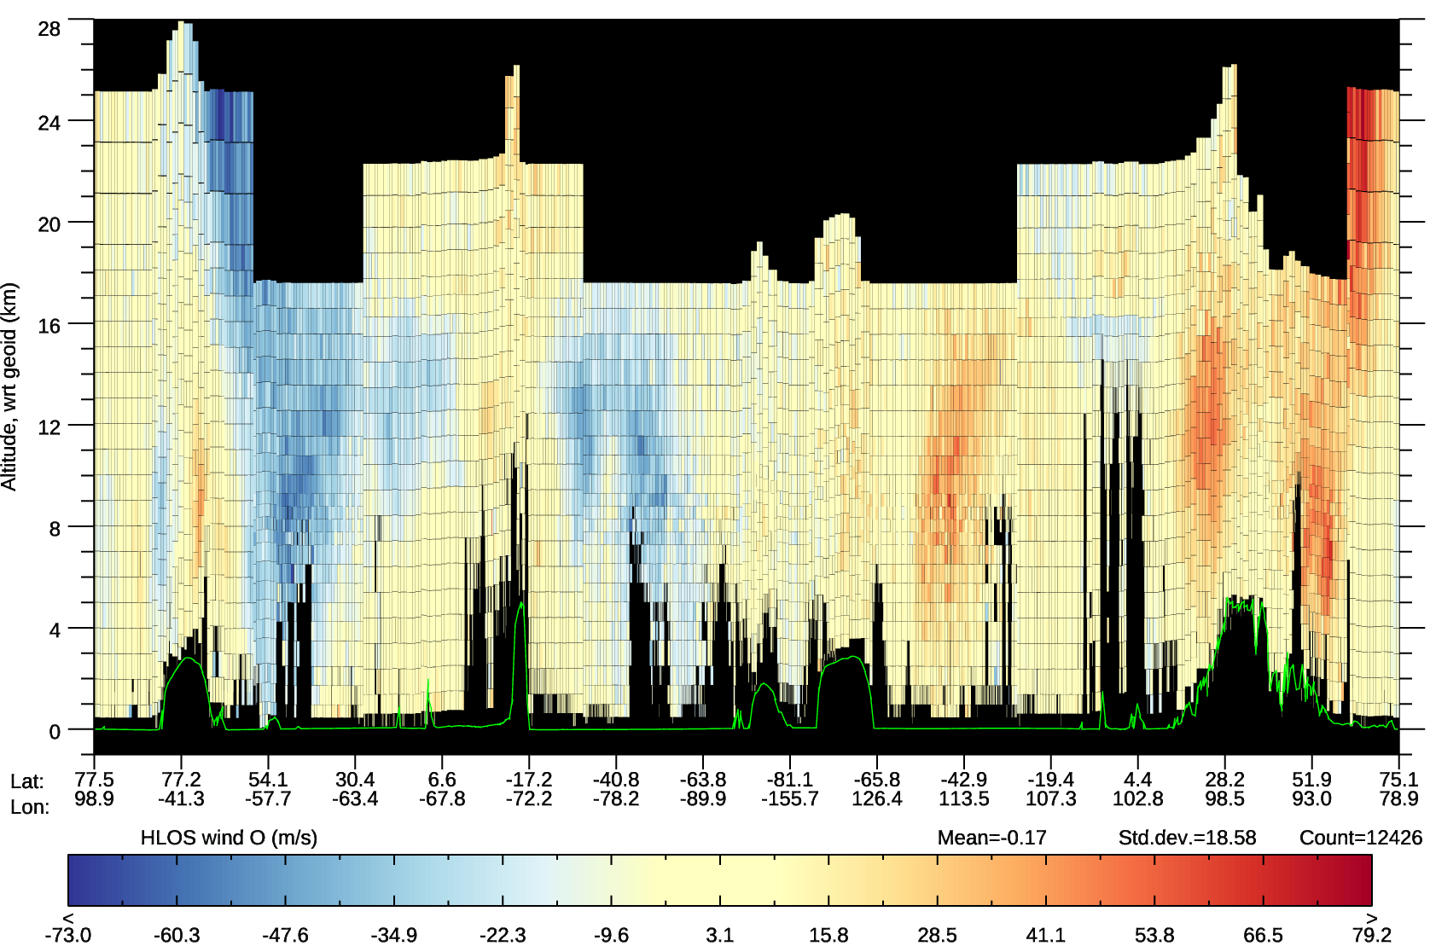
10 Feb 2020
Aeolus L2B Rayleigh-clear and Mie-cloudy HLOS winds (1 orbit)
Descending orbit phase
Ascending orbit phase
Polar-night jet (aka Polar Vortex); westerlies
Polar-night jet; westerlies)
Range-bin settings can vary along the orbit
Subtropical jet; westerlies
Polar front jet; westerlies
Mountains
Notes:
Orbit 8508

Slide 24
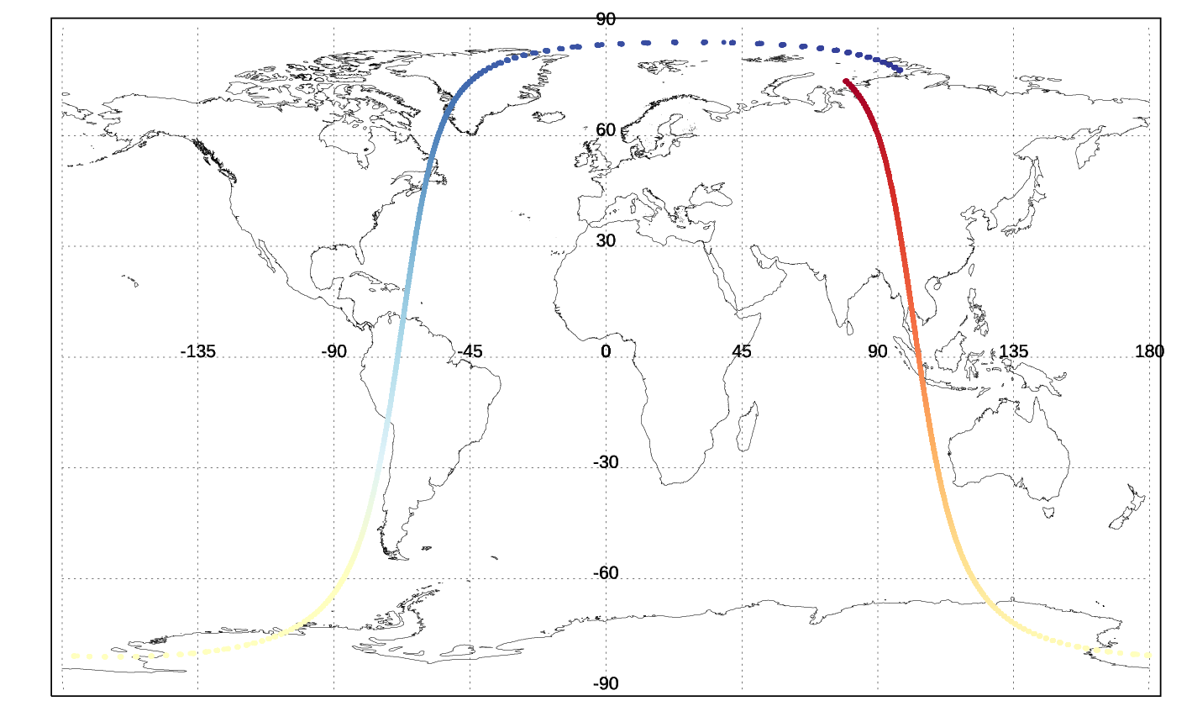
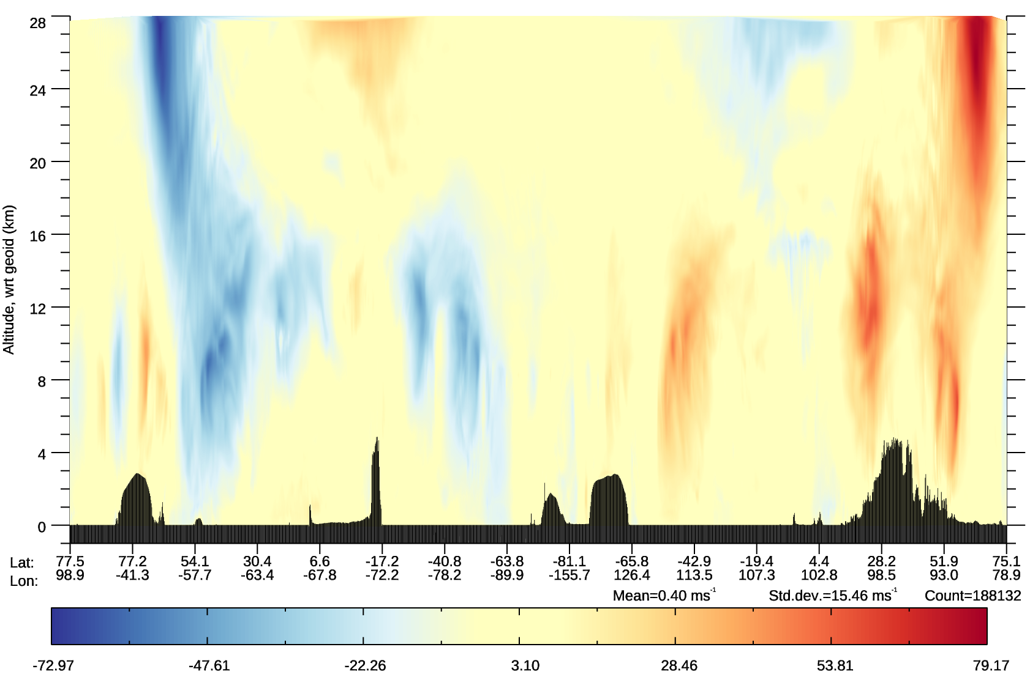

10 Feb 2020
ECMWF forward modelled HLOS wind (1 orbit)
$$v_{HLOS}=−usin∅−vcos∅$$
Lidar “curtain” type plot
Aeolus HLOS winds are positive if wind blowing away from satellite
Along satellite track
m/s
Notes:
Get a positive HLOS wind if laser is pointing in same direction as wind vector. Giving positive HLOS winds in westerly jets in ascending orbit, negative HLOS winds in westerly jets in descending orbit.

Slide 25

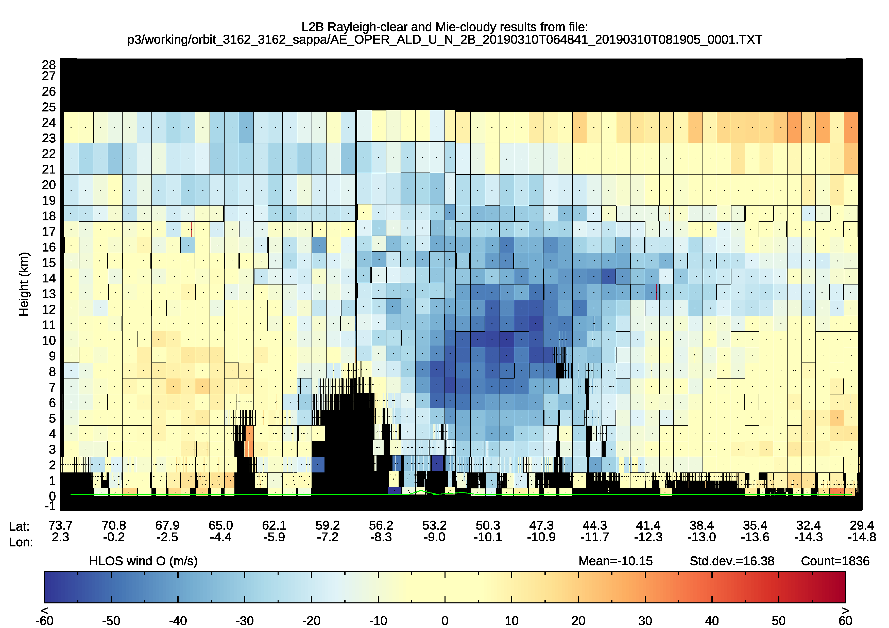
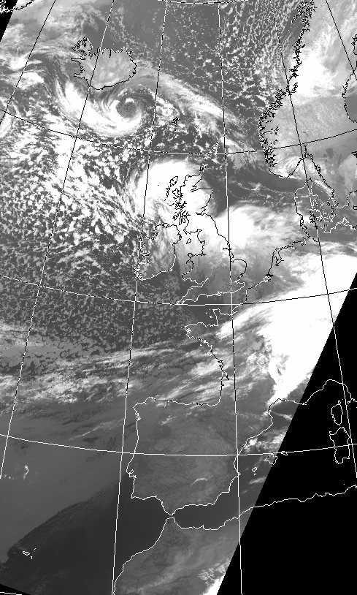
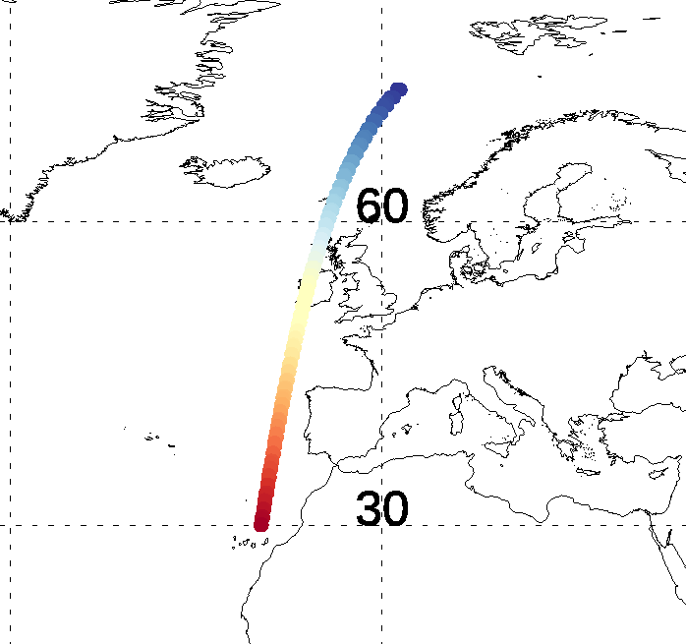
A very windy day in north-west Europe (10 March 2019)
Photo from my garden near Reading:
apart from low level clouds, sky was clear
What Aeolus observed (Rayleigh + Mie winds) near the low
Polar front jet
sat.dundee.ac.uk
Notes:
~07 UTC on 10/3/2019

Slide 26
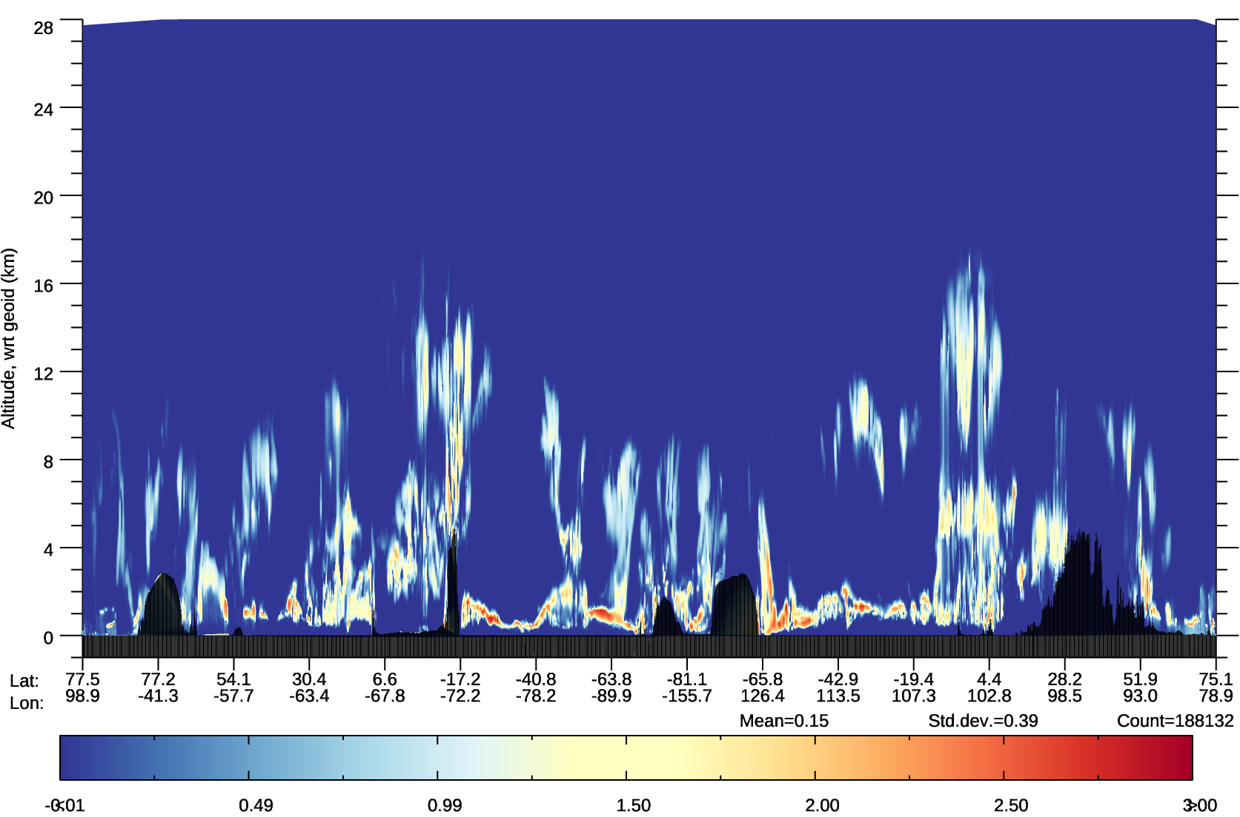
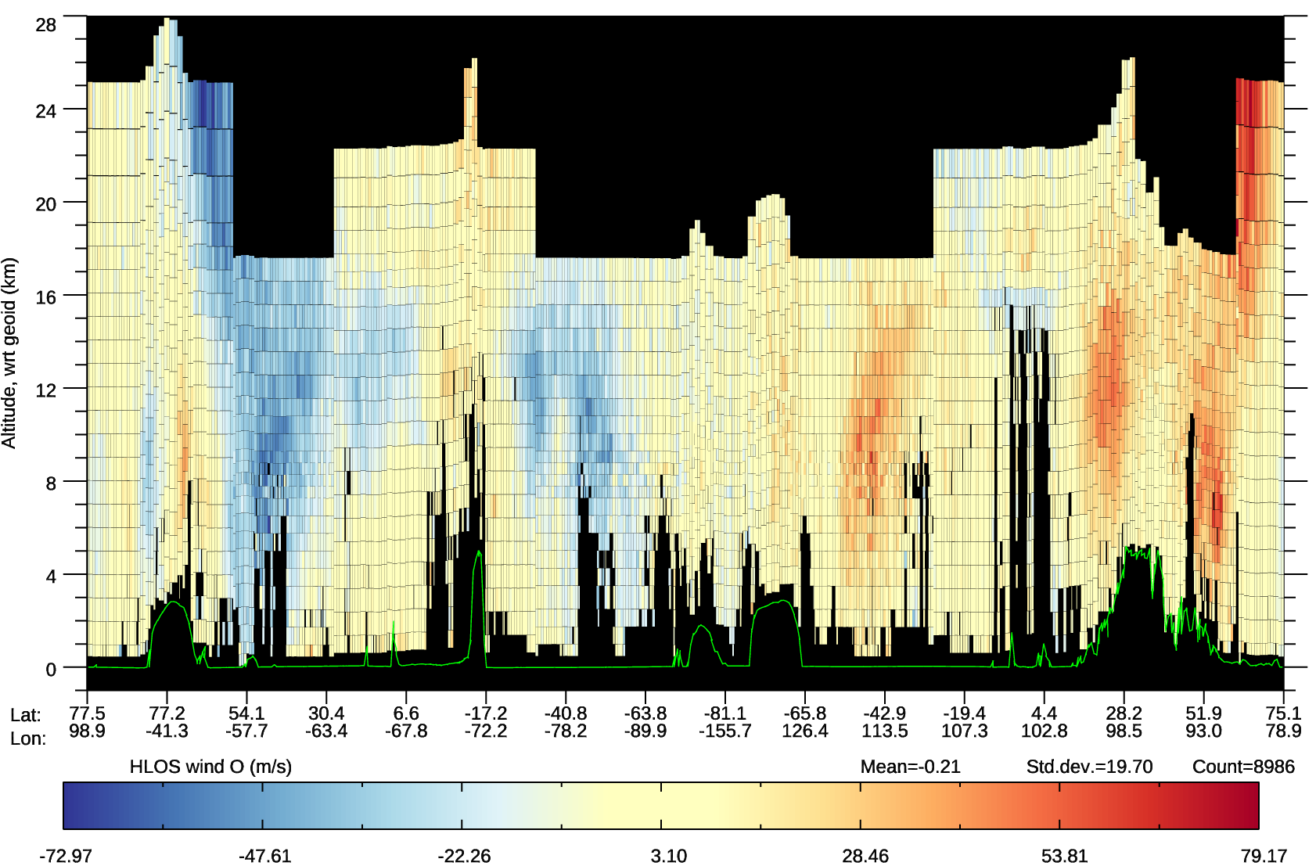
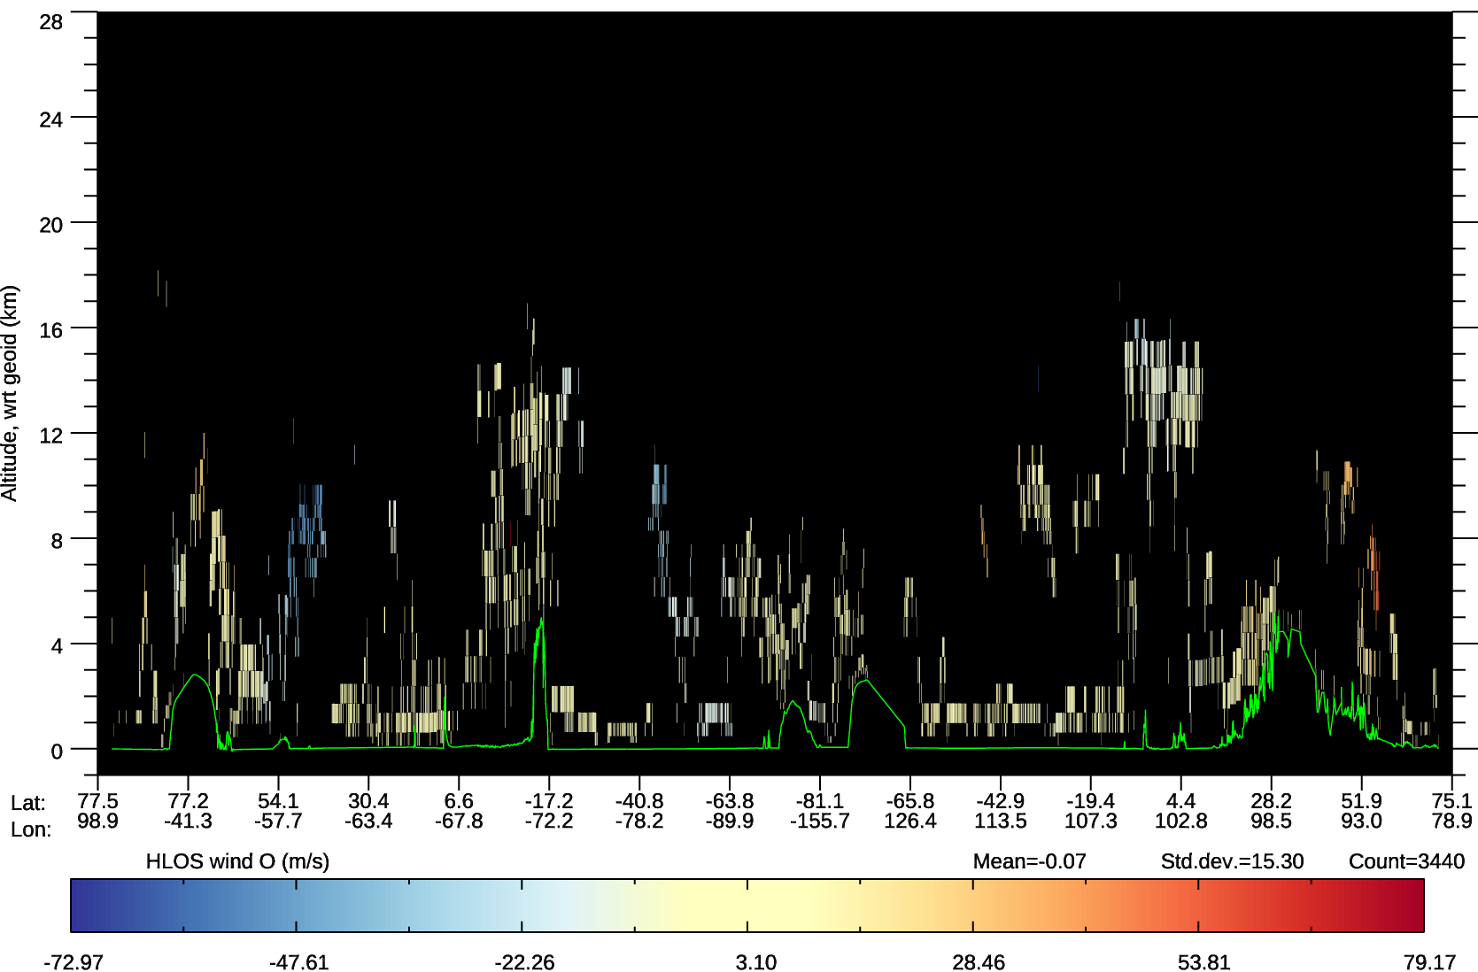
Rayleigh and Mie winds are complementary
ECMWF model cloud
Rayleigh-clear L2B HLOS winds
Mie-cloudy L2B HLOS winds
~14 km horizontal averages
~86 km horizontal averages

Slide 27
Use of Aeolus in NWP at ECMWF

Slide 28
Aeolus use in global NWP at ECMWF
Positive NWP impact has been demonstrated at ECMWF
  However, data quality was not as good as expected pre-launch i.e. significantly noisier winds, larger biases than expected
  Larger noise is an instrumental issue that ground processing cannot fully resolve (signal loss in transmit path of instrument; possible Laser Induced Contamination)
  Larger biases than expected meant a bias correction scheme was required
Despite this NWP impact is very good for one satellite instrument
Aeolus Level-2B HLOS wind operationally assimilated since 9 January 2020
Other NWP centres corroborate positive impact; operationally assimilated at DWD, Météo-France, Met Office and NCMRWF
Being still a relatively new mission and still finding ways to improve the data and its usage

Slide 29
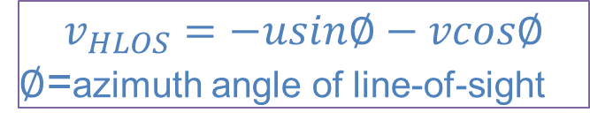
L2B HLOS (horizontal line-of-sight) wind assimilation
ECMWF forward model: HLOS forward model (point-wind version)
  Interpolation of model wind to obs geolocation point
  Calculate HLOS wind from model wind vector (u,v)
  Dot product of wind vector with laser pointing unit vector
Assigned observation error (R matrix) uses L2B processor estimated instrument noise and representativeness error for Mie-cloudy
Improvements to forward model for consideration:
  Spatial averaging (horizontal and vertical)
    HLOS wind no really a “point” measurement, but a spatial average
      However, model effective resolution is ~4-8 times the grid (~36-72 km horizontally)
      Vertical averaging may be more important
  Include vertical wind component w (assume averages to zero over Aeolus scales, but may be important in local conditions of convection, gravity waves)
  Account for Rayleigh wind retrieval sensitivity to T, p (a small dependence on background error)
$$v_{HLOS}=−usin∅−vcos∅$$
$∅$=azimuth angle of line-of-sight
Notes:
Errors in Rayleigh winds due to a priori:
0.003 (m/s)/hPa LOS
0.1 (m/s)/K LOS?

Slide 30
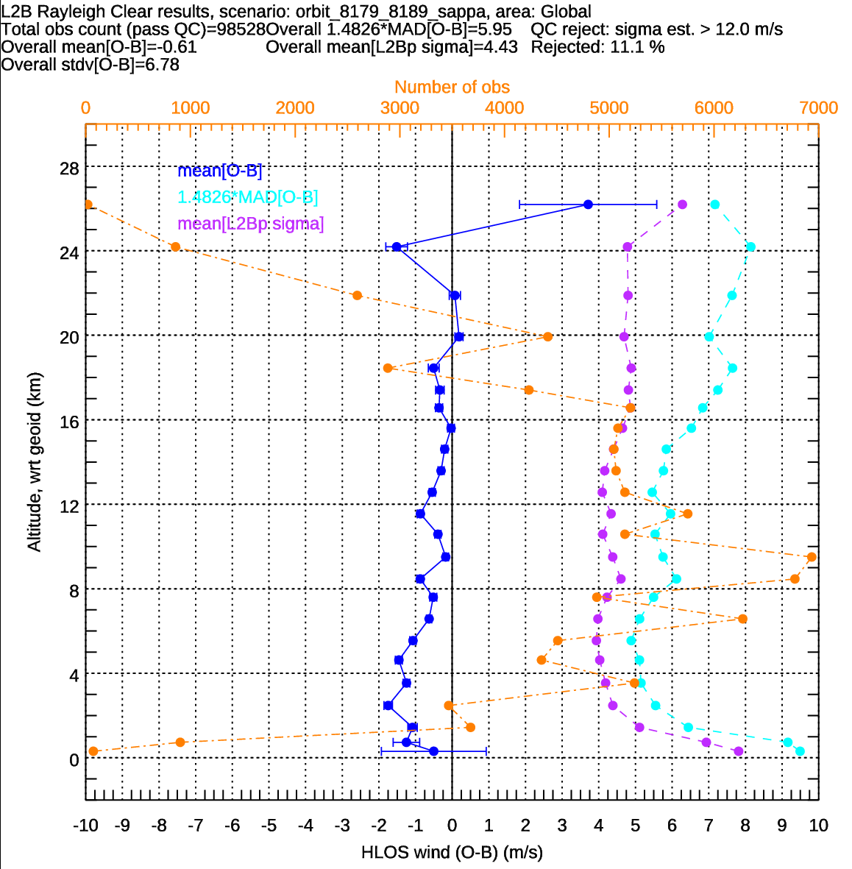
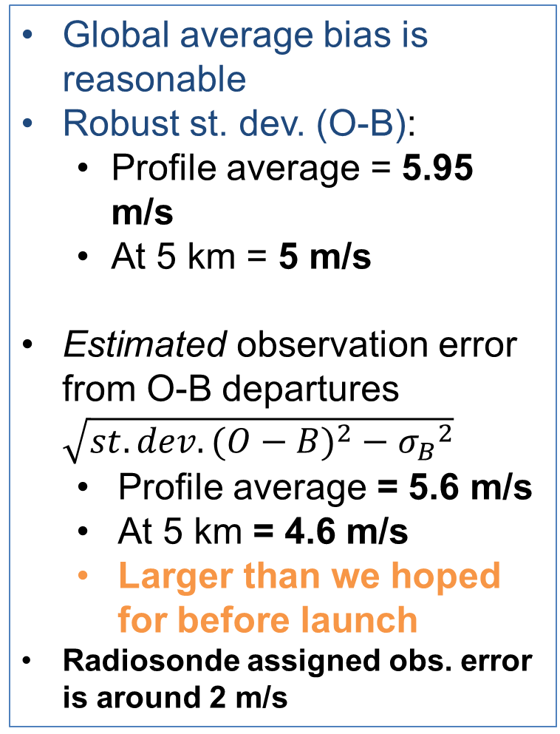
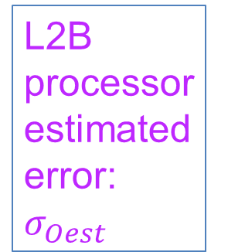
Global HLOS wind O-B departure statistics for L2B Rayleigh-clear, 10 orbits on 21 Jan 2020
mean(O-B)
Global average bias is reasonable
Robust st. dev. (O-B):
  Profile average = 5.95 m/s
  At 5 km = 5 m/s
Estimated observation error from O-B departures $\sqrt{{st.dev. (O−B)}^{2}−{σ_{B}}^{2}}$
  Profile average = 5.6 m/s
  At 5 km = 4.6 m/s
  Larger than we hoped for before launch
Radiosonde assigned obs. error is around 2 m/s
Obs count
Robust standard deviation (O-B)
L2B processor estimated error:$σ_{Oest}$

Slide 31
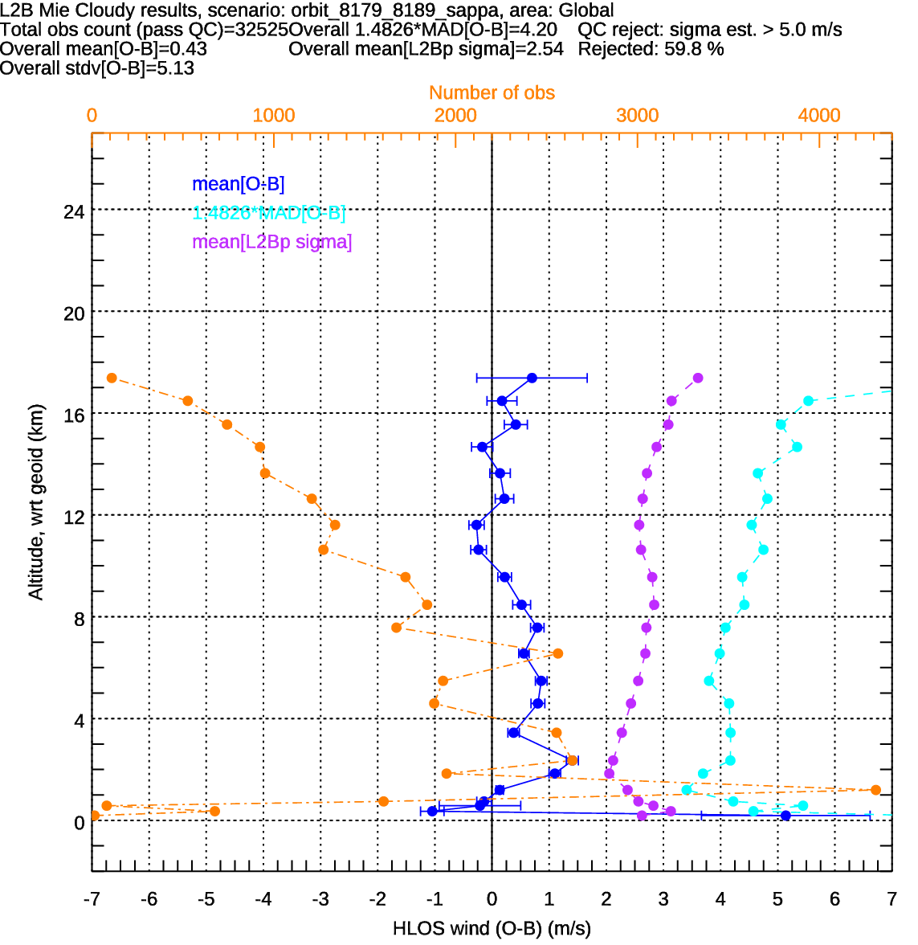

Global HLOS O-B statistics for L2B Mie-cloudy, 10 orbits on 21 Jan 2020
Global average bias is reasonable and stable with time
Global average robust std. dev. (O-B):
  Profile average = 4.2 m/s
  At 1-2 km ~ 3.5 m/s
Estimated observation random error from O-B departures $\sqrt{{st.dev(O−B))}^{2}−{σ_{B}}^{2}}$ is
  Profile average = 3.7 m/s
  At 1-2 km = 2.9 m/s
Mie averaging length scale is $≤$ 14 km (Rayleigh is $≤$ ~86 km)
Mie noise better despite finer horizontal resolution than Rayleigh

Slide 32
A breakthrough in 2019: explanation for dominant source of Rayleigh wind bias which varies on less than one orbit time-scales was found
Investigations showed Rayleigh wind bias, which varies along the orbit, is strongly correlated with telescope primary mirror temperatures variations
Temperatures vary due to varying Earthshine and the mirror’s thermal control
  Temperature variations correlate with outgoing SW and LW radiation
Probable mechanism: thermal variations alter primary mirror shape, causing angular changes of light onto spectrometer, causing apparent frequency changes
Bias correction using measured telescope primary mirror temperatures was demonstrated to work in offline testing and is being implemented in next processor versions:
  See references for more details:
  https://rmets.onlinelibrary.wiley.com/doi/full/10.1002/qj.4142
  https://amt.copernicus.org/articles/14/7167/2021/amt-14-7167-2021-discussion.html

Slide 33




Rayleigh has large biases which vary with geolocation
Ascending orbit phase
e.g. 6/8/2019 to 7/9/2019
Average M1 telescope mirror temperature
Plot from F. Weiler (DLR)
m/s
Descending orbit phase
M1 mirror
Ø 1.5 m
m/s

Slide 34


Regression of <O-B> versus M1 temperature function
Best results on 8/8/19 obtained with:
Outer temp. average: AHT-27, TC-20, TC-21
Inner temp. average: AHT-24, AHT-25, AHT-26, TC-18, TC-19
R² = 0.93
15 m/s HLOS range!
<O-B>
Demonstrates the power of NWP models for helping to determine the source of errors in observations
Only 0.3°C range
Outer minus inner M1 temperature function (°C)

Slide 35

Example of bias correction
stdev(<O-B>):
2.62 m/s
1.05 m/s
0.76 m/s
Rayleigh bias versus time on 9/8/19
<O-B>
16
Hour of day
24

Slide 36
Aeolus NWP impact at ECMWF

Slide 37
Methods for Aeolus L2B wind NWP impact assessment at ECMWF
Observing System Experiments (OSEs):
  For robust assessment of impact into the medium-range
  2nd reprocessed FM-B period (most recent OSE for long period):
    Rayleigh-clear + Mie-cloudy as in current operations; 29 June 2019 to 30 April 2020 (still running)
    T_{CO}639 model resolution (~18 km)
Forecast Sensitivity Observation Impact (FSOI):
  Assessment of short-range forecast impact – with some limitations
  Operational FSOI; since 9 January 2020
  FSOI via 2nd reprocessed dataset OSE (Aeolus “on” experiment)

Slide 38

Standard deviation of zonal wind analysis differences (with Aeolus minus without Aeolus) i.e. where Aeolus is changing the analysis
ITCZ
Asian monsoon
SPCZ
SACZ
Mid-2020 OSE: Period 4 April to 19 August 2020
Similar picture for different periods
(~3 km)
(~10 km)
(~13-14 km)
(~48 km)
Largest changes made to tropical upper troposphere and SH extratropics – in climatological convergence zones; larger model wind errors in convective outflow is the likely explanation

Slide 39





Background (short-range forecast) fit to other observations when assimilating Aeolus – 2nd reprocessed dataset (29 June 2019 – 30 April 2020)
Fit to “conventional” wind observations: from aircraft, radiosondes and radar wind profilers
N. Hemi. extratropics
tropics
S. Hemi. extratropics
~30 km
~20 km
~15 km
~10 km
Better with Aeolus if < 100%
Small positive in NH extratropics
V. good impact in the tropics
Good impact in SH extratropics; apart from > 850 hPa
Aeolus’ impact largest in tropical upper troposphere – similar to previous OSEs

Slide 40





… background fit to other observations when assimilating Aeolus
Fit to important temperature/humidity sensitive data
Global, ATMS (microwave radiances)
Global, GNSS radio occultation (bending angles)
Water vapour
ATMS channel weighting functions
Temperature
Better with Aeolus if < 100%
Good positive impact: Aeolus improves wind, temperature and humidity background fits, most strongly in upper troposphere

Slide 41




Impact of Aeolus; forecast root mean square error
Vector wind RMSE zonal average
Short-range analysis-based verification is not trustworthy
Temperature RMSE zonal average
+4%
+4%
Vector wind RMSE 500 hPa (±10%)
2 days
3 days
Temperature RMSE 500 hPa (±10%)
2 days
3 days
(9 days)
-4%
-4%
Better with Aeolus if blue
A lot of positive impact – but magnitude reduces as longer period included (due to Rayleigh-clear noise increasing)

Slide 42

Aeolus signal levels during mission so far – unfortunately, signal is dropping at steady rate (loss in transmission likely because of Laser Induced Contamination)
laser
laser
?
Figure by O. Lux, DLR

Slide 43


Long-term L2B quality monitoring via operational ECMWF (observation minus ECMWF; (O-B)) statistics
Up to 10 Jan 2022
Generally the L2B winds got noisier with time
Profile average random error recently ~6 m/s
Best was about 4.7 m/s in early FM-A and early FM-B
L2B Rayleigh-clear winds; global, daily, whole profile
FM-A laser
FM-B laser
Bias improved due to telescope-mirror temperature dependent bias correction
QC: $\left|O−B\right|>15 m/s$ rejected

Slide 44


L2B Mie-cloudy; global, daily, whole profile O-B
QC: $\left|O−B\right|>10 m/s$ rejected
FM-A laser
FM-B laser
Mie-cloudy quality has improved a bit recently
Due to ground processing improvements

Slide 45


Relative FSOI with 2nd reprocessed dataset; 3-29 July 2019 (when Aeolus had its smallest random errors)
Relative FSOI split by instrument
Wind lidar = Aeolus = 5.1%
Larger impact than radiosondes for this period
Aeolus does very well for one satellite instrument (2nd; after MetOp-B IASI)
When have reasonable Rayleigh-clear random errors

Slide 46

Time-series of FSOI for Aeolus from July 2019 to 24 Feb 2022 (combined offline via 1st reprocessing and operations)
Impact depends on random error and amount of data used (data gaps, QC)
  Impact decreased over time with FM-B laser – instrument noise
Still have positive impact
  But about half of July 2019 impact
  Both Mie and Rayleigh impact decreasing
  Mie > Rayleigh recently
1st reprocessed dataset
Operations, NRT dataset
FM-B laser

Slide 47


1 Jan to 12 Feb 2022 relative FSOI, from operations
Aeolus is still useful in operational NWP – but less than half the maximum impact
Relative FSOI by instrument type
Wind lidar = Aeolus = 2.4%
Relative FSOI by observation group

Slide 48
Summary on Aeolus NWP impact at ECMWF
Short-to-medium range Aeolus forecast impact via OSEs:
  Reprocessed data OSE shows the best impact seen
    Due to: larger sample (statistical significance); higher resolution OSE; improved L2B data quality
  Highlights:
    Statistically significant and good magnitude positive impact on wind, temperature, geopotential and humidity forecasts in tropics and polar regions:
      Up to 9-10 days in tropics and S. Hemi. extratropics at 100 and 50 hPa (15-20 km)
      Even N. Hemi. extratropics geopotential at 500 hPa (~5 km) is improved to day 4 by ~1%
  Impact starts to wane as OSE length increased, increasingly noisy data
Short forecast range Aeolus impact via FSOI:
  July 2019 for 2nd reprocessing gives 2nd largest impact of individual satellite instruments (after MetOp-B IASI) and has similar impact to radiosonde network
  Operational FSOI still shows positive impact recently (~2.4%)
    But less than half of July 2019 (~5.1%); due to noise increasing

Slide 49

Beyond NWP: some of the other scientific highlights of Aeolus
Several applications found in atmospheric dynamics research of Aeolus winds:
  gravity waves, equatorial waves, SSW events, QBO disruption events
Aeolus winds are useful for verifying and improving usage of other satellite wind observation types, particularly Atmospheric Motion Vectors
Aeolus optical properties are being used in atmospheric composition research e.g. wildfire smoke, Saharan dust, volcanic plumes and atmospheric composition data assimilation
  The unique ability of Aeolus to measure dynamics and optical properties should be exploited further – the example of the Australian wildfire smoke vortex highlights this; coupled composition and dynamics forecasts
Hunga Tonga Hunga Ha'apai volcano plume (yellow) between 20-30 km in February 2022

Slide 50
Summary of lecture on Aeolus
Aeolus is the first Doppler wind lidar and space, and hopefully not the last
Has demonstrated the principle of measuring wind profiles from space of sufficient quality to improve global NWP forecasts by a decent amount
NWP impact is of good magnitude considering that < 1% of observation assimilated are from Aeolus and that this is a new technology with many data quality issues
  Second largest satellite instrument FSOI when signal was highest
If random errors met original aim of 2.5 m/s (rather than 4-5 m/s for the Rayleigh), then it is thought that the impact would be significantly larger
Future:
  A switch back to laser FM-A is probably going to be necessary this year
  The available onboard fuel for such a low orbit means Aeolus will probably last to 2023-2024 (increased solar activity – drag)
  An operational follow-on mission with two satellites (one after the other) in 2030 time-frame being considered by ESA/EUMETSAT (phase A/B1 is in progress)
  The operational follow-on mission design improves many aspects of Aeolus e.g. more stable laser(s), more vertical range-bins, better radiometric performance of the transmit-receive path (alignment), reduced risk of LIC (bistatic design)

Slide 51
The end

Slide 52
Backup slides

Slide 53
Aeolus’ orbital parameters
Dawn-dusk sun synchronous (18:00 ascending node)
7 day repeat cycle (111 orbits)
Inclination: ~97 degrees
Altitude: ~320 km
The laser points towards the dark side of the terminator to reduce UV solar background noise – but this can’t be avoided over the poles in summer

Slide 54
Some features of DWL
Advantages:
  Good vertical and horizontal resolution is possible
  Not many processing steps and assumptions to get wind i.e. reasonably direct measure of the geophysical variable
  Provides vertical profiles of wind (along line-of-sight)
Disadvantages:
  Totally attenuated by optically thick cloud or aerosol
  Space-borne DWL:
    Complex technology – Aeolus was delayed by a decade!
    Several LOS “looks” are required to get vector wind, nominally have wind component along the LOS
    Limited sampling across-track (e.g. sub-satellite “curtain”)
    Due to 1/r² dependence of signal, then needs to be relatively low orbit (closer to target)
  Calibration can be tricky

Slide 55
Types of Doppler wind lidar
Coherent detection
  Detecting beat signal mixing of returned signal with internal reference
  Particulate (Mie) scattering only
Direct detection:
  Aeolus uses this
  Measurement is signal intensity (or photon counts) through optical filters (interferometers) which varies with the frequency of light
  Molecules and particles are the source of the backscattered signal
    Useful for NWP to have both clear air + cloud/aerosol winds

Slide 56

Aeolus Rayleigh channel
Uses “filter method”, specifically the double-edge technique
  Two frequency filters (A and B) sample sides of Rayleigh-Brillouin spectrum, providing photon counts
  Contrast function (response) calculated from counts: $R=\frac{A−B}{A+B}$
  R is measured for both internal reference (i.e. outgoing laser spectrum) and for atmospheric return
  Calibration is needed for both internal and atmospheric responses to relate response to frequency
  Change in frequency of atmospheric relative to internal frequency is obtained $∆f=f_{atm}−f_{int}$ i.e. the Doppler shift, hence LOS wind

Slide 57

Aeolus Mie channel
Wind derived from the narrow Mie spectrum obtained by “Fringe Imaging Technique”
  Position of interference pattern (called a ‘‘fringe’’) is related to frequency (by calibration), both for the internal and atmospheric returns
  Measured fringe centroid for both internal and atmospheric signals is then converted to frequency, hence calculate $∆f=f_{atm}−f_{int}$ i.e. the Doppler shift, hence LOS wind

Slide 58


Slide 59


Example of Level-1B signal amplitude (photon counts, i.e. not winds) for a 3000 km stretch of data
Each data point is ~2.7 km across (a flexible instrument setting)
Rayleigh channel signal
Mie channel signal
Clear air
Clear air
Clouds
Clouds
No signal
No signal
Satellite moves at ~7.3 km/s to sweep out this lidar “curtain”

Slide 60

There are 24 vertical range-bins to assign
A possible setting for the range-bins
Range-bin thickness can vary from 0.25 to 2 km thick in 0.25 km increments
Rayleigh and Mie range-bin settings can be different
Range-bins settings can vary according to latitude/longitude boxes that are defined on-board the satellite
  An attempt has been made to optimise the settings for NWP impact – varying with latitude

Slide 61
What to assimilate from Aeolus for NWP?
More complex obs operator: increasing knowledge of instrument/physics needed
H(x)
Lidar signal:
H(u,v,w,T,p,CLWC, CIWC, aerosol)
Current choice
HLOS wind:
H(u,v,w)
or H(u,v)
RR:
H(u,v,w,T,p)
LOS wind:
H(u,v,w)
Wind vector:
H(u) +H(v)
Obs closer to instrument measurements
Obs closer to geophysical variable of interest
L1B Lidar signal
L1B Rayleigh
Response (RR)
L2B LOS wind
L2B HLOS wind:
Mie
Rayleigh
L2C wind vector: Bad idea!
y
More complex retrieval (processing)
Need a priori: e.g. 1D-Var retrieval
strong sensitivity!
Need a priori: T, p
Weak sensitivity

Slide 62


Bias correction to the ECMWF model
Implemented bias correction scheme: <O-B> vs. “orbit’s argument of latitude” and longitude
Updates to bias correction look-up table done typically done every few days in experiments
Mie biases very stable and do not require the longitude dimension
Example of how Rayleigh biases varied during the FM-B period
Early August 2019
+5 m/s
+5 m/s
Mid-November 2019
M1 temperature induced biases were larger in boreal summer
-5 m/s
-5 m/s

