Slide 1

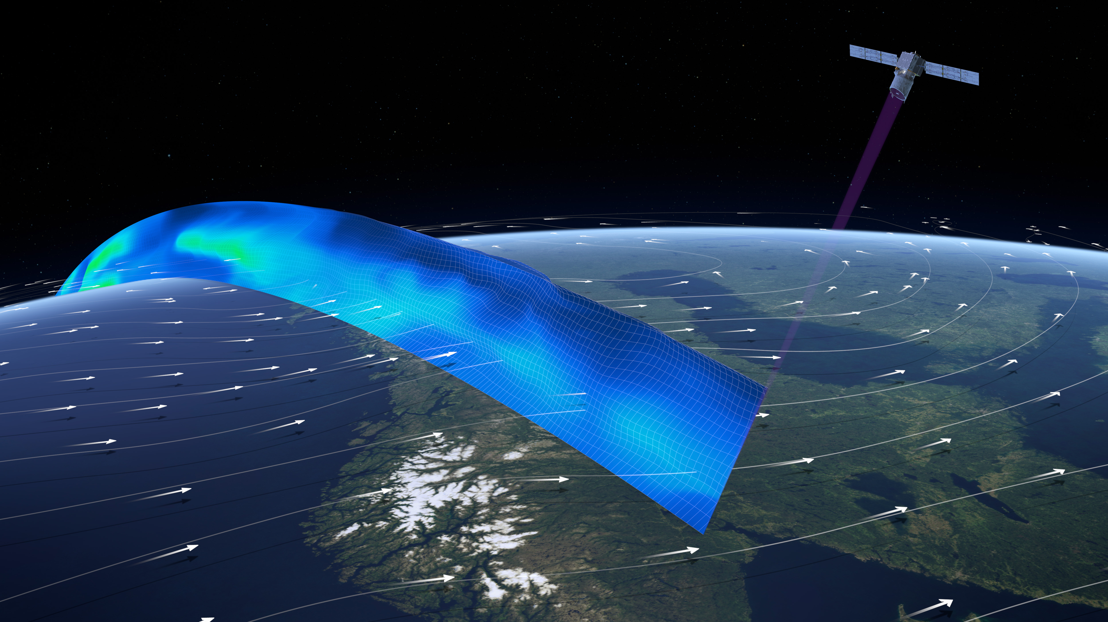
ADM-Aeolus Level-2B wind observations
Workshop on Wind Profiles and Mesoscale Data Assimilation, Ljubljana, 19-20 September 2016
Michael Rennie, ECMWF
Acknowledgements: ESA and L1/L2 expert teams, in particular KNMI (Jos de Kloe, Gert-Jan Marseille and Ad Stoffelen) and Lars Isaksen (ECMWF)

Slide 2
Outline
Brief intro to Aeolus
What are L2B winds?
What accuracy is expected (using simulations)?
Discussion on assimilation choices
Where to get the data?

Slide 3
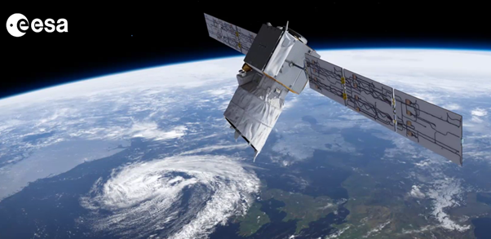
Atmospheric Dynamics Mission (ADM) Aeolus:
ESA Earth Explorer Core Mission
  chosen in 1999
  part of Living Planet Programme
Doppler wind lidar (DWL) payload
Technology demonstration; engineered to last for 3 years
Will be first European lidar and first wind lidar in space
Mission status:
Long delays due to many technical difficulties
  Lack of stability with burst mode
  Laser induced damage and laser induced contamination in vacuum
Recent good news:
  ALADIN (Atmospheric LAser Doppler INstrument) integrated with rest of satellite at Airbus D&S Stevenage
  Launcher contract signed
  Expect launch end of 2017

Slide 4
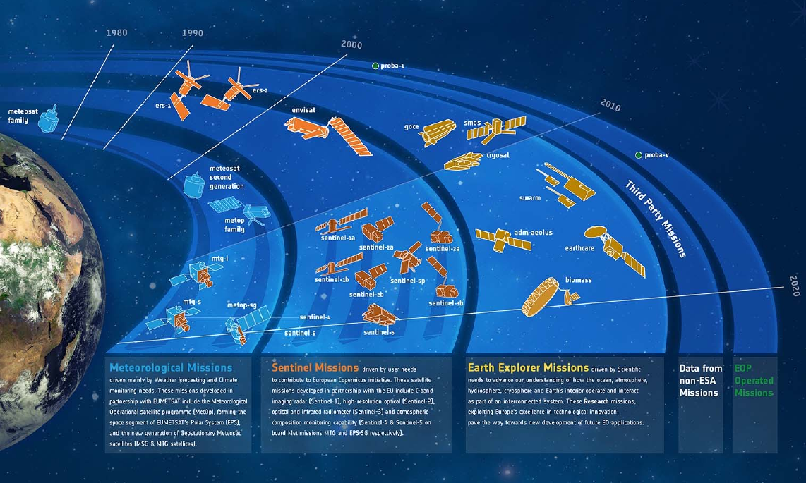
Where Aeolus fits into ESA’s Earth observation satellite programme

Slide 5
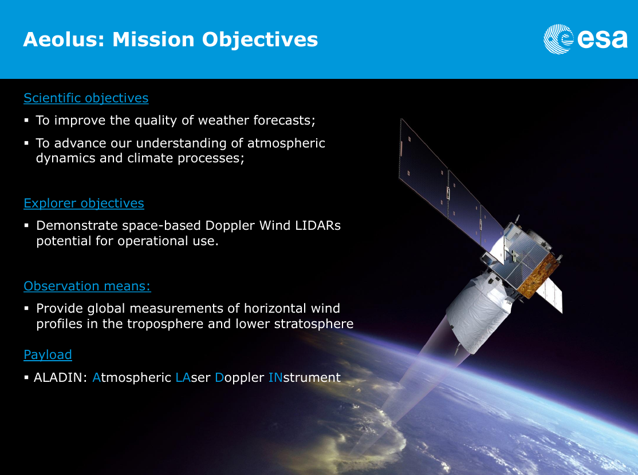

Slide 6
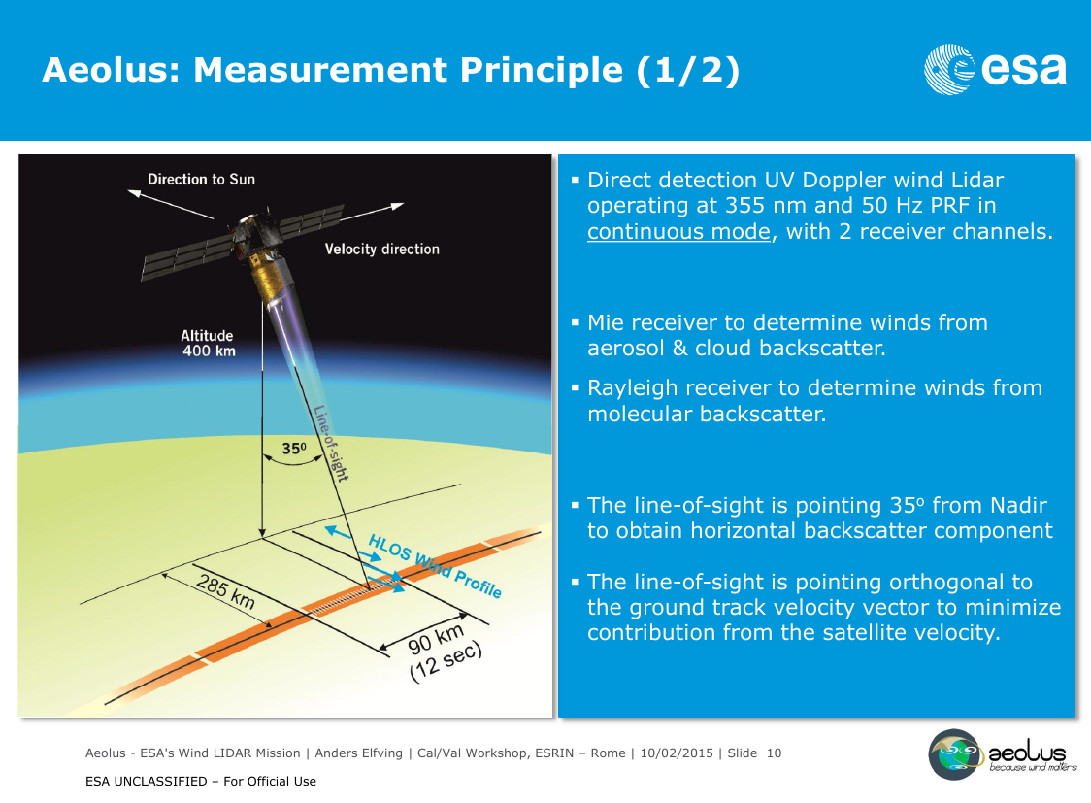

Slide 7
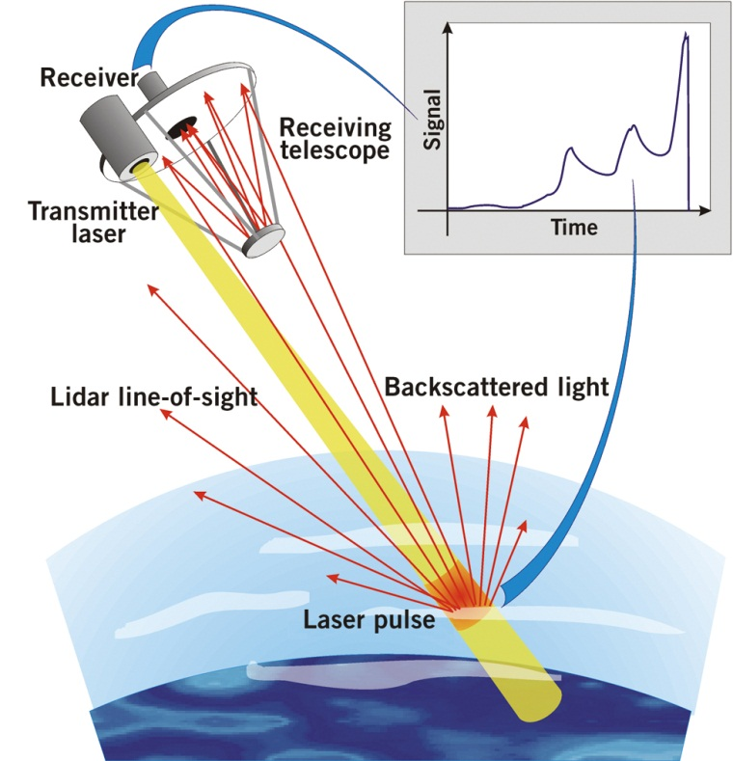
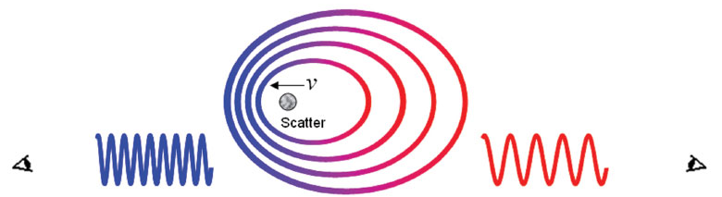
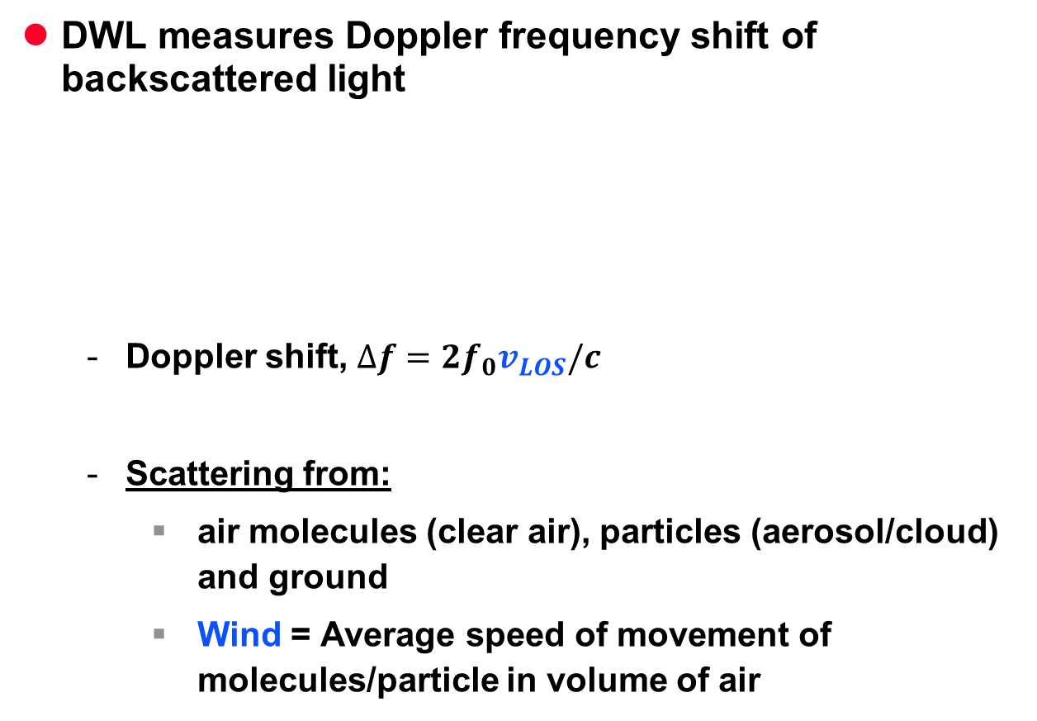
Doppler wind lidar
DWL measures Doppler frequency shift of backscattered light
  Doppler shift, $∆f=2f_{0}v_{LOS}/c$
  Scattering from:
    air molecules (clear air), particles (aerosol/cloud) and ground
    Wind = Average speed of movement of molecules/particle in volume of air
Notes:
Lidar geometry doppler shift
Very demanding to detect such small changes in frequency 10-7 10-8, need sophisticated technology

Slide 8
Two types of wind observations from Aeolus
Rayleigh winds:
  Molecular backscatter
  Majority of wind results
  Coverage: From surface to ~30 km (if clear)
  Very noisy below thicker clouds
Mie winds:
  Particulate backscatter (cloud ice/water droplets, aerosols, hydrometeors)
  Coverage: top of optically thick clouds, within optically thin clouds, boundary layer aerosol (if no cloud)
  Lower noise than Rayleigh winds
Complementary
  i.e. good Rayleigh in clear conditions and good Mie with (some) cloud

Slide 9
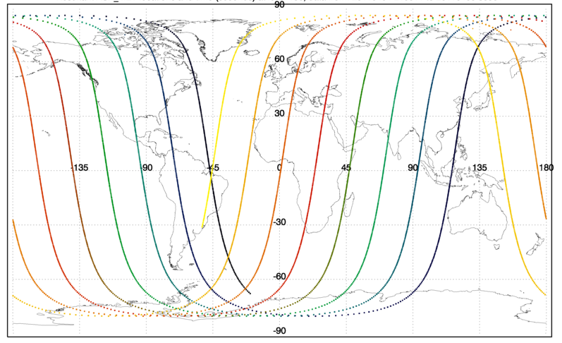
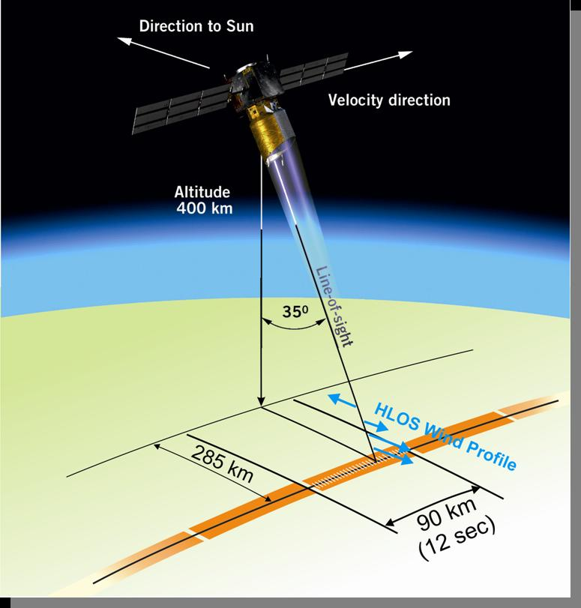
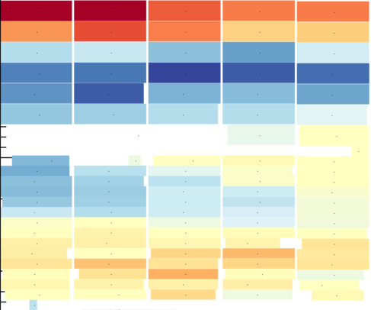
Example Aeolus wind observation sampling
12 hrs coverage, ~72K “good” winds; ~11% increase in wind GOS
Coverage up to ~83 °N/S
UV lidar
Example of Aeolus vertical sampling (24 bins)
Mostly zonal component of wind
30 km ~10 hPa
observation
16 km
16 km
Mie
Rayleigh
BRC
Continuous coverage along-track
0 km
0 km
WGS84

Slide 10
Aeolus spatial sampling
Laser pulses (pulse rate 50 Hz, energy per pulse 80-120 mJ)
10 m
0.25 – 2 km
Range-bin
Ground track speed ~7.2 km/s
144 m
144 m
10 m
0.25 – 2 km
Measurement = accumulation of 20 pulses on instrument
20*0.144=2.88 km
Observation = average of e.g. 30 measurements, in ground processing
0.25 – 2 km
90 km BRC
Notes:
Return for one laser pulse too noisy for useful wind, therefore accumulate pulses to get accuracy ~2 m/s
Since satellite moving
Average across varying atmospheric scene
Wind turbulence averaged: more suitable for global NWP (representativeness error reduced)
Less horizontal averaging needed for Mie

Slide 11
Aeolus instrument data processing levels
L2A
AISP
L0
L1A
L1B
L2B
L2C
Data preparation
Products exploitable in NWP
Product is result of NWP DA

Slide 12
L1B product
  Measurement-level Mie & Rayleigh useful signal data with many corrections/calibrations applied
  (H)LOS wind observations with fixed 1 BRC (~86 km) horizontal resolution. Critical corrections missing for Rayleigh winds.
  Some calibration modes
L2B product:
  (H)LOS wind observations suitable for NWP data assimilation
L2C product:
  Vector winds from the ECMWF analysis after the assimilation of L2B winds
L2A product:
  Supplementary aerosol and cloud product
  Cross-talk corrected profiles of particle co-polar backscatter and extinction coefficients

Slide 13
L2B product properties
Line-of-sight (LOS) or Horizontal LOS wind component observations
Rayleigh winds corrected for temperature, pressure dependence and particle cross-talk
  using a priori information – not done for L1B
Each observation (either Mie or Rayleigh):
  Classified into a type: cloudy or clear
  Geolocation info: geometric height, lat, lon, azimuth angle, time
  Uncertainty estimates for each wind result, quality flags
“Flexible “grouping” algorithm for observations
Many processing options easily controllable from a settings file
L2B processor developed by ECMWF and KNMI for ESA

Slide 14
Simulated examples of L2B winds
Notes:
The processsing of the simulated raw Aeolus measurements is done with the to be opertaional processors, i.e. the L1B followed by L2B processors.

Slide 15
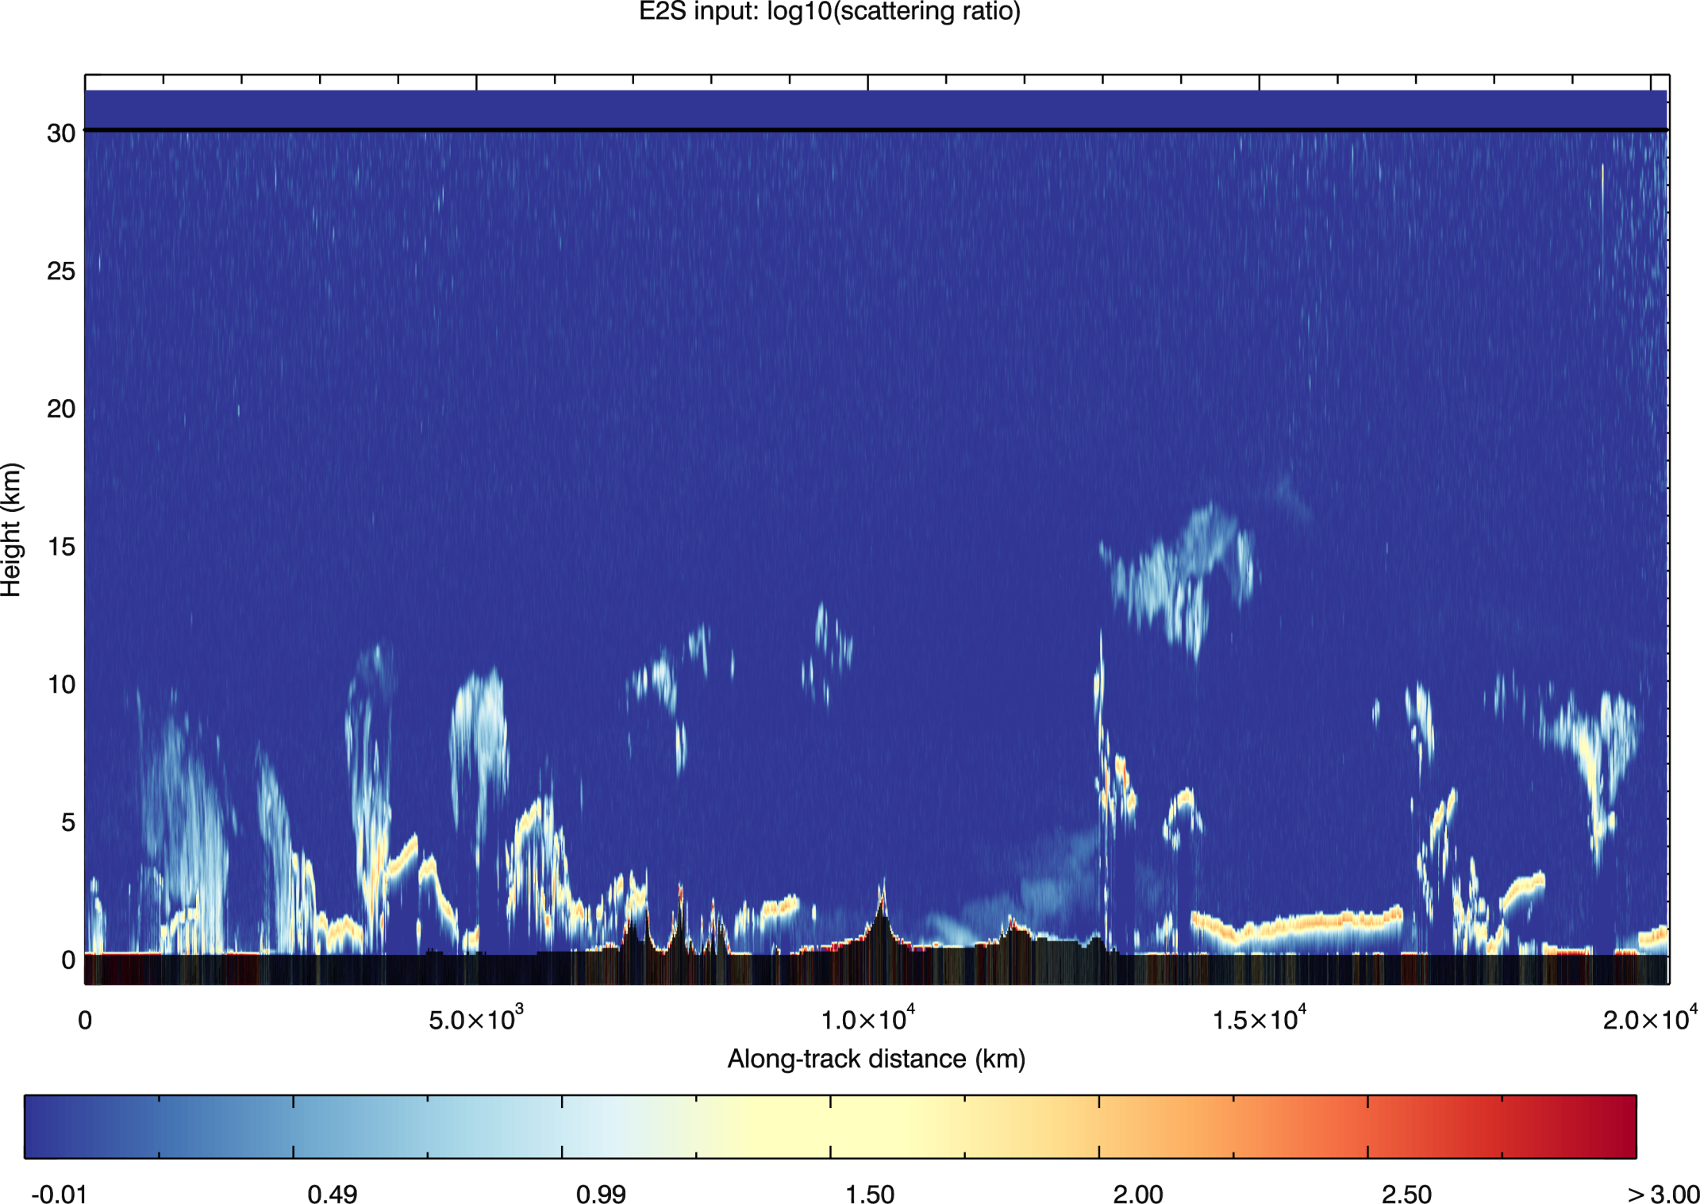
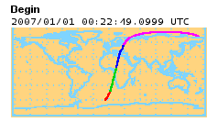
e.g. Aeolus simulator input: log₁₀(scattering ratio) at 355 nm (derived from CALIPSO)
CALIPSO scene courtesy of G. J. Marseille and J de Kloe, KNMI
Saharan dust
Ice cloud:
tropical cirrus
Frontal system cloud
Ice cloud:
cirrus

Slide 16
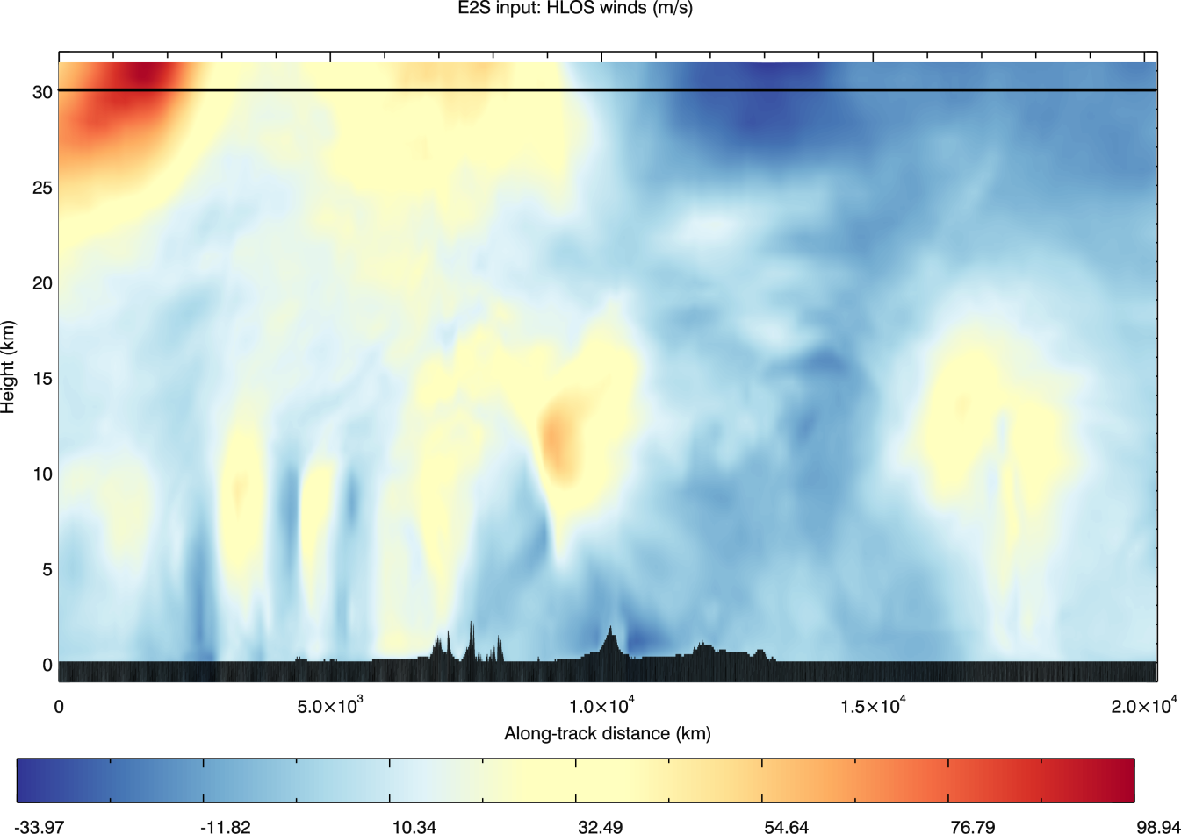
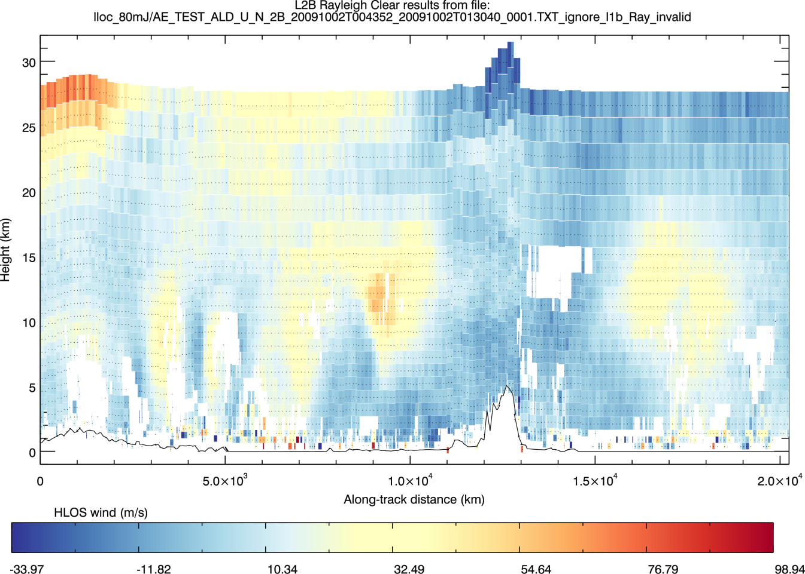
Simulator input: “True” HLOS wind (ECMWF model)
Altitude (km)
Along-track distance (km)
Output: L2B “Rayleigh-clear” HLOS wind i.e. what the winds should look like
Notes:
Polar jet stream partially obscured by cloud
Extensive coverage along the “curtain” of the orbital ground-track

Slide 17

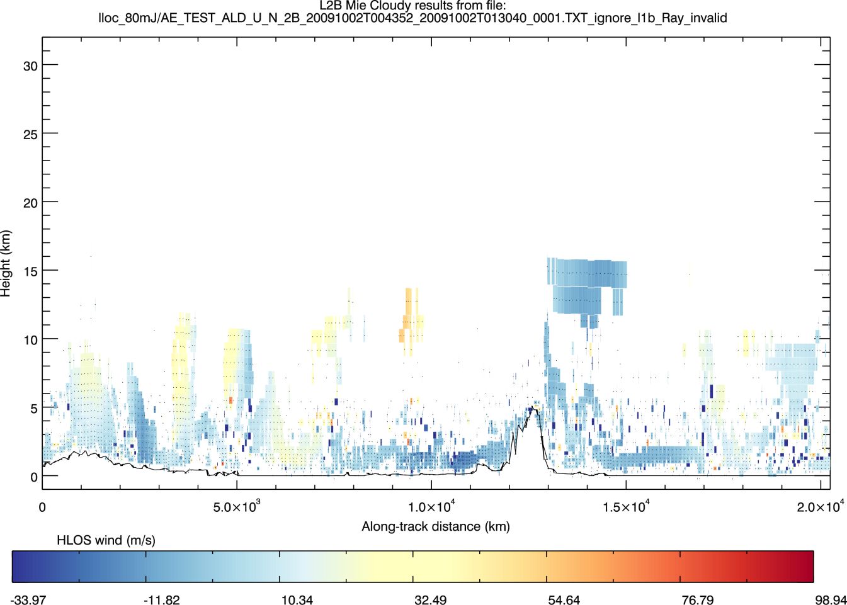
Simulator input: “True” HLOS wind (ECMWF)
Output: L2B “Mie-cloudy” HLOS wind
Notes:
Polar jet stream partially obscured by cloud
Extensive coverage along the “curtain” of the orbital ground-track

Slide 18
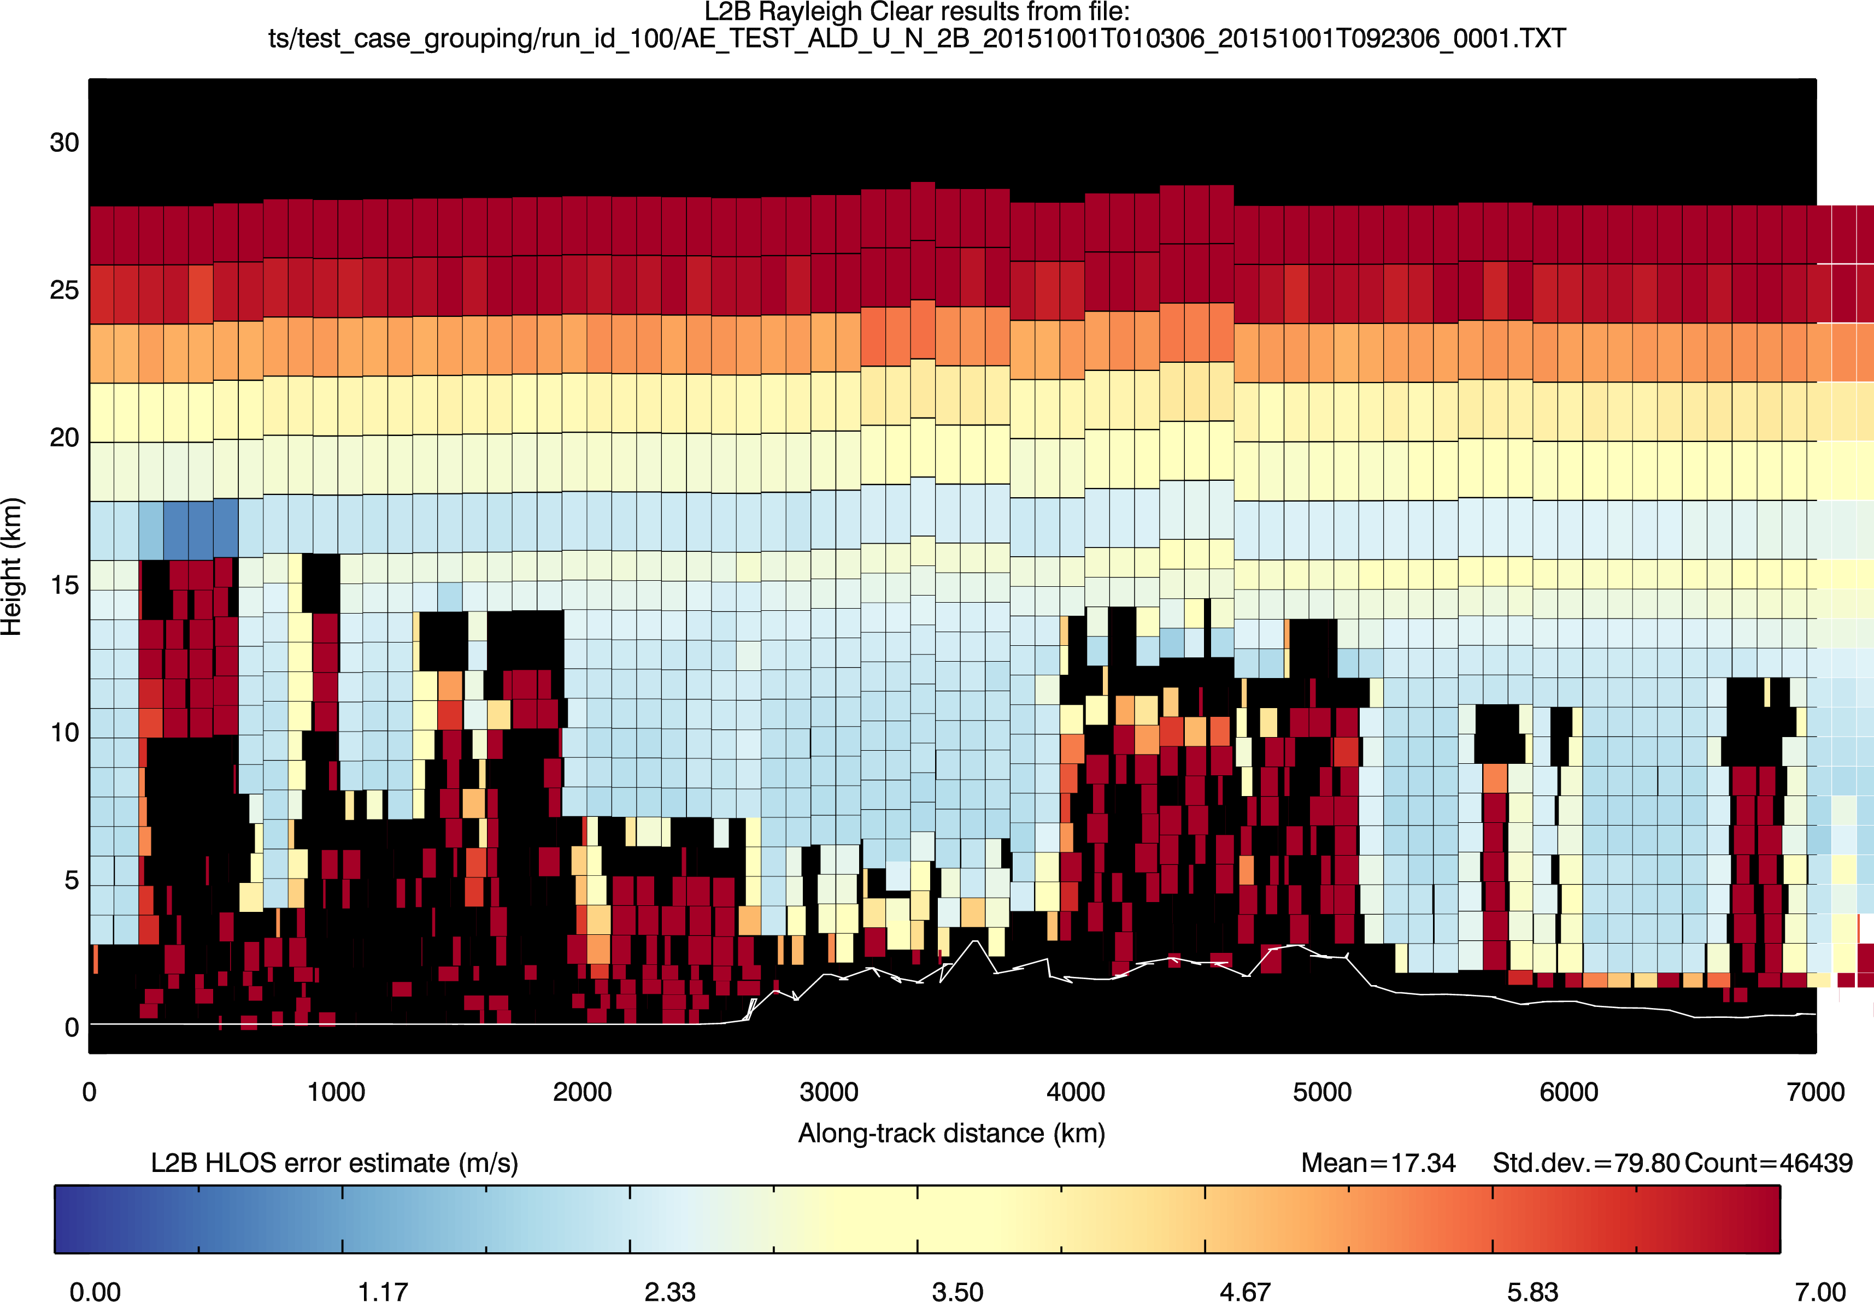
L2B 1-σ estimates provided with each wind
Rayleigh-clear
m/s

Slide 19
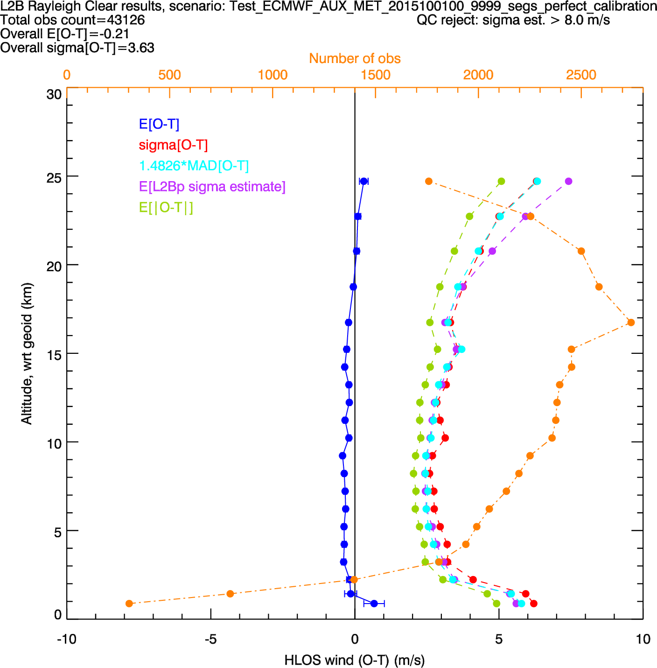
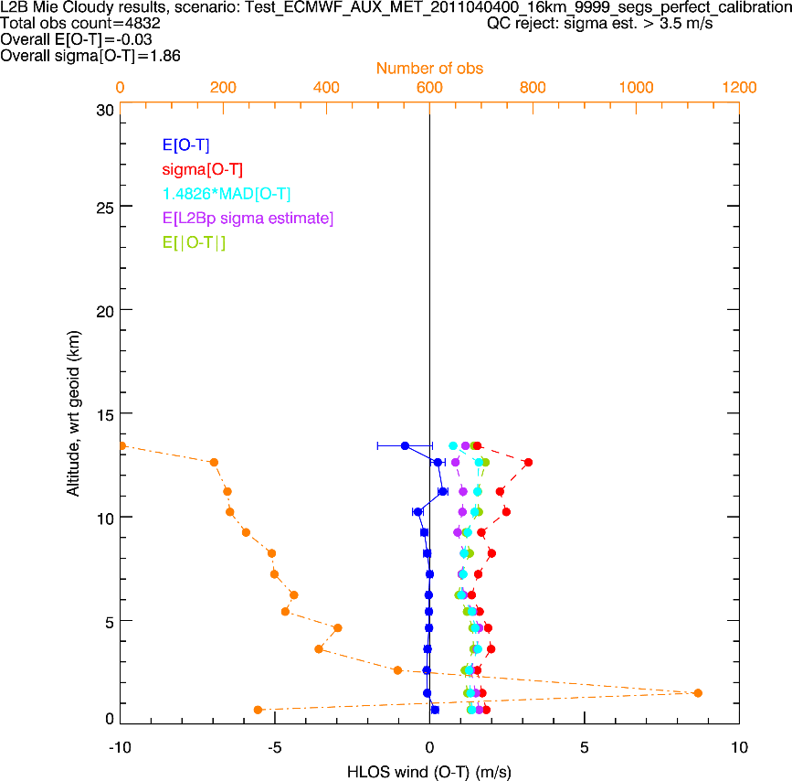
Typical L2B HLOS wind error statistics (2016)
E2S input: ECMWF TcO1279
St. dev.(error)
Mean(error)
Number of obs
Rayleigh-clear (typical solar conditions)
Mie-cloudy
~3 m/s
Typically < 0.5 m/s
1.5-2 m/s
~0.1 m/s
Notes:
Based on 4 orbits. Using ECMWF cloud properties for cloud backscatter
80 mJ laser
1 BRC horizontal averaging
Stats are sensitive to QC; QC applied:
reject > 5 m/s error estimates on Rayleigh
Reject > 3 m/s error estimates on Mie
Rayleigh signal attenuated by clouds lower down, hence drop off in number of “good” quality observations.

Slide 20
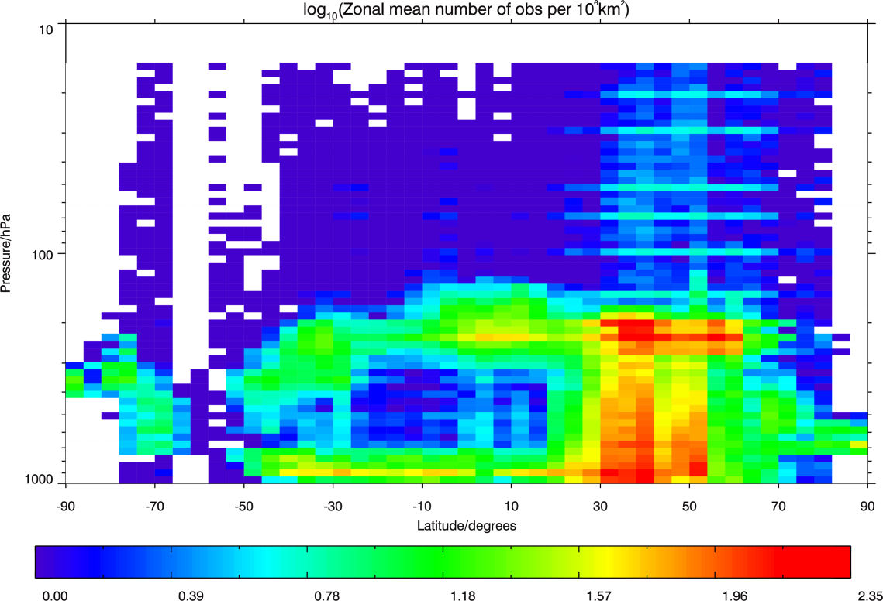
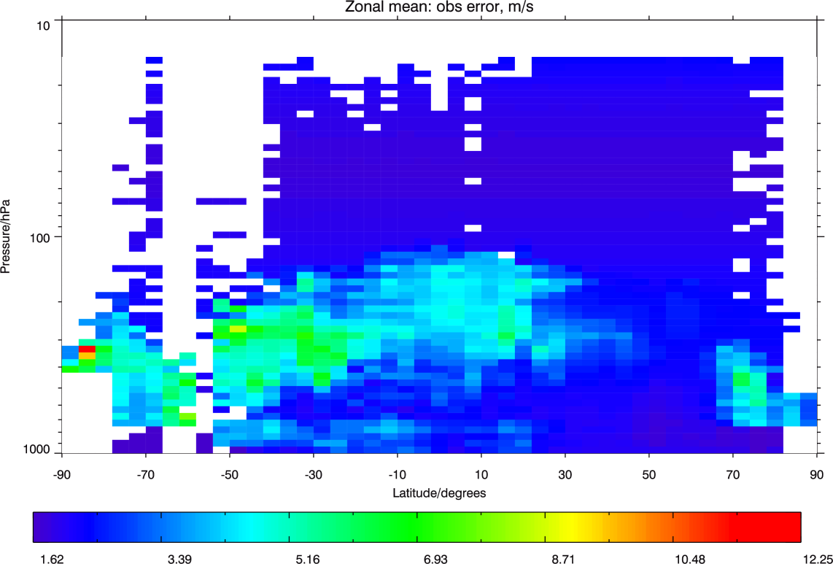
Typical ECMWF DA; assigned u-wind obs error
~30 km
sondes
Zonal mean: log₁₀(number of obs per area)
sondes
AMVs
aircraft
AMVs
AMVs
aircraft
L2B errors are larger than conventional and scatterometer, but less than AMVs
~30 km
Zonal mean: assigned obs error (m/s)

Slide 21
Assessing appropriate averaging length scale
Investigate horizontal averaging lengths in the L2B processor
  see how the (L2B wind – “true” wind) errors vary
  truth wind defined as point wind from model
Test scenario:
ECMWF TcO1279 (~9 km grid) as input “truth” meteorological data i.e. HLOS, T, p, ice/water clouds
  underestimates Mie performance in PBL (in cloud-free conditions) since no aerosol in E2S input fields

Slide 22
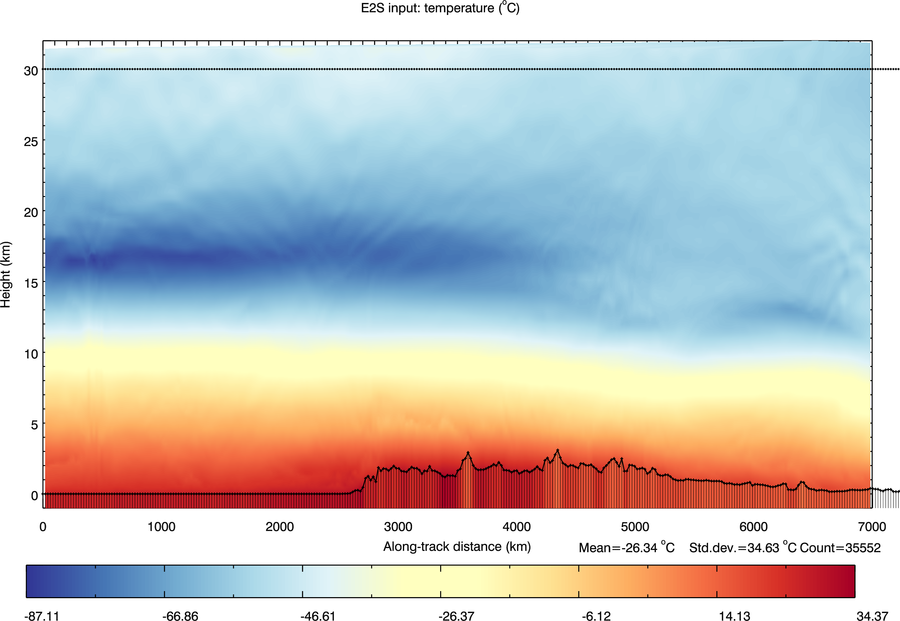
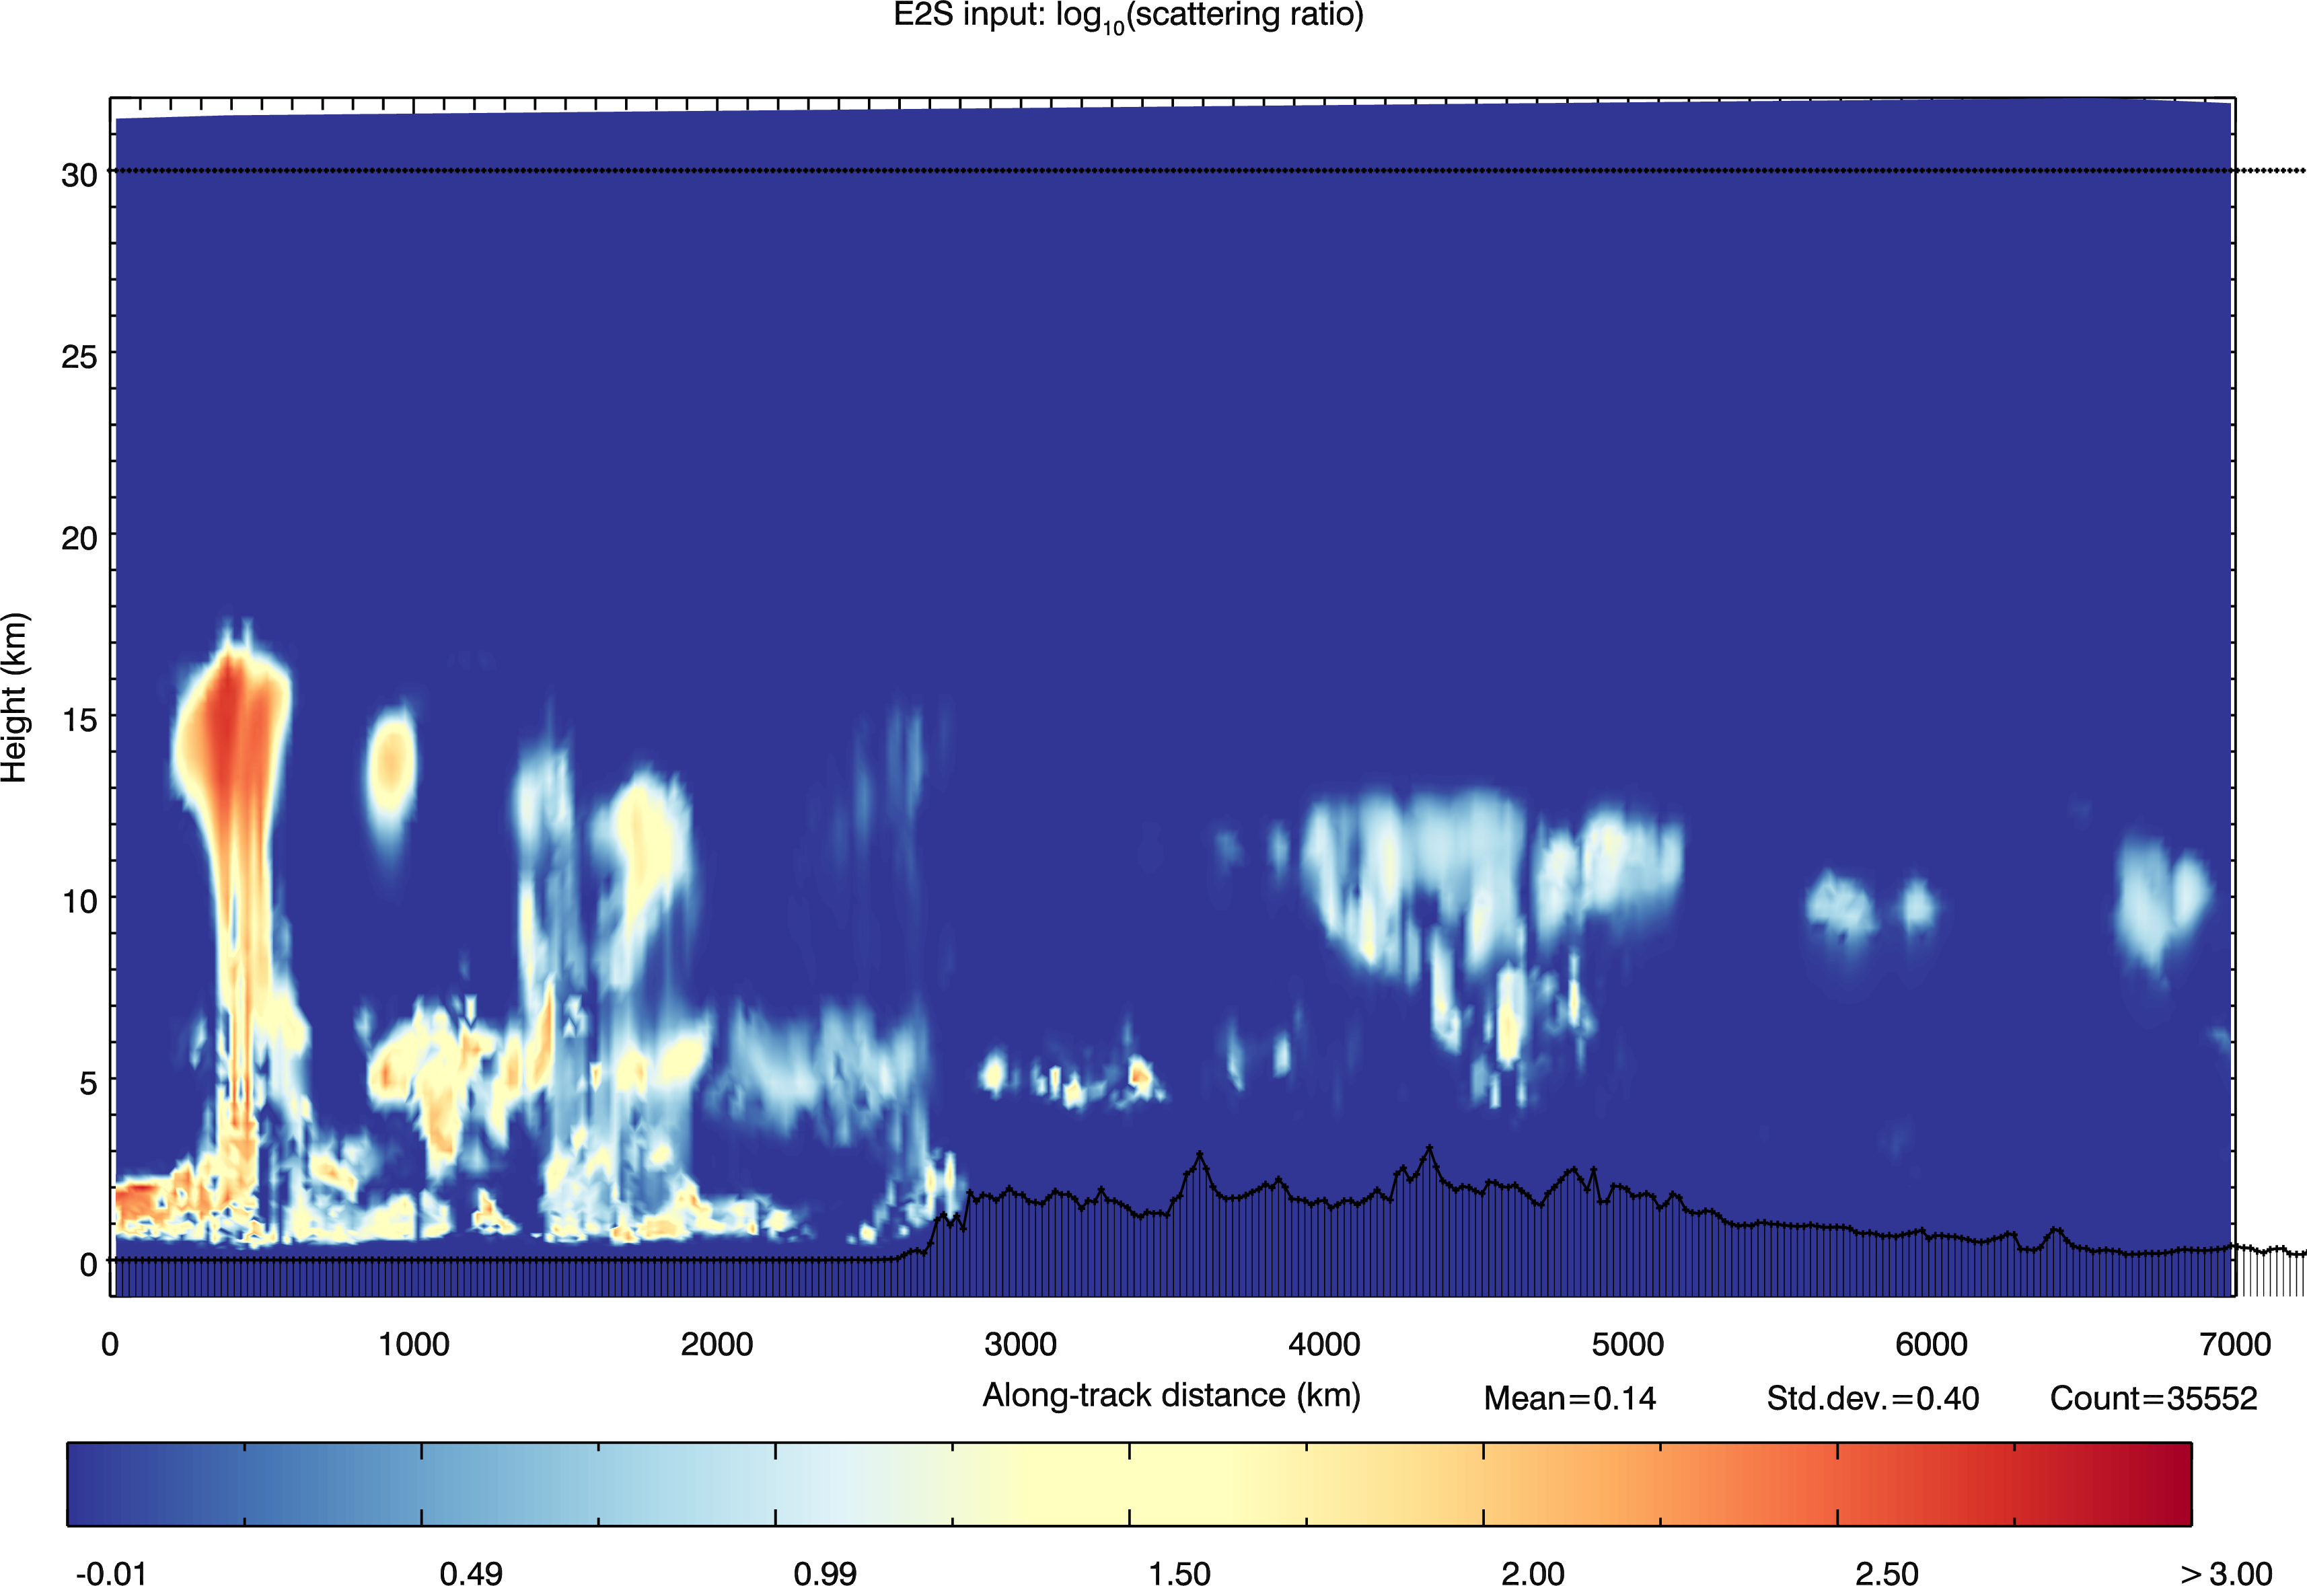
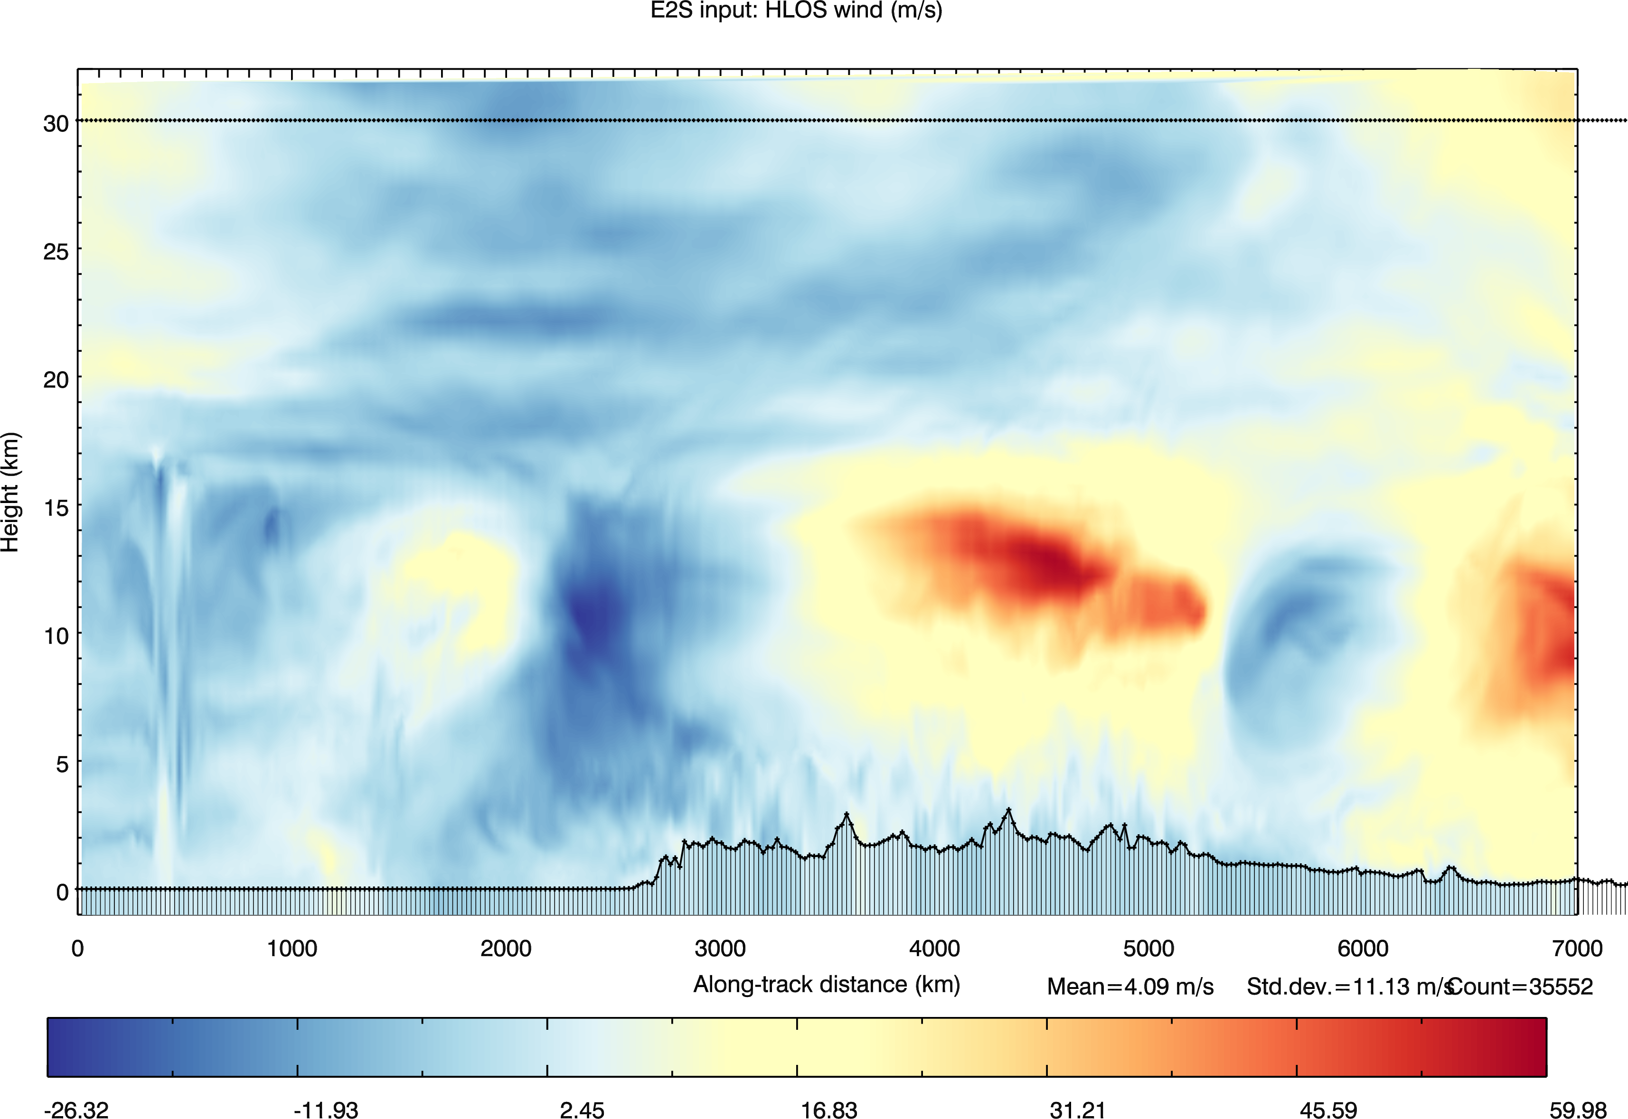
ECMWF TcO1279 inputs to simulator: “truth”
Notes:
Starts in tropics, ascending toward N America, rockies

Slide 23
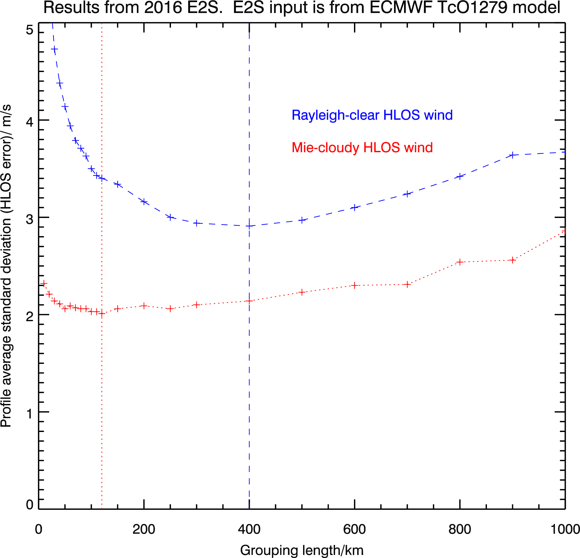
L2B wind error st. dev. vs. grouping length

Slide 24
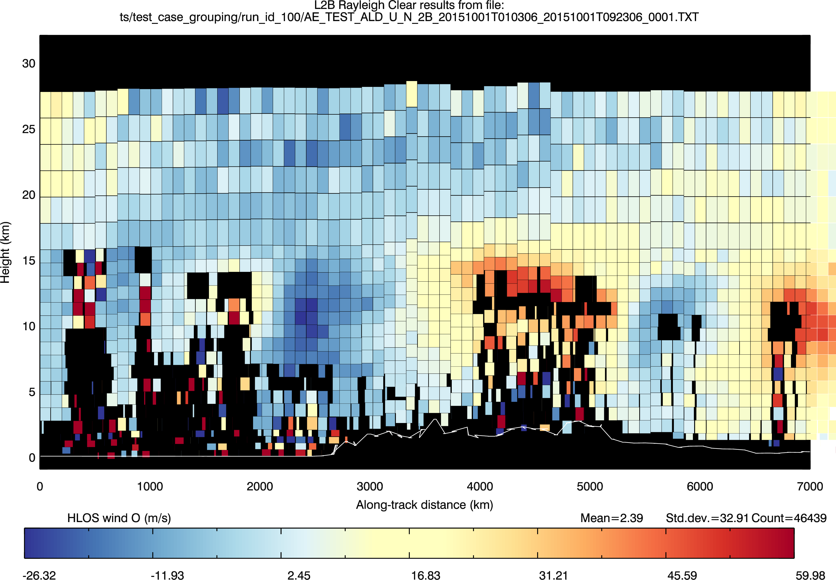
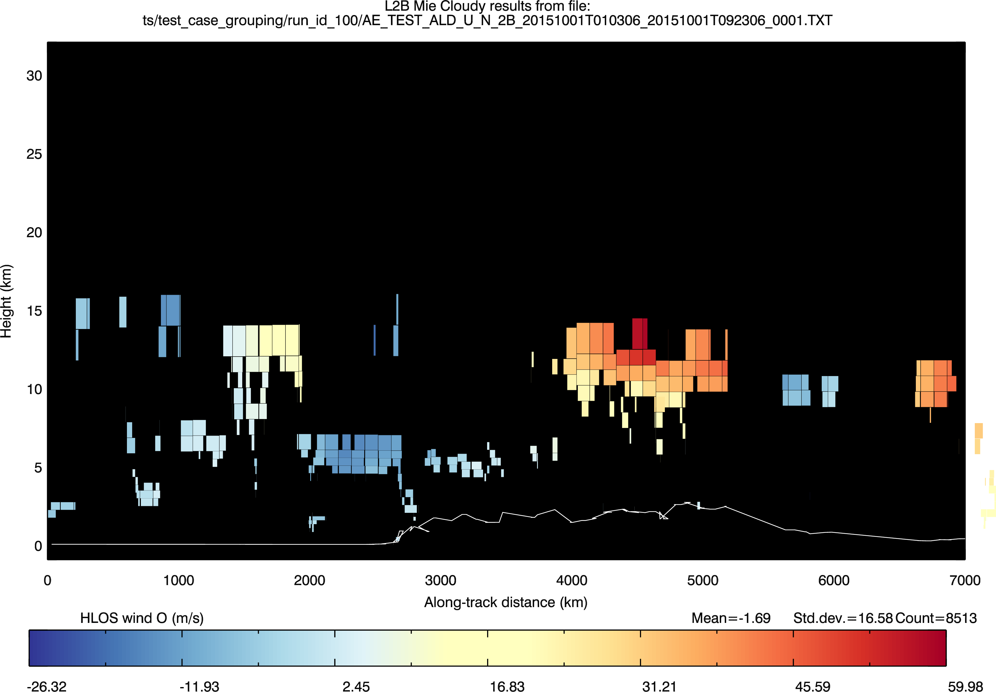
100 km group size

Slide 25
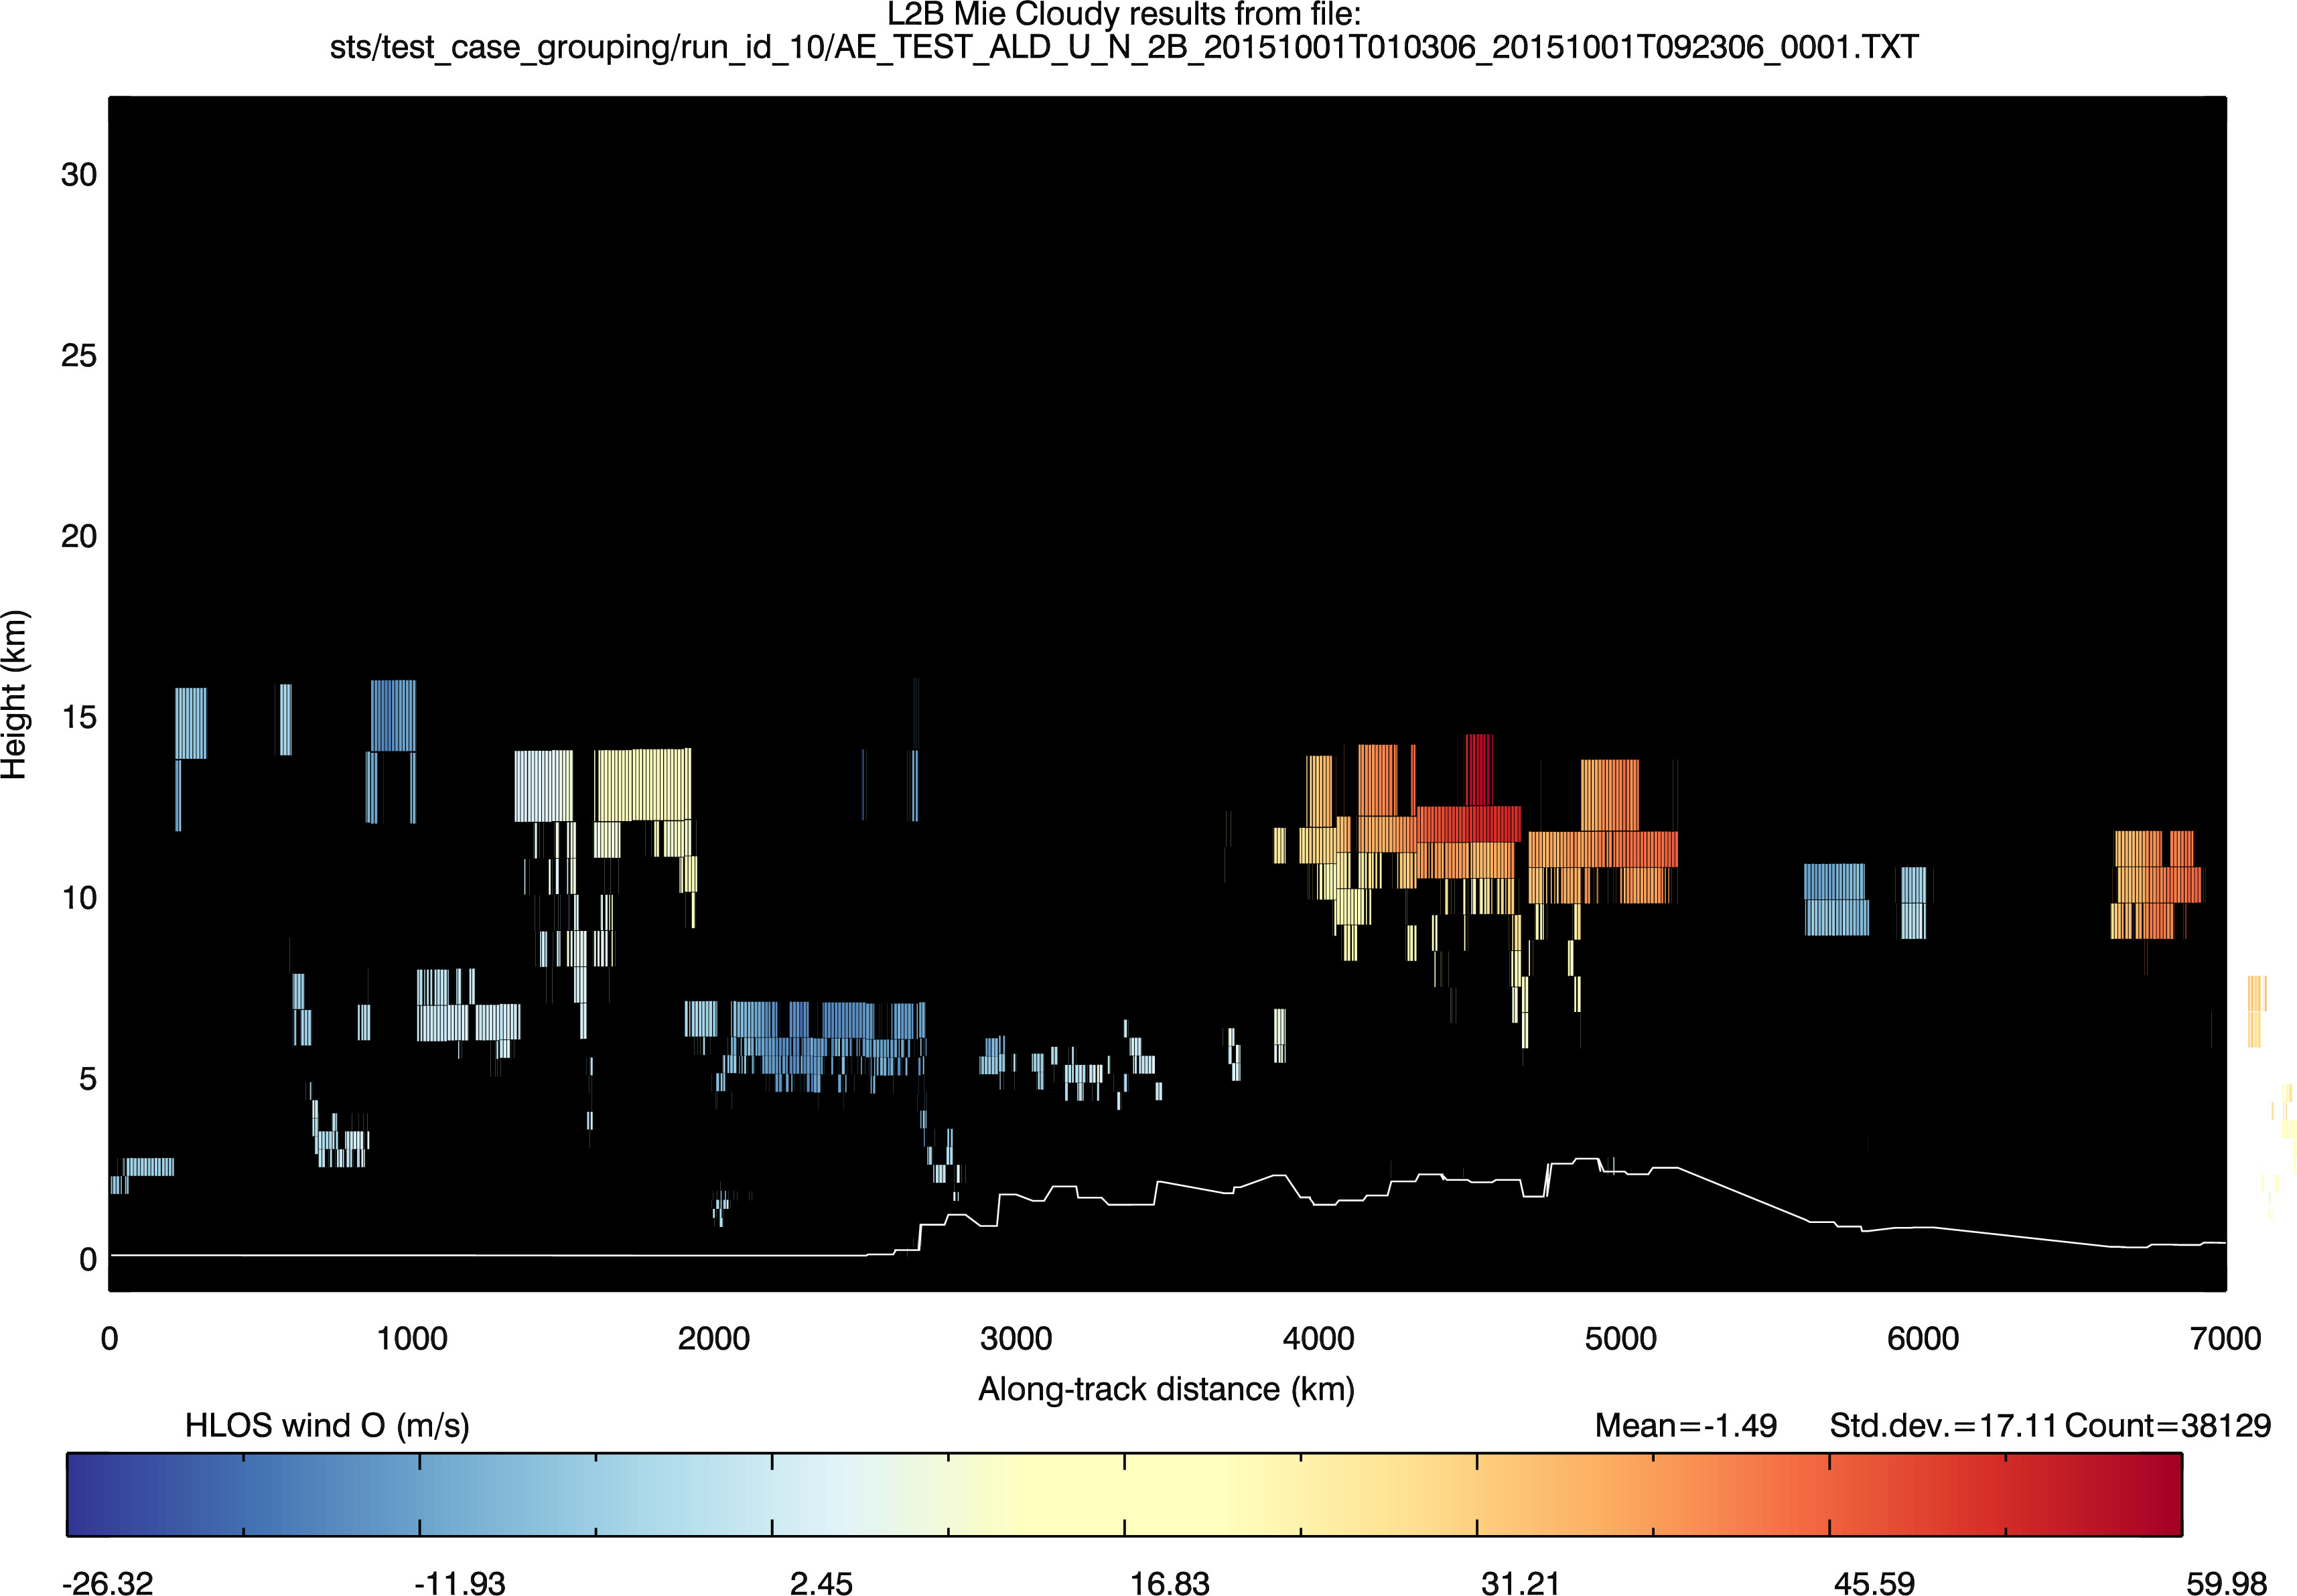
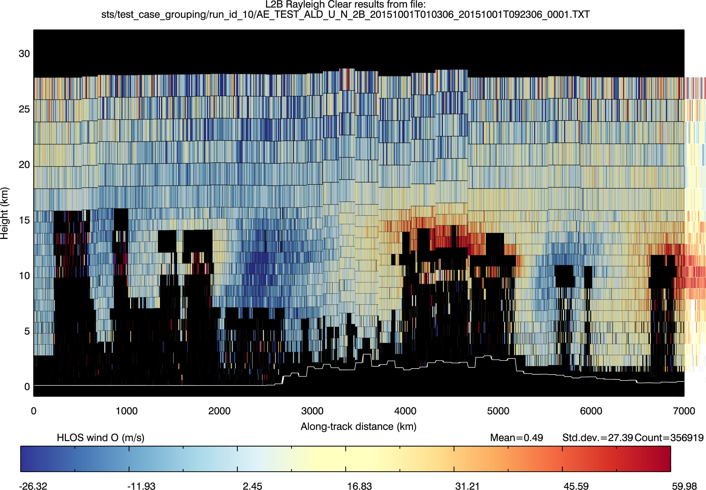
10 km group size

Slide 26
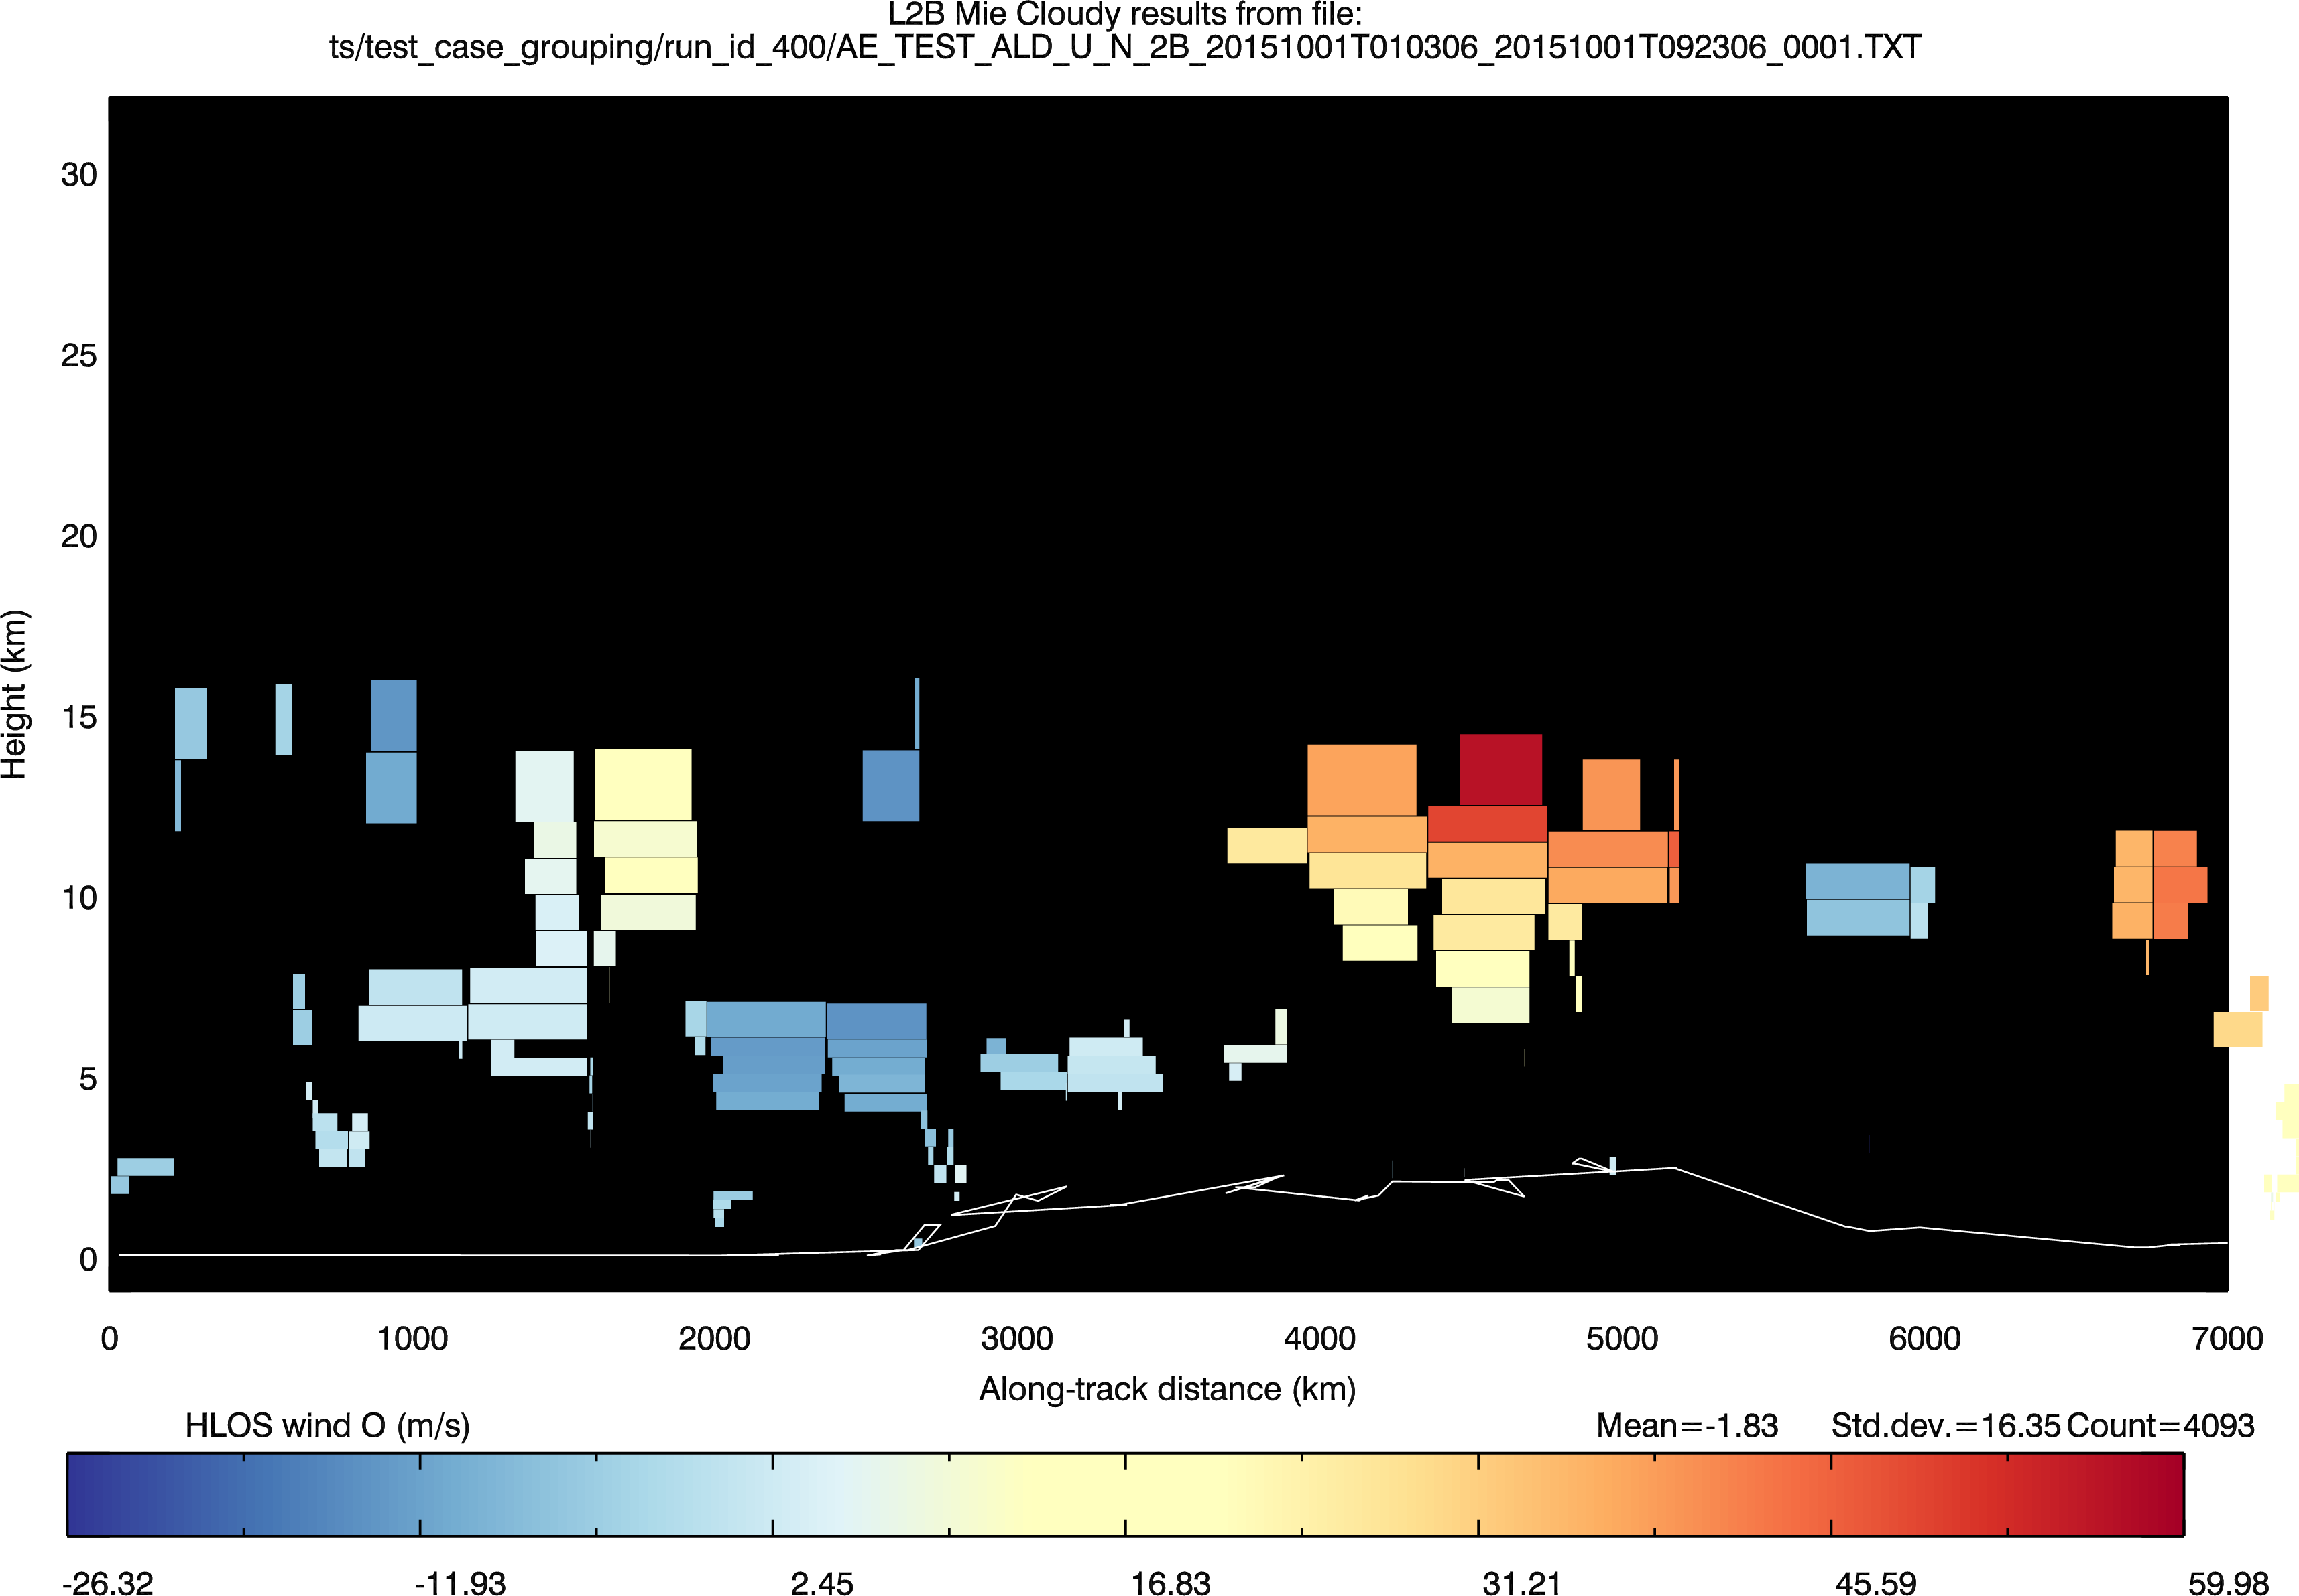
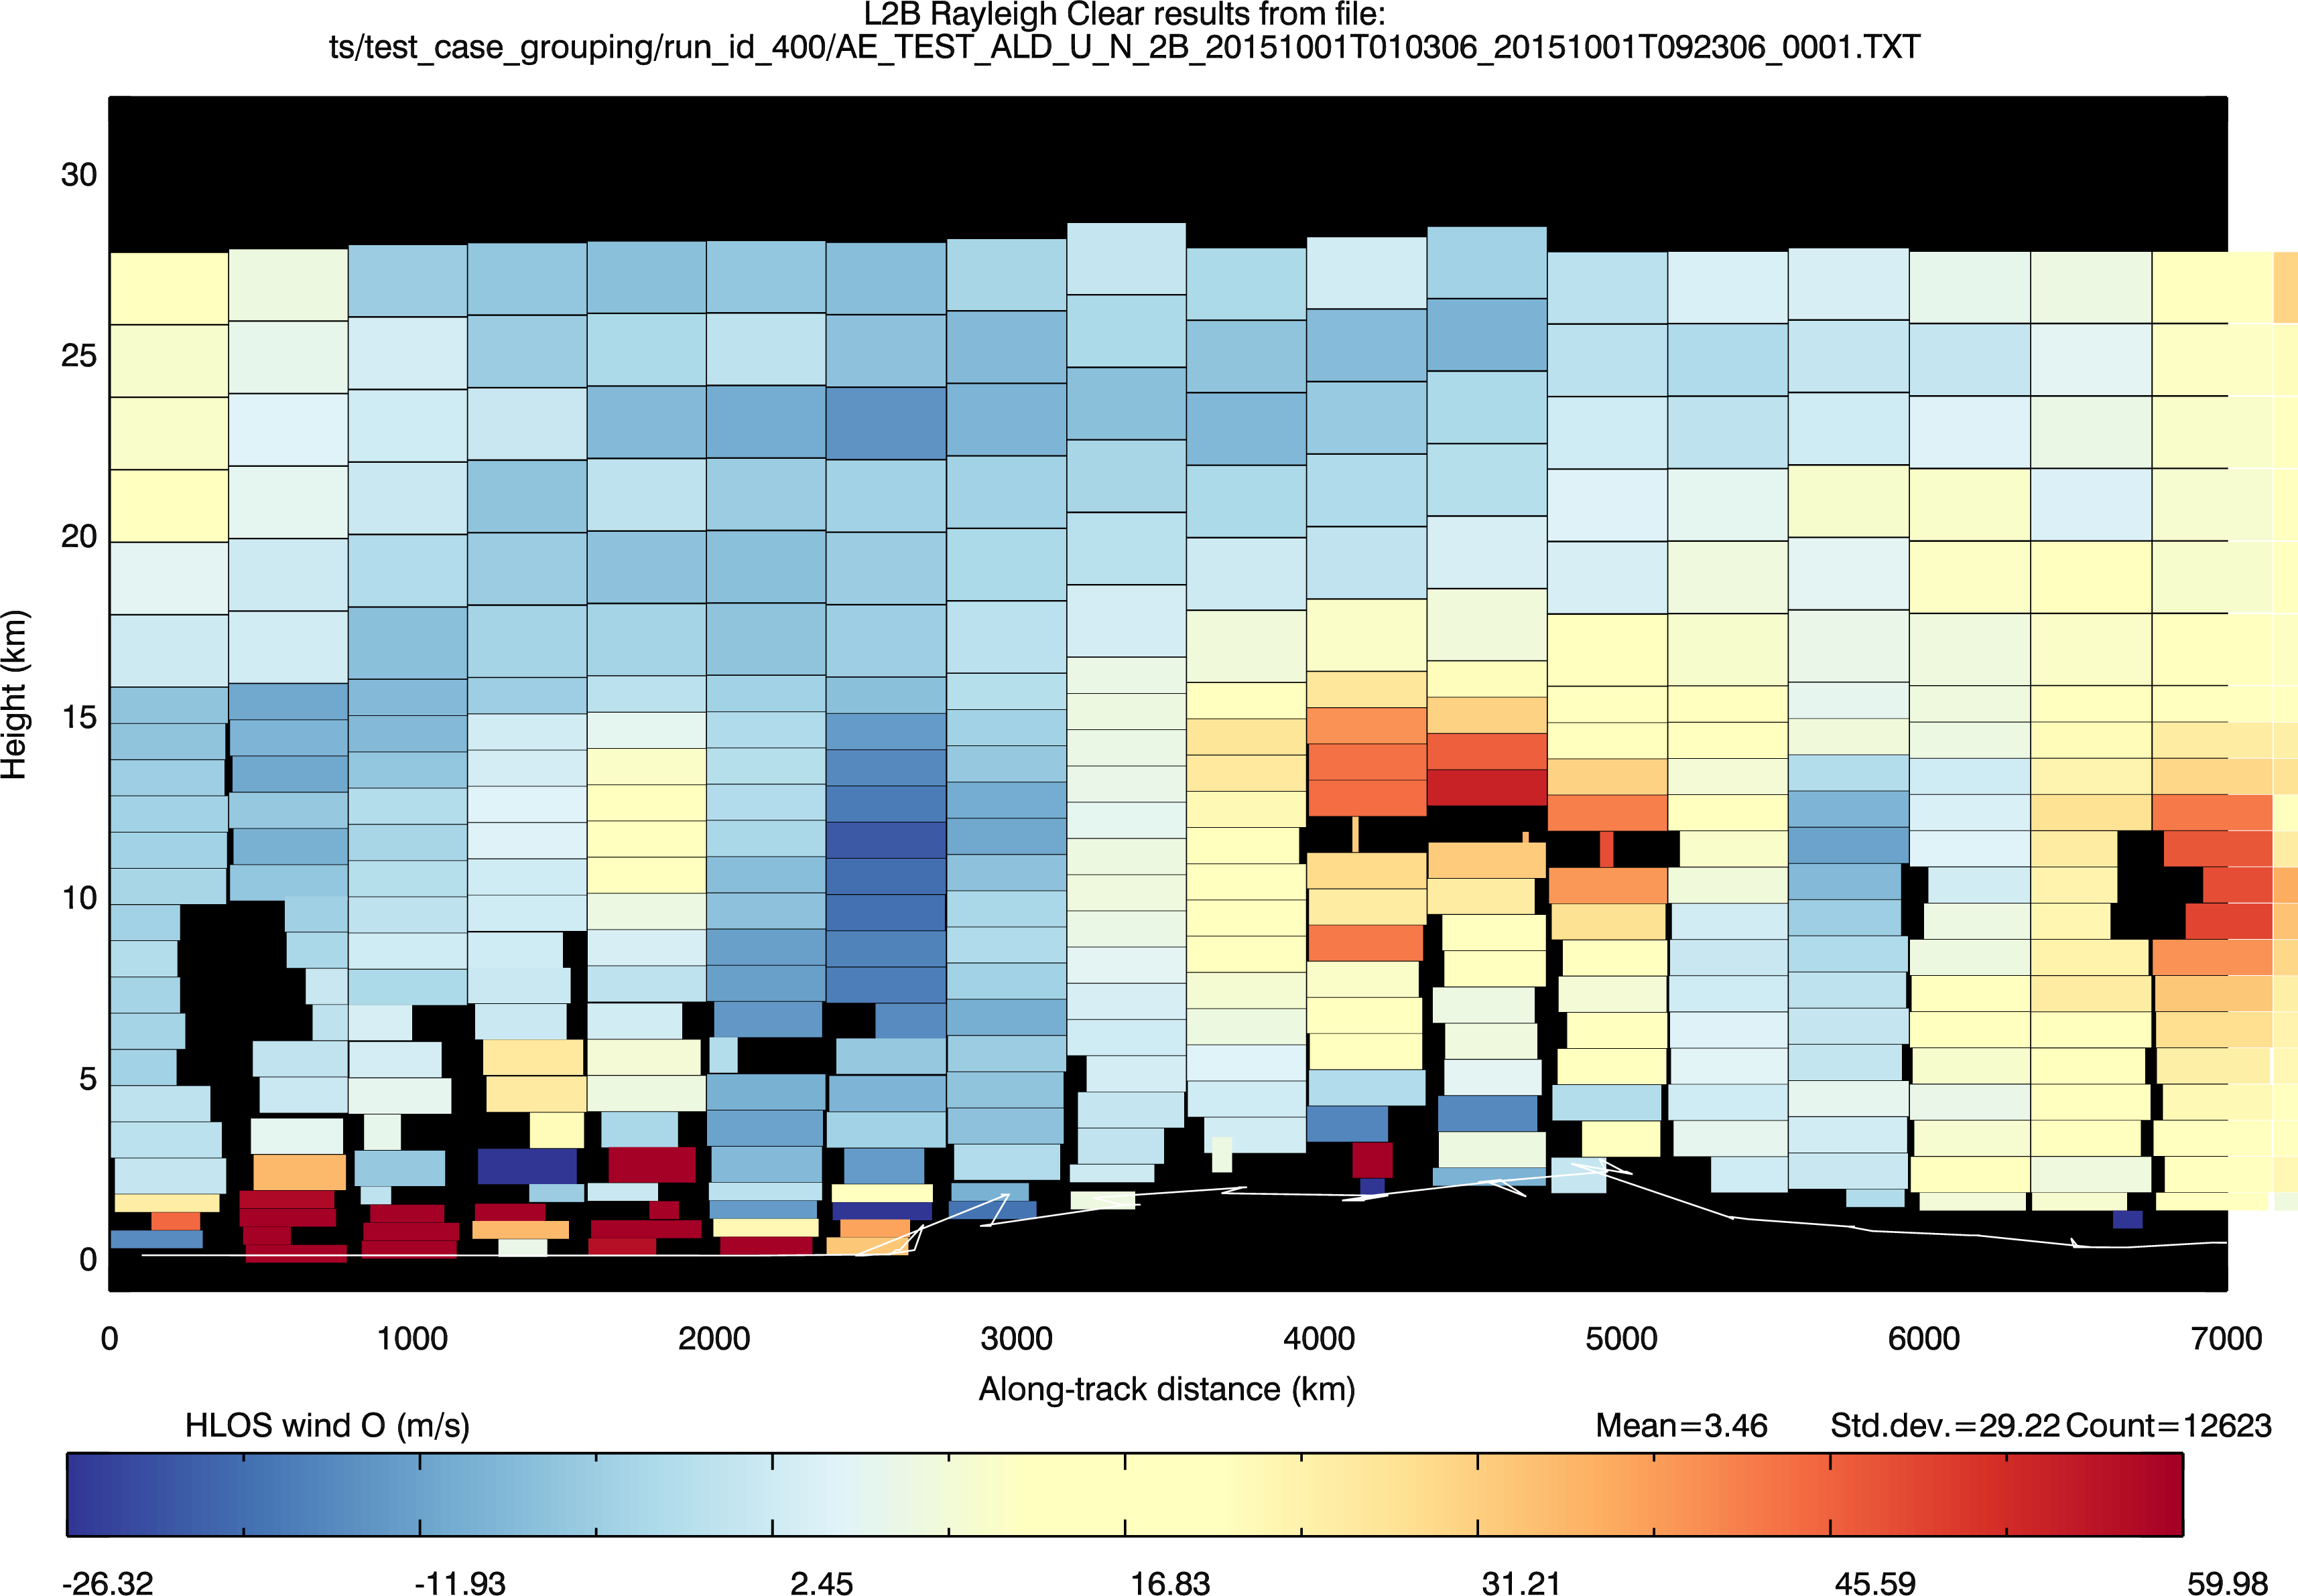
400 km group size

Slide 27
L2B wind error st. dev. vs. grouping length
Can achieve reasonable accuracy 10 km Mie winds
For ECMWF: 100 km for Rayleigh and ~30 km for Mie seems reasonable
For e.g. 2 km models, I would try the 10 km averaging for Mie

Slide 28
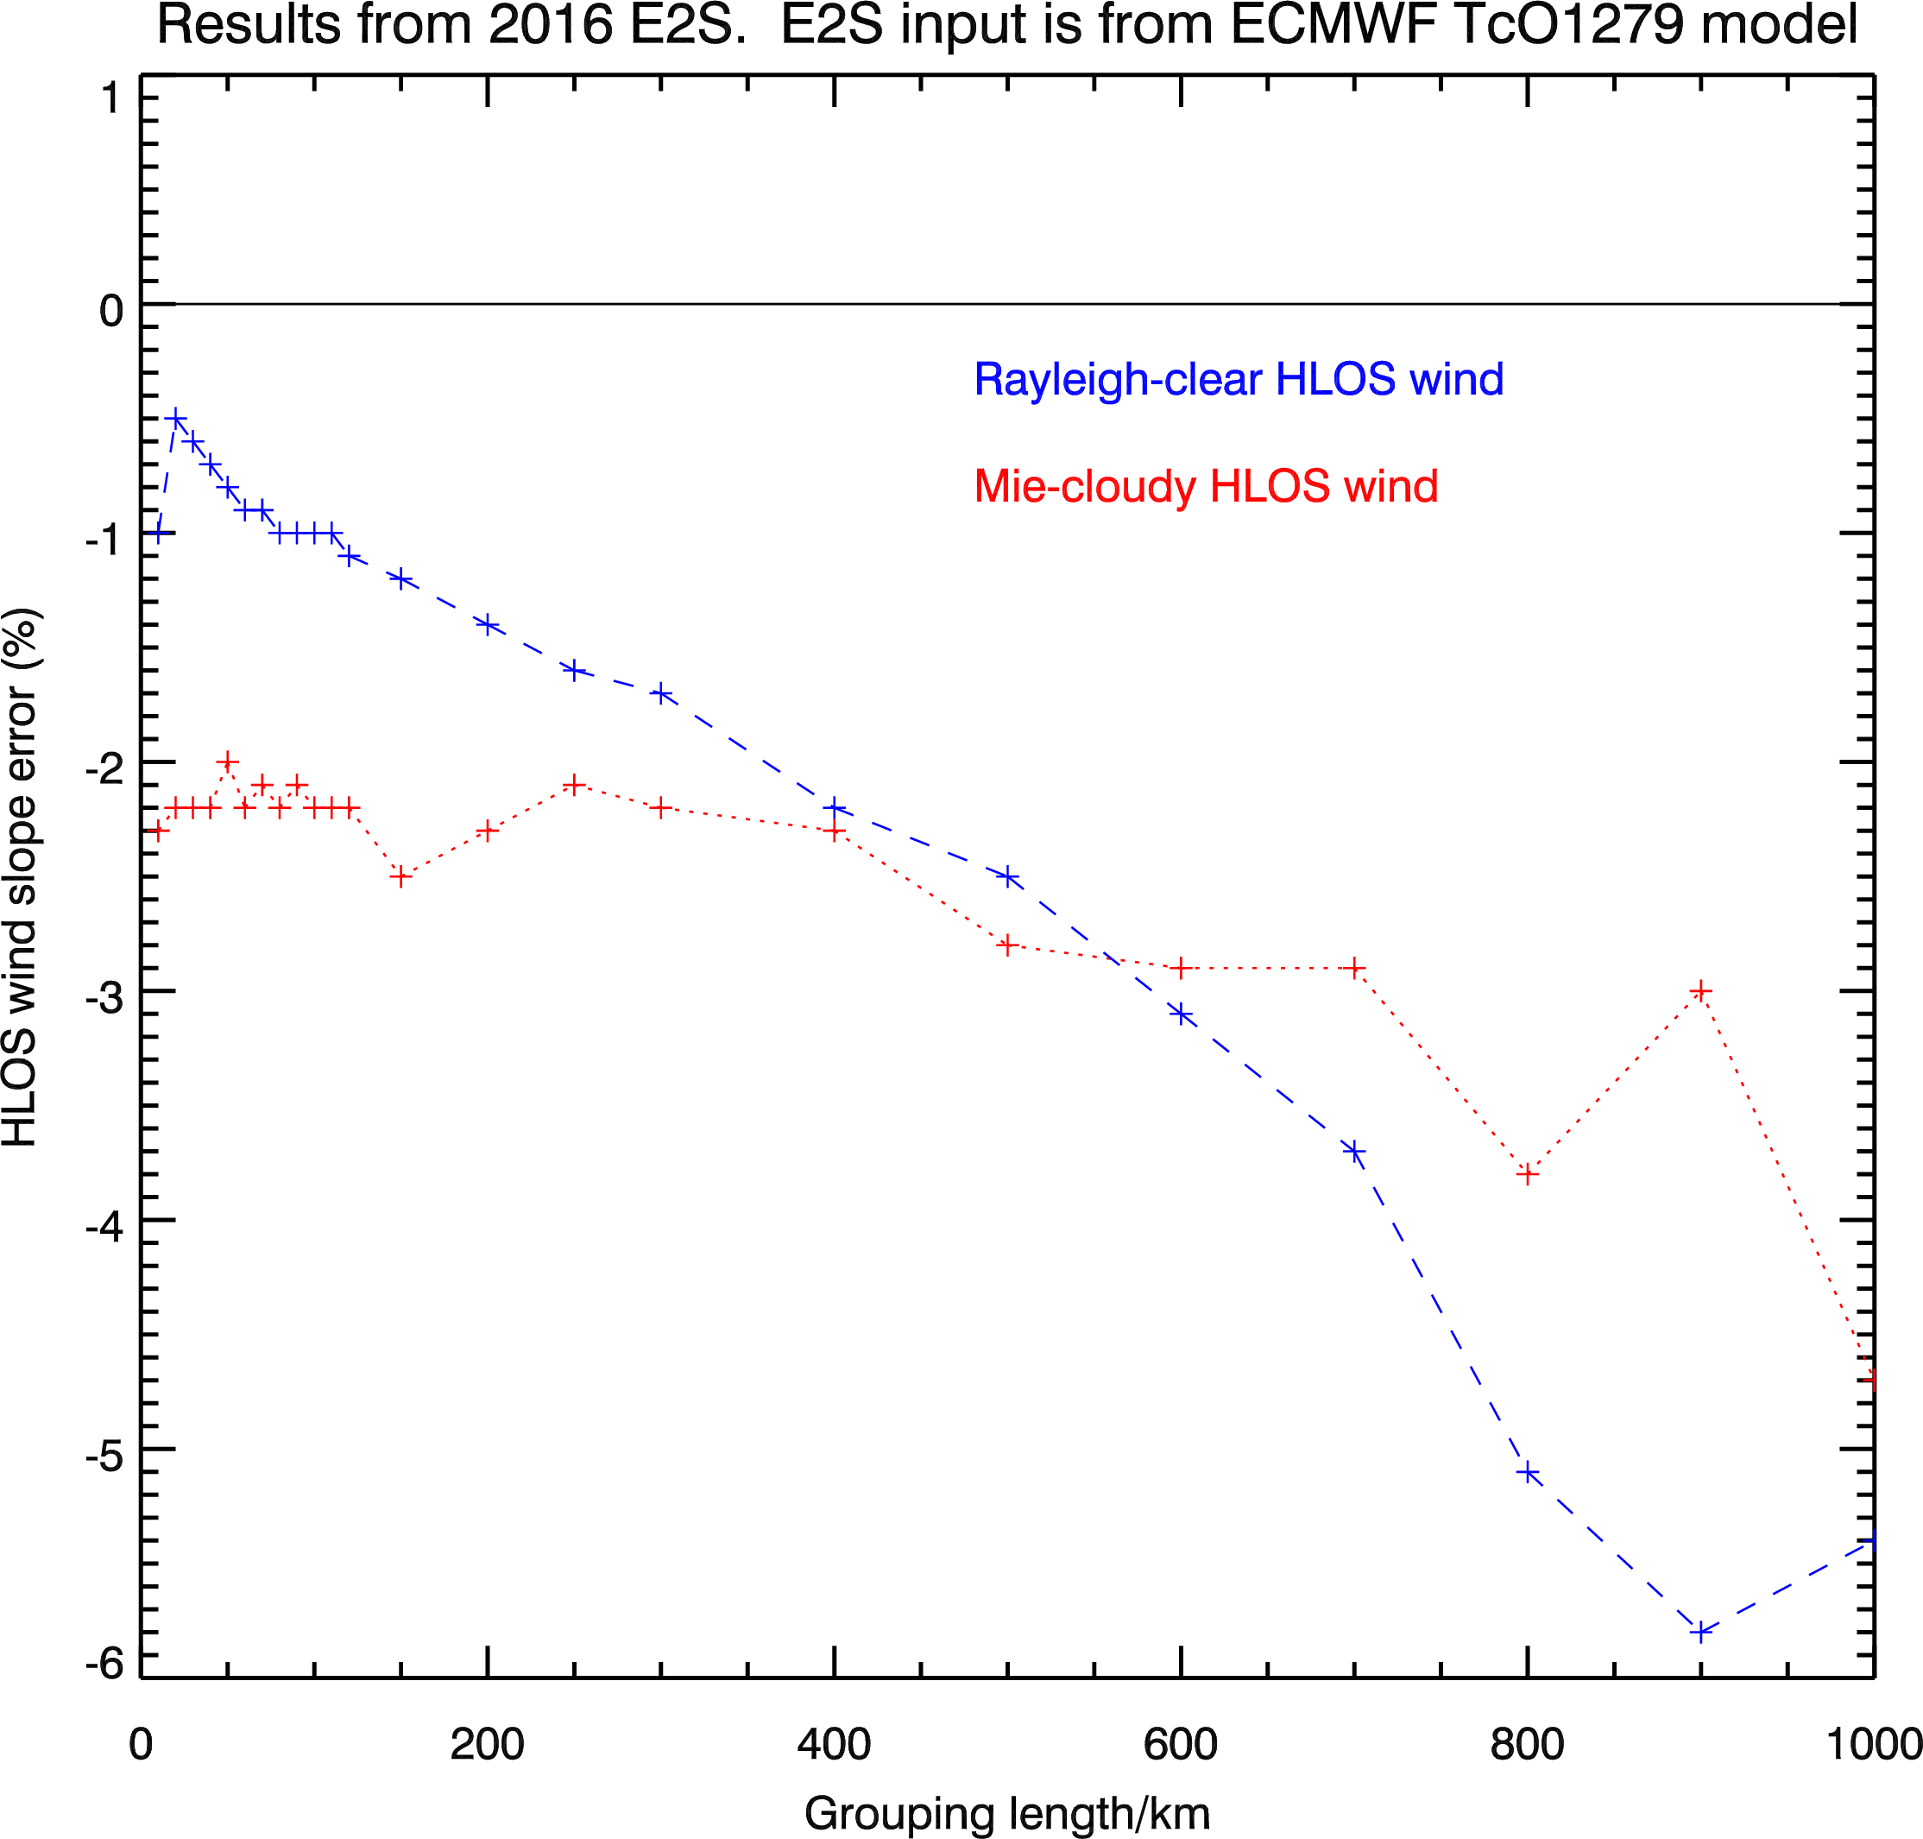
L2B wind slope error vs. grouping length
obs
ideal
actual
truth
Too much horizontal averaging blurs jet stream gradients in Rayleigh winds – i.e. reducing the extremes and hence leading to a slope error (bias) compared to “point” winds

Slide 29

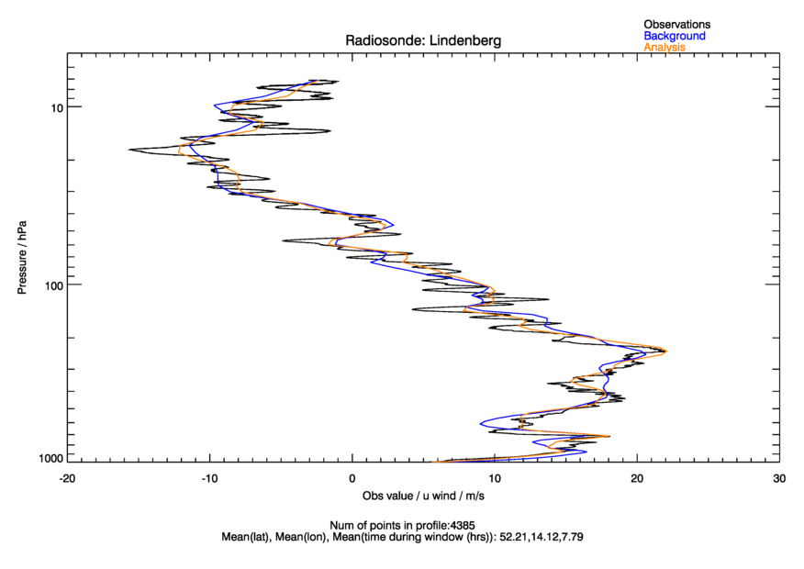
Vertical representativeness issues
Variability over sampling volume in: scatterers and wind
Relevant reference: K. Houchi et al. 2010
Example of Aeolus vertical sampling (24 bins)
30 km ~10 hPa
16 km
16 km
0 km
0 km
WGS84

Slide 30
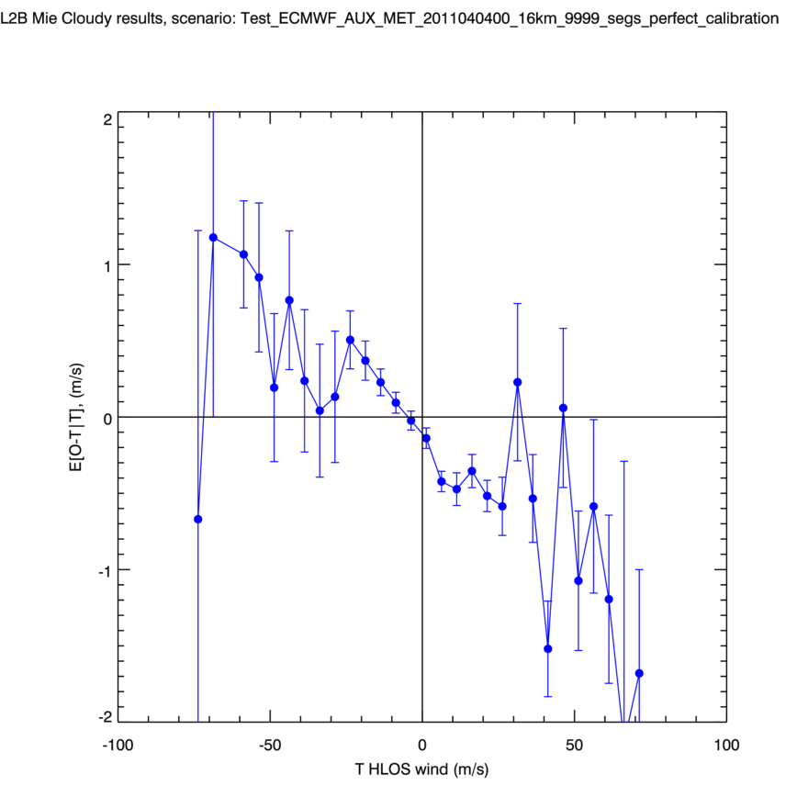
Mie test case in realistic atmosphere (ECMWF clouds) with “perfect” calibration
L2B Mie-cloudy HLOS wind error dependence on true HLOS wind
Slope error ~2%
Even “perfect” calibration has a large overall slope error

Slide 31
Possible explanation for Mie slope error in ECMWF wind/cloud atmosphere
Larger HLOS wind associated with jet streams
Jet streams have large vertical wind shear
Mie wind obs in strong vertical wind shear combined with thicker range-bins can have unrepresentative height assignment giving effective HLOS wind bias
See slope error due to symmetry of +ve (ascending) and –ve HLOS wind (descending orbit)
range-bin
height
assigned height (mid-bin)
true height
HLOS wind

Slide 32
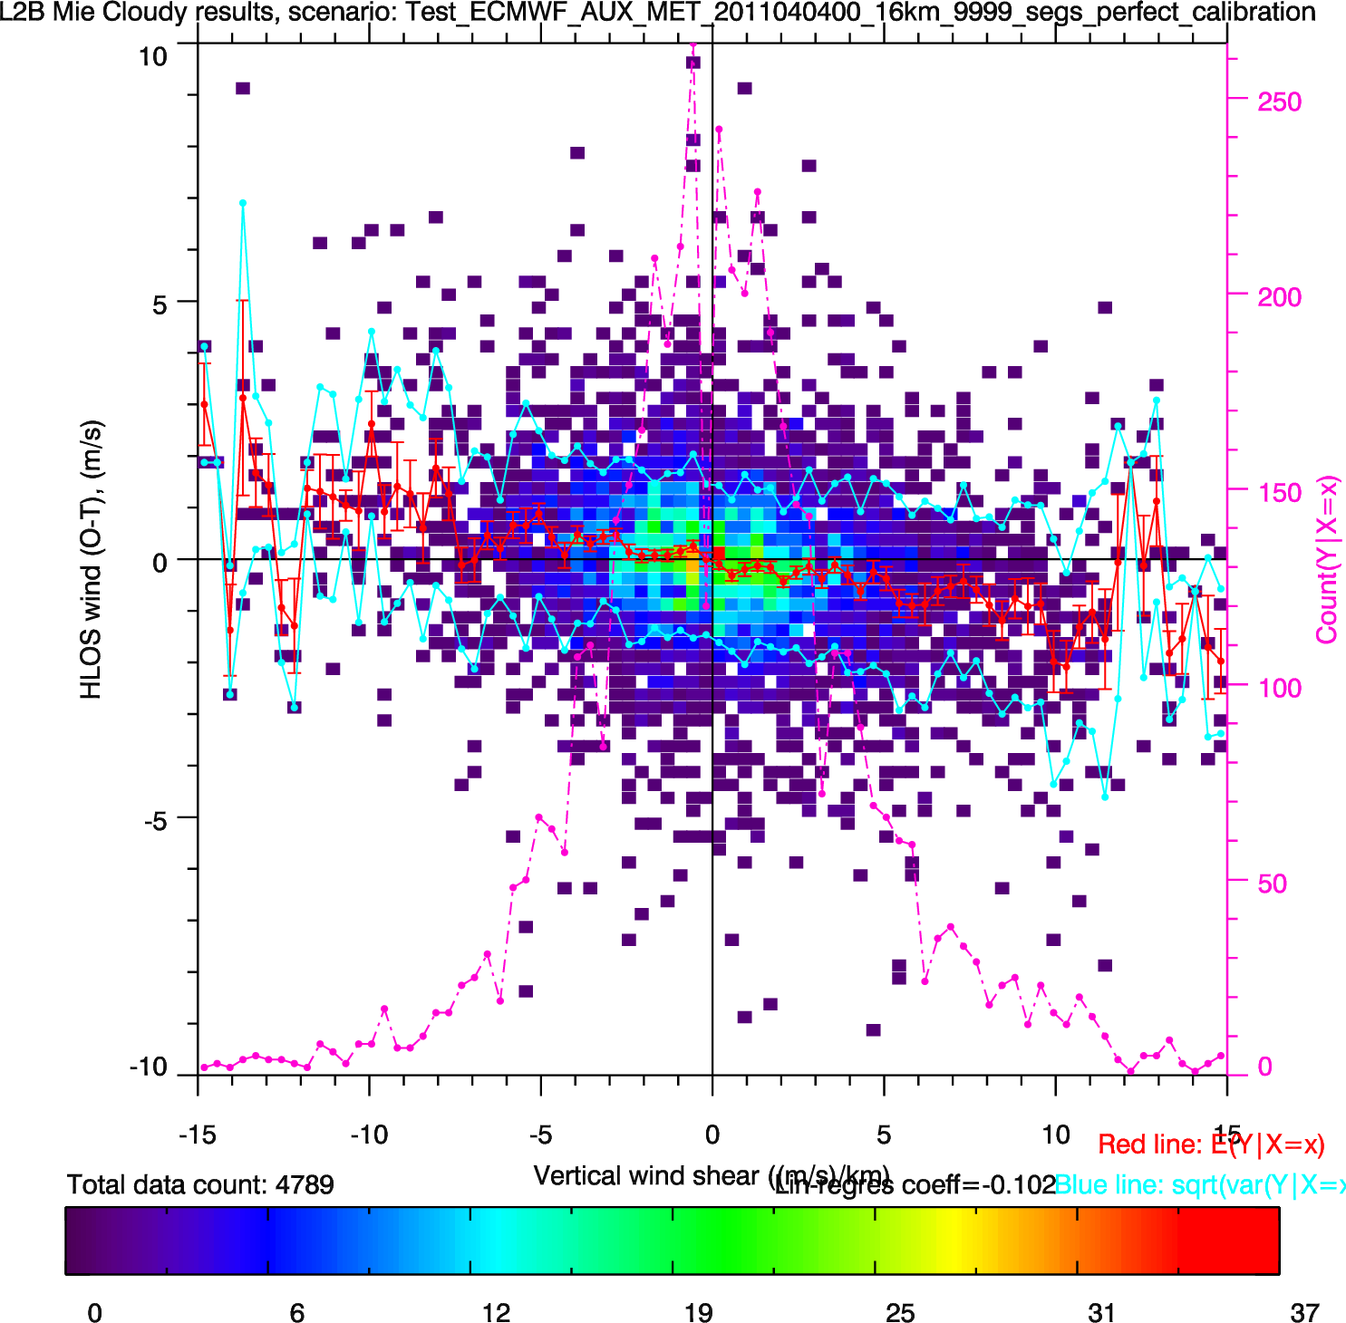
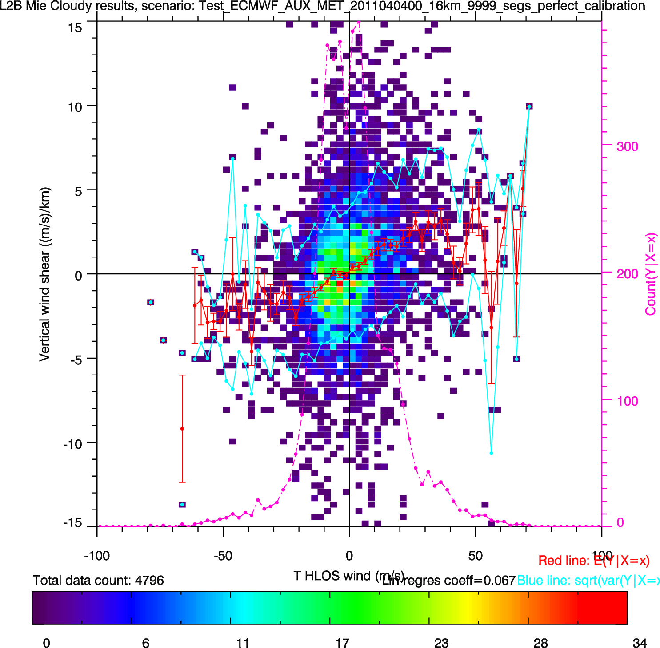
Evidence in monitoring
L2B Mie-cloudy HLOS wind mean error has small dependence on HLOS vertical wind shear
HLOS wind vertical wind shear wind shear positively correlated with HLOS wind

Slide 33
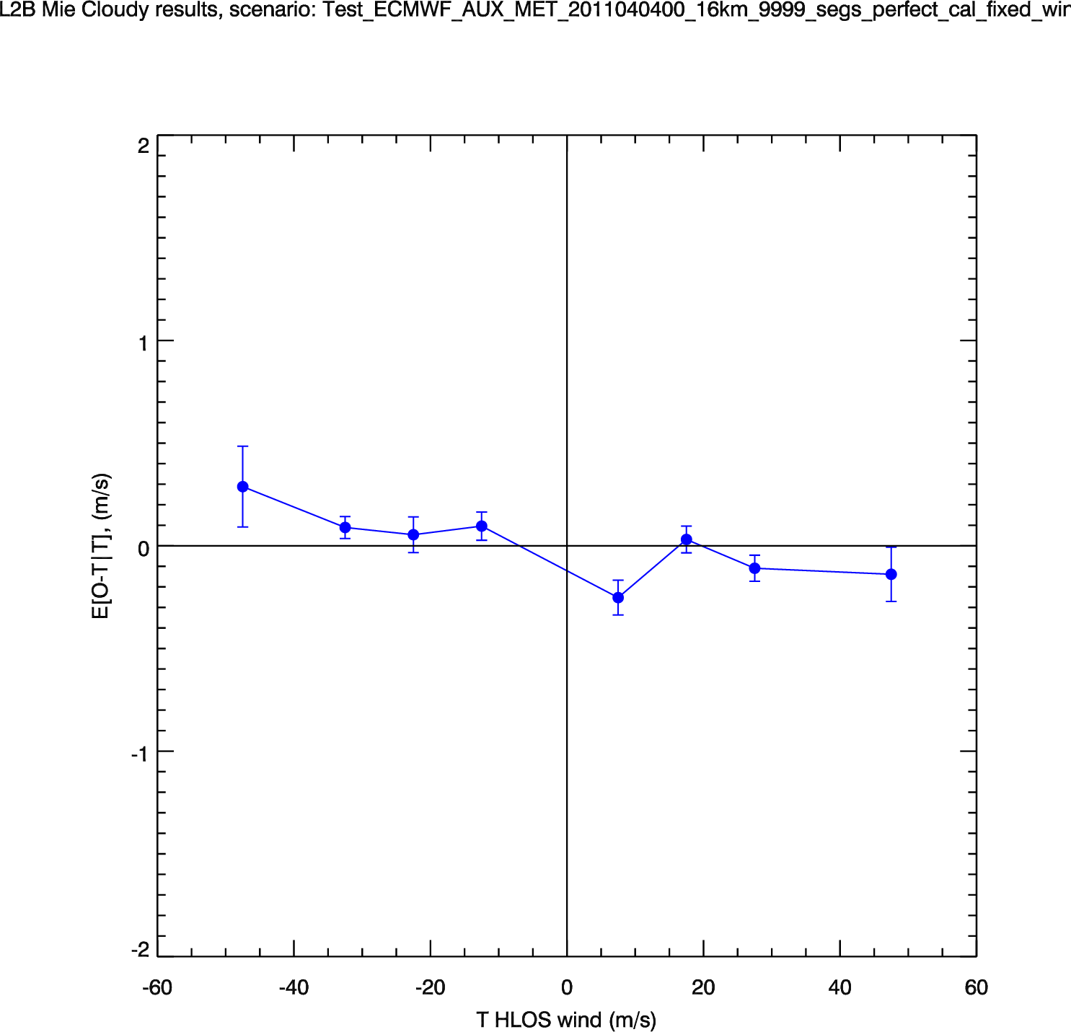
Test hypothesis: use same optical properties (clouds) but with zero vertical wind shear
New: with no vertical wind shear
Original: with ECMWF winds
Slope error reduced – but not the whole story

Slide 34
Data assimilation of Aeolus

Slide 35
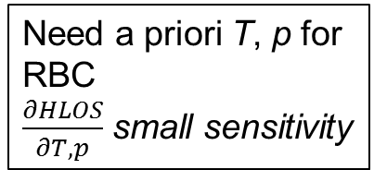
What level Aeolus product to assimilate in NWP?
More complex obs operator: increasing knowledge of instrument and atmospheric physics
H(x)
lidar signal:
H(u,v,w,T,p,CLWC, CIWC, aerosol)
Current choice at ECMWF
RR:
H(u,v,w,T,p)
LOS wind:
H(u,v,w)
HLOS wind:
H(u,v)
Wind vector:
H(u) +H(v)
“Raw” obs
Geophysical variable/direct obs
L1B lidar useful signal
L1B Rayleigh
Response (RR)
L2B LOS wind
L2B HLOS wind:
Mie
Rayleigh
L2C wind vector: Bad idea!
y
More complex retrieval (processing)
Need a priori T, p for RBC
$\frac{∂HLOS}{∂T,p}$ small sensitivity
Need a priori: e.g. 1D-Var retrieval
strong sensitivity!

Slide 36
L2B HLOS wind assimilation
Observation operator: HLOS wind operator (point-wind version)
  Interpolation of model wind to obs geolocation point
  Calculate HLOS wind from model u,v
  Dot product of wind vector with laser pointing unit vector
Weaknesses:
  HLOS wind assumed as grid-point wind rather than spatial average
    However model effective resolution is 4-8 times the grid (~36-72 km horizontally), so may not matter
  Ignores vertical wind component w
  L2B Rayleigh wind retrieval uses a priori knowledge of T, p (a small dependence on background error), but can be accounted for in obs operator, see D. Tan (2007)
R can be based on L2B standard error estimates
Notes:
Errors in Rayleigh winds due to a priori:
0.003 (m/s)/hPa LOS
0.1 (m/s)/K LOS?

Slide 37
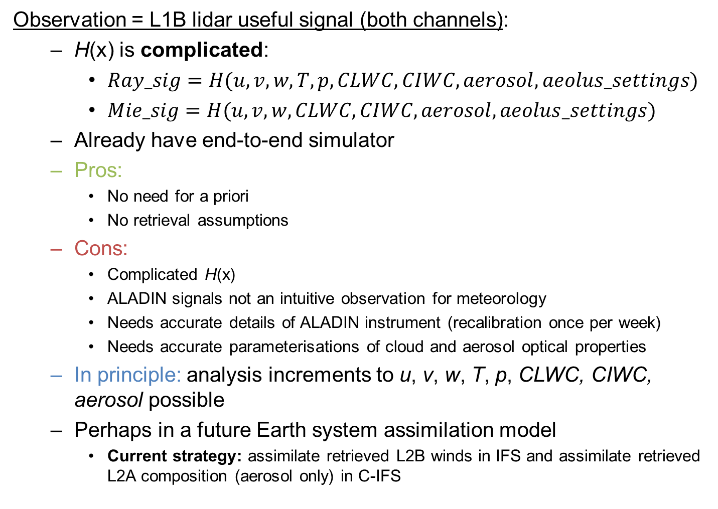
Could L1B signals be assimilated?
Observation = L1B lidar useful signal (both channels):
  H(x) is complicated:
    $Ray_sig=H(u,v,w,T,p,CLWC,CIWC, aerosol, aeolus_settings)$
    $Mie_sig=H(u,v,w, CLWC, CIWC, aerosol,aeolus_settings)$
  Already have end-to-end simulator
  Pros:
    No need for a priori
    No retrieval assumptions
  Cons:
    Complicated H(x)
    ALADIN signals not an intuitive observation for meteorology
    Needs accurate details of ALADIN instrument (recalibration once per week)
    Needs accurate parameterisations of cloud and aerosol optical properties
  In principle: analysis increments to u, v, w, T, p, CLWC, CIWC, aerosol possible
  Perhaps in a future Earth system assimilation model
    Current strategy: assimilate retrieved L2B winds in IFS and assimilate retrieved L2A composition (aerosol only) in C-IFS

Slide 38
Where to get the data?

Slide 39
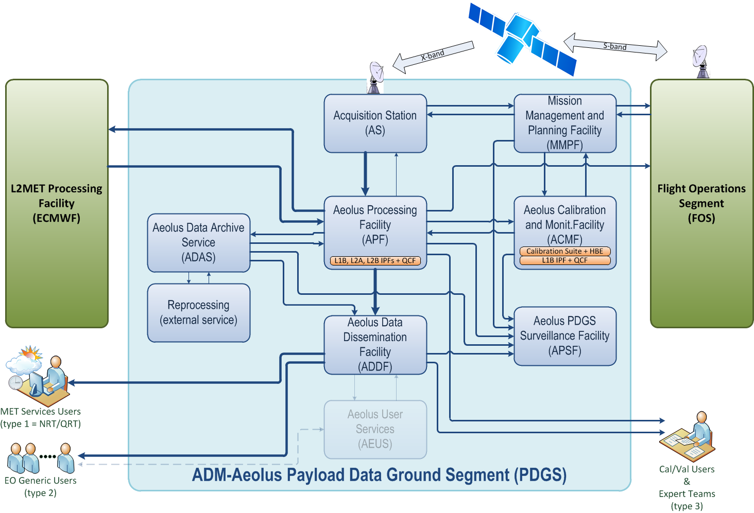

Slide 40
Aeolus L2B products during the mission
ECMWF will operationally produce L2B products for ESA in NRT
  Processor settings will be optimised for ECMWF’s benefit
  L2B WMO approved BUFR archived for member states
User’s may wish to install and run L2B processor themselves
  Get involved in research to improve winds!
  Highly portable, easily installed software – mostly Fortran 90
  Easy to run on Linux
  Software can be freely downloaded from:
    https://software.ecmwf.int/wiki/display/AEOL/ADM-Aeolus+Level-2B+Processor+Package
  L1B data will be provided in NRT by ESA
KNMI may also be producing research products in NRT

Slide 41
ADM-Aeolus operational L2B (winds) processing at ECMWF
ECMWF to be funded by ESA to operationally process and monitor L2B winds during mission
L2B processing will now run as part of operational observation pre-processing:
Data driven: process each L1B product as it arrives from ESA’s PDGS
This means ECMWF will perform Near-Real-Time L2B processing
Benefits:
  Reduced complication compared to having L2Bp as part of the data assimilation suite(s).
  Will allow more Aeolus L2B data into early delivery data assimilation suite.
  Member states and other users will have access to Aeolus L2B BUFR sooner.
To achieve this, the forecast background used in the processing (“AUX_MET”) will be based on our early delivery forecast (up to 19 h forecast) and predicted orbits.

Slide 42
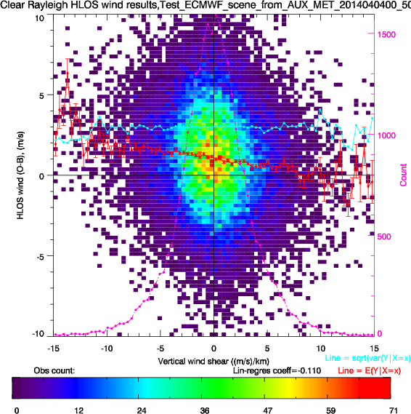
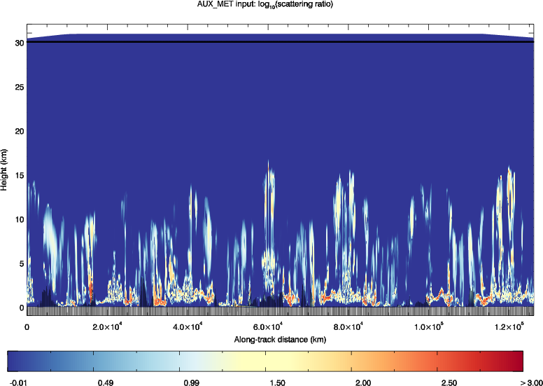
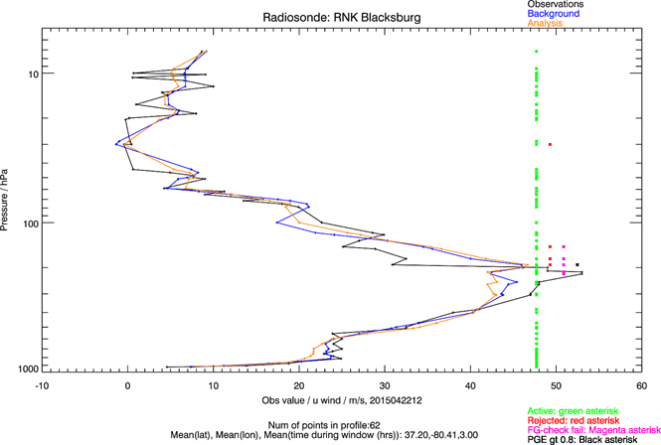
Advanced monitoring of L1B/L2B data
Developed advanced monitoring tools for Aeolus – NWP model as reference
Want to understand Aeolus data problems soon after launch
Focus on bias detection
Assess conditions where NWP model has large bias – i.e. is less useful as reference
Bias models:
ECMWF predicted optical prop.:
Detailed look at assimilation:

Slide 43
Any questions?

Slide 44
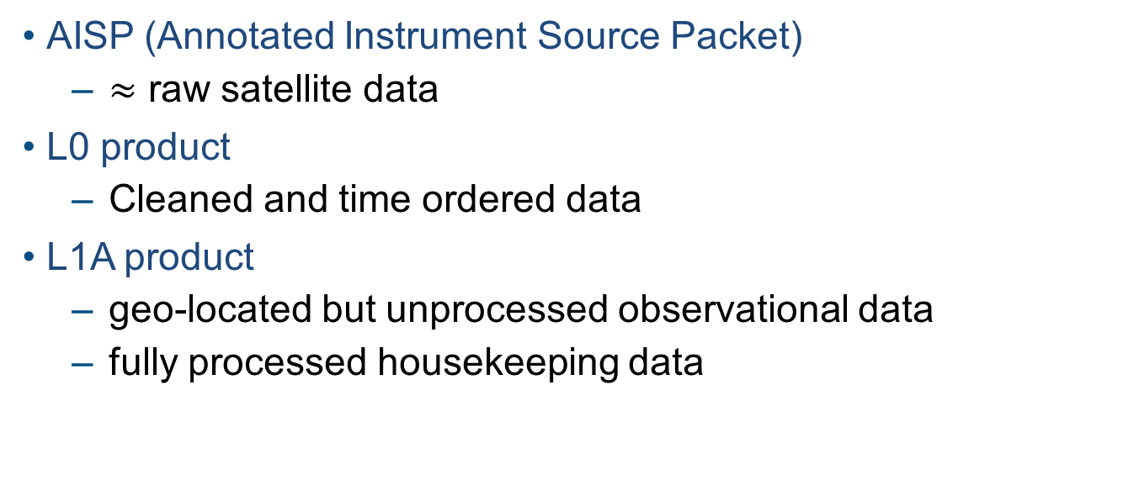
Data preparation
AISP (Annotated Instrument Source Packet)
  $≈$ raw satellite data
L0 product
  Cleaned and time ordered data
L1A product
  geo-located but unprocessed observational data
  fully processed housekeeping data

Slide 45
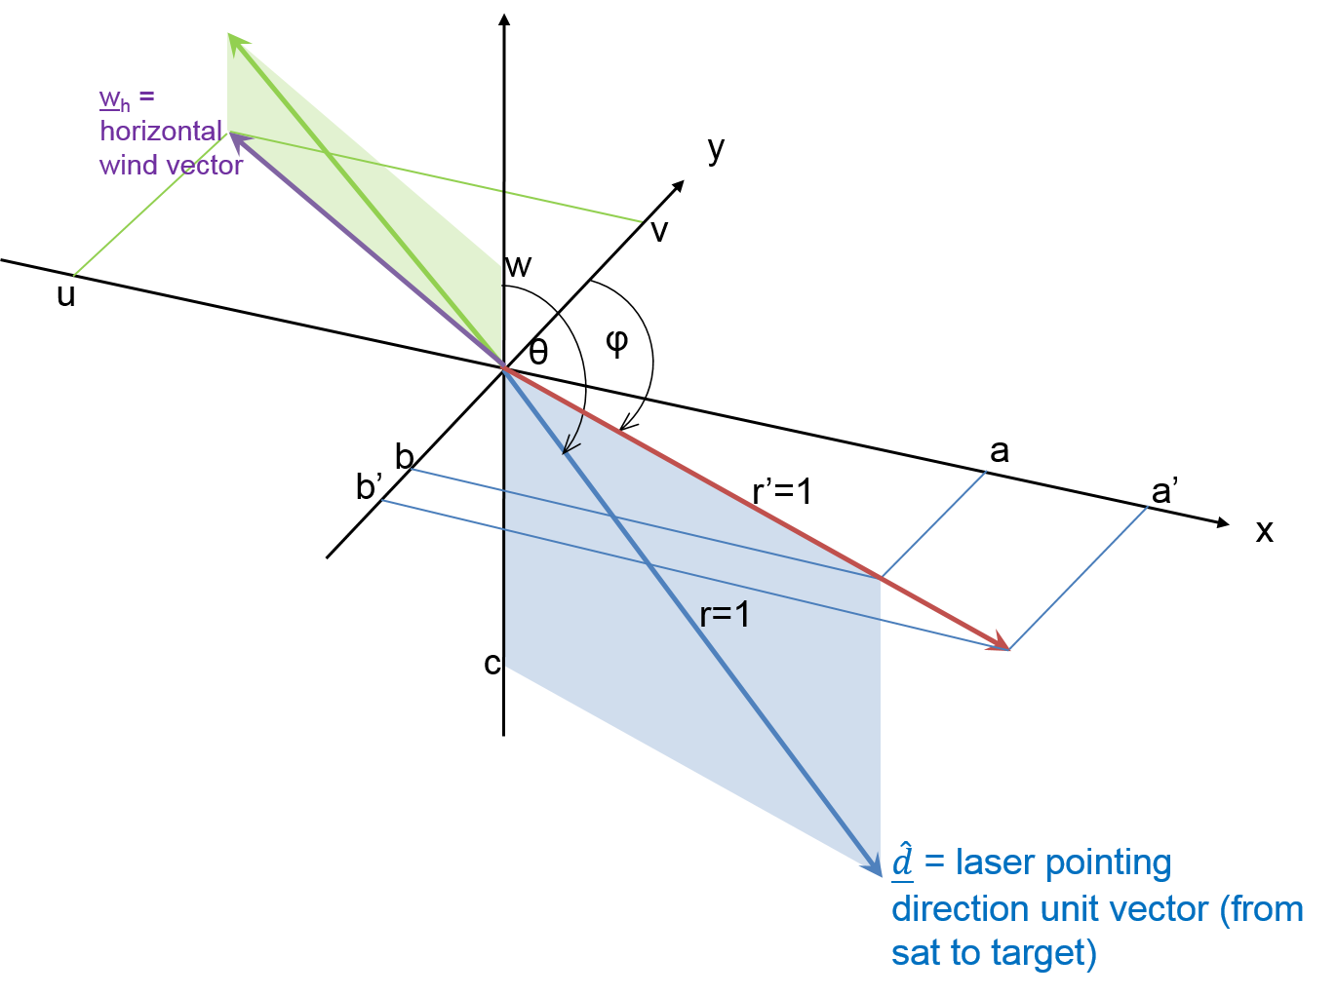
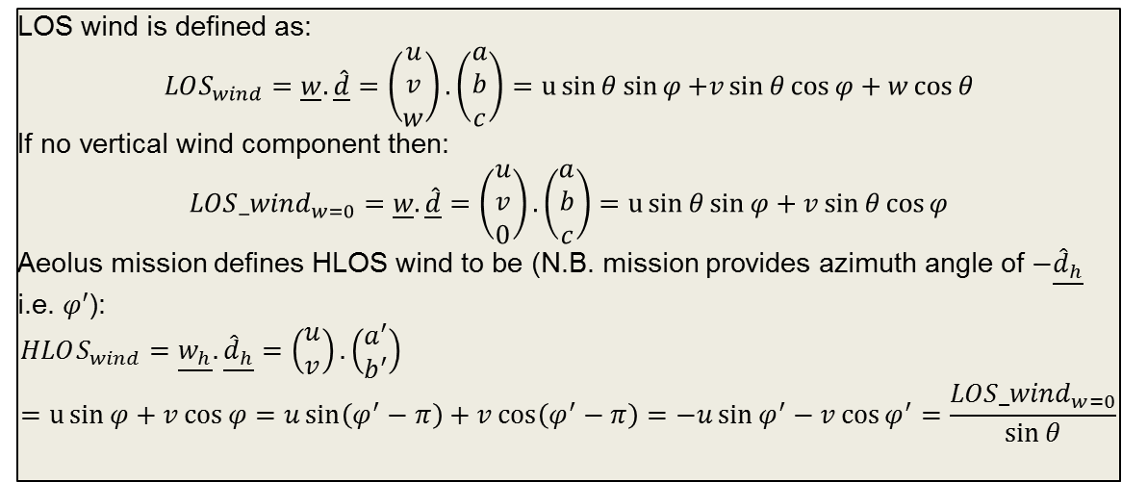
LOS wind is defined as:
$$LOS_{wind}=\underline{w}.\underline{\hat{d}}=\left(\begin{matrix}u \\ v \\ w\end{matrix}\right).\left(\begin{matrix}a \\ b \\ c\end{matrix}\right)=u\sin{θ\sin{φ}{+v\sin{θ\cos{φ+w\cos{θ}}}}}$$
If no vertical wind component then:
$${LOS_wind}_{w=0}=\underline{w}.\underline{\hat{d}}=\left(\begin{matrix}u \\ v \\ 0\end{matrix}\right).\left(\begin{matrix}a \\ b \\ c\end{matrix}\right)=u\sin{θ\sin{φ+v\sin{θ\cos{φ}}}}$$
Aeolus mission defines HLOS wind to be (N.B. mission provides azimuth angle of $−\underline{{\hat{d}}_{h}}$ i.e. $φ′$):
$$HLOS_{wind}=\underline{w_{h}}.\underline{{\hat{d}}_{h}}=\left(\begin{matrix}u \\ v\end{matrix}\right).\left(\begin{matrix}a^{′} \\ b^{′}\end{matrix}\right)=u\sin{φ}+v\cos{φ}{=u\sin\left(φ^{′}−π\right)+v\cos\left(φ^{′}−π\right)=−u\sin{φ^{′}}−v\cos{φ^{′}}=\frac{{LOS_wind}_{w=0}}{\sin{θ}}}$$

Slide 46
Aeolus geometry
v_{sat}
satellite
(ascending orbit)
N
elevation angle
If horizontal wind +ve u
Then get +ve HLOS wind
target
W
E
azimuth angle (~260 deg) = angle clockwise from N to target-to-satellite pointing vector (projected on horizontal)
S

Slide 47
v_{sat}
satellite
(descending orbit)
N
elevation angle
target
If horizontal wind +ve u
Then get -ve HLOS wind
W
E
azimuth angle (~100 deg)
S

Slide 48
L2B processor
Software developed over many years by ECMWF, KNMI + for ESA
Steps in HLOS wind retrieval:
  Input Screening of L1B data e.g. range checks
  Match AUX_MET (T,p) data to measurements (used for Rayleigh T, p correction)
  Optional: Optical properties
    Estimates of measurement-level particulate backscatter/extinction; scattering ratio
  Horizontal grouping of measurements
  Classification (clear/cloud) of measurements
    Default: using threshold on L1B scattering ratio
    Optional: using threshold on L2B optical properties
  Accumulation of measurement signals
  Mie channel wind retrieval
  Rayleigh channel wind retrieval (with Rayleigh-Brillouin correction)
  Error quantifier estimation
Additional tools: L2B EE to BUFR converter, various ASCII dump tools, etc.

Slide 49
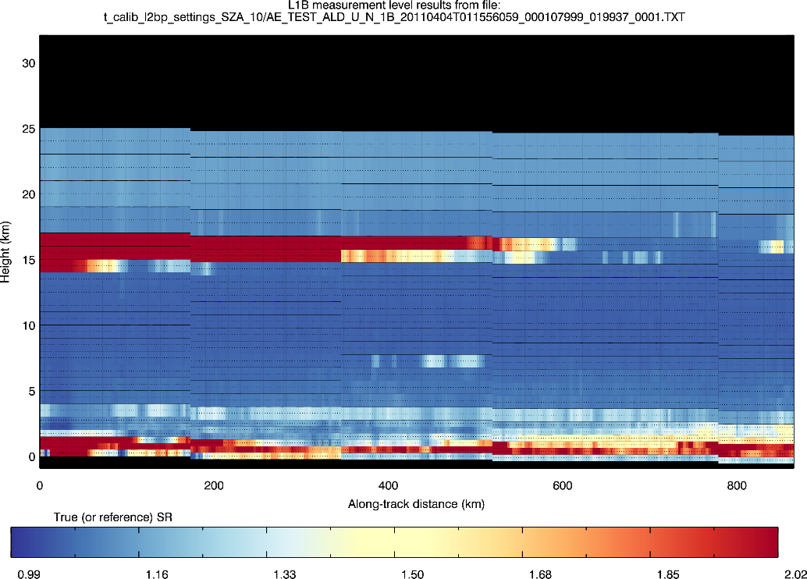
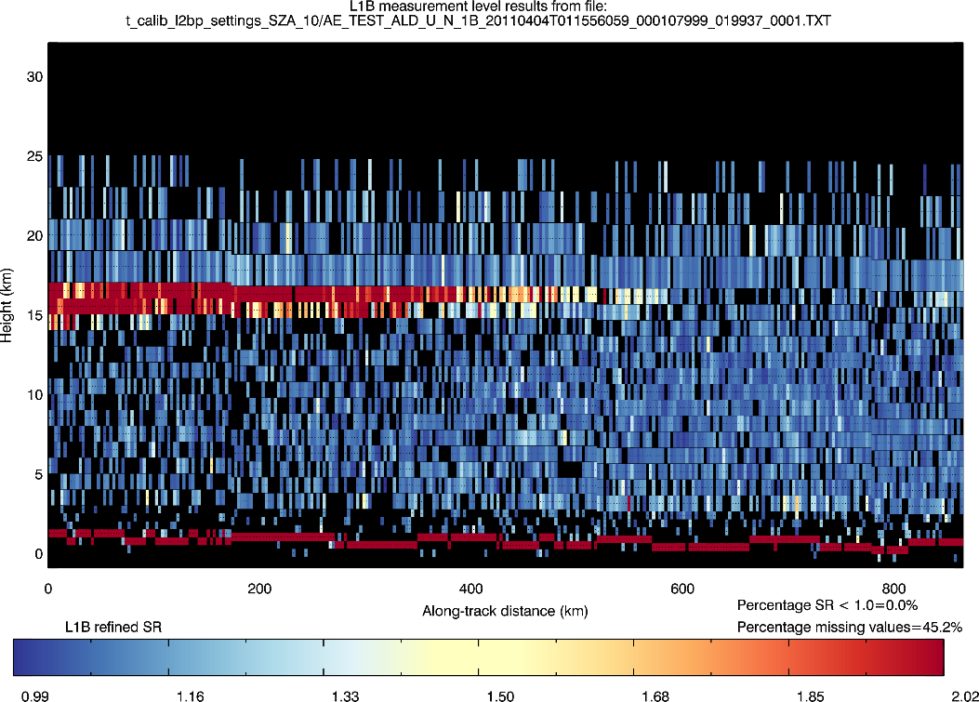
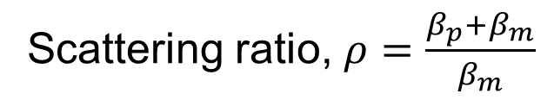
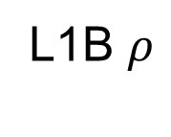

Classification into clear/cloudy: using L1B measurement level scattering ratio
Scattering ratio, $ρ=\frac{β_{p}+β_{m}}{β_{m}}$
Truth$ρ$
L1B $ρ$
LITE scene A
45% missing values
Optical properties retrieval may improve upon L1B $ρ$

Slide 50

Grouping of measurements and accumulation

Slide 51


Slide 52


Typical L2B HLOS wind error statistics (2014)
E2S input: ECMWF T1279
Stdev(error)
Mean(error)
Number of obs
ESA required accuracy
Rayleigh and Mie are complementary
Rayleigh-clear (night-time)
Mie-cloudy
2-3 m/s
Typically < 0.5 m/s
1-2 m/s
~0.3 m/s
Notes:
Based on 4 orbits. Using ECMWF cloud properties for cloud backscatter
80 mJ laser
1 BRC horizontal averaging
Stats are sensitive to QC; QC applied:
reject > 5 m/s error estimates on Rayleigh
Reject > 3 m/s error estimates on Mie
Rayleigh signal attenuated by clouds lower down, hence drop off in number of “good” quality observations.

Slide 53
L2B wind error sources
Instrument errors:
  e.g. readout noise, laser frequency stability, digitisation errors, vertical bin overlap, detection chain offset
Unwanted signals:
  Shot noise: SNR ~√N
  Solar background, dark current
  Unknown non-zero ground relative velocity and angular sensitivity
  Vertical wind; assumed zero in HLOS wind
  Rayleigh sensitivity to T, p of atmosphere
  Cross-talk
  Mixing of ground return and near surface winds
Imperfect calibrations
  Inst. error and unwanted signals during calibration
  Instrument drift
Many biases can be partially corrected for by ground returns
Notes:
non-moving rigid surface with high SNR
Dark current noise
SNR ~Sqrt(N)

Slide 54


