Slide 1
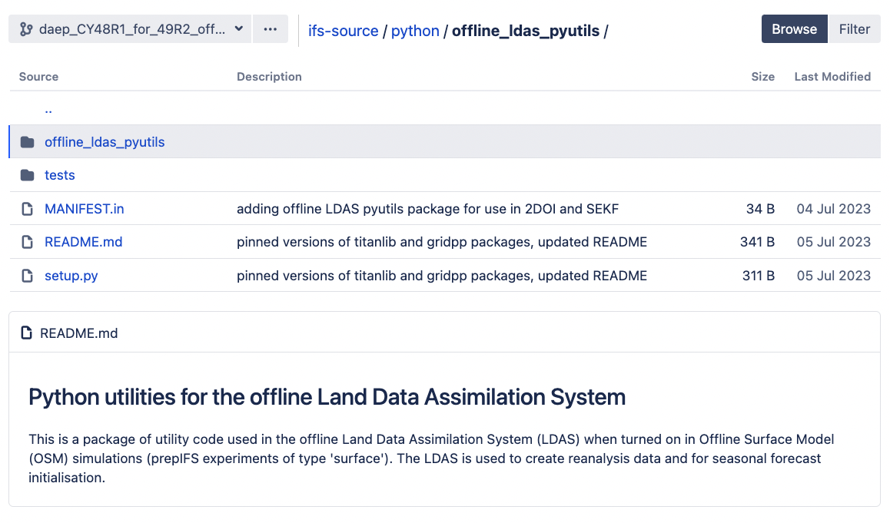
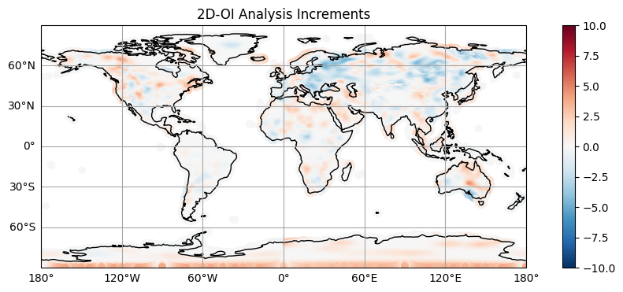
Offline LDAS 2DOI Implementation
The 2DOI uses Python packages from Met Norway (titanlib and gridpp)
Changes to ifs-source, ifs-scripts, ifs-suites & ifs-defaults
Have added SAPP retrieval for NRT operational suite following David’s Ascat examples
Also including synop_bufr2odb.py script to convert the retrieved SAPP synop observations from BUFR to ODB
Offline LDAS python utils package added to ifs-source
Notes:
1

Slide 2
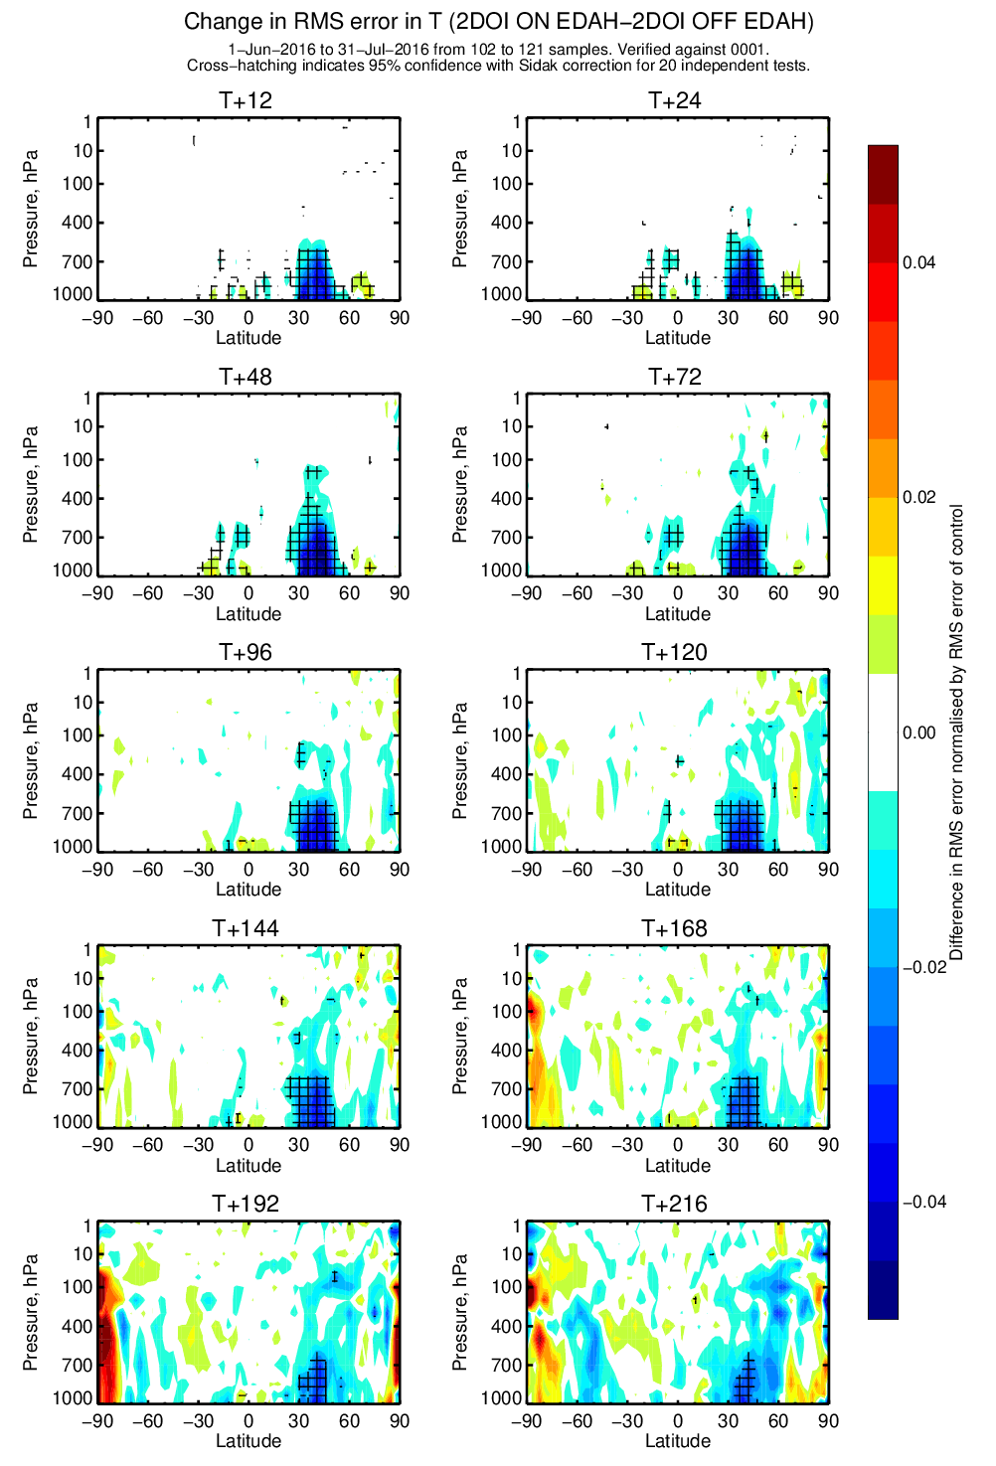
2DOI Impact
Using 2DOI in Offline LDAS improves subsequent forecast only experiments for temperature and relative humidity vs. assimilation of ERA5 pseudo-observations
Plot (right) shows reductions in RMSE for Temperature at long lead times
Can see how to implement the 2DOI in notebook here: confluence.ecmwf.int/display/~daep/Notebook+example+for+T2m+2DOI
Notes:
2

