Slide 1
gridpp and titanlib in NWP and CARRA2
Trygve Aspelien

Slide 2
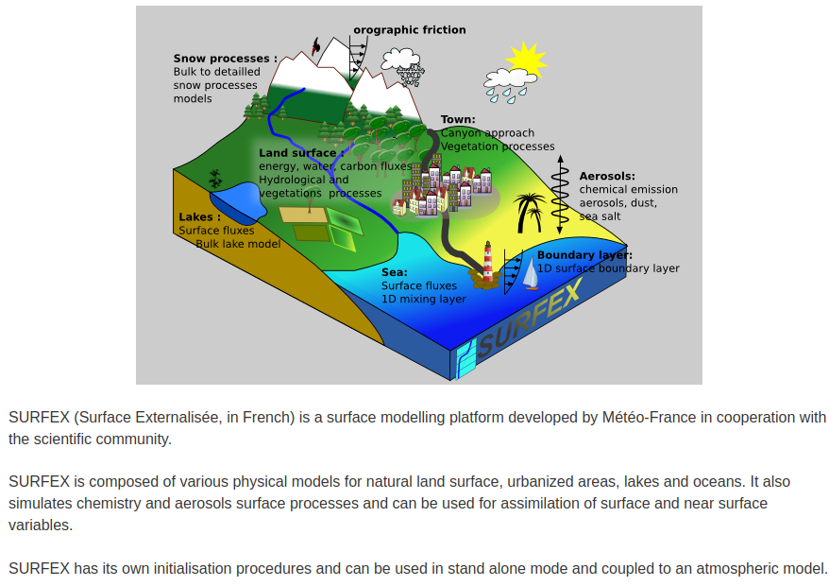
https://www.umr-cnrm.fr/surfex/

Slide 3
https://github.com/metno/pysurfex
Implemented in pysurfex
  python API to external surface model SURFEX used in AROME(ALARO)
    entry points used in non-python systems i.e Harmonie
  Also treats observation input, QC (titanlib) and monitoring and horizontal OI (gridpp)
    https://github.com/metno/pysurfex/blob/master/pysurfex/interpolation.py
    https://github.com/metno/pysurfex/blob/master/pysurfex/titan.py
  Create forcing (e.g, for perturbed runs in SEKF)
  Prepare namelists and execute binaries (e.g SODA updating surface variables based on analysed observations)

Slide 4
Use cases with titanlib + gridpp
MetCoOp nowcast (MNWC) [operational]
AROME-Arctic preop2 [pre-operational]
CARRA2 [operational in 2024]
LDAS system at MET-Norway [being set up] (H2O project)
  https://github.com/metno/pysurfex-experiment
  Script system with ecflow scheduler to run offline experiments
  Using pysurfex (+troika etc, synergies with DEODE)
Harmonie (AROME) cy46h1 [code base, targeted reference system]
Tested in CERISE [Blyverket, Bakketun et.al]
Planned:
  Analysed forcing as input to offline re-forecasts to be used as initial values [Bakketun et.al]

Slide 5
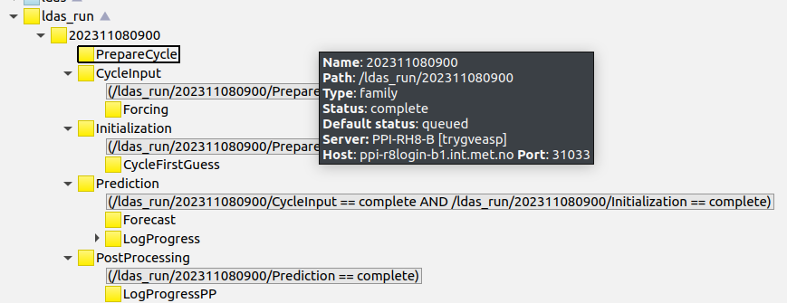
Latest LDAS demo run (no analysis)

Slide 6
Future
we are doing the same with partly the same tools
  could we collaborate on common parts?
  licence issues?
Differences:
  not using ODB (not suitable for offline community)
  Different land-models
  We have a fortran program to update surface files (SODA)
Other things
  call surface model SURFEX also from python?

