Slide 1
Offline land data assimilation system
LSC 2023
11th October 2023
David Fairbairn, Patricia de Rosnay, Ewan Pinnington, Kenta Ochi, Christoph Herbert, Peter Weston, Sebastien Garrigues
Notes:
1

Slide 2
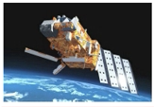
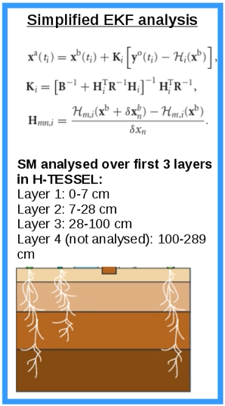
1. Cycle 48R1
Atmospheric forcing
SSM derived from
change-detection approach
(Wagner et al., 1999)
HTESSEL land surface model
Input observations:
ASCAT SM
T2m/RH2m
EKF SM analysis
Output fields:
SM layers 1-3
Adapted from H SAF suite by Clement Albergel (2016)
12-hour assimilation windows (0-12 h and 12-24h)
Option of EDA H Jacobians or finite differences in SEKF
Simplified Extended Kalman (SEKF) filter of
de Rosnay et al., 2013
Notes:
2

Slide 3
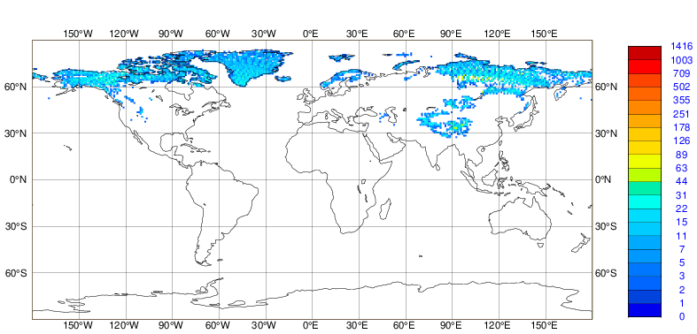
2. Cycle 49R1
Atmospheric forcing
SSM derived from
change-detection approach
(Wagner et al., 1999)
HTESSEL land surface model
Input observations:
ASCAT SM
T2m/RH2m
Input observations:
IMS snow cover
EKF SM analysis
EKF snow analysis
Output fields:
SM layers 1-3
Output fields:
Snow depth
Addition of snow depth analysis
Optimization of python code for higher resolution analyses
Adaptive SM bias-correction
Notes:
3

Slide 4
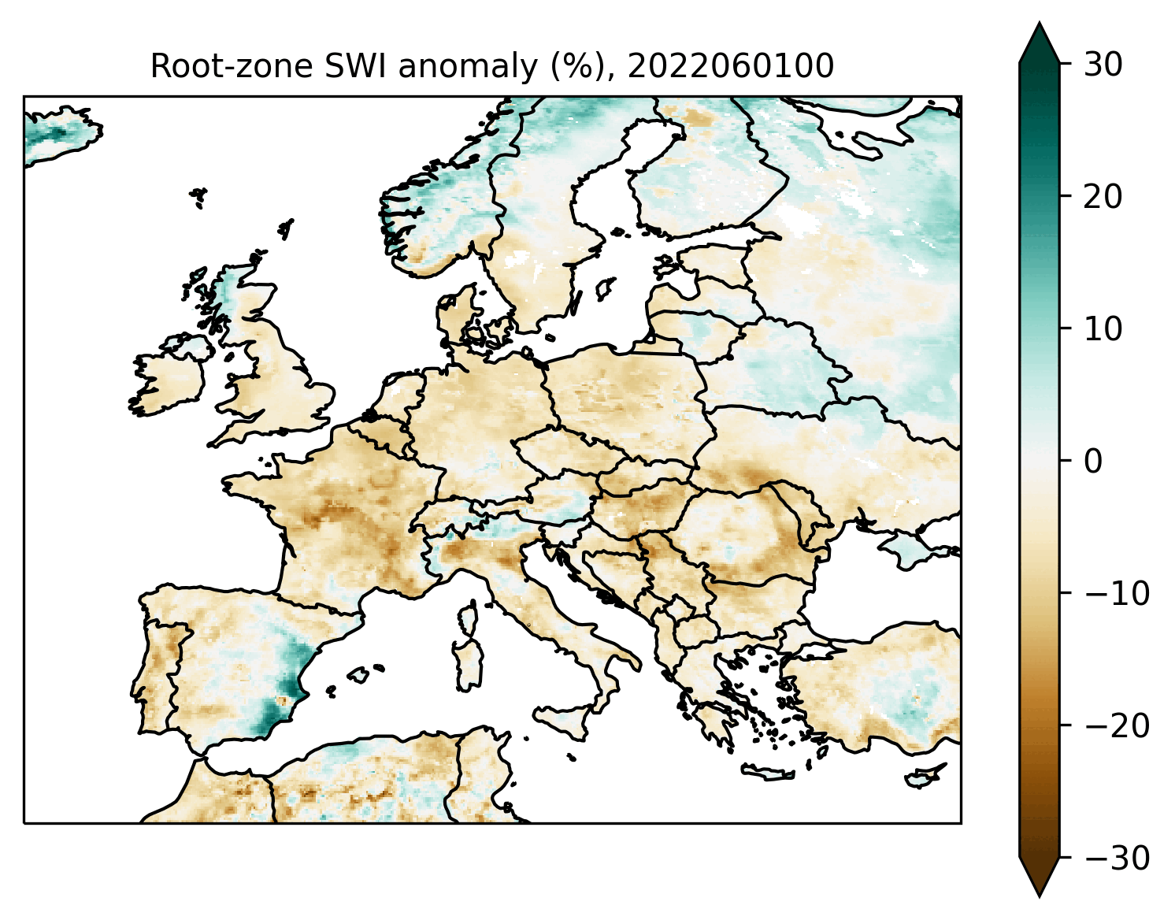
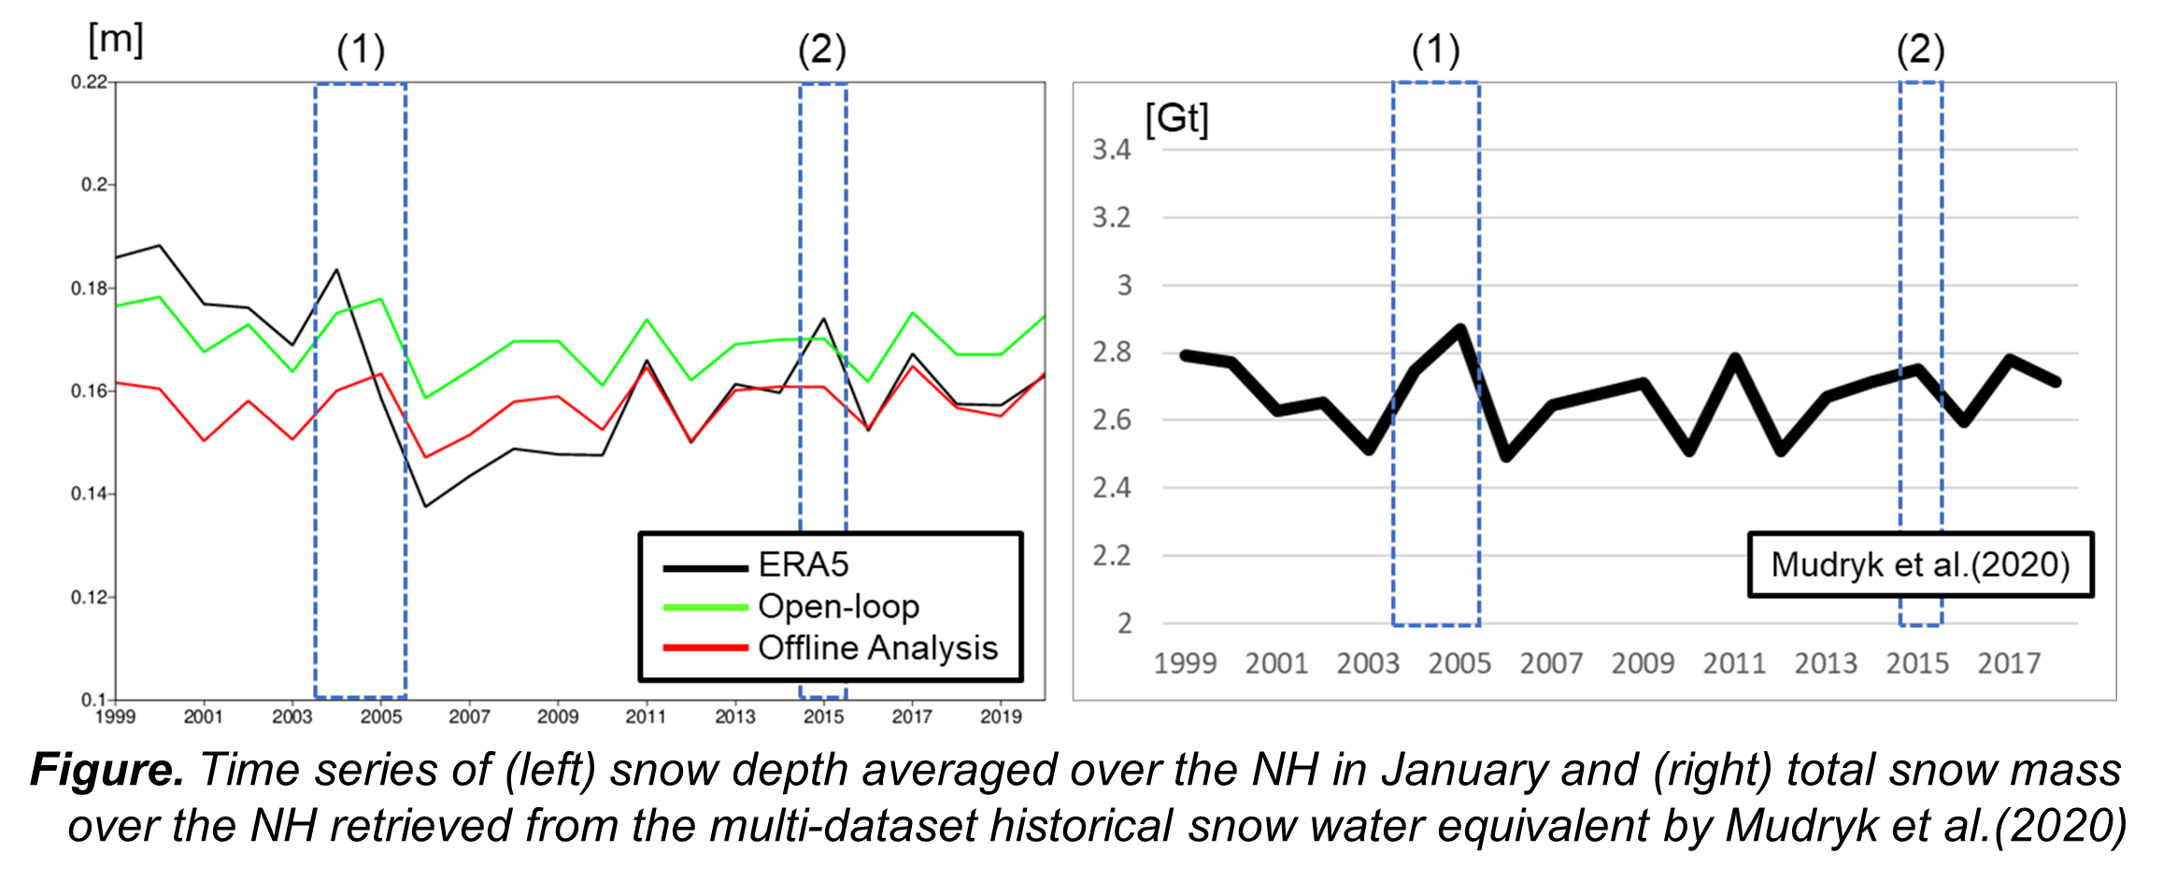
3. Example applications
Offline snow depth analysis comparison with ERA5 and open loop (model only)
Offline soil moisture analysis (28-100 cm depth) anomaly (%) with respect to 1992-2021 mean
Drought captured over Europe
Improved snow depth in offline analysis –
Kenta Ochi

Slide 5
3. Cycle 49R2 (in progress)
Synop
observation
Calibrated length-scale
Input observations:
T2m/RH2m
Synop
Output fields:
T2m
RH2m
2D OI
EKF SM analysis
Currently external T2m/RH2m analysis (e.g. from ERA5) used as pseudo obs for SEKF – inconsistencies between offline cycle 48R1 and ERA5 (cycle 41R2)
Development of 2D OI screen-level analysis as input obs for SEKF SM analysis
New suite structure for long-range and SEAS6 forecast initialization
T2m/RH2m analysis with 2DOI – Ewan Pinnington
Notes:
5

Slide 6
Assimilating VOD to analyse LAI
Use LAI climatology as background LAI
Rescale AMSR2 & SMOS VOD observations to CONFESS (time-varying) LAI
Atmospheric forcing
Additionally analyse LAI for both high and low vegetation types
LAI climatology
HTESSEL land surface model
Input observations:
ASCAT SM
T2m/RH2m
AMSR2 & SMOS VOD
Input observations:
ASCAT SM
T2m/RH2m
EKF SM analysis
Output fields:
SM layers 1-3
LAI (high & low veg types)
Output fields:
SM layers 1-3
LAI analysis – Peter Weston

Slide 7
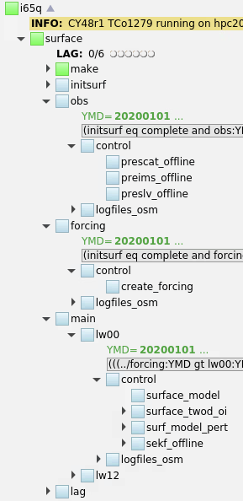
Suite structure
Obs family:
Retrieve SCAT/IMS/T2m/RH2m obs
Forcing family:
Retrieve
Atmospheric forcing
Main family:
Run
Surface model (first guess)
T2m/RH2m 2D OI
SEKF SM and Snow analysis
Lag family:
Archive an/fc/flux fields

