Slide 1
ECMWF Land data assimilation
Patricia de Rosnay, David Fairbairn, Sébastien Garrigues, Christoph Herbert,
Kenta Ochi, Ewan Pinnington, Kirsti Salonen, Dinand Schepers, Pete Weston
and many others

Slide 2
ECMWF data assimilation systems
4D-Var
Atmosphere
Sea Ice
3D-Var
Land
EKF-OI
Ocean
Integrated Forecasting System (IFS)
3D-Var
Waves
OI

Slide 3
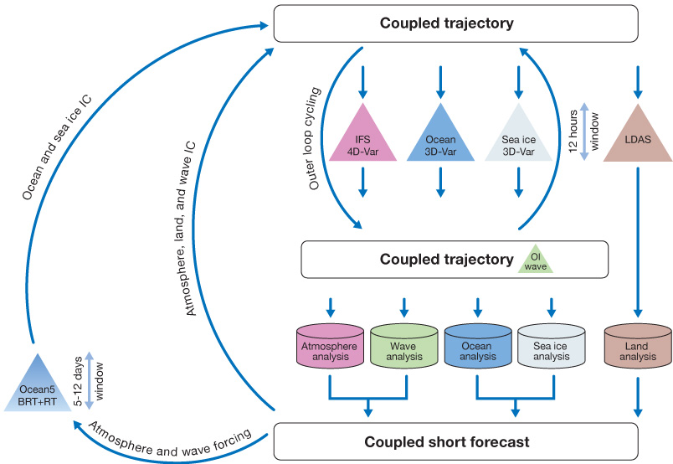
Coupled Assimilation for operational NWP at ECMWF (IFS 48r1, 49r1)
Weakly coupled data assimilation
Land-atmosphere-ocean
(land-atm-wave)
LDAS: Land Data Assimilation System
(ocean and sea ice)
(land-atm-wave)
More details in the ECMWF data assimilation training course: https://events.ecmwf.int/event/333/timetable/
3

Slide 4
Land Surface data assimilation in the IFS
Screen-level T2m, RH2m
  Method: 2D Optimal Interpolation (2D-OI)
  Conventional Observations: SYNOP T2m, RH2m
Snow depth
  Method: 2D Optimal Interpolation (2D-OI)
  Conventional Observations: in situ snow depth
  Satellite data: NOAA/NESDIS IMS Snow Cover Extent
Soil Moisture
  Method: Simplified Extended Kalman Filter (EKF)
  Conventional observations: Analysed T2m, RH2m from the 2D-OI
  Satellite data : ASCAT soil moisture, SMOS
Soil Temperature and Snow temperature
  Method: 1D-OI for the first layer of soil and snow temperature
  Conventional observations: T2m analysis increments from the 2D-OI
Initialise model prognostic variables
  Snow: SWE, density
  SM: layers 1-2-3,
  Soil temperature layer1,
  snow temperature
Based on:
  12-hour LWDA DA windows (21-09 UTC & 09-21 UTC), and
  6-hour early delivery windows (21-03 & 9-15 UTC)
→ Analysis at 00 & 06 UTC, and 12 & 18 UTC
4
Notes:
4

Slide 5
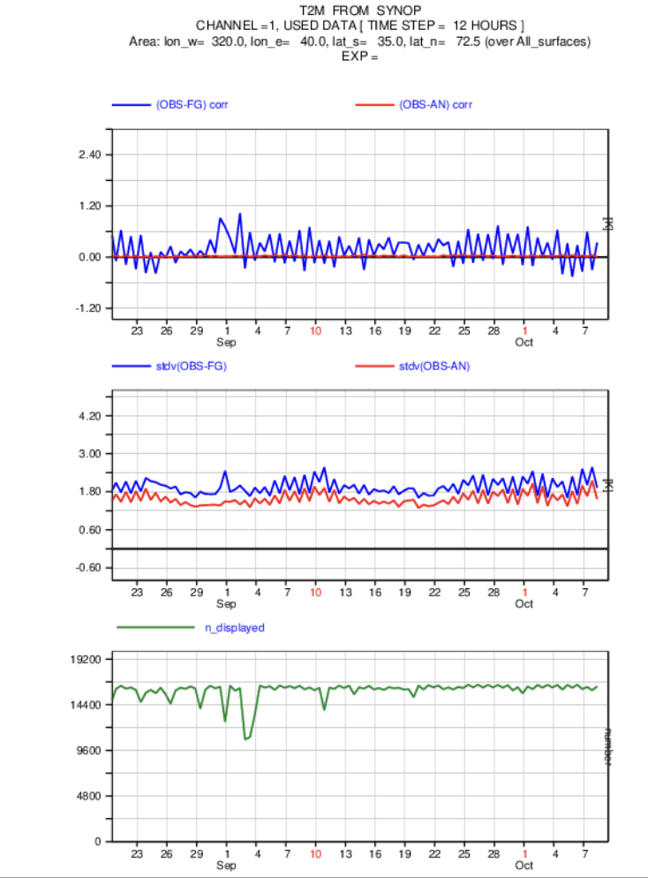
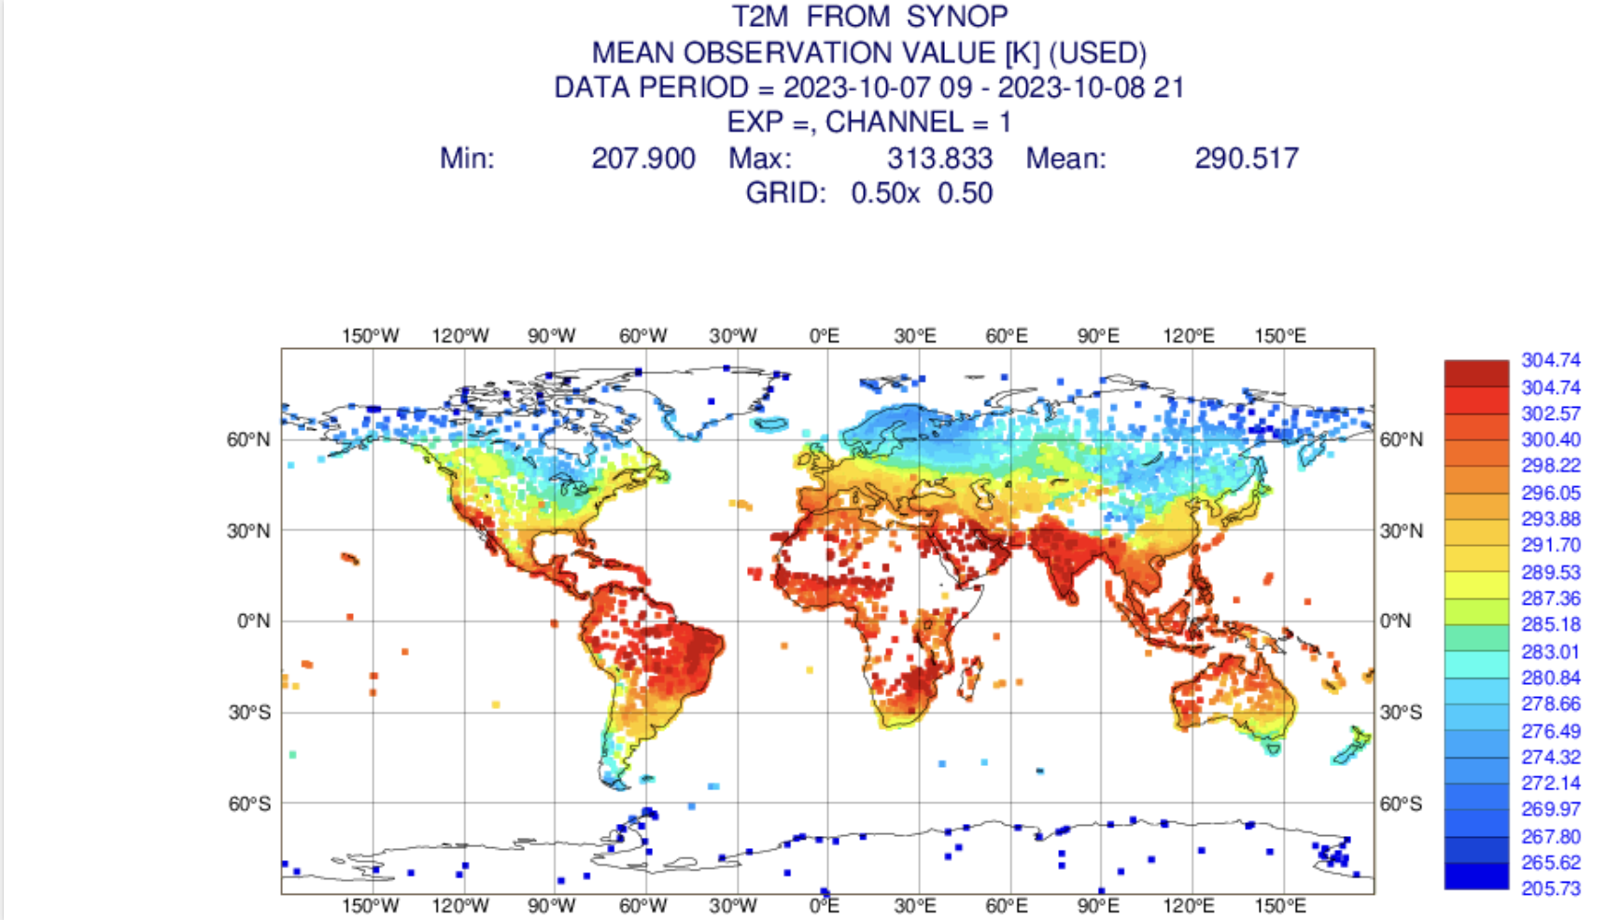
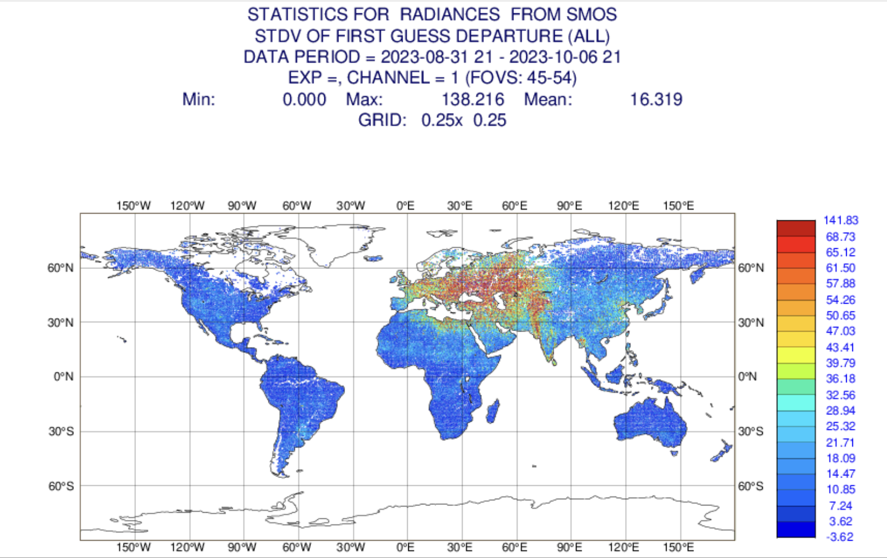
Land surface observations monitoring
Satellite:
Soil moisture (SMOS, SMAP, ASCAT)
Snow cover (IMS)
Conventional: T2m, RH2m, snow depth
SMOS-> Kirsti Salonen
→ Development of a consistent workflow for land, ocean and atmospheric observations
https://www.ecmwf.int/en/forecasts/quality-our-forecasts/monitoring-observing-system

Slide 6
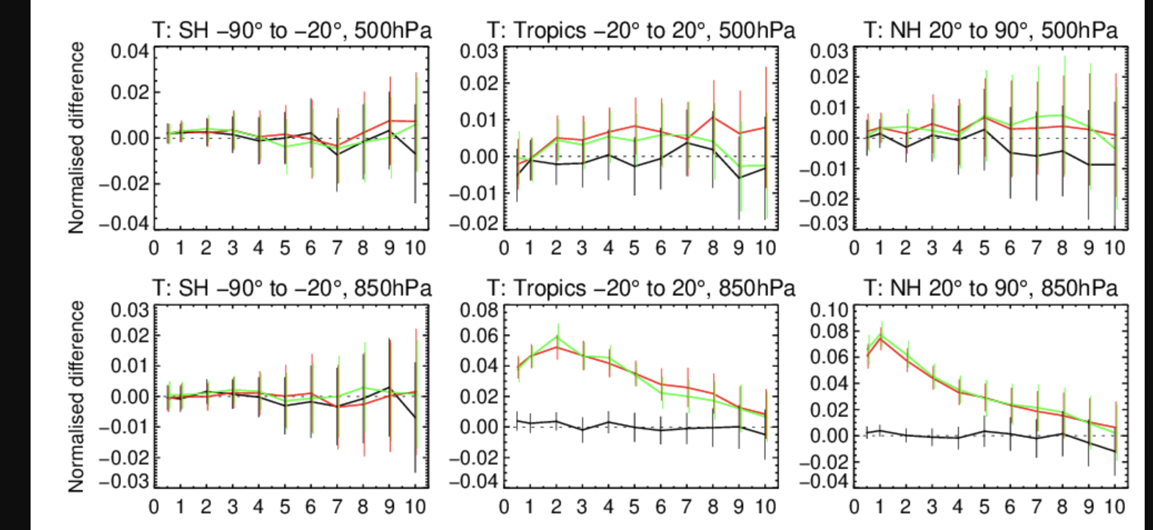
Soil analysis in the IFS: impact on the atmospheric forecast
Temperature RMSE
JJA 2020
IFS cycle 48r1
☺
☹
☺
☹
Without soil moisture DA
Without soil moisture DA
With soil moisture DA
FC lead time
FC lead time
FC lead time
Significant positive impact of land DA on low level atmospheric temperature forecasts
Sébastien Garrigues
6

Slide 7
Land Surface data assimilation in ECLand offline in 49r1
Screen-level T2m, RH2m
  Method: 2D Optimal Interpolation (2D-OI)
  Conventional Observations: SYNOP T2m, RH2m
Snow depth
  Method: SEKF
  Satellite data: NOAA/NESDIS IMS Snow Cover Extent, CCI snow cover
Soil Moisture
  Method: Simplified Extended Kalman Filter (EKF)
  Conventional observations: Analysed T2m, RH2m from the 2D-OI, or analysed from external experiment
  Satellite data : ASCAT soil moisture, SMOS SM
Soil Temperature and Snow temperature
  Method: SEKF
  Conventional observations: T2m analysis increments from external experiment
LAI
  Method: SEKF
  Satellite observations: VOD from SMOS and AMSR2 (C-band, X-band)
New developments:
- For 49r2
- Research purpose
7
Notes:
7

Slide 8

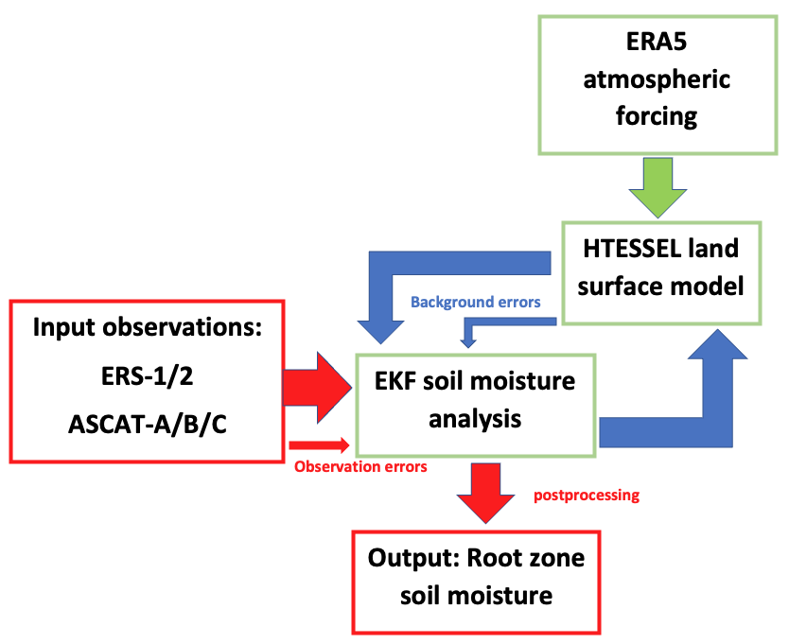
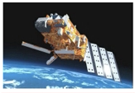
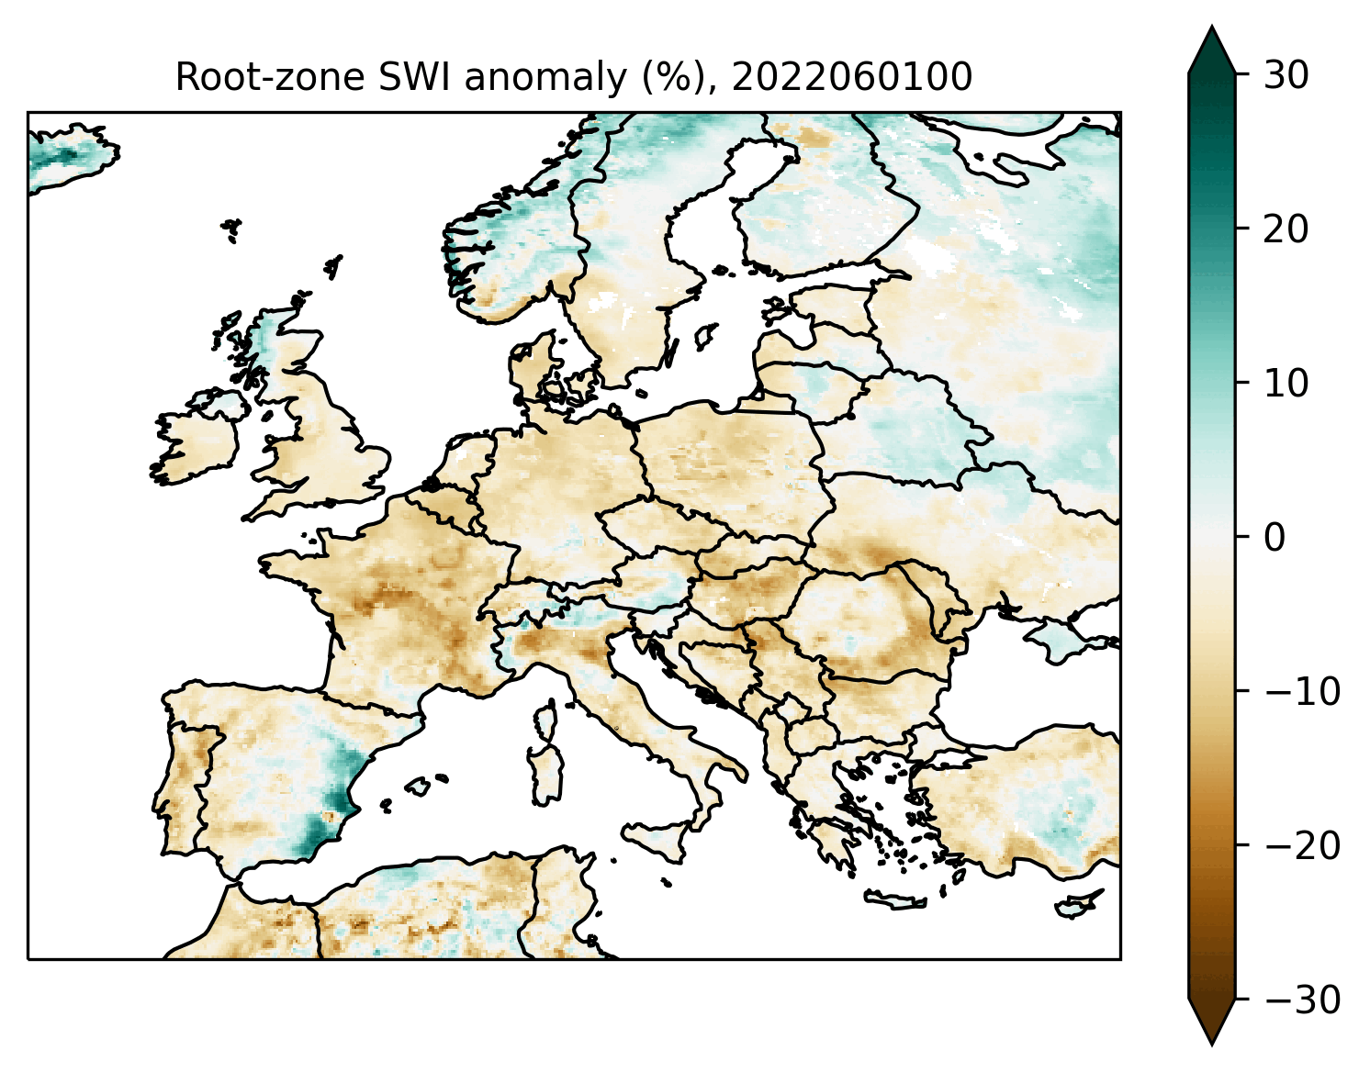
Offline land DA for soil moisture
Python-based version of the SEKF
Uses the offline model and atmospheric forcing from a specified experiment ID
  → Preparation of new H SAF SM data record (1992-2023, planned release 2024)
H SAF product RZSM-SCAT-ASCAT-CDOP-4-CDR-10km (H145) + offline extension (H146)
David Fairbairn

Slide 9


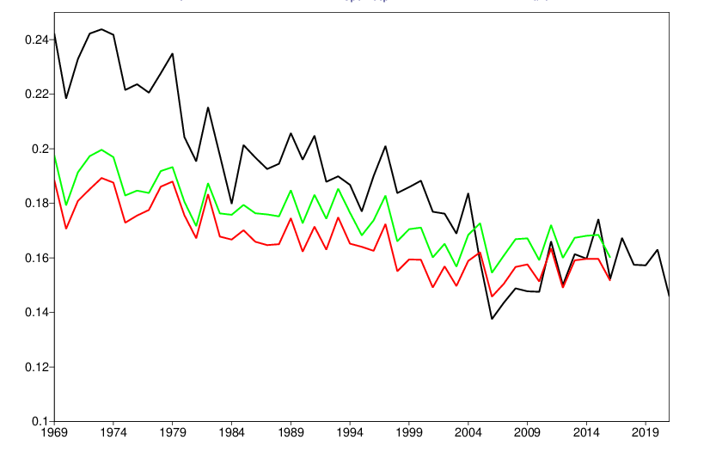
Snow reanalysis for ERA6 (49r2)
- Step change in the ERA5 snow mass from 2004 (IMS snow cover started to be assimilated)
- Snow data assimilation reduced the positive snow cover bias, but it amplified the snow mass negative trend
In ERA6:
  Snow model and a set of snow data assimilation improvements
  ESA CCI AVHRR (1982-2017) + NOAA/NESDIS IMS (2017-NRT)
→ ERA6-Land 1st prototype in CERISE (1939-2022)
- ERA5
- New model no snow DA
- New model new snow DA
NH snow depth (m)
Kenta Ochi

Slide 10

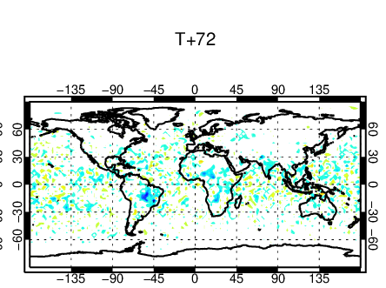

VOD assimilation→CoCO2 project
Assimilation of Vegetation Optical Depth (VOD) from passive microwave sensors to constrain vegetation water and carbon cycle variables.
- L-band VOD (1.41GHz) from SMOS
- C-band VOD (6.9GHz) and X-band VOD (10.65GHz) from AMSR2
T2m RMSE reduction (blue) 2018-2021
Positive impact of VOD assimilation on NWP
Challenges in terms of GPP impact
In ECLand, Pete Weston

Slide 11

Unified ensemble Land DA → CERISE project
CERISE: CopERnIcus climate change Service Evolution (2023-2026)
Support the long-term evolution of C3S (Copernicus Climate Change Service) for:
- regional and global climate reanalysis and
- multi-system seasonal prediction,
towards an Earth system approach with a focus on
land-atmosphere coupling.
4D-Var
Atmosphere
Sea Ice
3D-Var
→ Development of unified ensemble-based coupled land-atmosphere data assimilation for the C3S global and regional reanalyses.
Land
EKF-OI
Ocean
https://www.cerise-project.eu/
3D-Var
Waves
OI
The CERISE project (grant agreement No101082139) is funded by the European Union. Views and opinions expressed are however those of the author(s) only and do not necessarily reflect those of the European Union or the Commission. Neither the European Union nor the granting authority can be held responsible for them.

Slide 12
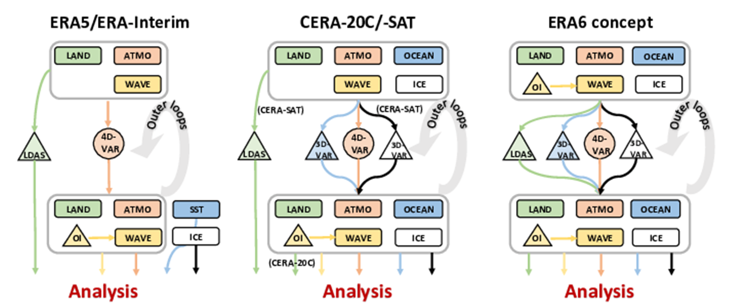


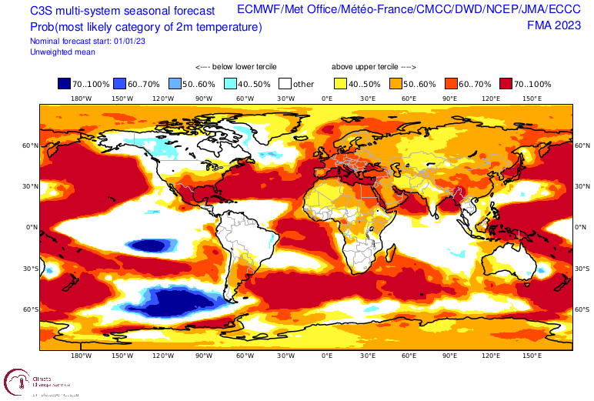
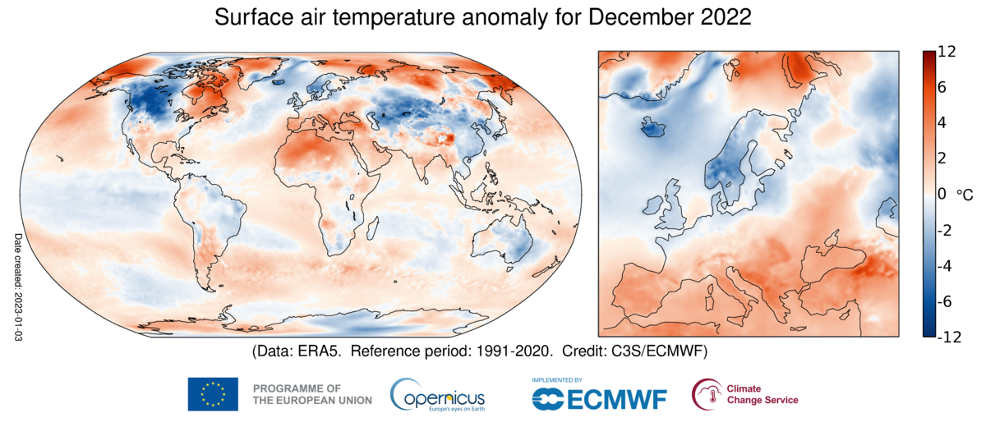
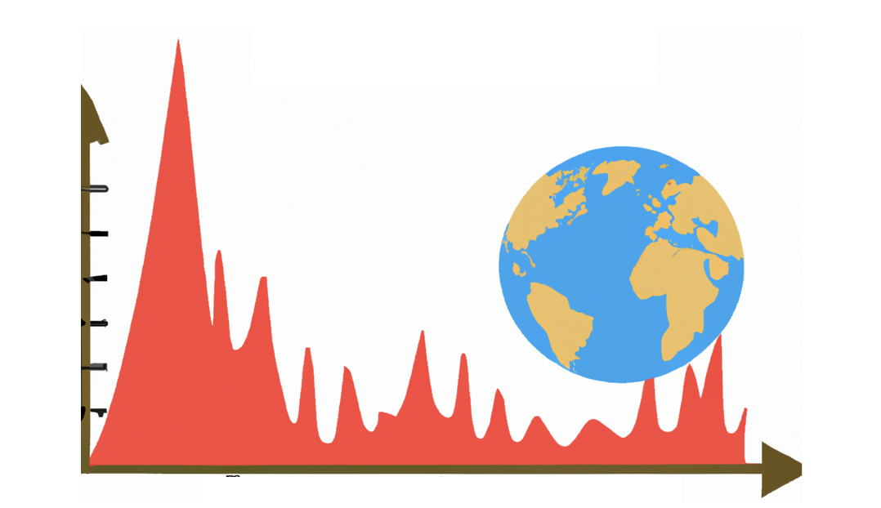
CERISE developments
Land and coupled land-atmosphere data assimilation
Explore ML-based observation operators to improve the exploitation of satellite observations
Multidecadal representation of evolving vegetation and lakes, building up on CONFESS H2020
Prototypes of seamless reanalysis and multi-system seasonal prediction → High readiness level: ERA6-Land, ERA7, CARRA3, SEAS7
Novel diagnostic tools to assess physical consistency of Earth system reanalysis and prediction
The CERISE project (grant agreement No101082139) is funded by the European Union. Views and opinions expressed are however those of the author(s) only and do not necessarily reflect those of the European Union or the Commission. Neither the European Union nor the granting authority can be held responsible for them.

Slide 13
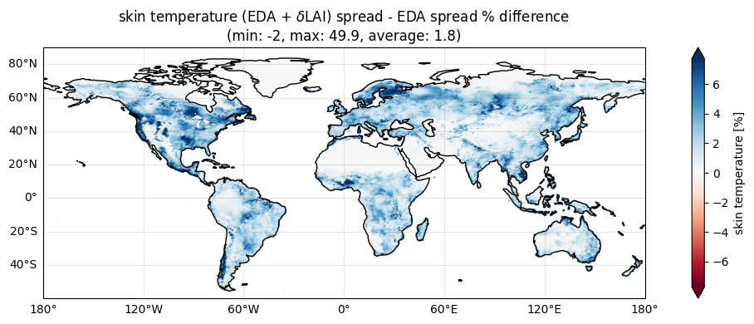
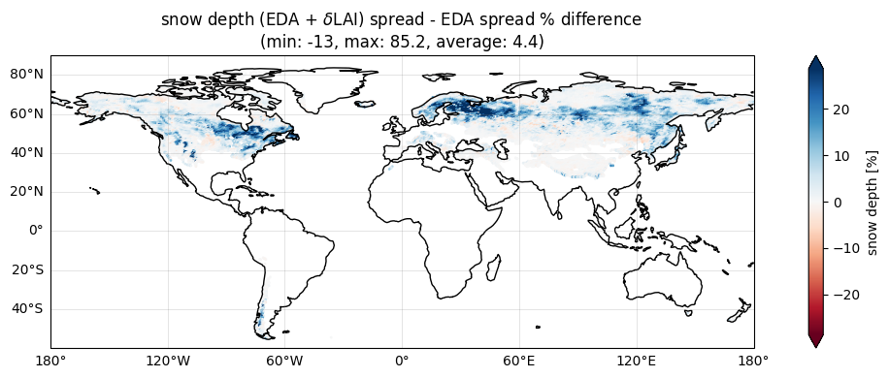
Land surface parameter perturbations
The ECMWF Ensemble of Data Assimilations (EDA) is under-spread at the surface
As part of CERISE project, we explore methods to increase ensemble spread at the land surface for future Land Surface Data Assimilation Systems (LDAS)
Stochastic Parameter Perturbation approach for Leaf Area Index (LAI) and vegetation fraction in the offline land DA system
Draper et al., JHM 2021 also investigated surface parameter perturbations https://doi.org/10.1175/JHM-D-21-0016.1
Skin temperature
Snow depth
Differences in spread between the EDA offline surface ensemble with and without perturbations.
Ewan Pinnington
The CERISE project (grant agreement No101082139) is funded by the European Union. Views and opinions expressed are however those of the author(s) only and do not necessarily reflect those of the European Union or the Commission. Neither the European Union nor the granting authority can be held responsible for them.

Slide 14
Summary
Progressive implementation of coupled assimilation at ECMWF for operational NWP, upcoming reanalyses, CAMS/CO2MVS, and DE
Towards a unified consistent ensemble-based land data assimilation in coupled IFS & offline ECLand
Several degrees of coupling
  in the IFS: coupled (oper) or stand alone (skip 4D-Var)
  In offline ECLand: python LDAS for research (e.g. VOD DA) and OPER SEAS6 and ERA6-Land
Key features of offline land DA for operations in 49r2
    NRT capability
    2D-OI screen level analysis
Future plans and ideas: land-hydro DA developments and land DA for fire
14

Slide 15
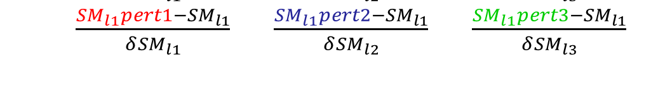
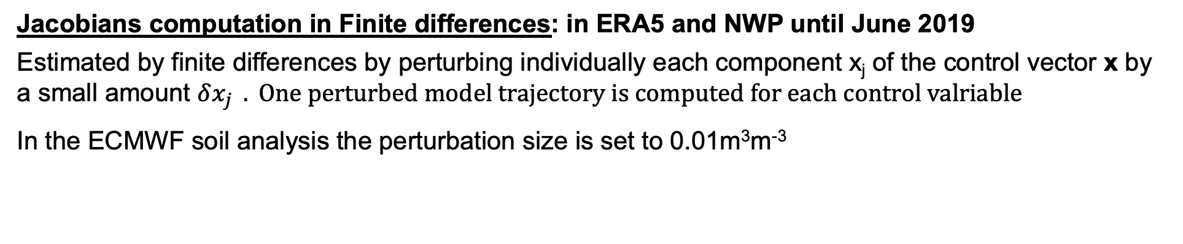

Surface-only LDAS
Simplifed EKF soil moisture analysis
Jacobians computation in Finite differences: in ERA5 and NWP until June 2019
Estimated by finite differences by perturbing individually each component x_{j} of the control vector x by a small amount $δx_{j } . One perturbed model trajectory is computed for each control valriable$
In the ECMWF soil analysis the perturbation size is set to 0.01m³m⁻³
09:00
21:00
Ctrl trajectory not pert
Trajectory perturbed SM_{l1}
Trajectory perturbed SM_{l2}
Trajectory perturbed SM_{l3}
$\begin{matrix}\frac{T_{2m}pert1−T_{2m}}{δ{SM}_{l1}} & \frac{T_{2m}pert2−T_{2m}}{δ{SM}_{l2}} & \frac{T_{2m}pert3−T_{2m}}{δ{SM}_{l3}} \\ \frac{{RH}_{2m}pert1−{RH}_{2m}}{δ{SM}_{l1}} & \frac{{RH}_{2m}pert2−{RH}_{2m}}{δ{SM}_{l2}} & \frac{{RH}_{2m}pert3−{RH}_{2m}}{δ{SM}_{l3}} \\ \frac{{SM}_{l1}pert1−{SM}_{l1}}{δ{SM}_{l1}} & \frac{{SM}_{l1}pert2−{SM}_{l1}}{δ{SM}_{l2}} & \frac{{SM}_{l1}pert3−{SM}_{l1}}{δ{SM}_{l3}}\end{matrix}$
H =
15

Slide 16
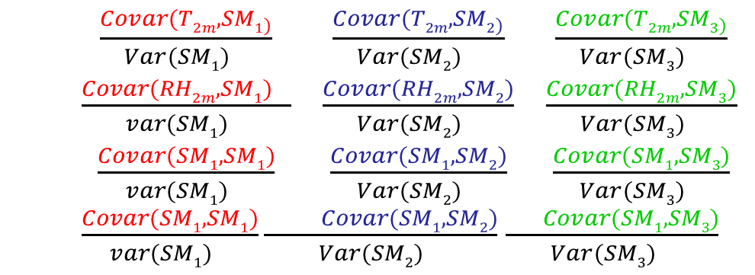

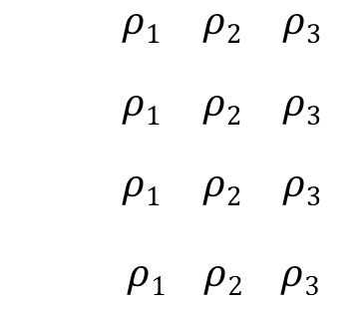
Surface-only LDAS
Simplifed EKF soil moisture analysis
Jacobians computation based on the EDA: in NWP since June 2019 (IFS cycle 46r1 Doc)
Use the EDA (Ensemble Data Assimilation) spread to compute covariances and the SEKF Jacobians
In the case of assimilation of four observations T2m, RH2m, ASCAT, SMOS:
09:00
21:00
Single trajectory
$\begin{matrix}\frac{{Covar(T2m,SM1}_{)}}{Var({SM1)}_{}} & \frac{{Covar(T2m,SM2}_{)}}{Var({SM2)}_{}} & \frac{{Covar(T2m,SM3}_{)}}{Var({SM3)}_{}} \\ \frac{{Covar(RH2m, SM1)}_{}}{var({SM1)}_{}} & \frac{Covar(RH2m, SM2)}{Var({SM2)}_{}} & \frac{Covar(RH2m, SM3)}{Var({SM3)}_{}} \\ \frac{Covar(SM1, SM1)}{var({SM1)}_{}} & \frac{Covar(SM1, SM2)}{Var({SM2)}_{}} & \frac{Covar(SM1, SM3)}{Var({SM3)}_{}}\end{matrix}$
$\frac{Covar(SM1, SM1)}{var({SM1)}_{}}\frac{ Covar(SM1, SM2)}{Var({SM2)}_{}}$ $\frac{ Covar(SM1, SM3)}{Var({SM3)}_{}}$
$$\begin{matrix}\begin{aligned}ρ1 \\ \end{aligned} & \begin{aligned}ρ2 \\ \end{aligned} & \begin{aligned}ρ3 \\ \end{aligned} \\ \begin{aligned}ρ1 \\ \end{aligned} & \begin{aligned}ρ2 \\ \end{aligned} & \begin{aligned}ρ3 \\ \end{aligned} \\ \begin{aligned}ρ1 \\ \end{aligned} & \begin{aligned}ρ2 \\ \end{aligned} & \begin{aligned}ρ3 \\ \end{aligned}\end{matrix}$$
$ρ1$ $ρ2$ $ρ3$
H =
$$∘$$
with i soil layer index, ρ_{i} = 1/[1+ (i-1) α_{sekf}] and α_{sekf} = 0.6 tapering coefficient
16

