Slide 1
Prepare a Forecast Challenge
Use and Interpretation of ECMWF Products 2023

Slide 2

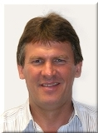
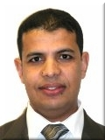


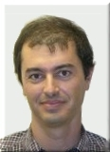
Tomorrow each group lead is going on a 3-month trip
What do I need to pack?

Slide 3

Using the products and tools you’ve learned about during the course
Create a forecast to help them pack

Slide 4
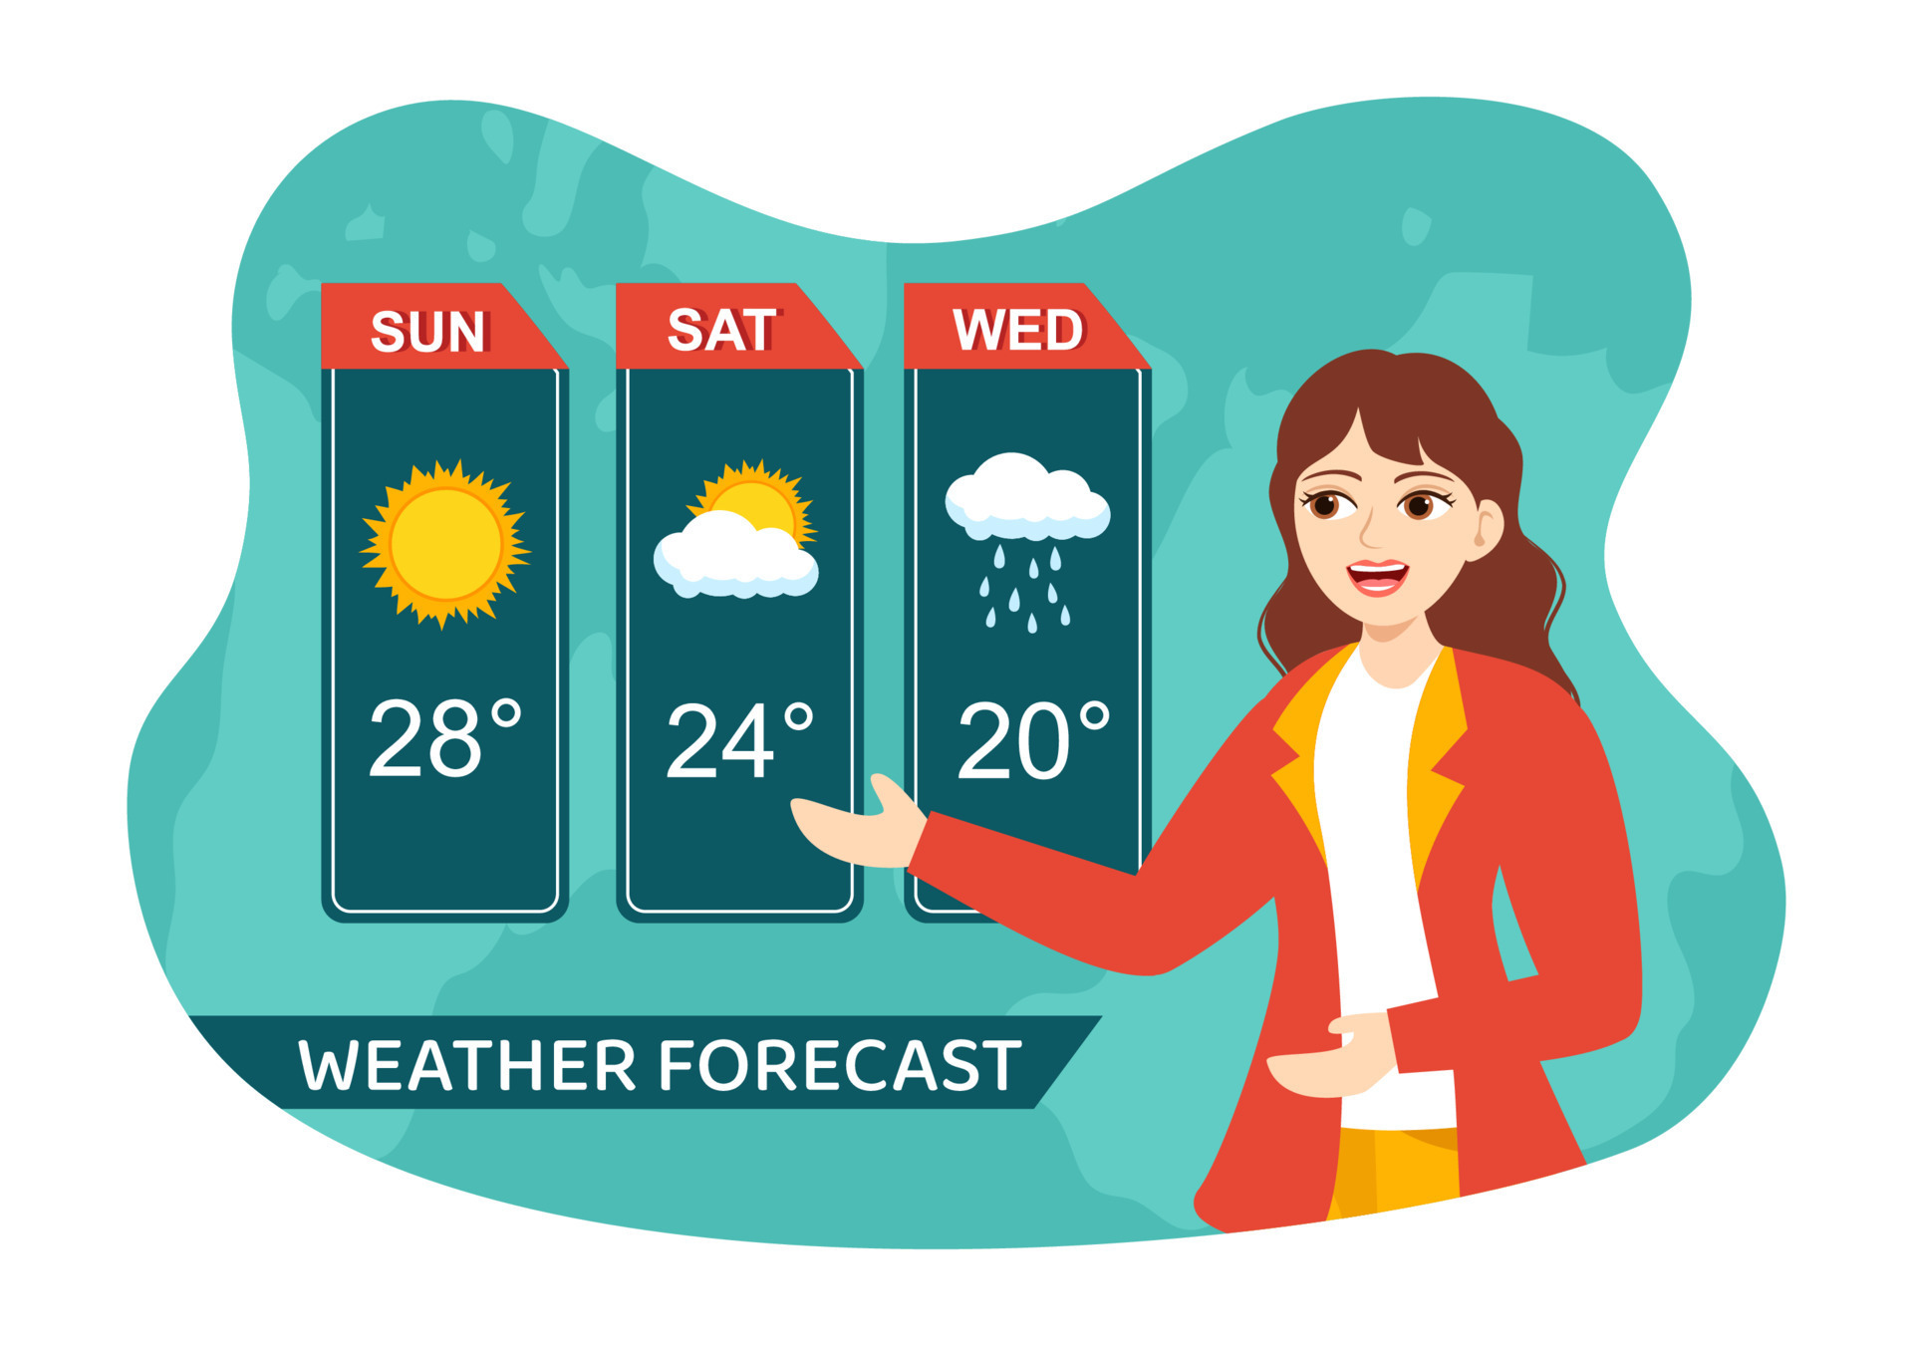
You will have 10 minutes to present your forecast this afternoon

