Slide 1
STATISTICAL FORWARD OBSERVATION OPERATOR TO ASSIMILATE LEVEL-1 ASCAT OBSERVATIONS
Sebastien Garrigues with contributions to
Patricia de Rosnay, Pete Weston, Ewan Pinnington, David Fairbairn
ECMWF

Slide 2
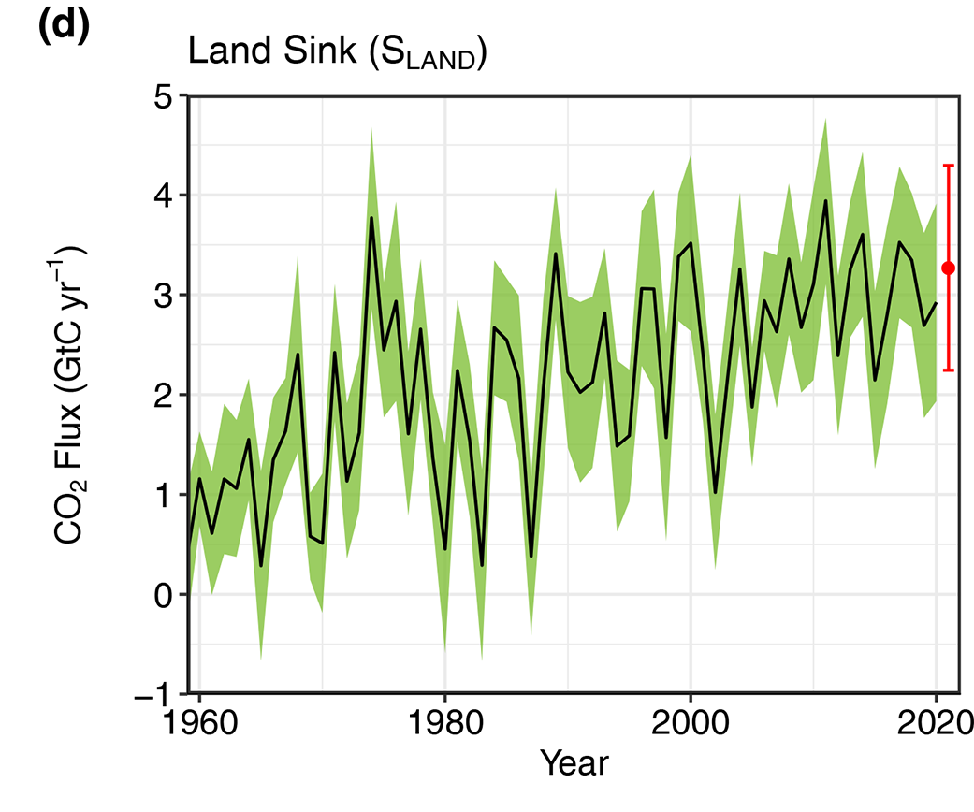
Introduction
Large uncertainties in biogenic C0₂ fluxes
CORSO Copernicus project
  Preparation of the C02MVS
  Better constraint biogenic fluxes
  Develop statistical forward observation operators to analyse land surface variables controlling carbon fluxes
Why assimilating level-1 satellite observations instead of soil moisture retrieval ?
  More accurate quantification of uncertainties
  Analyze not only soil moisture but also vegetation variables
  Consistent with NWP radiance DA framework
Why statistical observation operator ?
  Large uncertainties in physical-based model for land surface: e.g. surface heterogeneity, volume scattering, subsurface scattering
  Remove bias between model and retrieval
Friedlingstein et al.: Global Carbon Budget 2021

Slide 3
Introduction
Challenges
  How to maximize the information content of the training database ?
    Better understand the drivers of the ASCAT backscatter signal at 40 degree
      Impact of vegetation: LAI, vegetation cover, vegetation types
      Impact of soil type: e.g. influence of subsurface scattering for dry sandy soil
      Impact of snow, ice: need to filter out snow and ice surfaces ?
    Uncertainties in the model fields (e.g. lack of interannual variability for vegetation variables)
    Lack of information in the model fields (e.g. subsurface scattering…)
  Which ML algorithm ?
    Ensemble trees vs neural network (NN)
    Localization
      grid point NN
      global network with categorical variables : land surface type,… to help with localization
    Use of generative methods to deal with uncertainties and lack of information in the feature space

Slide 4
ASCAT training database
  Active microwave ASCAT:
    Credit: P. Weston see Aires, Weston et al., 2021
    2016-2019; 0.25°-resolution grid.
    Satellite: Backscatter coefficient at 40 degree
    ERA-5 model variables: LAI, soil moisture, soil temperature, magnitude of 2m temperature diurnal cycle
    Target= Satellite backscatter coefficient at 40 degree
    features: LAI, soil moisture (layer1,2,3), soil temperature (layer1,2,3), magnitude of 2m temperature diurnal cycle, high and low vegetation cover, soil type, vegetation type
    2 year of training (2016-2017)

Slide 5
Exploration of the training database information content

Slide 6
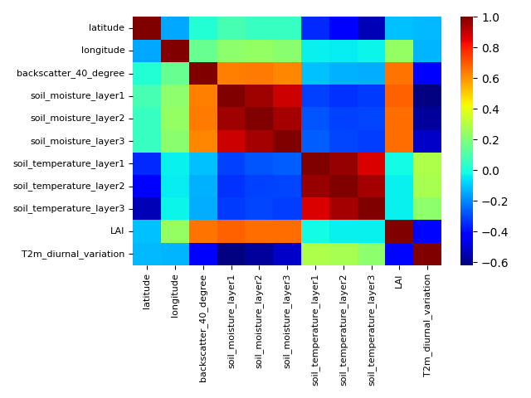
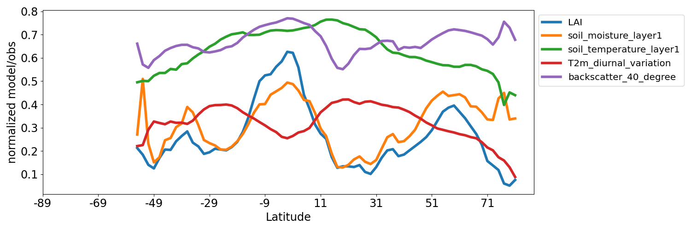
Information content of active microwave database (ASCAT)
Correlation map
Latitude transect of model variables and backscatter
Lat
Lon
Backscatter
SM1
SM2
SM3
ST1
ST2
ST3
LAI
T2m amplitude
Lat
Lon
Backscatter
SM1
SM2
SM3
ST1
ST2
ST3
LAI
T2m amplitude
Main influent model variables on the backscatter coefficient at 40 degree

Slide 7
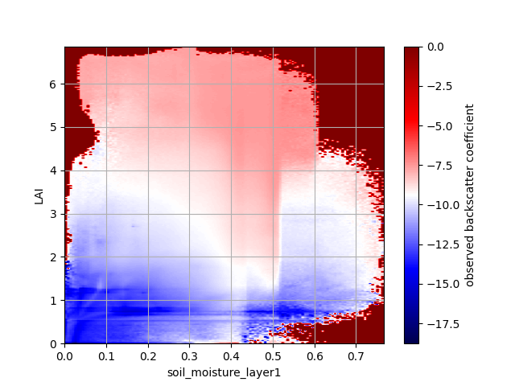
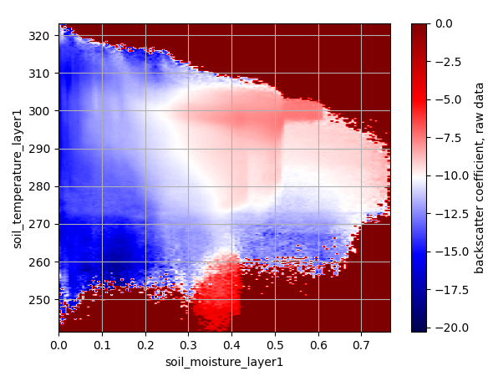
Information content of active microwave database (ASCAT)
One year, global 2d histograms
Soil temp
LAI
Backscatter 40 degree
Backscatter 40 degree
Soil moisture
Soil moisture

Slide 8
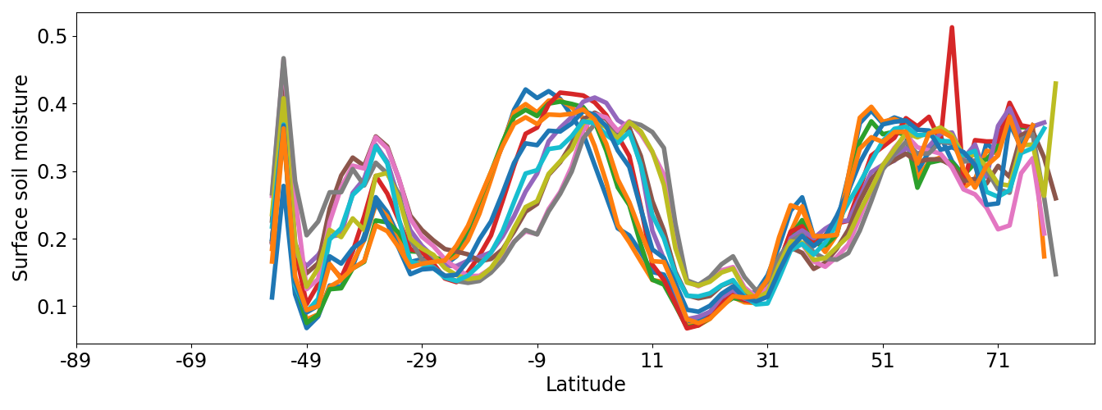
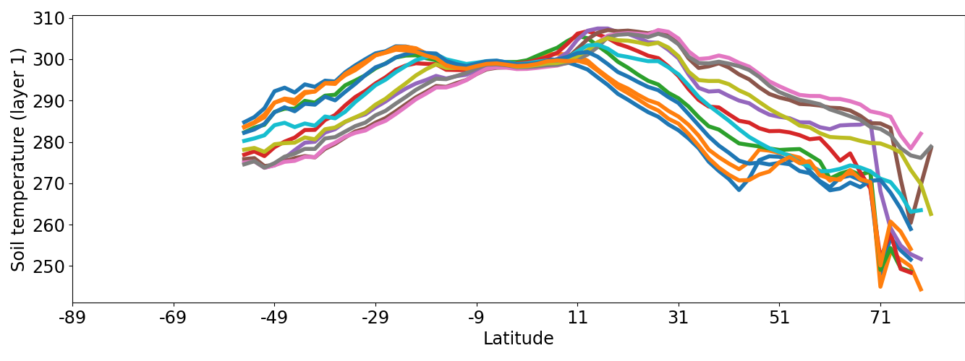
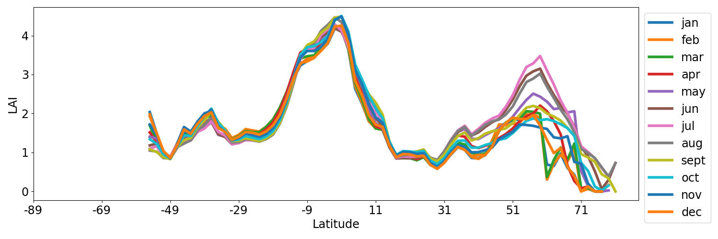
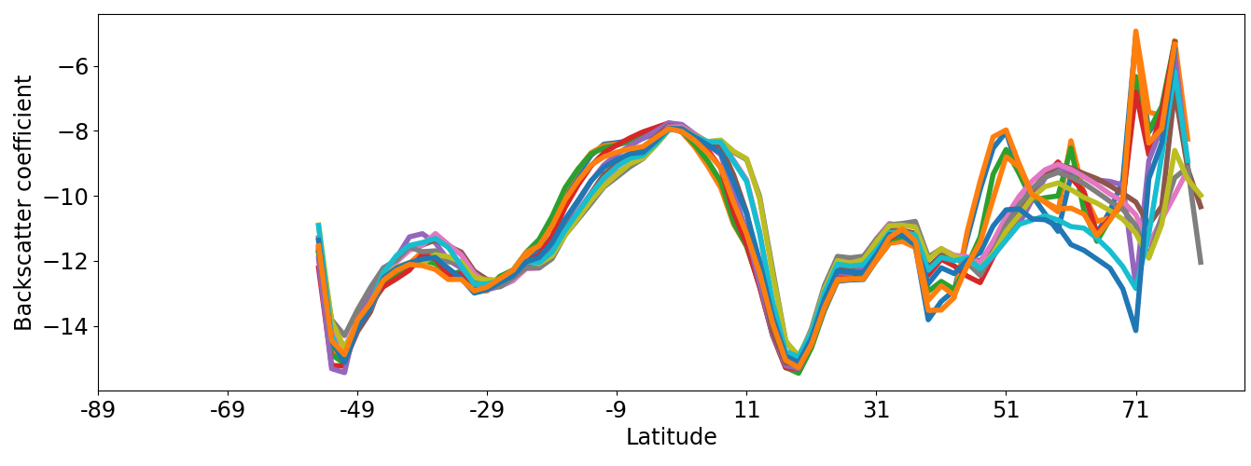
Information content of active microwave database (ASCAT)
Latitude-monthly transects
Soil moisture
Soil temperature
Backscatter
LAI

Slide 9
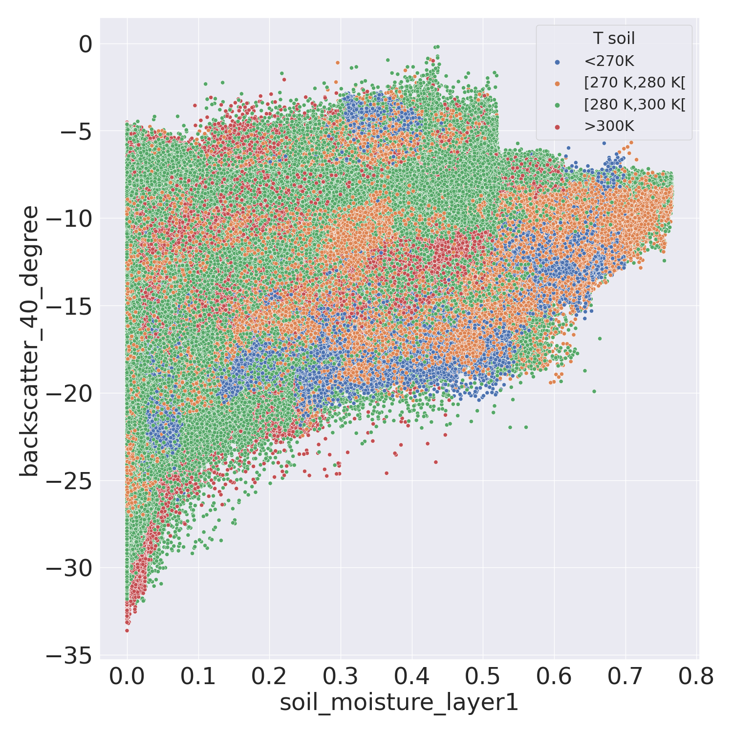
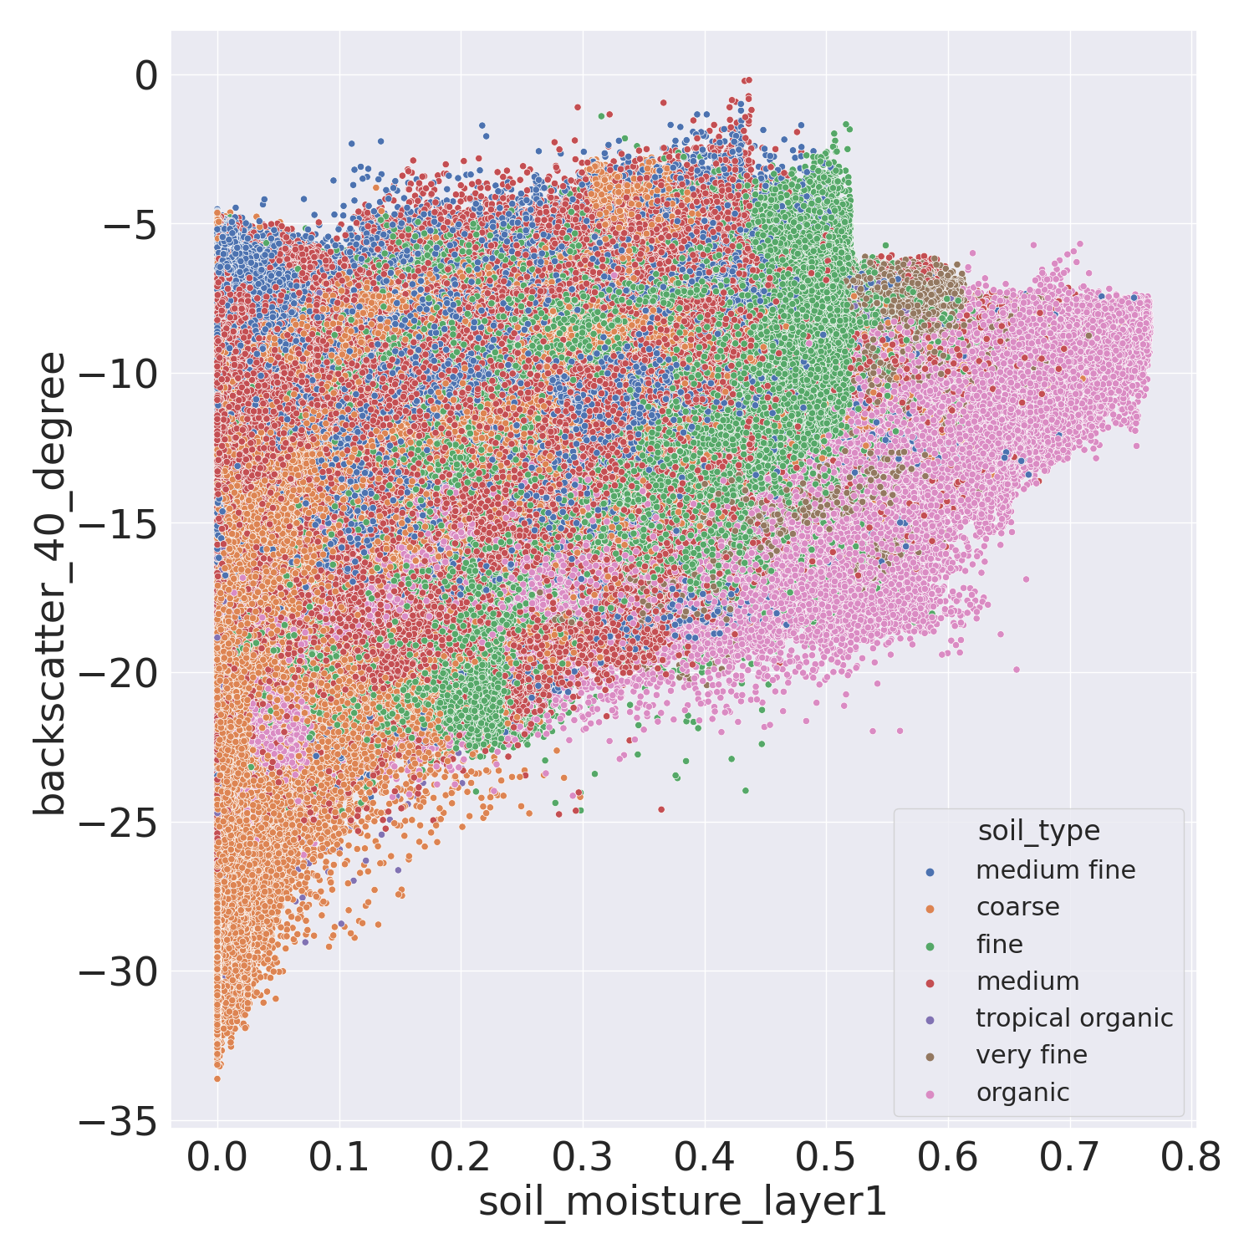
Information content of active microwave database (ASCAT)
Soil temp bin
Soil types

Slide 10
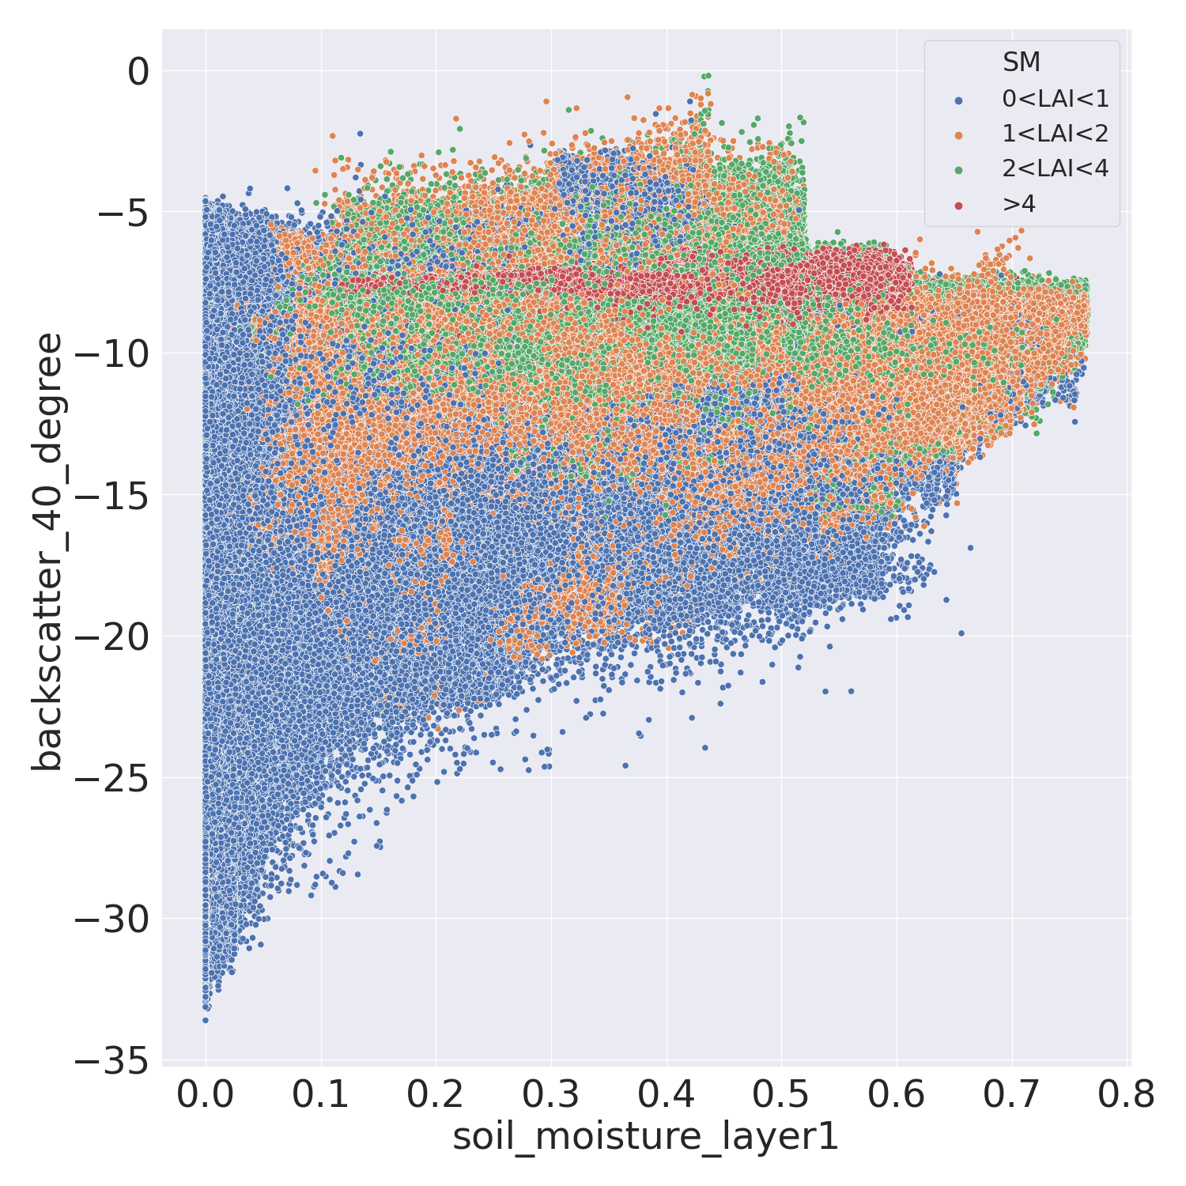
Information content of active microwave database (ASCAT)
Scatter plots
LAI bins

Slide 11
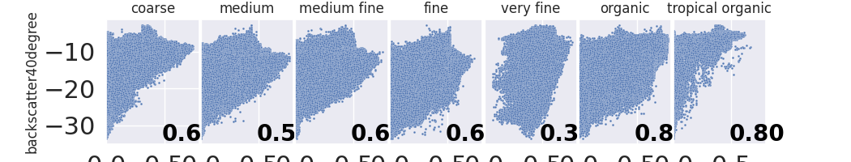
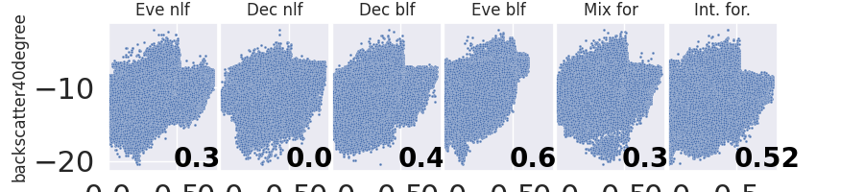
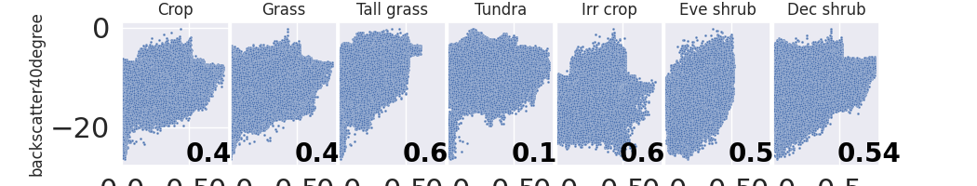
Information content of active microwave database (ASCAT)
Scatter plots
Soil type
Forest type
Low veg type

Slide 12
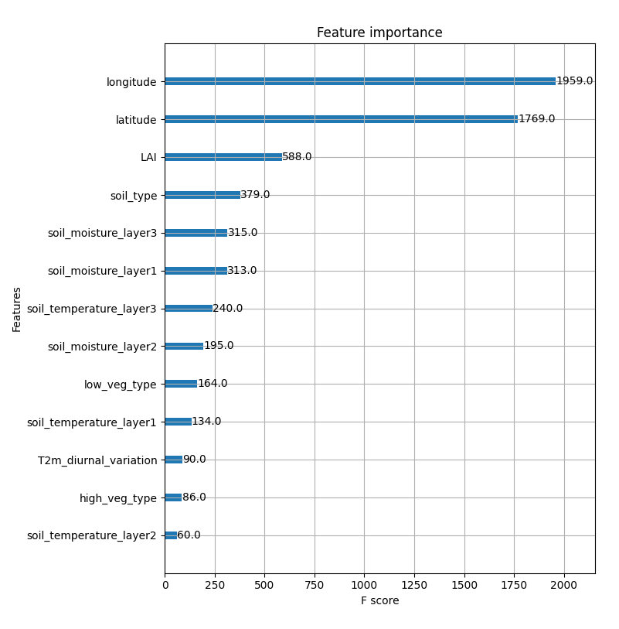
Importance of model fields on the signal prediction from xgboost
Lat, lon
Categorical variable soil type

Slide 13
ML-based forward operator:first results

Slide 14
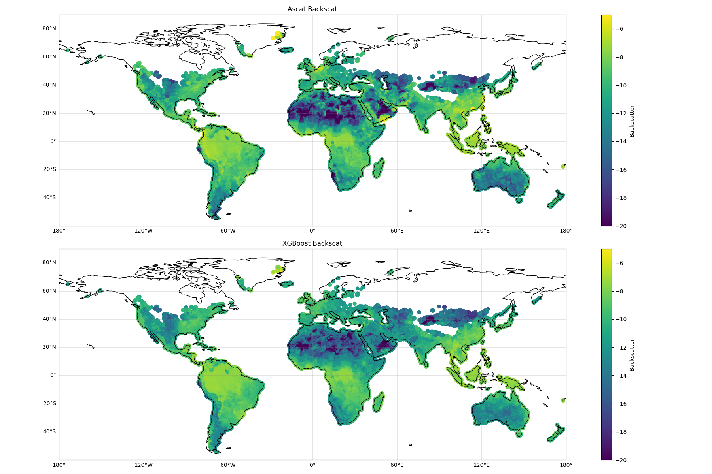
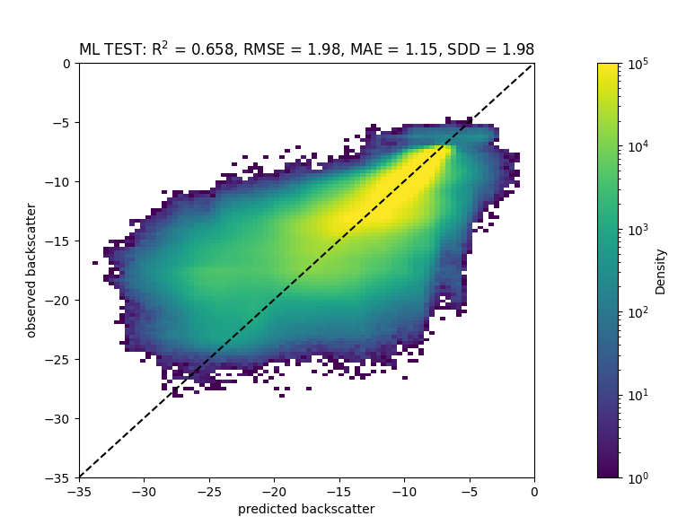
Comparison of ML approaches for forward operator for ASCAT
Gradient boosted trees (xgboost package, histogram method)
Observation
Evaluation over 2017 test set
R2=0.66 RMSE=1.98, MAE=1.15
Observation
Prediction
Prediction

Slide 15
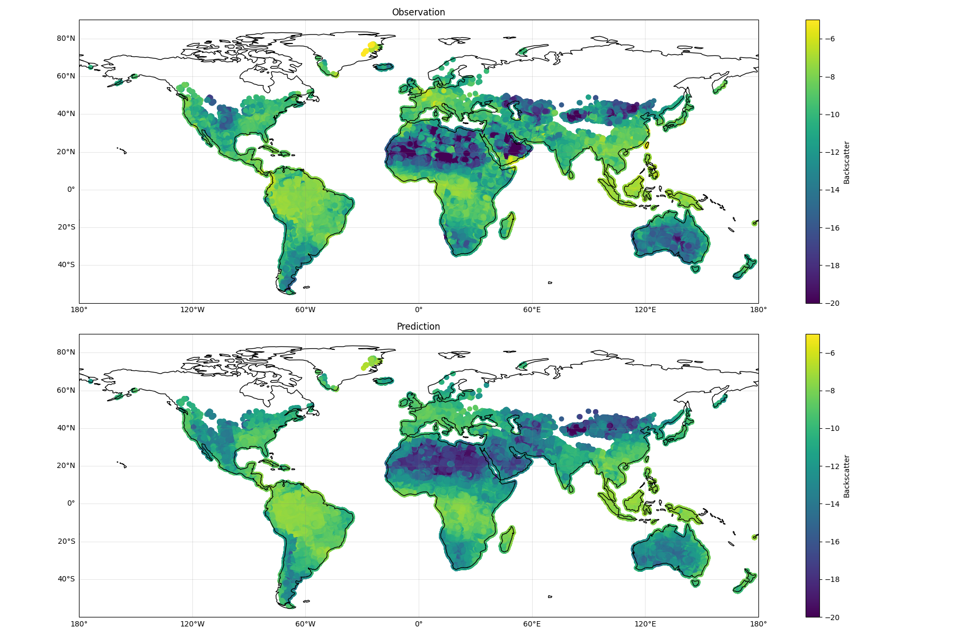
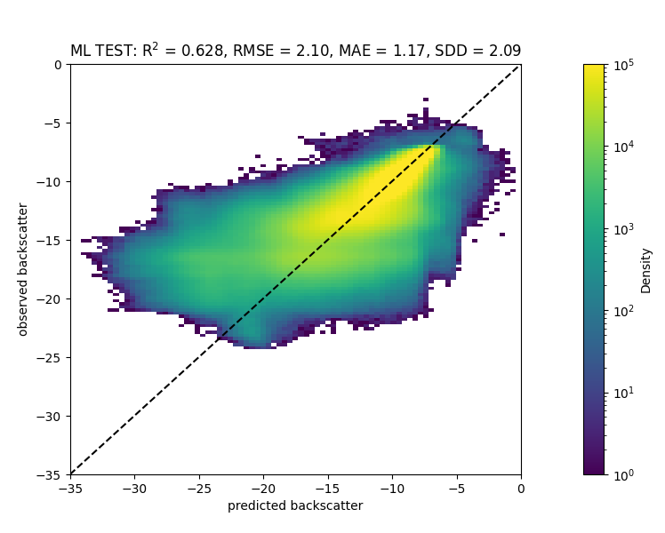
Comparison of ML approaches for forward operator for ASCAT
NN (2 hidden layers, 60 neurons, LeakyReLu,)
Observation
Evaluation over 2017 test set
R2=0.63 RMSE=2.1, MAE=1.17
Observation
Prediction
Prediction

Slide 16
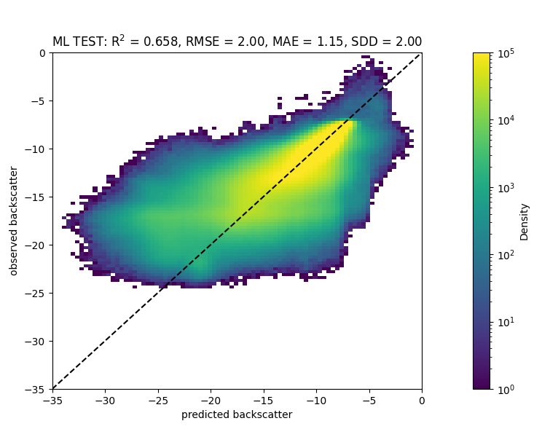
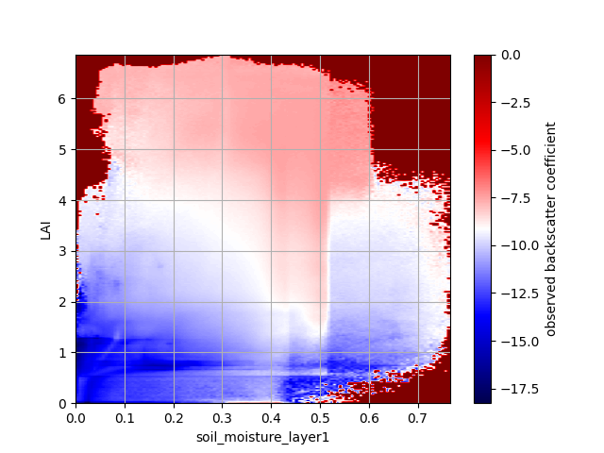
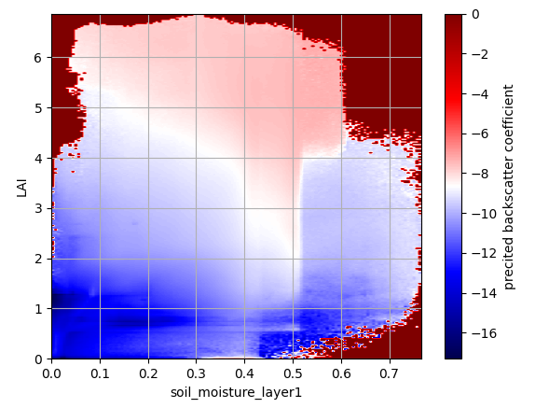
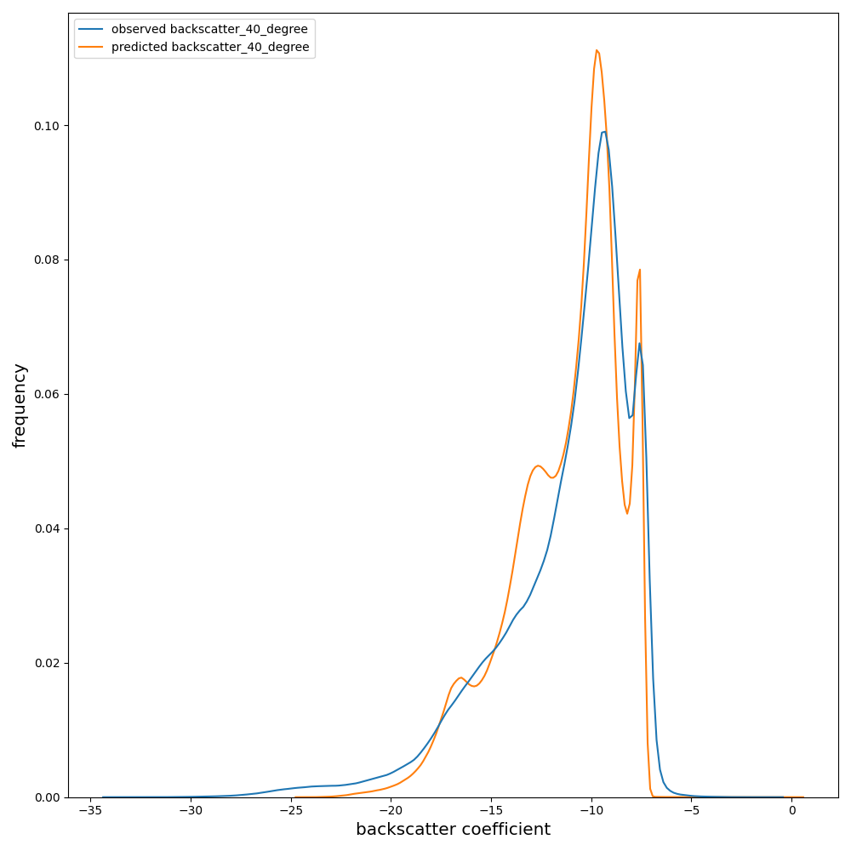
Impact of extending the training database (2 years)
Feedforward neural network (2 hidden layers, 60 neurons, LeakyReLu)
Evaluation over 2018 test set
R2=0.66 RMSE=2.00, MAE=1.15
Observed backscatter
predicted backscatter
LAI
LAI
Observation
Soil moisture
Soil moisture
Backscatter signal
prediction
Prediction
observation

Slide 17
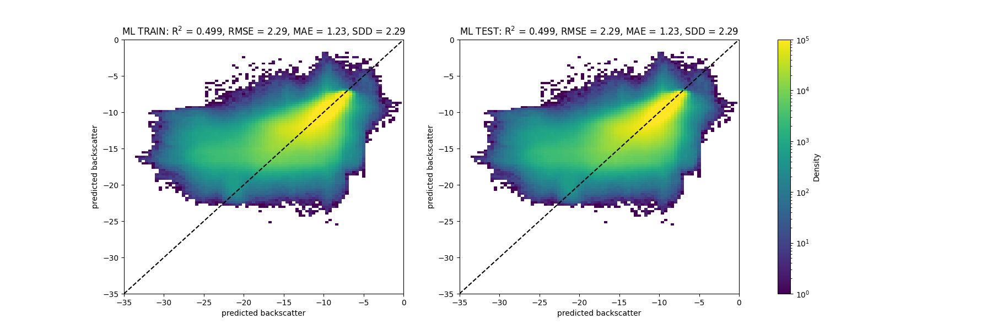
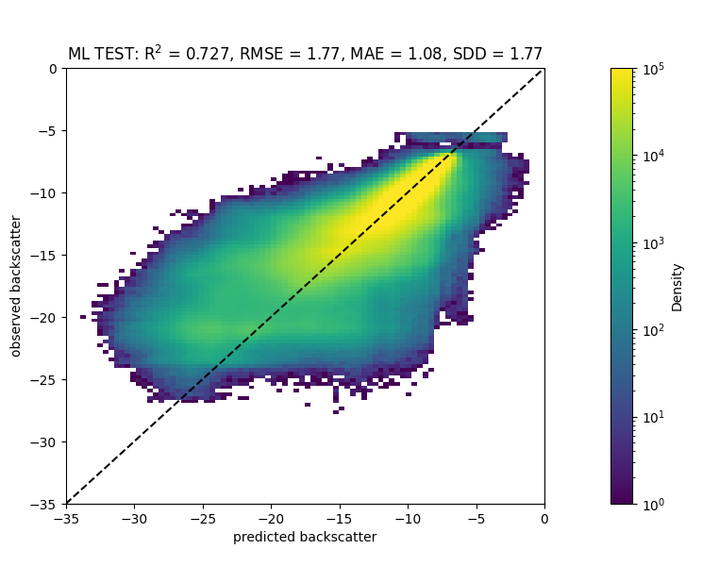
Impact of adding categorical variables
Training 2016, Evaluation over 2017
xgboost
NN
R2=0.7, RMSE=1.77, MAE=1.8
R2=0.5, RMSE=2.3, MAE=1.2
Observation
Observation
Observation
Prediction
Prediction
Prediction

Slide 18
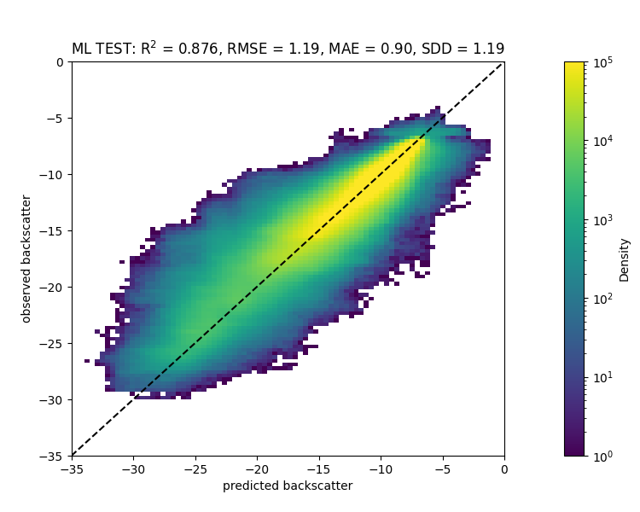
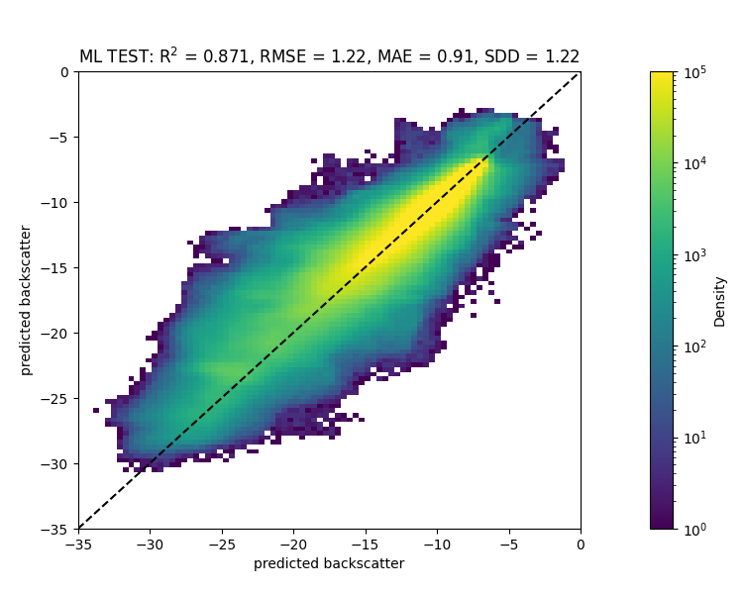
Impact of adding latitude longitude
Training 2016, Evaluation over 2017
xgboost
NN
R2=0.88, RMSE=1.2, MAE=0.9
R2=0.87, RMSE=1.2, MAE=0.9
Observation
Observation
Observation
Prediction
Prediction
Prediction

Slide 19
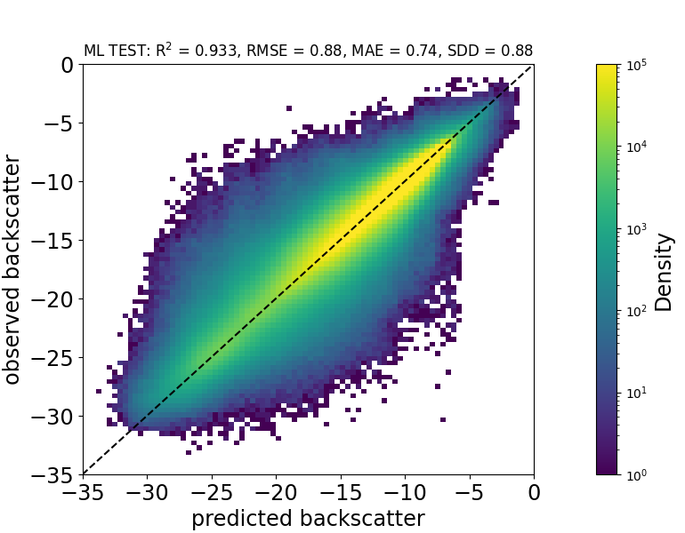
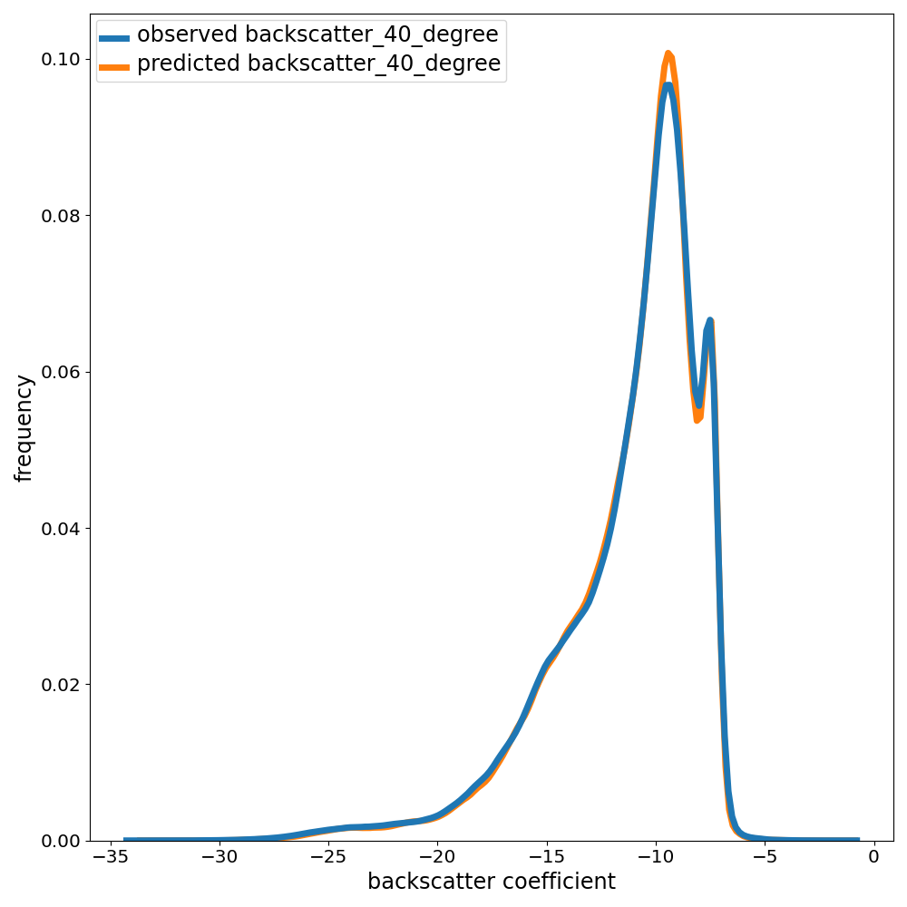
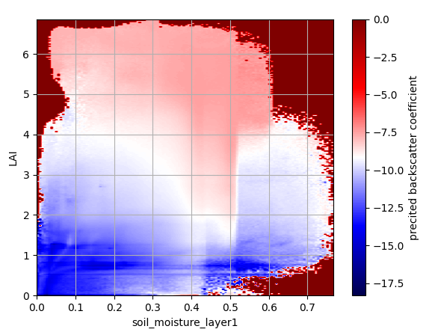
Local ML at grid point scale
Evaluation over 2017
xgboost
R2=0.9, RMSE=0.88, MAE=0.74
Observation
Prediction
Raw data
Prediction
LAI
Soil moisture
Soil moisture

Slide 20
Discussion
What are the main drivers of the backscatter coefficient
  Vegetation (dry biomass and water content) affects the slope and curvature of the relationship between backscatter and incidence angle
  How is normalized backscatter (at 40 degree) sensitive to vegetation ?
  Main influent factors: soil type, LAI, type of vegetation (high/low vegetation) ?
  Impact of snow and ice
Possibility of using backscatter from each beam to better capture vegetation changes ?
Choice of input model variables for the observation operator:
  LAI, Soil moisture up to 1m, Soil temperature up to 1 meter, T2m ?, Soil type, Vegetation type, vegetation cover
  Importance of time and day of the year ? (impact of variation in satellite geometry?)
Localization approaches
  Grid point in the observation space
  Global but using information on surface type, vegetation type, soil type
  Filtering

Slide 21
Conclusions and next steps
Implement a first simple version the observation operator in IFS to test level-1 ASCAT assimilation
Refine the forward operator
  Test other deep learning architecture: use of convolutional layer and autoencoder to deal with lack of information content and uncertainties in the model variables
  Use backscatter from each beam as outputs ?
Application to passive microwave: AMSR-2 (C,X,Ka,Ku bands)+SMOS (L-band)
Develop a training database and a NN for SIF

Slide 22
Local ML at grid point scale
Training 2016 (for 15000 points), Evaluation over 2017
xgboost
NN
R2=, RMSE=, MAE=
R2=0.9, RMSE=0.88, MAE=0.74
Observation
Observation
Observation
Prediction
Prediction
Prediction

Slide 23
Comparison of ML approaches for forward operator for ASCAT
Gradient boosted trees (xgboost package)
Observation
Evaluation over 2017 test set
R2=0.66 RMSE=1.98, MAE=1.15
Observation
Prediction
Prediction

Slide 24
Comparison of ML approaches for forward operator for ASCAT
Feedforward neural network (2 hidden layers, 60 neurons, LeakyReLu)
Evaluation over 2018 test set
R2=0.66 RMSE=2.00, MAE=1.15
Observed backscatter
LAI
Observation
LAI
predicted backscatter
Prediction

Slide 25

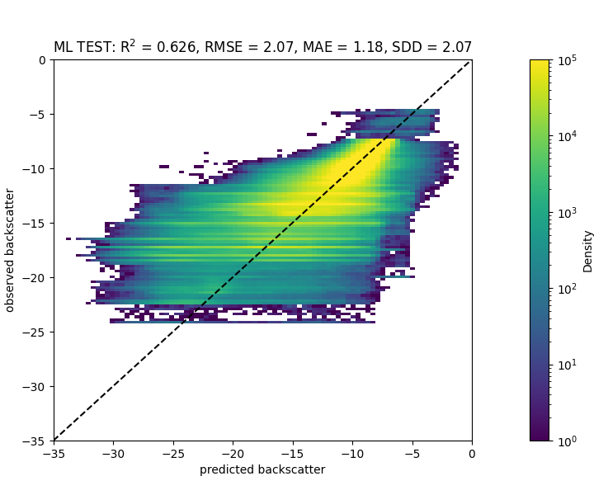
Comparison of ML approaches for forward operator for ASCAT
Random forest (10 trees, max depth=10)
Observation
Evaluation over 2017 test set
R2=0.63 RMSE=2.07, MAE=1.18
Observation
Prediction
Prediction

Slide 26
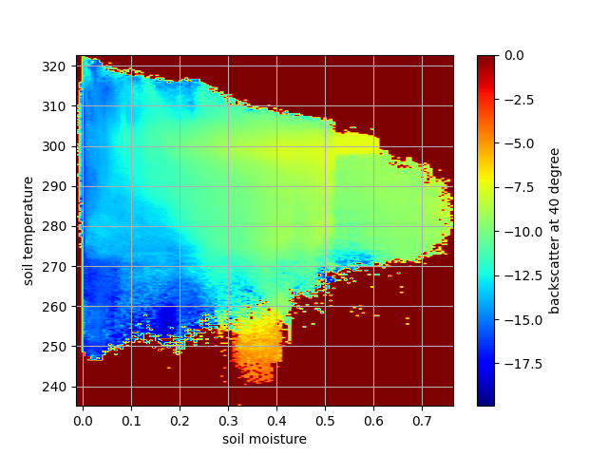
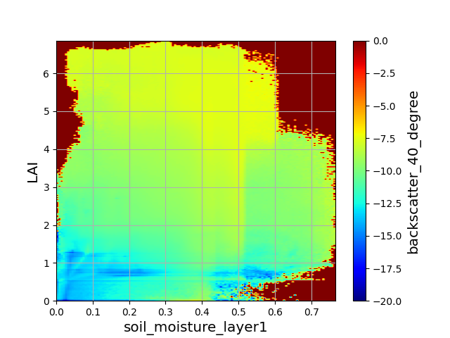
Information content of active microwave database (ASCAT)
One year, global 2d histograms
Soil temp
LAI
Soil moisture
Soil moisture

