Slide 1



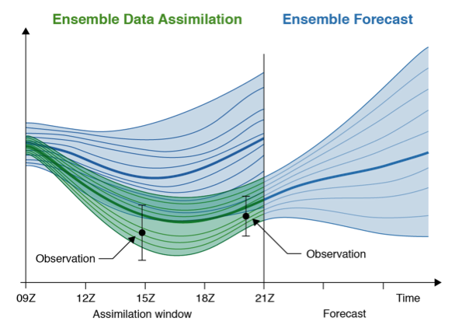
SEKF Background Error
Currently assume static background error (0.01 m³ m⁻³)
Ensemble of Data Assimilations (EDA) provides info on soil moisture spread
Experiments conducted on forecast impact of using EDA spread in B matrix
Ensemble of Data Assimilations - Ensemble of atmospheric 4DVars with perturbed observations and forcing fields

Slide 2
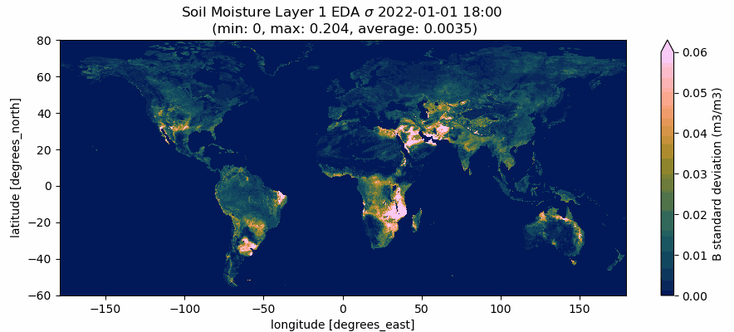
SEKF Background Error
Currently assume static background error (0.01 m³ m⁻³)
Ensemble of Data Assimilations (EDA) provides info on soil moisture spread
Experiments conducted on forecast impact of using EDA spread in B matrix

Slide 3
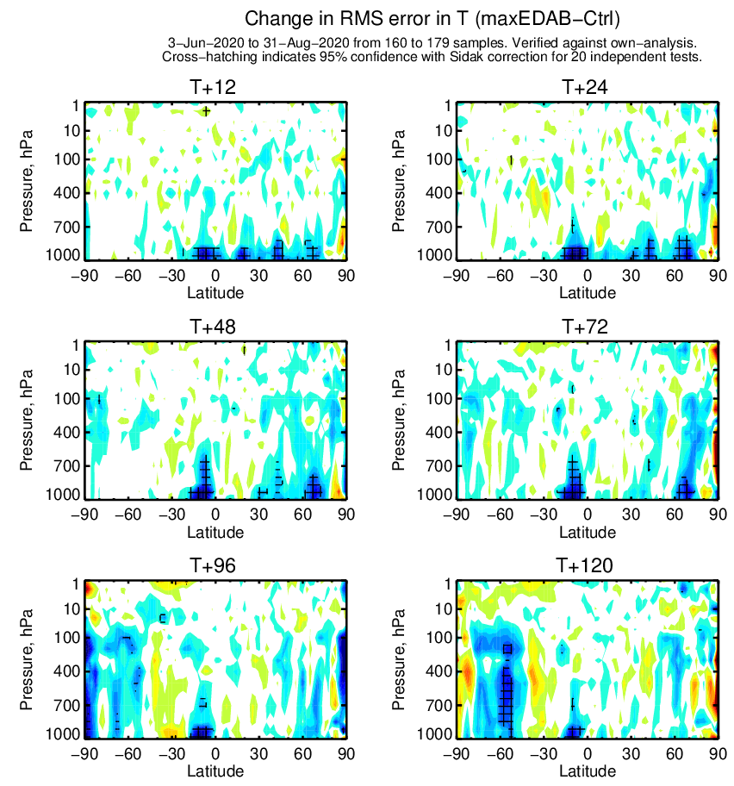
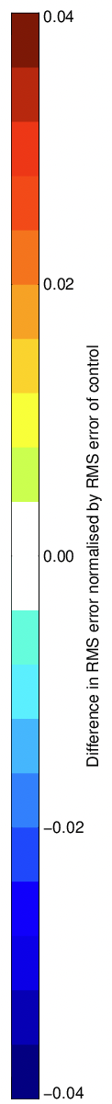
SEKF Background Error
Change in RMSE in Temperature (EDA B – CTRL)
See good improvements to surface temperature in forecast from EDA B…

Slide 4
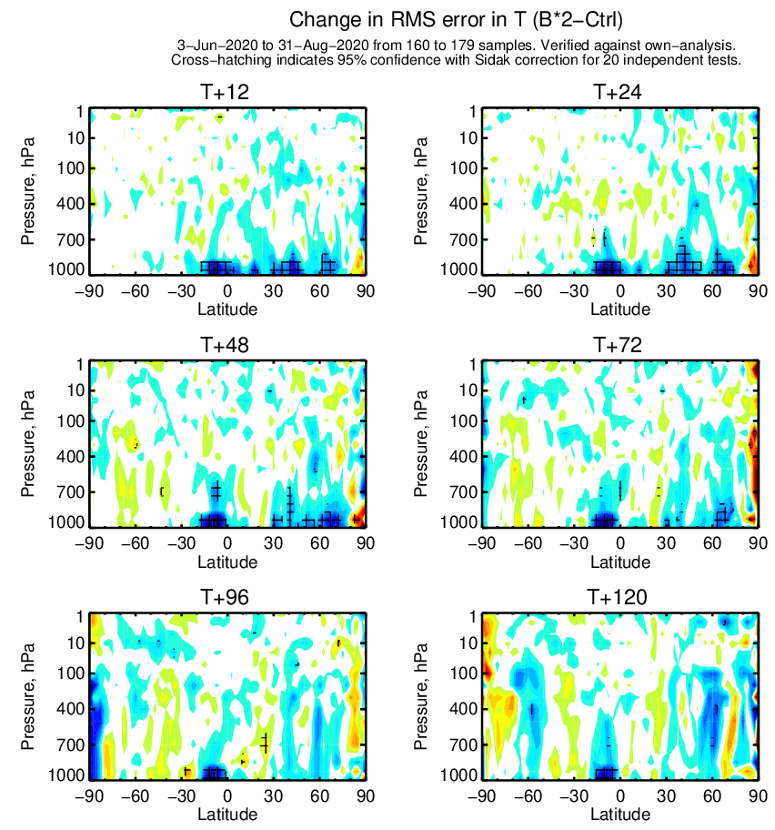
SEKF Background Error
Change in RMSE in Temperature (inflated B – CTRL)
See good improvements to surface temperature in forecast from EDA B…
Also find improvements by just inflating background error
  Putting this into next operational cycle merged with other Coupled Assimilation Team changes

