Slide 1
Met Office LSDA
Cristina Charlton-Perez
Samantha Pullen
Chris Harris
James Rucinski
ECMWF-Met Office Meeting
5 June 2023

Slide 2

Outline
Brief overview of current Met Office LSDA systems
Bias correction of the ASCAT observation
Issues with high soil wetness from ASCAT in urban areas
Brief overview of Global and Regional (UK) snow DA in SURF
Global Snow plans
LSDA with the next generation LFRic modelling system
Longer term: future Met Office LSDA system within the JEDI framework
Notes:
Cristina

Slide 3
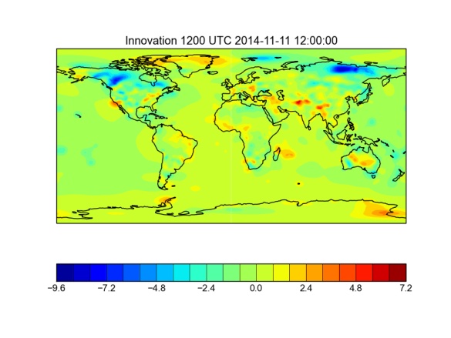
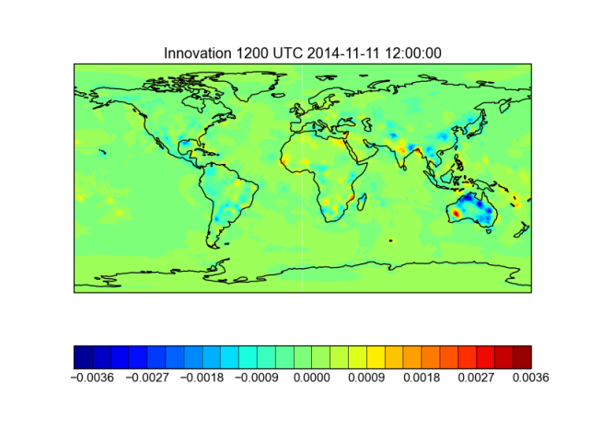
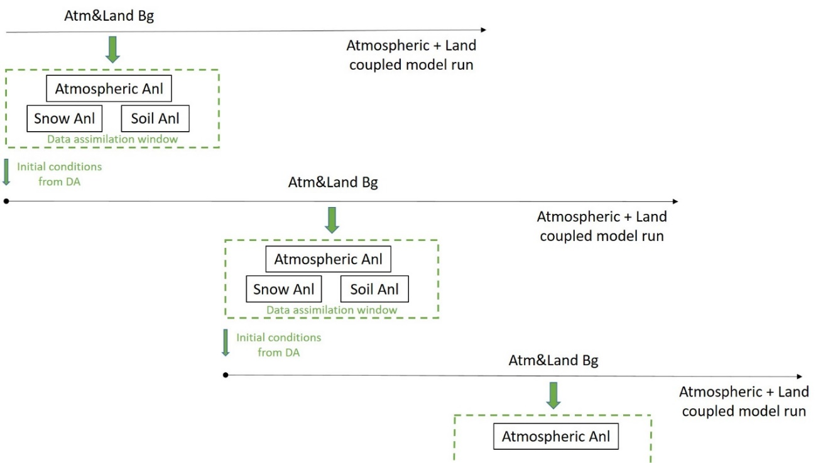
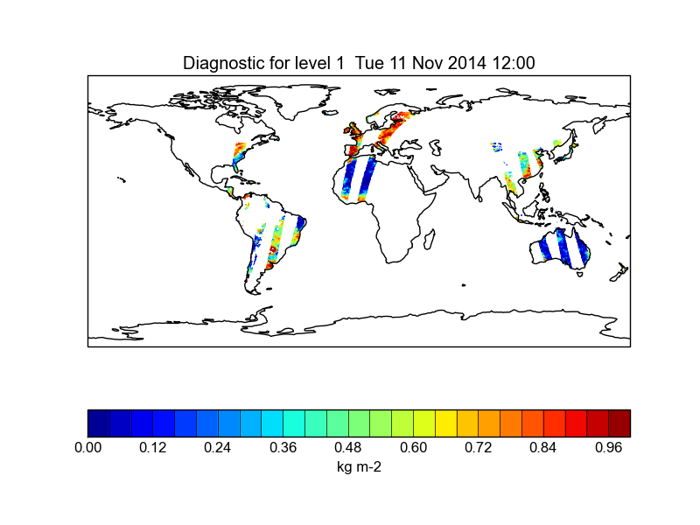


Operational LSDA
Observations
  Soil T and moisture on 4 layers
  Snow T up to 3 layers and tiles
  Skin T on tiles
  Global: 9 tiles (1 urban)
  UKV: 10 tiles (2 urban)
1. ASCAT Bias Correction
Analysed variables
2. Simplified Extended Kalman Filter
1.5 m Temp (Gridded)
$$x_{i}^{a}=x_{i}^{b}+K_{i}\left[y_{i}^{o}−H_{i}\left(x_{i}^{b}\right)\right]$$
$$K_{i}=BH_{i}^{T}{\left[H_{i}BH_{i}^{T}+R\right]}^{−1}$$
Column-based system (1D)
JULES land surface model used to estimate Jacobian
Global analysis every 6h
UKV regional analysis every hour
1.5 m Hum (Gridded)
ASCAT soil wetness index
The Met Office Operational Soil Moisture Analysis System (Gomez, Charlton-Perez, Lewis, Candy, 2020 )
Notes:
Cristina: Weakly coupled LSDA: Information from the atmospheric analysis is used in creating the land analysis (pseudo-obs), which is one of the requirements of a quasi-strongly coupled system.
However, the opposite is not true, and the only feedback from the land analysis into the atmospheric analysis is through the coupled model run.
Because the interaction between the analyses is one-way, we label our system as weakly coupled.

Slide 4

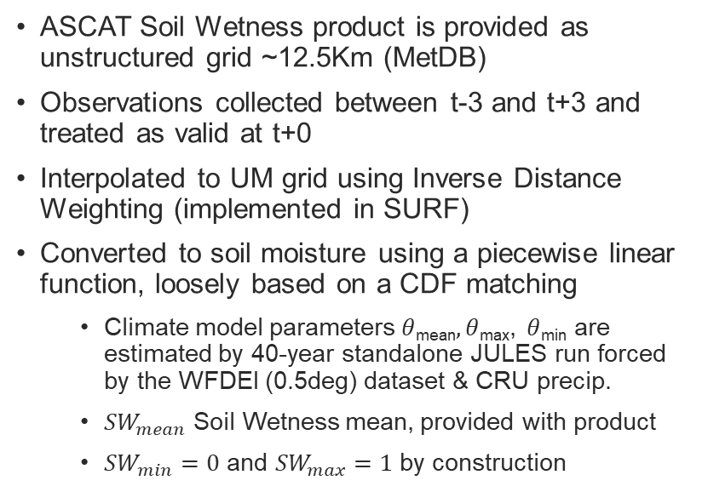







Processing ASCAT Soil Wetness
Model soil moisture
ASCAT Soil Wetness product is provided as unstructured grid ~12.5Km (MetDB)
Observations collected between t-3 and t+3 and treated as valid at t+0
Interpolated to UM grid using Inverse Distance Weighting (implemented in SURF)
Converted to soil moisture using a piecewise linear function, loosely based on a CDF matching
  Climate model parameters $θ$_{mean}$,θ$_{max}, $θ$_{min} are estimated by 40-year standalone JULES run forced by the WFDEI (0.5deg) dataset & CRU precip.
  ${SW}_{mean}$ Soil Wetness mean, provided with product
  ${SW}_{min}=0$ and ${SW}_{max}=1$ by construction
$$θ_{max}$$
$$θ$$
$$θ_{mean}$$
$$θ_{min}$$
$${SW}_{min}$$
$${SW}_{mean}$$
$$SW$$
$${SW}_{max}$$
Soil wetness
Notes:
Cristina

Slide 5
ASCAT Error boost
Error is boosted at very dry and wet regimes to account for errors in the Soil Wetness Index calculation
Boosting factor is calculated using the observation before bias correction
Boost values are user configurable by a piece wise linear function
Boost factor
Soil wetness index
Notes:
Cristina: Improved daytime maximum temperature forecasts and provided a modest improvement to night-time minimum temperatures, partially addressing the model performance over the Summer 2018. Tests over Winter 2018-2019 indicate that there are also improvements over this period.

Slide 6
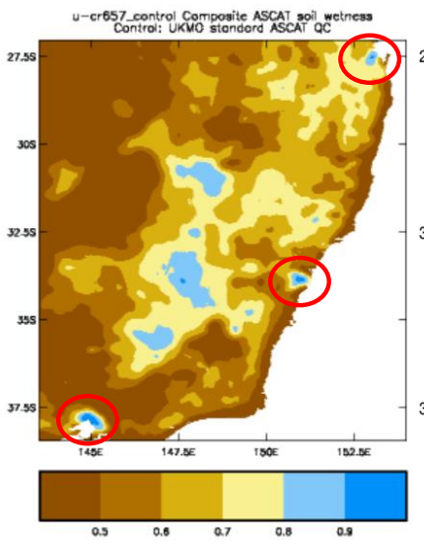
ASCAT Soil wetness in urban areas
BoM (UM Partner) brought up the issue of overestimation of model soil moisture in urban areas in Australia (Melbourne, Sydney, Brisbane and Perth)
Their investigation led to two culprits:
  ASCAT backscatter is high in urban areas and is erroneously interpreted as high soil wetness and
  JULES allows infiltration but suppresses evaporation on the urban tile.
Together we created some QC for the ASCAT obs in urban areas as defined by model ancillaries.
Testing underway at both BoM and MO. Different model configurations and ASCAT bias correction make comparing our results difficult.
BoM’s initial results show the ASCAT QC alone results in drier model soil in urban areas and an increase in surface temperature in suburban areas.
Figure courtesy Imtiaz Dharssi (BoM)
Notes:
Cristina

Slide 7
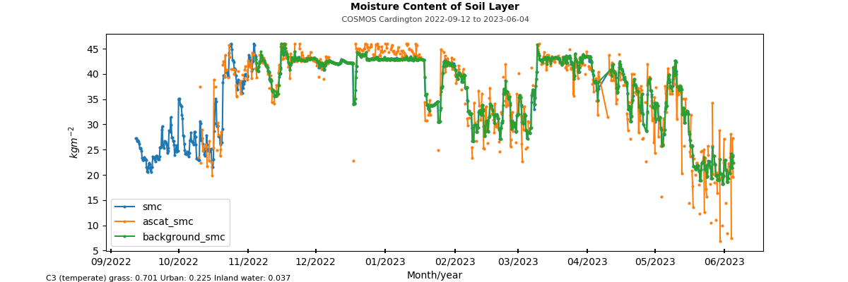
Spurious ASCAT increments for frozen soil
During Winter 22/23 we noticed some large apparent soil moisture decreases at some locations during cold periods
Surface temperature not close enough to freezing in model to QC these out with current scheme

Slide 8
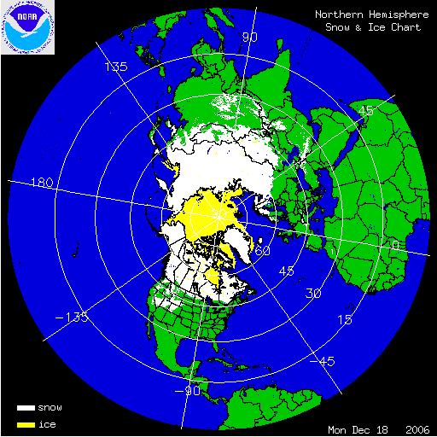
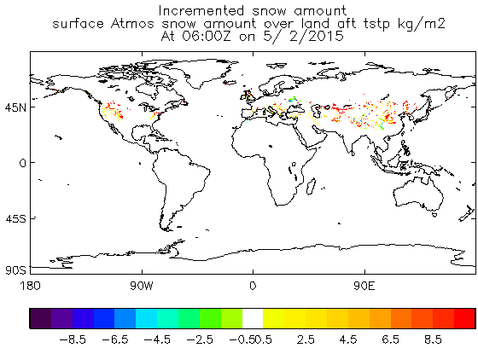
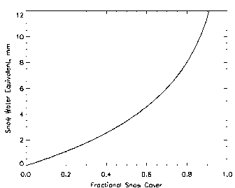
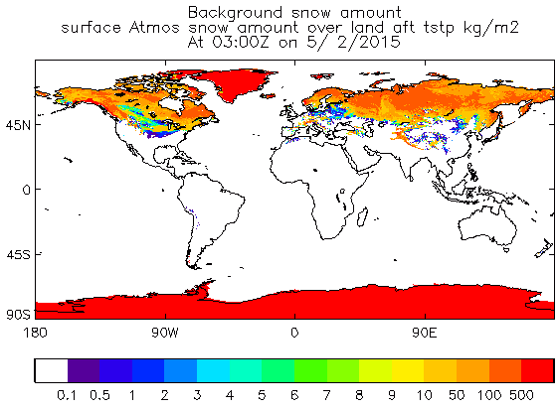
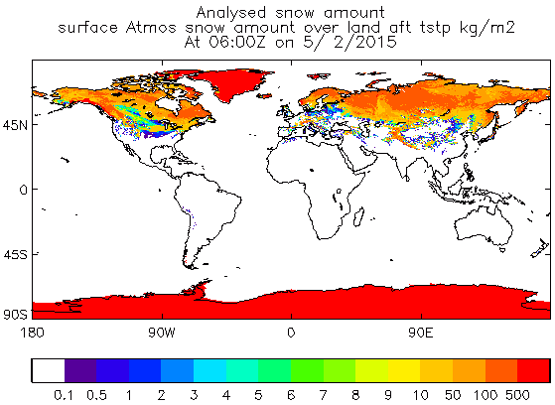
Global Snow Data Assimilation
NESDIS IMS 4km
06 UTC Increments
Observation/Background
no snow/no snow or snow/snow
do nothing
snow/no snow
no snow/snow
Observation
Snow cover converted into gridbox Fractional Cover
+
Relating fc and depth
06 UTC Analysis
Remove snow
UM N1280
~10km
Time delay check
Using T+6 from previous day
Background
Snow amount (kg m⁻²)
T+6 from previous cycle
Notes:
Sam

Slide 9
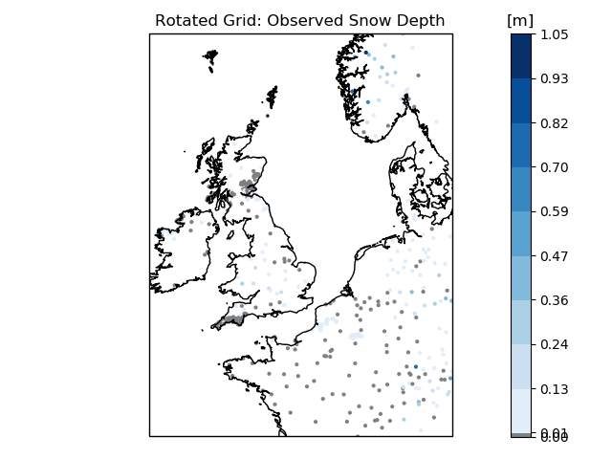
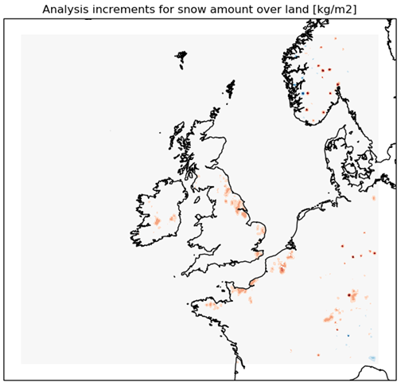
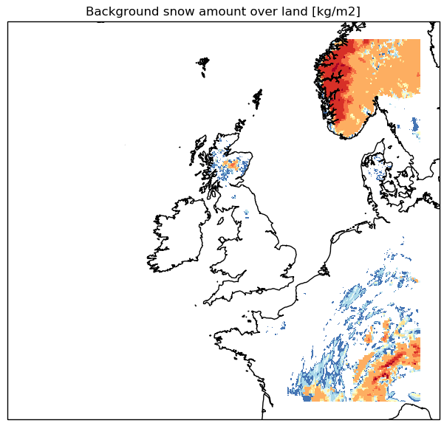

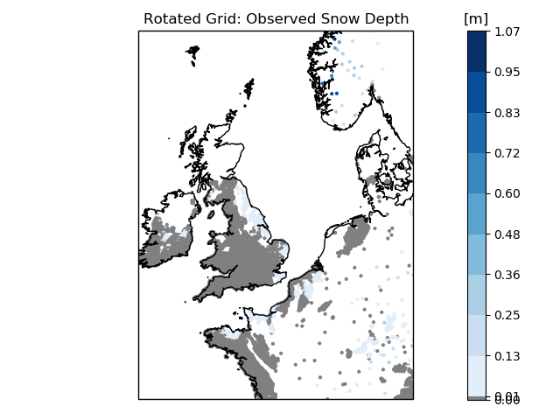
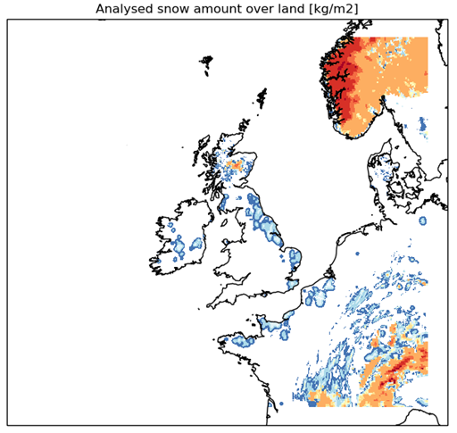
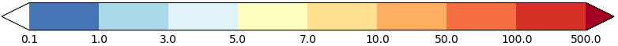
Snow DA for the UK
Observations
Analysed snow amount
Ground-based Synop network
snow depth
state of ground (snow or no snow)
4 times per day
“Observed” snow depth
(0.05 m snow depth from snow-cover product where model snow-free)
2D
Optimal Interpolation
Background snow amount
Satellite data from MSG-SEVIRI
H SAF daily snow cover product
Once per day
Notes:
Sam

Slide 10
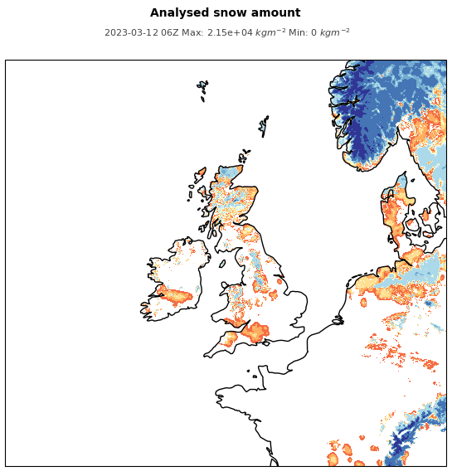
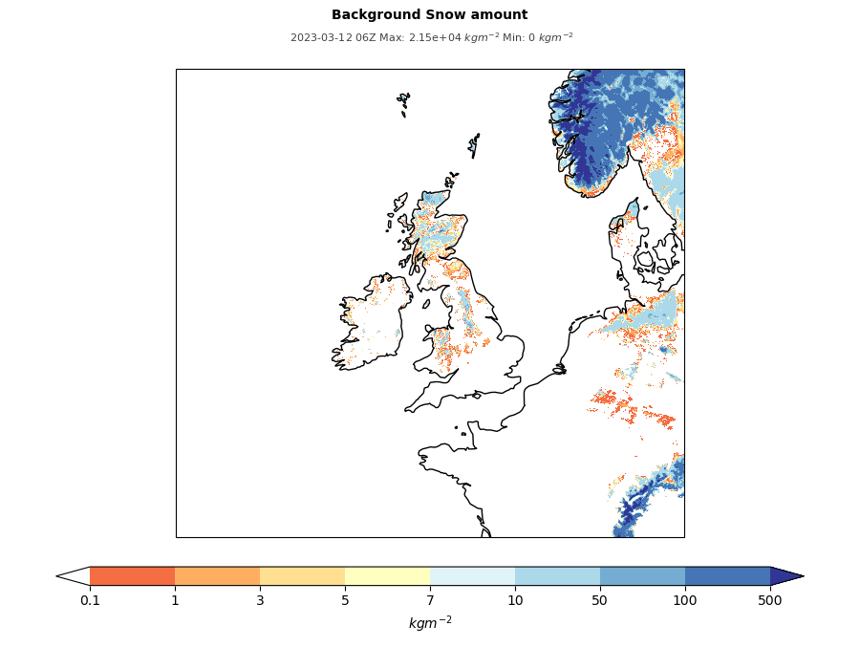
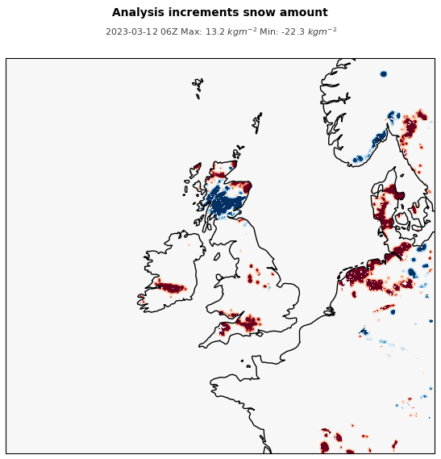
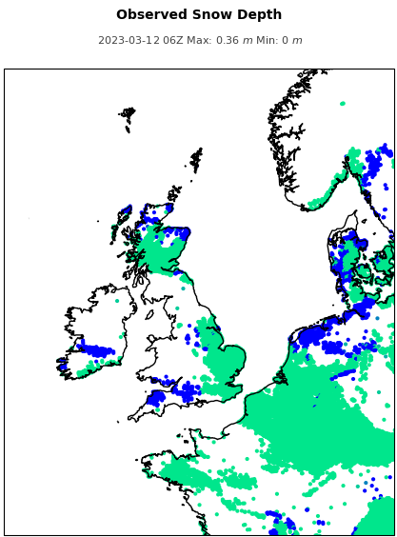
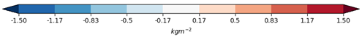
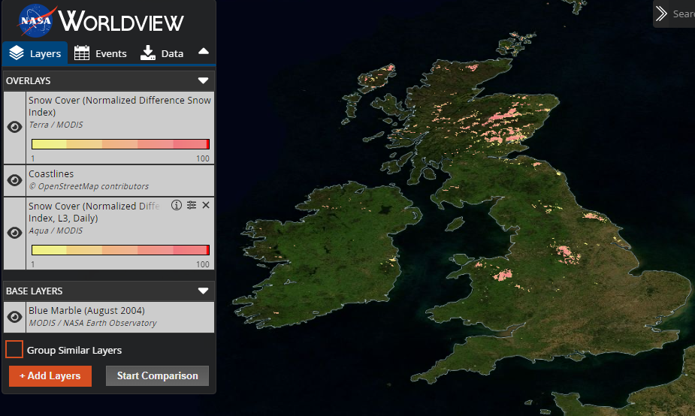

Anomalous snow cover in H SAF product
12-03-2023 0600H
Analysis
Background
Increments
Observations
Overestimation of widespread lying snow over SW UK and Ireland
Local snow cover verified on Dartmoor
Potential mis-classification of surface water
Occurs most frequently in western parts

Slide 11
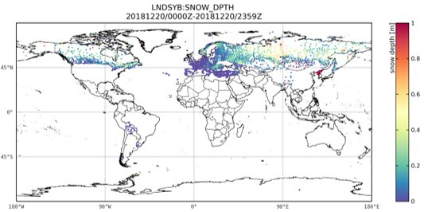
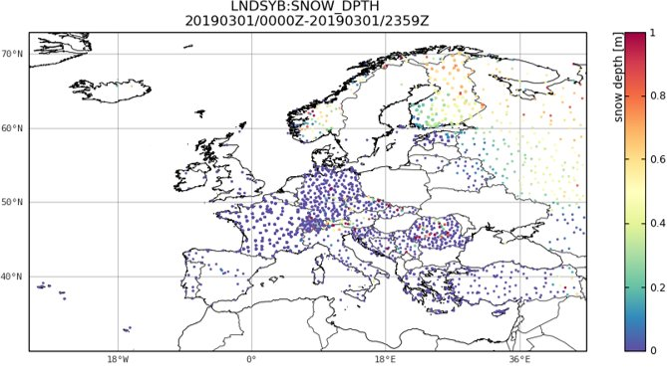
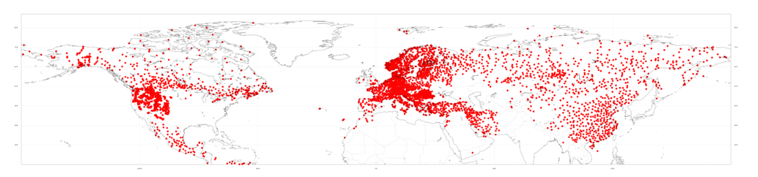
Global snow depth reports
Year on year improvements in availability of global station snow depth reports since adoption by WMO of Resolution 15 (EC-69) in 2017
Improved reporting and exchange of station snow depth obs (SYNOP network)
Increase in reporting of zero snow in snow-free conditions during winter season
Exchange of national network obs using new dedicated BUFR sequence
Addition of US SNOTEL network (>1000 new stations) from 29 March 2023
Extend OI snow depth assimilation to global model to exploit these observations…..
Snow depth reports available on GTS 11 April 2023
WIGOS Newsletter April 2023, vol. 9, no. 2
Notes:
Sam

Slide 12
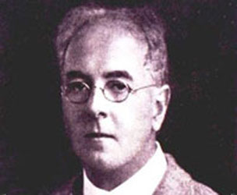

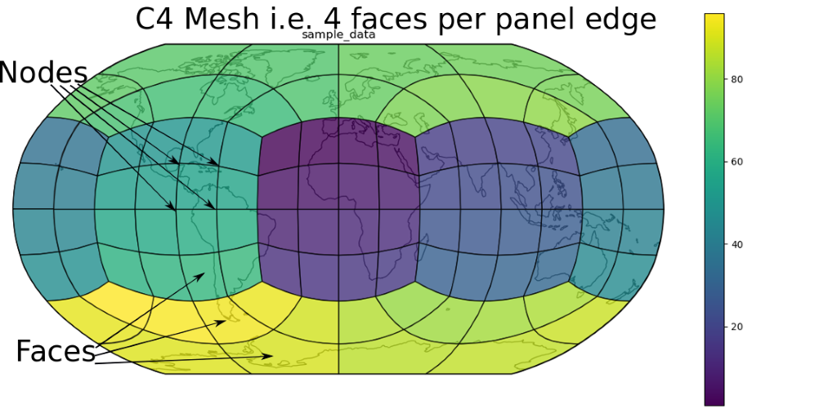
LFRic and the unstructured grid
What is LFRic? Post-GungHo (dynamical core project)
LFRic modelling infrastructure project will
change from the latitude-longitude mesh to the cubed-sphere mesh,
enable equations to be solved using a finite-element method replacing the finite-difference method,
implement “separation of concerns”: separate the natural science aspects from the technical implementation. Key to this is automatic code generation. STFC developed the Psyclone application to auto-generate parallel code for LFRic
use netcdf files for I/O
Next Generation (NG) MO Systems
Notes:
Cristina

Slide 13
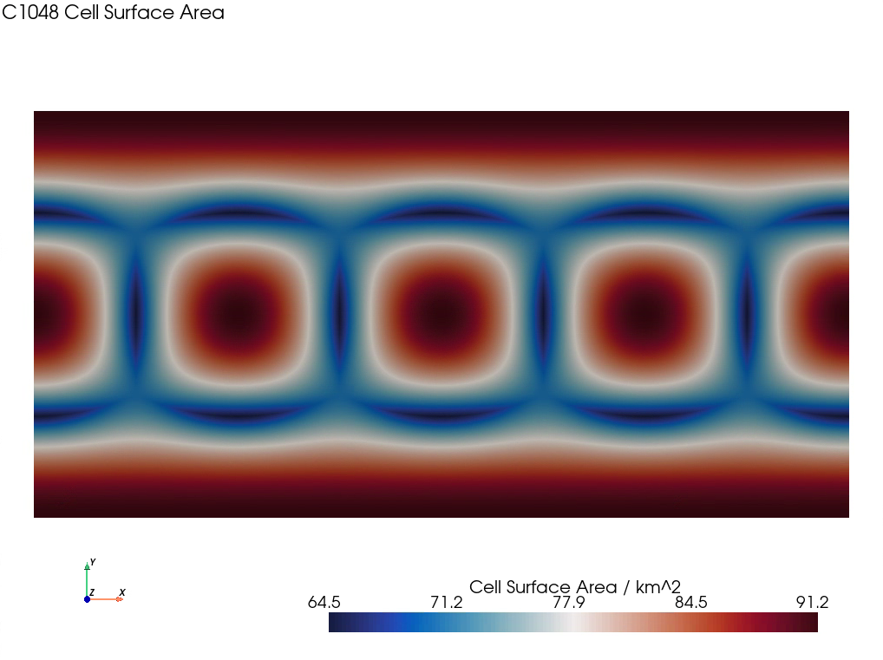
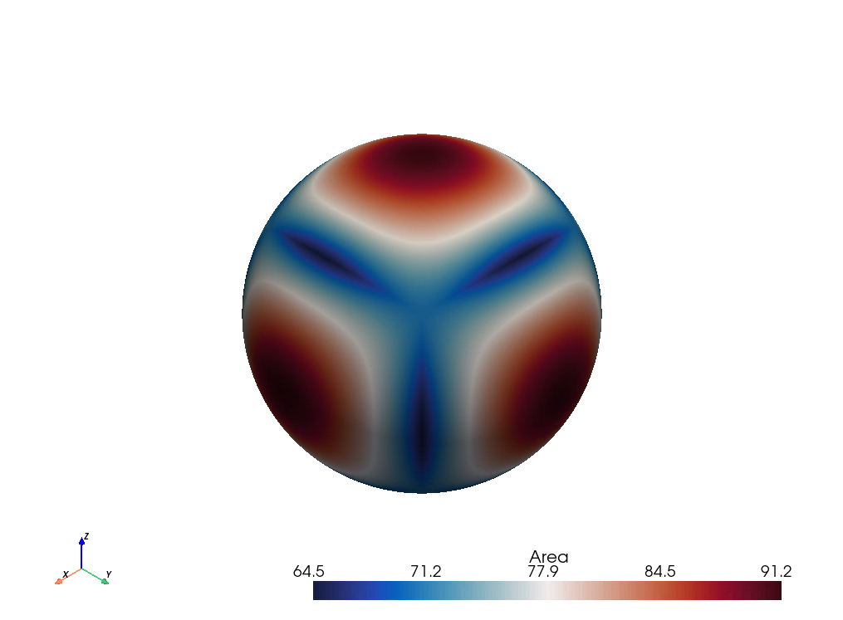
Cell Surface Area C1048
Example of cubed sphere mesh close to current operational resolution
Bill Little plotted using his geovista Python library
Notes:
Cristina

Slide 14
Adapt SURF to work for UM and LFRic:
Moving to an unstructured grid
Adapt interpolation and nearest neighbour routines for placing obs. on either lat/lon regular grid or the cubed sphere mesh
Remains a column by column set-up with ability to analyse same land variables on lat/lon regular grid or the cubed sphere mesh
No change to observations or DA schemes
Modernise the data structures for ease of use on either grid
Ensure that SURF can work with netcdf files for I/O and as interfaces throughout
Use new LFRic ancillary files
Ensure that SURF interacts with JULES as required
Read LFRic inputs and produce LFRic outputs
This work is separate to development of Next Generation LSDA
Rhiannon Davies, Software Engineering Expertise
Notes:
Cristina

Slide 15
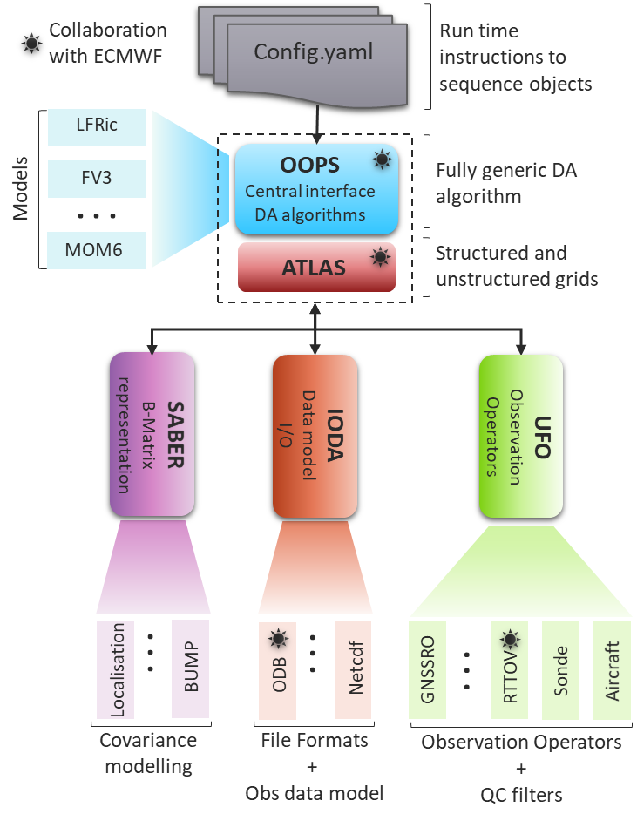
JEDI - Joint Effort for Data assimilation Integration
Model Interfaces
Configuration files
Provide the link between the individual models and the agnostic JEDI code.
Provide the scientific instruction for running the JEDI code.
System Agnostic Background Error Representation
Object Oriented Prediction System
Provides a generic, portable, model-agnostic DA system interface
Holds background error covariance models (both static and ensemble-based versions)
Interface for Observation Data Access
Unified Forward Operator
Provides the interfaces that bridge the external observation data to the components within JEDI that utilize those data, namely OOPS and UFO.
Contains a collection of forward operators and abstract observation filters
Notes:
Sam

Slide 16
LSDA in the JEDI Framework
Motivation and aims
Common infrastructure for atmosphere and land surface observation processing and data assimilation
  Opens opportunities for stronger coupling between atmosphere and land surface
  Enables sharing of scientific and technical expertise
  Streamlined system maintenance
  Observation processing for LSDA can build on existing capabilities in JOPA (MO “JEDI-based Observation Processing Application”)
Modularity of the JEDI approach offers us opportunities to test and incorporate new obs, obs operators and DA schemes faster than before
  Numerous DA algorithms available to use in OOPS
  Observation operators can be added to JEDI via an abstract interface to UFO
Opportunities to collaborate with JCSDA Partners using JEDI
  NOAA has already implemented support for snow observations (IMS and station snow depth)
  Common developments will be needed for processing soil moisture and screen observations
Notes:
Sam

Slide 17


Planning the new JEDI-based LSDA system
Planning will take place over the course of this year
What we know already:
We will not port the current system
Aim to harmonise with a single multi-variate land surface analysis
Starting point will use all the obs types we currently use (at least)
Observation processing will build on capability introduced for our atmospheric DA (JOPA)
Aim to exploit DA methods that already exist in JEDI
Will be part of an ensemble-based NWP system
Enabling future enhanced coupling between atmosphere and land surface will be a key consideration for our choice of DA methodology
Notes:
Sam

Slide 18
Questions

