Slide 1
ECMWF-Met Office land surface data assimilation meeting
5 June 2023, University of Reading
ECMWF land DA overview and strategy
Patricia de Rosnay, David Fairbairn, Sébastien Garrigues, Christoph Herbert, Kenta Ochi, Ewan Pinnington, Kirsti Salonen, Pete Weston,
and many others
1

Slide 2
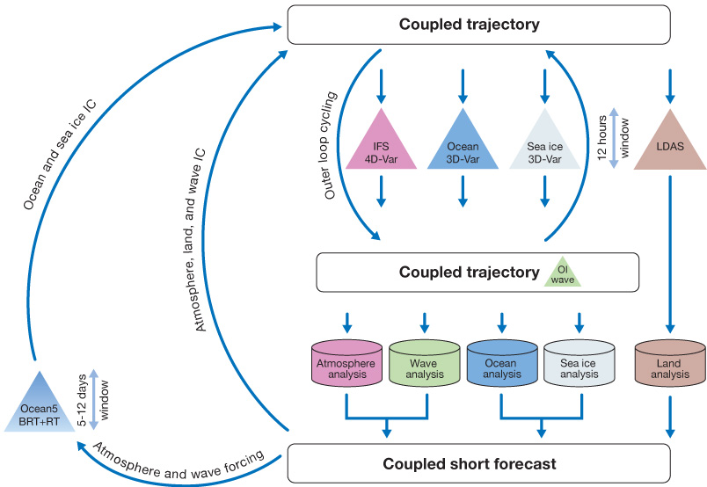
Coupled Assimilation for operational NWP at ECMWF
Weakly coupled data assimilation
Land-atmosphere-ocean
(land-atm-wave)
T2m, RH2m 2D-OI
Snow 2D-OI
Soil moisture SEKF
Tsoil, Tsnow 1D-OI
(ocean and sea ice)
(land-atm-wave)
2

Slide 3


ECMWF land data assimilation for operational NWP at ECMWF
Ensemble Data Assimilation (EDA)
NWP Forecast
Coupled Land-Atmosphere
Land initial conditions
(SM, ST, SnD, Tsoil, TSn)
EDA Jacobians
T2m, RH2m
& soil moisture
Background
Soil Analysis (SEKF)
SM1, SM2, SM3
σ_{O_T2M}= 1K
σ_{b_}= 0.01m3/m3
σ_{SMOS_NN}= 0.02+3ε
σ_{O_RH2M}= 4%
σ_{ASCAT}= 0.05m3/m3
Pseudo-obs
T2m, RH2m
SMOS Neural network
SMOS TB
2D-OI + 1D-OI
T2m RH2m SnD Tsoil Tsn
in situ
T2m RH2m
snow depth
satellite
ASCAT SSM
SMOS SSM
IMS
$$σoT2m=2K$$
$$σoRH2m=10\%$$
$$σoSynopSD=4cm$$
$$σoIMSD=8cm$$
3

Slide 4
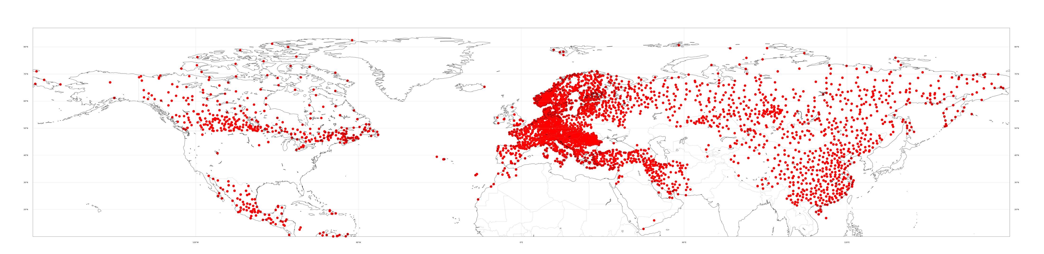
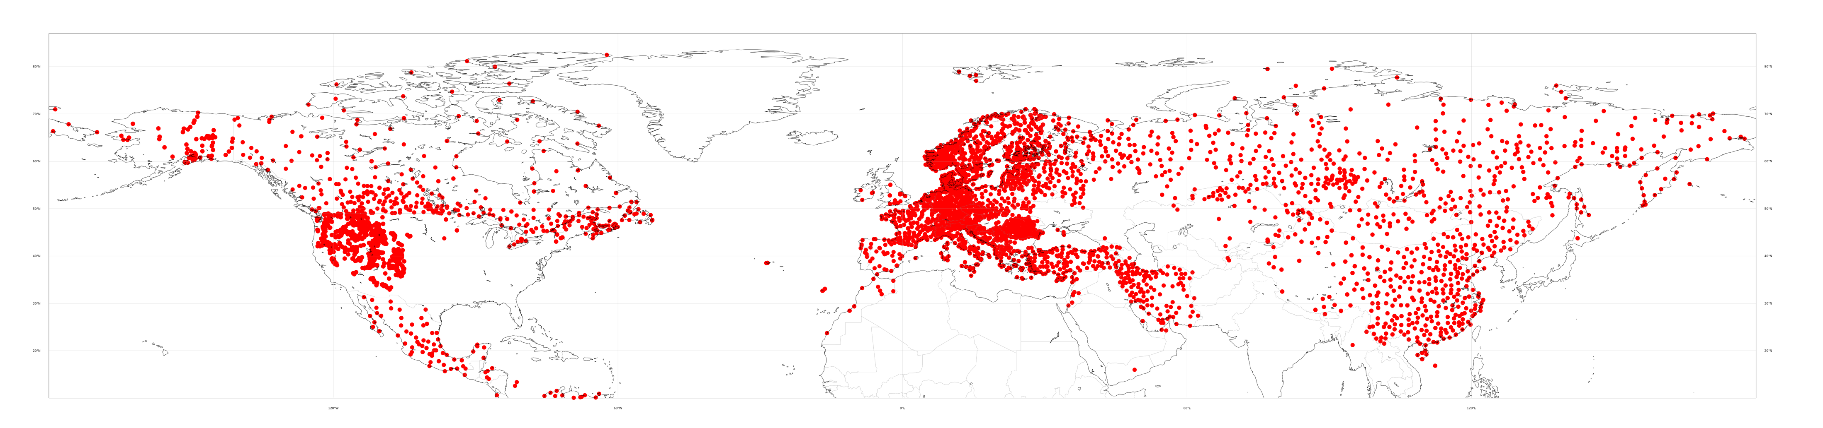
Land observing system: the example of in situ snow depth
Near-Real-Time access to observations
Prior 29 March 2023
From 29 March 2023
Snow depth availability on the Global Telecommunication System (GTS)
→ Strong link with MWO ((GCW, SnowWatch, JET-EOSDE)
WIGOS (WMO Integrated Global Observing System) Newsletter April 2023
https://community.wmo.int/en/news/wigos_newletters
4

Slide 5


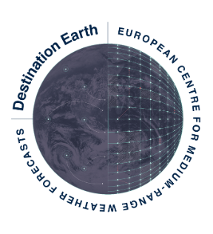
Land surface assimilation work and plans
Development of a unified ensemble-based coupled land-atmosphere data assimilation
For NWP, C3S, CAMS, DestinE
Exploitation of current and new observations
  Development of ML/AI observation operators,
  New & future observations: SIF, SCA, CIMR, CRISTAL, LSTM
Projects: EUMETSAT H SAF; ESA SMOS ESL; EU CoCO2, CORSO, CERISE, DestinE; Collaboration JMA
Kenta
Snow analysis
IMS DA
Snow CCI DA
David
ASCAT DA
Adaptive BC
Pete
LAI analysis
based on VOD DA
Sébastien
Observation operators
ASCAT, PMW, SIF
Coupled DA for CO2MVS
Christoph
Soil T and snow T SEKF
Pete -> Kirsti
SMOS
NN, TB monitoring
Ewan
SEKF B, Ensemble DA
Observation operators
Pete
Outer loop coupling
Observation operators

Slide 6
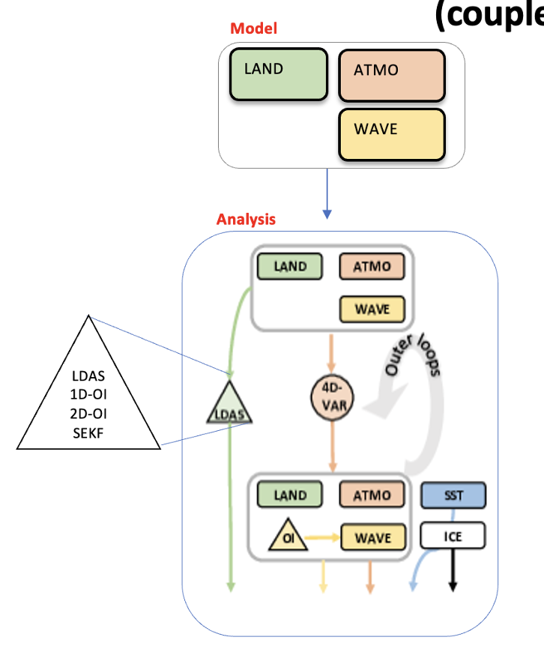
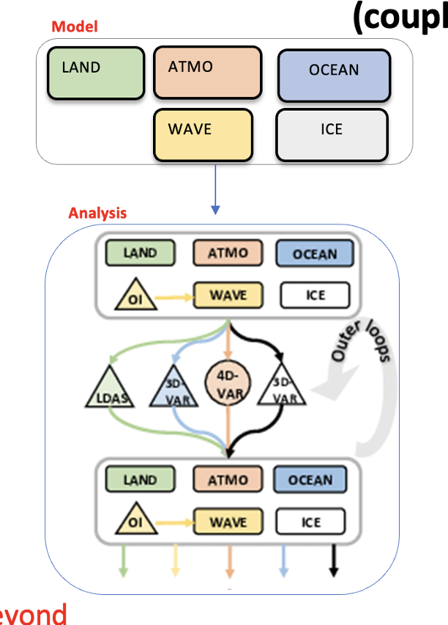
Where are we going?
Development of a unified ensemble-based coupled land-atmosphere data assimilation
For NWP, C3S, CAMS, DestinE
ERA5
ERA7
benefit SEAS7

Slide 7
Coupled DA Team land DA contributions for IFS cycle 49r1
  Doubling B in the soil moisture analysis (Ewan)
  T2m lapse rate correction in the land DA system (Patricia)
  ASCAT soil moisture bias correction update (David)
  Other technical changes in the SEKF soil moisture analysis (Christoph)
  Snow data assimilation: IMS thinning and IMS DA in mountainous areas (Kenta)
  → Strong land surface cycle with also very significant changes on the model side and new land cover.

Slide 8
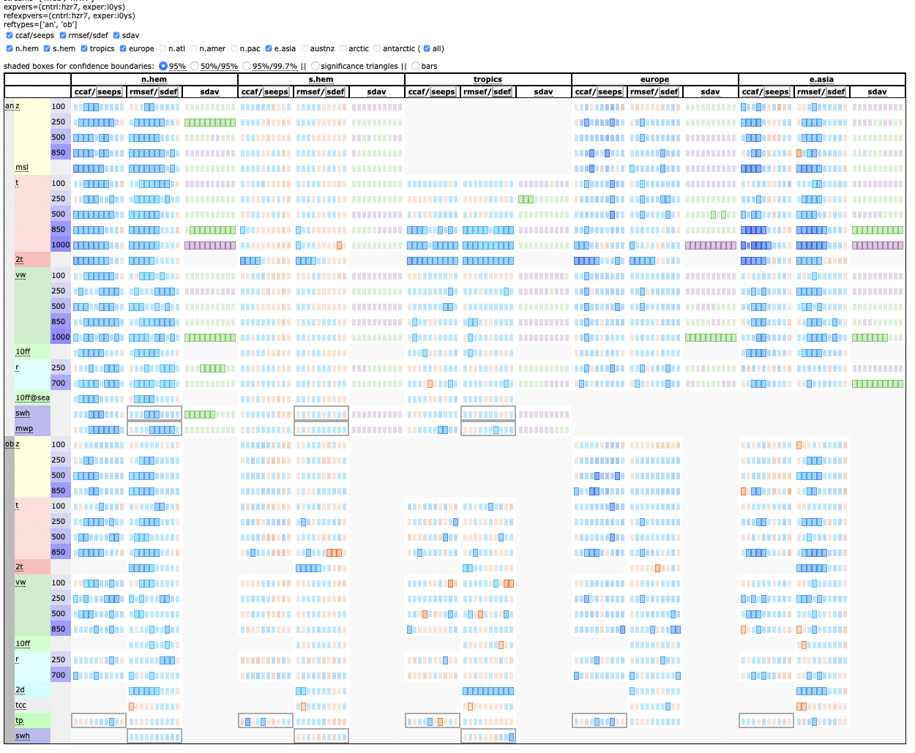
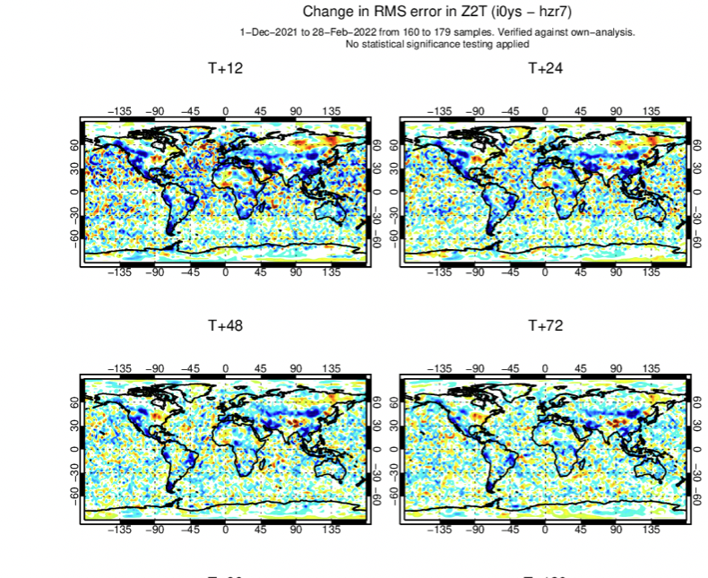
Coupled DA Team land DA contributions for IFS cycle 49r1
Merged land DA + SCF winter 2021/22

Slide 9
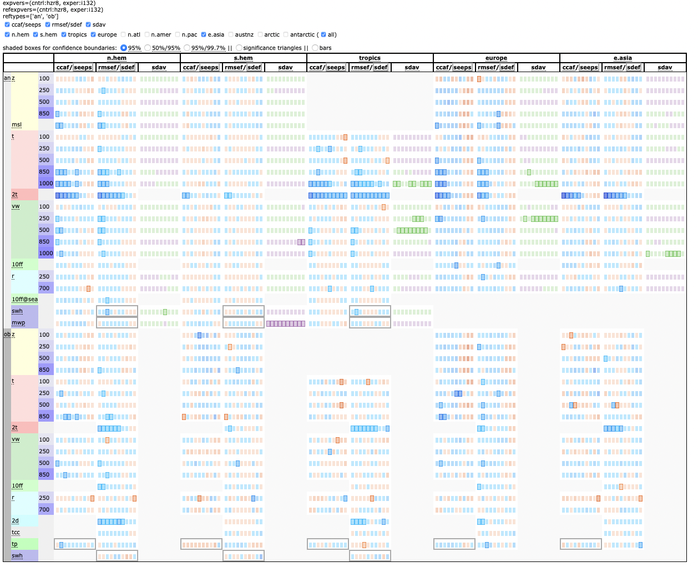
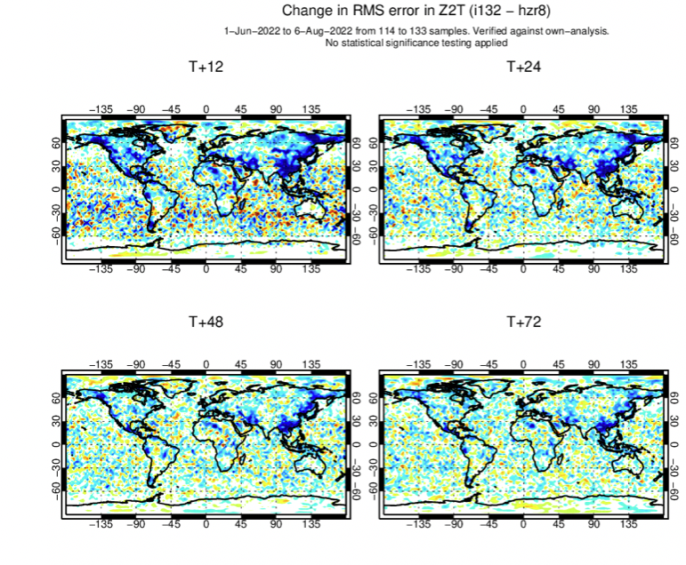
Coupled DA Team land DA contributions for IFS cycle 49r1
Merged land DA + SCF summer 2022
Note: until 31 July → TBC

Slide 10

CERISE Horizon Europe project
Development of a unified ensemble-based coupled land-atmosphere data assimilation
CERISE¹:
CopERnIcus climate change Service Evolution
Long-term evolution of the C3S climate reanalysis and multi-system seasonal prediction systems towards an Earth system approach
HE project 2023-2026
https://www.cerise-project.eu/
¹ The CERISE project (grant agreement No101082139) is funded by the European Union. Views and opinions expressed are however those of the author(s) only and do not necessarily reflect those of the European Union or the Commission. Neither the European Union nor the granting authority can be held responsible for them.

Slide 11
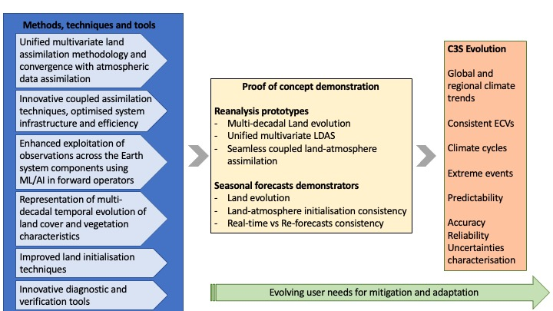
CERISE concept and partners
Partners | Country
ECMWF | Int.
MetNo | Norway
SMHI | Sweden
Météo-France | France
DWD | Germany
CMCC | Italy
BSC | Spain
MetO | UK
DMI | Denmark
Estellus | France
IPMA | Portugal
NILU | Norway

Slide 12
CORSO Horizon Europe project
Development of a unified ensemble-based coupled land-atmosphere data assimilation
CORSO¹:
CO2MVS Research on Supplementary Observations (CORSO)
WP4: Enhance the exploitation of satellite observations in coupled land-atmosphere assimilation to constrain vegetation water and carbon cycle variables
HE project 2023-2025
https://www.corso-project.eu/
¹ The CORSO project (grant agreement No101082194) is funded by the European Union. Views and opinions expressed are however those of the author(s) only and do not necessarily reflect those of the European Union or the Commission. Neither the European Union nor the granting authority can be held responsible for them.

Slide 13
CORSO Horizon Europe project
Development of a unified ensemble-based coupled land-atmosphere data assimilation
Enhance the exploitation of satellite observations in coupled land-atmosphere assimilation to constrain vegetation water and carbon cycle variables:
Extend the assimilation of observations that we already use for NWP but not yet for CO2MVS, such as SMOS and ASCAT, to analyse vegetation variables,
Develop assimilation of existing observations that are not yet used such as SIF observations,
Pave the way for future observations assimilation such as Metop-SG/SCA, Copernicus Expansion CO2 and CIMR missions, which are all relevant to consistently constrain vegetation and carbon fluxes in CO2MVS
Partners WP4
ECMWF
CEA (LSCE)
iLab
Meteo-France
U Lund
EMPA
¹ The CORSO project (grant agreement No101082194) is funded by the European Union. Views and opinions expressed are however those of the author(s) only and do not necessarily reflect those of the European Union or the Commission. Neither the European Union nor the granting authority can be held responsible for them.

Slide 14
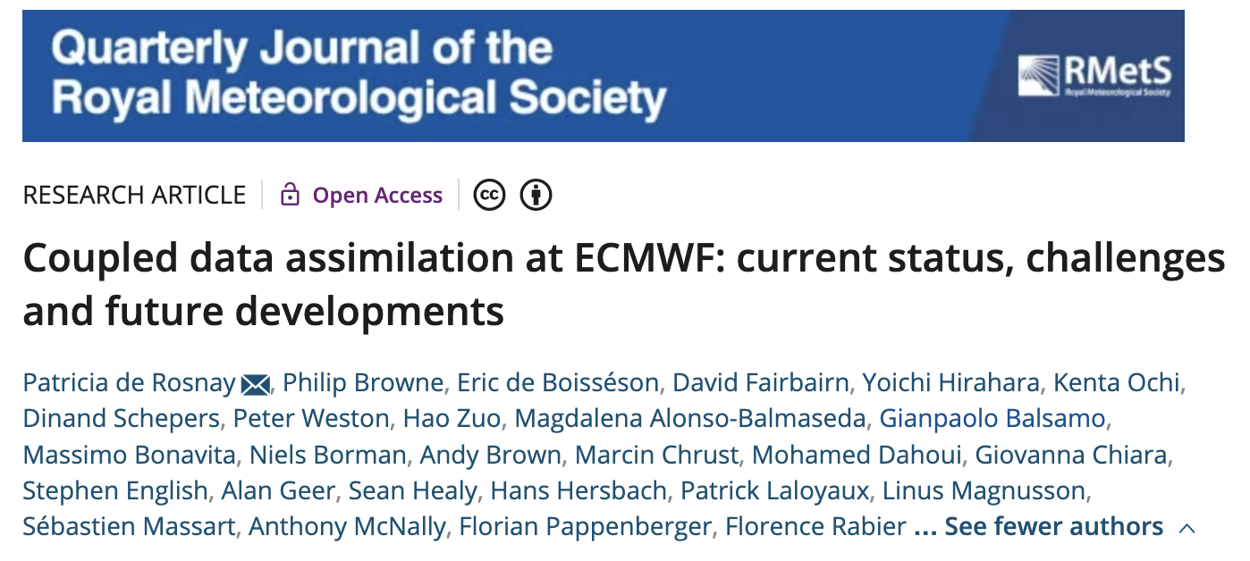
Special Collection Quarterly Journal of The Royal Meteorological Society “Coupled Earth system data assimilation” Submission deadline: 31 December 2023 https://rmets.onlinelibrary.wiley.com/
https://rmets.onlinelibrary.wiley.com/doi/full/10.1002/qj.4330

Slide 15
Agenda
Development of a unified ensemble-based coupled land-atmosphere data assimilation
For NWP, C3S, CAMS, DestinE
Exploitation of current and new observations
  Development of ML/AI observation operators,
  New & future observations: SIF, SCA, CIMR, CRISTAL, LSTM
Projects: EUMETSAT H SAF; ESA SMOS ESL; EU CoCO2, CORSO, CERISE, DestinE; Collaboration JMA
3-Kenta
Snow analysis
IMS DA
Snow CCI DA
1-David
ASCAT DA
Adaptive BC
2-Pete
LAI analysis
based on VOD DA
5-Sébastien
Observation operators
ASCAT, PMW, SIF
Coupled DA for CO2MVS
4-Christoph
Soil T and snow T SEKF
2-Pete -> Kirsti
SMOS
NN, TB monitoring
6-Ewan
SEKF B, Ensemble DA
Observation operators
Pete
Outer loop coupling
Observation operators

