Slide 1
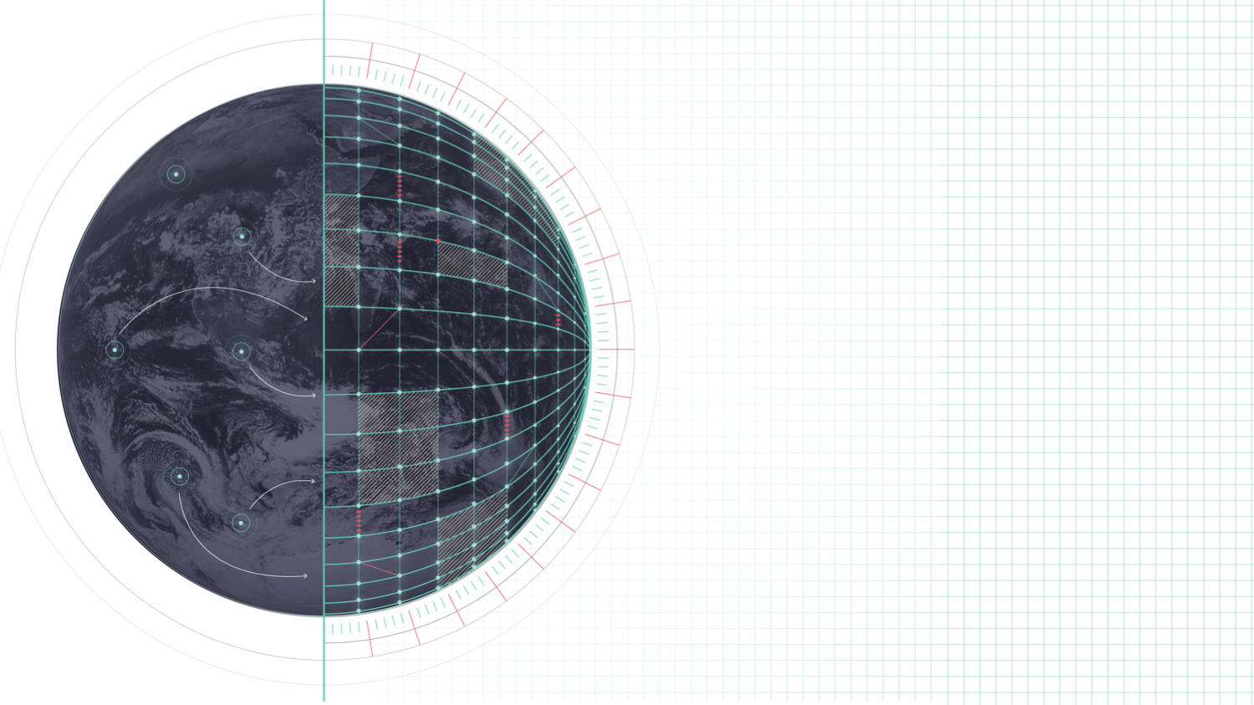
DESTINATION EARTH
New grib2 tile template
Notes:
Welcome slide

Slide 2

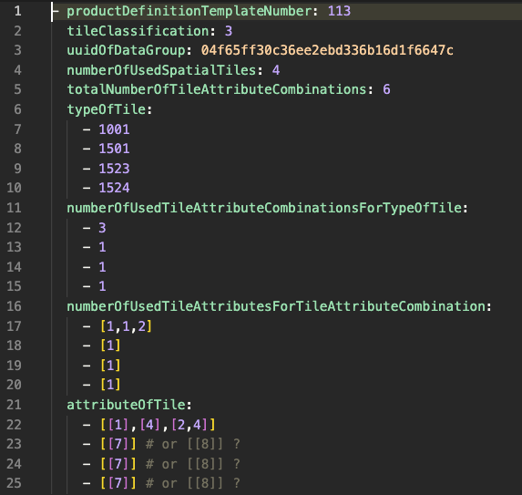
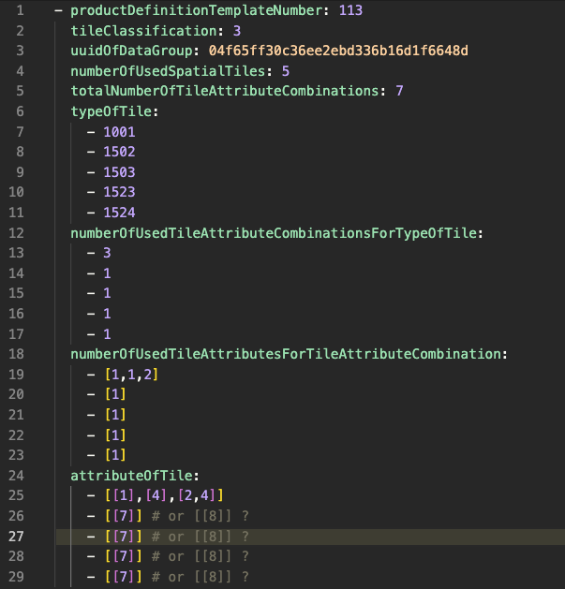
TILE template
Tile demo. Two regimes:
ISBA (all patches)
2-patch
Notes:
Blank slides

Slide 3
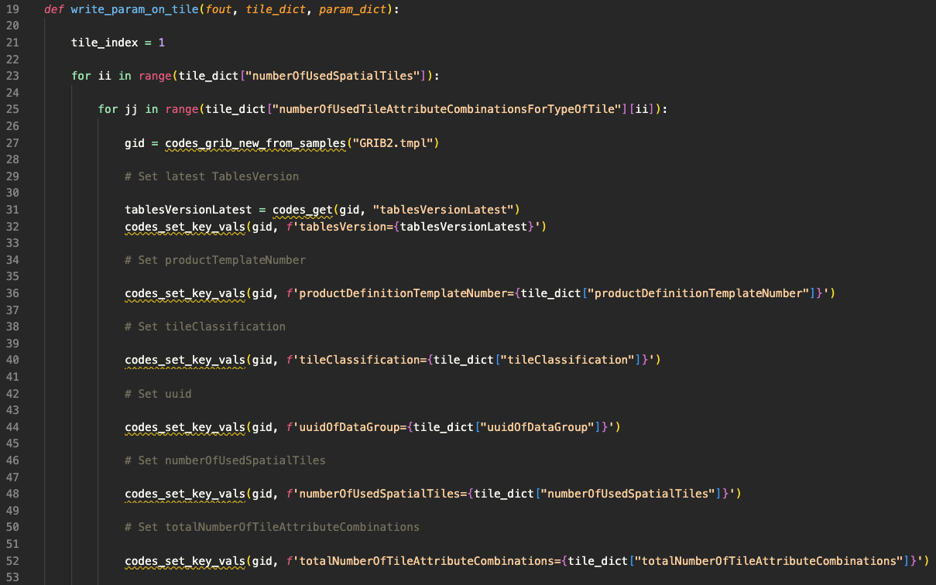
TILE template
Python code:
Notes:
Blank slides

Slide 4
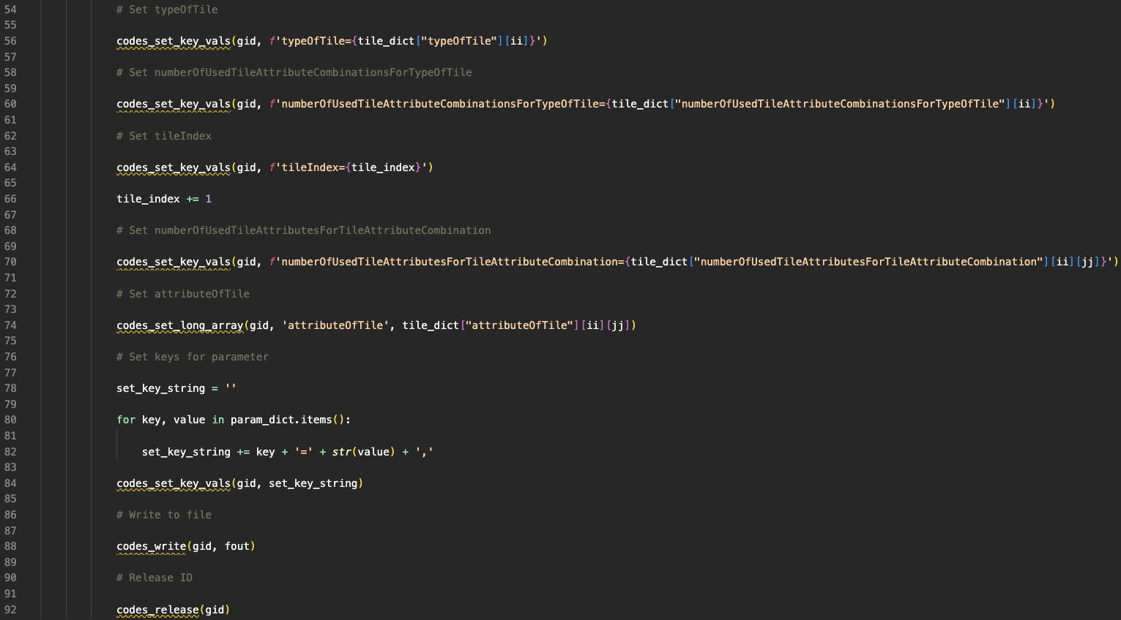
TILE template
Python code:
Notes:
Blank slides

Slide 5
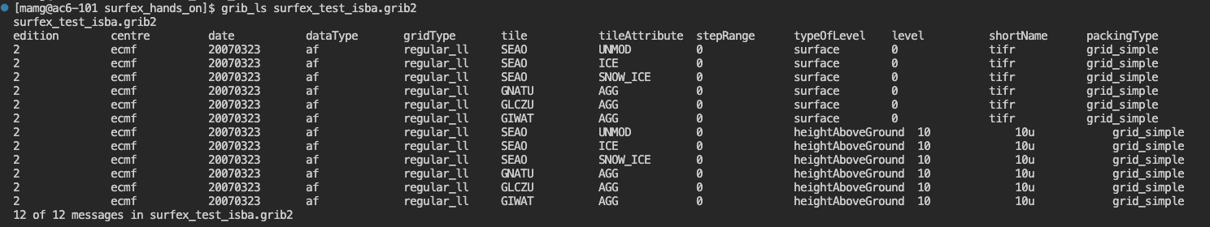
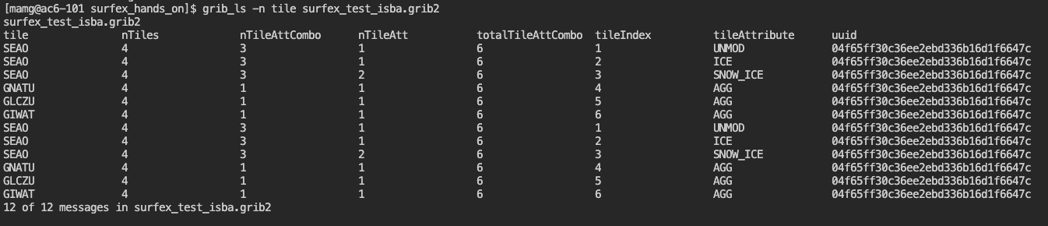
TILE template
grib_ls
ISBA (all patches) – general ls
ISBA (all patches) – tile namespace
Notes:
Blank slides

Slide 6
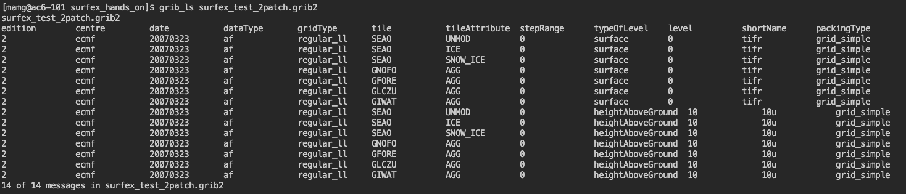
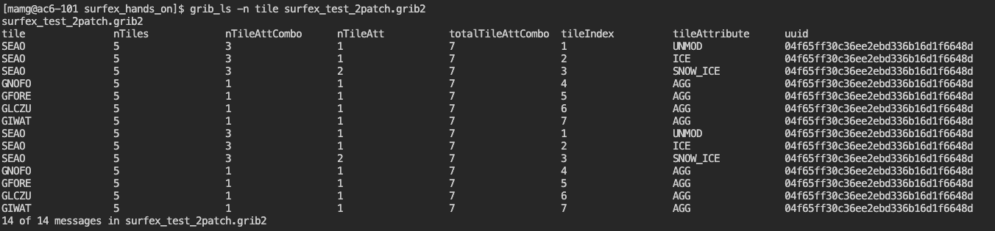
TILE template
grib_ls
2-patch – general ls
2-patch – tile namespace
Notes:
Blank slides

Slide 7
TILE template
Questions on variables:
 |  |  | Questions/comments | Answers
"RN", | Averaged net radiation | W/m2 | Is this defined as sum of ingoing, outgoing short and long wave radiation? And does it take albedo into account?
"RNC_P", | Averaged net radiation on patch | J/m2 | Same as above.
"DRAINC_ISBA", | Averaged soil drainage flux on full nature tile | kg/m2 | New variable likely needed.
"H_ML", | Height of mixed layer (?) in flake | m | Is this mixed layer depth within a lake? Currently we have "Mixed layer depth" but only for the atmosphere.
"EMIS", | Surface emissivity | 0-1 | Can more details be provided for this variable please.
"CH", | Drag thermal coefficient | - | New variable likely needed.
"CE", | Drag evaporation coefficient | - | New variable likely needed.
"TSWI_T_ISBA" | Total soil wetness index (total) | - | Can more details be provided for this variable please.
"TSWI1_ISBA" | Total soil wetness index layer 1 | - | Can more details be provided for this variable please.
"TSWI1_P" | Total soil wetness index layer 1 | - | Can more details be provided for this variable please.
"X001TC" | Canopy air temp | K | Can more details be provided for this variable please.
"TCANYON" | Road canyon temp | K | Can more details be provided for this variable please.
"QCANYON" | Road canyon humidity | kg/kg | Can more details be provided for this variable please.
Notes:
Blank slides

Slide 8
TILE template
Any other questions?
Notes:
Blank slides

