Slide 1
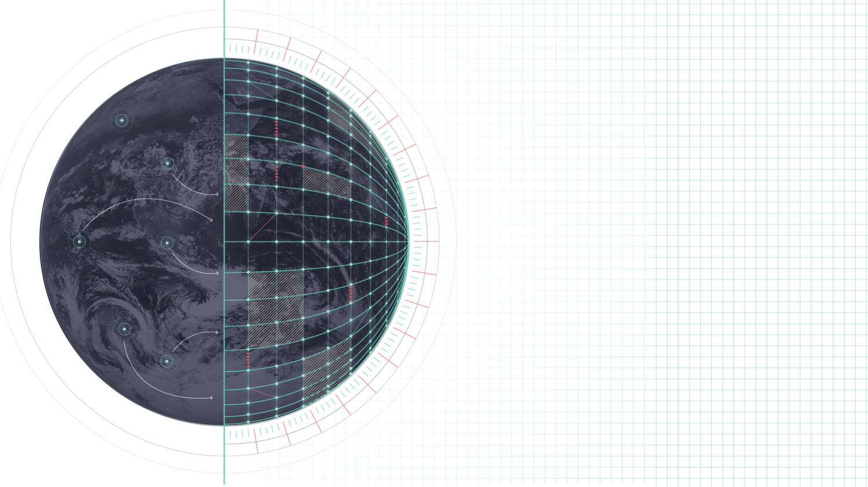
DESTINATION EARTH
New grib2 tile template
Notes:
Welcome slide

Slide 2

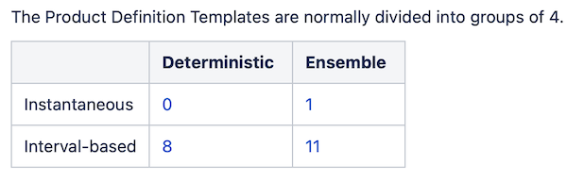
Test template Q&A
Q: StatisticalProcess: I have not been able to encode variables such as T2MMAX/MIN. As I understand it, this is because the template definition file needs to include statistical processing. There may be other variables that depend on similar definitions files?
A: We intend to add time-integrated parameters once we have instantaneous ones all working correctly, so t2mmax/min would certainly be in the pipeline. For example, we may have 4 total templates for tiles, as is done for other template styles; see below:
Notes:
Blank slides

Slide 3
Test template Q&A
Q: tileClass: I have used the tileClass groupings from 1000 and onwards, as we encode SURFEX variables. But there is no urban group, this is only under common classes. Is this ok or should there be an urban grouping?
A: There should be an urban grouping specific to yours also, however the only grouping information I know is what you provided in the veg-type patches pdf. I am happy to add as many groups as you have in the model for grouping the ECOCLIMAP tiles, so please just let me know if you have any others (for all 33 tiles).
Notes:
Blank slides

Slide 4
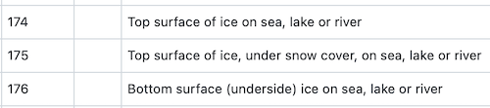
Test template Q&A
Q: tileAttributes: As I see it, this key is mostly relevant for other surface models, but seems useful for the ocean tile, at least, where you have both T2M_SEA and T2M_SEAICE. However, on the sea ice you also have snow cover, so what is the proper way to encode it? As tileAttribute 2, 4 or 6?
A: It depends exactly what you want to do, but it might just be better to encode 2t with associated typeOfFirstFixedSurface as follows:
Notes:
Blank slides

Slide 5
Test template Q&A
Q: Snow variables: So far I have used snow depth for the WSN_ICE_XX, and applied snow layers for levels, but is that correct? If not, this is a new parameter that needs grib2 codes. There are possibly more than this.
A: For WSN you may want param 228038, WMO ID 2/3/23. This is "Liquid water in snow pack". But encoding on snow levels seems the correct thing to do!
Notes:
Blank slides

Slide 6
Test template Q&A
General example
# 5 tile fractions
grib_set –s tablesVersion=30,productDefinitionTemplateNumber=99,tileClass=1504,attributeOfTile=1,numberOfUsedTileAttributes=1,numberOfUsedSpatialTiles=5,totalNumberOfTileAttributePairs=5,tileIndex=1,discipline=2,parameterCategory=0,parameterNumber=36,uuidOfDataGroup=367574097bb0967a5e1b70aefc56cc9b GRIB2_zeros.tmpl 5tile_tile1_tilefrac.grib2
grib_set -s tablesVersion=30,productDefinitionTemplateNumber=99,tileClass=1505,attributeOfTile=1,numberOfUsedTileAttributes=1,numberOfUsedSpatialTiles=5,totalNumberOfTileAttributePairs=5,tileIndex=2,discipline=2,parameterCategory=0,parameterNumber=36,uuidOfDataGroup=367574097bb0967a5e1b70aefc56cc9b GRIB2_zeros.tmpl 5tile_tile2_tilefrac.grib2
grib_set -s tablesVersion=30,productDefinitionTemplateNumber=99,tileClass=1508,attributeOfTile=1,numberOfUsedTileAttributes=1,numberOfUsedSpatialTiles=5,totalNumberOfTileAttributePairs=5,tileIndex=3,discipline=2,parameterCategory=0,parameterNumber=36,uuidOfDataGroup=367574097bb0967a5e1b70aefc56cc9b GRIB2_zeros.tmpl 5tile_tile3_tilefrac.grib2
grib_set -s tablesVersion=30,productDefinitionTemplateNumber=99,tileClass=1023,attributeOfTile=1,numberOfUsedTileAttributes=1,numberOfUsedSpatialTiles=5,totalNumberOfTileAttributePairs=5,tileIndex=4,discipline=2,parameterCategory=0,parameterNumber=36,uuidOfDataGroup=367574097bb0967a5e1b70aefc56cc9b GRIB2_zeros.tmpl 5tile_tile4_tilefrac.grib2
grib_set -s tablesVersion=30,productDefinitionTemplateNumber=99,tileClass=1509,attributeOfTile=1,numberOfUsedTileAttributes=1,numberOfUsedSpatialTiles=5,totalNumberOfTileAttributePairs=5,tileIndex=5,discipline=2,parameterCategory=0,parameterNumber=36,uuidOfDataGroup=367574097bb0967a5e1b70aefc56cc9b GRIB2_zeros.tmpl 5tile_tile5_tilefrac.grib2
Notes:
Blank slides

Slide 7
Test template Q&A
General example
# 5 tile temperature
grib_set –s tablesVersion=30,productDefinitionTemplateNumber=99,tileClass=1504,attributeOfTile=1,numberOfUsedTileAttributes=1,numberOfUsedSpatialTiles=5,totalNumberOfTileAttributePairs=5,tileIndex=1,shortName=2t,uuidOfDataGroup=367574097bb0967a5e1b70aefc56cc9b GRIB2_zeros.tmpl 5tile_tile1_2t.grib2
grib_set -s tablesVersion=30,productDefinitionTemplateNumber=99,tileClass=1505,attributeOfTile=1,numberOfUsedTileAttributes=1,numberOfUsedSpatialTiles=5,totalNumberOfTileAttributePairs=5,tileIndex=2,shortName=2t,uuidOfDataGroup=367574097bb0967a5e1b70aefc56cc9b GRIB2_zeros.tmpl 5tile_tile2_2t.grib2
grib_set -s tablesVersion=30,productDefinitionTemplateNumber=99,tileClass=1508,attributeOfTile=1,numberOfUsedTileAttributes=1,numberOfUsedSpatialTiles=5,totalNumberOfTileAttributePairs=5,tileIndex=3,shortName=2t,uuidOfDataGroup=367574097bb0967a5e1b70aefc56cc9b GRIB2_zeros.tmpl 5tile_tile3_2t.grib2
grib_set -s tablesVersion=30,productDefinitionTemplateNumber=99,tileClass=1023,attributeOfTile=1,numberOfUsedTileAttributes=1,numberOfUsedSpatialTiles=5,totalNumberOfTileAttributePairs=5,tileIndex=4,shortName=2t,uuidOfDataGroup=367574097bb0967a5e1b70aefc56cc9b GRIB2_zeros.tmpl 5tile_tile4_2t.grib2
grib_set -s tablesVersion=30,productDefinitionTemplateNumber=99,tileClass=1509,attributeOfTile=1,numberOfUsedTileAttributes=1,numberOfUsedSpatialTiles=5,totalNumberOfTileAttributePairs=5,tileIndex=5,shortName=2t,uuidOfDataGroup=367574097bb0967a5e1b70aefc56cc9b GRIB2_zeros.tmpl 5tile_tile5_2t.grib2
Notes:
Blank slides

Slide 8
Test template Q&A
General example
# concatenate
cat 5tile_tile1_tilefrac.grib2 5tile_tile2_tilefrac.grib2 5tile_tile3_tilefrac.grib2 5tile_tile4_tilefrac.grib2 5tile_tile5_tilefrac.grib2 5tile_tile1_2t.grib2 5tile_tile2_2t.grib2 5tile_tile3_2t.grib2 5tile_tile4_2t.grib2 5tile_tile5_2t.grib2 > surfex_5tile_2t_nocov.grib2
Notes:
Blank slides

Slide 9

QUESTIONS?
Notes:
Blank slides

