Slide 1

5th IESWG meeting, FMI Finland 26-28 Sep 2023
Coupled land-atmosphere data assimilation at ECMWF
Patricia de Rosnay, David Fairbairn, Sébastien Garrigues, Christoph Herbert,
Kenta Ochi, Ewan Pinnington, Kirsti Salonen, Dinand Schepers, Pete Weston,
Gabriele Arduini, Gianpaolo Balsamo, Richard Engelen, and Hans Hersbach
Thanks to: Massimo Bonavita, Niels Bormann, Phil Browne, Mohamed Dahoui, Steve English, Alan Geer, Elias Holm, Martin Leutbecher, Tony McNally, and many others

Slide 2
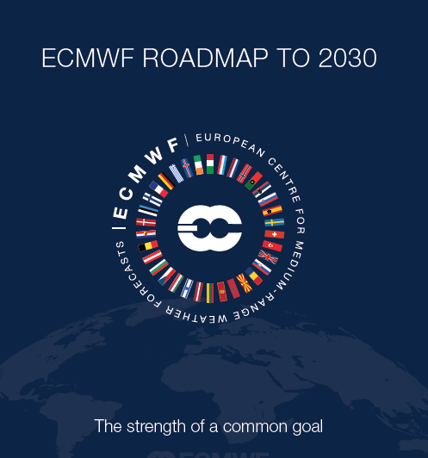
Earth system approach
4D-Var
Atmosphere
Sea Ice
3D-Var
Land
EKF-OI
Ocean
Integrated Forecasting System (IFS)
3D-Var
Waves
OI
- Coupled assimilation developments for NWP and reanalyses
- Importance of interface observations (e.g. LST, snow, soil moisture)

Slide 3
Coupled assimilation in operational systems
Observing system availability, acquisition and monitoring:
Access to observations, acquisition, pre-processing, file format, quality control, data selection, feedback files, monitoring, auto-alert system, …
Methodology and infrastructure:
Developments in each component, consistency, coupling strategy and level of coupling, etc
Link to unified framework development (e.g. OOPS at ECMWF)
Consistent & modular suite definition and file system across components, for Res & Oper
Interface observations:
Exploitation of observations that depend on more than one component, forward operator coupling, and explore AI/ML approaches in support of ‘all surface’ approach developments

Slide 4
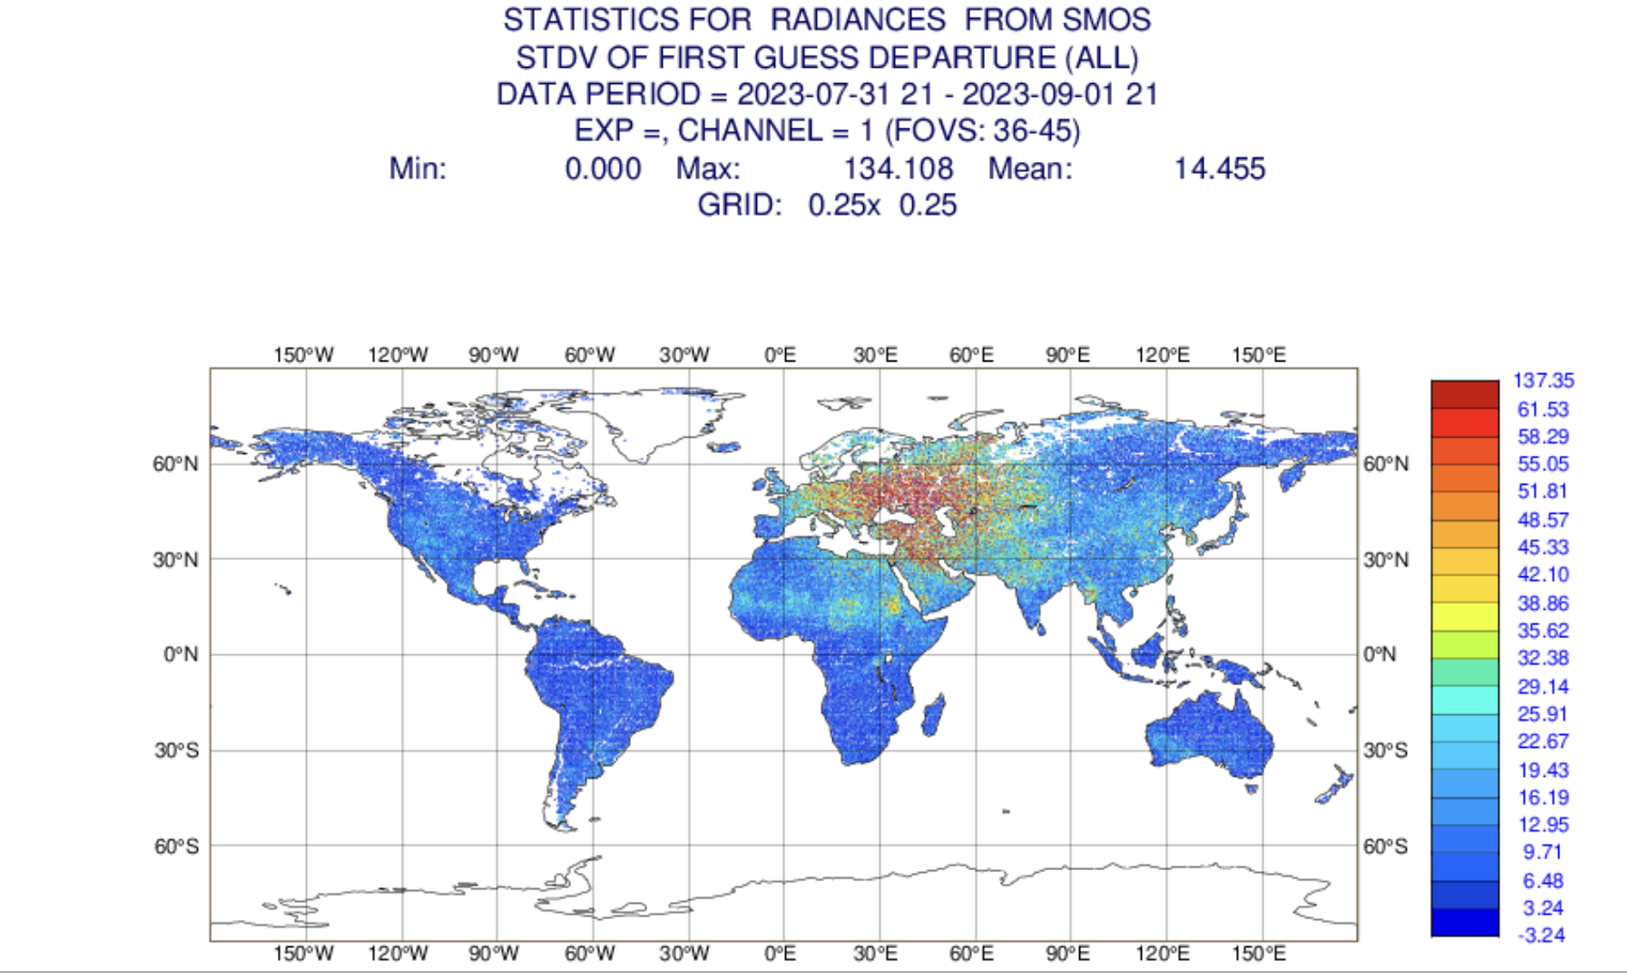
Observing system and monitoring
Need timely, sustainable and reliable access to observations across the Earth system components
Observations sustainability for land, cryosphere and ocean → level of support from governing bodies to ensure data provision, relevance of WMO data policy evolutions; works of JET-EOSDE, GCW, etc…
Observations acquisition:
  Operational acquisition streams needed
Observations monitoring:
  Ocean operational monitoring (since 2017)
  Land operational monitoring (since 2013), SYNOP monthly ‘blocklist’ & auto-alert (since Sept 2020)
→ Coupled assimilation relies on a consistent workflow for land, ocean and atmospheric observations
https://www.ecmwf.int/en/forecasts/quality-our-forecasts/monitoring-observing-system

Slide 5
Coupled data assimilation
What: Exchange of information between data assimilation systems so that observations from one component can influence the analysis of other components (Penny et al., WMO white paper, 2017)
Why: to provide balanced initial conditions across the coupled forecast model components (e.g. Laloyaux et al.,QJRMS 2016)
How: Diversity of methodologies ranging from weak to strong coupling (e.g. Fujii et al., QJRMS 2021, Browne et al., 2019; Fairbairn et al. JHM 2019; Schepers et al., ECMWF NewsLett 2018, Storto et al., MWR 2018; Karspeck et al., QJRMS 2018, Frolov et al., MWR 2016, Smith et al., TellusA, 2015);

Slide 6
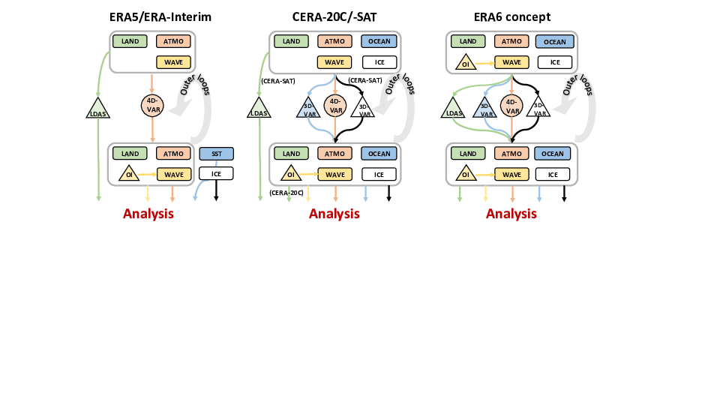
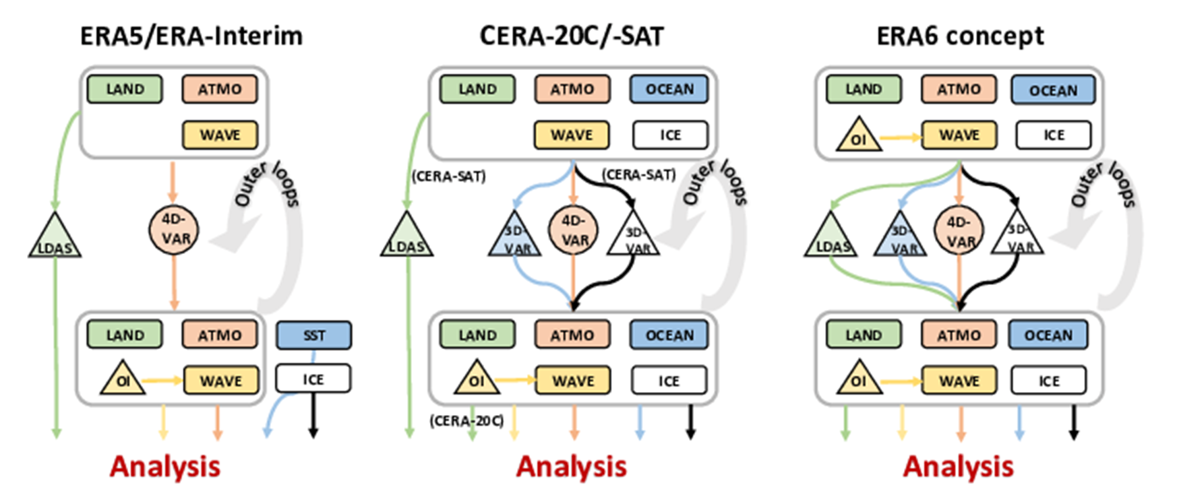
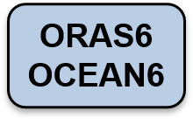
Coupling for NWP and reanalysis: status and plans
Weakly coupled data assimilation for
- Land-atmosphere-waves (ERA5)
- Land-atmosphere-waves-ocean-sea ice (NWP & ERA6)
Enhanced outer coupled data assimilation for
- Land-atmosphere-waves-ocean-sea ice
→ future NWP and ERA7
1D-OI
2D-OI
SEKF
?
de Rosnay et al., QJRMS 2022
https://doi.org/10.1002/qj.4330

Slide 7
ECMWF Land Data Assimilation System (LDAS)
satellite ASCAT SSM
satellite
SMOS SSM NN
in-situ T2m + RH2m
in-situ Snow Depth
satellite IMS Snow Cover
Observations
2D Optimal Interpolation T2m, RH2m
2D Optimal Interpolation Snow Depth
Assimilation
SEKF Jacobians based on the Ensemble Data Assimilation (EDA) spread
Simplified Extended KF SM1, SM2, SM3
1D Optimal Interpolation
Tsoil, Tsnow
Output
Analysed control vector:
(SM, ST, SnowD, Tsoil, Tsnow)
Ewan Pinnington

Slide 8
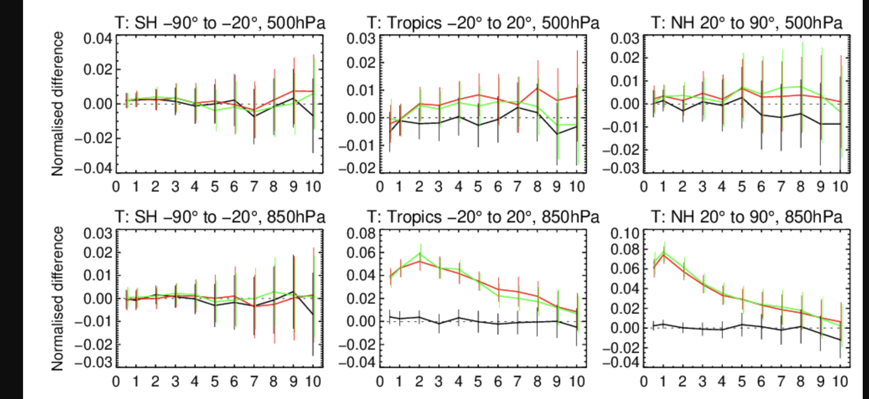
Soil analysis for NWP: impact on the atmospheric forecast
Temperature RMSE
JJA 2020
IFS cycle 48r1
☺
☹
☺
☹
Without soil moisture DA
Without soil moisture DA
With soil moisture DA
FC lead time
FC lead time
FC lead time
Significant positive impact of land DA on low level atmospheric temperature forecasts
Sébastien Garrigues
8

Slide 9

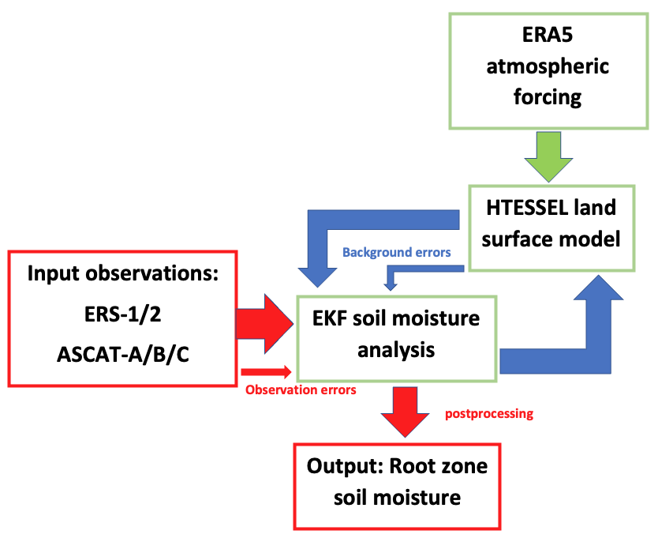
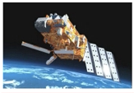
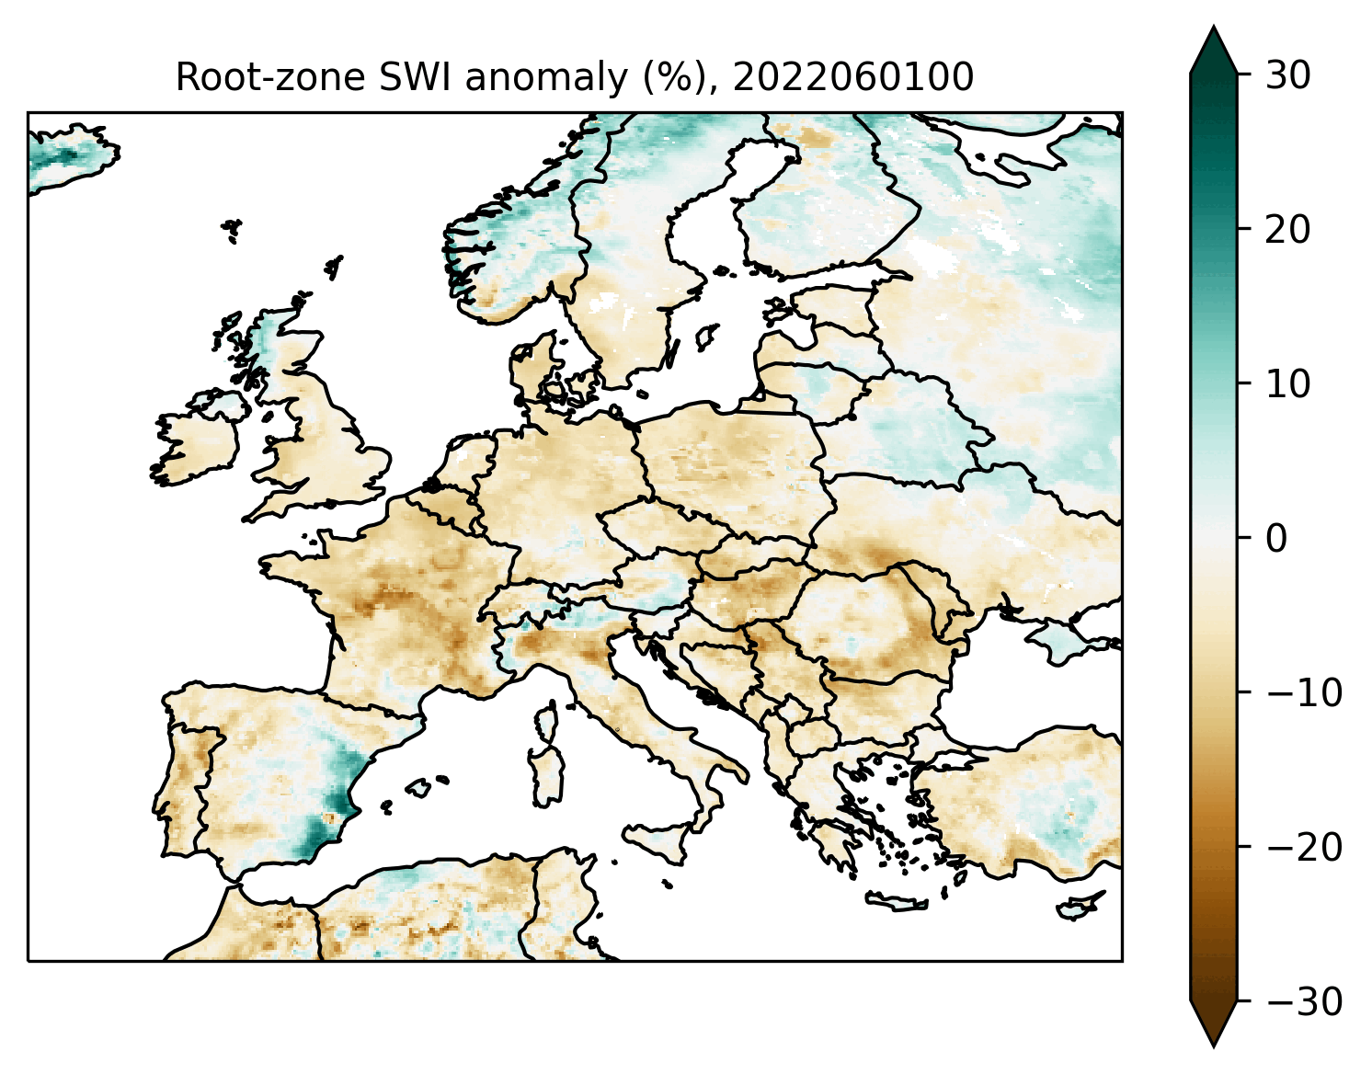
H SAF root zone soil moisture data record
  Preparation of new SM data record (1992-2023, planned release 2024)
  Offline land DA with adaptive ASCAT SM bias-correction following Draper et al., JHM 2015
H SAF product RZSM-SCAT-ASCAT-CDOP-4-CDR-10km (H145) + offline extension (H146)
David Fairbairn

Slide 10
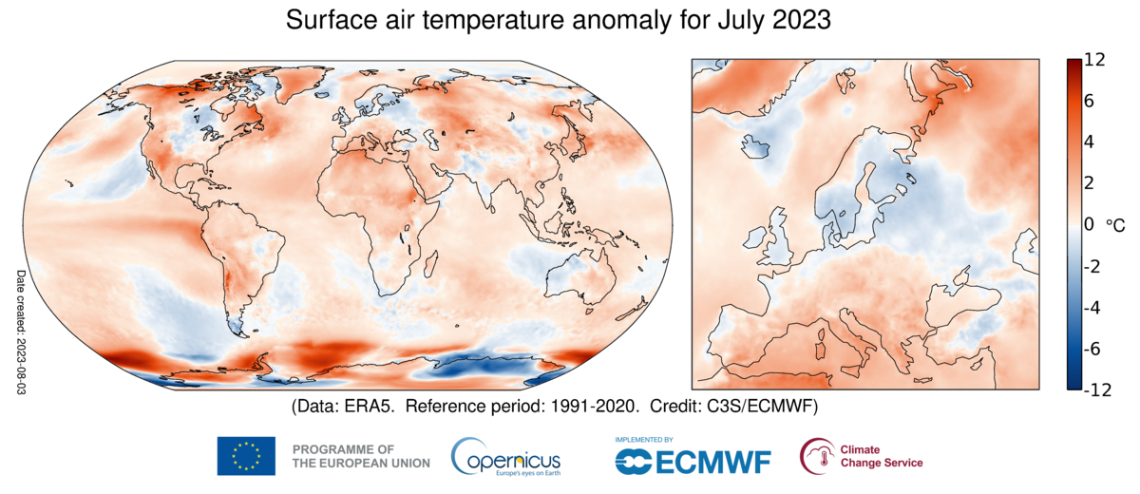
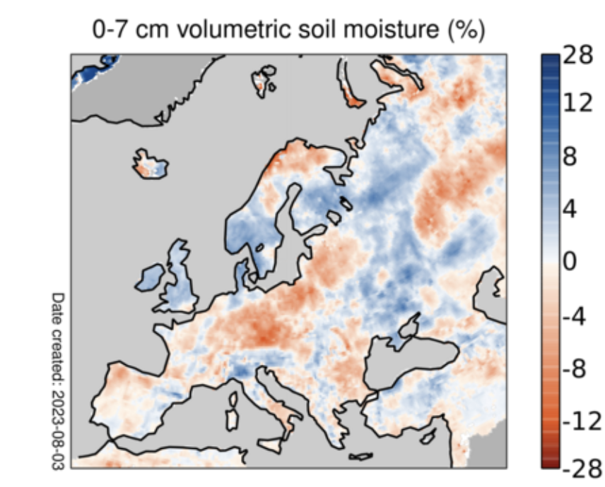
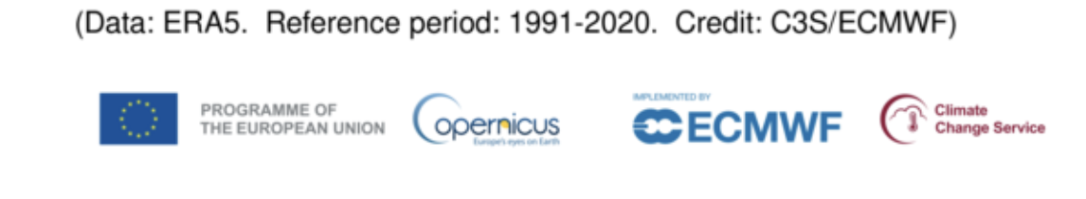
Land-atmosphere coupling progresses
- Developments of Land DA systems in the past 20 years (soil moisture, satellite DA, snow DA etc), but still univariate approach.
- And relatively little effort has been dedicated to land-atmosphere coupled data assimilation, despite the fact that near-surface conditions over land are of critical interest to users.
https://climate.copernicus.eu/climate-bulletins

Slide 11



CERISE Horizon Europe project
CERISE: CopERnIcus climate change Service Evolution (2023-2026)
Support the long-term evolution of C3S (Copernicus Climate Change Service) for:
- regional and global climate reanalysis and
- multi-system seasonal prediction,
towards an Earth system approach with a focus on
land-atmosphere coupling.
4D-Var
Atmosphere
Sea Ice
3D-Var
→ Development of unified ensemble-based coupled land-atmosphere data assimilation for the C3S global and regional reanalyses.
Land
EKF-OI
Ocean
https://www.cerise-project.eu/
3D-Var
Waves
OI
The CERISE project (grant agreement No101082139) is funded by the European Union. Views and opinions expressed are however those of the author(s) only and do not necessarily reflect those of the European Union or the Commission. Neither the European Union nor the granting authority can be held responsible for them.

Slide 12


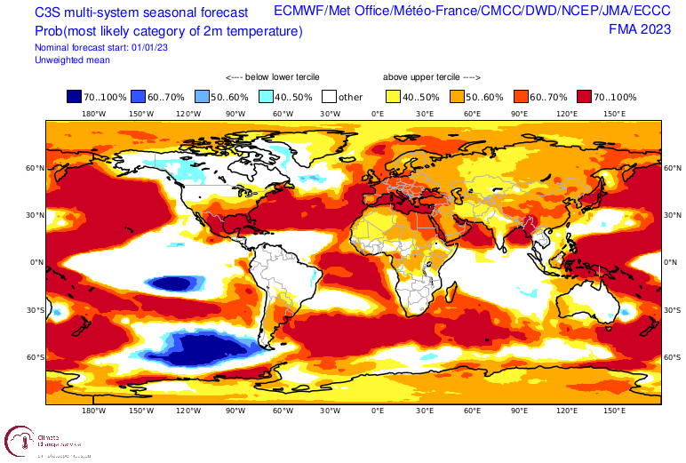
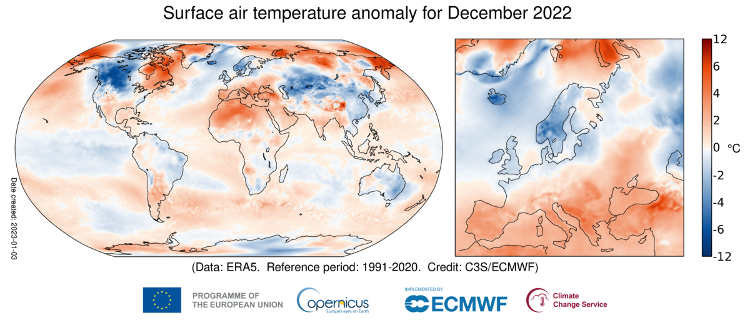
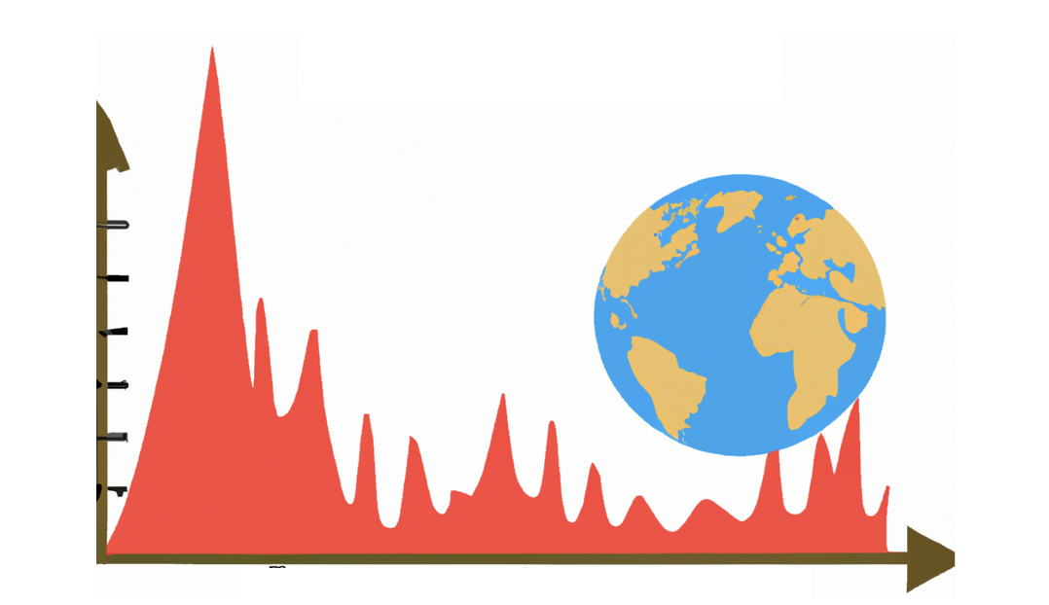
CERISE developments
Land and coupled land-atmosphere data assimilation
Explore ML-based observation operators to improve the exploitation of satellite observations
Multidecadal representation of evolving vegetation and lakes, building up on CONFESS H2020
Prototypes of seamless reanalysis and multi-system seasonal prediction → High readiness level: ERA6-Land, ERA7, SEAS7
Novel diagnostic tools to assess physical consistency of Earth system reanalysis and prediction
The CERISE project (grant agreement No101082139) is funded by the European Union. Views and opinions expressed are however those of the author(s) only and do not necessarily reflect those of the European Union or the Commission. Neither the European Union nor the granting authority can be held responsible for them.

Slide 13
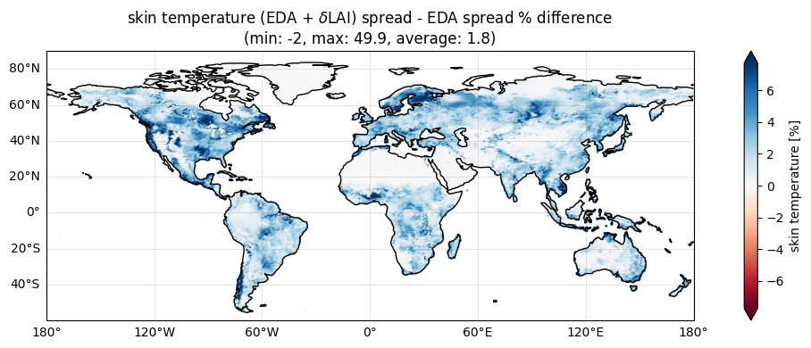
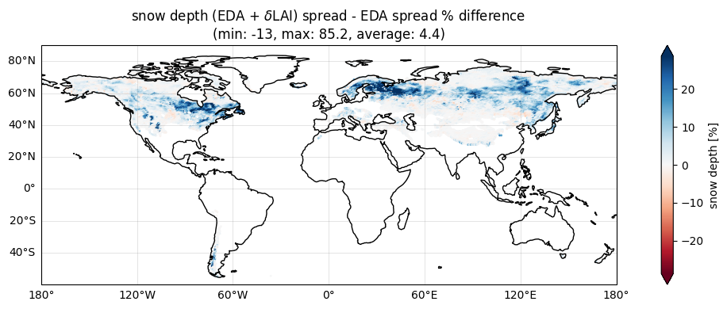
Land surface parameter perturbations
→ Ewan Pinnington’s presentation yesterday
The ECMWF Ensemble of Data Assimilations (EDA) is under-spread at the surface
As part of CERISE project, we explore methods to increase ensemble spread at the land surface for future Land Surface Data Assimilation Systems (LDAS)
Stochastic Parameter Perturbation approach for Leaf Area Index (LAI) and vegetation fraction in the offline land DA system
Draper et al., JHM 2021 also investigated surface parameter perturbations https://doi.org/10.1175/JHM-D-21-0016.1
Skin temperature
Snow depth
Differences in spread between the EDA offline surface ensemble with and without perturbations.
The CERISE project (grant agreement No101082139) is funded by the European Union. Views and opinions expressed are however those of the author(s) only and do not necessarily reflect those of the European Union or the Commission. Neither the European Union nor the granting authority can be held responsible for them.

Slide 14
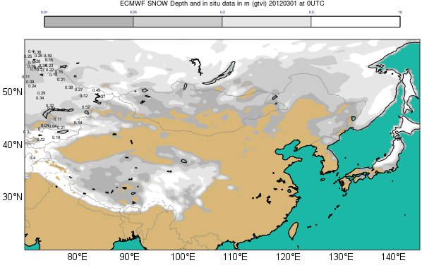
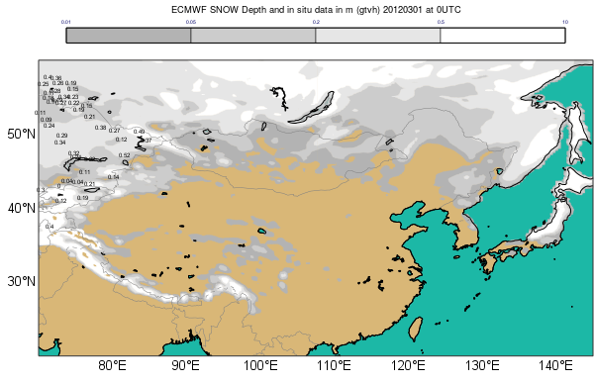
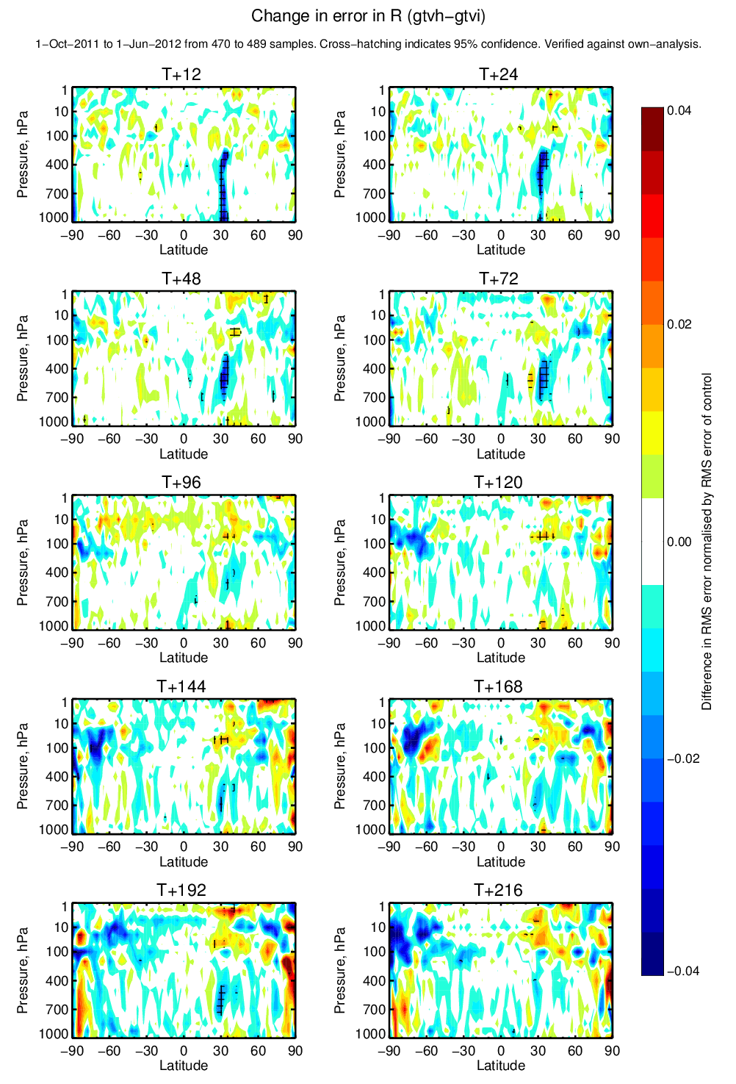
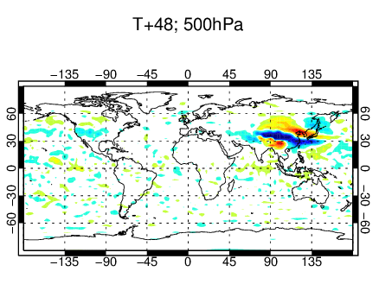
Coupled snow-atmosphere data assimilation
Impact on albedo and momentum
Modifies the jet circulation
Change in humidity FC error
Oct 2011 – June 2012
☹
☺
CTRL (no IMS DA)
Overestimate snow
Test (IMS DA)
More realistic snow
In previous studies, we showed the potential of snow cover data assimilation over the Tibetan Plateau (Orsolini et al, TC 2019, de Rosnay et al.).
Challenges related to model biases and snow-boundary layer coupling needed to be addressed to mitigate mixed atmospheric impact.
Multi-layer snow model reduced the snow model biases and enhanced consistency between snow and boundary layer processes. (Arduini et al, JAMES, 2020, https://doi.org/10.1029/2019MS001725)
Change in zonal wind
Oct 2011 – June 2012
14

Slide 15
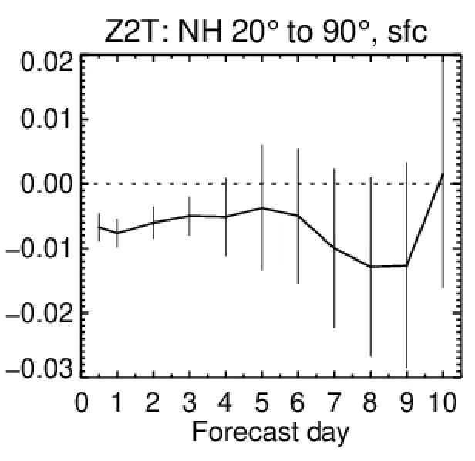
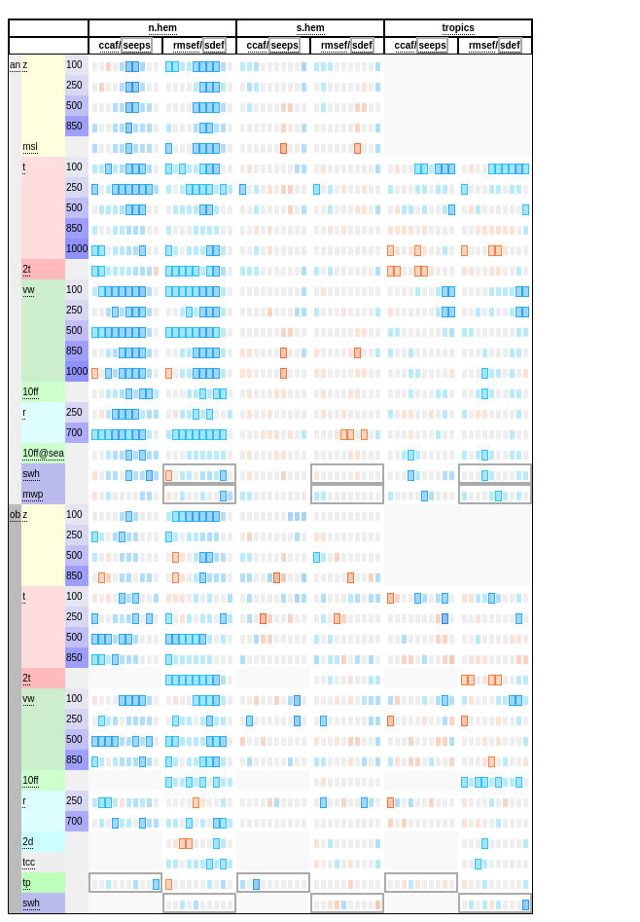
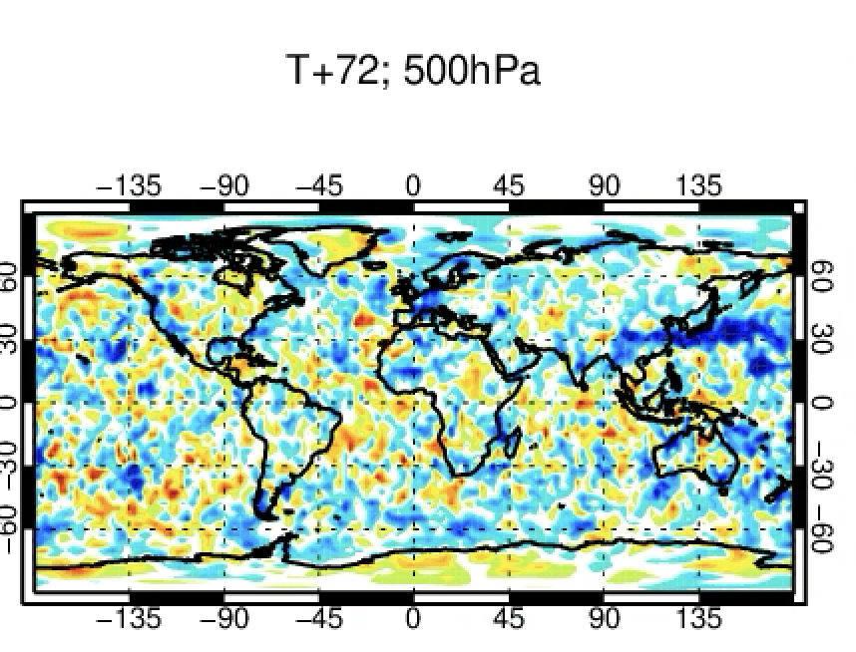
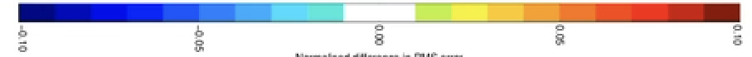
Further snow data assimilation improvements (IFS cycle 49r1 & ERA6)
Refined snow cover modelling and assimilation methodology.
positive impact of IMS snow cover assimilation in mountainous areas
→ IFS cycle 49r1 & 49r2 (ERA6 and ERA6-Land)
☹
☺
Vector wind error reduction
Surface air temperature improvement
Scorecard →
(blue= improved
red=degraded)
Kenta Ochi
☺ ☹

Slide 16
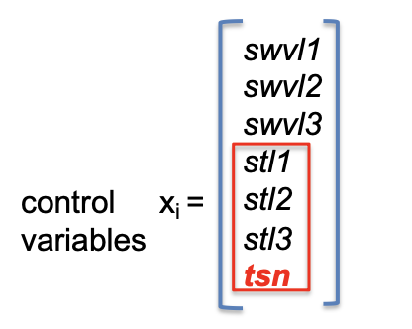
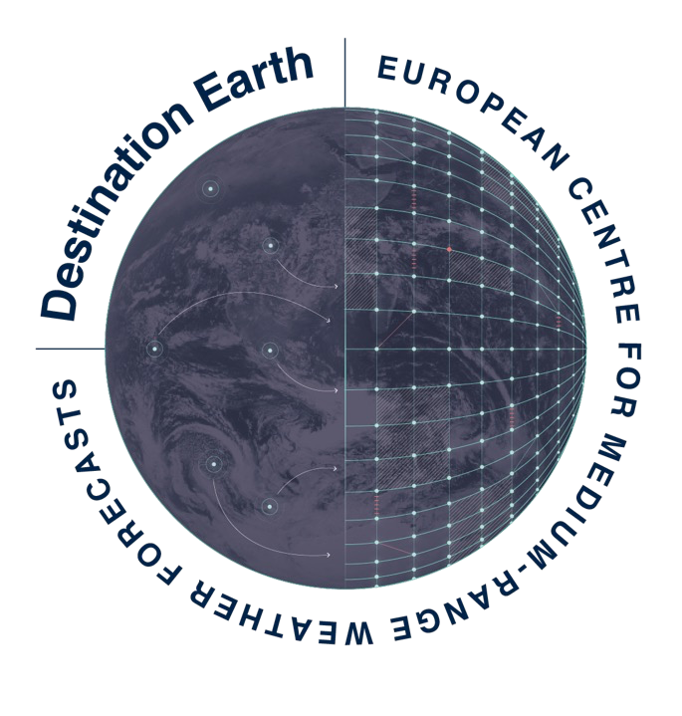
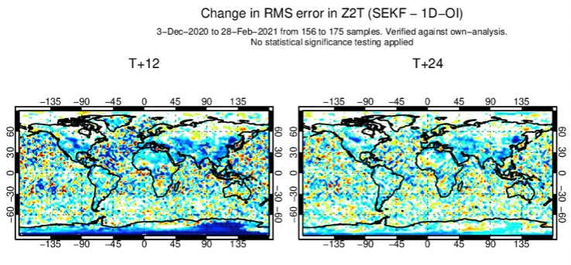
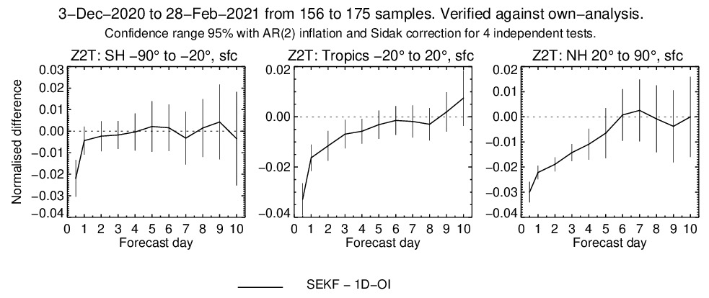
Soil and snow temperature analysis
Integration of the soil and snow temperature analysis in the SEKF, instead of using a 1D-OI approach
- Significant improvement in T2m analysis and forecasts
- Steps towards unified LDAS
☹
☺
Christoph Herbert

Slide 17

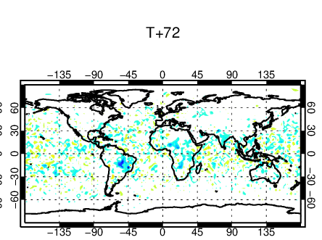

CoCO2 Horizon 2020 project
Assimilation of Vegetation Optical Depth (VOD) from passive microwave sensors to constrain vegetation water and carbon cycle variables.
- L-band VOD (1.41GHz) from SMOS
- C-band VOD (6.9GHz) and X-band VOD (10.65GHz) from AMSR2
T2m RMSE reduction (blue) 2018-2021
Positive impact of VOD assimilation on NWP
Challenges in terms of GPP impact
→ Pete Weston’s presentation this afternoon

Slide 18

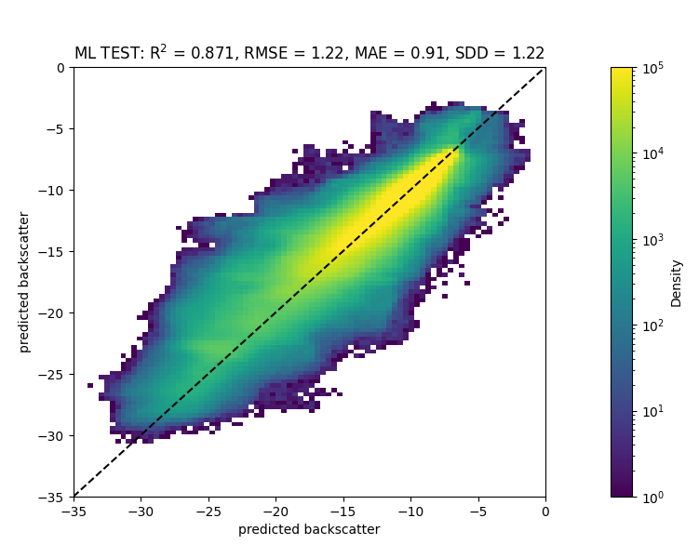
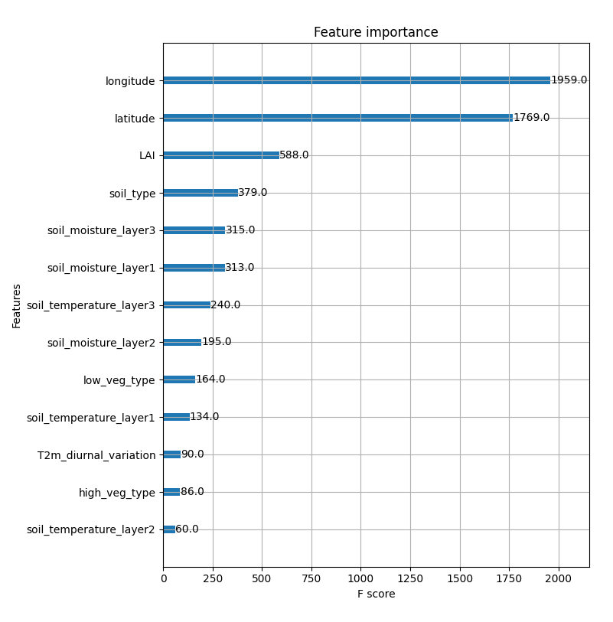
CORSO Horizon Europe project
Enhance the exploitation of satellite observations in coupled land-atmosphere
assimilation to constrain vegetation water and carbon cycle variables.
Development of ML-based observation operators for MW and SIF observations
Information content analysis
ASCAT Observations
Sébastien Garrigues
→ Pave the way for future observations assimilation such as Metop-SG/SCA, Copernicus Expansion CO2 and CIMR missions, which are all relevant to consistently constrain vegetation and carbon fluxes in CO2MVS
NN model
The CORSO project (grant agreement No101082194) is funded by the European Union. Views and opinions expressed are however those of the author(s) only and do not necessarily reflect those of the European Union or the Commission. Neither the European Union nor the granting authority can be held responsible for them.

Slide 19
Summary (1/2)
Progressive implementation of coupled assimilation at ECMWF for operational NWP and future generations of reanalyses → NWP, Copernicus Services, and high-resolution Destination Earth
Relevance of interface observations, e.g. Snow (cover, water equivalent, depth), vegetation-related observations, soil moisture, for NWP and reanalysis → importance of future missions such as Metop-SG, CIMR
Challenges of Earth System approach for NWP, e.g. Coupling through the observation operator, e.g. snow surfaces. Opportunities to enhance the exploitation of current and future satellite data
19

Slide 20
Summary (2/2)
  Transition to lower level (level 1) products assimilation: key for coupled assimilation to enhance assimilation of observations that are sensitive to the surface
    Work on skin temperature DA over ocean → extend to land
    Investigate multivariate soil and vegetation analysis (consistent water and carbon cycle)
    Further developments on forward operator coupling, integrating ML/AI to tackle challenges of radiative transfer over complex surfaces in support of an all-surface approach
  Earth system approach → also extend to more components, e.g. river and flood forecast system
20

Slide 21
Special Collection Quarterly Journal of The Royal Meteorological Society
“Coupled Earth system data assimilation”
Submission deadline: 31 December 2023 https://rmets.onlinelibrary.wiley.com/

