Slide 1
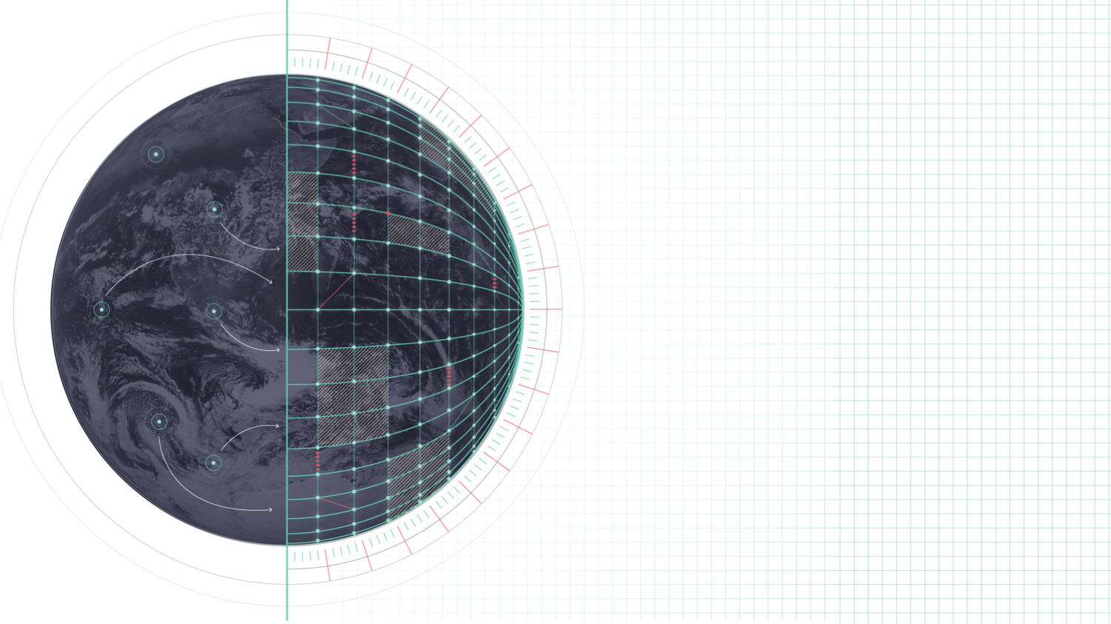
DESTINATION EARTH
New grib2 tile template
Notes:
Welcome slide

Slide 2

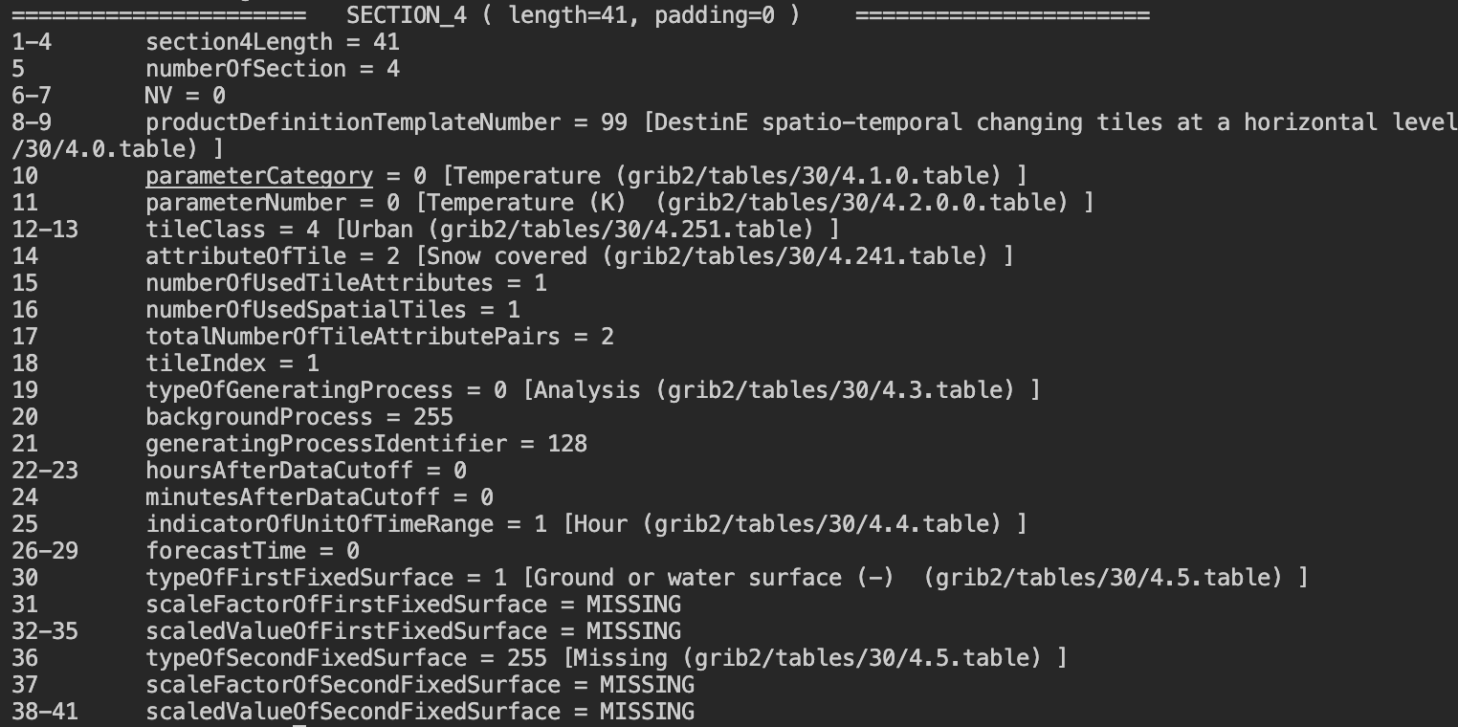
Test template
Points of interest
}
}
Notes:
Blank slides

Slide 3
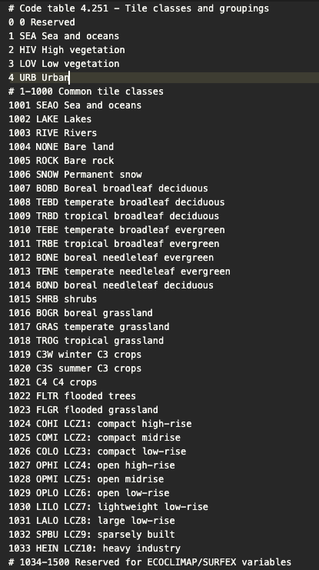
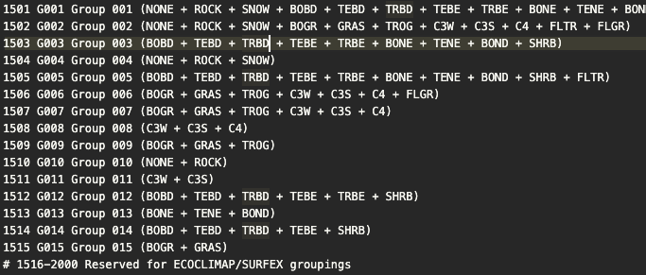
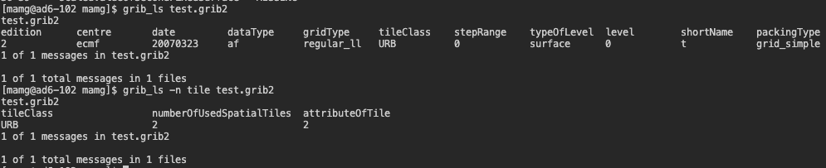
Test template
Table 4.251 Tile Classes and groupings (SURFEX)
Usage:
Notes:
Blank slides

Slide 4
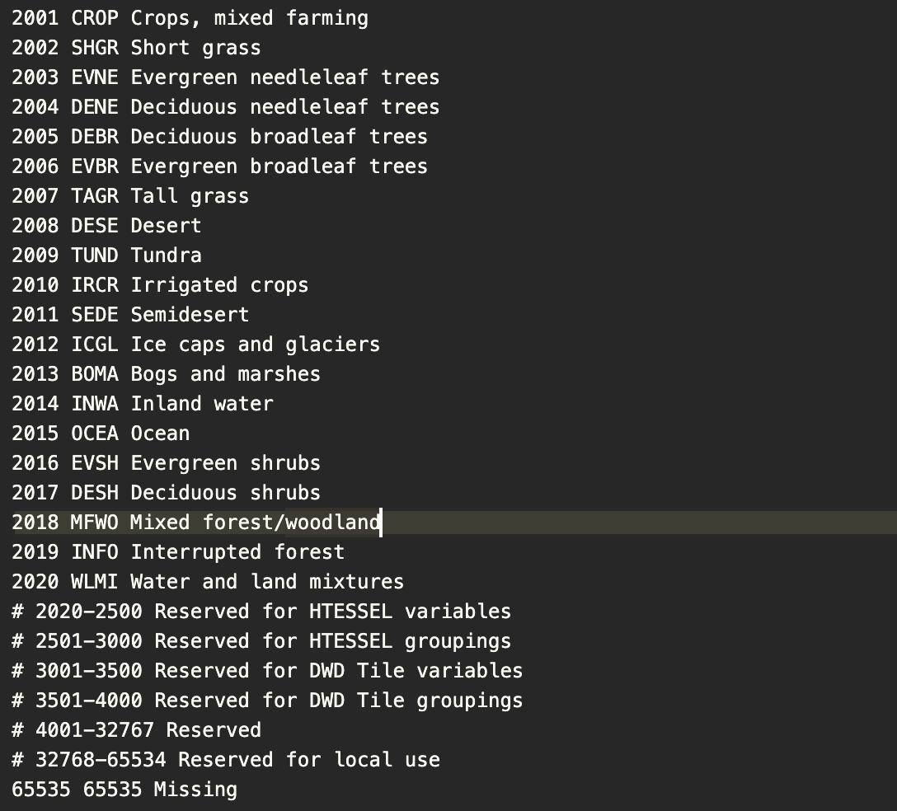
Test template
Table 4.251 Tile Classes and groupings (HTESSEL)
Notes:
Blank slides

Slide 5
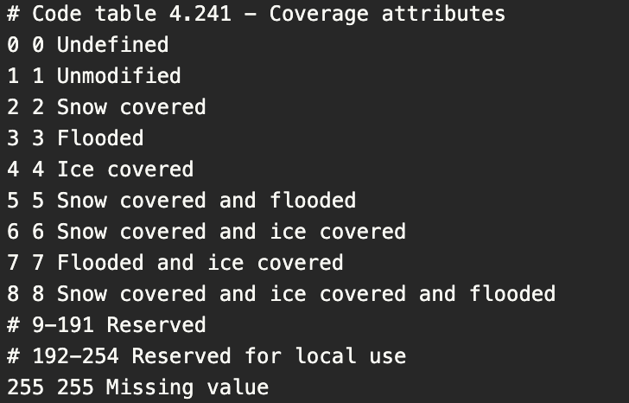
Test template
Attribute of tiles
Then a GRIB2 file might contain several messages as follows:
param | tileClass | tileAttribute
--------------------------------------------
fraction, grass, snow
fraction, grass, flood
fraction, grass, flood+ice
fraction, grass, unmodified
fraction, forest, snow
fraction, forest, unmodified
2t, grass, snow
2t,grass, flood
2t, grass, flood+ice
2t, grass, unmodified
2t, forest, snow
2t, forest, unmodified
Ability to encode variable on specific subset of tile, e.g. snow-covered high vegetation.
Notes:
Blank slides

Slide 6
Test template
OTHER tile keys (some subject to change)
tileIndex – Allows looping over tile variables in a way which can be specified based on local requirements.
numberOfUsedTileAttributes – Number of used attributes per tile
numberOfUsedSpatialTiles – Number of used tiles in a gridbox
totalNumberOfTileAttributePairs – Sum over all tile-attribute pairs over entire gridbox
FixedSurface – Allows the placement of e.g. 2m temperature on land and/or sea tile.
Notes:
Blank slides

Slide 7

QUESTIONS?
Notes:
Blank slides

