Slide 1
European Weather Cloud
Discussion platform
Francesco Murdaca
Notes:
Title slide template 1 of 2 with presentation title/information on the left. Please choose between slide 1 or 2 for the title slide and delete the other.

Slide 2
Agenda
Objectives
Description
Installation
Registration
Features

Slide 3
Objectives
The platform shall be open for the EWC community and managed by ECMWF and EUMETSAT

Slide 4
Objectives
The platform shall be open for the EWC community and managed by ECMWF and EUMETSAT
Stimulate the building of the community and keep it active
Facilitate the collaboration among users and the creation of synergies

Slide 5
Objectives
The platform shall be open for the EWC community and managed by ECMWF and EUMETSAT
Stimulate the building of the community and keep it active
Facilitate the collaboration among users and the creation of synergies
Gather feedbacks and inputs more frequently and actively

Slide 6
Objectives
The platform shall be open for the EWC community and managed by ECMWF and EUMETSAT
Stimulate the building of the community and keep it active
Facilitate the collaboration among users and the creation of synergies
Gather feedbacks and inputs more frequently and actively
Benefit from the users' interactions and shared information and reduce E&E workloads

Slide 7
Objectives
The platform shall be open for the EWC community and managed by ECMWF and EUMETSAT
Stimulate the building of the community and keep it active
Facilitate the collaboration among users and the creation of synergies
Gather feedbacks and inputs more frequently and actively
Benefit from the users' interactions and shared information and reduce E&E workloads
Share and keep track of the information and contents and make it discoverable and available to the community

Slide 8

Description
Rocket.Chat
Customizable communication platform
Secure and compliant to standards (e.g. E2E encryption, GDPR)
Open Source
Integration with many tools

Slide 9
Description
Rocket.Chat
Customizable communication platform
Secure and compliant to standards (e.g. E2E encryption, GDPR)
Open Source
Integration with many tools
Not an official support tool!! -> JIRA ticket or support email

Slide 10
Description
Rocket.Chat
Customizable communication platform
Secure and compliant to standards (e.g. E2E encryption, GDPR)
Open Source
Integration with many tools
Not an official support tool!! -> JIRA ticket or support email
It's a pilot -> review process after one year

Slide 11
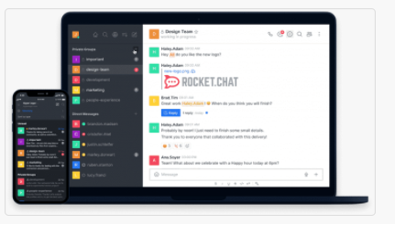
Installation
Web based
Desktop App
Mobile

Slide 12
Registration
All Member States developers can self-register (based on email domain)
External users can't self-register but can be invited. They need to be accepted by admins.

Slide 13
Features: channels
Pre-designed public channels for EWC users
#general

Slide 14
Features: channels
Pre-designed public channels for EWC users
#general
#random / #off-topic

Slide 15
Features: channels
Pre-designed public channels for EWC users
#general
#random / #off-topic
#peer-support / #community-support

Slide 16

Features: channels
Pre-designed public channels for EWC users
#general
#random / #off-topic
#peer-support / #community-support

Slide 17
Features: nice to have
Bot integrations (e.g. with Confluence, Jira, GIT, CI/CD...)
Unlimited history of discussions
Two-factor authentication
Push notifications

Slide 18
Thank you!

