Slide 1
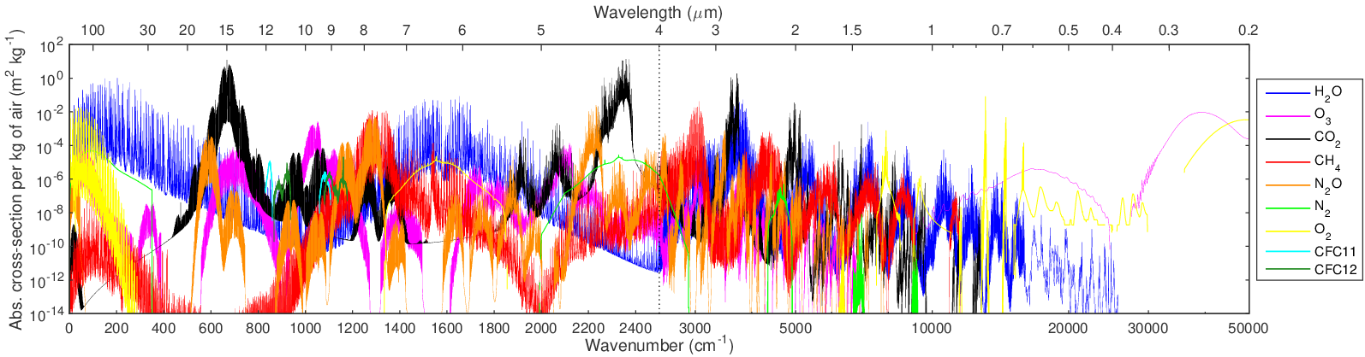
Evaluating and improving the treatment of gases in radiation schemes: the Correlated K-Distribution Model Intercomparison Project (CKDMIP)
Robin Hogan and Marco Matricardi (ECMWF)
Data from Robert Pincus, Peter Ukkonen, Miho Sekiguchi, Fred Rose, Seiji Kato, Mathieu Compiegne, Frederic Andre et al.
Absorption spectrum of nine gases at 100 hPa (Hogan & Matricardi 2020)
r.j.hogan@ecmwf.int

Slide 2
Why do we need another radiation intercomparison?
Need to evaluate fast gas-optics models specifically, not the whole radiation scheme
  Line-by-line models are accurate and consistent, but there is still a 35% spread in CO₂ forcing amongst climate-model radiation schemes (Soden et al. 2018), even more for shortwave H₂O (DeAngelis et al. 2015)
  CKDMIP aims to isolate the errors from the correlated k-distribution algorithm by providing participants with the gas spectroscopy and solar spectrum, using identical radiative transfer algorithm, and recommending common bands
Need to compare the efficiency-accuracy trade-off
  Radiation schemes are an expensive part of climate simulations, and their total cost scales with the number of quasi-monochromatic spectral intervals (k-terms or g-points), which is determined by the gas-optics scheme
  Participants can provide multiple CKD models with different numbers of k-terms to explore this trade-off
Evaluate heating-rate profiles up to 0.02 Pa (78 km), important for GCMs but previously neglected
Towards faster and more accurate gas optics schemes
  How can we use CKDMIP to figure out the best way to construct CKD models in future?
  Can we provide free tools to enable users to easily generate gas-optics models for specific applications?

Slide 3
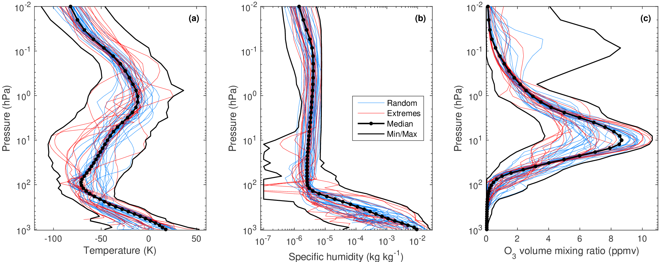
CKDMIP training and evaluation dataset (Hogan & Matricardi 2020)
CKDMIP motivation: to evaluate the various methods for generating gas optics schemes
100x 137-level profiles of T, q and O₃ from Eresmaa and McNally (2014)
34 greenhouse gas scenarios
1 TB dataset of the layer optical depth of 9 gases from LBLRTM
+12 further scenarios for studying gas overlap

Slide 4
CKDMIP workflow
https://dissemination.ecmwf.int/ecpds/home/ckdmip/
Free datasets of absorption spectra for each gas (600 GB)
  "Idealized" vs. p, T, q for generating k distributions
  50-profile "Evaluation-1" for training & evaluating CKD models
Free CKDMIP software for performing LBL RT on spectra
Evaluation-1 & Evaluation-2 profiles:
100 T, p, q, O₃ × 34 GHG scenarios (17 MB)
optional
Files containing layer optical depth per g point for each profile/scenario
Participant’s CKD tool
CKD model 1, 2…
Participant’s contribution
to ECMWF
Withheld “Evaluation-2” spectra for independent evaluation (400 GB)
CKDMIP software
Improvements and bug fixes
Flux files and evaluation plots for CKDMIP web site
https://confluence.ecmwf.int/display/CKDMIP

Slide 5
CKDMIP participants
Submissions so far listed as number of bands / number of k terms (“climate”=supports GHG perturbations)
CKD tool | Contact | Climate | Longwave models | Shortwave models
RRTMG | Robin Hogan | Y | 16/140 | 14/112
RRTMGP | Robert Pincus | Y | 16/256, 16/128 | 14/224, 14/112
RRTMGP neural net | Peter Ukkonen | Y | 16/128 | 14/112
ecCKD | Robin Hogan | Y | 13/64, 1/32, 1/16... | 19/64, 5/32, 5/16...
PSLACKD | F. Rose, S. Kato |  | 14/79 | 20/77
MSTRN | Miho Sekiguchi | Y |  | 30/102
ARTDECO-PyKdis | Mathieu Compiegne |  |  | 13/476, 5/235
CMA | Hua Zhang |  | 13/124 | 13/142
SOCRATES | James Manners | Y
KBIN | J. Bureau, R. Preusker
MODTRAN | Lex Berk | Y
Fu-Liou | Lei Lin?
Coming soon!
New participants welcome! Note that many tools still under active development

Slide 6
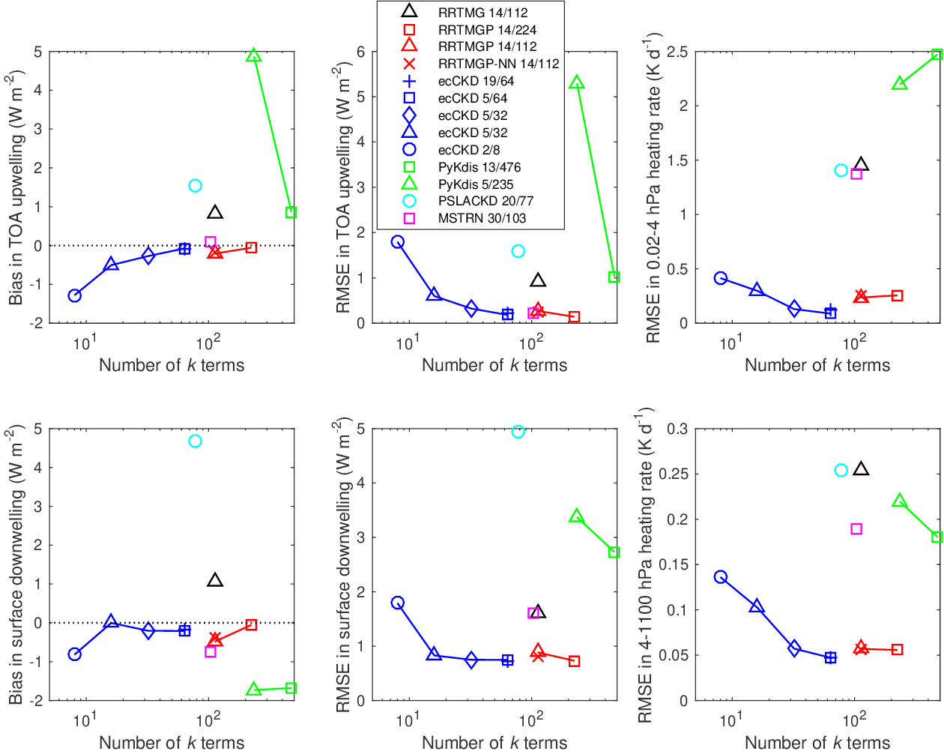
Shortwave
For an individual tool (e.g. RRTMGP, ecCKD), more k terms means more accuracy
But comparing different tools shows that how the tool works is more important for accuracy than number of k terms
Note that most tools still under development!
Ukkonen et al. (2022) neural network version of RRTMGP-14/112 gas optics has similar accuracy but 3x faster to compute

Slide 7
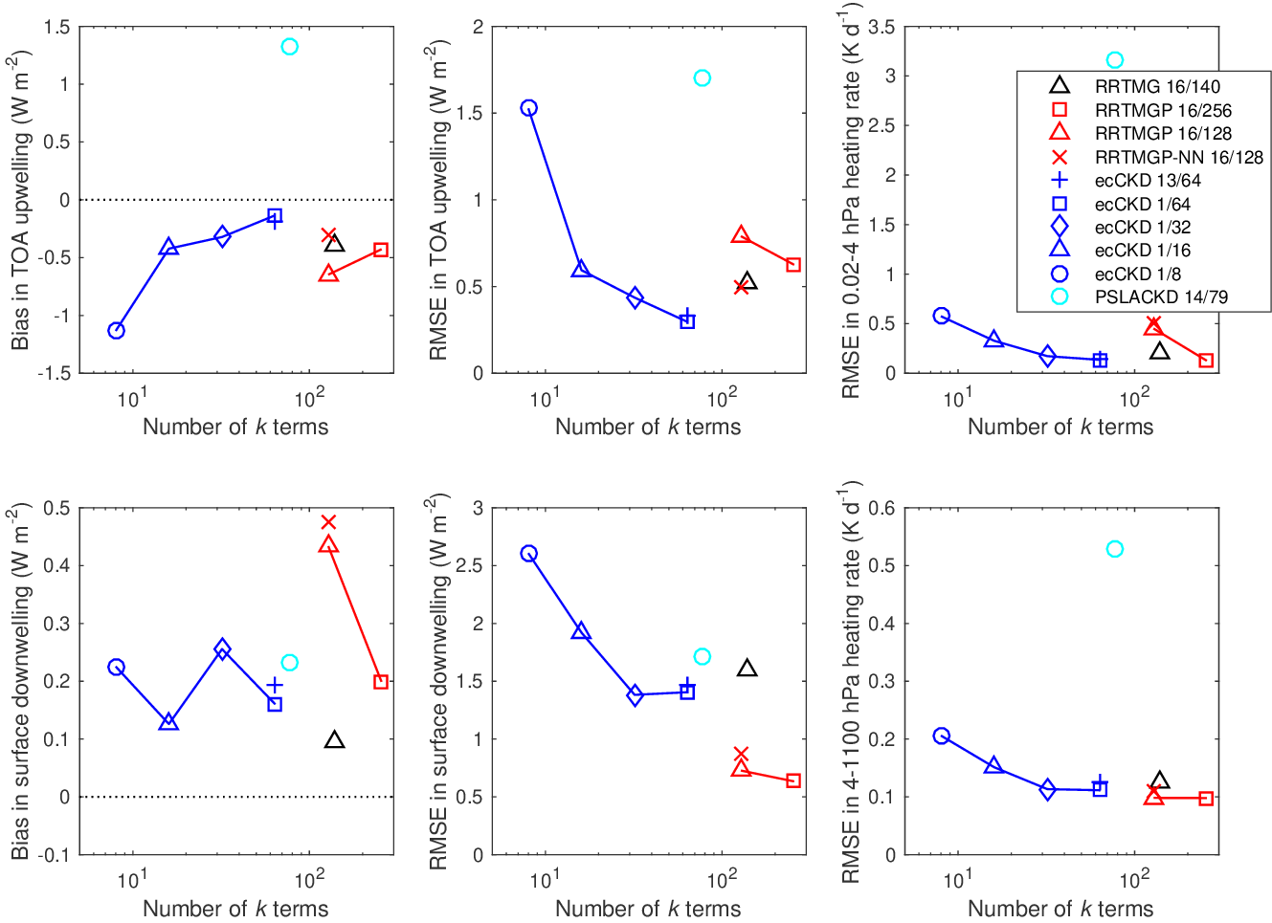
Longwave
Similar conclusion to shortwave
Most accurate LW models are RRTMGP-16/256 and ecCKD-1/64
ecCKD can generate viable models with fewer k terms than other tools
More bands need not mean more accuracy; in fact 1-band ecCKD is slightly more accurate than 13-band ecCKD (for 64 k-terms)

Slide 8
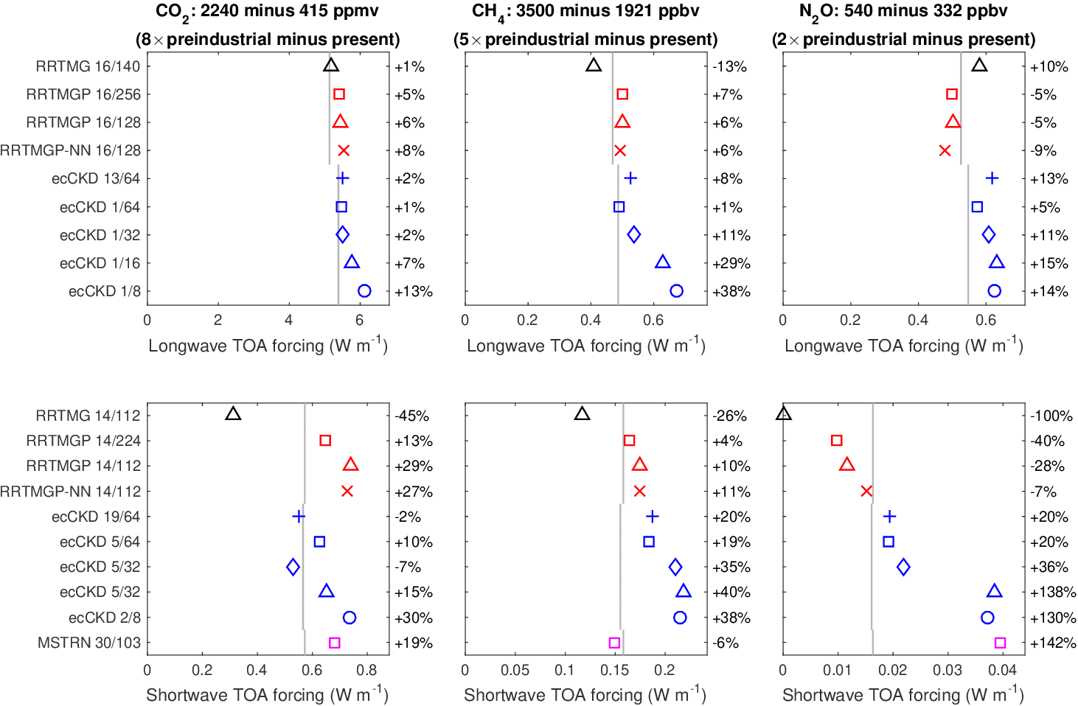
Radiative forcing
Consider highest concentrations from CMIP6 SSPs
Instantaneous forcing averaged over 50 profiles (daylight average for shortwave)
Longwave CO₂ generally good to 8%, but other gases perform worse (in a relative sense)
Line-by-line
reference

Slide 9
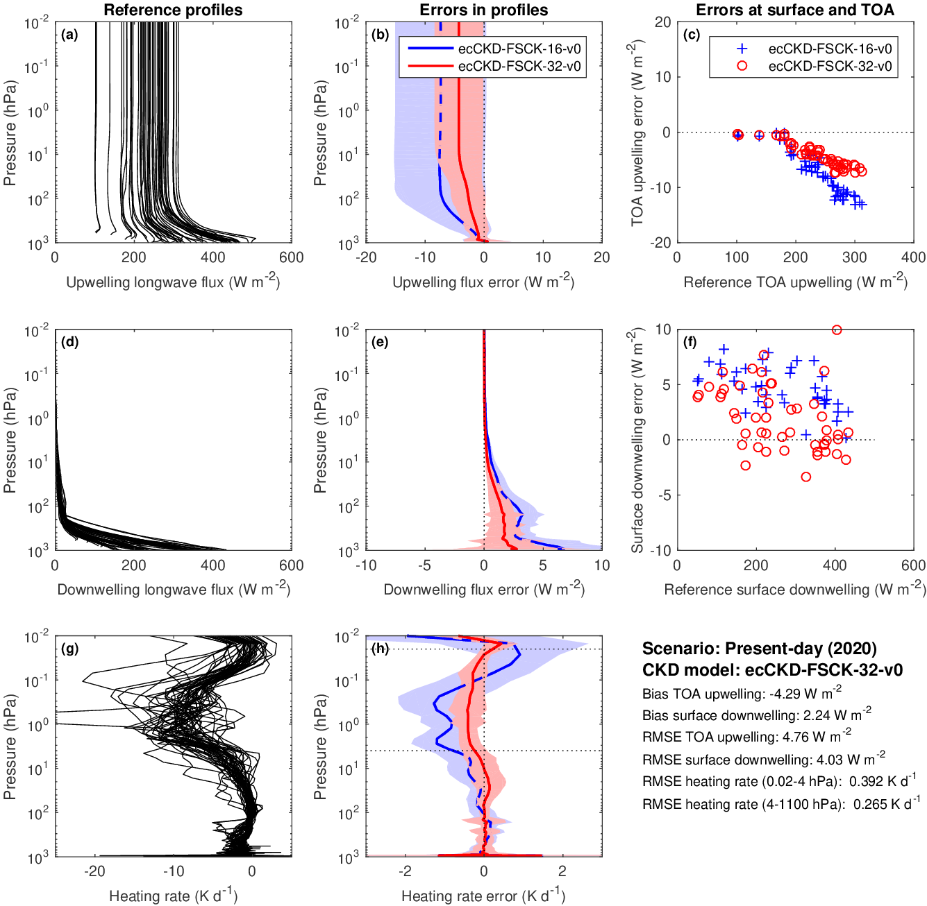
How should absorptions be averaged to k terms?
ecCKD’s “raw” CKD models are generated by averaging single-gas absorptions to conserve mean layer transmittance, but have large errors in fluxes and heating rates!

Slide 10
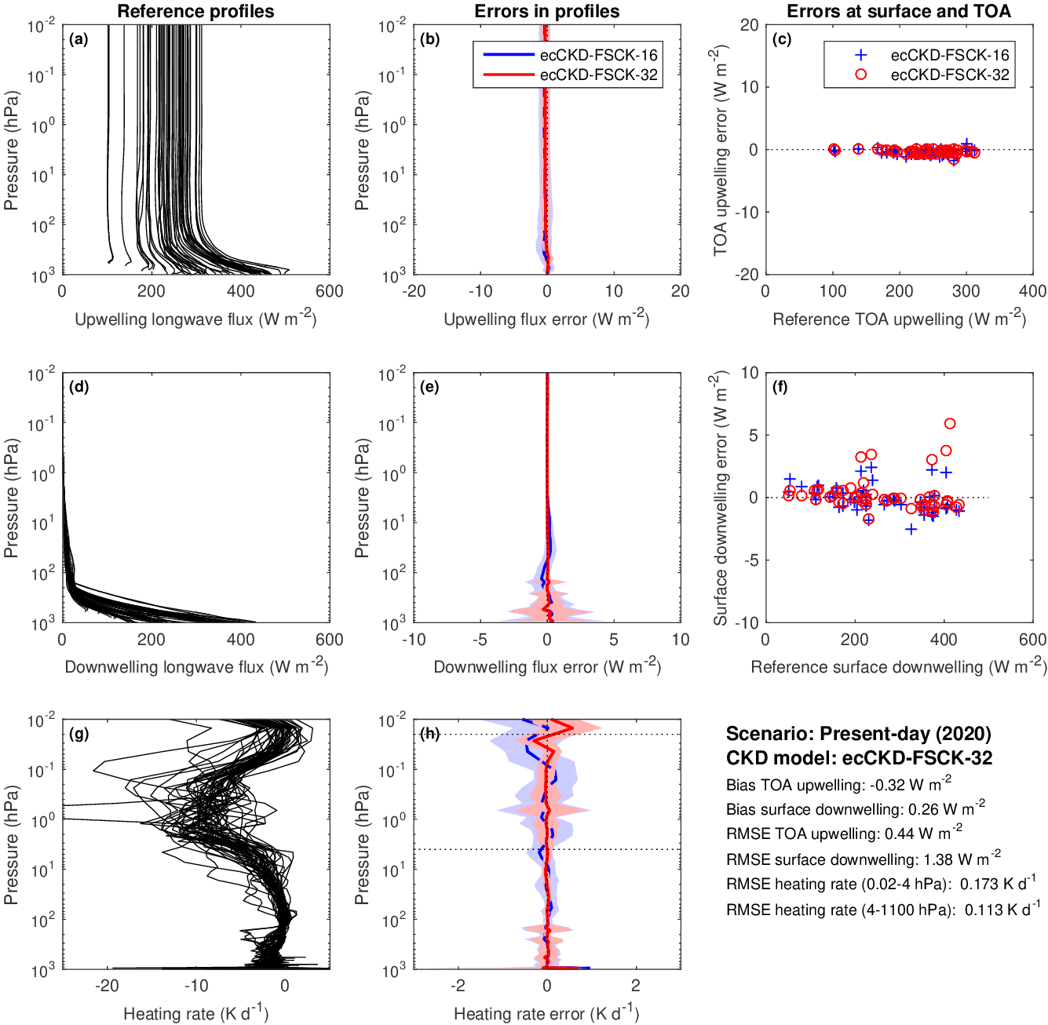
How should absorptions be averaged to k terms?
ecCKD’s “raw” CKD models are generated by averaging single-gas absorptions to conserve mean layer transmittance, but have large errors in fluxes and heating rates!
…but these are much reduced by optimizing the coefficients to minimize errors against a set of training profiles (evaluating against independent profiles)
How do other tools do this averaging if they don’t use an optimization step?

Slide 11
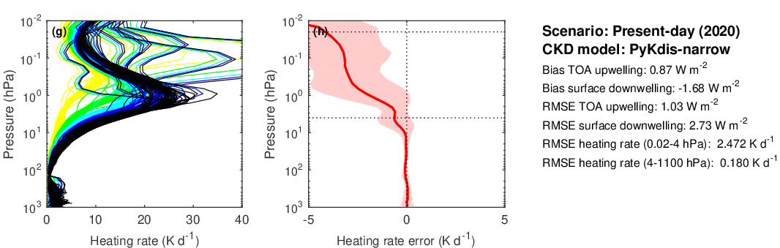
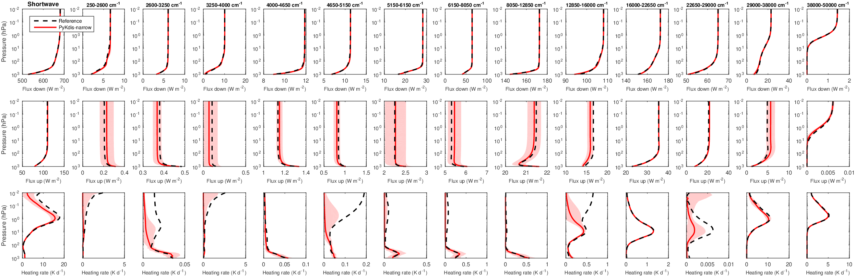
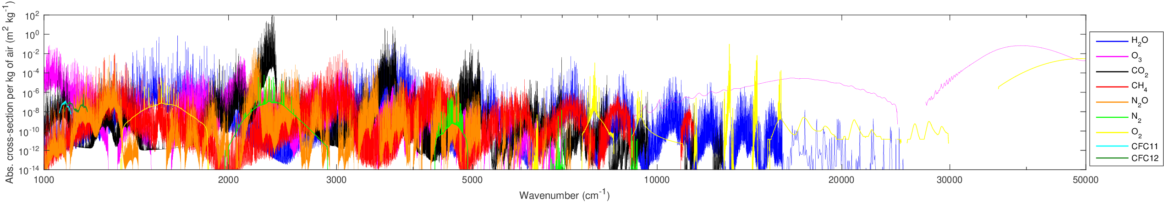
Common problem: underestimate shortwave mesospheric heating
Evaluate individual bands
Missing absorption from CO₂ 4.3 and 2.8 μm bands
k distributions need to be discretized carefully: strongest CO₂ absorption from only ~0.2 W m⁻² (0.01% of solar spectrum)
!
!
1 hPa CKDMIP “median atmosphere” reference spectra

Slide 12
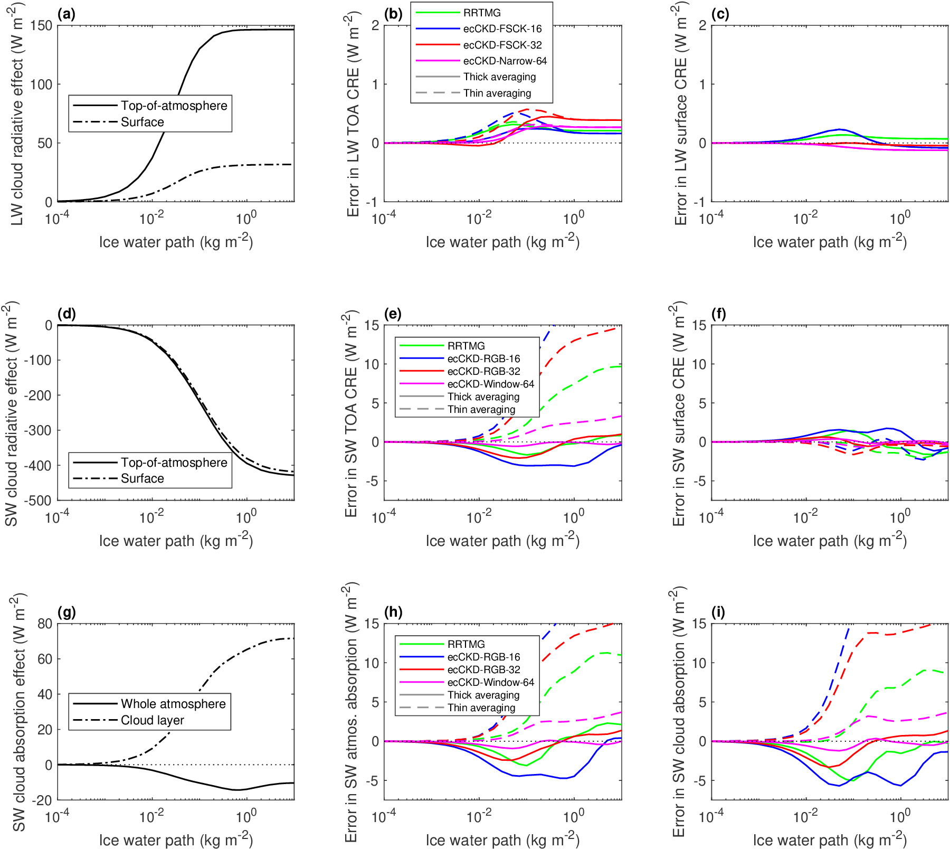
Cloud radiative effect (CRE): CKD models vs line-by-line (preliminary)
LW CRE accurate, even for ecCKD-1/32 (full-spectrum correlated k) provided cloud properties per k term
Much larger errors in SW; ecCKD-5/32 similar to RRTMG-14/112, but ecCKD-19/64 more accurate
“Thick” spectral averaging (Edwards & Slingo 1996) more accurate than “thin”
Other CKD models to be added

Slide 13
Outlook
CKDMIP is a framework to evaluate specifically the gas-optics component of fast radiation schemes (independent of RT algorithm), crucial for weather and climate prediction; full description from Hogan & Matricardi (JAMES 2020)
Underpinned by freely available datasets at https://dissemination.ecmwf.int/ecpds/home/ckdmip/
Results so far posted at https://confluence.ecmwf.int/display/CKDMIP
CKDMIP has already facilitated development of the ecCKD tool, and feedback to participants has led to improvements in their tools; note that most tools are still under active development
Preliminary analysis shows potential to use CKDMIP dataset to evaluate the impact of spectral discretization on cloud radiative effect, and whether there is a benefit of using cloud optical properties per k term rather than per band
Next step: can we use the very different performance (accuracy and speed) of the various CKD models to understand the best way to generate them (e.g. treatment of gas overlap, choice of k terms, spectral averaging to k terms, tricks such as optimization of coefficients against training profile) and hence improve gas optics models in future?
New participants still welcome – email me!

Slide 15
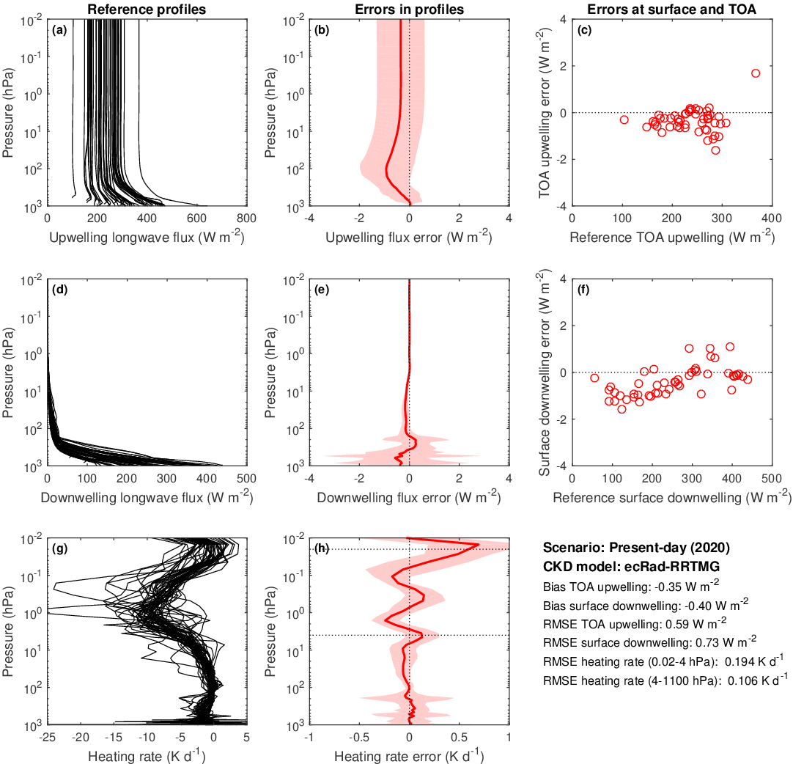
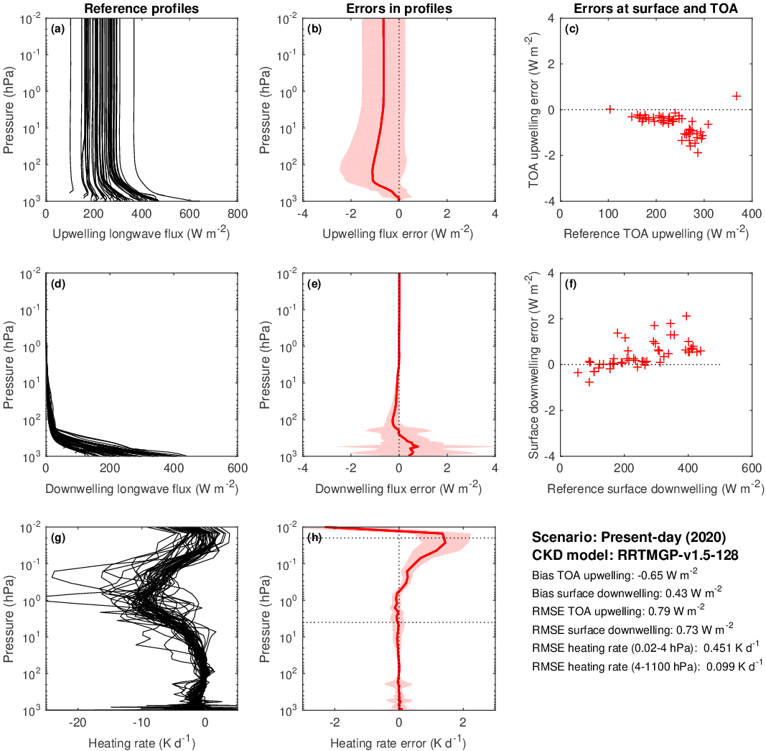
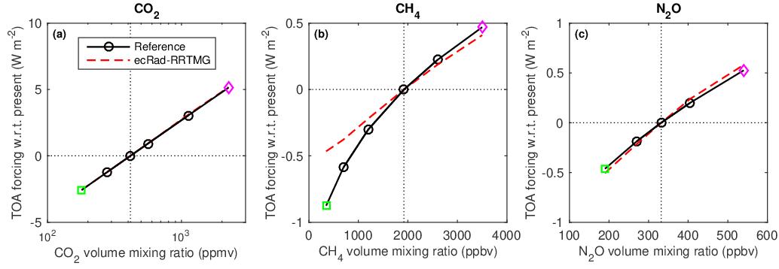
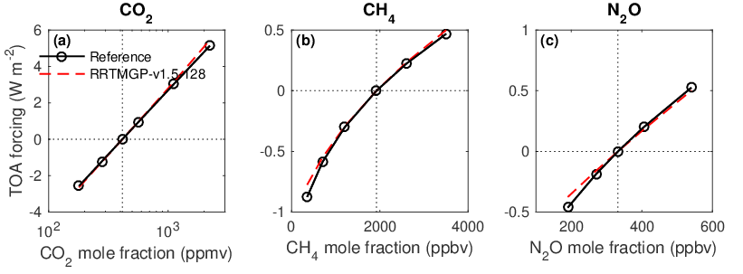
Longwave RRTMG 16/140
a
Longwave RRTMGP 16/128

Slide 16
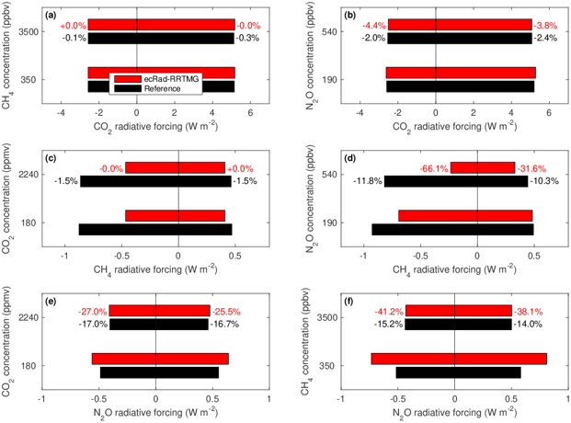
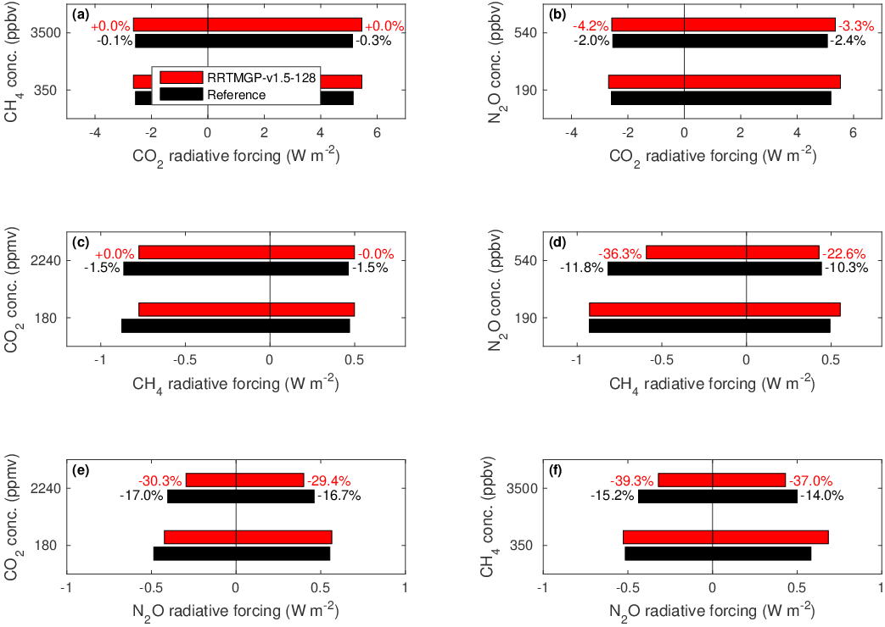
Longwave RRTMG 16/140 Longwave RRTMGP 16/128
Inspired by Etminan et al. (2016) we simulate forcing by positive and negative concentration extremes of CO₂, CH₄ and N₂O, and combinations thereof, in order to test spectral overlap
RRTMG underestimates forcing from low CH₄, (last glacial maximum) and overestimates interaction of CH₄ & N₂O forcing; better in RRTMGP

Slide 17
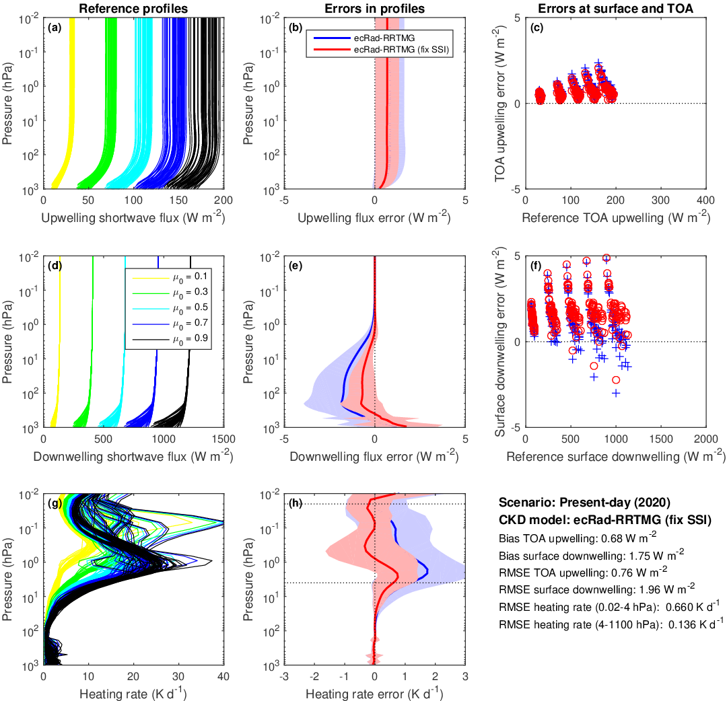
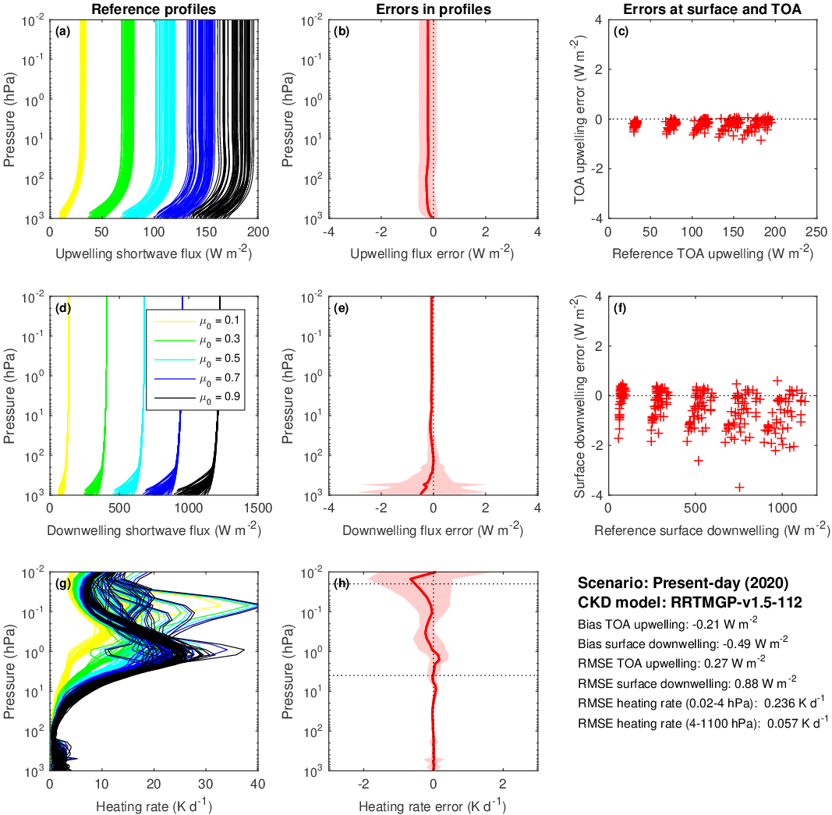
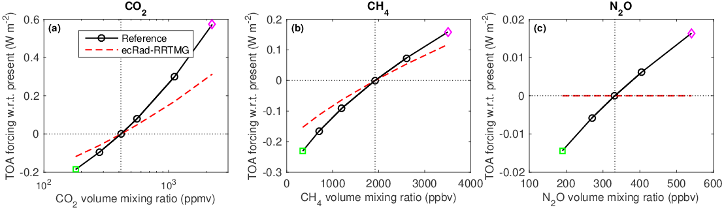
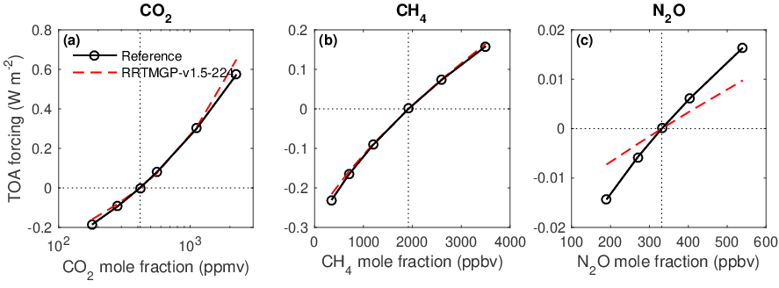
Shortwave RRTMGP 14/112
Shortwave RRTMG 14/112

Slide 18
Summary of datasets on FTP site for CKDMIP participants
Absorption spectra use 7.1M points in longwave, 3.1M in shortwave
Stored in NetCDF4/HDF5 format with compression
Evaluation-1 dataset:
  50 profiles: 265 GB in LW, 136 GB in SW
Evaluation-2 dataset:
  For independent evaluation (not released)
  Same size as Evaluation-1
MMM dataset:
  Median, min and max profiles
  3 profiles: 30 GB in LW, 15 GB in SW
Idealized dataset:
  For creating CKD look-up tables
  6 profiles: 139 GB in LW, 74 GB in SW

Slide 19
Problems with gas-optics schemes
The ultimate black box: only a few specialists know how to generate them, so the average user has no control over the number of spectral calculations
Are they optimized for the model top, which can vary from 40 to 80 km? Why waste spectral intervals to get the O₃ heating / CO₂ cooling above the model top?
Are they optimized for the range of gas concentrations to be simulated? An NWP model may only need to simulate present-day greenhouse gases
What controls the number of bands used?
The correlated-k-distribution model intercomparison project (CKD-MIP)
Model A
How do current schemes perform the trade-off of error versus number of spectral intervals for main applications?
Can we develop a free tool so that anyone can generate optimal CKD models for their application?
Participants: ECMWF (FSCK), AER/U.Colorado (RRTM), Met Office (SOCRATES), GFDL, ECCC, NASA…
Model B
RMS error in heating-rates/fluxes
Climate scenarios
NWP scenarios
Number of spectral intervals

Slide 20
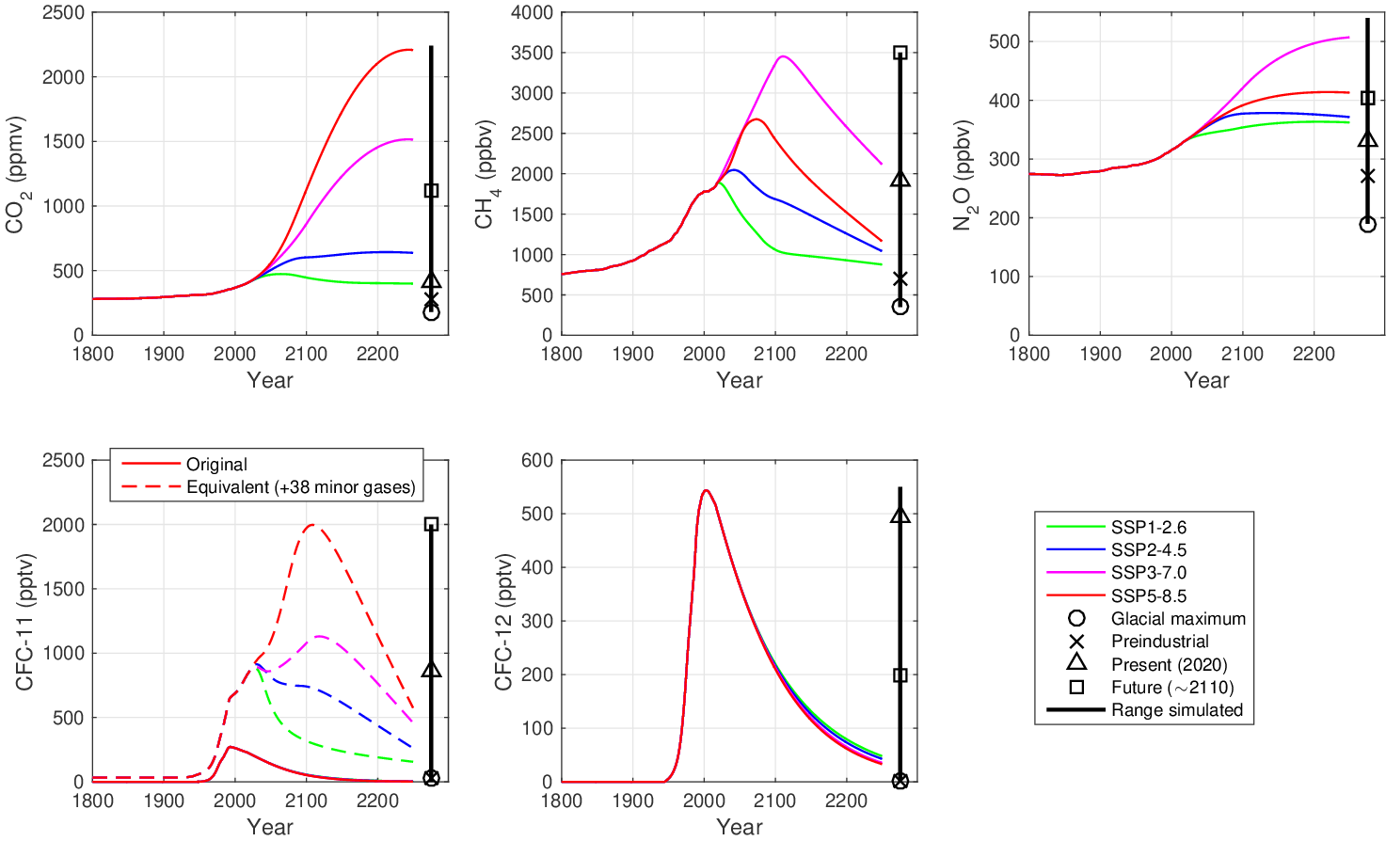
CKDMIP Evaluation-1 dataset: Well-mixed gases
Consider five well-mixed greenhouse gases
Further 38 implicitly considered via “equivalent CFC11” (Meinshausen et al. 2017)
Evaluate concentrations from Glacial Maximum to the worst of the CMIP6 future scenarios
Participants produce CKD models for both climate and present-day NWP
Per-molecule absorption of these gases is independent of concentration, so only store absorption spectra at one concentration and scale
Also N₂ and O₂ absorption

Slide 21
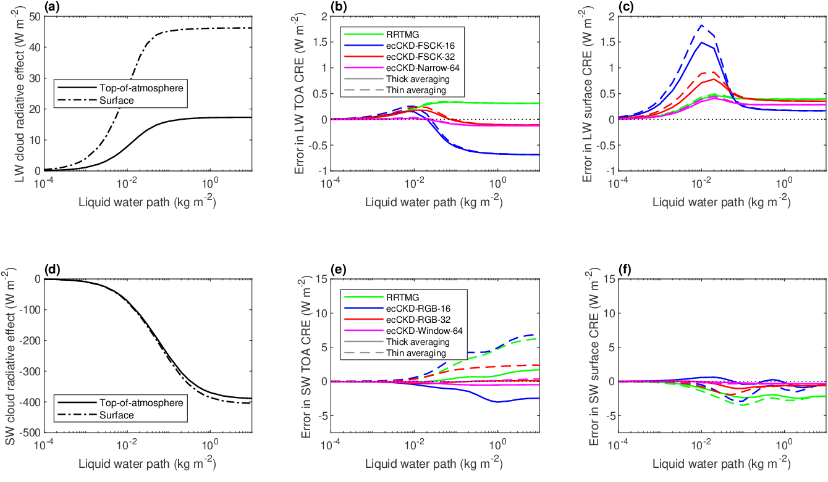
Liquid cloud radiative effect (CRE): CKD models vs line-by-line
LW CRE accurate despite FSCK, provided cloud properties per k term
ecCKD-32 similar accuracy to RRTMG
ecCKD with 64 k terms and more bands is most accurate
“Thick” spectral averaging (Edwards & Slingo 1996) more accurate than “thin”

Slide 22
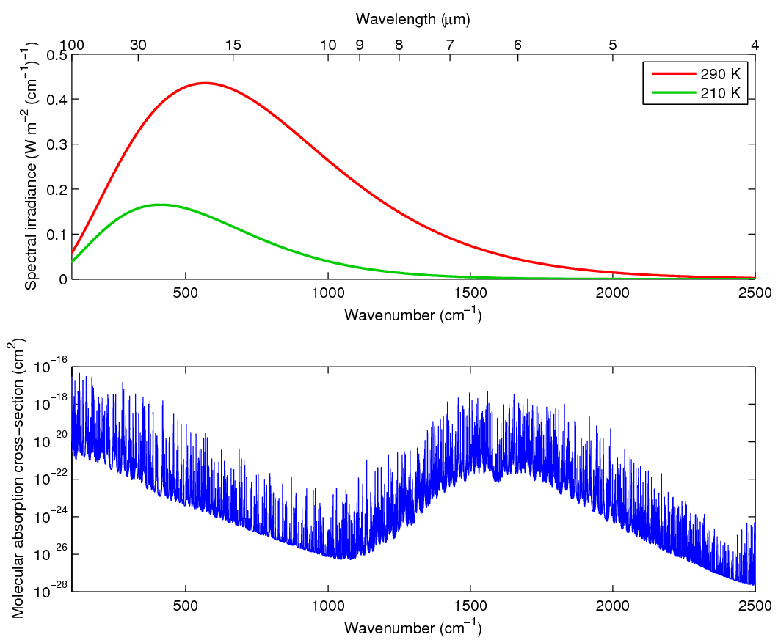
What is the CKD method? 1. Consider longwave absorption spectrum (k)
Line-by-line reference requires 10⁶ to 10⁷ monochromatic radiation calculations
Water vapour spectrum (k) Planck function

Slide 23
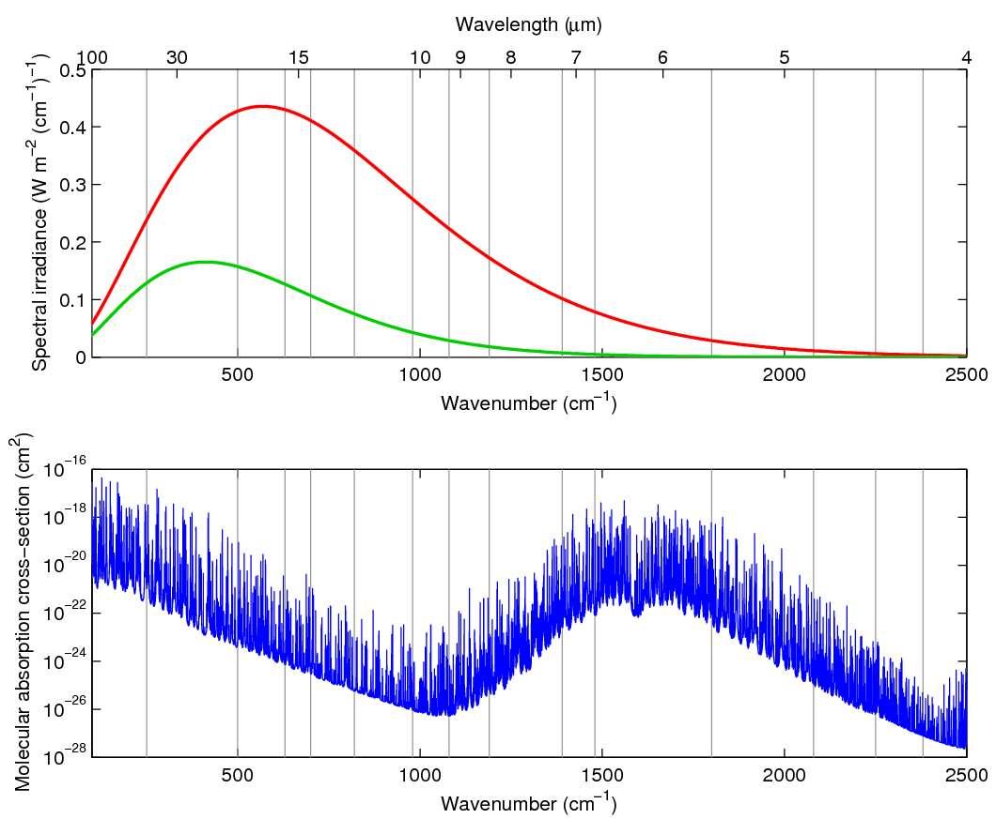
What is the CKD method? 2. Bands
16 RRTMG bands
What determines optimum band structure?
Note that the full-spectrum correlated-k method (FSCK) doesn’t use bands (Pawlak et al. 2004, Hogan 2010)
Water vapour spectrum (k) Planck function

Slide 24
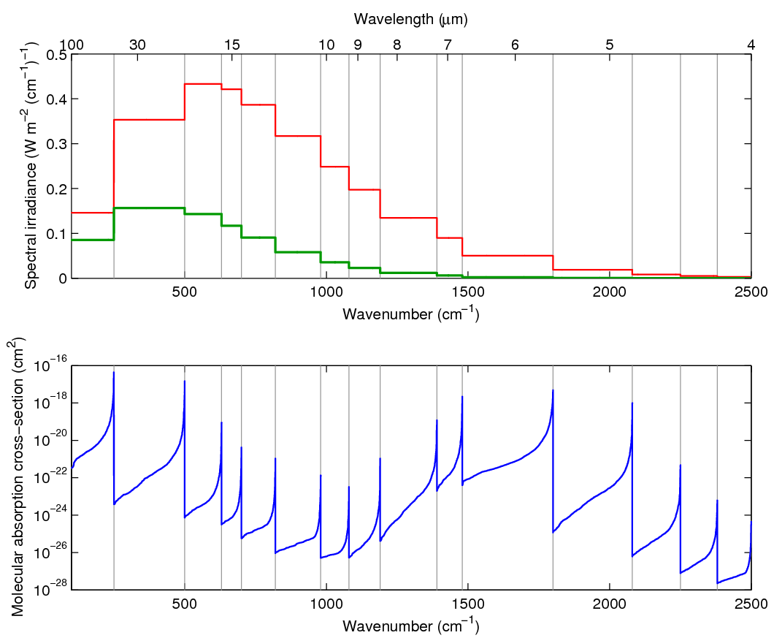
What is the CKD method? 3. Reorder spectrum within each band
Line location within band is irrelevant: only need the k distribution
Reordered spectrum more conducive to numerical integration
Water vapour spectrum (k) Planck function

Slide 25
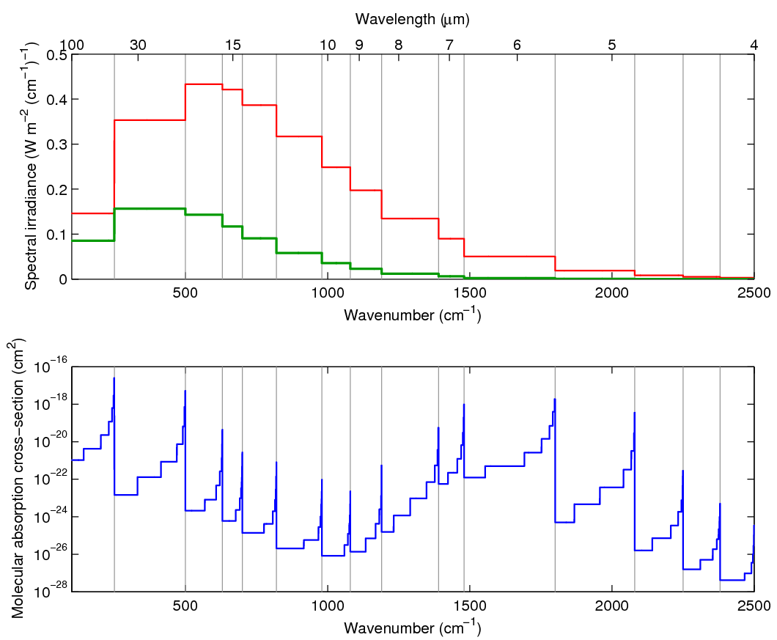
What is the CKD method? 4. Discretize smooth reordered spectra
Only 10² monochromatic calculations now required!
Assume perfect rank correlation of absorption with pressure when doing radiative transfer through full profile
Need some black magic to treat overlapping gases
Water vapour spectrum (k) Planck function

Slide 26
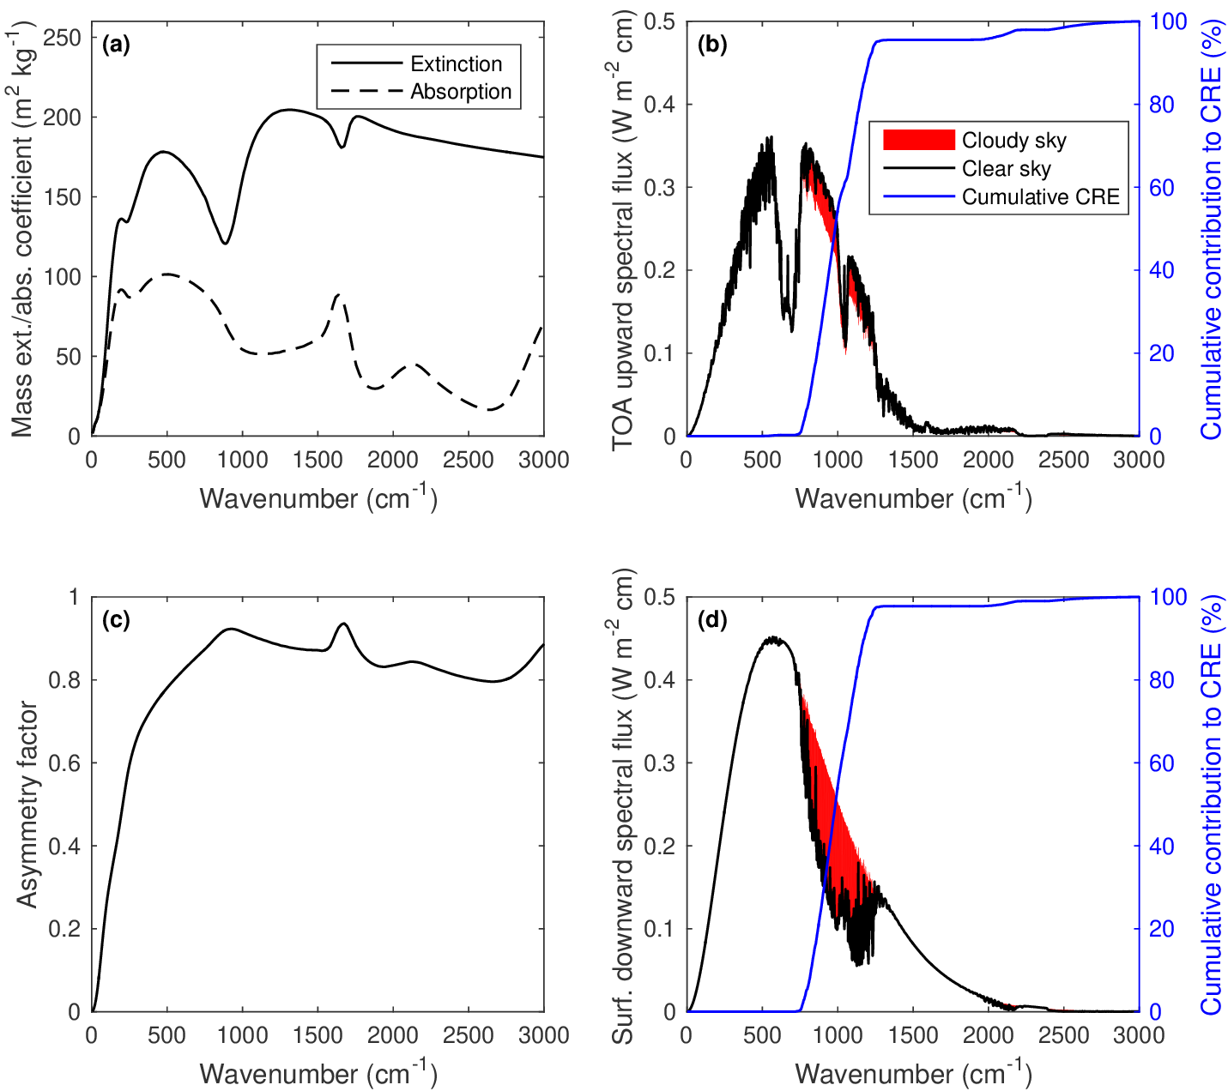

Slide 27
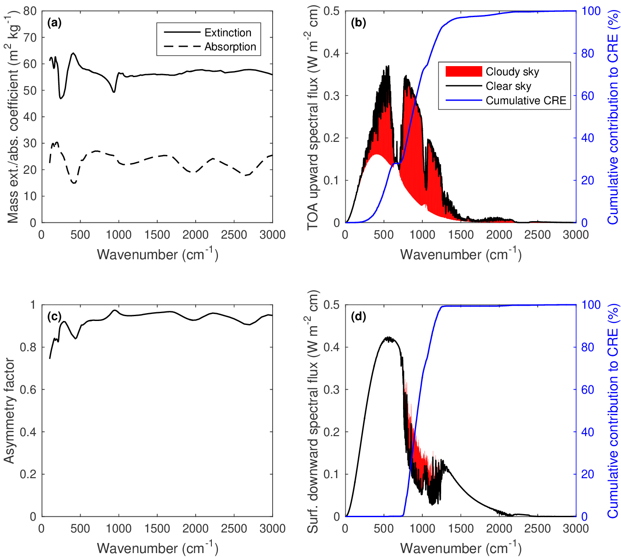

Slide 28
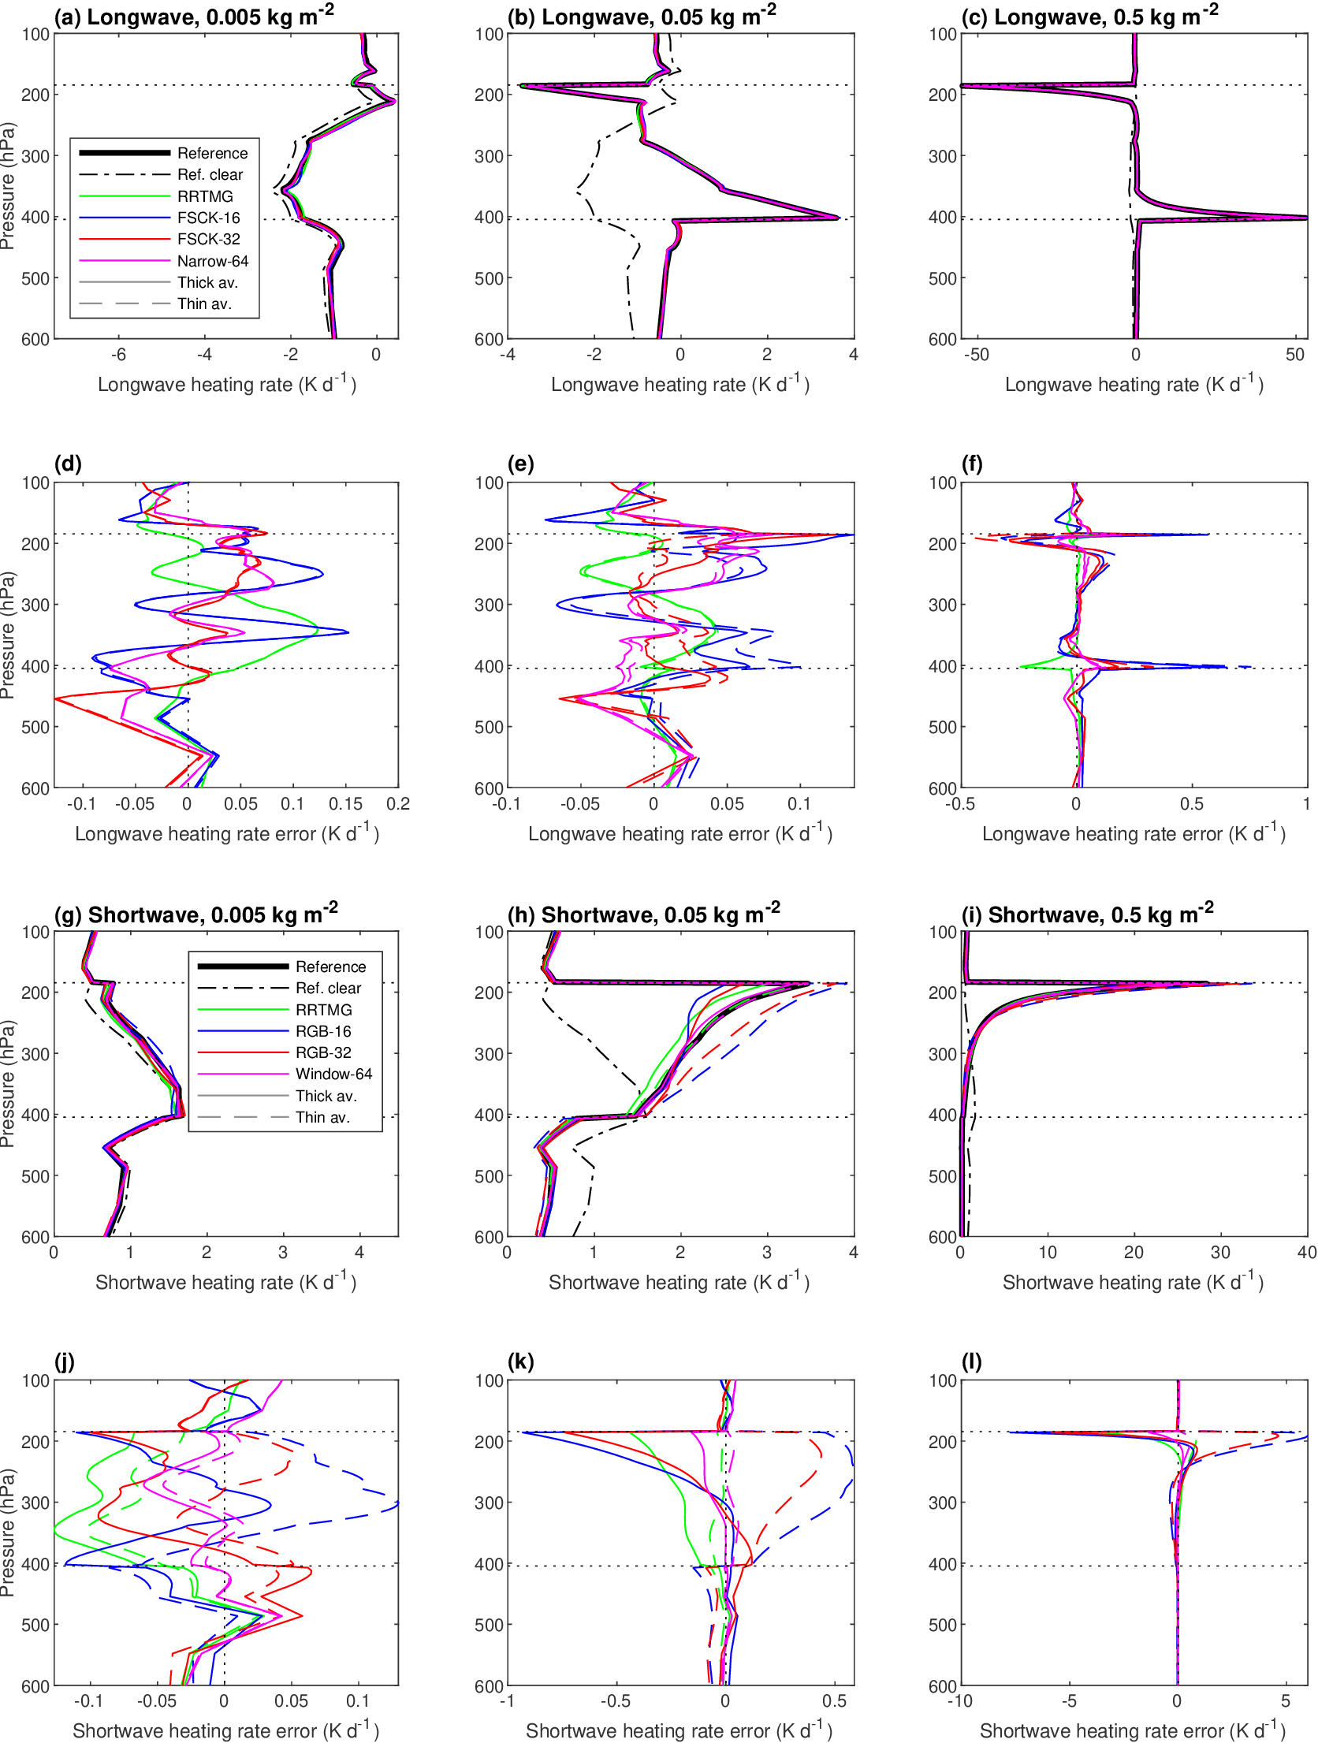

Slide 30
