Slide 1
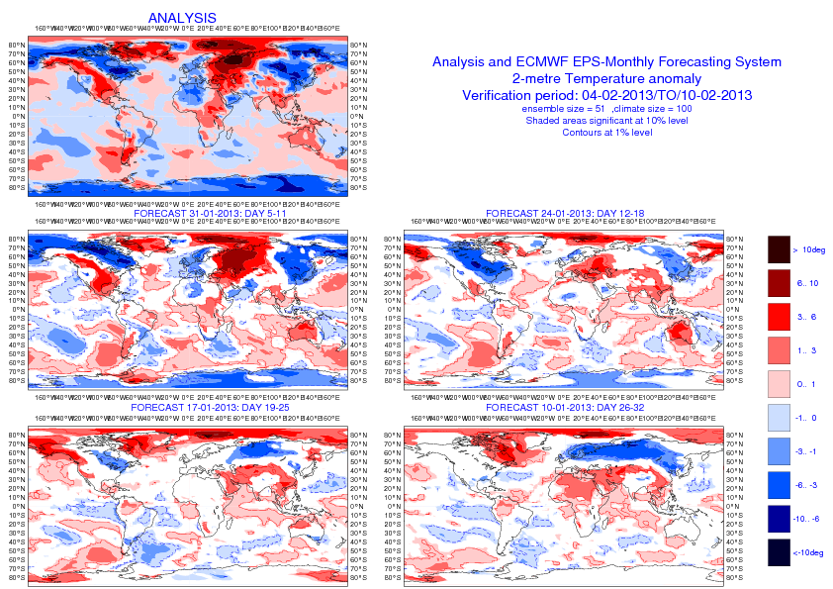
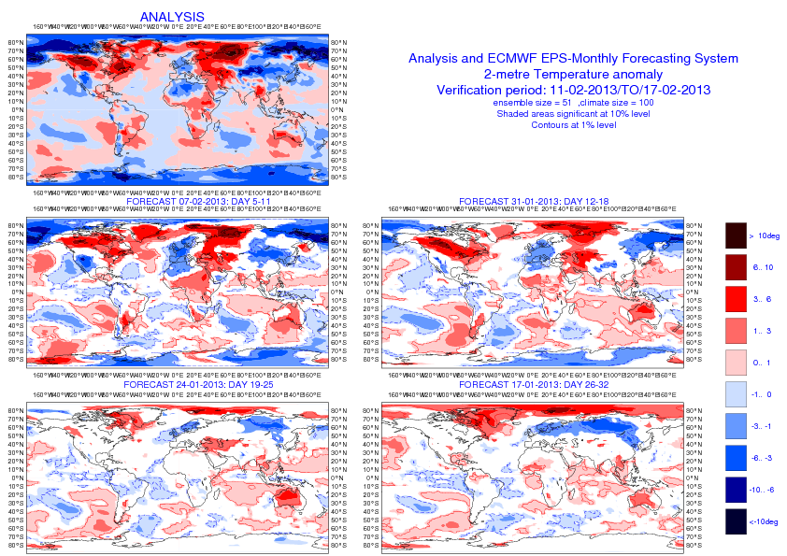
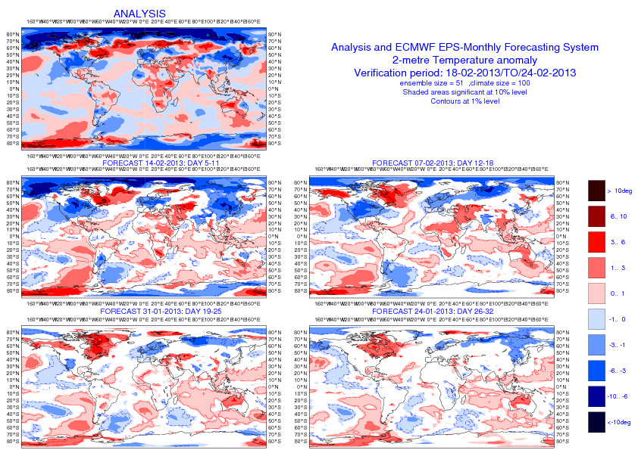
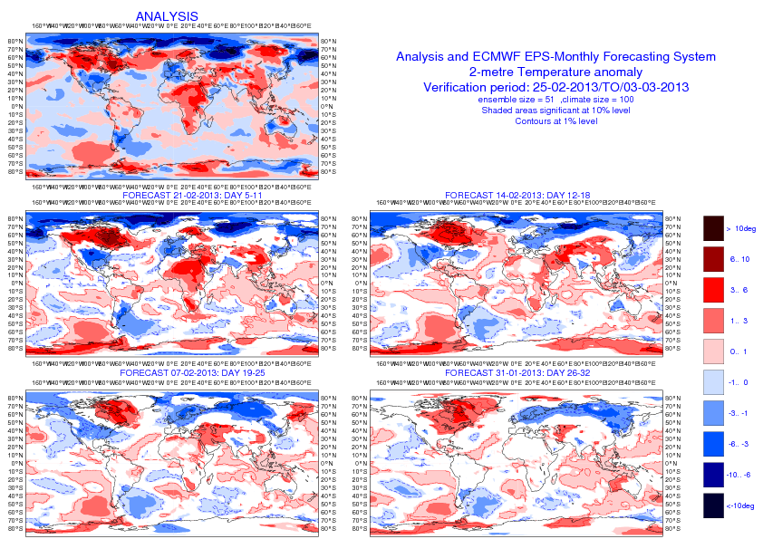
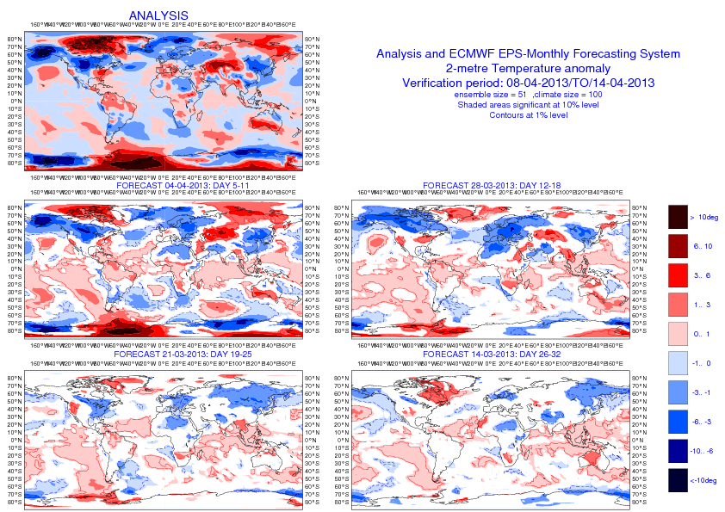
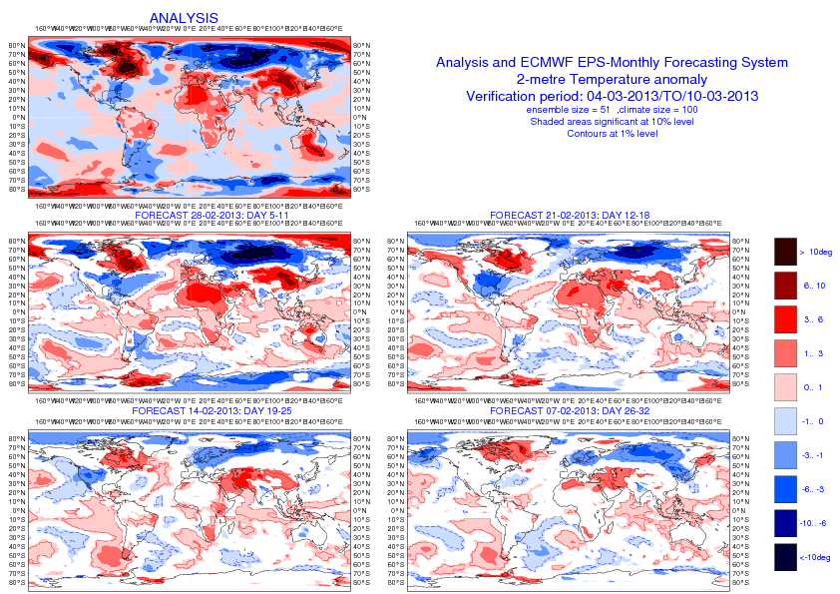
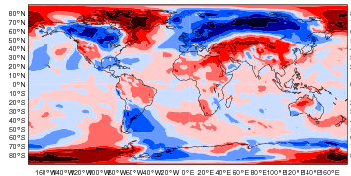
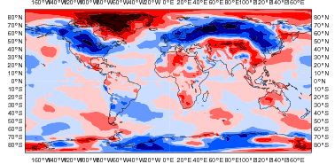
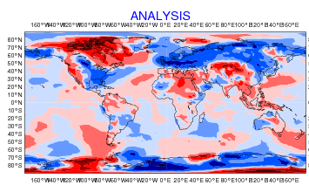
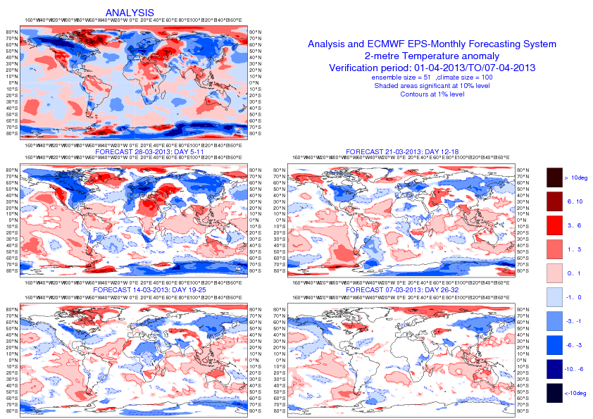
2-metre temperature anomalies
4-10 Feb
11-17 Feb
18-25 Feb
26 Feb-3 March
4 -10 March
11 -17 March
18 -25 March
26 -31 March
1-7 April
8-15 April

Slide 2
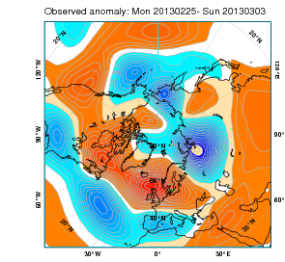
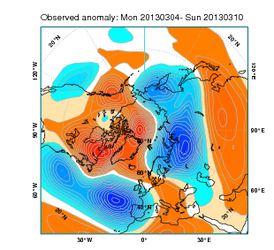
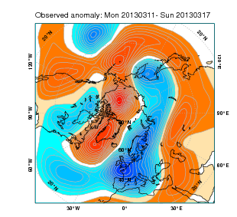
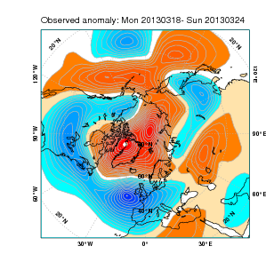
Z500 anomalies
25Feb-3March
4-10 March
11-17 March

Slide 3
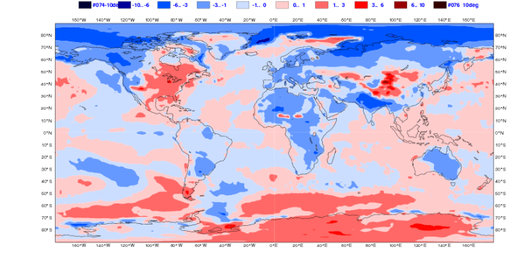
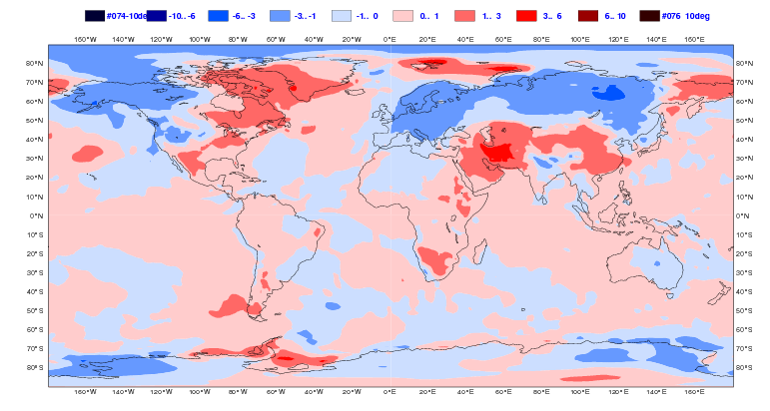
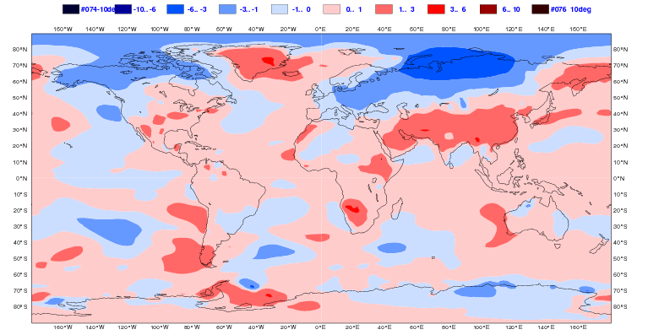
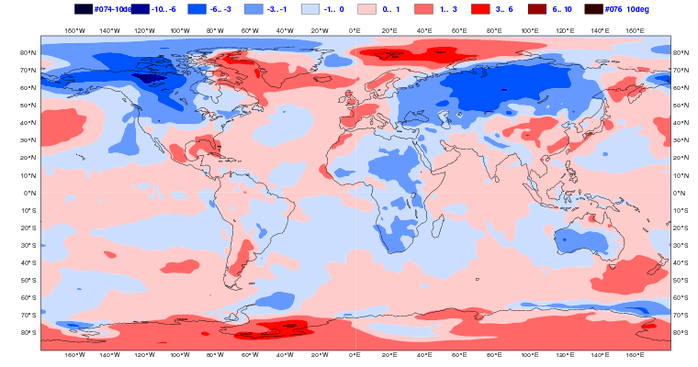
2mtm anomalies 14 Feb day 26-32
11 -17 March
ERA Interim
EC
ECMWF
JMA
NCEP

Slide 4
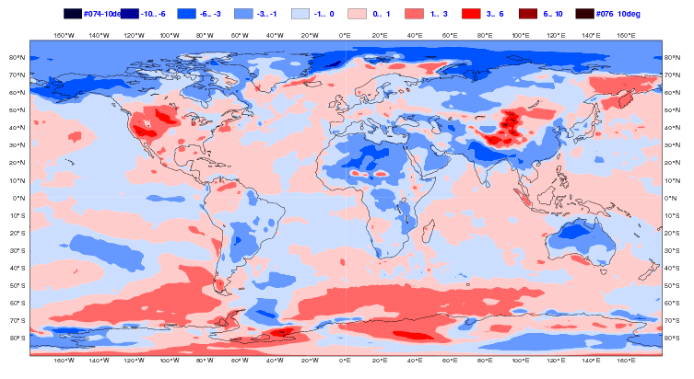
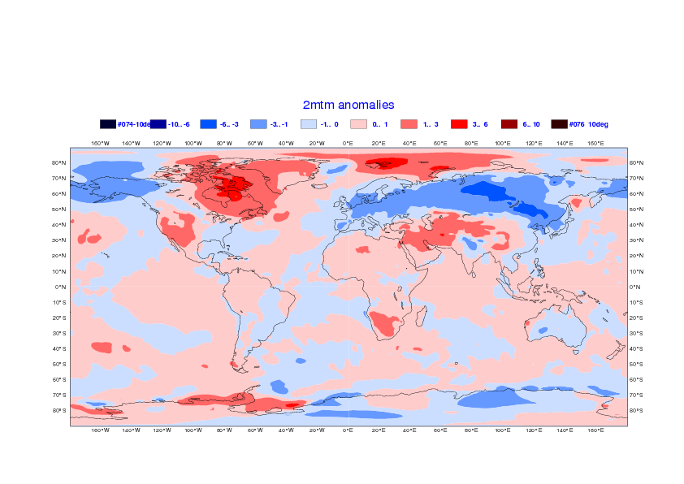
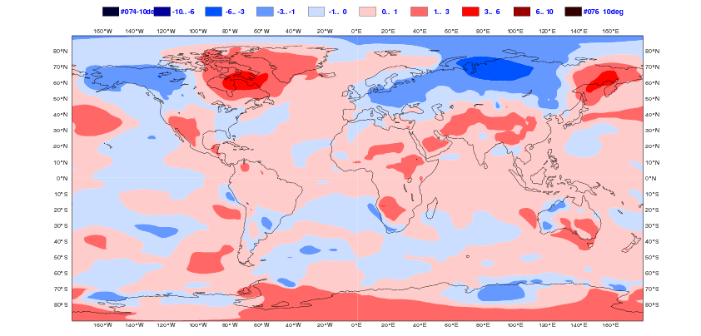
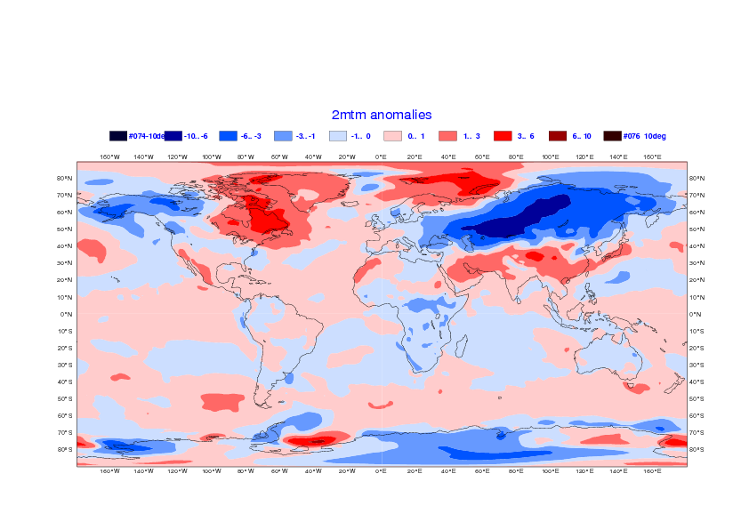
2mtm anomalies 21 Feb day 26-32
18 -24 March
ERA Interim
EC
ECMWF
JMA
NCEP

Slide 5
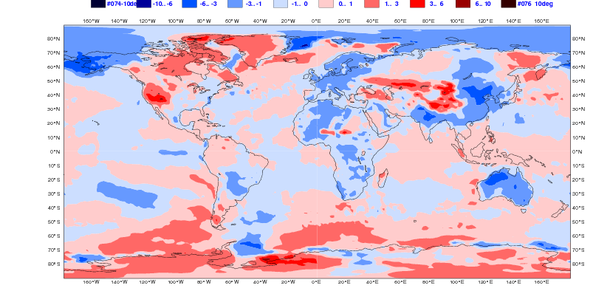
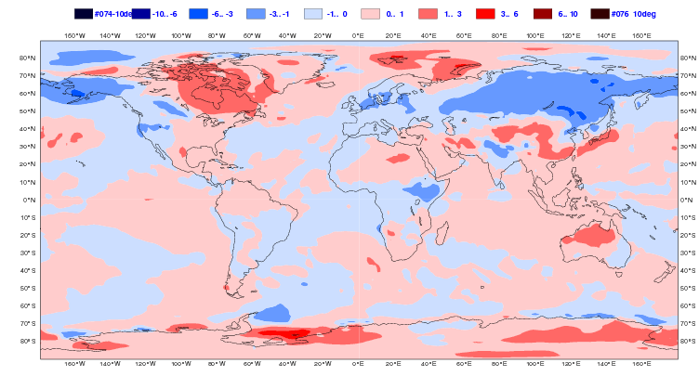
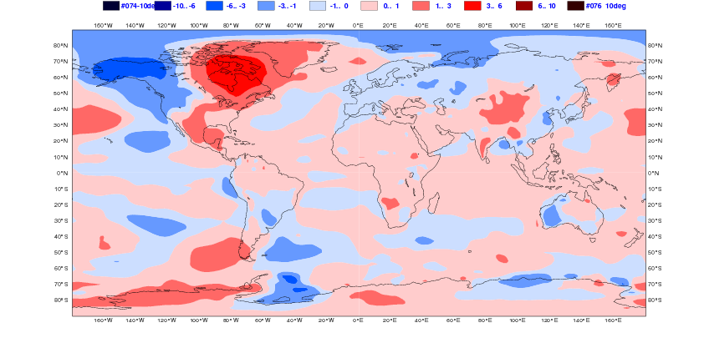
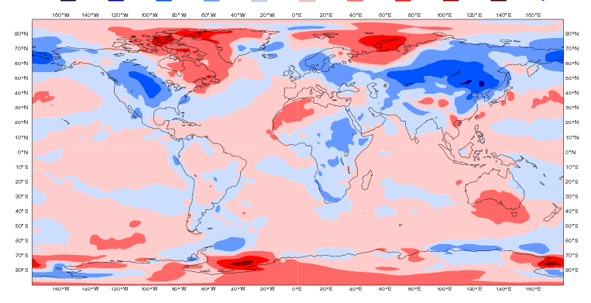
2mtm anomalies 28 Feb day 26-32
26 -31 March
ERA Interim
EC
ECMWF
JMA
NCEP

Slide 6
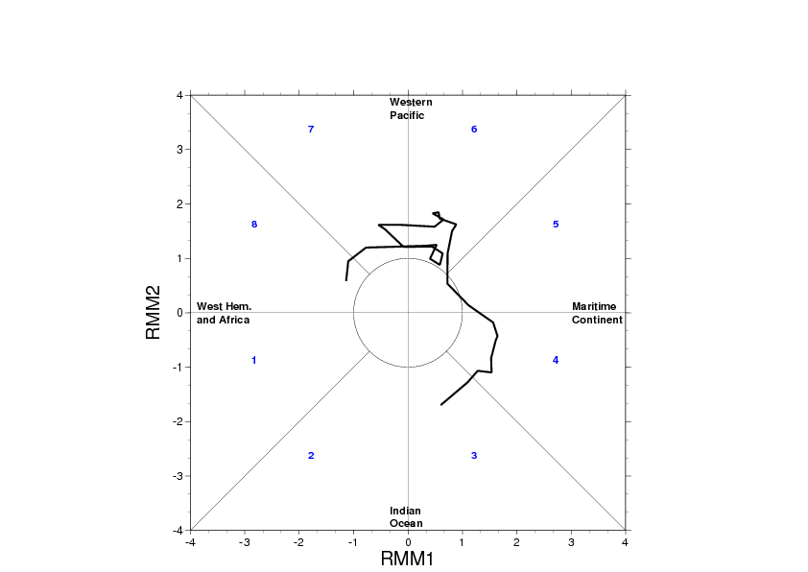
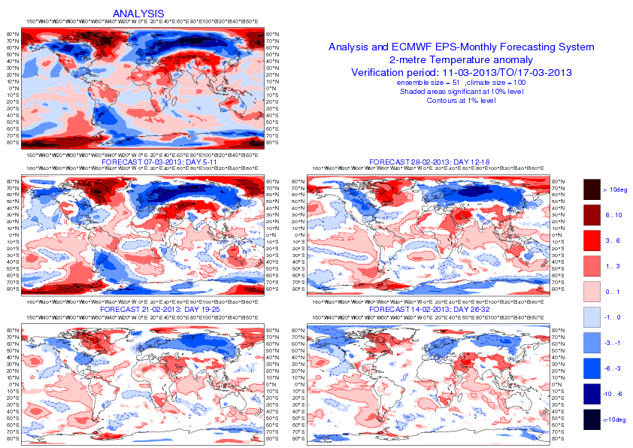
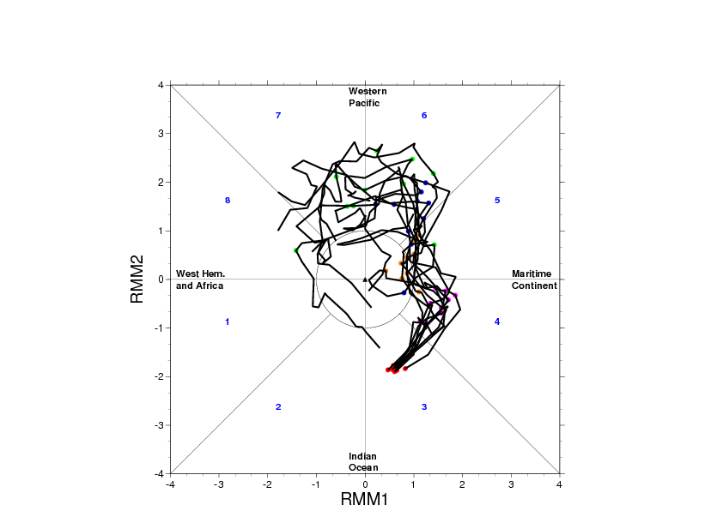
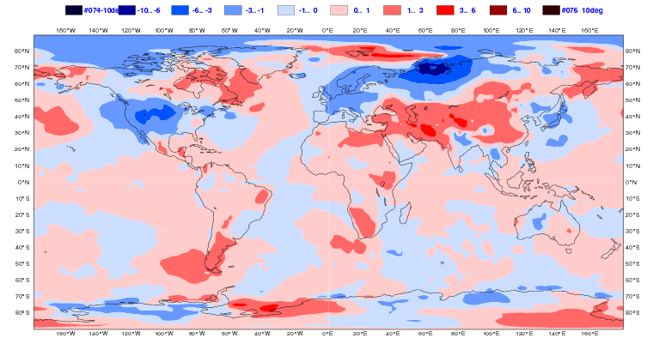
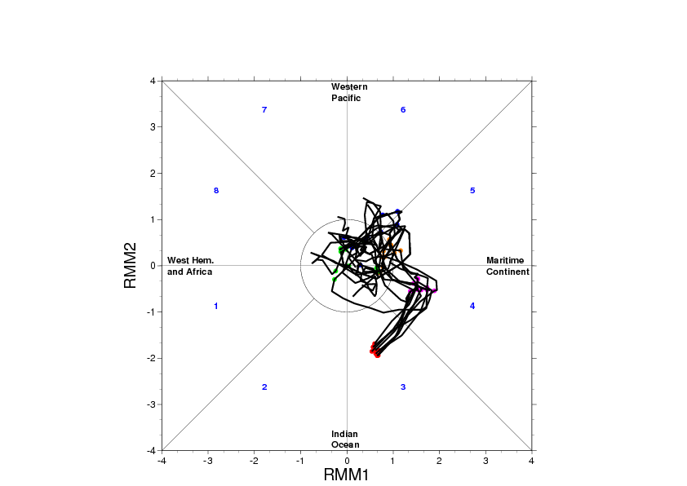
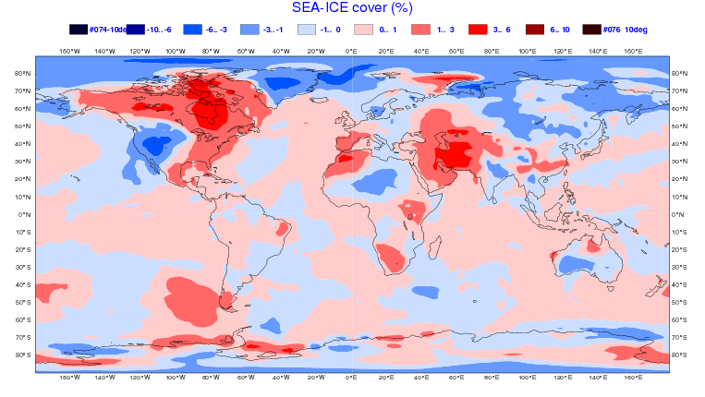
Cold March 2013 – 14 Feb 2013 -Day 26-32

Slide 7
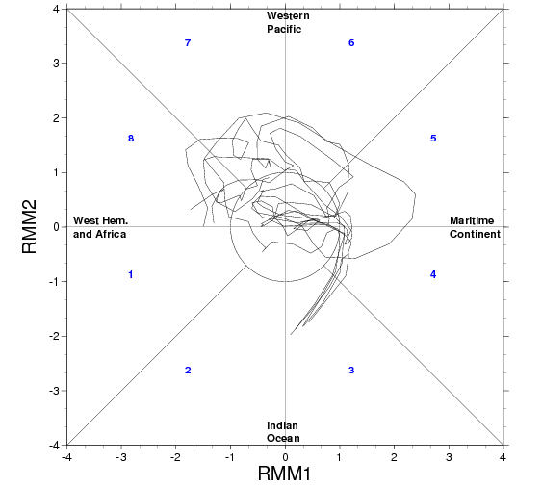
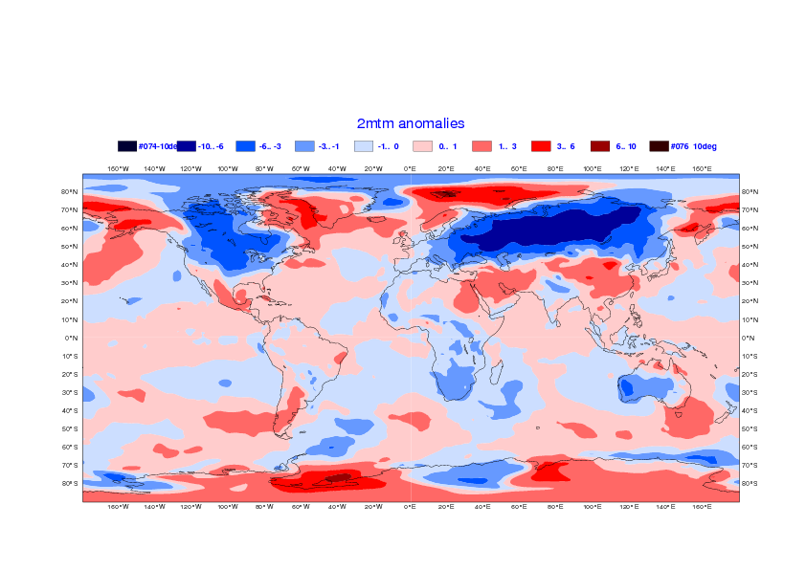
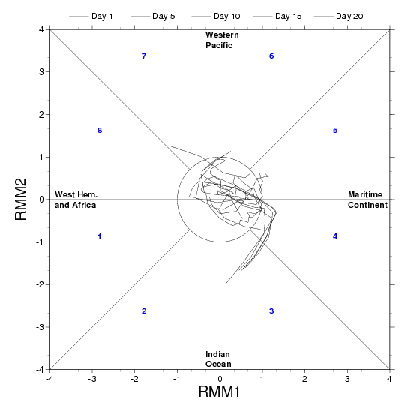
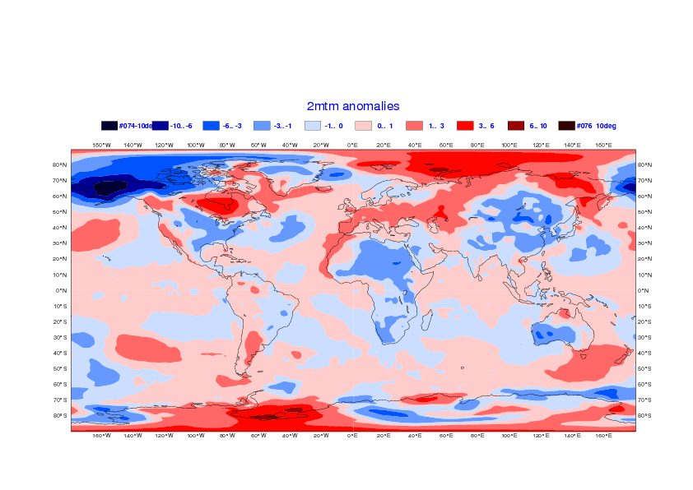
NCEP
Cold March 2013 – 14 Feb 2013 -Day 26-32

Slide 8
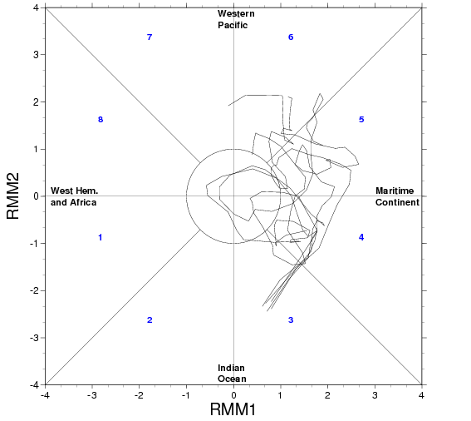
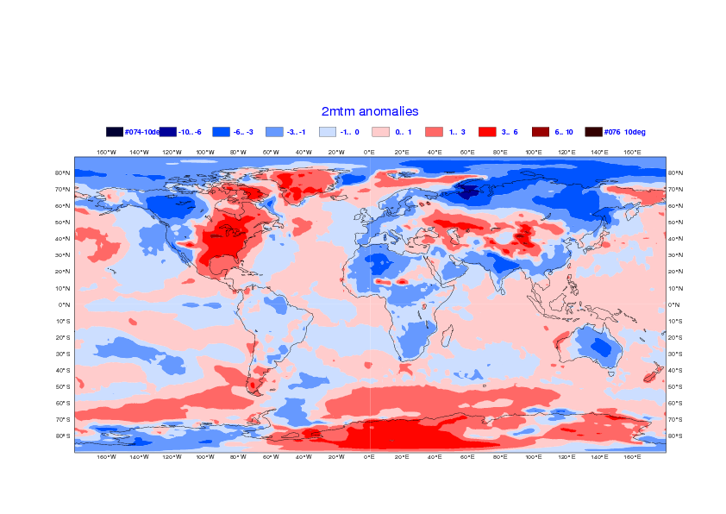
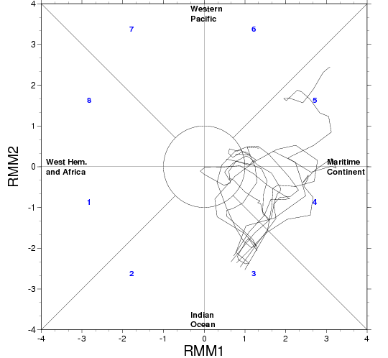
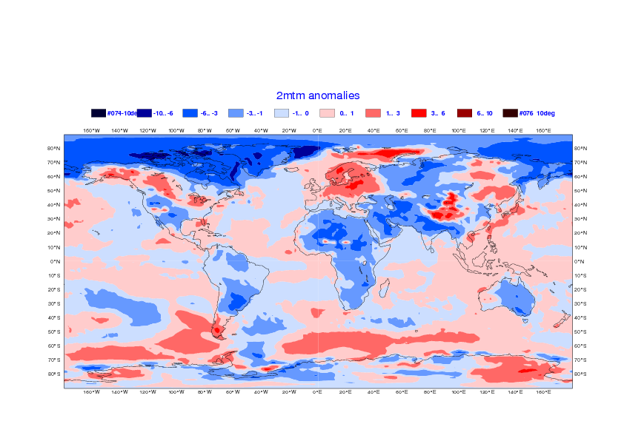
EC
Cold March 2013 – 14 Feb 2013 -Day 26-32

Slide 9
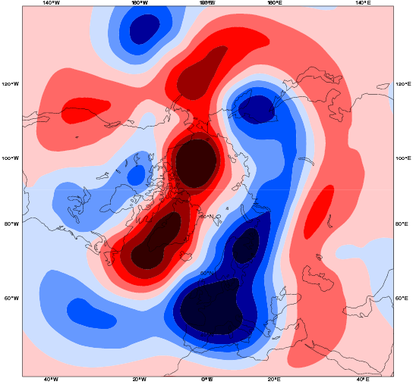
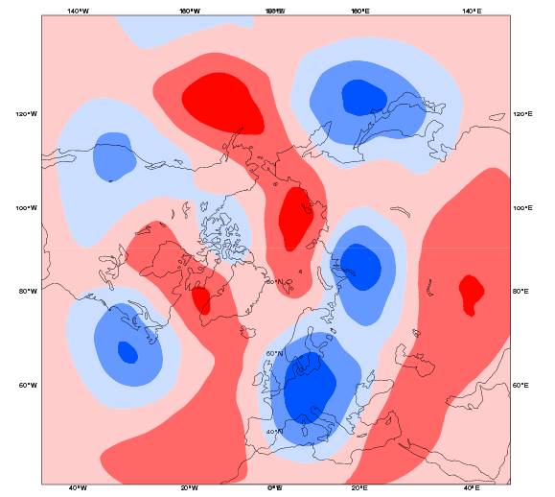
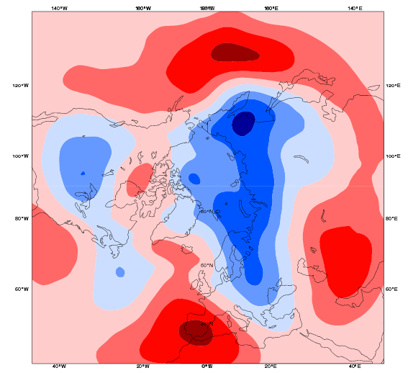
Cold March 2013 – 14 Feb 2013 -Day 26-32

Slide 10
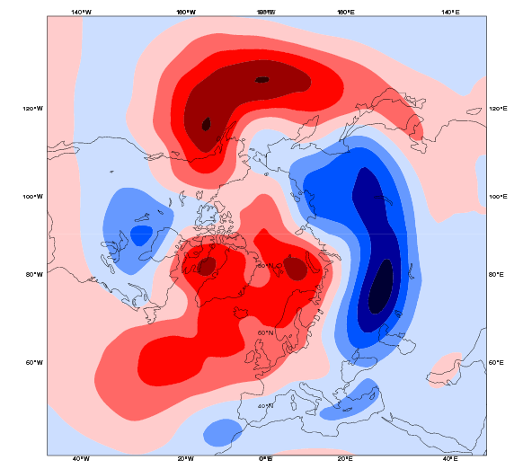
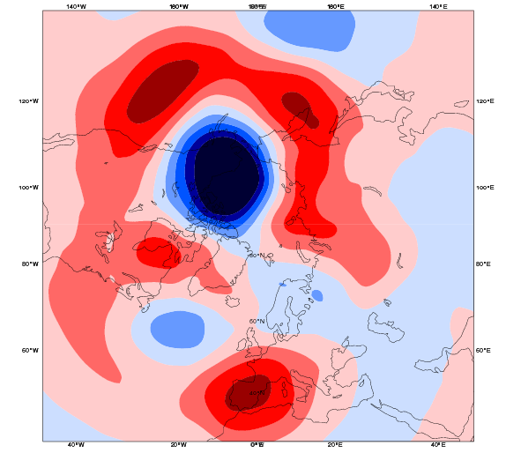
NCEP
Cold March 2013 – 14 Feb 2013 -Day 26-32

Slide 11
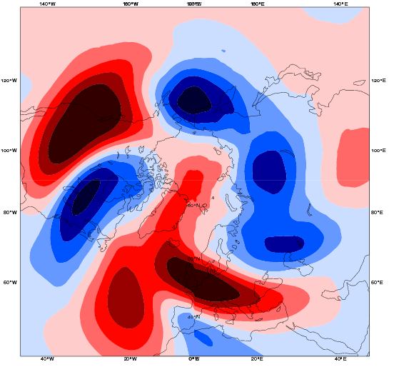
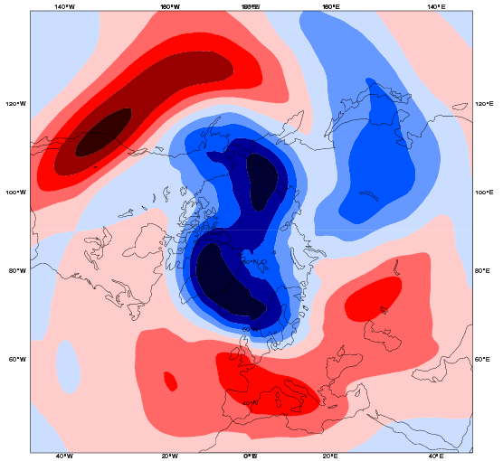
EC
Cold March 2013 – 14 Feb 2013 -Day 26-32

Slide 12
RELAXATION EXPERIMENTS

Slide 13
Experimental setup
Control: IFS CY40R1 – 51 member ensemble, T639/319 L91, 60 day-integrations
RELAX1: same as Control with tropics (20N-20S) relaxed to analysis
RELAX2: Same as control with N. Extratropics (North of 35N) relaxed to analysis

Slide 14
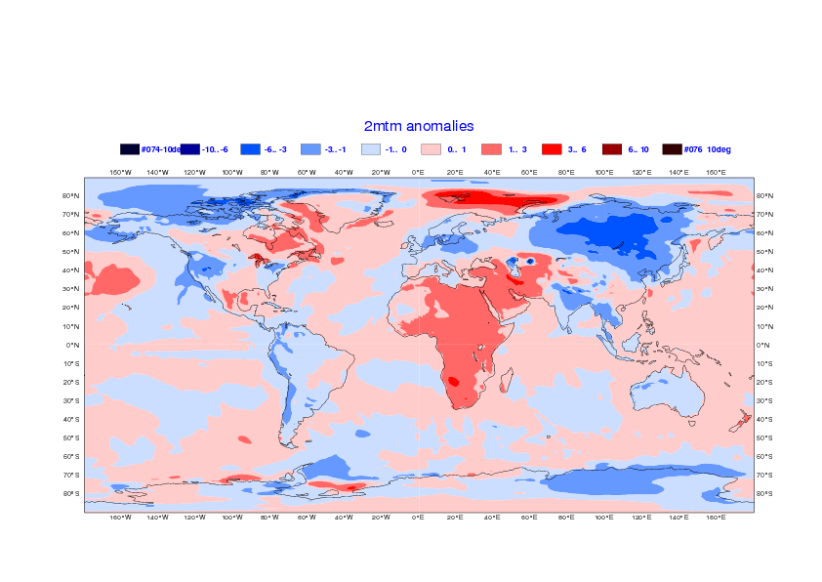
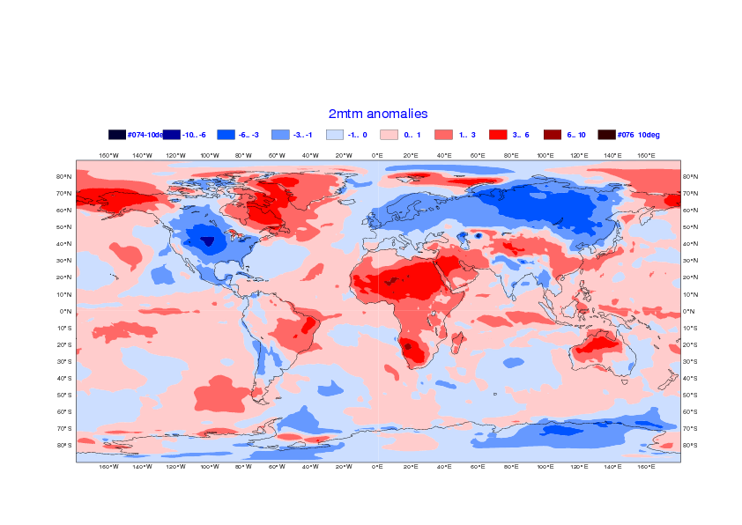
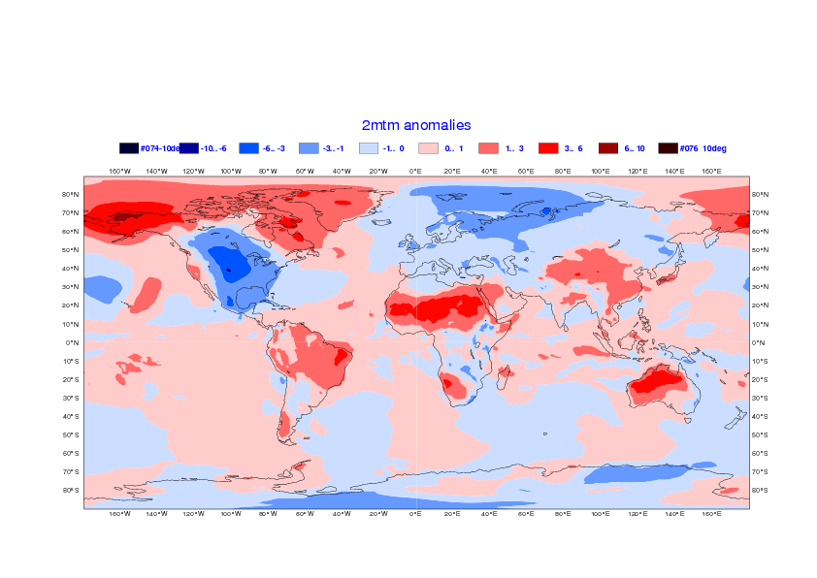
Control
Tropics relaxed to analysis
Analysis
RELAX1-Control

Slide 15


Control
RELAX2
Analysis
RELAX2-Control

Slide 16


Impact of relaxation on the MJO
ERA INTERIM
Control
RELAX 2
(NH relaxed)
Ensemble mean
51 Ens. Members day 1
51 Ens. Members day 5
51 Ens. Members day 10
51 Ens. Members day 15
51 Ens. Members day 20

Slide 17








Relaxation in the Tropics
2013 initial conditions
2012 initial conditions
2011 initial conditions
2010 initial conditions
2009 initial conditions
2008 initial conditions
2007 initial conditions
2006 initial conditions

Slide 18




Z500 anomalies
Control
Tropics relaxed to analysis
Analysis
RELAX1-Control

Slide 19







2013 initial conditions
2012 initial conditions
2011 initial conditions
2010 initial conditions
2009 initial conditions
2008 initial conditions
2007 initial conditions
2006 initial conditions

Slide 20




Z300 anomalies
Control
Tropics relaxed to analysis
Analysis
RELAX1-Control

Slide 21







2013 initial conditions
2012 initial conditions
2011 initial conditions
2010 initial conditions
2009 initial conditions
2008 initial conditions
2007 initial conditions
2006 initial conditions

