Slide 1
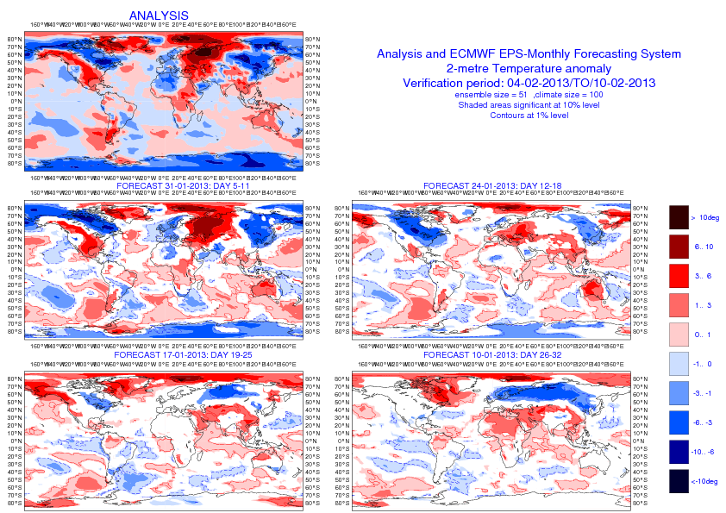
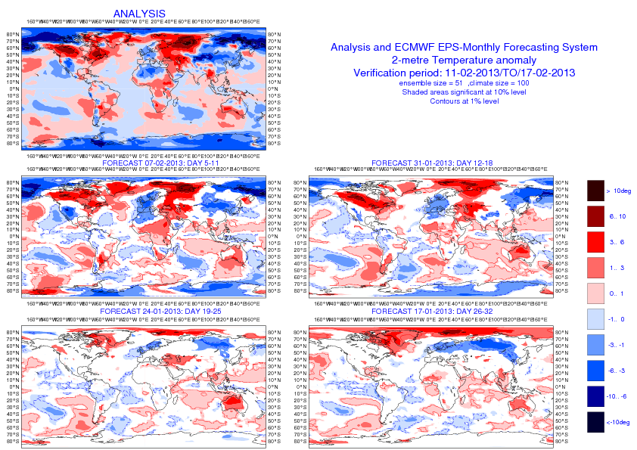
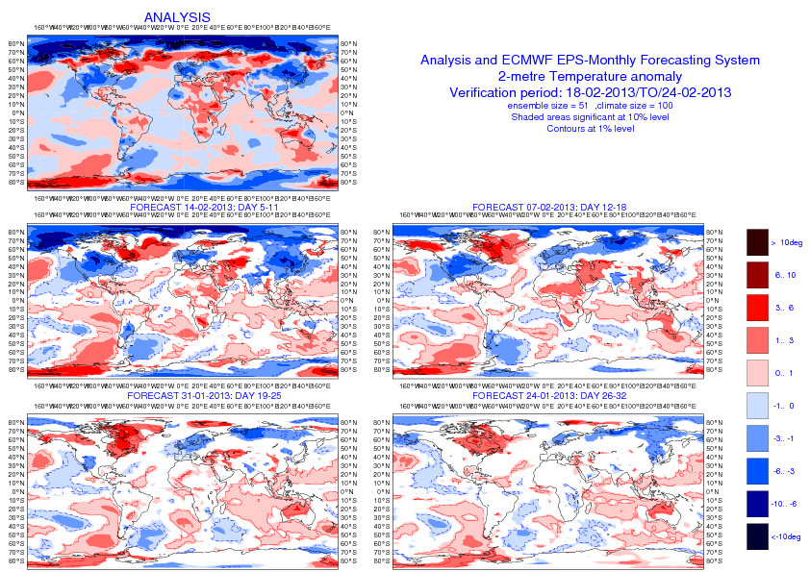
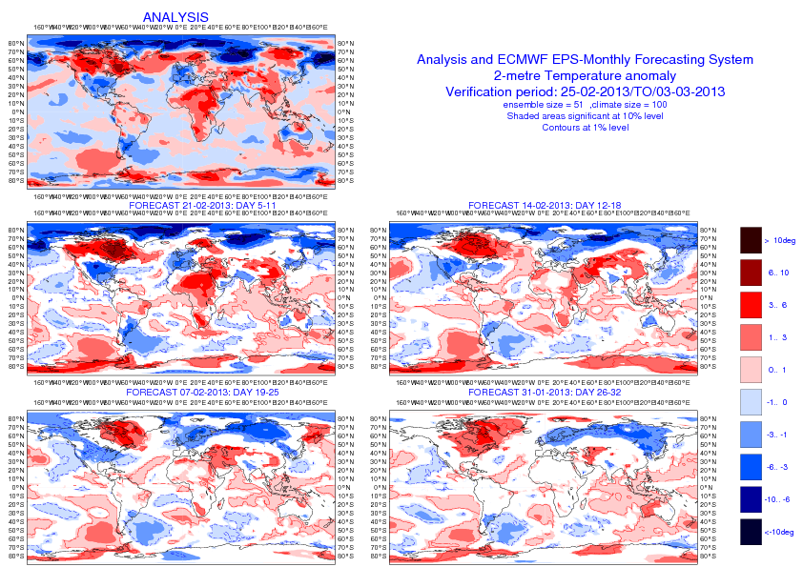
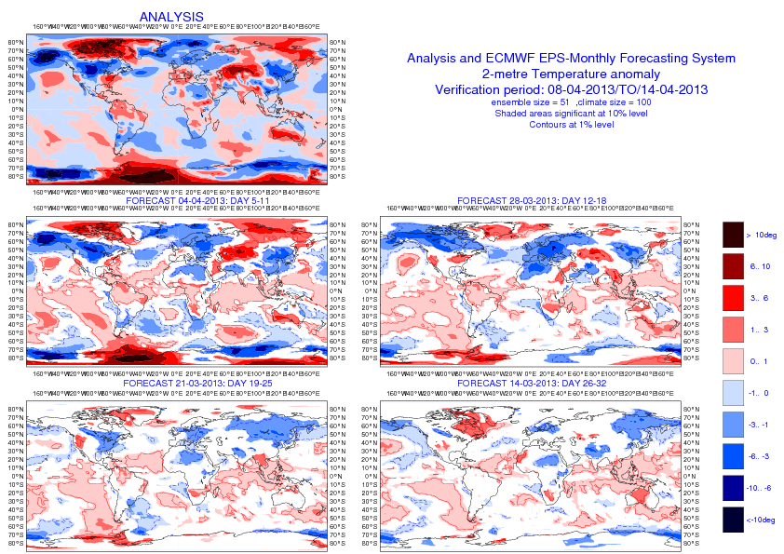
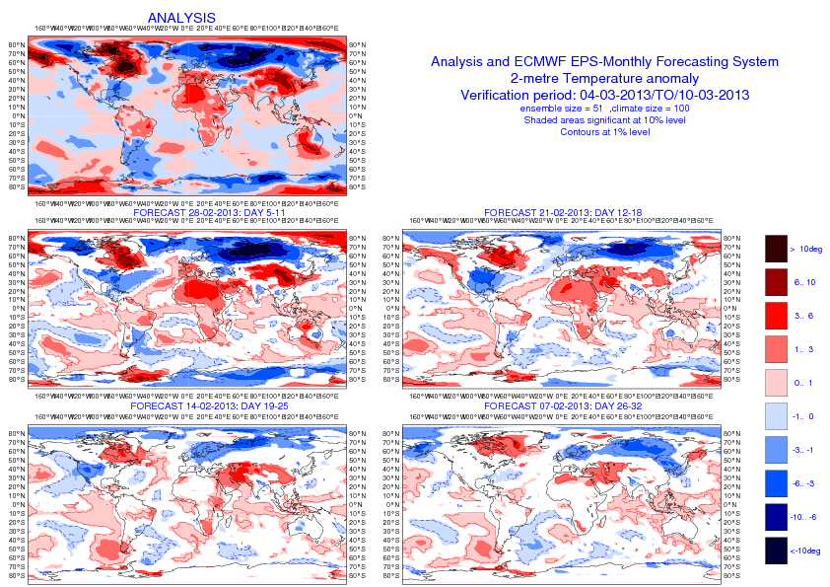
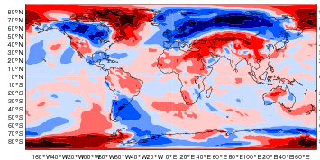
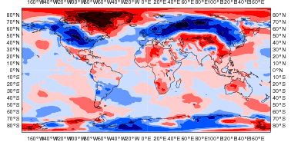
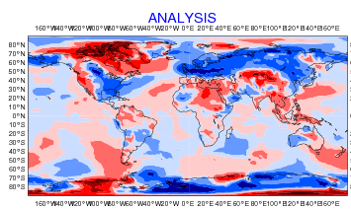
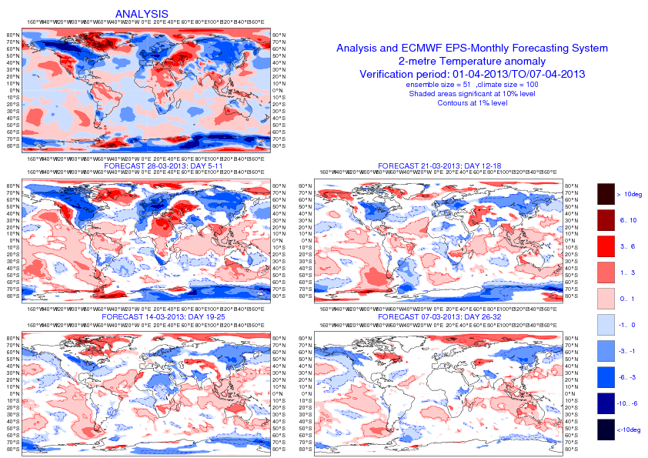
2-metre temperature anomalies
4-10 Feb
11-17 Feb
18-25 Feb
26 Feb-3 March
4 -10 March
11 -17 March
18 -25 March
26 -31 March
1-7 April
8-15 April

Slide 2
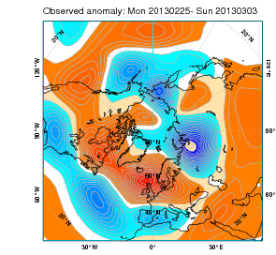
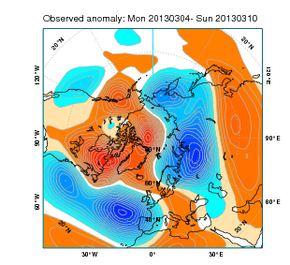
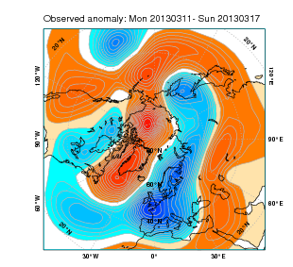
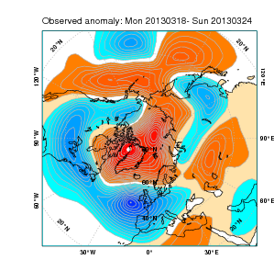
Z500 anomalies
25Feb-3March
4-10 March
11-17 March

Slide 3
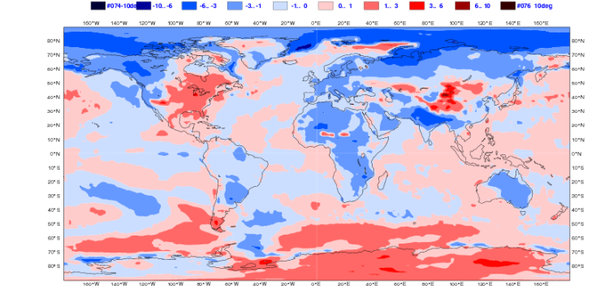
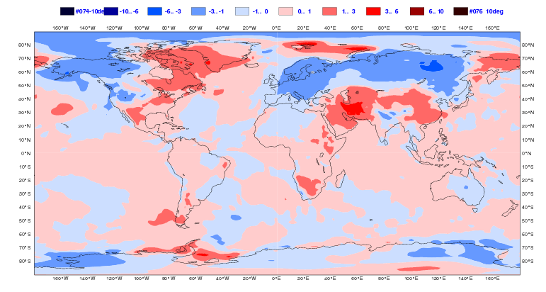
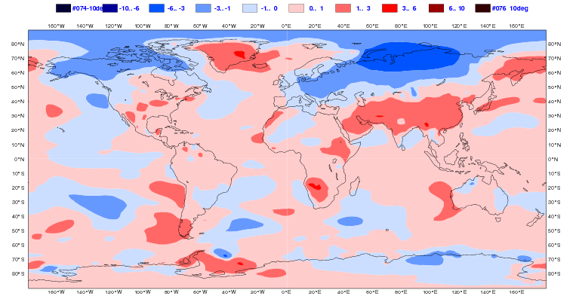
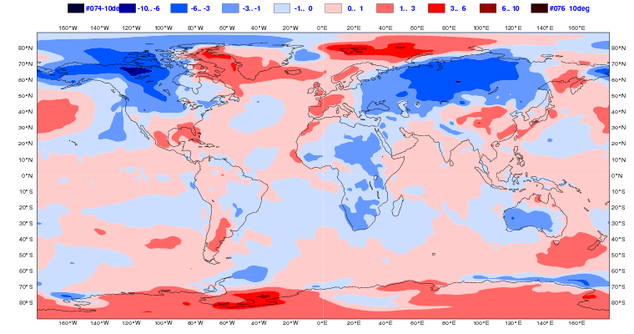
2mtm anomalies 14 Feb day 26-32
11 -17 March
ERA Interim
EC
ECMWF
JMA
NCEP

Slide 4
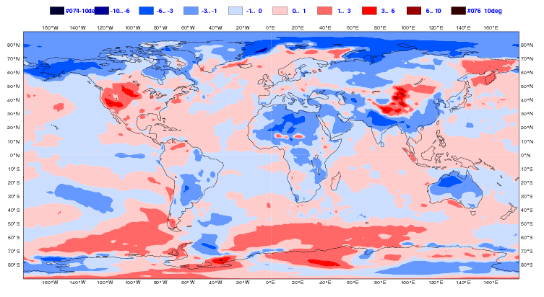
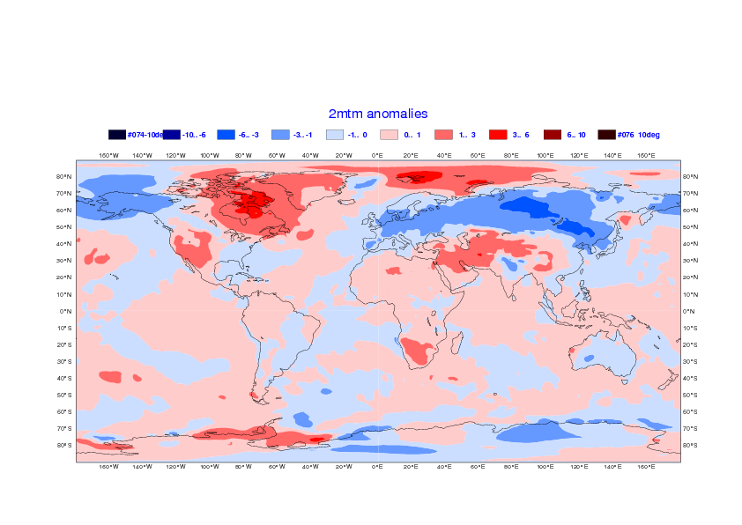
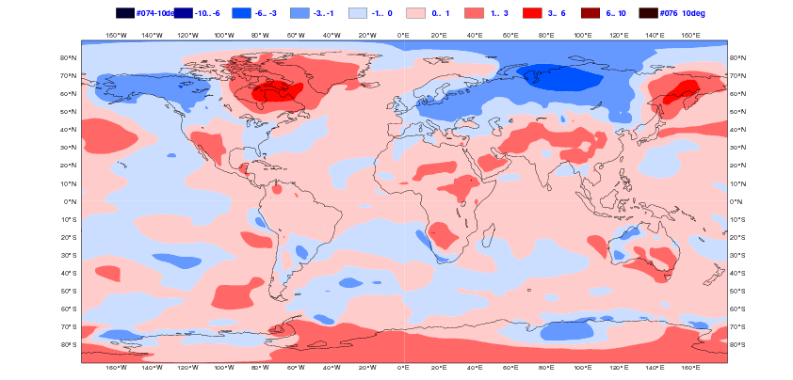
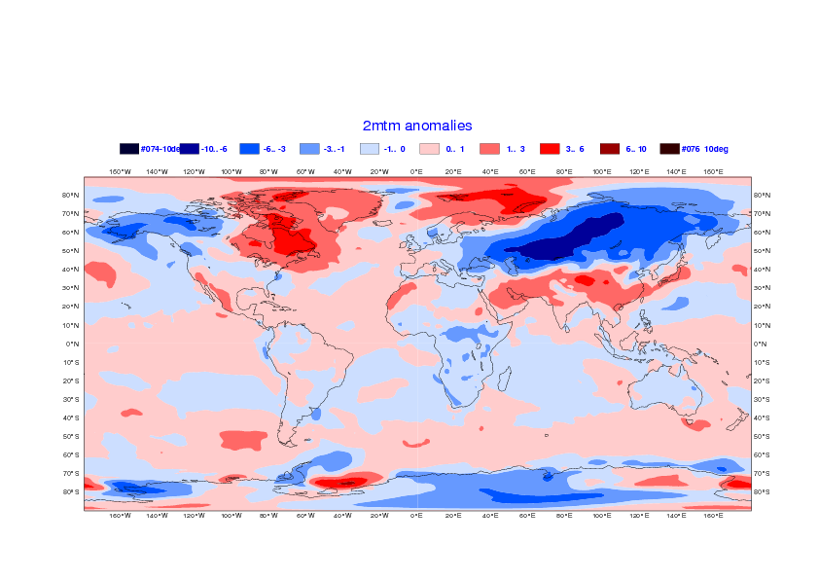
2mtm anomalies 21 Feb day 26-32
18 -24 March
ERA Interim
EC
ECMWF
JMA
NCEP

Slide 5
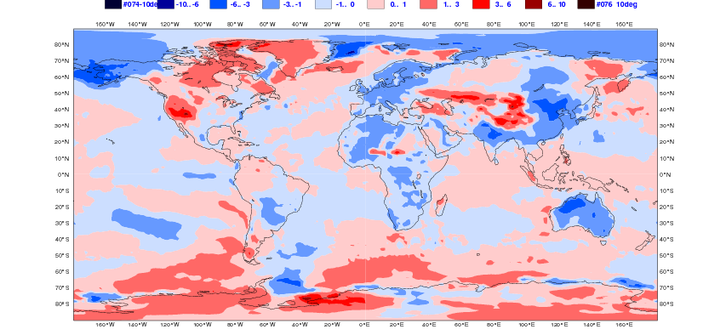
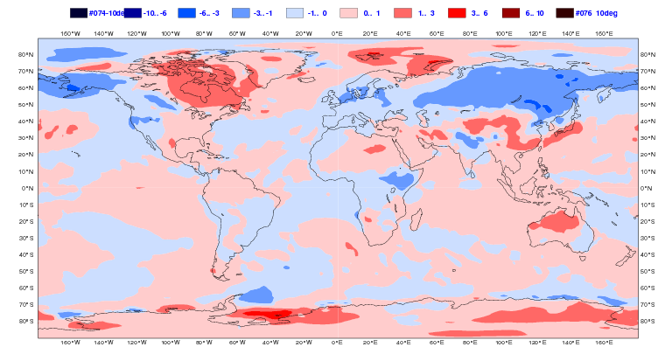
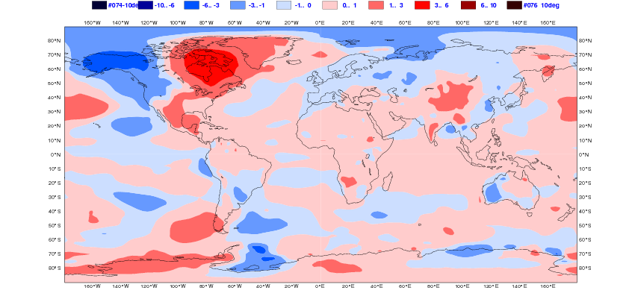
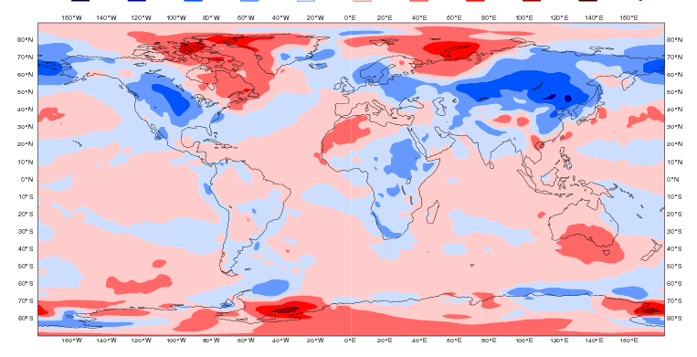
2mtm anomalies 28 Feb day 26-32
26 -31 March
ERA Interim
EC
ECMWF
JMA
NCEP

Slide 6
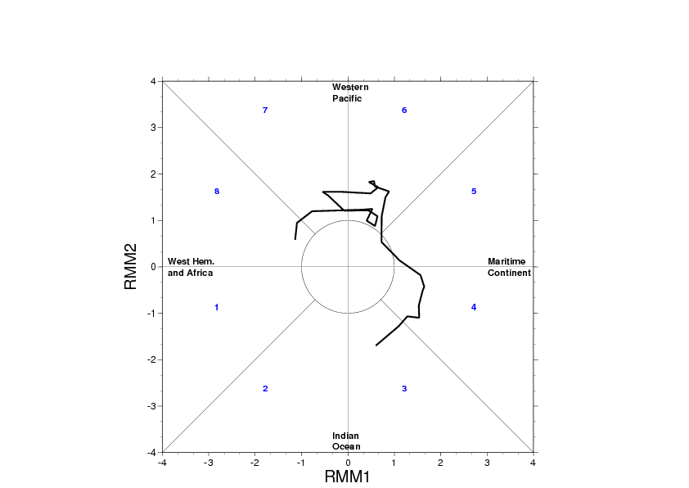
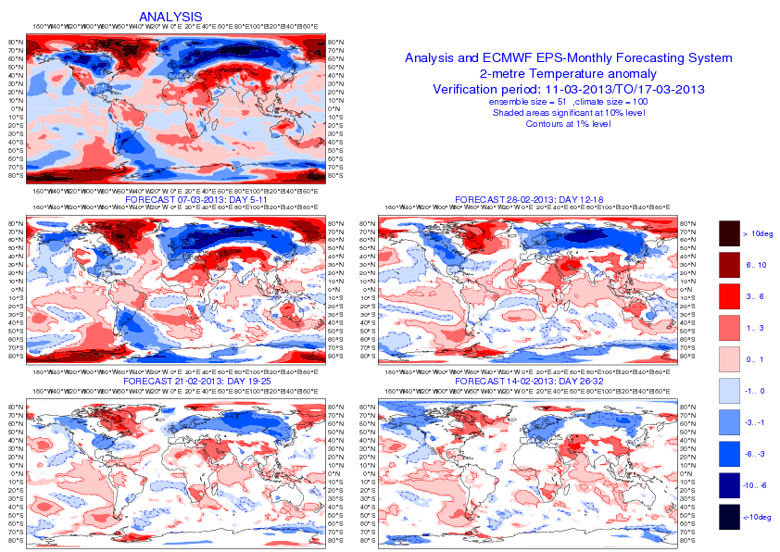
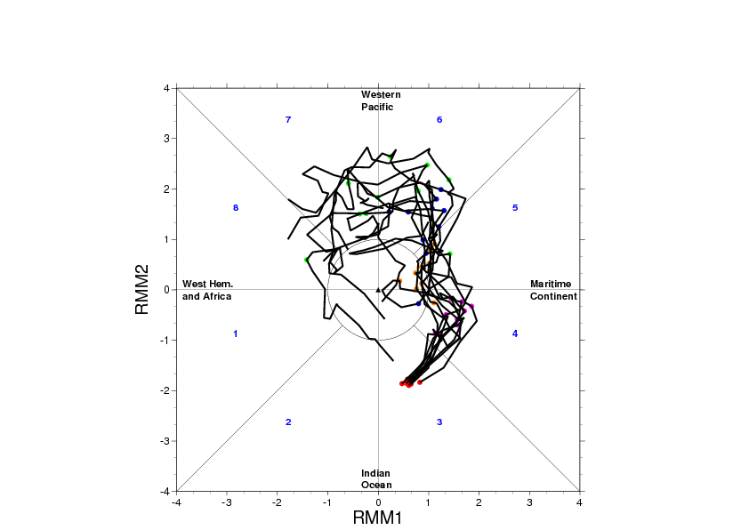
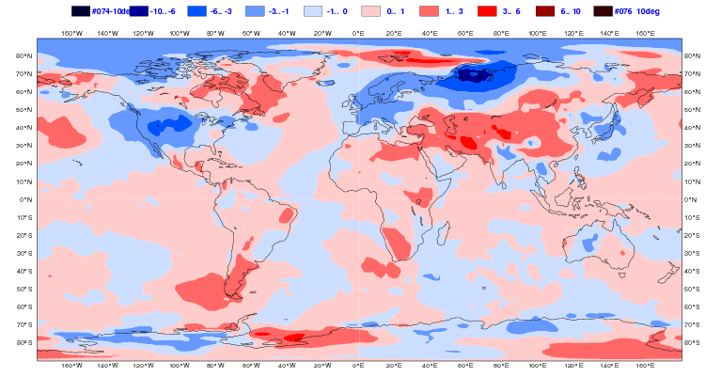
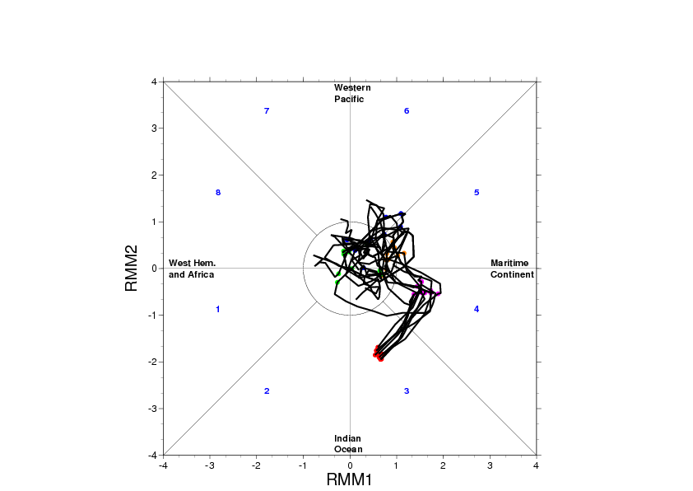
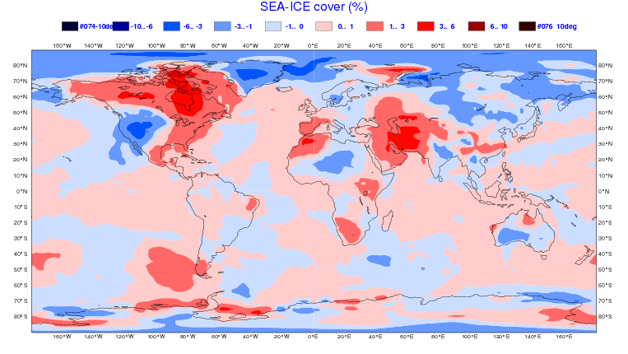
Cold March 2013 – 14 Feb 2013 -Day 26-32

Slide 7
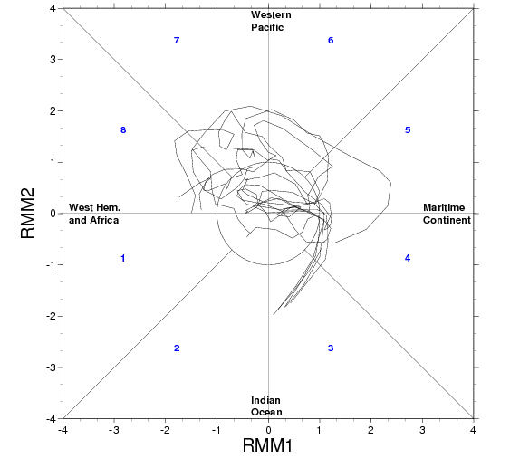
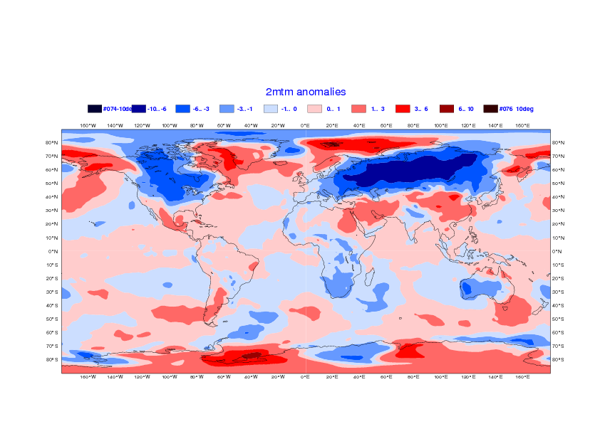
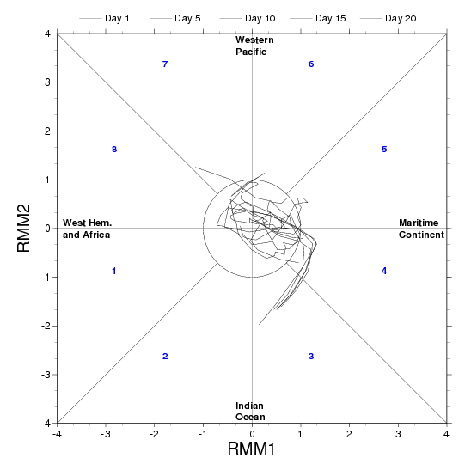
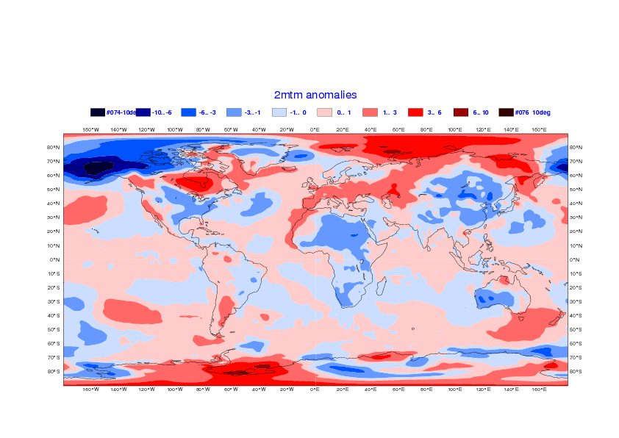
NCEP
Cold March 2013 – 14 Feb 2013 -Day 26-32

Slide 8
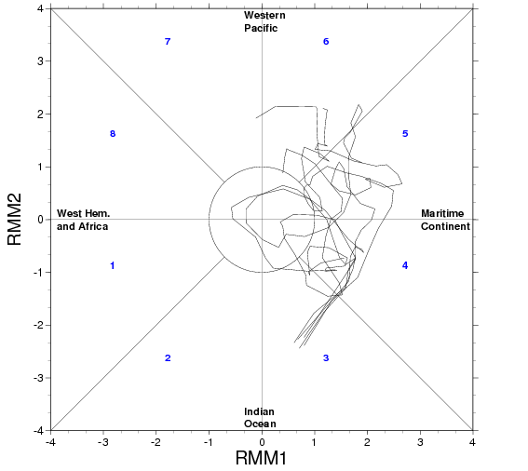
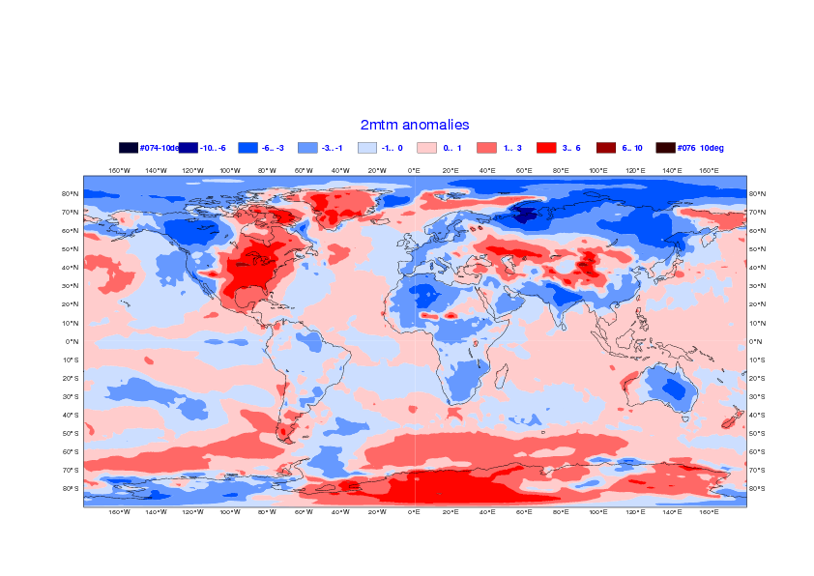
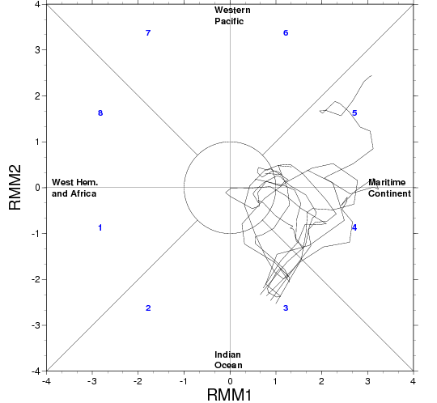
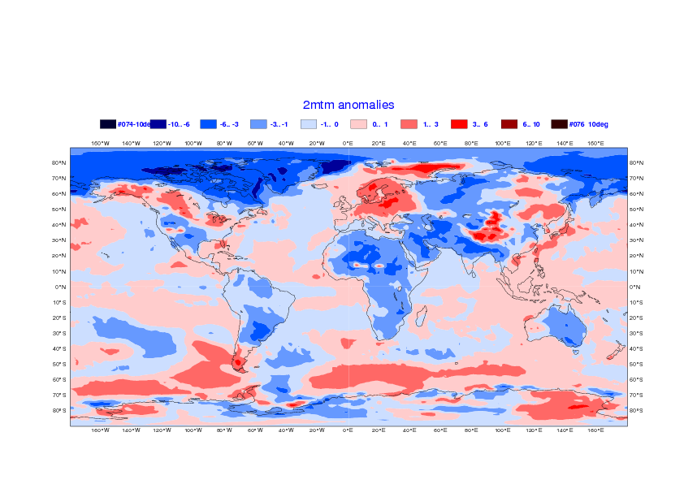
EC
Cold March 2013 – 14 Feb 2013 -Day 26-32

Slide 9
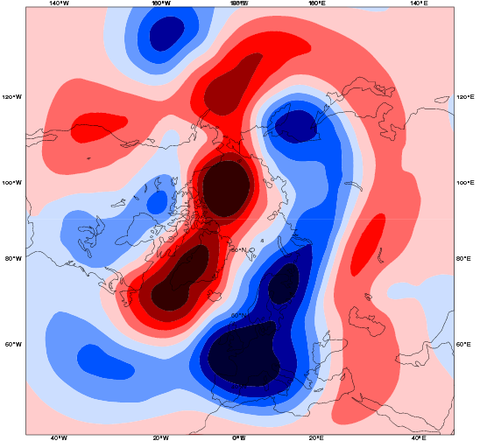
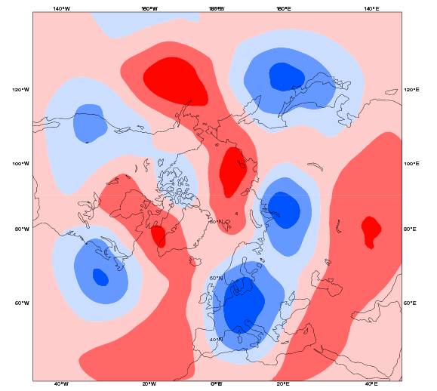
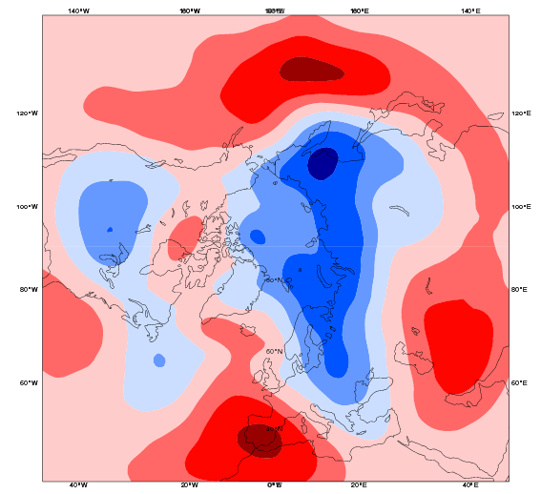
Cold March 2013 – 14 Feb 2013 -Day 26-32

Slide 10
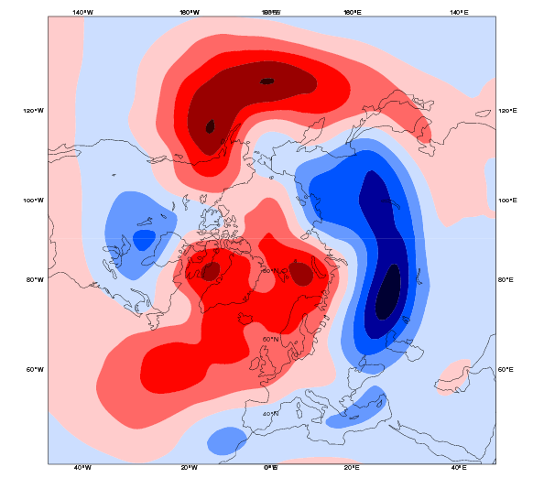
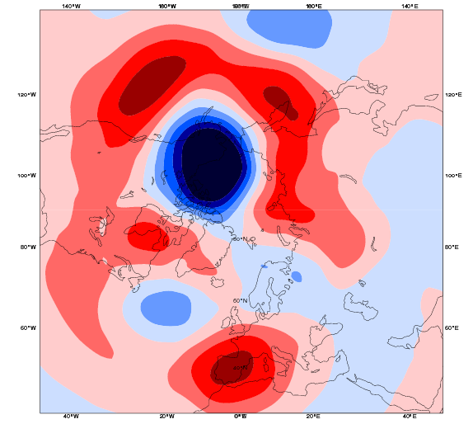
NCEP
Cold March 2013 – 14 Feb 2013 -Day 26-32

Slide 11
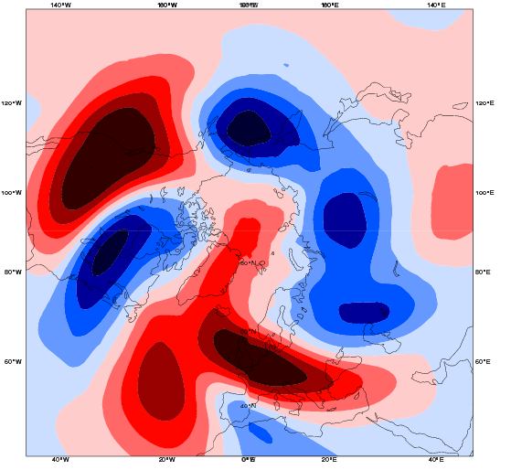
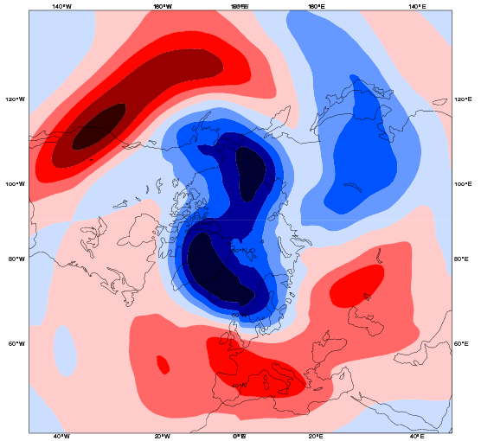
EC
Cold March 2013 – 14 Feb 2013 -Day 26-32

Slide 12
RELAXATION EXPERIMENTS

Slide 13
Experimental setup
Control: IFS CY40R1 – 51 member ensemble, T639/319 L91, 60 day-integrations
RELAX1: same as Control with tropics (20N-20S) relaxed to analysis
RELAX2: Same as control with N. Extratropics (North of 35N) relaxed to analysis

Slide 14
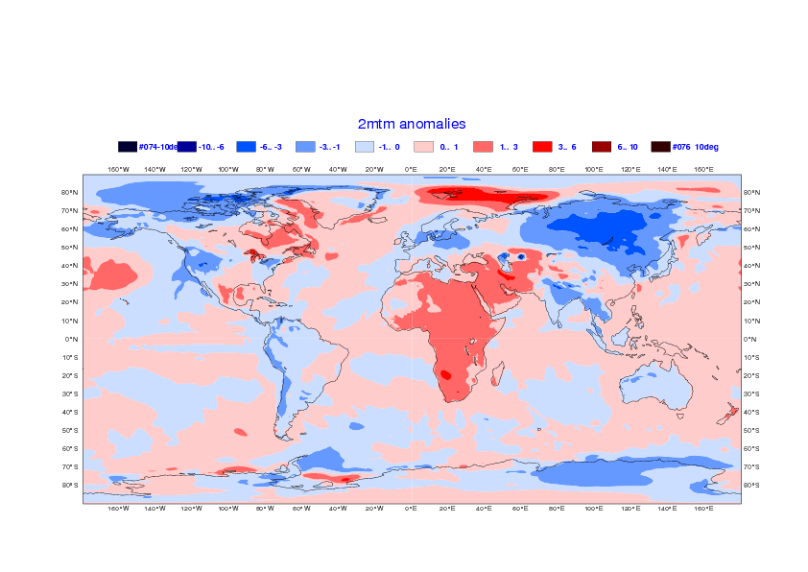
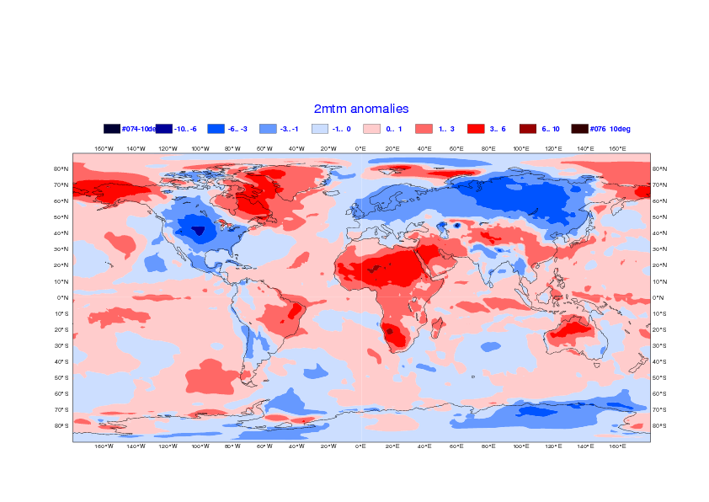
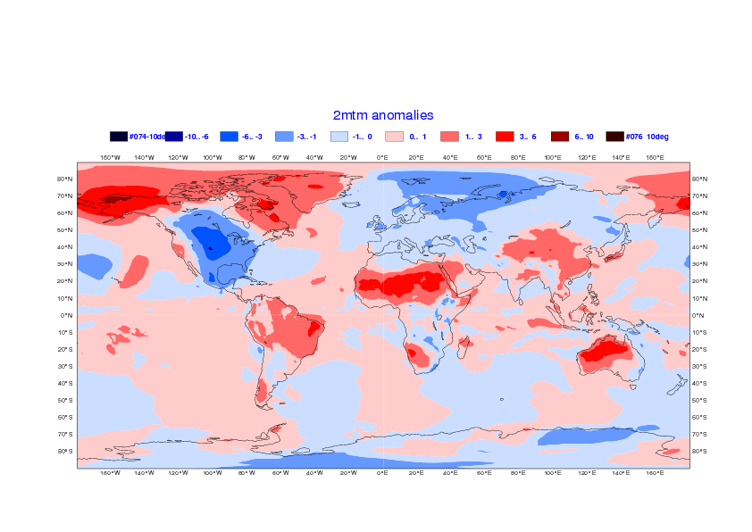
Control
RELAX1
Analysis
RELAX1-Control

Slide 15


Control
RELAX2
Analysis
RELAX2-Control

Slide 16


Impact of relaxation on the MJO
Control
RELAX 2
(NH relaxed)

Slide 17

Relaxation in the Tropics
2013 initial conditions
2012 initial conditions

