Slide 1
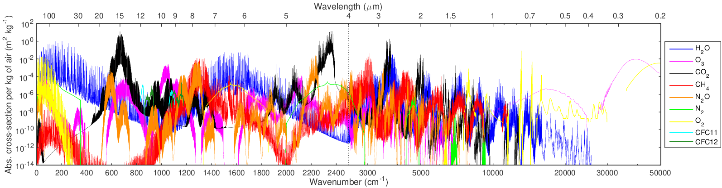
The full-spectrum correlated-k method for gas optics:
How fast can radiation schemes get while retaining accuracy?
Robin Hogan and Marco Matricardi
r.j.hogan@ecmwf.int
Absorption spectrum of nine gases at 100 hPa (Hogan & Matricardi 2020)

Slide 2
Overview
Can radiation schemes be faster and more accurate?
  Radiation often cited as most costly part of climate models, but NWP models can benefit from faster schemes too
  Some IPCC models use legacy codes that predict inaccurate greenhouse gas forcing (e.g. Soden et al. 2018)
The correlated k-distribution (CKD) method underpins most radiation schemes: it divides the spectrum into bands, each of which contains a number of k terms to represent the gas absorption spectrum
  Cost of entire radiation scheme proportional to total number of spectral intervals, but most current schemes give the user no control over this number, e.g. to optimize for climate or NWP, or perform accuracy-efficiency trade-off
The full-spectrum correlated-k (FSCK) method treats entire spectrum with a single band
  Proposed by Modest and Zhang (2002) for combustion; fast prototype atmospheric models in shortwave (Pawlak et al. 2004) and longwave (Hogan 2010), but until now not ready for operational use
This talk presents ecCKD, a tool for generating CKD gas optics schemes for specific applications
  Train and evaluate new schemes using line-by-line calculations from the Correlated K Distribution Model Intercomparison Project (CKDMIP), a 1-TB dataset (Hogan and Matricardi, GMD 2020)
  Demonstrate the FSCK method for the longwave, and a hybrid FSCK approach in the shortwave to handle spectrally varying cloud and surface absorption and reflection
  Performance in the ecRad radiation scheme both in the offline version, and online in the ECMWF model

Slide 3
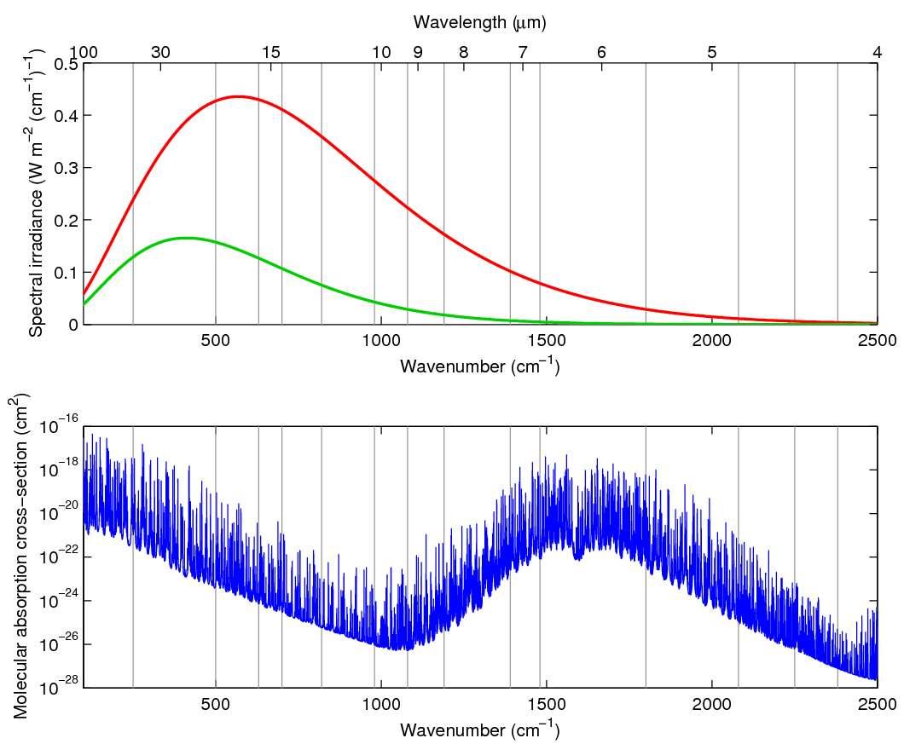
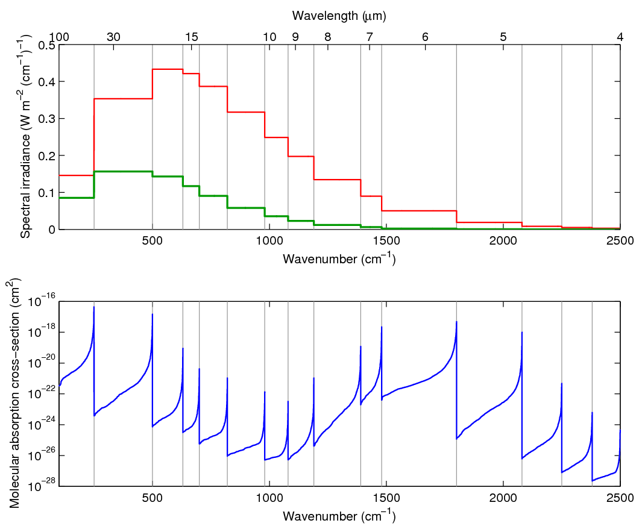
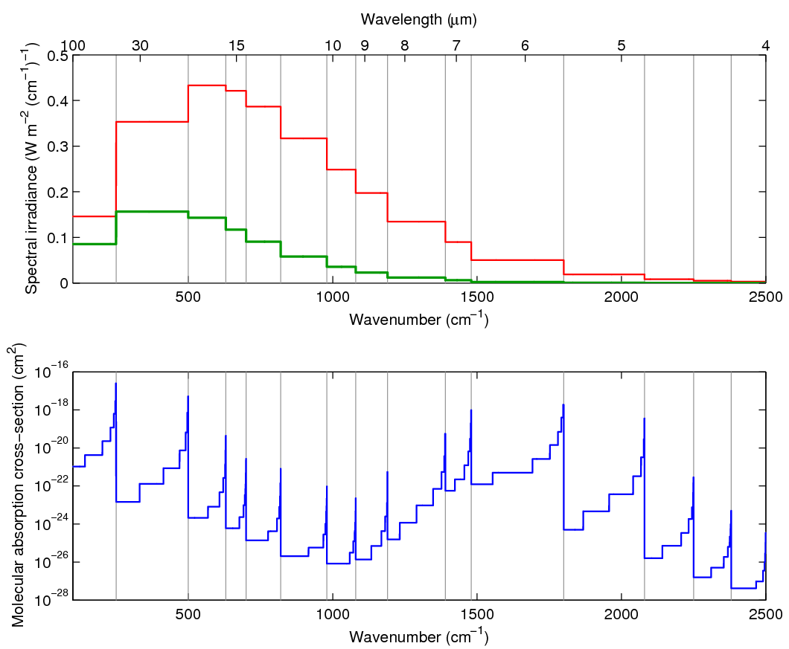
A new C++ tool to generate CKD models: ecCKD
Band
Generates a CKD model automatically (no hand tuning) from a few user-specified configuration parameters, including several novel steps
Reorder “median” spectrum of each gas in each user-defined band (fast) uniquely in order of the height of the peak heating/cooling rate
Partition the reordered spectrum for each gas, then merge gases
  Automatically choose number of intervals (“k terms” / “g points”) to ensure RMS heating-rate error associated with each is less than user-specified tolerance
  Equipartition algorithm ensures RMS error is the same for each interval
  Hypercube partition method (Hogan 2010) allows partitioned spectra of multiple gases to be combined optimally
  Compute Planck-function look-up table vs T for each k-term
Molar absorption of each gas/k-term from CKDMIP Idealized dataset
Optimize molar absorptions to minimize errors in fluxes & heating rates
  Train on 50 CKDMIP Evaluation-1 profiles x 20 greenhouse gas scenarios
  Use C++ Adept automatic differentiation library (Hogan 2014) with L-BFGS minimizer to optimize 10⁵ look-up table coefficients
Molar absorption (k)

Slide 4
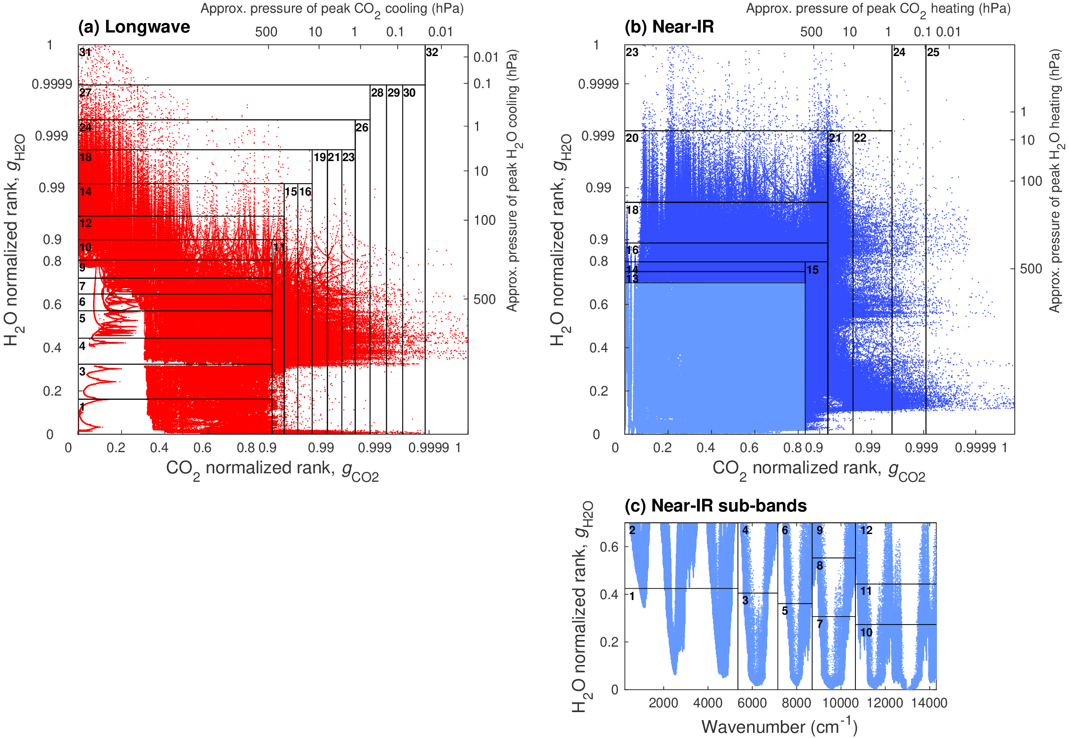
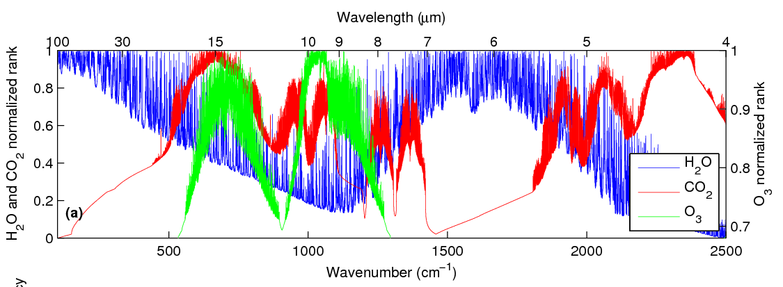
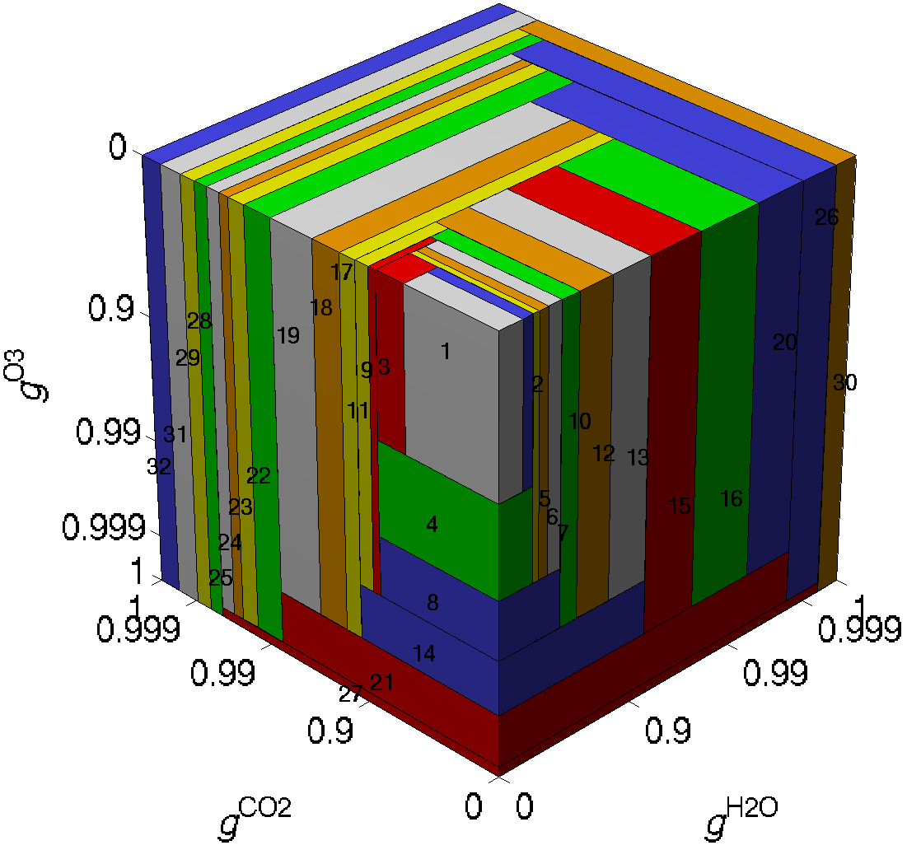
How can we treat overlapping gases?
H₂O
Consider first water vapour and carbon dioxide in the longwave spectrum, whose k distributions are to be discretized into around n_{H2O}=14 and n_{CO2}=12 k terms: need 168 terms?
But when CO₂ is strong, no need to discretize H₂O spectrum!
Efficient method requires only n_{H2O}+n_{CO2}–1 = 25 terms in total
With other gases (n_{O3}=5, n_{CH4}=3, n_{N2O}=2) we require 32 rather than 5040 terms in total
CO₂

Slide 5
A 32-term longwave FSCK model
Each k term maps uniquely to specific spectral points as shown
Planck function used by a k term is integral over those points
Some k terms “specialize” in treating a specific gas, but all gases can contribute to the optical depth of all k terms in the form of a simple look-up table versus pressure & temperature
The user-specified error tolerance has been chosen so that models with 2^{n} terms are generated (e.g. 16 and 32) which is optimal for vector lengths on some computer architectures
  This is fewer than the 47-156 used in seven global NWP models surveyed by Hogan et al. (2017)
Cloud optical properties are averaged per k term
  Hypothesis to be tested: longwave cloud radiative effect is dominated by a fairly narrow part of the spectrum (the infrared window) and cloud optical properties vary only modestly in the longwave, so this does not lead to large errors
Increasing optical depth

Slide 6
Clear-sky evaluation: longwave
Evaluation against 50 independent line-by-line calculations (CKDMIP Evaluation-2 dataset) for present-day greenhouse gas concentrations
32-term model obviously more accurate than 16-term model
32-term model has similar accuracy to 140-term RRTMG model used at ECMWF (and elsewhere): potentially much faster
16-term model potentially suitable for TL/AD part of data assimilation cycle, which needs to be fast and is only run for 12 hours

Slide 7
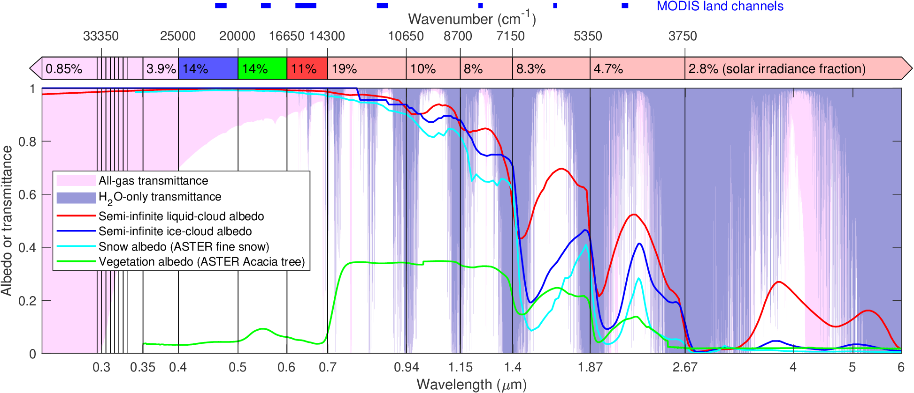
Challenges for FSCK in the shortwave
Near-infrared: very large variations in absorption and scattering by clouds and the surface
Visible and ultraviolet: absorption and Rayleigh scattering vary monotonically with wavelength
Users want wavelength-specific products: RGB imagery, photosynthetically active radiation (PAR)…

Slide 8
32-term “Hybrid FSCK” model in the shortwave
Optically thick parts of the near-IR: use FSCK since clouds and the surface not important
Optically thin parts of the near-IR: use several sub-bands coinciding with near-IR windows to resolve cloud and surface variations
Visible: impose red, green and blue bands for imagery (and PAR=R+G+B); ecCKD would otherwise partition them into a similar number of intervals but with less useful boundaries
Ultraviolet: let ecCKD partition automatically
R G B

Slide 9
Clear-sky evaluation: shortwave
16-term model less accurate than 32-term model in mesosphere due to 3 rather than 5 CO₂-specific terms
Small heating-rate bias in lower troposphere in 16-term model can lead to substantial warm bias due to long radiative timescales here

Slide 10
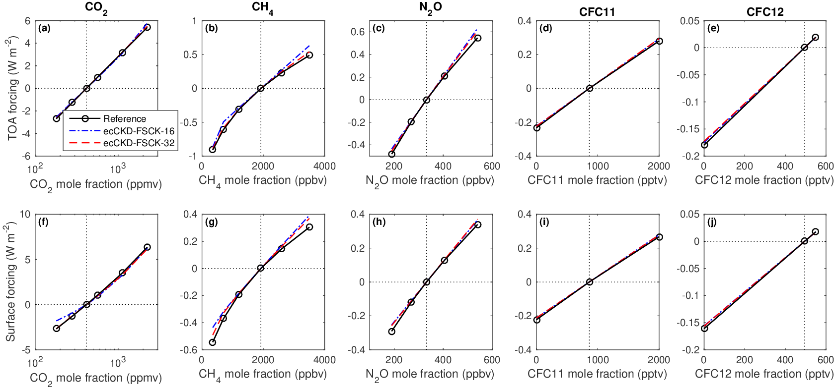
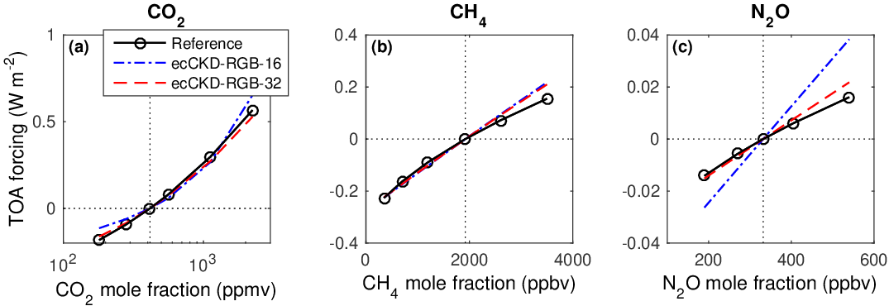
Evaluation of instantaneous forcing by 5 main well-mixed greenhouse gases
32-term model has very good performance on CKDMIP climate scenarios, including CO₂ concentrations from 180 ppmv (glacial maximum) to 2240 ppmv (8x preindustrial)
16-term model less accurate in longwave for CH₄ due to 1 rather than 2 specialized k terms
Shortwave TOA Longwave TOA

Slide 11
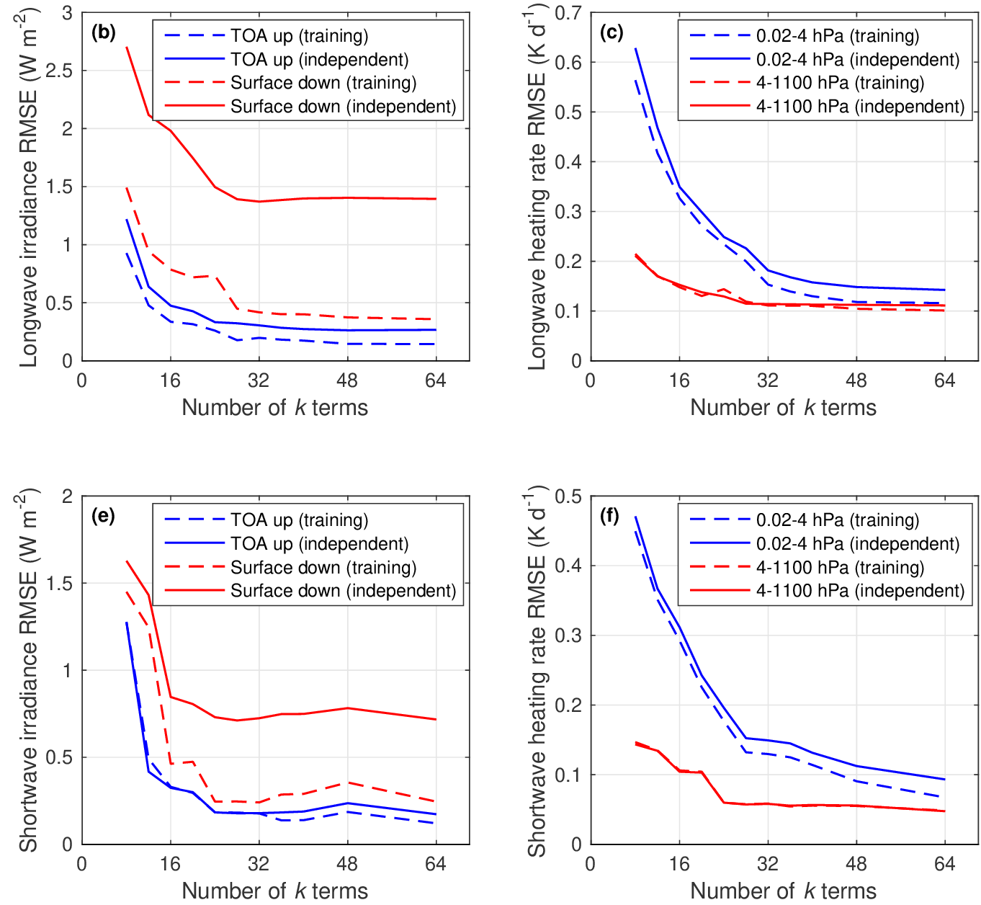
Accuracy vs efficiency
Consider 8(!) terms up to 64 for multiple climate scenarios
Accuracy improves up to 32 terms, beyond which there is little change
  Is this a fundamental limit of the CKD method due to imperfect correlation of spectra at different heights?
  Or maybe 50 profiles is simply not large enough to properly optimize all combinations of T, p, q

Slide 12
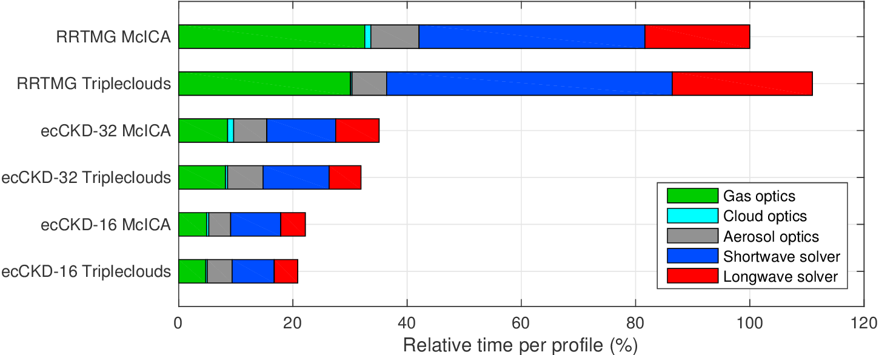
Computational cost in offline single-precision ecRad (Intel Xeon, gfortran)
IFS configuration
Noise-free solver
3.1x faster overall (3.9x fewer k terms)
4.9x faster overall (7.8x fewer k terms)
Cloud & aerosol optics now per k term not per band, so similar cost in RRTMG and ecCKD
Optimized noise-free Tripleclouds solver is now a little faster than McICA!

Slide 13
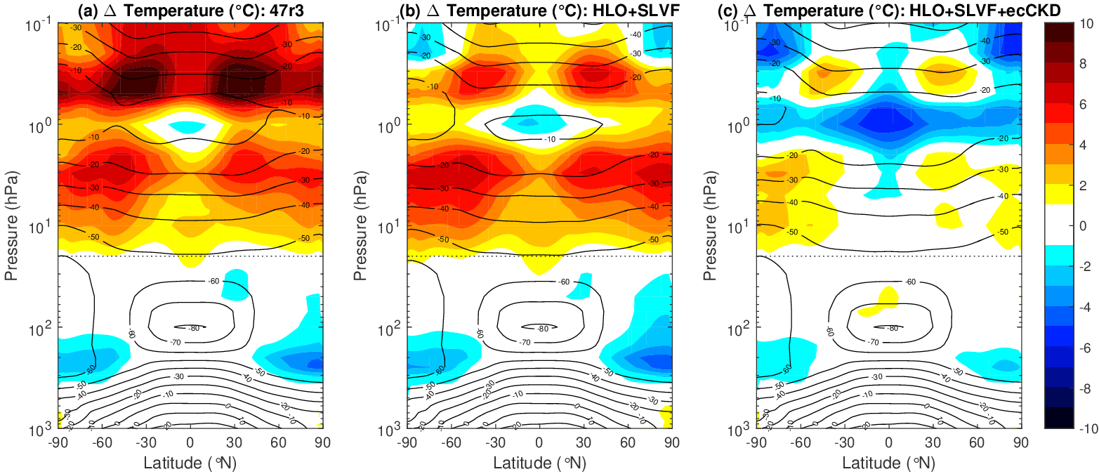
Temperature bias of free-running ECMWF model versus ERA5/MLS
47r3 48r1 49r1
ecCKD uses improved solar spectrum, less UV
troposphere | stratosphere | mesosphere
Better gas optics halves longstanding polar lower-stratosphere cold bias, important for monthly forecasts
New “HLO” ozone treatment reduces mesosphere warm bias

Slide 14
Summary and next steps
The ecCKD tool offers the ability to generate faster and more accurate gas optics models targeted at different applications, and which are simple enough (defined by a netCDF file) to be implemented in any radiation scheme, not just ecRad
More information at https://confluence.ecmwf.int/x/XwU0Dw and Hogan & Matricardi (JAMES 2022, in review)
ecCKD tool freely available at https://github.com/ecmwf-ifs/ecckd
Implemented in freely available ecRad radiation scheme: https://github.com/ecmwf-ifs/ecrad
Performance of ecCKD and other CKD tools assessed in my CKDMIP talk 11am Wednesday in Session 6, including cloudy skies
ecCKD is undergoing testing for operational implementation in ECMWF IFS Cycle 49r1 (2023)
In principle can take advantage of cheaper scheme to improve radiation accuracy in ECMWF operations, e.g. more frequent calls or more accurate solver with more streams or 3D effects
Improved spectral detail in surface albedo scheme to generate online RGB imagery and other shortwave spectral diagnostics (e.g. UV index) from forecasts
New gas optics models, e.g. to represent alternative water-vapour continuum models

Slide 16
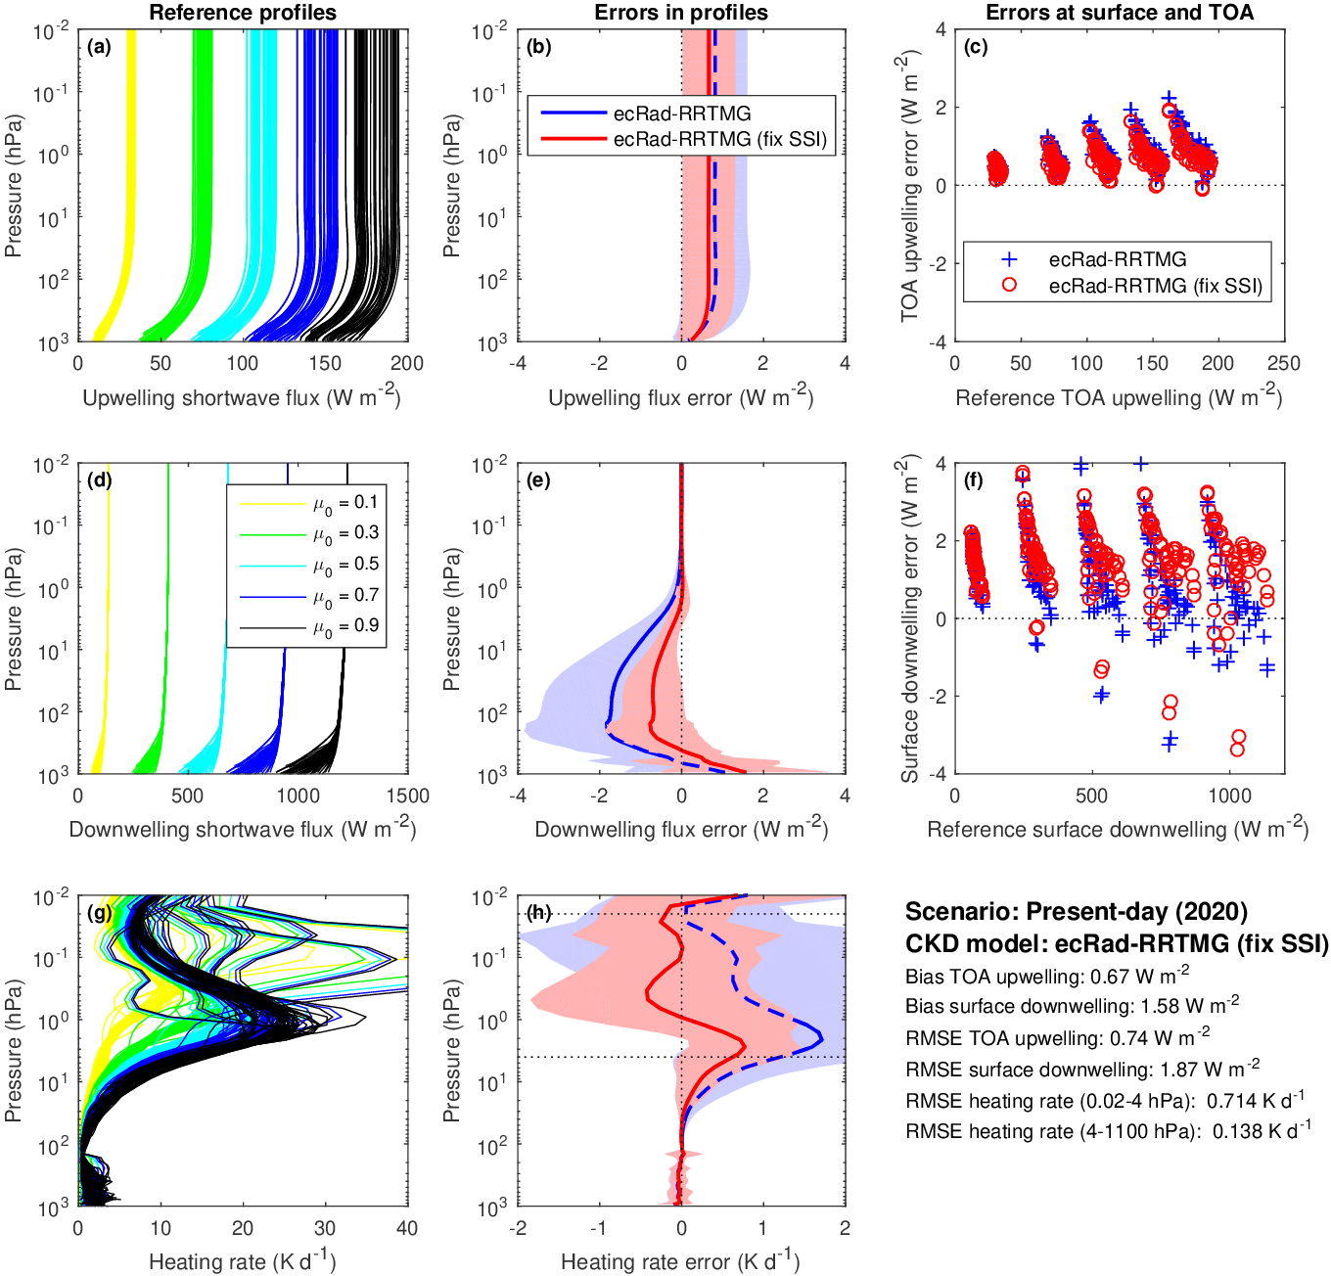
RRTMG-SW evaluation
112-term RRTMG model used at ECMWF (equivalent to RRTMG v3.9) has much larger errors in stratosphere heating rate due to older Kurucz solar spectrum with more ultraviolet
Scaling the solar energy in each band to match the latest spectrum improves performance, but appreciable biases remain in the upper stratosphere

Slide 17
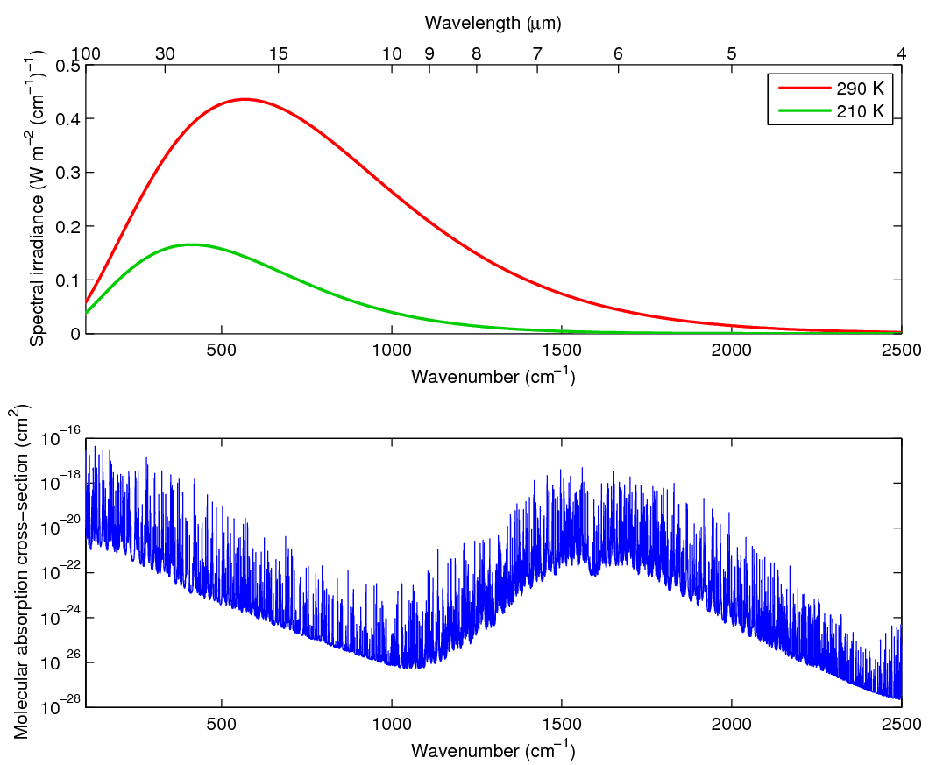
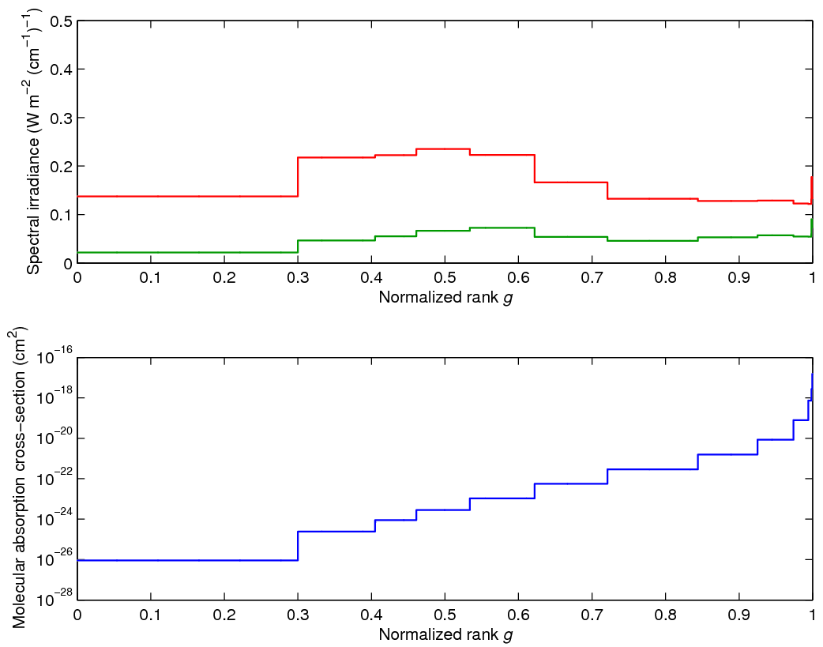
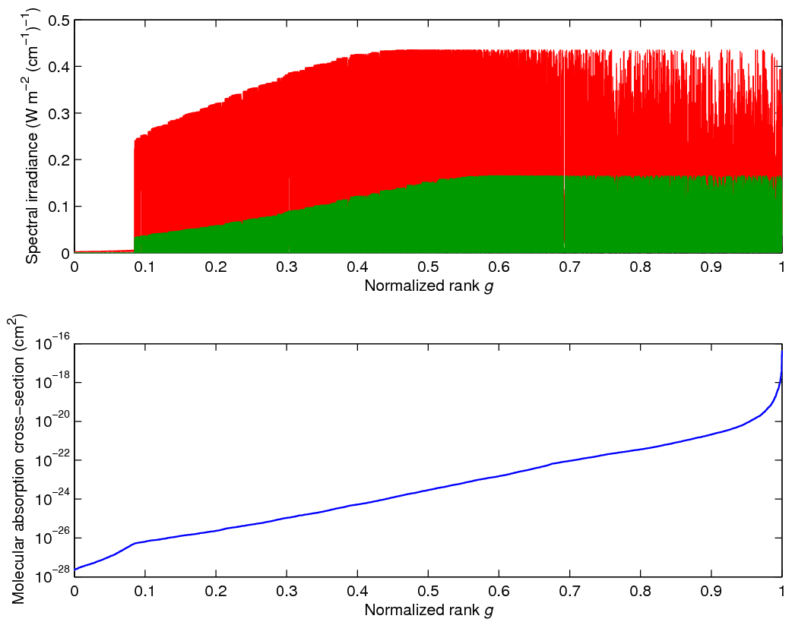
Full-spectrum correlated-k (FSCK) method
First applied to combusting gases by Modest and Zhang (2002)
Demonstrated for the atmosphere in the shortwave by Pawlak et al. (2004) and longwave by Hogan (2010)
Reorder the entire spectrum
Discretize such that the heating-rate error for each full-spectrum quadrature point equals some specified tolerance
Average the Planck function across the wavelengths contributing to each quadrature point
Water vapour spectrum Planck function

Slide 18
Are we using our computer time wisely?
There is a trade-off between the temporal, spatial and spectral resolution of radiation, as well as the sophistication of the solver (e.g. 2 vs. 4 or more streams)
In 2017, ECMWF had lowest spatial & temporal resolution of 7 global NWP models
Met Office NWP model uses 3.7 times fewer spectral intervals than RRTMG!
RRTMG gas optics scheme
Hogan et al. (2017: ECMWF technical memo #816)

Slide 19
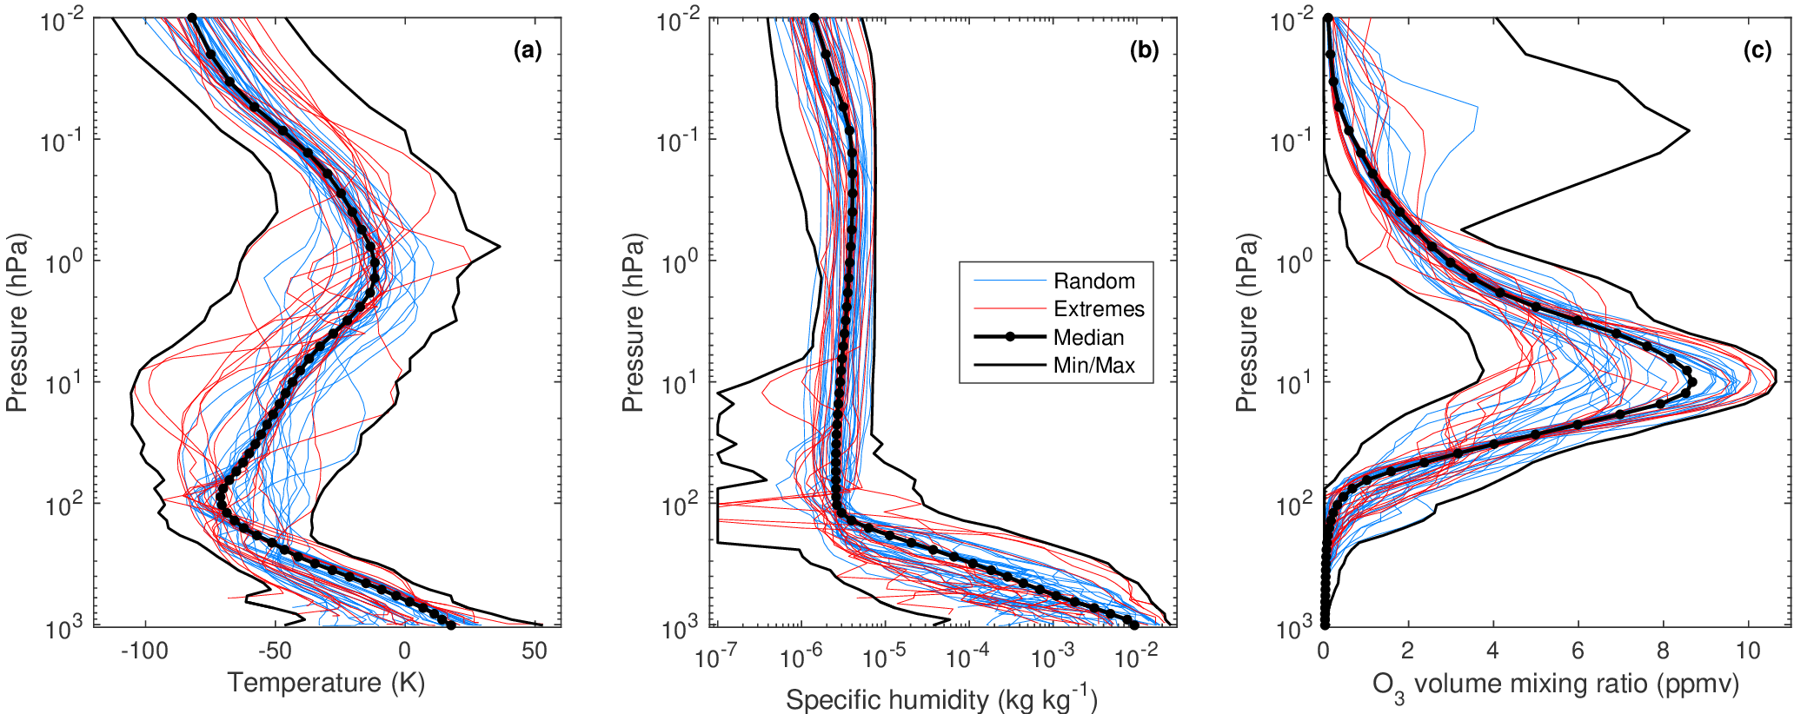
CKDMIP training and evaluation dataset (Hogan & Matricardi 2020)
CKDMIP motivation: to evaluate the various methods for generating gas optics schemes
100x 137-level profiles of T, q and O₃ from Eresmaa and McNally (2014)
34 greenhouse gas scenarios
1 TB dataset of the layer optical depth of 9 gases from LBLRTM
+12 further scenarios for studying gas overlap

Slide 20
The correlated k-distribution (CKD) method
CKD method underpins radiation schemes in most current models
Consider longwave absorption spectrum for one gas
Divide into bands (e.g. 16 for RRTMG)
In each band, sort the spectrum and average the Planck function
Discretize into 2-16 “g-points” for each band (total 140 for RRTMG)
Reduced number of pseudo-monochromatic calculations from ~10⁵ to ~10²!
Water vapour spectrum Planck function

Slide 22
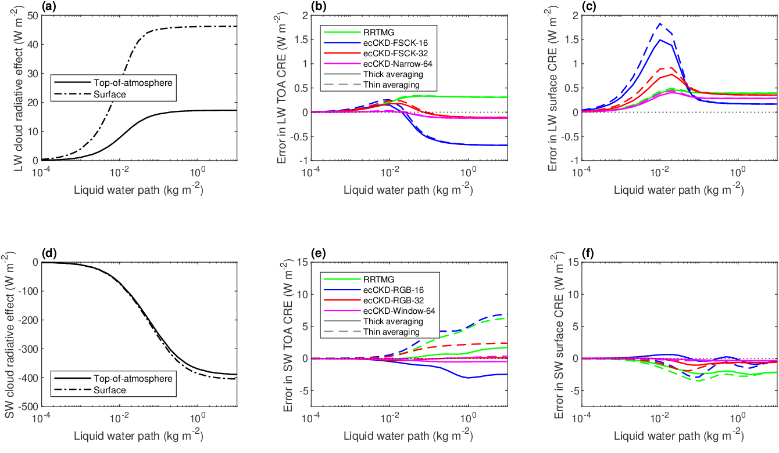
Liquid cloud radiative effect (CRE): CKD models vs line-by-line
LW CRE accurate despite FSCK, provided cloud properties per k term
ecCKD-32 similar accuracy to RRTMG
ecCKD with 64 k terms and more bands is most accurate
“Thick” spectral averaging (Edwards & Slingo 1996) more accurate than “thin”

Slide 23
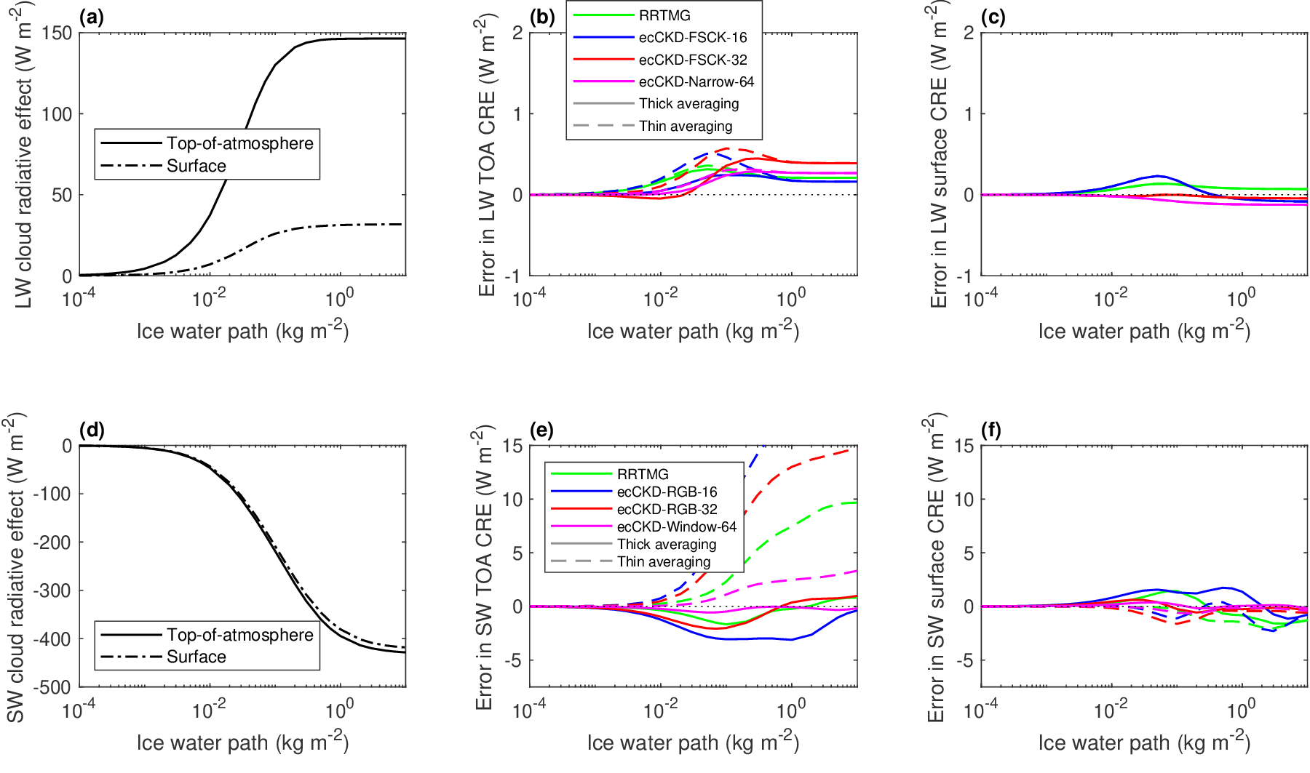
Ice cloud radiative effect (CRE): CKD models vs line-by-line
LW CRE accurate despite FSCK, provided cloud properties per k term
ecCKD-32 similar accuracy to RRTMG
ecCKD with 64 k terms and more bands is most accurate
“Thick” spectral averaging (Edwards & Slingo 1996) more accurate than “thin”

Slide 24
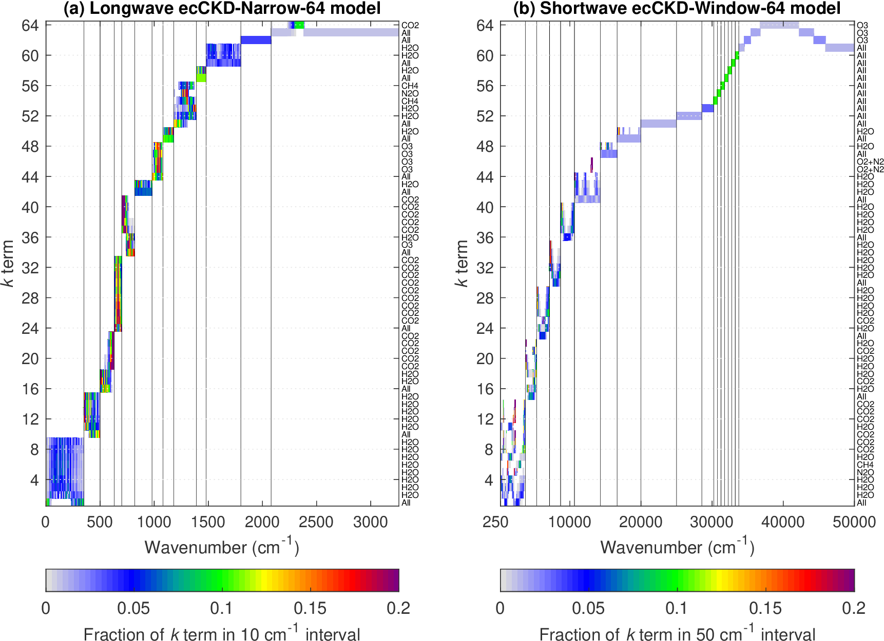

Slide 25
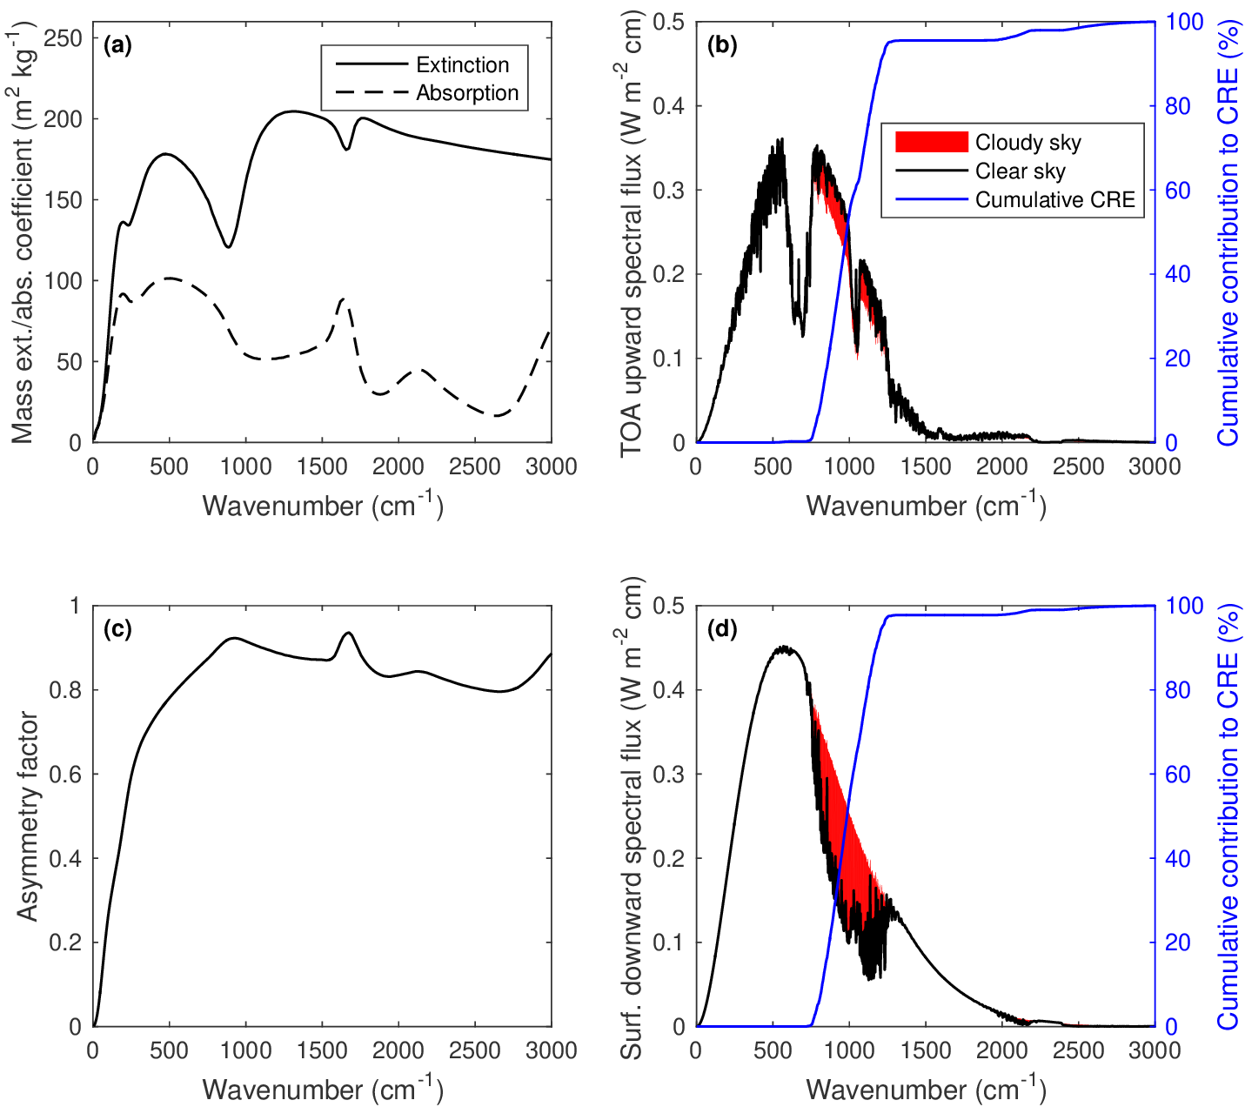

Slide 26
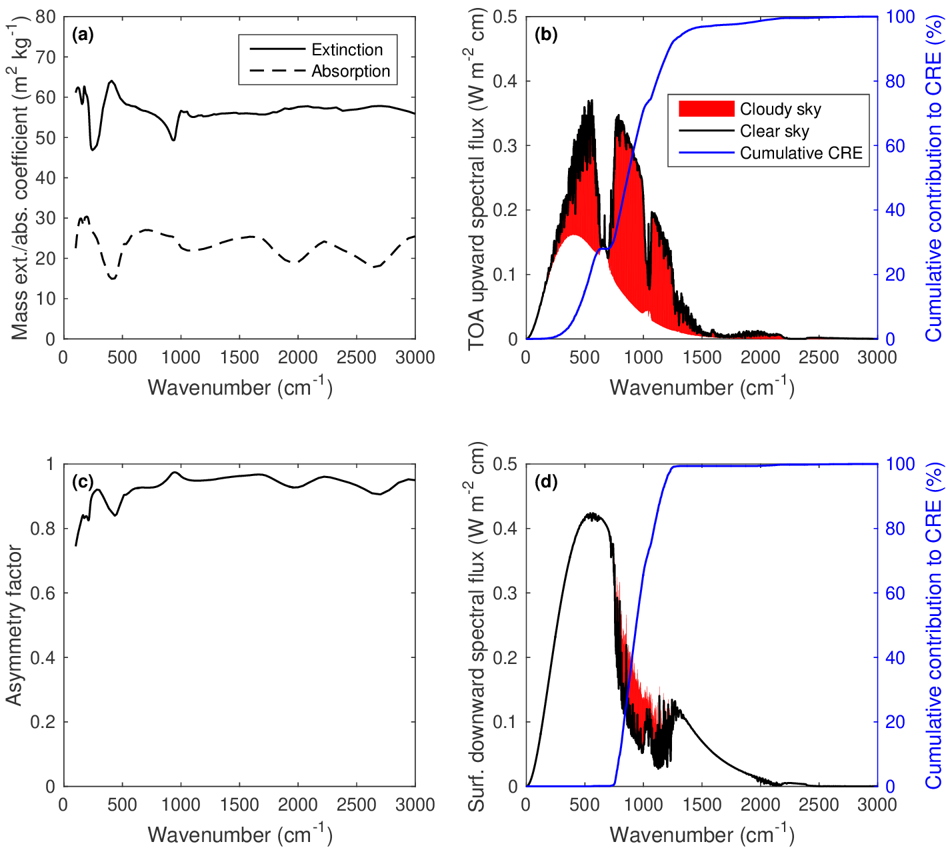

Slide 27
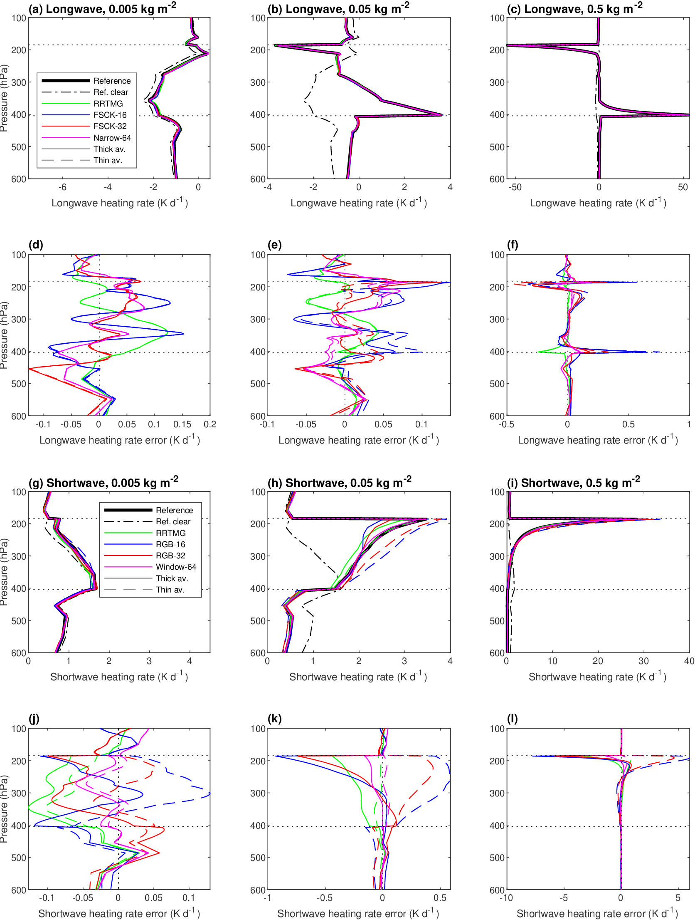

Slide 29
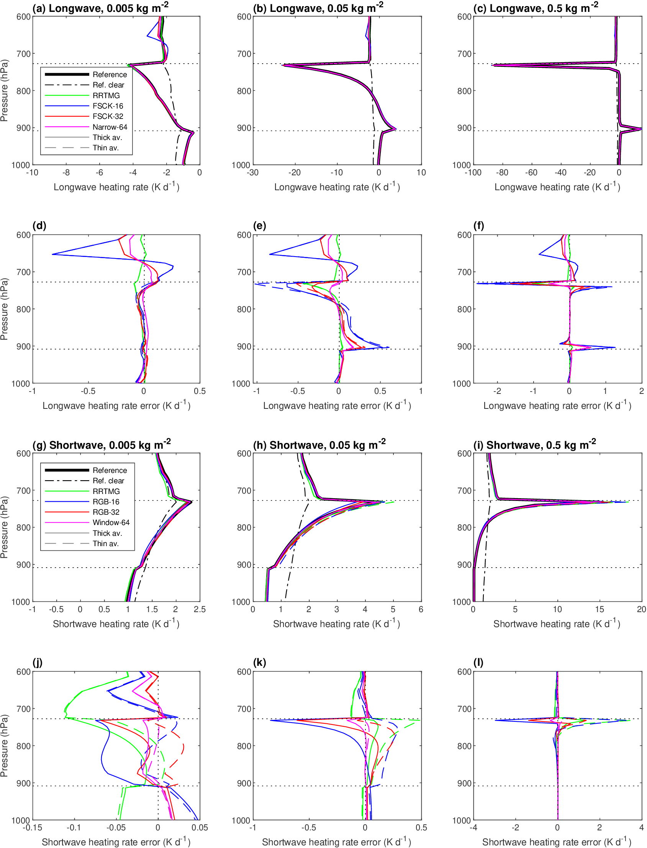

Slide 31
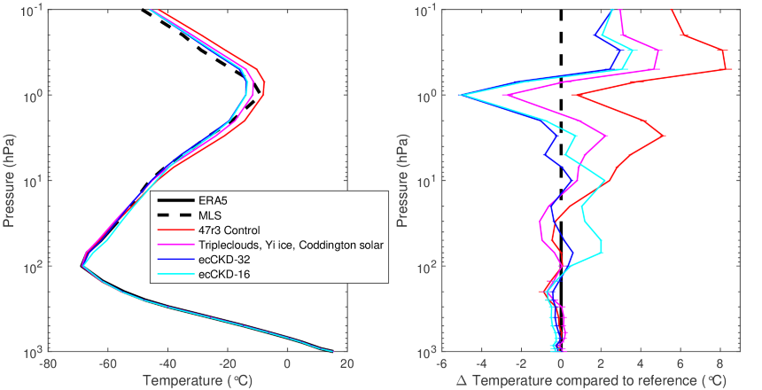
…or as a global-mean vertical profile
Stratospheric climate for ecCKD-32 significantly better than RRTMG control, even with revised solar spectrum (but other compensating errors may be present)
ecCKD-16 is 1.5 K warmer in the lower stratosphere than ecCKD-32, related to a heating rate bias of only 0.05 K/day and the long radiative timescale of ~30 days
Perhaps training should penalize heating-rate errors more strongly here?

