Slide 1
North India Floods June 2013
Yuhei Takaya, JMA

Slide 2
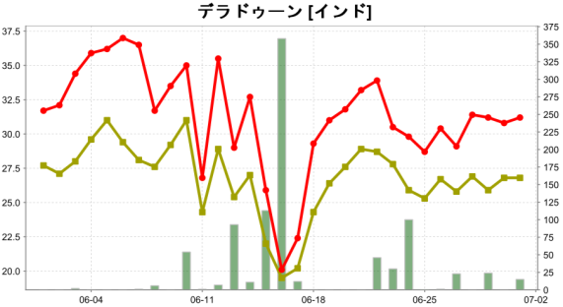
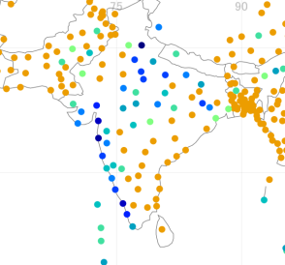

Ground Observations
Dehradun
Precipitation on 16 June 2013
Dehradun [78E, 30N]
Dehradun
358 mm on 16 June
New Delhi
Temperature (deg C)
daily accumulated precip. (mm)
max. temp.
ave. temp.
precip.

Slide 3
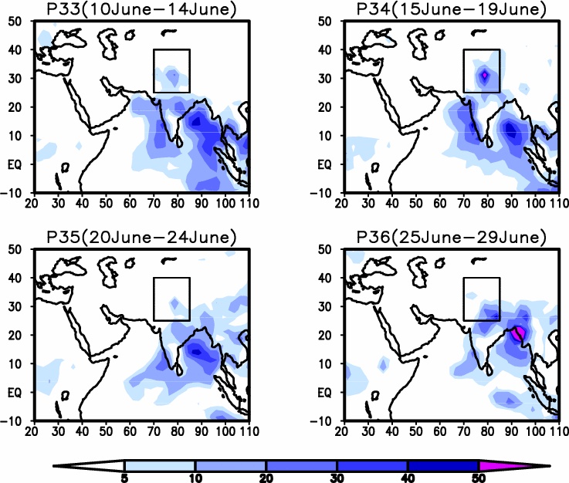
CMAP Pentad Precipitation Analysis June 2013
Box:
70-85E
25-40N
mm/day

Slide 4
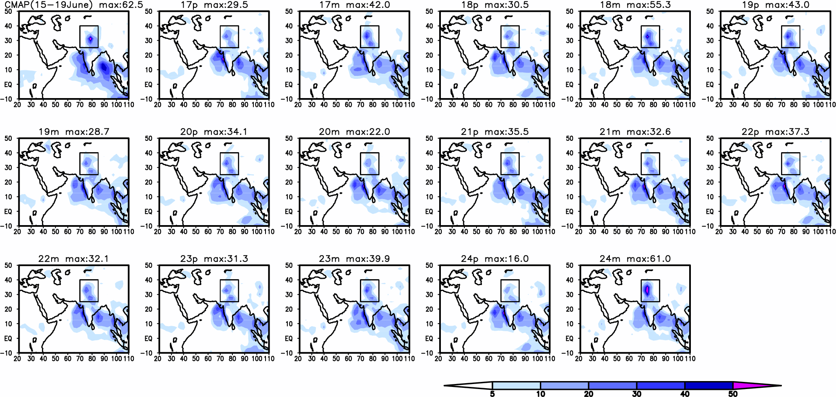
Explanation of Figures
CMAP analysis
5-day average
Figures over each panel show the maximum precipitation rate (mm/day) in the box area.
Box:
70-85E
25-40N
Purple boxes indicate members of the maximum precipitation > 30 [mm/day].

Slide 5
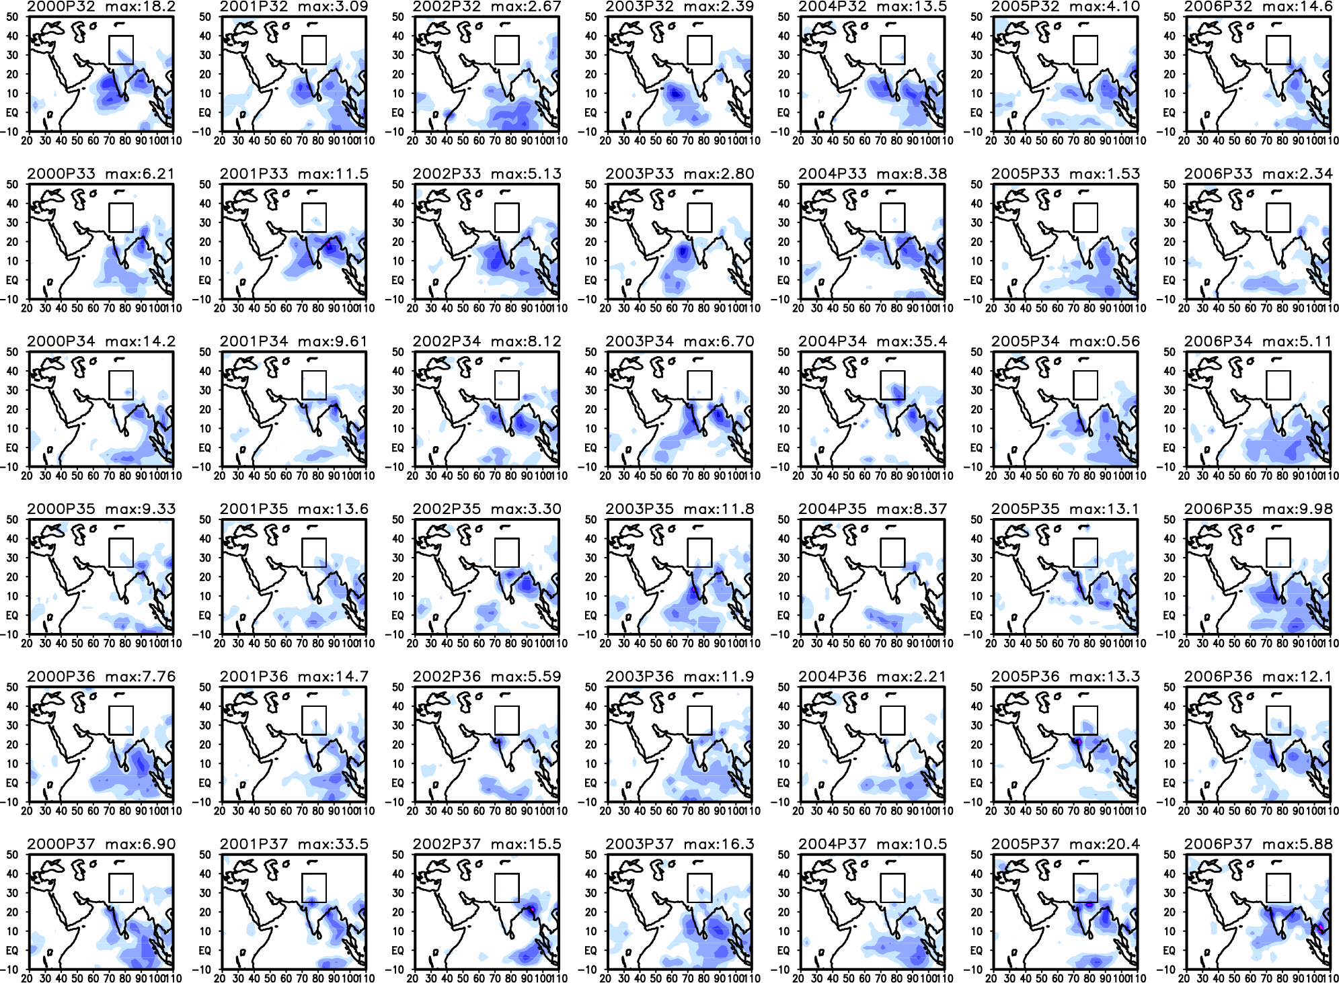
Historical Precipitation Analysis
30 June 25 June 20 June 15 June 10 June 5 June

Slide 6
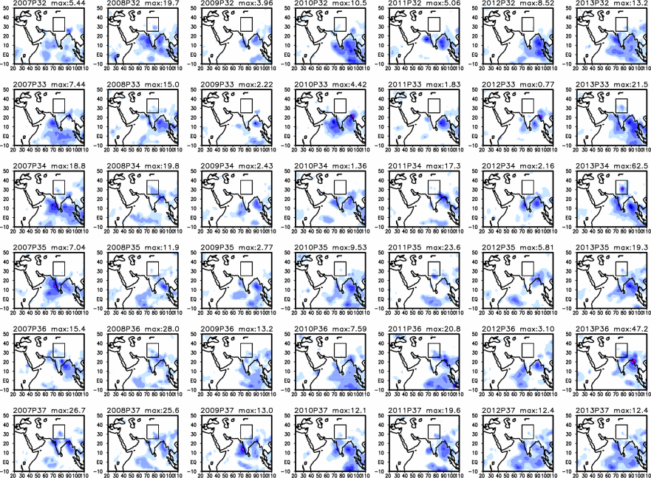
Historical Precipitation Analysis (CMAP)
2013 North India Flood
30 June 25 June 20 June 15 June 10 June 5 June

Slide 7
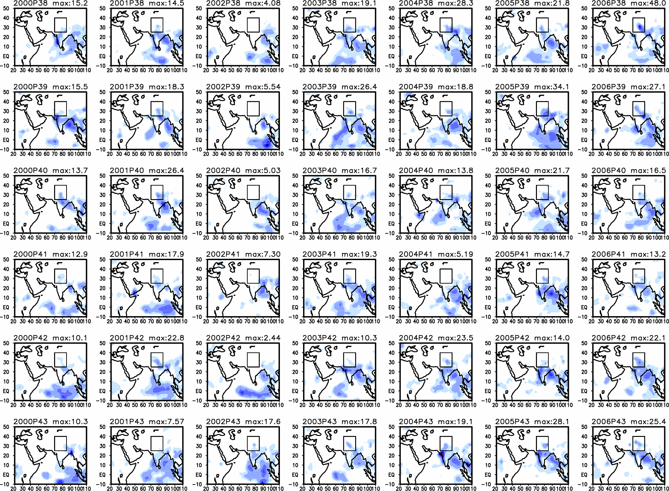
Historical Precipitation Analysis (CMAP)
30 July 25 July 20 July 15 July 10 July 5 July

Slide 8
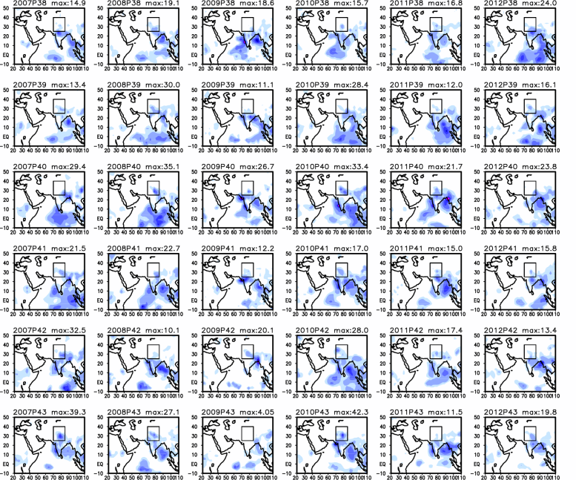
Historical Precipitation Analysis (CMAP)
30 July 25 July 20 July 15 July 10 July 5 July
2010 Pakistan flood

Slide 9

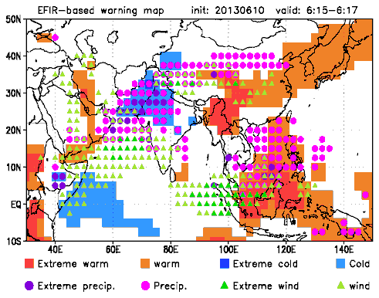
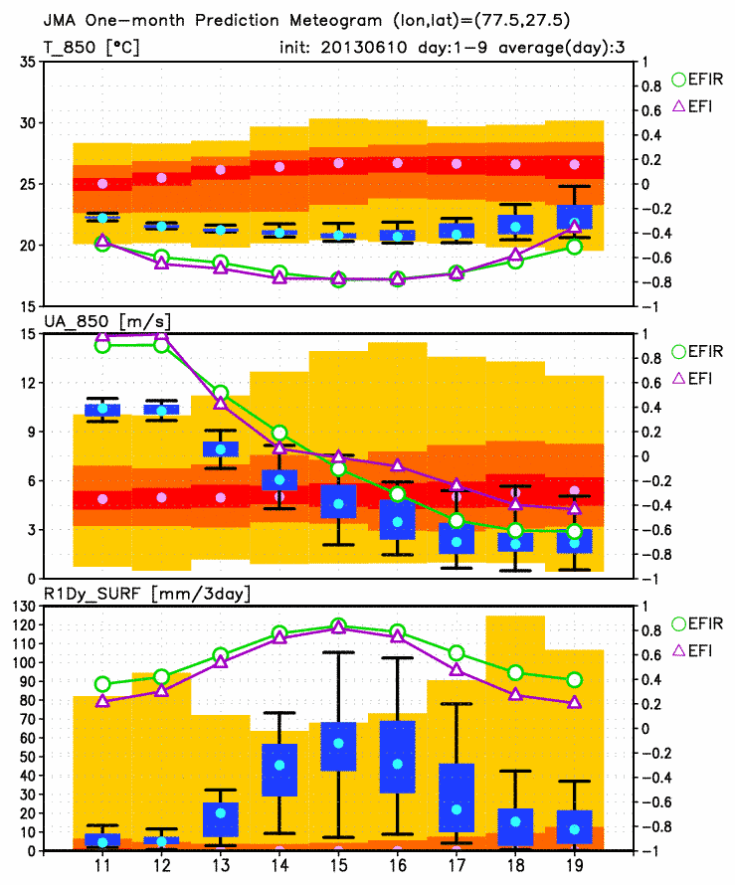
Warning Map Using Extreme Forecast Index
(3-day average, Initial date: 10 June 2013)
Dehradun
Warning Map
(Based on EFIR, Zsótér 2006)
EPSgram at New Delhi
Precipitation [mm/3day]
The 3-day accumulated (15-17 June) precipitation (blue boxes indicating a 20-80% range of ensemble forecasts) is above model climatology (orange: 20-80%).
EFIR > 0.8
EFIR > 0.5
from Satoko Matsueda

Slide 10
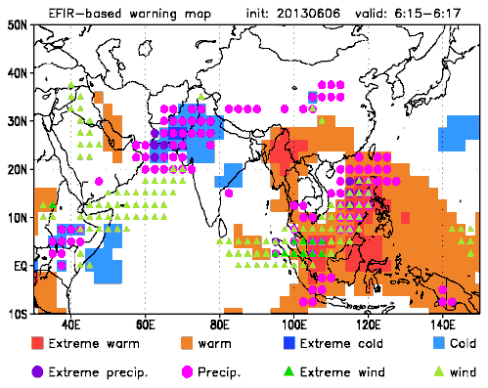
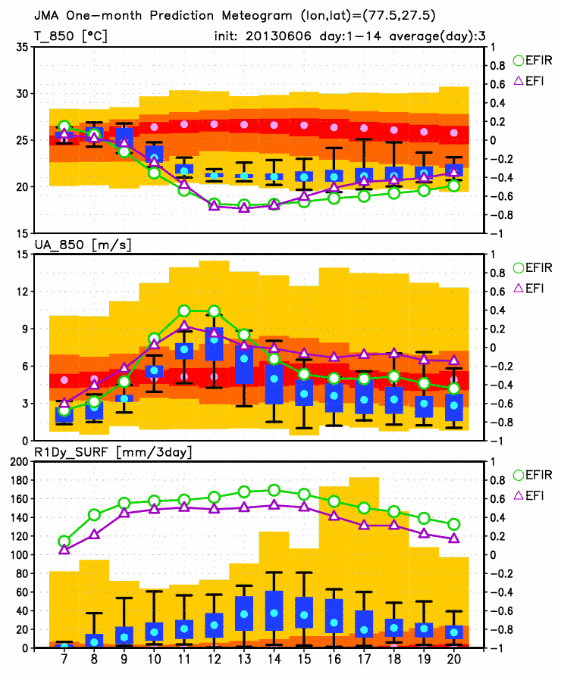
Warning Map Using Extreme Forecast Index
(3-day average, Initial date: 6 June 2013)
Dehradun
Warning Map
(Based on EFIR, Zsótér 2006)
EPSgram at New Delhi
Precipitation [mm/3day]
The 3-day accumulated (15-17 June) precipitation (blue boxes indicating a 20-80% range of ensemble forecasts) is above model climatology (orange: 20-80%).
EFIR > 0.8
EFIR > 0.5
from Satoko Matsueda

Slide 11
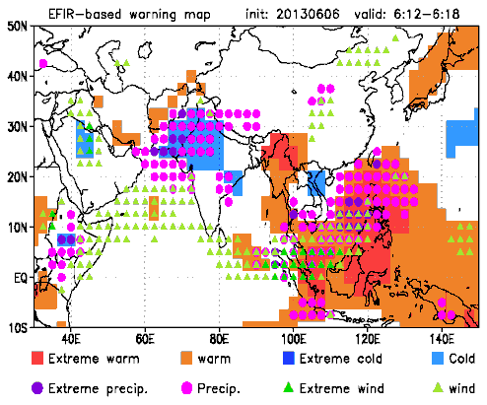
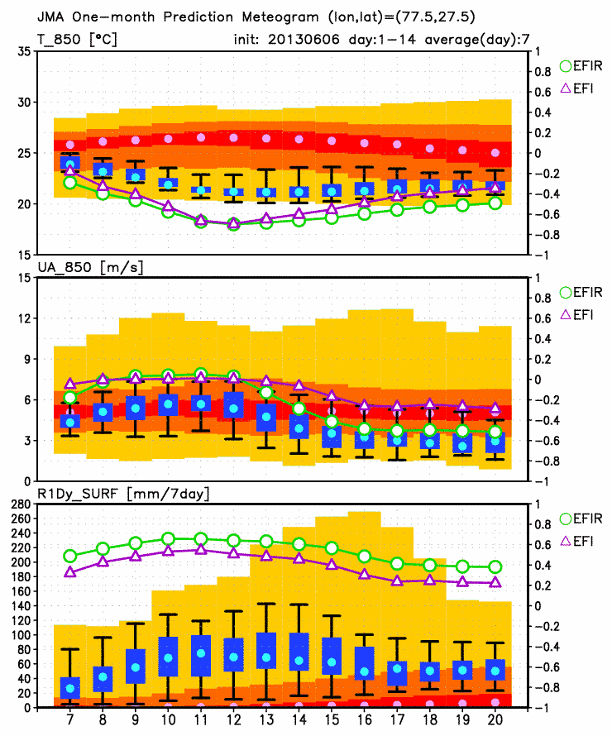
Warning Map Using Extreme Forecast Index
(7-day average, Initial date: 6 June 2013)
Dehradun
Warning Map
(Based on EFIR, Zsótér 2006)
EPSgram at New Delhi
Precipitation [mm/7day]
The 7-day accumulated (12-18 June) precipitation (blue boxes indicating a 20-80% range of ensemble forecasts) is above model climatology (orange: 20-80%). SYNOP obs: 82 mm
EFIR > 0.8
EFIR > 0.5
from Satoko Matsueda

Slide 12
Initial date: 13 June 2013

Slide 13
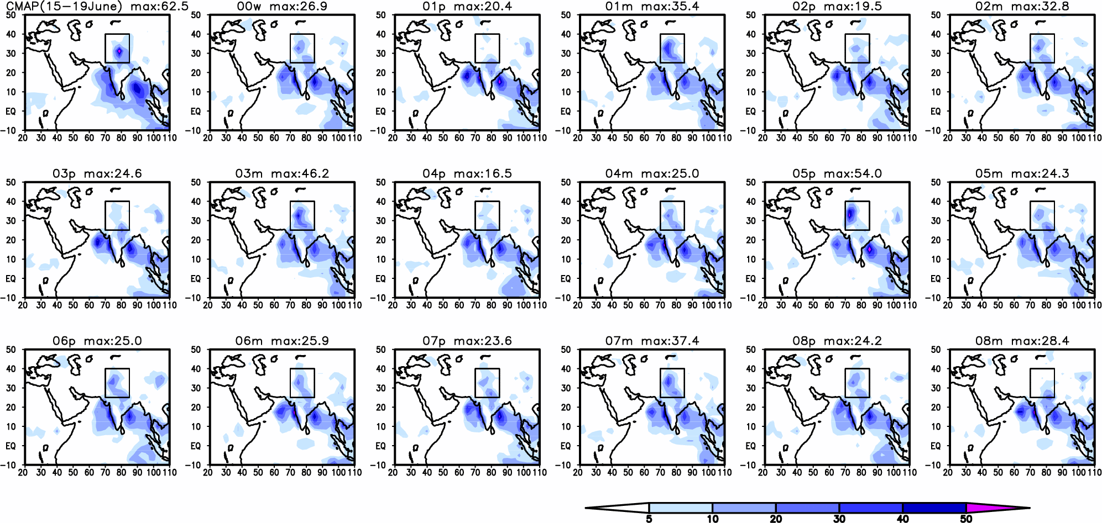
JMA Monthly EPS (Init: 13 June 2013)
Averaged Precipitation 15-19 June
mm/day

Slide 14

JMA Monthly EPS (Init: 13 June 2013)
Averaged Precipitation 15-19 June
mm/day

Slide 15
JMA Monthly EPS (Init: 13 June 2013)
Averaged Precipitation 15-19 June
mm/day

Slide 16
Initial date: 6 June 2013

Slide 17
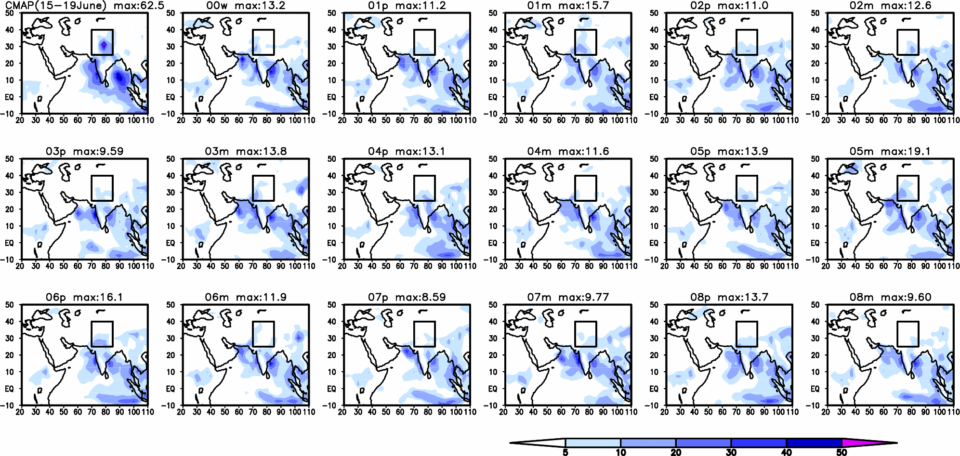
JMA Monthly EPS (Init: 6 June 2013)
Averaged Precipitation 15-19 June
mm/day

Slide 18
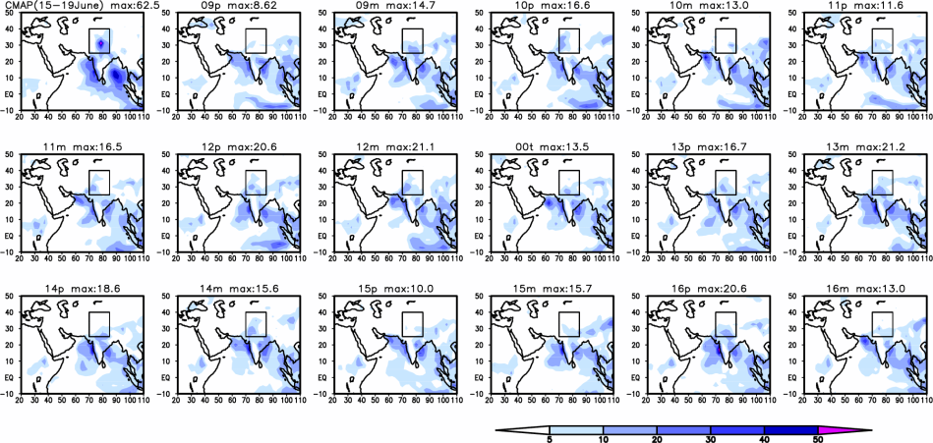
JMA Monthly EPS (Init: 6 June 2013)
Averaged Precipitation 15-19 June
mm/day

Slide 19
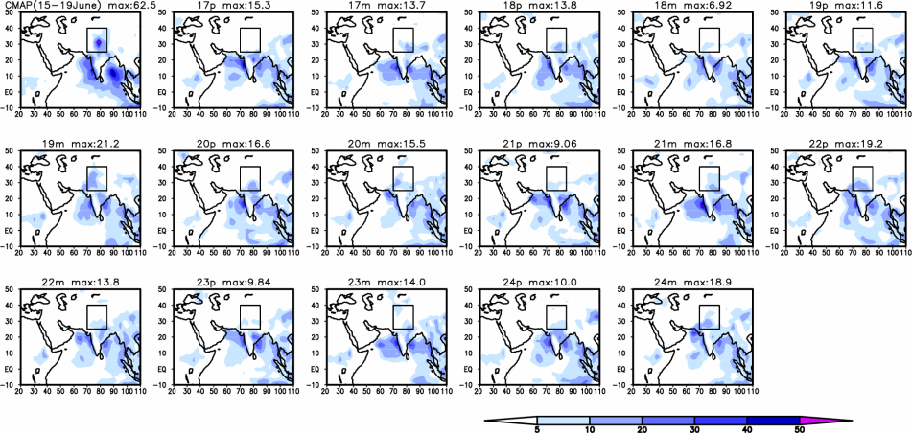
JMA Monthly EPS (Init: 6 June 2013)
Averaged Precipitation 15-19 June
mm/day

Slide 20
Initial date: 30 May 2013

Slide 21
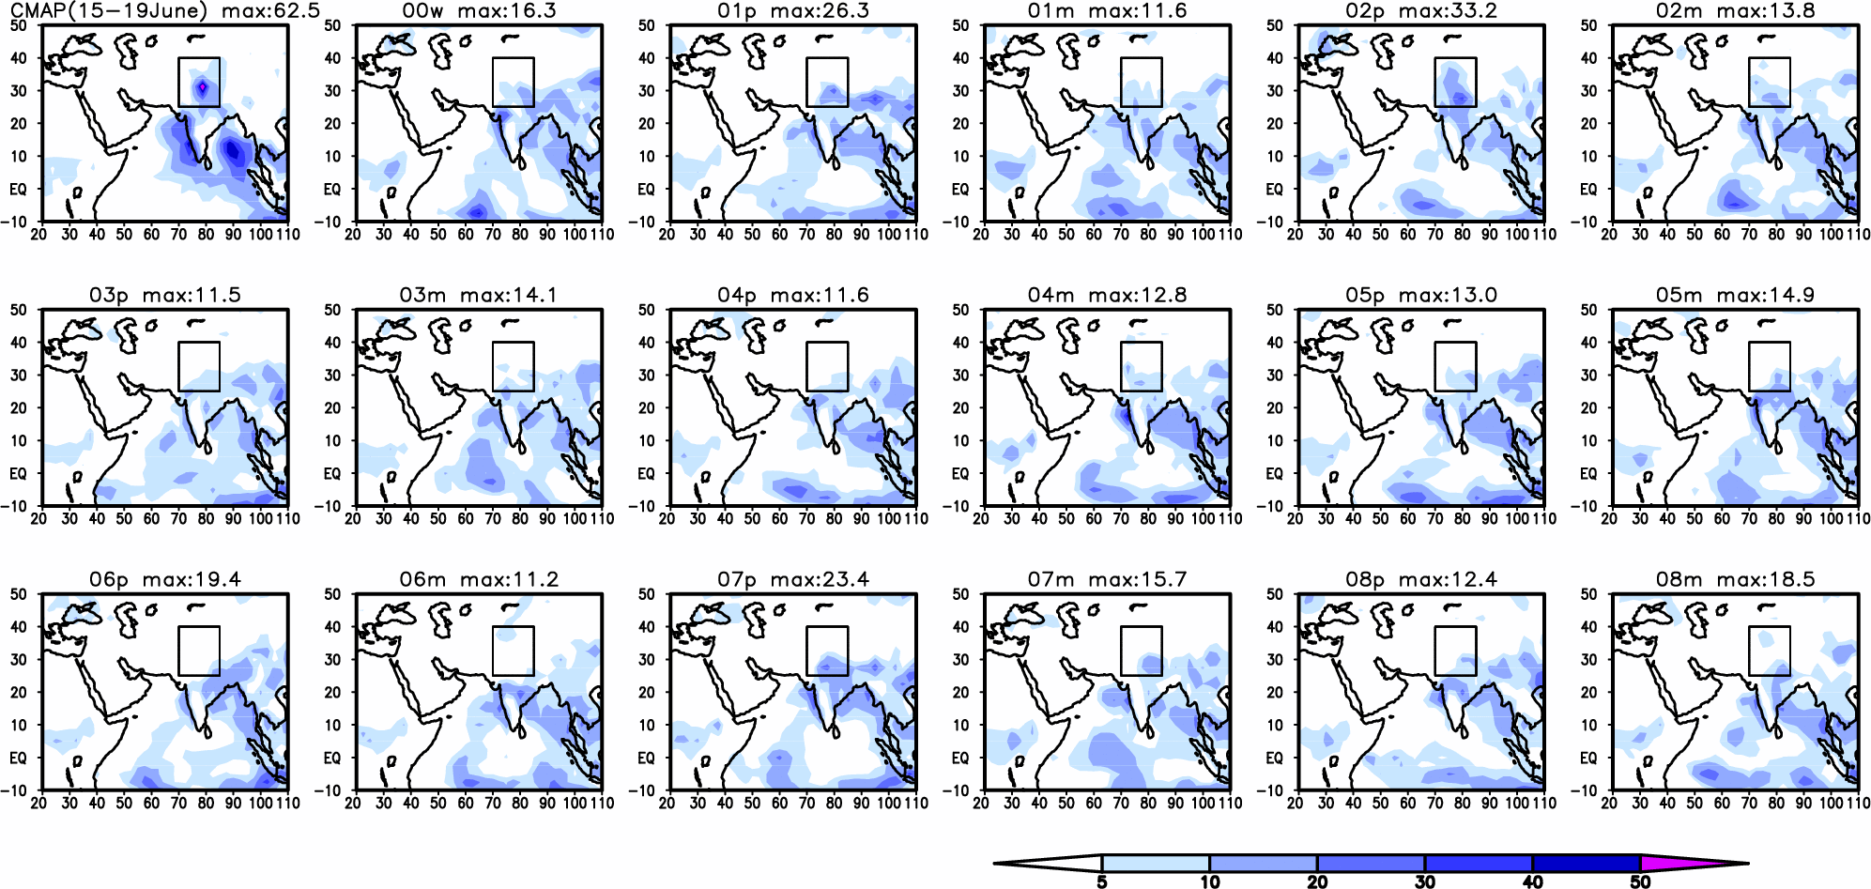
JMA Monthly EPS (Init: 30 May 2013)
Averaged Precipitation 15-19 June
mm/day

Slide 22
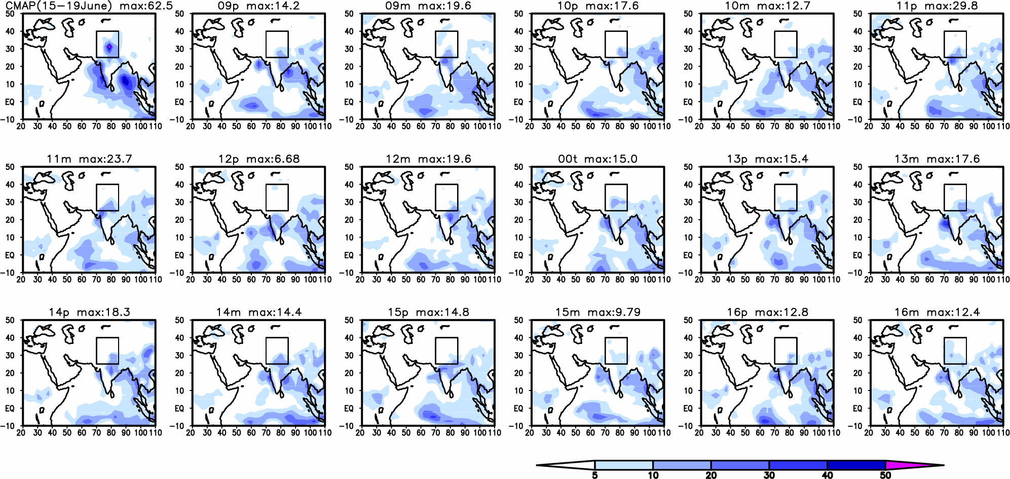
JMA Monthly EPS (Init: 30 May 2013)
Averaged Precipitation 15-19 June
mm/day

Slide 23
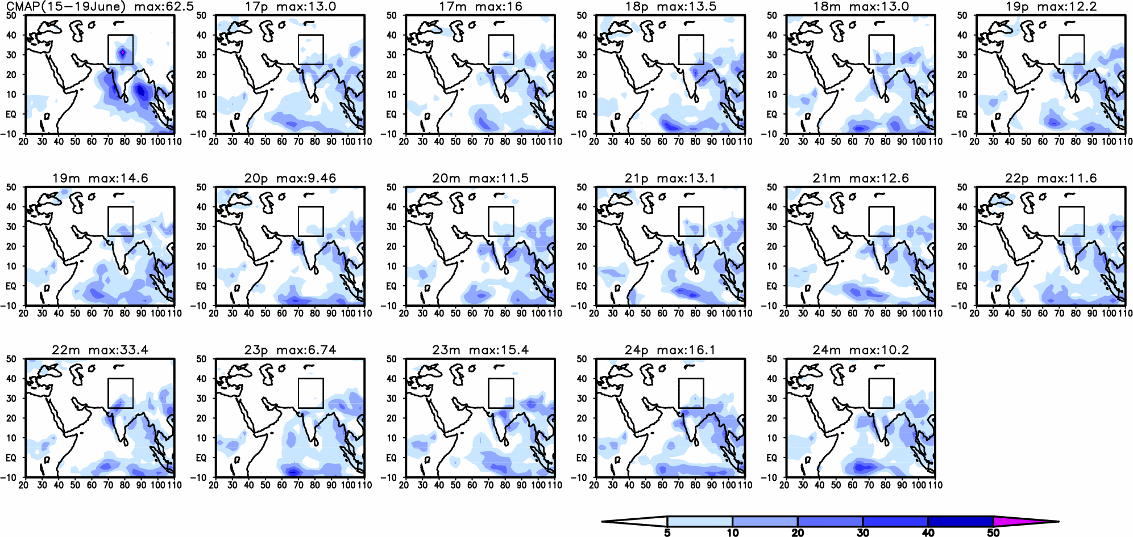
JMA Monthly EPS (Init: 30 May 2013)
Averaged Precipitation 15-19 June
mm/day

