Slide 1

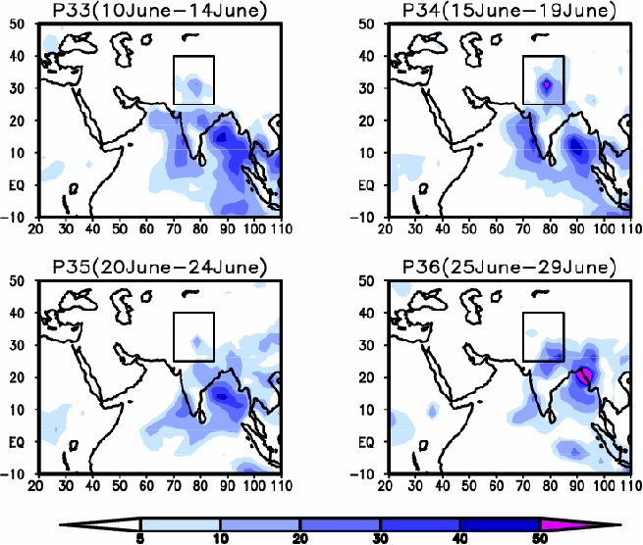

Slide 2
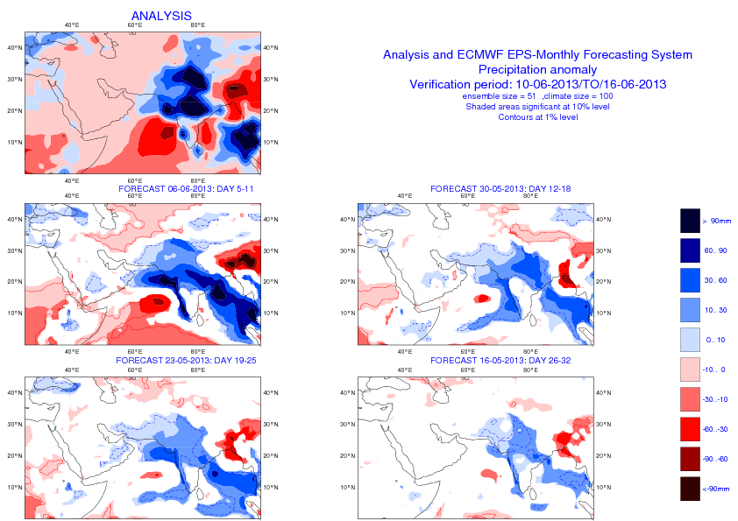

Slide 3
Ensemble distribution
Climagrams:
25-75% distribution
Extremes
Median

Slide 4
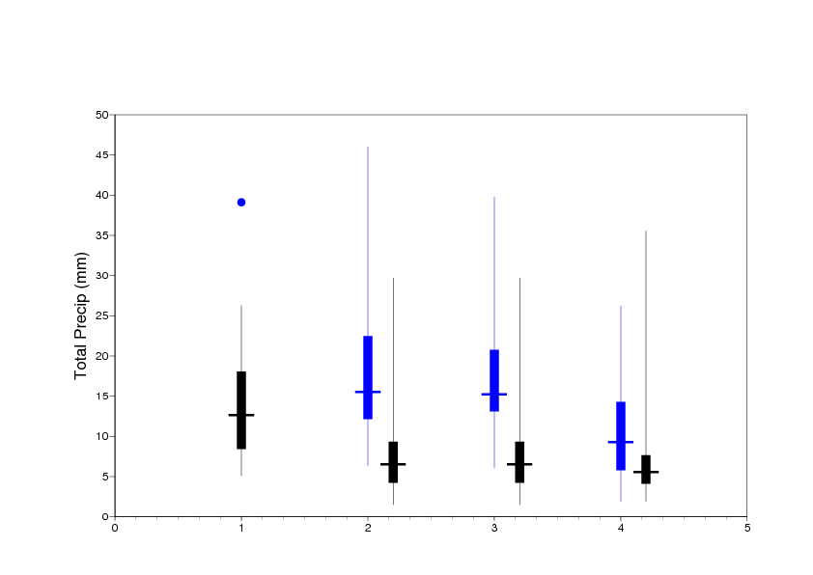
Precipitation Forecast
15-19 June 2013
BOX: 70-85N 25N-40N
Clim.
distribution
Forecast Distribution
Analysis 2013
ERA Interim
Fcst 30/05
Fcst 27/05
Fcst 23/05

Slide 5
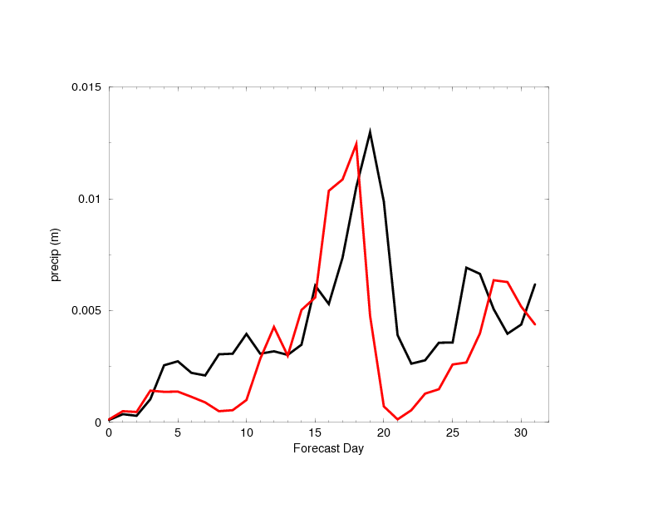
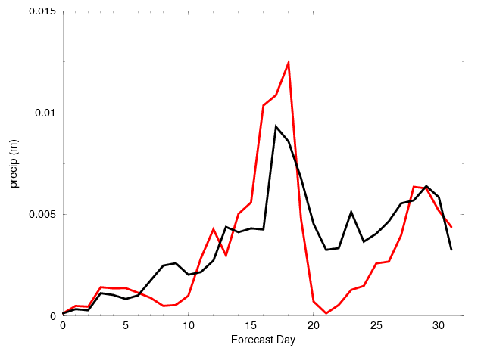
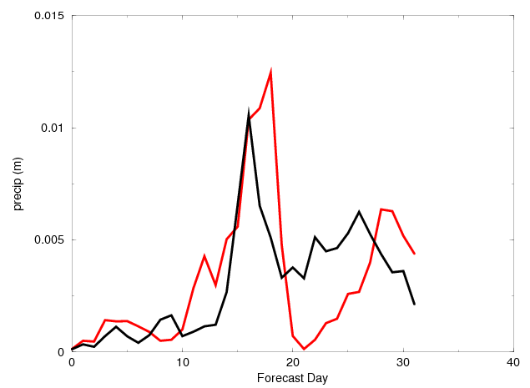
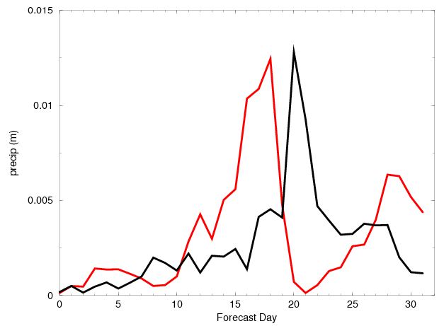
Examples of forecasts
BOX: 70-85N 25N-40N forecasts starting on 30/05/2013
Analysis
Forecast
Ens. 1
Ens. 16
Ens. 10
Ens. 14

