Slide 1
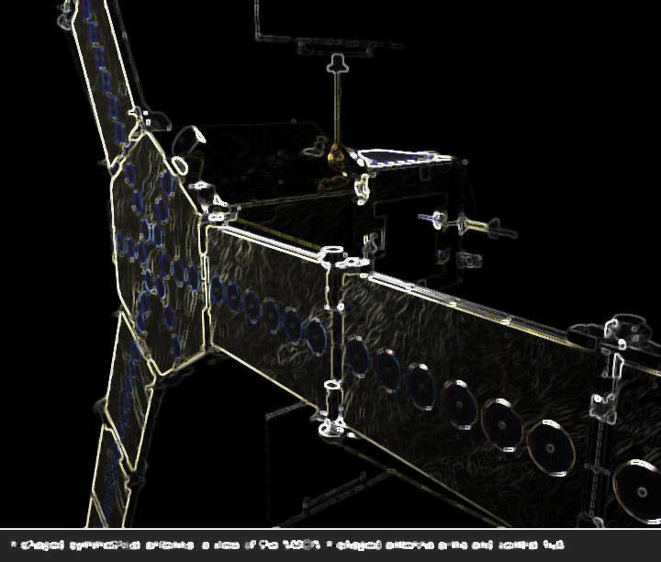
SMOS at ECMWF
Monitoring and assimilation - current status -
Joaquín Muñoz Sabater

Slide 2
Monitoring – Status
  SMOS Monitoring Suite:
    New monitoring suite running in cy37r3 under expt fmcl (previous suite implemented in cy36r4), for almost a year now,
    15-Nov-2011: transition between old and new suite. It took place smoothly, scripts were synchronized with the aim of not affecting the statistics since it happened in the middle of a month,
    New suite running only in monitoring mode and only with SMOS data → only first model trajectory is run, no minimizations or surface analysis is produced → computing resources are drastically reduced and suite runs much faster. The new suite rapidly caught up the NRT and it does not need extra resources or priority,

Slide 3
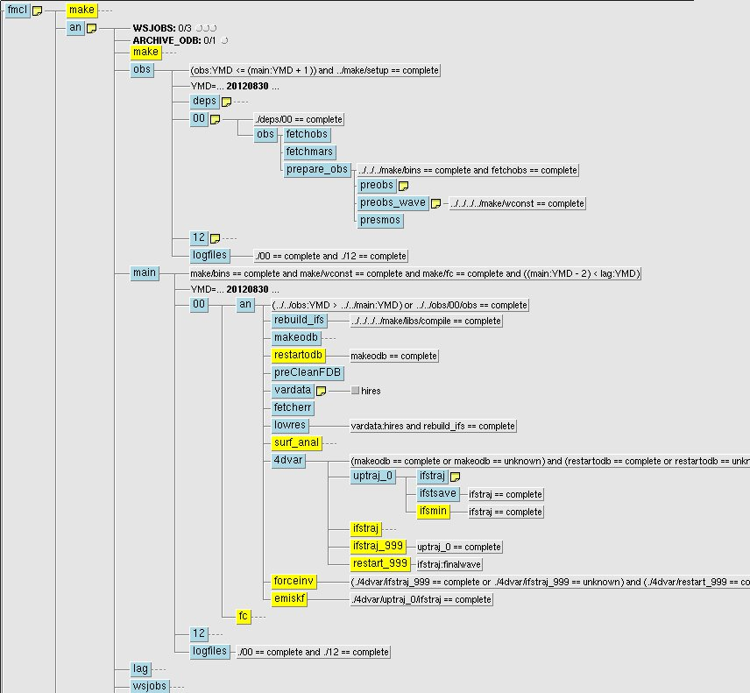
Monitoring – Status
Only few instruments are pre-processed
Surface analysis, minimization and forecast always ‘completed’.

Slide 4
Monitoring – Status
  SMOS Monitoring Suite:
    New monitoring suite running in cy37r3 under expt fmcl (previous suite implemented in cy36r4), for almost a year now,
    15-Nov-2011: transition between old and new suite. It took place smoothly, scripts were synchronized with the aim of not affecting the statistics since it happened in the middle of a month,
    New suite running only in monitoring mode and only with SMOS data → only first model trajectory is run, no minimizations or surface analysis is produced → computing resources are drastically reduced and suite runs much faster. The new suite rapidly caught up the NRT and it does not need extra resources or priority,
    SMOS monitoring will be operational in cy38r2, out of the critical path (under test within the COPE project).

Slide 5
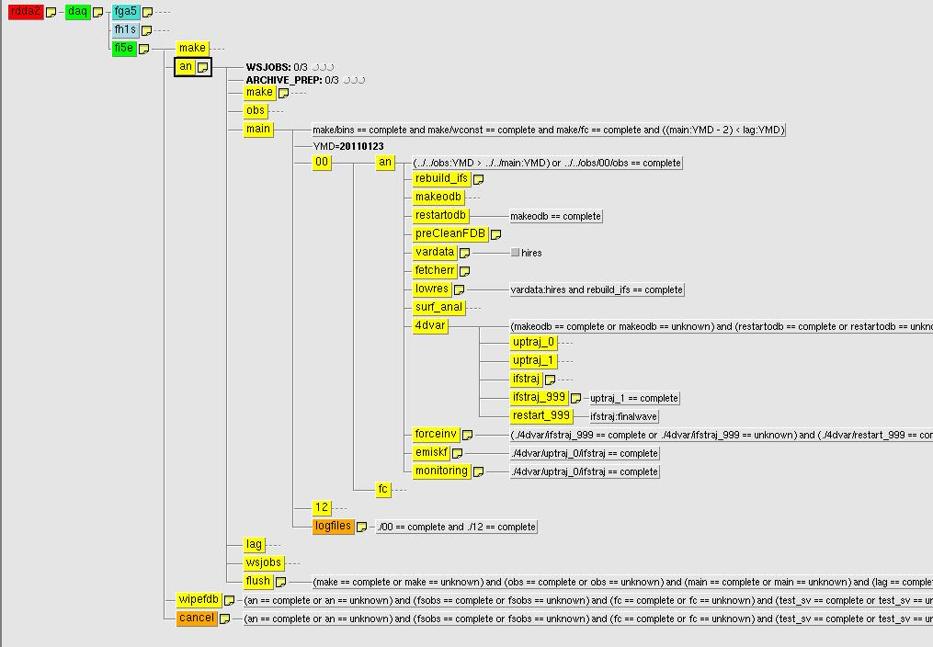
current vs. operational monitoring
Passive data can be decoupled from the main atmospheric analysis.
Monitoring of passive data should be out of the critical path.
SMOS could be the first, but a new family would include other passive data.
Advantage for SMOS: supported by operations
Current monitoring
Oper. monitoring

Slide 6
Monitoring – Status
  SMOS Monitoring Suite:
    New monitoring suite running in cy37r3 under expt fmcl (previous suite implemented in cy36r4), for almost a year now,
    15-Nov-2011: transition between old and new suite. It took place smoothly, scripts were synchronized with the aim of not affecting the statistics since it happened in the middle of a month,
    New suite running only in monitoring mode and only with SMOS data → only first model trajectory is run, no minimizations or surface analysis is produced → computing resources are drastically reduced and suite runs much faster. The new suite rapidly caught up the NRT and it does not need extra resources or priority,
    SMOS monitoring will be operational in cy38r2, out of the critical path (under test within the COPE project).
    Also, for next monitoring suite, a mask and frozen soil mask is used based on forecast fields. Limited utility of the RFI flag limited. Only areas which are ‘clean’ according to this flag will be monitored, focus on geophysical aspects only in areas where observations will be assimilated.
    Introduced v4.1 of IFS version of CMEM,

Slide 7
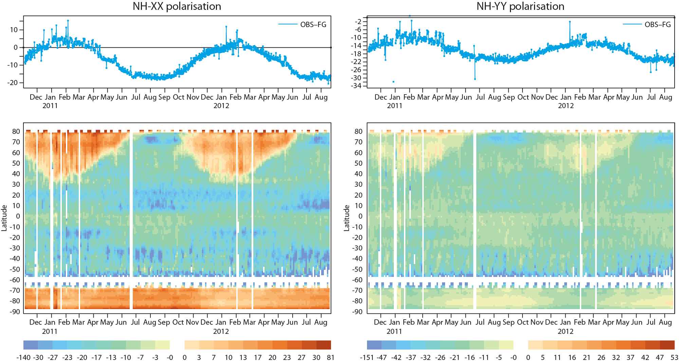
Bias and first-guess departures
40 degrees incidence angle
Period: Nov-2010-August 2012

Slide 8
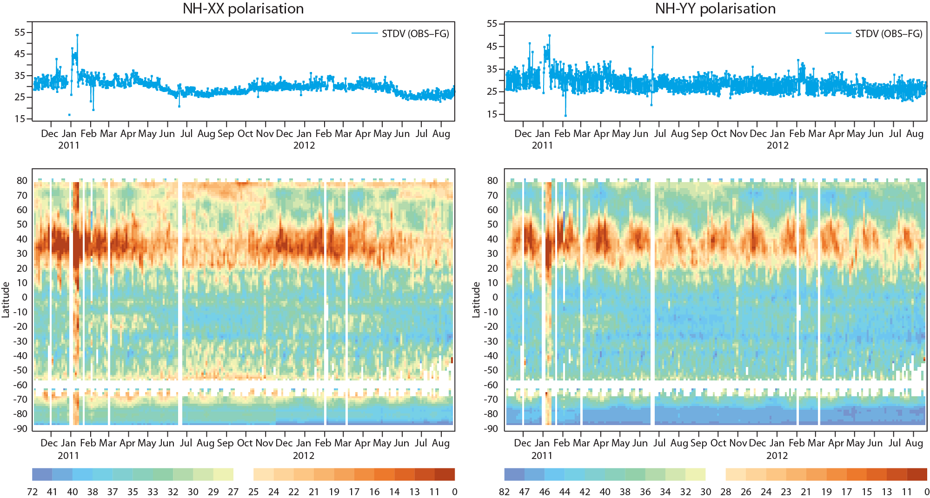
Monitoring results
40 degrees incidence angle
Period: Nov-2010-August 2012

Slide 9
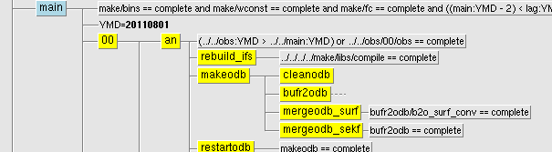
Assimilation of SMOS T_{B} (status)
  Preparation activities for the assimilation:
    Thinning, Noise filtering, Bias correction
  Implementation of SMOS data within the SEKF completed → lot of time devoted to technical work,
  Jacobians calibration, sensitivity of CMEM and calibration of SEKF for SMOS,
  “Technical” experiments,
  New features of the SEKF for CY38R2,
    All possible combinations of screen level variables and satellite data can be assimilated separately for SM analysis,
    A new surf_sekf database is created only for remote sensing data for the SM analysis (throughout symbolic links, so no more memory involved), implying opening (expensive) only once the observational database. → door is open to accommodate future satellite data sensitive to SM (SMAP).
    memory used by SMOS reduced to a minimum, (still room for optimization),
    CMEM configuration in SEKF independent of monitoring,
    Configuration of assimilated observations controlled by namelist.

Slide 10
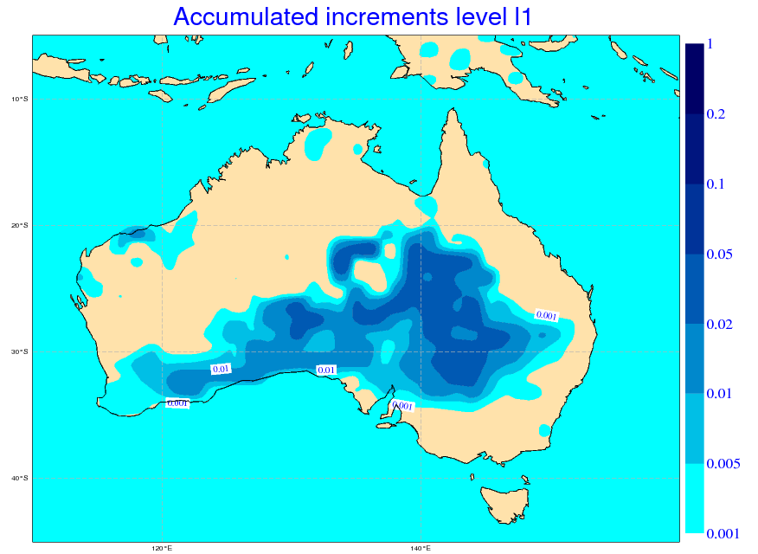
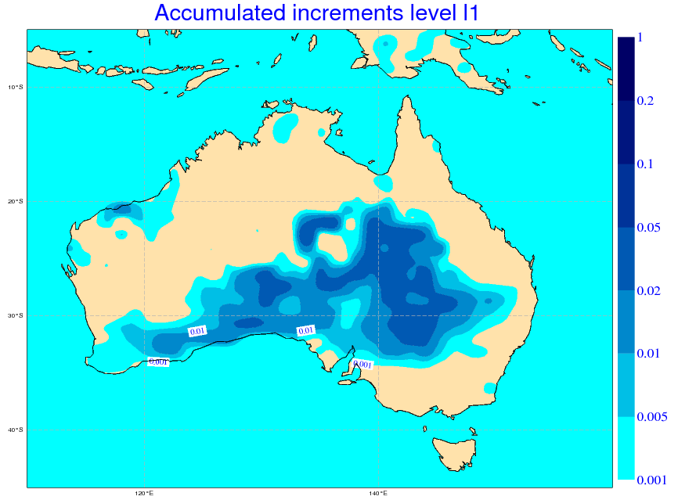
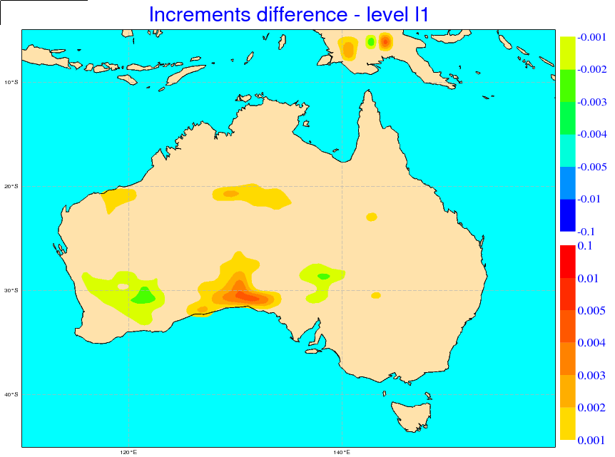
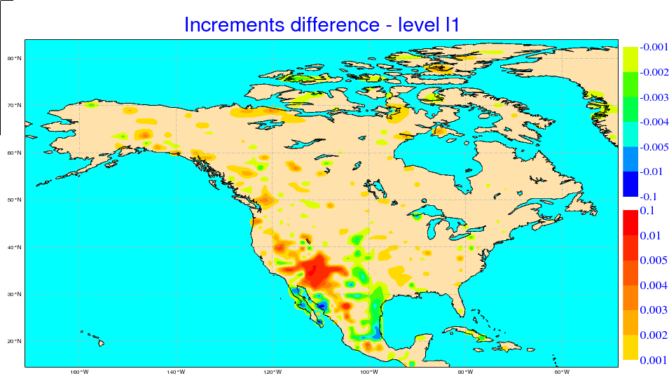
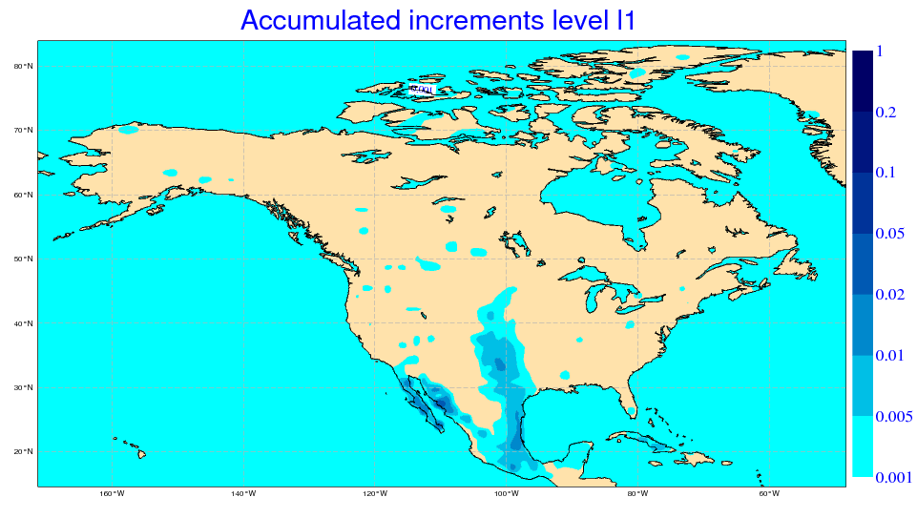
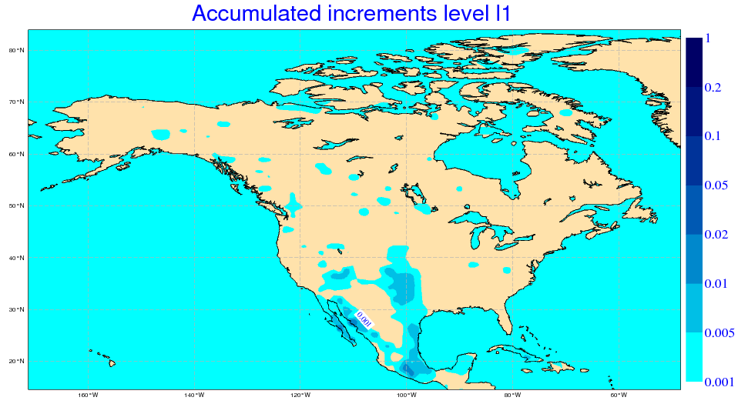
  Assimilation of SMOS T_{B} in the antenna reference frame, two preliminary case studies:
    Period: 04 April 2011 00UTC – 10 April 2011 12UTC analysis, T159 (~125 km)
    Observations: NRT brightness temperatures (standard product), 40 degrees ± ΔT_{B}=0.5 K, XX & YY polarisations,
CASE a) Australia (no RFI, soil water recharge period)
expt-foew: assimilation T2m, RH2m (CTRL)
expt-foev: assimilation T2m, RH2m, SMOS T_{B}
CASE b) North-America (start of drying period)
expt-foeu: assimilation T2m, RH2m (CTRL)
expt-foeq: assimilation T2m, RH2m, SMOS T_{B}
ctrl (foew)
expt (foev)
add water
remove water
ctrl (foeu)
expt (foeq)

Slide 12
Implementation of SMOS data in the SEKF
  Main problems encountered in the implementation (not the only ones):
    Developing of SMOS in SEKF was started in cy36r4. All routines were transferred to CY37s to use latest versions of IFS → Systematic failure of experiments and difficult to trace back.
    Testing long and slow,
    “The SMOS failure in cycle 37R1 onwards was due to a cleaning aiming to remove duplicated code. The removed code did direct memory copy of observation data to model space arrays in the case that the data was already on the right processor. Instead all observation data was message passed to model space. Most observation types in IFS are randomly distributed over processors, but the SMOS observations are co-located with the model grid. So although the cleaning was fine for other data types, for SMOS it introduced an unbalanced memory requirement for message passing to the point of crashing the tasks with the most SMOS observations.”
    The integration of perturbed runs for the Jacobian computation requires to run several times the L-band forward model. Information on model time step of the observation need to be previously stored, as this information is lost when running the forward model from the SEKF.

Slide 13
Implementation of SMOS data in the SEKF
  Main problems encountered in the implementation (not the only ones):
    Many SMOS ‘active’ observations were missing within the SEKF → The current operational SEKF for SM analysis is only active if SM>1%. In this way a chess-like perturbation for perturbed runs avoids negative values of SM if the size of perturbation is larger than 1% when SM <= 1%. → Substitution of this condition by a land-sea mask condition (if LSM> 50% then is considered land).
    Computation of observation time step in SEKF was not accurate and resulted in observations with a wrong model equivalent, often a missing value.
    Observations corresponding to the first model time step were missing. Two complex bugs were found in ODB software, it was very difficult to track . Another bug was found because dimension of tables was wrong.
    Last but not least → previous tasks have involved lot of testing and debugging, which is slow and requires lot of expt (queue time, priorities, running time, etc.)

Slide 14
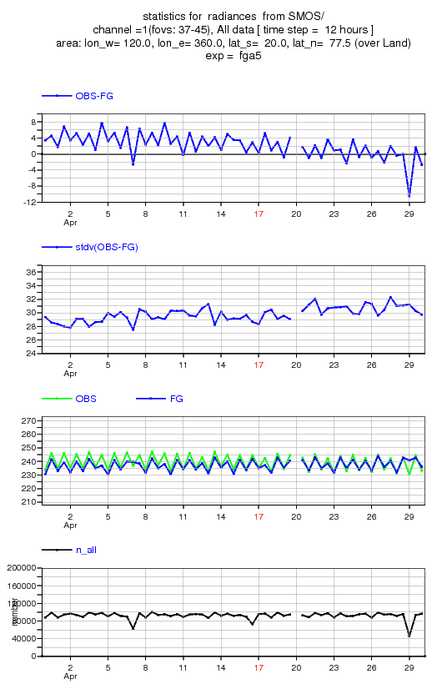
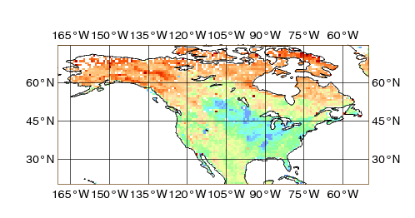
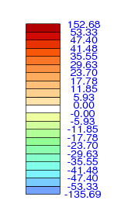
North America – XX polarisation
Mean bias (6-20 April)
Assimilation window

Slide 15
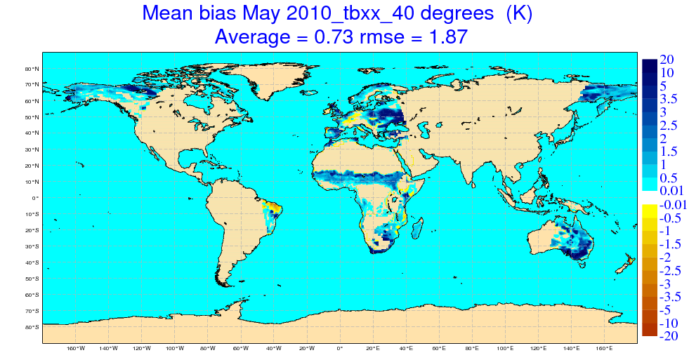
Monitoring – Status
  T_{B} (CMEM,v4.0) – T_{B}(CMEM, v3.0) [06h & 18h files]
      New roughness parameter for coniferous forest,
      Effective temperature computation revised,

Slide 16
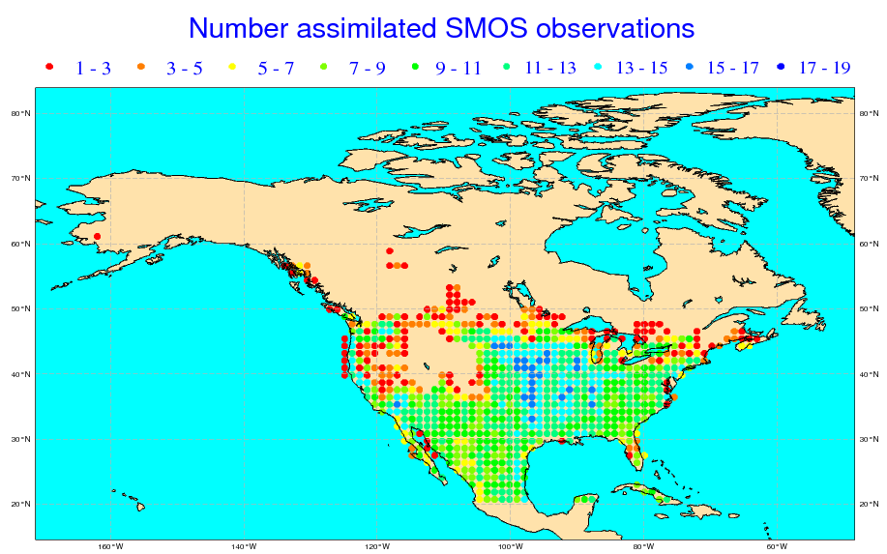
Quality control & bias correction
  Quality control & data thinning:
    Routine checks for each observation
    RFI hard filtering: 50 < T_{B} < 350 K
    ‘Own light product’ applied at T159 (very small dataset)
    ‘Simple’ snow mask applied based on snow depth forecasted field
  ‘Crude’ bias correction:
    Hypothesis: Bias are stationary over the assimilation week period
    Bias = f(polarisation, region, angle)
    T_{B} (bc) = T_{B} + bias (6 Apr to 20 Apr)
MEAN BIAS | XX | YY
North America | 0.5 | -11.0
Australia | -21.6 | -19.7

