Slide 1
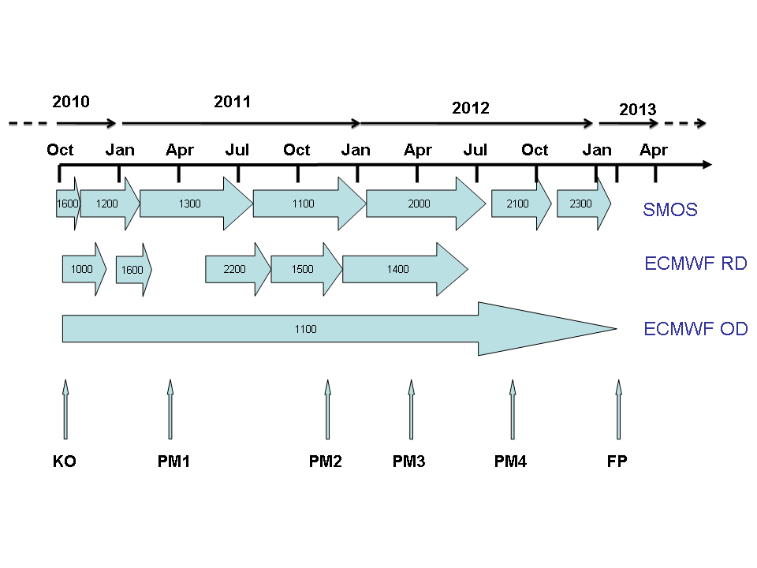
Overview on status of individual tasks (WP)
ESA SMOS Project at ECMWF Status in March 2012
Notes:
1

Slide 2
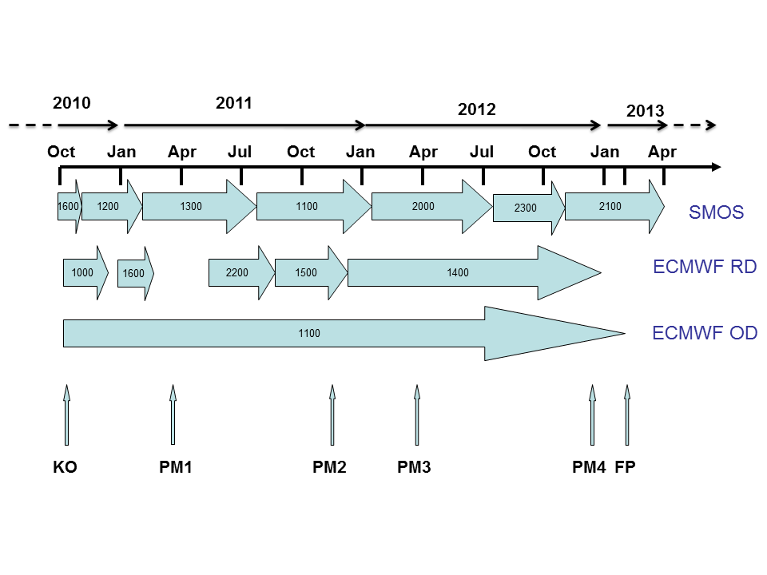
Overview on status of individual tasks (WP)
ESA SMOS Project at ECMWF Status in December 2012
Today
Notes:
2

Slide 3
Overview progress since last PM in February
  Monitoring: Up to date with monitoring suite (c2a and new cycles) + preparation for next o-suite,
  Assimilation:
    Global calibration of CMEM done (several metrics) + on going CDF matching parameters computation (for 40XX, 40YY, 50XX, 50YY),
    Continuous technical developments/implementations in SEKF (developments, masks, bugs corrections, compatibility, etc.)
    DA experiments (preliminary impact study):
      first set of technical experiments over Australia and North America, at T159 → intended to demonstrate the feasibility of the technical approach (many caviats), √
      second set of experiments over Australia in February 2011 → show an impact on SM, but no validation data (set also scripting work for validation and impact on land surface and atmosphere), √
      third set of experiments over North and South America in July 2011 → with validation data at SCAN network (still approximate BC) (on-going)
    Hot spot analysis started,
      seasonal maps of obs STD with monitoring suite,
      on-going seasonal offline Jacobians

Slide 4
Status of deliverables
ESA SMOS Project at ECMWF
Project Phase-II (28 Months):
- 01 October 2010 - 31 January 2013
- 11 WPs (13PM ECMWF ; 28 PM ESA)
WP | ECMWF Funding (OD+RD) | ESA Funding (Joaquín) | Task
WP 1000 | 1 pm | 1 pm | Coordination ✓
WP 1100 | 2 pm | 3 pm | Continuous monitoring ✓
WP 1200 |  | 3 pm | Data thinning ✓
WP 1300 |  | 6 pm | Noise filtering ✓
WP 1400 | 6 pm |  | Bias correction -
WP 1500 |  | 3 pm | CMEM maintenance ✓
WP 1600 | 1 pm |  | Web Page ✓
WP 2000 |  | 6 pm | Data assimilation -
WP 2100 |  | 3 pm | L3/4 Root zone SM
WP 2200 |  | 3 pm | Validation data base ✓
WP 2300 | 3 pm |  | Hot spot analysis
Colour code:
- To do
- Ongoing
- Done
→ Start before Xmas

Slide 5
Status of deliverables
  On going Final Report of first contract → Hampered by other DA, deliver before end of current contract?
  New Monitoring report → When?
  Bias correction and global calibration report → On going,
  DA Impact report → When?
  L3 root-zone SM report → We can deliver it by the end of current contract,
  Hot spot analysis → Unlikely to have time to do it by end January.
  Final report → need of the previous ones.

Slide 6
Monitoring – Status
  SMOS Monitoring Suite:
    NRT monitoring suite currently running in cy37r3 in old c1a,
    NRT suite migrated to new c2a
      Running and statistics are identical with previous suite,
      Waiting availability of OD to substitute current suite in c1a,
      Suite running only in monitoring mode and only with SMOS data→ few computer resources needed, guaranteeing the NRT.
    Future operational monitoring running in current e-suite (CY38R2). It will run outside the critical path, in a new monitoring family of passive data to avoid strong time constraints in operational suite.
    Operational suite will include:
      Freezing soil and snow covered areas masks based on forecast fields.
      Version v4.1 of CMEM in IFS.
    Next implementations:
      Topography mask (4% maximum slope allowed),
      RFI flag of standard NRT (currently limited information, only strong sources).

Slide 7
Main technical work and developments since last PM
    Scripting work to make compatible operational monitoring and assimilation experiments in the SEKF,
    Bias correction of SMOS observations through grib files of CDF-matching parameters implemented,
    Compatibility of the Operational DataBase to support in an optimized way several sources of satellite data in the SEKF, and independent handling,
    Snow cover and freezing soils masks added to SMOS screening,
    Bug correction for Jacobians computation (routines and interfaces modified),
    SEKF adjustments to compute Jacobians at the right time and over areas with forecasted SM equal to zero + calibration of Jacobians (experiments equivalent to 36 weeks),
    SEKF developments to include debugging meaningful information of SMOS fields in grib fields, independently for some polarisations and angles,
    Added real estimated observation error as SMOS observation error (R matrix),
    Other bugs associated to compatibility with new observations (ralt, cris) or no satellite observations,
    Bug correction associated to a float number divided by zero with current IFS Fortran compiler. Discovered when using new calibrated configuration of CMEM (for std metric).
    Developments necessary to handle with an unique namelist for observations configuration, both monitoring and assimilation of SMOS data in an unique experiment.

Slide 8
WPs 1500 and 1400 CMEM maintenance, calibration and Bias correction
More work on CMEM:
May 2012: CMEM v4.1: vertical grid interpolation (multi-layer version)
  Soil moisture and soil temperature profiles 2D REAL and vertical interplation flexible for any LSM and MW discretisation (layers numbers and depths).
May and August 2012: bug fixes on Wigneron 2007 roughness model and Wang porosity. Small impact, however redo calibration for Wang.
Support to new users: Thomas Kaminski (FastOpt), Maheshwari Neelam (Texas Univ).
CMEM reprocessed data and Calib/BC:
Second reprocessed data acquisition is still ongoing (Ioannis does it in parallel to operation task that have priority) - Convertion bufr2grib of 2nd reprocessed data ongoing (2010 40° completed)
March: 18 CMEM configurations, 06UTC
Dec: 36 config (3 diel x 4 roughness x 3 vegetation),00, 06,12,18 UTC
Notes:
8
8

Slide 9
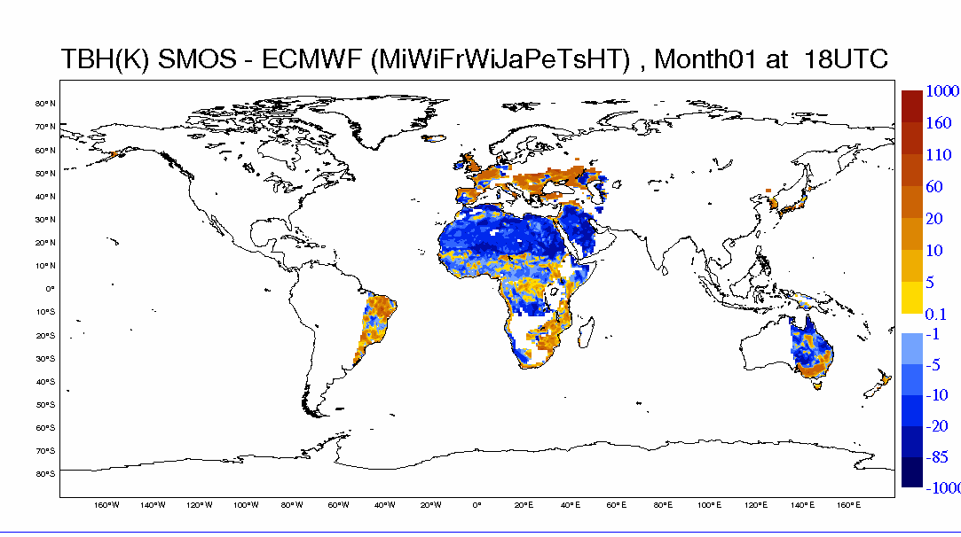
36 CMEM simulations for Calib&BC
- 3 dielectric models: wang, Dobson, Mironov
3 vegetation opacity models: Jackson, Wigneron, Kirdyashev
4 roughness models Wigneron simple, Choudhury, Wigneron texture, Wigneron 2007
→ 36 config x 2 pol x 4 times (00, 06, 12, 18)

Slide 10
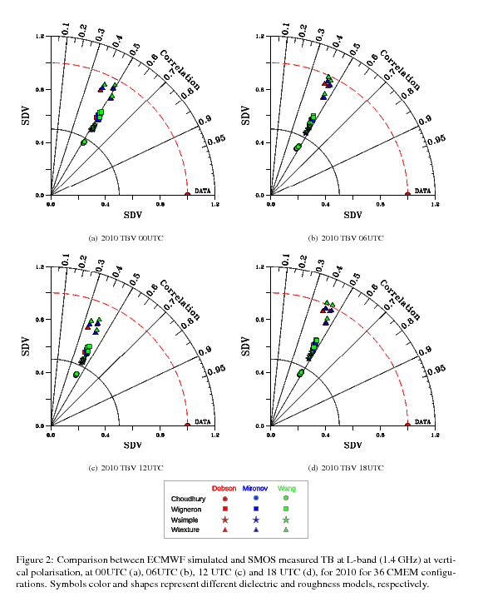
Metrics:
Bias,
R,
uRMSD
SDV standardised
Taylor diagrams
As in ALMIP-MEM
(de Rosnay et al JGR 2009)
Roughness:
Best SDV Wtexture
Best R: Wsimple
Dielectric model:
Best: Mironov & Wang
Consistent
at 00, 06, 12, 18
Draft report on BC
(de Rosnay et al 2013)

Slide 11
Metrics:
Bias,
R,
uRMSD
SDV standardised
Taylor diagrams
As in ALMIP-MEM
(de Rosnay et al JGR 2009)
Roughness:
Best SDV Wtexture
Best R: Wsimple
Dielectric model:
Best: Mironov & Wang
Consistent
at 00, 06, 12, 18
Draft report on BC
(de Rosnay et al 2013)

Slide 12
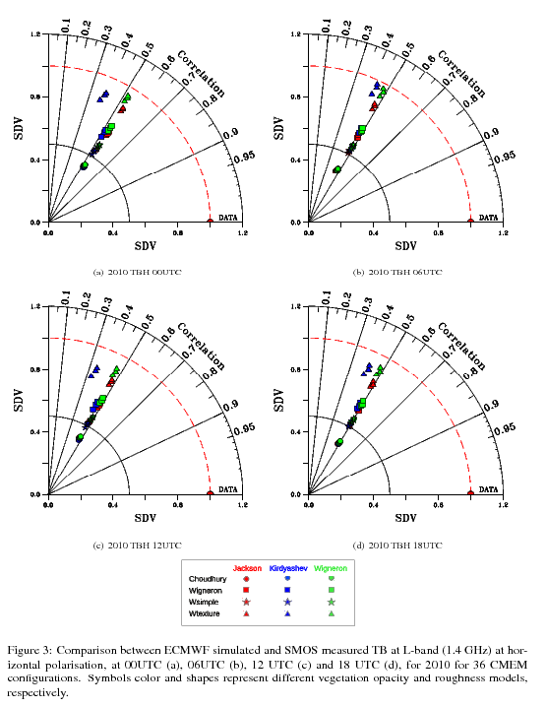
Metrics:
Bias,
R,
uRMSD
SDV standardised
Taylor diagrams
As in ALMIP-MEM
(de Rosnay et al JGR 2009)
Roughness:
Best SDV Wtexture
Best R: Wsimple
Vegetation model:
Best: Jackson (R)
Wigneron (SDV)
Consistent H&V and
at 00, 06, 12, 18
Consistent monthly & yearly

Slide 13
Last DA impact experiments
  Assimilation of SMOS T_{B} in the antenna reference frame. Experimental setup:
    Period: 01 July 2011 00UTC – 31 July 2011 12UTC analysis
    Resolution: T511 (~40 km ~ SMOS resolution)
    Observations:
      NRT brightness temperatures (standard product),
      expt-fska: 20, 50 (± 0.5) degrees, XX polarisation → (20XX, 50XX),
    CMEM configuration calibrated according to SDV metric.
    Jacobians calibrated (Δθj=0.01m³m⁻³, ІH⁻_{max}І = ІH⁺_{max}І =250 K/m³m⁻³)
    STD of observations error → radiometric accuracy
    Degraded observational system → expt run faster and shows better the impact of SMOS on the SM fields and fc skill (only conventional data at global scale is used to constrain atmospheric analysis),
- Assimilation expts: North and South America (few RFI, dry period North America)
ctrl-fskc: assimilation of T^{2m}, RH^{2m} → default configuration (CTRL)
expt-fska: assimilation of T^{2m}, RH^{2m}, SMOS T_{B} (20XX,50XX)

Slide 14
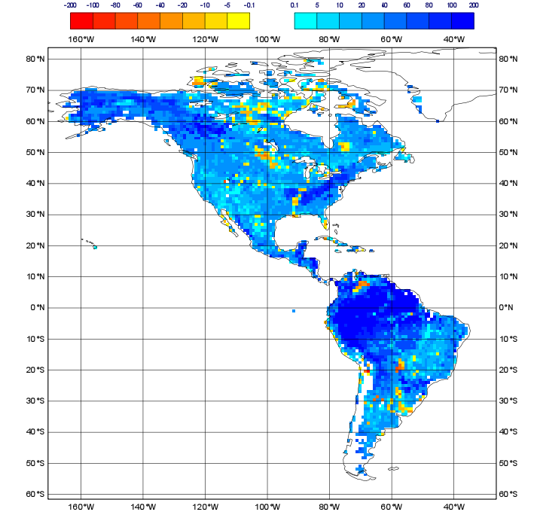
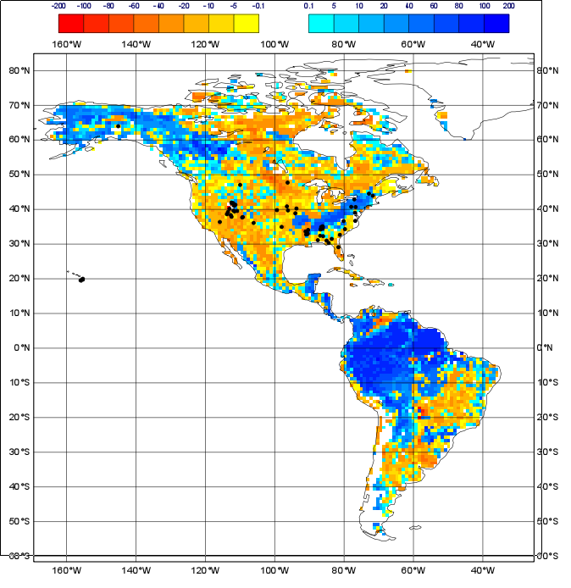
Last DA impact experiments
Without bias correction (20XX)
With approximate bias correction

Slide 15
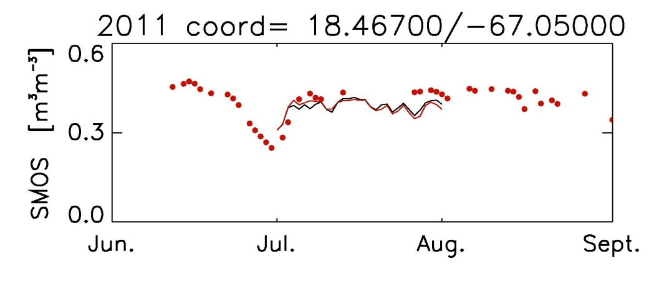
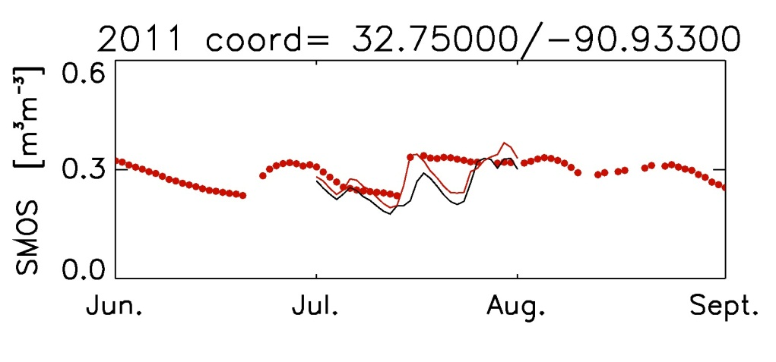
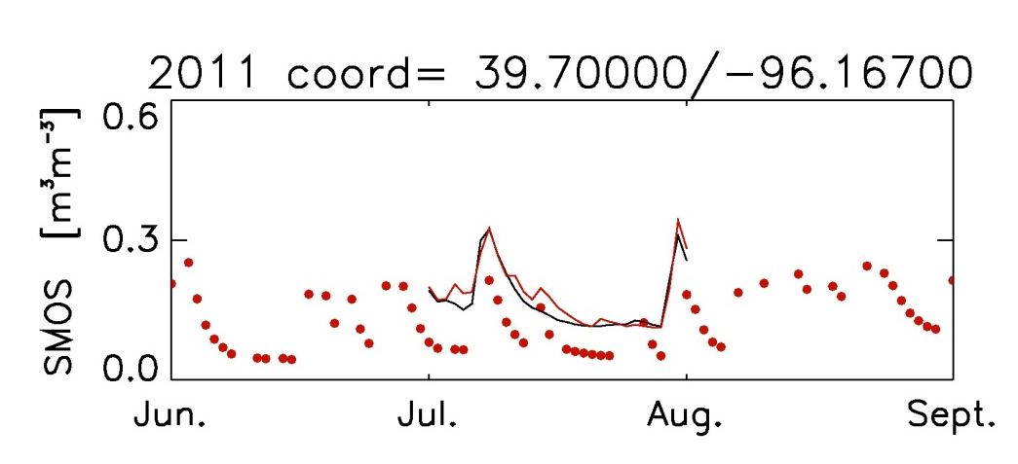
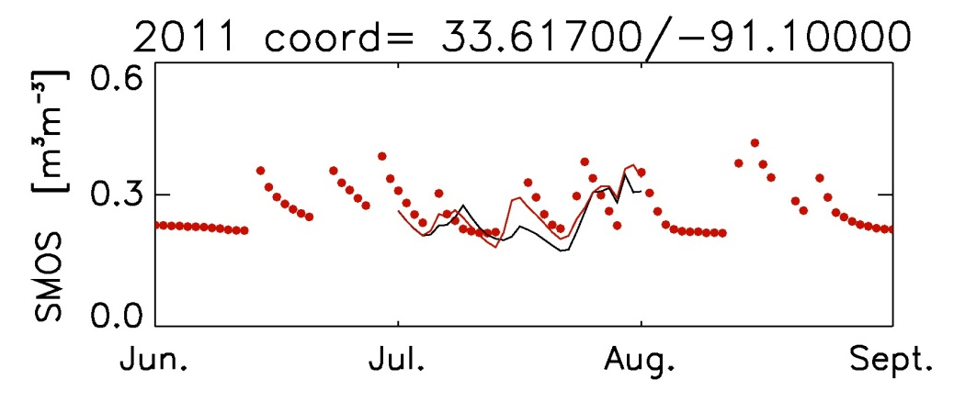
NRCS-SCAN networks 07-2011
Last DA impact experiments
Obs (5cm)
CTRL
EXP_SMOS

Slide 16
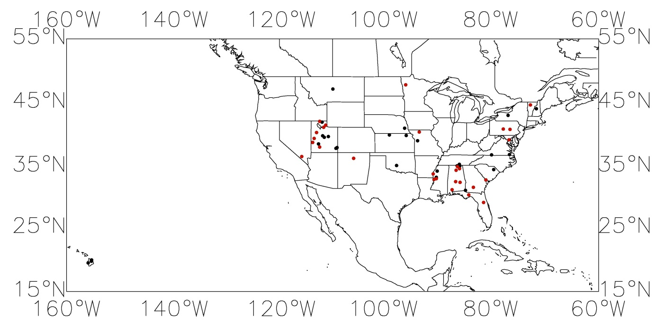
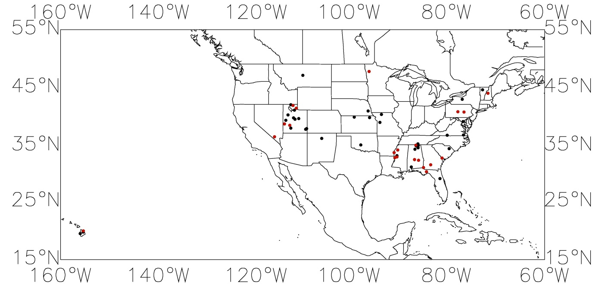
NRCS-SCAN networks 07-2011
Last DA impact experiments
R EXP_SMOS
>
R CTRL
(29 over 57)
RMSD EXP_SMOS
<
RMSD CTRL
(21 over 57)

Slide 17
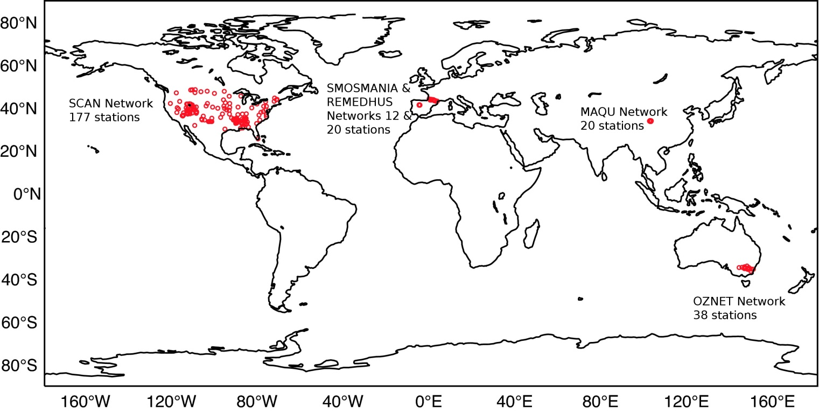
NRCS-SCAN networks 07-2011
Last DA impact experiments
57 stations with significant R (p-value <0.05) in July
Metrics | Without SMOS (CTRL) | With SMOS (EXP_SMOS)
R (-) | 0.70 | 0.69
Bias (m³m⁻³) | -0.088 | -0.098
RMSD (m³m⁻³) | 0.130 | 0.135
29 stations over 57 where R (EXP_SMOS) > R (CTRL)
21 stations over 57 where RMSD (EXP_SMOS) < RMSD (CTRL)

Slide 18
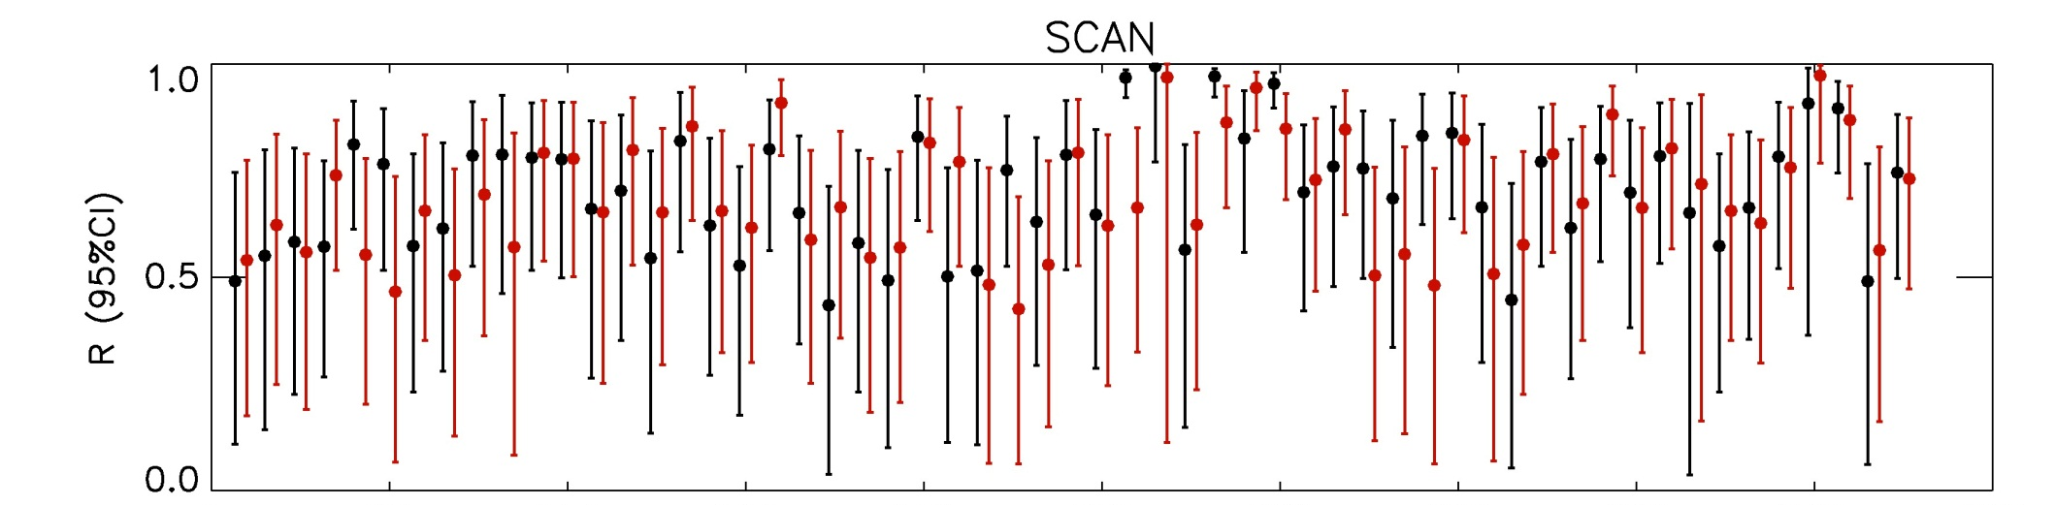
NRCS-SCAN networks 07-2011
Last DA impact experiments
CTRL
EXP_SMOS
For each R estimate a 95% Confidence Interval (CI) was calculated using a Fisher Z transform
Small sample (1 month) ➔ large CI
One experiment is not significantly better than the other

Slide 19
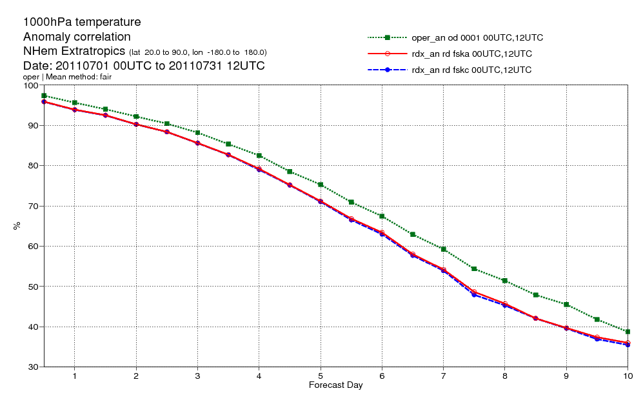
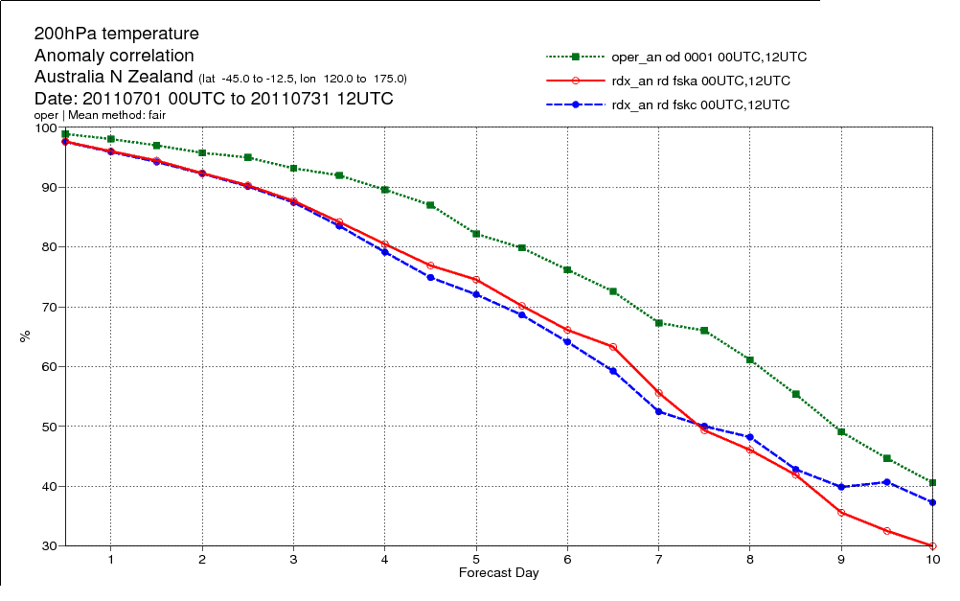
Last DA impact experiments

