Slide 1


Copernicus
Atmosphere
Monitoring
Service
Copernicus
Climate
Change
Service
C3S and CAMS
Polar and snow covered regions
Joaquin.Munoz@ecmwf.int

Slide 2
OUTLINE
CAMS
  Transport of aerosol and other pollutants to polar regions
  Tropospheric and stratospheric composition, ozone and UV radiation
C3S
  Structure of the Climate Change Service
  ECV roadmap for C3S
  Global (ERA5) and regional re-analyses
  Modelling and data assimilation activities at ECMWF (snow/ice)

Slide 3
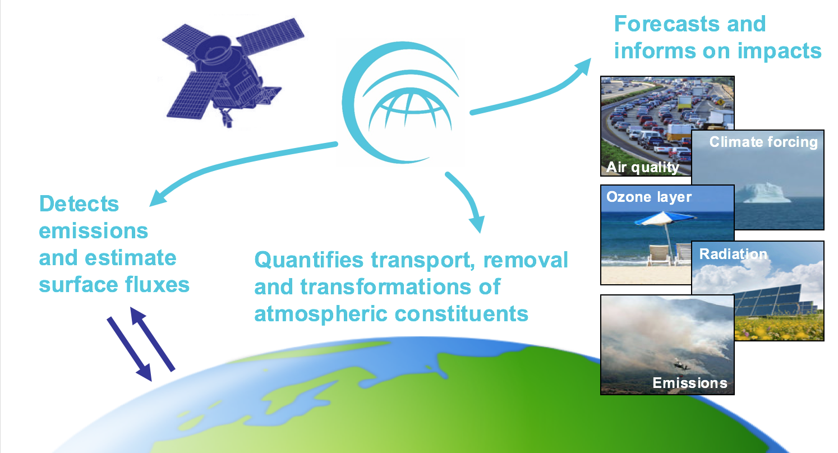
CAMS IN A NUTSHELL

Slide 4
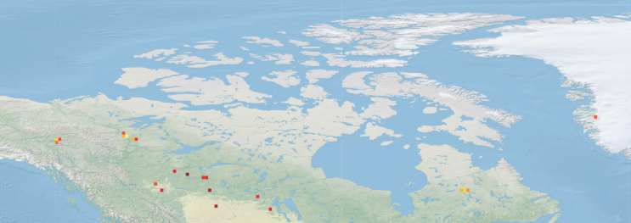
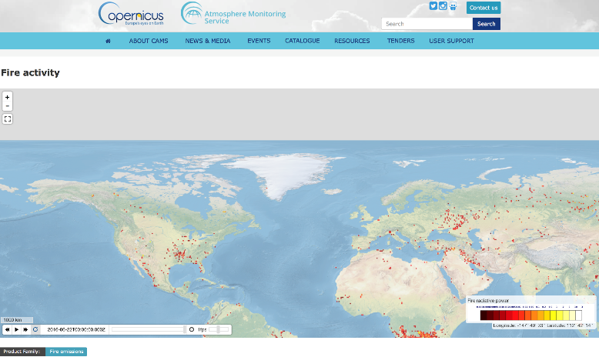
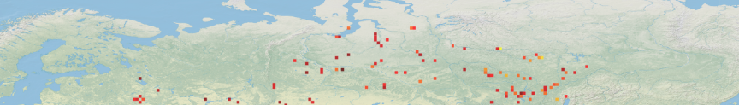
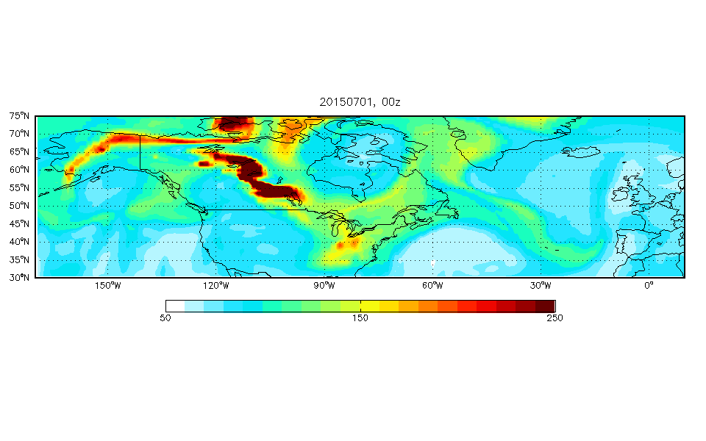
LONG-RANGE TRANSPORT OF ATMOSPHERIC POLLUTION
Active fires: 22/06/2016
Alaskan/Canadian fires plume transport (July 2015)

Slide 5
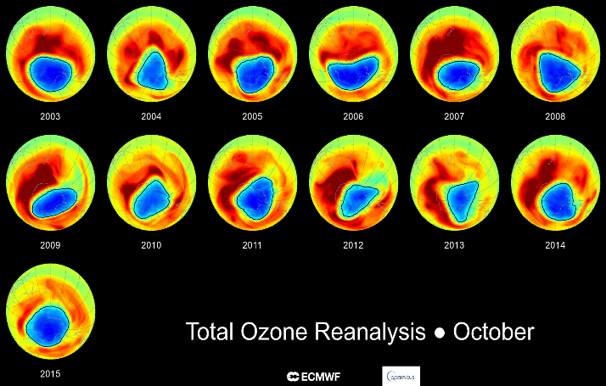
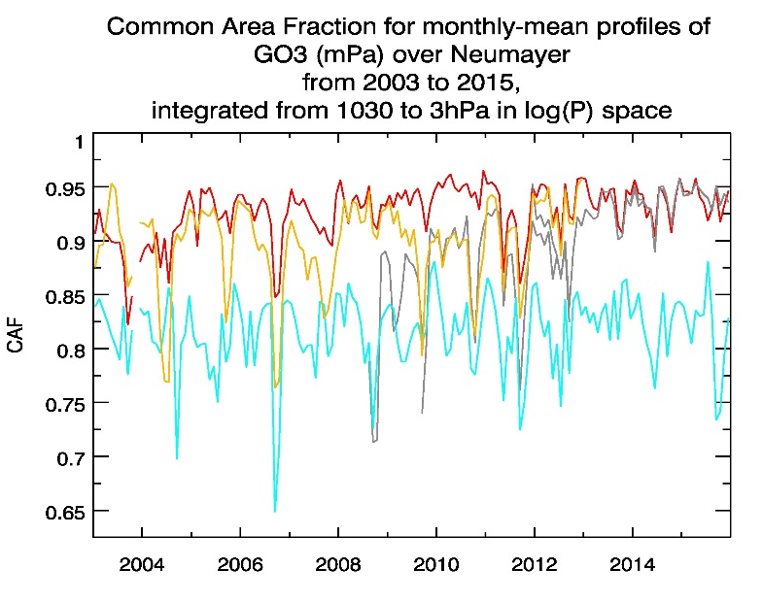

STRATOSPHERIC OZONE ANALYSES/RE-ANALYSES
Increasing skill of CAMS ozone vertical profiles in analyses/re-analyses
Ozone hole monitoring by CAMS
CAMS REAN (iterim)
MACC REAN
Control
NRT analysis

Slide 6

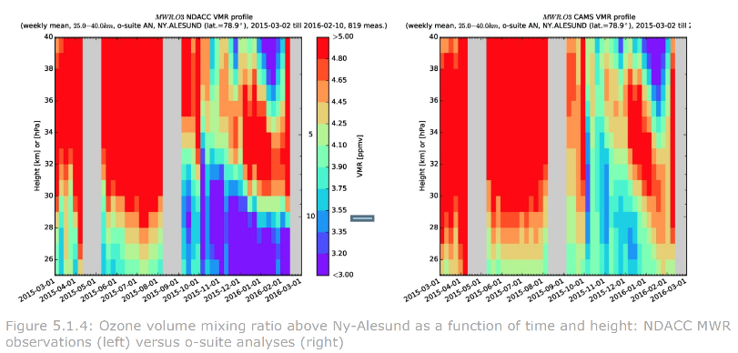
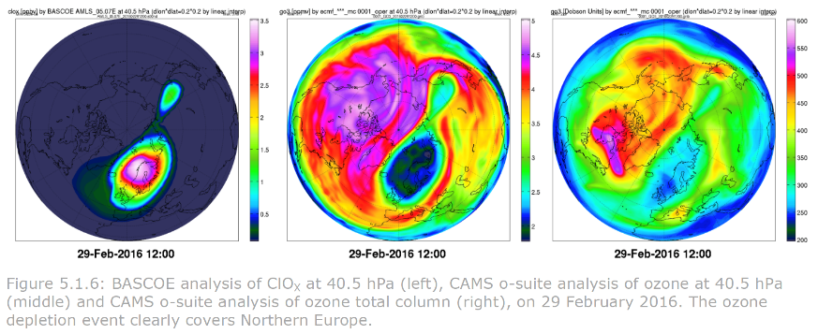
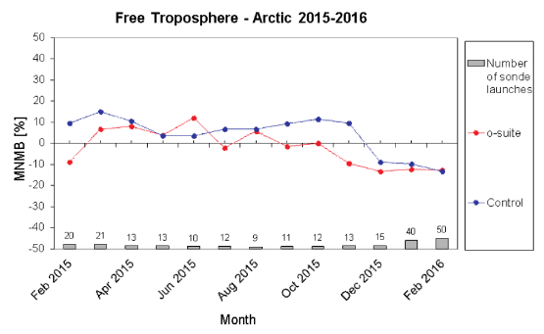
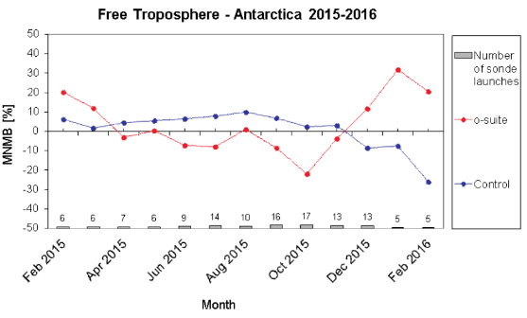
CAMS ANALYSES & FORECASTS VALIDATION IN THE ARTIC
From CAMS Quarterly Validation Reports (May 2016, status until 01/03/2016)
Ozone 25-40km, Spitsbergen
Ozone depletion event (Feb. 2016)
Tropospheric ozone, Arctic and Antarctica
Surface ozone, Point Barrow (Alaska)

Slide 7

C3S in a nutshell
from European commission e.g.,FP7 Space call, H2020
from EU Member States, ESA, EUMETSAT, EEA, WMO..
Climate Data Store
Quality assurance
Integrity of Service
User requirements
Evaluation & QC function
Outreach & Dissemination
Sectoral Information System
Stakeholders & users
Implemented by

Slide 8
Climate Data Store content
Scientific basis:
Essential Climate Variables as defined by GCOS
GCOS Status Report and Implementation Plan
IPCC, CMIP
Action engaged
In preparation
(PIN or ITT out)
Not started
Observations
Global estimates of ECVs from satellite and in-situ observations
Reprocessed CDRs, reference observations
Climate reanalysis
Global atmosphere, ocean, land
Regional reanalysis for Europe & Arctic
Model output
Multi-model seasonal forecast products
Access to CMIP data and products (global and regional)
Support for data rescue, climate data collections
Coupled climate reanalysis for 100 years
Reference set of climate projections for Europe
Climate Indicators

Slide 9
ECV products for CDS
Action engaged
  Initial set of ~ 30 ECVs planned for stages II and III
  Products will become available via the CDS during 2017/2018
  Additional/alternative ECV products to follow (e.g. NOAA CDRs, GPCP, …)
In preparation
(PIN or ITT out)
C3S_312a | ECV products from observations | 9 contracts, 12 ECVs | Started 2016Q4
C3S_311a | In situ observations (Lot 4) | High-resolution ECV products for Europe | Started 2017Q1
C3S_312b | ECV products from observations | Additional 8-10 ECVs | ITT in preparation
ERA5 | Global atmospheric reanalysis | Atmosphere, land, sea state | Started 2016Q1
ORA5 | Global ocean reanalysis | Ocean, sea ice | Complete
Notes:
~ 30 ECVs, described in the C3S Technical Annex, and planned for stages II and III, are either:
engaged (via ERA5/ORA5, 312a lots all awarded, and 311a in-situ)
or
under PIN / ITT (2nd set ECVs in 312b).
These ECVs will progressively become available through 2017/2018.
Will be complemented by additional ECVs (as outcomes or reanalysis products)
Liaison with other Copernicus services (e.g. CAMS, CMEMS ..) and ESA-CCI, SAFs, NOAA, etc. is being implemented (Coordination, ITTs spec, evaluation and follow-up, etc.) to ensure complementary and synergies
ECVs are all traceable to GCOS status report

Slide 10
ECV ROADMAP FOR C3S

Slide 11
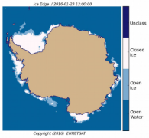
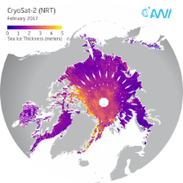
Sea Ice Production Service (DMI)
Complementary with EUMETSAT OSI SAF & ESA CCI
Sea Ice Edge:
Sea Ice concentration:
OSI SAF CDR (OSI-409) and ICDR (OSI-430)
Global coverage
10 km resolution
Includes uncertainty estimates
Distinguish between Open water, Open Ice and Closed Ice
Global coverage
10 km resolution
CDR: 1979 – 2016
ICDR: 2016 – onwards
CDR: 10.1978 – 04.2015
ICDR: 05.2015 - onwards
Sea Ice Thickness:
Sea Ice Type:
Distinguish between First-Year Ice and Multi-year Ice
Nothern Hemisphere
10 km resolution
Nothern Hemisphere
25 km resolution
Includes uncertainty estimates
CDR: 1979 – 2016
ICDR: 2016 – onwards
ICDR: 2010 – onwards

Slide 12
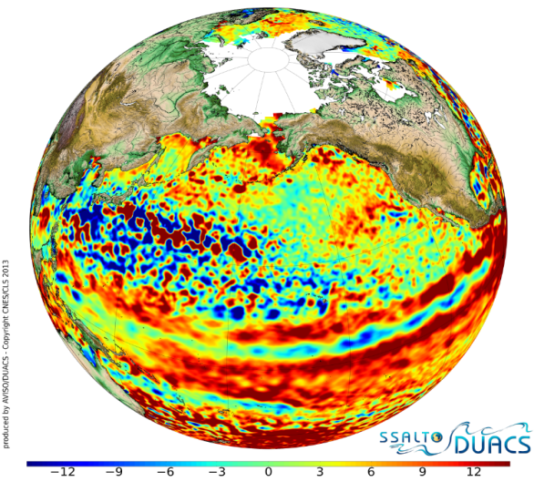
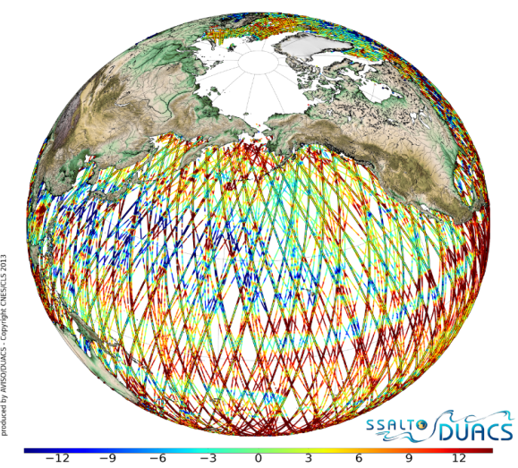
Sea Level Production Service (CLS)
The ECV is derived from satellite altimetry
Strong interaction and complementarity with the Copernicus Marine Service (CMEMS):
- C3S: retrieval of long-term variability and focus on the Mean Sea Level stability with a stable altimeter constellation in time.
- CMEMS: focus on the mesoscale estimation with all satellites missions available to provide the best sampling.
Regions of interest: global ocean, Med. sea and Black sea
Type of products:
Gridded daily maps:
1/4° (global) and 1/8° (Med. And Black seas)
The existing Sea Level ECV will be first delivered in April 2017 and the record will be regularly updated.
A full reprocessing will be delivered in March 2018
Interactions with spaces agencies will ensure the service quality and evolution.
Notes:
Serviced ensured by CLS and LEGOS (France)
Regions of interest: global ocean, Med. sea and Black sea
Type of products:
Gridded daily maps:
1/4° (global) and 1/8° (Med. And Black seas) of:
Absolute Dynamic Topography
Sea Level Anomalies
Geostrophic velocities
The existing Sea Level ECV will be first delivered
in April 2017 and the record will be regularly updated.
A full reprocessing will be delivered in March 2018
Interactions with spaces agencies will ensure the
service quality and evolution

Slide 13
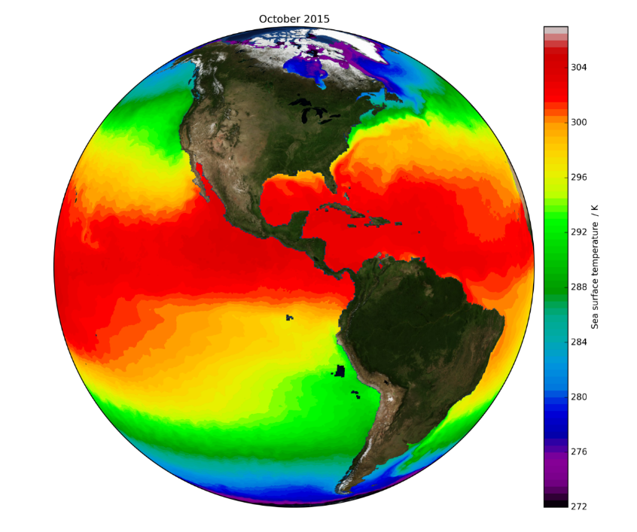
SST CDR Production Service (TVUK)
The project will setup a pre-operational service to generate L2, L3 and L4 SST products, covering a range of user requirements
SSTs are observed from several AVHRR sensors and blended using methods developed within SST CCI.
Inheritance from ESA’s SST CCI project:
SST ICDR production will start in May 2017 with monthly updates, data ~ 6 months old initially
Aim is to generate SST ICDR daily with timeliness < 5 days by March 2018

Slide 14
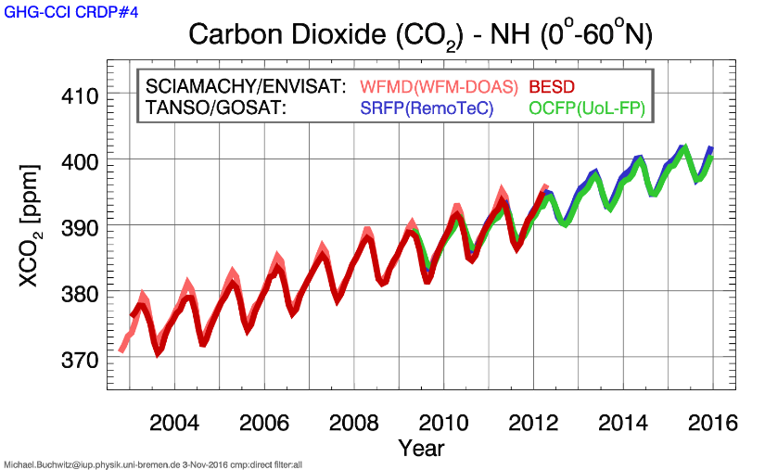
Ozone (BIRA), CO2 and CH4 (DLR) services
Objective - Operationalize CCI ozone CDR processing lines to feed Copernicus Climate Data Store
Specific objectives:
Produce and deliver high-quality long-term gridded data records of:
  Total ozone from GOME/-2, SCIAMACHY, OMI (+ MSR)
  Nadir ozone profiles from BUV (GOME/-2, SCIAMACHY, OMI) and TIR (IASI)
  Limb ozone profiles from MIPAS, GOMOS, SCIAMACHY, ACE-FTS, OSIRIS, SMR, MLS, HALOE, SAGE-II and SABER
Full traceability of production process, Quality control and Quality Assurance (QA/AC) of Service and Data Products, User feedback, communication and outreach
To be extended via C3S
Data products:
Column-averaged CO₂ („XCO₂“) and CH₄ („XCH₄“)
Mid/upper tropospheric CO₂ and CH₄
Level 2 (individual sensors), merged L2, merged L3
Satellite sensors:
SCIAMACHY, GOSAT, IASI, …

Slide 15
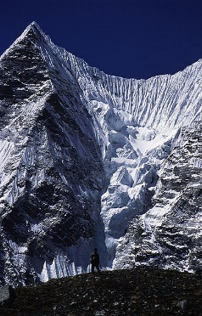
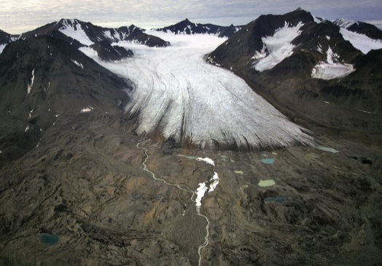
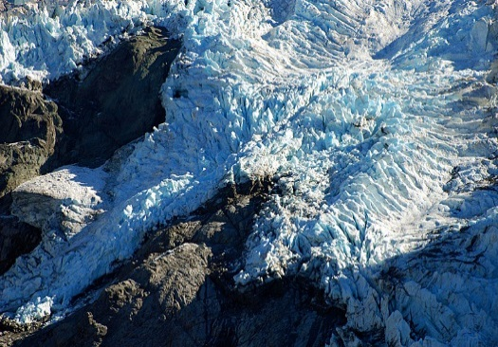
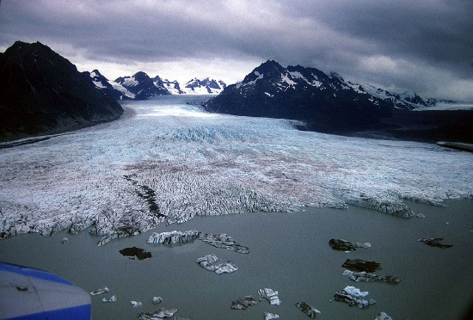
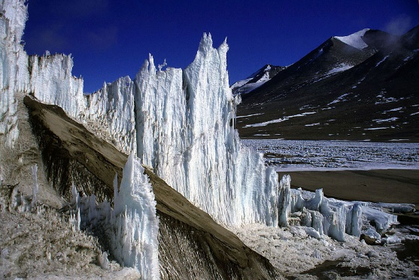
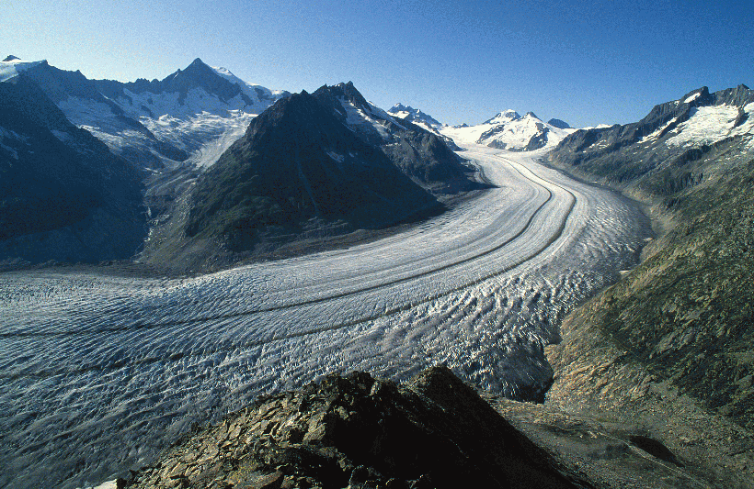
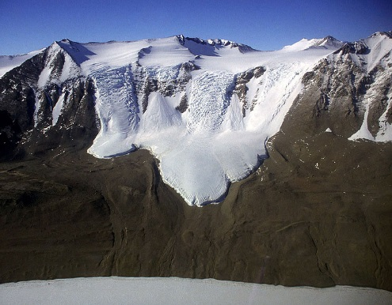
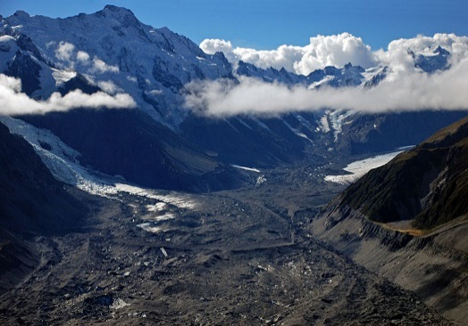
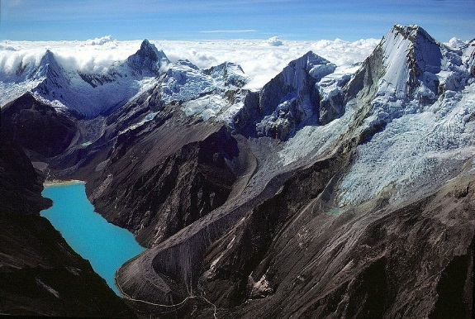
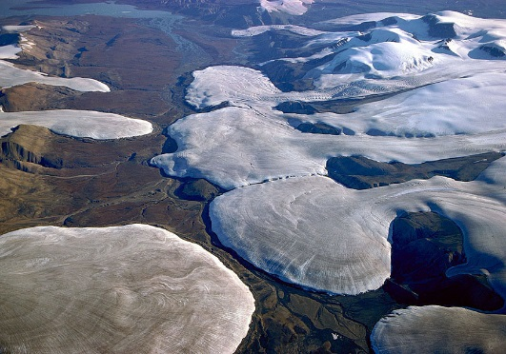

Glaciers & Ice Caps Services (Univ. Zurich)
Notes:
Glaciers are globally distributed and show a wide range of types and shapes:
From the easily recognizable clean glaciers in the Arctic (lower right, Axel Heiberg Island) to highly debris-covered glaciers where the tongue is hard to see in New Zealand (lower left, Tasman Glacier).
Mapping their extents and changes through time precisely is thus quite a challenge and includes manual work of experienced analysts.
click for text slide
- just read the text

Slide 16
Glaciers & Ice Caps Services (Univ. Zurich)
A globally distributed ECV and monitoring concept
  Glaciers occur globally and have a wide range of surface/dynamic characteristics
  Their monitoring is based on a global network of observers and has a >100 yr tradition
  RS data processing is also globally distributed (GLIMS) & based on scene-by-scene analysis
  GCOS accuracy reqs. can only be met when manual editing is applied (debris, clouds)
The Glacier Distribution and Change Service in C3S is based on
  Glacier mapping & change assessm. with optical satellite data (L8/S2) in key regions
  Utilizing latest DEMs (TanDEM-X, Arctic DEM) to obtain glacier-specific elevation changes
  Enriching and improving pre-existing datasets (GLIMS/RGI & WGMS database)
  Collecting and integrating already published data from the community (reach out)
Developing of adaptors for integration of glacier data in the CDS
  Step 1: Adaptor 1 & 2 brings existing RGI (inventory) & FoG (WGMS) databases into the CDS
  Step 2: Updating the CDS with new datasets (new, enriched, and collected products)
  Step 3: Adaptor 3 merges extents & elevation changes for improved calculation of sea level
Notes:
Glaciers are globally distributed and show a wide range of types and shapes:
From the easily recognizable clean glaciers in the Arctic (lower right, Axel Heiberg Island) to highly debris-covered glaciers where the tongue is hard to see in New Zealand (lower left, Tasman Glacier).
Mapping their extents and changes through time precisely is thus quite a challenge and includes manual work of experienced analysts.
click for text slide
- just read the text

Slide 17
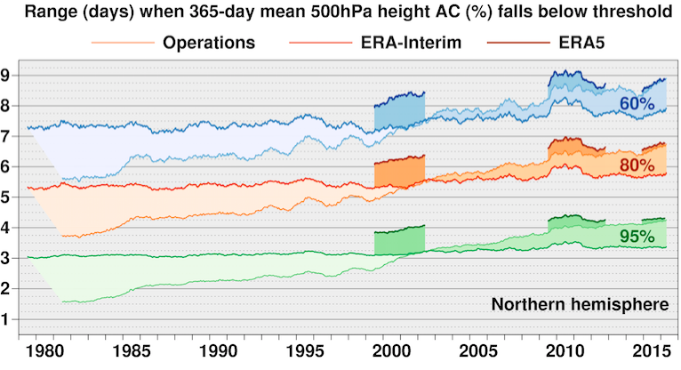
Climate Data Store: Reanalyses
ERA5 global reanalysis:
Atmosphere/land/wave parameters
31 km global resolution, 137 levels
Hourly output from 1979 onward
Using improved input observations
Ensemble data assimilation
Providing uncertainty estimates
  However, need to
  provide better regional estimates of surface parameters by using improved model representations of surface fluxes;
  assimilate observations that are not used well (or not at all) in global reanalyses;
  improve the representation of extreme values and extreme events.
  → Regional reanalysis (European + Arctic domains)

Slide 18
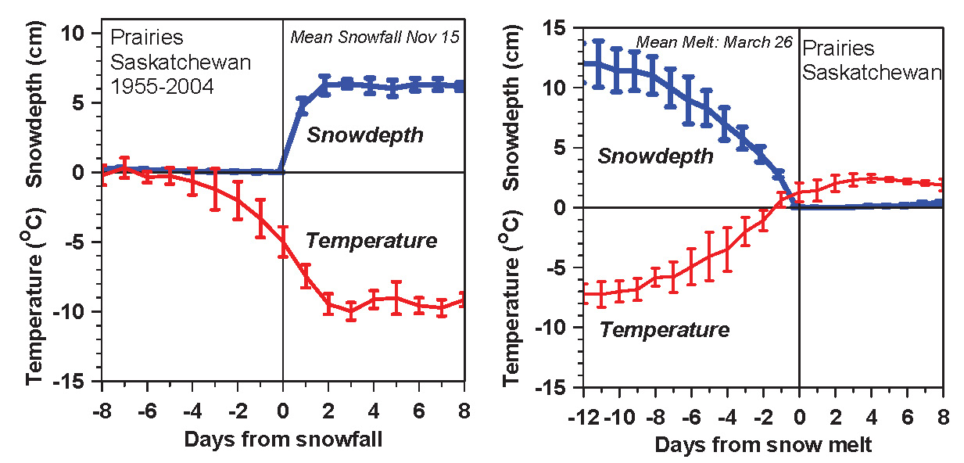
Earth surface role, observational evidence (snow)
  Global and regional reanalysis benefit from advances in modelling and data assimilation activities. Observations (truth) are needed.
Temperature falls/rises about 10K with first snowfall/snowmelt
Snow reflects sunlight; shift to cold stable BL
  Local climate switch between warm and cold seasons
  Winter comes fast with snow
Betts et al. 2014

Slide 19
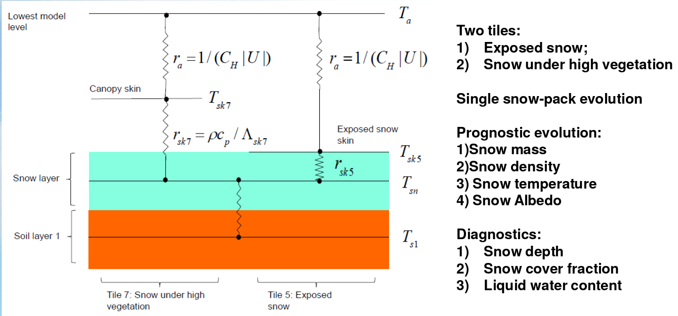
Snow representation at ECMWF
  E. Dutra
  Global and regional reanalysis benefit from advances in modelling and data assimilation activities. Observations (truth) are needed.

Slide 20
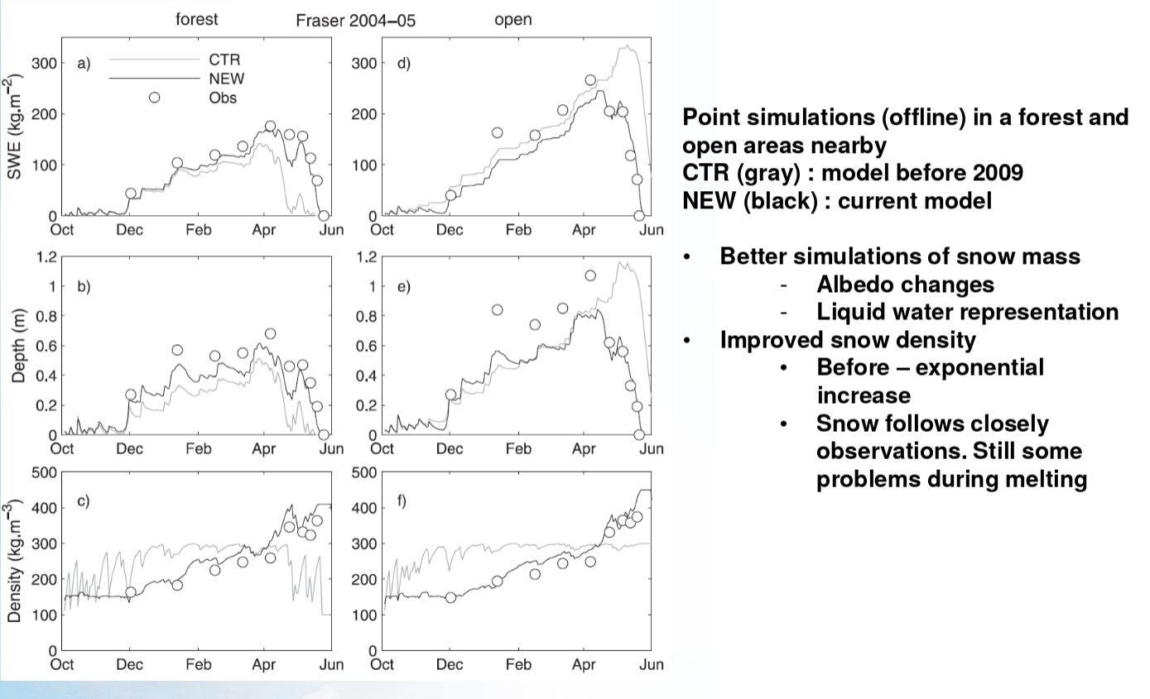
Snow representation at ECMWF – Point evaluation
  E. Dutra

Slide 21
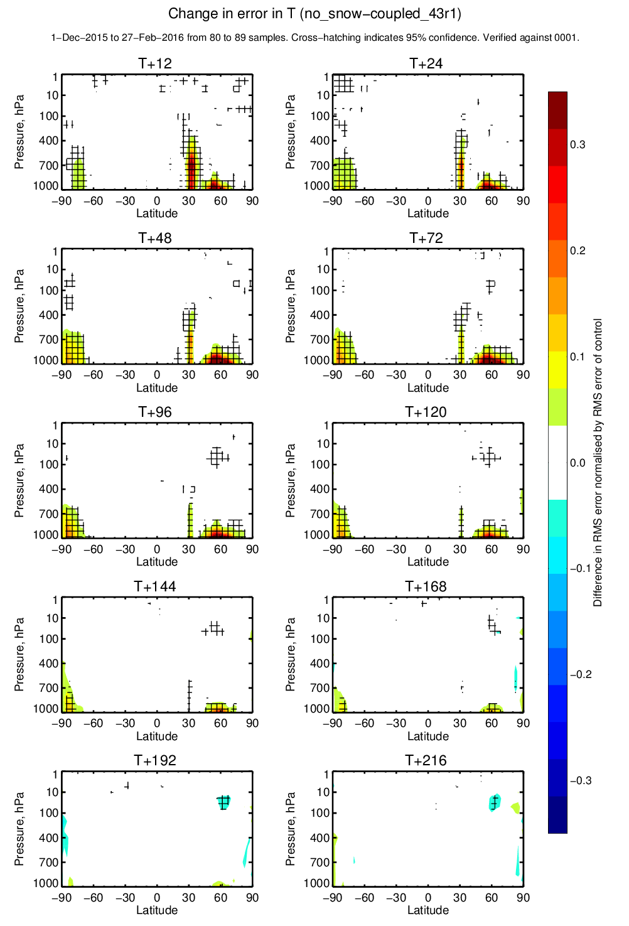
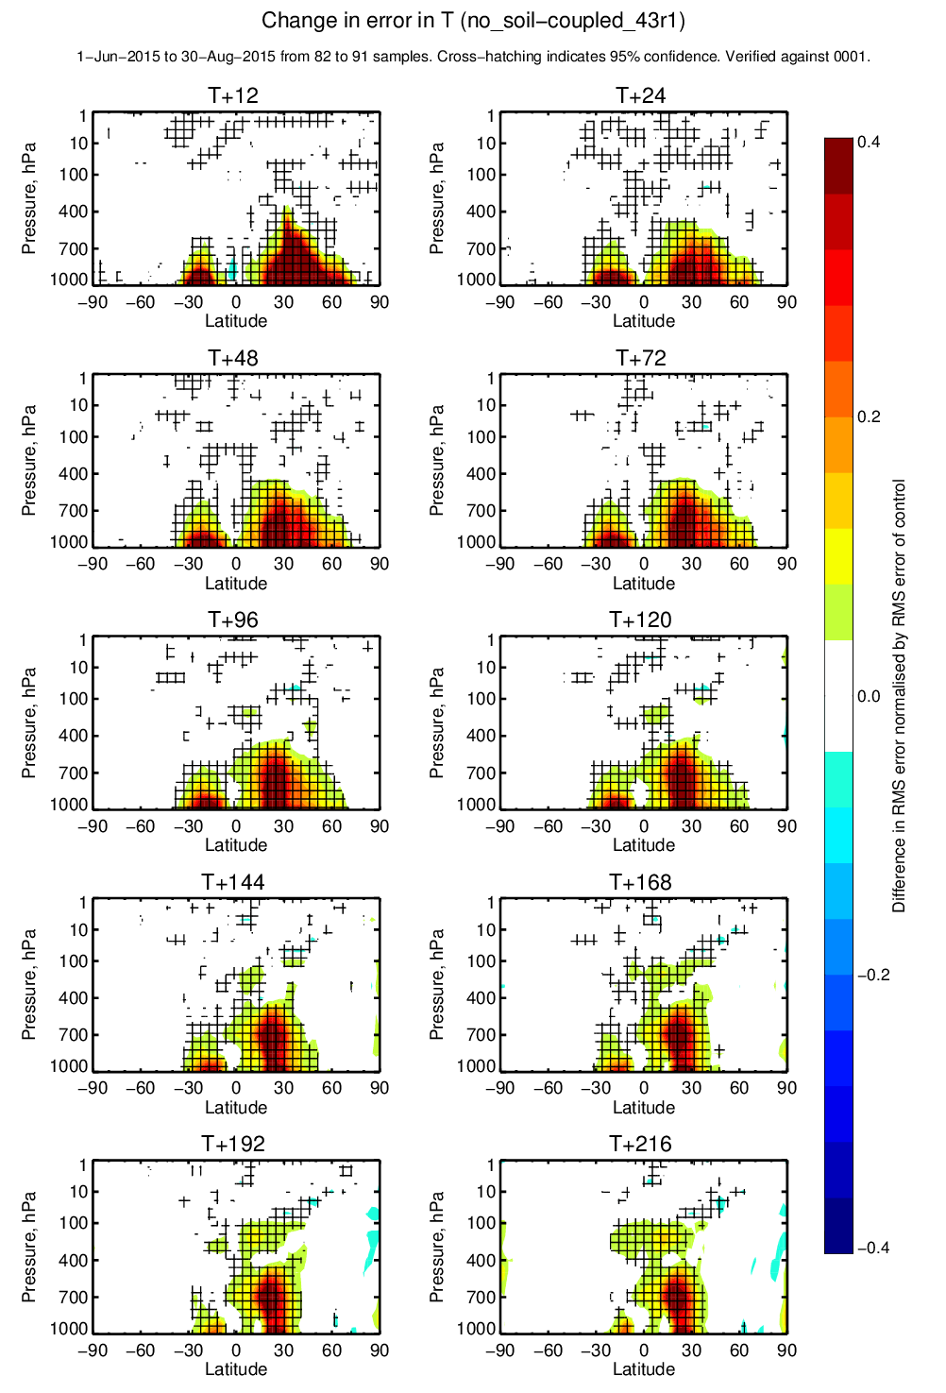
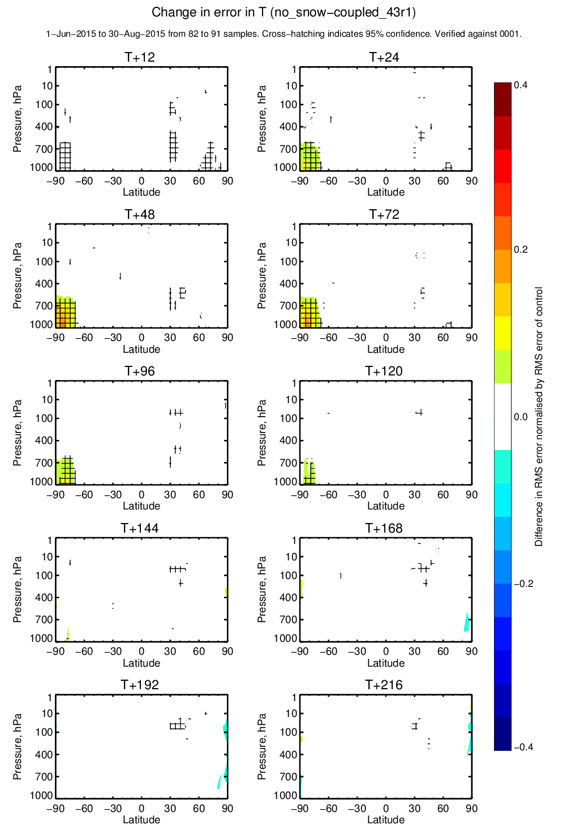
Relative Soil & Snow forecast impact
Snow processes (winter 2015-16)
Snow processes (summer 2015)
Snow has both NH/SH impact (20-30% winter, 10-20% summer) lower troposphere

Slide 22
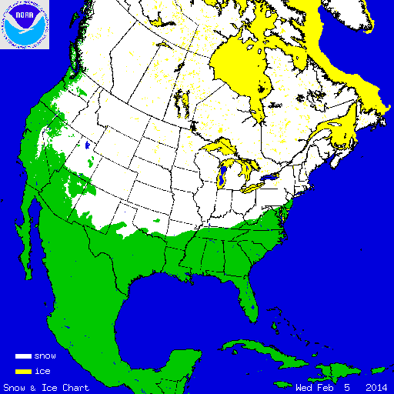
Snow data assimilation at ECMWF
Snow depth
  Methods: Cressman for ERA-Interim, 2D Optimal Interpolation (OI) for NWP & ERA5
  Conventional observations: in situ snow depth (SYNOP & additional National data)
  Satellite data: NOAA/NESDIS IMS Snow Cover Extent (daily product).
Soil Temperature and Snow Temperature
1D-OI using analysed T2m as observation (NWP, ERA-Interim, ERA5)

Slide 23
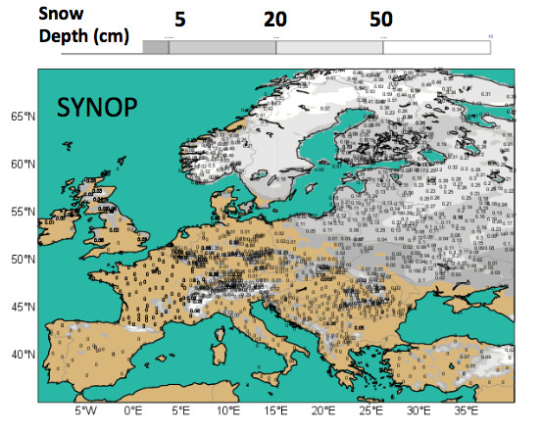
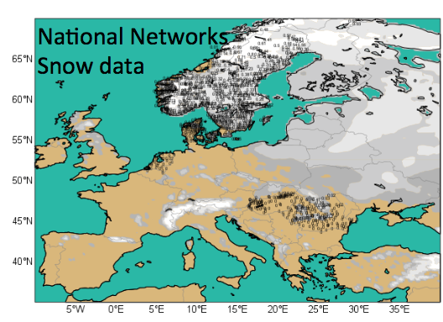
Snow data assimilation at ECMWF
  P. de Rosnay
Available in the global GTS
January 2017
Notes:
~ 30 ECVs, described in the C3S Technical Annex, and planned for stages II and III, are either:
engaged (via ERA5/ORA5, 312a lots all awarded, and 311a in-situ)
or
under PIN / ITT (2nd set ECVs in 312b).
These ECVs will progressively become available through 2017/2018.
Will be complemented by additional ECVs (as outcomes or reanalysis products)
Liaison with other Copernicus services (e.g. CAMS, CMEMS ..) and ESA-CCI, SAFs, NOAA, etc. is being implemented (Coordination, ITTs spec, evaluation and follow-up, etc.) to ensure complementary and synergies
ECVs are all traceable to GCOS status report

Slide 24
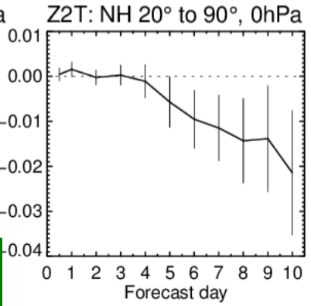
Snow data assimilation at ECMWF
  P. de Rosnay
  All data assimilated (SYNOP + Nat + IMS) compared to SYNOP + IMS assimilation → Further T2m error reduction
  Contribution and complementarities of each observation types to improve T2m forecasts at short and medium ranges.
Notes:
~ 30 ECVs, described in the C3S Technical Annex, and planned for stages II and III, are either:
engaged (via ERA5/ORA5, 312a lots all awarded, and 311a in-situ)
or
under PIN / ITT (2nd set ECVs in 312b).
These ECVs will progressively become available through 2017/2018.
Will be complemented by additional ECVs (as outcomes or reanalysis products)
Liaison with other Copernicus services (e.g. CAMS, CMEMS ..) and ESA-CCI, SAFs, NOAA, etc. is being implemented (Coordination, ITTs spec, evaluation and follow-up, etc.) to ensure complementary and synergies
ECVs are all traceable to GCOS status report

Slide 25
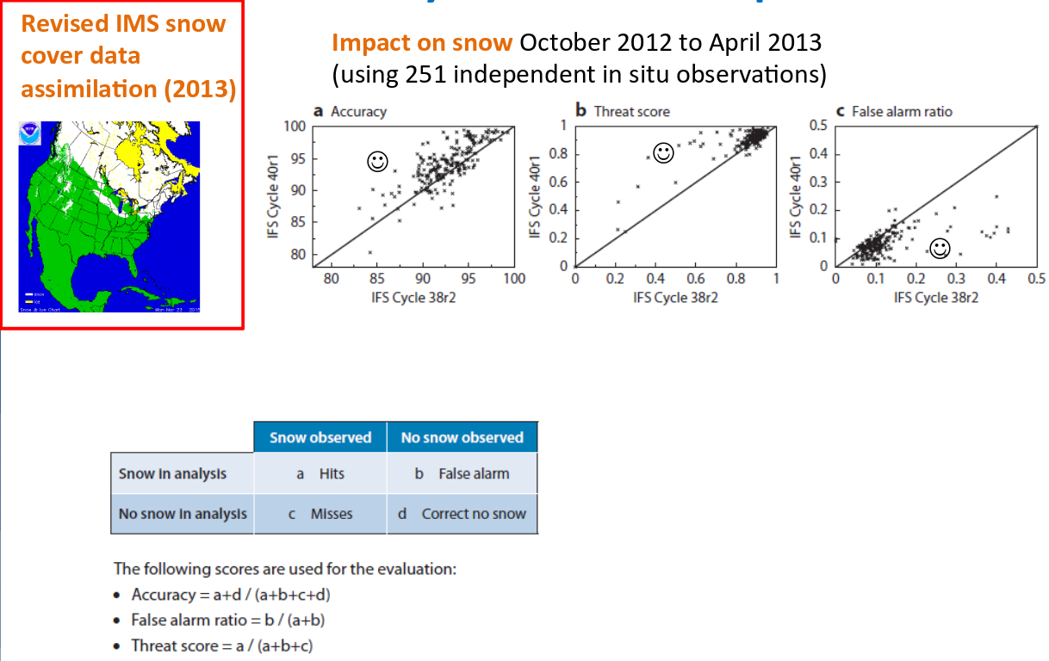
Snow data assimilation at ECMWF
  P. de Rosnay
Notes:
~ 30 ECVs, described in the C3S Technical Annex, and planned for stages II and III, are either:
engaged (via ERA5/ORA5, 312a lots all awarded, and 311a in-situ)
or
under PIN / ITT (2nd set ECVs in 312b).
These ECVs will progressively become available through 2017/2018.
Will be complemented by additional ECVs (as outcomes or reanalysis products)
Liaison with other Copernicus services (e.g. CAMS, CMEMS ..) and ESA-CCI, SAFs, NOAA, etc. is being implemented (Coordination, ITTs spec, evaluation and follow-up, etc.) to ensure complementary and synergies
ECVs are all traceable to GCOS status report

Slide 26
Snow modeling & data assimilation at ECMWF
  In the past few years major development in the ECMWF modelling and data assimilation (DA) system affecting forecasts and analyses at Polar regions
  Snow DA assimilation crucial for NWP
    Significant improvement of near-surface meteorology
    In the absence of satellite dedicated missions, in-situ snow depth observations is by far the most relevant information for snow DA.
    GAPS, in snow reports availability in the GTS
      Some areas with poor reporting (Iceland)
      Areas with seasonal reporting because they only report on snow covered areas
      For some countries the data exist and is available in NRT → need to include it in the GTS network (decisions, resources)
      For other countries (Finland) data policy issues
      For all areas with gaps awareness is necessary
  Challenges in retrieving Snow Mass from satellite measurements
    Novel mission concept required for SWE in NWP
Notes:
~ 30 ECVs, described in the C3S Technical Annex, and planned for stages II and III, are either:
engaged (via ERA5/ORA5, 312a lots all awarded, and 311a in-situ)
or
under PIN / ITT (2nd set ECVs in 312b).
These ECVs will progressively become available through 2017/2018.
Will be complemented by additional ECVs (as outcomes or reanalysis products)
Liaison with other Copernicus services (e.g. CAMS, CMEMS ..) and ESA-CCI, SAFs, NOAA, etc. is being implemented (Coordination, ITTs spec, evaluation and follow-up, etc.) to ensure complementary and synergies
ECVs are all traceable to GCOS status report

Slide 27
Summary
  CAMS and C3S provide an increasing volume of atmospheric composition and climate information relevant for polar regions and snow covered areas, based on a combination of satellite and in-situ observations using the latest methods and tools.
  The Climate Data Store will offer a “one-stop-shop” access to this information
    Data (including sectoral information)
    Tools (data accessible and discoverable)
    Best practices
  The Copernicus data policy is “full-free-open” → This will foster uptake by downstream services (national, local, private and public) and therefore support market development for EO and climate services in Europe.
  Modelling and data assimilation activities (as well as in-situ observations) are very relevant for reanalyses
  → Continuity and evolution of the C3S & CAMS services require sustained observation capability
Notes:
What information gaps exist currently? → which new mission concepts are needed?
Deficiencies are primarily related to frequency of measurements, resolution, sensor capability, and information discovery and distribution.
Polar regions are important for the
* Ozone hole monitoring
* Carbon and other atmospheric component concentrations
* Carbon stocks can be released with melting, and also methane. Sea ice and snow cover properties (like density) are important because depend on that release of fluxes. There might be lot of carbon stored in the ice created by bacteria.
- since Nov 2016 we have a dynamical sea ice model (LIM2), so sea-ice cover can be dynamically forecasted up to 15 days, rather than be static as in their previous version.

