Slide 1
ECMWF-ECCC Land DA online meeting, 24 August 2021
Coupled land-atmosphere data assimilation for operational NWP and reanalyses
Patricia de Rosnay, David Fairbairn, Pete Weston, Phil Browne,
and many other colleagues

Slide 2
Toward coupled assimilation in ECMWF’s operational systems
4D-Var
Atmosphere
Earth system approach
Integrated Forecasting System (IFS)
Sea Ice
3D-Var
Land
EKF-OI
Ocean
3D-Var
Waves
OI
- Consistency of the coupling approaches across the different components of the Earth System
- Modularity to account for the different components in coupled assimilation
- Common infrastructure for land, atmosphere, ocean, sea ice, waves for NWP and reanalysis

Slide 3
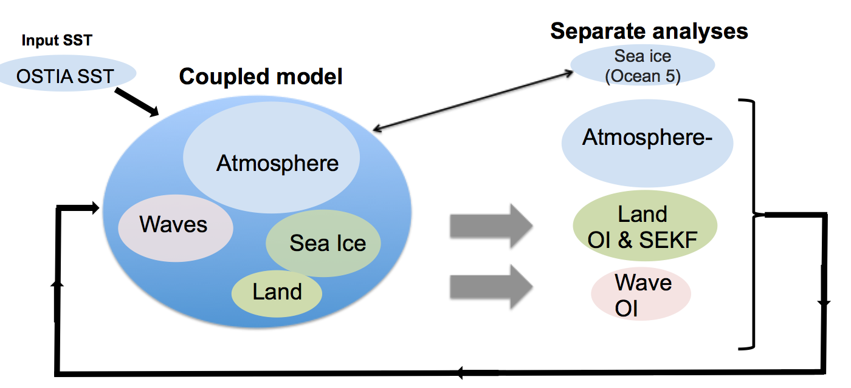
Current operational NWP system at ECMWF
Weakly coupled land-atmosphere-wave and sea ice assimilation
SST,Sea ice
3D-Var
4D-Var
Plans to develop land-atmosphere coupling at the outer-loop level of the atmospheric 4D-Var
3

Slide 4
Coupled assimilation in operational systems
Methodology:
Coupled assimilation challenges, coupling strategy from weak to strong coupling, etc
Link to methodology and unified framework development (e.g. OOPS at ECMWF)
Infrastructure:
Earth System approach → consistent & modular suite definition for land and atmosphere, use same file system for all components,
Develop/maintain consistent research offline and coupled, and operational coupled tools
Observing system and monitoring:
Access to observations, common acquisition for land & atmosphere, observation pre-processing, quality control, data selection, feedback files, monitoring, auto-alert system, …
Observation operators:
Coupling for observations that depend on more than one sub-system (e.g. low frequency MW observations sensitive to the surface), explore AI/ML approaches

Slide 5
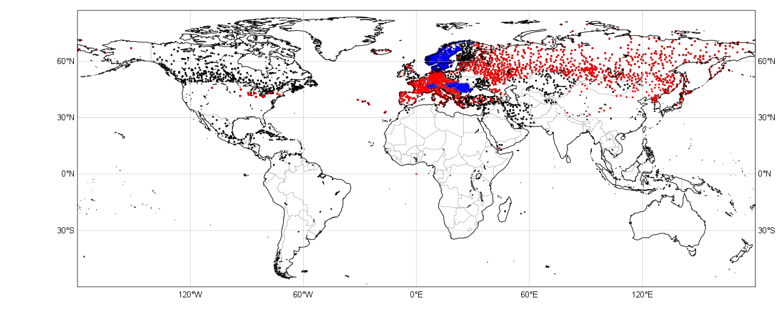
Observing system: the example of in situ snow depth
Near-Real-Time access to observations
SYNOP TAC SYNOP BUFR national BUFR data
15 January 2015
Snow depth availability o the Global Telecommunication System (GTS)

Slide 6
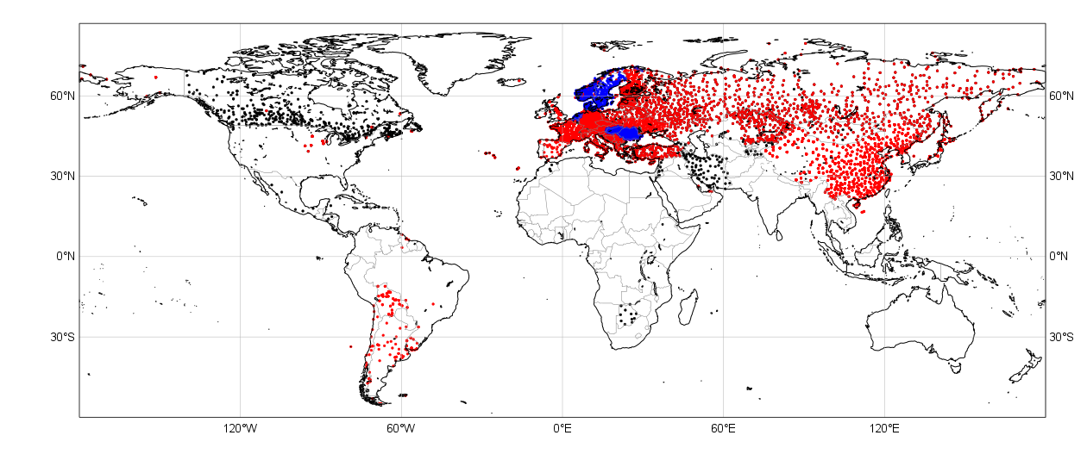
Observing system: the example of in situ snow depth
Near-Real-Time access to observations
SYNOP TAC SYNOP BUFR national BUFR data
15 January 2021
Snow depth availability o the Global Telecommunication System (GTS)
Ongoing/near future: improvement in the US (NOAA)

Slide 7
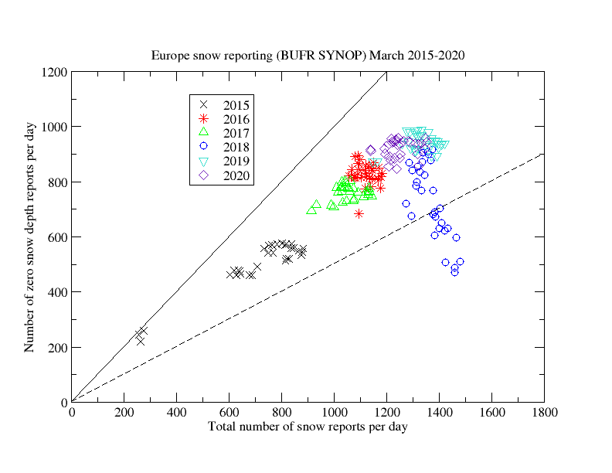
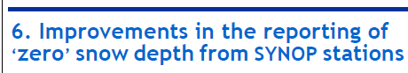
Snow data exchange and WMO
Global Cryosphere Watch (GCW) and Snow Watch Team
  snow data exchange WMO regulation, BUFR template (with Observation Team), link to GODEX
SG-CRYO and JET-EOSDE (both WMO Infrastructure Commission) → relevant for coupled assimilation
WIGOS Newsletter April 2020

Slide 8

ECMWF Soil Analysis for NWP
Simplified Extended Kalman Filter (SEKF)
with EDA Jacobians
Ensemble Data Assimilation (EDA)
NWP Forecast
Coupled Land-Atmosphere
Land initial conditions
EDA Jacobians
T2m, RH2m
& soil moisture
Background
Soil Analysis (SEKF)
SM1, SM2, SM3
σ_{O_T2M}= 1K
σ_{b_}= 0.01m3/m3
σ_{SMOS_NN}= 0.02+3ε
σ_{O_RH2M}= 4%
σ_{ASCAT}= 0.05m3/m3
SMOS Neural network
SMOS TB
Screen level analysis (2D-OI)
T_2m RH_2m
in situ
T_2m RH_2m
satellite
ASCAT SM
SMOS SM
$$σoT2m=2K$$
$$σoRH2m=10\%$$
8

Slide 9
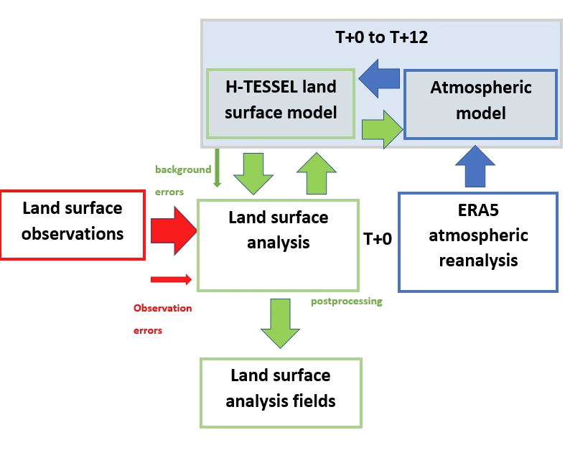
Uncouped Land surface analysis systems
→ Support research and land surface reanalysis
System(s) consistency and maintenance
Offline surface model forced by atmospheric reanalysis (e.g. ERA5-land)
  ☺ Allows enhanced surface model/resolution
  ☹ No land DA
Offline soil moisture DA (Rogriguez-Fernandez et al, 2019)
  As (1), but offline soil moisture analysis included
  A priori observation processing and gridding
  No snow DA
Stand-alone surface analysis (SSA, Fairbairn et al., 2019)
  ☺ Full land DA system in IFS (soil moisture, snow, etc…)
  Coupled land-atmosphere model
  Same observation interface than NWP
  No atmosphere DA so cheaper than coupled DA system
  ☹ Still significantly more computationally expensive than (1) and (2)
SSA forced by ERA5
Fairbairn et al., 2019 J. Hydrometeor, 2019. https://doi.org/10.1175/JHM-D-19-0074.1
Rodriguez-Fernandez et al., Rem. Sens. 2019 https://www.mdpi.com/2072-4292/11/11/1334
Notes:
9

Slide 10
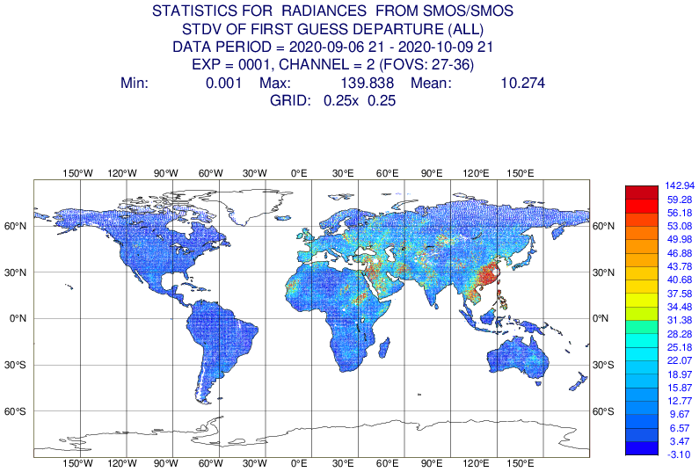
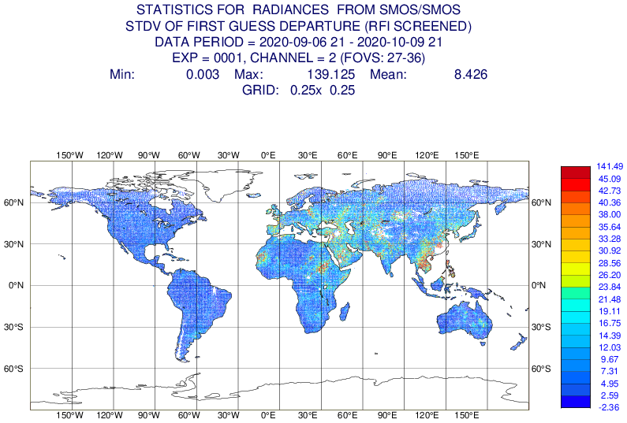
Observation monitoring and quality control
SMOS brightness temperature operational monitoring
Summer 2020: a large area of RFI (Radio Frequency Interference) contamination over South-East China
Improved screening does a better job of filtering it out but still not perfect
  Need for further improvements in RFI filtering flags
  Importance of quality control
Basic RFI screening
Stronger RFI screening

Slide 11
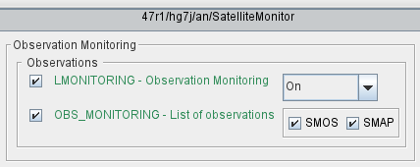
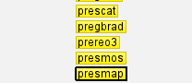
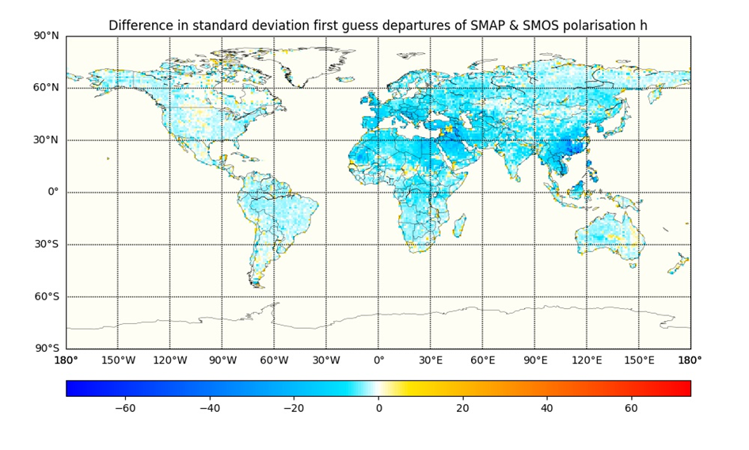
New observation implementation
SMAP monitoring (May 2021)
Set-up operational NRT acquisition
Scripts suite and prepIFS changes complete
SMAP Observation interface (Obs Data base, ODB)
Script and Fortran changes
Suite definition and prepIFS
Monitoring webpage update
Next: SMAP assimilation
→ Full chain of developments to integrate new observations in a complex (Earth) system
Pete Weston

Slide 12
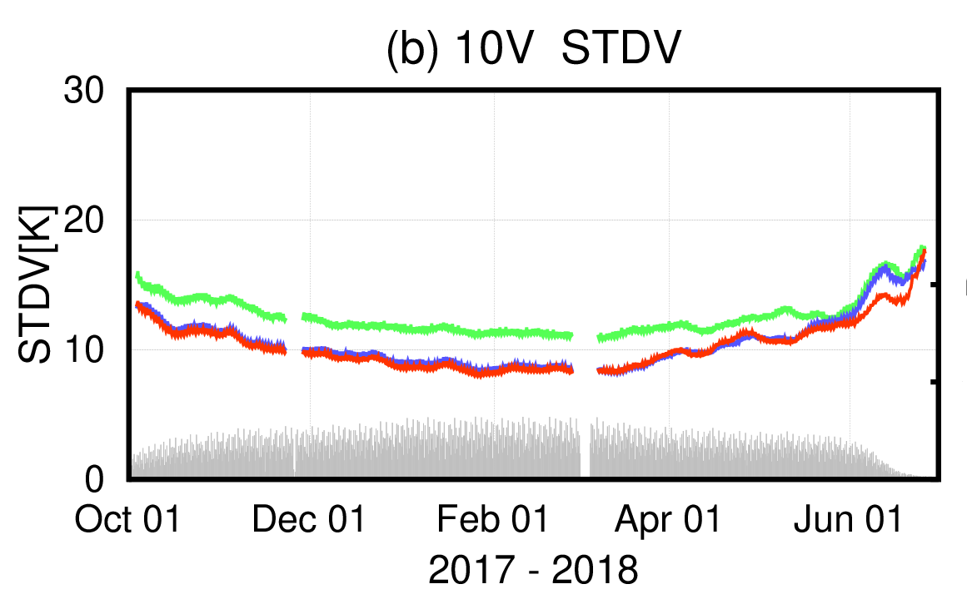
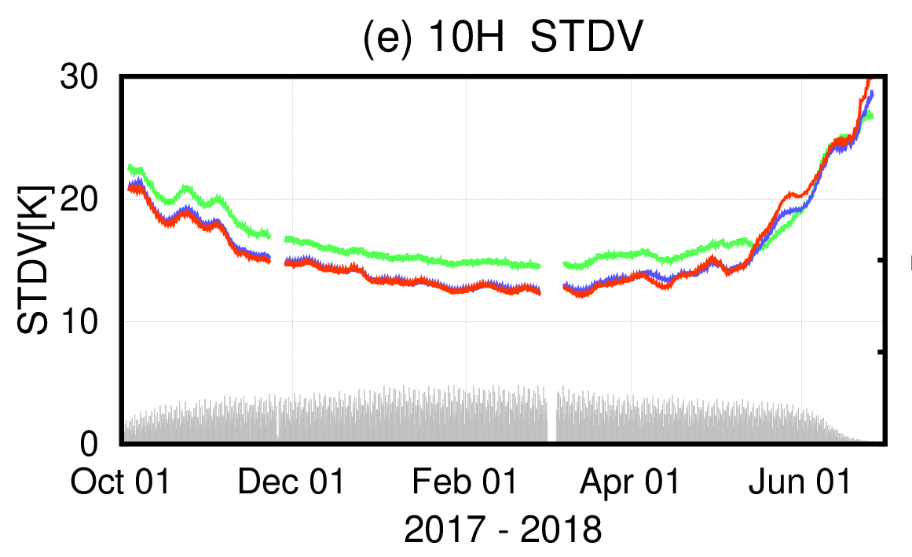
Coupling through the observation operator
  New interface between CMEM (surface) and RTTOV (atmosphere) radiative transfer schemes
  Multi-layer snow radiative transfer scheme (HUT, Lemmetyinen et al., 2010) in CMEM offline
  Adapt to model cycle changes, take advantage to improve coupled DA
Use the multi-layer snowpack model (Arduini et al JAMES 2019) to assess the impact of multi-layer approach on snow emissions against AMSR2 10GHz data
Multi-layer snowpack scheme leads to reduce STDV and gives higher correlation values between ECMWF forward and AMSR2 observed brightness temperatures at 10GHz
--- Single Layer
--- Multi-layer snowpack and RT
--- Multi-layer snowpack only
Hirahara et al., 2020 https://doi.org/10.3390/rs12182946

Slide 13
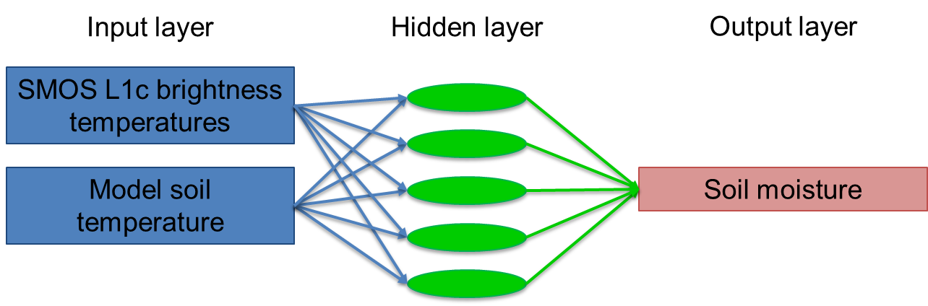
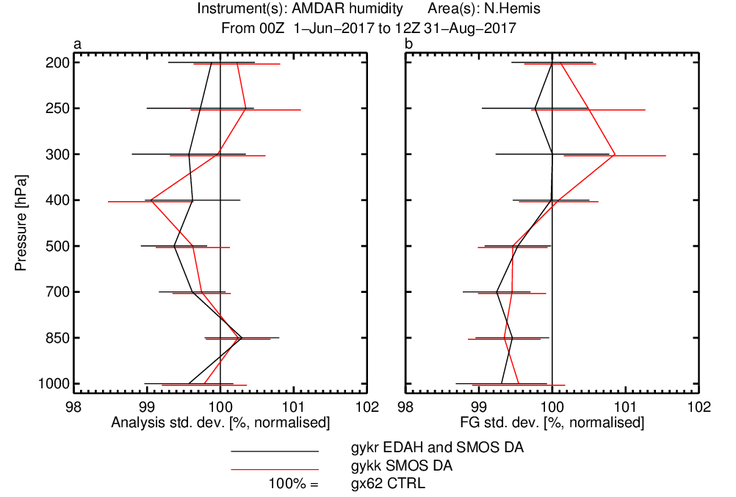

SMOS neural network soil moisture assimilation
SMOS DA impact
Aircraft humidity (JJA 2017)
Rodriguez-Fernandez et al., HESS 2017, RS 2019
A priori training of the SMOS neural network processor
-> retraining when L1Tb or IFS soil change
Online training possibilities?
Further explore ML/AI for forward modelling
Recent work from Aires et al QJRMS 2021: use neural network to investigate the relation between ASCAT backscatter and soil moisture
Pressure (hPa)

Slide 14
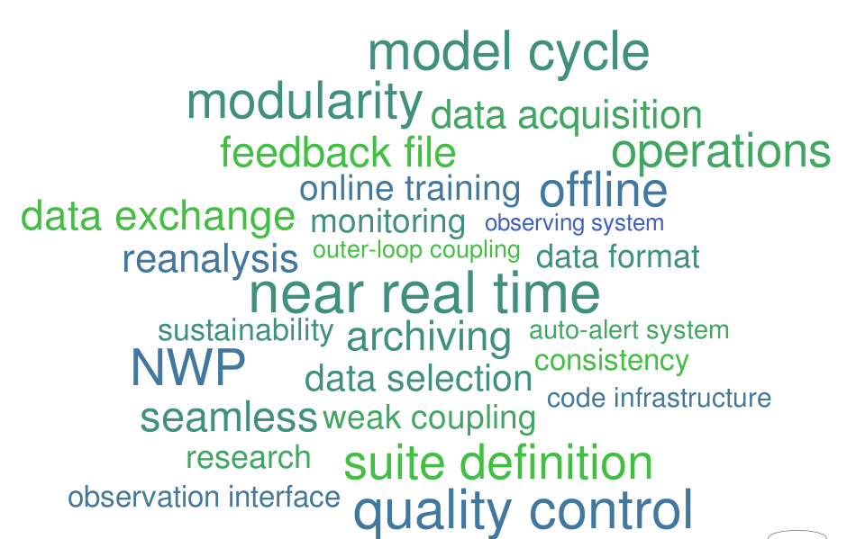
Summary

Slide 15
Future plans
Land DA
  Unified multivariate ensemble-based land DA system: progressively include more variables in the SEKF control vector, use the EDA to estimate flow-dependent B, enhance observation usage
  Move towards level 1 observation usage: develop forward operator using combined physical and include ML approaches tackle challenges of complex surfaces radiative transfer modelling
Coupled land-atmosphere DA
  Develop modular coupling infrastructure to enable different degrees of coupling flexibility under a single suite definition (optimal maintenance, useful for land reanalysis and initialisation of reforecasts)
  Develop outer loop coupling consistent with ocean-atmosphere coupling
  Observation operator coupling to enhance the exploitation of satellite observations e.g. over snow covered surfaces
  Assimilate 4D-Var Extended Control Variable as land pseudo-observations (e.g. skin temperature)

