Slide 1
Use of Ensemble forecasting for:
Strategic ship routing
Offshore site forecasting
Long term forecasting for Energy sector
by
Martin Lindberg, Maritime Service, DMI
(Danish Meteorological Service )

Slide 2
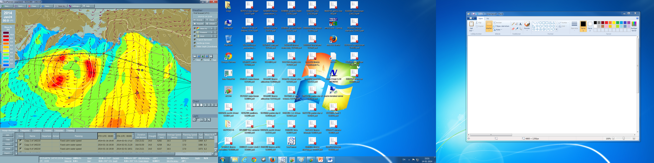
Strategic ship routing over the Pacific Ocean
Weather routing of Maersk Swaziland from Lazaro Cardenas, Mexico to Vostochny, Russia.
ETD: January 16th 19:30utc, ETA: February 2nd 06:00utc (Service/eco-speed 20.5/12.0 kts).
ECMWF forecast issued 2014-01-14 00:00 valid 2014-01-24 00.00 (+240hrs).
The deterministic forecast ends before vessel (the red triangles) reaches half way, therefore the optimizations are of no good use and strategic planning with usage of ensemble forecasting is necessary.

Slide 3
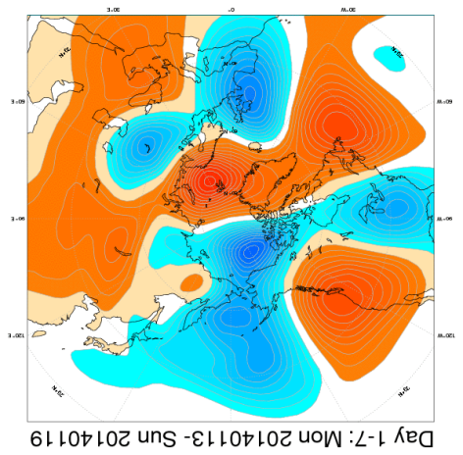
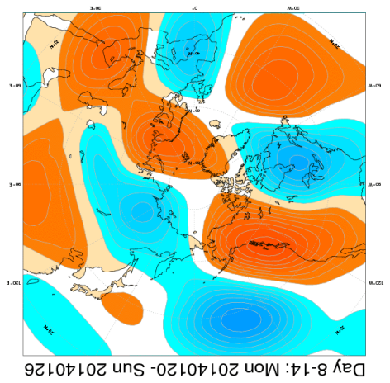
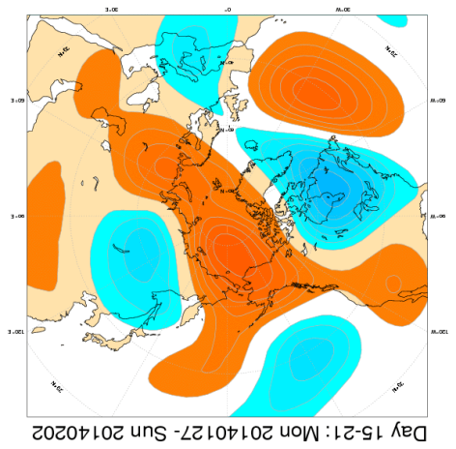
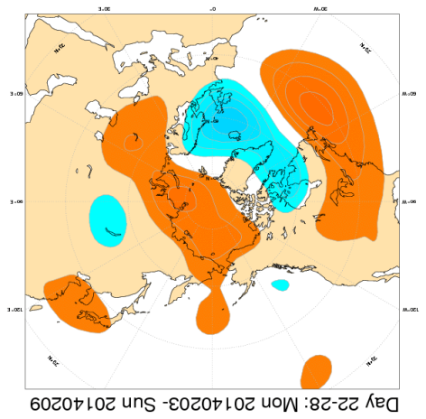
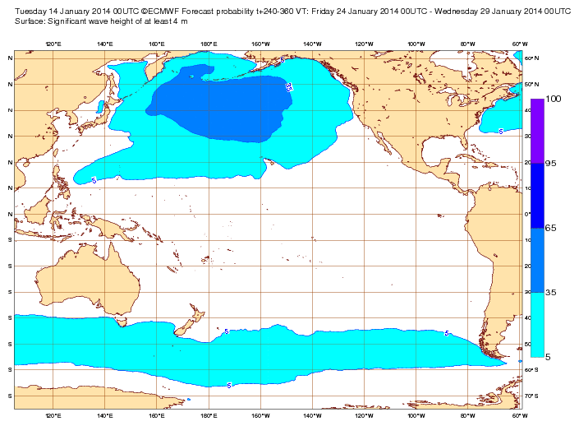
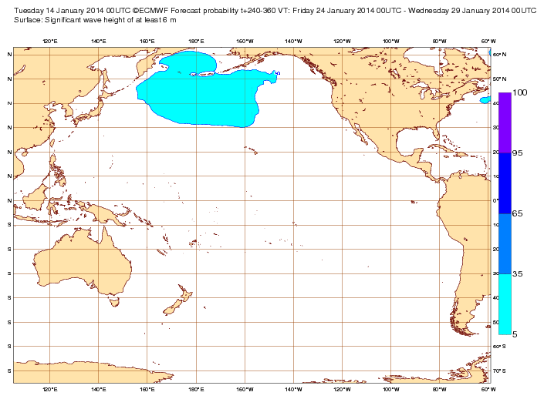
Large scale mean flow: weekly-mean 500hPa gpt anomaly for the ensemble mean
The weekly mean 500hPa anomaly is not always easy to interpret as it often becomes ”middled-out” with time and fast moving lows result in less anomaly than stationary (and filling) lows. However, this product (weekly anomaly charts for the next 4 weeks) is a good tool for our strategic route-planning.
From the end of January a trend of rising mean pressure can be seen in the weekly mean ensemble charts (the two charts to the right). In week 3-4 probably less deep lows near the Aleut islands and over the northern Pacific, while lows may track north from Japan towards eastern Sibiria. Northerly routes via the Aleutean islands then seems favourable.
Over 4m
Over 6m
Forecast probability of significant wave height T+240-360hrs VT: 24/1-29/1

Slide 4
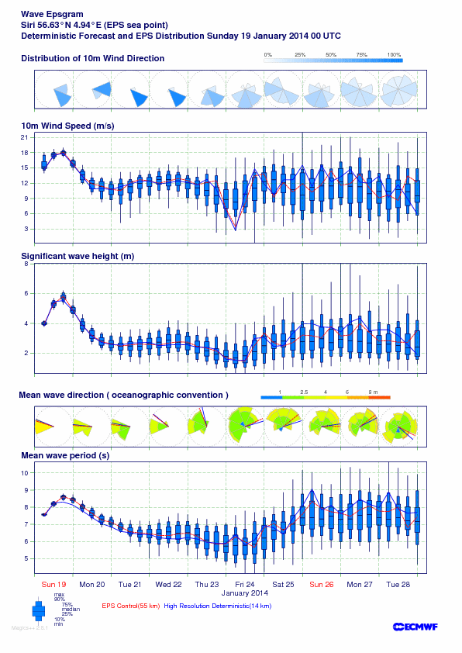
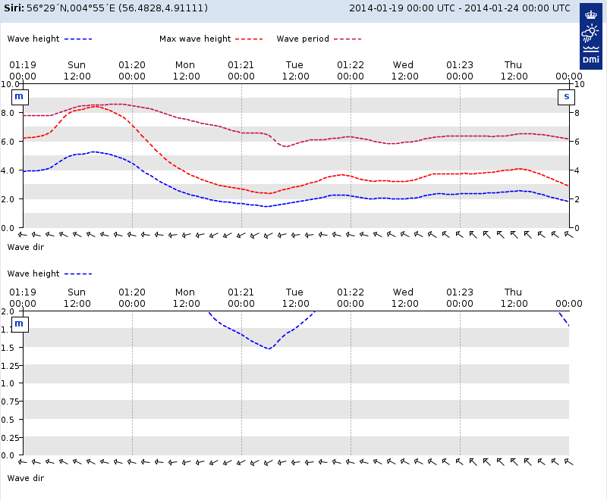
Forecasting wave height for offshore industry. Estimate of forecast confidence
In the Maritime Service at DMI we service many
offshore customers. We forecast especially the wave height (sea and swell) and comment on the forecast confidence.
The Wave EPSgram from ECMWF is a very useful tool when estimating the reliablility of the forecast.
It show the spread of all the ensemble values , together with the high resolution deterministic run and the (low resolution) Control run.

Slide 5
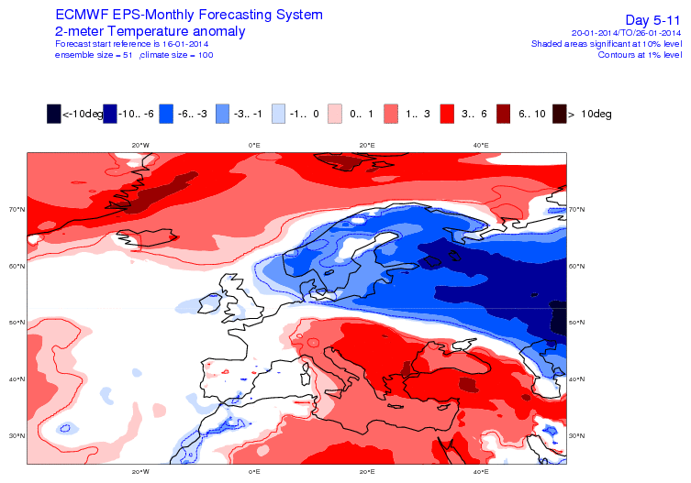
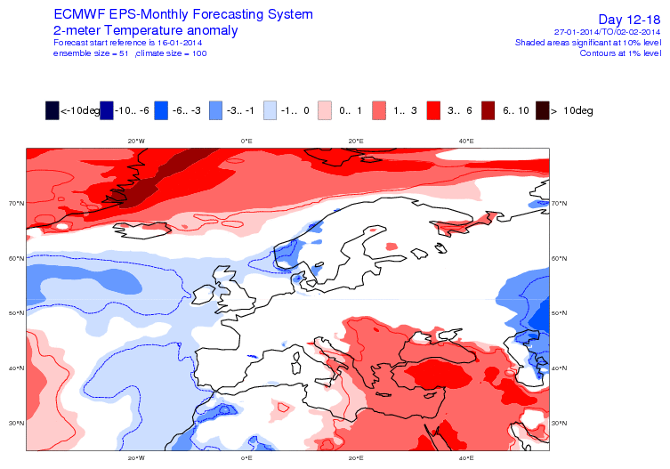
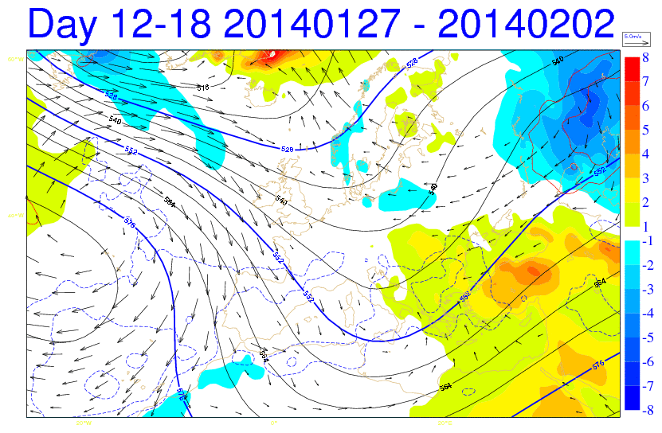
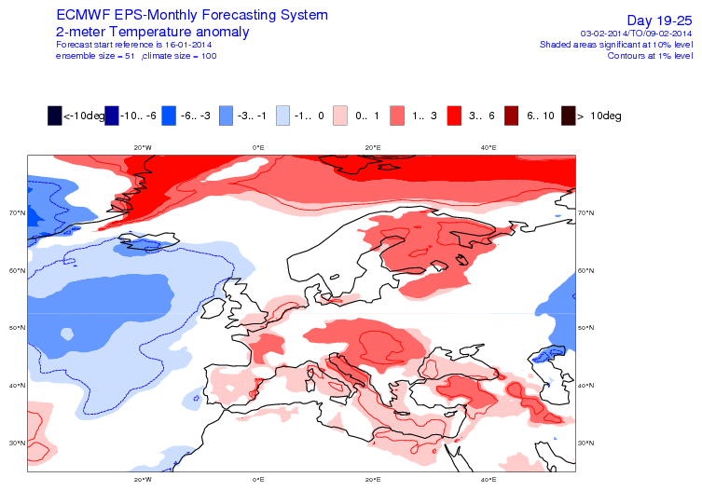
Monthly forecasts of temperature and wind for
the energy market.
Two useful tools from the ECMWF monthly ensemble forecasts. The 2m-temperature anomly (charts to the right) and the Multiparameter chart (below), which show the weekly average of ensemble mean geopotental height and the anomalies of the 2-metre temperature, sunshine and 10-metre wind (with respect to 18 years of model climate).
The ensemble mean of the 500hPa geopotential height does of course get ”middled-out” a lot, but for the second week the trough of low over Denmark and ridge of high over Finland are clearly distinguishable.
Week 1
Week 2
Week 3

Slide 6
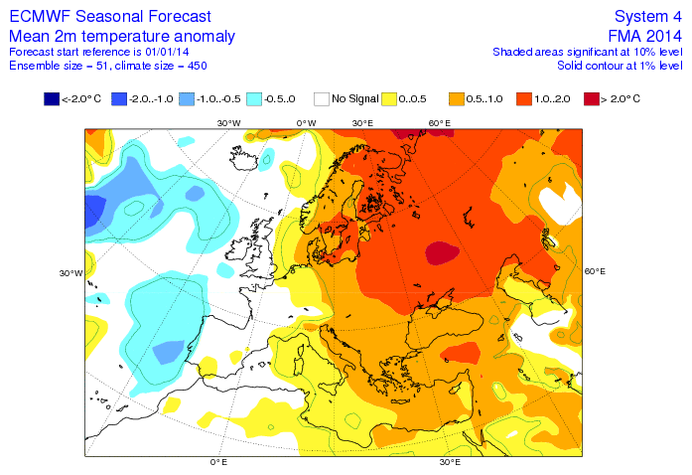
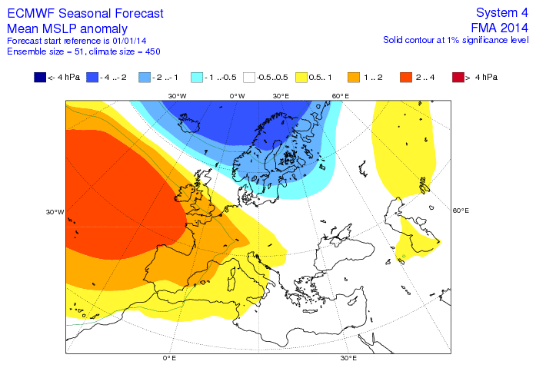
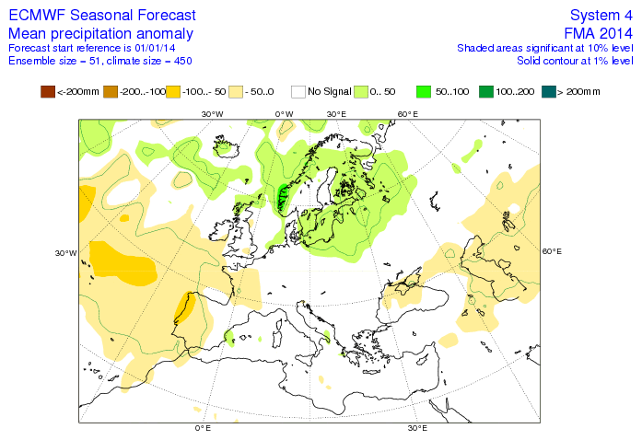
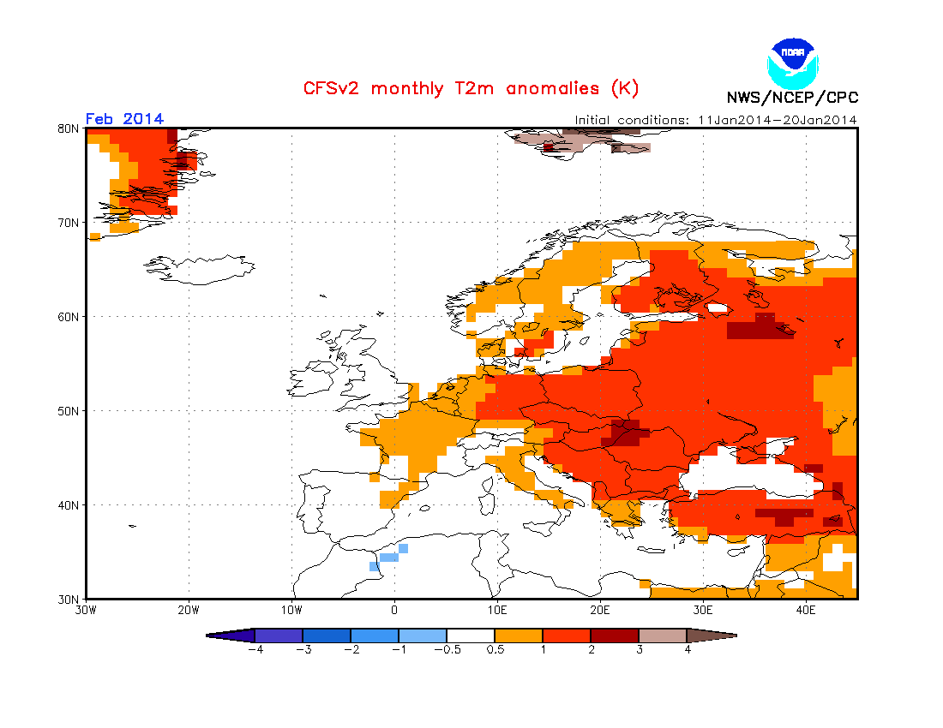
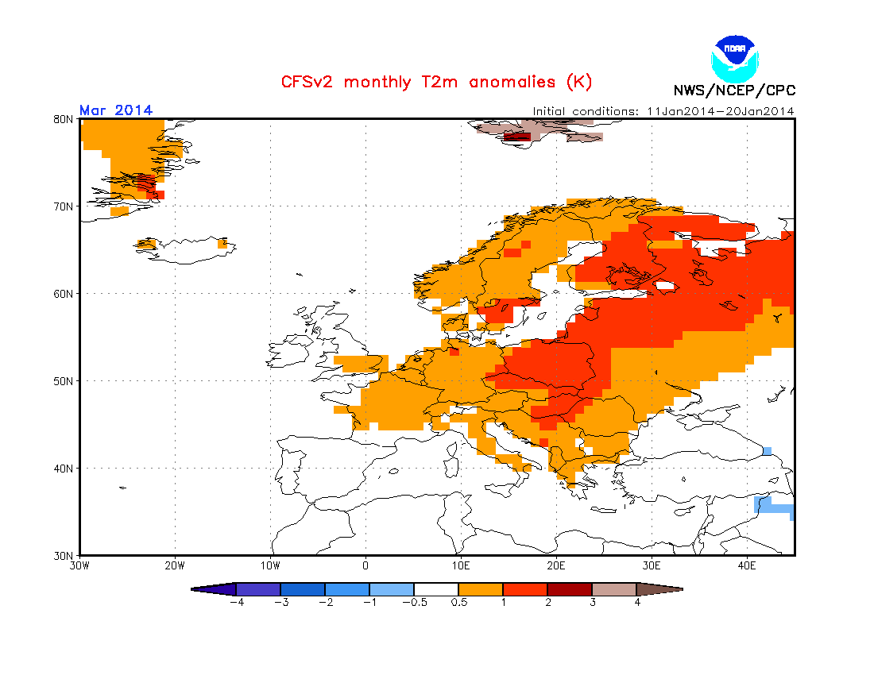
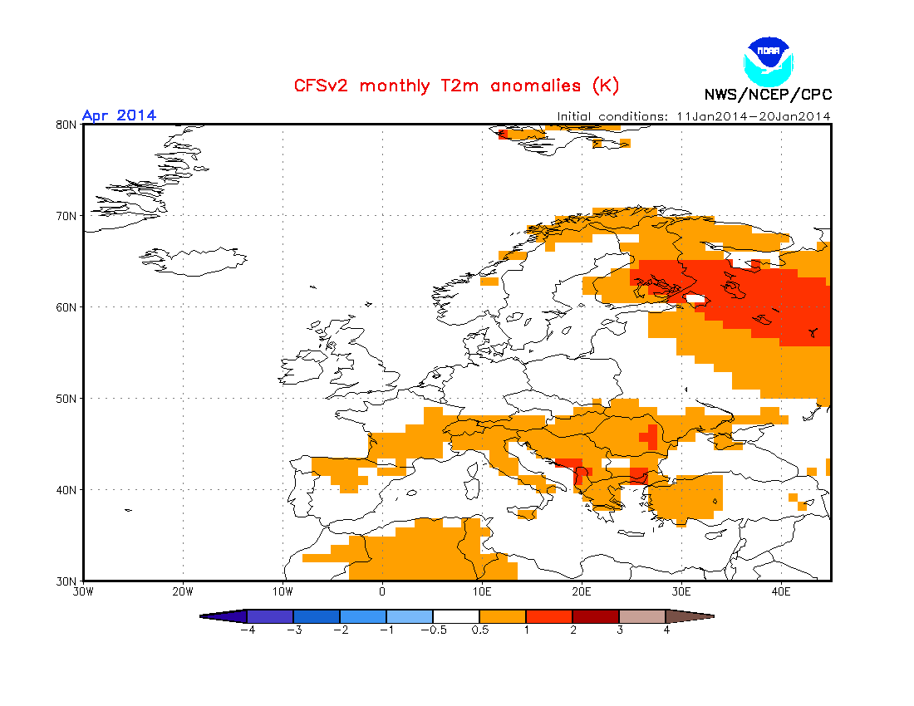
Seasonal forecasting
3-month (Feb-Apr) ensemble mean of temp., pressure and precip
We interpret the ECMWF and NOAA seasonal forecast charts to make 3-months forecasts for Denmark.
This product, a brief summary of expected over-all weather regimes for the next three months is put on
the website of DMI. Sometimes customers want sprecial forecasts for a certain area or time, like for instance
a forecast on snow conditions in Scandinavia and the Alps over this winter.
The 3-months charts above indicate a dominating negative NAO-index with lows taking northerly tracks,
bringing generally westerly winds, milder temperatures and slightly more rain than normal to Denmark.
NOAA 2m-temperature anomalies for february, march and april

