Slide 1
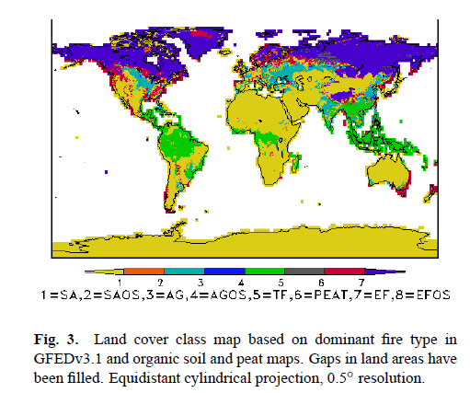
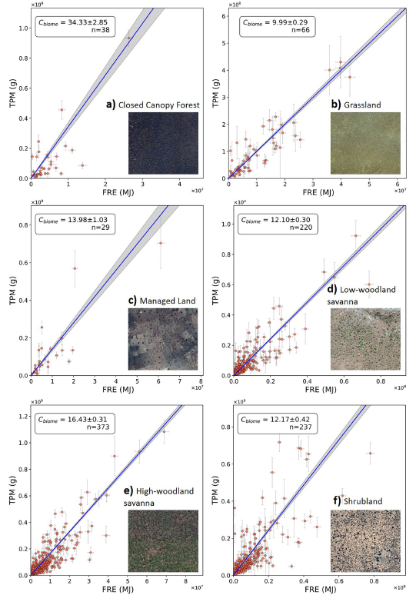
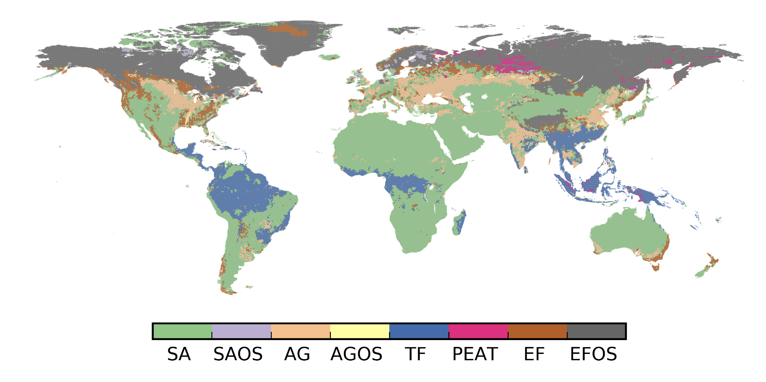
CAMS44_2 fire biome map
Motivation
Current operational GFAS LC map is based on GFEDv3.1 (van der Werf et al. 2010) predominant vegetation type, organic soil and peat maps
Generally still fit for purpose, but:
  New advances in LC mapping in the last decade
  Temporally static
  Fire relevant LCs missing in some areas (e.g. agricultural areas of Africa)
Recent work by Mota & Wooster (2018) and Nguyen & Wooster (2020) find relationships between MODIS MIAC AOD derived TPM and SEVIRI FRE for different vegetation types
Ideally, classes would be driven by similar fire behaviour/emission factors
GFAS v1.0 Kaiser et al., 2012
TPM vs FRE relationships for different land covers. From Wooster & Nguyen (2020)
Land cover map used in the GFASv1.2 system, which is currently operational at ECMWF. Reproduced from Hüser et al., (2019). Green = savannah (SA), lilac = savannah with organic soils (SAOS), apricot = agriculture (AG), yellow = agriculture with organic soils (AGOS), blue = tropical rainforest (TF), pink = peat (PEAT), brown = extratropical forest (EF), grey = extratropical forest with organic soils(EFOS).

Slide 2
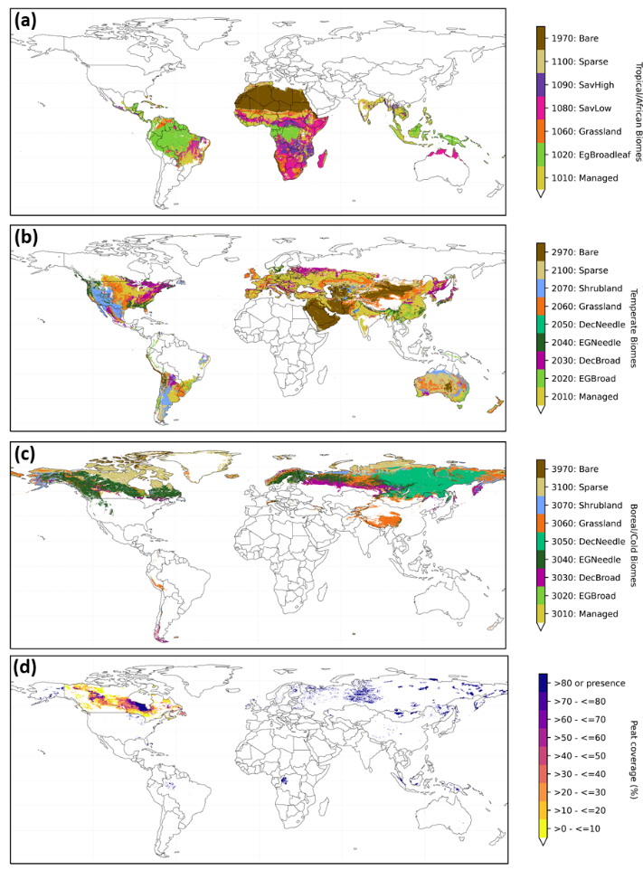
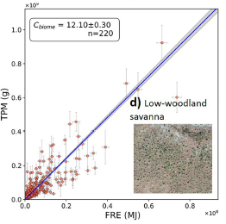
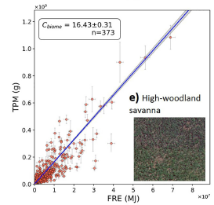
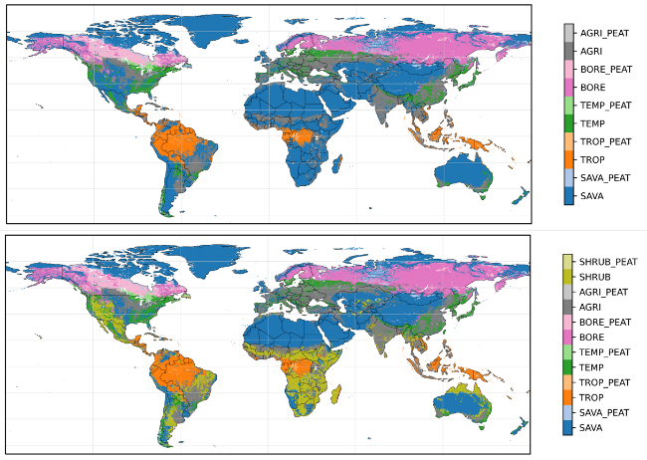
CAMS44_2 fire biome map
New GFAS ‘fire biome’ map based on the CCI LC map for 2018 with modifications for biomass burning (Fig. 1)
Expands on Wooster & Nguyen (2020) approach
Simplified CCI classes vary by broad Köppen Climate Zones
MOD44b VCF % tree cover used for discrimination of different biomass burning behaviour in high and low tree cover savannahs (Fig. 2)
Information on peatland extent from PEATMAP (Xu et al., 2018)
BUT final fuel map is limited based on available emission factors (Fig.3)
Figure 2 TPM vs FRE relationships for high and low savannah (20% tree cover threshold). From Wooster & Nguyen (2020)
Figure 3 Fuel type map variants derived by matching the broad fuel types for which emission factors (EFs) are available in the literature to the fire biome classes created as part of CAMS_44 deliverable D44.4.1.3. Top: Andreae (2019) based, bottom: Andreae+Akagi et al. shrubland class
Figure 1 300m global fire biome map resampled to 0.1-degree spatial resolution for compatibility with GFAS (FBM-GFAS). Biomes found within the (a) ‘Tropical & Africa’, (b) ‘Temperate’, and (c) ‘Boreal/Cold’ climate zones. (d) shows the distribution of peatland. Note: all this information is contained in a single 2-dimensional map, they are displayed here as separate panels for visual clarity.

